Slide 1

A new high resolution European emission inventory for 1999 in support of the EURODELTA trend initiative
Jeroen Kuenen, Hugo Denier van der Gon, Antoon Visschedijk, René van Gijlswijk (TNO)
TFMM meeting, Zurich, 13 May 2011

Slide 2
Outline
Short introduction
The 2005 baseline inventory
Scaling methodology
Results: numbers and maps
Conclusions

Slide 3
Background
Eurodelta is a regional model intercomparison, initiated by TFMM and TFIAM
Base year 1999 – emission inventory for that particular year required
CONCAWE asked TNO to make this emission inventory for 1999 in a limited effort, similar to what was done in the EU FP7 project MACC
Project started 1 January, emission grids delivered to modellers on March 15

Slide 4
Approach to base year inventory (2005)
In the past independent emission inventories were made
The TNO 2005 emission inventory is set up using official reported emissions at the source sector level – as much as possible
  Makes use of national expertise & links to the policy arena
Emissions are downloaded from the European Environment Agency (http://www.eea.europa.eu/data-and-maps/data).
However, the reported emissions by individual countries contain gaps and errors – various consistency checks need to be made.
  Alternative emissions : IIASA GAINS emissions and /or TNO default.
  Extreme deviations adjusted - allows maximum use of official data while not hazarding the quality of the final result

Slide 5
The ~ 200 source categories are aggregated by type:
Each source category is linked to a distribution pattern but sources can share the same distribution

Slide 6
TNO compiled (new) distribution patterns for
point source data (location, capacity and fuel used) for
Power generation
Refineries
Iron and Steel production
Non-ferro industry
Cement production
Ports and harbours (handling of bulk goods)
Other point sources, not updated
Waste Incineration
Mining – oil and gas exploration
Chemical Industry
Area sources
    Animal density; population density ; road transport; etc.

Slide 7
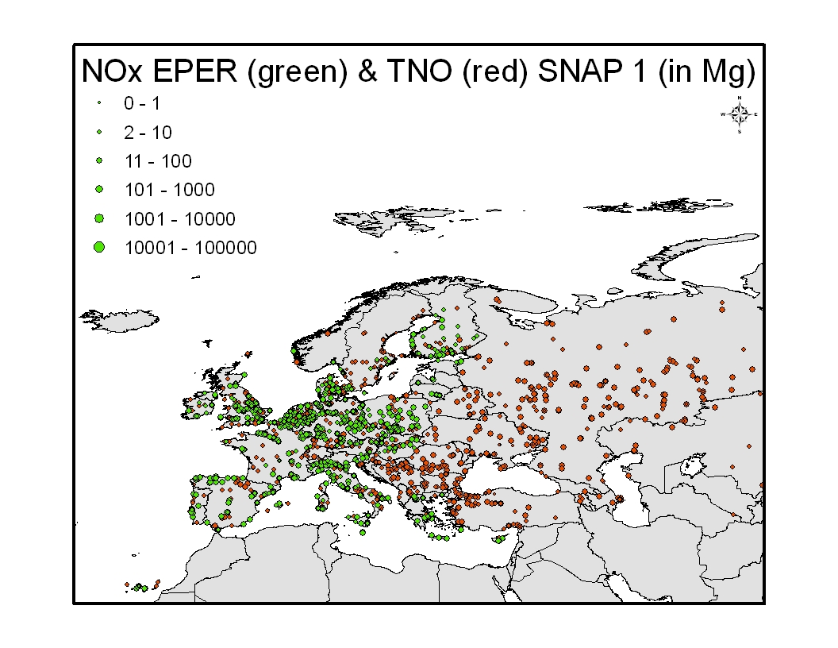
EPER reported power plants overlaying the TNO data base
New file contains 1823 point sources for power plants; updated + expansion.

Slide 8
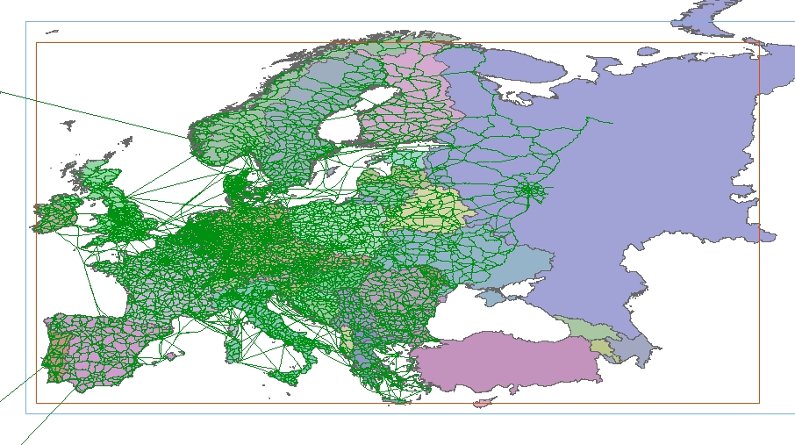
Non-urban road transport emissions distributed using a European traffic intensity road map based on EU Transtools project
Completed East-ward with simple road network

Slide 9
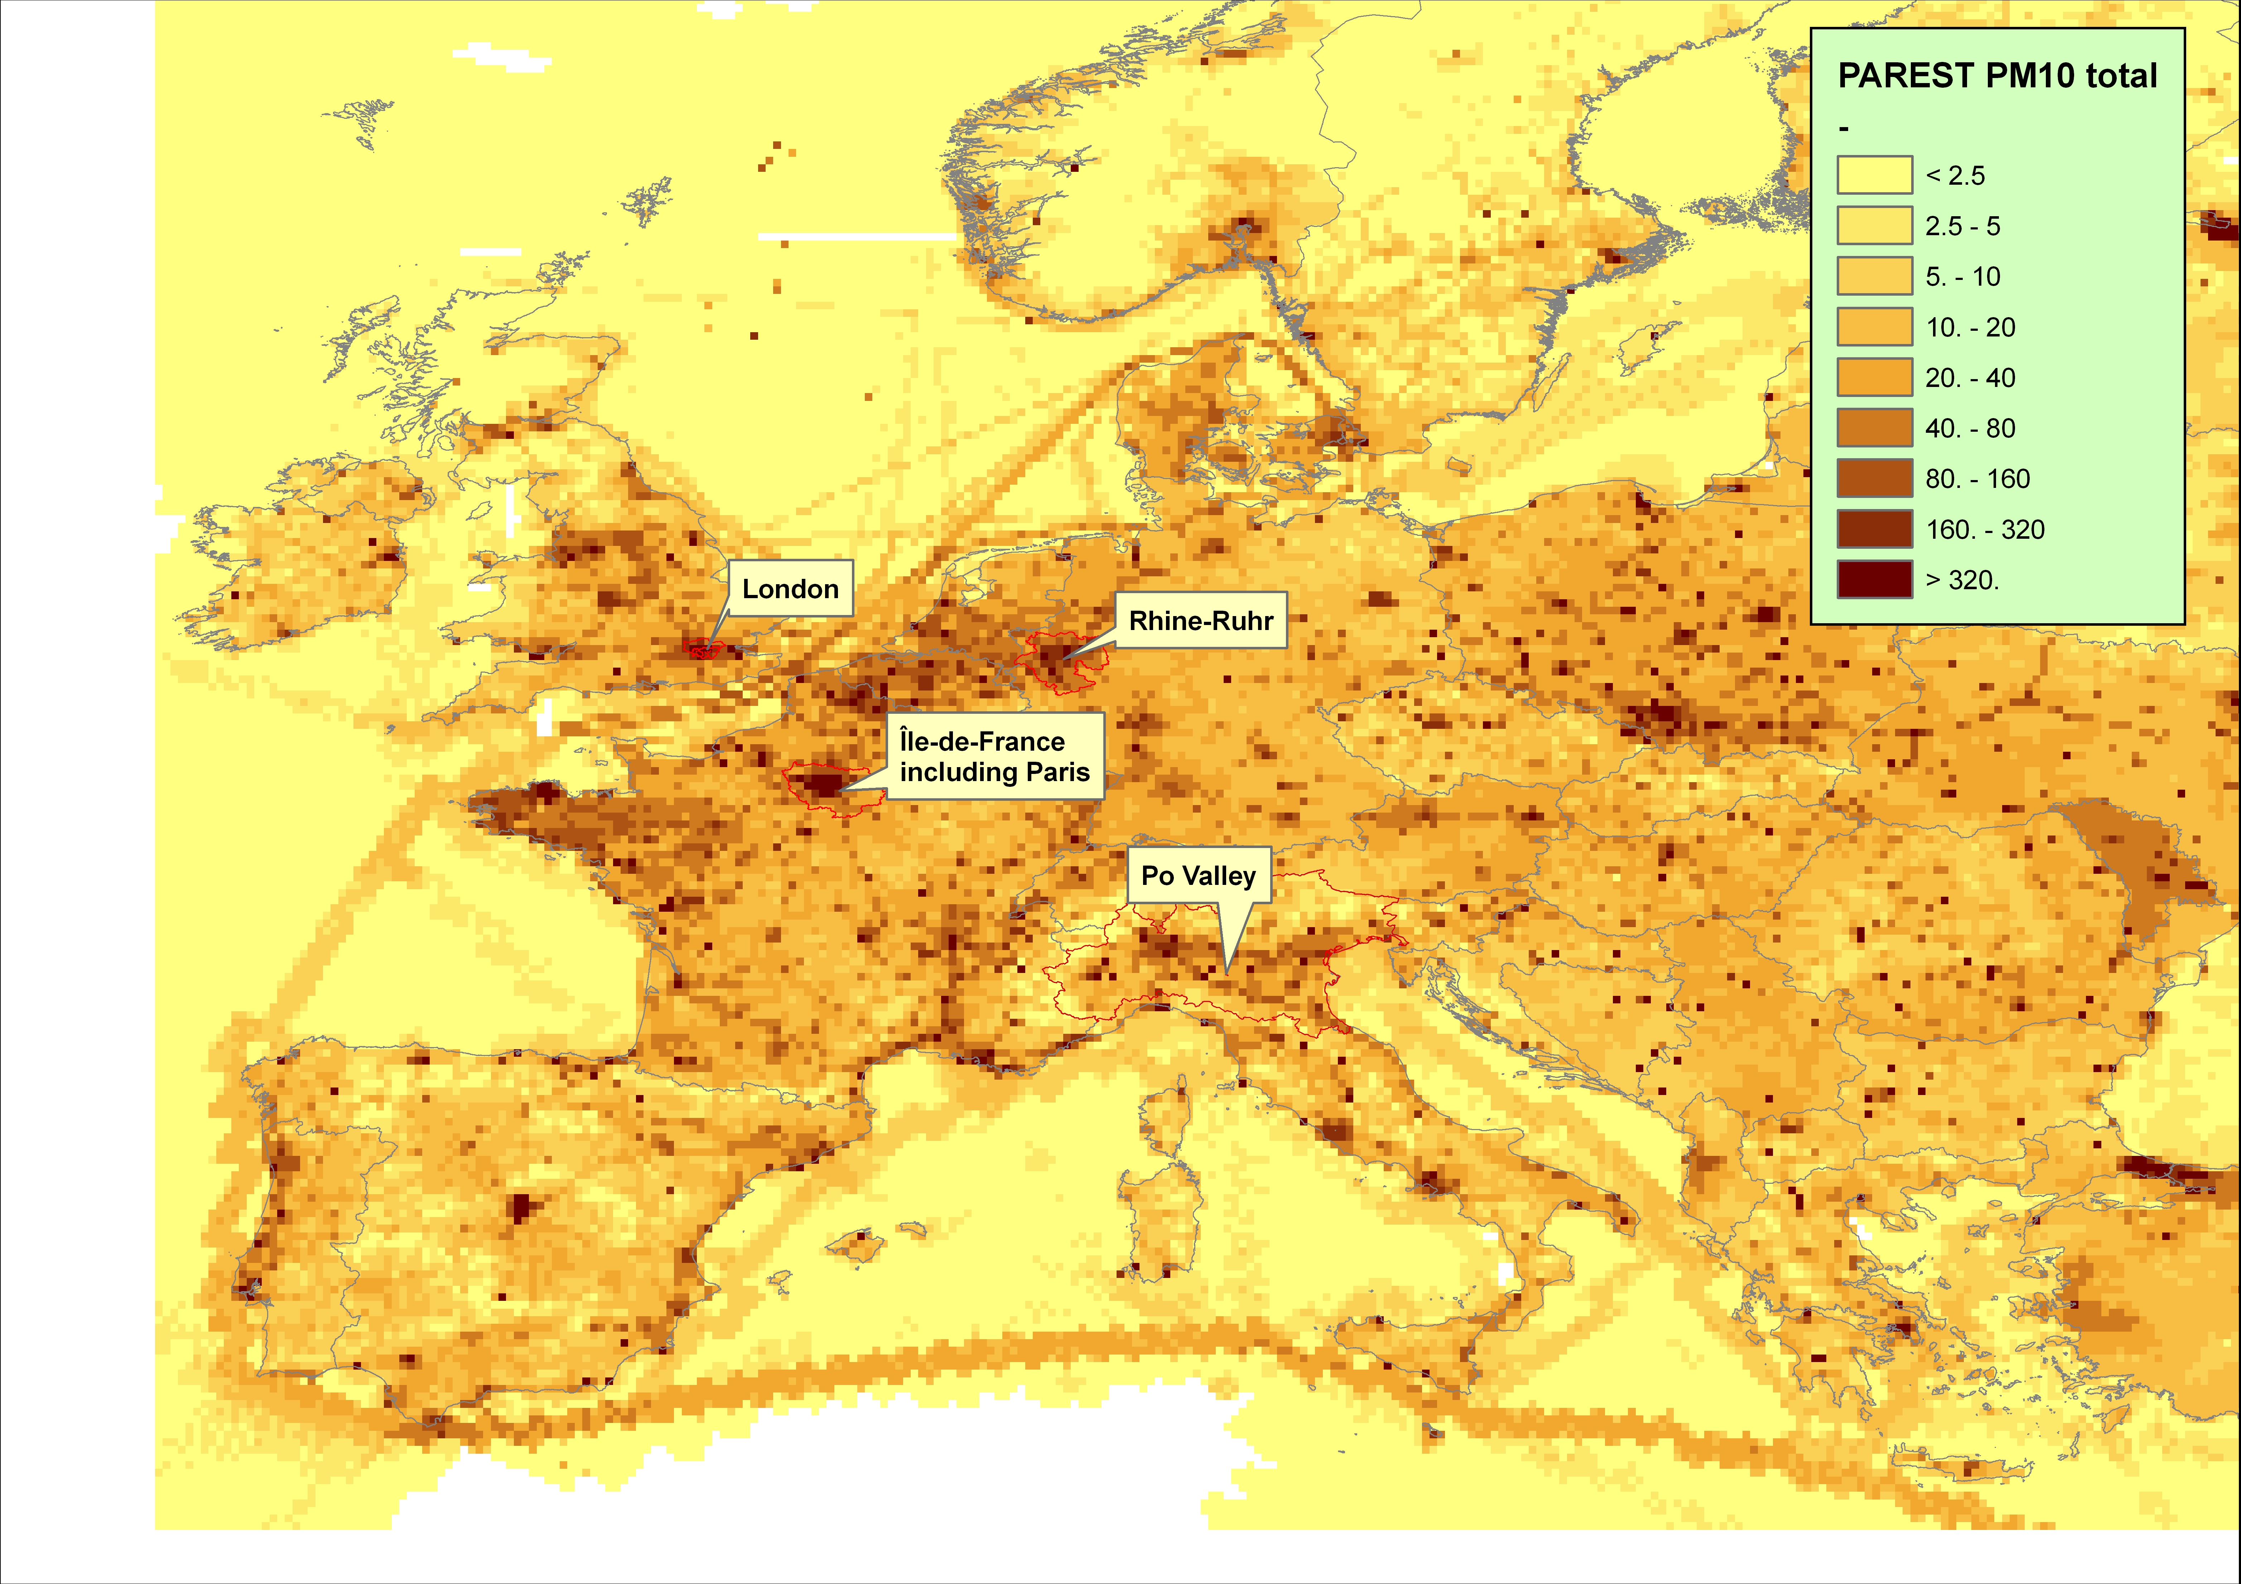
Spatial resolution: 1/8° x 1/16° ~ 7x7 km over all of Europe
MACC / MEGAPOLI 2005 PM10 total

Slide 10
1999 inventory approach
Objective: to make an emission inventory for 1999 using a scaling of the already available 2005 emission grids
Idea was a two-step approach:
  Use “official” country reported emission data (per SNAP source sector) both for 1999 & 2005 to calculate scaling factors, and
  Apply these scaling factors to each grid cell in the 2005 inventory
Country reported data available in database from EEA (including all countries)
  Looks simple & straightforward, but…

Slide 11
Time series of reported emissions

Slide 12
Quality of reported data

Slide 13
Scaling of emissions for 1999
Reported data not always available and/or suitable to calculate scaling factors
GAINS emissions used as alternative dataset to calculate scaling factors, interpolated for the years between the 5-year intervals
Per pollutant, country and SNAP level 1 time series of reported data were analysed
  If time series not “trusted” or incomplete, they were either interpolated/extrapolated, or GAINS emissions were used instead
  For remaining countries, GAINS emissions were first choice

Slide 14
Emission decrease from 1999 to 2006
Reported reduction
in Turkey
GAINS sector
specific reductions

Slide 15
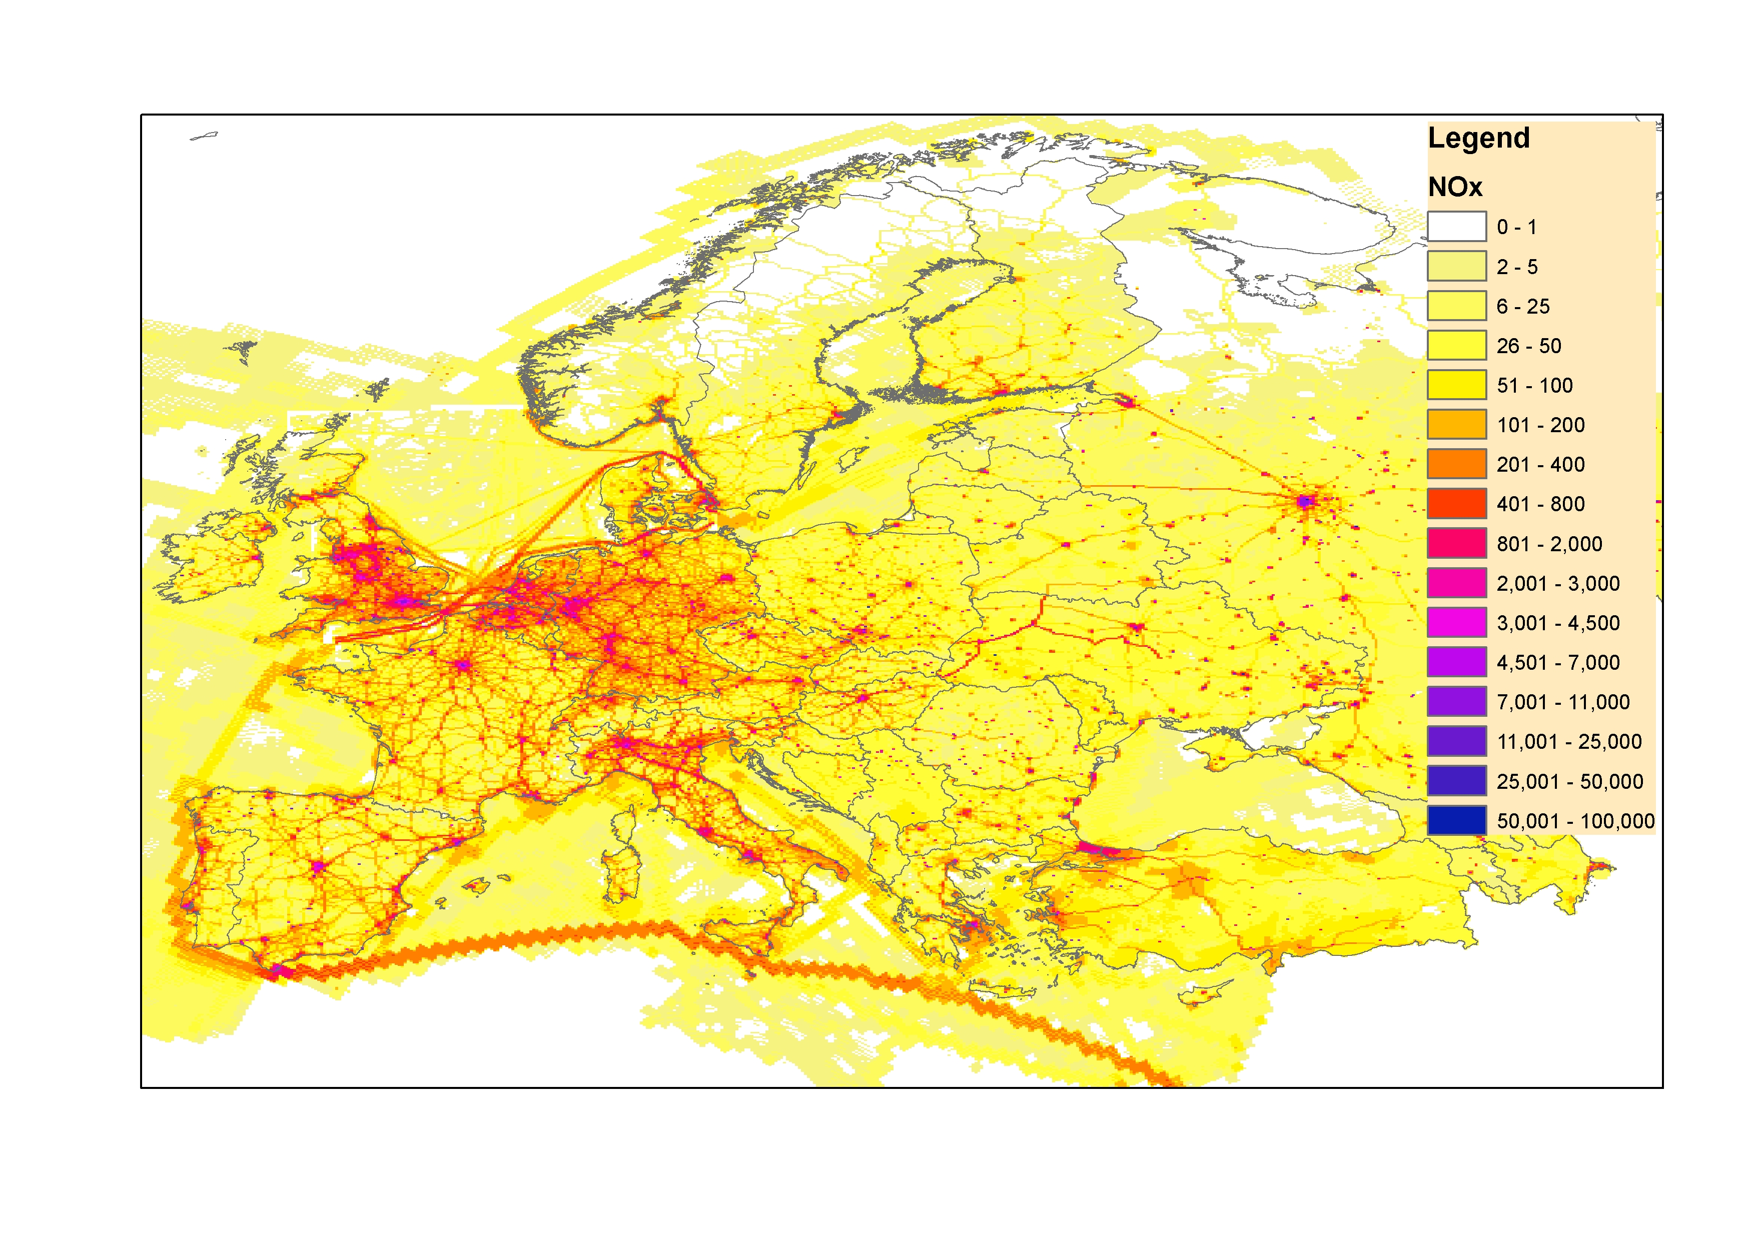

Slide 16
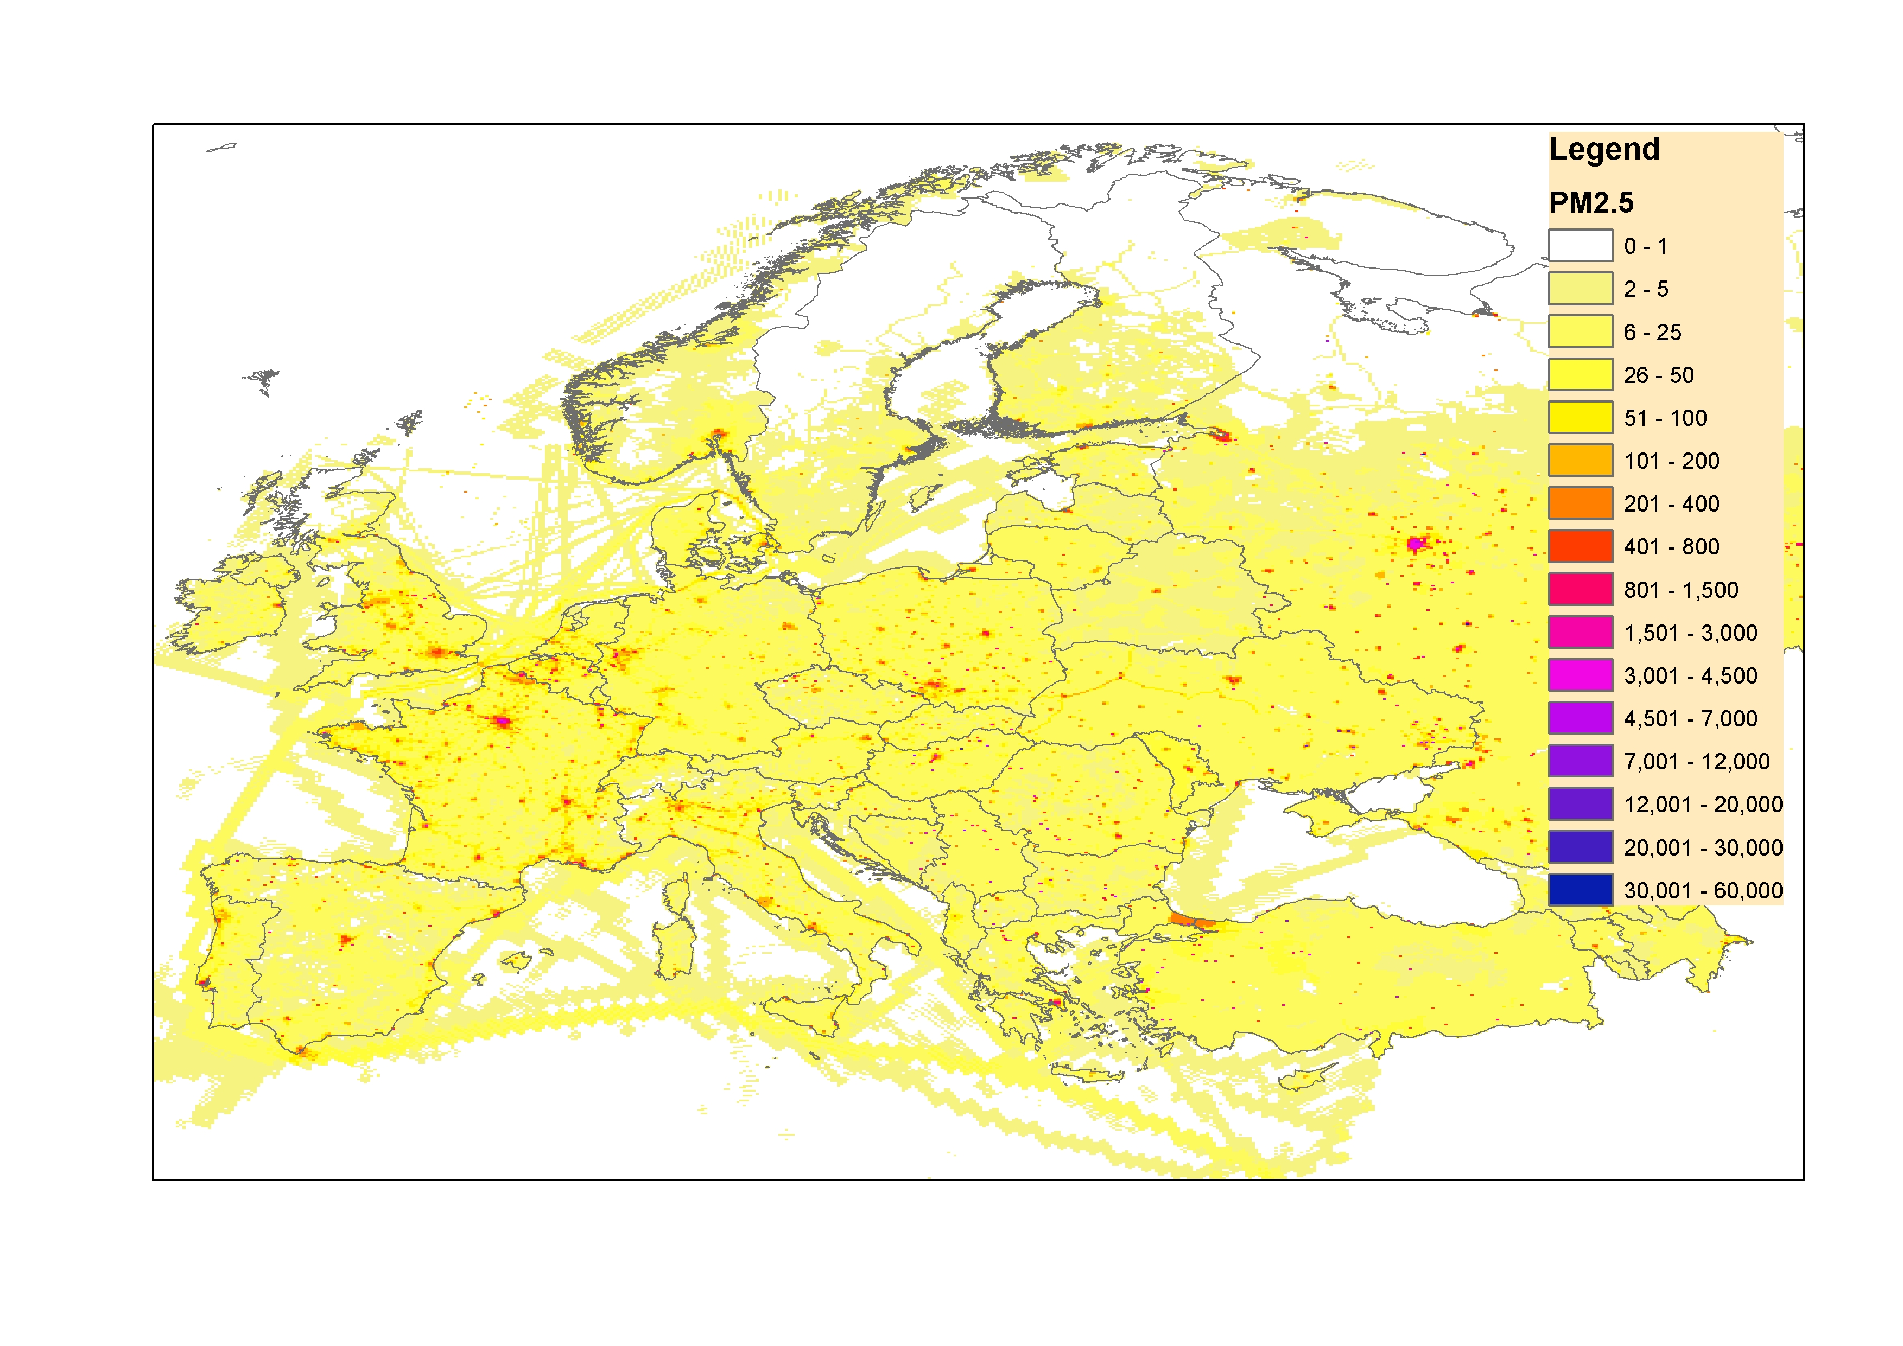

Slide 17
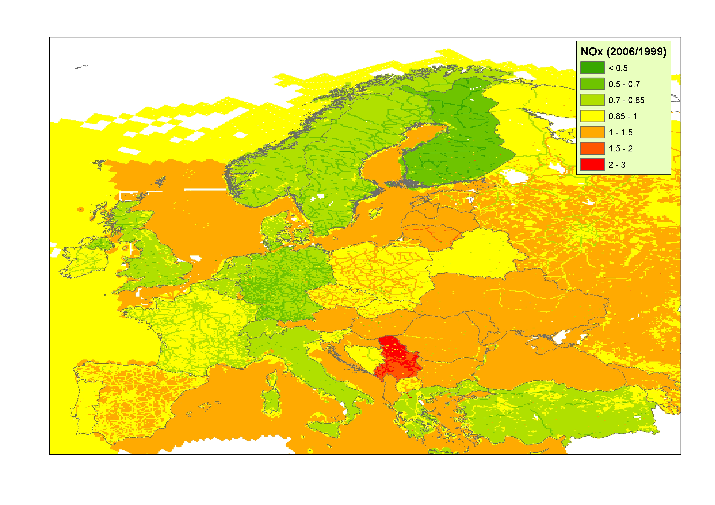
Plaatjes van René NOx invoegen

Slide 18
Wrap-up & Outlook
Emission inventory for 1999 for Eurodelta is a limited effort (~ 1 MM) and therefore no in-depth analysis possible
Links with reported data (close to policy making) but omitting outliers
High spatial resolution (7x7 km)
Gaps are filled, complete dataset but substantial uncertainties exist!
A scaled inventory has been developed for 2003-2007 (EU FP7 MACC) before and now also for 1999
Full time series of 1999-2009 to be completed later this year
It is possible to “nest” local or national inventories to make the maps more accurate, but this is more complex than it looks (EU FP7 MEGAPOLI)

