Slide 1
Title
Testing EMEP model with AMS measurements from 2008-09 intensive periods
Presented by Svetlana Tsyro
TFMM 12th meeting, 11-13 May 2011

Slide 2
EMEP model performance for 2008
 | Ns | Obs ug(S/N)/m³ | Mod ug(S/N)/m³ | Bias (%) | RMSE | R | IOA
SO4 | 56 | 0.57 | 0.35 | -39 | 0.30 | 0.7 | 0.68
NO3 | 28 | 0.36 | 0.34 | -7 | 0.16 | 0.71 | 0.82
NH4 | 35 | 0.70 | 0.54 | -23 | 0.26 | 0.80 | 0.84
 | win/aut | spr/sum
SO4 | -49 | -33
NO3 | 22 | -43
NH4 | -11 | -38
Meteorologisk Institutt met.no

Slide 3
Why to look at hourly data?
Testing the soundness of processes’ description in the model and identifying deficiencies
May help to explain model disagreements with “standard” daily observations and improve the model
Meteorologisk Institutt met.no

Slide 4
What processes drive diurnal variation of concentrations in the EMEP model
Meteorology
Dispersion: night suppression, daytime mixing
Chemistry: daytime - more efficient photo-chemistry , evaporation of semi-volatile aerosols
Dry deposition: less efficient at night (?) due to increased aerodynamic resistance (but e.g. surface R is smaller for SO2 due to higher Rh), but… higher surface concentrations
Emissions
diurnal variation – rather crude
Height | 1 energy | 2 resid comb | 3 Indus comb | 4 indus proc. | 5 extraction | 6 sol-vent | 7 road traff | 8 other mobil | 9 waste | 10 agric
Day night | 1 1 | 1.2 0.8 | 1.2 0.8 | 1 1 | 1 1 | 1.5 0.5 | 1.5 0.5 | 1.2 0.8 | 1 1 | 1.4 0.6
Meteorologisk Institutt met.no

Slide 5
AMS (Aerodyne Aerosol Mass Spectrometer:
SO_{4,} NO_{3,} NH₄ in appr. PM₁ - hourly
Sites
CH02 Payerne 510 m 5min
DE44 Melpitz 87 m
ES19 Barcelona 80 m
FI63 Puijo Smear IV 306 m 5min
FR30 Puy de Dôme 1465 m
HU02 K-puszta 125 m
IT10 San Pietro Capofiume 11 m
SE11 Vavihill 172 m
Meteorologisk Institutt met.no

Slide 6
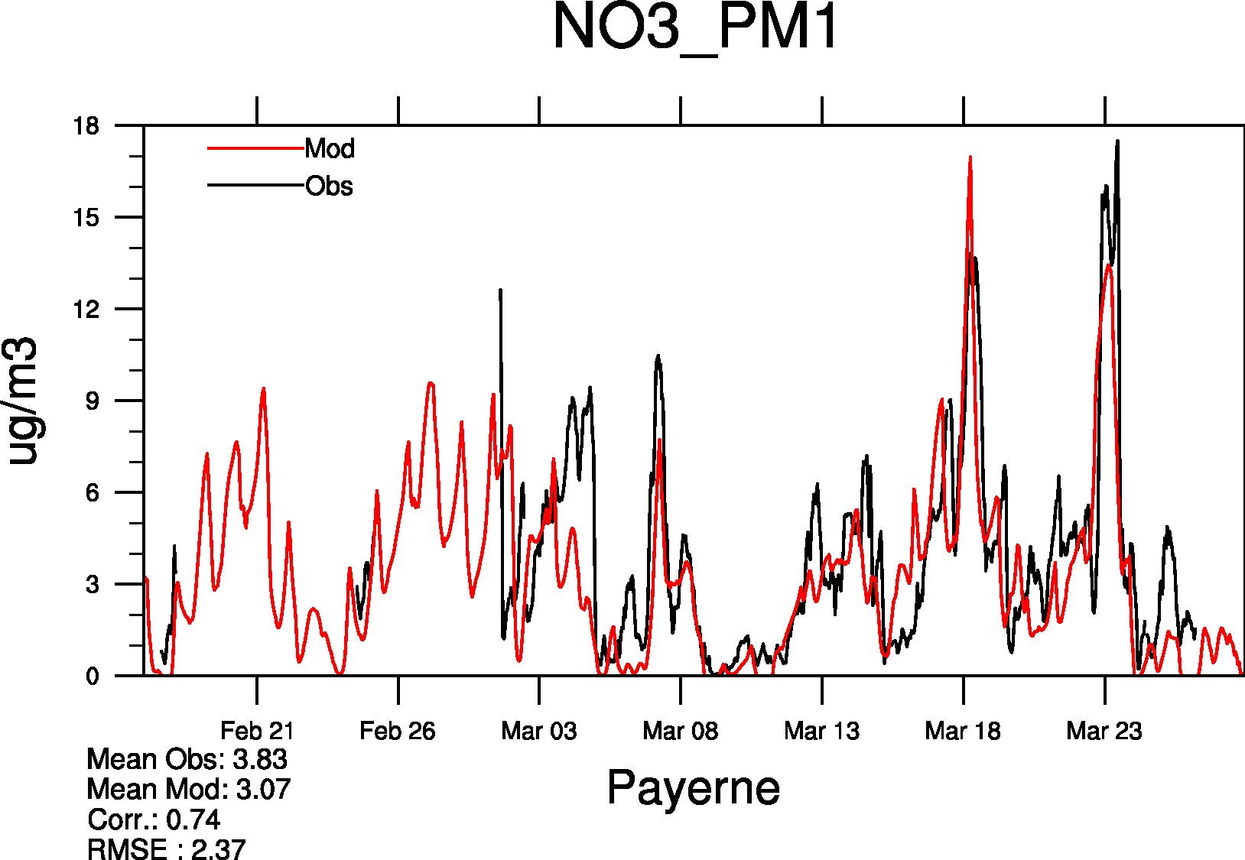
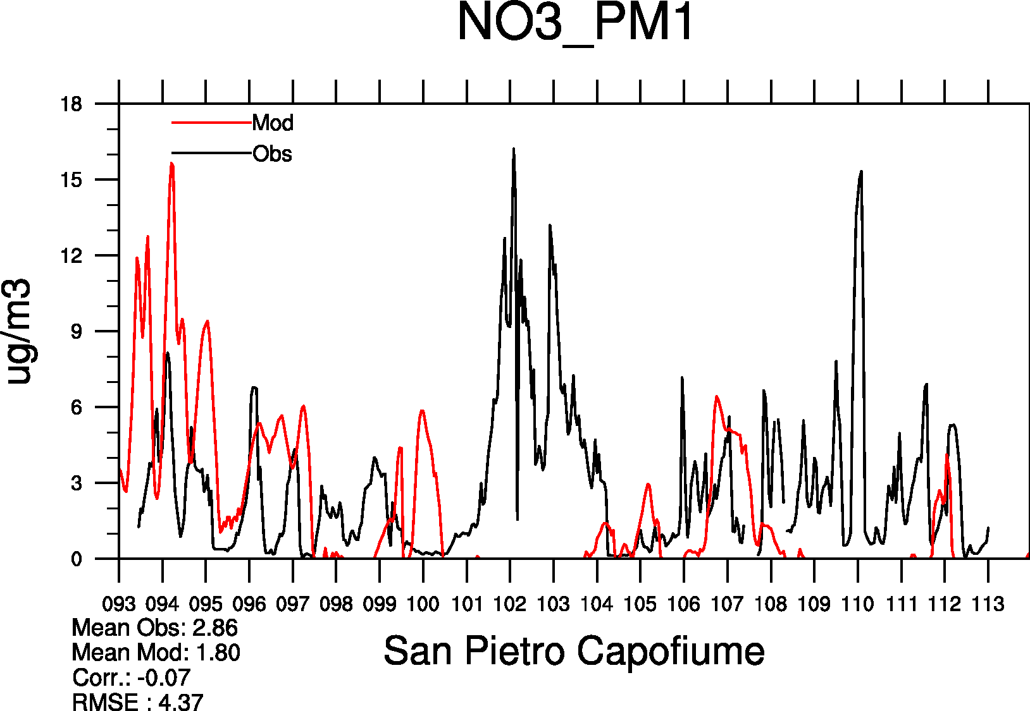
.. Just two examples
Meteorologisk Institutt met.no

Slide 7
SO₄
NH₄
NO₃
Meteorologisk Institutt met.no

Slide 8
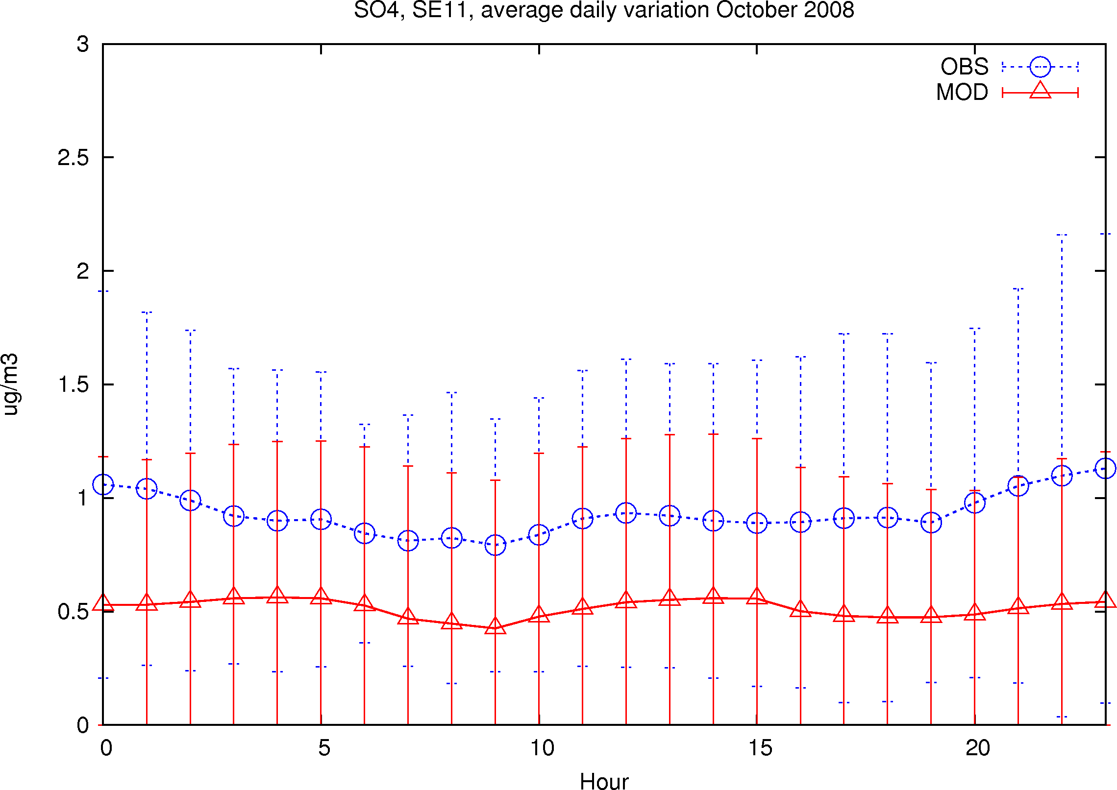
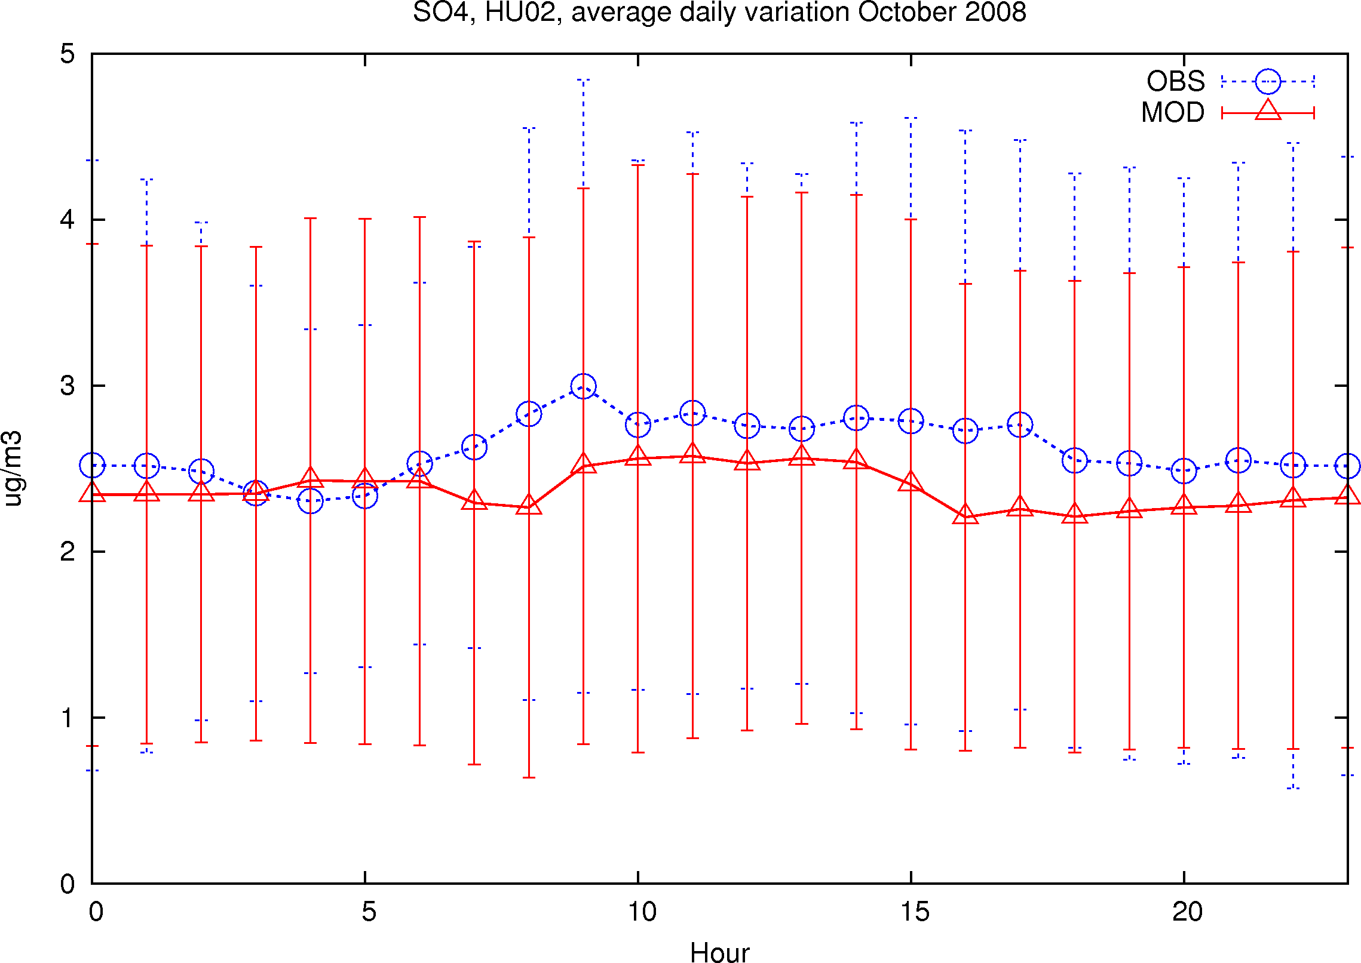
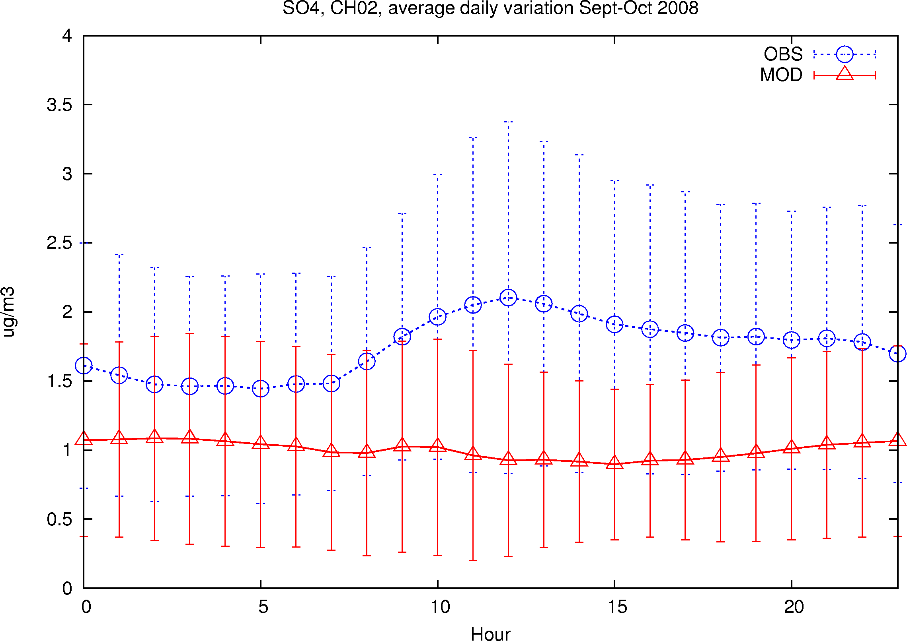
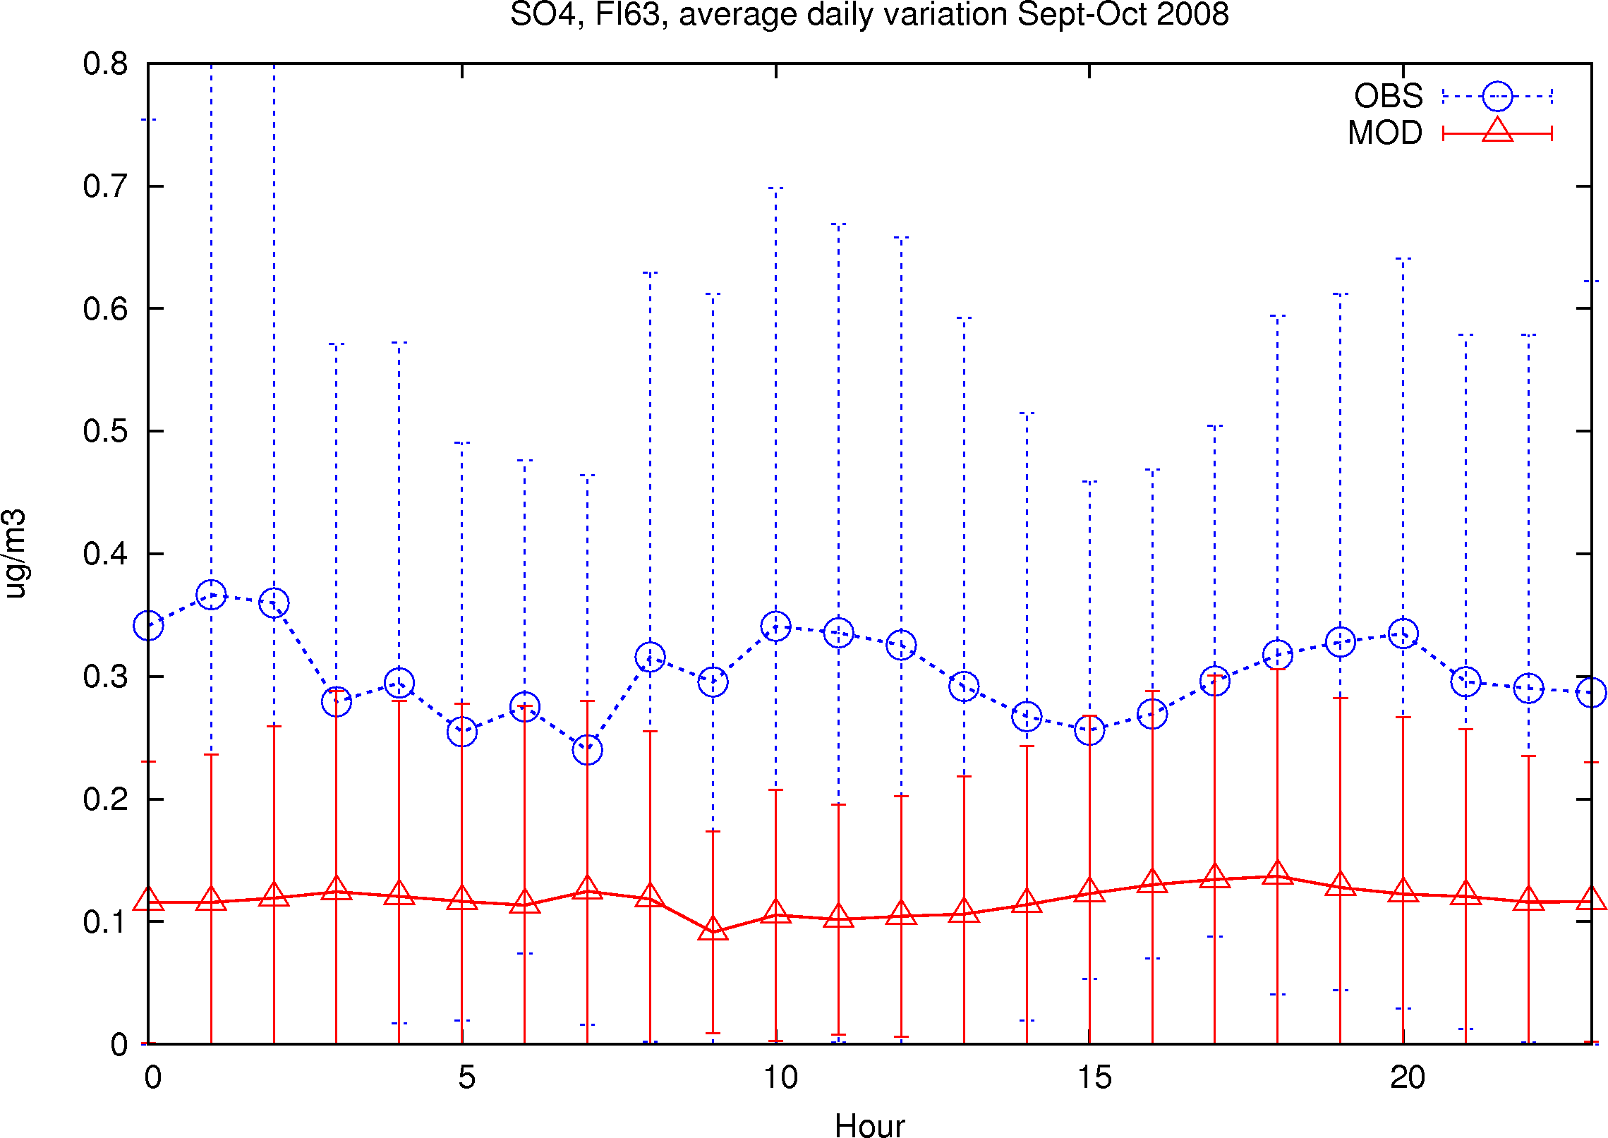
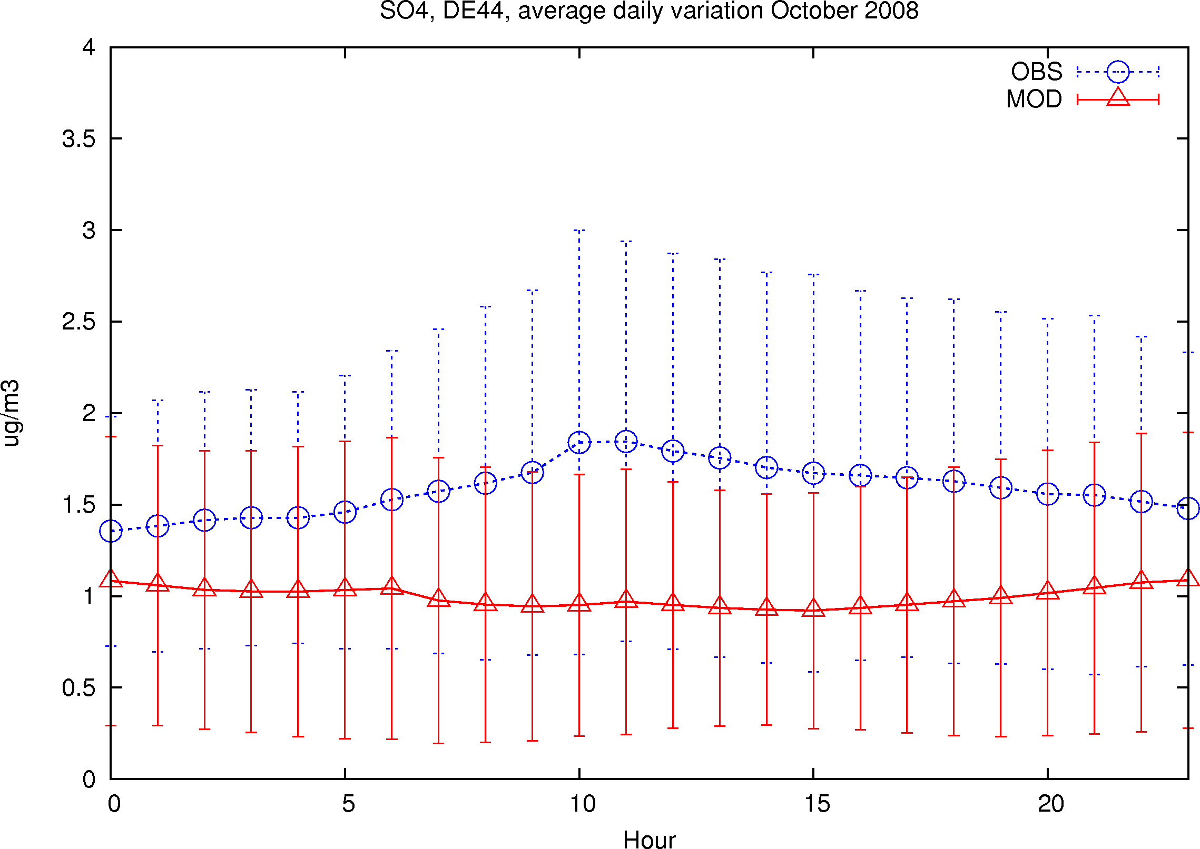
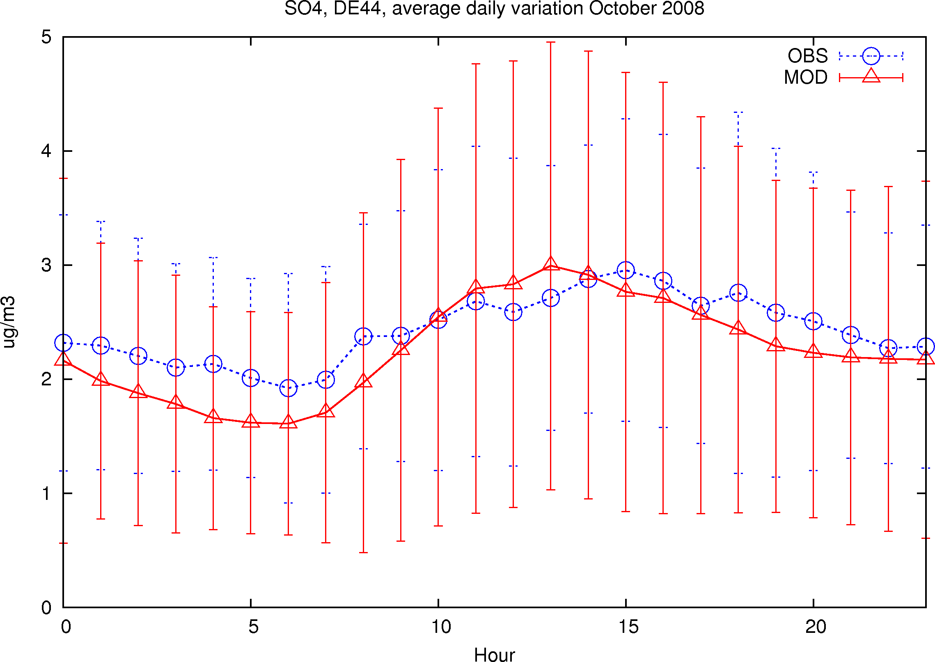
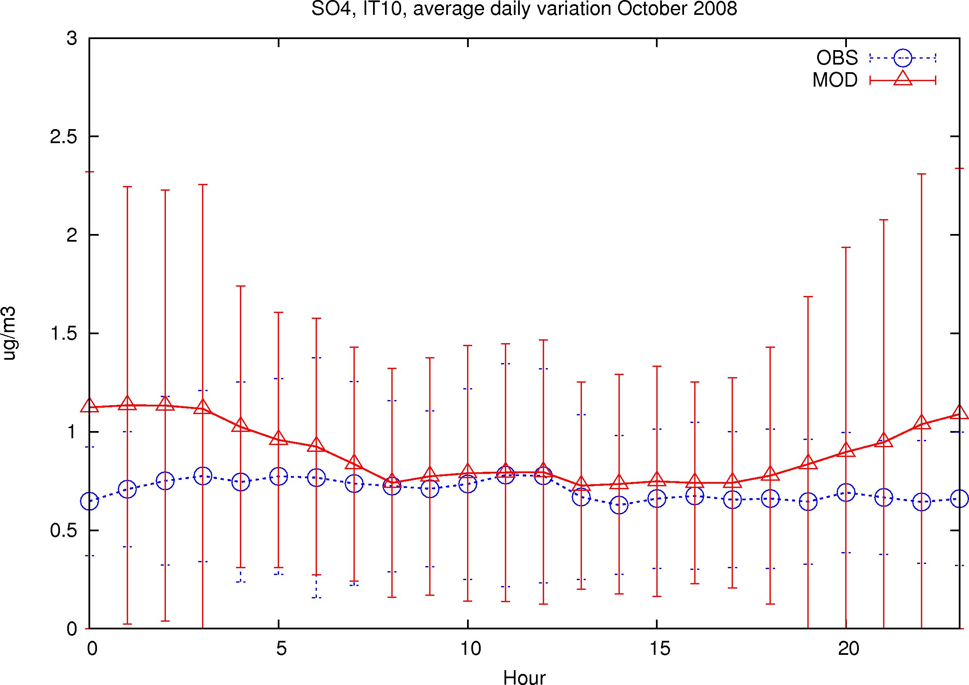
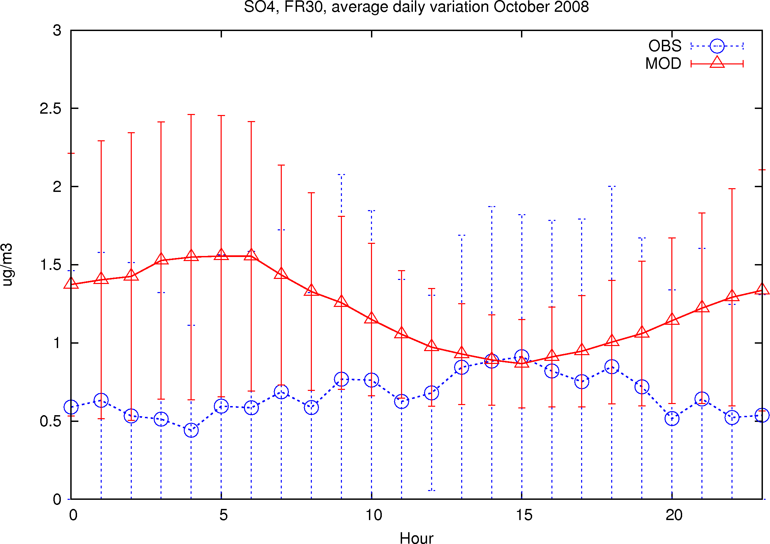
SE11
OUTLINE
HU02
CH02
May-June
FI63
DE44
DE44
IT10
FR30
SO₄
Sept-Oct 2008
Meteorologisk Institutt met.no

Slide 9
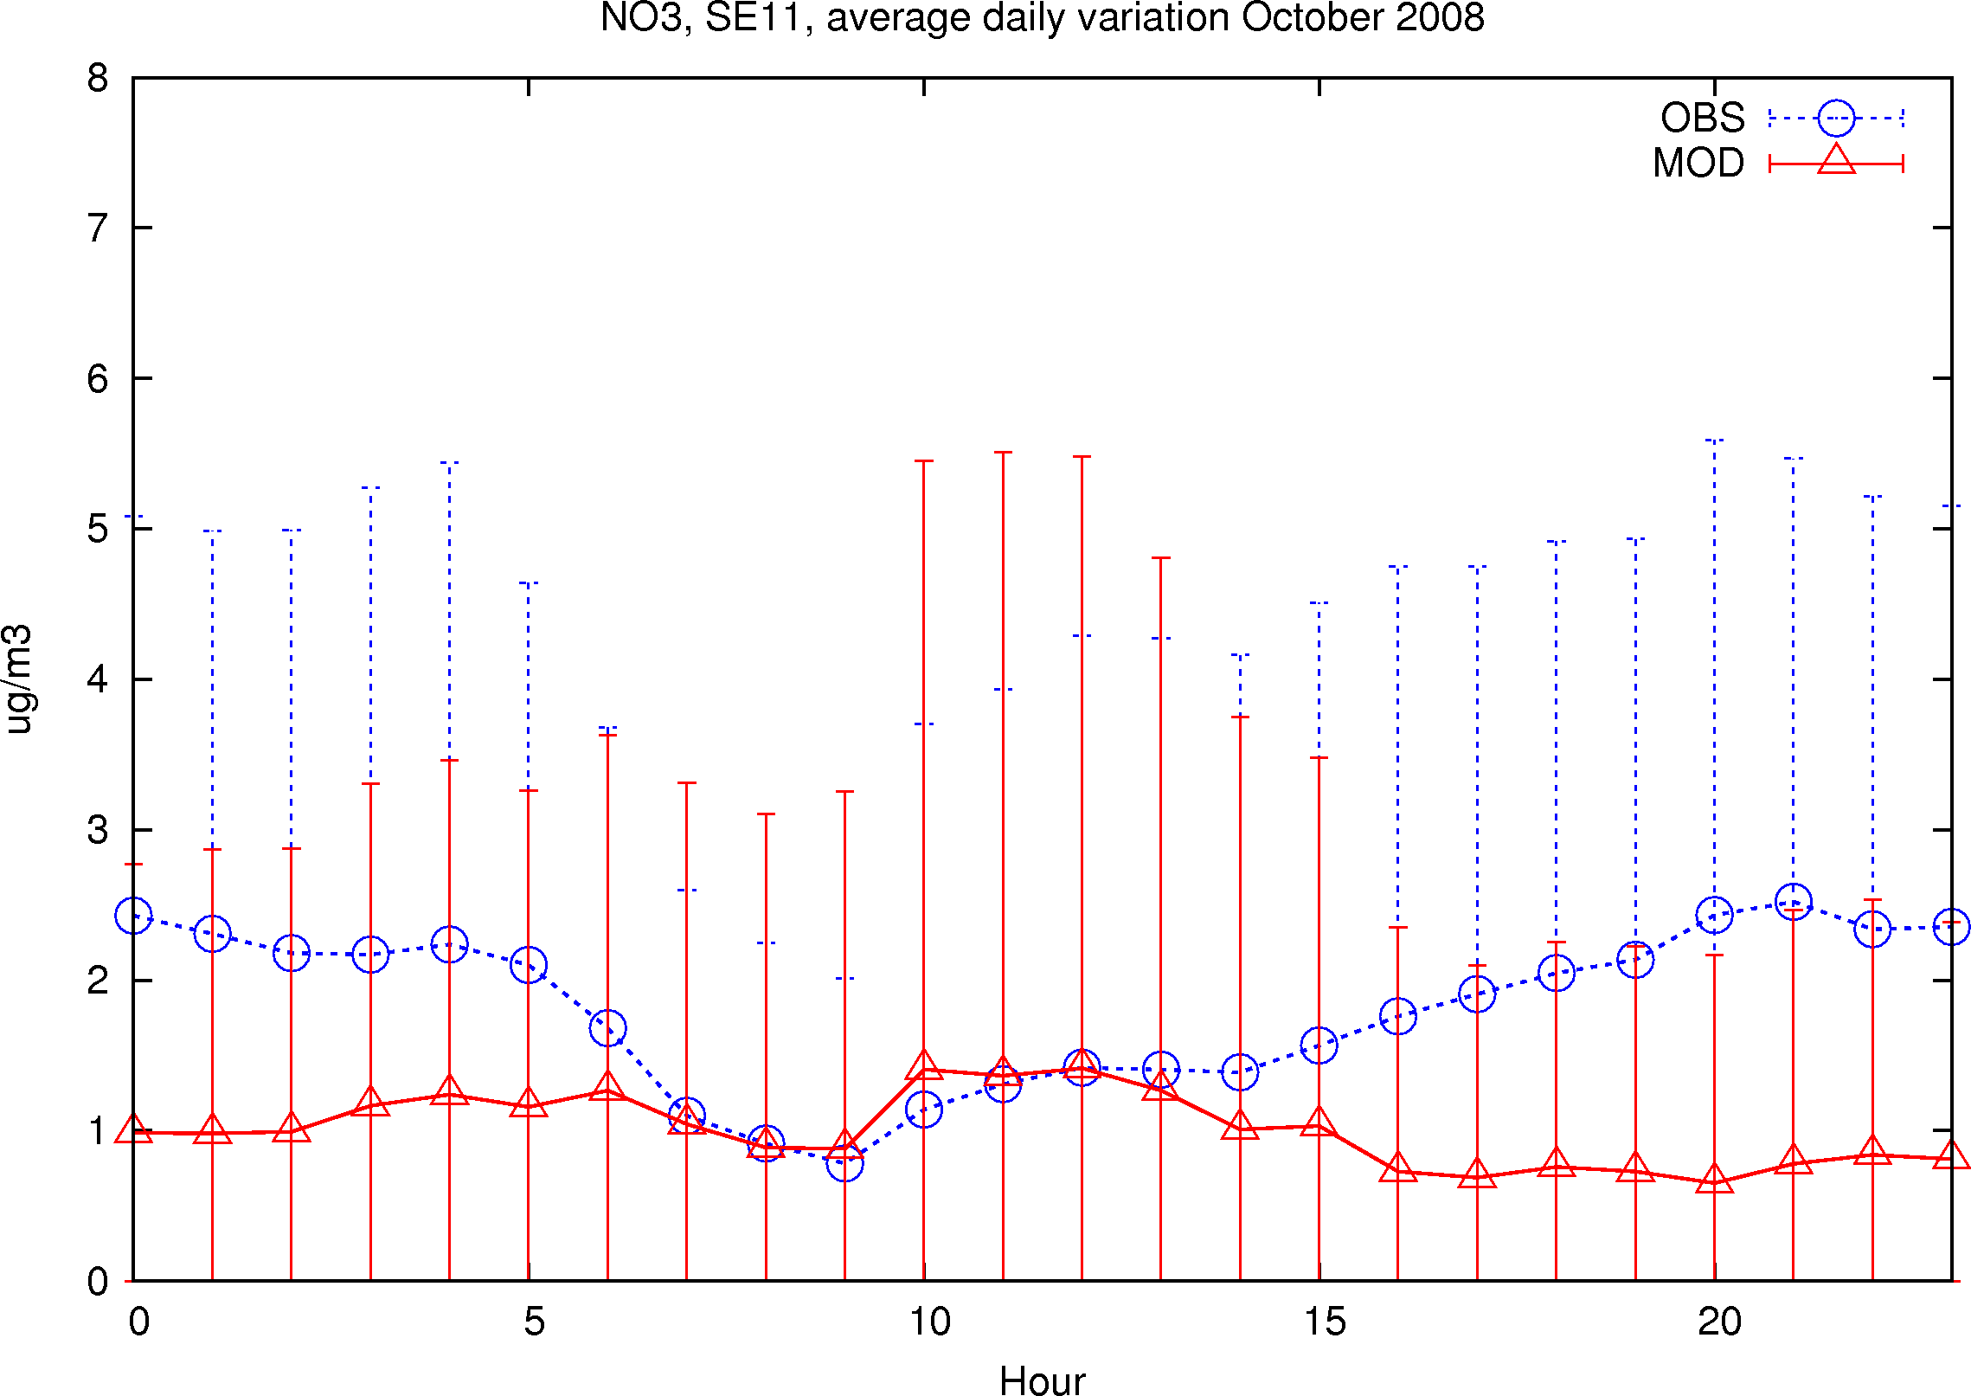
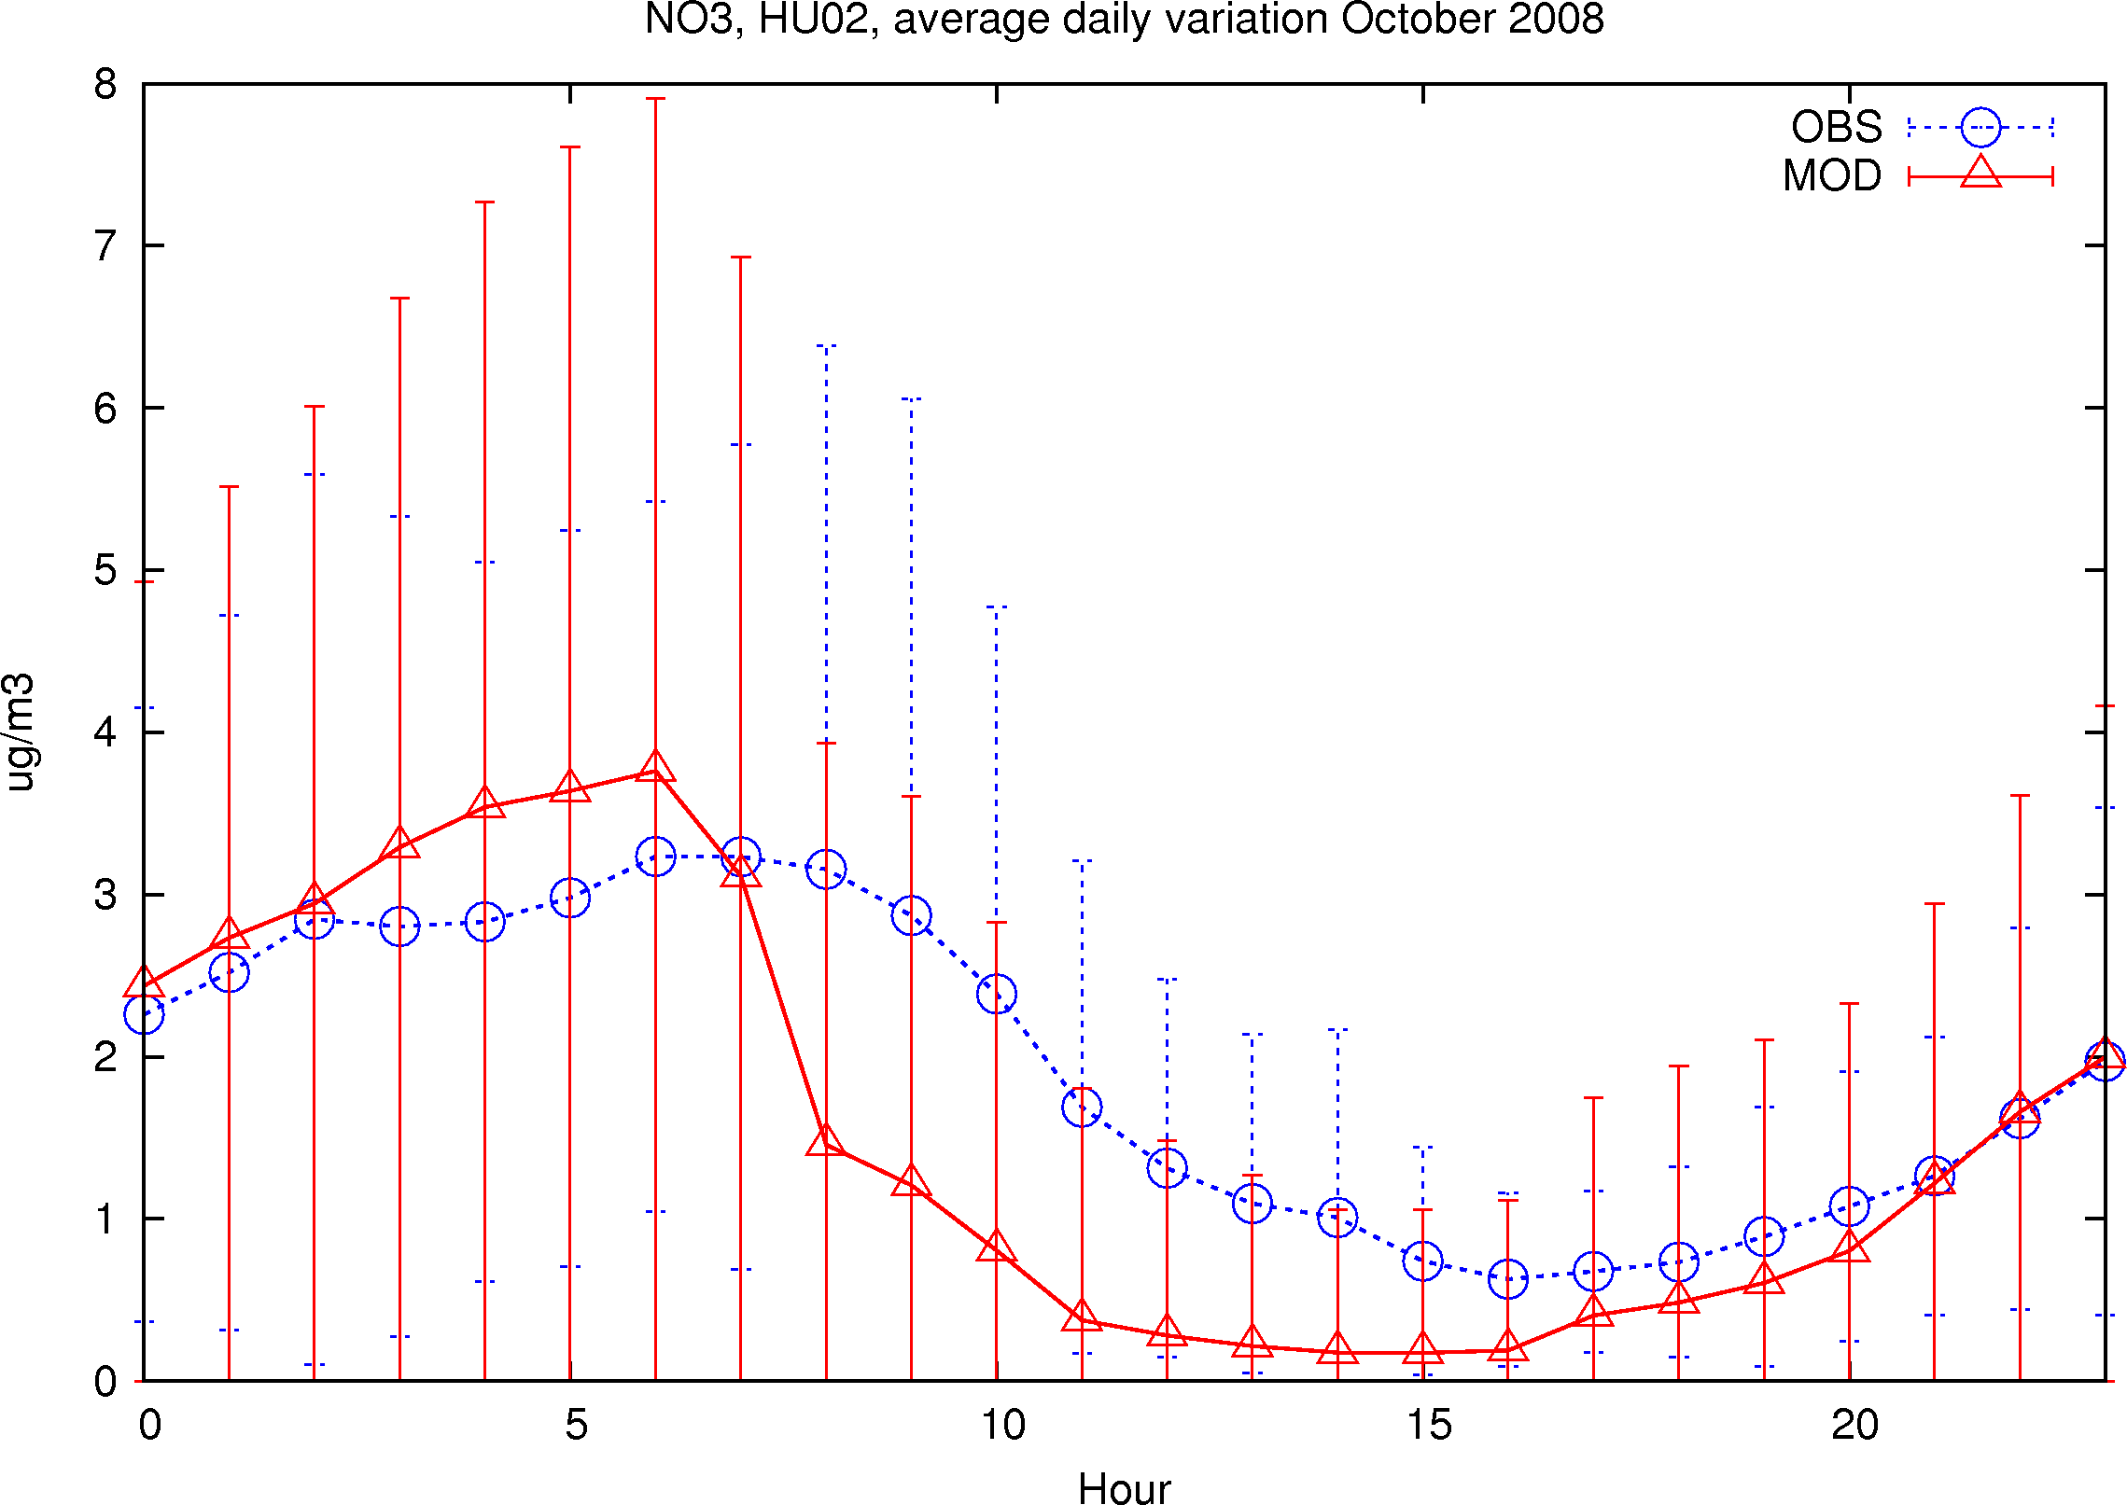
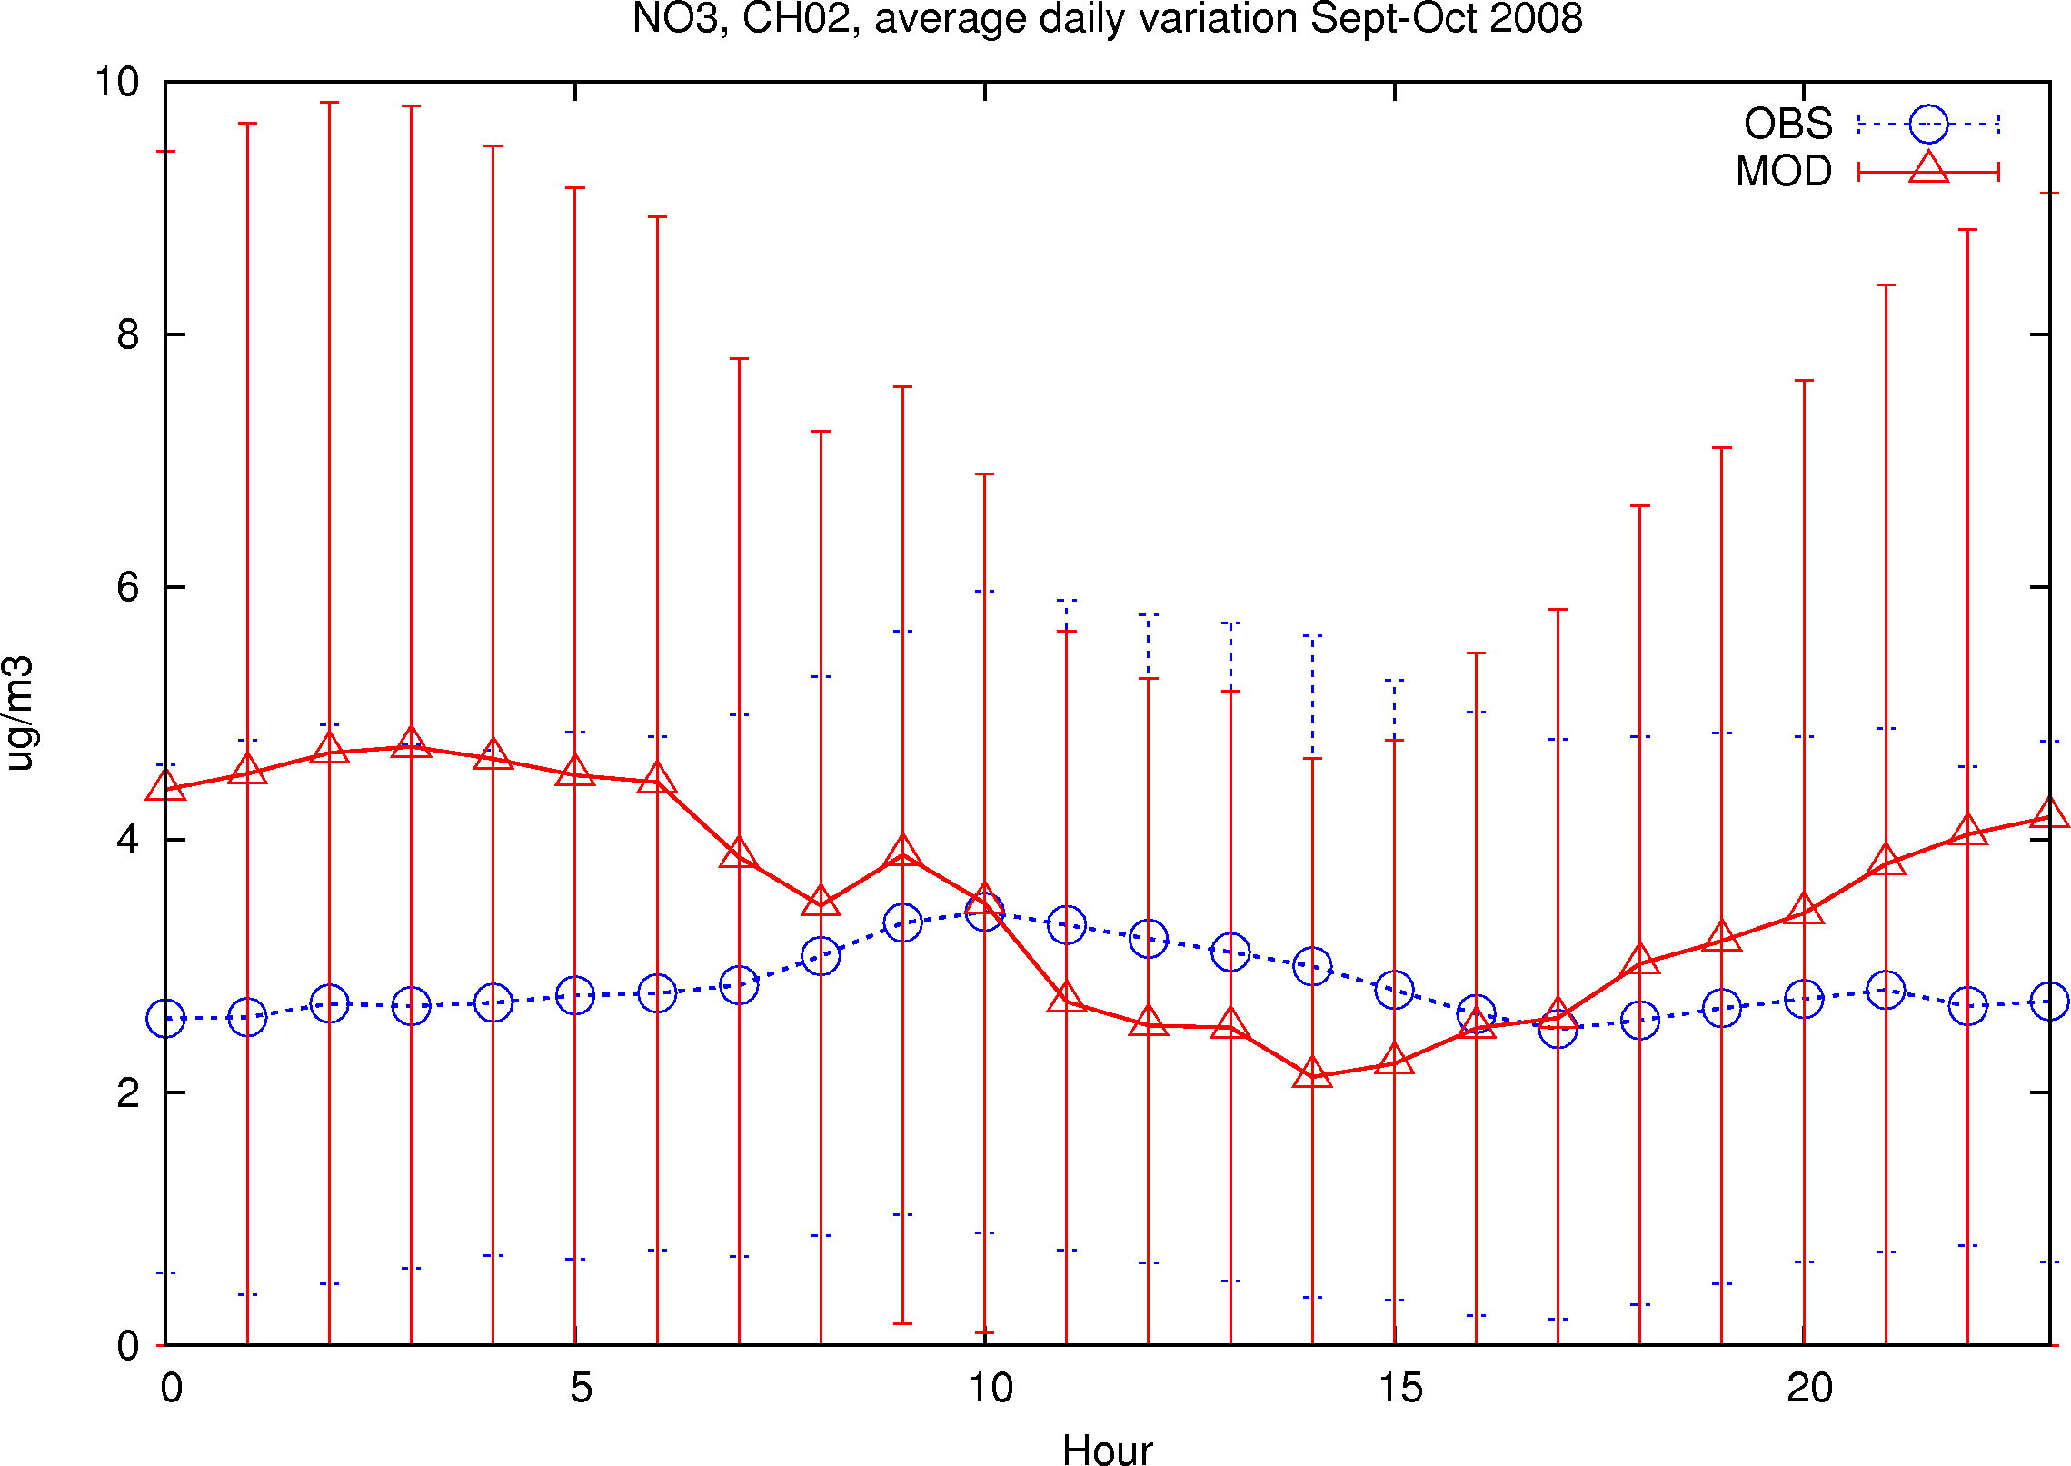
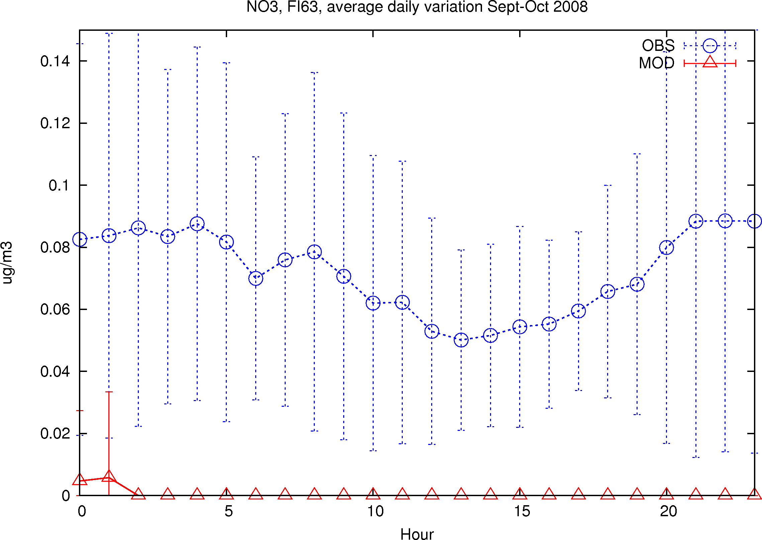
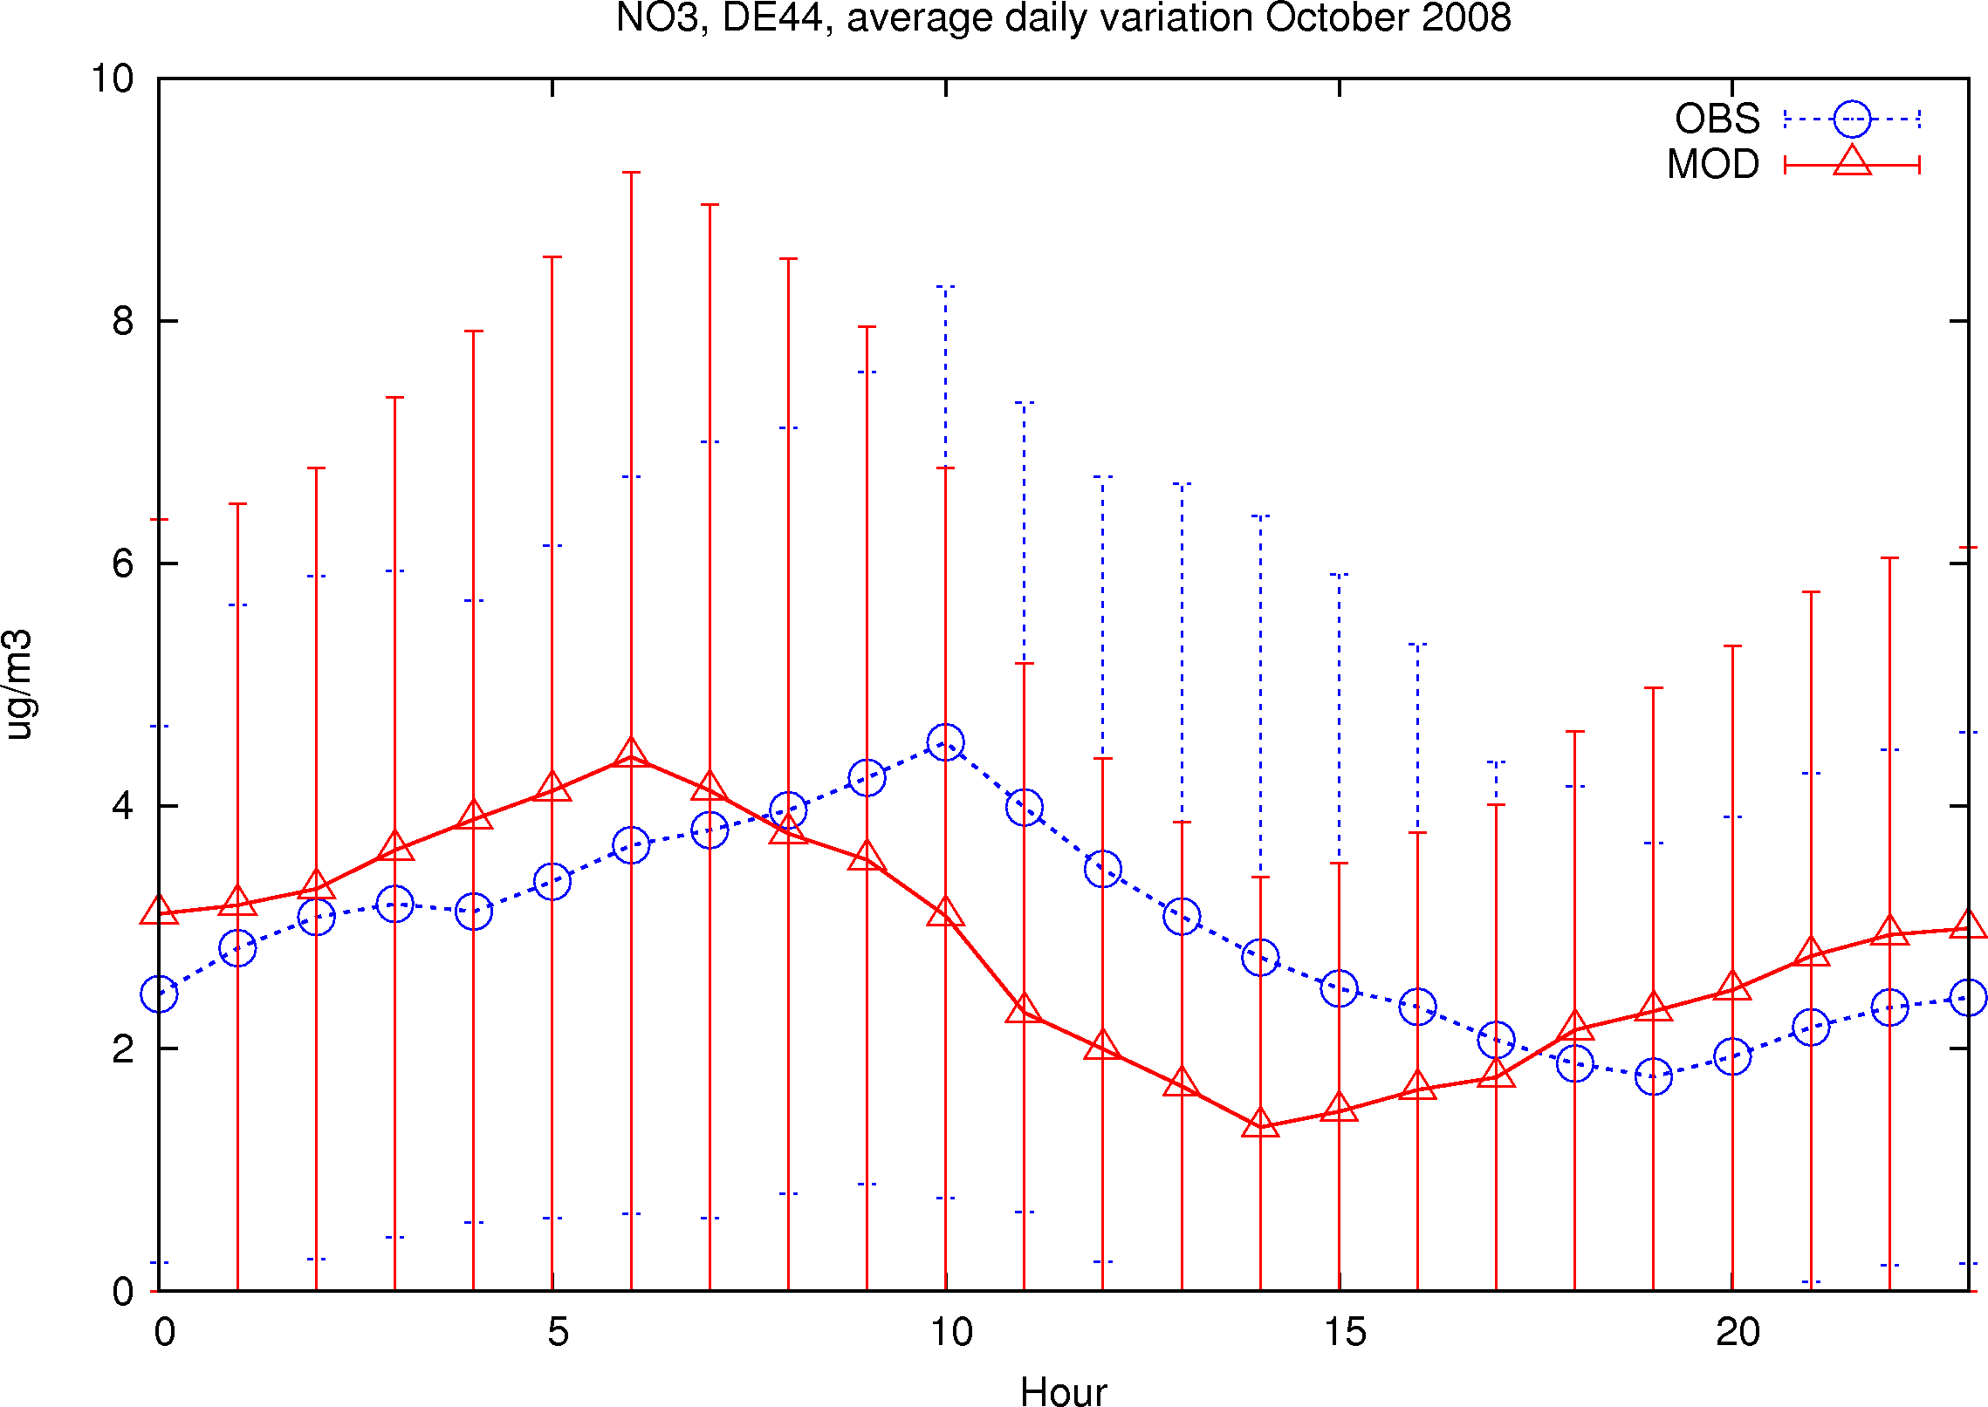
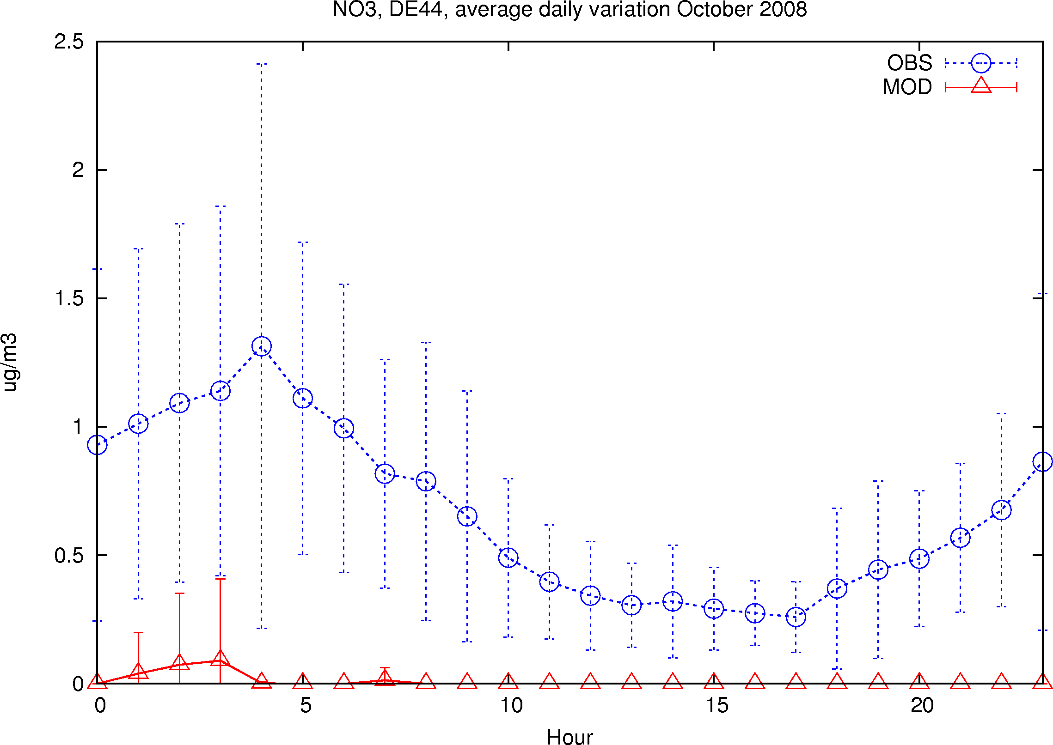
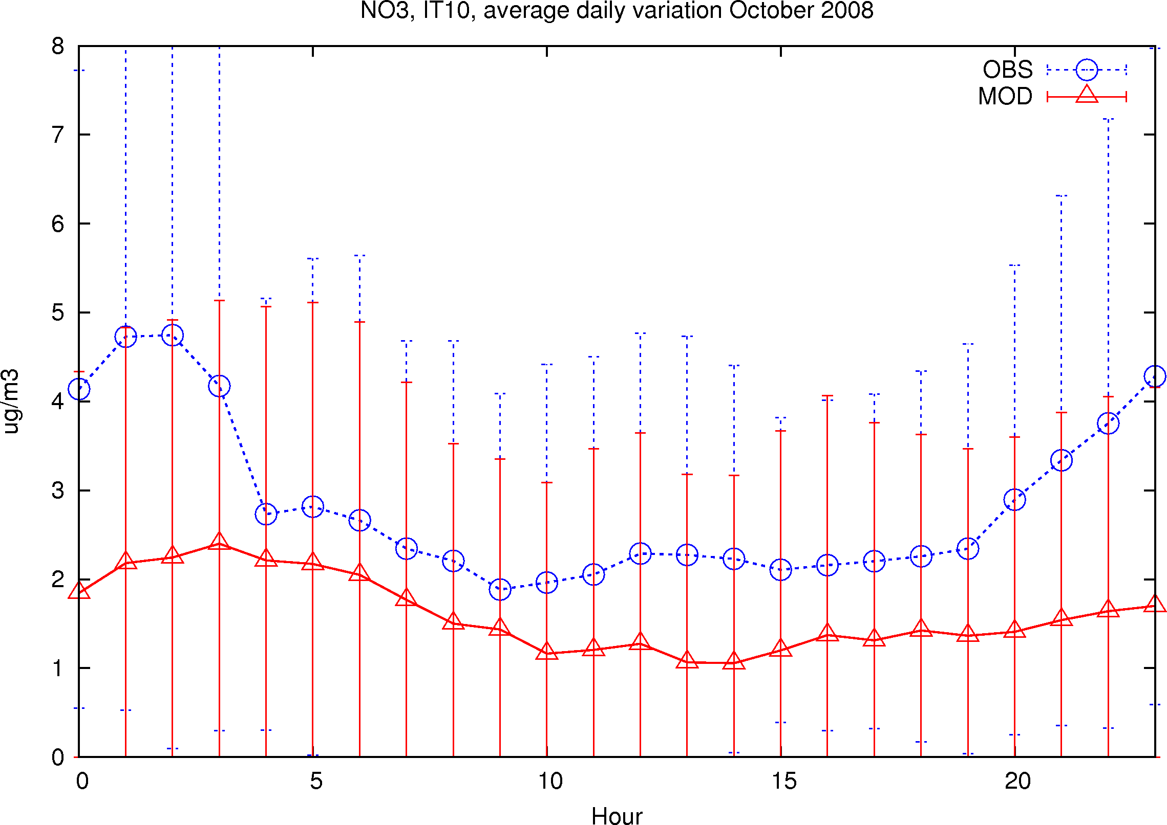
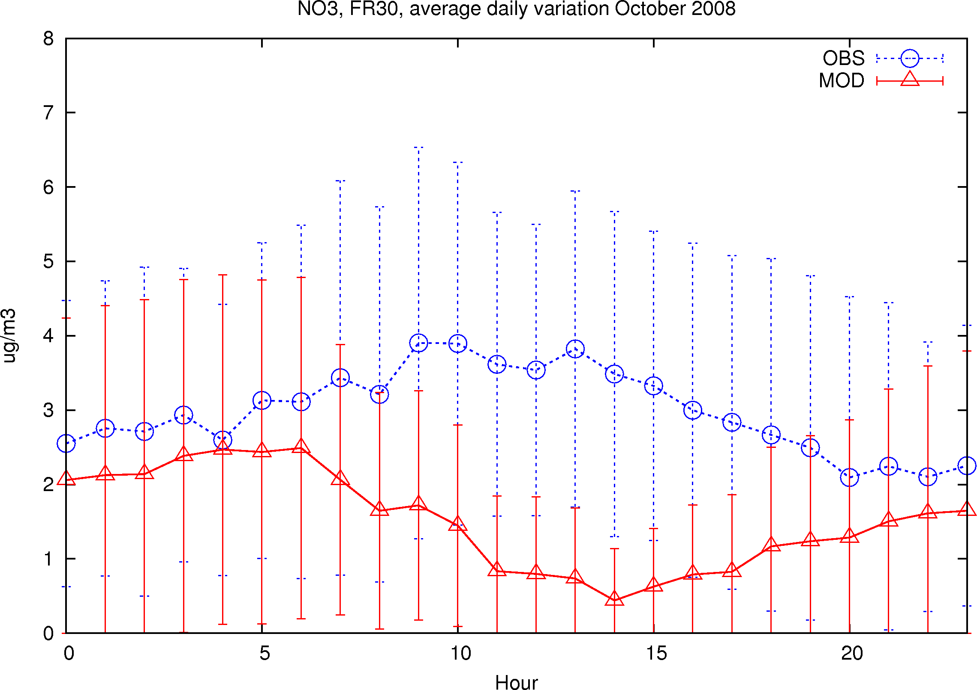
SE11
HU02
CH02
May-June
FI63
DE44
DE44
IT10
FR30
NO₃
Sept-Oct 2008
Meteorologisk Institutt met.no

Slide 10
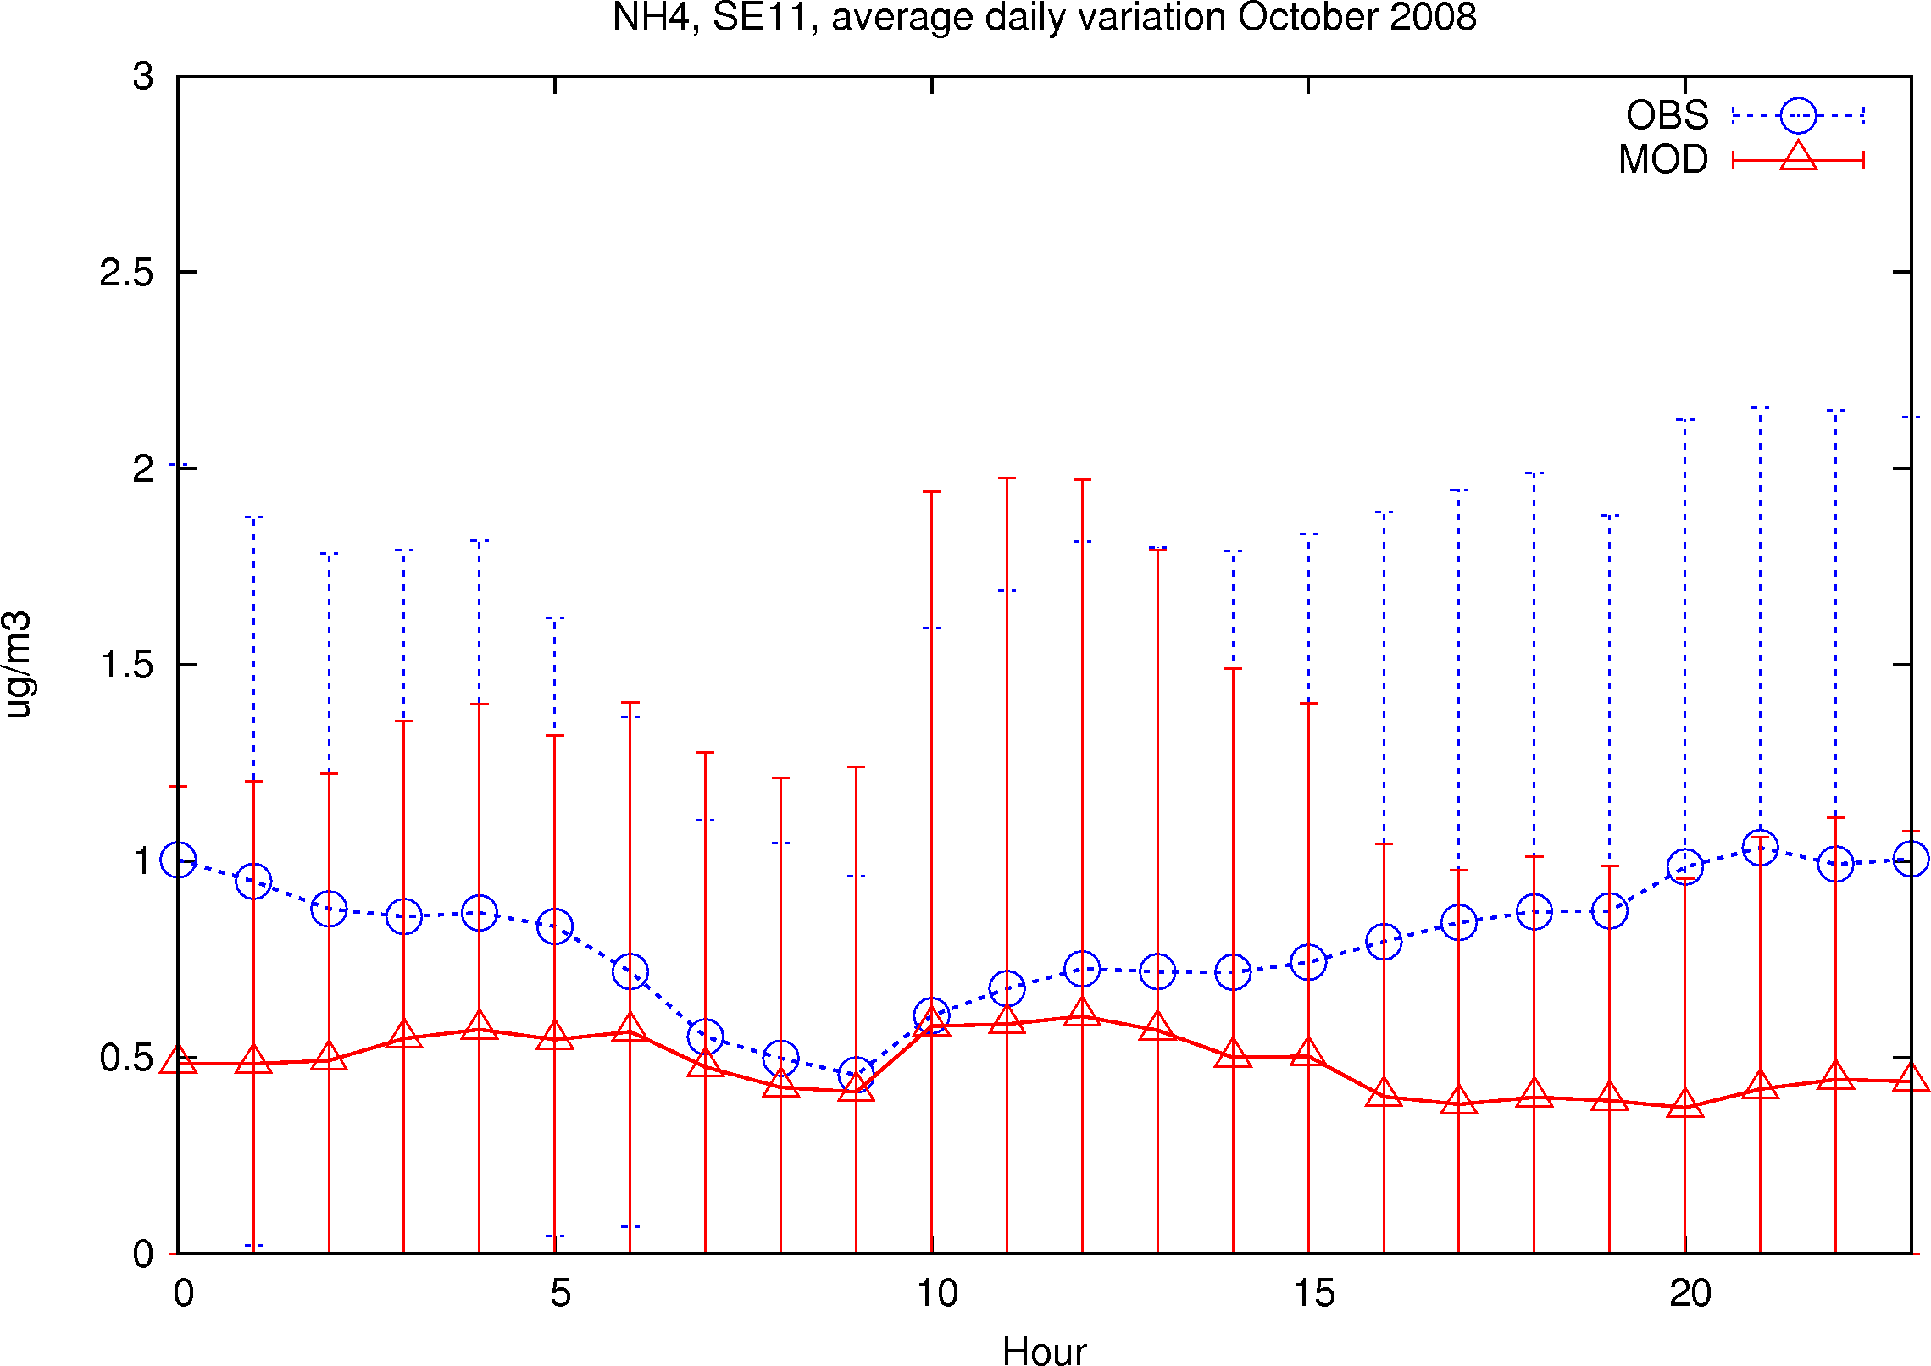
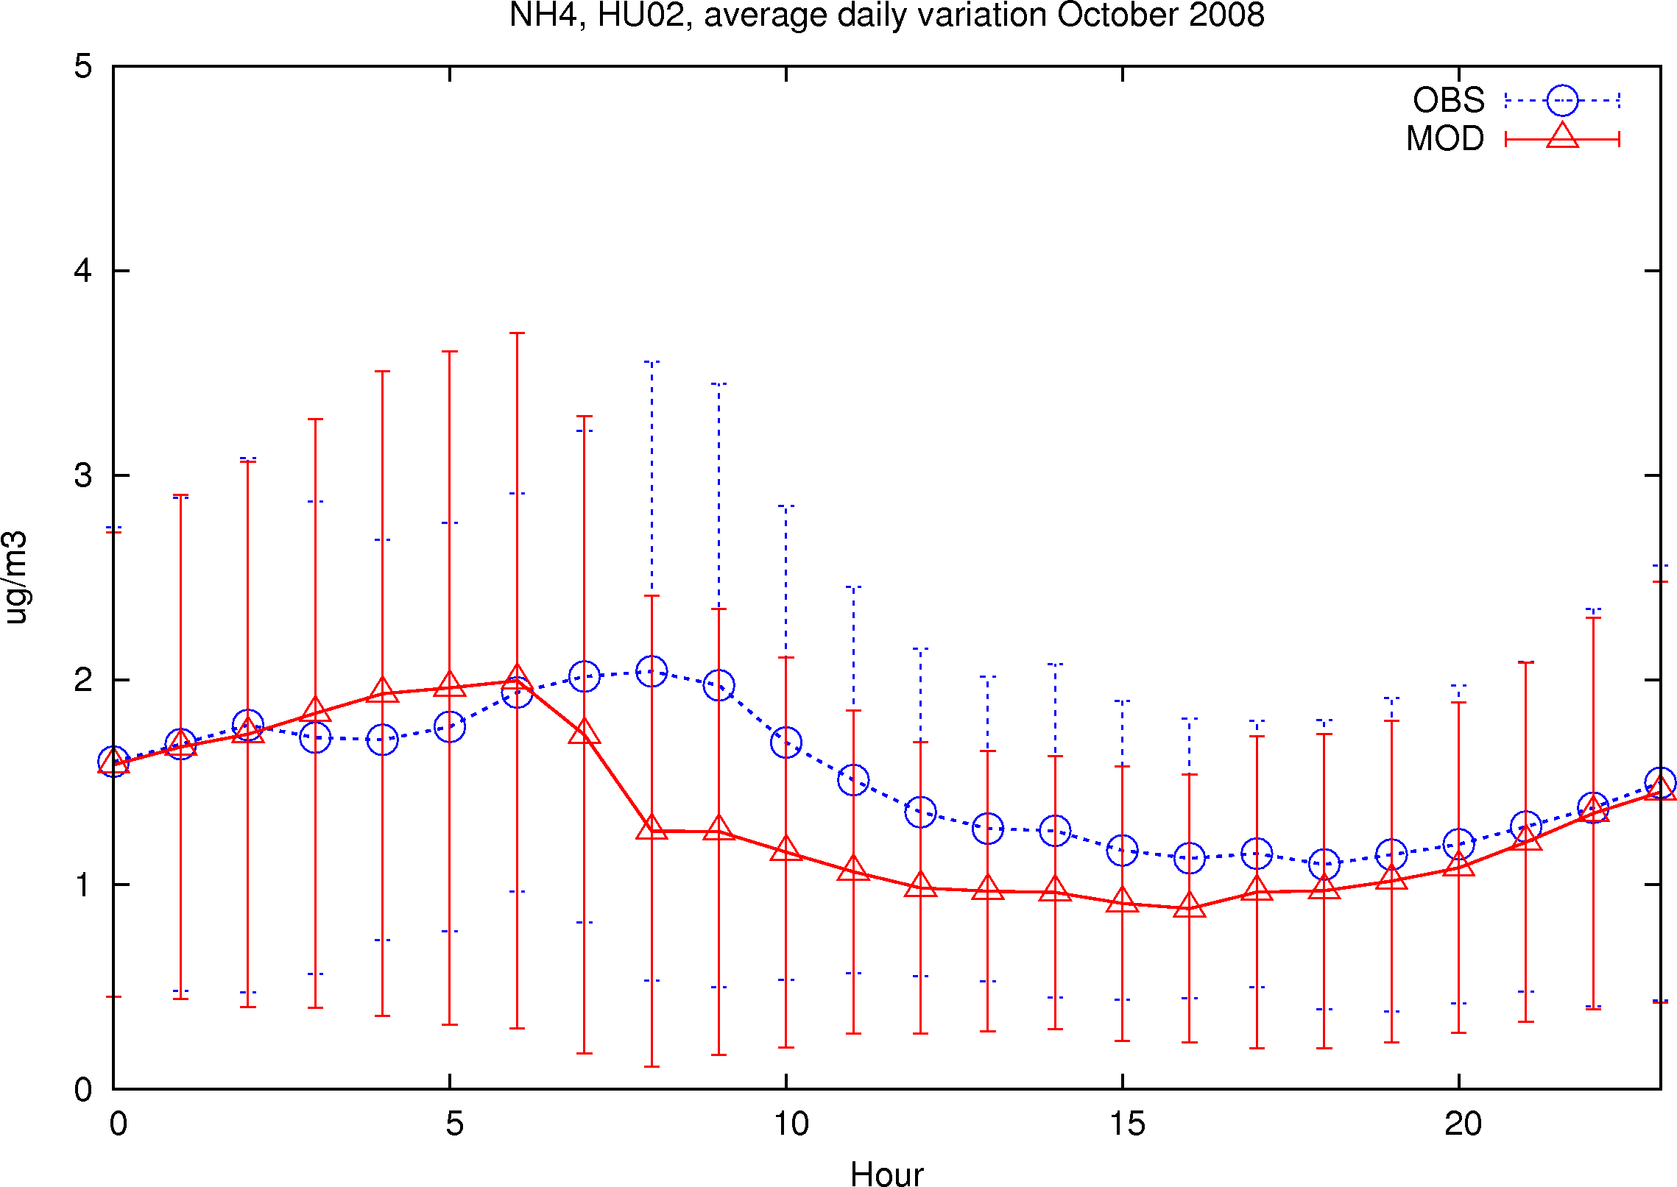
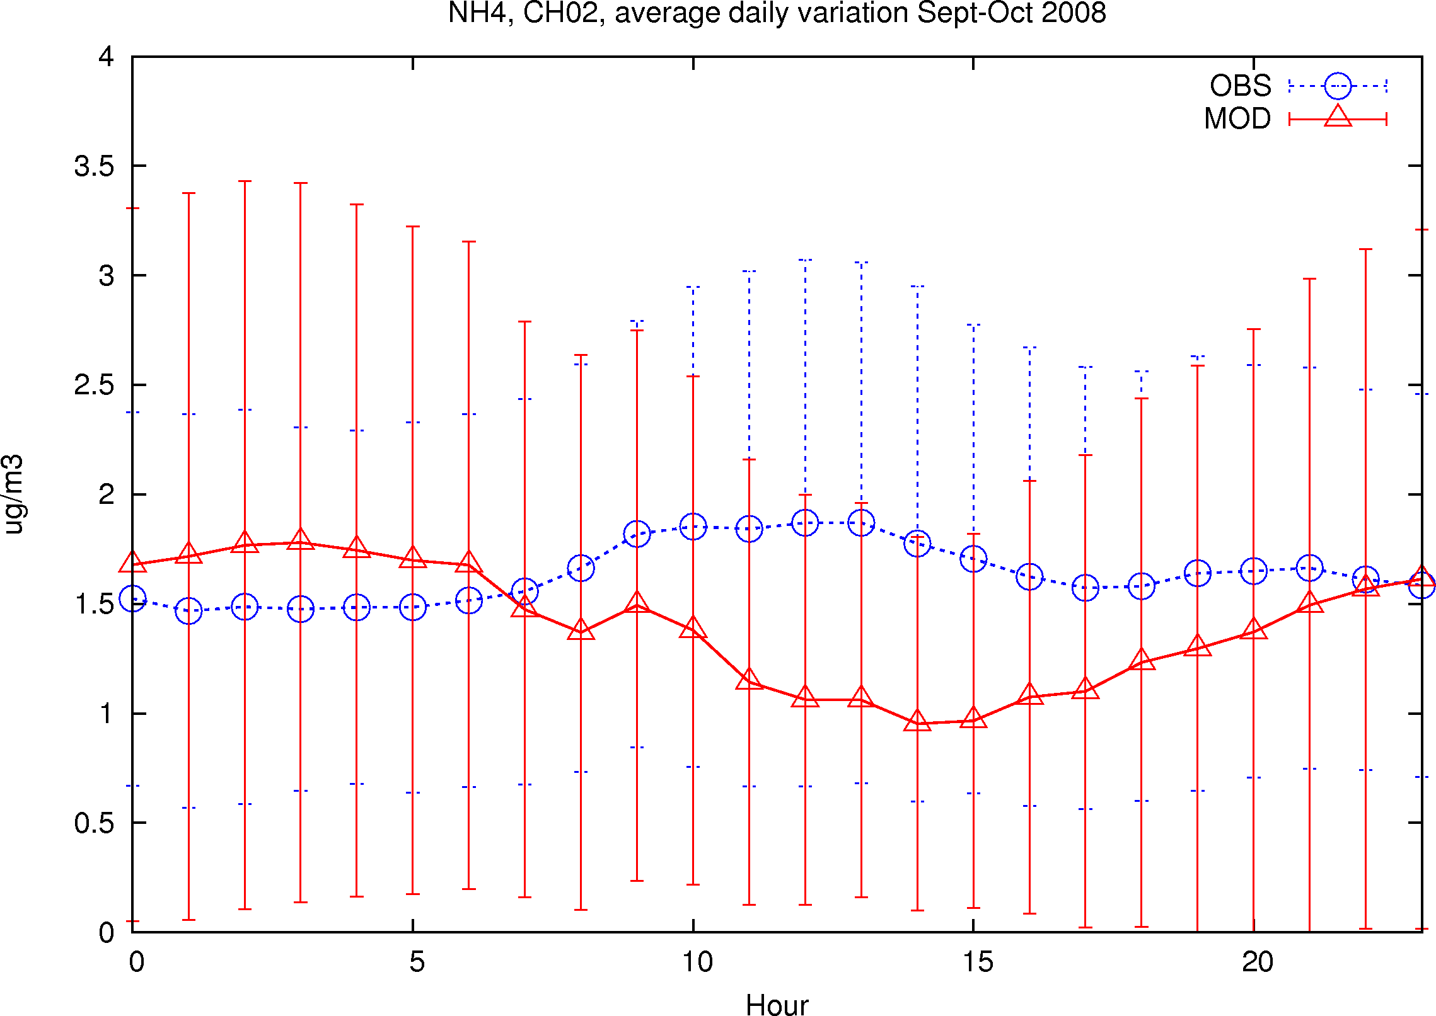
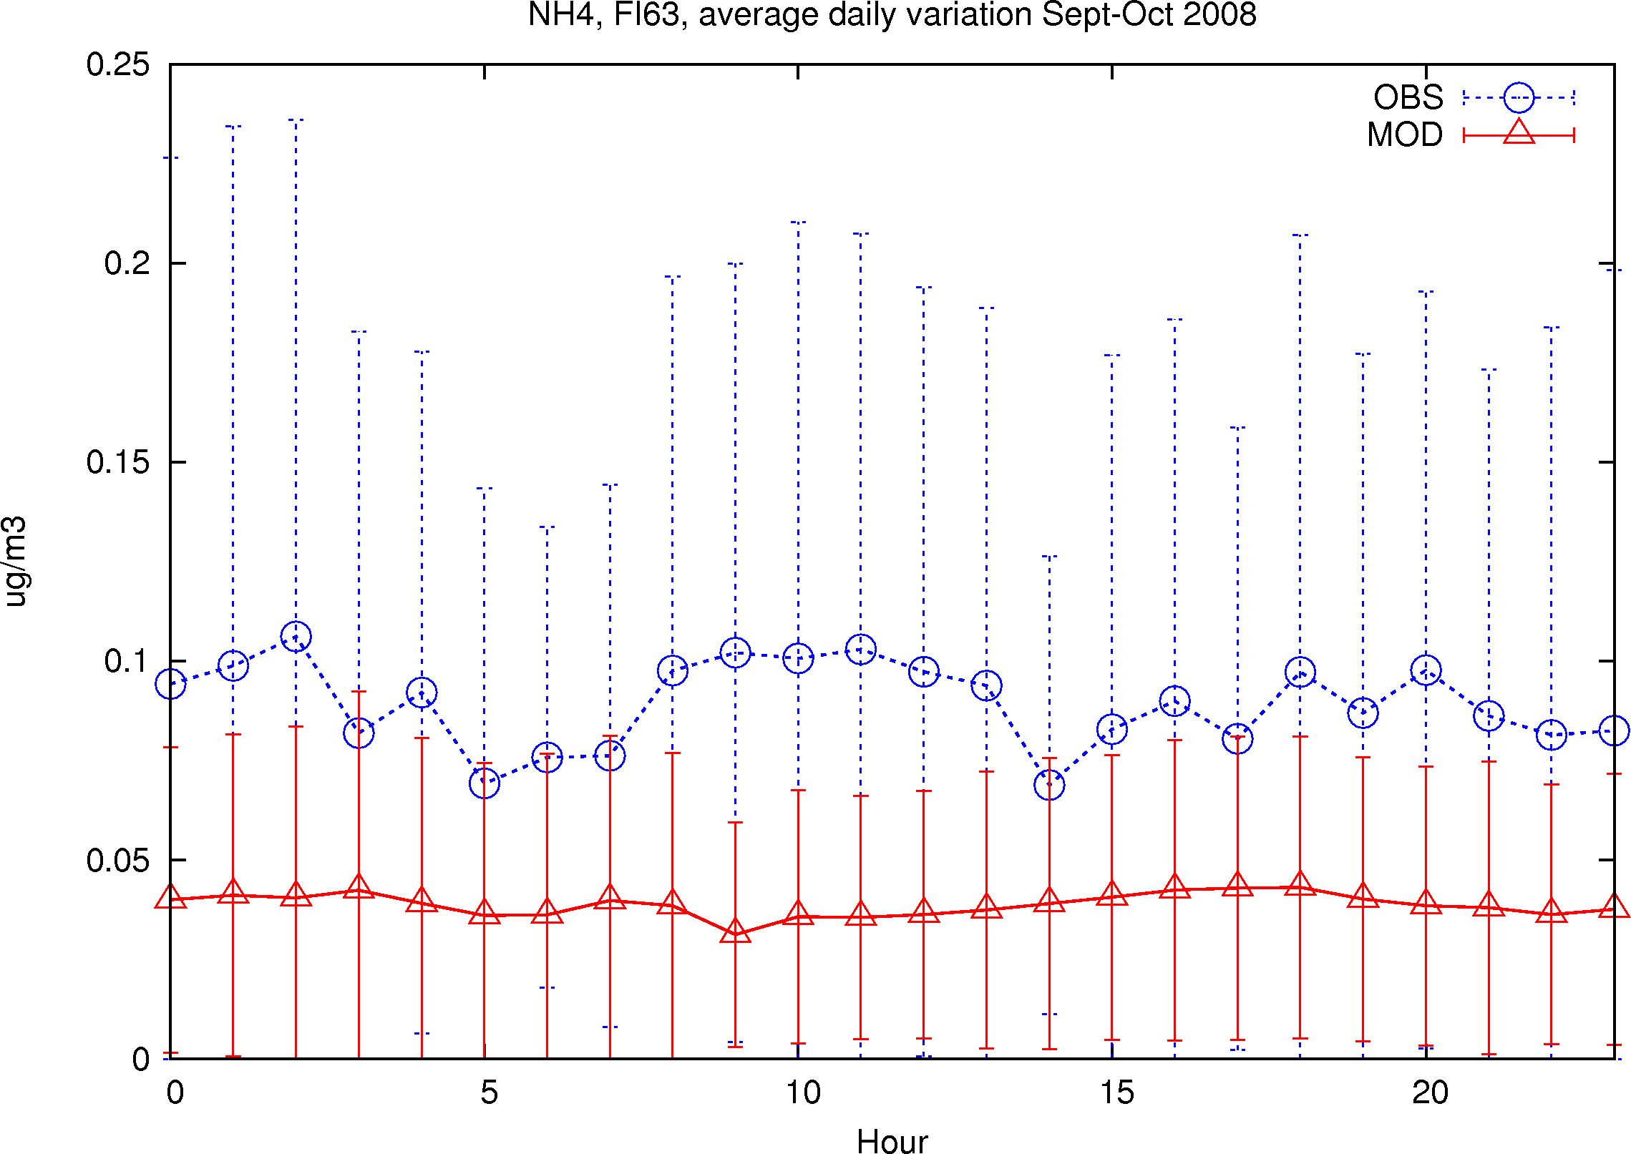
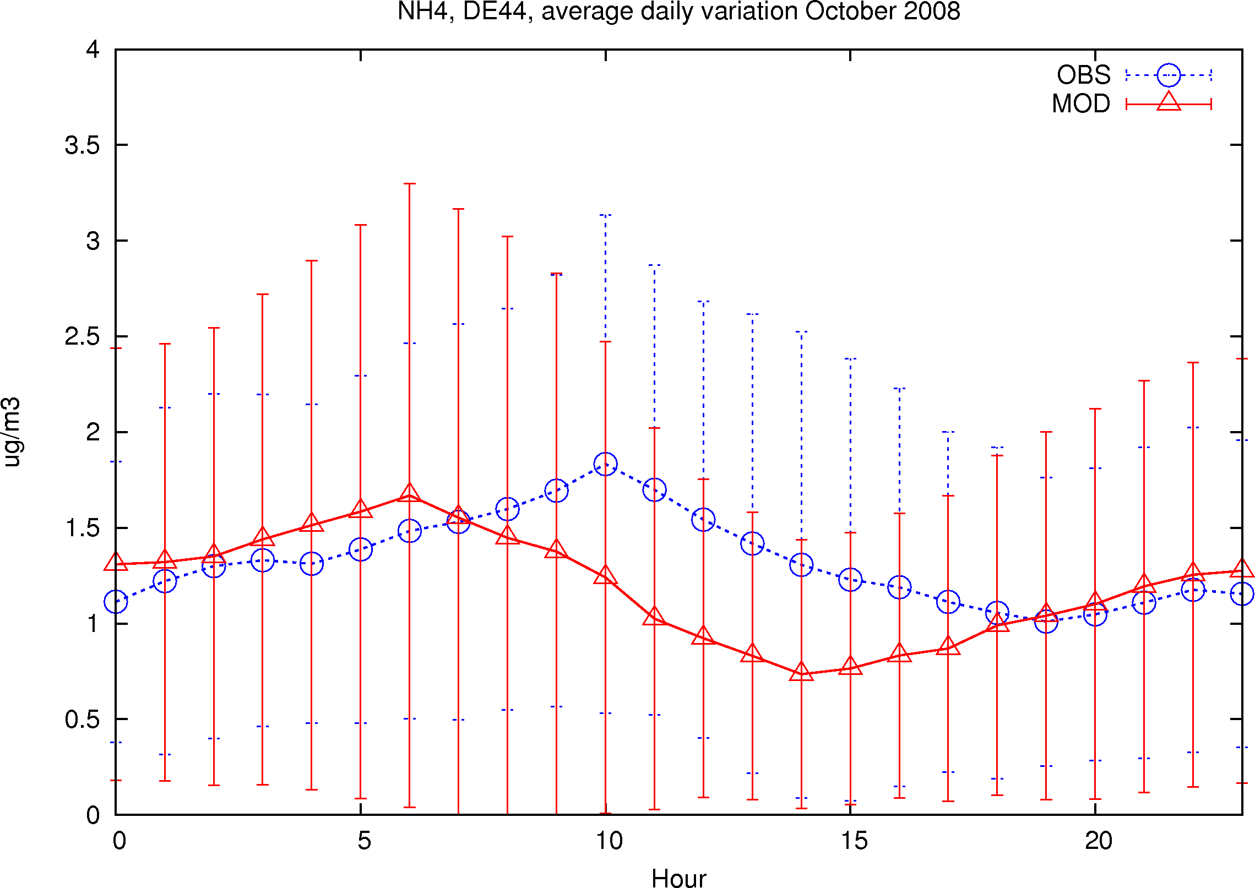
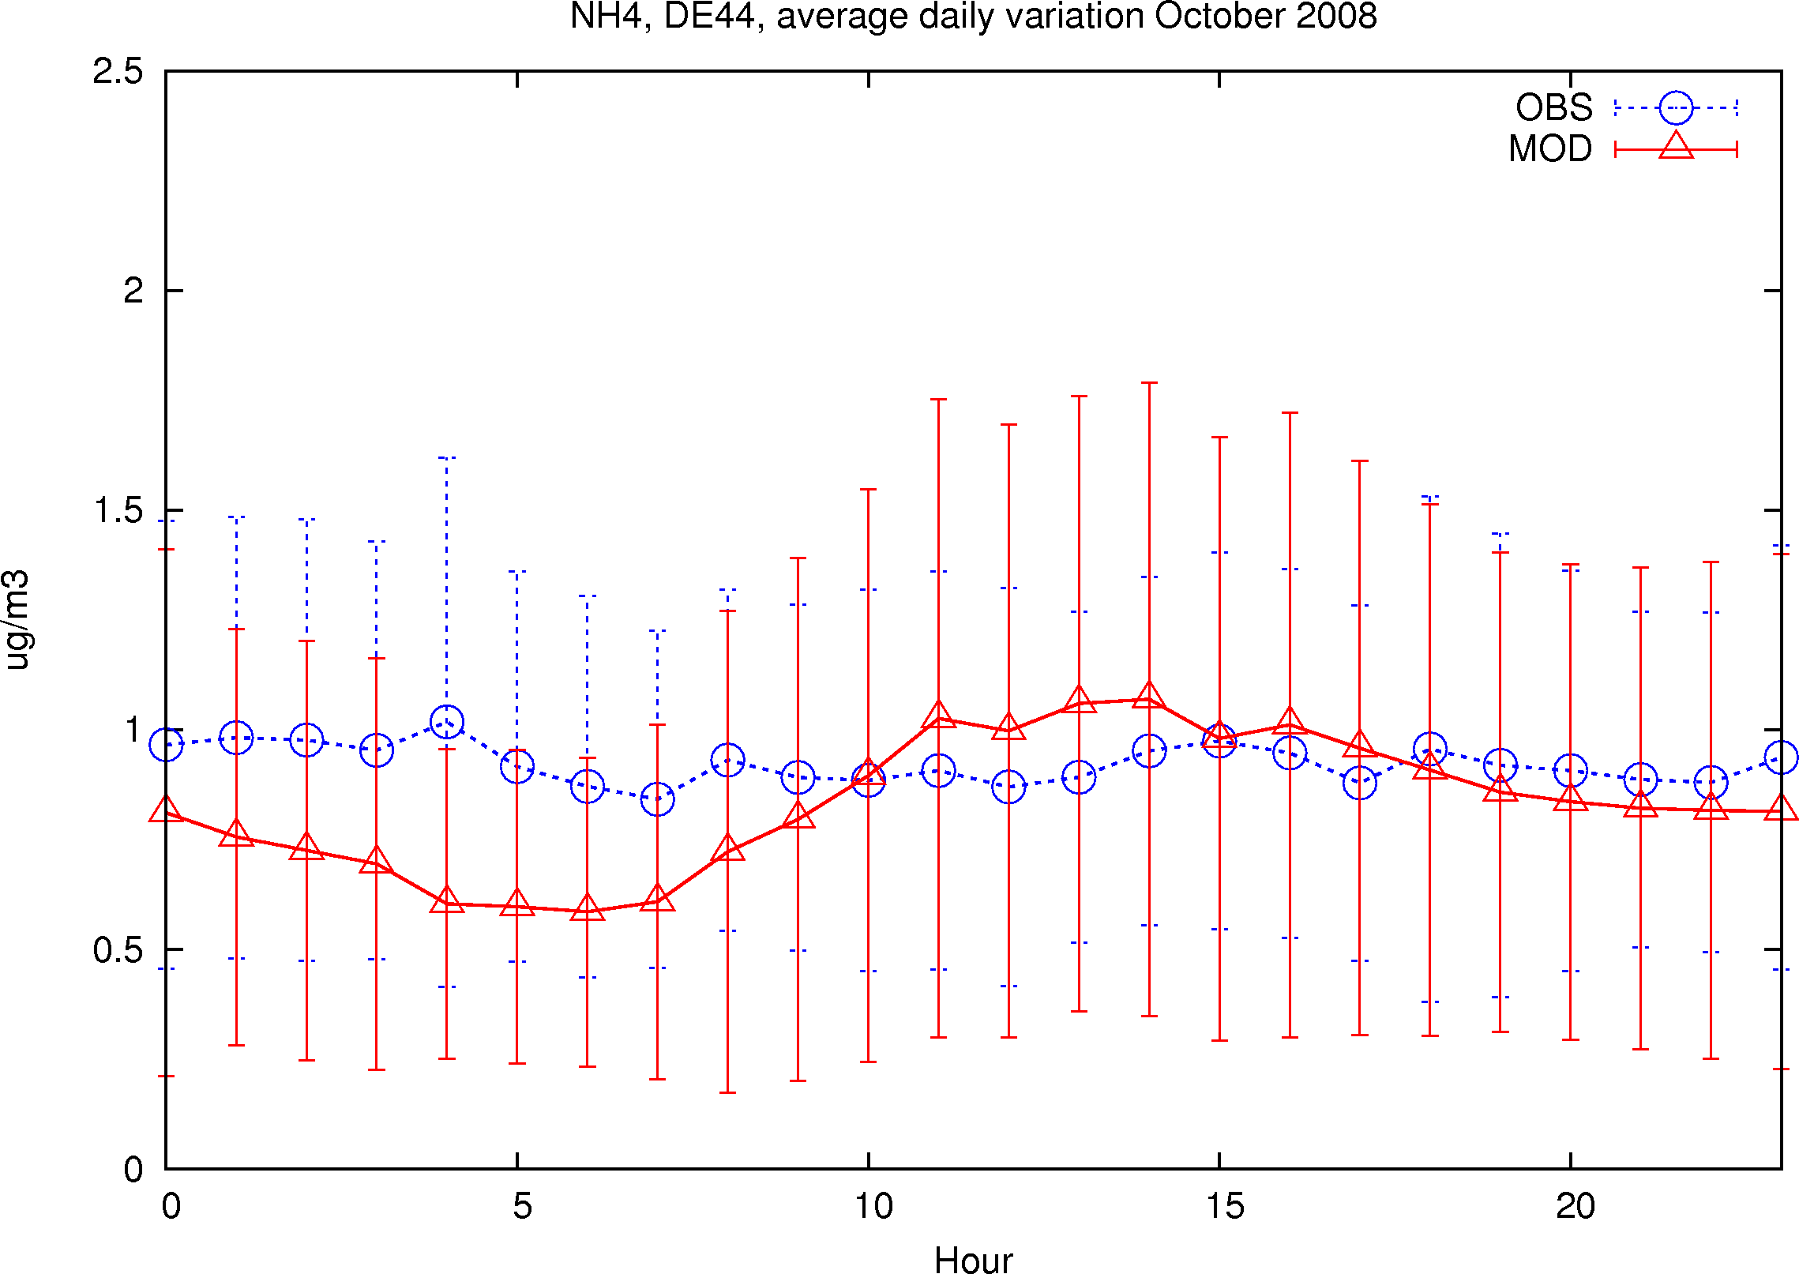
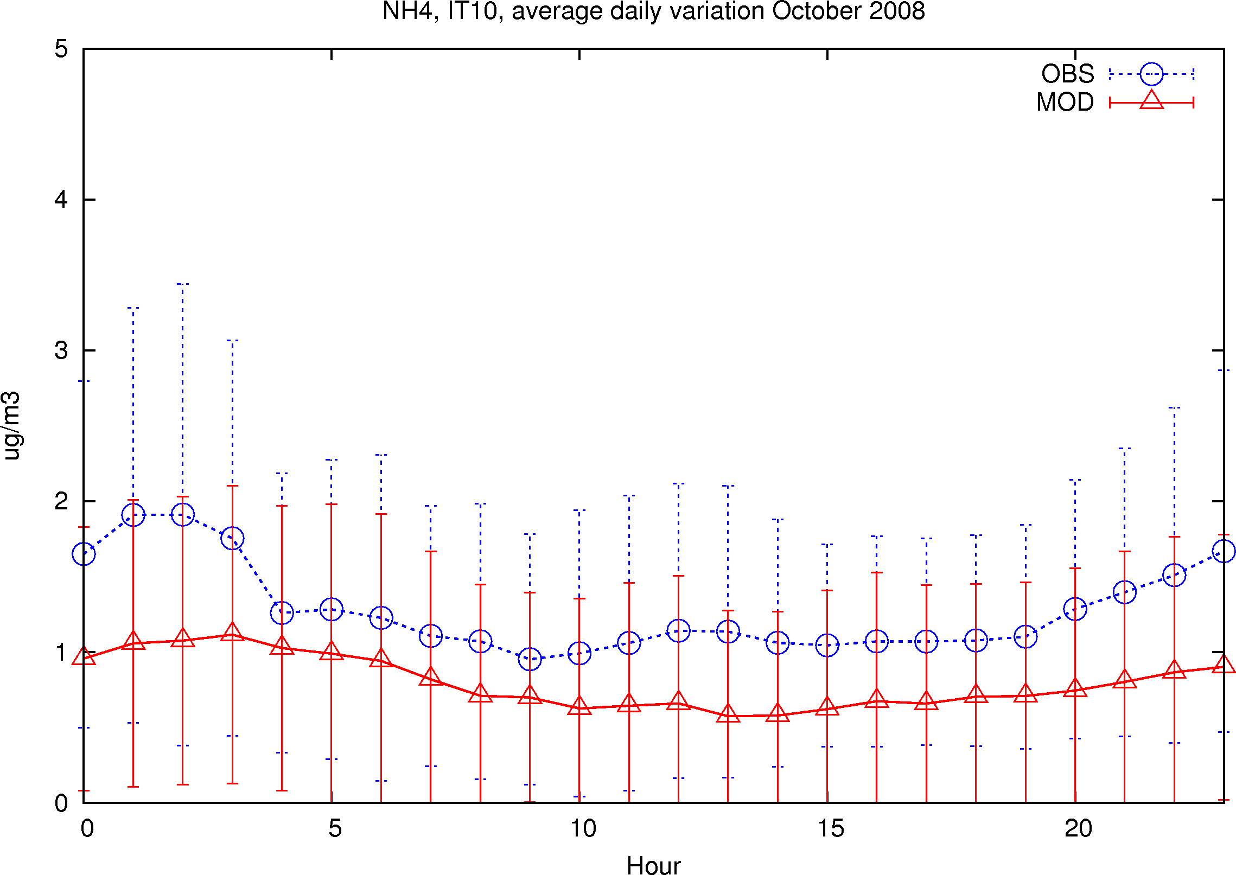
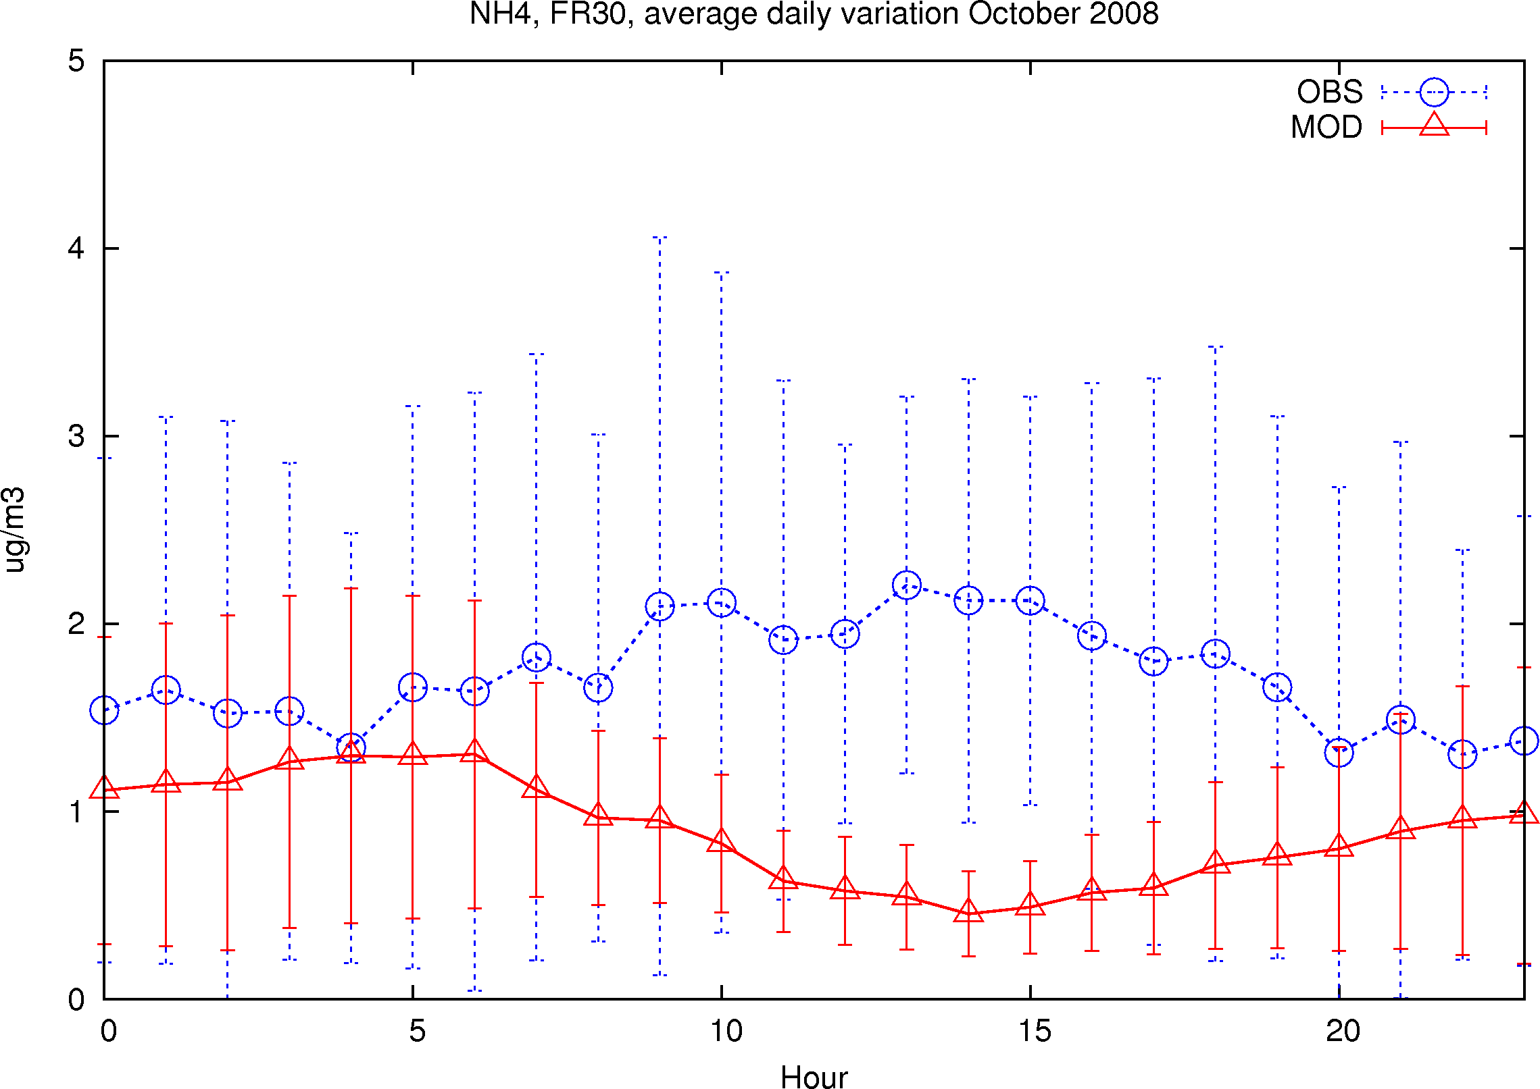
SE11
HU02
CH02
May-June
FI63
DE44
DE44
IT10
FR30
NH₄
Sept-Oct 2008
Meteorologisk Institutt met.no

Slide 11
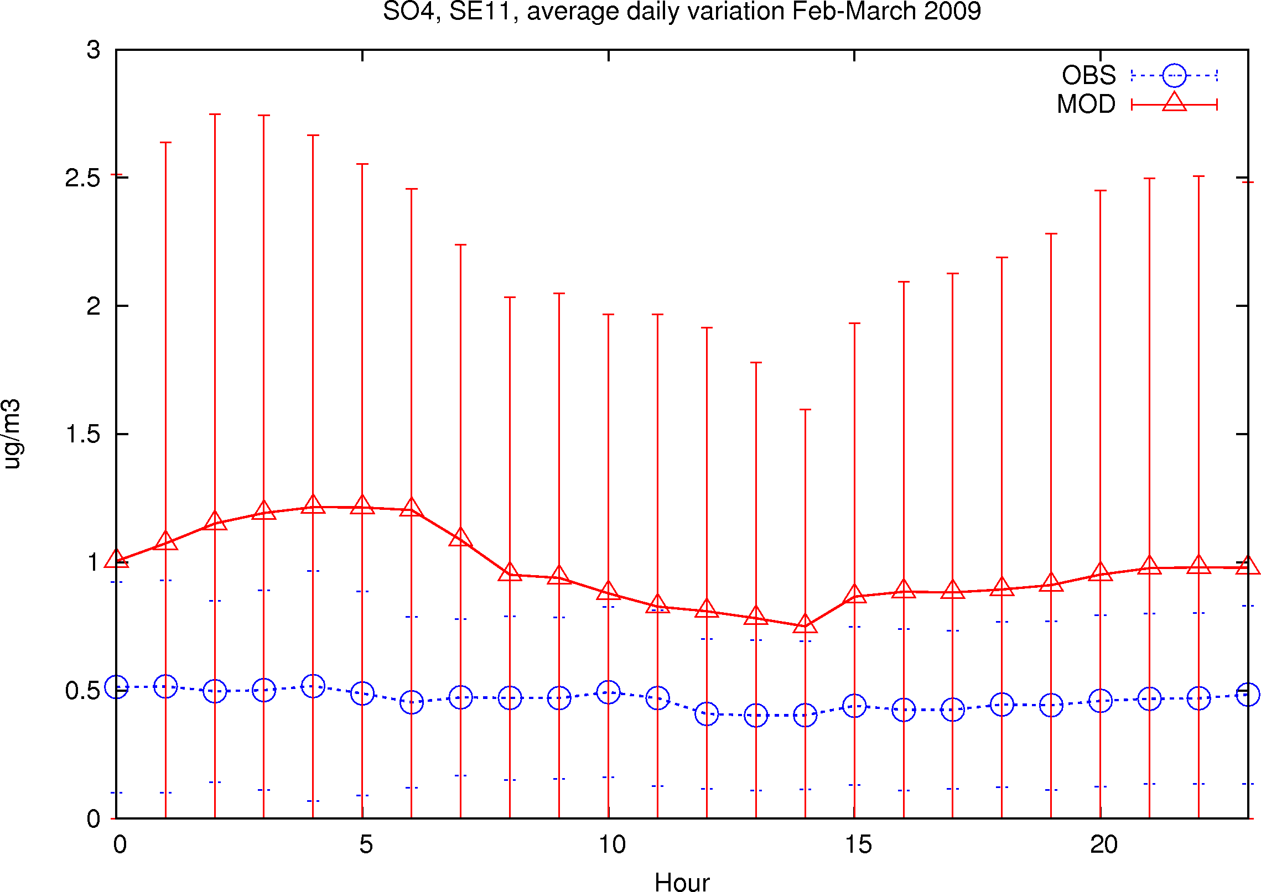
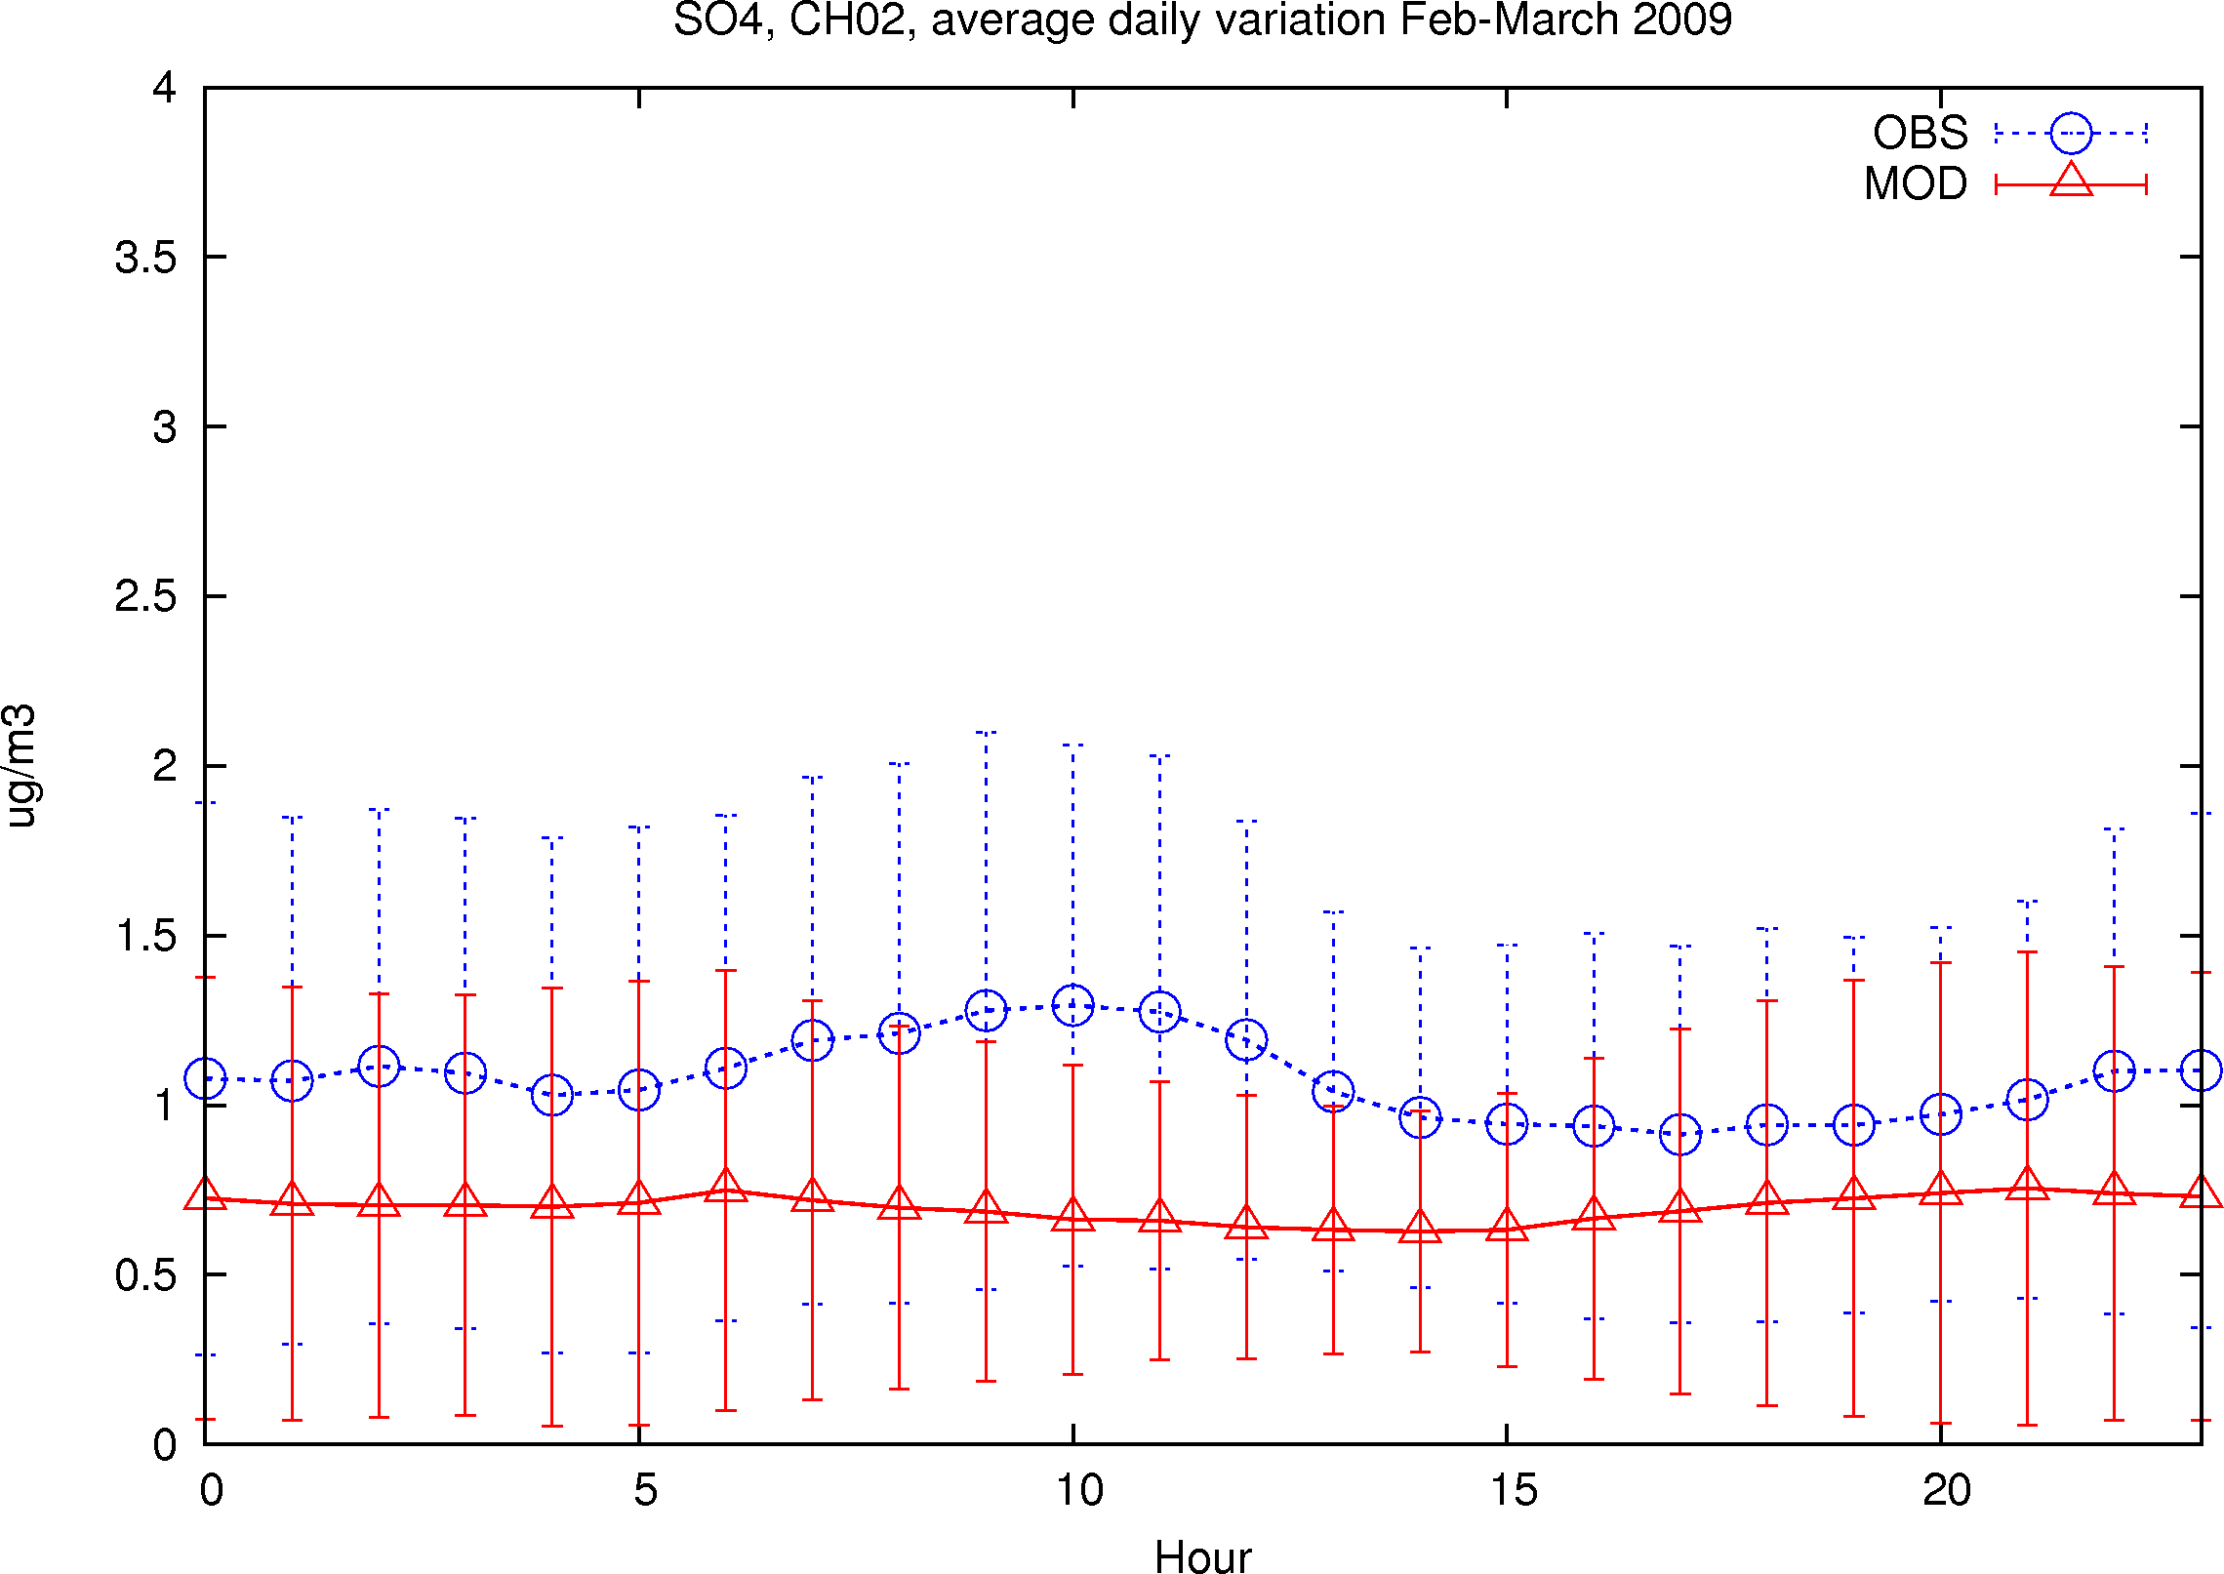
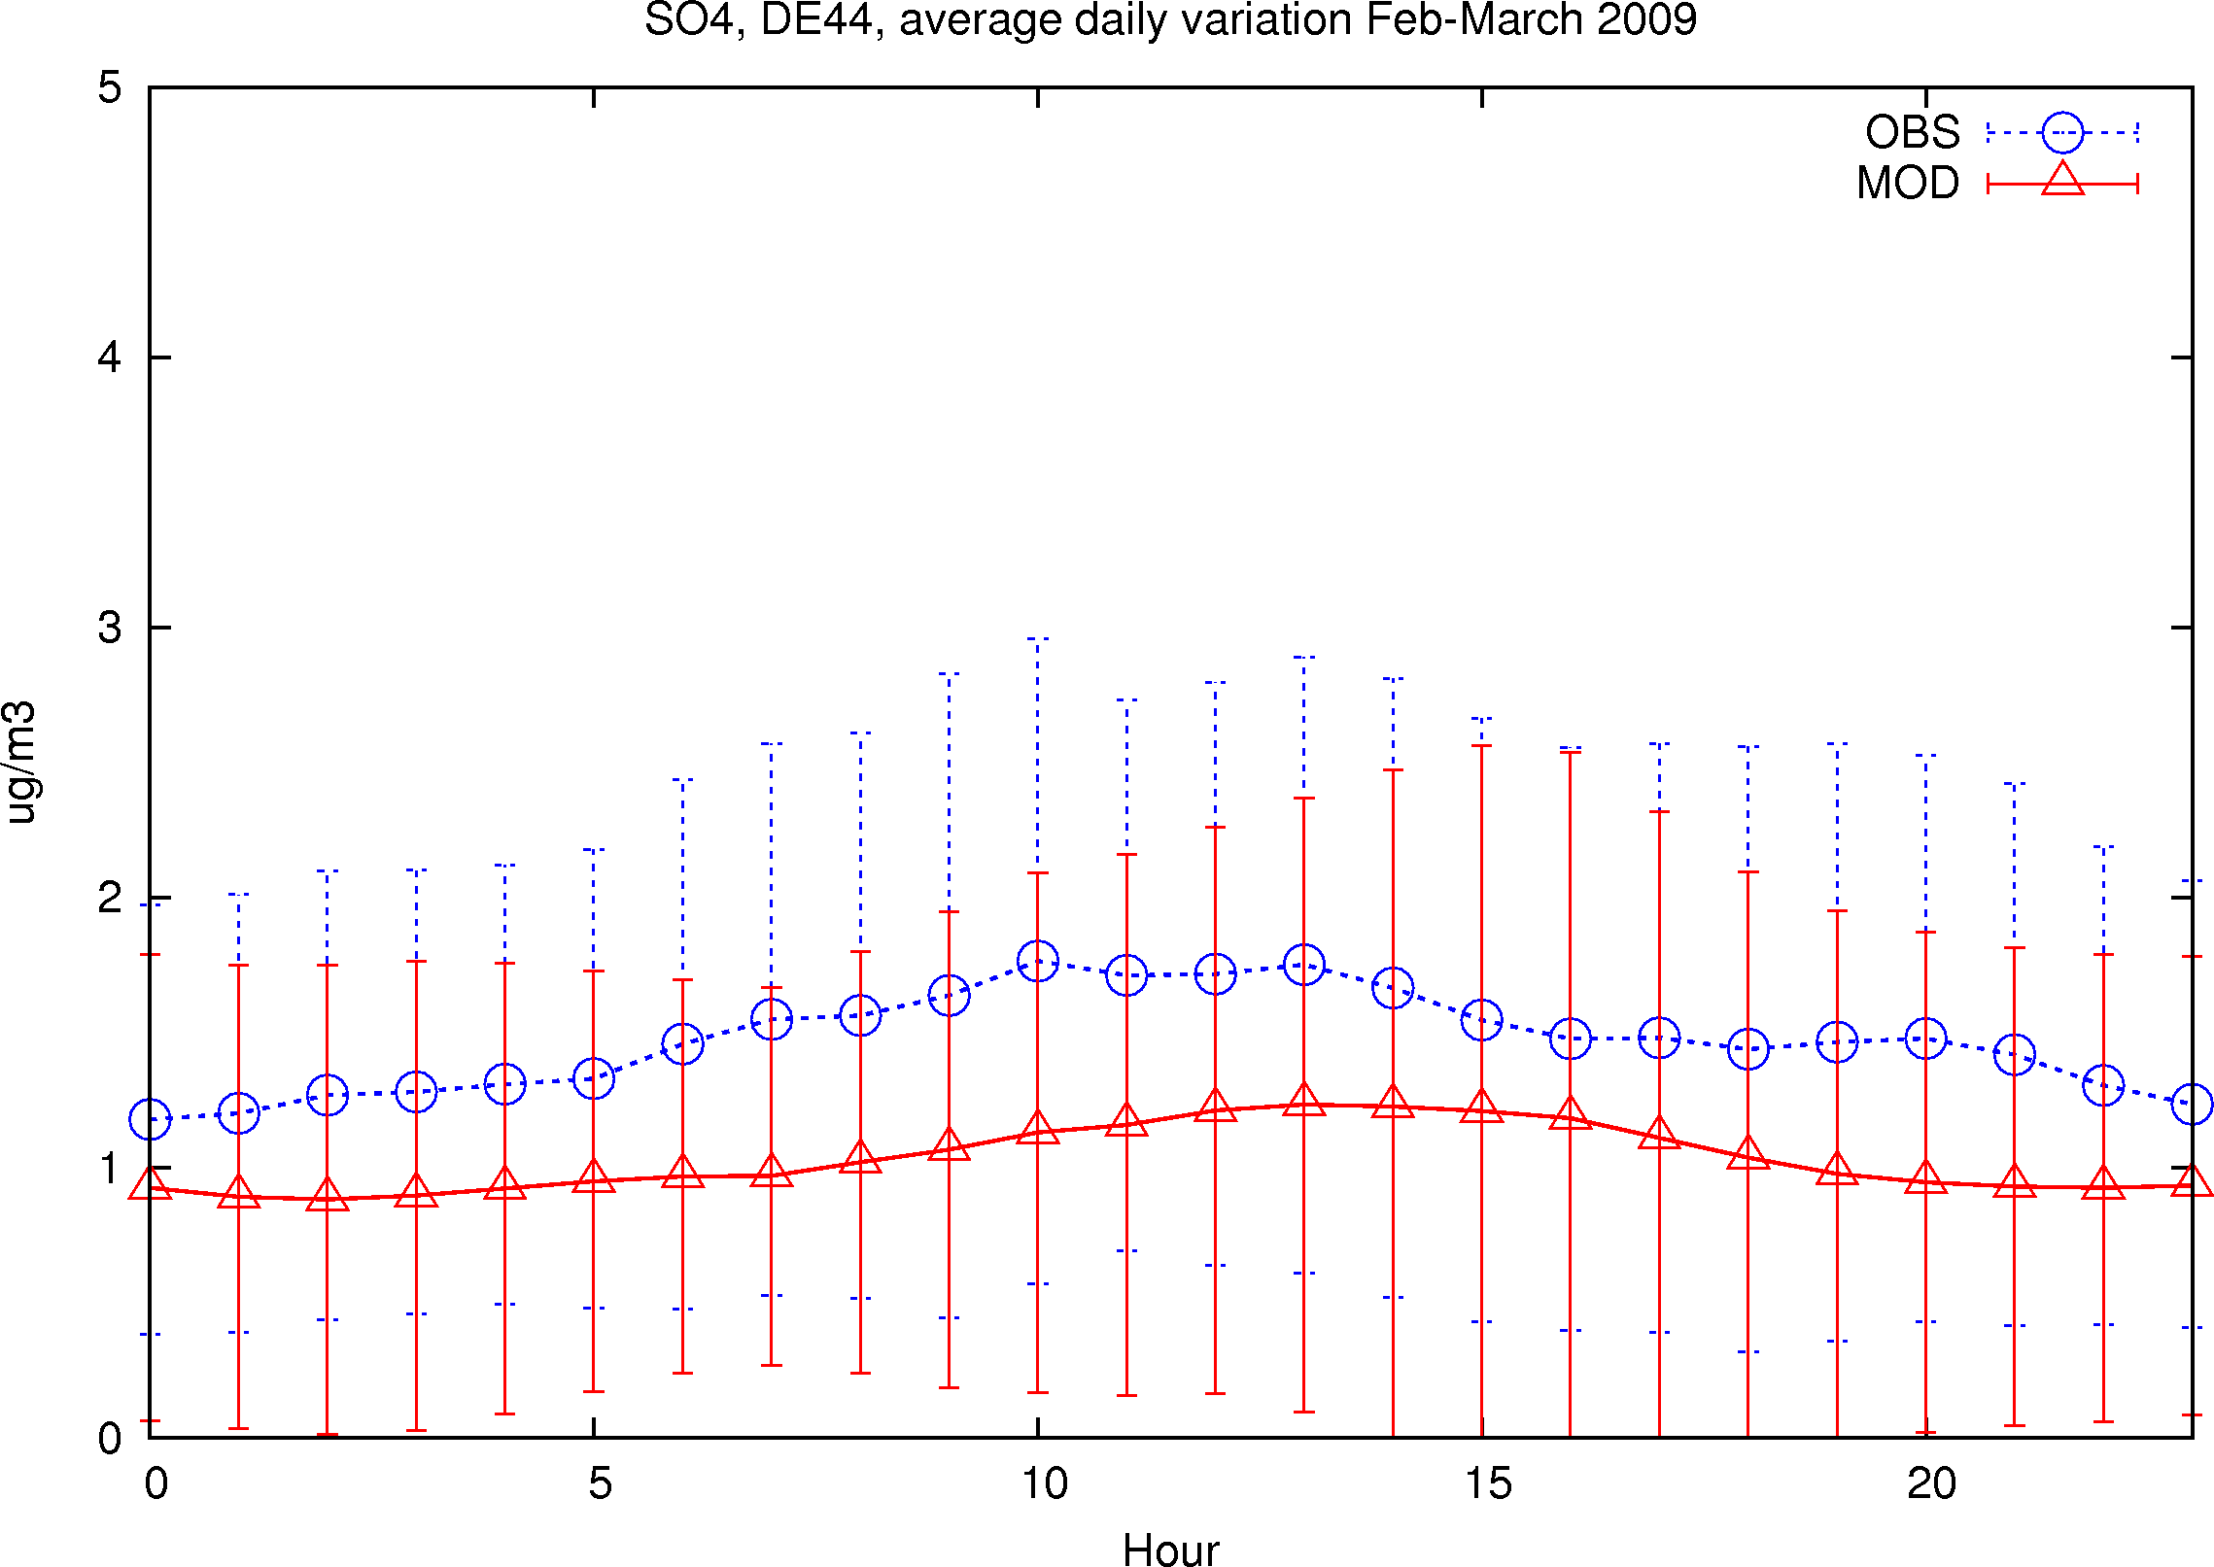
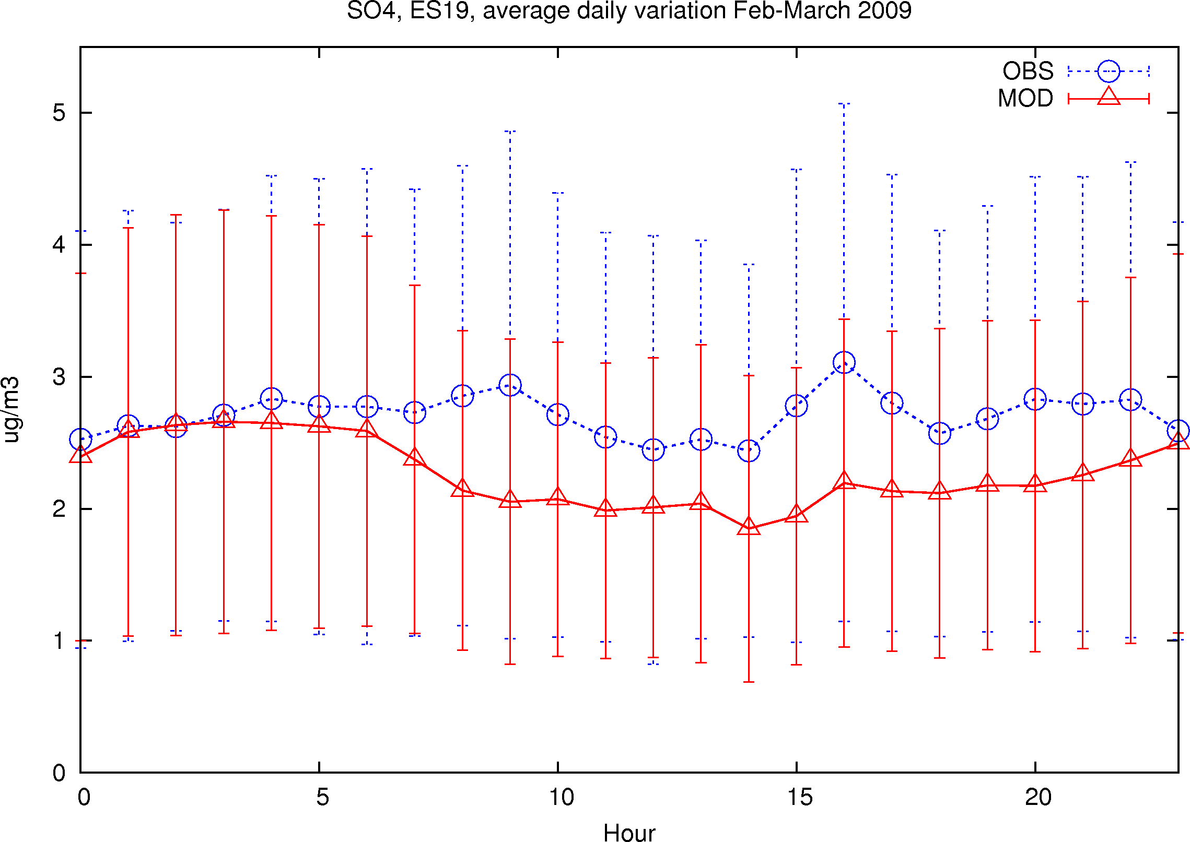
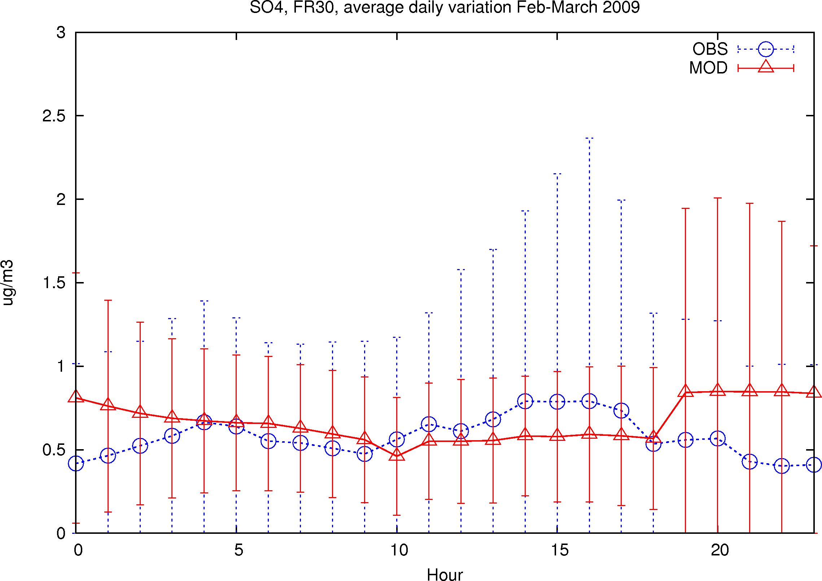
SE11
CH02
DE44
ES19
FR30
SO₄
Feb-Mar 2009
Meteorologisk Institutt met.no

Slide 12
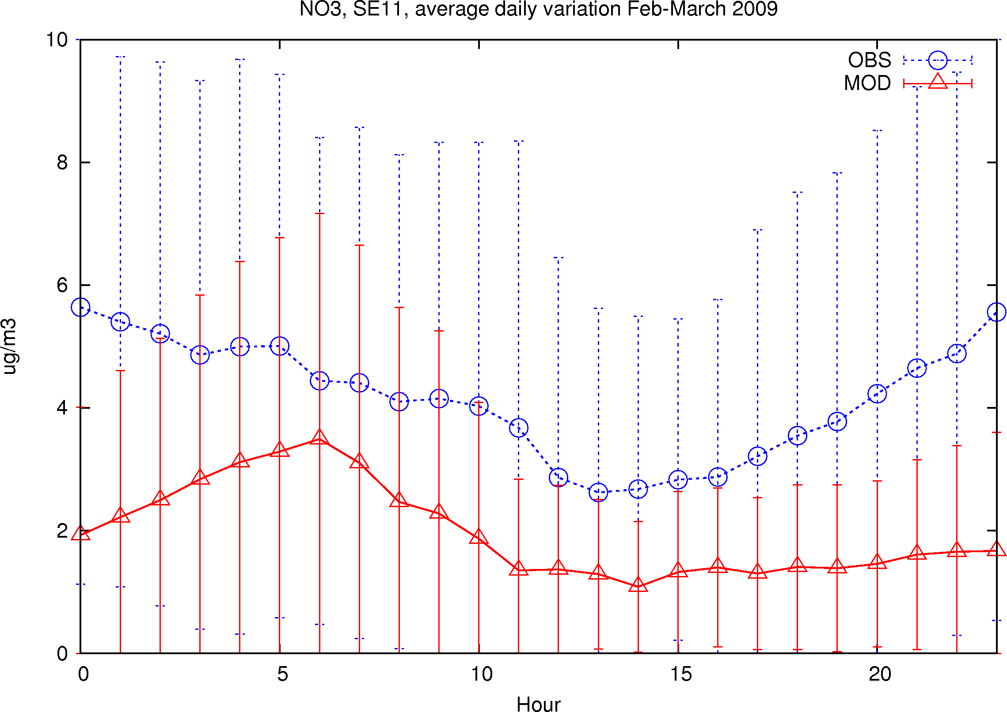
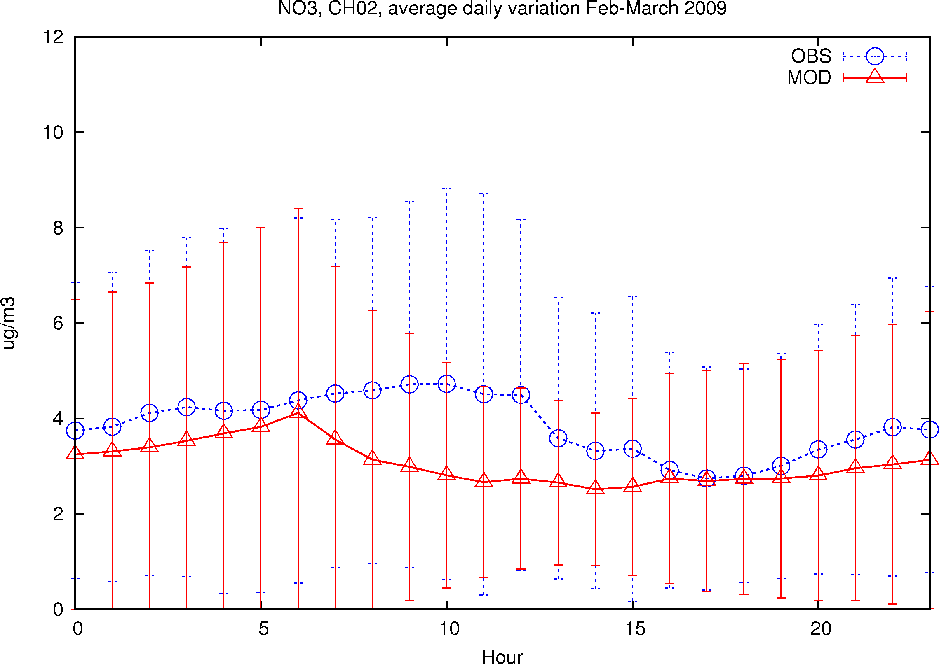
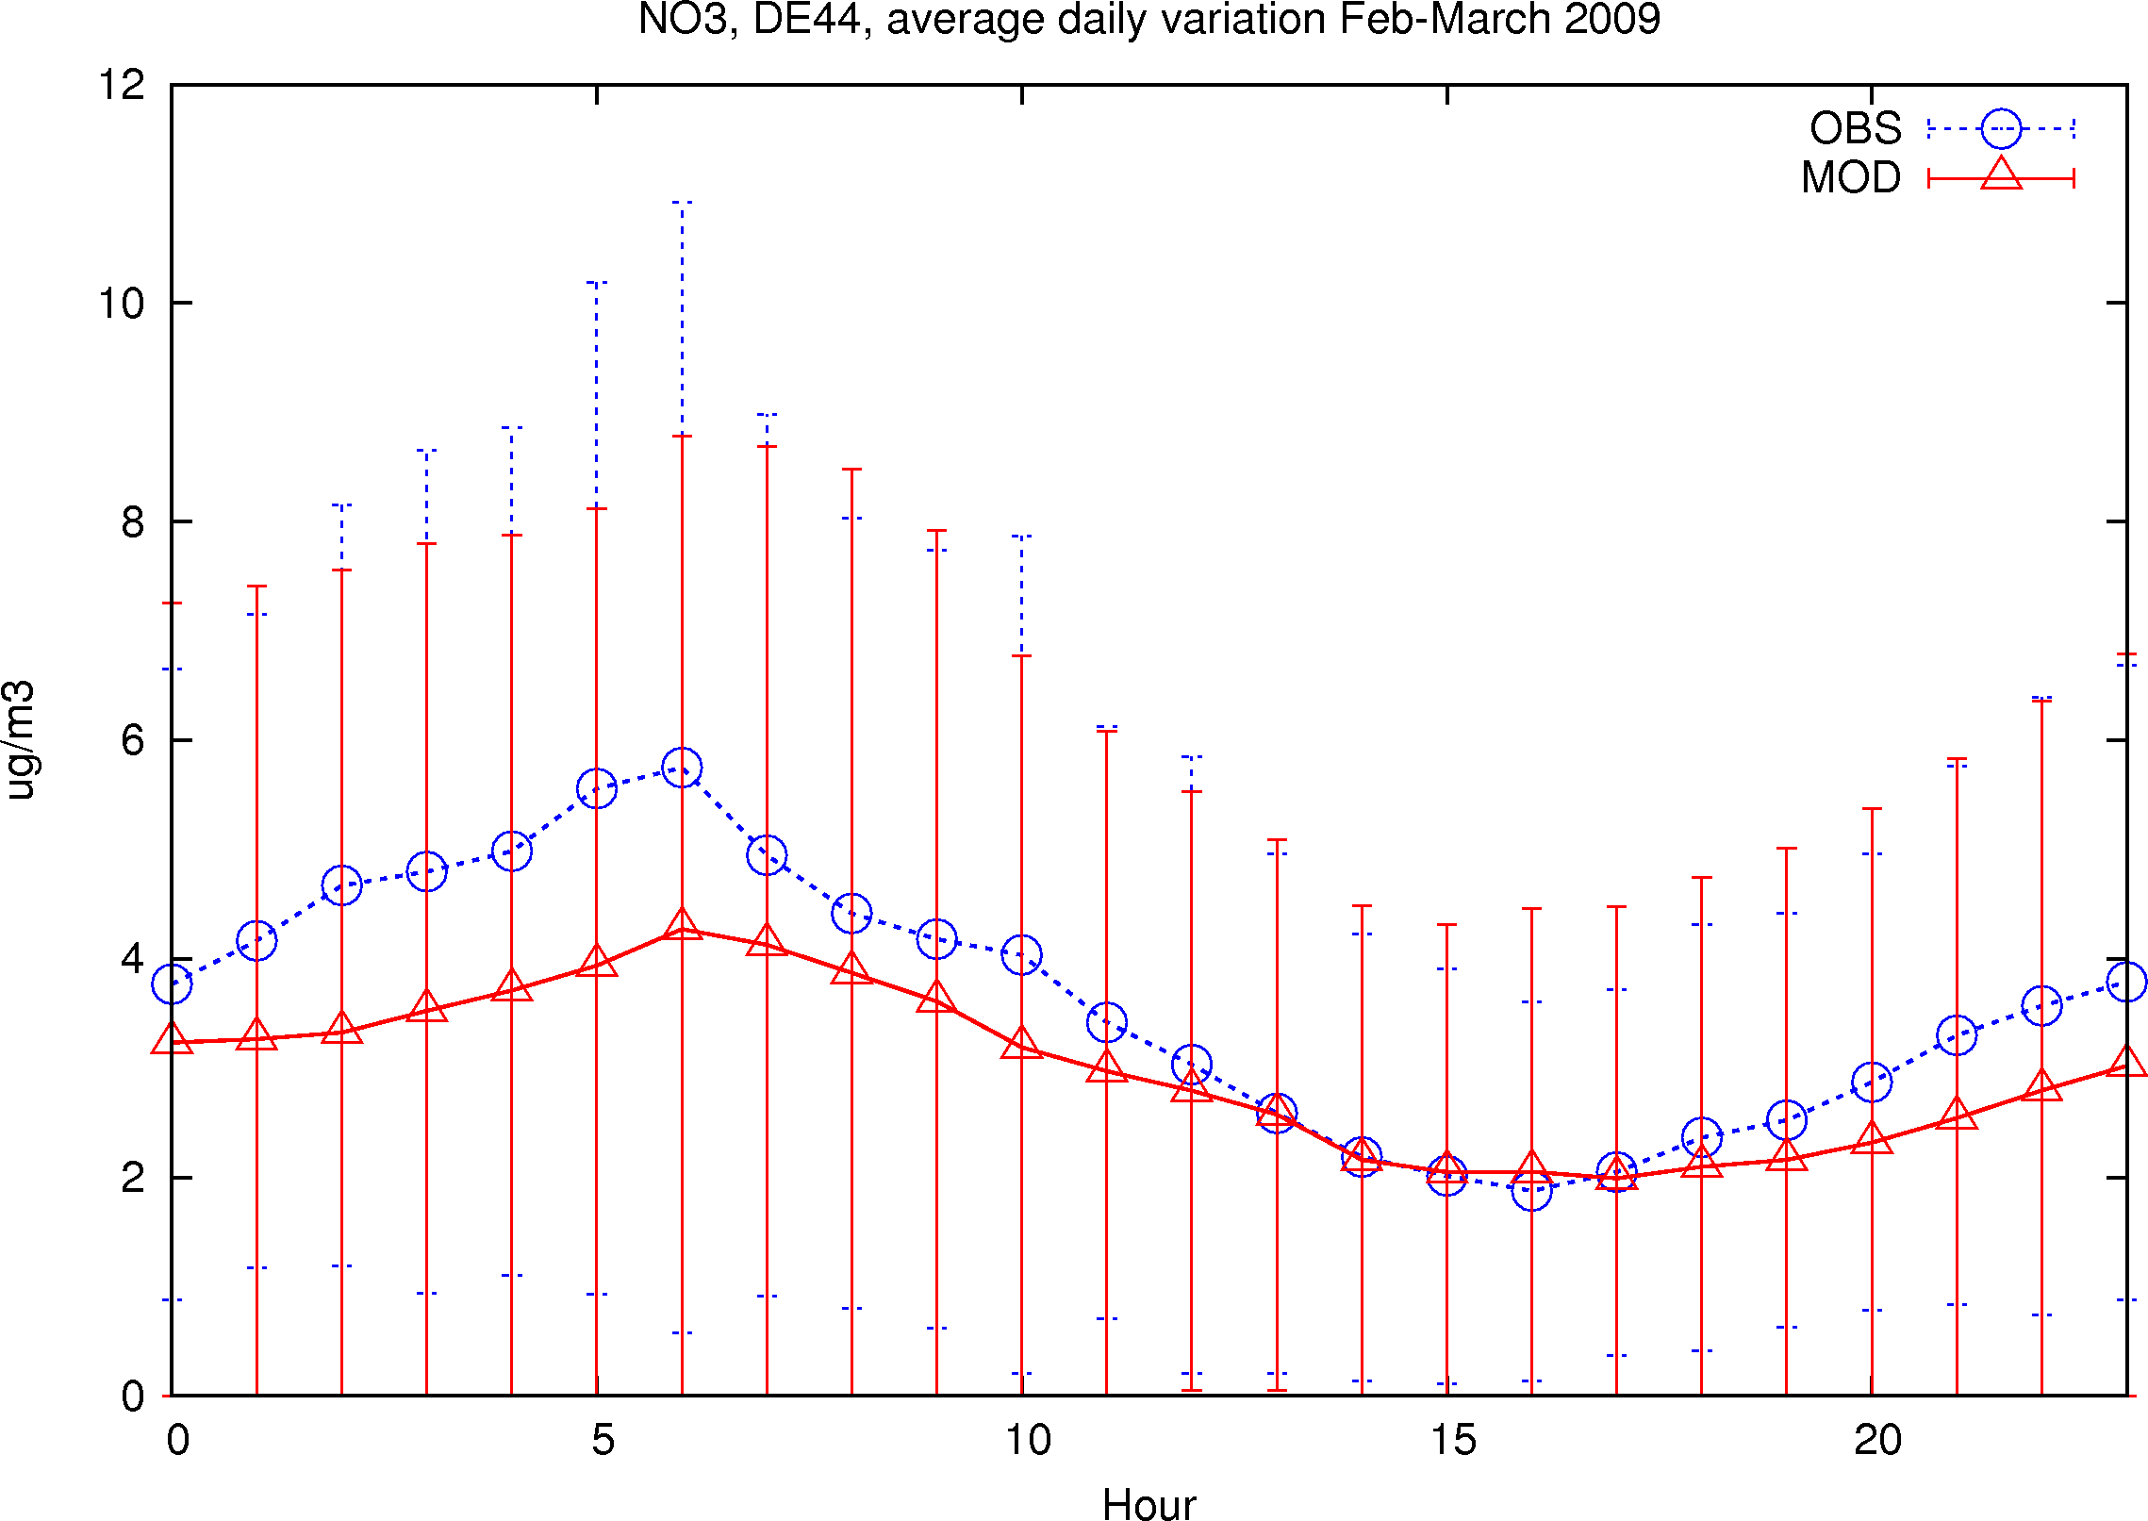
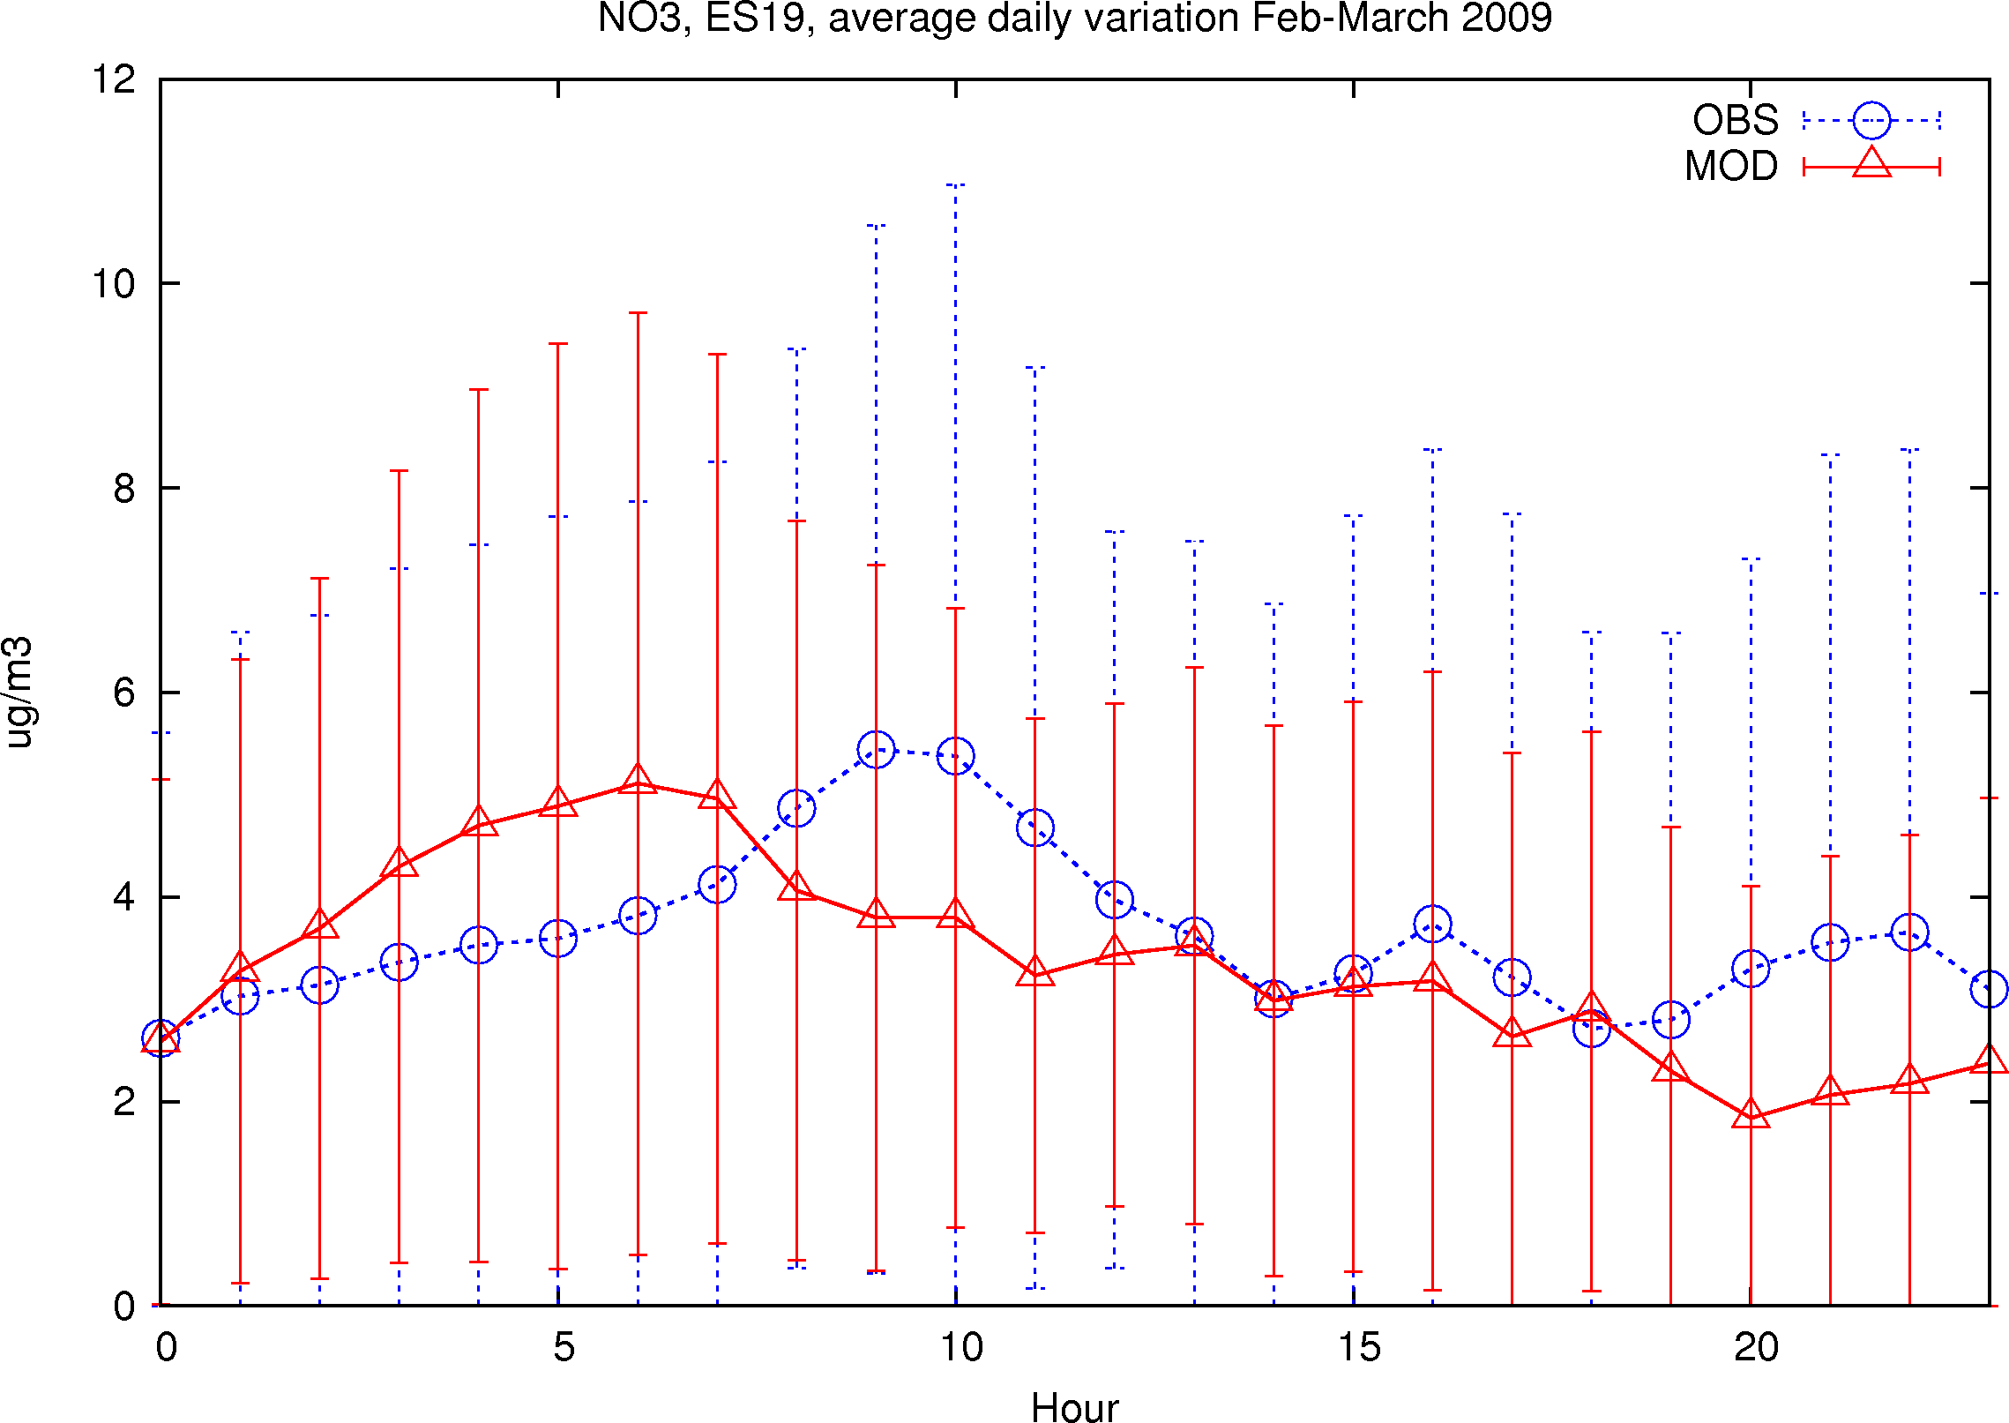
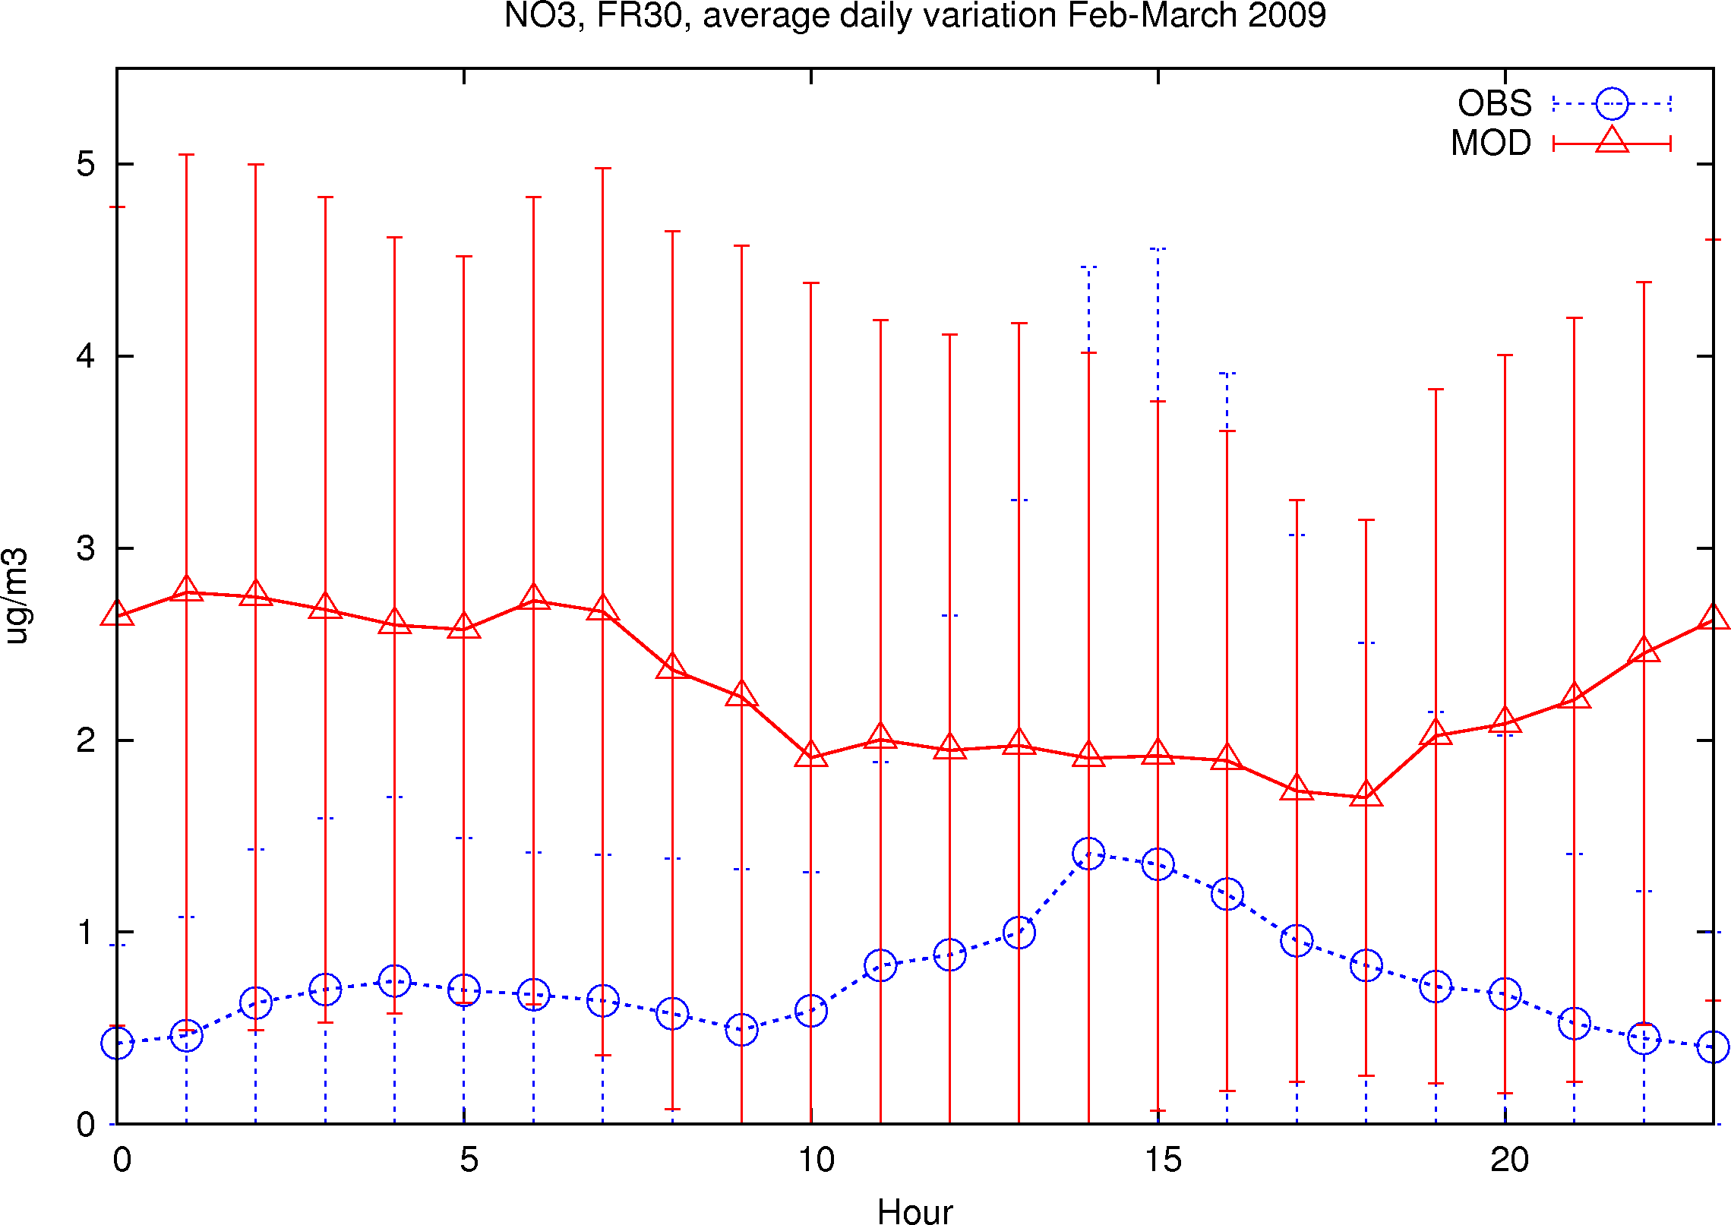
SE11
CH02
DE44
ES19
FR30
NO₃
Feb-Mar 2009
Meteorologisk Institutt met.no

Slide 13
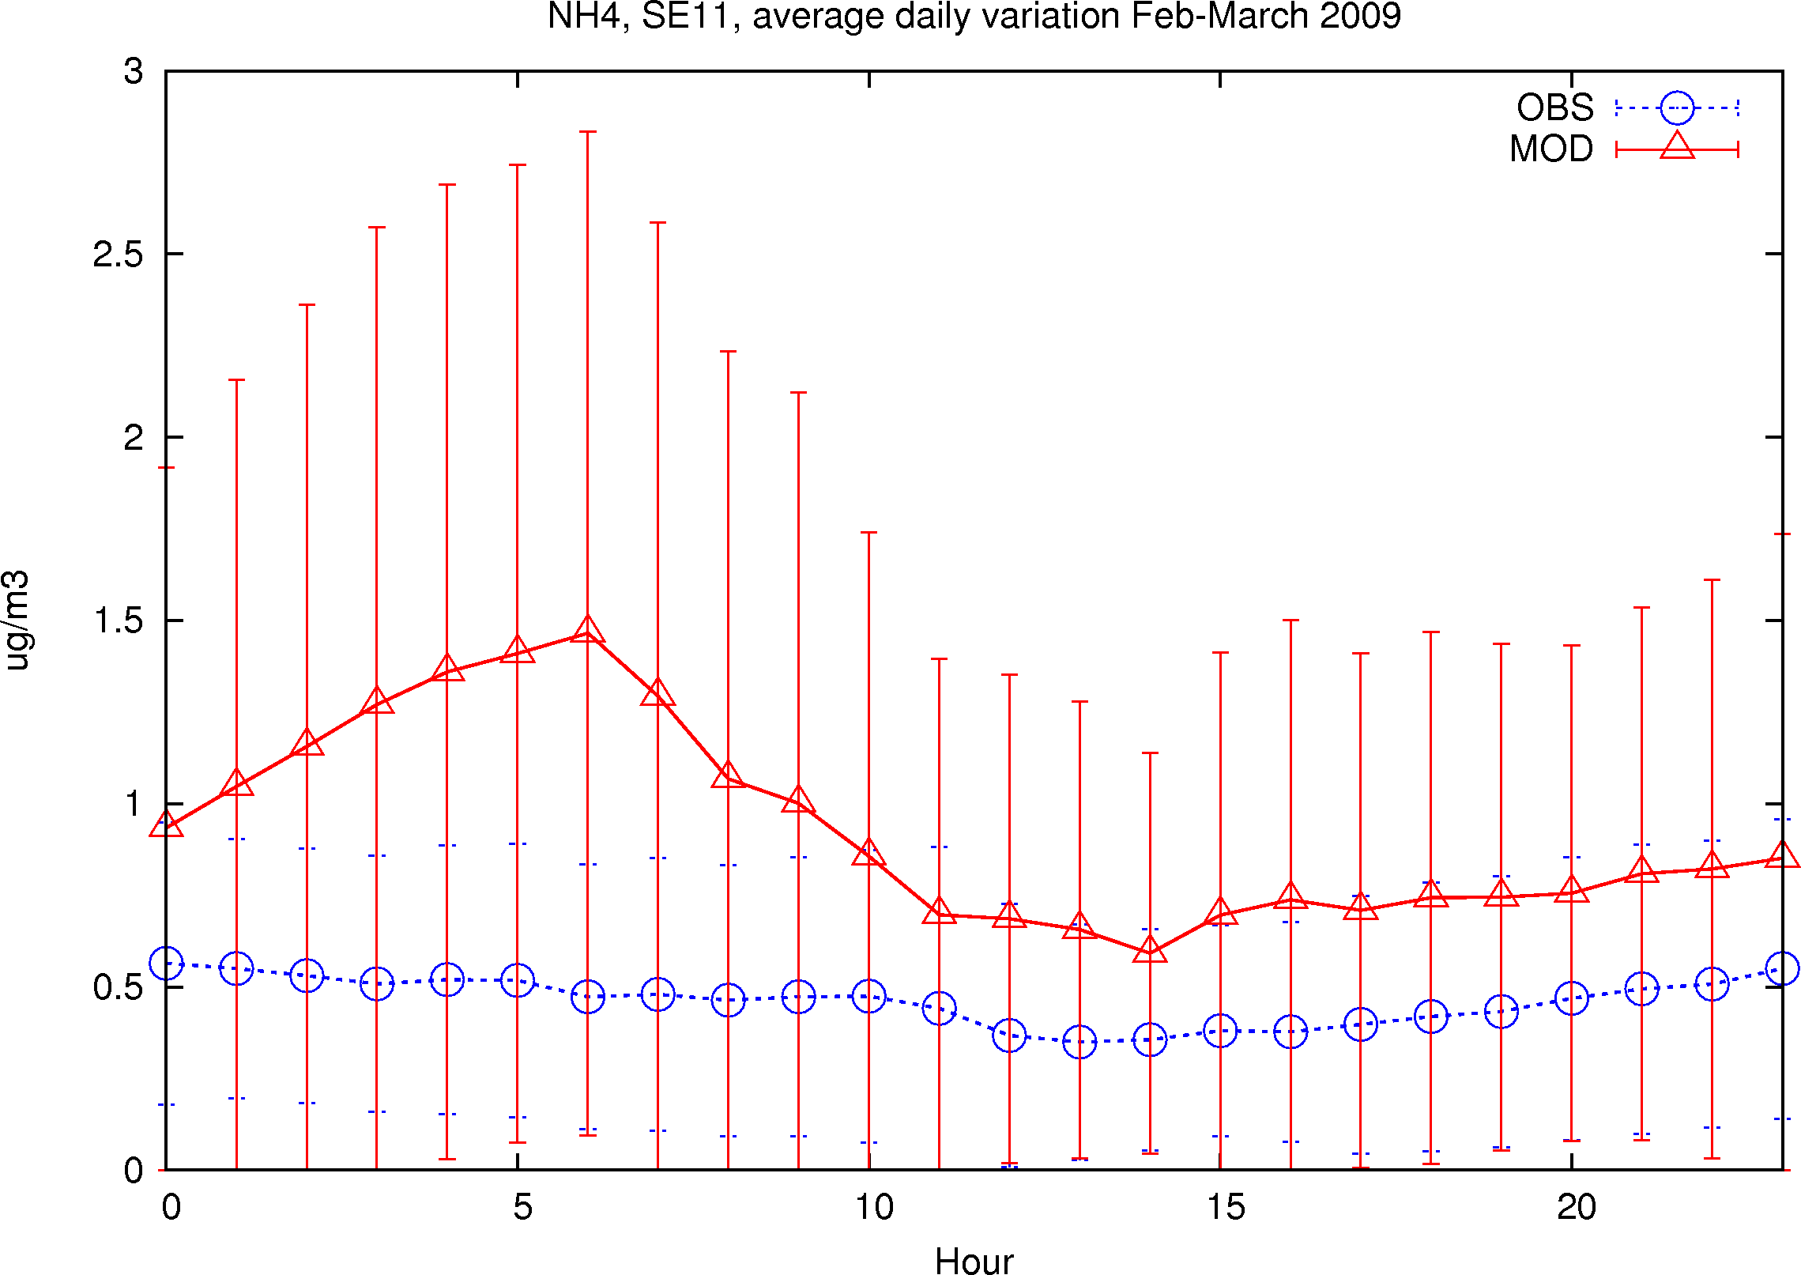
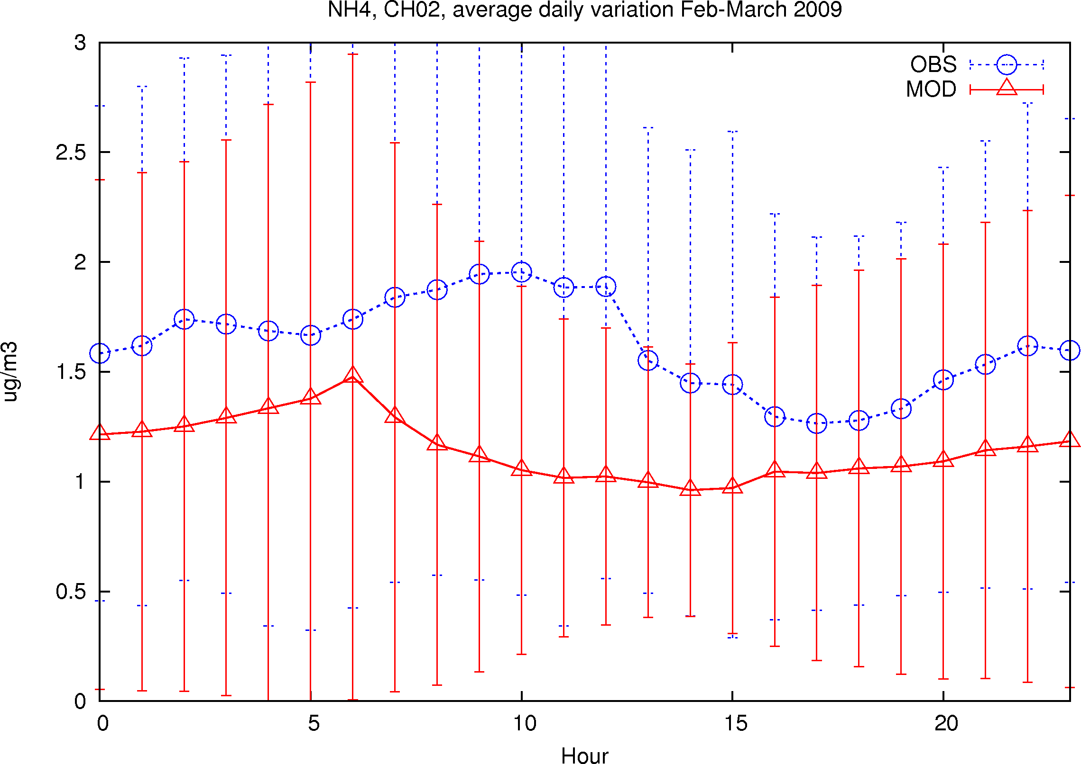
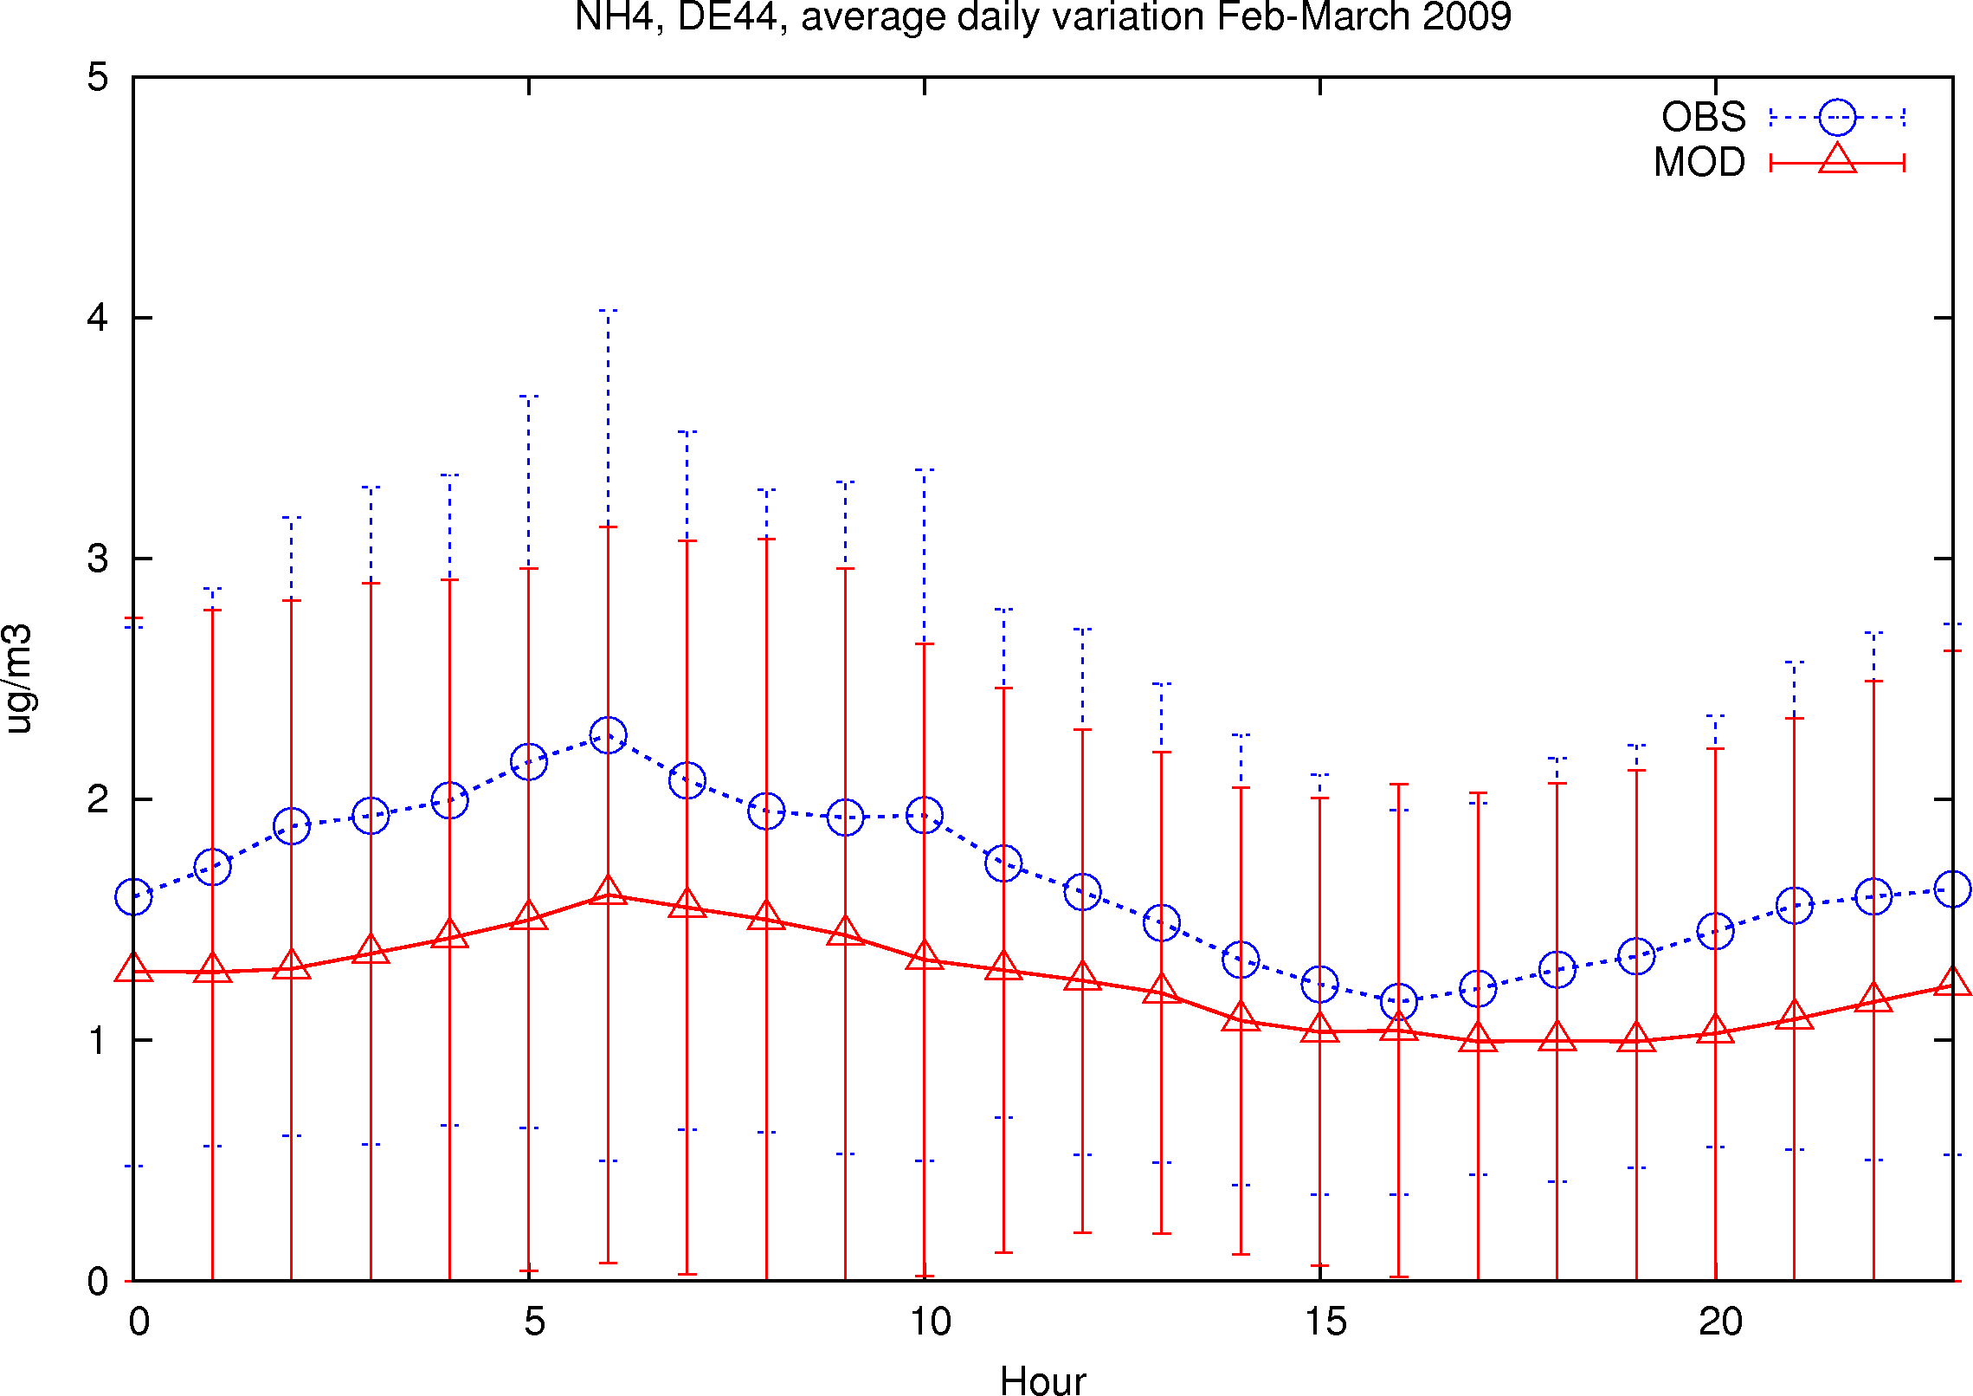
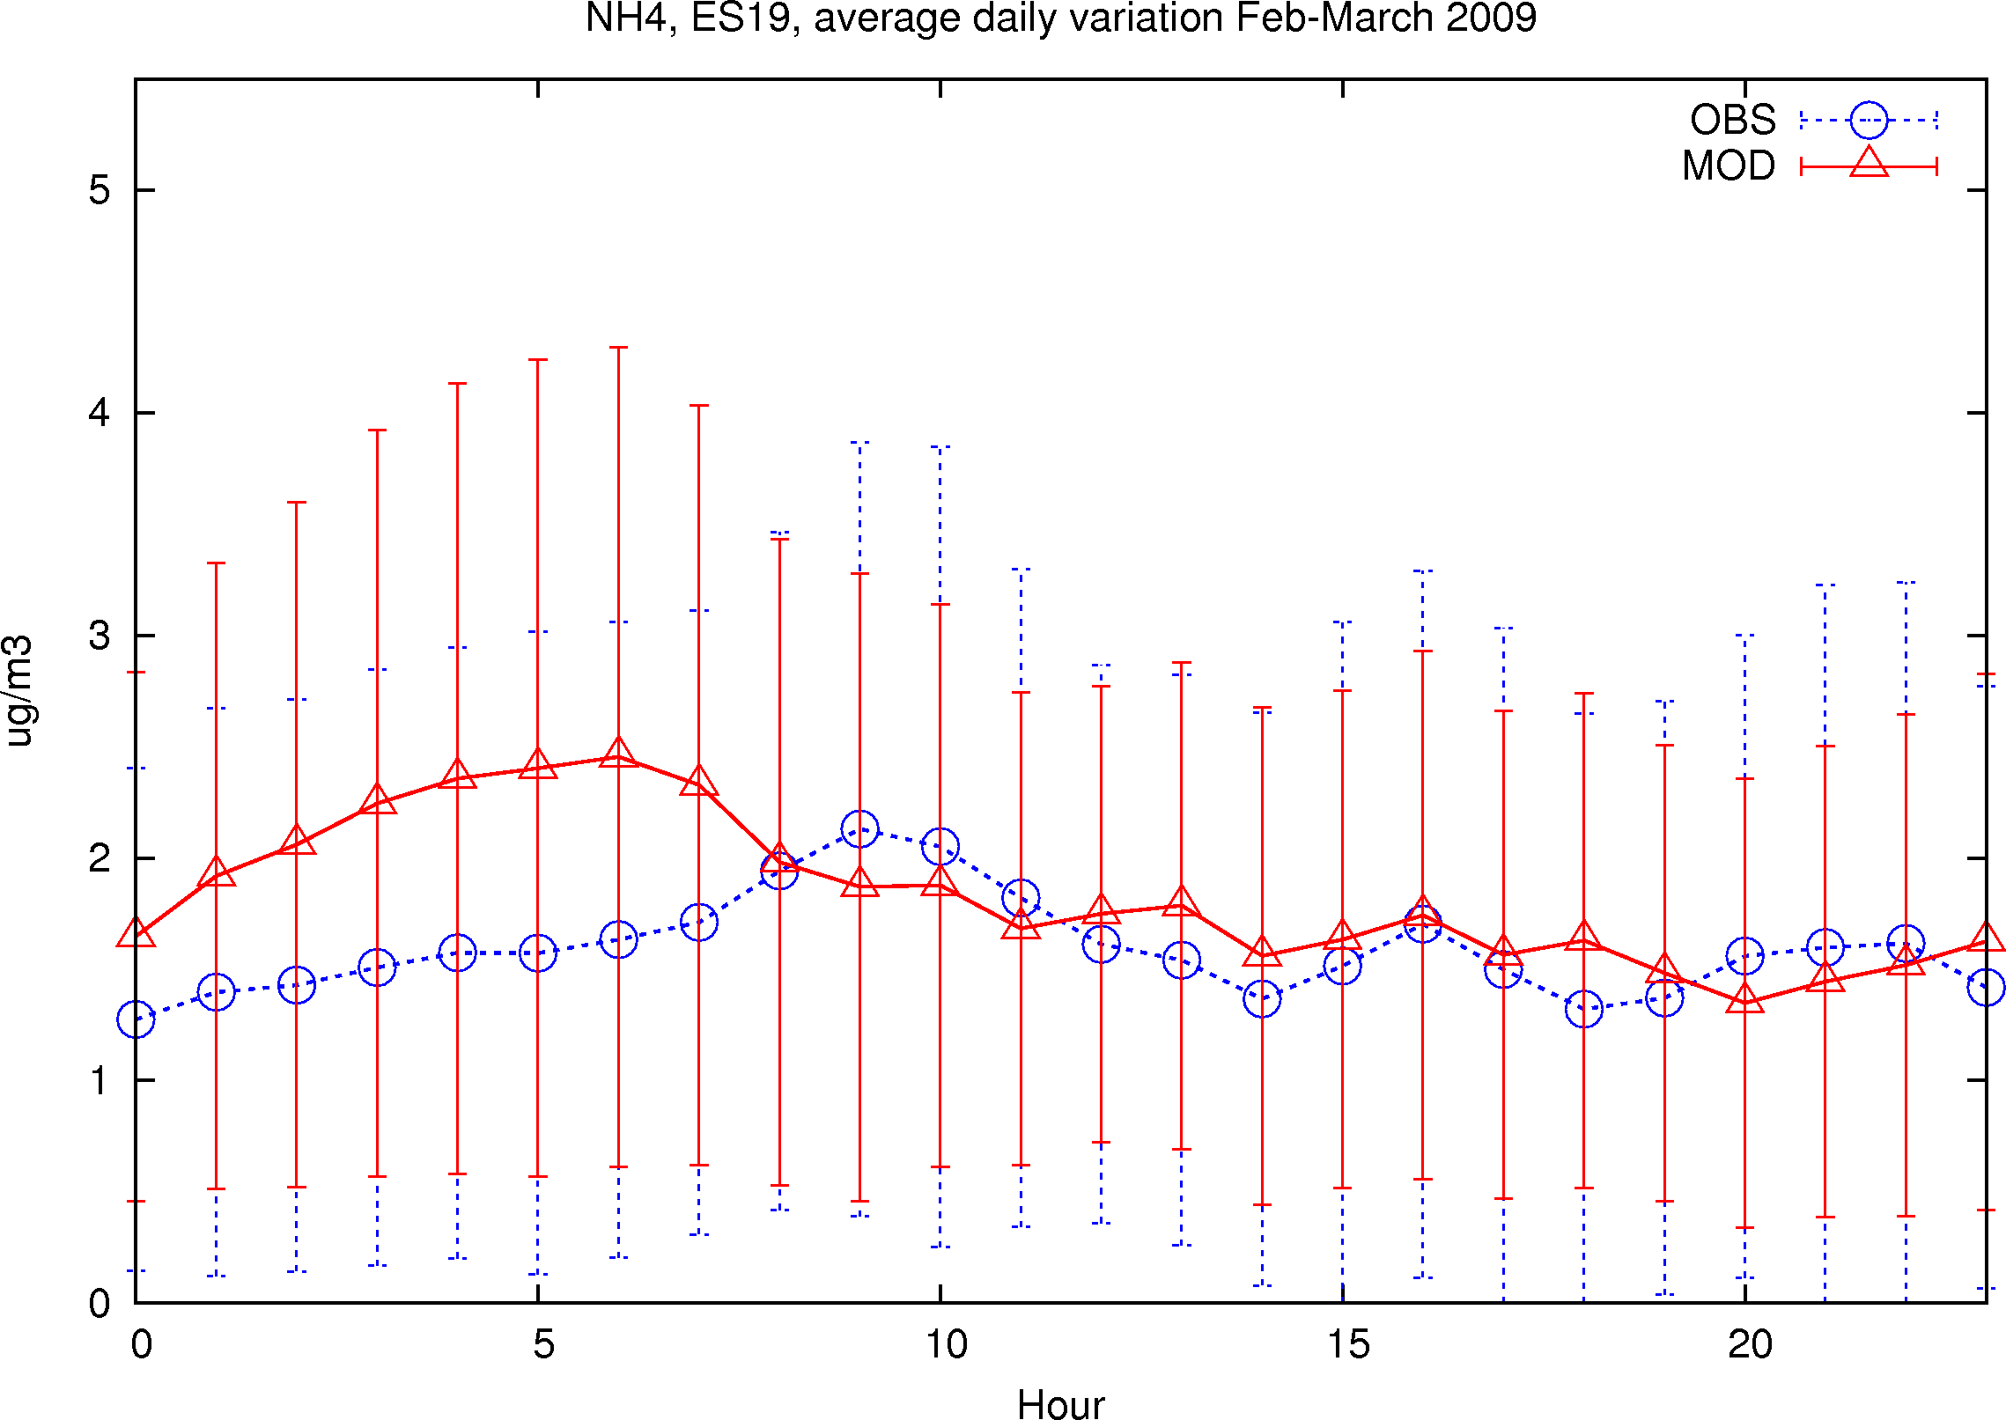
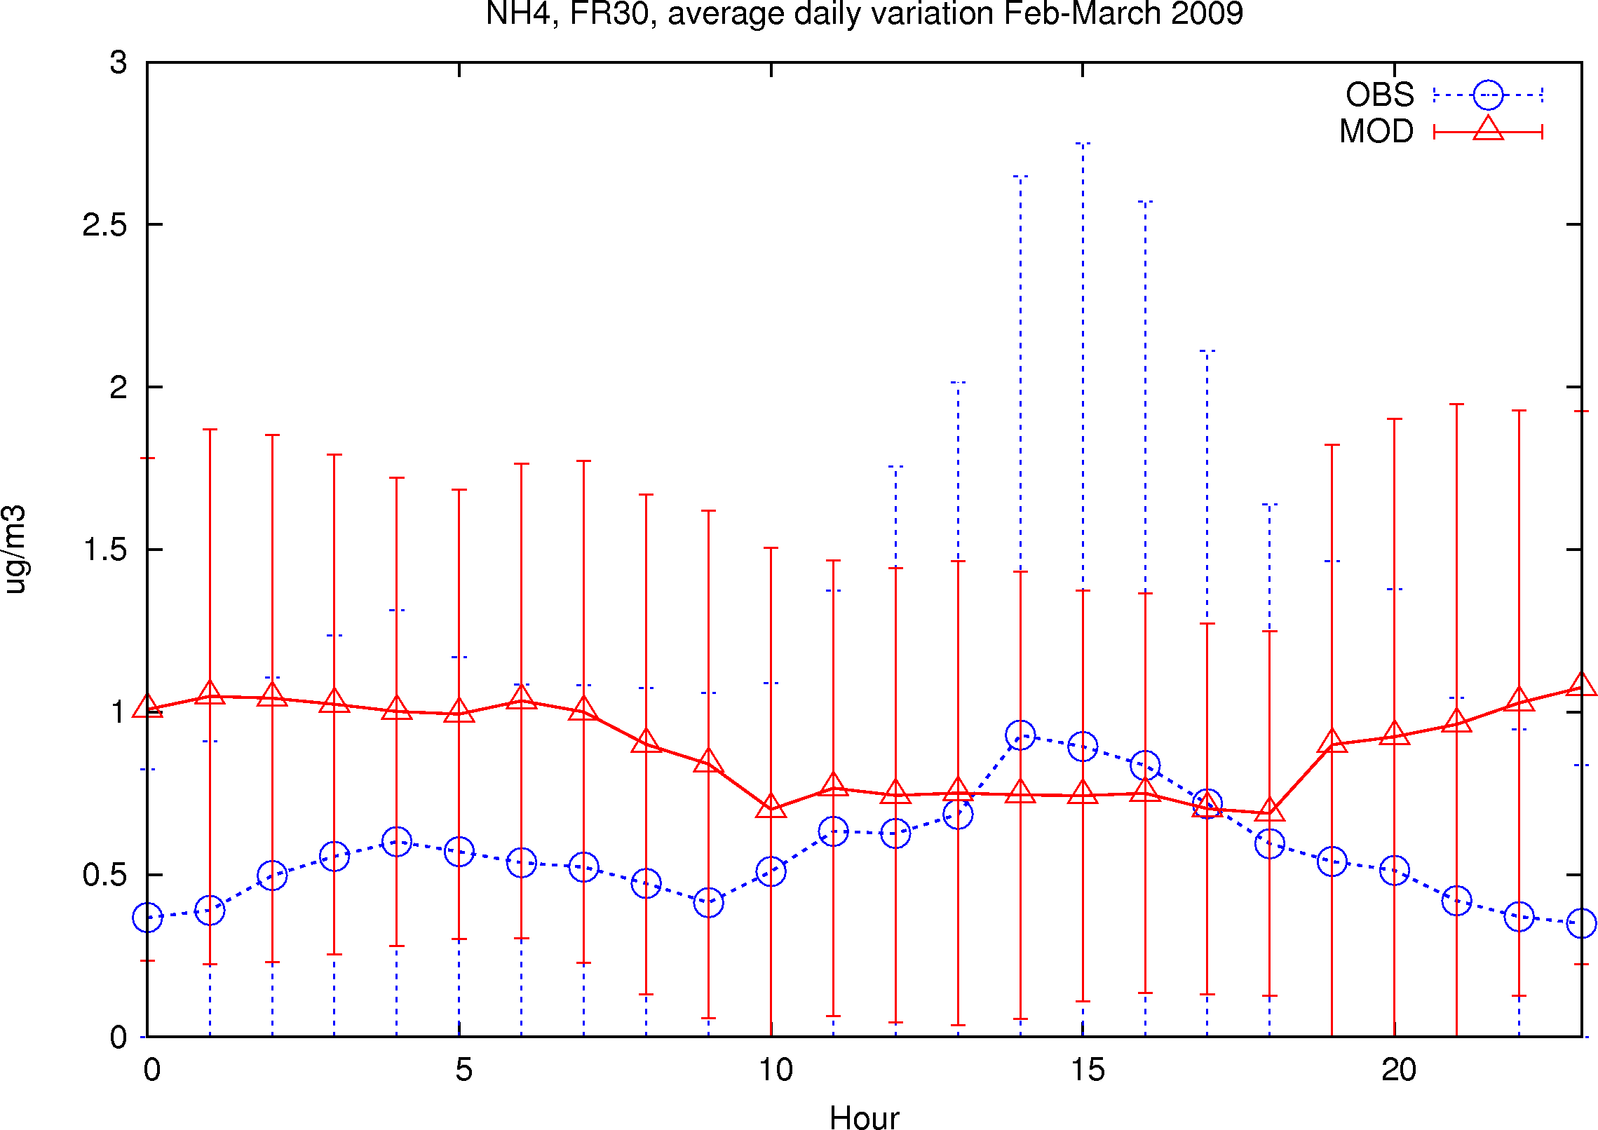
SE11
CH02
DE44
ES19
FR30
NH₄
Feb-Mar 2009
Meteorologisk Institutt met.no

Slide 14
Main first findings
SO4 - Model tends to underestimate (exc. SE11, IT10, FR30)
Calculated diurnal profiles are flat-ish, even with slight daytime minimum – formation in daytime / dry deposition at night
NO3 – some tendency to underestimation, in particular in summer (unstable NH4NO3) and north (lack of NH3)
Model reproduces morning max (though 2-3h to earlier than observed) and afternoon min, showing steeper decrease – meteorology variation, EQSAM accuracy
NH4 - Both some under/overestimation
Diurnal – similar to NO3; variable results vs observations
Meteorologisk Institutt met.no

Slide 15
Geographical differences in model performance
Payerne: Obs – NH₄ follows SO₄; Mod – NH₄ follows NO₃
Too little H₂SO₄ in Mod? – the greatest “-” bias
Melpitz , K-puszta: NH₄NO₃–like variation in both Obs and Mod,
but Mod gives NO₃=0 at DE44 in summer
Vavihill: Obs&Mod indicate predominance NH₄NO₃ in 2008
unexpected large overest. SO₄ and NH₄ in 2009 (comp. to 2008 and EMEP filters)
Mod - all SIA show similar variation, with morning max;
Obs - SO₄ and NH₄ - low values, flat; NO₃- high, daytime min
Barcelona – surprisingly good agreement for urban site
NO₃- max at 6 am in Mod, but at 9-10 am in Obs (traffic)?
Meteorologisk Institutt met.no

Slide 16
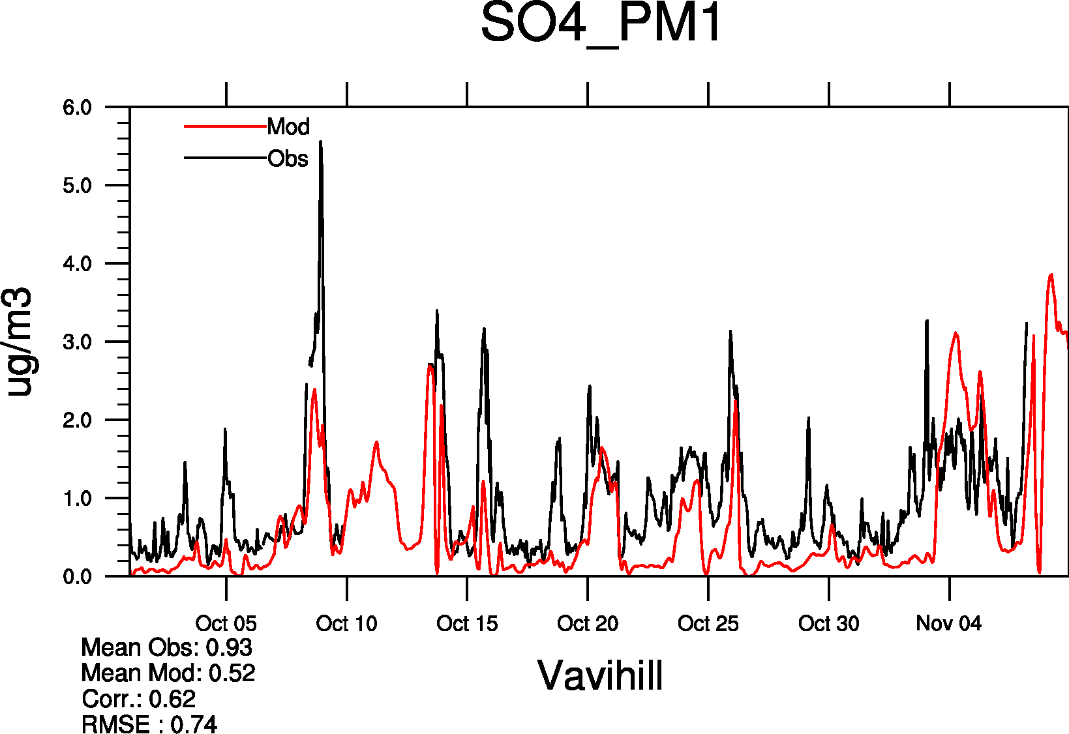
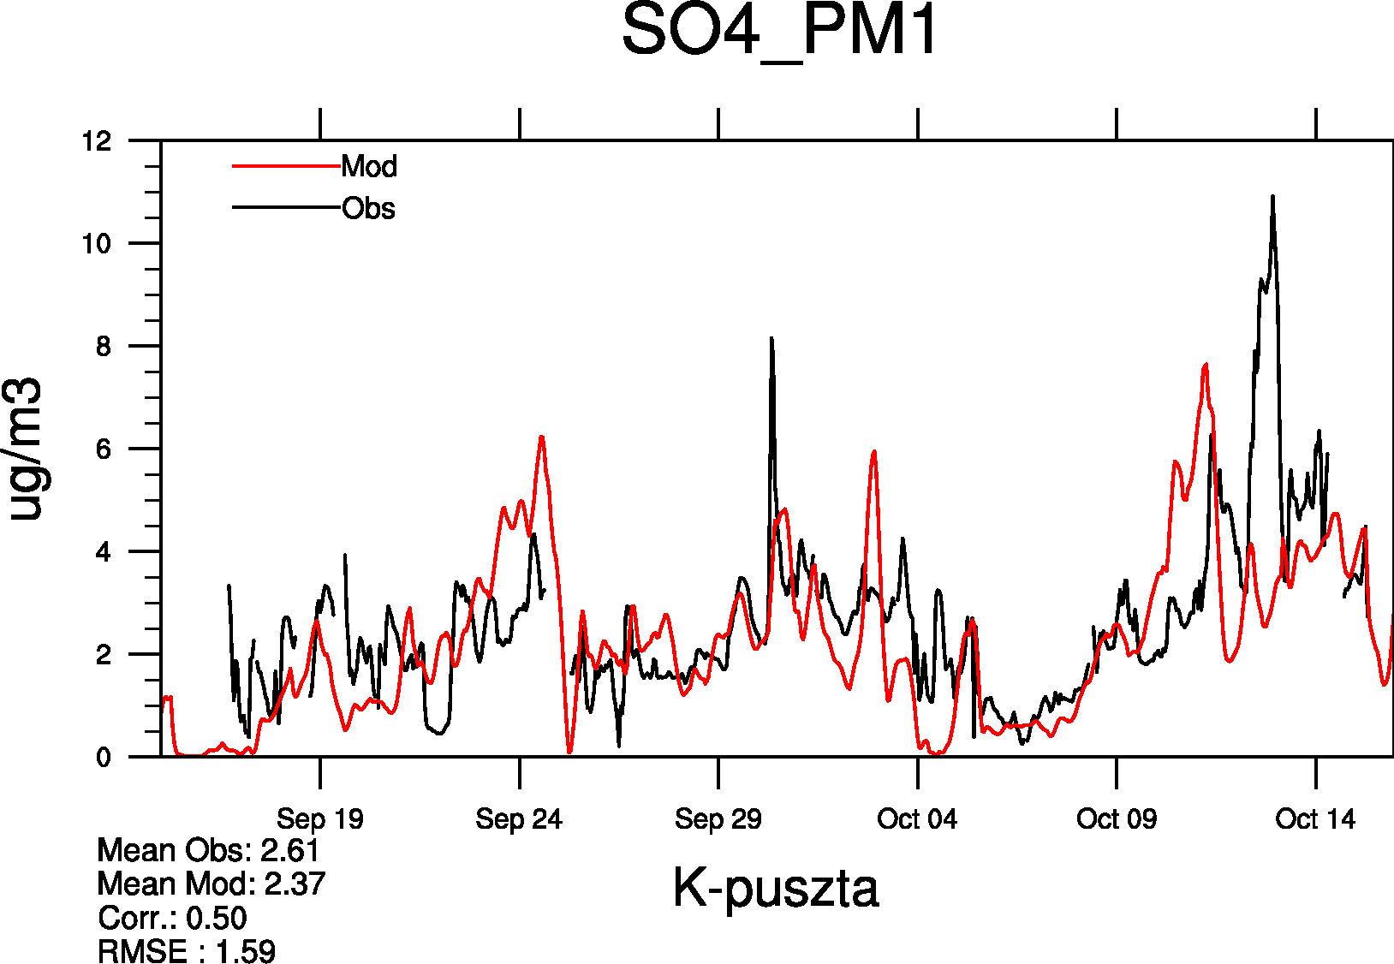
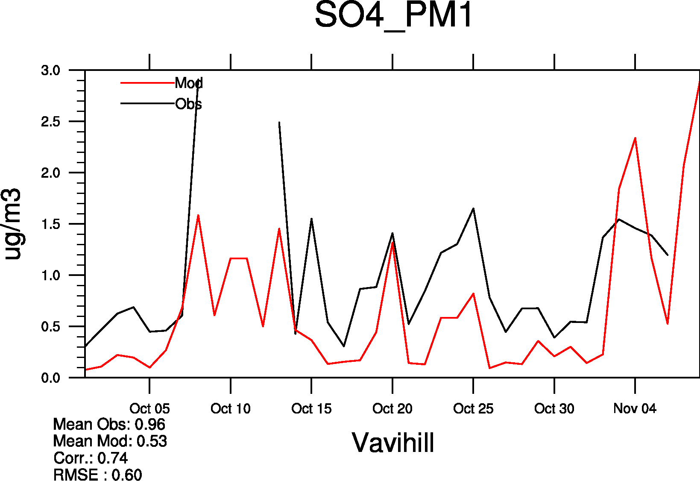
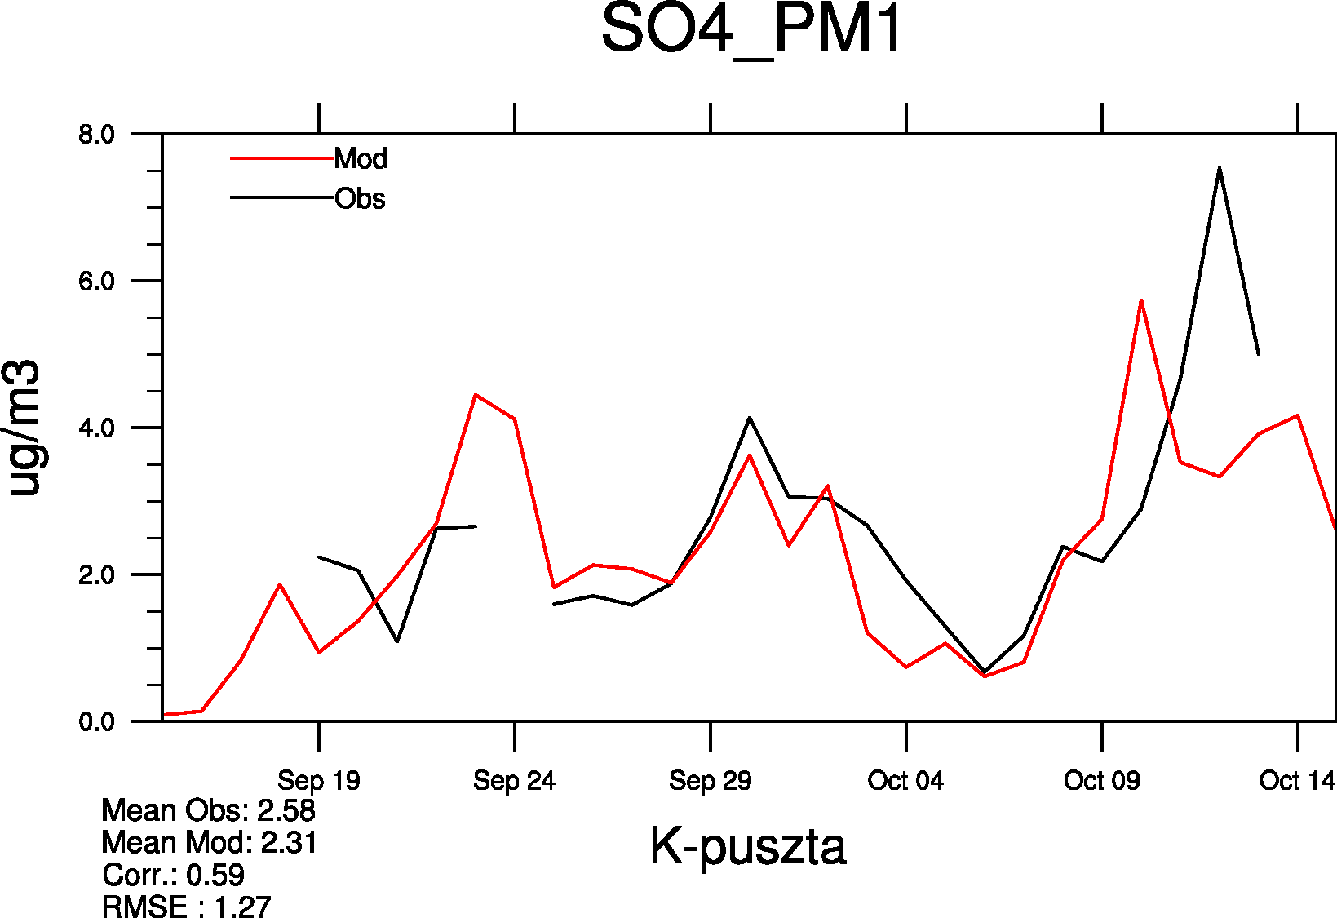
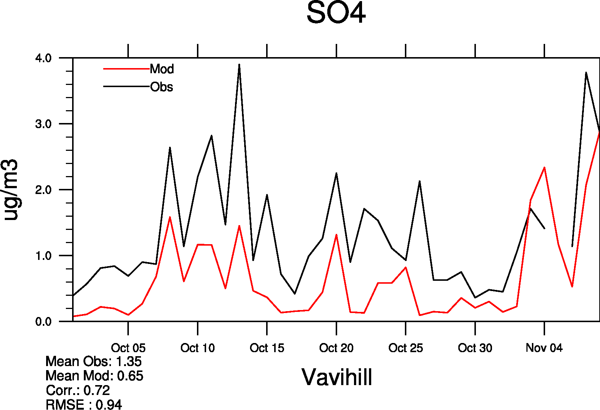
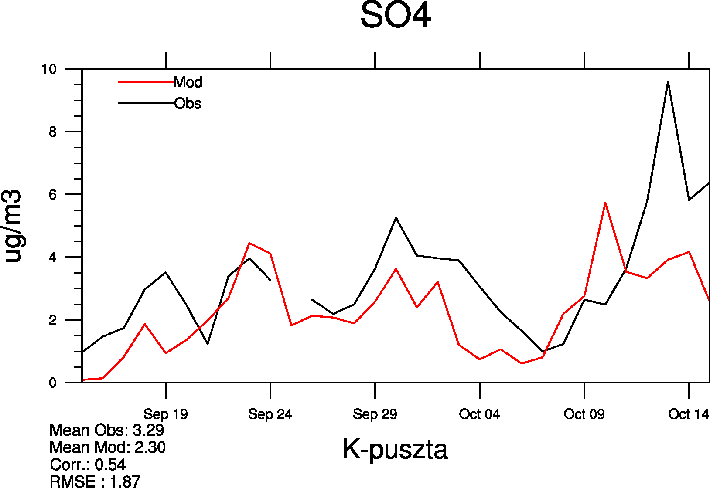
- 45%
- 9%
Hourly
Hourly to Daily
EMEP
- 52%
- 30%
SO4: AMS and Filter
Meteorologisk Institutt met.no

Slide 17
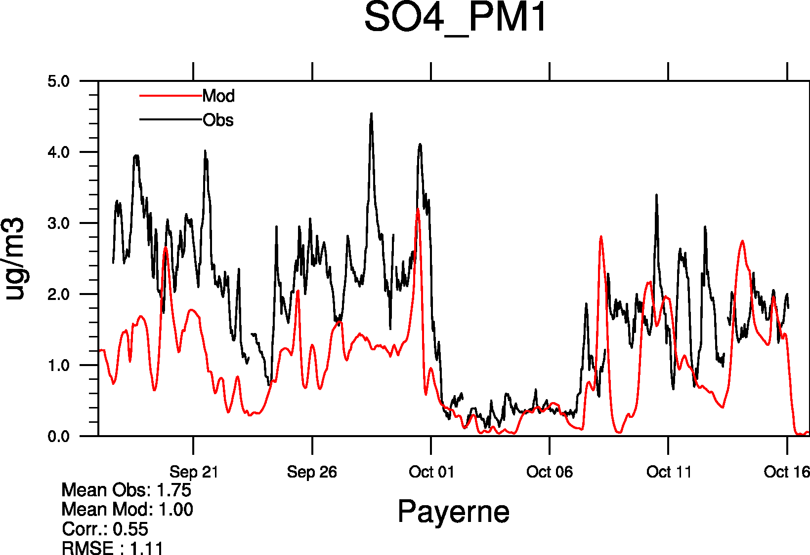
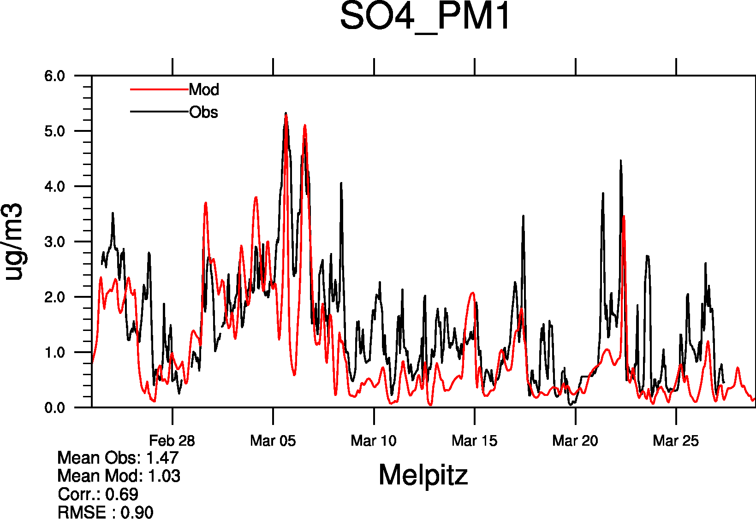
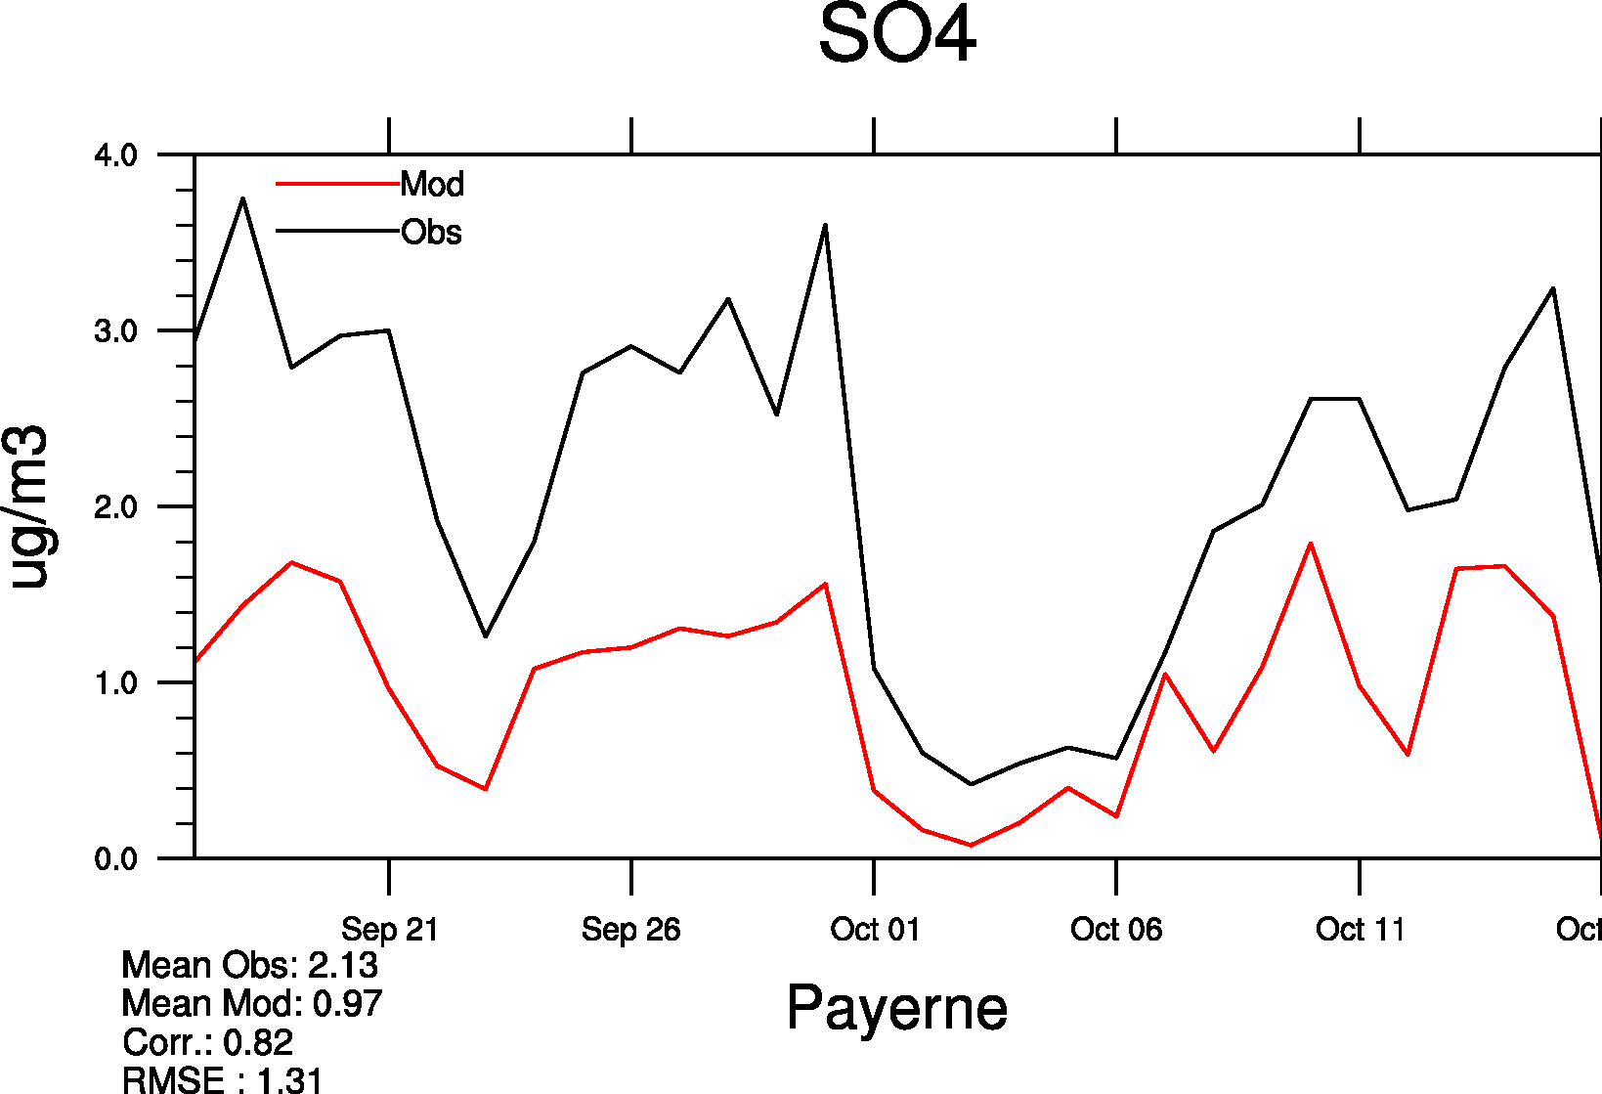
- 43%
- 30%
- 54%
- 56%
SO4: AMS and Filter
Meteorologisk Institutt met.no

Slide 18
100%
- 35%
- 35%
- 53%
SO4: AMS and Filter
Meteorologisk Institutt met.no

Slide 19
- 16%
- 12%
Hourly
Hourly to Daily
EMEP
93%
38%
NO3 & NH4:
AMS and Filter
Meteorologisk Institutt met.no

Slide 20
Model performance against diff. types of measurements:
Filterpacks:
SO₄ – greater underestimation (SO₄ larger 1um)
NO₃ and NH₄– smaller underestimation, and even overestimation (evaporation from filters, model overestimation of coarse NO₃)
MARGA - larger SIA underestimation in PM_{2.5} and PM₁₀ :
SO₄ - only “fine” in model; SO₄ in 1-10 um ?
NO₃ and NH₄ - unstable NH₄NO₃ in model, too little coarse NO₃ (?), NH₄ in 1-10 um ?
Meteorologisk Institutt met.no

Slide 21
Concluding remarks
Considerable amount of information (results) to analyse and interpret
Some – can be associated with particular process in the model:
NO₃ (fine) – EQSAM tends to shift equilibrium too far towards the gas phase as T increases (Rh decr)
NH₄ – appears in different dominant form in model and obs: (NH₄)_{x}SO₄ or NH₄NO₃ - too unstable ammonium nitrate aerosols , lack of ammonia
Other still need to be explained: SO₄ – diurnal profile
.. To be presented in Report 4/2011
Meteorologisk Institutt met.no

Slide 22
Thank you for attention!
Meteorologisk Institutt met.no

Slide 23
SO4
 | 2008 |  |  |  |  |  |  |  |  | 2009
 | Obs | Mod | Bias | R | RMSE | IOA |  | Obs | Mod | Bias | R | RMSE | IOA
CH02 | 1.7 | 1.0 | -43 | 0.55 | 1.1 | 0.65 |  | 1.0 | 0.7 | -35 | 0.49 | 0.7 | 0.66
HU02 | 2.6 | 2.4 | -9 | 0.50 | 1.6 | 0.68
DE44 | 1.6 | 1.0 | -37 | 0.53 | 1.0 | 0.66 |  | 1.5 | 1.0 | -30 | 0.69 | 0.9 | 0.79
DE44* | 2.4 | 2.3 | -7 | 0.67 | 1.2 | 0.79
SE11 | 0.9 | 0.5 | -45 | 0.62 | 0.7 | 0.72 |  | 0.5 | 1.0 | 113 | 0.66 | 1.2 | 0.46
FI63 | 0.3 | 0.25 | -17 | 0.41 | 0.3 | 0.58
ES19 |  |  |  |  |  |  |  | 2.7 | 2.3 | -16 | 0.63 | 1.4 | 0.77
IT10 | 0.7 | 0.9 | 27 | 0.0 | 1.0 | 0.21
FR30 | 0.7 | 1.2 | 82 | 0.14 | 1.2 | 0.45 |  | 0.6 | 0.7 | 16 | 0.0 | 1.0 | 0.25
Meteorologisk Institutt met.no

Slide 24
NO3
 |  |  | 2008 |  |  |  |  |  |  | 2009
 | Obs | Mod | Bias | R | RMSE | IOA |  | Obs | Mod | Bias | R | RMSE | IOA
CH02 | 2.8 | 3.5 | 26 | 0.57 | 3.4 | 0.66 |  | 3.8 | 3.1 | -20 | 0.74 | 2.4 | 0.84
HU02 | 1.9 | 1.6 | -16 | 0.69 | 2.0 | 0.81
DE44 | 2.9 | 2.8 | -4 | 0.63 | 2.8 | 0.79 |  | 3.6 | 3.0 | -18 | 0.64 | 3.0 | 0.79
DE44* | 0.6 | 0.01 | -98 | 0.36 | 0.9 | 0.42
SE11 | 1.8 | 1.0 | -45 | 0.59 | 2.4 | 0.74 |  | 4.2 | 2.0 | -53 | 0.5 | 4.2 | 0.62
FI63 | 0.07 | 0.0 | 100 | 0.11 | 0.1 | 0.44
ES19 |  |  |  |  |  |  |  | 3.6 | 3.4 | -7 | 0.47 | 4.0 | 0.67
IT10 | 2.9 | 1.6 | -44 | -0.11 | 4.16 | 0.35
FR30 | 2.9 | 1.5 | -49 | 0.05 | 0.31 | 0.43 |  | 0.7 | 2.3 | 208 | 0.31 | 2.6 | 0.47
Meteorologisk Institutt met.no

Slide 25
NH4
 |  |  | 2008 |  |  |  |  |  |  | 2009
 | Obs | Mod | Bias | R | RMSE | IOA |  | Obs | Mod | Bias | R | RMSE | IOA
CH02 | 1.6 | 1.4 | -14 | 0.58 | 1.1 | 0.73 |  | 1.6 | 1.2 | -29 | 0.71 | 1.0 | 0.81
HU02 | 1.5 | 1.3 | -12 | 0.66 | 0.9 | 0.80
DE44 | 1.3 | 1.2 | -10 | 0.63 | 0.9 | 0.78 |  | 1.7 | 1.3 | -25 | 0.65 | 1.1 | 0.78
DE44* | 0.9 | 0.8 | -10 | 0.55 | 0.5 | 0.72
SE11 | 0.8 | 0.5 | -40 | 0.62 | 0.8 | 0.76 |  | 0.5 | 0.9 | 104 | 0.54 | 1.0 | 0.48
FI63 | 0.09 | 0.1 | 11 | 0.31 | 0.1 | 0.55
ES19 |  |  |  |  |  |  |  | 1.6 | 1.8 | 16 | 0.52 | 1.4 | 0.71
IT10 | 1.2 | 0.8 | -38 | -0.12 | 1.5 | 0.36
FR30 | 1.7 | 0.9 | -49 | 0.30 | 1.6 | 0.49 |  | 0.6 | 0.9 | 61 | 0.23 | 1.1 | 0.49
Meteorologisk Institutt met.no

