Slide 1
EMEP intensive measurement periods 2008/2009
Wenche Aas and Karl Espen Yttri

Slide 2
Objectives of the 2nd intensive measurement periods 17 Sep. – 15 Oct. 2008 and 25 Feb. – 26 Mar. 2009
Obtain a comprehensive dataset on chemical speciation of particulate matter with respect to its inorganic, mineral and carbonaceous content with daily/weekly (EMEP) or hourly (EUCAARI) time resolution
  Gas/particle phase distribution of inorganic nitrogen constituents
  Aerosol size distribution (EUCAARI/EUSAAR)
  Separation of the carbonaceous aerosol into
    primary vs. secondary
    biogenic vs. anthropogenic
Attempts to quantify the aerosol water content (EUCAARI)
Attempts to quantify the OC/OM ratio (EUCAARI)

Slide 3
Sites and programme

Slide 4
Data availability
The AMS data will be presented by
S. Tsyro and A. Prevot

Slide 5
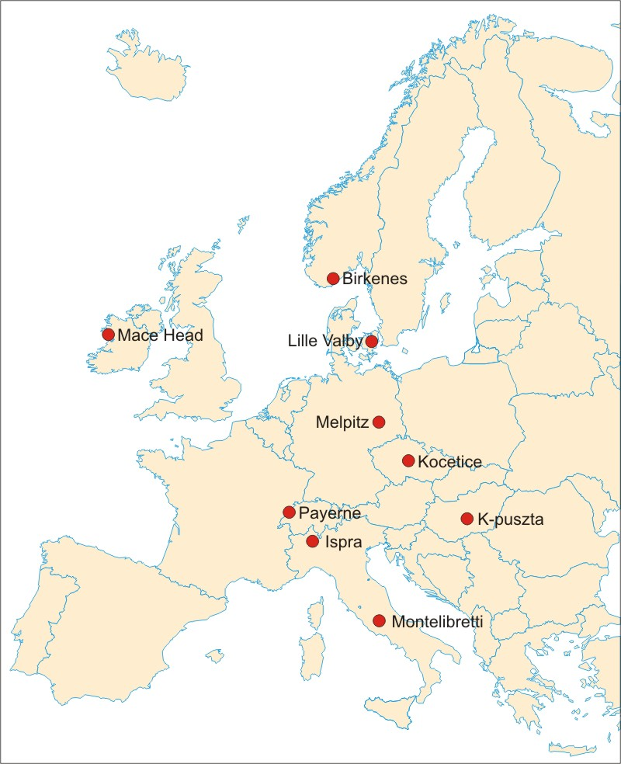
EMEP Intensives – cont.
9 participating sites, for EC/OC, levoglucosan and ¹⁴ C analysis at centralized laboratories
Status
severe delay with respect to the ¹⁴C analysis due to unforeseen renovation at the laboratory facilities in Bern as well as lack of manpower at the Bern laboratory.
some of the samples have unexpected high F¹⁴C levels (confirmed by reanalysis)
an identical analysis at another research facility was performed (at the cost of EMEP-CCC). Reanalysis (received in late March 2011) confirmed the high F¹⁴C values.
To be done: (before the summer holidays)
Further interpretation of the data and inclusion into the peer reviewed paper. The F¹⁴C results will be subject to statistical treatment(Latin Hypercube Sampling) along with the EC/OC and levoglucosan data

Slide 6
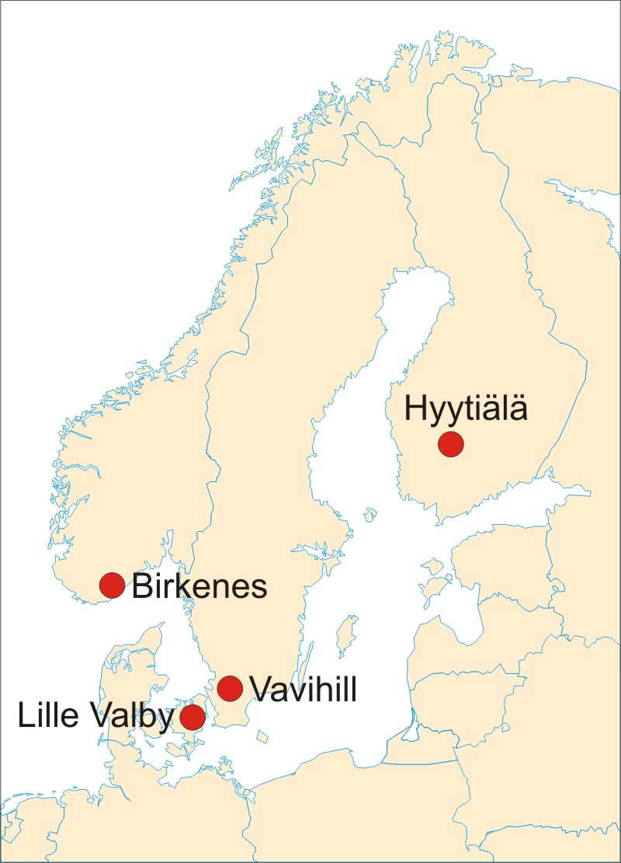
EMEP Intensives – cont.
4 sites in Norhtern Europe subject to extended sampling and chemical analysis
Status:
All chemical analysis finished
Paper submitted to ACP Special Issue

Slide 7
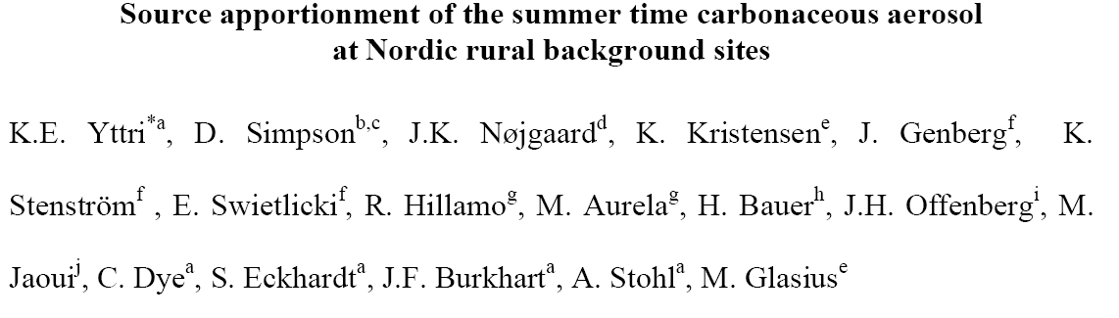
SONORA (Secondary Organic aerosol in the NOrdic RurAl 6 Environment)
Supported by Nordic Council of Ministers and the EU 6th framework EUCAARI
Paper, just been submitted to ACPD

Slide 8
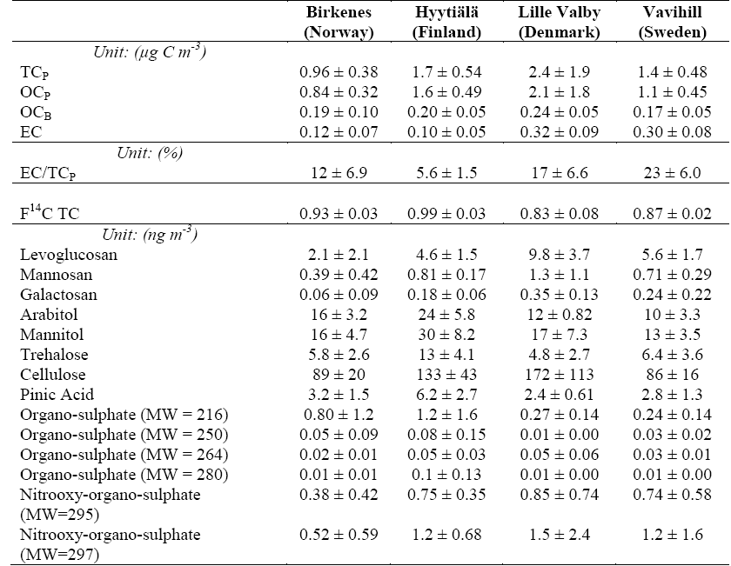

Slide 9
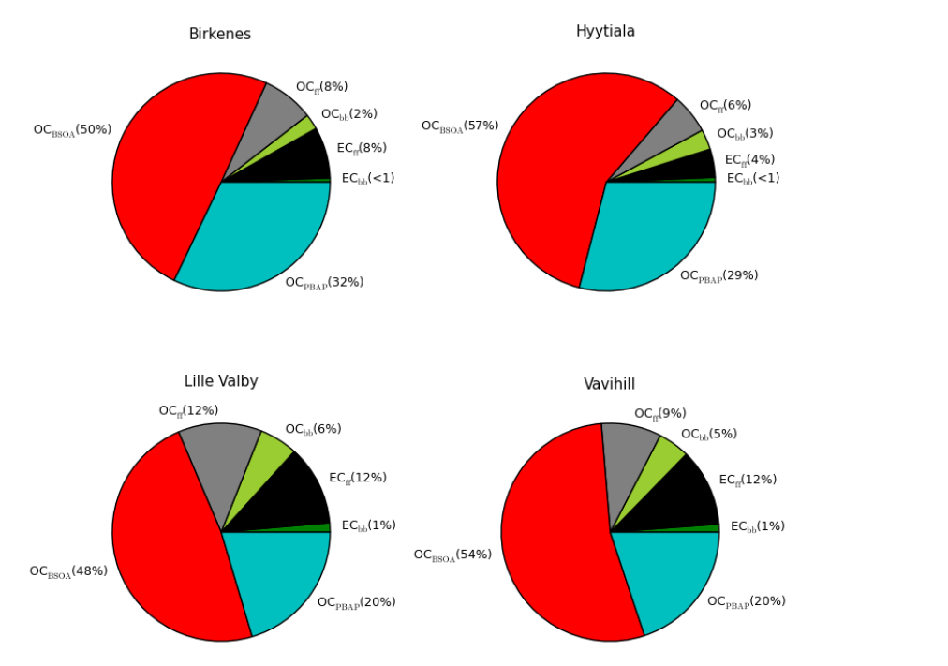
Contribution of carbonaceous sources to TC
Yttri et al, ACPD 2011
Notes:
The carbonaceous aerosol (here: TCp; i.e. particulate TC) was totally dominated by natural sources (69-86%), with biogenic secondary organic aerosol (BSOA) being the single most important source (48-57%). Interestingly, primary biological aerosol particles (PBAP) were the second most important source (20-32%). The anthropogenic contribution was mainly attributed to fossil fuel sources (OCff and ECff) (10-24%), whereas no more than 3-7% was explained by combustion of biomass (OCbb and ECbb in this late summer campaign i.e. emissions from residential wood burning and/or wild/agricultural fires.
Fossil fuel sources totally dominated the 3 ambient EC loading, accounting for 4-12% of TCp, whereas <1.5% was attributed to 4 combustion of biomass.

Slide 10
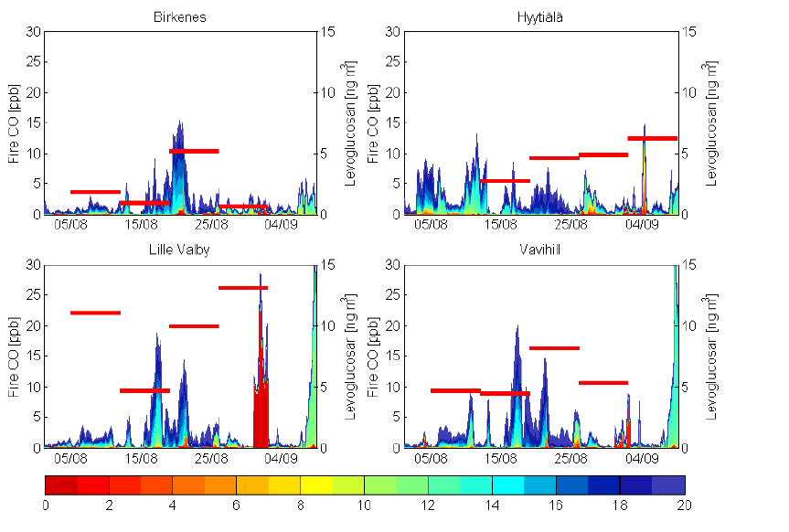
Levoclucosan and CO wild/agricultrural fire tracer
Number of days
Yttri et al, ACPD 2011
Notes:
increased levels of levoglucosan were associated with 16 nearby wild fires (i.e. atmospheric residence time <5 days)

Slide 11
Summary
Successful cooperation between EUSAAR/EUCAARI/EMEP
  I.e. Established reporting guidelines and QA/QC procedures for a range of new components for the EMEP Community
A range of papers from all the intensive periods are in the steps to be published
Delay in reporting finalized datasets from some EUCAARI sites and for the ¹⁴C
Data availability through ebas.nilu.no or contact CCC
  password protected for some of the non-regular EMEP data
Time to start planning the next periods
  In cooperation with PEGASUS/ACTRIS and others?
  What should EMEP do in addition?

