Slide 1
From EUSAAR to ACTRIS: recommendations for the monitoring of short-lived species in Europe
…and sustainability
Paolo Laj
TFMM meeting
Zurich, Switzerland
11-13th May, 2011

Slide 2
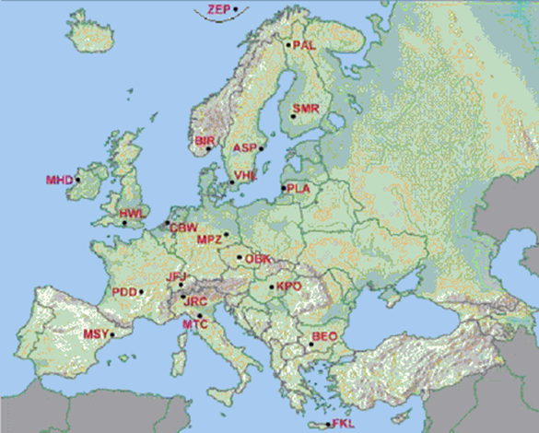
FP6-EUSAAR has ended March 31st, 2011
Integrate measurements of atmospheric aerosol properties performed at 20 European Supersites.
Elaborate and propose most suited monitoring strategies (sampling / analyses/ data transmission and access) for aerosol parameters
Facilitate access to high quality aerosol data to a community of users in Air Quality/ Climate communities
A program to efficiently consolidated links between EPAs and research communities (i.e. EUCAARI)
TFMM, Zurich, 11-13 May, 2011

Slide 3
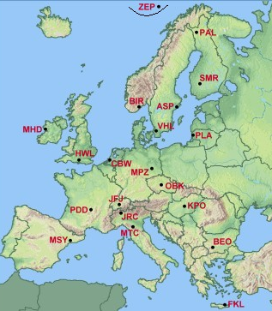
EUSAAR end-products
A series of technical papers and, jointly with research programs, a detailed analysis of aerosol properties and variability in the EU atmosphere
Quality
control
and
standardization
Variability at
single stations
Single
component
Integration
papers
Model-
Observation /
AEROCOM
papers
EUSAAR EUCAARI
data provision
EUSAAR recommandation papers
Single group initiatives
EUCAARI
Integration
papers
EUCAARI
assessment
papers
TFMM, Zurich, 11-13 May, 2011
Notes:
3

Slide 4
EUSAAR Recommendation papers
Organic / Elemental Carbon – Intercomparisons of TC (F. Cavalli)
A methodology (EUSAAR-2) that is widely used at EU level
A recommandation to deploy the denuder/filter sampling train
A need to implement these recommandation within EMEP (avoid waiting for CEN)
Cavalli, F., et al.(2010). Toward a standardised thermal-optical protocol for measuring atmospheric organic and elemental carbon: the EUSAAR protocol. AMT, 3, 79-89.
Notes:
List all deliverables.

Slide 5
EUSAAR Recommendation papers
2. Size distribution and Number concentrations
2008-2009 data in EBAS are of very good quality both in term of sizing and concentration except if we consider particles below 15 nm. There, current SMPS operated at EUSAAR stations are simply not comparable.
Wiedensohler et al. Particle mobility size spectrometers: harmonization of technical standards and data structure to facilitate high quality long-term observations of atmospheric particle number size distributions Atmos. Meas. Tech. Discuss., 3, 5521-5587, 2010
TFMM, Zurich, 11-13 May, 2011,
Notes:
List all deliverables.

Slide 6
EUSAAR Recommendation papers
3. Absorption Coefficient and BC concentrations
Large technique-to-technique (and for aethalometers instrument-to-instrument) variability associated with BC measurements
Provide absorption coefficient rather than BC concentrations for aethalometers until agreement on a correction procedure (that will come soon)
Müller et al., Atmos. Meas. Tech. Discuss., Characterization and intercomparison of aerosol absorption photometers: result of two intercomparison workshops, 3, 1511–1582, 2010
www.atmos-meas-tech-discuss.net/3/1511/2010/
Collaud Coen, M., Weingartner, E., Apituley, A., Ceburnis, D., Fierz-Schmidhauser, R., Flentje, H., Henzing, J. S., Jennings, S. G., Moerman, M., Petzold, A., Schmid, O., and Baltensperger, U., (2010). Minimizing light absorption measurement artifacts of the Aethalometer: evaluation of five correction algorithms: the EUSAAR protocol. AMT, 3, 457-474.
TFMM, Zurich, 11-13 May, 2011,
Notes:
List all deliverables.

Slide 7
EUSAAR Recommendation papers
4. Scattering Coefficient
Most sites are operating with commercial instruments (either ECOTECH or TSI). Recent versions of ECOTECH Aurora are providing good accuracy.
Recommand the use of RH-controlled instruments (ideally side by side with ambiant)
Simple cost-effective technique for RH-control in ECOTECH instrument
Mueller, T., et al. (2009). Angular Illumination and Truncation of three Different
Integrating Nephelometers: Implications for Empirical, Size-Based Corrections.
Aerosol Science and Technology, 43 (6), 581 – 586.
Rahel Fierz-Schmidhause et al.,Measurement of relative humidity dependent light scattering of aerosols, AMT 2010, Atmos. Meas. Tech., 3, 39–50, 2010.
TFMM, Zurich, 11-13 May, 2011,
Notes:
List all deliverables.

Slide 8
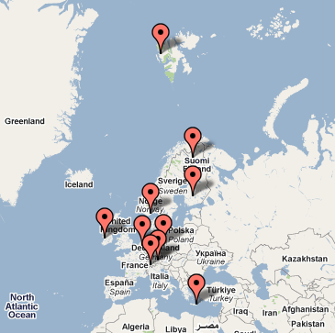
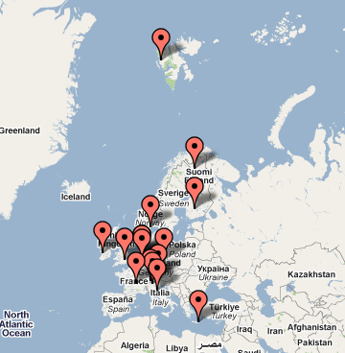
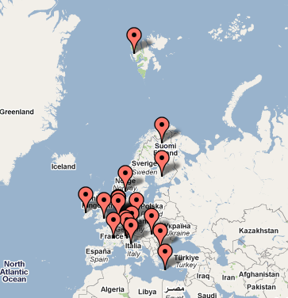
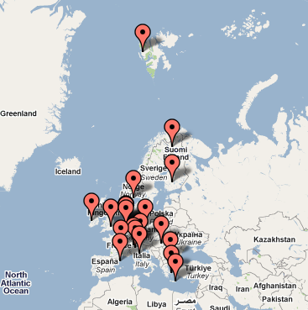
EUSAAR contribution to EBAS
The most extensive multi-variable aerosol parameter data base (as shown by Wenche this morning)
CREATE
EUSAAR 2006
EUSAAR 2008
waiting for 2010 data (July 2011)
TFMM, Zurich, 11-13 May, 2011
Notes:
8

Slide 9
Results from single stations
A number of papers have been published or are submitted describing the variability of aerosol variables at single stations – not exhaustive
EC/OC measurements:
Bourcier et al., OC/EC at puy de Dôme, submitted
Size Distribution:
N. Kalivitis, W. Birmili, M. Stock, B. Wehner, A. Massling, A. Wiedensohler, E. Gerasopoulos, and N. Mihalopoulos, Particle size distributions in the Eastern Mediterranean troposphere, Atmos. Chem. Phys., 8, 6729-6738, 2008
H. Venzac, K. Sellegri, P. Villani, D. Picard, and P. Laj Seasonal variation of aerosol size distributions in the free troposphere and residual layer at the puy de Dôme station,Atmos. Chem. Phys., 9, 1465-1478, 2009
Hygroscopic measurements
Kammermann, et al.,13-month climatology of the aerosol hygroscopicity at the free tropospheric site Jungfraujoch (3580 m a.s.l.), Atmos. Chem. Phys., 10, 10717-10732, 2010
Z. Jurányi, M. Gysel, E. Weingartner, P. F. DeCarlo, L. Kammermann, and U. Baltensperger, Measured and modelled cloud condensation nuclei number concentration at the high alpine site Jungfraujoch, Atmos. Chem. Phys., 10, 7891-7906, 2010
Sjögren, S., Gysel, M., Weingartner, E., Alfarra, M.R., Duplissy, J., Cozic, J., Crosier, J., Coe, H. and Baltensperger, U. (2008). Hygroscopicity of the submicrometer aerosol at the high-alpine site Jungfraujoch, 3580 m a.s.l., Switzerland . Atmos. Chem. Phys.,8, 5715-5729.
TFMM, Zurich, 11-13 May, 2011,

Slide 10
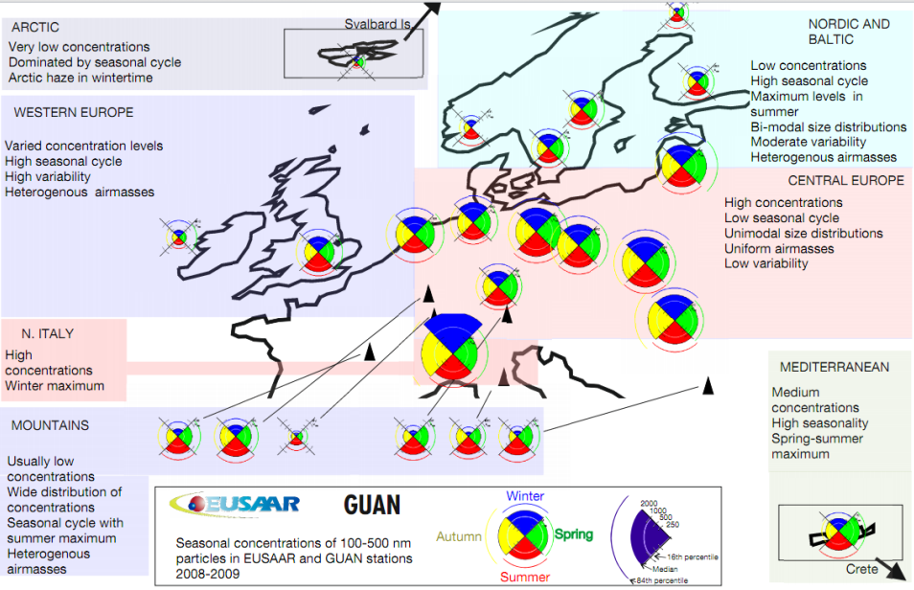
EUSAAR-EUCAARI Integration papers
Size distribution measurements:
Asmi et al. identification of the general features to be reproduced to test Transport-Chemistry Models
(free troposphere/boundary layer)
Spracklen, et al. Explaining global surface aerosol number concentrations in terms of primary emissions and particle formation. Atmos. Chem. Phys., 10, 4775-4793, 2010
EC/OC measurements:
J.P. Putaud to lead such a paper, perhaps discussing the issue of artifacts in Europe.
Diffusion Coefficient / optical properties
Betsy Andrews et al. Global and focussed on high altitude sites (>2 km)
Submitted to Atmos Res.
Absorption coefficient
An analysis of BC variability in Europe in preparation
Synthesis papers
Kulmala et al., submitted and Laj et al., in prep
TFMM, Zurich, 11-13 May, 2011,
Notes:
List all deliverables.

Slide 11
April 1st 2011: ACTRIS (Aerosol, Cloud and Trace Gases Research Network) takes over
Capacities Specific Programme : Research Infrastructures
Integrating Activity – Combination of Collaborative Project and Coordination and Support Action
Project acronym: ACTRIS
Starting date : April 1st, 2011
Duration : 4 years
Coordination CNR, Management : CNRS/CNR
Coordinators : G. Papparlardo-CNR, P. Laj-CNRS
Partnership : 28
Budget : 7.8 M€
ACTRIS Kick-off meeting :
25-26-27 May Zurich
TFMM, Zurich, 11-13 May, 2011
Notes:
11

Slide 12
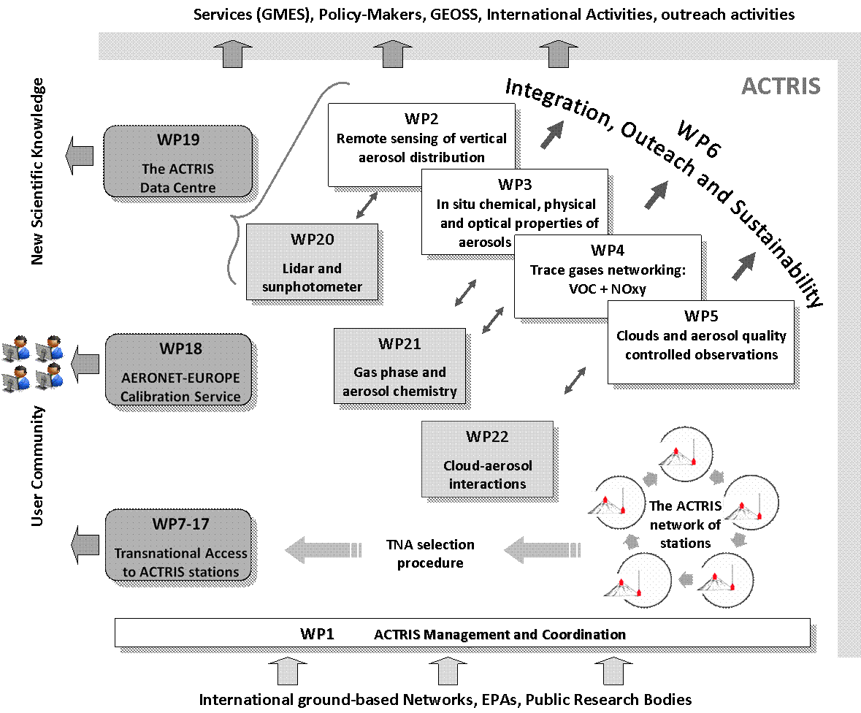
April 1st 2011: ACTRIS (Aerosol, Cloud and Trace Gases Research Network) takes over
EARLINET
Joint EU strategy for Level2/3 sustainability
EUSAAR
APRIORI
CLOUDNET
TFMM, Zurich, 11-13 May, 2011
Notes:
12

Slide 13
ACTRIS – EMEP
ACTRIS contributes to EMEP strategy : level 3 (and 2) sites – Great challenge for NOy and VOC species but also for 3-D monitoring (learn from the Volcano episode) , PM speciation (tracer approach) and EC/BC issues – additional Reference laboratory needed ?
Joint research campaigns also possibly with PEGASOS (but need for a strong coordination) – 2012 - from Germany to Italy
Coordinated data center strategy also with GAW
(as regard to data quality): a single portal for access
to data (NILU)
ACTRIS Maintain the link between EU-Climate and
Environment programs and the policy-driven monitoring programs (incl. GMES for NRT data provision)
TFMM, Zurich, 11-13 May, 2011
Notes:
13

Slide 14
ACTRIS Challenge ahead
ACTRIS main objective is to secure funding to monitoring atmospheric composition changes : ESFRI strategy in Air Quality/Climate context
Not as optimistic as Wenche
CREATE-EUSAAR-ACTRIS : 12 years of maturation for research-driven monitoring activities
Funding situation in many member states not so good and level-2/3 sites still very fragile
EU-Infrastructure (new I3 or ESFRI) support possible only if a clear strategy is proposed – What happens without EU structuration ? Shall we elaborate together a « Gothenburg question » document for policy-makers ? What is the added-value of level 2/3 also economically
WP6 essential : 28 partners from 17 countries agree on a joint strategy (ICOS ?) and develop arguments to explain the strategy to public authorities/Research institutions/EU Commission
Taking the breath of the Earth with observations; can Europe meet the challenge?
P. Ciais, M. Kulmala, S. Sorvari, W. Los, U. Baltensberger, J.-L. Brenguier, B. Buchmann, M De Mazière, G. Pappalardo, K. Tørseth, L. Rivier, G. Hansen, P. Laj, E. Turunen and A. Volz-Thomas
TFMM, Zurich, 11-13 May, 2011
Notes:
14

