Slide 1
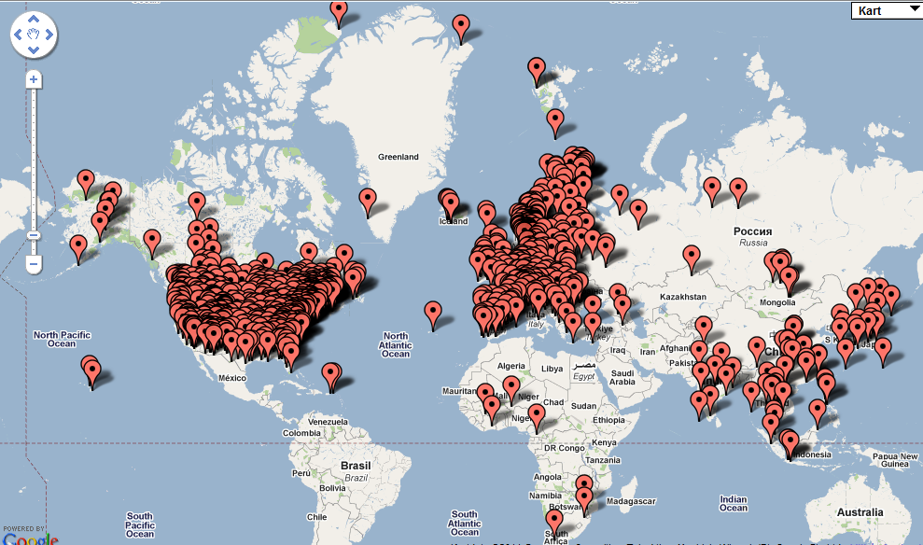
Monitoring climate forcers in EMEP
Kjetil Tørseth, Cathrine Lund Myhre, Wenche Aas, Andreas Stohl (EMEP/CCC)
Strategies of CLRTAP and EMEP
Current situation
Way forward
Total SO4 (HTAP)

Slide 2
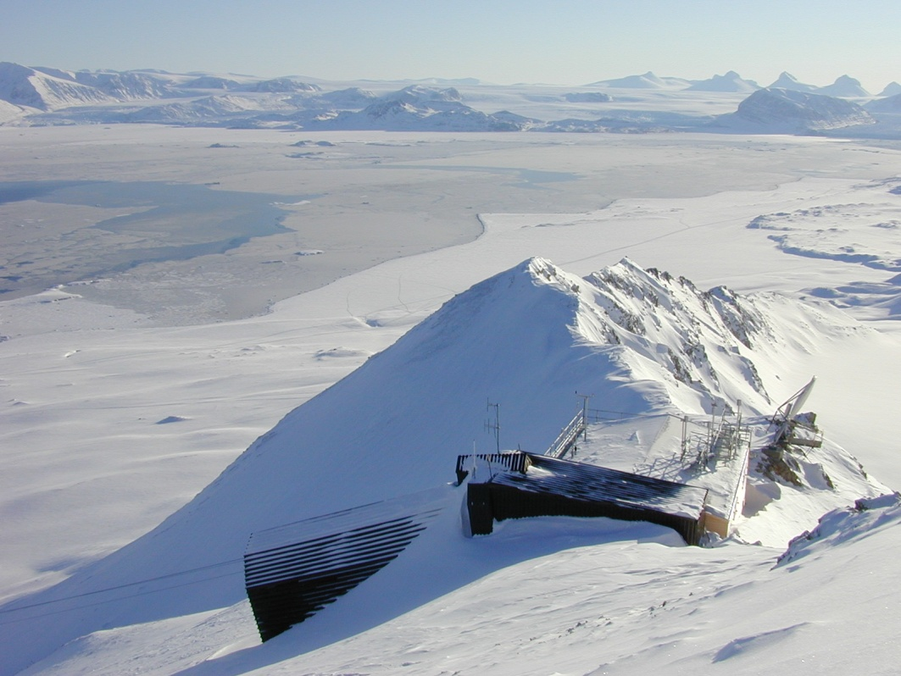
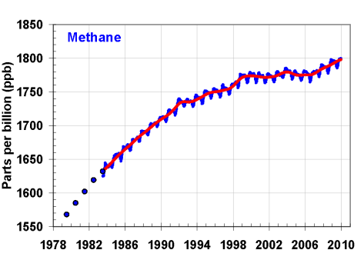

Slide 3
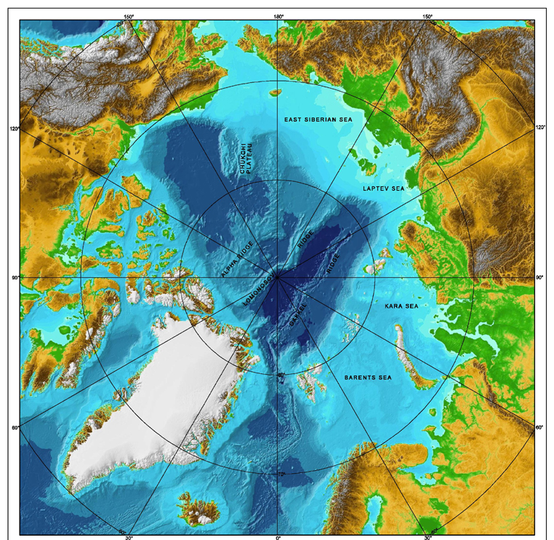
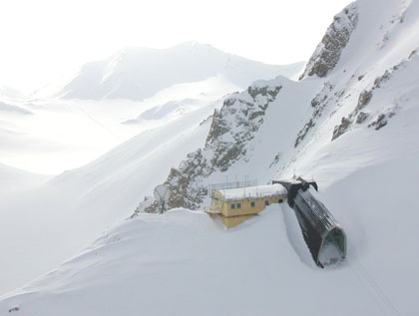
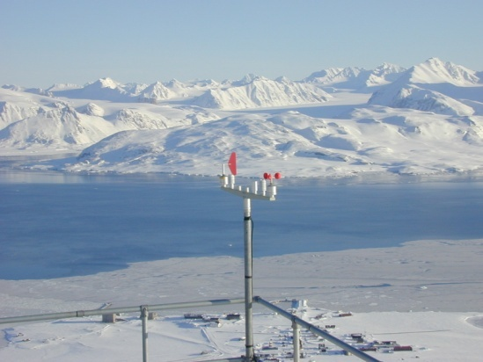
Sources to Arctic Methane
Wetland
Permafrost outbursts
Wetland
Hydrathes
Fires
Zeppelin
Fires
Wetland
Hydrathes
Oil/gas fields
Wetland
Hydrathes
*
Wetland

Slide 4
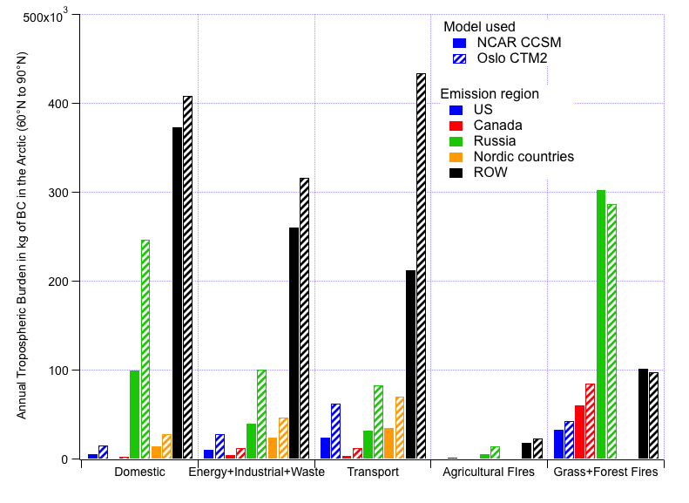
Contribution to the Arctic Atmospheric BC Burden (60° - 90°N) from the Different Regions and Energy Sectors as Calculated by the Two Models
Report of the AMAP Expert Group on
Short-Lived Climate Forcers (in prep)

Slide 5
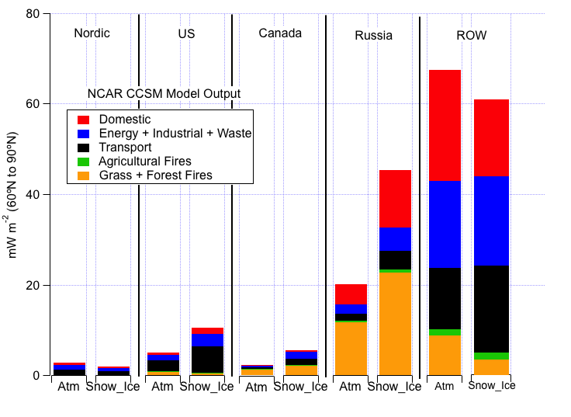
Absolute Level of Impact: Forcing due to BC + OC Mixture by Source Sector and Region
within the Arctic Council Nations and ROW
Report of the AMAP Expert Group on
Short-Lived Climate Forcers

Slide 6
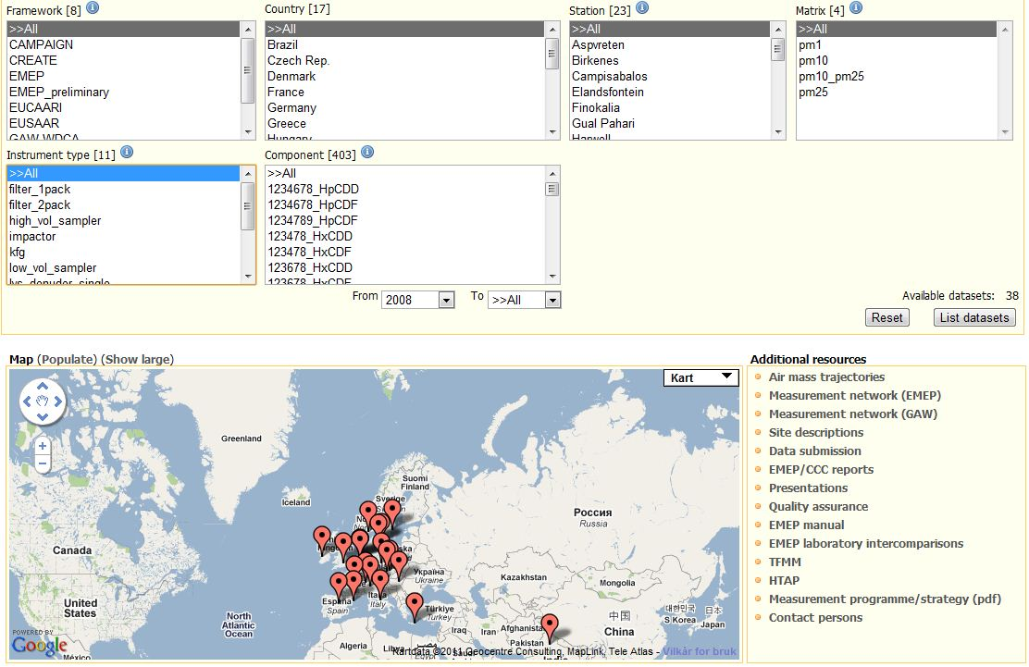
Elemental carbon

Slide 7
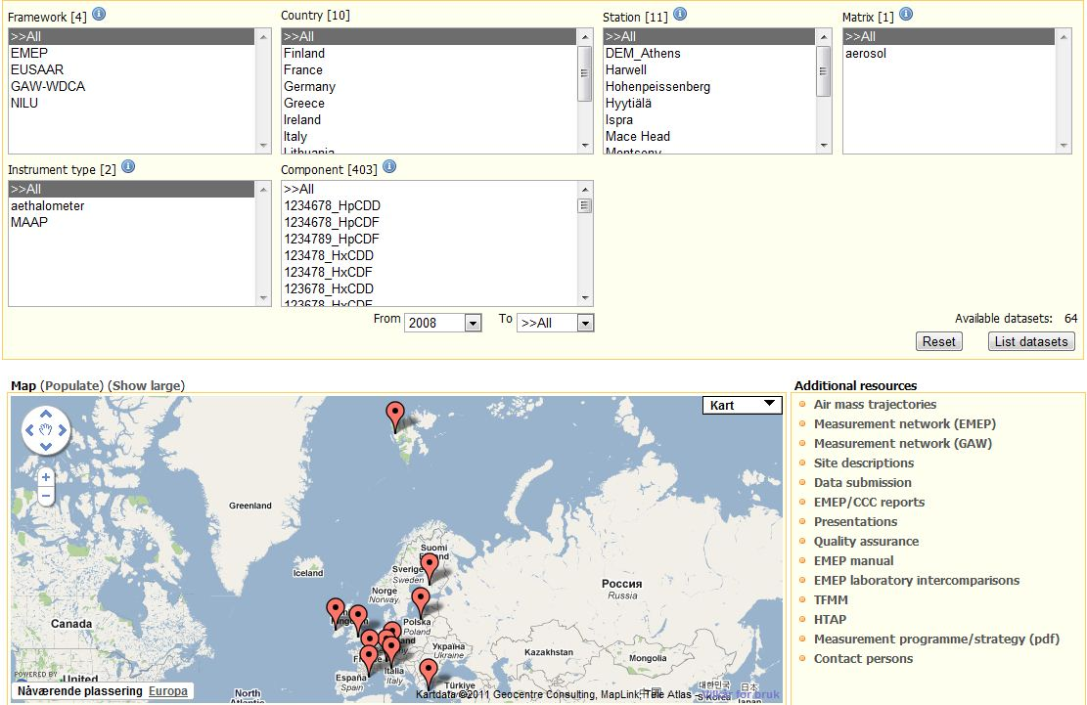
Black carbon

Slide 8
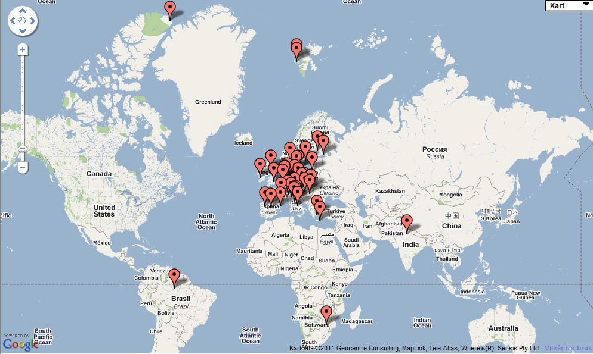
EC + BC (EMEP+GAW-WDCA+AMAP) all years

Slide 9
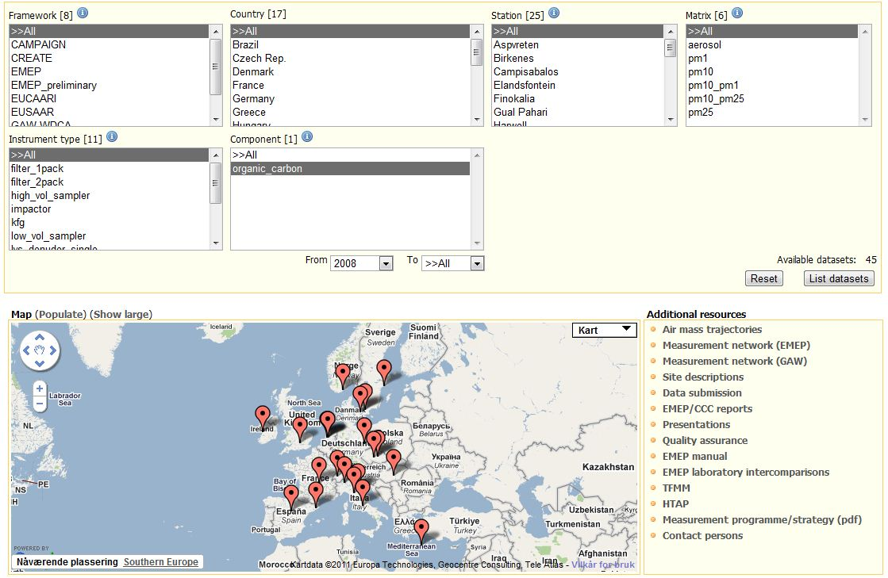
Organic carbon

Slide 10
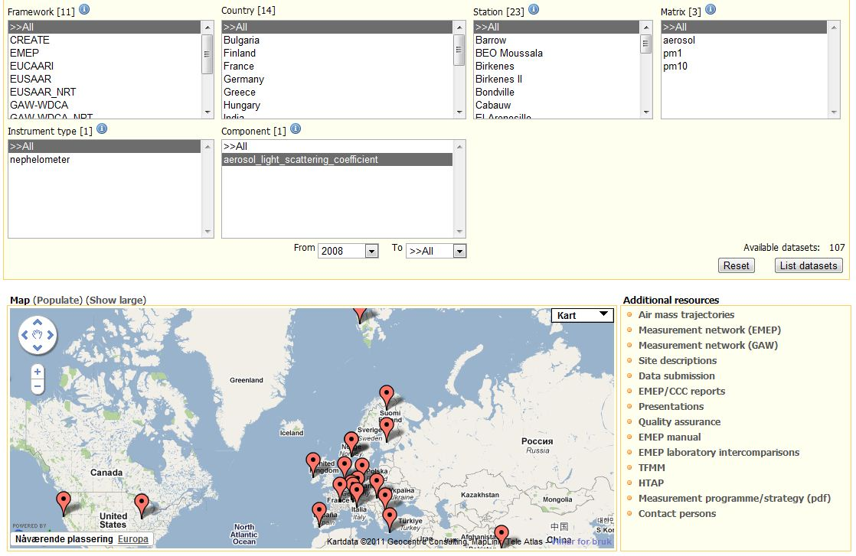
Aerosol light scattering coef.

Slide 11
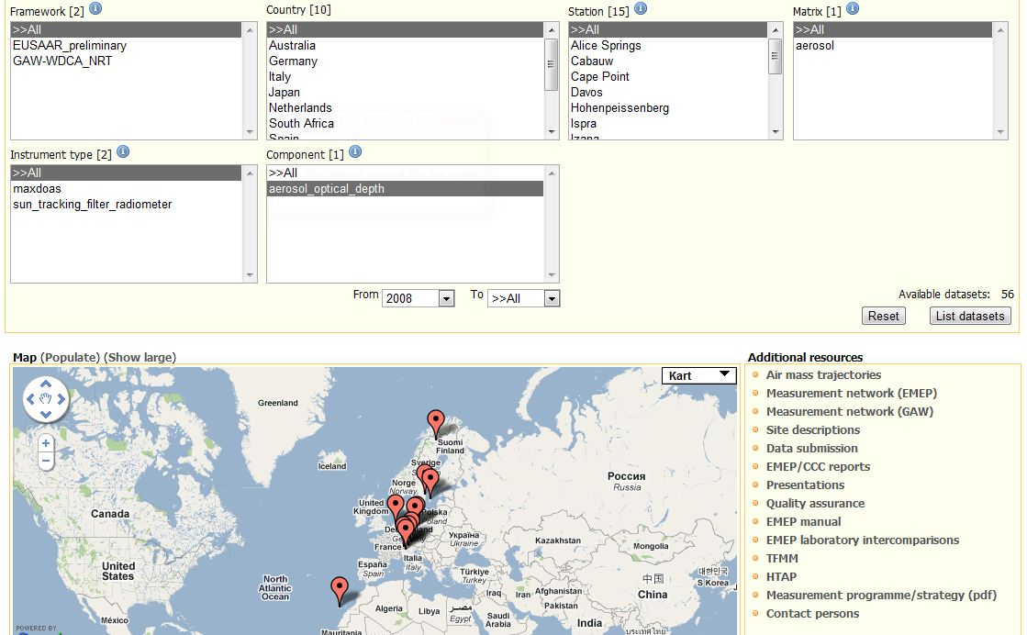
Aerosol Optical Depth

Slide 12
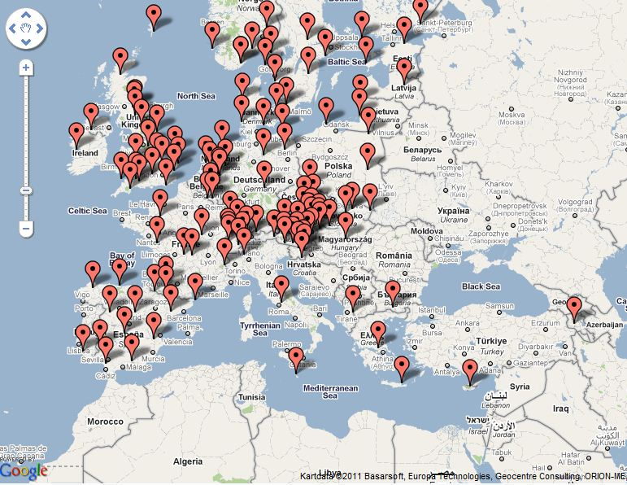
Ozone

Slide 13
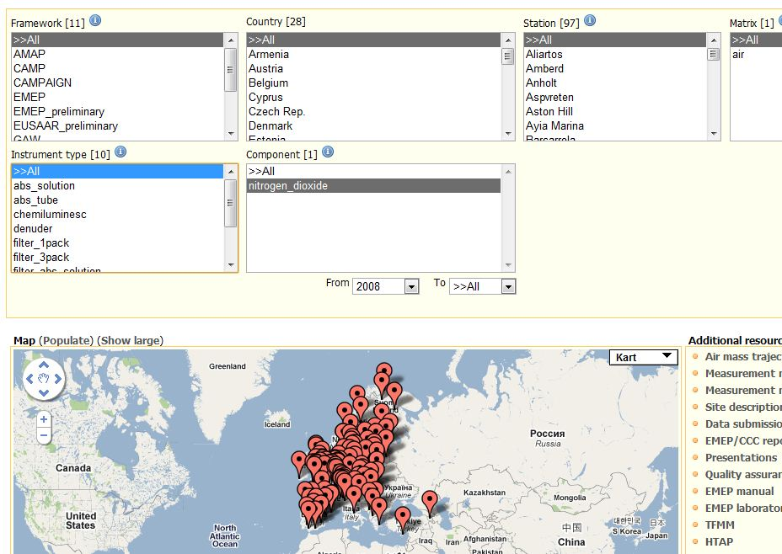
NO2

Slide 14
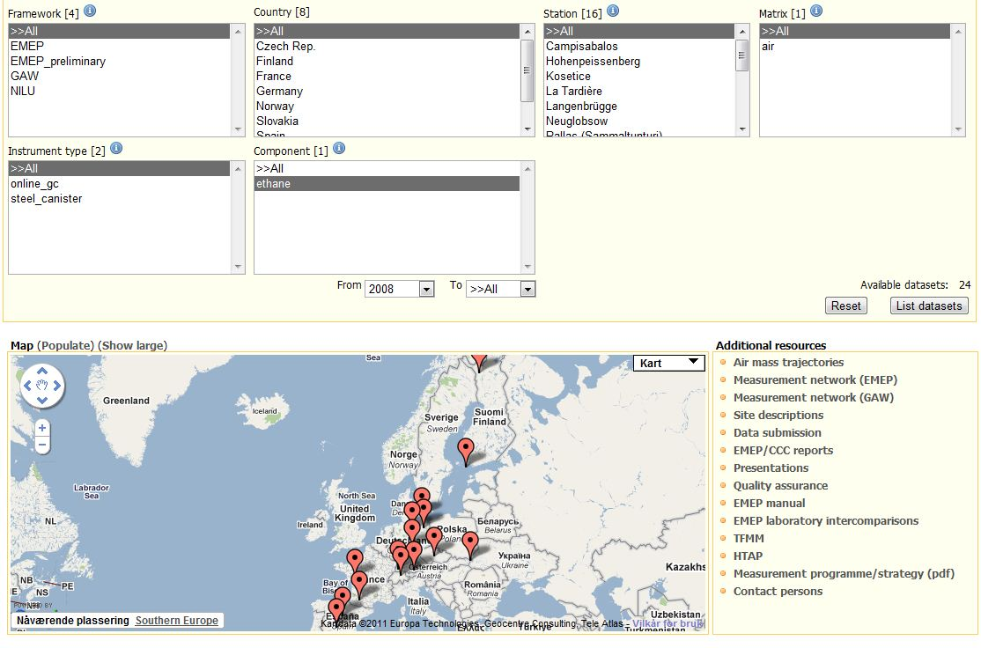
VOCs (Ethane)

Slide 15
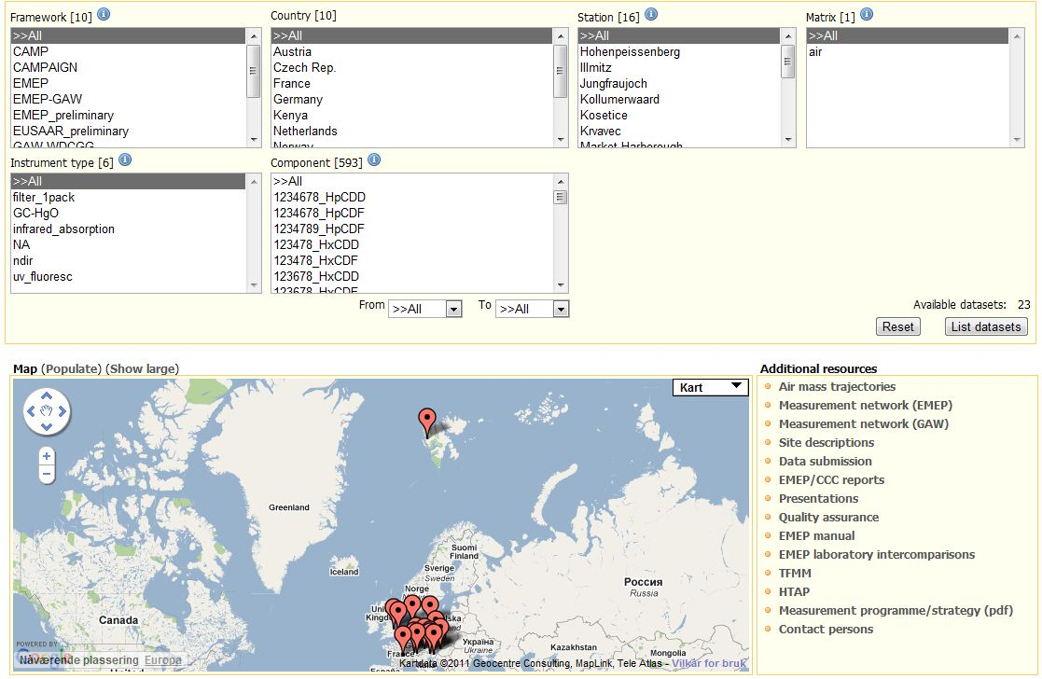
CO

Slide 16
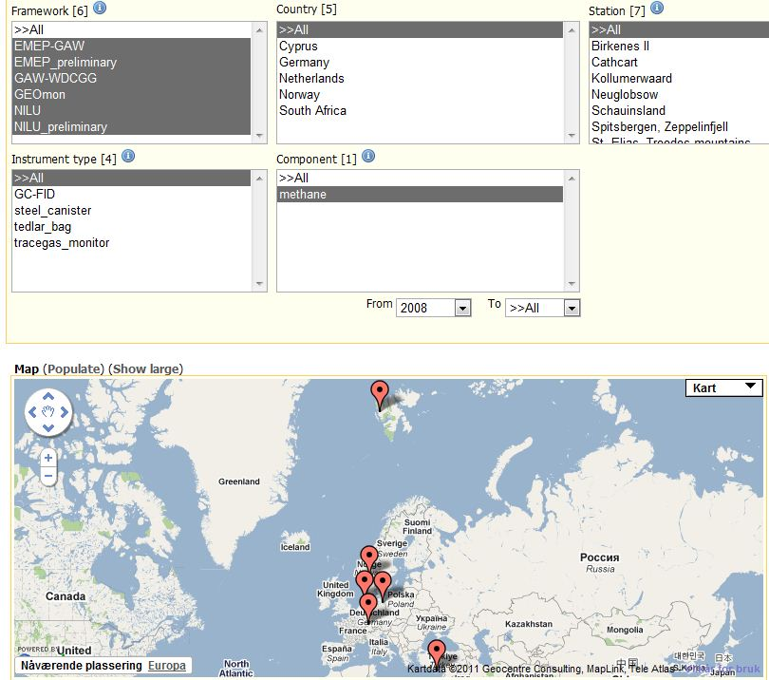
CH4

Slide 17
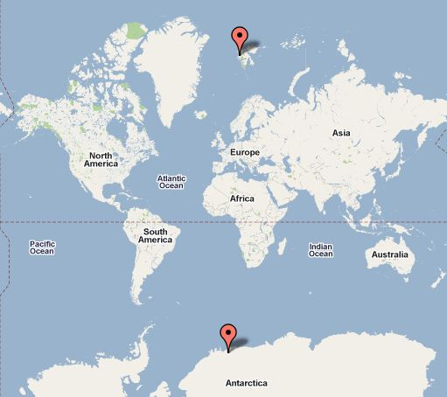
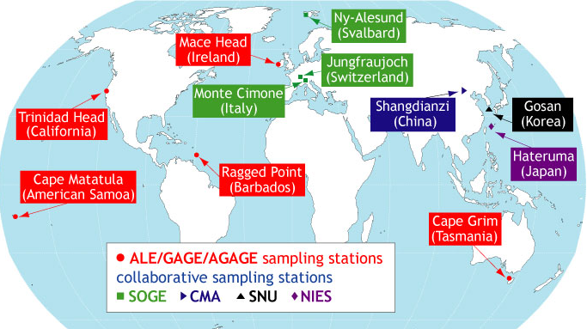

Halocarbons (HFC_124)

Slide 18

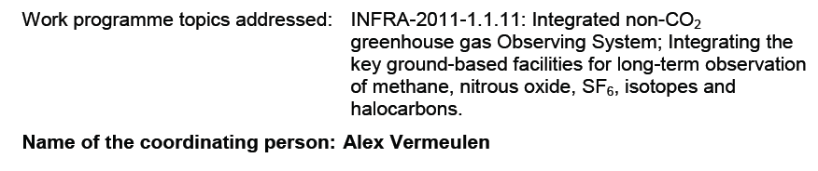
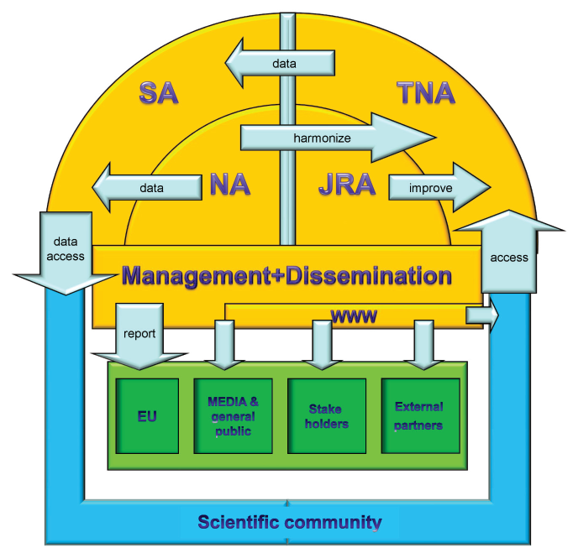
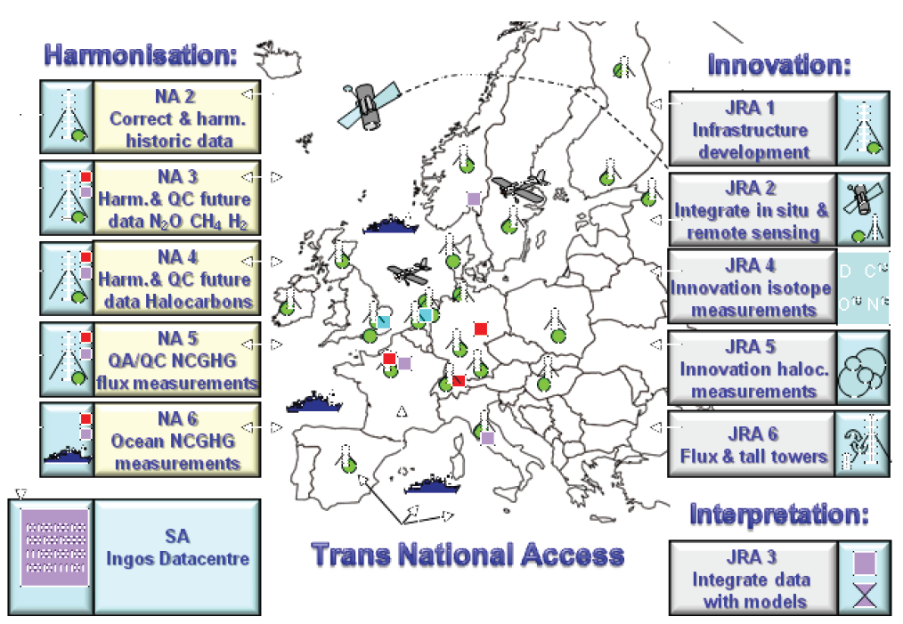

Slide 19
11. EMEP monitoring should support, in an integrated way, information needs associated with the coupling between atmospheric composition and deposition rates with climate variability/change. These include radiative forcing agents with a significant regional gradient (e.g. aerosols and ozone) where transboundary fluxes of the agents and their source-receptor relationships need to be assessed. Secondly, the monitoring of long-lived greenhouse gases should be closely integrated with the traditional EMEP parameters, where relevant, with a view
to further developing the monitoring programme defined for the strategic period of 2004–2009. Finally, the EMEP observation efforts should support the coupling between the carbon cycle and reactive nitrogen cycle.

Slide 20

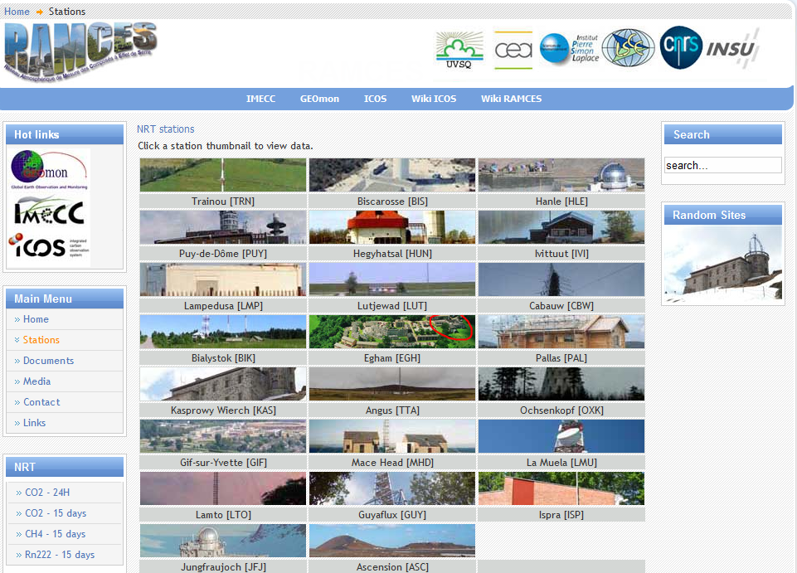

Slide 21
Goals
Form a more secure basis for funding observations of EMEP variables by more clearly identifying their relevance for CF
Training and capacity building
Better and more comprehensive observation basis (call for available data, also historic)
Involving GHGs experts in EMEP monitoring/assessments (+ QAQC matters)
Research infrastructures funding does NOT fund monitoring

Slide 22
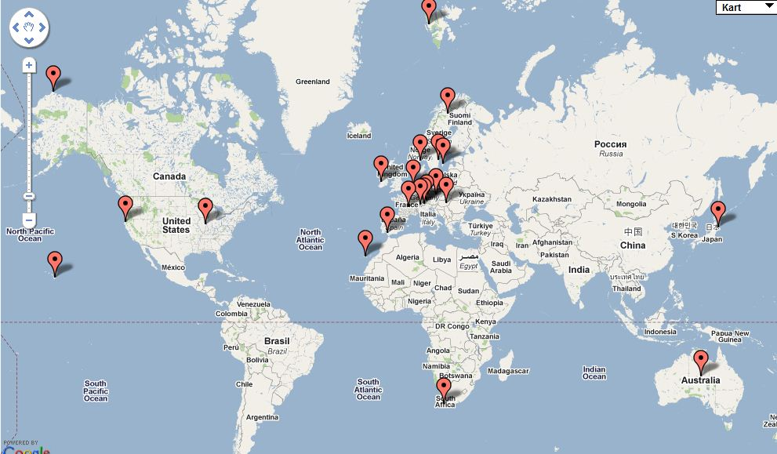
Near-real time
EMEP, EUSAAR, GAW-WDCA, NOAA,

Slide 23
Thank you

Slide 24
Additional slides, not presented

Slide 25
10. EMEP monitoring constitutes the core infrastructure for monitoring atmospheric composition change throughout the EMEP domain by ensuring adequate geographical coverage of monitoring efforts by Parties as well as by ensuring that that these data can be combined with data generated outside the region. One of the key challenges is to understand the role of intercontinental transport of pollutants of short-lived species as well as long-lived species affecting the topics addressed by EMEP.
EMEP observations contribute to the Global Earth Observation System of Systems (GEOSS). EMEP observations and monitoring sites are particularly well suited to serve as complementary sources of data to airborne and spaceborne remote sensing instrumentation, and it is expected that satellite data will towards the end of the coming strategic period provide essential information for addressing air pollution across the EMEP domain. The capabilities of satellites, however, will continue to rely on the reliable data for calibration and validation that EMEP observations contribute to.

Slide 26
14. The monitoring requirements provide important data for the assessment of environmental issues considered by other conventions including local air quality, climate change, water quality and biodiversity. There is also a significant overlap in the technical infrastructures at the national level, and most EMEP supersites (see below) are also core infrastructures for measurements of parameters needed to assess such topics. Due to the significant interactions between the suite of chemical constituents and the associated physical properties of air pollutants, as well as the synergies in abatement measures, national and international monitoring efforts should be closely coordinated. Such an approach will ensure a sound observational basis for EMEP by combining resources and avoiding duplication of efforts

Slide 27
15. The monitoring strategy of EMEP is to use progress in scientific understanding represented by new methods for the conduct of monitoring, new technologies and techniques to integrate observations from measurement platforms (e.g. in situ, profiles, remote sensing) and methods for integrating observational data with modelling efforts through, for example, data assimilation. EMEP will, where relevant and appropriate, introduce monitoring of parameters at a timeliness allowing more rapid access to data on the air pollution situation across the EMEP domain. EMEP will in collaboration with the European Environment Agency contribute to the provision of near-real time data for Global Monitoring for the Environment and Security (GMES) in agreement with the Parties. Such efforts will be based on voluntary contributions from Parties and will follow the guidance of the EMEP Steering Body.

Slide 28
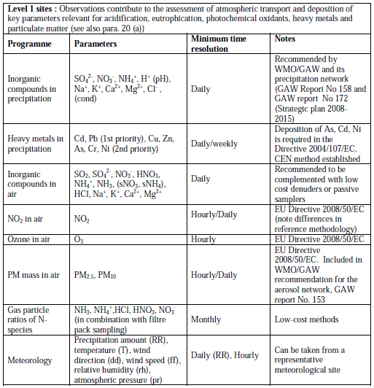

Slide 29
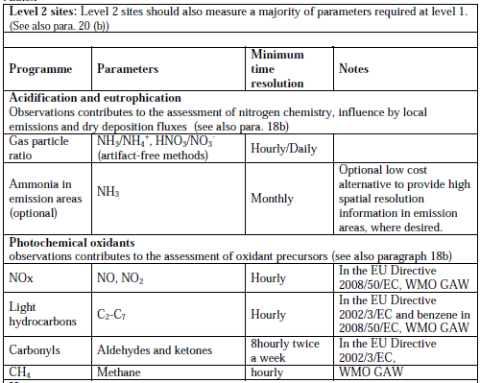

Slide 30
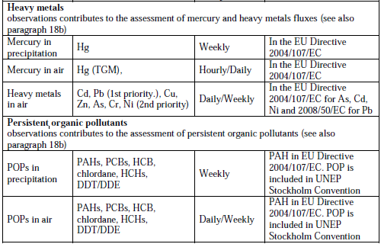

Slide 31
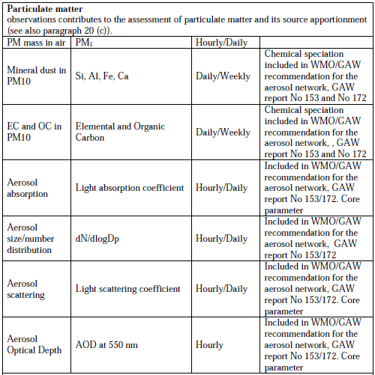

Slide 32
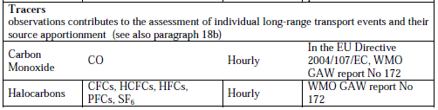

Slide 33
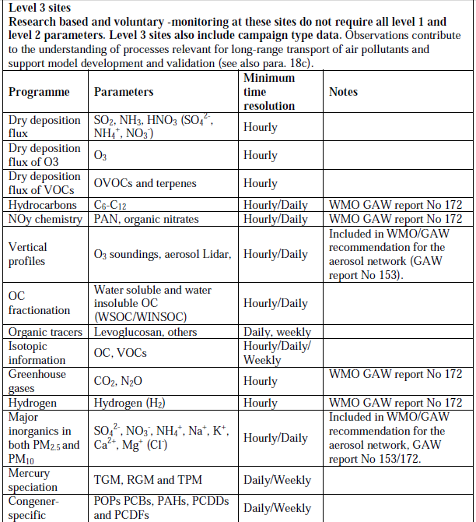

Slide 34
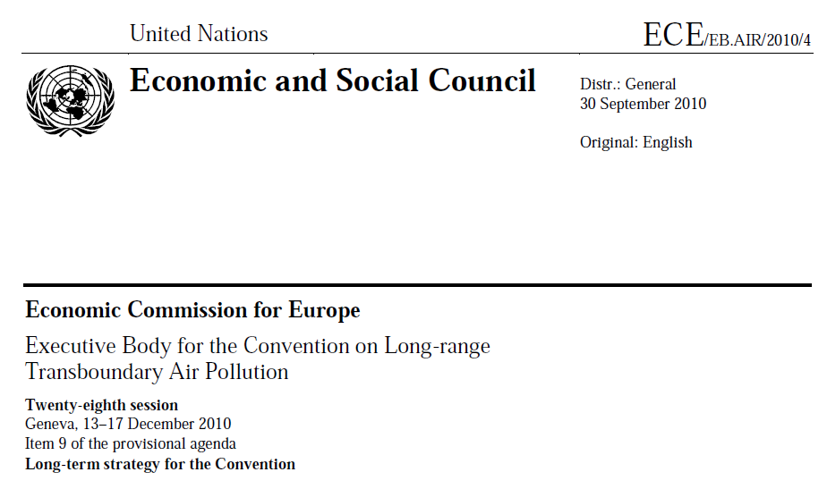

Slide 35

(i) The Convention recognizes the importance of identifying the co-benefits in
combating air pollution and climate change. It will give high priority now and in the longer term to establishing work on the links between climate change and air quality. In the short term, attention will be focused on SLCFs where there is a strong argument that optimal control policies for these pollutants should be regional in nature. There is, however, no international governance of this issue and this represents an important opportunity and challenge for the Convention. The Convention will assess the feasibility of incorporating SLCFs into instruments such as a revised Gothenburg Protocol, for instance, with regard to black carbon, as part of PM, and to methane and carbon monoxide as precursors of ozone. Links between UNEP and the technical centres under the Convention were already established on scientific issues. Links with the UNFCCC and UNEP more broadly will be strengthened by the secretariats in order to establish longer-term cooperation on a more strategic level. The Convention could strengthen the links between policies in Parties to address both air pollution and climate change by adopting long-term goals for air pollutants and SLCFs commensurate with the outcomes of long-term policies to reduce emissions of greenhouse gases;

Slide 36
Variables relevant for climate forcing
  Aerosols
    Inorganic ions, sea salts and mineral dust
    Elemental/black carbon
    Organic carbon
    Aerosol physical properties (mass, size number distribution)
    Optical properties (absoption, scattering,
  Ozone
    VOCs and Noy
    CO
  CH4
  CO2
  N2O
  Halocarbons
  H2

