Slide 1
A 12 Year Study of Atmospheric Pollution in the Central Mediterranean and Future Research Prospects
Martin Saliba
Francelle Farrugia
Raymond Ellul
ray.ellul@um.edu.mt
Physics Department
University of Malta
Msida MSD 2080
Malta
Atmospheric Research
University Gozo Centre
Xewkija XWK 9016
Gozo

Slide 2
Principal Collaborators and Co Workers
Dr Hans Gϋsten Institut fϋr Meteorologie und Klimaforschung, Karlsruhe,
Dr Gϋnther Heinrich Germany.
Dr Michael Nolle Physics Department, University of Malta, Msida MSD 2080,
Malta.
Dr S Nickovic ICOD, FIS, University of Malta, Valletta, Malta.
Dr Marie Dominique Unite de Biogeochemie Marine, Ecole Normale Superiore
Loye – Pilot Paris, France.
Dr P Kalabokas Academy of Athens, Research Centre for Atmospheric
Physics and Climatology, Athens, Greece.
Prof. J Lelieveld Max Planck Institut fϋr Chemie, Mainz, Germany.
Prof. P Crutzen
Equipment donors and special thanks to:
Max Planck Institut fϋr Chemie, Mainz.
IMK, Forschungszentrum Karlsruhe.
International Bϋro - Jϋlich/ Bonn.

Slide 3
Pollution in the Mediterranean
Natural Causes:
Dust events from North Africa
Volcanic emissions
Anthropogenic sources:
Emissions from population centres
Ships’ traffic
Imported pollution

Slide 4
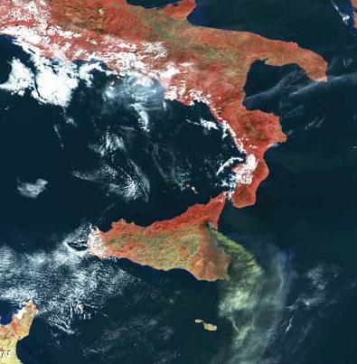
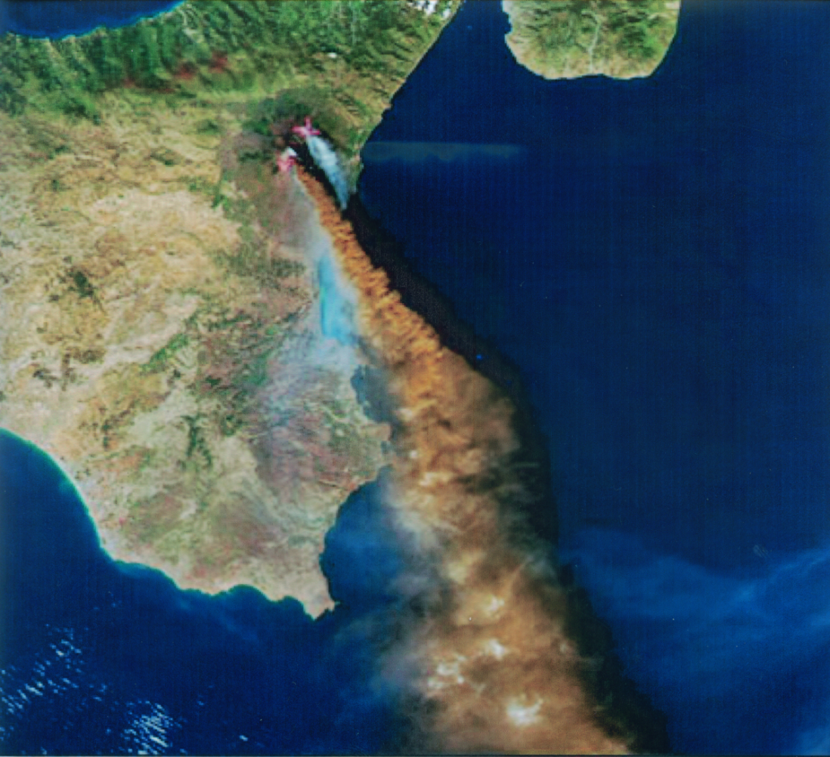
Etna Emissions when the wind is from the Northern sector.
Courtesy of NASA

Slide 5
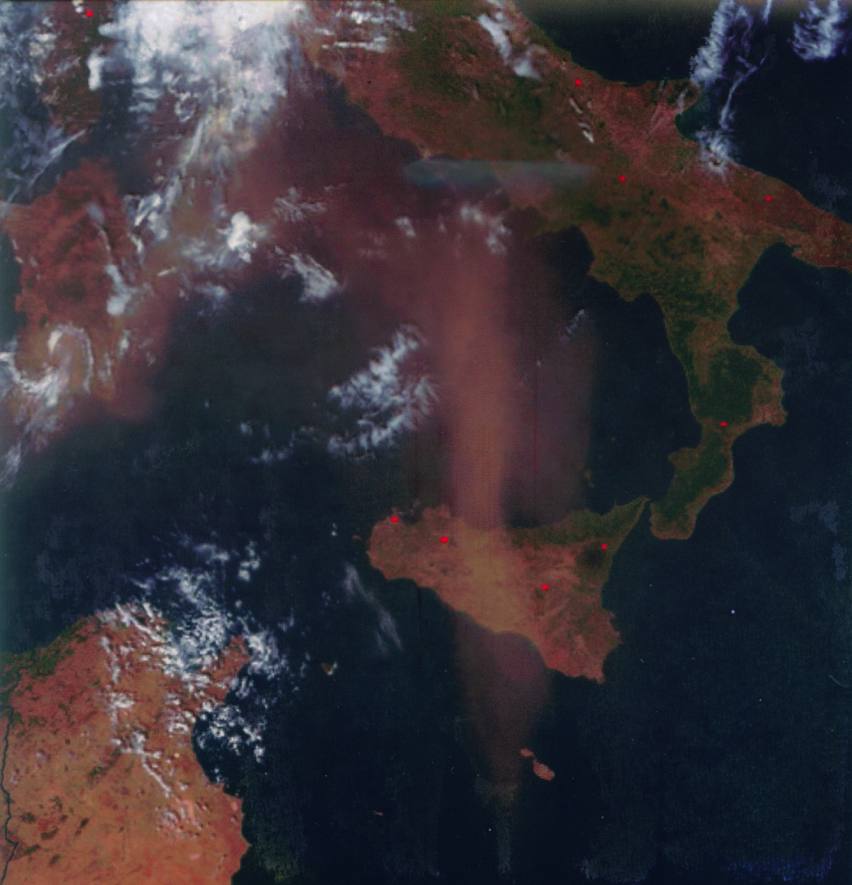
A Saharan Dust event
Courtesy of NASA

Slide 6
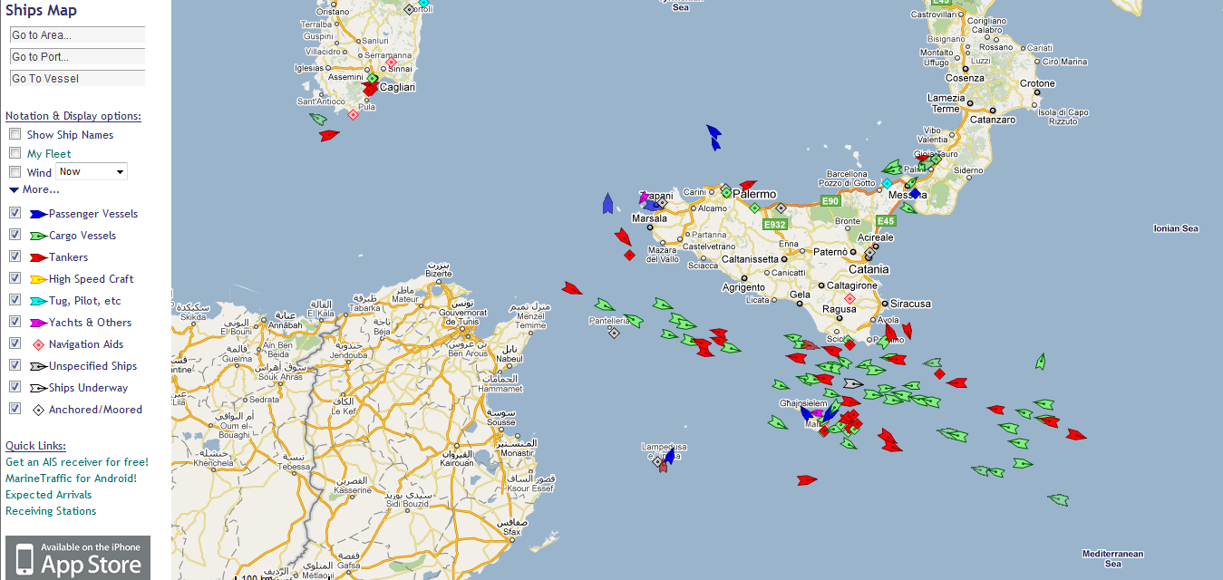
View of Ships in Malta – Sicily Channel
9th May 2011
www.marinetraffic.com

Slide 7
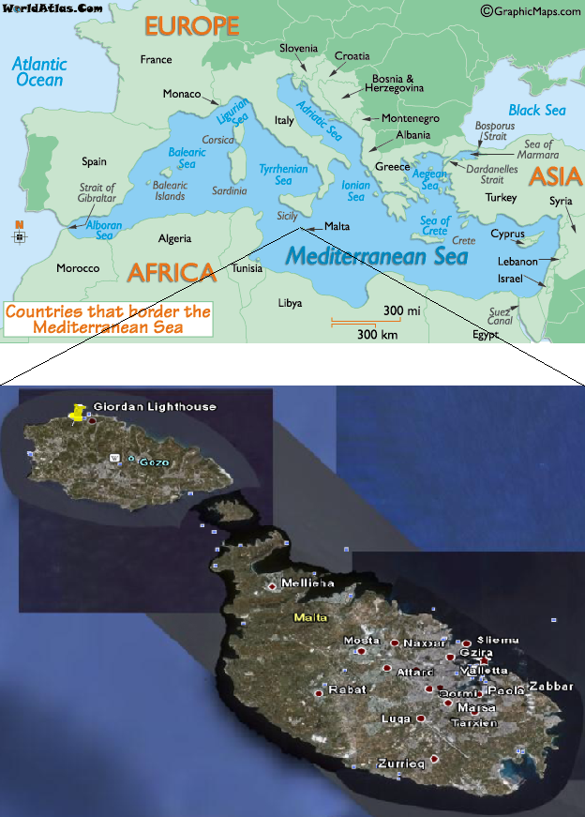
The Location of the GAW background station on the island of Gozo, Malta
Population of Malta
410,290 (End 2007, NSO)
Area 315 sq km
93 km South of Sicily
Population of Gozo
31,053 (End 2007, NSO)
Area 67 sq km
5 km NW of Malta
Station Coordinates
Lat: 36.073º N
Lon: 14.219º E
Alt: 167 metres, a.s.l
M Saliba 2009

Slide 8
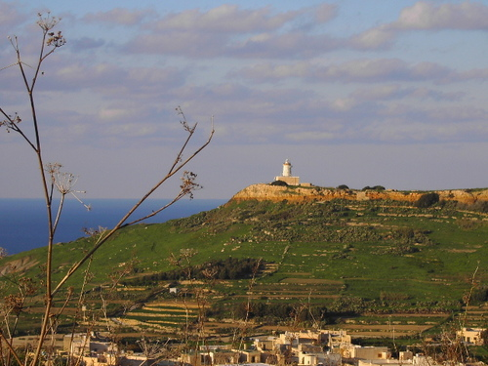
Giordan Lighthouse - Gozo
M Saliba 2009

Slide 9
Instruments and Measurements
Preliminary measurements of surface ozone and carbon monoxide mixing ratios together with meteorological parameters started in early 1997. In 2004 a sulphur dioxide analyser was also installed.
The list below represents the analysers used to monitor the trace gases at the Giordan lighthouse GAW station:
Ozone analyser
Ozone analyser
Ozone analyser
Carbon monoxide analyser
Sulphur dioxide analyser
Dasibi RS 1008
Dasibi AH 1006
Environnement O341M
Horiba APMA-350E
Teledyne ML 9850
(1997)
(2006)
(1997)
(2004)
Meteorological Sensors:
Temperature & RH sensor
Wind speed and direction
Pressure sensor
Vaisala nso 50Y
Lambrecht anemometer 14512
Vaisala PTB 101 B

Slide 10
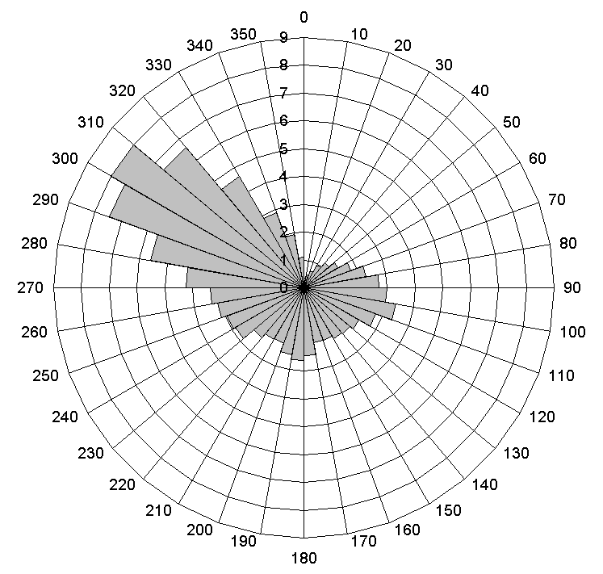
Local wind and RH data
The annual wind rose (1997 – 2008)
Relative humidity and Dew Point (1997 – 2008)
The length of each bar represents the total percentage of occurrence of that wind range.
The prevailing wind direction on the Maltese islands is the west-north-west (~31% of annual wind rose).
The most common wind speed (2-5 m/s) is from NW with maximum of 30 m/s.
Relative humidity is very high and ranges between 70% to 80%.
Maximum RH occurs in April, with a secondary maximum in October, whilst a minimum occurs in June.

Slide 11
ADIOS Campaign 2002 – 2003
Assessment of annual fallout of mineral dust and nutrient from the atmosphere to the Mediterranean Sea
Location of ADIOS network atmospheric sampling stations (red dots) and Malta additional station (yellow dot).
ADIOS Report to EC. Deliverable Nr 44. (2004)

Slide 12
Conclusions of ADIOS Campaign
Atmospheric deposition of major elements and nutrients is higher at Gozo site than in NW Mediterranean ADIOS sites.
Marine fraction from recycling of sea salts is dominant and much more important than at other sites (probably due to NW winds in winter).
Non sea salt sulphur and inorganic nitrogen (anthropogenic sources) are higher at Gozo site. Relative role of long range transport and ship traffic need further study.
Non sea salt Calcium is higher than in NW Mediterranean sites in relation to higher input of Saharan dust.
Saharan dust fallout at Gozo site (as in Tunisia ADIOS site) is higher than in Western and Eastern sites suggesting that Saharan dust deposition in Central Mediterranean is higher than in other basins.
ADIOS Report to EC. Deliverable Nr44. (2004)

Slide 13
Monthly averages of Ozone mixing ratio versus wind direction and month of year.
Ozone Data 1997 – 2008, Giordan Lighthouse.
M Saliba, M Nolle and R Ellul. Data from 1997 - 2008

Slide 14

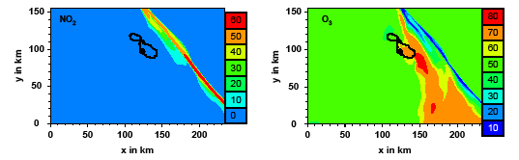
Modelling of Effect of Ships’ emissions on Maltese Islands.
Copy of poster of B Vogel, H Vogel, H Gϋsten, IMK, Karlsruhe (2002).

Slide 15
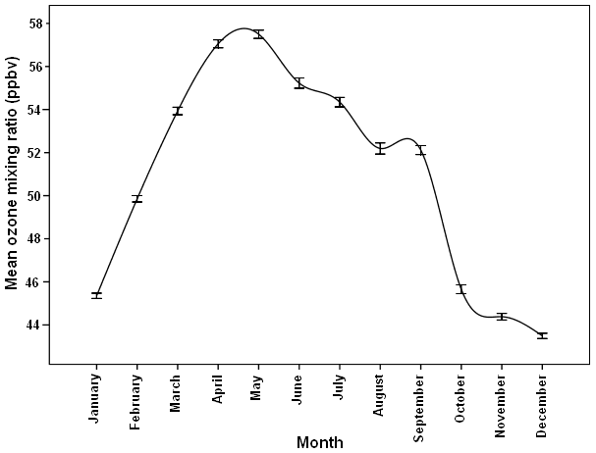
Annual variation of Ozone Concentration at Giordan lighthouse (1997 – 2006).
Saliba et. al. Journal of Atmospheric Chemistry Vol 60, Pg 117 (2008)

Slide 16
Annual variation of Ozone Concentration at Giordan lighthouse (1997 – 2006).
M Saliba (2009)

Slide 17
Comparison of Carbon Monoxide and Sulphur Dioxide concentrations over the Maltese Islands.
Saliba et. al. Journal of Atmospheric Chemistry, Vol 60, Pg 117 (2008)

Slide 18
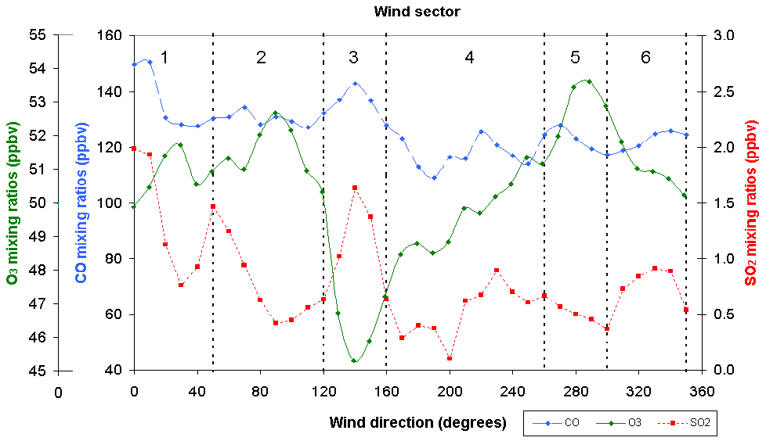
Comparison of Ozone, Carbon monoxide and Sulphur dioxide concentrations measured at Giordan lighthouse.
Saliba et. al. Journal of Atmospheric Chemistry, Vol 60, Pg 117 (2008)

Slide 19
Pre industrial and Modern Ozone concentrations.
Nolle et. al. Atmospheric Environment Vol 39, Pg 5608-5618, (2005)

Slide 20
Summary of our findings at GAW station Giordan lighthouse.
Ozone concentrations have probably increased by a factor of 4 – 5 over the last century.
Ozone concentrations in the Central Mediterranean show a present day median value of around 50 ppbv – One of the highest in the Northern hemisphere with a correspondingly serious effect on local crop losses.
Many anthropogenic events appear to originate from Sicily and Europe.
The Carbon monoxide concentration shows a typical Northern hemisphere variation with many Anthropogenic events being identified originating in Northern and Southern Europe.
The Sulphur dioxide background is high with peaks both from the direction of the main island of Malta as well as the Malta – Sicily channel and possibly Etna.
The Ships’ traffic in the Malta – Sicily channel needs to be quantified and the emissions measured. International action needs to be taken to limit these emissions.

Slide 21
New GAW Station at Giordan Lighthouse
As of December 2010 we have effectively established a new station at Giordan lighthouse with the following instruments:
Ozone monitor Thermoelectron LDL of 1.0 ppbv
Sulphur Dioxide monitor Thermoelectron LDL of 0.05 ppbv
Nitrogen Oxides analyser Thermoelectron LDL in the ppt region
Carbon Monoxide analyser Aero Laser LDL of 2 ppbv
Calibration system Thermoelectron
Zero air generator Thermoelectron
Aerosol spectrometer Grimm 10 nm - 10 microns in 72 channels
It consists of an SMPS, OPC and CPC plus MAAP to measure Black Carbon.
(TSI parts by Institute for Tropospheric research in Leipzig, Germany)

Slide 22
Instruments - continued
Radon – 222 detector Tracer lab
Two Low Volume samplers Leckel
Two Cup and Vane anemometers Lambrecht and Vector
Ultrasonic anemometer Gill, 50 Hz 3D
Temperature Sensor Vaisala
Relative Humidity Sensor Vaisala
Pressure Sensor Vaisala
Xewkija
Three radiation sensors: SP-Lite, CMP-3, CMP-6 Kipp and Zonen
Two anemometers Lambrecht and Young

Slide 23
Future works
We are also planning to add, under a Malta – Italy structural funds agreement:
Aethalometer McGee
Present Weather sensor Campbell
Aerosol Optical Depth photometer Cimel
CRDS for CO, CO₂, CH₄ and H₂O Picarro
Ultra microbalance - to be used with low volume samplers
Possibly LIDAR for Volcanic Ash

Slide 24

Data Logging
Data logging of all instruments and Meteorological parameters is being undertaken at the Xewkija Gozo base station server, and also at Air Monitors Ltd. UK server.
All data is being made available to the GAW community.

Slide 25
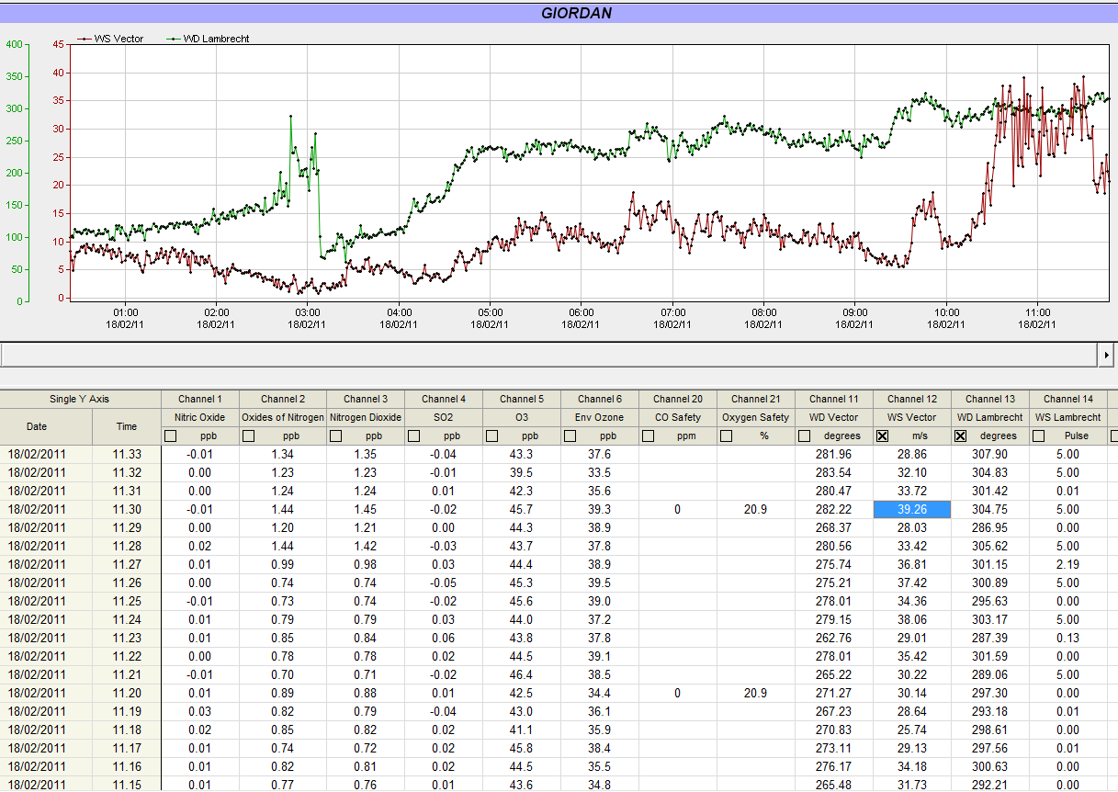
Hurricane force winds
18th February 2011
Max wind speed of over 39 m/s (140 km/hr)

Slide 26
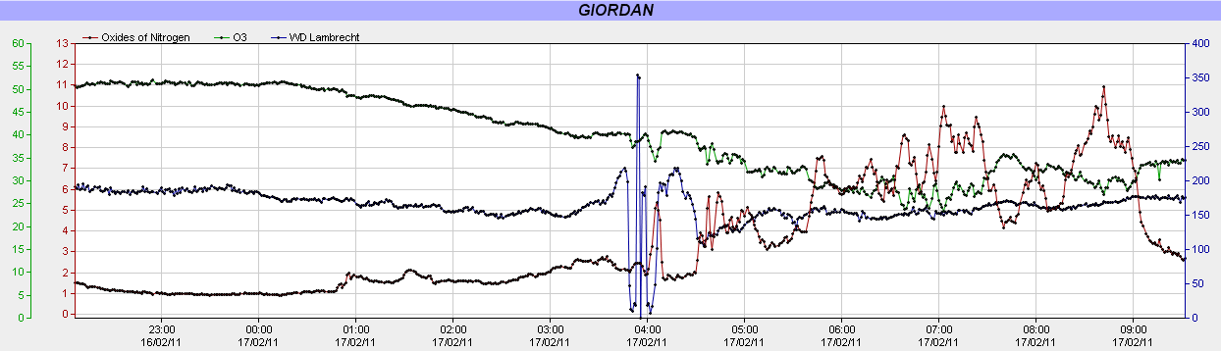
Trace gases as measured at Giordan Lighthouse
Wind Direction - South East (over Malta)
17th February 2011

Slide 27
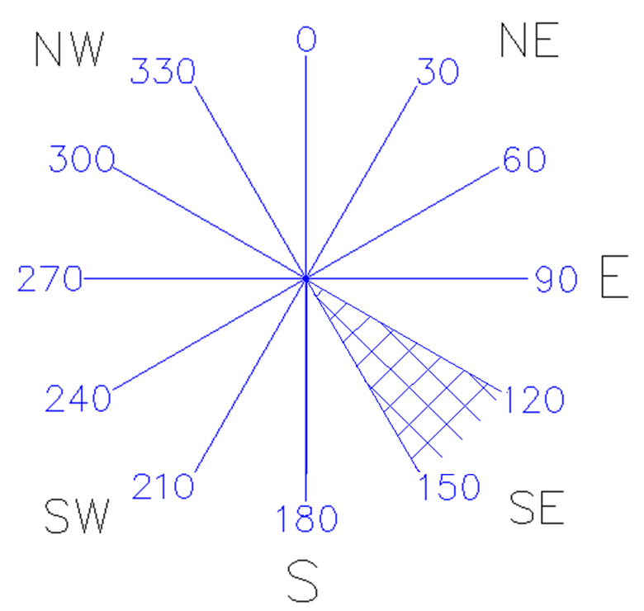
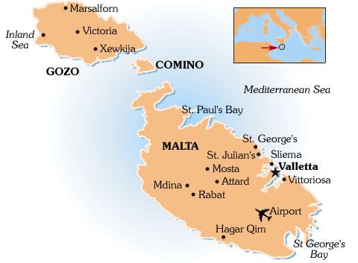
Wind Direction Segments

Slide 28
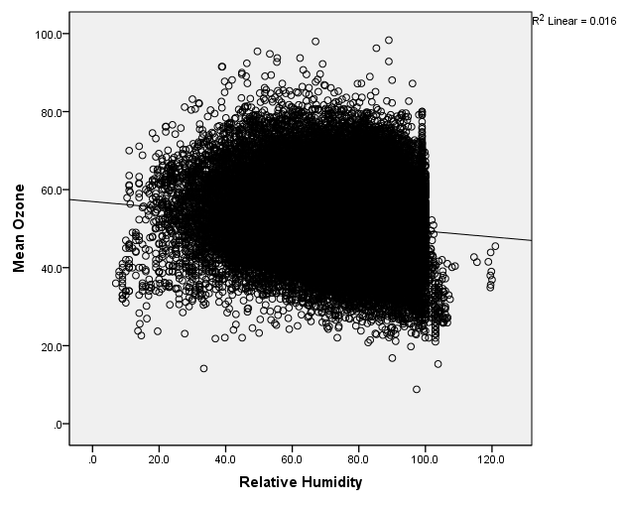
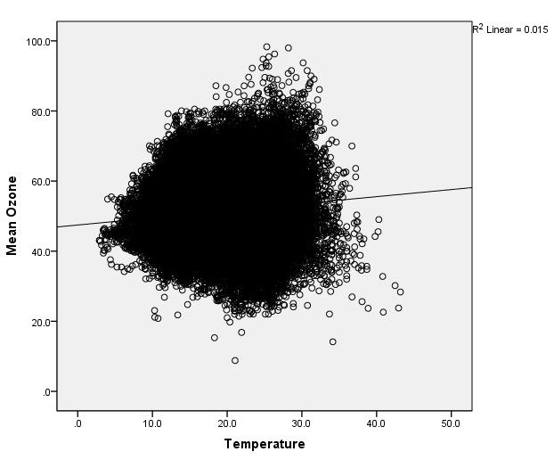
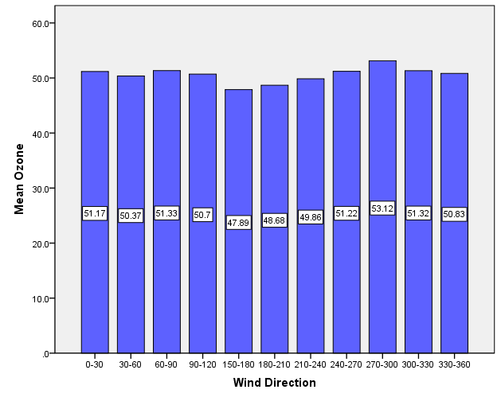
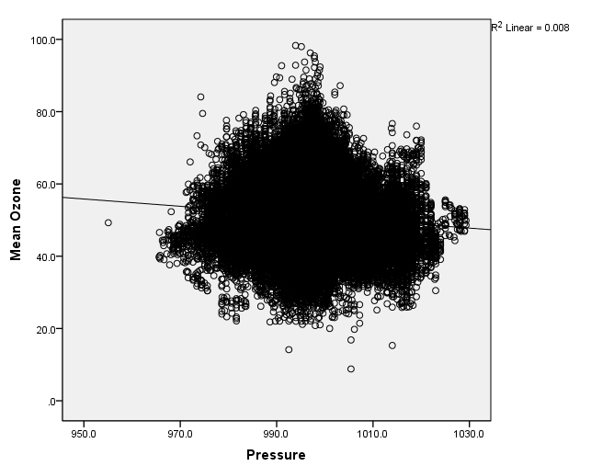
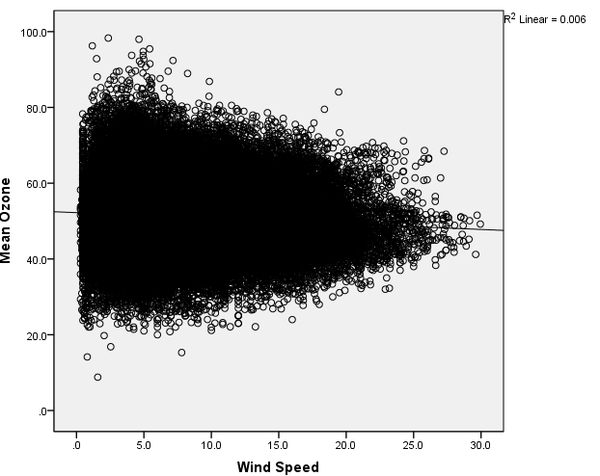
Ozone dependence on Meteorological Parameters

Slide 29
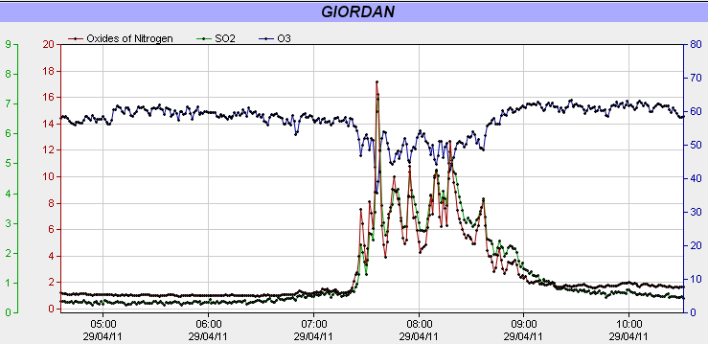
Anthropogenic effects on Measurements of Trace gases
29th April 2011

Slide 30
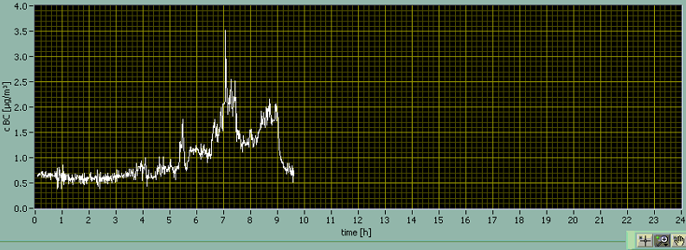
Black Carbon Concentration
Wind Direction - South East (over Malta)
17th February 2011

Slide 31
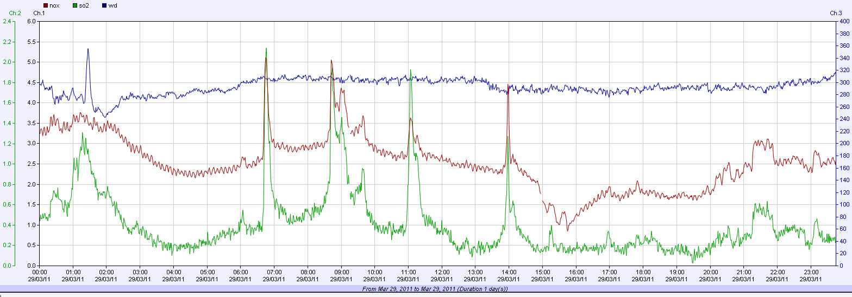
Effect of Ships’ emissions on Maltese Islands
Wind Direction – North West
29th March 2011

Slide 32
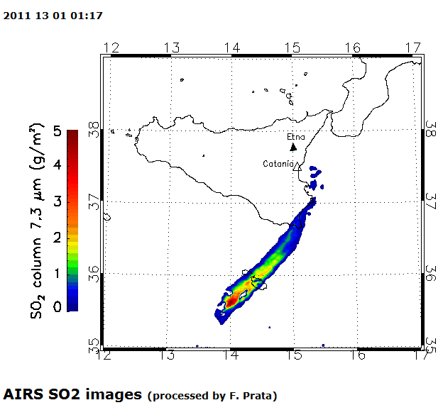
Etna Emission
13th January 2011
http://savaa.nilu.no/Etna/tabid/4267/Default.aspx

Slide 33
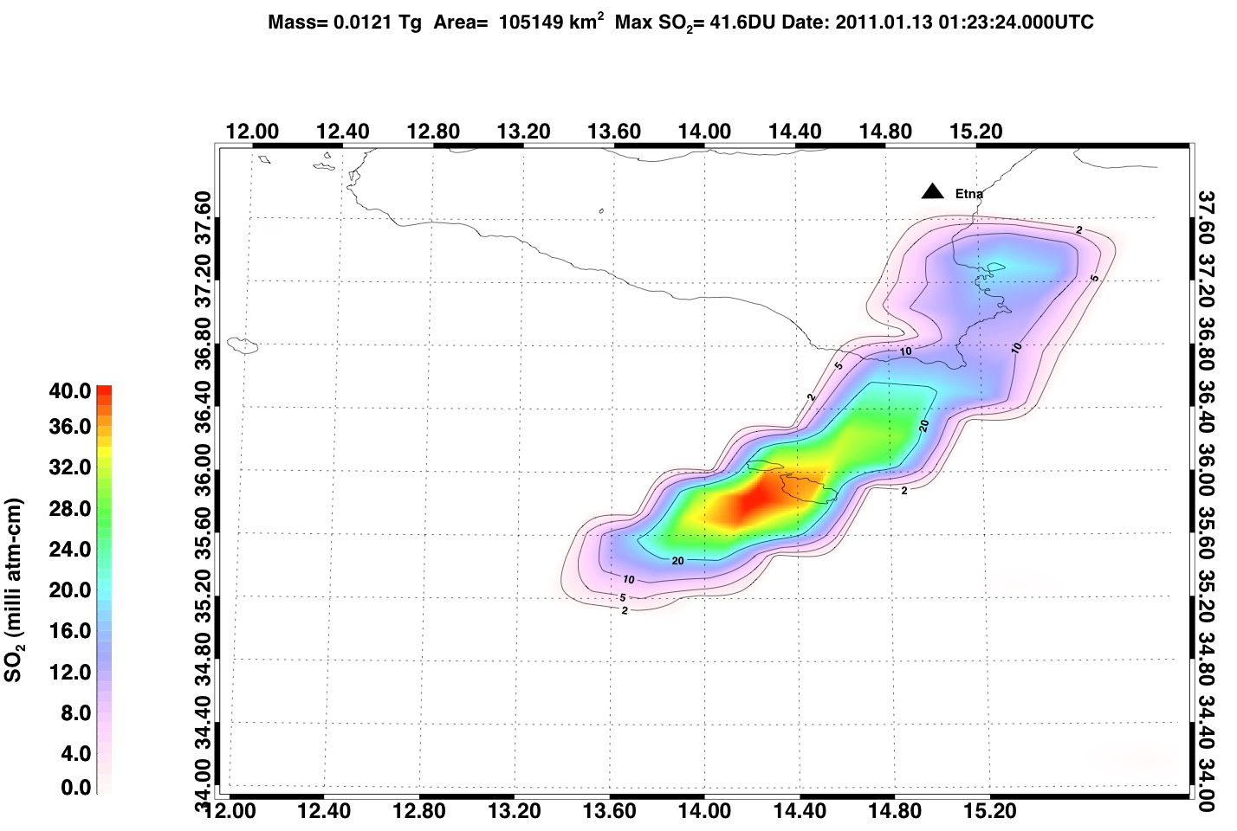
Etna Emission
13th January 2011

Slide 34
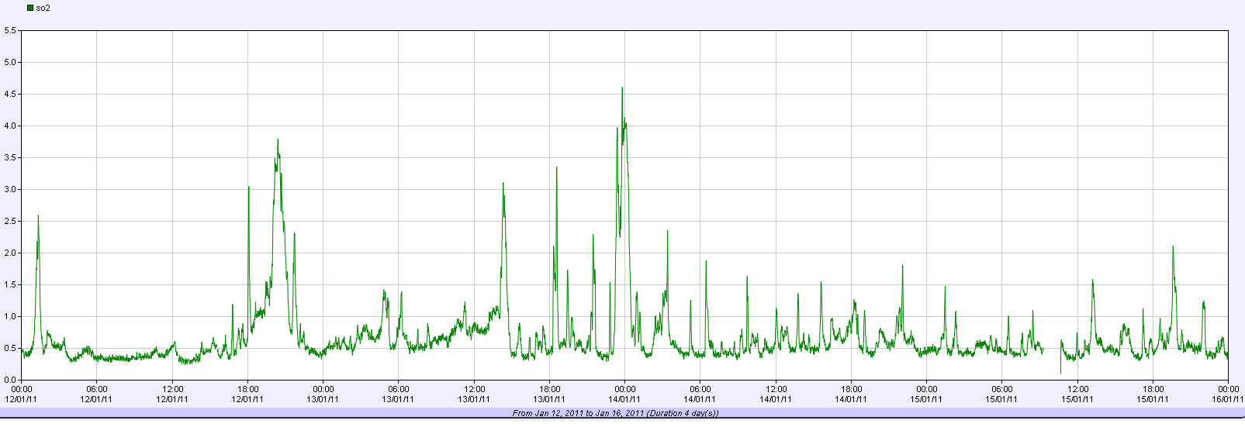
SO₂ as measured at Giordan Lighthouse
12 - 15th January 2011
13-01-2011 01.17
13-01-2011 23.24

Slide 35
Staff
Raymond Ellul – Principal Investigator
Martin Saliba – Technical Officer
Francelle Farrugia - Research Officer
Miriam Azzopardi – Technical administrator
One other position for Research Officer - Vacant

