Slide 1


UK Eutrophying and Acidifying Atmospheric Pollutants Monitoring networks
UKEAP
YS Tang¹, JN Cape¹, ID Leith¹, MM Twigg¹, M Coyle¹, J Kentisbeer¹, S Leeson¹, C DiMarco¹, E Nemitz¹, WJ Bealey¹, D Leaver¹, J Poskitt², S Beith², S Thacker², I Simmons¹, N van Dijk¹, U Dragosits¹, T Dore¹, K Letho², C Woods², D Sleep², MG Pereira², MA Sutton¹, C Conolly³, R Yardley³, A Collings³, M Davies³, D Knight², K Vincent³, J Lingard³, S Richie³, S Telling³, B Donovan³, CF Braban¹
¹ CEH Edinburgh, Bush Estate, Penicuik, Midlothian EH26 0QB
² CEH Lancaster, Lancaster Environment Centre, Bailrigg, Lancaster LA1 4AP
³ Ricardo-AEA, Harwell Business Centre, Didcot, Oxon OX11 0QJ
⁴School of Chemistry, University of Edinburgh, West Mains Road. Edinburgh EH9 3JJ
⁵Defra, ALE, Nobel House, 17 Smith Square, London SW1P 3JR

Slide 2
UK Eutrophying & Acidifying atmospheric Pollutants (UKEAP)
OBJECTIVES:
Monitoring of concentrations and deposition of eutrophying and acidifying species in air and precipitation in rural areas of the UK with sufficient spatial and temporal resolution to allow:
• Evaluation of policy measures to reduce concentration and deposition;
• Assessment of risks to ecosystems and exceedences of critical loads;
• Estimation of secondary components of PM_{x}.
Provide UK input to the European Monitoring and Evaluation Programme (http://www.emep.int/)
Notes:
Purpose & Objectives of UKEAP

Slide 3
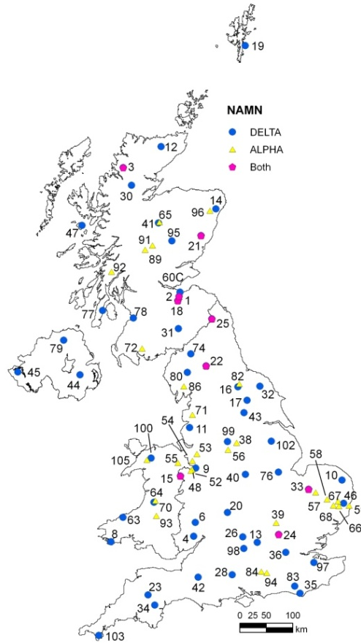
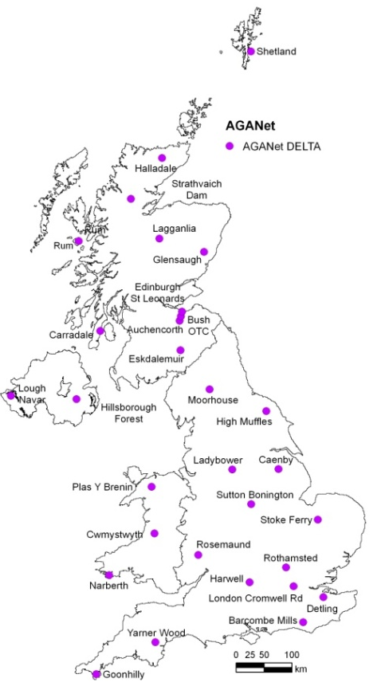
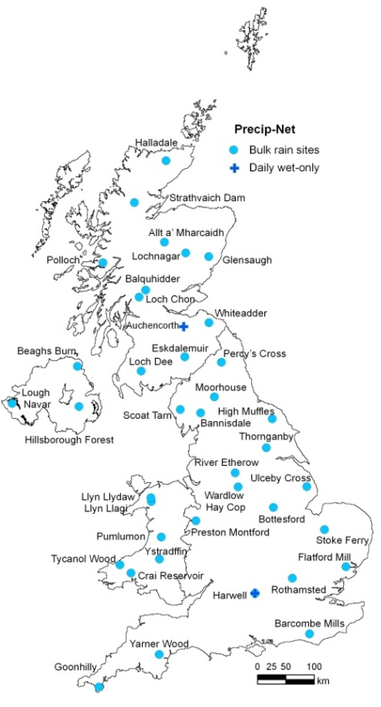
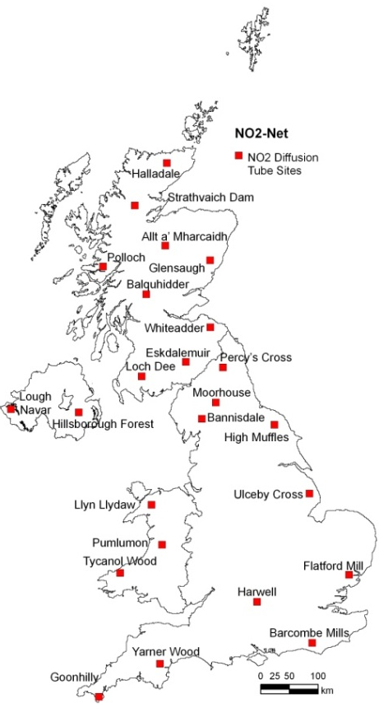
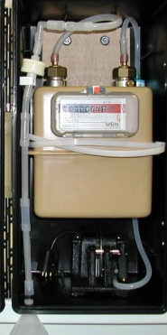
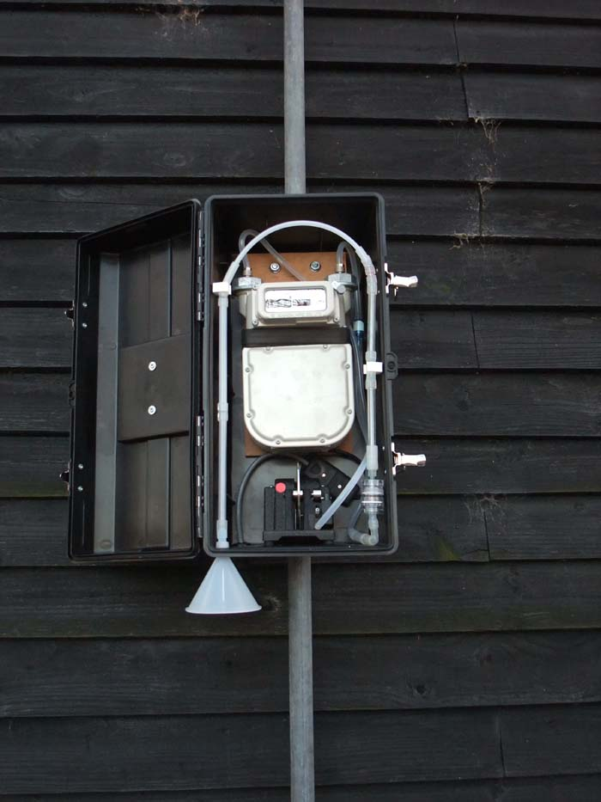
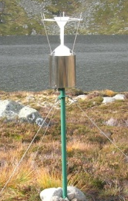
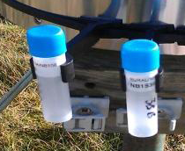
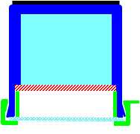
UKEAP: Component networks
NAMN
85 sites
AGANet
30 sites
Precip-Net
39 sites
NO₂-Net
24 sites
ALPHA
 | NAMN | AGANet | Precip-Net | NO₂-Net
Method | DELTA / ALPHA | DELTA | Bulk rain collector | Diffusion Tubes
Resolution | Monthly | Monthly | 2-weekly (daily at 2 sites) | 4-weekly
Species | NH₃ NH₄⁺ | HNO₃, SO₂, HCl, NO₃⁻, SO₄²⁻, Cl⁻, Na⁺, Ca²⁺, Mg²⁺ | pH, conductivity, NH₄⁺, NO₃⁻, PO₄³⁻, SO₄²⁻, Cl⁻, Na⁺, K⁺, Ca²⁺, Mg²⁺ | NO₂
Inception | 1996 | 1999 | 1985 | 1984
Notes:
Brief introduction to the 4 component networks

Slide 4
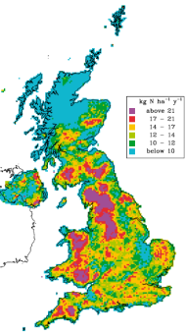
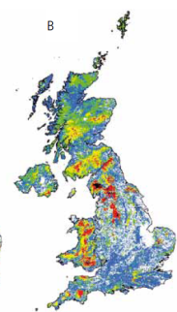
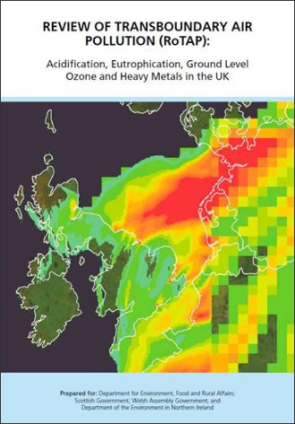


Measurement data uses
UKEAP monitoring
measurements
Modelling and mapping pollutant concentrations and deposition (CBED, FRAME, PCM)
Critical Loads and levels calculations and exceedence mapping
Submitted to databases
EMEP
OSPAR
UK-Air
UK Pollutant Deposition
National assessments of the
UK environment (e.g. RoTAP)
Air pollution information service
APIS
http://www.apis.ac.uk/
Public access to data
Local Environmental Impact Assessments
Screening tools
e.g. SCAIL
http://www..scail.ceh.ac.uk/

Slide 5
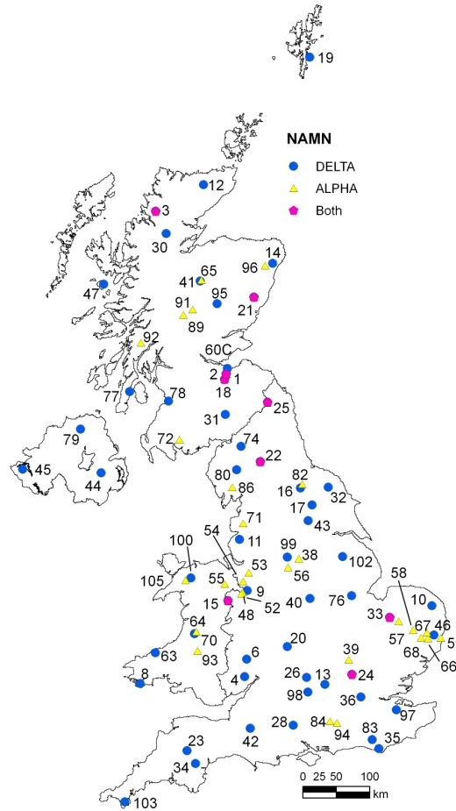
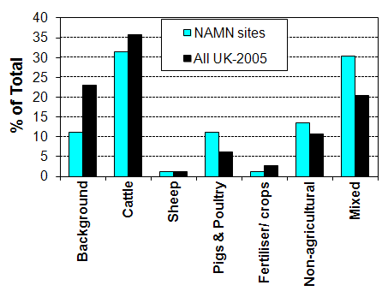
National ammonia monitoring network NAMN
Sites selected such that:
No proximity to large scale sources
Higher density of sites in regions where ammonia is of interest, e.g. East Anglia
29 sites are on NNR/LNRs or research sites
11 on ECN sites
11 on AURN sites
2 urban sites

Slide 6
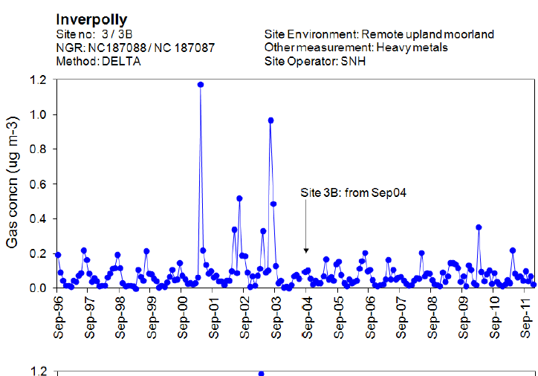
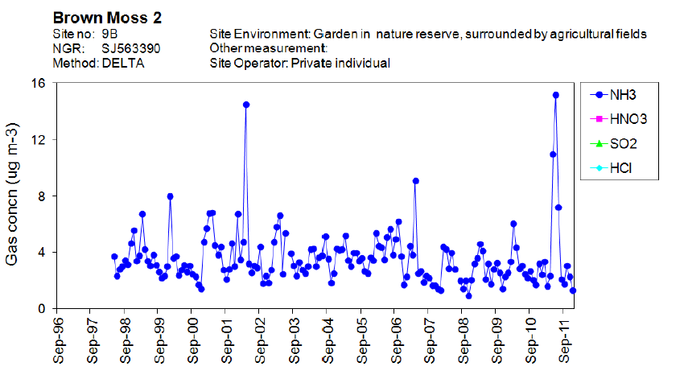
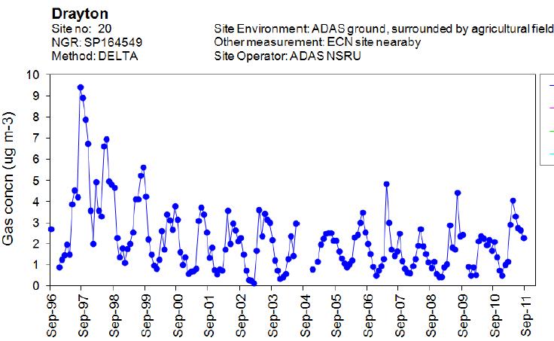
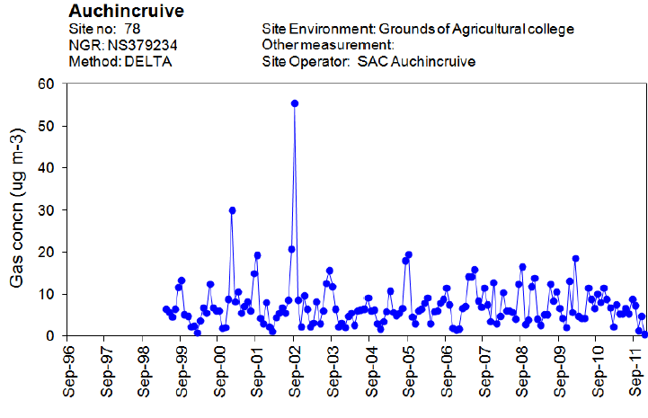
Example sites

Slide 7
Annual cycles in NH₃
NH₃ temporal variability
NH₄⁺ temporal variability

Slide 8
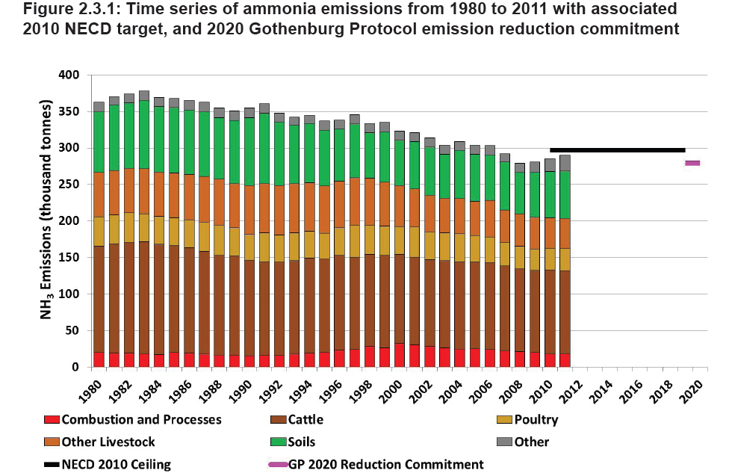

Slide 9
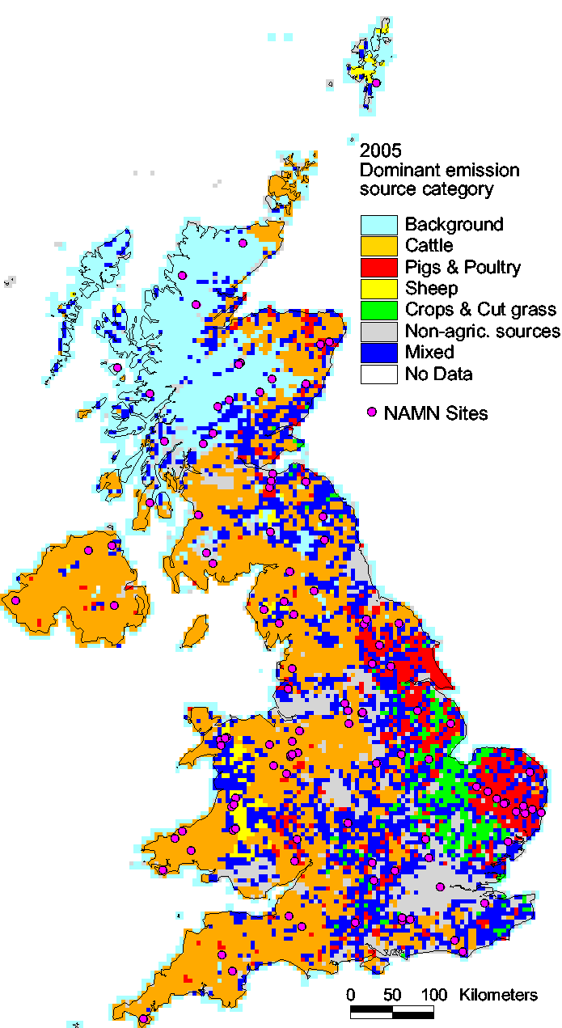
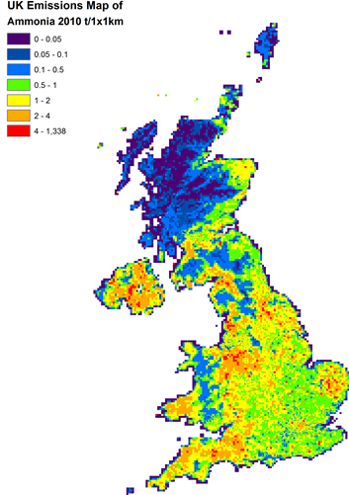
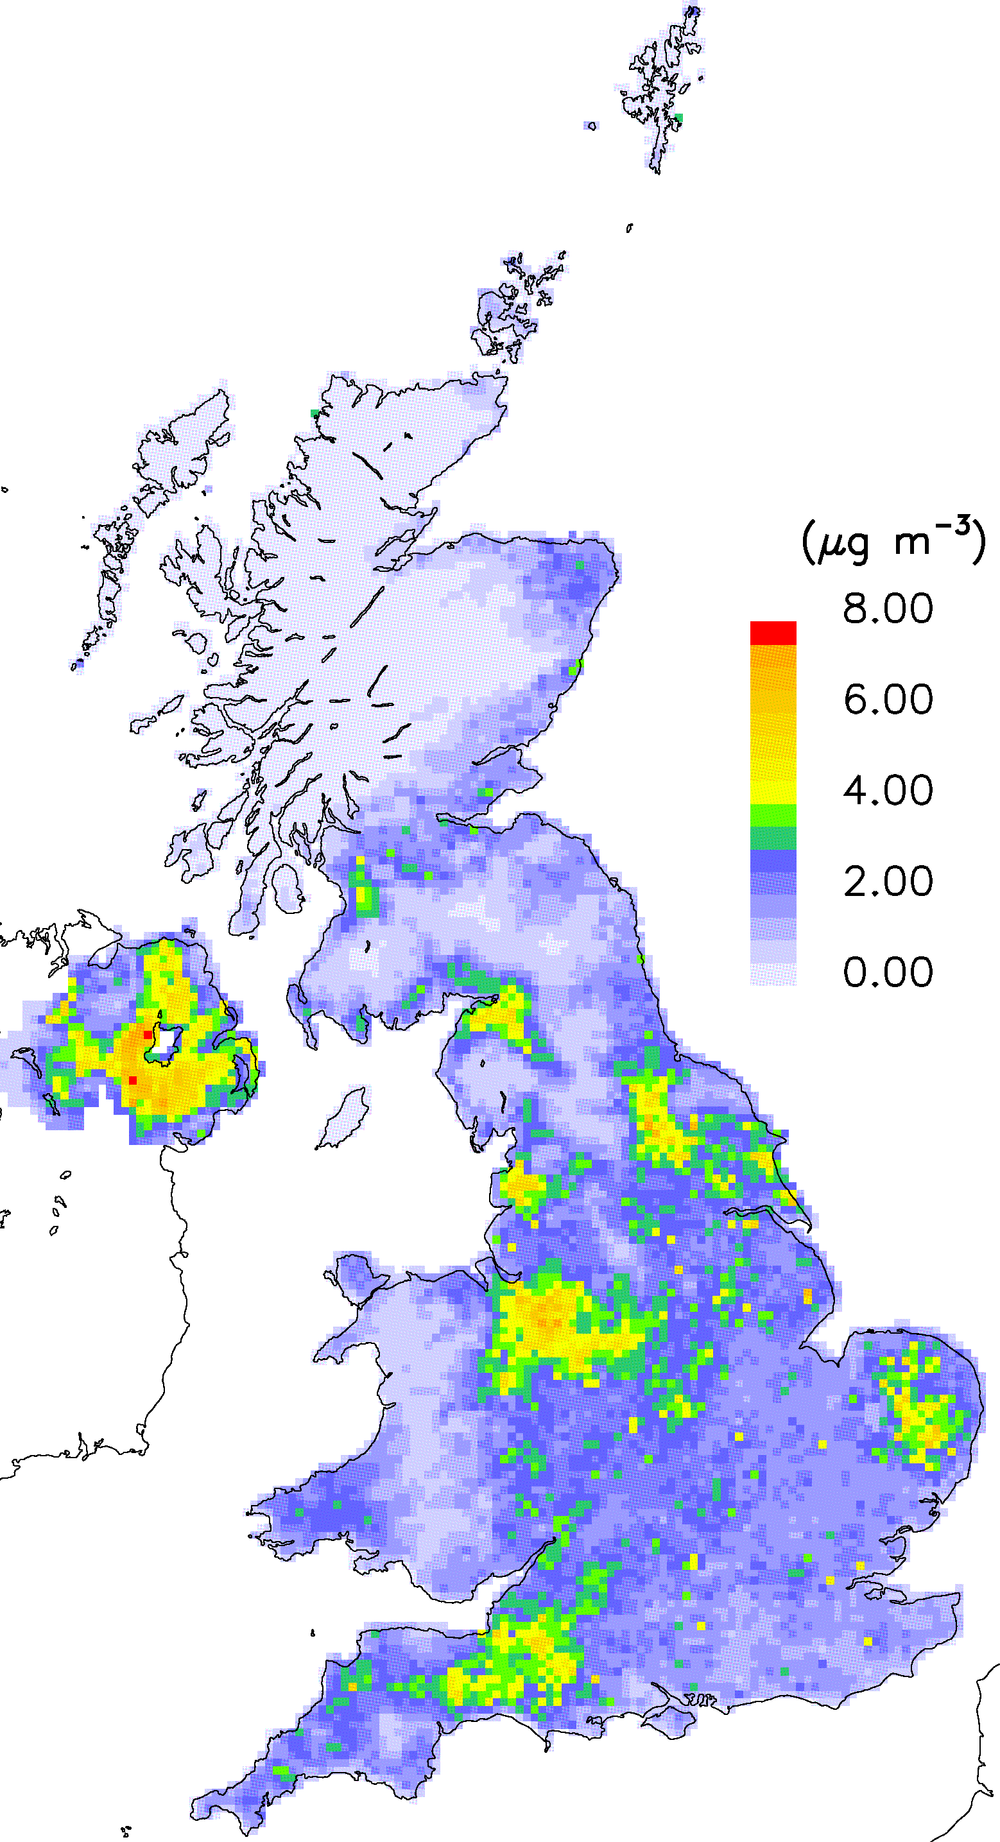
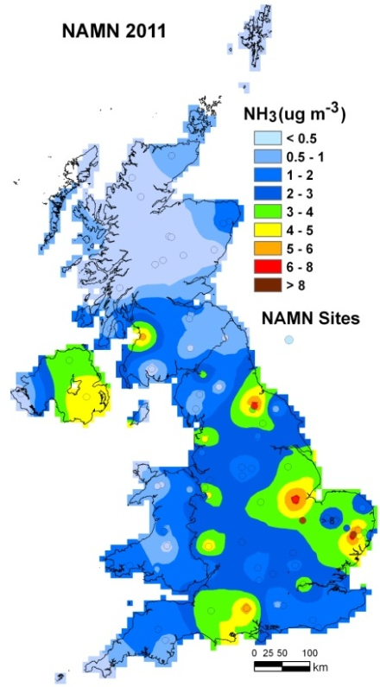
NAMN: UK Mapping
NH₃ Emission Source Category Map
NH₃ Emissions Map
NAMN 2011
FRAME
Notes:
Using the UK AENEID model, each site in the network is classified according to one of seven different dominant emission source categories.
A key benefit of the large number of sites in the NH₃ network is that group analysis can be conducted according to the major source sectors (AENEID model).
Compare average seasonal cycles in NH₃ and NH₄⁺ concentration of grouped sites from four different emission source categories.

Slide 10
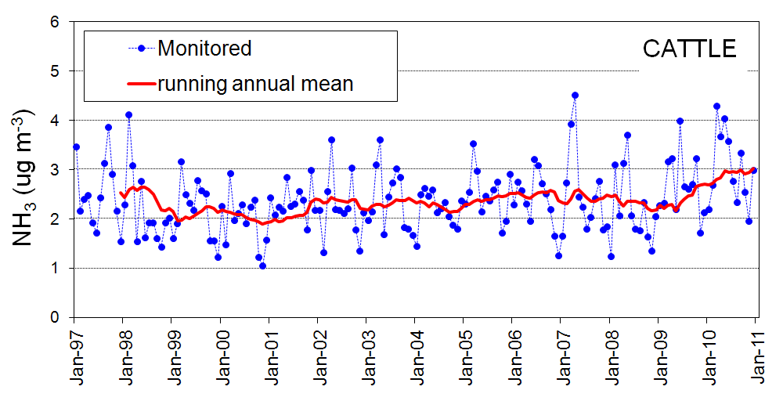
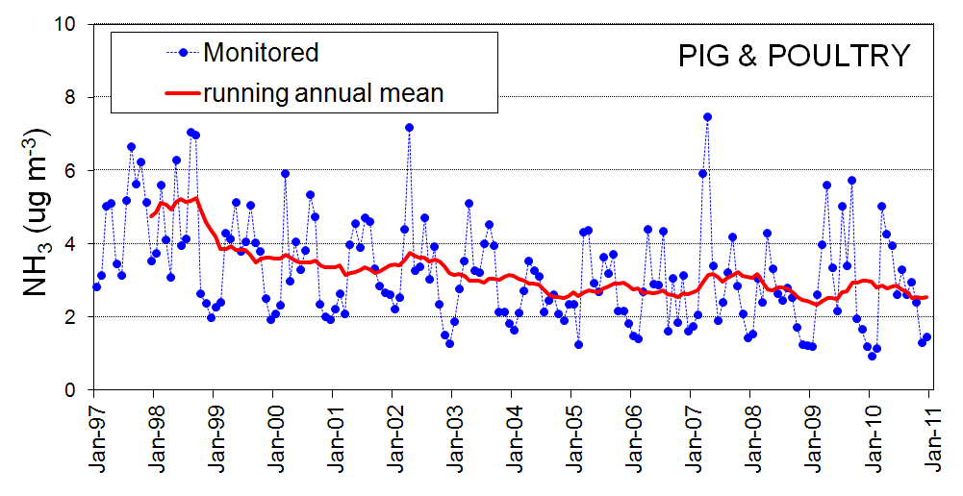
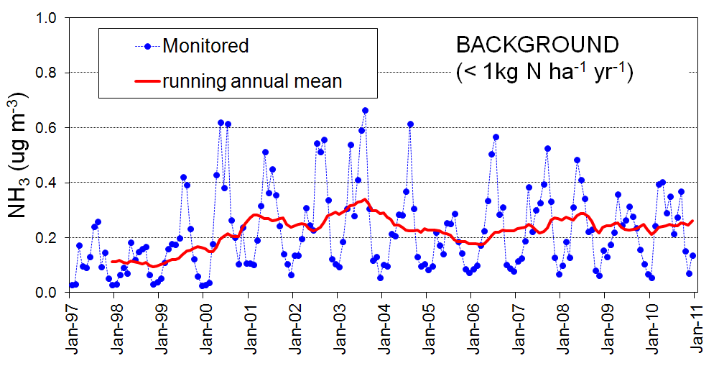
NAMN: Time series
% Change 2010/1998 | CATTLE | PIG & POULTRY | BACKGROUND
NAEI | -9.3 % | -42.5 % | -
NAMN | +38.5 % | -38.5 % | + 152 %
Notes:
Group analysis data show informative trend differences in NH₃ concentrations.

Slide 11

Acid gases and Aerosol Network (AGA-Net)
Sites selected such that:
Co-located with NAMN sites
Sufficient coverage across UK to allow kriging of data
2 urban sites
DH2
DA1
DA2
DH1
Basic filter
NO3, NO2, SO4,
Cl, Na, Ca, Mg
2. Acid filter
NH4

Slide 12
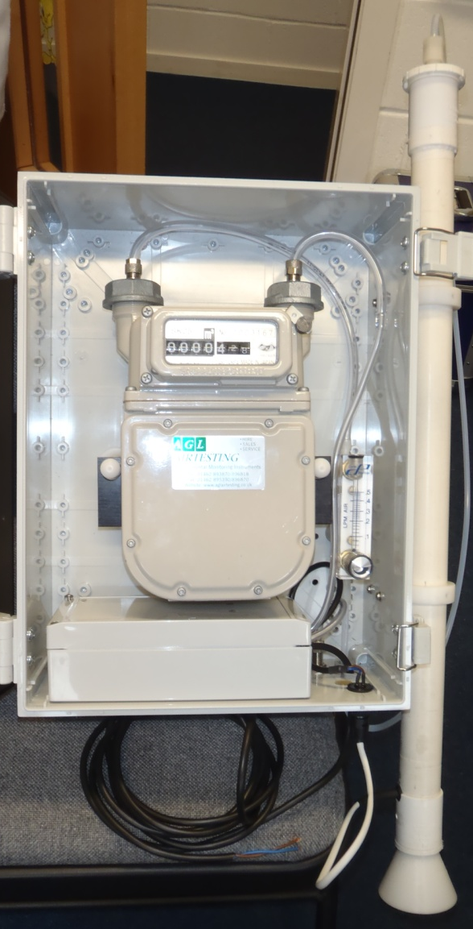
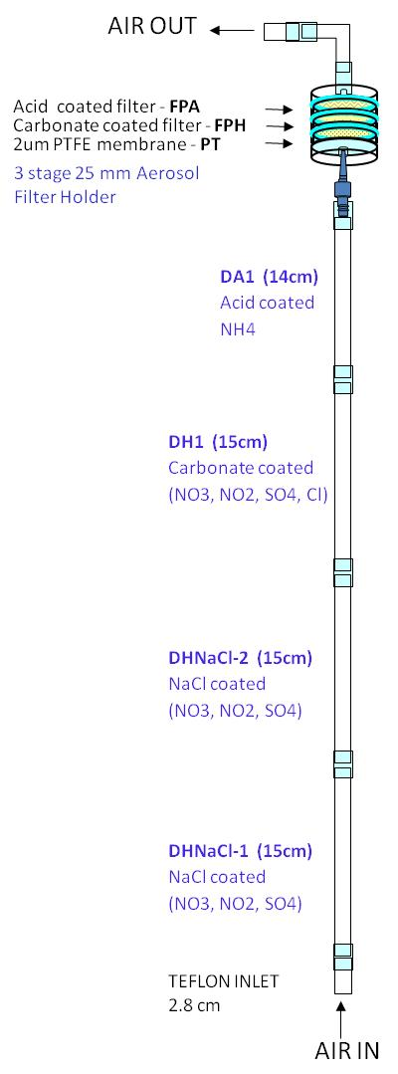
DELTA System
New DELTA system
Current Design
DH2
DA1
DA2
DH1
Basic filter
NO3, NO2, SO4,
Cl, Na, Ca, Mg
2. Acid filter
NH4

Slide 13
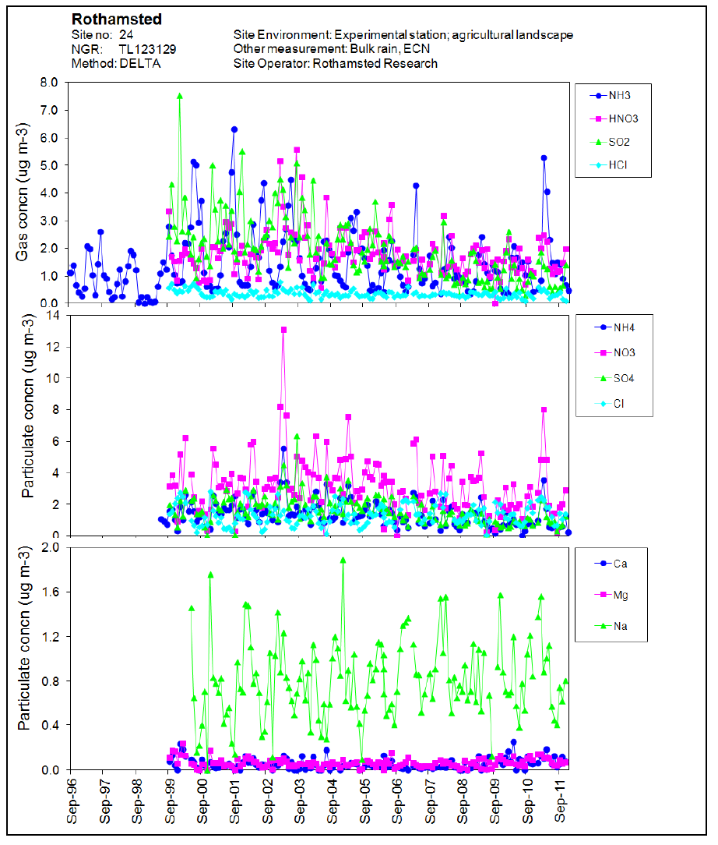

Slide 14
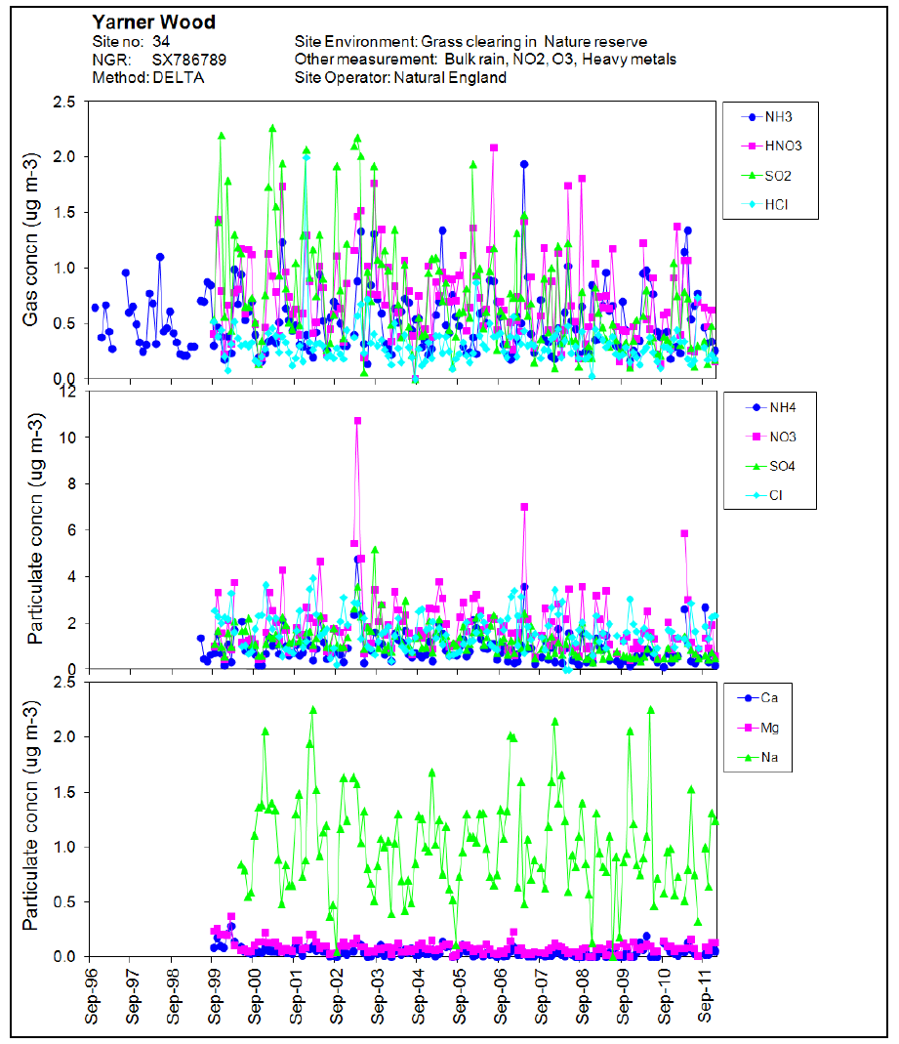

Slide 15
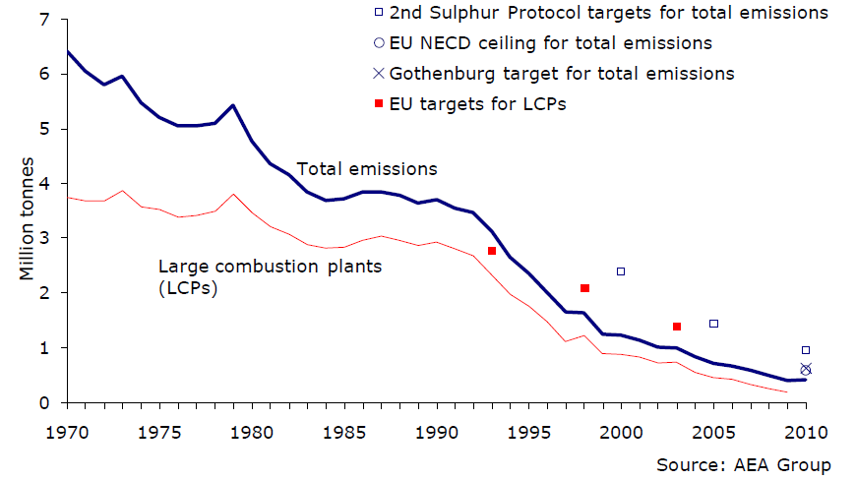
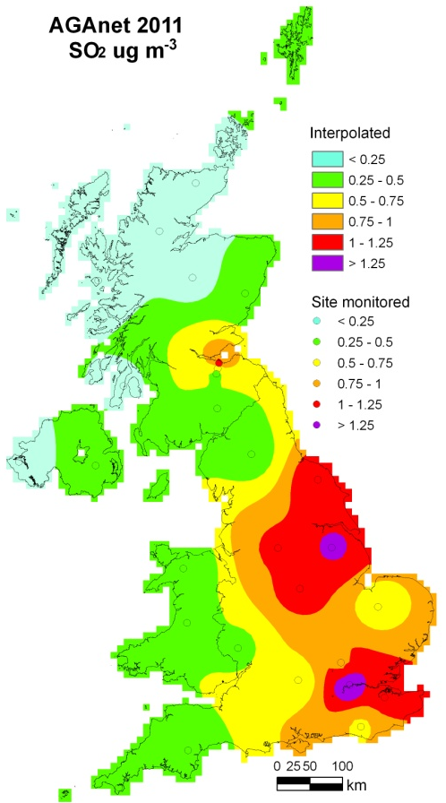
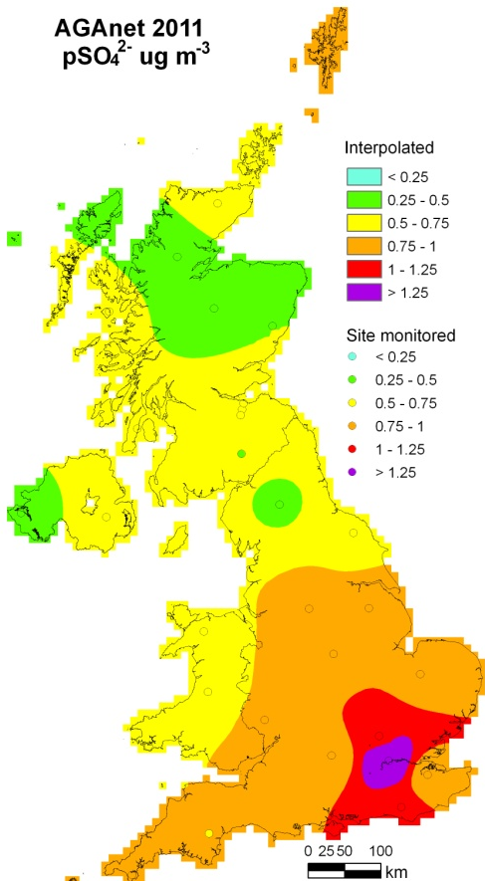
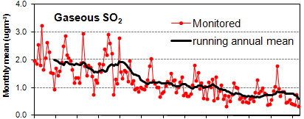
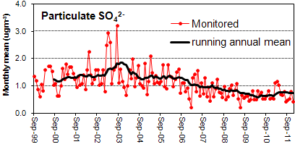
AGANet: UK Sulphur changes
UK SO₂ emissions and targets:
1970 – 2010
Source: Defra National Statistics Release: Emissions of air pollutants in the UK, 1970 to 2010

Slide 16

Precip-Net
Sites selection (before my time!)
- driven by acid rain issues of the 1980s
UK coverage for mapping purposes

Slide 17

NO₂-Net
Site Name | 2011 Concentrations | Data capture
Allt a'Mharcaidh | 1.55 | 100%
Balquhidder 2 | 2.63 | 97%
Bannisdale | 4.73 | 100%
Barcombe Mills | 10.7 | 100%
Driby 2 | 11.6 | 100%
Eskdalemuir^{T} | 3.49 | 100%
Flatford Mill | 12.4 | 99%
Forsinain 2/Halladale | 2.07 | 92%
Glensaugh | 3.42 | 100%
Goonhilly | 4.56 | 99%
Harwell^{T} | 12.2 | 100%
High Muffles | 7.73 | 100%
Hillsborough Forest | 7.39 | 100%
Llyn Llydaw | 3.07 | 100%
Loch Dee | 3.75 | 75%
Lough Navar | 2.07 | 100%
Moorhouse | 4.8 | 100%
Percy's Cross | 5.23 | 92%
Polloch | 1.42 | 100%
Pumlumon | 4.2 | 100%
Strathvaich Dam | 1.19 | 100%
Tycanol Wood | 3.52 | 96%
Whiteadder | 3.62 | 100%
Yarner Wood^{T} | 4.93 | 100%

Slide 18
Measurement data uses
UKEAP monitoring
measurements
Modelling and mapping pollutant concentrations and deposition
Critical Loads and exceedence mapping
Submitted to databases
EMEP
OSPAR
UK-Air
UK Pollutant Deposition
National Assessments of the
UK environment (e.g. RoTAP)
Air pollution information service
APIS
http://www.apis.ac.uk/
Public access to data
Local Environmental Impact Assessments
Screening tools
e.g. SCAIL
http://pollutantdeposition.defra.gov.uk/
http://uk-air.defra.gov.uk
http://www.ceh.ac.uk/sci_programmes/UKEAP-Project.html
http://cldm.defra.gov.uk/index.htm
http://uk-air.defra.gov.uk/research/air-quality-modelling
http://www..scail.ceh.ac.uk/

Slide 19
Summary
UKEAP measurements underpin the capability to understand changes in rural air quality across the UK;
It should be possible for significant future UK mitigation, emissions reductions and ecosystem exposure to be observed;
S deposition is a driver of the acidifying input for sensitive catchments and to critical load exceedance and has been most important historically;
Inputs of NH_{x} are the dominant driver of ecological effects of deposited N, and the importance of NH_{x} is predicted to increase relative to oxidised N, as NO_{x} emissions decrease further

