Slide 1
Introduction of a simple (!) index to assess intensity and changes in monitoring activities (not compliance with monitoring strategy)
Kjetil Tørseth, Anne Hjellbrekke and Wenche Aas
EMEP-CCC

Slide 2
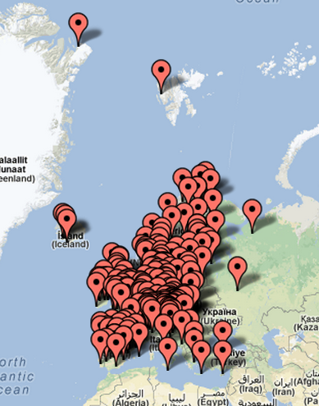
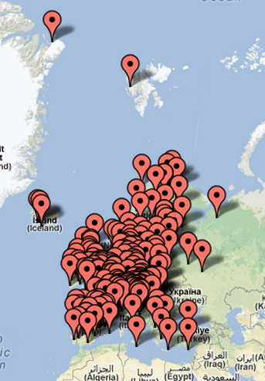
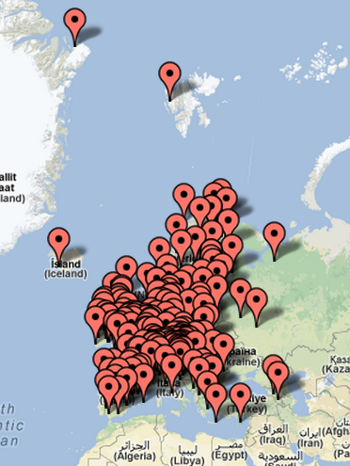
2000
2005
2010

Slide 3
Based on data submissions
Number of sites with data reported
Number of variables reported
Number of variables having adequate time resolution
Major inorganics in precipitation (10 variables)
Major inorganics in air (13 variables)
Ozone (1 variable)
PM mass (2 variables)
Heavy metals in precipitation (7 variables)
Compare «actual» number of variables reported with «expected»

Slide 4
Recommended site density Level 1: 1/50000 km2
Land area -> give «target number» of sites
Adjustment for countries with very large area and few sites (-> 1/500000 km2)(KZ, RU, TR, UA)
Not account of marine areas

Slide 5
Example Norway 2005:
Country code | Country | Land area (km2) | 50000 | #sites_required
NO | Norway | 385000 | 7,7 | 8
 | main precip #siteswithdata | main precip #components reported | main precip #components sufficient_time_res
 | 6 | 60 | 50
Expected: 8 sites * # variables expected = 80 datasets of precipitation chemistry
Reported: 60, however only 50 meet requirements wrt time resolution
These 10 datasets are given 50% weight: 50 + 10/2 = 55%
«implementation» = 55/80 = 69%

Slide 6
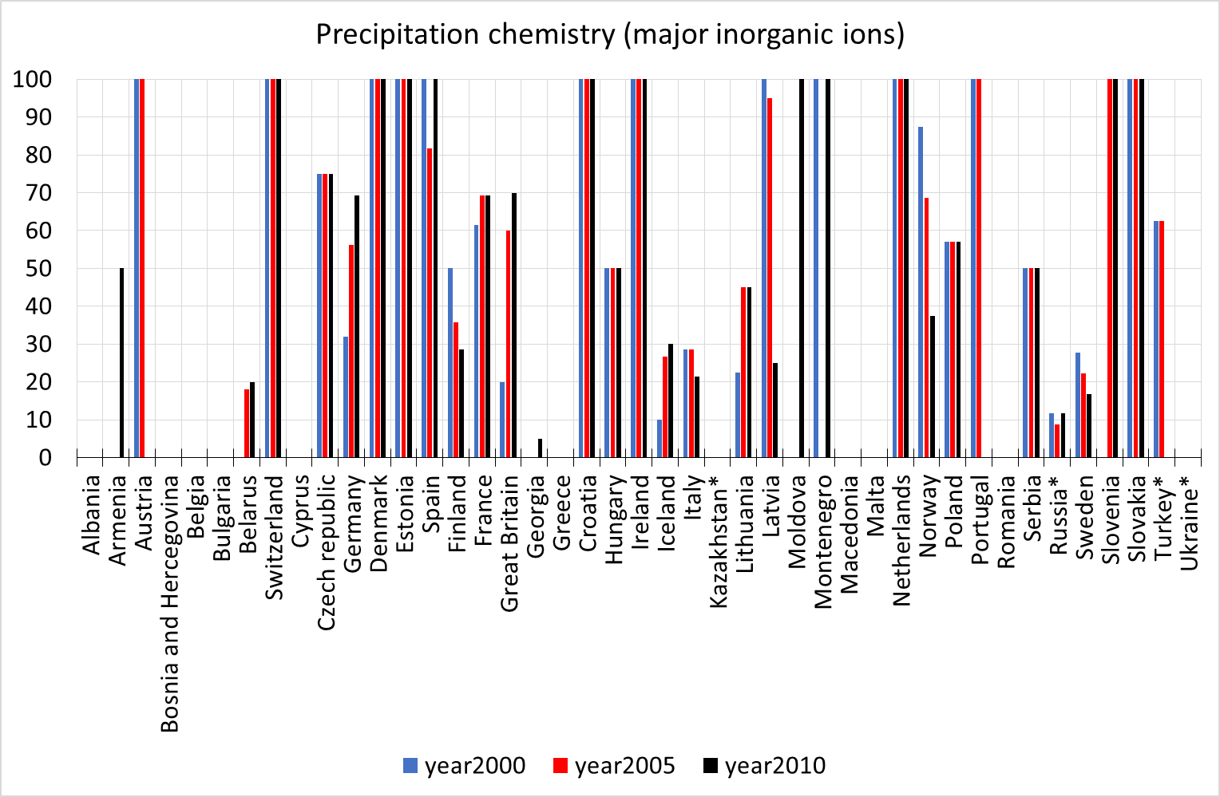
69
Comment: IF implementation > 100%: plot max 120%

Slide 7
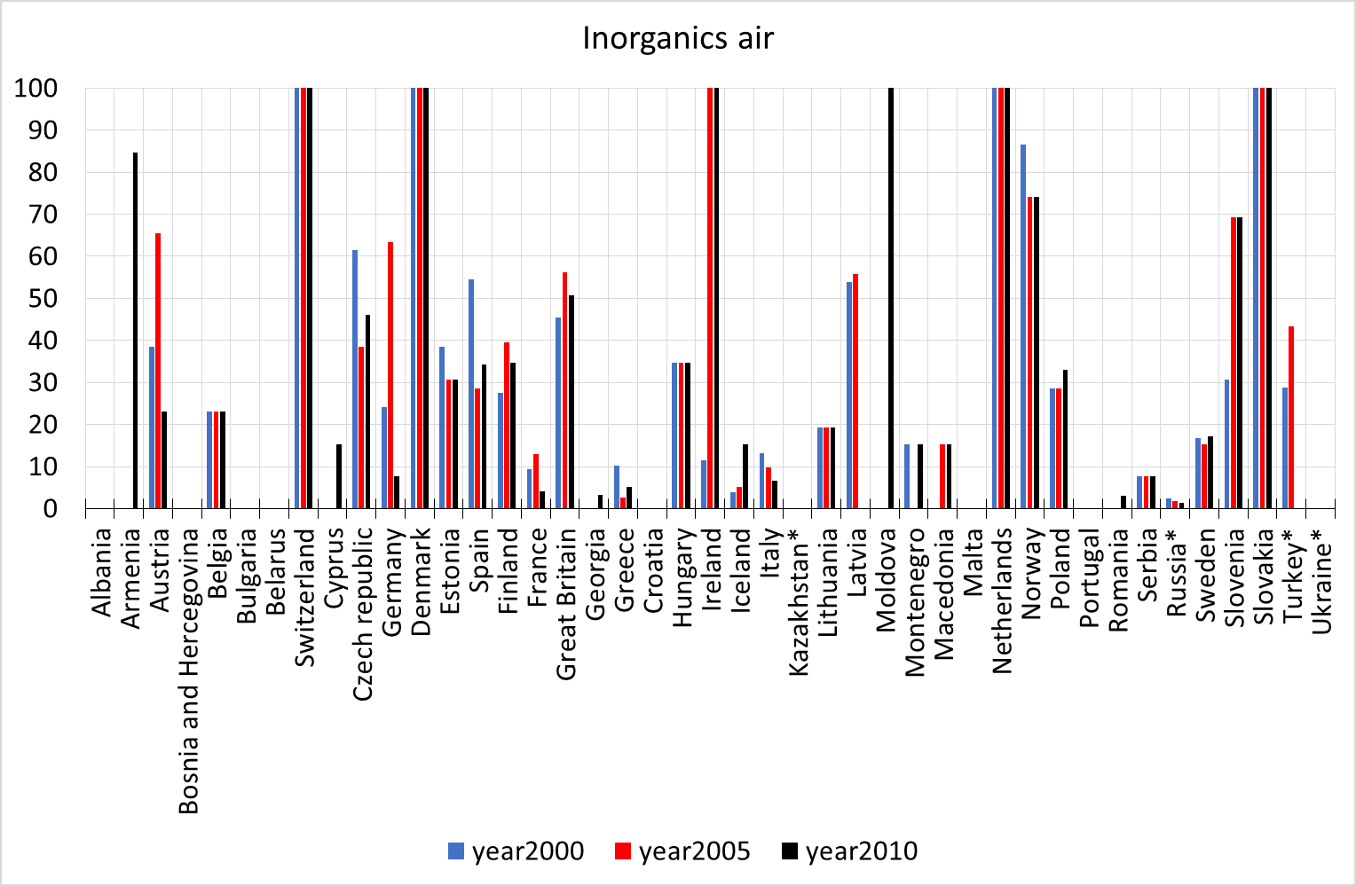

Slide 8
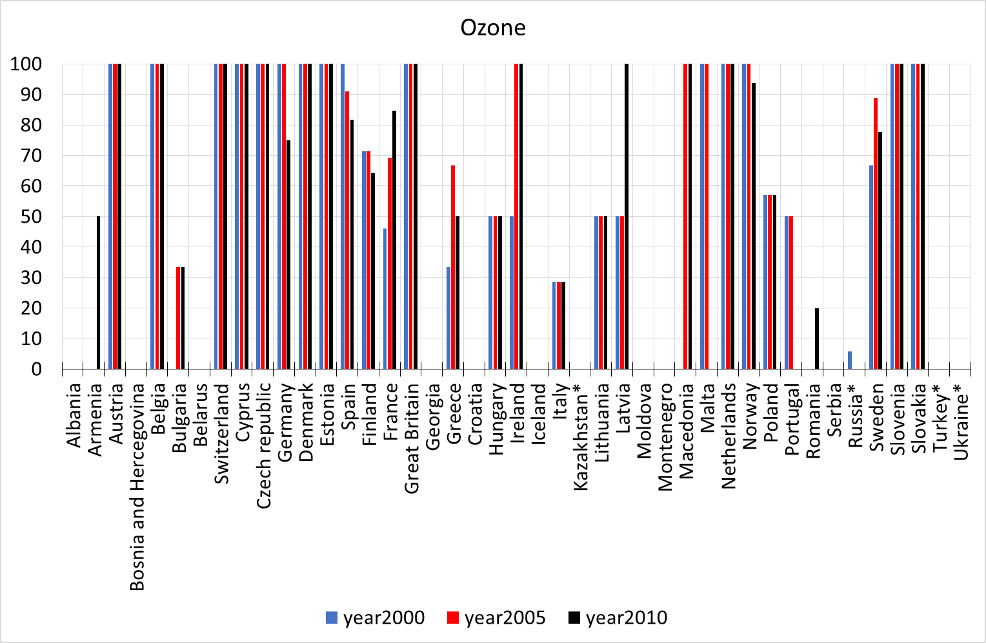

Slide 9
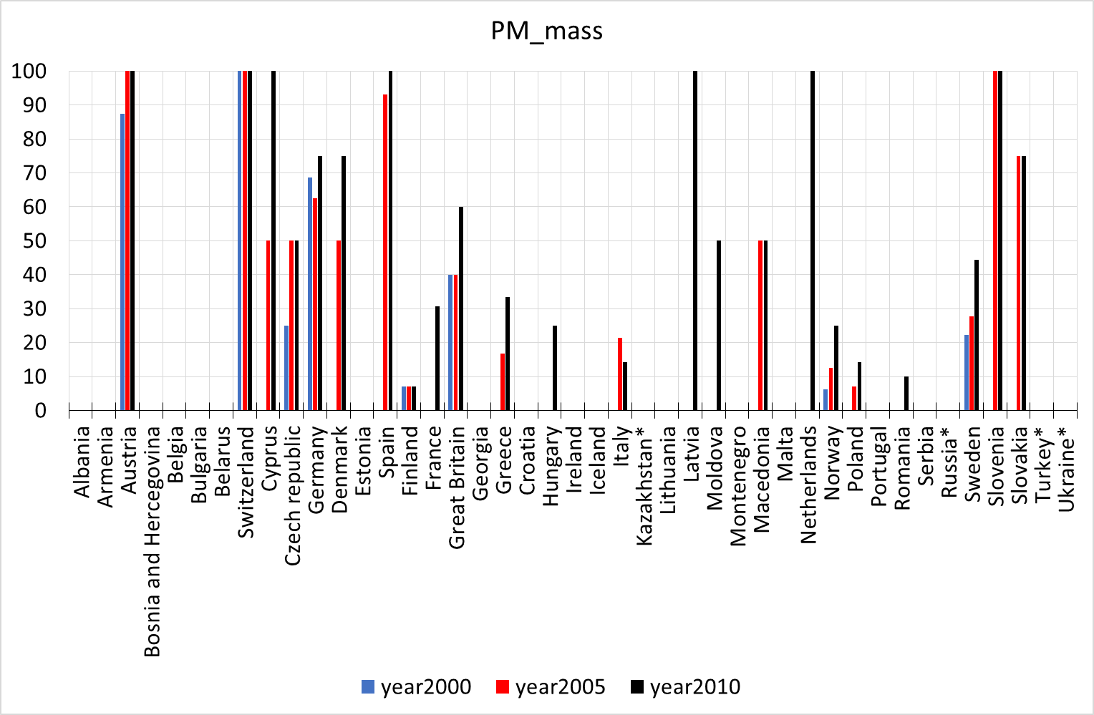

Slide 10
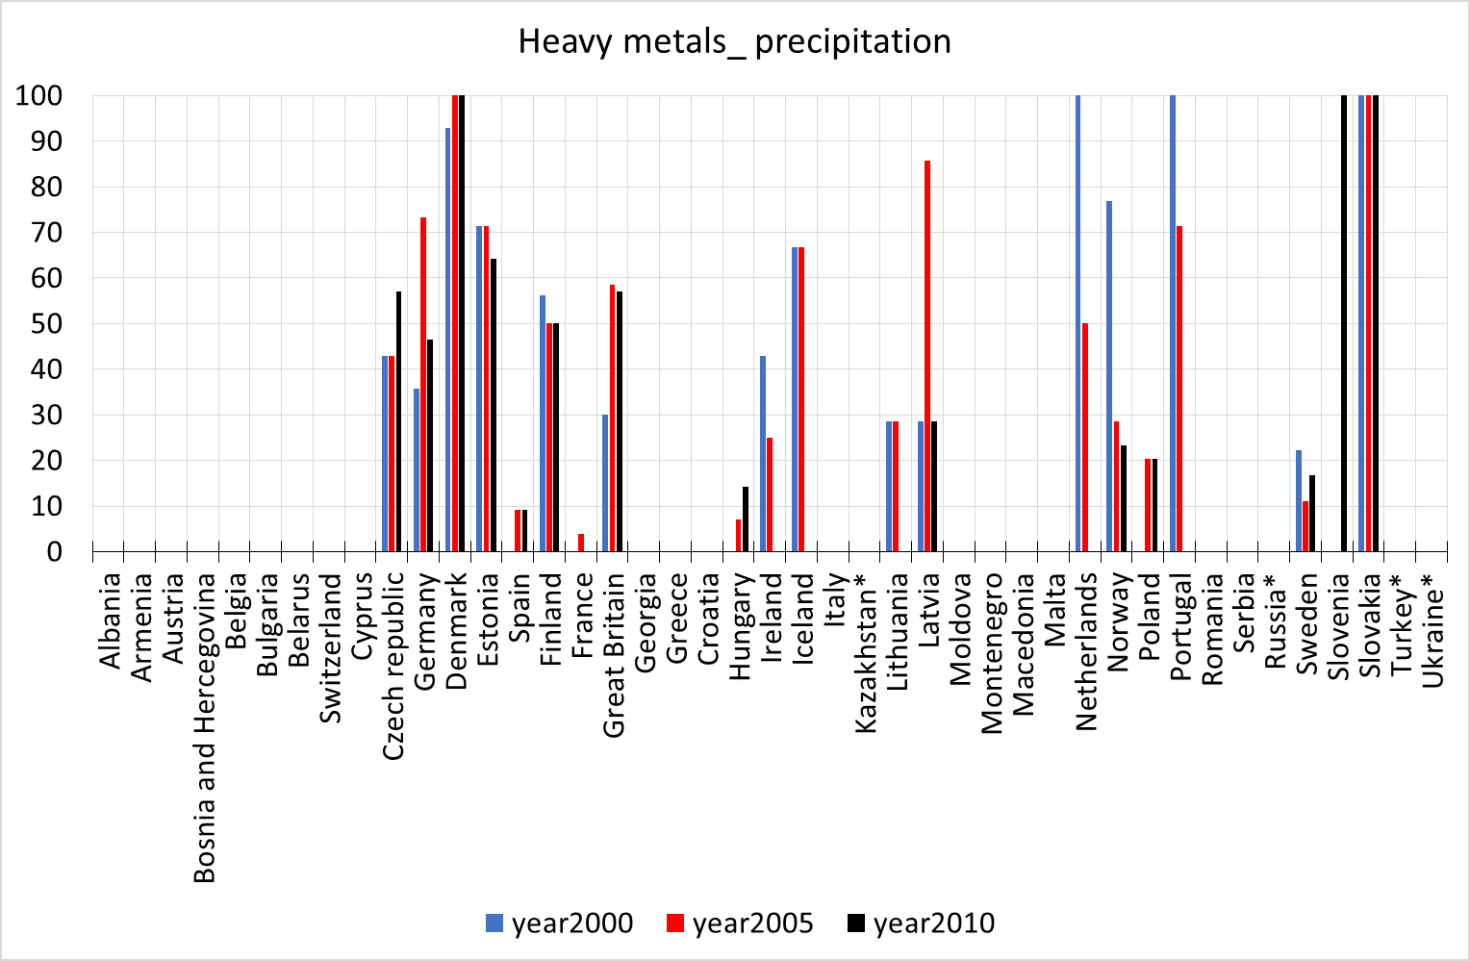

Slide 11
Simplifying (?) going from % implementation to an index
Based on relative implementation, assuming the following weights:
Inorganics in precipitation: 30%
Inorganics in air: 30%
Ozone: 20%
PM mass: 10%
Heavy metals: 10%
«implementation» limited to 100%
Example Norway 2005:
(0,3 * 63%) + (0,3 * 74%) + (0,2 * 100%) + (0,1 * 13%) + (0,1 * 29%) = 65

Slide 12
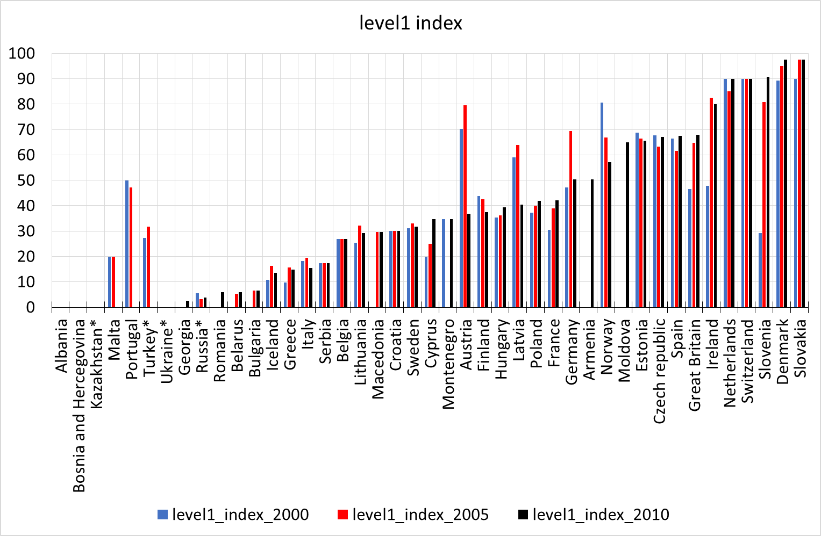

Slide 13
What about level2:
More difficult to assess due to larger heterogenity
In particular «time resolution» (campaigns etc)
Many variables/compounds
Example of a first attempt shown on next slide, but more work is needed

Slide 14
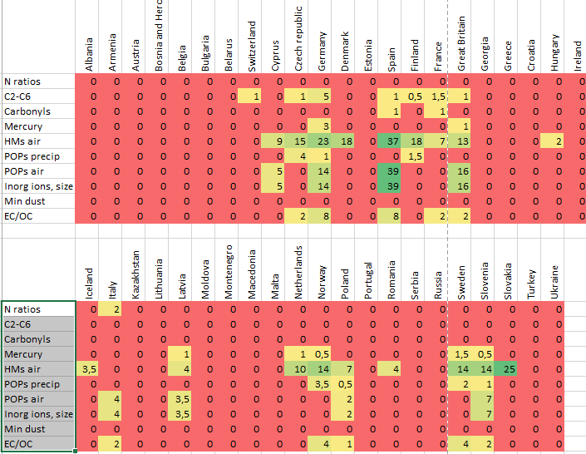
Level2

Slide 15
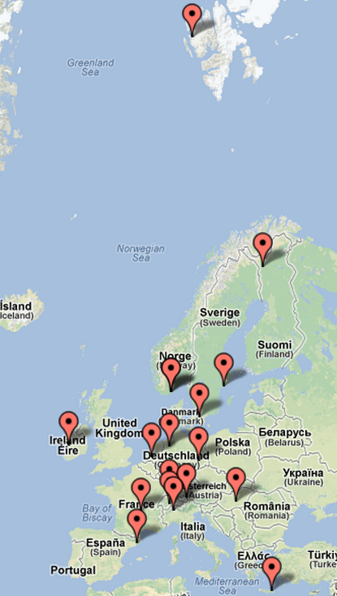
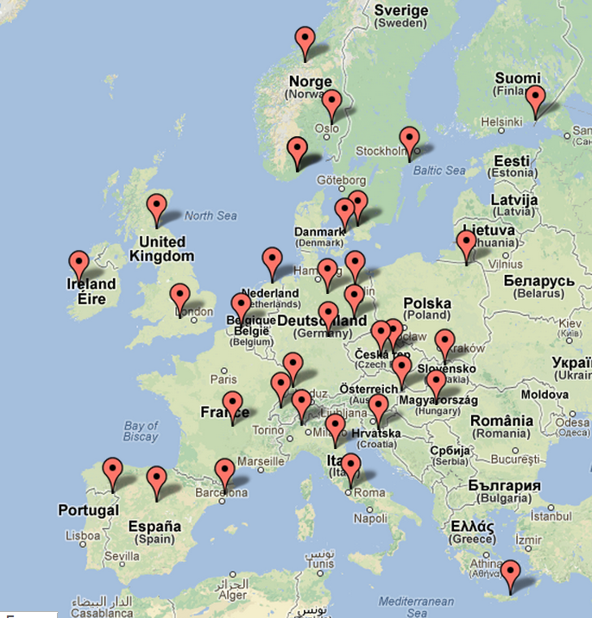
Point maps may be the best way to show data available. Here: BC and EC measurements in 2010

Slide 16
Conclusions:
Implementation of Level1 still an issue
Need for increased awareness at SB level
Plots of implementation index to be presented in data reports and at SB sessions
Level2 activities need strengthening
campaigns vs continuous
Post ACTRIS, need for relevant international research calls, etc.

