Slide 1







French contribution to the EMEP 2012-2013 summer and winter campaigns: overview and preliminary results
S. SAUVAGE, V. RIFFAULT, A. SETYAN, V. CRENN (Mines Douai)
J.L. JAFFREZ (LGGE), J. SCIARE (LSCE), K. SELLEGRI (LaMP-OPGC), O. FAVEZ (INERIS), S. CONIL (OPE), J. DESCLOITRES (ICARE) … and all co-workers
CONVENTION ON LONG-RANGE TRANSBOUNDARY AIR POLLUTION
14th Task Force on Measurement and Modelling Meeting / EMEP
Zagreb (Croatia), 6-8 May 2013

Slide 2
Outline
Field sites
Instrumentation
Results (preliminary)
  Quick look on PM₁₀ chemical speciation for both seasons at 3 sites
  Site of Revin: focus on carbonaceous gas-phase and particulate species in summer
Conclusions / Future work

Slide 3
Field sites
Cap Corse: remote, coastal
Puy-de-Dôme (PdD): remote,
mid-altitude
OPE: remote
SIRTA: urban background
Revin: remote
ChArMEx
ACTRIS
ACTRIS
ACTRIS
MERA/EMEP
© GoogleMaps
Large variety of geographical locations and influences expected to affect PM measurements

Slide 4


Instrumentation
 | Sampling period | Cap Corse | OPE | Puy-de-Dôme | Revin | SIRTA
PM₁₀ mass | < 1hr | S, W | S, W | S, W | S, W
PM₁₀ speciation | ≥ daily | S, W | S, W | S, W | S, W | S, W
PM_{2.5} mass | < 1hr |  | S, W |  | S, W
PM_{2.5} speciation | ≥ daily | S, W | S, W |  |  | S, W
PM₁ mass |  | S, W |  |  |  | S, W
PM₁ speciation (AMS, ACSM) | < 1hr | S, W |  | W | S | S, W
Black Carbon | < 1 hr | S, W | W | S, W | S, W | S, W
Precursor (O)VOCs | ≤ 6 hrs | S, W |  | S, W | S, W
NMHCs / (O)VOCs | < 1 hr | S |  |  | W | S, W
NO_{x}, CO and O₃ | < 1 hr | S, W | S, W | S, W | S, W | S, W
CO₂ | < 1 hr |  |  | S, W | S, W | S, W
SO₂ | < 1 hr |  |  | S, W | S
NH₃ | < 1 hr |  |  |  | S | S, W
Diff./scat. coef. | < 1 hr | S, W | W | S, W |  | S, W
Extinction, AOD | < 1 hr | S, W | W | S, W
Size distribution | < 1 hr | S, W | S, W | S, W |  | S, W

Slide 5
Preliminary results
Quick look on ions in PM₁₀ for 3 sites:
PdD, OPE and Revin
© GoogleMaps

Slide 6


Quick look on PM₁₀ chemical speciation
6
Revin
OPE
PdD
0.8
Revin
OPE
PdD
4
0.6
0.4
2
0.2
0
0
6
Revin
OPE
PdD
0.4
Revin
OPE
PdD
4
0.2
2
0
0

Slide 7
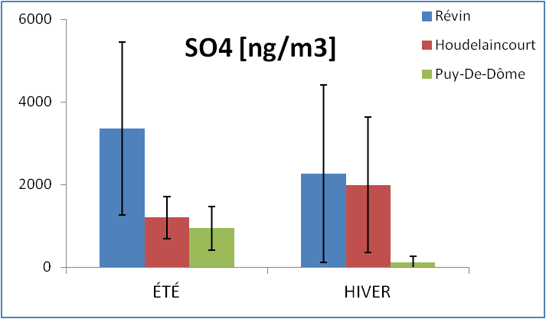
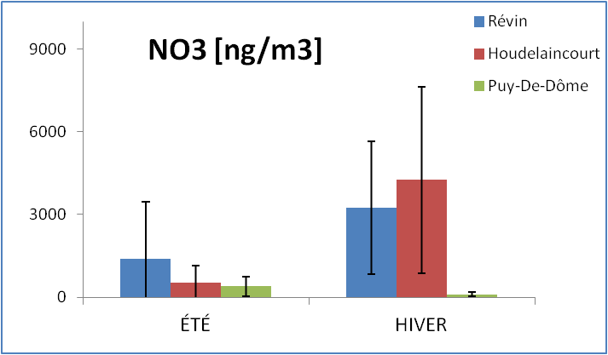
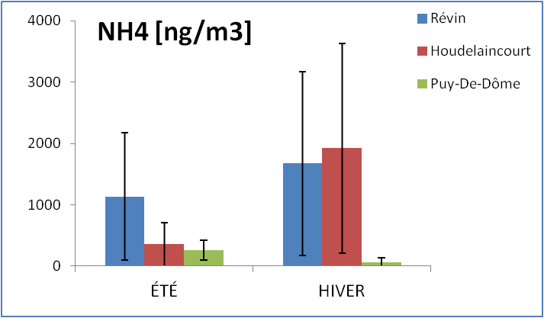
Quick look on PM₁₀ chemical speciation
6000
Revin
OPE
PdD
Revin
OPE
PdD
9000
4000
6000
2000
3000
0
0
4000
Revin
OPE
PdD
3000
2000
1000
0

Slide 8
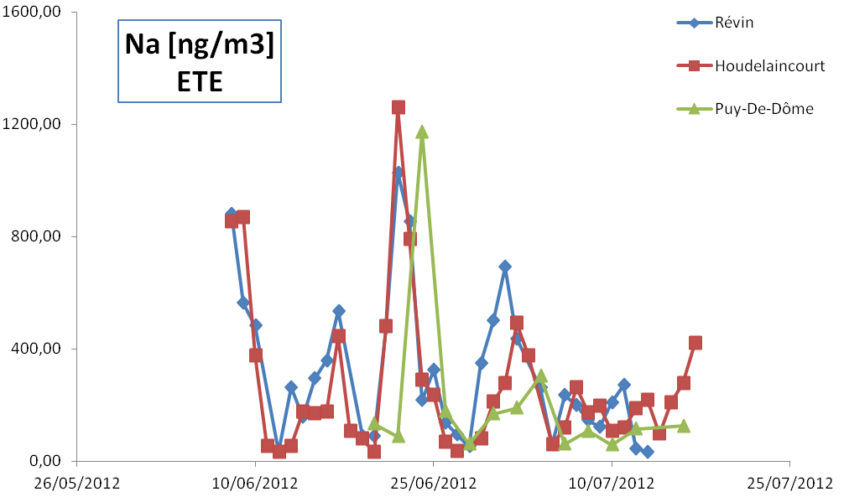
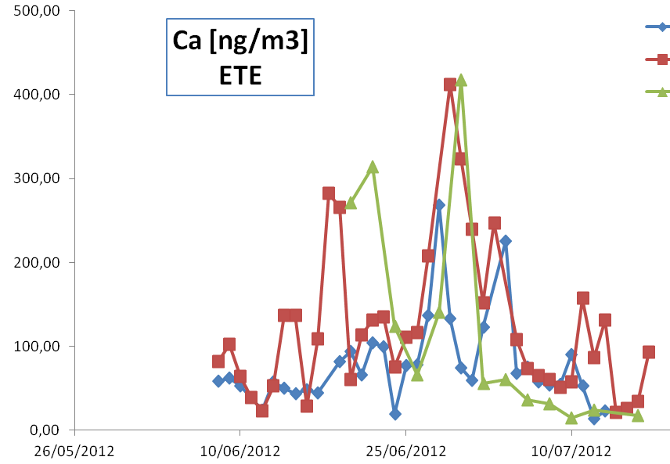
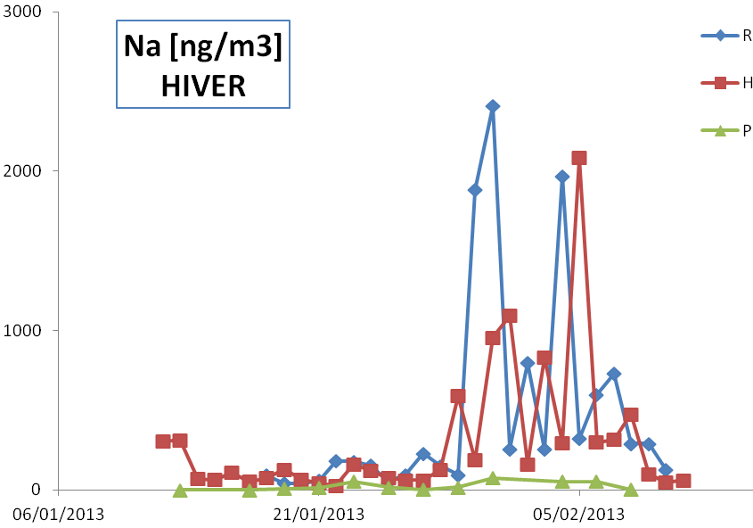
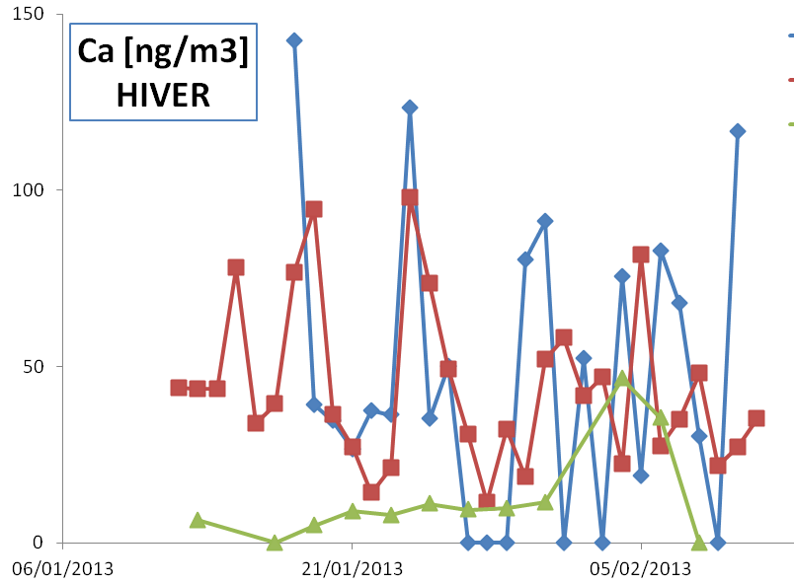
Quick look on PM₁₀ chemical speciation
500
Likely dust event
1600
Revin
OPE
PdD
400
1200
300
800
200
400
100
0
0
3000
Revin
OPE
PdD
150
2000
100
1000
50
0
0

Slide 9
Preliminary results
Site of Revin:
Focus on carbonaceous gas-phase and particulate species
© GoogleMaps

Slide 10
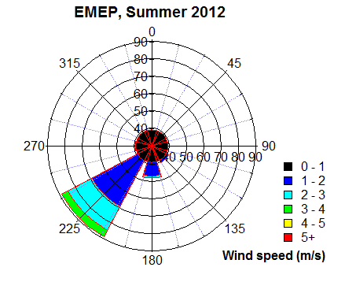
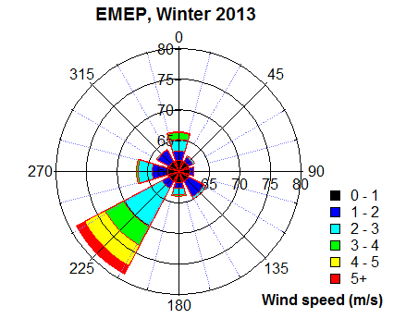
Campaign conditions in Revin
Jun 26 –
Jul 14, 2012
Jan 11 –
Feb 8, 2013
 | Parameter | Mean ± stdev | Min / max
R E V I N | T (°C) | 15.0 ± 3.9 | 5.6 / 28.6
 | RH(%) | 84 ± 15 | 37 / 100
 | P (hPa) | 969 ± 5 | 956 / 978
 | UV (W m⁻²) | 112 ± 137 | - / 556
 | WS (m s⁻¹) | 1.33 ± 0.92 | - / 4.50
 | Parameter | Mean ± stdev | Min / max
R E V I N | T (°C) | -0.2 ± 3.9 | -7.0 / 10.7
 | RH(%) | 96.6 ± 4.9 | 70 / 102
 | P (hPa) | 962 ± 8 | 942 / 975
 | UV (W m⁻²) | 18 ± 30 | - / 151
 | WS (m s⁻¹) | 1.0 ± 1.4 | - / 5.80
© GoogleMaps
Wind speeds slower than 1 m/s are considered as directionless
One main direction: SW winds
High frequency of wind speeds < 1 m/s

Slide 11
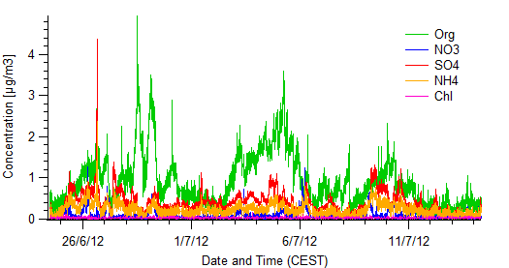
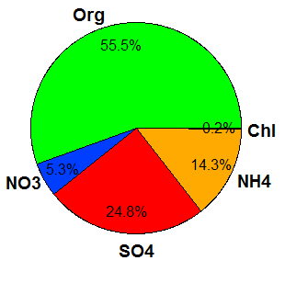
Revin : PM_{x}
PM_{x}
BC
3 main organic events observed

Slide 12
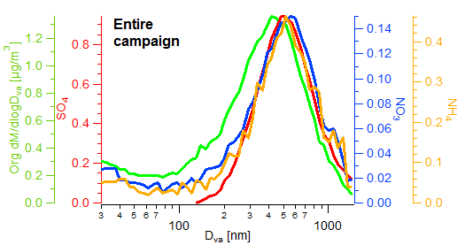
Revin: size distributions in NR-PM₁
One mode per species
- centered around 500-600 nm for inorganic species
- slightly lower for organics (~400 nm)
Rather aged aerosol
Notes:
NR-PM1: non-refractory

Slide 13
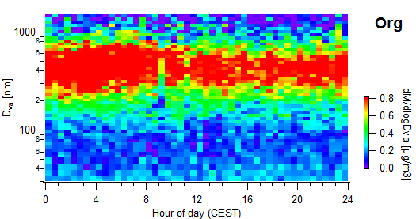
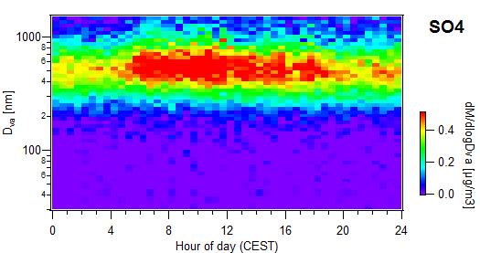
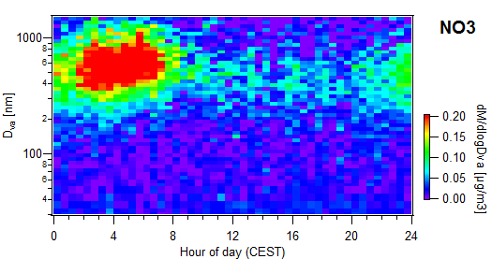
Revin: size distributions in NR-PM₁
Daily profiles:
- Organics and sulfate seem pretty constant during the day
- Nitrate higher at the end of the night
May be nighttime nitrate chemistry going on … needs more investigation!

Slide 14
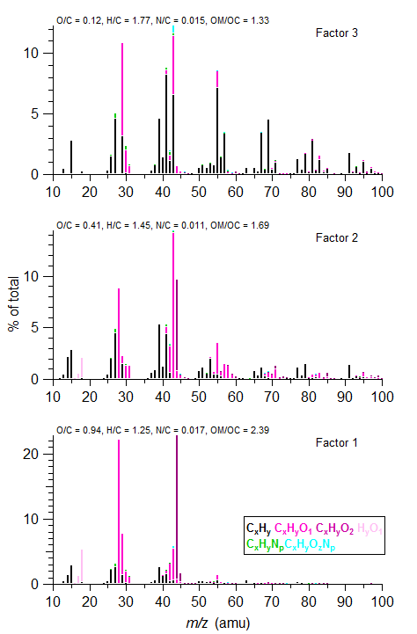
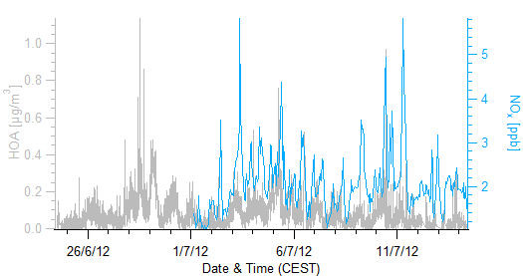
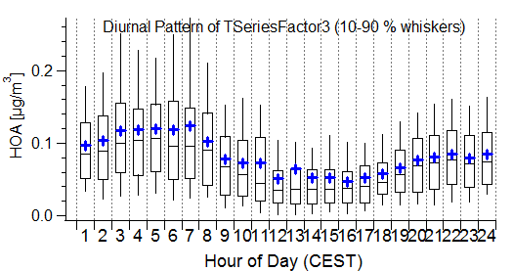
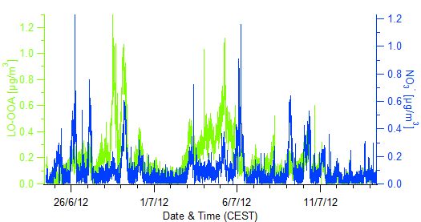
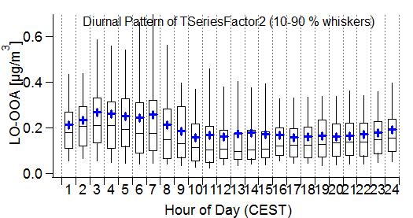
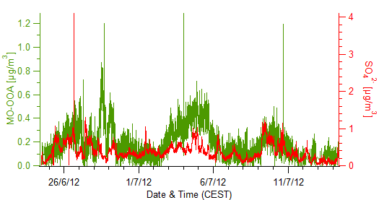
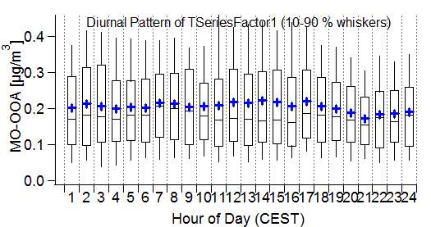
Revin: PMF analysis ⇨ 3 factors identified
OM/OC
HOA
1.33
LO-OOA
1.69
MO-OOA
2.39
HOA slightly oxygenated (probably not local)
LO-OOA not so well correlated w/ NO3;
MO-OOA agrees quite well w/ SO4
Notes:
HOA: Hydrocarbon-like Organic Aerosol
OOA: Oxygenated Organic Aerosol (LO-, less oxidized; MO-, more oxidized)

Slide 15
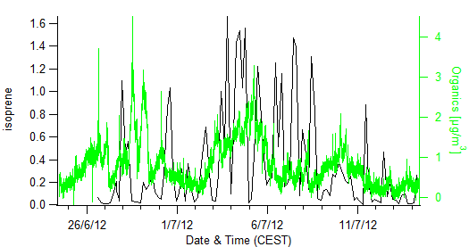
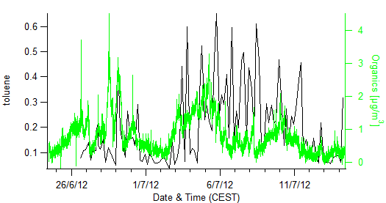
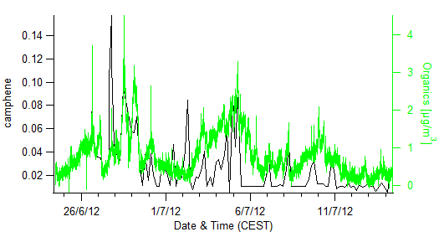
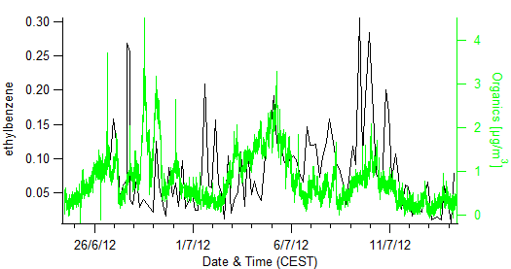
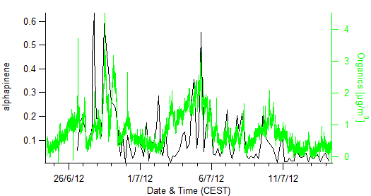
Exploring the potential links with precursor VOCs
Isoprene
Toluene
Camphene
Ethylbenzene
a-Pinene
Possible links between the organic events and some biogenics and aromatics
but concentrations close to the DL

Slide 16
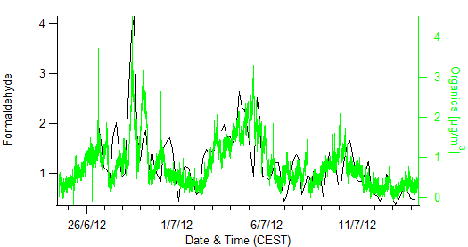
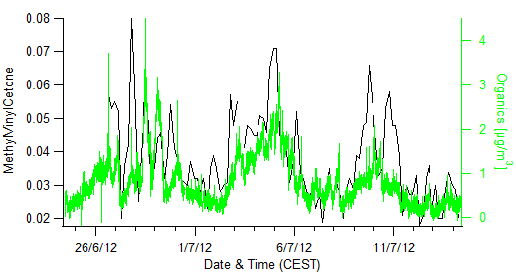
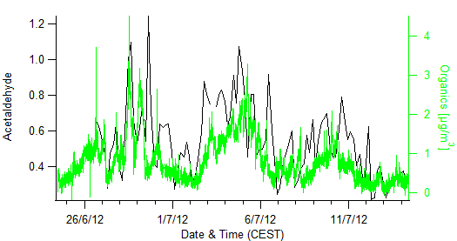
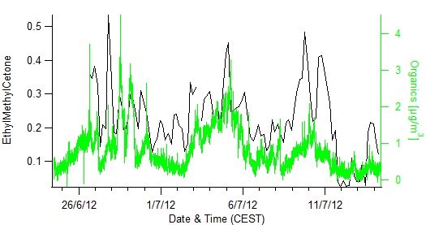
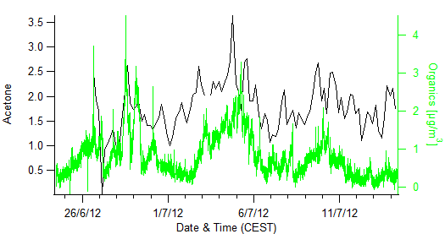
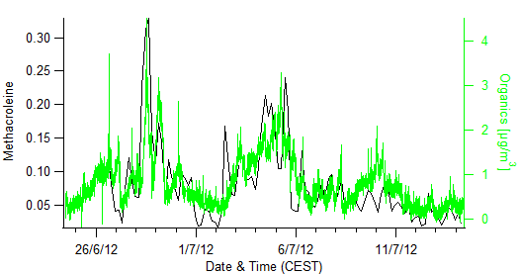
Exploring the potential links with precursor VOCs
MVK
HCHO
EMK
CH₃CHO
Acetone
Methacroleine
Strong links with carbonyl compounds:
HCHO, CH₃CHO, Acetone, MVK, EMK, Methacroleine

Slide 17
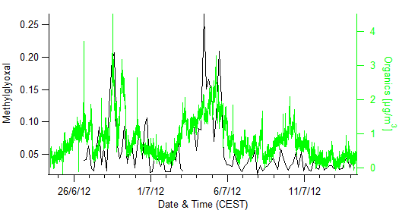
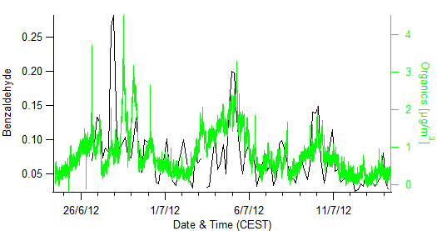
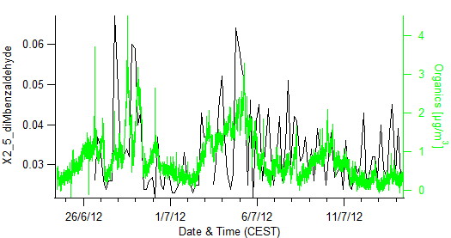
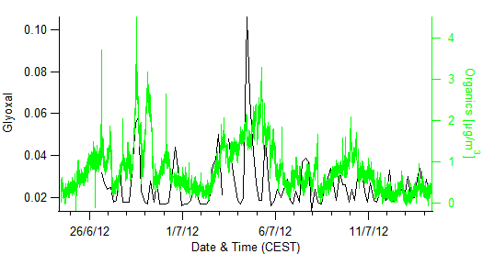
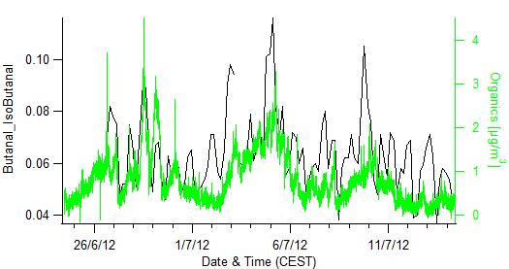
Exploring the potential links with precursor VOCs
Benzaldehyde
Methylglyoxal
Dimethylbenzaldehyde
Glyoxal
Butanal + iButanal
Strong links with more carbonyl compounds:
- Benzaldehyde, Dimethylbenzaldehyde
- Glyoxal, MethylGlyoxal
- Butanal + iso-butanal

Slide 18
Conclusions and future work
French contribution: 5 well-instrumented sites for both seasons
Many data analyses still ongoing for the summer and winter campaigns … promising database so far!
PM₁₀ chemical speciation ⇨ influence of crustal and marine sources, with similar profiles at 3 sites
For the Revin site:
  Main influence from long-range transport for PM₁
  Interesting correlations shown between particulate organics and some VOCs
  Detailed VOC speciation allows to better understand the links between organic gaseous and particulate phases

