Slide 1
ANALYSIS OF UK AND EUROPEAN NO_{x} AND VOC EMISSION SCENARIOS IN THE DEFRA MODEL INTERCOMPARISON EXERCISE
Dick Derwent
rdscientific, Newbury, United Kingdom
14th TFMM meeting, Zagreb, Croatia, 7th May 2013
This study was supported by the ALE program of the UK Department for Environment Food and Rural Affairs under contract AQ0704

Slide 2
ACKNOWLEDGEMENTS
Without the help of the UK modelling teams, this study would not have been possible:
Paul Agnew^{b}, Sean Beevers^{c}, David Carslaw^{c}, Charles Chemel^{d}, Sally Cooke^{e}, Xavier Francis^{f}, Andrea Fraser^{e}, Mathew R. Heal^{g}, Nutthida Kitwiroon^{c}, Justin Lingard^{e}, Alison Redington^{b}, Ranjeet Sokhi^{f}, Massimo Vieno^{h}
^{b}Met Office, Exeter, Devon, United Kingdom
^{c}Environmental Research Group, King’s College London, London, United Kingdom
^{d}National Centre for Atmospheric Science (NCAS), University of Hertfordshire, Hatfield, United Kingdom
^{e}AEA Energy & Environment, Gemini Building, Fermi Avenue, Harwell International Business Centre, Didcot, United Kingdom
^{f}University of Hertfordshire, Hatfield, United Kingdom
^{g}School of Chemistry, University of Edinburgh, Edinburgh, United Kingdom.
^{h}Centre for Ecology and Hydrology, Bush Estate, Penicuik, United Kingdom

Slide 3
MODEL EVALUATION FRAMEWORK
Operational evaluation – usually against historic observations, what are the biases?
Diagnostic evaluation – are model biases caused by model inputs or model processes?
Dynamic evaluation – what are model responses to changes in emissions?
Probabilistic evaluation – what are the uncertainties in models?
In this study, the focus is on dynamic evaluation using changes in NO_{x} and VOC emissions.

Slide 4
STUDY DESIGN
‘Blind’ intercomparison with no harmonisation of input
Base case
S1: 30% reductions in NO_{x} emissions across Europe,
S2: 30% reductions in VOC emissions across Europe,
To test NO_{x}- versus VOC-sensitivity
S3: 30% reductions in NO_{x} and VOC emissions across Europe,
S4: 30% reductions in NO_{x} and VOC emissions across the United Kingdom only
To test UK- versus RoE-dominance

Slide 5
PARTICIPATING MODELS
Eulerian grid models
1. Community Multi-scale Air Quality (CMAQ) model (3 versions)
2. Air Quality Unified Model (AQUM)
3. EMEP for the UK (EMEP4UK) model
Lagrangian dispersion model
4. Numerical Atmospheric Dispersion Model Environment (NAME) model
Moving air parcel models
5. Ozone Source Receptor Model (OSRM)
6. Photochemical Trajectory Model (PTM)

Slide 6
STUDY PERIOD AND LOCATION
July 1st to 31st 2006
This period contained the most severe heat-wave ever recorded in UK which broke the 363-year Central England Temperature record. It was unparalleled in the instrumental record for its combination of high pressures and southerly winds.
Study location was Harwell, Oxfordshire in southern England. EMEP site GB0036R
O₃ levels exceeded 50 ppb during 1st – 4th, 6th, 15th – 22nd, 24th – 27th July with peak hourly level 106 ppb on 18th July.

Slide 7
BASE CASE MODEL RESULTS
All models predicted this episode
All models predicted this episode
This episode was poorly predicted

Slide 8
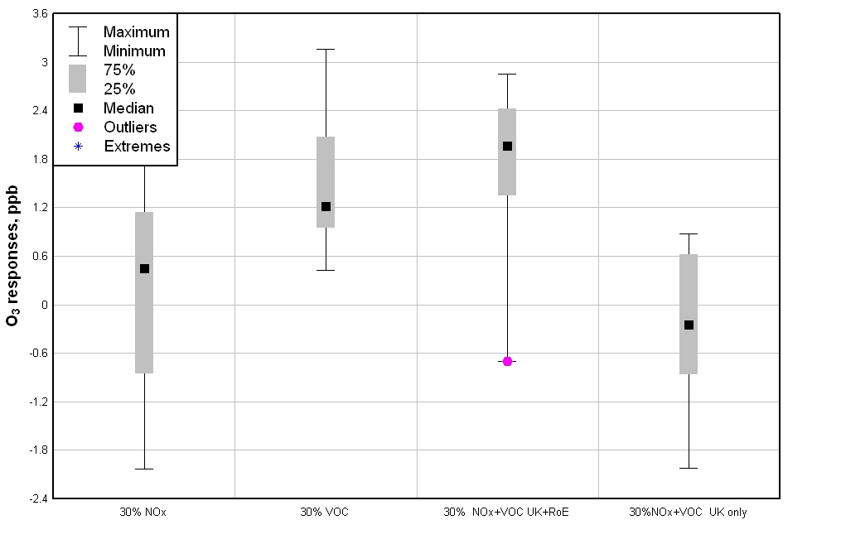
RESULTS FOR EMISSION SCENARIOS
O₃ response is O₃ ^{base case} – O₃ ^{scenario case}
Changes in July mean daily maximum O₃ levels

Slide 9
VOC- VERSUS NO_{x}-SENSITIVITY
Base case
S1: 30% reductions in NO_{x} emissions across Europe
S2: 30% reductions in VOC emissions across Europe
If (O₃ ^{base case} – O₃ ^{S1 case}) is greater than (O₃ ^{base case} – O₃ ^{S2 case}) then day is assigned as NO_{x}-sensitive.
If (O₃ ^{base case} – O₃ ^{S2 case}) is greater than (O₃ ^{base case} – O₃ ^{S1 case}) then day is assigned as VOC-sensitive

Slide 10
VOC- VERSUS NO_{x}-SENSITIVITY
VOC-sensitive
NO_{x}-sensitive
Responses for >50 ppb episode days

Slide 11
ASSIGNMENTS OF NO_{x}- VERSUS VOC-SENSITIVITY
Model | A | B | C | D | E | F | G | H
1st | VOC | VOC | VOC | VOC | VOC | VOC | VOC | VOC
2nd | NO_{x} | NO_{x} | NO_{x} | NO_{x} | NO_{x} | NO_{x} | NO_{x} | NO_{x}
3rd | NO_{x} | VOC | VOC | NO_{x} | VOC | VOC | NO_{x} | NO_{x}
4th | NO_{x} | VOC | VOC | VOC | VOC | NO_{x} | NO_{x} | VOC
5th | NO_{x} | VOC | VOC | VOC | NO_{x} | NO_{x} | NO_{x} | VOC
6th | VOC | VOC | NO_{x} | VOC | NO_{x} | NO_{x} | NO_{x} | NO_{x}
7th | NO_{x} | VOC | VOC | VOC | VOC | NO_{x} | NO_{x} | VOC
8th | NO_{x} | VOC | NO_{x} | NO_{x} | NO_{x} | NO_{x} | NO_{x} | NO_{x}
9th | NO_{x} | NO_{x} | NO_{x} | NO_{x} | NO_{x} | NO_{x} | NO_{x} | VOC
10th | NO_{x} | VOC | VOC | NOx | NOx | VOC | VOC | VOC
11th | NO_{x} | NO_{x} | NO_{x} | VOC | NO_{x} | NO_{x} | NO_{x} | NO_{x}
12th | NO_{x} | VOC | VOC | VOC | VOC | VOC | VOC | VOC
13th | VOC | VOC | VOC | VOC | VOC | VOC | VOC | VOC
14th | NO_{x} | VOC | VOC | NO_{x} | NO_{x} | VOC | NO_{x} | NO_{x}
15th | NO_{x} | VOC | VOC | VOC | NO_{x} | VOC | VOC | NO_{x}
16th | VOC | VOC | VOC | VOC | VOC | VOC | VOC | NO_{x}
17th | VOC | VOC | VOC | VOC | VOC | VOC | NO_{x} | VOC
18th | VOC | VOC | VOC | VOC | VOC | NO_{x} | NO_{x} | VOC
19th | NO_{x} | VOC | VOC | NO_{x} | VOC | NO_{x} | VOC | NO_{x}
20th | NO_{x} | VOC | VOC | NO_{x} | NO_{x} | NO_{x} | NO_{x} | NO_{x}
21st | NO_{x} | NO_{x} | NO_{x} | NO_{x} | NO_{x} | NO_{x} | NO_{x} | NO_{x}
22nd | VOC | VOC | VOC | NO_{x} | NO_{x} | VOC | NO_{x} | NO_{x}
23rd | VOC | VOC | VOC | NO_{x} | VOC | NO_{x} | NO_{x} | VOC
24th | VOC | VOC | VOC | VOC | VOC | VOC | NO_{x} | VOC
25th | NO_{x} | VOC | VOC | VOC | NO_{x} | NO_{x} | NO_{x} | NO_{x}
26th | VOC | VOC | VOC | VOC | NO_{x} | NO_{x} | NO_{x} | NO_{x}
27th | VOC | VOC | VOC | NO_{x} | NO_{x} | VOC | NO_{x} | NO_{x}
28th | NO_{x} | VOC | VOC | NO_{x} | VOC | VOC | NO_{x} | NO_{x}
29th | NO_{x} | NO_{x} | NO_{x} | NO_{x} | NO_{x} | NO_{x} | NO_{x} | NO_{x}
30th | NO_{x} | NO_{x} | NO_{x} | NO_{x} | NO_{x} | NO_{x} | NO_{x} | NO_{x}
31st | NO_{x} | VOC | VOC | NO_{x} | NO_{x} | NO_{x} | NO_{x} | NO_{x}
Some measure of conflict on all but 6 days
Which is ‘best’ model?

Slide 12
NO_{x}- VERSUS VOC-SENSITIVITY
Unprocessed model results show conflicting assignments on all but 6 days
Set a threshold of model performance of -0.1 < NMB < +0.1 before ‘accepting’ NO_{x}- versus VOC-sensitivity for each day and for each model
This removes almost all of the conflicting assignments

Slide 13
NO_{x}- VERSUS VOC-SENSITIVITY FOR ‘ACCEPTABLE’ MODELS ONLY
Model | Obs, ppb | A | B | C | D | E | F | G | H
1st | 82 |  |  |  |  |  |  | VOC
2nd | 80 | NOx | NOx | NO_{x} | NOx | NOx | NOx | NOx | NOx
3rd | 81 |  |  |  |  |  |  | NO_{x}
4th | 79
5th | 38 | NO_{x}
6th | 60 | VOC |  | NO_{x} |  | NO_{x} | NO_{x} |  | NO_{x}
7th | 29 |  |  | VOC
8th | 34 | NO_{x} |  |  |  | NO_{x}
9th | 32 | NO_{x} |  | NO_{x} |  | NO_{x}
10th | 21 |  |  | VOC
11th | 39 |  |  |  |  |  |  | NO_{x}
12th | 35 | NO_{x} |  | VOC |  |  |  | VOC
13th | 33 | VOC |  |  | VOC | VOC |  | VOC
14th | 42 |  |  |  |  |  |  | NO_{x}
15th | 51 |  |  |  |  |  | VOC | VOC
16th | 75 |  |  |  |  |  |  | VOC
17th | 76
18th | 106
19th | 103 | NO_{x}
20th | 58 | NO_{x} |  |  |  |  |  | NO_{x}
21st | 61 |  |  |  | NO_{x} |  |  | NO_{x}
22nd | 56 |  |  |  | NO_{x} |  |  | NO_{x} | NO_{x}
23rd | 43 | VOC |  |  |  |  | NO_{x} | NO_{x}
24th | 72
25th | 69 |  | VOC |  |  | NO_{x}
26th | 65 |  |  | VOC | VOC | NO_{x}
27th | 63 |  | VOC
28th | 43 |  | VOC |  | NO_{x} |  |  |  | NO_{x}
29th | 36 |  |  |  |  | NO_{x} | NO_{x} | NO_{x} | NO_{x}
30th | 36 | NO_{x} | NO_{x} |  | NO_{x} | NO_{x}
31st | 43 |  | VOC |  | NO_{x} |  | NO_{x} | NO_{x}
All models are ‘acceptable’ on at least one day
Selecting on the basis of model performance reduces conflicts
No models are ‘acceptable’ on all days
There is no model that is always ‘best’

Slide 14
UK- VERSUS RoE-DOMINANCE
Base case
S3: 30% reductions in NO_{x} and VOC emissions across UK and Rest of Europe
S4: 30% reductions in NO_{x} and VOC emissions across the United Kingdom only
If (O₃ ^{base case} – O₃ ^{S3 case}) - (O₃ ^{base case} – O₃ ^{S4 case}) is greater than (O₃ ^{base case} – O₃ ^{S4 case}) then day is assigned as Rest of Europe dominant
If (O₃ ^{base case} – O₃ ^{S3 case}) - (O₃ ^{base case} – O₃ ^{S4 case}) is less than
(O₃ ^{base case} – O₃ ^{S4 case}) then day is assigned as UK dominant

Slide 15
UK- VERSUS RoE-DOMINANCE
UK-dominant
RoE-dominant
Responses on 50 ppb episode days

Slide 16
UK- VERSUS RoE-DOMINANCE
Model | A | B | C | D | E | F | G | H
1st | RoE | UK | RoE | UK | RoE | RoE | RoE | RoE
2nd | RoE | RoE | RoE | RoE | RoE | RoE | RoE | RoE
3rd | RoE | RoE | RoE | RoE | RoE | RoE | RoE | RoE
4th | RoE | UK | RoE | RoE | RoE | RoE | RoE | RoE
5th | RoE | RoE | RoE | RoE | UK | RoE | RoE | RoE
6th | UK | RoE | RoE | RoE | UK | RoE | RoE | RoE
7th | UK | RoE | RoE | RoE | RoE | UK | UK | RoE
8th | RoE | RoE | RoE | RoE | RoE | RoE | RoE | UK
9th | UK | RoE | RoE | RoE | RoE | UK | RoE | RoE
10th | UK | UK | RoE | RoE | RoE | UK | RoE | RoE
11th | UK | UK | UK | RoE | UK | UK | UK | UK
12th | UK | RoE | RoE | RoE | RoE | RoE | RoE | RoE
13th | RoE | RoE | RoE | RoE | RoE | RoE | RoE | RoE
14th | UK | RoE | RoE | RoE | UK | RoE | UK | UK
15th | UK | UK | RoE | RoE | UK | RoE | RoE | UK
16th | RoE | RoE | RoE | RoE | RoE | RoE | RoE | RoE
17th | RoE | RoE | RoE | RoE | UK | RoE | RoE | RoE
18th | RoE | RoE | RoE | RoE | RoE | RoE | RoE | RoE
19th | RoE | RoE | RoE | RoE | RoE | RoE | RoE | UK
20th | RoE | RoE | UK | RoE | RoE | RoE | RoE | RoE
21st | RoE | RoE | UK | RoE | RoE | RoE | UK | UK
22nd | UK | UK | RoE | RoE | RoE | RoE | RoE | RoE
23rd | UK | RoE | RoE | UK | RoE | UK | UK | RoE
24th | UK | UK | RoE | RoE | RoE | UK | UK | RoE
25th | RoE | UK | RoE | RoE | RoE | RoE | RoE | RoE
26th | RoE | RoE | RoE | UK | RoE | RoE | UK | RoE
27th | UK | RoE | RoE | RoE | RoE | RoE | UK | UK
28th | UK | RoE | RoE | RoE | RoE | RoE | UK | UK
29th | RoE | UK | RoE | RoE | RoE | RoE | RoE | RoE
30th | UK | RoE | UK | UK | RoE | UK | UK | UK
31st | RoE | RoE | RoE | RoE | RoE | RoE | UK | RoE
Some measure of conflict on all but 5 days
Which is best model?

Slide 17
UK- VERSUS RoE DOMINANCE
Unprocessed model results show conflicting assignments on all but 5 days
Set a threshold of model performance of -0.1 < NMB < +0.1 before ‘accepting’ UK- versus RoE-dominace for each day and for each model
This removes almost all of the conflicting assignments

Slide 18
UK- VERSUS RoE-DOMINANCE
Model | A | B | C | D | E | F | G | H
1st |  |  |  |  |  |  | RoE
2nd |  |  | RoE
3rd |  |  |  |  |  |  | RoE
4th
5th | RoE
6th | UK |  | RoE |  | UK | RoE |  | RoE
7th |  |  | RoE
8th | RoE |  |  |  | RoE
9th | UK |  | RoE |  | RoE
10th |  |  | RoE
11th |  |  |  |  |  |  | UK
12th | UK |  | RoE |  |  |  | RoE
13th | RoE |  |  | RoE | RoE |  | RoE
14th |  |  |  |  |  |  | UK
15th |  |  |  |  |  | RoE | RoE
16th |  |  |  |  |  |  | RoE
17th
18th
19th | RoE
20th | RoE |  |  |  |  |  | RoE
21st |  |  |  | RoE |  |  | UK
22nd |  |  |  | RoE |  |  | RoE | RoE
23rd | UK |  |  |  |  | UK | UK
24th
25th |  | UK |  |  | RoE
26th |  |  | RoE | UK | RoE
27th |  | RoE
28th |  | RoE |  | RoE |  |  |  | UK
29th |  |  |  |  | RoE | RoE | RoE | RoE
30th | UK | RoE |  | UK | RoE
31st |  | RoE |  | RoE |  | RoE | UK
Selecting on the basis of model performance reduces conflicts

Slide 19
CONCLUSIONS
Model performance was highly variable between days during July 2006 at the one site: Harwell, GB0036R
selecting model results on the basis of -0.1 < NMB < +0.1 for each day dramatically reduced conflicting assignments as to NO_{x}- versus VOC-sensitivity and UK- versus RoE-dominance
there was always one day for each model when it was the ‘best’ model
no one model was ‘best’ model on all days
best to control VOC emissions rather than NO_{x} emissions and to take action across Europe rather than in the UK only

