Slide 1
INTERCOMPARISON AND EVALUATION OF CHEMICAL MECHANISMS FOR AIR QUALITY POLICY ASSESSMENT
Dick Derwent
rdscientific, Newbury, UK
17th Meeting of the EMEP Task Force on Measurement and Modelling
Utrecht, Netherlands
19th May 2016

Slide 2
SUMMARY OF PRESENTATION
Reduced chemical mechanisms
The constrained Zero-D model
Comparison of ozone responses to NO_{x} and VOC controls
Comparison of OH responses to NO_{x} and VOC controls

Slide 3
SUMMARY OF REDUCED CHEMICAL MECHANISMS STUDIED
CB05
CB6
SAPRC-99
CS07A
GEOS-CHEM
CRIv2
These are evaluated against the gold standard mechanism which we will take as the Master Chemical Mechanism v3.3.

Slide 4
MECHANISM REDUCTION TECHNIQUES
Lumping reaction products
Reaction products are no longer identifiable compounds but represent a series of compounds such as aldehydes or ketones
Lumping VOCs
Emitted VOCs are no longer identifiable compounds but are represented by surrogate species that are mixtures of emitted VOCs
These techniques complicate mechanism evaluation. These techniques are not employed in the MCMv3.3 or CRIv2 which are entirely explicit mechanisms.

Slide 5
MECHANISM EVALUATION PROTOCOL
Harmonise as much evaluation data as possible
Standardise the inorganic chemistry to IUPAC
Standardise the photolysis rate data
Standardise the PAN chemistry to the MCMv3.3
Restrict VOC coverage to simple VOC species and not to surrogate emission species
Supply standard background environmental conditions

Slide 6
STOCHEM-CRI MODEL EXPERIMENTS
STOCHEM-CRI is a global Lagrangian 3-D chemistry transport model
250 chemical species 650 chemical reactions
spin-up: 1st October to 31st March
model experiment: 1st April to 31st December
European study region: 40 º latitude x 40 º longitude
results for 1 month * 32 grid boxes
runs with CRIv2
Employed here to provide background environmental conditions.

Slide 7
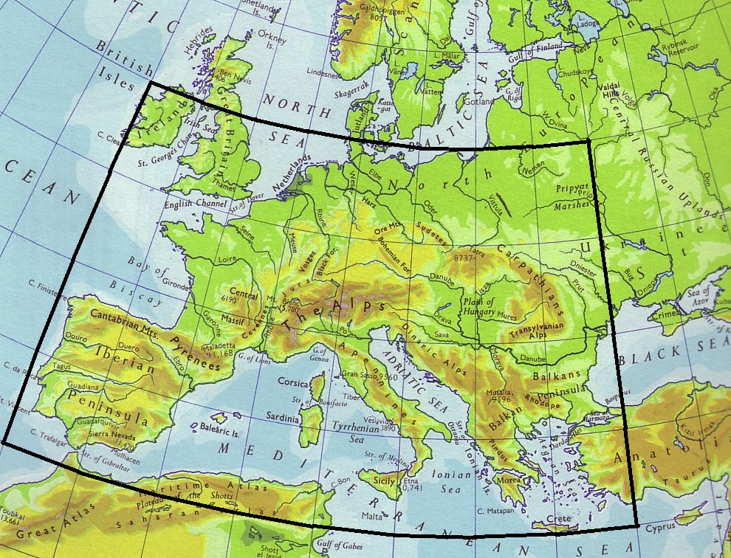
LOCATIONS OF THE CHOSEN CHEMICAL ENVIRONMENTS
25
LATITUDE RANGE FROM 35ºN TO 55ºN
LOCATIONS WERE CHOSEN FROM THE OUTPUT OF THE STOCHEM MODEL AT 5º x 5º INTERVALS
26
27
28
29
30
31
32
17
18
19
20
LONGITUDE RANGE FROM 10ºW TO 30ºE
21
22
23
24
9
10
11
12
13
14
15
16
1
2
3
4
5
6
7
8

Slide 8
ZERO-DIMENSIONAL (0-D) BOX MODEL STUDIES
chemistry mechanisms studied include Master Chemical Mechanism v3.3, CRIv2, SAPRC-99 and -07, CB05 and CB-6, GEOS-CHEM
all mechanisms have been standardised
run in box model with no dry deposition or exchange with free troposphere
composition taken from STOCHEM-CRI run for 30 long lifetime (>1 hour) chemical species
composition constrained to STOCHEM values by addition or subtraction of fluxes for each long lifetime species at end of every time step
model run for 5 days
outputs are time-averaged constrained fluxes or time profiles of short lifetime species

Slide 9
MIXING RATIO CONSTRAINED ZERO-D MODEL
d[O₃]/dt = P - l[O₃]
d[O₃]/dt = 0 = P - l[O₃] + flux
This accomplished at every time step within the GEAR’s method numerical integrator
Net photochemical production
Constraint level
[O₃]
Net photochemical destruction

Slide 10
SPECIES WITH CONSTRAINED MIXING RATIOS
ozone, NO, NO₂, HNO₃, PAN, MPAN
CH₄, H₂, CO
H₂O₂, CH₃OOH
C₂H₆, C₃H₈, nC₄H₁₀
C₂H₄, C₃H₆, trans-but-2-ene
C₂H₂,benzene, toluene, o-xylene
isoprene, α-pinene, β-pinene
HCHO, CH₃CHO, CH₃COCH₃, CH₃COC₂H₅, CH₃OH, C₂H₅CHO
The Gear’s method integrator returns the rates of production or destruction required to maintain the constrained mixing ratio of each species.
Not all of these species are in all the mechanisms studied.
Species without constraints are allowed to run free eg. OH, HO₂ etc

Slide 11
STANDARDISING THE CHEMICAL MECHANISMS
MCMv3.3 and CRIv2 were left as downloaded.
The condensed mechanisms were standardised as follows:
inorganic chemistry was replaced with a common set of IUPAC reactions and rate coefficients
all photolysis rate coefficients were replaced with a common set from the MCM website
all PAN-type rate coefficients were replaced with the MCMv3.3 values
To indicate that the mechanisms are not used as described by mechanism developers we signify this by use of italics.

Slide 12
Dispersion between the model results is within ± 4%
All the mechanisms exactly overlap
Standardisation and harmonisation steps have not introduced significant bias into the model results

Slide 13
Dispersion is large below 1.5 ppb
Dispersion is narrow above 1.5 ppb
Some cb6 points produce more ozone compared with MCMv3.3
Most mechanisms produce slightly less ozone compared with MCMv3.3
All GEOS-CHEM and cb05 produce much less ozone compared with MCMv3.3

Slide 14
MCMv3.3 predicts significantly lower OH number densities compared with the other mechanisms
Standardisation and harmonisation have not introduced significant bias between the mechanisms
Detailed analysis of one chosen environment out of the 32

Slide 15
VOC limited
NO_{x} limited
Circle points above squares
-30% NO_{x} responses > -30% VOC responses

Slide 16
VOC response
FOR A GIVEN NO_{x} RESPONSE THERE IS AN UPPER LIMIT TO THE VOC RESPONSE
THE UPPER LIMIT TO THE VOC RESPONSE IS LESS THAN ONE HALF OF THE NO_{x} RESPONSE
NO_{x} response
THESE ENVIRONMENTS ARE NO_{x} LIMITED

Slide 17
OZONE RESPONSES TO POLICY OPTIONS ARE MECHANISM DEPENDENT
Mechanism | Relative response to -30% NO_{x} reduction | Relative response to -30% VOC reduction
cb05 | 0.732 | 0.975
cb6 | 0.841 | 1.100
CRIv2 | 0.901 | 1.230
GEOS-CHEM | 0.733 | 0.744
MCMv3.3 | 1.0 | 1.0
SAPRC-07 | 1.100 | 1.100
SAPRC-99 | 1.330 | 1.330
These ozone responses have been averaged over all 32 environments

Slide 21
RESPONSES IN OH RADICAL NUMBER DENSITIES TO POLICY OPTIONS ARE MECHANISM DEPENDENT
Mechanism | Relative response to -30% NO_{x} reduction | Relative response to -30% VOC reduction
cb05 | 1.50 | 1.43
cb6 | 1.21 | 1.14
CRIv2 | 1.40 | 1.41
GEOS-CHEM | 1.43 | 1.16
MCMv3.3 | 1.0 | 1.0
SAPRC-07 | 1.36 | 1.49
SAPRC-99 | 1.39 | 1.60
These responses in OH radical number densities have been averaged over all 32 environments

Slide 22
CONCLUSIONS
Six reduced chemical mechanisms have been compared against the MCMv3.3 under European background environmental conditions with the following conclusions:
Photochemical ozone production rates agree to within ± 4%
Responses in ozone to -30% NO_{x} reductions are much greater than those to -30% VOC reductions
Nevertheless, responses in ozone to -30% NO_{x} and VOC reductions show significant variations between mechanisms
Most mechanisms predict much higher OH radical number densities compared with the MCMv3.3
Responses in average OH radical number densities show significant variations between mechanisms

