Slide 1
Martin Adams | EEA
Sebnem Aksoyoglu | PSI
Michel André | IFSTTAR
Bertrand Bessagnet | INERIS
Augustin Colette | INERIS
Florian Couvidat | INERIS
Neil Donahue | CMU
Chris Dore | Aether Ltd
Hugo Denier Van Der Gon | TNO
Hilde Fagerli | MET.NO
Isaline Fraboulet | INERIS
Christian Gaegauf | Oekozentrum
Marta Garcia Vivanco | CIEMAT
Alma Hodzic | NCAR
Jeroen Kuenen | TNO
Yao Liu | IFSTTAR
Rob Maas | RIVM
Mihaela Mircea | ENEA
Ole-Kenneth Nielsen | AU
Spyros Pandis | CMU
Guido Pirovano | RSE
André Prevôst | PSI
Stewart Robert | AEAT
Allen Robinson | CMU
Laurence Rouïl | INERIS
Kristina Saarinen | SYKE
Karine Sartelet | CEREA
David Simpson | CHALMERS
Carlo Trozzi | Techne Consulting
Cross-cutting WG TFMM-TFEIP
on SVOC emissions - Outcome of the workshop in TFEIP
Bertrand Bessagnet (www.ineris.fr)

Slide 2
Why this working group?
Organic matter (OM) represents 20 to 30% of the particulate matter in Europe, this fraction is dominated by the secondary organic fraction produced by chemical reactions of organic precursors (Freutel et al., 2013, Crippa et al., 2013)
Official primary PM emissions decrease (e. g. use of filtering techniques for the case of diesel vehicles, improvement of efficiency of wood stoves, etc…)
Air quality models usually underestimate PM, and the lack of some emissions is considered as one of the explanations (particularly in winter due to wood burning)
The secondary fraction and/or the organic fraction are underestimated by models
In smog chambers, the aging of diesel vs gasoline exhausts show the importance of SOA formation. In some experiments, gasoline vehicles produce more aerosols than diesel vehicles after several hours in the chambers → role of VOC and S/IVOC
WG on emissions decided during the 2015 TFMM in Krakow
Semi volatile Organic Compounds (SVOC) are partly included in emission inventories
How to complement these emissions inventories?

Slide 3
Concept of SVOC - I
All organic species are more or less volatile and can be considered as semi-volatile, their vapour pressure is the key parameter to define the volatility.
The temperature and the organic aerosol loading (the total mass of organic species into which semi-volatile species can condense) influence the partitioning between the gas and particle phases.
VOCs represent the most volatile fraction of organic species.
The heaviest organic molecules (in term of molecular weight) can be considered to be entirely in the particulate phase, they constitute what is commonly called organic matter.
In between, there is a large spectrum of molecules that are partitioned between the gas and particle phases, they are called in a broad sense SVOC (semi-volatile organic compounds).

Slide 4
Concept of SVOC - II
Organic species can be split in:
ELVOC (Extremely low Volatile Organic Compounds)
LVOC (Low Volatile Organic Compounds)
SVOC (Semi Volatile Organic Compounds)
IVOC (Intermediate Volatility Organic Compounds)
VOC (Volatile Organic Compounds)
These categories can be delimited by vapour pressure thresholds
This delimitation is arbitrary, the Gas/Particle partitioning can change with the temperature and the level of concentrations
Chemistry transport models host secondary organic aerosol modules able to produce secondary organic aerosol from gas phase organic species
POA (Primary Organic Aerosol) in gas and particle phases
SVOC in a broad sense

Slide 5
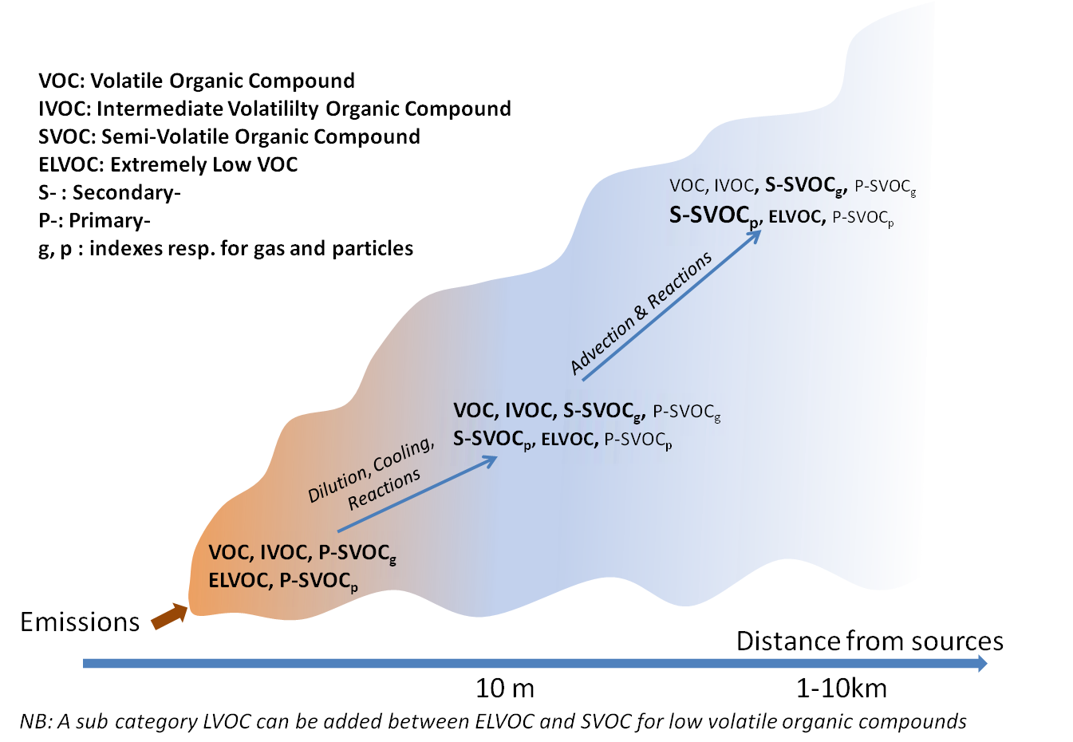
Evolution of SVOCs
Air quality models have chemistry modules to account for the VOC and SVOC chemistry
Some simple considerations:
Dilution of SVOC leads to evaporation
Decrease of T° leads to condensation/absorption of SVOC
Oxidation reactions lead to the formation of bigger molecules

Slide 6
Until now, how do modellers manage SVOC emissions?
So far, emission inventories are targeted on VOC, NOx, SOx, NH3, CO and PM broken down into PM2.5 and PM10
A speciation is often proposed to identify the organic matter in each PM fraction
EC / OM / Other
OM is organic matter supposed as particulate matter at the emission
“other” means non carbonaceous species (dust, inorganics, etc…)
Modellers do their own calculation of total primary organic matter (gas + particles) emitted by a given sector with coefficients based on dilution curves reported in the literature.
TPOM= 2 * OA (as an example)
IVOC can be considered as not included in TPOM then IVOC is estimated from TPOM or VOC emission factors (Ots et al., 2016)

Slide 7
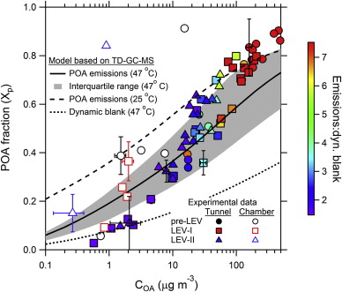
Dilution curves - a tool to estimate total POA
At C_{oa}=10 µg/m³ and 25°C, about 55% is in the particle phase
If you measure solid POA, you have to multiply 1/0.55~2 to get the total organic fraction (Gas+Particles)
If we could measure higher C_{oa} we could take into account missing SVOC (the so called IVOC)
Dilution curve from 51 light-duty American gasoline vehicles (from May et al. 2013a) at 47°C and 25°C.
55%

Slide 8
PM EF measurements – focus on the organic fraction
IVOC SVOC LVOC ELVOC
Ambient POA
+
POA in dilution samplers
14
+
+
Total SVOC without IVOC
12
IVOC
10
Not adsorbed on filters
8
Emission Factor in mg km⁻¹
6
Adsorbed vapors on filters
Inorganics
4
Metals-dust
2
Elemental Carbon
VOC
12 16 20 24 28 32 36
Molecule Carbon number
Adapted from Robinson et al. (2010)

Slide 9
How much organics in EF?
For a good assessment we need to identify + + +
The coefficients used for this estimation are based on very few publications (dilution curves) and sometimes old coefficients
We don’t have any clues about the operating conditions (T° and PM load) of the EF measurements
In the dilution sampler
?
SVOC
PM
Inorganics
Dust
Elemental Carbon

Slide 10
How to proceed to identify SVOC/IVOC in emissions for a better air pollution assessment ?

Slide 11
Two options for the future (10 years)
OPTION I
An updated (=increased) PM emission estimate including SVOC will be determined with (by activity sector), integrated with:
A split by components : OM, EC, other (minimum requirement)
A split by volatility for OM (including SVOC), for each of volatility classes a split by species will be provided
An updated (=increased) total VOC estimate including IVOC will be determined, integrated with
Improvement of the VOC split including also IVOC
Impact:
Automatically, increase the total emissions by country

Slide 12
Two options for the future (10 years)
OPTION II
PM without OM should be known
OM including SVOC will be determined separately
A split by volatility for OM (including SVOC), for each of volatility class a split by species will be provided
VOC
Improvement of the VOC split
IVOC will be determined separately with a split by species

Slide 13
Some outcomes of the workshop I
TFEIP knows better our needs in terms of semi volatile compounds and why, and the community is evolving to methods including “condensables”
“Condensable” vs “Semi Volatile Organic Compounds”
Condensables include inorganic species too :
Comparable orders of magnitude for nitrate /ammonium and organic compounds
For high fuel contents (shipping) sulfate can dominate the “condensable” fraction
We wonder if “condensable” is the right word perhaps “condensed “ is more appropriated, then we would miss the gas fraction that modellers need.
The guidebook of EF has been reviewed with an information on the type of particles taken into account : filterable PM or total (means including condensables)

Slide 14
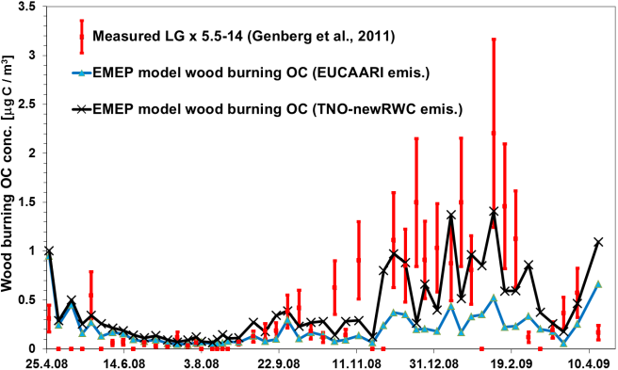
Some outcomes of the workshop II
Presentation by Jeroen (TNO) of the impact of the new approach to account for condensable (+ an update of activities) in Emission Inventories (Denier van der Gon, 2015)
David (EMEP) presented some basics of SOA modelling with EMEP and how they handle POA emissions (No adjustment coefficient for modelling in the frame of the Convention)

Slide 15
Some outcomes of the workshop III
A suggestion for EI was made to get all the organic matter from VOC to ELVOC in one species OM (+ volatility split and screening by species)
We (modellers) suspect the “condensable” fraction of organics is not exactly what we need in models:
IVOC are not included
Gas phase fraction of SVOC molecules could be also not included
INERIS has proposed for France a pilot study for the road traffic sector consisting in:
Calculating total PM emissions by subsectors for FR (ex. EURO5 diesel emission PC , etc…)
Identify corresponding EF for each subsector (COPERT used in FR)
Interactions with COPERT team (AUTH) to understand how the EF are determined and under which operating conditions and if they account for all organics species
Develop a method based on AUTH expertise or dilution curves to complete our needs for modelling
If relevant, we could repeat this exercise in other countries

Slide 16
THANK YOU FOR YOUR ATTENTION

Slide 17
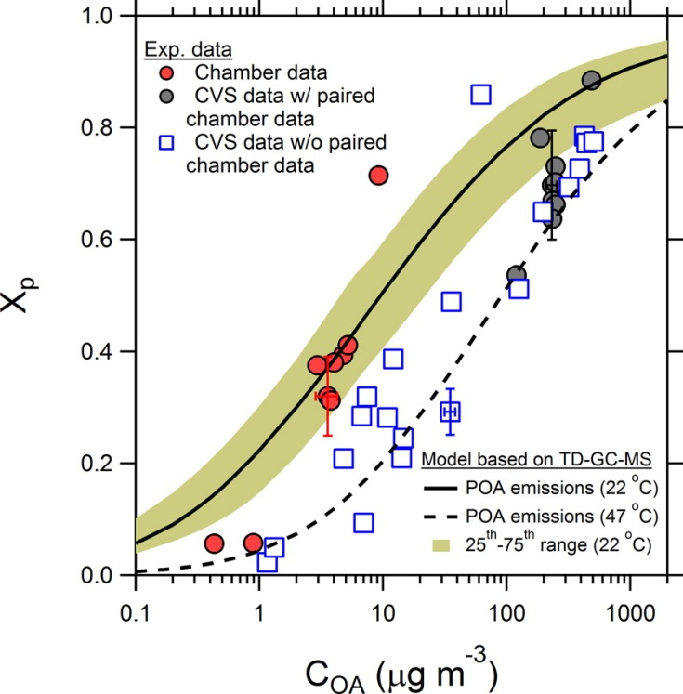
Dilution curves – application with french data for vehicle emissions
What are the level of PM concentrations and temperatures in the CVS sampling system:
Diesel vehicle (without Particulate filter) : 1.10² - 6.10³ µg/m³
Petrol or Diesel vehicle (with Particulate filter) : 4.10¹ - 1.5.10³ µg/m³
Temperature : 36°C
Determination of Xp:
Diesel vehicle (without Particulate filter) : 70-95%
Petrol or Diesel vehicle (with Particulate filter) : 50-90%
Total POA (including all SVOC) could be 2 times
that is measured
May et al, 2013

