Slide 1
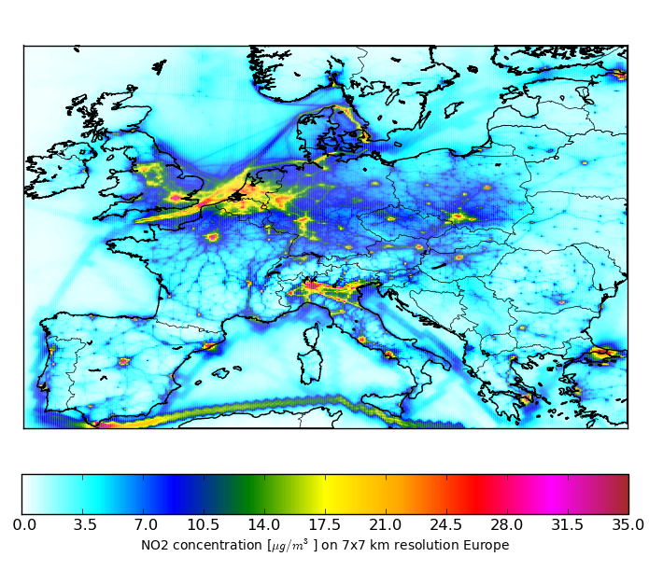
TNO contributions to EMEP
Martijn Schaap

Slide 2
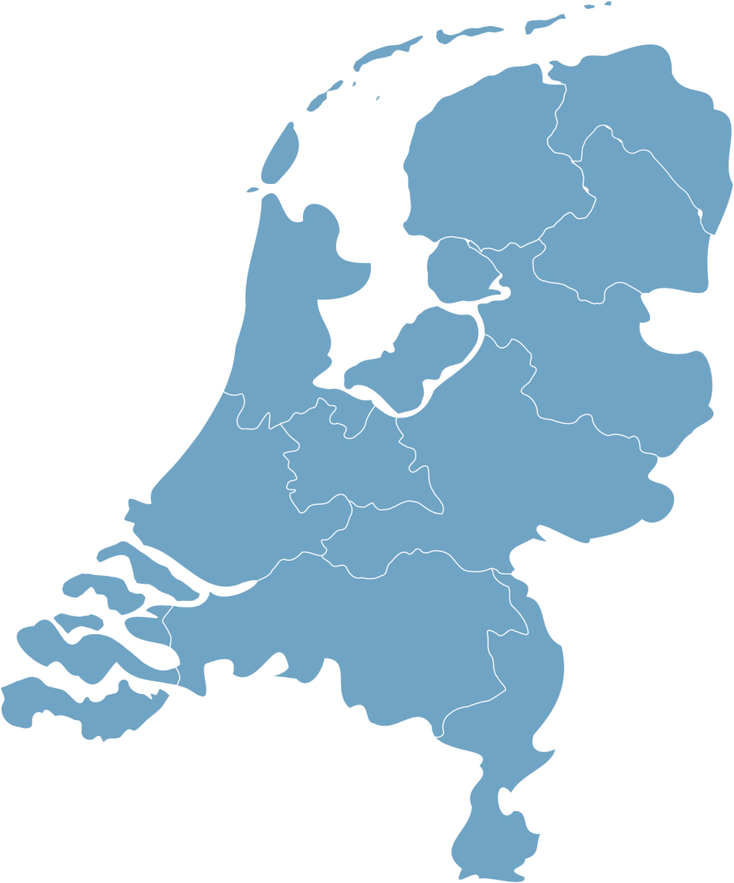

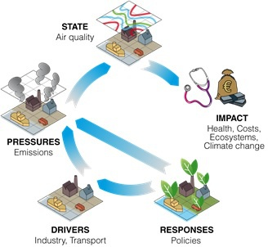
TNO: a NON-profit Organisation department
Climate, air and sustainability
3000 professionals
Groningen
Leiden
Soesterberg
Zeist
Delft
Utrecht
Rijswijk
The Hague
Helmond
Eindhoven

Slide 3
How do we study air pollution?
TO ASSESS HUMAN PRESSURE ON HEALTH, CLIMATE AND BIODIVERSITY BY INTEGRATING EARTH OBSERVATION DATA AND ATMOSPHERIC MODELLING
To develop and apply strategies to monitor emission of air pollutants and short lived climate forcers based on the integration of EO data into models.
To develop and apply observation system simulation experiments to assess optimal sensing strategies and defines users requirements for new satellite missions.
To apply our knowledge and tools to answer questions from customers and other stakeholders to our best ability.
To quantify the fate of emissions to air through the assessment of human and ecosystem exposure as well as climate impacts of air pollutants.

Slide 4
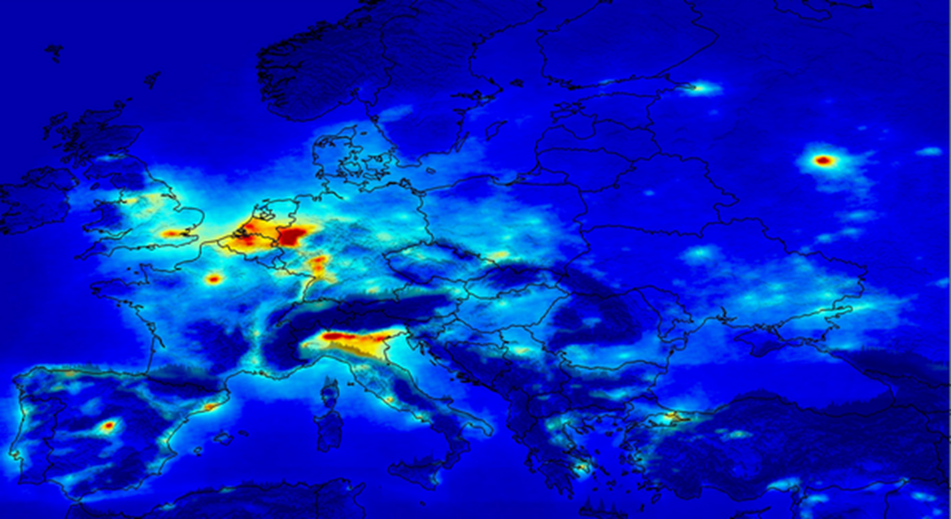
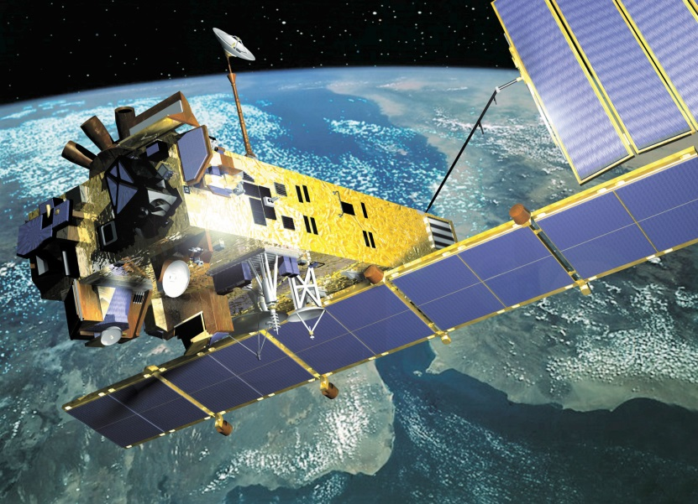
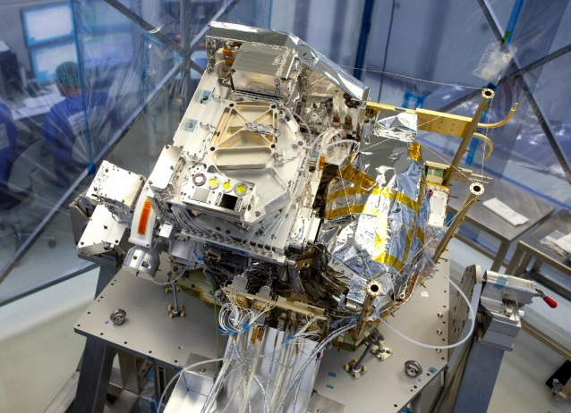
TNO designs and calibrates satellite instruments
Dutch space industry has contributed a series of instruments aimed at monitoring atmospheric composition (Sciamachy, GOME, OMI, TROPOMI)
Partners e.g. Dutch Space, SRON, KNMI
NO₂

Slide 5
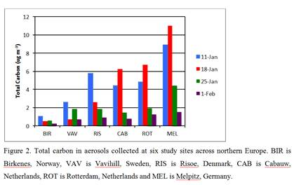

Monitoring climate relevant aerosol properties at Cabauw
Long term monitoring
EMEP intensives

Slide 6
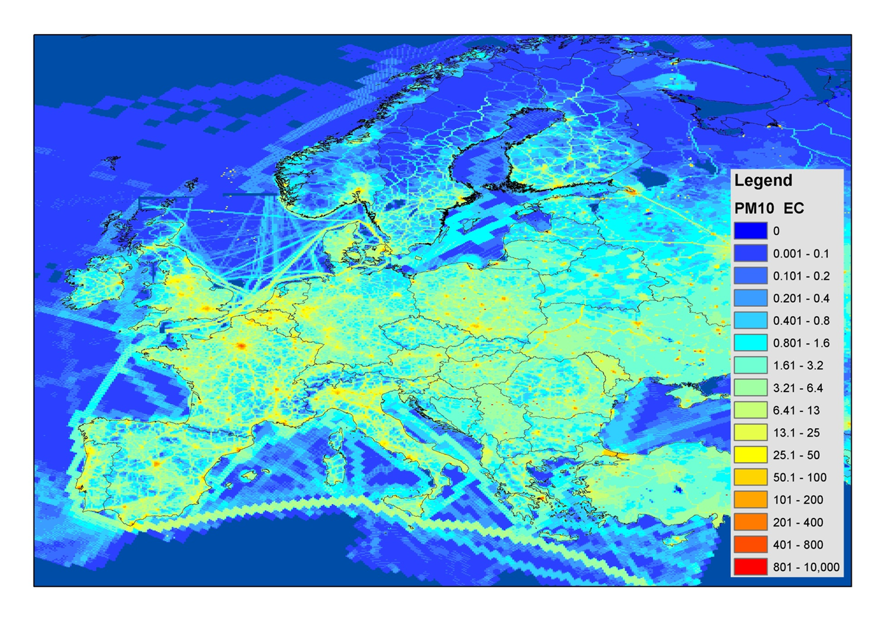
Emissions
National:
For reporting, national obligations to EU,
mitigation potential, national modelling
TNO-CAS plays a key role in the Dutch Emission
Registration
~40 years of experience
Prepare National Inventory Report to UNFCCC
Prepare emission to National reporting of air pollutants to EU/ P/ EMEP
  International: TNO-MACC_III emission high resolution emission inventory for air quality modelling and policy scenario’s, effectiveness of EU measures.
The TNO MACC Emission Inventory provides input to most modelling teams in Europe and will be a key asset in the Copernicus Atmosphere Monitoring Service (CAMS)
Notes:
Currently, the interactions between society and the environment are described by means of the DPSIR framework.
The social, demographic and economic developments in societies and the corresponding changes in lifestyles, overall levels of consumption and production patterns which will induce developments in release of substances (emissions), physical and biological agents, the use of resources and the use of land by human activities.
Within CAS department we have sufficient expertise to act at various level of this framework.
The emission inventory team provide information which help us quantify the PRESSURE.

Slide 7
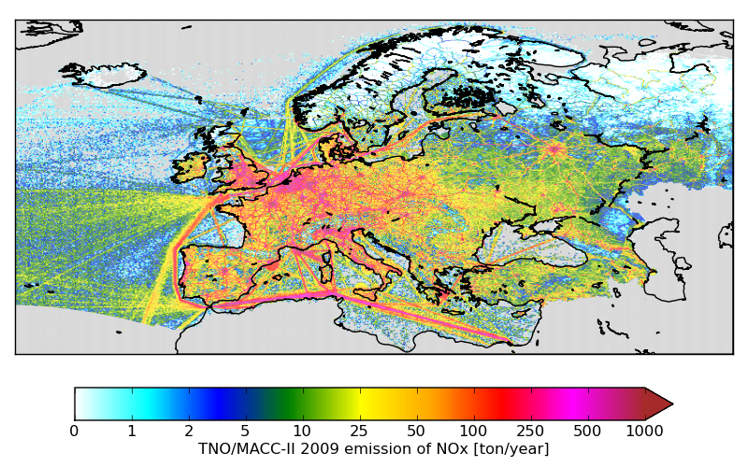
European emission inventories
European emission inventories:
High resolution inventories
HM & POPs
TNO-MACC-III inventory
Annual emission information per country as reported to EEA
Currently available 2005-2013
TNO-MACC-III inventory provides model ready gridded annual total emission data
TNO inventories often used to explore and develop new approaches prior to inclusion in official reporting

Slide 8
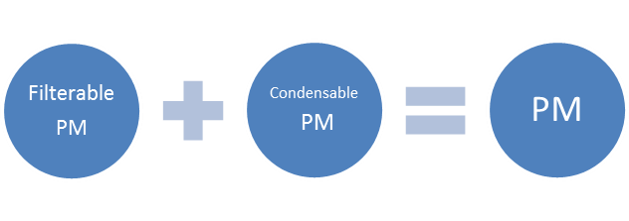
An alternative Inventory based on
Filterable PM and Condensable PM
the US EPA defines particulate matter (PM) as consisting of a filterable fraction (FPM) and a condensable fraction (CPM).
Filterable PM is directly emitted:
Solid or liquid
Captured on filter
PM₁₀ or PM_{2.5}
Condensable PM is in vapor:
Reacts upon cooling and dilution
Forms solid or liquid particle
Always PM_{2.5} or less
where should the PM mass be that forms almost instantaneously?

Slide 9
How important is the revision for European PM2.5 inventories?
Zooming in on the EU28 and 2013, the impact is high with an increase in PM2.5 emissions of about 60 %.
This is a major impact and needs further investigation and verification! Research is needed both at
the emissions side (PM condensables by source type, better activity and appliance types information and emission factors)
the model side (PM, NMVOC, SVOC, IVOC and volatility base set approach)
Harmonization of emission reporting including condensables is needed to properly account for technological information
See presentation Bertrand tomorrow

Slide 10
Satellite data
SO2, NO2, NH3, AOD from e.g. TROPOMI, OMI, IASI, MODIS
Emission modelling in the future
Inverse modelling
Evaluation KPI’s
Emissions
Reported national totals,
E-PRTR,
…
Activities & technologies
e.g.
Electricity use, Fuel sales,
Animals,
Car park,
Population,
…
Pre-operational Emission processing chain
Knowledge Portal
Spatial distribution of anthropogenic emissions
Temporal emission allocation modules for Anthropogenic emissions
using EO and meteorology
Emission reanalysis
Users
CAMS,
Policy bodies, national centres,
Science
Early estimates
Emission forecast
T + 96 hr
Semi-natural emissions
BVOC
Marine
Dust
Fires …..
Time profiles
Proxy and distribution maps
Documentation
Training material
Satellite data
e.g.; GPS, AIS, Land use, vegetation, LAI, FRP, wave height, sea ice, snow cover, soil water, …

Slide 11
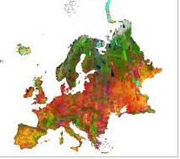
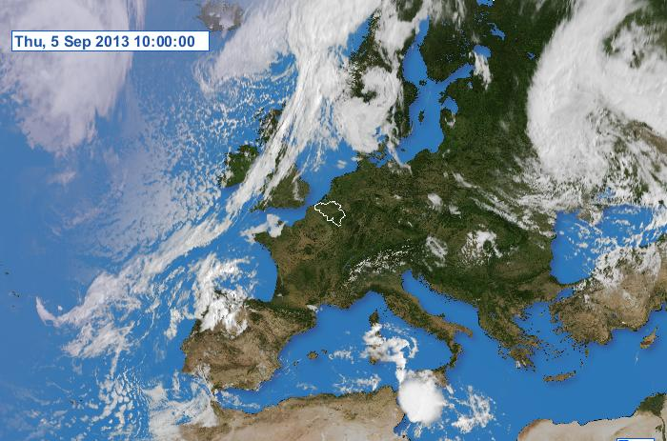
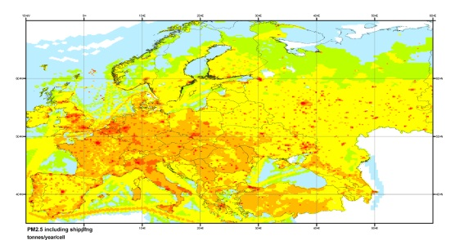
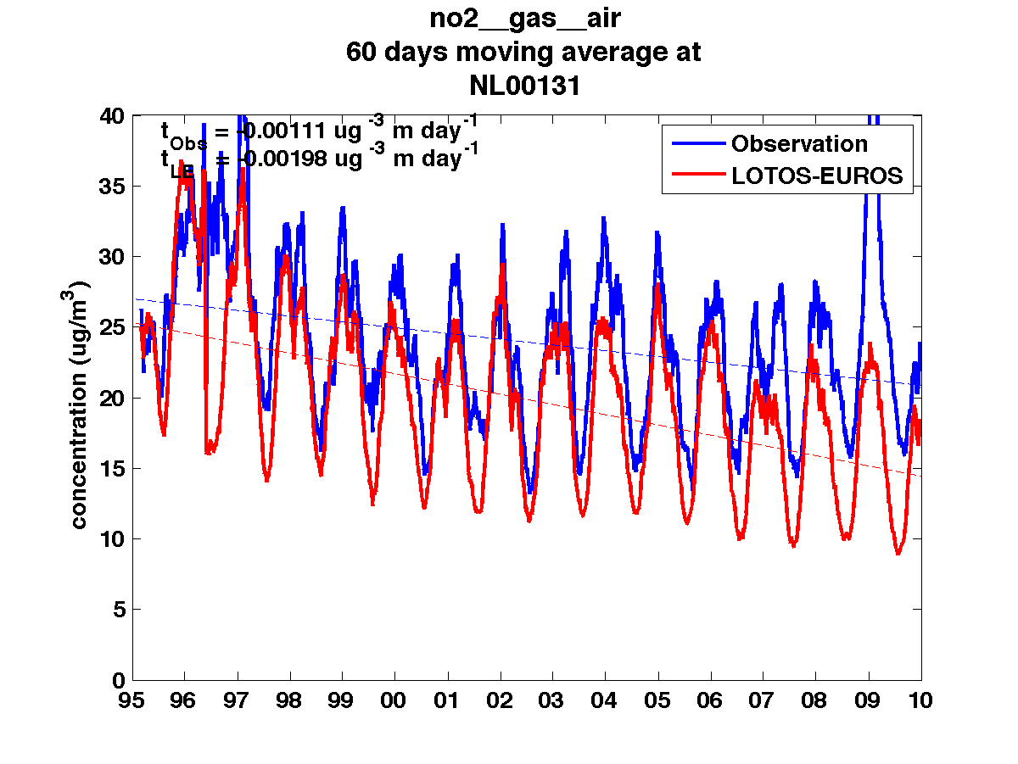
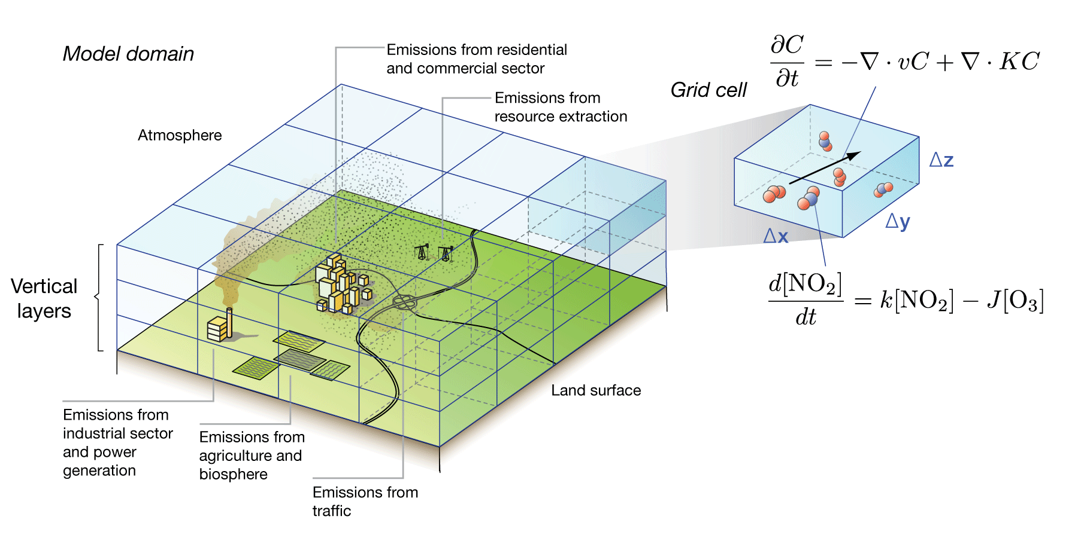
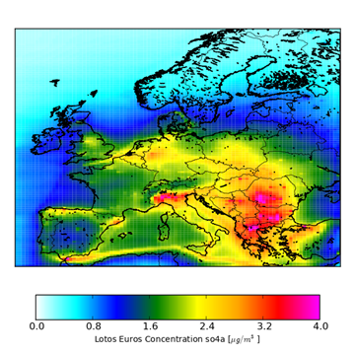
LOTOS-EUROS model
Simulation model for air quality
TNO, RIMV, KNMI
landcover/soil
emissions
...
meteorology
concentrations
numerical model

Slide 12


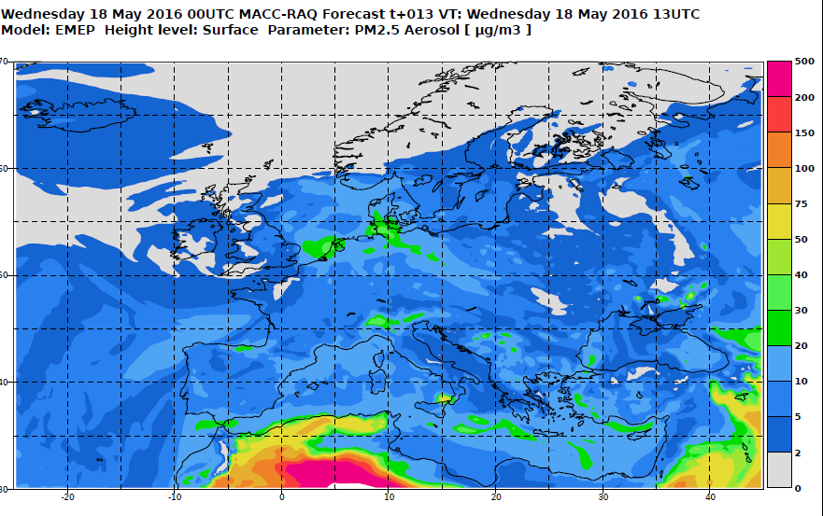
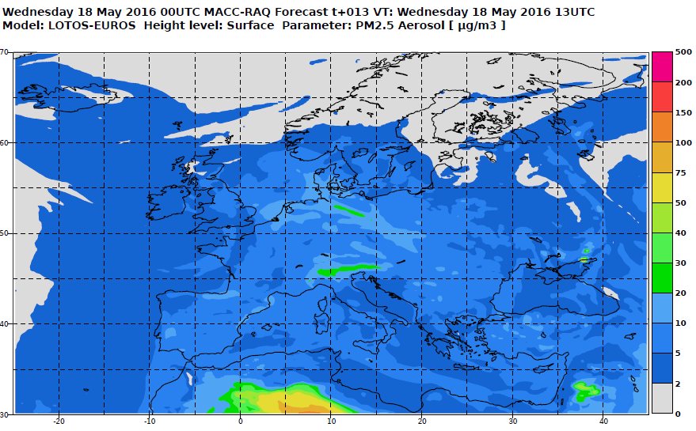
Operational Air quality forecasts
Europe (with RIVM/KNMI)
http://atmosphere.copernicus.eu/

Slide 13
Participation in and organisation of model comparisons to assess robustness of EMEP results for policy support
EMEP review
EURODELTA I & II
AQMEII I & II
ECLAIRE
TFMM Scale dependency
TFMM ED-Trends
…
Should we strengthen the exchange of experiences?

Slide 14
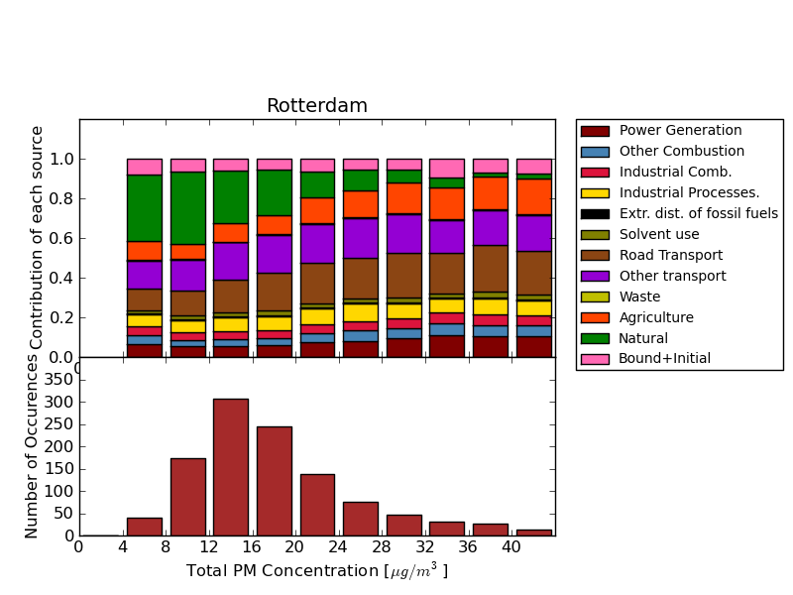
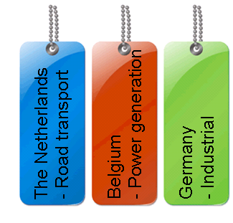
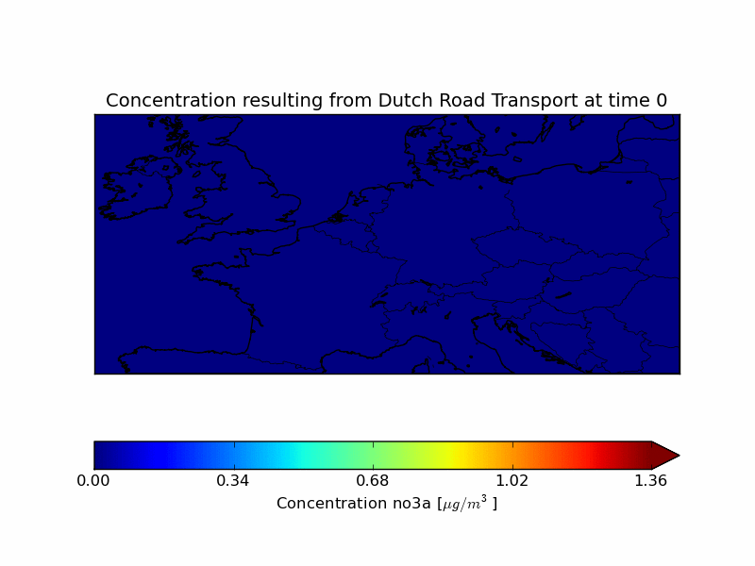
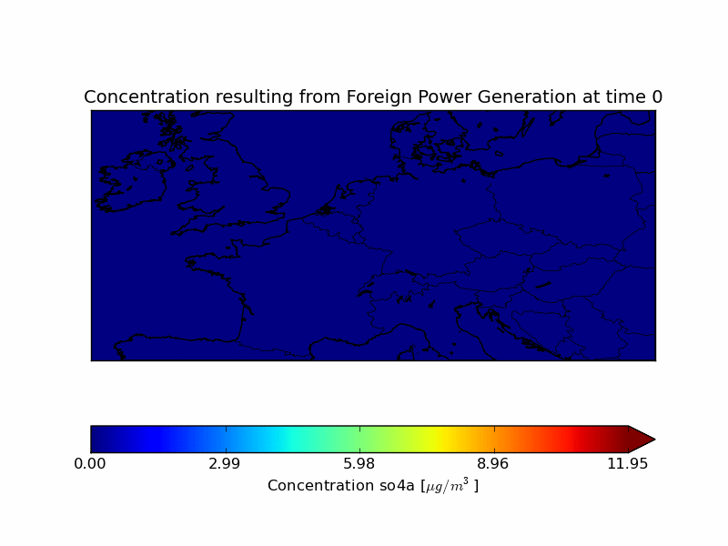
Source apportionment

Slide 15
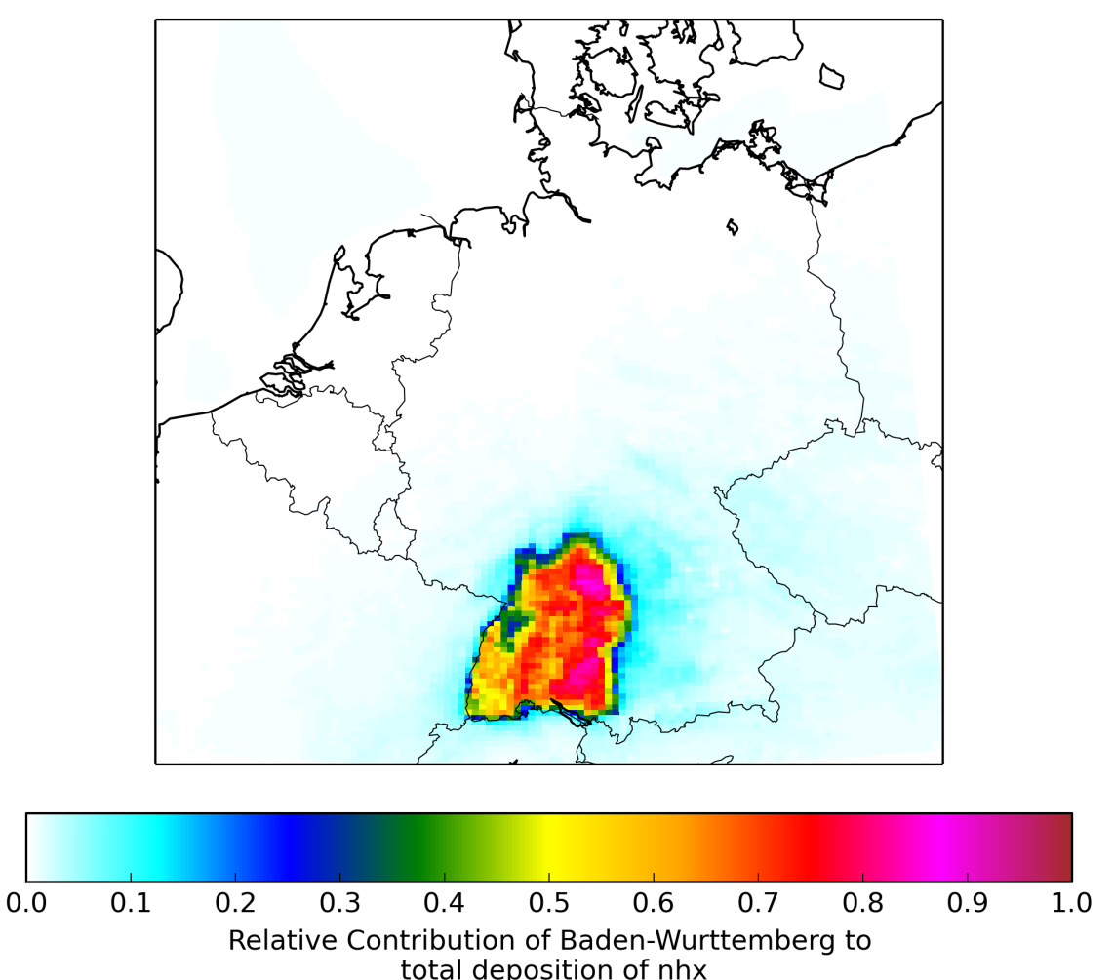
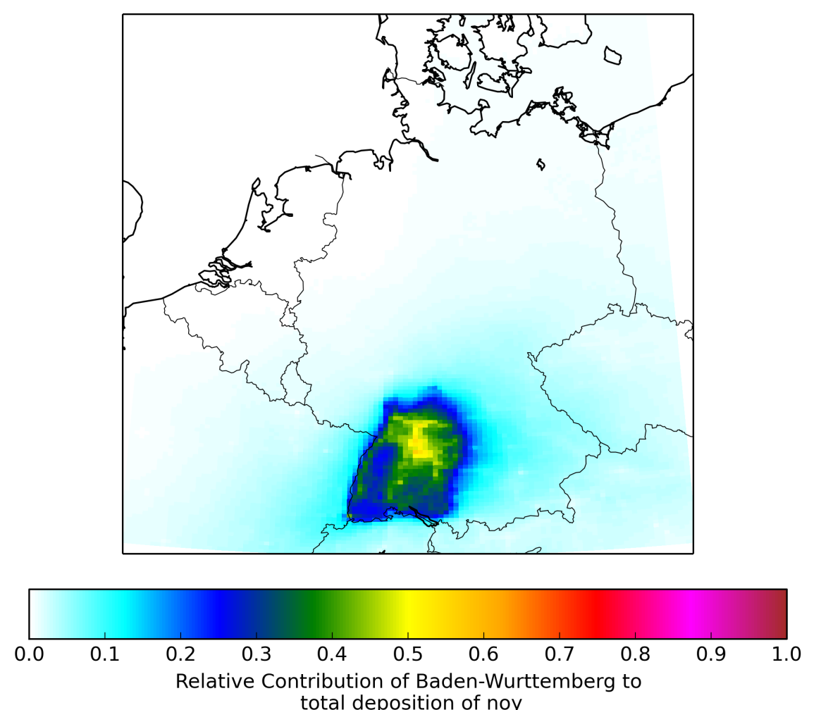

Modelled contribution of Baden-Württemberg to total nitrogen deposition
NHx
NOy
Policy support applications – in this case for Germany to assess the origin of N-deposition.

Slide 16
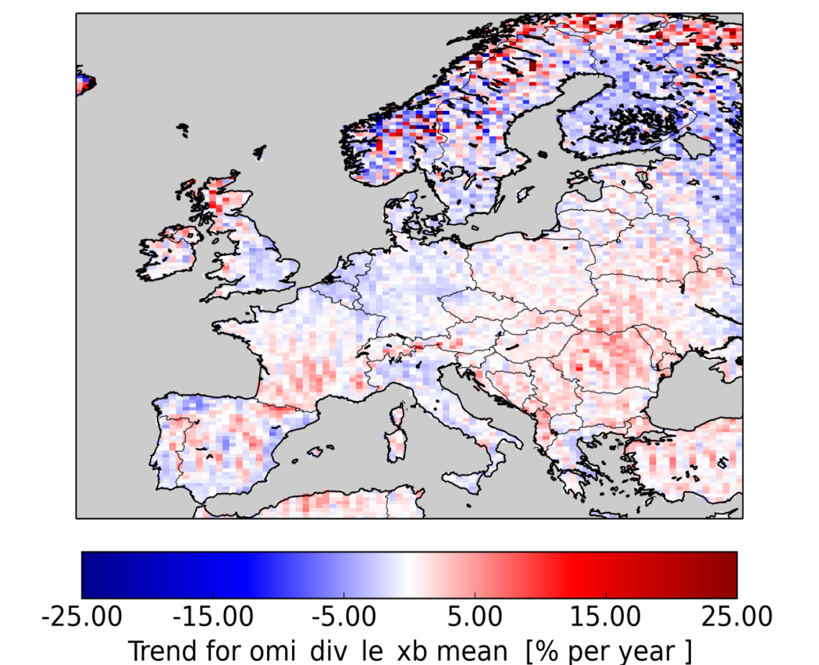
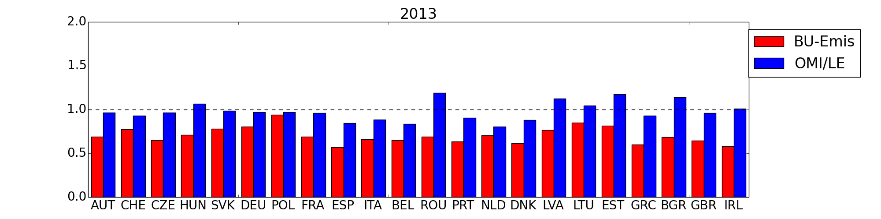
European Emission Trend Validation
Derivation of emission estimates for NO_{x} per country by data assimilation of satellite data in the LOTOS-EUROS model.
Comparison of reported emission ratio between 2013 and 2005 by countries and deduced from OMI-NO₂ and LOTOS-EUROS
.
Notes:
Titel van de presentatie
Wednesday, May 18, 2016
16

Slide 17

LOTOS-EUROS freely available after the summer break
|
Training workshop will be held in fall 2016
Comes with TNO emission data
www.lotos-euros.nl
info@lotos-euros.nl

Slide 18
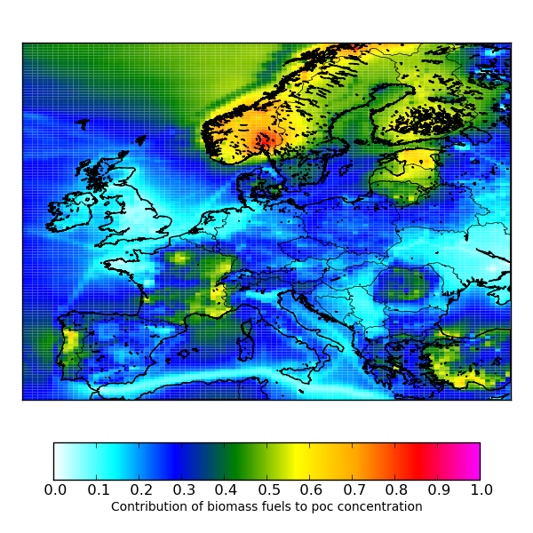
Contribution of reported wood combustion emissions to modelled POC

