Slide 1

Assessment of EMEP Model Performance across Croatia at two resolutions based on DELTA tool
Sonja Vidič
Meteorological and Hydrological Service sonja.vidic@cirus.dhz.hr

Slide 2

Context I
Can we use model(s) / EMEP or any other regional scale model for compliance issues?
- air quality assessment
- planning
- emission reduction
- special cases/exceedences
Whenever the question is elevated, the answer is:
- YES and NO
- Depends
- One must be careful
- Know what you are doing
- There are large uncertainties
Nevertheless, we do model constantly – we check, re-check, compare, intercompare, develop and advertise
– models are modestly introduced to AQD/EU policy instruments and we are addicted to them.

Slide 3
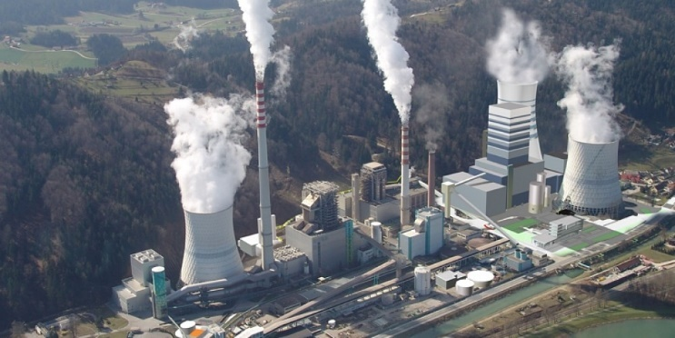
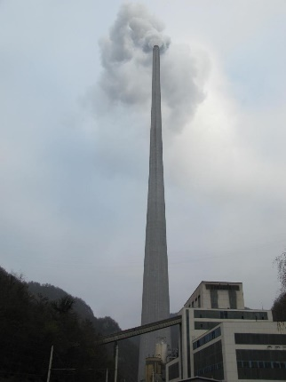
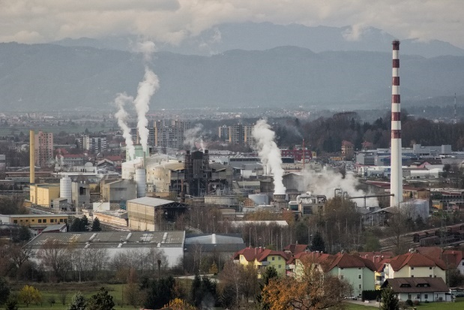
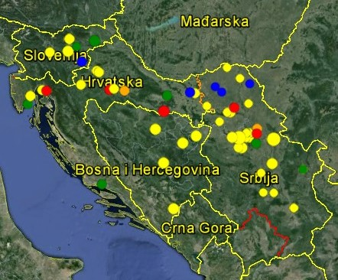
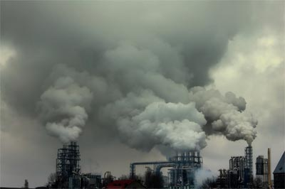
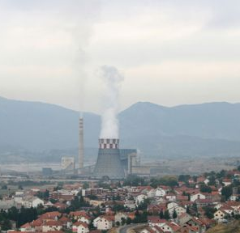
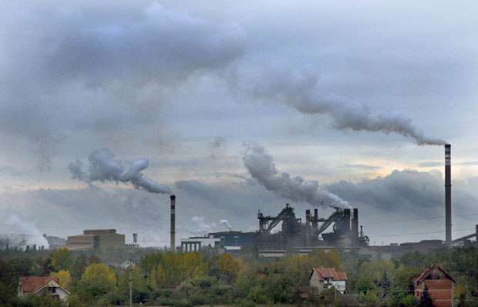
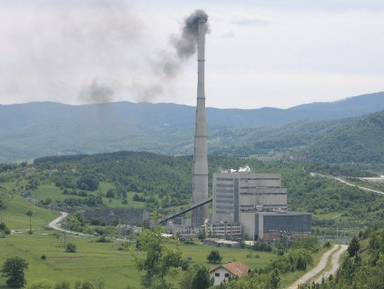
Context II

Slide 4
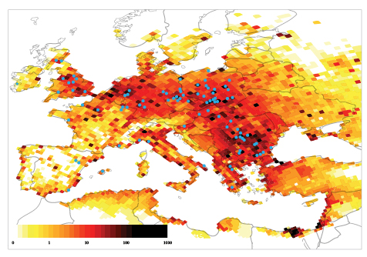
Coal dominant sources in Europe

Slide 5
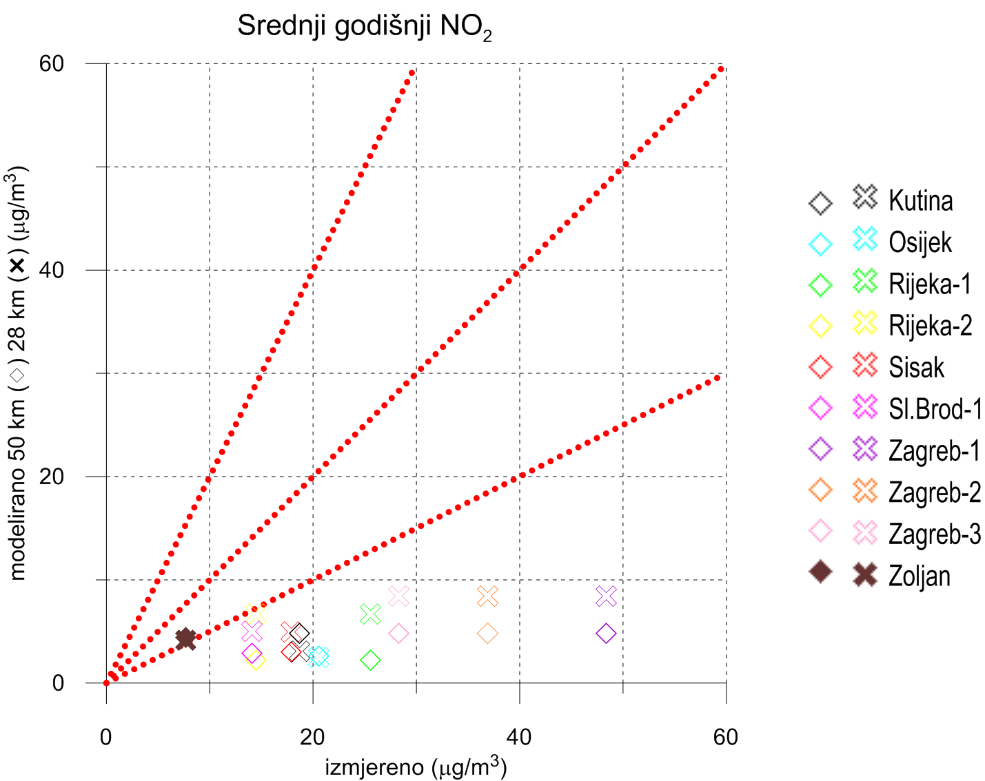
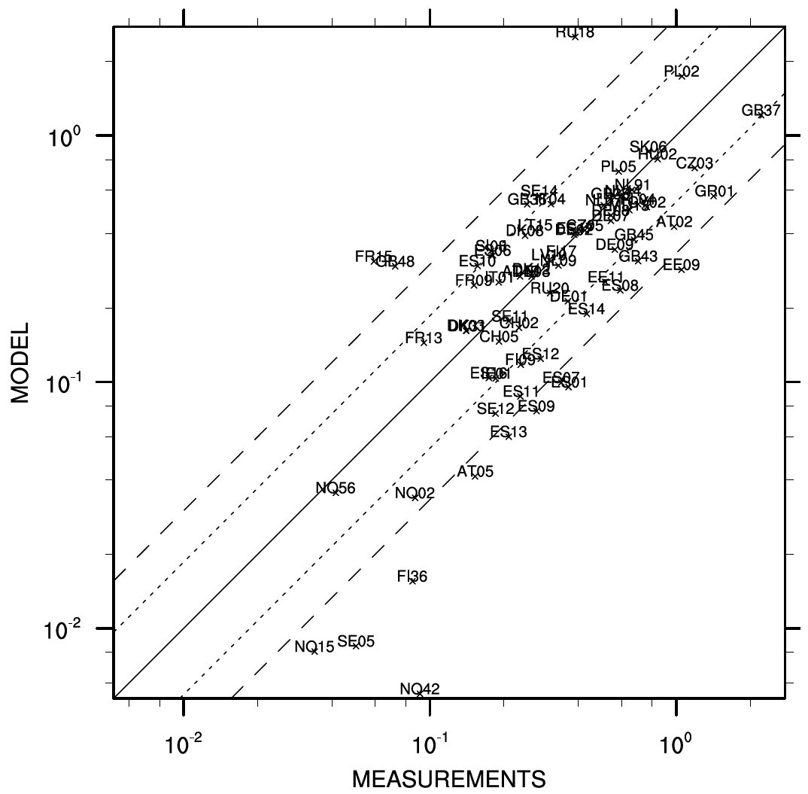
Context III
EMEP GRID
50 km x 50 km
EMEP GRID
50 km x 50 km

Slide 6
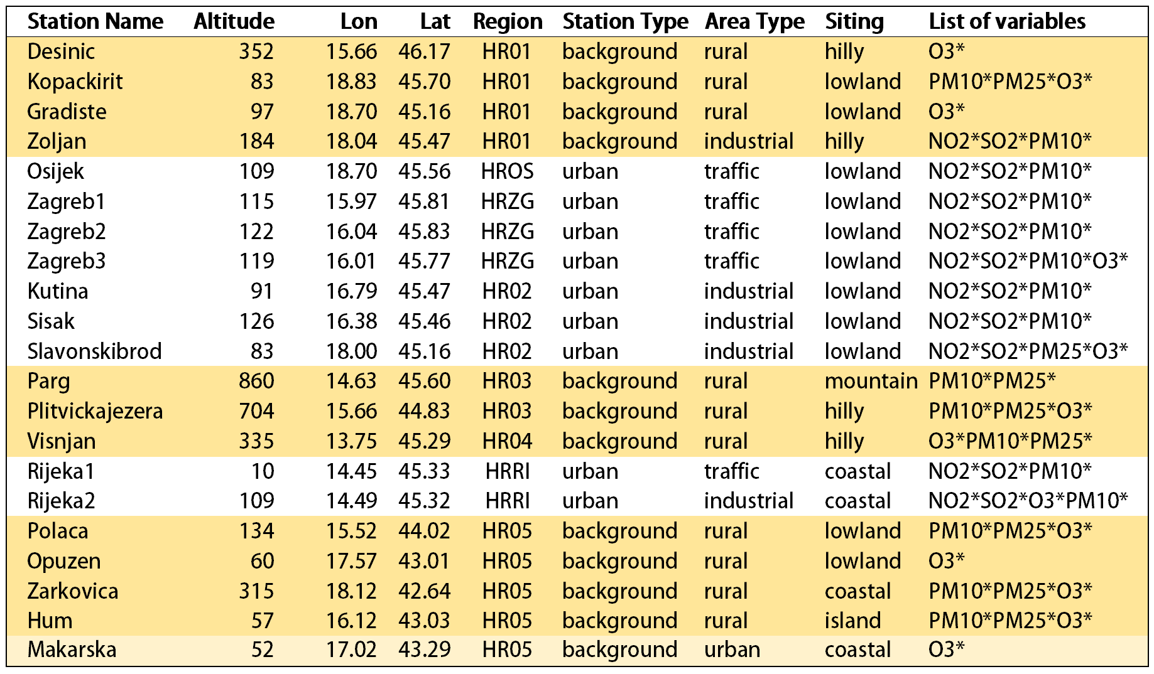
Air Quality Monitoring Network – sites used for the study

Slide 7
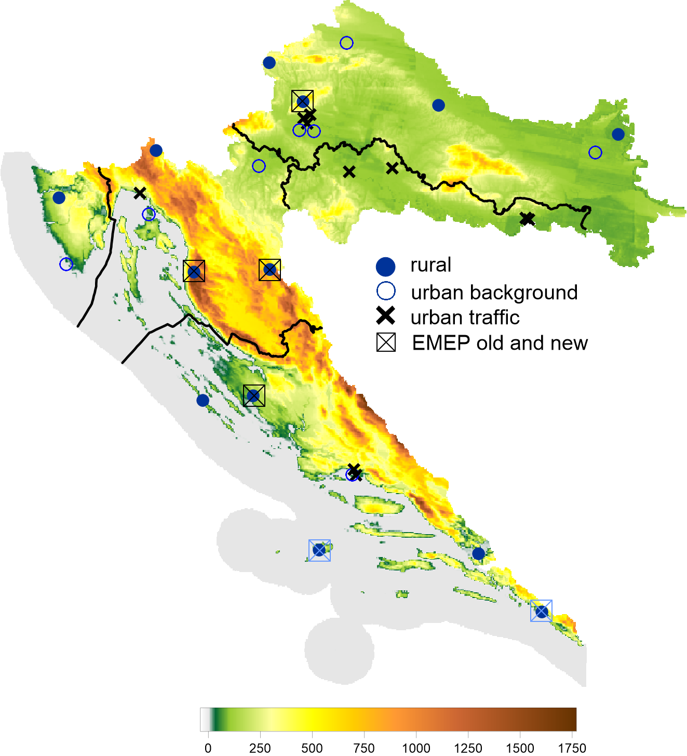

Slide 8
Model resolutions
GRID
50 km x 28 km
EMEP GRID
50 km x 50 km

Slide 9
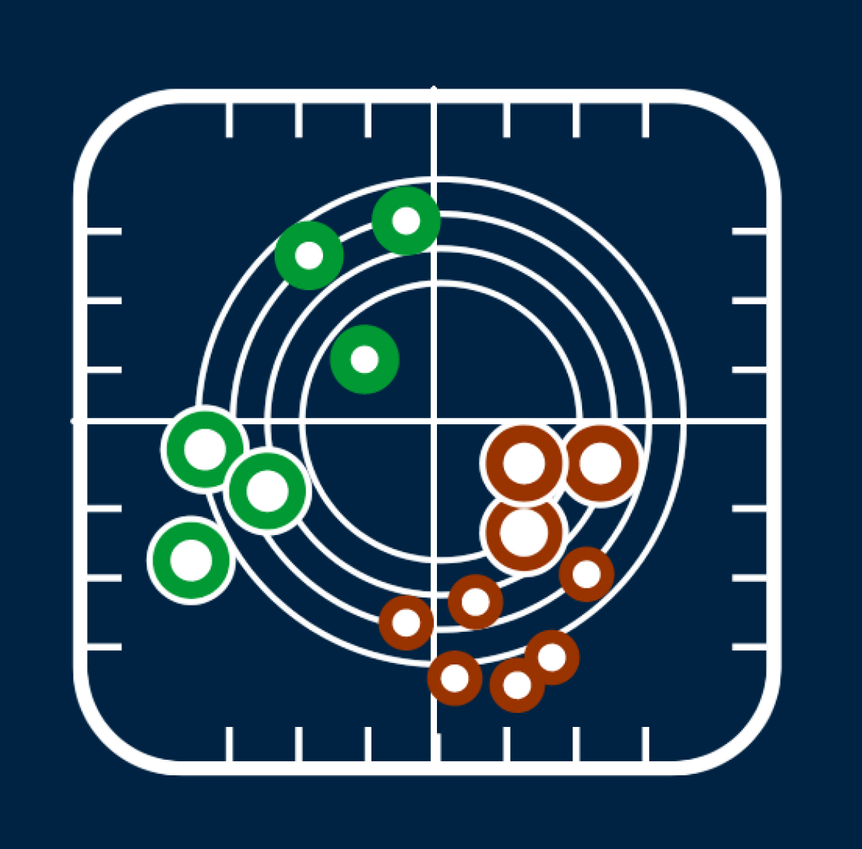
DELTA Tool
Evaluation software which includes the main assets of the EuroDelta, CityDelta, and POMI tools (Cuvelier et al. 2007; Thunis et al. 2007).
It allows to perform rapid diagnostics of air quality and meteorological model performances.
It works on the comparison of time series at specific locations and therefore addresses all relevant spatial scales (from local to regional).

Slide 10
DELTA Tool
TARGET DIAGRAM
Statistical performance indicators provide insight on model performance in general but they do not tell whether model results have reached a sufficient level of quality for a given application, e.g. for policy support (mean, stdev, bias, RMSE itd.). MPI
Model Quality Objective (MQO), defined as the minimum level of quality to be achieved by a model for policy use, is defined in AQD for several pollutants (NO₂, PM₁₀/PM_{2.5}, O₃).

Slide 11
MQO as defined in the AQD and in the current version of DELTA
Table summarizes the values of the MQO proposed in the Air quality directive (AQD) around the limit values (or target values) as well as those proposed in the current DELTA benchmarking.
Since MQO vary with the concentration level and cover the whole concentration range, a value at mid-range (Limit value /2) is also provided for information.

Slide 12
Air Quality Monitoring Network – sites used for the study

Slide 13
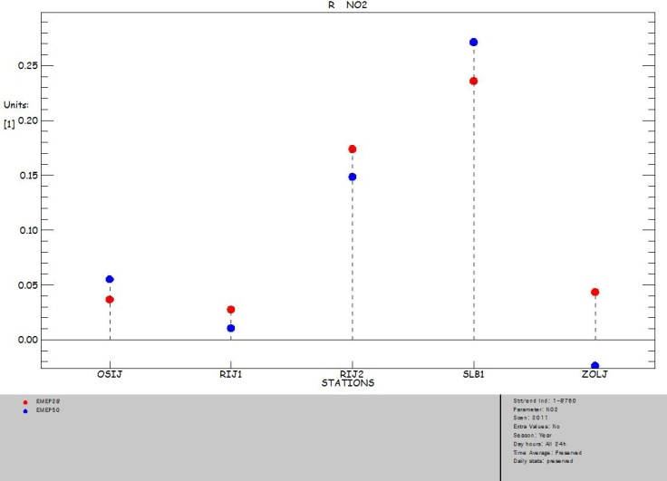
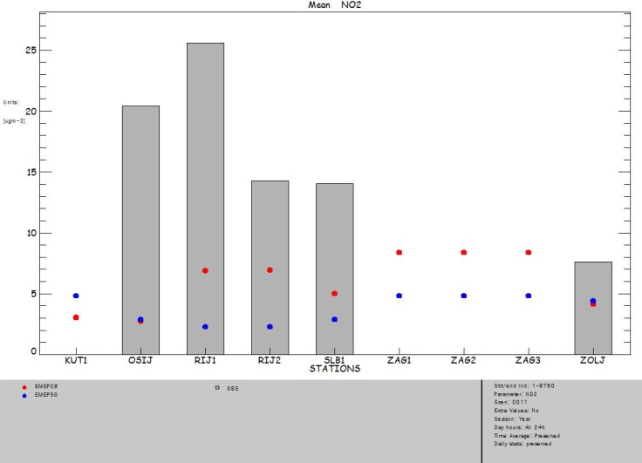
Results for NO₂
Mean annual no2 koncentrations
Correlation coefficients
28 km
50 km

Slide 14
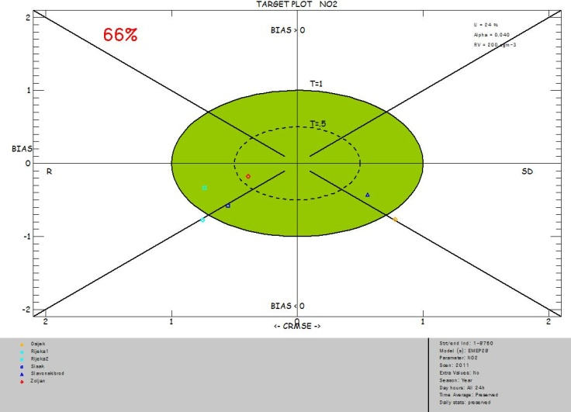
50 km grid
C₅₀ > C₂₈

Slide 15

28 km grid
C₅₀ > C₂₈

Slide 16
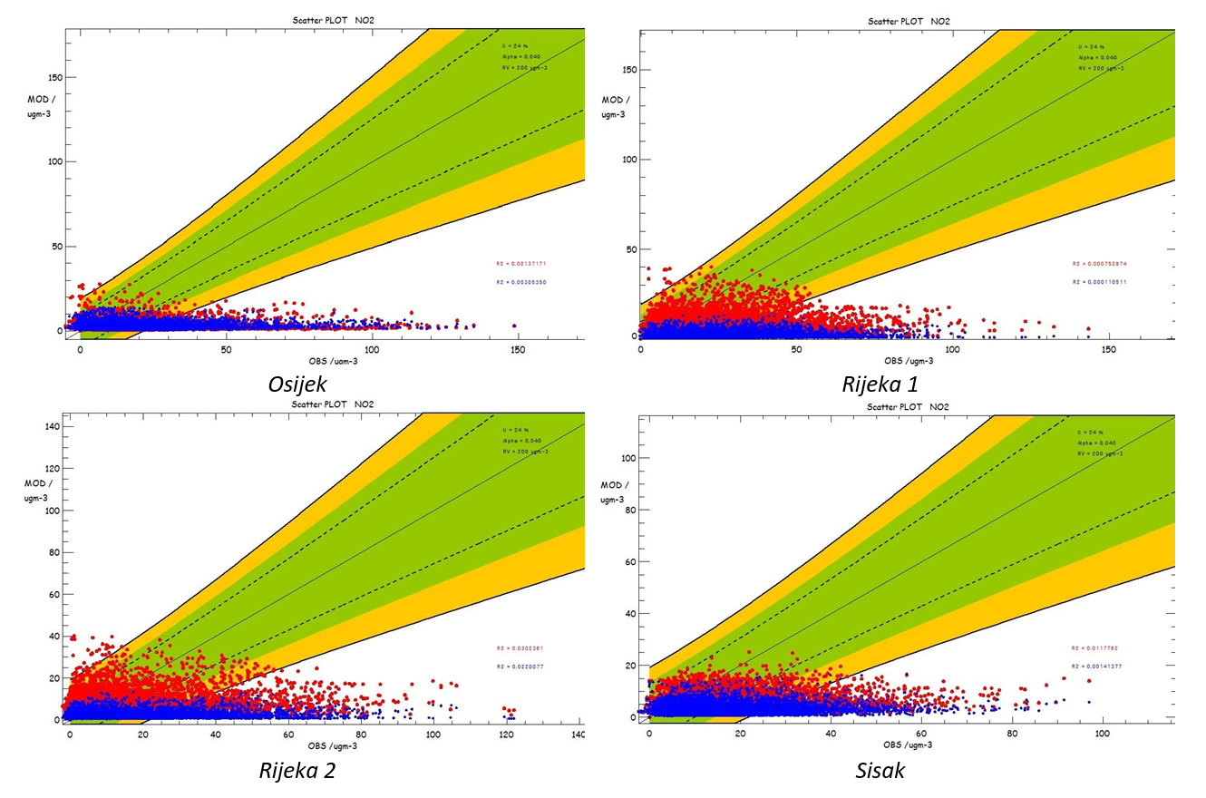
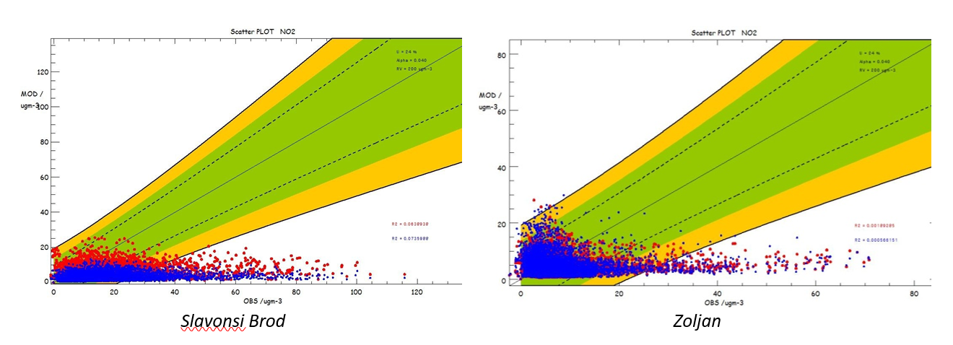

Slide 17
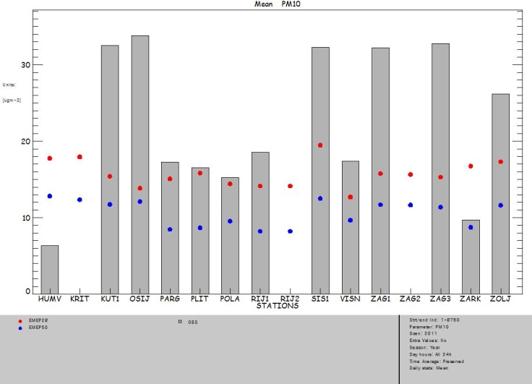
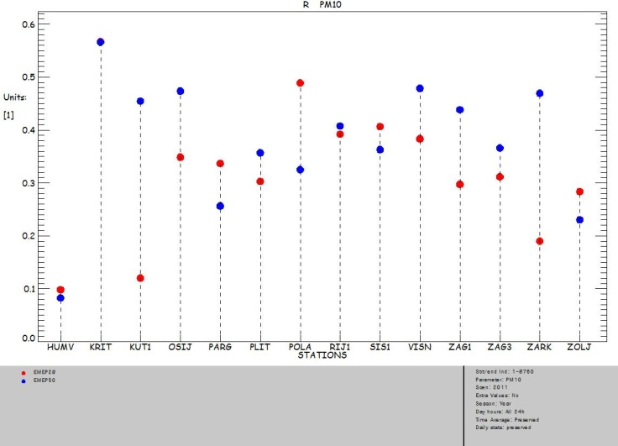
Results for PM₁₀ and PM_{2.5}
Rural background sites

Slide 18
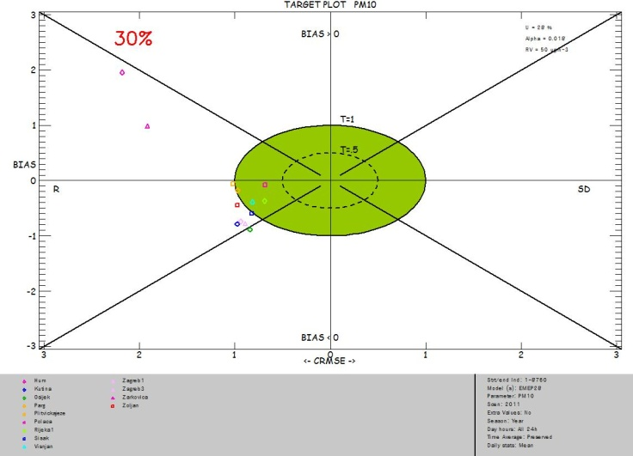
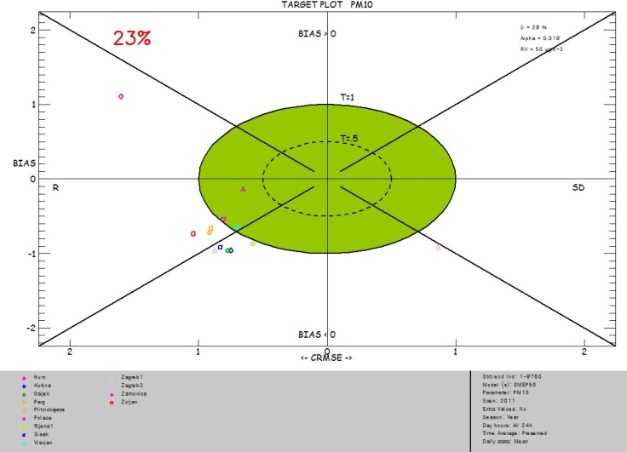
28 km grid

Slide 19
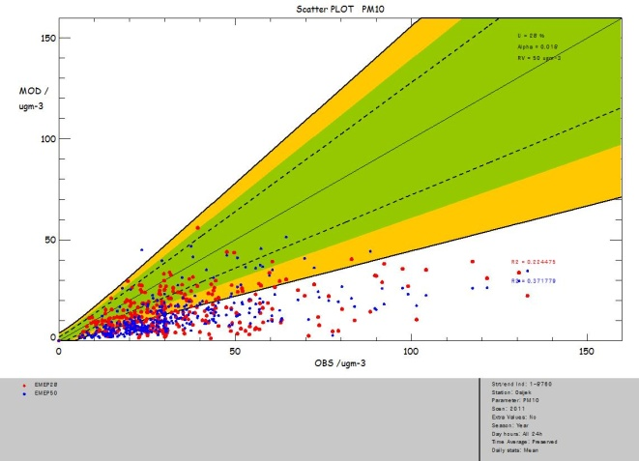
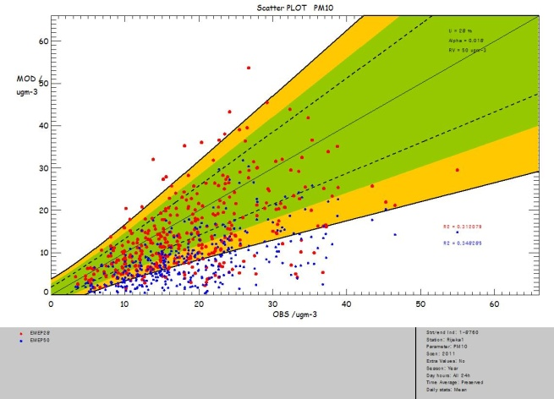
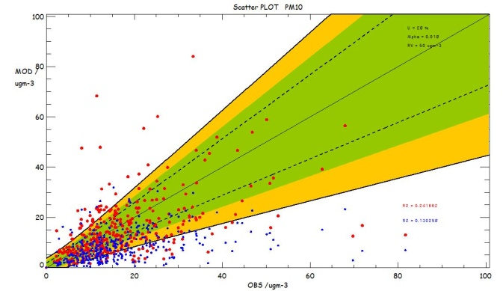
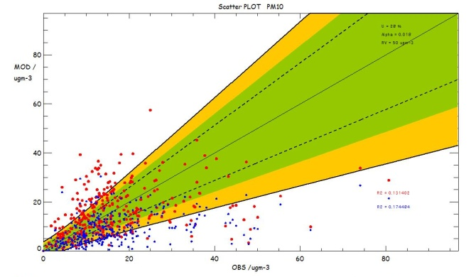
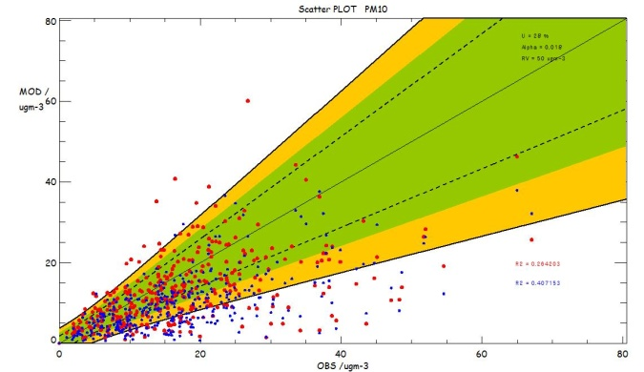
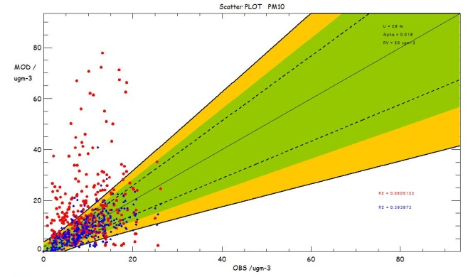
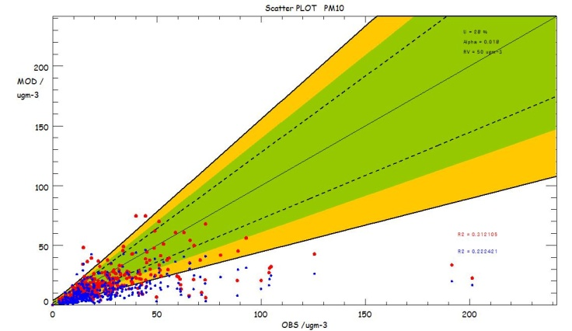

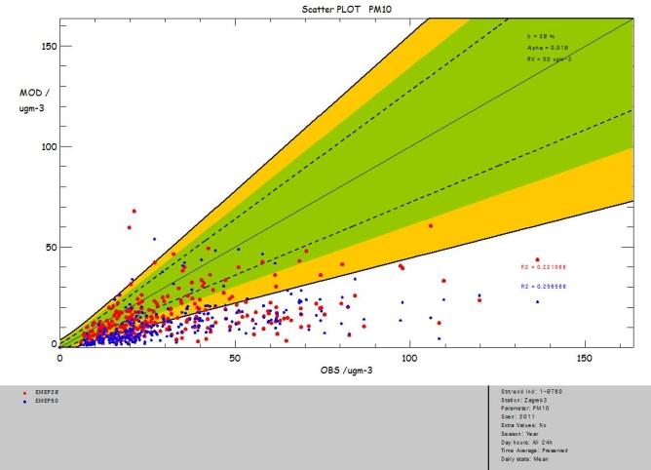
Rural sites
For all statistical indicators used in DELTA for benchmarking purposes the approach currently used in the AQD has been followed.
This means that the model quality objective must be fulfilled for at least 90% of the available stations. The practical implementation of this approach in DELTA consists in calculating the MQI associated to each station, rank them in ascending order and inferring the 90th percentile value.

Slide 20
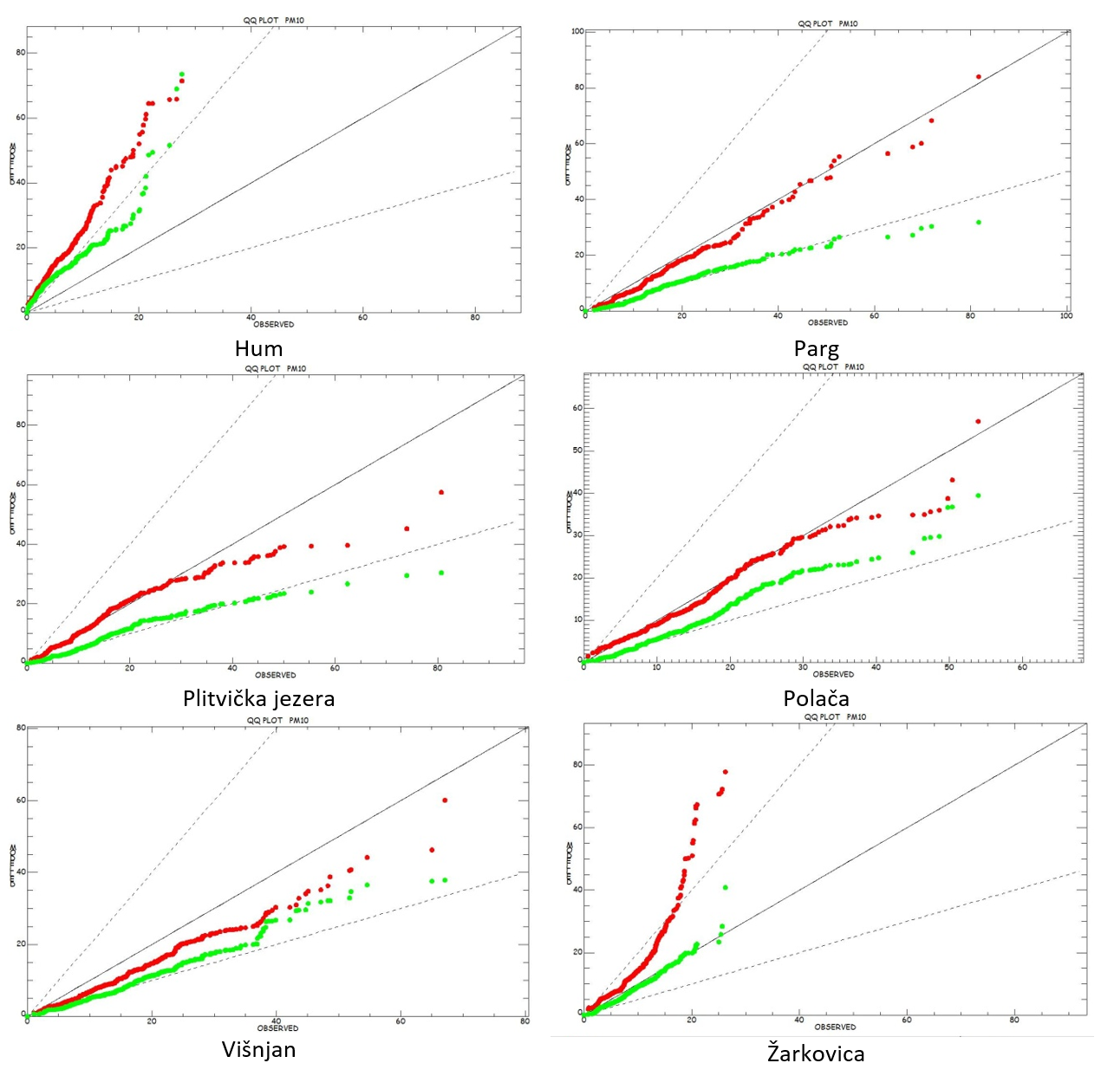
530 m
300 m

Slide 21
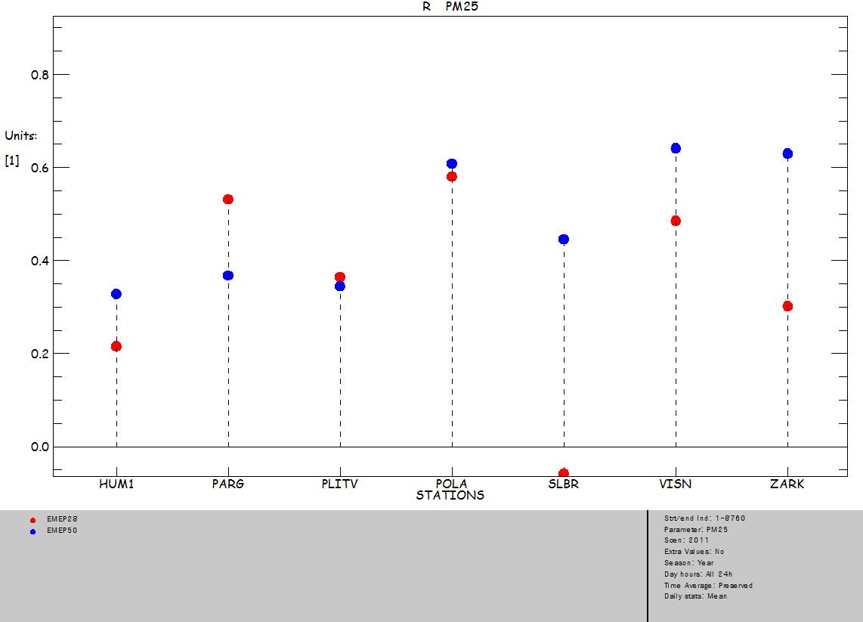
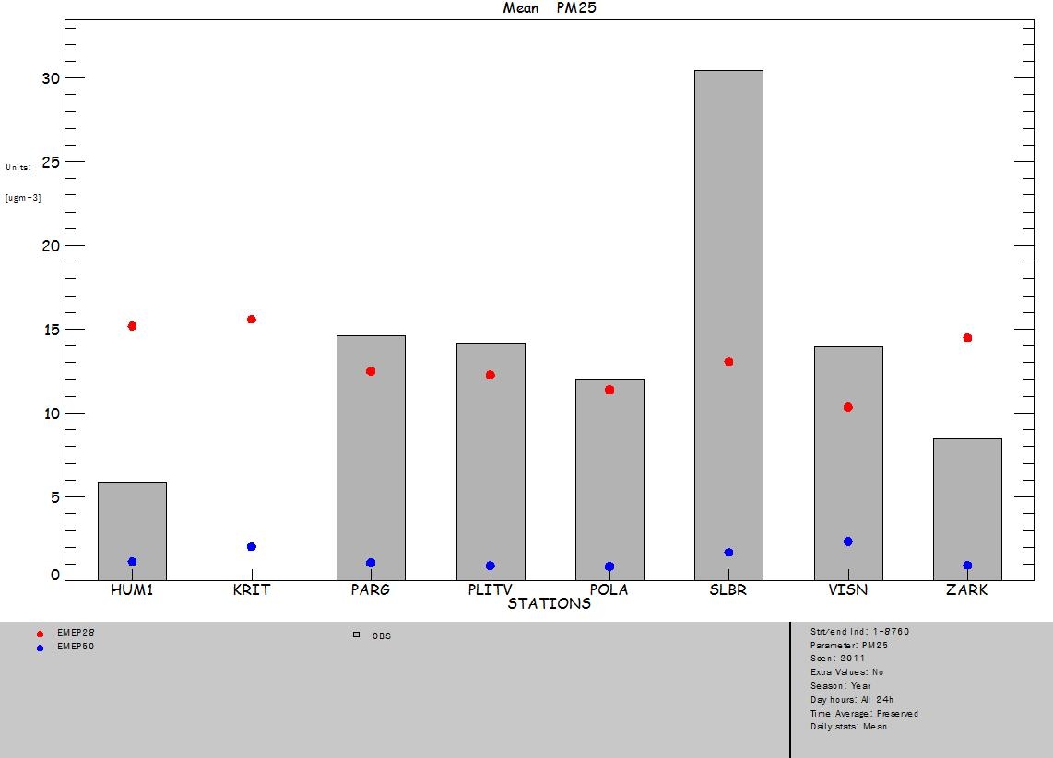
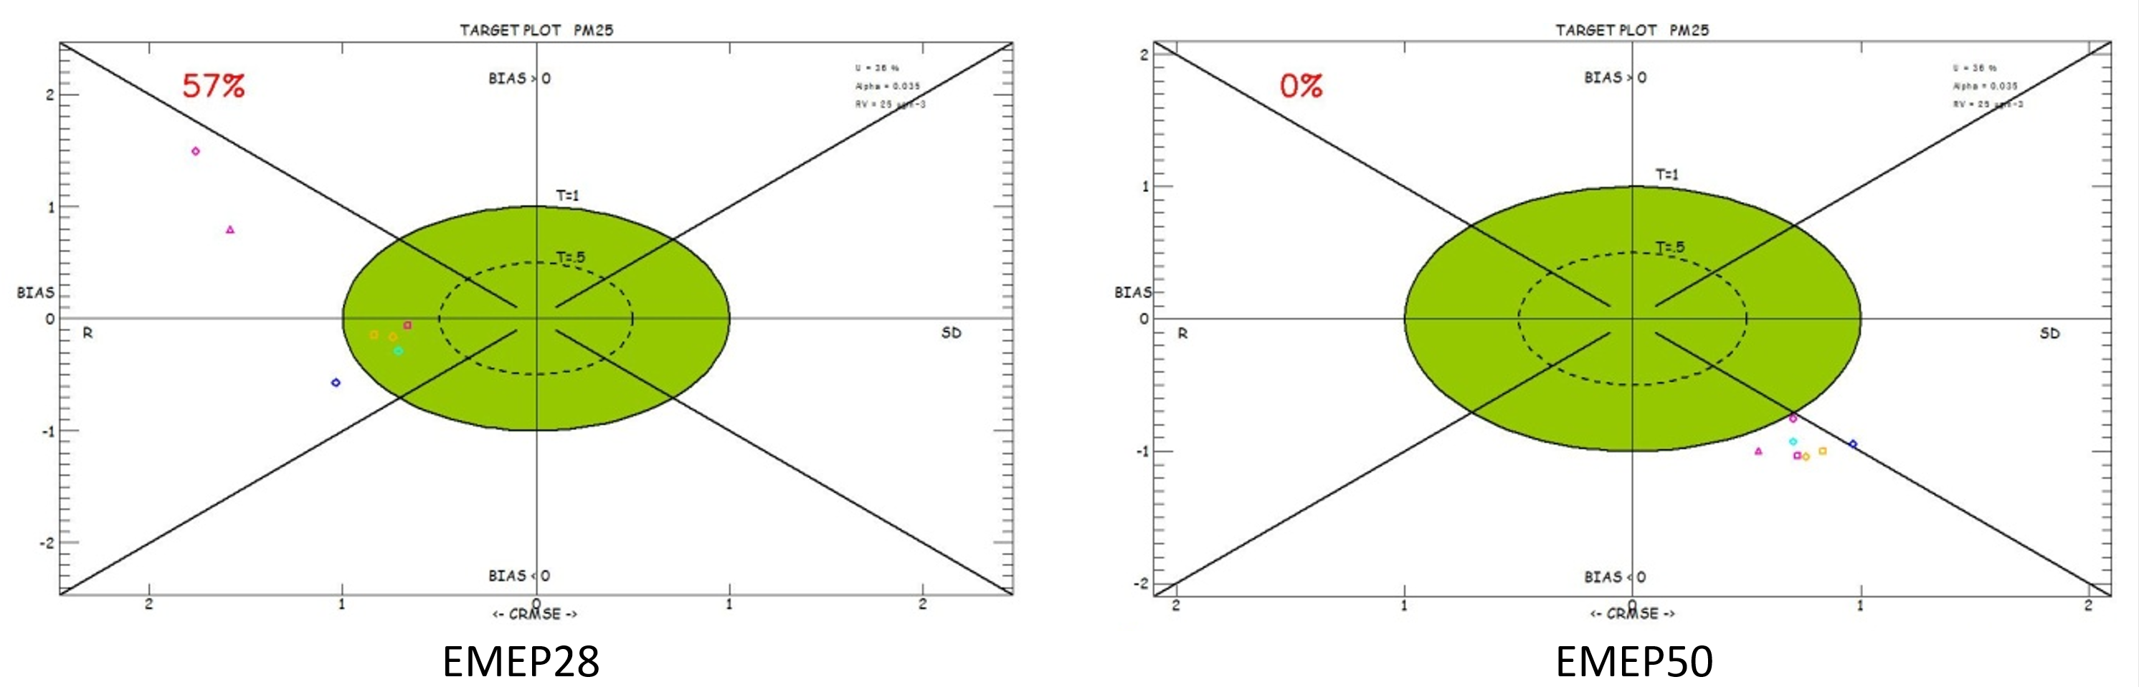
PM_{2.5}
Rural background sites

Slide 22
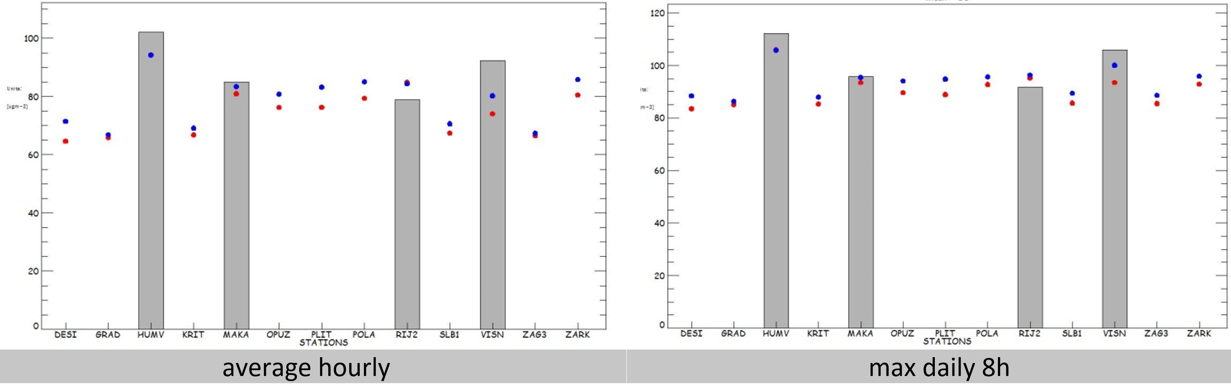
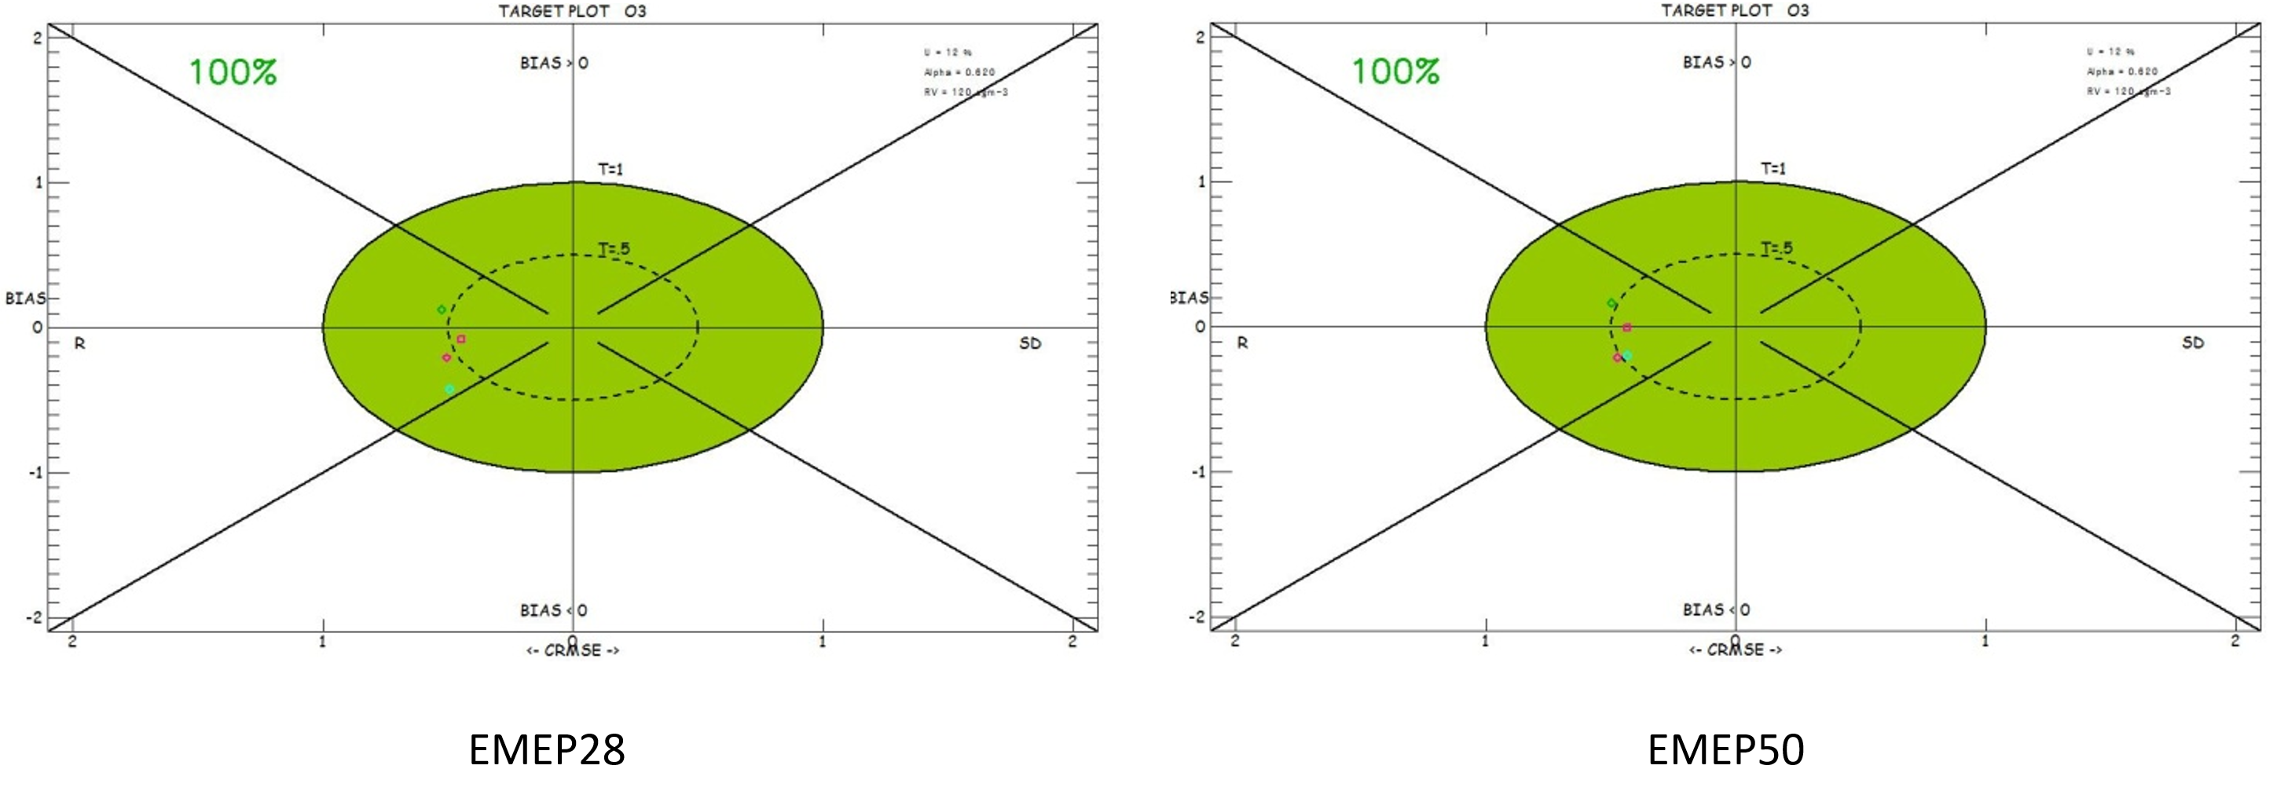
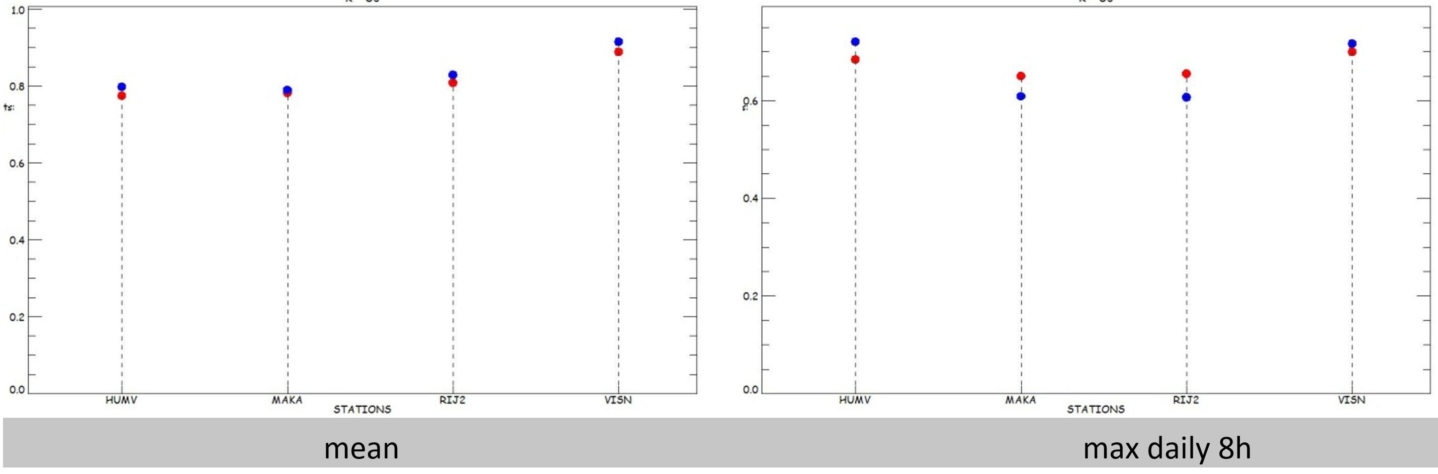
Results for ozone
mean
correlation coefficient

Slide 23
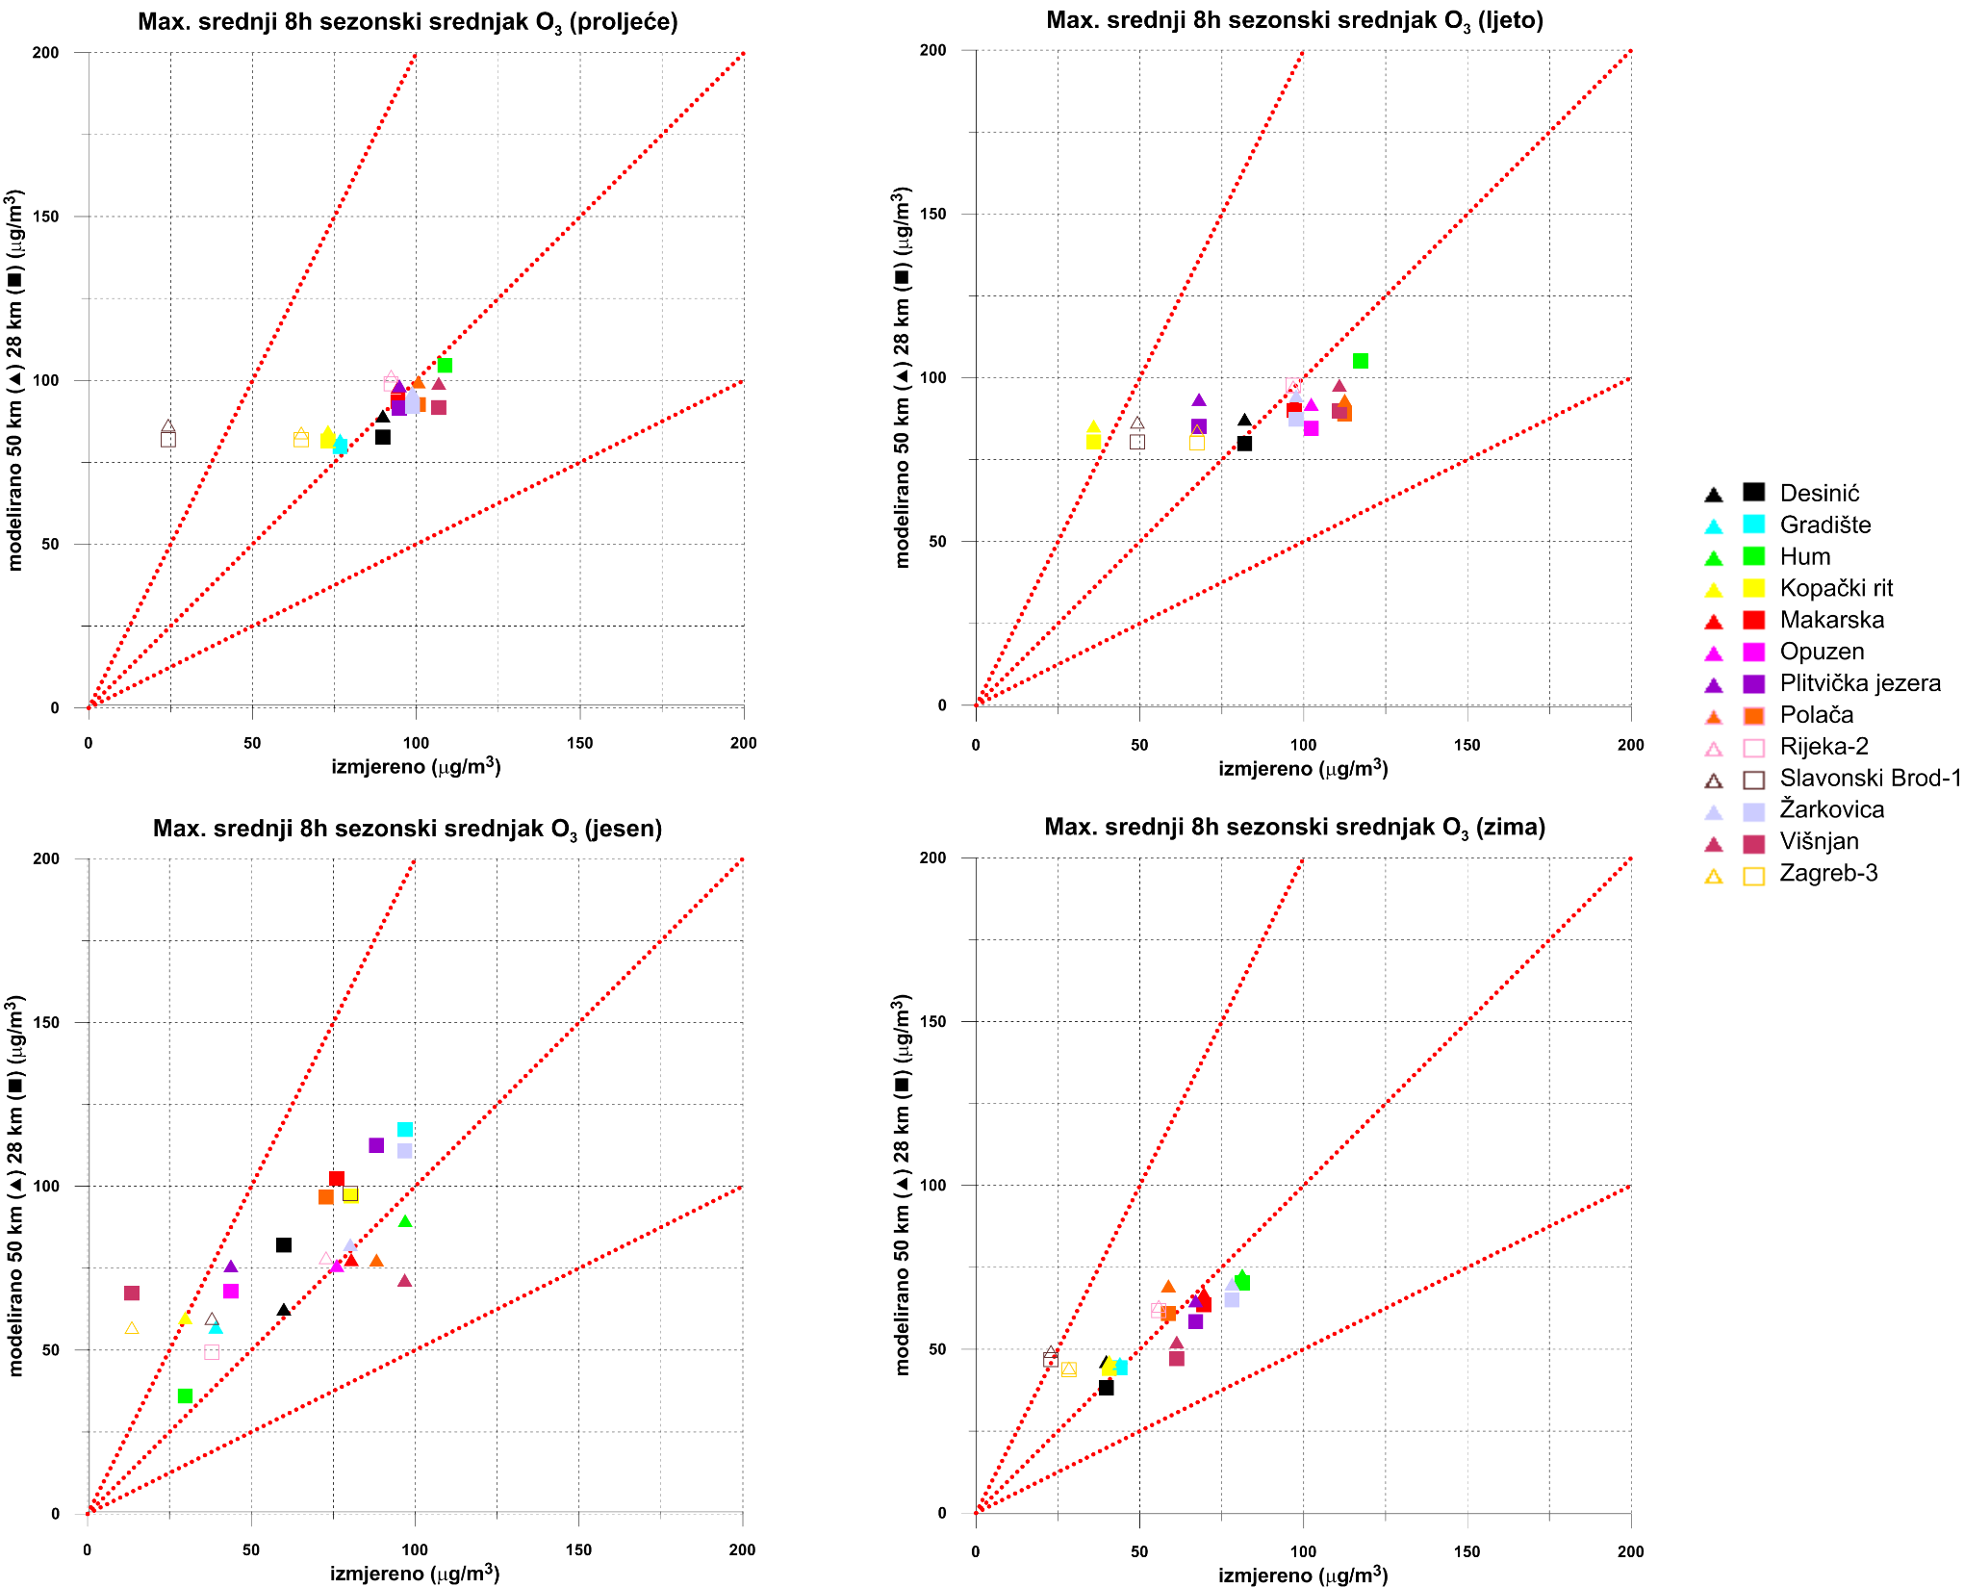

Slide 24
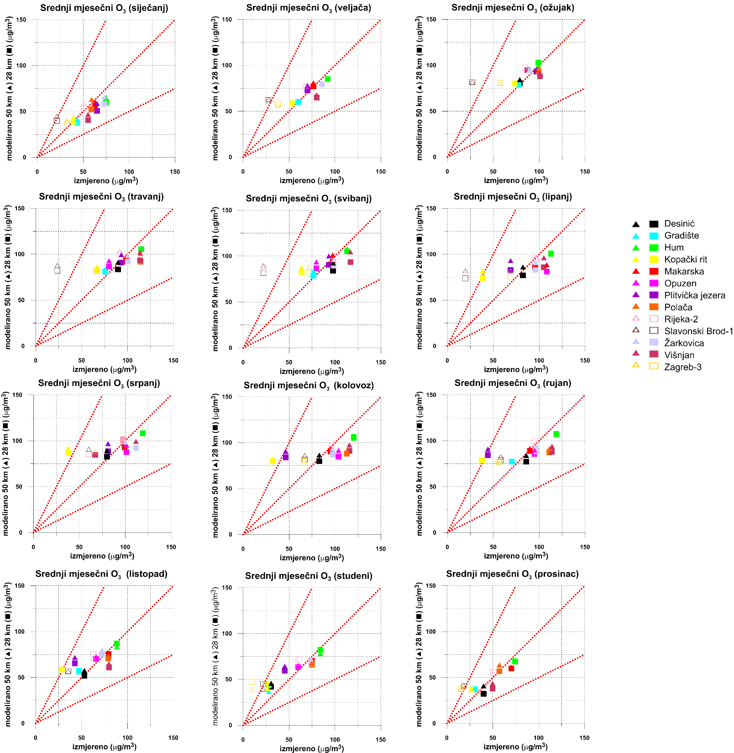

Slide 25
Conclusions
Modelled ozone fulfils MPC 100% (all stations) for both scales
NO₂ does not fulfil MPC even though some statistical indicators can be considered – mostly at urban sites; one rural site performs better
PM10 and PM2.5 at rural sites fulfil some statistical criteria bur not the overall target
28 km scale model performs better with the same model formulation
Expectation is that 7 km grid scale should improve Model Performance
Rural sites – important for model performance evaluation
Delta tool is very useful and versatile tool – helps synthetise and understand complex information in an easy and more intuitive manner

Slide 26
EMEP GRID
50 km x 28 km

