Slide 1

Outcomes of the WMO GAW International workshop on Nitrogen Cycle
Oksana Tarasova
WMO Research Department

Slide 2

GAW Implementation Plan (2015-2023)
The plan concerns only implementation of the GAW Programme, WMO Strategic Plan is taken as an overall strategy
Follows the concept “research enabling services” – the activities are around application areas rather than focused on GAW parameter specific areas
More focus on modelling tools and value added products
Provides clear framework for the programme implementation concerning network design, modelling tools, quality assurance principles, data management, collaboration with the other programmes
IP builds upon the premise that atmospheric composition matters - to climate, weather forecasting, human health, terrestrial and aquatic ecosystems, agricultural productivity, aeronautical operations, renewable energy production, and more.

Slide 3
Conceptual GAW diagramme
New GAW Data Management strategy
New Scientific Advisory Group on Applications

Slide 4
Simplified view of the Nitrogen Cascade
Greenhouse
gas balance
High temperature
combustion
& industry
Stratospheric
ozone loss
Nitrous Oxide
(N₂O)
Tropospheric
ozone formation
Urban air
quality
Particulate
Matter
Nitrogen oxides
(NO_{x})
Ammonium nitrate
in rain (NH₄NO₃)
Fertilizer
manufacture
Further emission
of NO_{x} & N₂O
carrying on
the cascade
Ammonia
(NH₃)
N_{r}
Crop biological
nitrogen fixation
Crops for food &
animal feed
Eventual
denitrification
to N₂
Intended
N flow
Livestock farming
for food
Terrestrial Eutrophication
Unintended
N flows
N_{r} in
manure
Natural ecosystems
Soil acidification
N form in
the cascade
Leached Nitrate
(NO₃⁻)
Nitrate in streams,
groundwater &
coastal seas
Environmental
concern from N_{r}
Freshwater Eutrophication
Marine Eutrophication
(M.Sutton)
European Nitrogen Assessment

Slide 5
Nitrogen and the Future - Global trends and risks for 2050
>9 billion people: +30%
Meat consumption: >50% increase?
Agricultural production +60-70%
Required increase of cereal production 1%/yr
Extension of agricultural land 10-20%
Loss of biodiversity (MSA) 10%
Increase of N discharge into sea +20%
Temperature rise >2 degr?
One third of the increase in food production is due to population growth, the rest is due to diet
Source: PBL Rio+20
ONW, 2013
(P. Monks)
Notes:
By far the most scarce resource is land for food, and the most treatened natural resource is biodiversity.
And Nitrogen is key factor both for the global food production capacity and biodiversity loss.

Slide 6
GAW International workshop on Nitrogen Cycle, 12-14 April 2016, York, UK
Objective: to establish a connection between GAW focal areas in support of ecosystem services and to ensure that GAW products contribute to the broader Nitrogen cycle agenda
Key partners: LRTAP Task Force on Reactive Nitrogen (TFRN), the International Nitrogen Management System (INMS), agricultural, metrological and effects communities.
Nitrogen in GAW: NOx in Reactive Gases, N₂O in Greenhouse Gases, Nitrate in deposition and Nitrate in Aerosols
GAW can assist by providing INMS with information on the concentrations and flows of fixed nitrogen through the atmosphere. GAW currently coordinates observations of N₂O and NO_{x} in the gas phase and NH₄⁺ and NO₃⁻ in the aerosol phase and in total deposition.

Slide 7
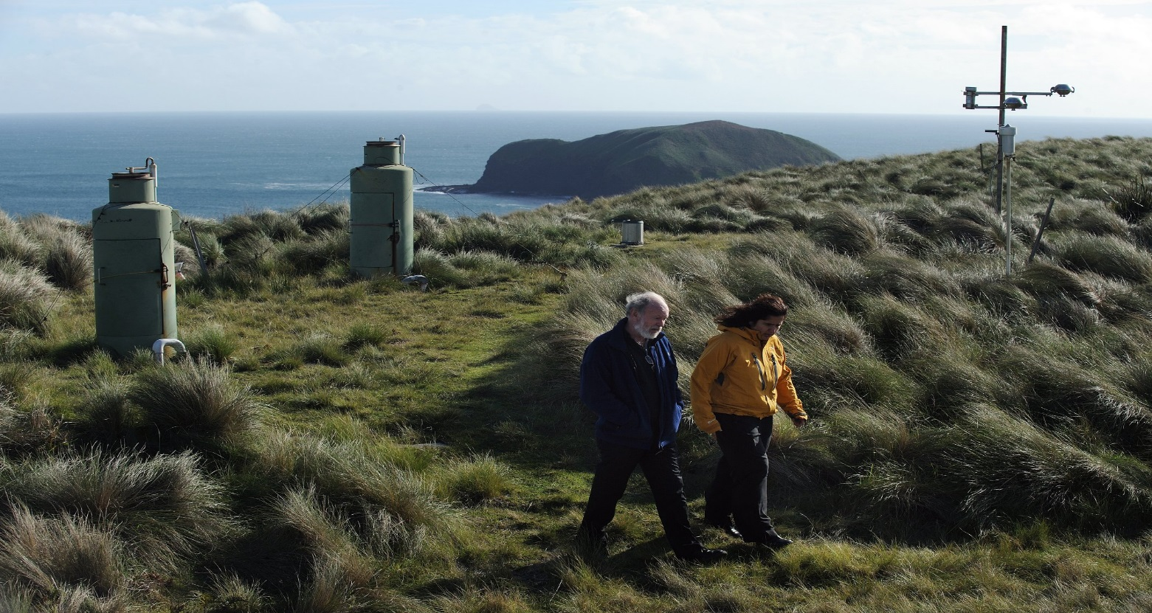
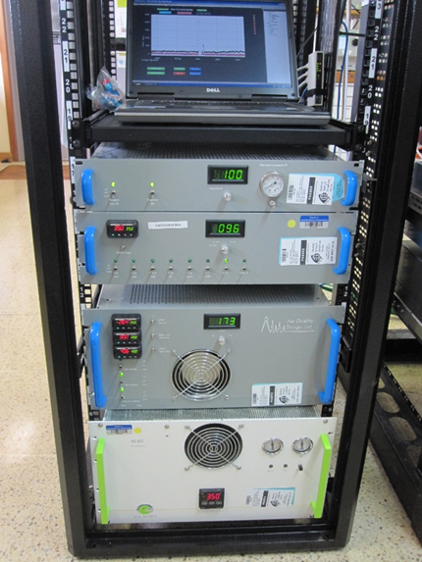
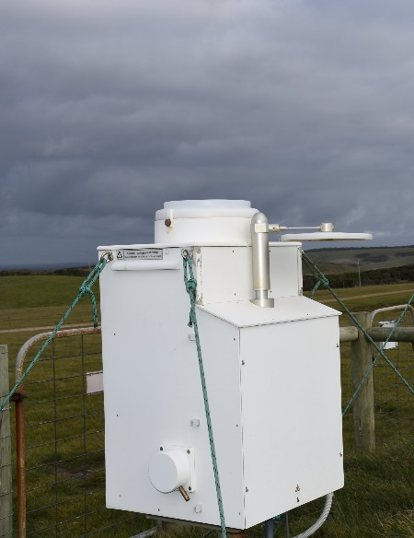
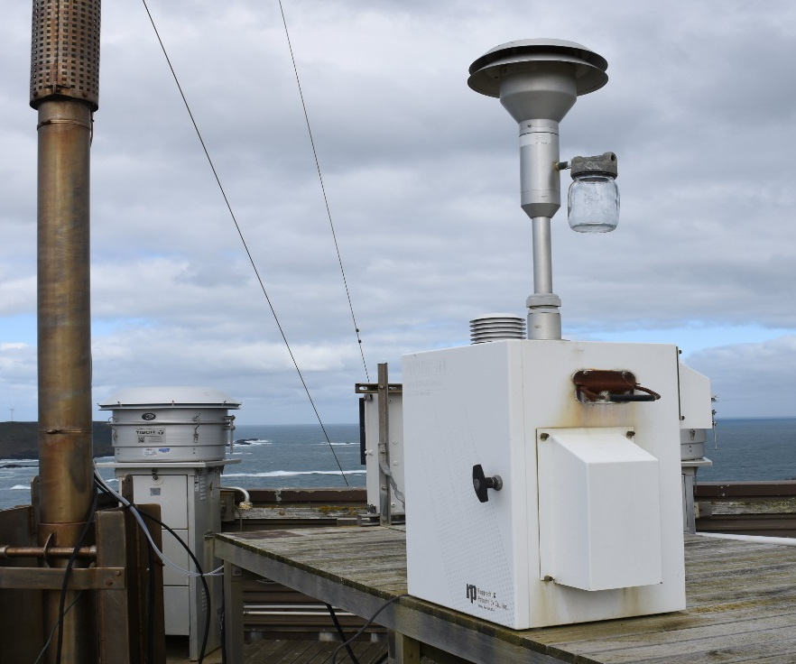
Reactive nitrogen measurements at Cape Grim
Gaseous NOxy 1978-79, 1995, 2009 - present
Precipitation Chemistry 1976 – present
Aerosol composition PM10 1976 - present
Aerosol composition PM2.5 2002 - present

Slide 8
Added value of combining rainwater, aerosol and gaseous concentrations
Strong seasonal cycle in all atmospheric fixed N at Cape Grim
Half of measured nitrate is on PM10 – PM2.5 aerosol
Nitrate-N on PM10 < gaseous NOx-N
Deposition rate of nitrate-N appears large compared to measured burden, suggests missing species that result in deposited nitrate. HNO₃ is a possibility of such missing species.
More work is required to give reliable estimates of fixed N input to oceans from stations such as Cape Grim.
Thanks to S. Cleland, S. Baly, J. Ward, N. Somerville, Cape Grim, Australian Bureau of Meteorology.

Slide 9
Recommendations (1)
The Workshop identified that NH₃ is not measured in the gas phase as part of the core GAW program and is a substantial contributor to atmospheric fixed nitrogen concentrations and flows. Given the recent developments in measurement techniques and metrology of NH₃ including presentations at the Workshop, the Workshop recommended that gaseous NH₃ be identified as low hanging fruit for GAW to focus research effort, measurement guideline development and measurements activities where possible.
The Workshop noted that there is a gap in regulation of ammonia emissions on international level. There is also a critical gap identified between NH₃ observations and emission inventories communities.
It would be useful for the GAW community that is involved in NH₃ measurements to get involved in the update of measurement guidelines to ensure the uptake of the measurement guidelines recommendations in the GAW programme.

Slide 10
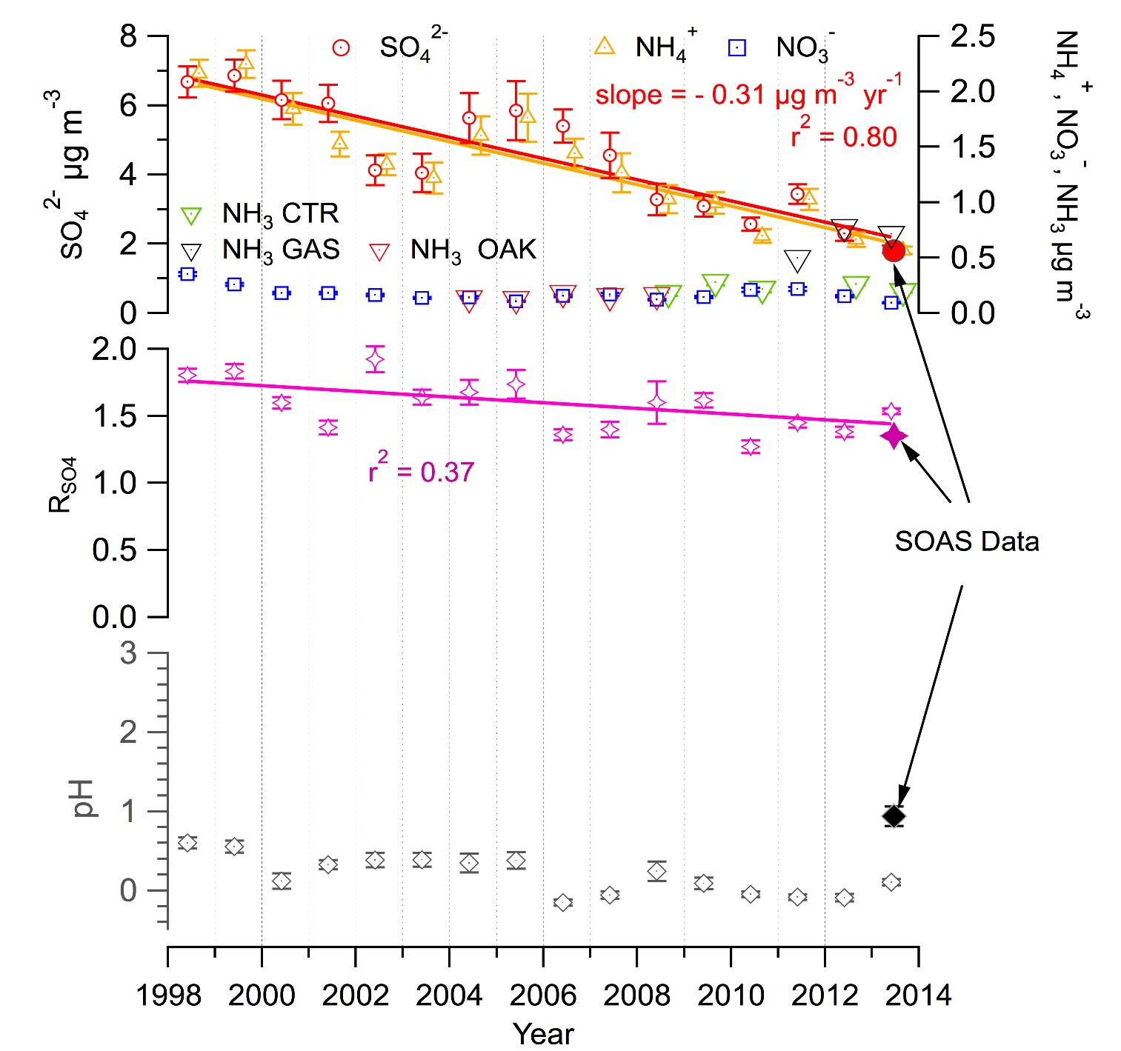
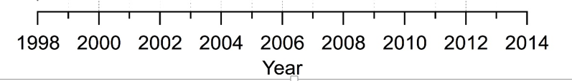
The acidity “paradox”
Historical Data:
SO₄ is going down
NH₃ is constant
Nitrate is ~ 0
Aerosol response:
Should have become more neutralized –
(NH₄)₂SO₄
NH₄HSO₄
H₂SO₄
… but it’s NOT becoming more neutral. In fact it’s “acidifying”.
Weber et al. (2016), Nature Geosci.

Slide 11
Recommendations (2)
Given the recent developments in measurement techniques and presentations at the Workshop, the Workshop recommended that organic nitrogen compounds in the gas phase, aerosol phase and total deposition be identified as an important area for GAW to focus research effort and measurements activities where possible. It was also recommended that a workshop be conducted to assess the state of knowledge related to organic nitrogen.
The Workshop recommended that closer ties be developed between the GAW nitrogen community and both the users of global and regional emissions inventories (e.g. GEIA and UNFCCC) and the users of global and regional chemical transport models that include reactive gases, aerosol and deposition. This has the potential, through model-measurement-fusion (MMF), to contribute to the improvement of knowledge of the regional and global atmospheric cycles of fixed nitrogen.
It was also recommended that inverse modelling techniques to infer fluxes are much broader utilized in GAW. The workshop also recommended to improve the density of N related observations in rural /agricultural areas which is critical for high quality flux inversion.

Slide 12
Recommendations (3)
WMO/GAW should improve its ties with the agricultural community. It may be beneficial to establish joint projects in the areas where pilot projects in support of the Global Framework for Climate Service are taking place due to high sensitivity of Nitrogen cycle to climate change and its importance for fertilizer management.
Finally, the Workshop identified that there is a lack of “intelligent” or “sensitivity” analyses of the contributions of individual or regional conglomerations of GAW stations rating their usefulness for policy questions. The Workshop recommended that GAW encourage such research including methods of network design so that the GAW network is both highly productive in terms of contributions and simultaneously efficient in use of resources. In this respect the recommendation was made to work closer with satellite community that has an extensive expertise in observational network design experiments. The final network design should be appropriate to demonstrate the effects of emission regulations on the levels of fixed Nitrogen components in the environment.

Slide 13

Thank you
Merci

