Slide 1

Good Afternoon!
Suggestions for an ACTRIS-EMEP
IMP 2016-2017 «MAC-Campaign»
Nicolas Bukowiecki
Laboratory of Atmospheric Chemistry
Paul Scherrer Institute, Switzerland
Coordinator of the ACTRIS2 Joint Research Activity 1:
Improving the accuracy of aerosol light absorption determinations

Slide 2
BC and the importance of the MAC value
Black carbon (BC) particulate is emitted by incomplete combustion of fossil fuels and biomass, and represents a small fraction of the European aerosol, ranging between 5-10% of PM 2.5 (Putaud et al., 2004).
BC radiative forcing (RF_{BC}) was estimated to be around +1.1 W m⁻¹(Bond et al., 2013). This value is, however, affected by a 90% uncertainty, making the RF ranging between 0.08-1.27 W m⁻¹ (Myhre et al, 2013).
The RF_{BC} calculation is based on the estimated black carbon absorption, which is converted from the BC atmospheric burden.
Thus, the absorption is not only sensitive to the BC concentration but also to the conversion factor, which is called mass absorption cross-section (MAC).

Slide 3
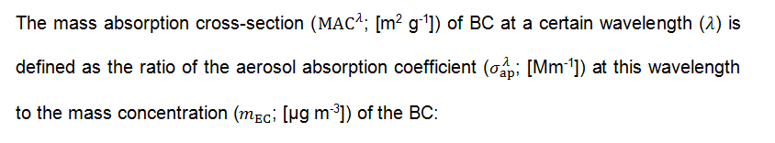
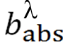
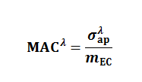
How MAC values can be determined
MAAP, Aethalometer, PSAP, …
EC/OC (EUSAAR-2)

Slide 4
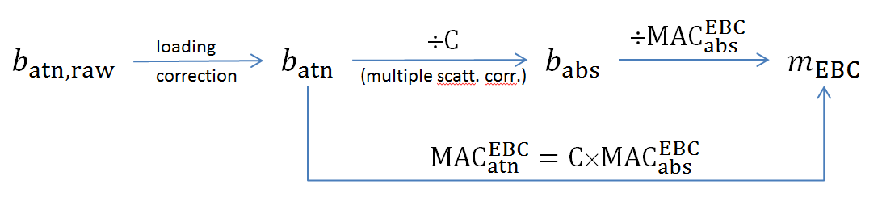
Conversion of Absorption to eBC and vice versa
Aethalometer
MAAP, CAPS-PM_{SSA}, Photoacoustic Sensors

Slide 5
MAC variability
Quite some spread of the MAC values found in the literature is caused by inconsistency of methods (that were to some extent known but not properly discussed).
The past and current ACTRIS instrument intercomparison and harmonization efforts solved some of these issues and made results much more consistent and physically reasonable, as shown in Zanatta et al. (submitted).
More on MAC variability see following slides….

Slide 6
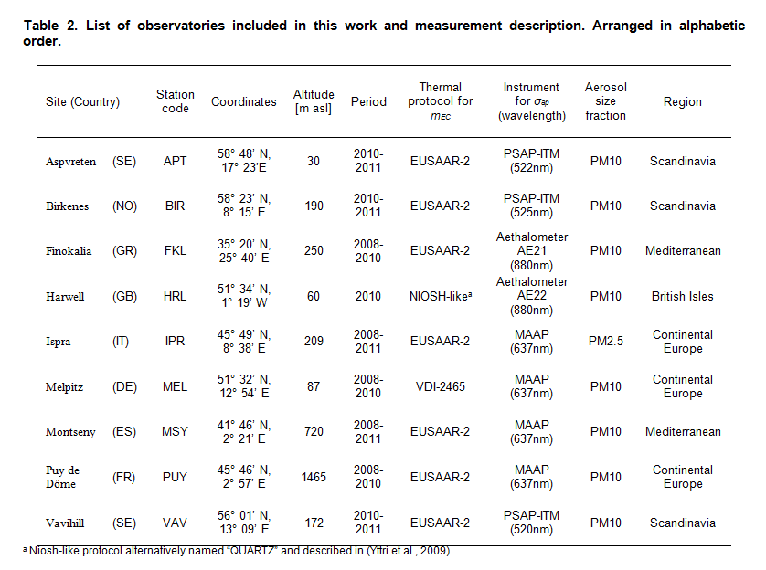
Recent study by Zanatta et al.

Slide 7
Zanatta et al.
Conclusions according to the final draft of the paper:
Grand average MAC = 10.0 m2/g
Spatial variability: as small as 7.5 to 13.3 m2/g (geom. SD of annual values from all sites
Seasonality: small; most seasonal patterns are hardly significant. (2 month campaign would anyway not address this.)
Temporal variability: there is some (geom. SD of 24h data typically < 1.5 including instrument noise at most) which seems to be related, at least to some extent, to the degree of internal mixing.

Slide 8
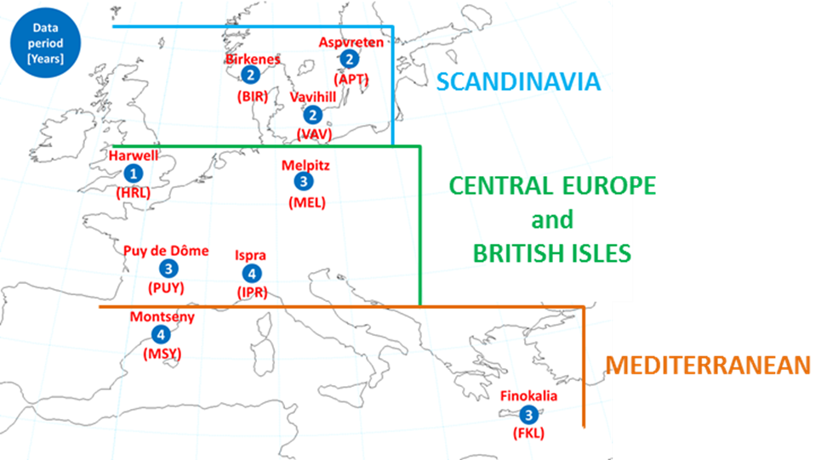
The ACTRIS and EBAS database
Introduction | Method | BC in Europe | Aged BC in the arctic | BC as ice nucleus | Conclusions
9 ACTRIS sites, representative of back ground air masses, data span 2008-2011
Notes:
anni

Slide 9
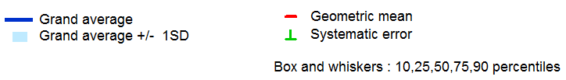
MAC spatial variability
Introduction | Method | BC in Europe | Aged BC in the arctic | BC as ice nucleus | Conclusions
Range of previous observations
Homogeneously distributed
Grand average MAC values (geometric mean) : 10 m² g⁻¹ ± 2.5 m² g⁻¹
Seasonal pattern: no statistically significant or common to all stations
Notes:
Due strumenti

Slide 10
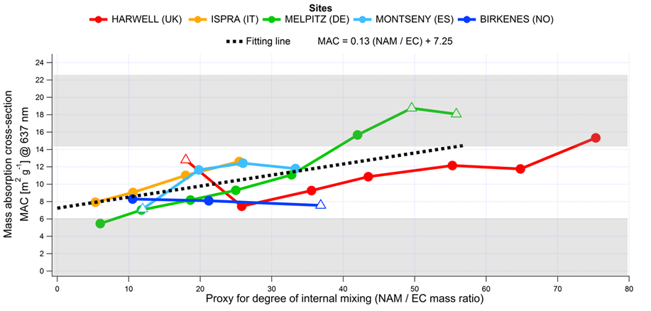
Introduction | Method | BC in Europe | Aged BC in the arctic | BC as ice nucleus | Conclusions
MAC and mixing degree
Question: what is the reason for variability ?
Physically unreasonable MAC
Physically unreasonable MAC
Non absorbing matter (NAM) = sum of non-sea salt sulfate, nitrate and organic matter
Evidence that presence of non-absorbing material might enhance the BC absorption
Notes:
pdf

Slide 11
Summarized: Minimal Campaign Requirements
Absorption measurements: MAAP + Aethalometers (AE31, but better AE33), instruments have participated in ACTRIS ECAC intercomparison (Every site would need a MAAP, as aethalometer alone provides absorption with much higher uncertainty. ➔ Only sites with MAAP (anchor point for absolute values) + Aethalometer (wavelength dependence) would provide most useful absorption data. MAAP alone is “OK”, aethalometer alone is not suitable)
EC/OC: Instruments for which the harmonization factor is known, instruments have participated in ACTRIS ECAC intercomparison
Duration: 2 months minimum (season not that critical due to comparably low MAC seasonality), focus should be on instrument completeness
Time resolution: Higher time resolution than just daily filters would likely be desirable when it comes to answering questions concerning variability of MAC with air mass type. It would also increase the statistical significance (as long as the lower filter loadings do not affect the precision of the EC measurements.
Minimal number of sites: Approx. 5, from which 3 are stations not yet the ones from the Zanatta paper

Slide 12










WP11: Improving the accuracy of aerosol light absorption determinations (JRA1)
MAC, b_{abs} , SSA
«JRAs will contribute to quantitative and qualitative improvements of the services provided by the infrastructures»
Satellite retrievals
Modelling (JRA3)
b_{abs} = MAC . m_{BC}
Improvement of near-surface (ground-based and airborne)
b_{abs} and MAC measurement methods
b_{abs} and SSA profiling vs vertically resolved in-situ
24h absorption profiling:
Improvement of b_{abs} and SSA retrievals
light absorption by black carbon:
causes positive radiative forcing
has mainly anthropogenic sources
absorption coefficient (b_{abs} ) and mass absorption cross section (MAC) are major sources of uncertainty
UAV
and/or
UAV
In-situ
MAC
b_{abs}
In-situ
lidar
sun/lunar
photometer
lidar
sun/lunar
photometer
Task 11.1
Task 11.3
Task 11.2

Slide 13
Link to ACTRIS2
Joint Research Activity 1 (JRA1): Improving the accuracy of aerosol light absorption determinations, see separate slide
Benefits for EMEP: Quality check of EMEP instruments by participation at ECAC intercomparisons (http://www.actris-ecac.eu)
Benefit for ACTRIS2 JRA1: Valuable input for JRA Goal 1.1: “Improvement of near-surface (ground-based and airborne) b(abs) and MAC measurement methods”. Also, if MAAP + AE33 are applied, this will help towards a better C-value determination for the AE33.

Slide 14
Backup slides

Slide 15
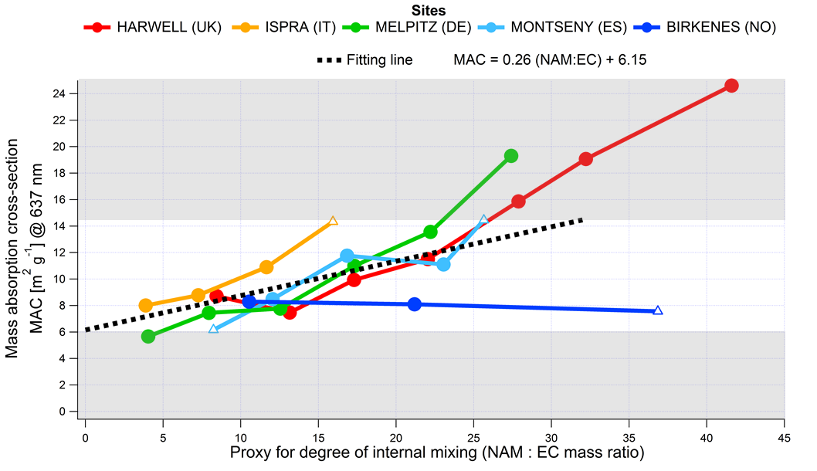
Lensing effect
Figure from Zanatta’s paper that provides evidence that the lensing effect does occur, i.e. that internal mixing of BC increases its mass absorption cross section and that the variability of the degree of internal mixing drives the variability of the MAC at least to some extent. However, corroborating this result with a more comprehensive data set would be great! The different behaviour of the Scandinavian site is an open question.

Slide 16
Issues for further studies
Size fractions: would it be of interest to quantify the respective fractions of total absorption that are caused by the sub- and supermicron aerosol, respectively.?
Any “MAC” campaign should definitely also address the EC mass side, i.e. how does EC mass compare between different methods (different thermal-optical protocols, if this is not answered to sufficient extent; thermal optical EC vs rBC from laser-induced incandescence, …) ➔ getting filters samples for to run different thermal-optical protocols would likely be possible. Getting many rBC measurements by means of LII (SP2, pulsed-LII) would likely be difficult.
BC mixing state: the “lensing effect” might potentially have the largest influence on the variability of the MAC value. If possible one should try to acquire a data set that allows to determine the mixing state of BC and magnitude of the lensing effect at least in a qualitative manner (SP2, SP-AMS, single particle mass spectrometers, working with thermodenuders, ...)? In the best case it might be possible to get "complete sets of EC, rBC + mixing state" instrumentation at to or three sites.

Slide 17
Issues for further studies
Absorption coefficient measurement: some instruments (e.g. MAAP) are quite accurate, while measurements from others are tainted with considerable uncertainty due to e.g. multi-scattering correction
=> there is room for improvement to infer ambient MAC from absorption measurements done with the best methods available (or improving the treatment of data from less accurate methods according to state-of-the-art correction schemes).
Inferring BC mass concentration from measured absorption coefficient: most commercial instruments do it with a MAC_abs value of 6.6 m2/g at 637 nm (MAAP) or with MAC_atn that provide similar numbers. However, 6.6 m2/g at 637 nm is at the bottom end of the range for possible true MAC_abs values of atmospheric aerosols (can be up to a factor of 2-3 higher).
Accordingly, eBC mass concentrations obtained from commercial instruments are potentially biased low.
Therefore we are interested in determining atmospherically relevant MAC_abs values and in quantifying its variability.

