Slide 1
Overview of the GAINS emission scenarios for GP revision
Z. Klimont, L. Hoglund, K. Kaltenegger, S. Zhang, G. Kiesewetter, F. Wagner, F. Brocza, Y. Kim, F. Lindl, C. Heyes, P. Purohit, J. Slater, T. Brito, R. Sander, B. Nguyen, M. Posch, W. Schoepp
EMEP Centre for Integrated Assessment Modelling (CIAM)
Task Force on HTAP, 7 – 9 May 2025, Potsdam

Slide 2
LRTAP Scenarios
Key storylines ^{a)}
  Baseline (CLE)
  Technical mitigation (MTFR)
  Ambitious climate policy, technical mitigation, behavioural changes (LOW)
Anthropogenic sources of air pollutants (SO₂, NOx, NH₃, NMVOC, PM_{2.5}, PM₁₀, BC, OC, OM) and methane ^{b)}
Developed with the GAINS model, global coverage until 2050, five-year intervals, annual and monthly, key IPCC sectors, gridded 0.1º x 0.1º, kg/m²/s, NetCDF format
Where can you find them:
  Klimont et al. (v2.1) https://zenodo.org/records/14748815
  For UNECE-LRTAP region: national and sectoral emissions : CIAM/TFIAM website (https://iiasa.ac.at/policy/applications/centre-for-integrated-assessment-modelling-ciam),
  GAINS-online explorer (https://gains.iiasa.ac.at/gains/GPV/index.login?logout=1)
^{a)} – Further scenarios developed to address human health and biodiversity goals -> not global
^{b)} – Mercury (Hg) can be made available too

Slide 3
Key scenarios for UNECE GP revision ^{a)}
Baseline ‘CLE ’
  Implementation of current policies
  Energy and agriculture for the EU27 – Green Deal, including Fit for 55 package, RePowerEU initiatives, revision of the IED, results of the MS consultations during fourth Clean Air Outlook ^{b)}
  West Balkan – PRIMES and CAPRI model activity scenarios, results of consultations during EU4Green project
  Rep of Moldova, Georgia, and Ukraine - PRIMES and CAPRI model activity scenarios, consultations with Moldova
  Turkey, remaining EECCA, US, Canada, and rest of the world - activity projections derived from IEA World Energy Outlook (IEA, 2023) and FAO agricultural outlook (FAO, 2018)
^{a)} – Further details available in the Policy Brief
^{b)} – https://environment.ec.europa.eu/topics/air/clean-air-outlook_en

Slide 4
Key scenarios for UNECE GP revision ^{a)}
Maximum Technically Feasible Reduction ‘MTFR ’
Alternative ‘LOW ’ scenario
  Climate policies compatible with Paris goals;
  MTFR for air pollutants and methane, including shipping sources
  Behavioural change - dietary changes (lower meat protein consumption)
Cost-optimal scenarios (work in progress)
  achieving -50% targets for mortality with different target setting options
  Recent work: joint optimization for health and biodiversity risks (CLempN)
^{a)} – Further details available in the Policy Brief

Slide 5
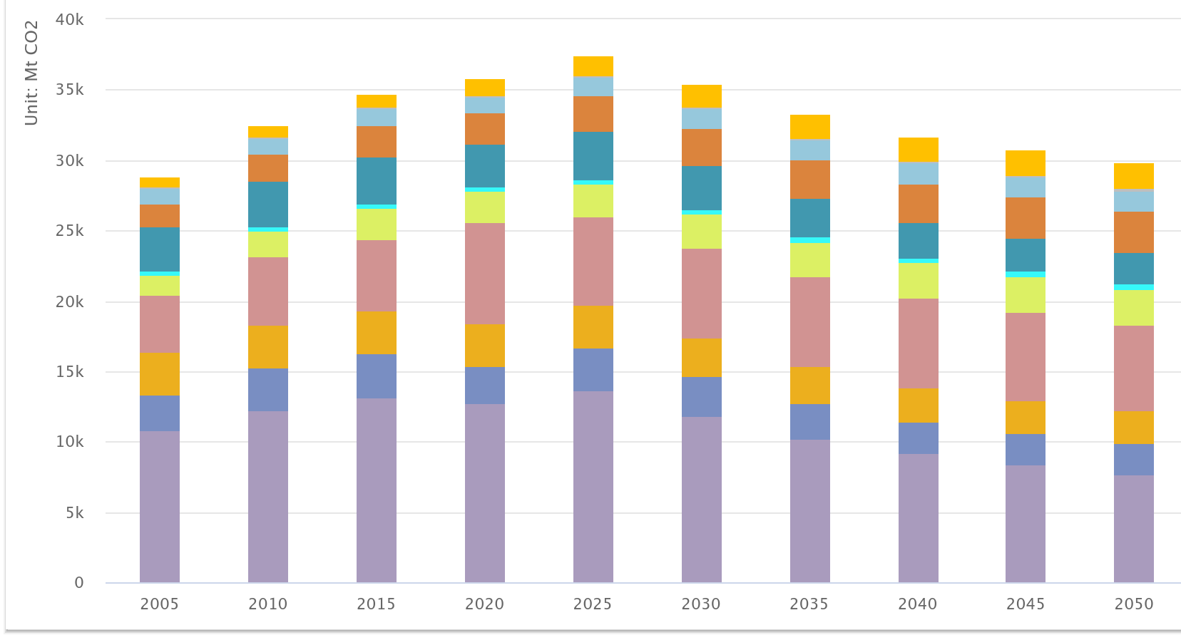
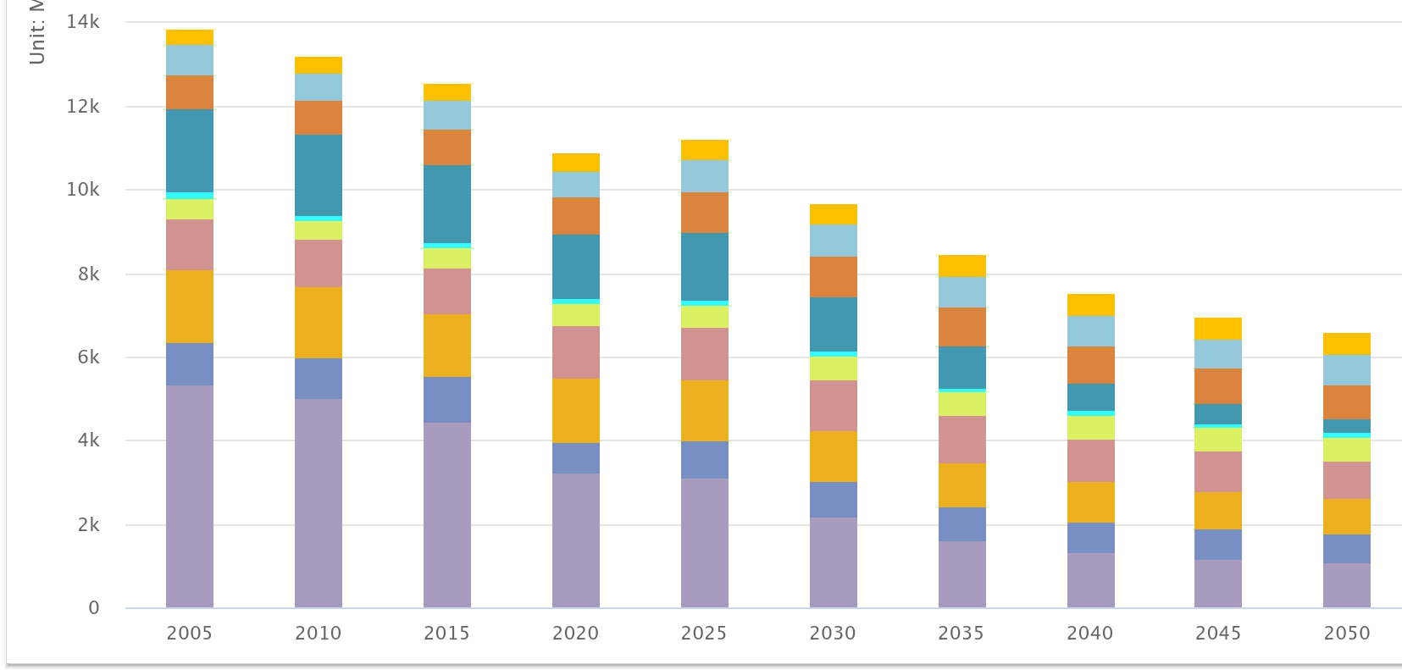
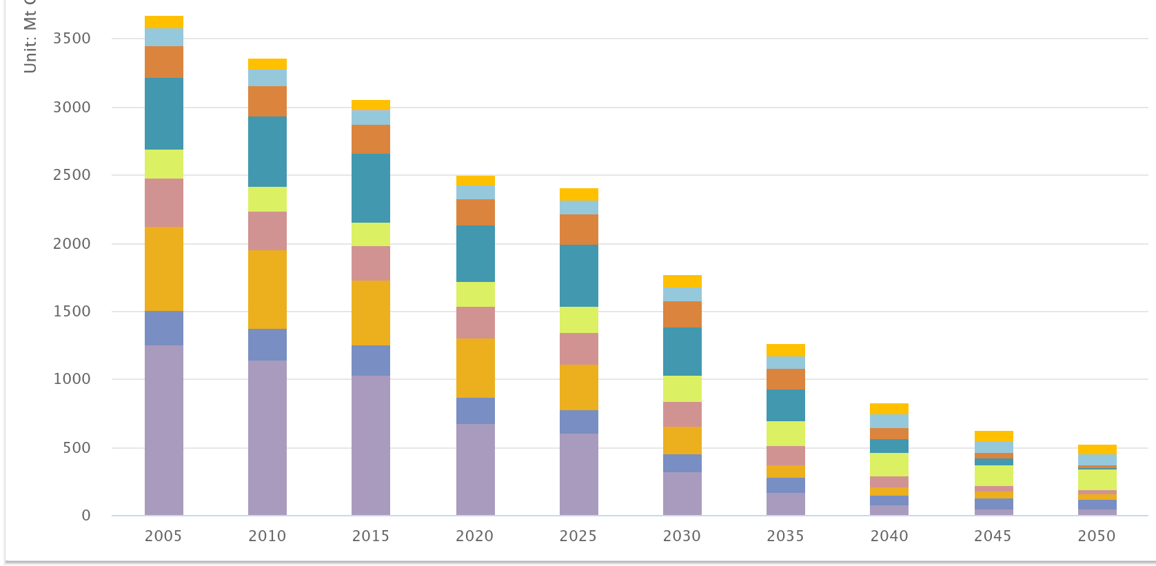
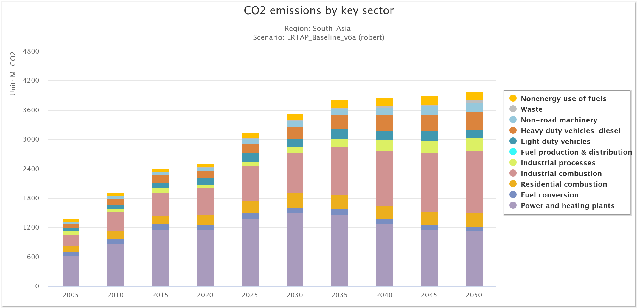
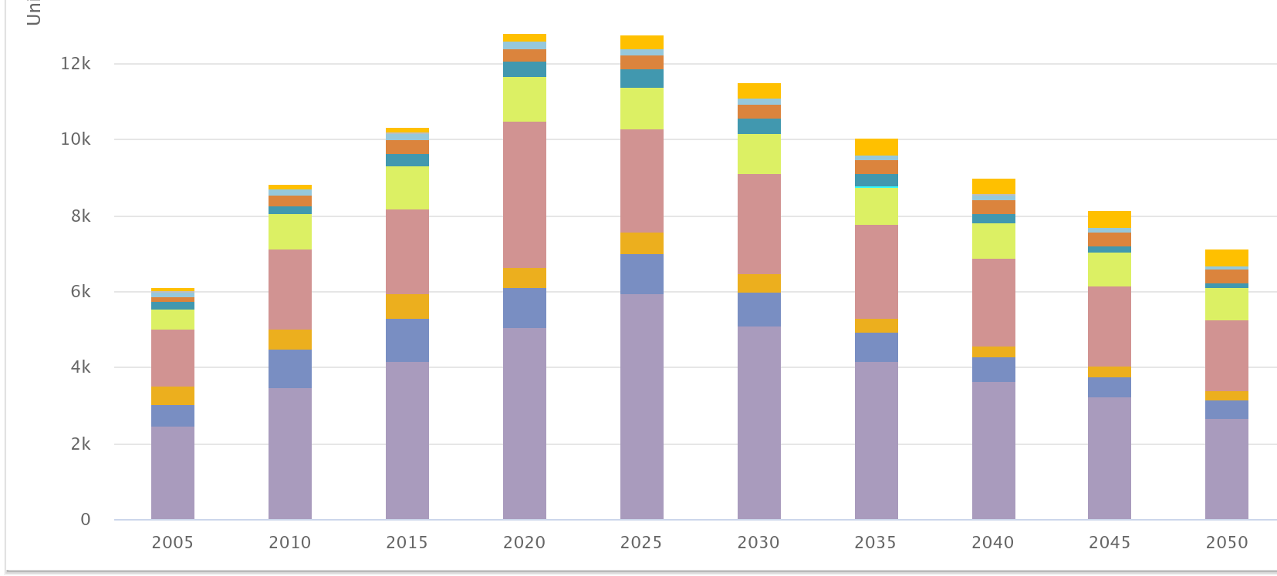
CO₂ from fossil combustion - Baseline
Global
UNECE
EU27
China
South Asia
5.8 Gt
6.5 Gt
ECLIPSE V6b
Source: IIASA-GAINS model

Slide 6
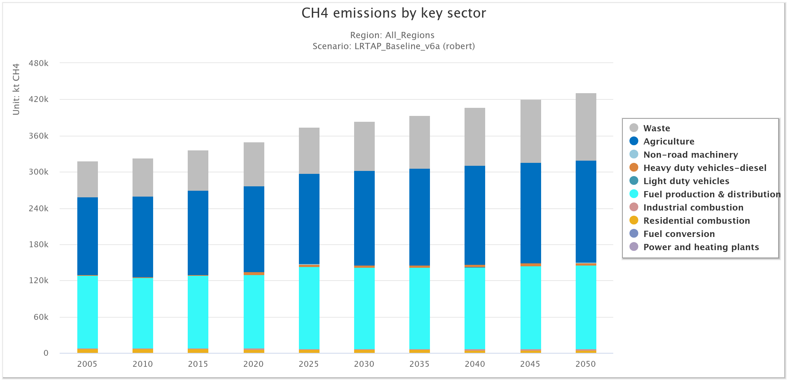
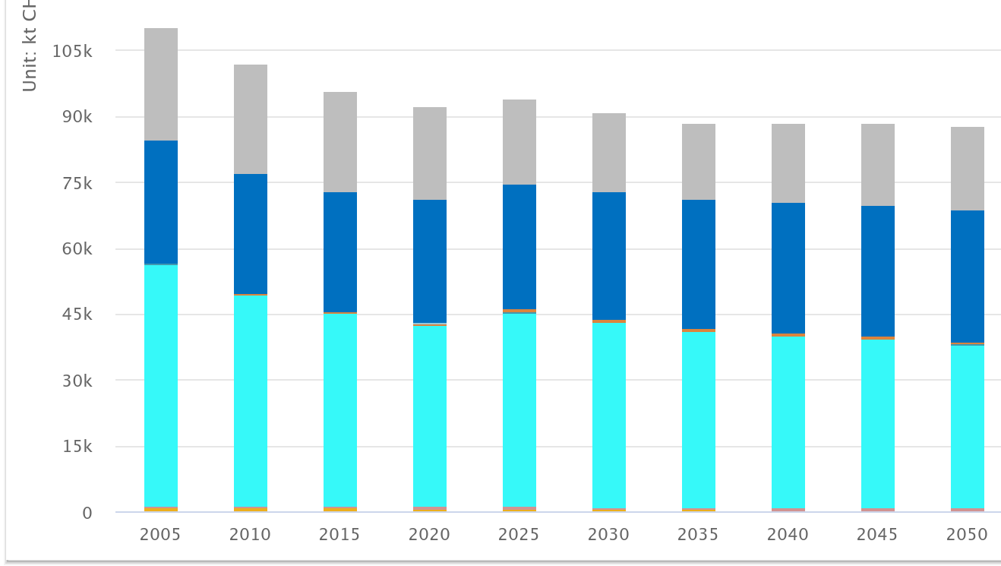
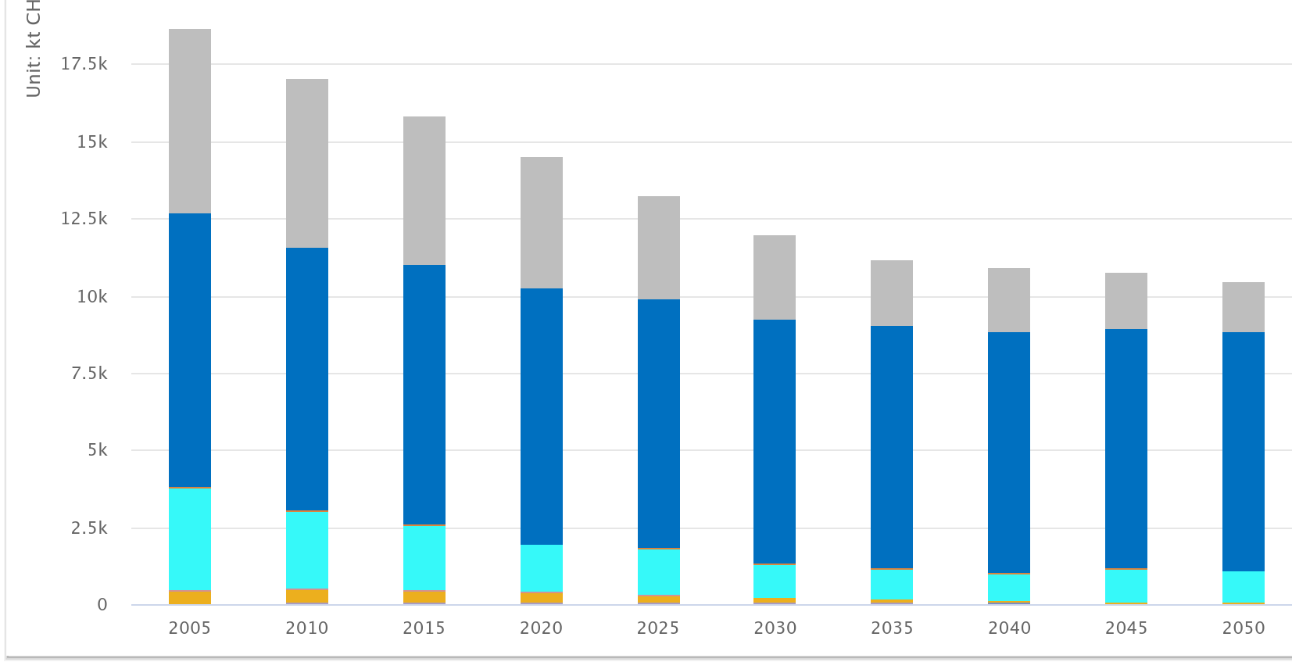
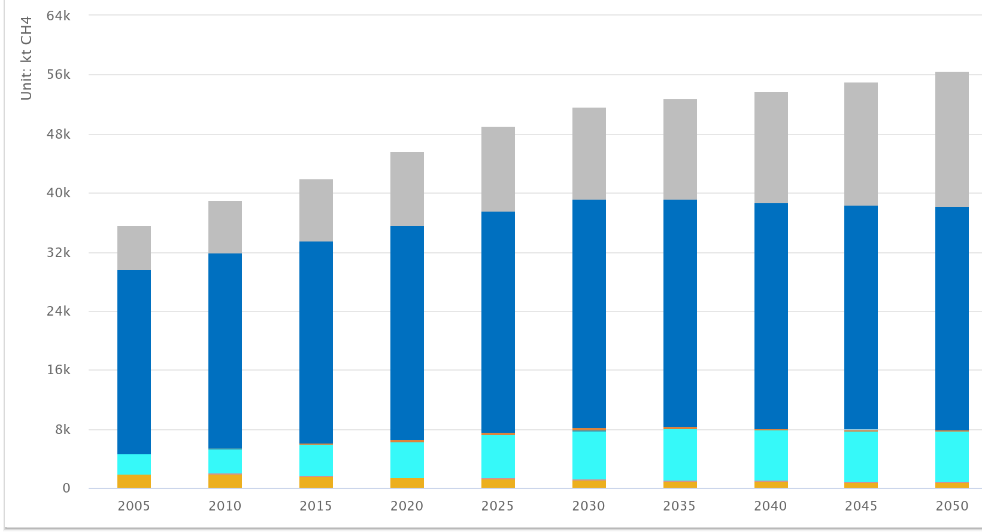
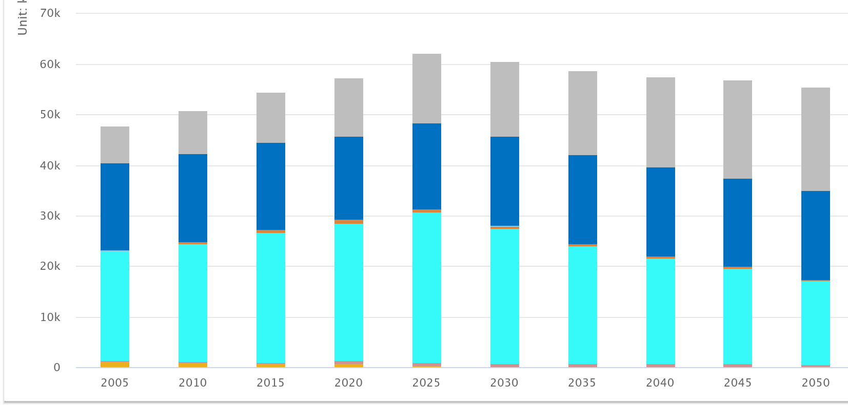
Anthropogenic CH₄ - Baseline
Global
UNECE
EU27
China
South Asia
ECLIPSE V6b
Source: IIASA-GAINS model

Slide 7
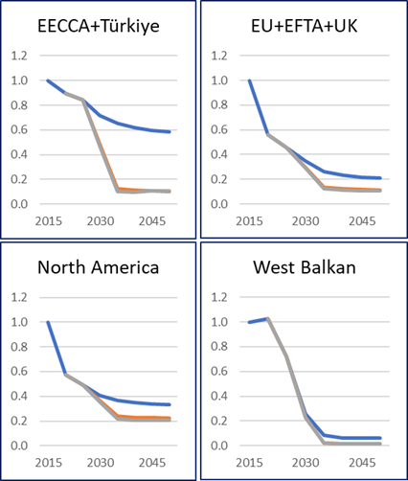
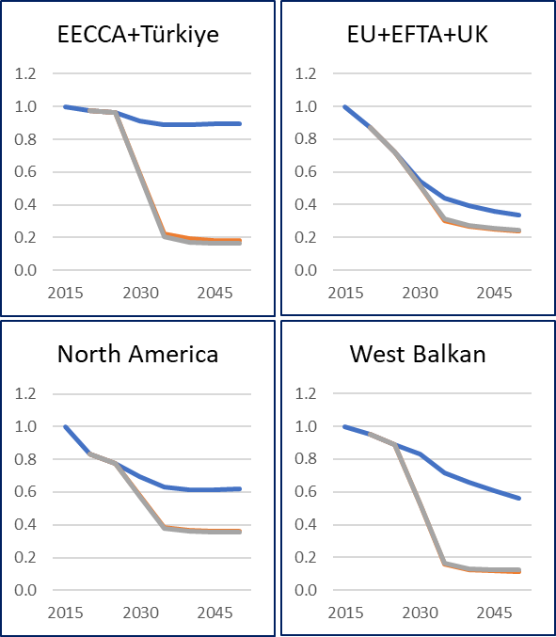
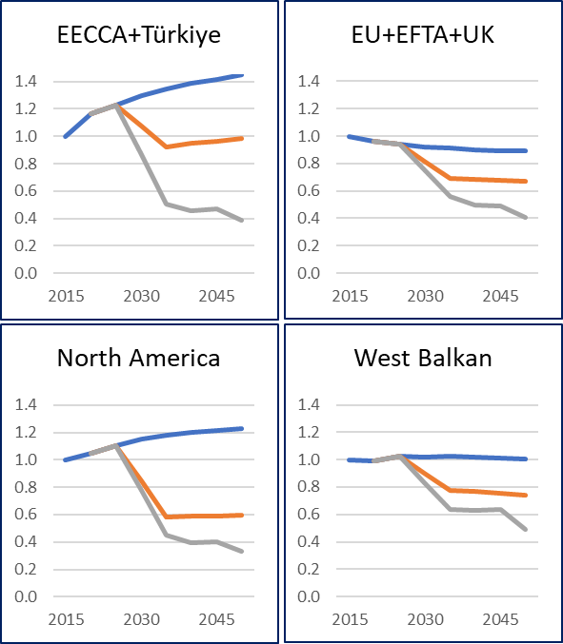

Key PM precursor emission trends across the UNECE region
SO₂
Scenario_v5
PM_{2.5}
Scenario_v5
NH₃
Scenario_v5
LOW scenario is not entirely consistent for energy sources; work in progress
Emissions have been made available on the CIAM website, gridded sets available from Zenodo and provided to MSC-W for running the EMEP model
Source: IIASA-GAINS model
Notes:
Further consultations on country emission data and projections ongoing

Slide 8
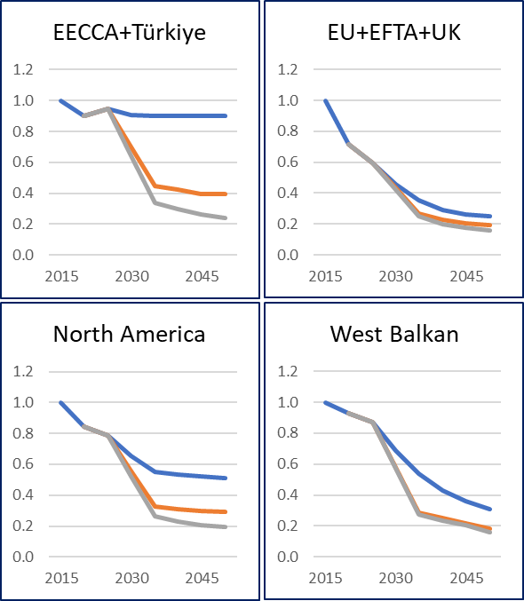
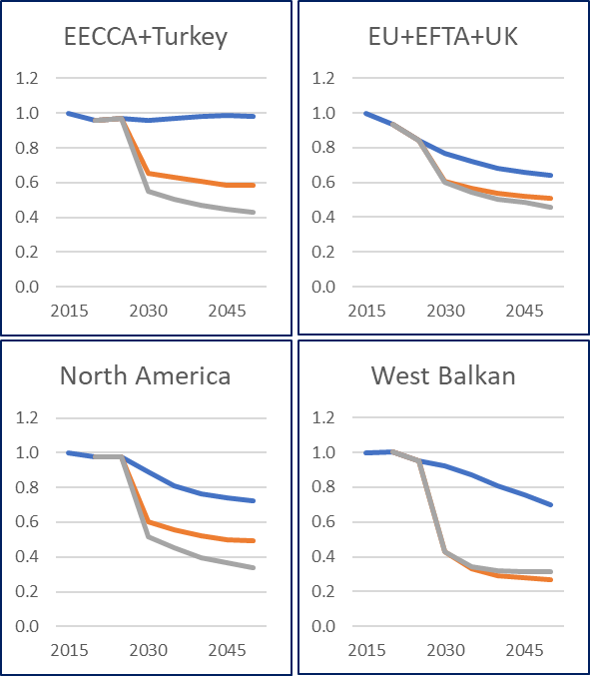
Emission trends across the UNECE region
(non-methane ozone precursors)
NO_{X}
Scenario_v5
NMVOC
Scenario_v5
LOW scenario is not entirely consistent for energy sources; work in progress
Source: IIASA-GAINS model
Notes:
Further consultations on country emission data and projections ongoing

Slide 9
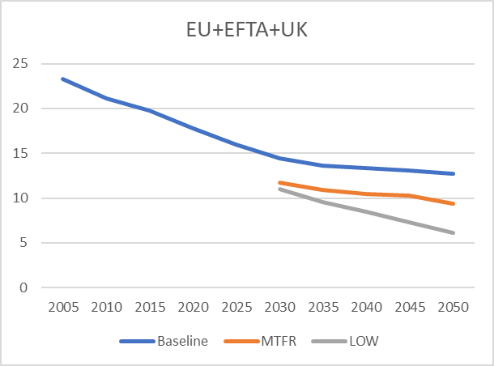
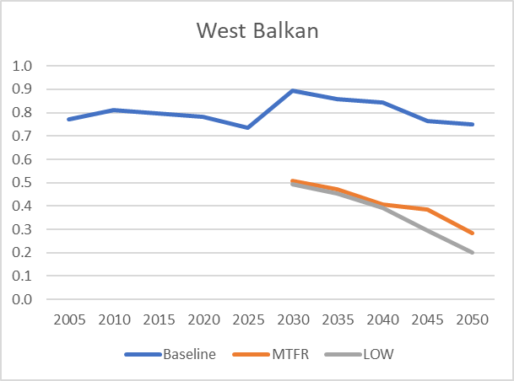
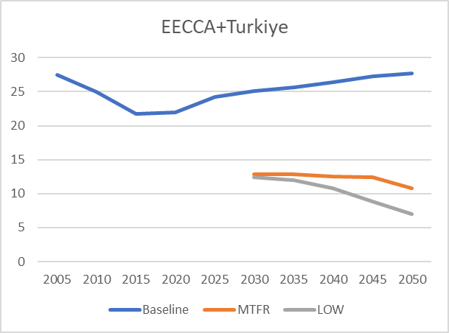
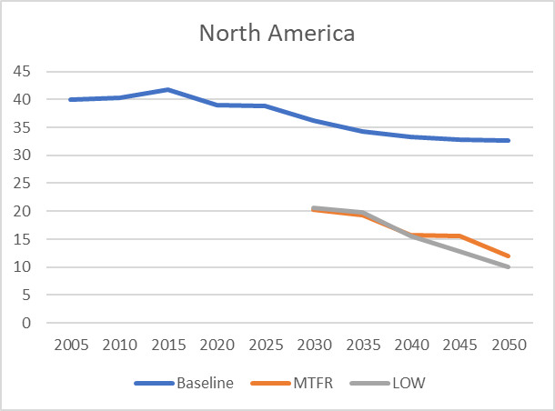
LRTAP methane scenarios and GMP objectives
Global Methane Pledge -
For illustration only as this is not necessarily the realistic outcome of reduction distribution; assuming that all signatories reduce 2020 emissions by 30%
Most near-term mitigation opportunities in fossil fuel and waste sector but for long-term agriculture is key
Source: IIASA-GAINS model

Slide 10
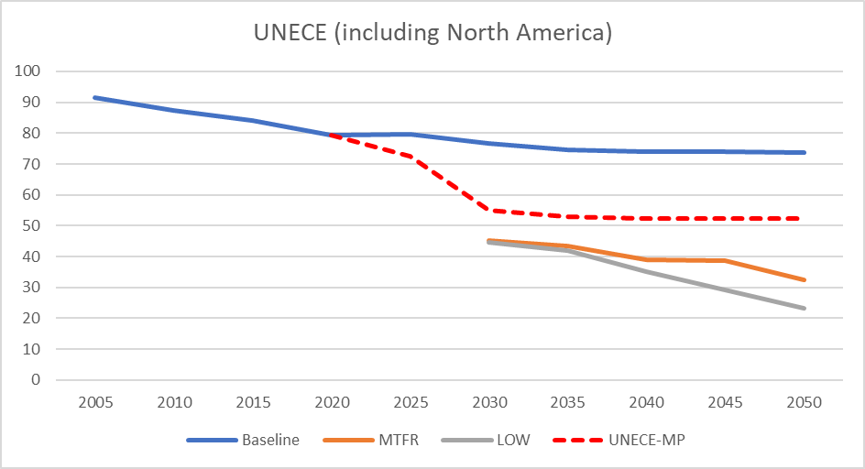
UNECE Methane emissions outlook (million tons)
Definition of UNECE–MP case
Methane pledge UNECE signatories -> 30% reduction of 2020 Baseline from 2030 onwards; for 2025 10% reduction arbitrarily assumed
UNECE non-signatories remain at Baseline

Slide 11
Further scenarios for UNECE region, excluding North America
  Reduce risk-based indicator “deaths per 100,000 inhabitants” assuming dynamic population (50% compared to 2015); Focus on anthropogenic (the avoidable) PM_{2.5}
  Assess least-cost solutions (=optimize) for 2040 relative to 2015
  Optimize reaching targets cost-effectively across the UNECE and through equal relative improvement in each country
  Extending analysis to include goals to reduce loss of biodiversity (40% compared to 2015)
  Only example shown – see extensive presentation material from the TFIAM meeting

Slide 12
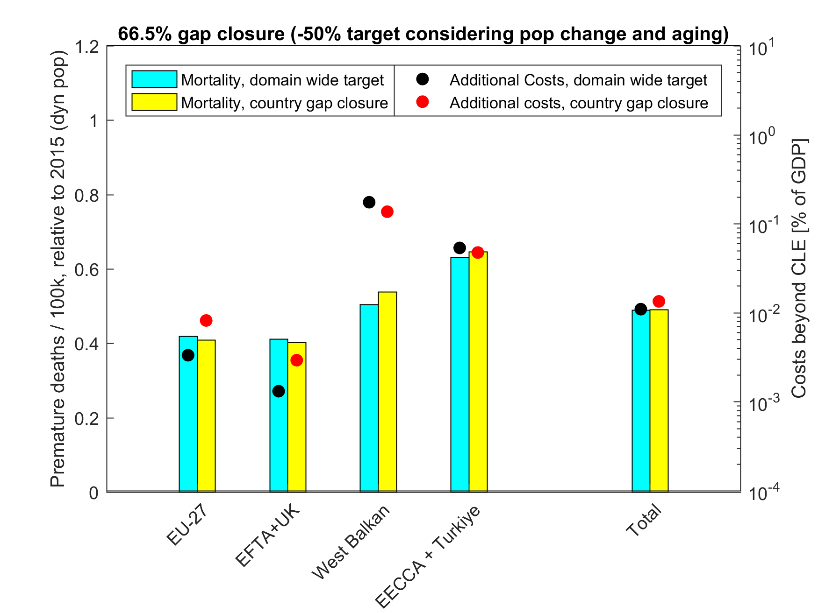
Least-cost reduction of PM health impacts (premature mortality)
in UNECE (excl. North America) by 2040
- 50%
from 2015
Results from Dec 2024; update considering downscaling in EECCA region will be included for May 2025 WGSR
Source: GAINS model (CIAM/IIASA)
Notes:
The collective risk reduction target of 50% will require overachievement in EU+EFTA, as the 50% target cannot be met in EECCA and WB (even with MTFR) and would require substantial higher expenditures in EECCA and WB as % of GDP.

Slide 13
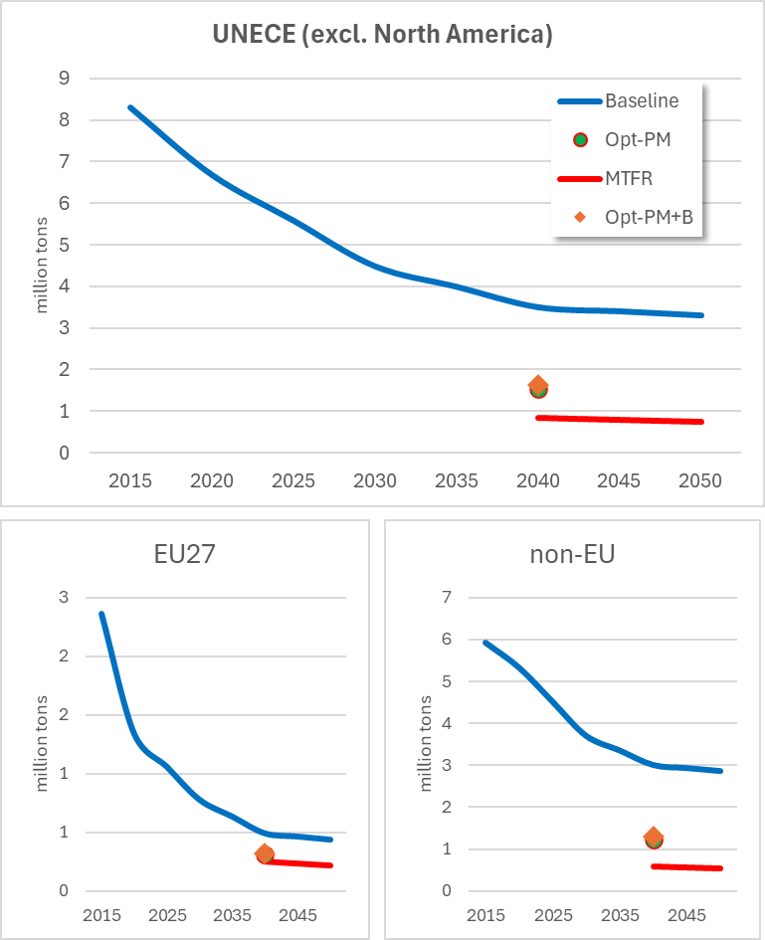
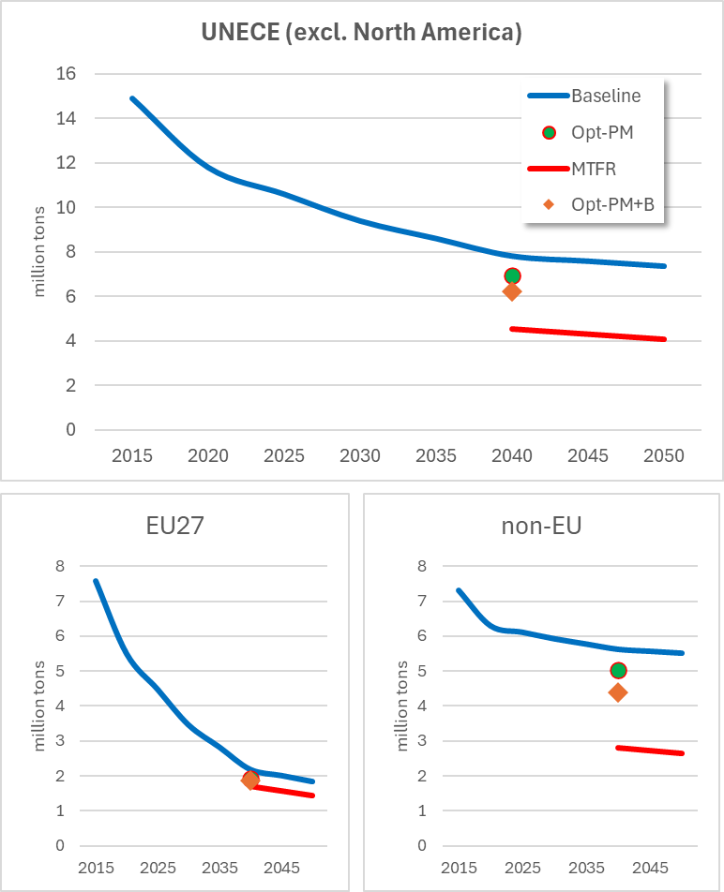
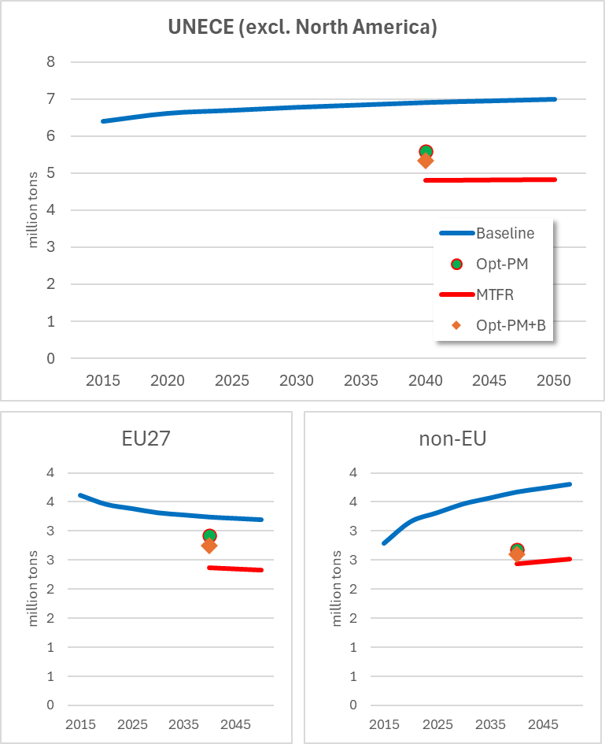
Sulfur and nitrogen emissions in the current scenarios (V5a)
Opt-PM - 50% reduction of premature mortality (PM) for UNECE, dynamic population,
Opt-PM+B refers to PM and biodiversity (B) targets,
Sulfur Dioxide (SO₂)
Nitrogen Oxides (NO_{x})
Ammonia (NH₃)
Source: CIAM/IIASA - GAINS model

Slide 14
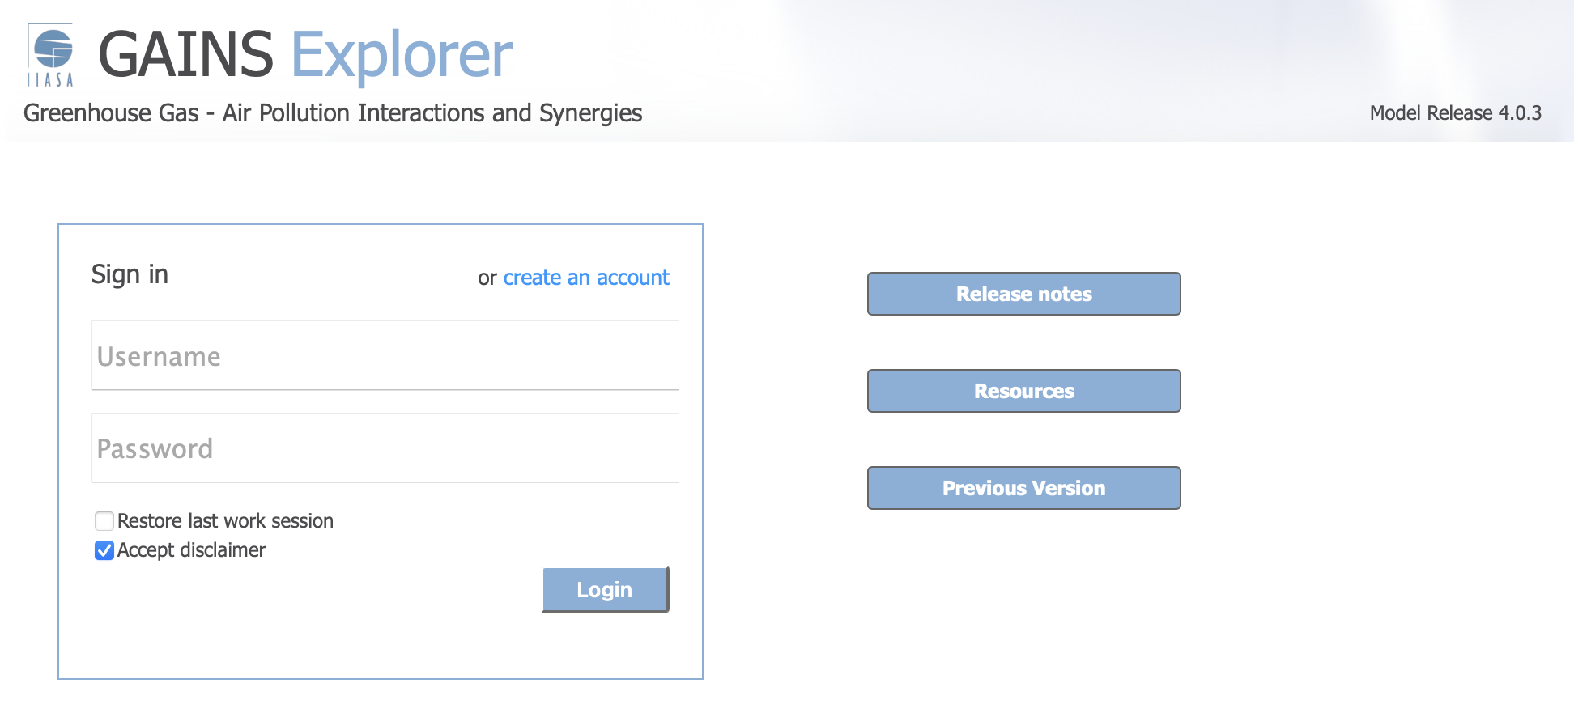
New GAINS Explorer (draft version) https://gains.iiasa.ac.at/gains/GPV/index.login
Online application to view for discussed policy scenarios:
Emissions,
Concentrations,
Exposure,
Impacts,
…and more coming

Slide 15
Ongoing and future scenario work (within GP revision)
Analysis for the next WGSR (May 2025)
  Varying ambition level for health goals
  What shall be the target for biodiversity?
  Inclusion of NFC^{a)} CLs for biodiversity …or at least ex-post analysis for current opt solution
Implementation of ozone in GAINS (joint with MSC-W)
  How to define targets for joint PM+ozone health impacts?
Towards new Baseline scenario -> updates before WGE (Sept, 2025)?
  Capitalizing on the TAIEX meeting (EECCA consultations)
  Further work with West Balkan
  Consultations with UK
Work on phased approach -> need guidance
Potentially, searching for more equitable solutions
Update of the LOW and LOW+ (hydrogen economy, alternative fuels, eg, ammonia, etc)
^{a)} – National Focal Centres

