Slide 1
Welcome to RIFS
The Research Institute for Sustainability at GFZ
2025 Meeting of the EMEP Task Force on Hemispheric Transport of Air Pollution
Potsdam, 7-9 May, 2025
Joint session with TFMM, May 7
Tim Butler
Research group leader – Air Quality Modelling for Policy Advice
Co-chair – Task Force on Hemispheric Transport of Air Pollution

Slide 2
Short history
Founded in 2009 as the Institute for Advanced Sustainability Studies (IASS Potsdam)
Transformative, Transdisciplinary, co-creative
In 2023 joined the Helmholtz Association as part of the GFZ Helmholtz Centre for Geosciences
  Name change: Research Institute for Sustainability at GFZ
Scientific Directors
  Doris Fuchs, professor of Sustainable Development, University of Münster
  Mark Lawrence, professor of Environmental Sciences and Geography, University of Potsdam
https://www.rifs-potsdam.de/en

Slide 3
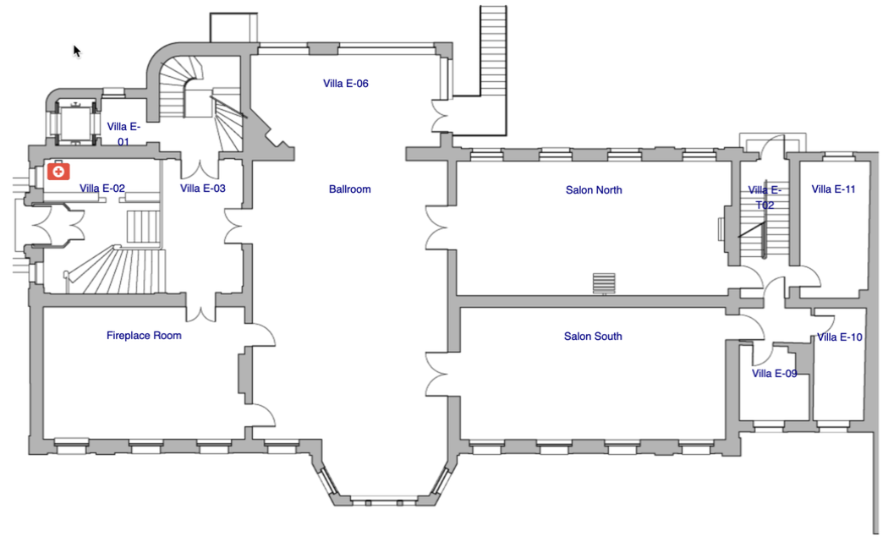
Meeting space – May 7
Garden
Main
Entrance
Restrooms downstairs
Lunch breaks
…
Screen
Street

Slide 4
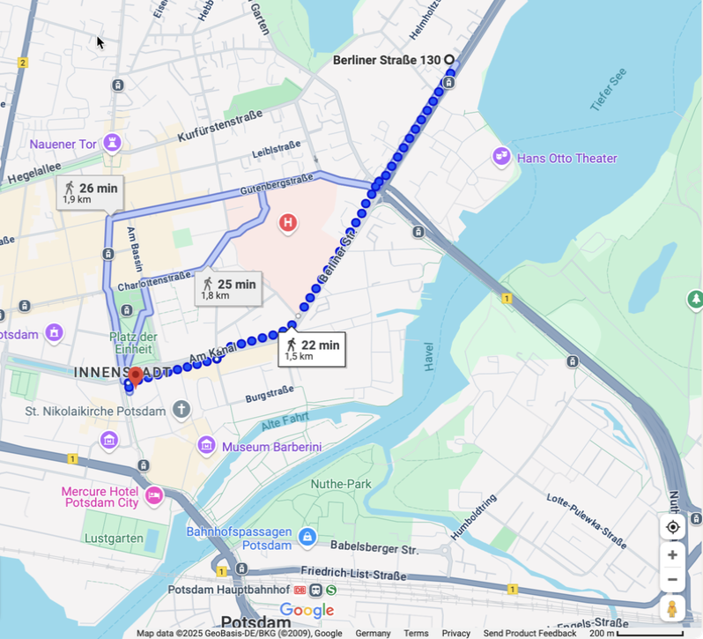
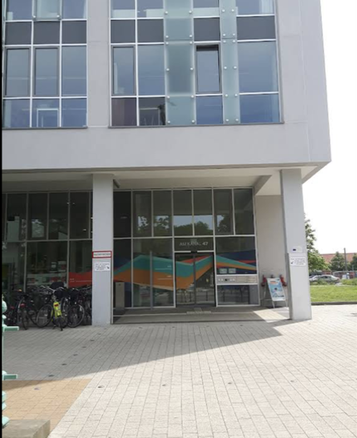
Meeting space – May 8-9
Scheduling conflict at RIFS Potsdam
For May 8-9 we have a new venue
Wissenschaftsetage im Bildungsforum Potsdam

Slide 5
HTAP3-OPNS
OPNS: Ozone, Particles, and the Deposition of N and S
Global to regional downscaling
A joint TFMM/TFHTAP session
May 7, 2025, RIFS Potsdam and online

Slide 6
Agenda for this session
Motivation for HTAP3-OPNS
Overview of model runs
GAINS LRTAP emission scenarios
Lessons from regional modelling in HTAP2
Initial results from MSC-W using the GAINS emission scenarios
Discussion of experimental design
Discussion of potential future cooperation between TFMM and TFHTAP

Slide 7

Motivation for HTAP3-OPNS
Revision of the CLRTAP Gothenburg Protocol
New GAINS LRTAP future scenarios
Assessment of air quality and long-range air pollution transport under the GAINS LRTAP scenarios
Special focus on methane as an ozone precursor
For further information, the HTAP3-OPNS white paper:
  https://docs.google.com/document/d/1CYgWl2ZzrQVIbcohU9gcOSMNwCIFBmGT

Slide 8
Relevant items from the 2026-27 draft workplan
1.1.1.7 | On basis of recent evidence, long-term trends and uncertainty in future projections, provide insight into robustness of modelled long-term O₃ projections in relation to CH₄ mitigation | Synthesis of O₃ mitigation options | TFHTAP, TFMM, MSC-W | EMEP budget
1.1.3.0 | Contribute to Gothenburg Protocol revision as mandated by Executive Body | Pending decision by Executive Body in December 2023 | TFIAM, CIAM, TFMM, MSC-W, CCC, TFHTAP, CCE, WGE | EMEP budget and recommended contributions
1.1.3.2 | O3 modelling of future scenarios | Organize new global model simulations of future scenarios developed by CIAM, including examination of role of CH4, source attribution methods, link to regional scale and impacts | TFHTAP, TFIAM, CIAM, TFMM, MSC-W, ICP Vegetation | EMEP budget
1.1.4.2 | Organize new global and regional model simulations of historical trends and future scenarios for Gothenburg Protocol pollutants with assessment of human health and vegetation impacts | Initial findings assessment (2025) | TFHTAP, TFMM, MSC-W, CIAM, ICP Vegetation | Parties’ in-kind contributions

Slide 9
GAINS LRTAP scenarios (1990-2050)
Scenarios developed by IIASA to inform the review of the Gothenburg Protocol
  CLE (Current Legislation)
    Includes all current air quality policies and implementation plans
    Climate forcing broadly consistent with SSP2-4.5
  MTFR (Maximum Technical Feasible Reduction)
    Same activity datasets as the CLE scenario
    Full implementation of all proven measures for all pollutants regardless of cost effectiveness
  “HILO” (Hybrid scenario)
    Methane from CLE and air pollutants from MTFR
    What if we take strong action to reduce traditional air pollutants, but do nothing on methane?

Slide 10
Overview of model experiments in HTAP3-OPNS
  Simulations using GAINS LRTAP emissions
    CCM future transient experiments
      To be discussed tomorrow
    CTM experiments (global)
      2015 GAINS emissions for model evaluation
      Focus on 2040 emissions with 2015 meteorology
        “Direct” simulation of the three 2040 GAINS scenarios (CLE, MTFR, HILO)
        Source-receptor relationships (to be discussed tomorrow)
    Global-regional downscaling
      Boundary conditions from the “direct” CTM experiments
      Main focus on Europe
  Simulations using HTAPv3.1 emissions
    CTM historical transient experiment 2003-2020
      To be discussed tomorrow

Slide 11
HTAP3 philosophy
Model experiments should be accessible as possible
  Maximise participation, minimise barriers to entry
Minimal “must have” aspects of model configuration
  Specified emission datasets for anthropogenic activities and biomass burning
  Specified years for CTM meteorological forcing
  Minimum requirements for output data fields
All other aspects of model configuration can be freely chosen, for example:
  Resolution
  Choice of reanalysis dataset
  Natural emissions
  All NMVOC speciation
White paper: https://docs.google.com/document/d/1CYgWl2ZzrQVIbcohU9gcOSMNwCIFBmGT

Slide 12
Emissions for CTM experiments (GAINS runs)
Anthropogenic emissions from GAINS (CLE, MTFR, and HILO)
  2015 CLE
  2040 CLE, MTFR, HILO
2015/2040 aviation emissions from “corrected CMIP6”
2015 biomass burning emissions from GFAS4HTAP
2015/2040 methane concentrations from Met.Norway (based on GAINS emissions)
All other emissions at the discretion of each modelling group (2015 conditions)

Slide 13
Regional model setup
One-year simulations with 2015 meteorology (plus spinup)
Boundary conditions from a global model “direct” scenario run
  2015 CLE
  2040 CLE, MTFR, HILO
Model domain:
  EMEP domain (encouraged)
  CAMS domain (acceptable)

Slide 14
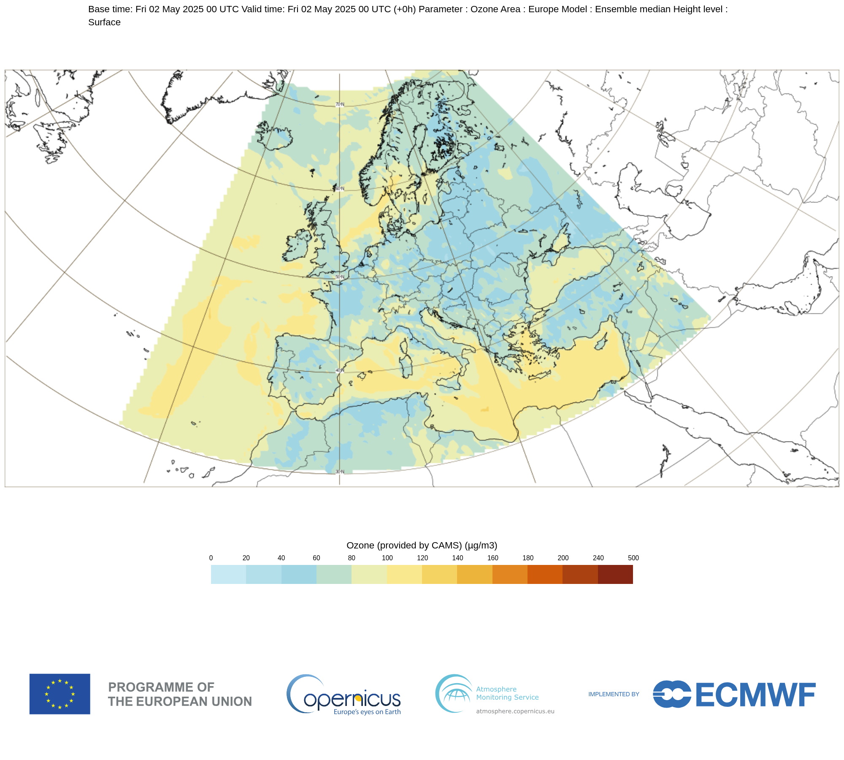
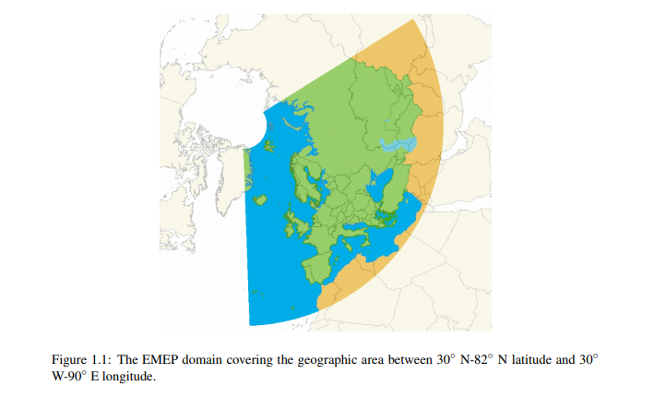
Two possible modelling domains:
EMEP and CAMS

Slide 15
Overview of regional model simulations (Europe)
 | Boundary conditions from global model
Emissions in regional domain | CLE2015 | CLE2040 | MTFR2040 | HILO2040
#1 CLE2015 | X
#2 CLE2040 |  | X
#3 MTFR2040 |  |  | X
#4 HILO2040 |  |  |  | X
#5 MTFR2040 |  | X
Five simulations requested
  Present day (2015)
  2040 CLE and MTFR
  Difference between CLE and MTFR in 2040
    Contribution of global methane
      #4 - #3
    Contribution of European emissions
      #5 - #2

Slide 16
Boundary conditions from global models
Several global modelling groups have indicated an interest in providing boundary conditions
  MSC-W EMEP model (EMEP domain)
  CAMS IFS (CAMS domain)
  NCAR CAM-chem (global coverage)
Groups with both global and regional modelling capacity are welcome to contribute both global and regional simulations
  And to make their global simulations available to other regional modellers

Slide 17
Participation in HTAP3-OPNS
Tables for contribution of model runs and participation in the analysis are available here:
  https://nextcloud.gfz.de/s/anZw7MLYMzpbqyW
Please check and update your planned contributions to both the model runs and the analyses

Slide 18
Next steps
Finalisation of the white paper and submission as an experiment description paper to GMD
Finalisation of remaining input datasets
  NMVOC speciation for GFAS4HTAP
  Future Fires dataset
Global model simulations for regional boundary conditions
Regional model simulations

Slide 19
Timeline
Boundary conditions from global models available
  By end of 2025
Regional simulations completed
  By Summer 2026
Analysis of results in time for the EMEP Steering Body meeting
  September 2026

Slide 20
Remaining questions and discussion
Collect list of interested regional modelling centres
Design of the exercise?
Requirements for regional boundary conditions?
Barriers for participation?
Letter of support from EMEP?

