Slide 1




EMEP4UK modelled changes in atmospheric composition in the UK from 1960 until present day
Tomas Liska,
Massimo Vieno (Team Lead), Janice Scheffler, Yuanlin Wang, Rachel Beck, Ed Carnell, Sam Tomlinson, Eiko Nemitz

Slide 2
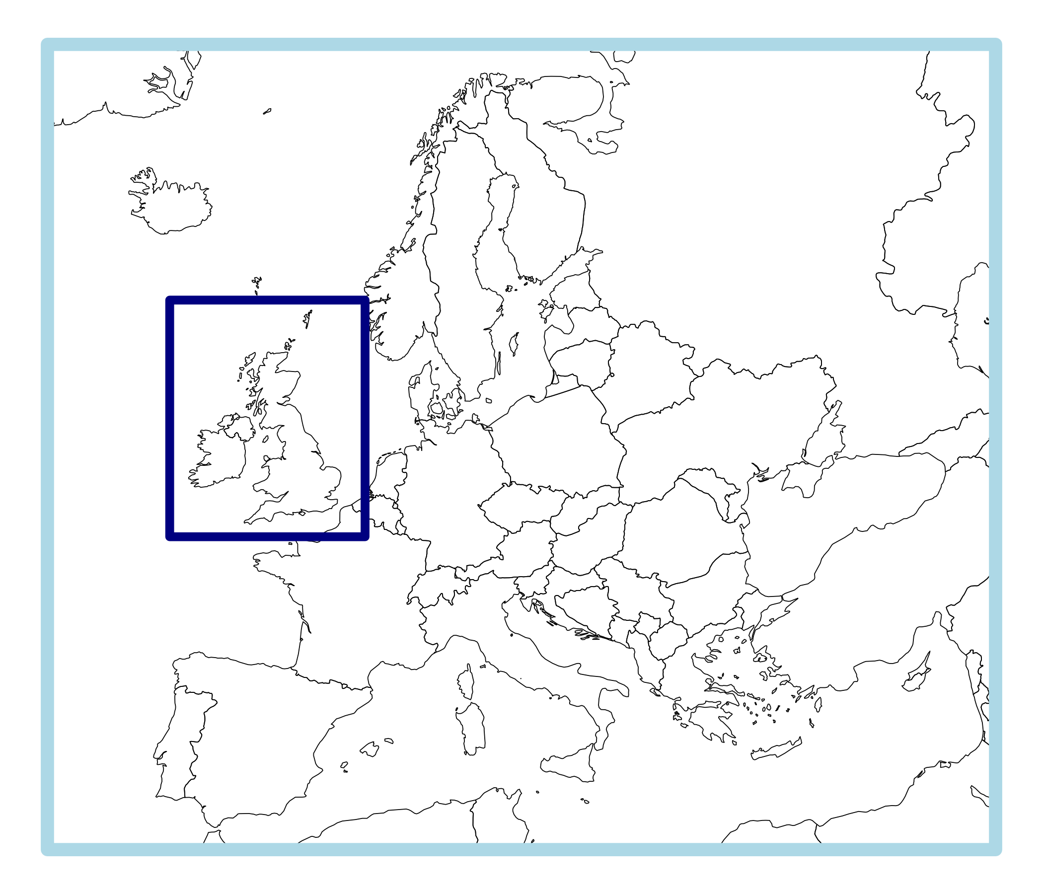
EMEP4UK model setup
EMEP4UK version 5.0
Meteorology driver is the Weather Research & Forecasting model (www.wrf-model.org) – used to downscale ERA5 reanalysis.
European domain at 27 km × 27 km,
UK + ROI domain 3 km × 3 km
Emissions are derived from EMEP (Europe), NAEI (UK)
Modelled years 1960, 1965, …, 2020, 2021,
NO₂, O₃, SO₂, PM_{2.5}

Slide 3
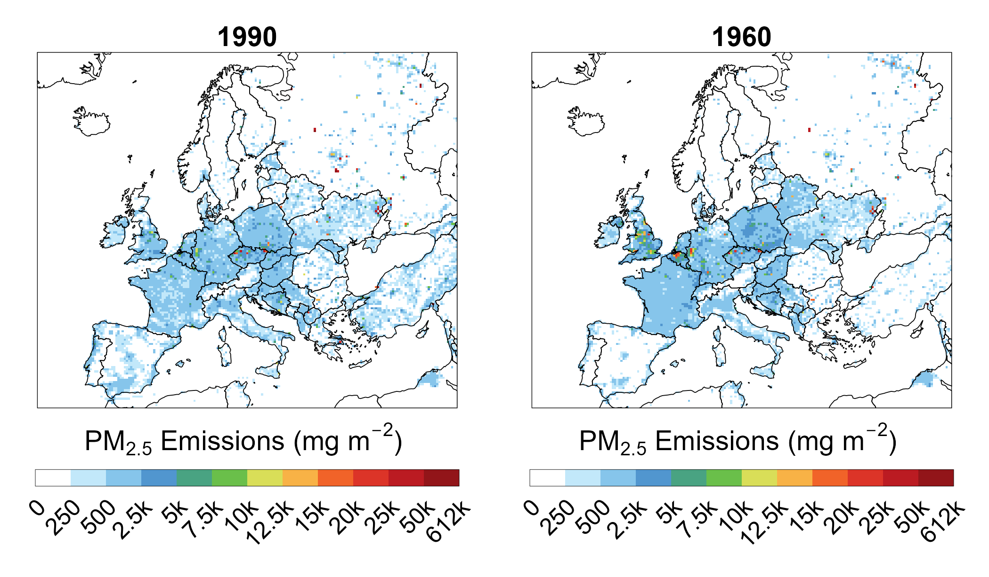
European Emissions
EMEP-CEIP annual emission totals used back to 1990 with 2021 gridded estimates
Prior to 1990 historical estimates from the CEDS were used to scale EMEP data back to 1960 (index of 1990 = 1)
Notes:
CEIP = Centre on Emission Inventories and Projections
CEDS = Community Estimates Data System

Slide 4
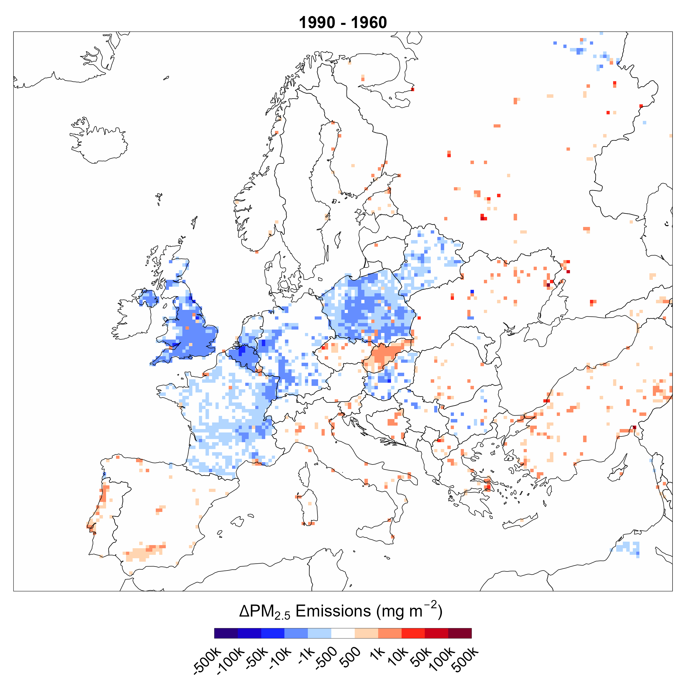
European Emissions
EMEP-CEIP annual emission totals used back to 1990 with 2021 gridded estimates
Prior to 1990 historical estimates from the CEDS were used to scale EMEP data back to 1960 (index of 1990 = 1)
Notes:
CEIP = Centre on Emission Inventories and Projections

Slide 5
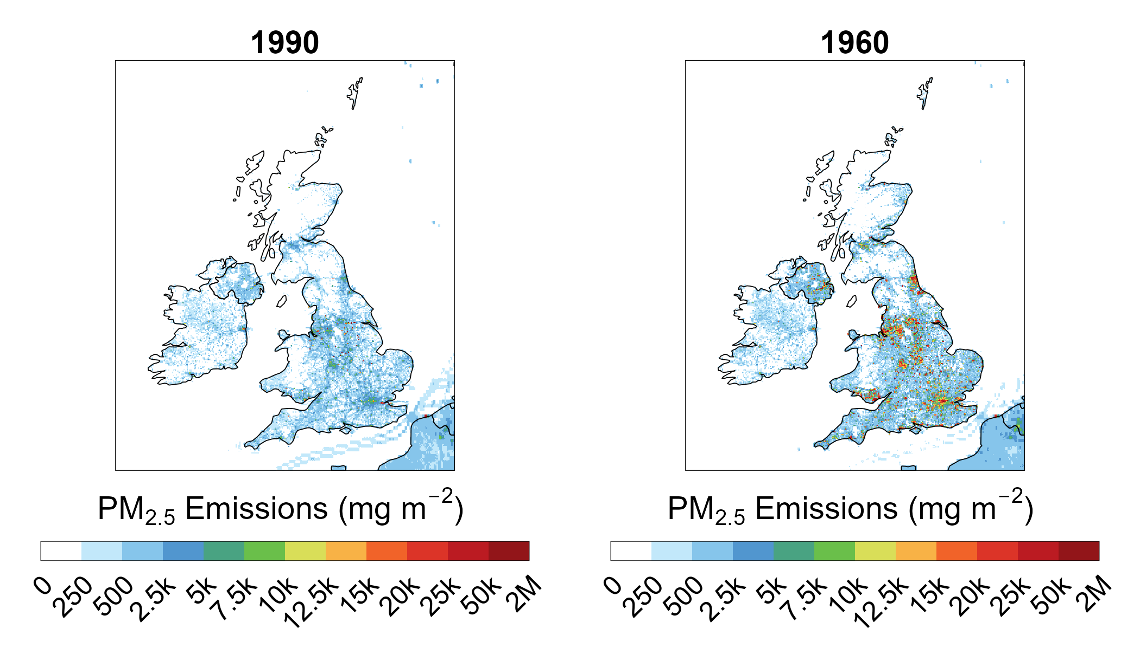
UK Emissions
Annual emission totals available from 1970 (1980 for NH₃)
Emission maps at 1 km x 1 km resolution in 2021 used to spatially disaggregate the annual emission totals
Point source data available from 2000 (non-energy) and 1990 (energy) – combined with diffused data distributions and re-scaled to match annual sector total
Prior to 2000 – non-energy sector point sources fixed at 2000
Prior to 1990 – energy sector points – ~120 power stations (>85% of generated electricity) spatially allocated, and their emissions estimated from national averages of fuel burnt
Non-energy emissions prior to 1970 (1980 for NH₃) estimated using historical statistics, compendiums and research

Slide 6
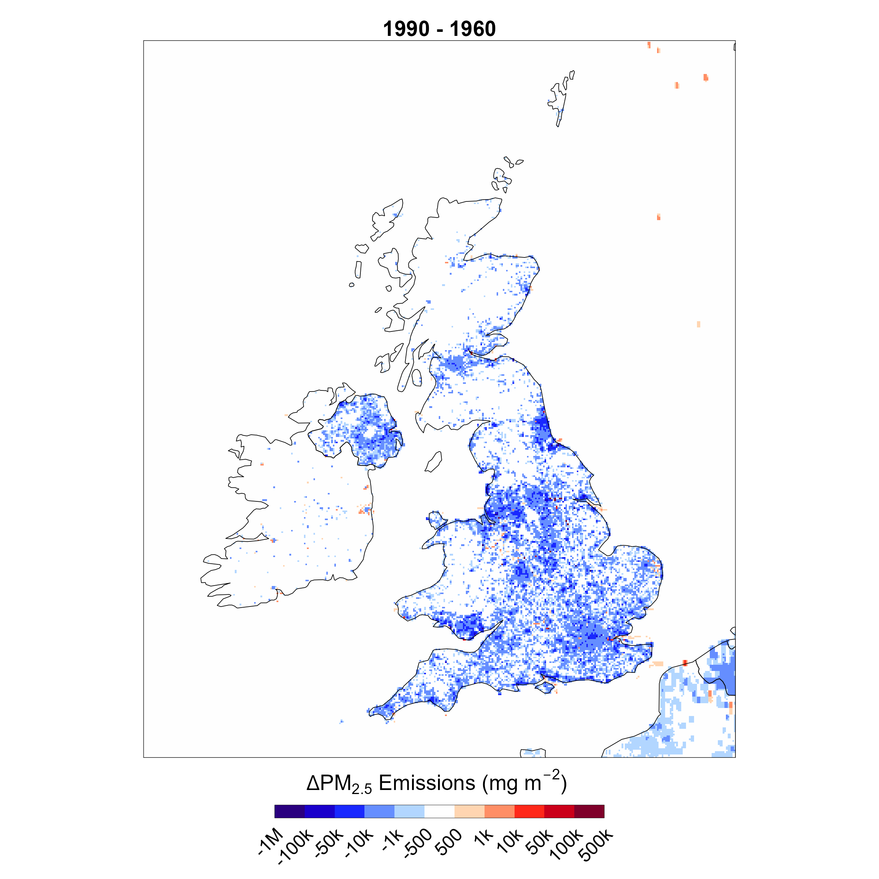
UK Emissions
Annual emission totals available from 1970 (1980 for NH₃)
Emission maps at 1 km x 1 km resolution in 2021 used to spatially disaggregate the annual emission totals
Point source data available from 2000 (non-energy) and 1990 (energy) – combined with diffused data distributions and re-scaled to match annual sector total
Prior to 2000 – non-energy sector point sources fixed at 2000
Prior to 1990 – energy sector points – ~120 power stations (>85% of generated electricity) spatially allocated, and their emissions estimated from national averages of fuel burnt
Non-energy emissions prior to 1970 (1980 for NH3) estimated using historical statistics, compendiums and research

Slide 7
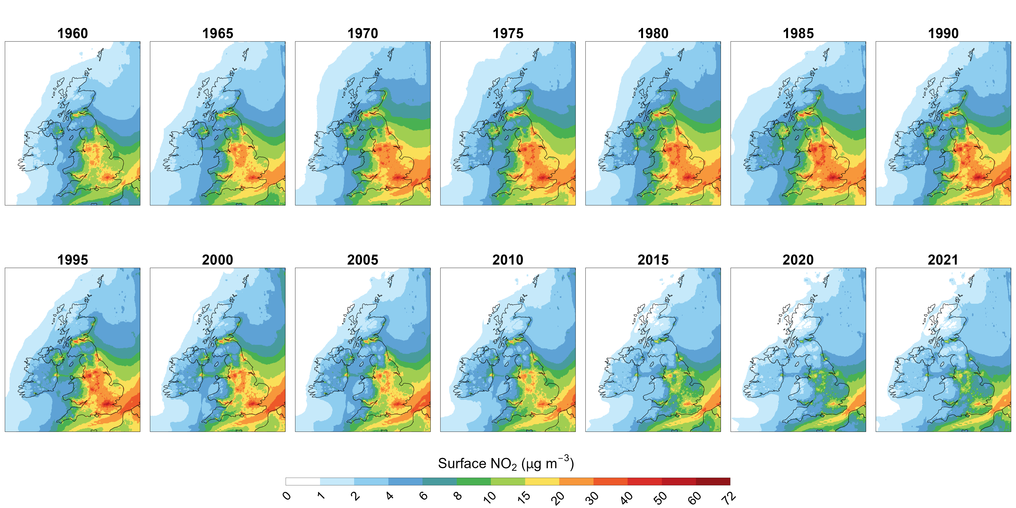
NO₂ annual mean

Slide 8
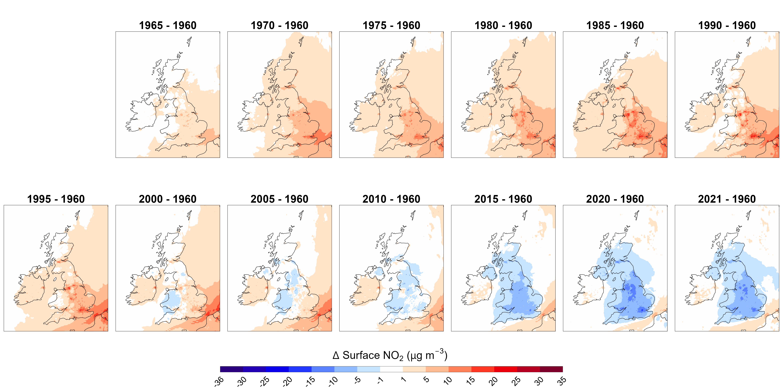
NO₂ annual mean difference relative to 1960

Slide 9
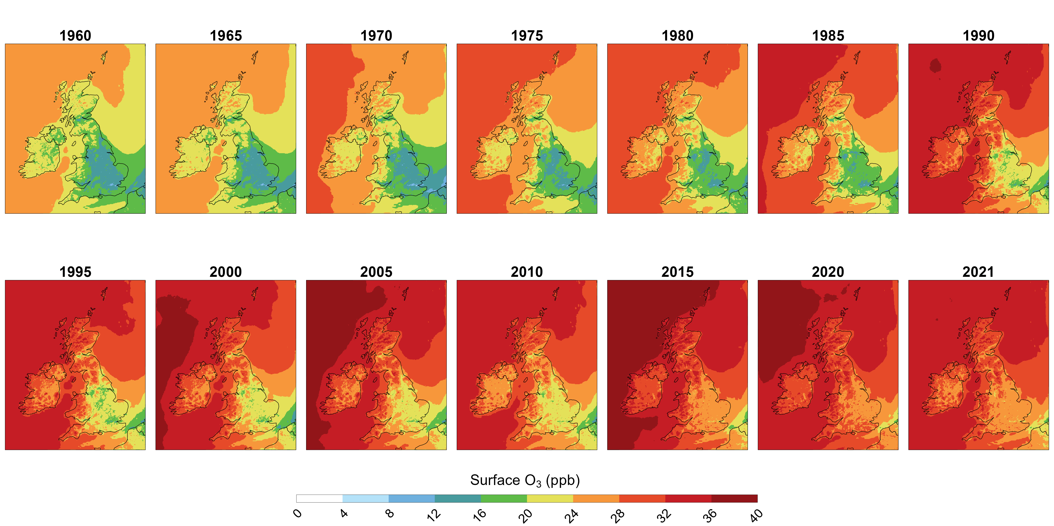
O₃ annual mean

Slide 10
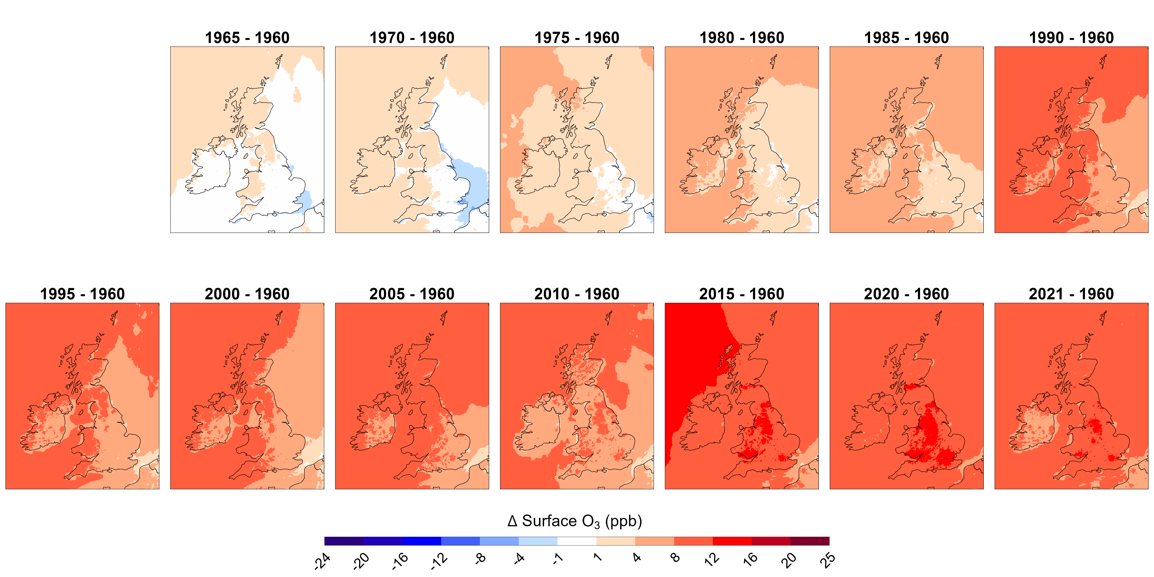
O₃ annual mean difference relative to 1960

Slide 11
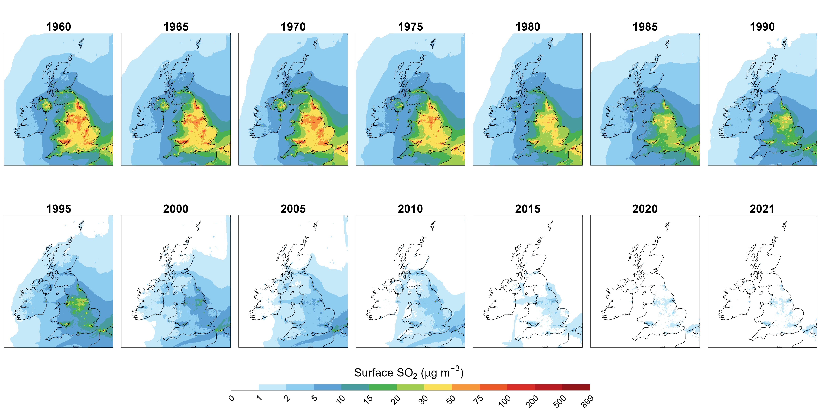
SO₂ annual mean

Slide 12
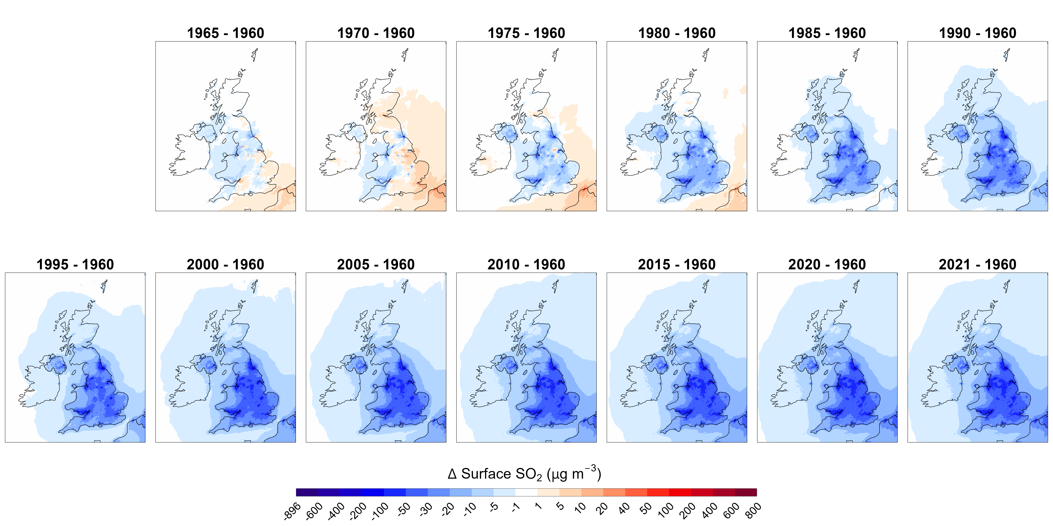
SO₂ annual mean difference relative to 1960

Slide 13
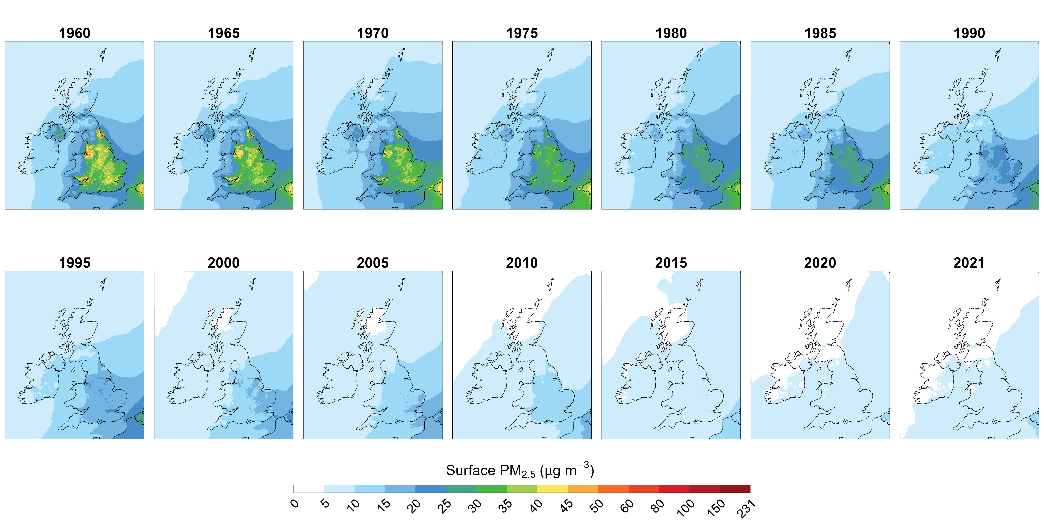
PM_{2.5} annual mean

Slide 14
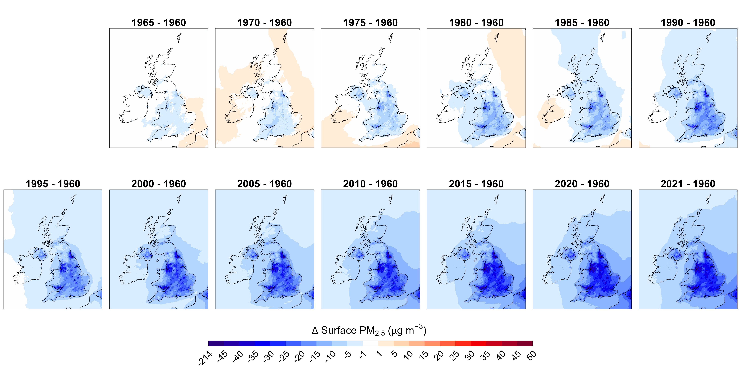
PM_{2.5} annual mean difference relative to 1960

Slide 15
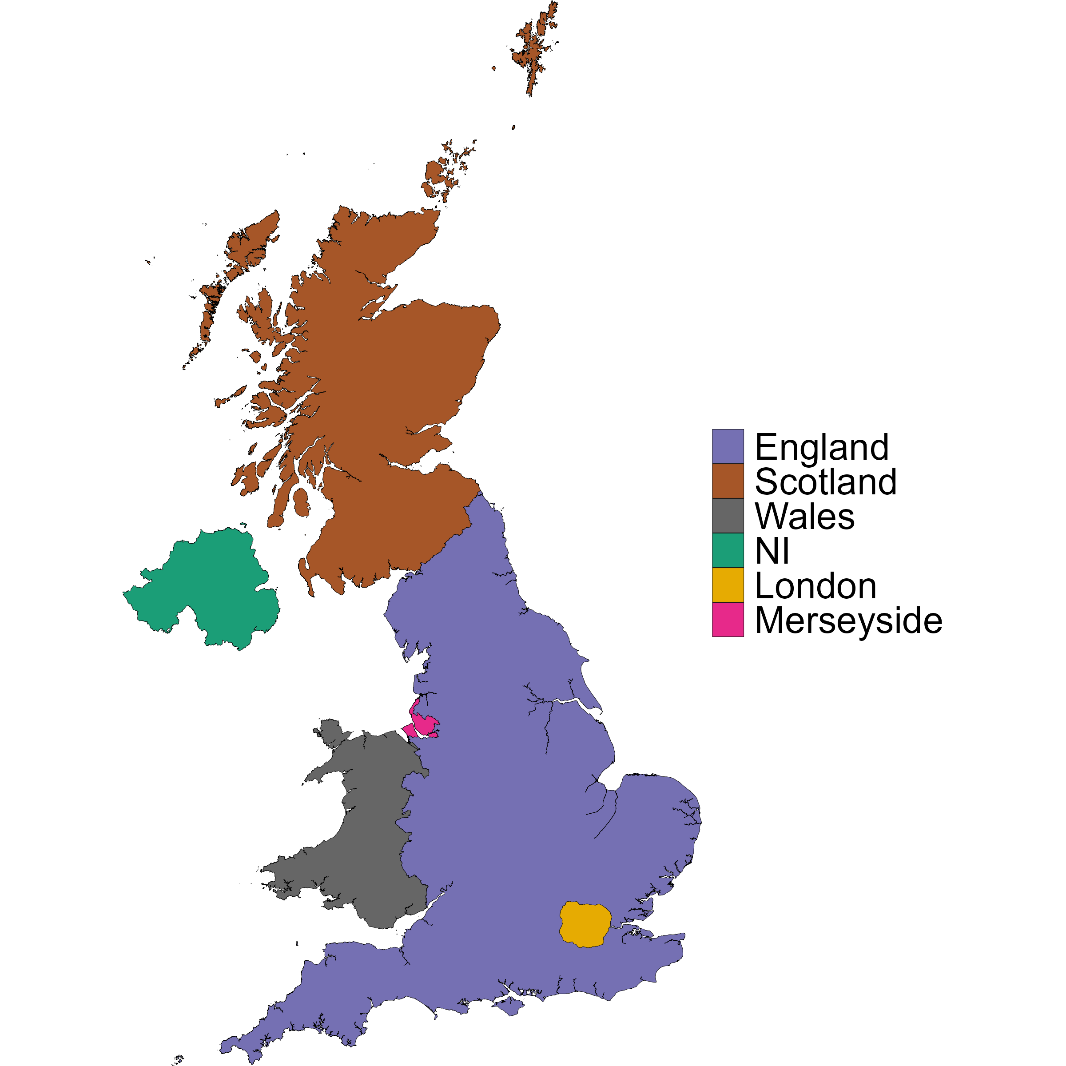
UK countries, London region and Merseyside
Contains OS data © Crown copyright and database right 2025

Slide 16
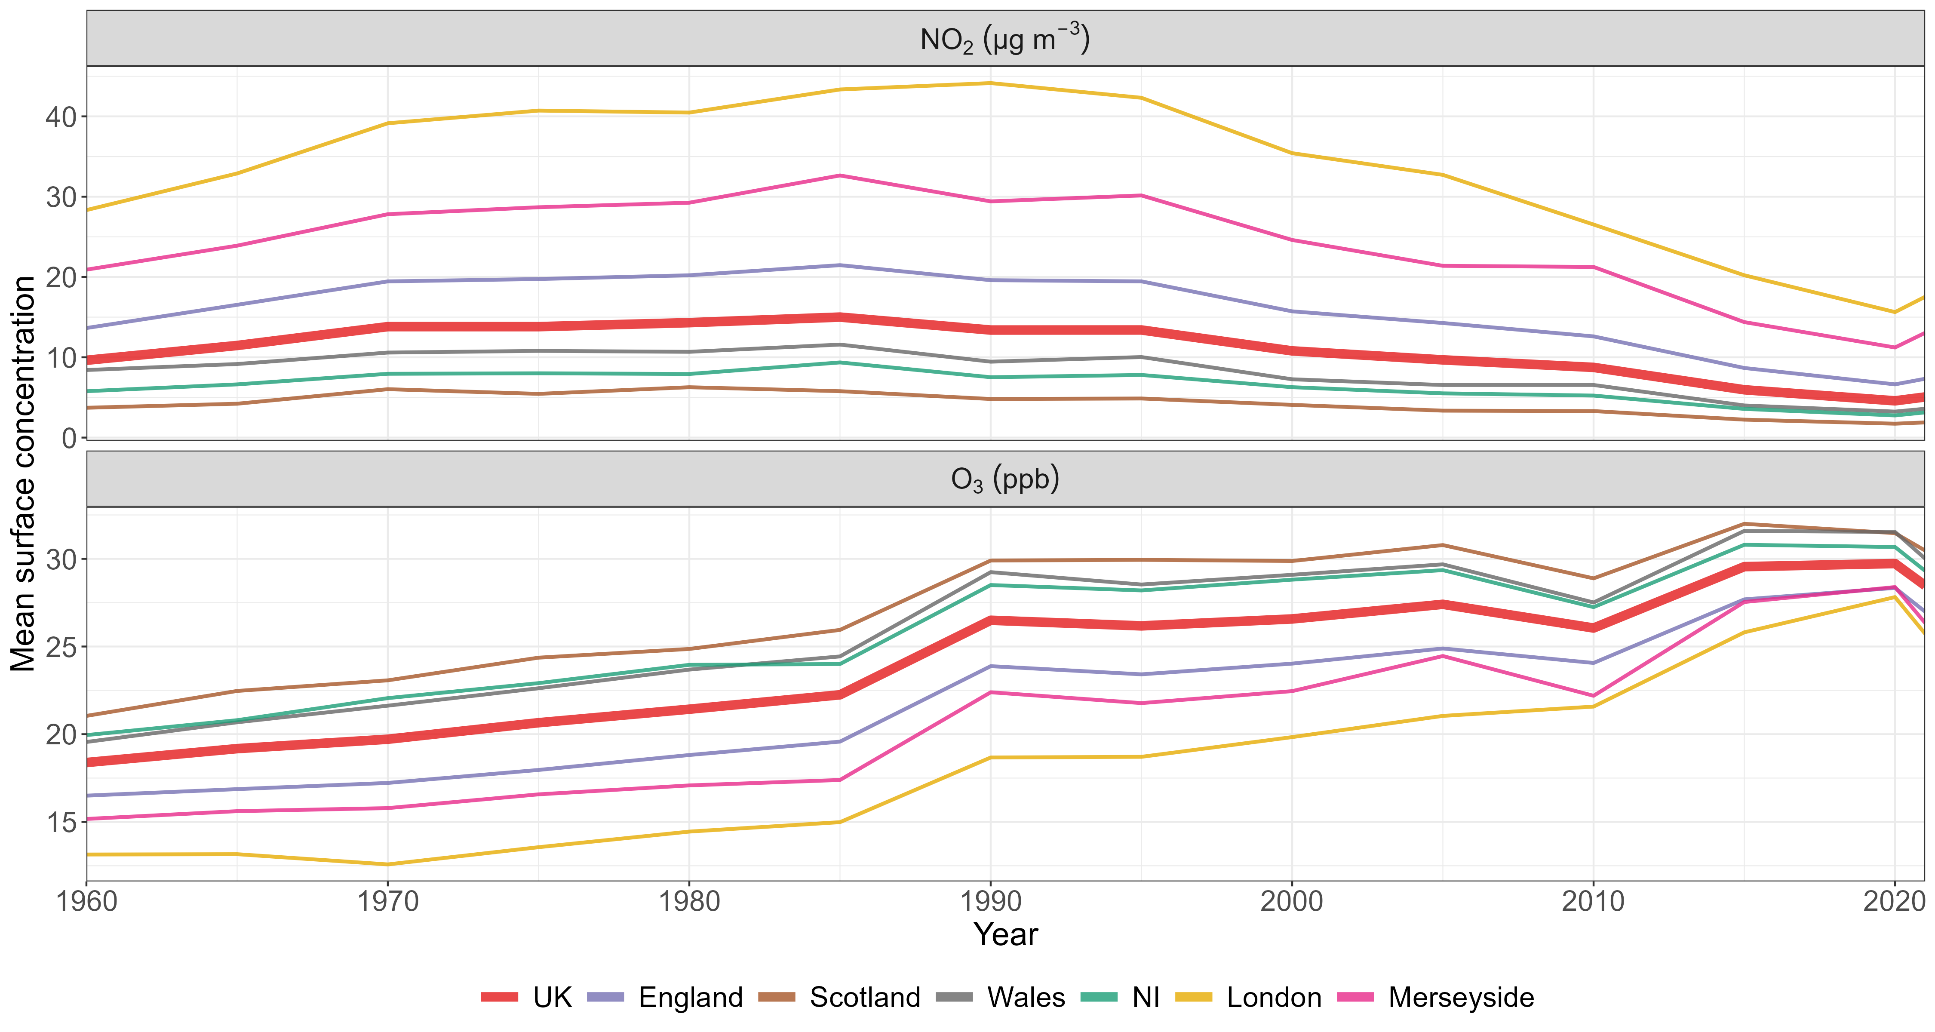
EMEP4UK regional annual means

Slide 17
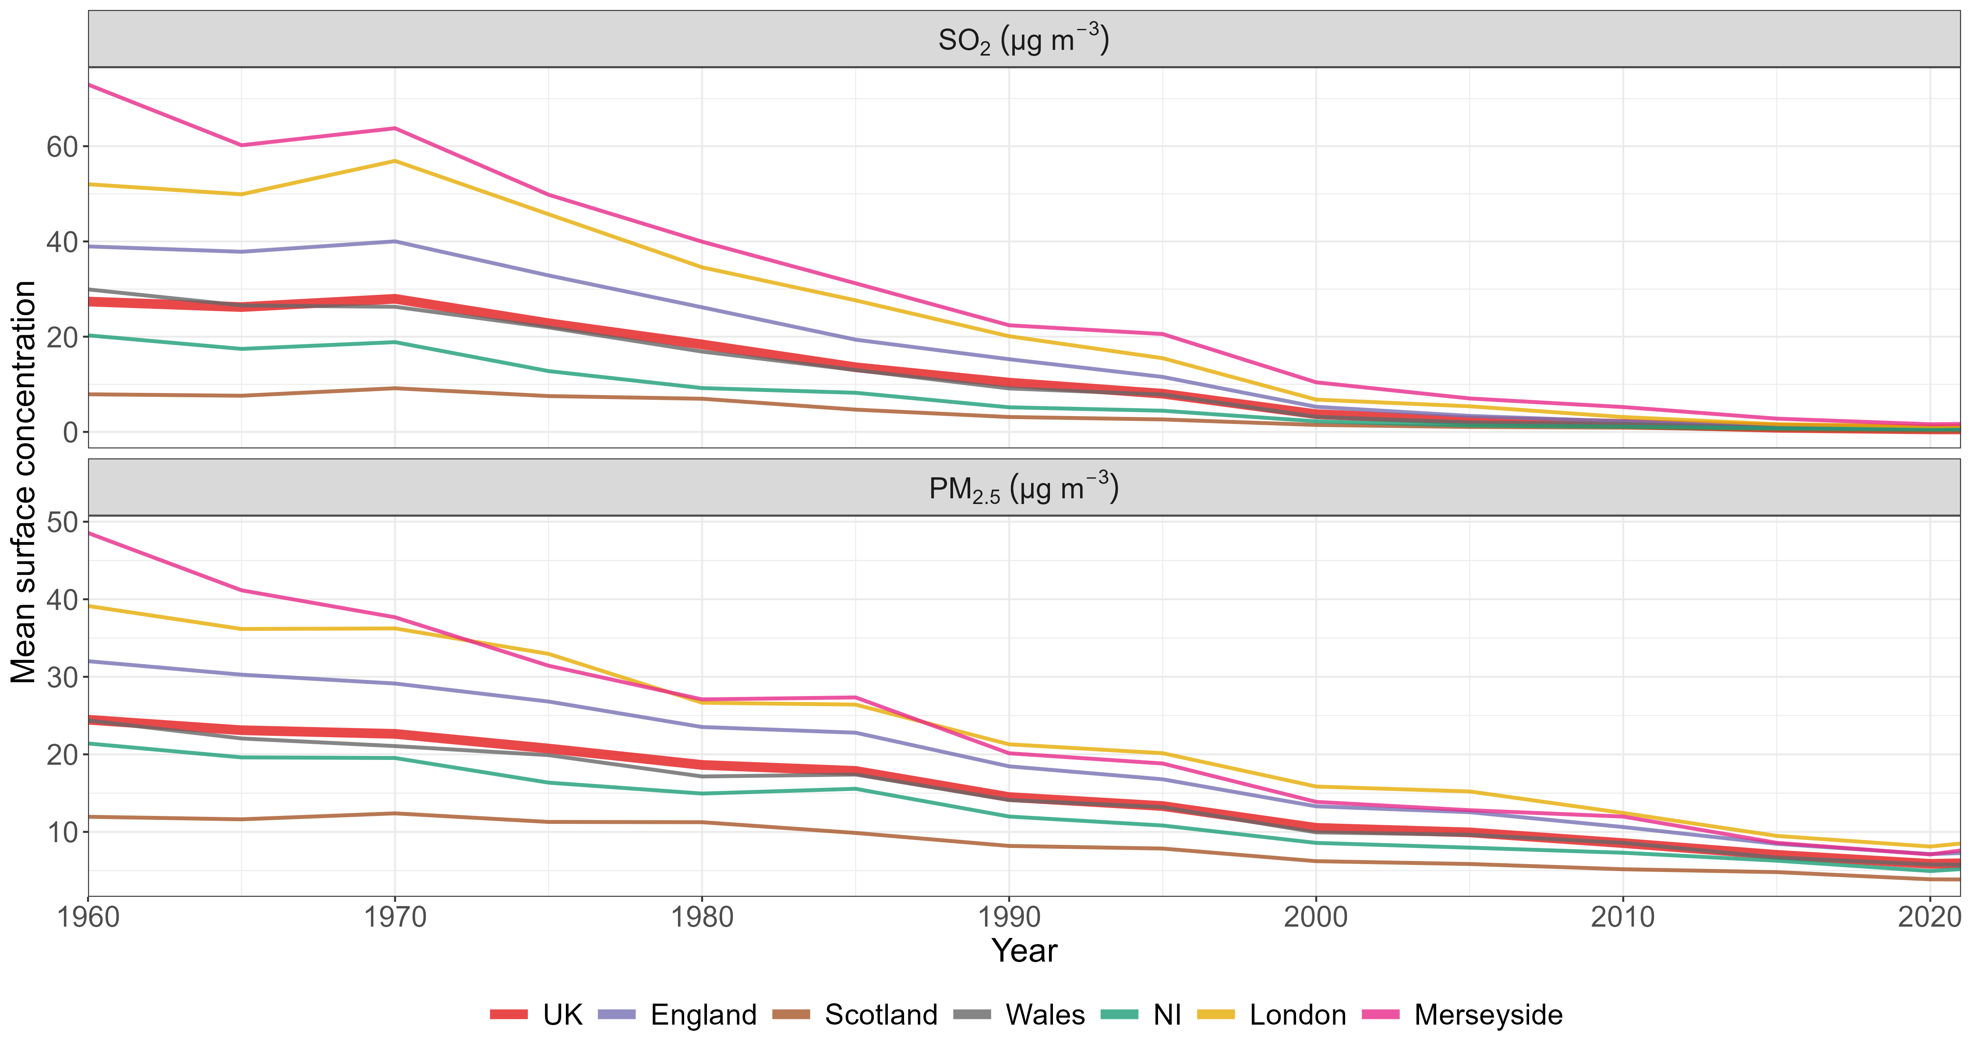
EMEP4UK regional annual means

Slide 18
Summary
We have created datasets of air pollution concentrations in the UK from 1960 to the present.
Over this period:
  NO₂ concentrations peaked in the 1990s but have since fallen to levels below those in 1960
  O₃ concentrations have shown a steady increase over time
  SO₂ levels have substantially declined across the UK
  PM_{2.5} levels have also declined, especially in the most polluted regions

Slide 19
Thank you!

Slide 21
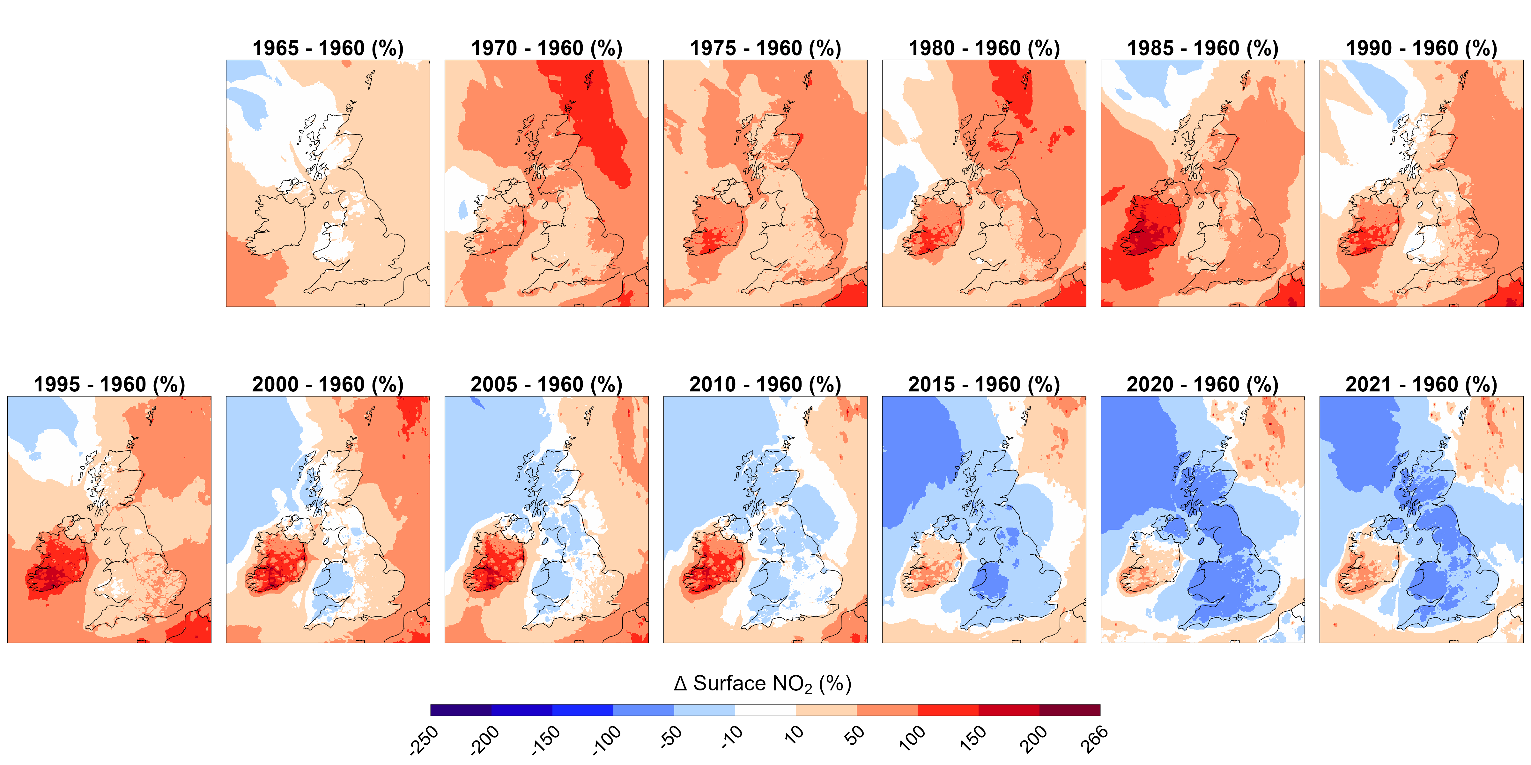
NO₂ annual mean difference relative to 1960 (%)

Slide 22
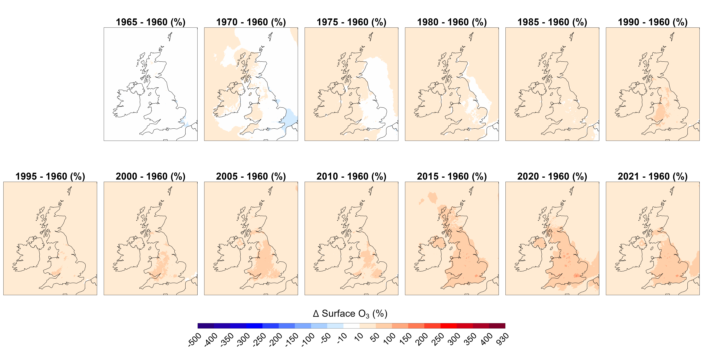
O₃ annual mean difference relative to 1960 (%)

Slide 23
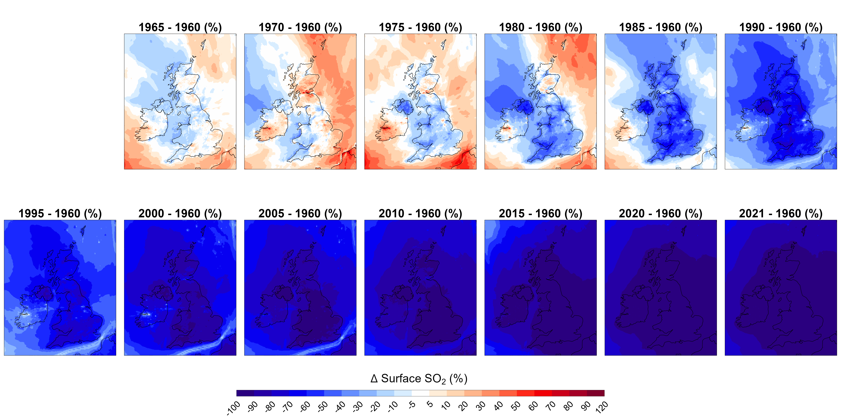
SO₂ annual mean difference relative to 1960 (%)

Slide 24
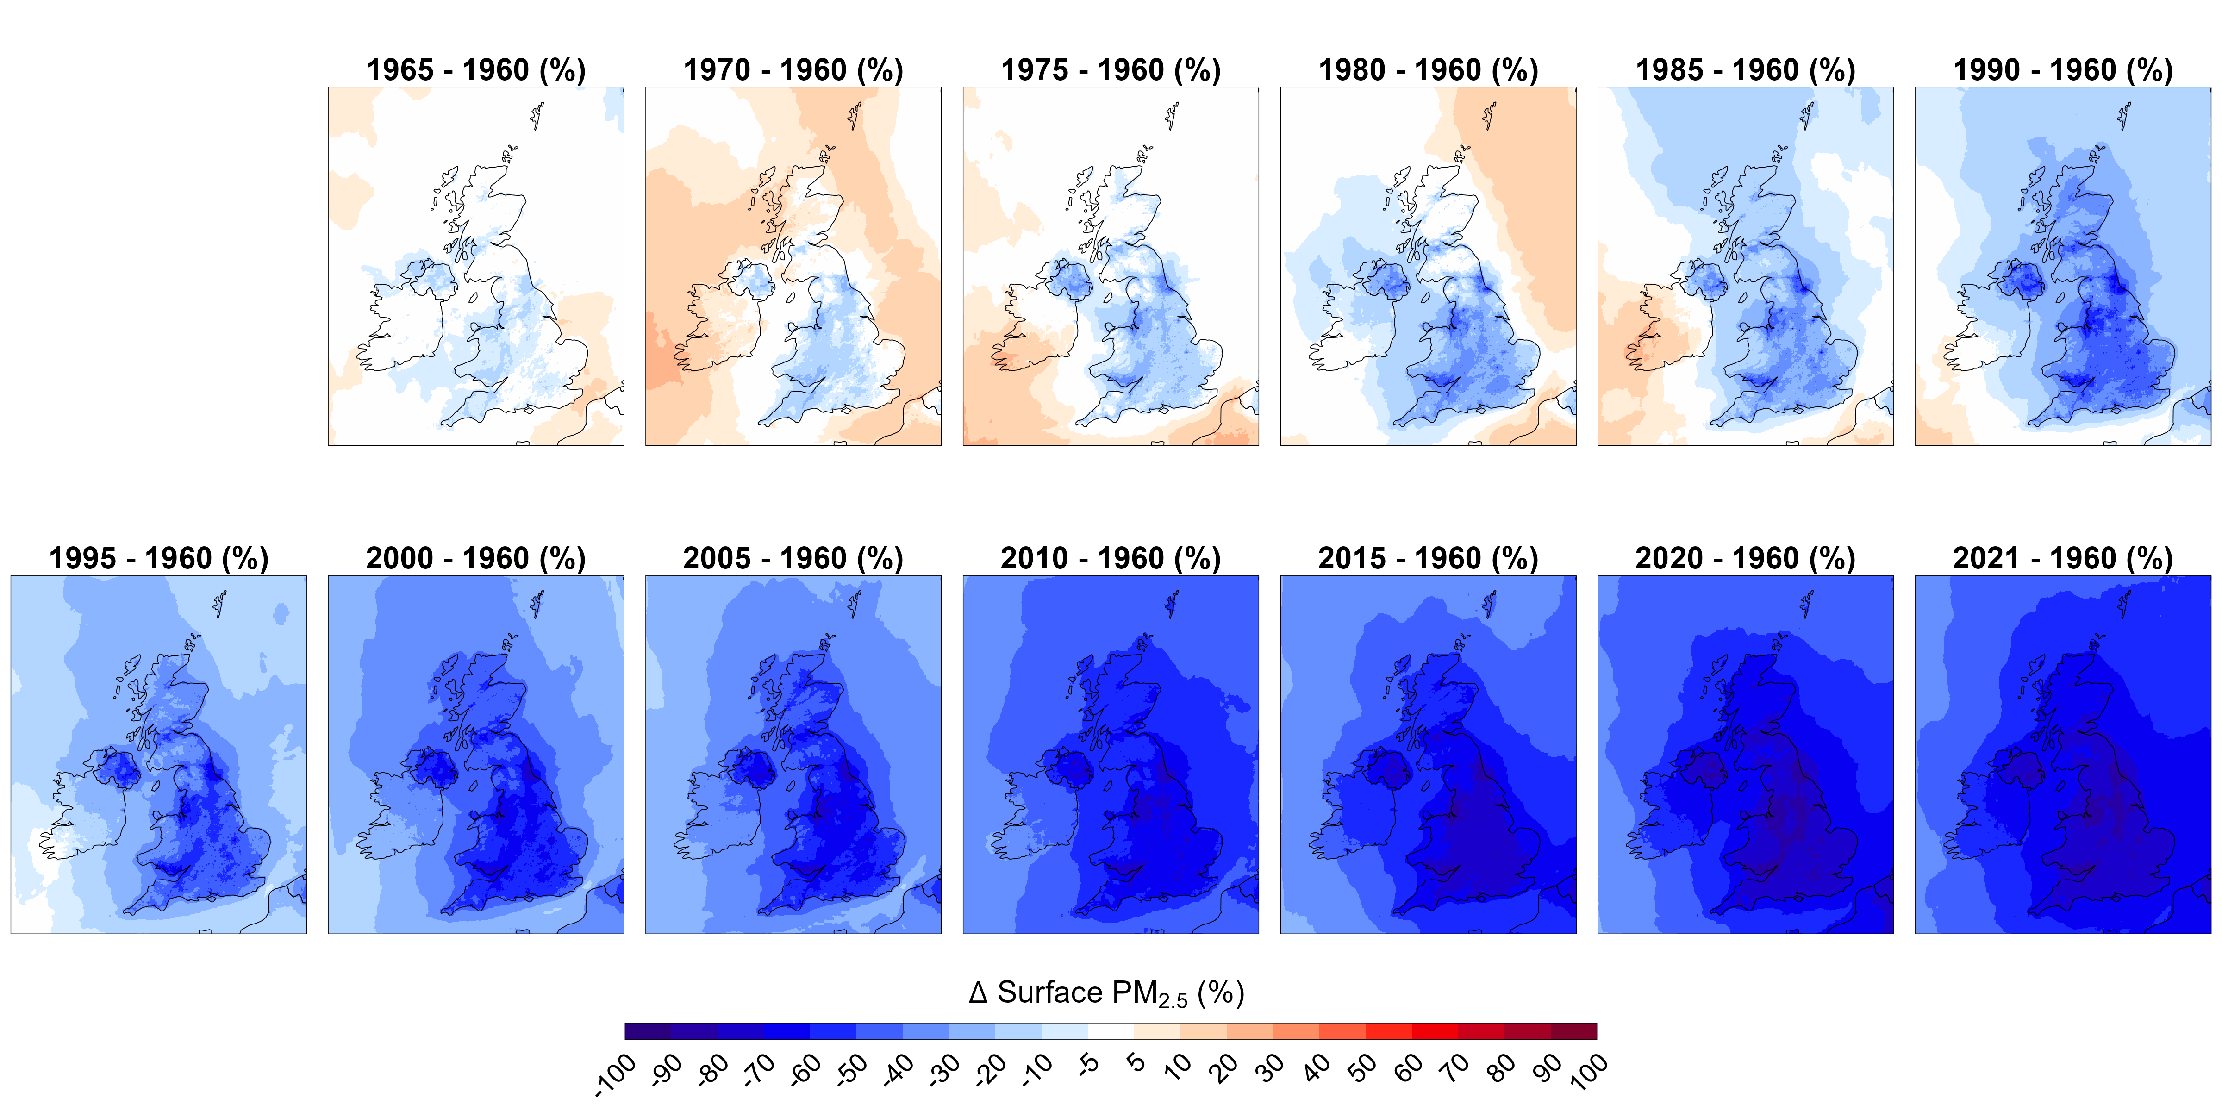
PM_{2.5} annual mean difference relative to 1960 (%)

