Slide 1


Retrospective modeling of the impact of climate change on emissions and air quality for the last decades
Florian Couvidat, A. Guion, V. Lannuque, P. Messina, E. Real, G. Descombes, A. Simeon, A. Colette (INERIS)
P. Buysse & Raia-Silvia Massad (INRAE)
26th TFMM, Potsdam, 5-7 May 2025
Funded by

Slide 2
Objectives of the study
  Isolate the effect of climate change on emissions (both natural and biogenic) and air quality on the 1990-2022
  Simulate with CHIMERE atmospheric concentrations at 0.25°resolution with constant practices (or activities) using ERA5 meteorology on the whole period
  Several developments were performed to match the current state-of-the-art on the effect of meteorological variables on emissions and air quality:
      Revision of the biogenic emissions module
      Harmonization of LAI data and stomatal flux between biogenic emissions and deposition module
      Use of dynamic parameterization for anthropogenic emissions

Slide 3
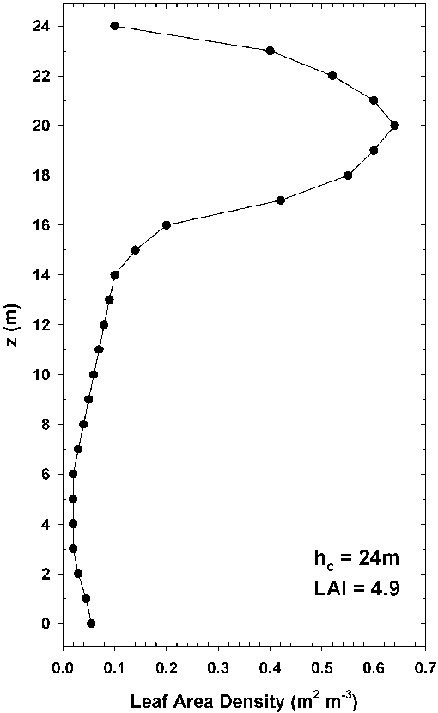








Method: Implementation of a canopy module in CHIMERE
  Revision of the speciation of emissions for light VOC (lighter than isoprene) based on MEGAN data
  effect of soil moisture on isoprene emissions with soil moisture from ECMWF and a Wilting Point database (IGPB-DIS)
  inhibition of isoprene emissions due to CO₂ concentrations
  Vertical distributions of LAI, uniform distributions for grass, shrubs, crops
  Combinaison of LAI satellite data and LAI growth curve from Emberson et al. (2000) to redistribute LAI by vegetation categories
PAR
$$T_{leaf,1}$$
PAR
$$T_{leaf,2}$$
$$T_{leaf,3}$$
$$T_{leaf,4}$$
Leaf area density
$$T_{leaf,5}$$
$$T_{leaf,6}$$
Soil humidity
$$F_{veg,i}={{EF}_{veg,i}C}_{CE,veg,i}γ_{SM,i}γ_{age,veg,i}γ_{CO2,i}\sum{∆{LAI}_{veg,layer}}γ_{PT,veg,i}\left(T_{leaf,layer},{PAR}_{layer}\right)$$

Slide 4
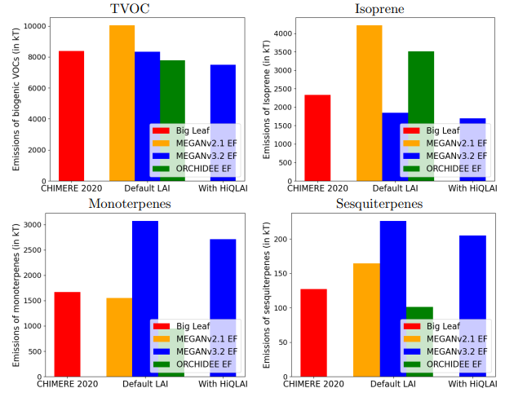
Methods: Estimated biogenic emissions over Europe
Source of LAI data:
- Default LAI for 2013 from MODIS (Yuan et al., 2011)
- Time-varying LAI: HiQLAI (2000-2022) combined to GlobMap (1980-2000) from MODIS
Three sources of biogenic emissions factor:
MEGAN2.1 emission factors (Guenther et al., 2012)
MEGAN3.2 emission factors
ORCHIDEE emission factors (Messina et al., 2016)
MEGAN 3.2 EF seems better based on the literature

Slide 5
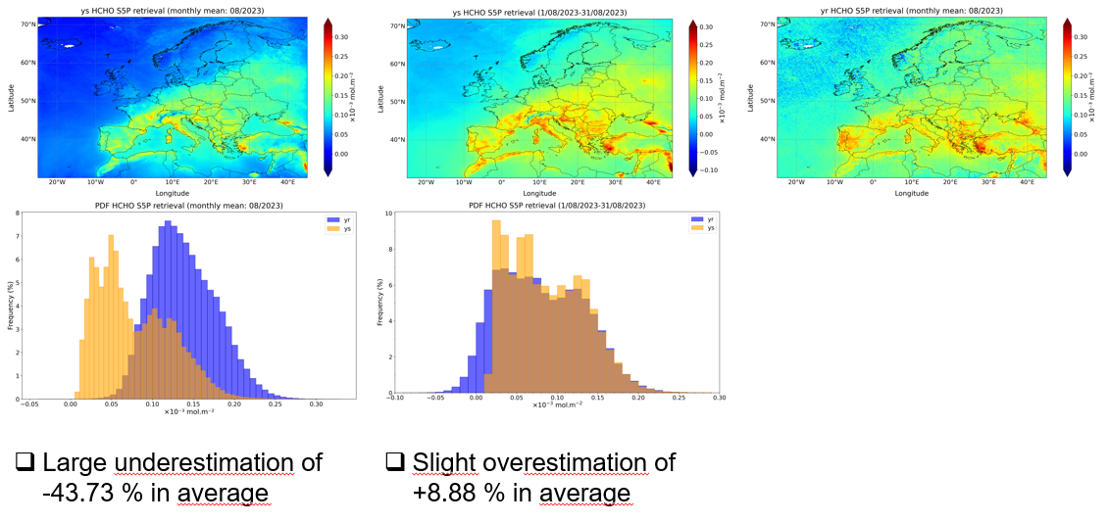

Methods: Speciation of biogenic emissions
Comparison to HCHO sentinel data
CHIMERE with revised speciation
Sentinel data
Old CHIMERE
August
2023
Courtesy of G. Descombes and A. Simeon

Slide 6
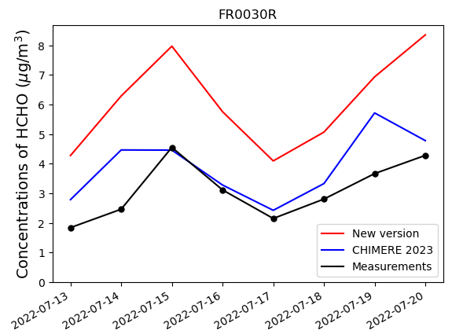
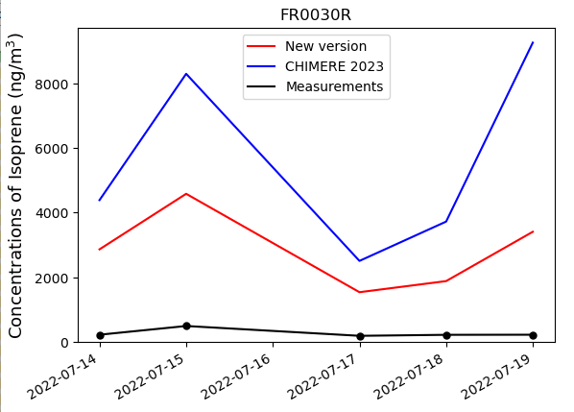
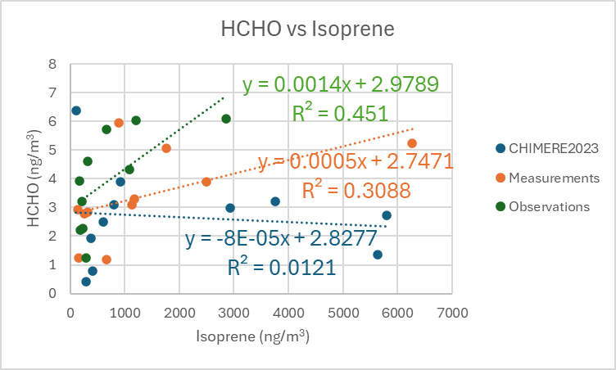
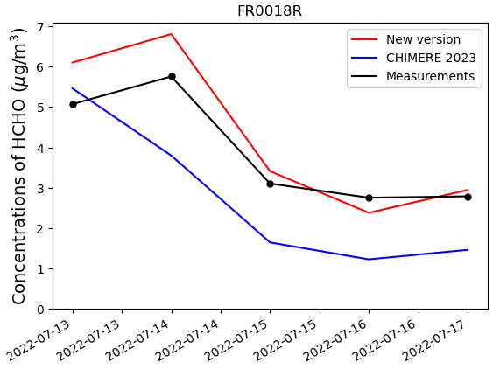
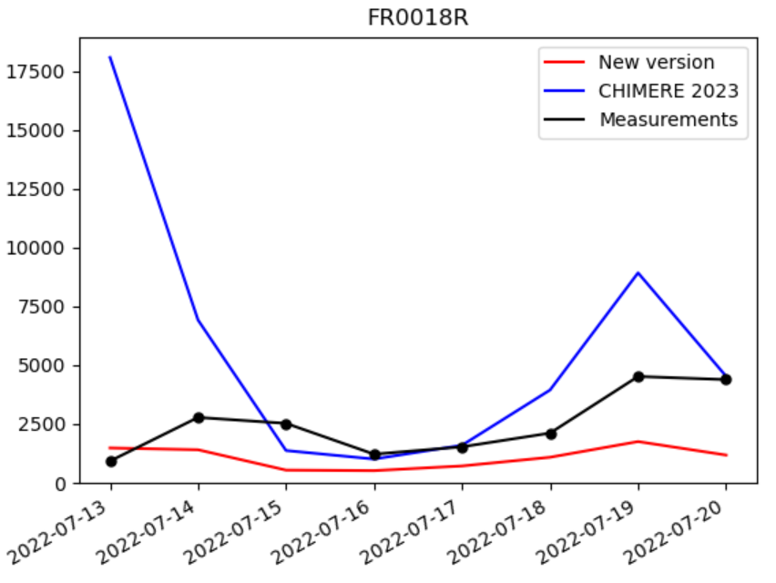
Methods: Comparison of biogenic VOC to in-situ measurements
HCHO
Isoprene
Comparison with in-situ measurements do not indicate a clear message (especially for Isoprene)

Slide 7
Methods: Other emissions
Implementation of Yienger and Levi (1990) parameterization (include effects of soil temperature, soil humidity, precipitation) for soil NOx emissions
Dynamic parametrisation for anthropogenic emissions calibrated to reproduce 2018 emissions:
  NH₃ from fertilizers based on a resistance approach
  NH₃ from livestock based on data reported by countries on CEIP and parameterizations of skjoth et al. (2011)
  Use of Heating Degree Days approach to project 2018 residential emissions using meteorology
  Other parameterisations for cold start NO₂ emissions from traffic, NMVOC emissions from solvents and gasoline evaporation

Slide 8
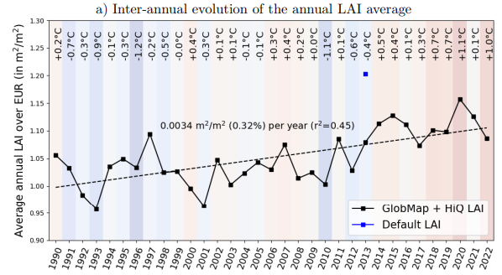
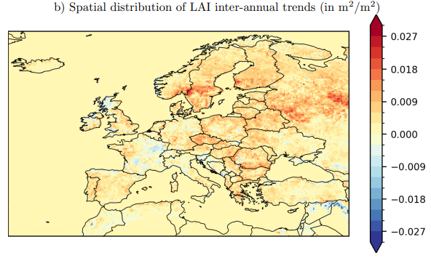
Results: Climate change and LAI evolution
Significant increase of LAI in Northern and Eastern Europe due to CO2 fertilization or the increase of the growing season
Local decrease especially for broadloeaf forests in France due to increase of drought

Slide 9
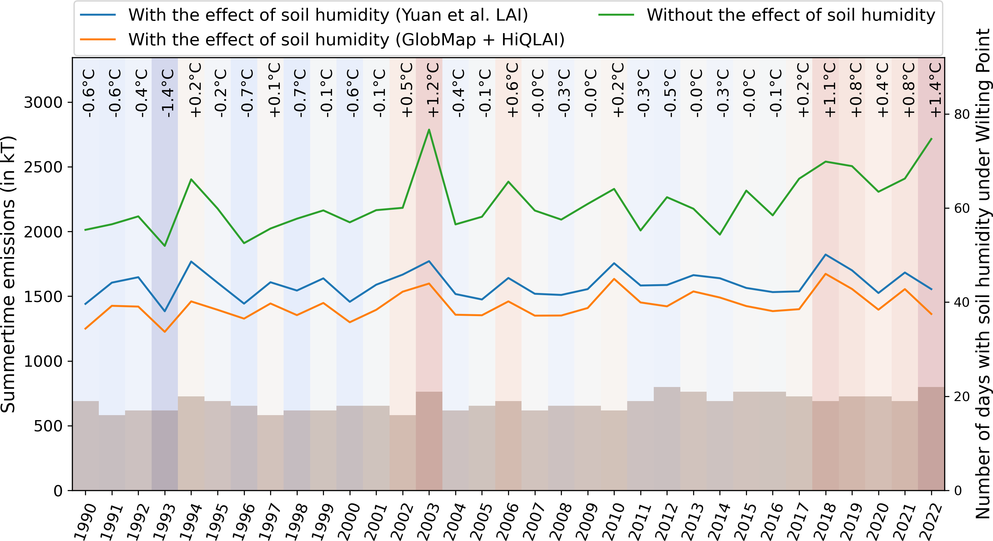
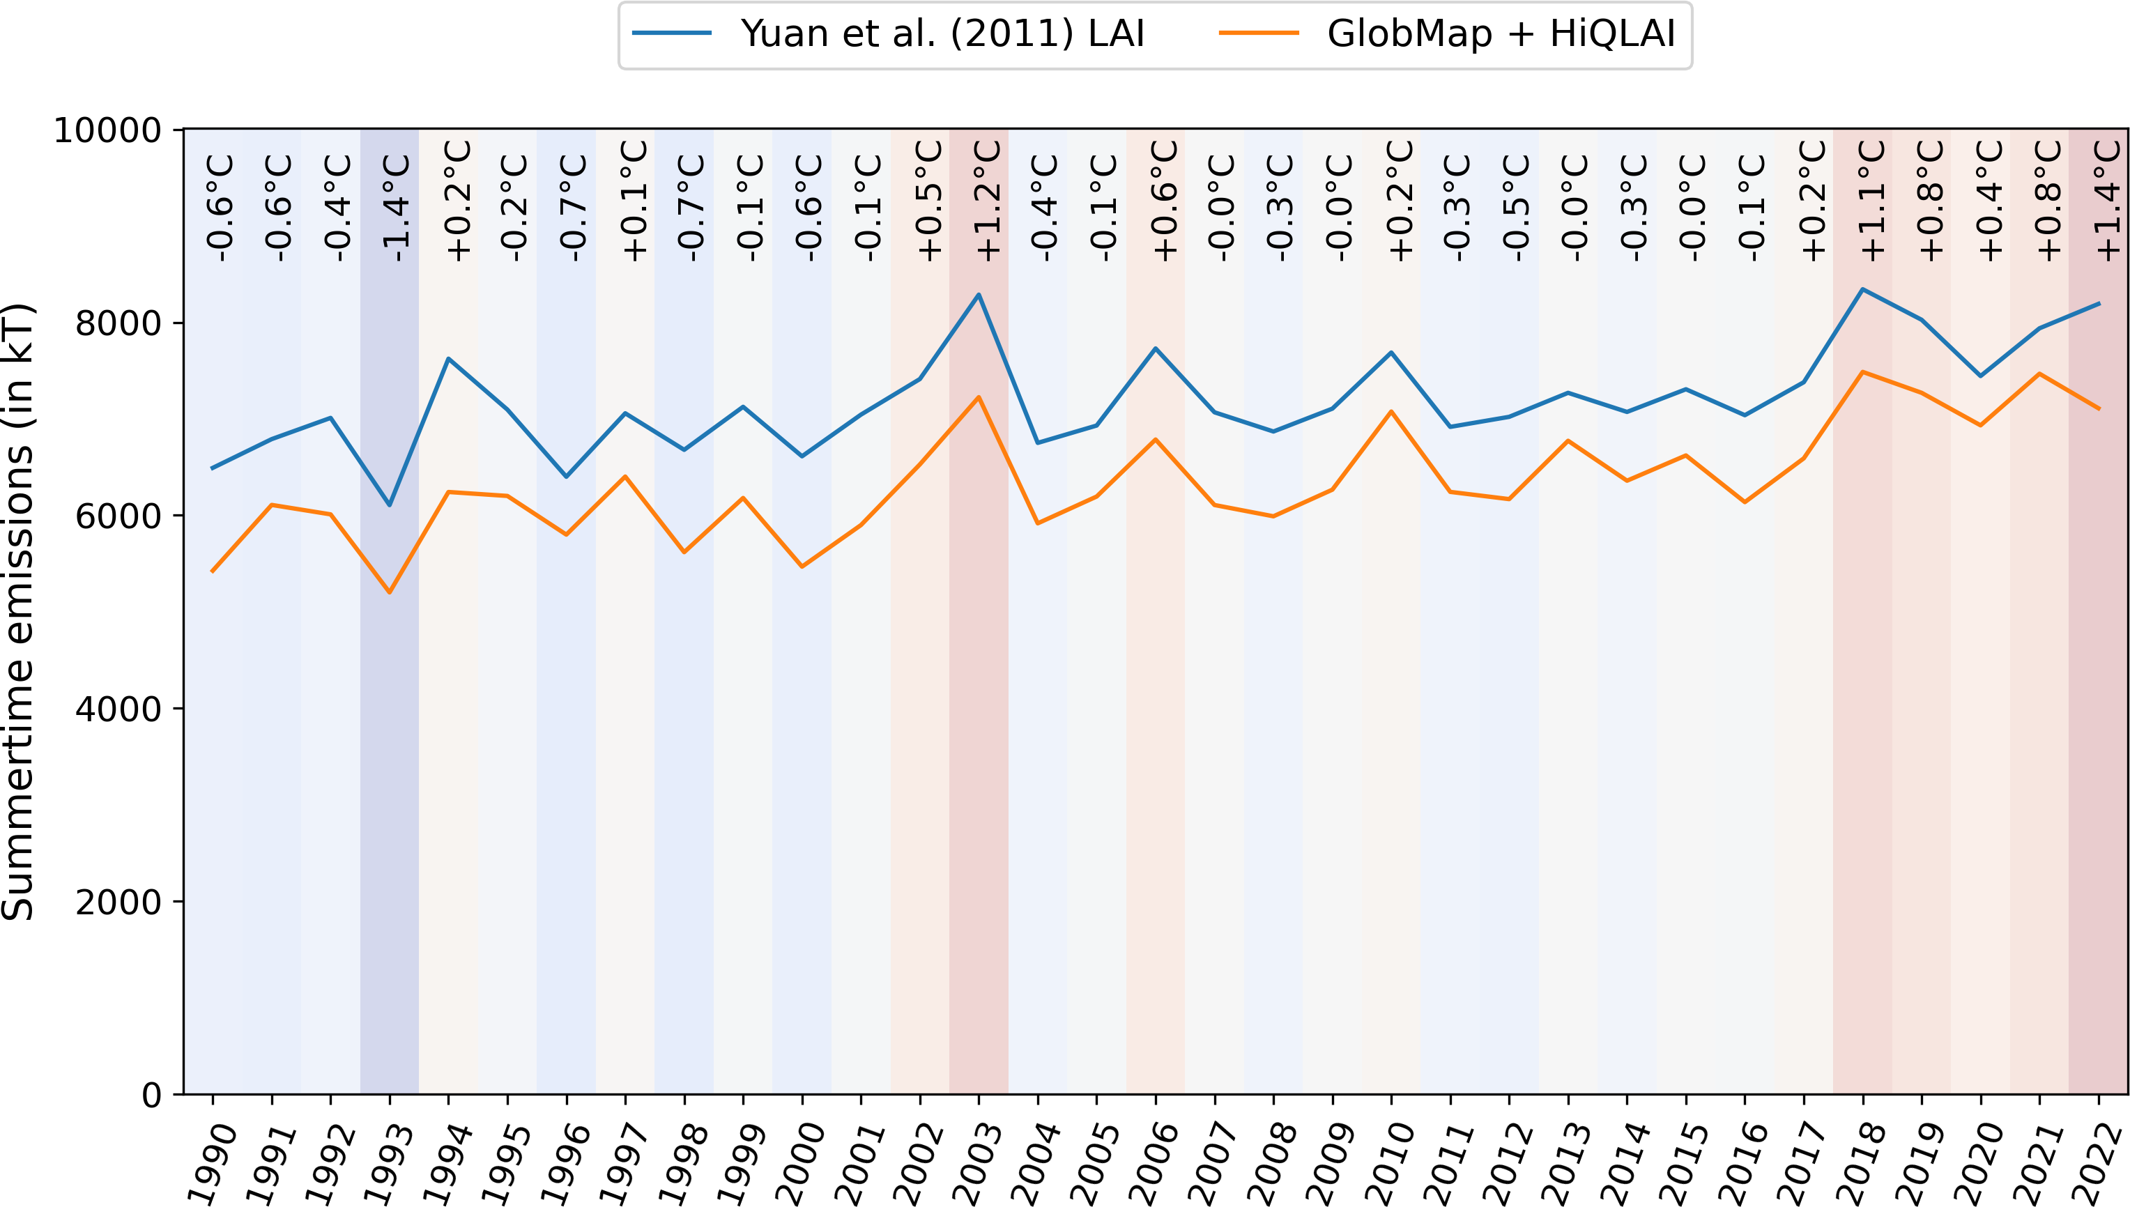
Results: Climate change and biogenic emissions
Isoprene
Total VOC
+7.9%/°C 0.35%/y
+13.5%/°C 0.67%/y

Slide 10
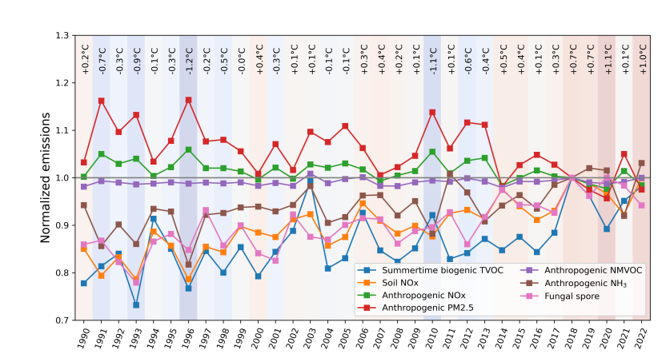
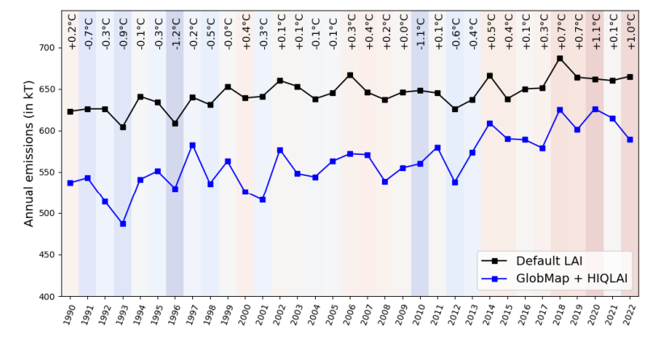
Results: Evolution of all emissions
Fungal spore emissions
Soil NOx, NH3, BVOC, fungal spore emissions increase
PM and other NOx emissions decrease
+0.51%/y
57% of the increase due to LAI
43% due to humidity

Slide 11
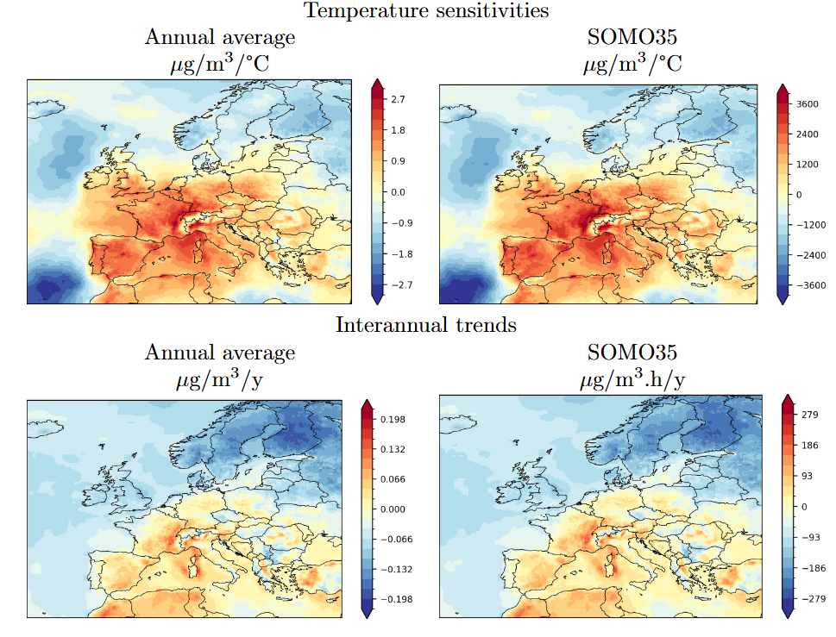
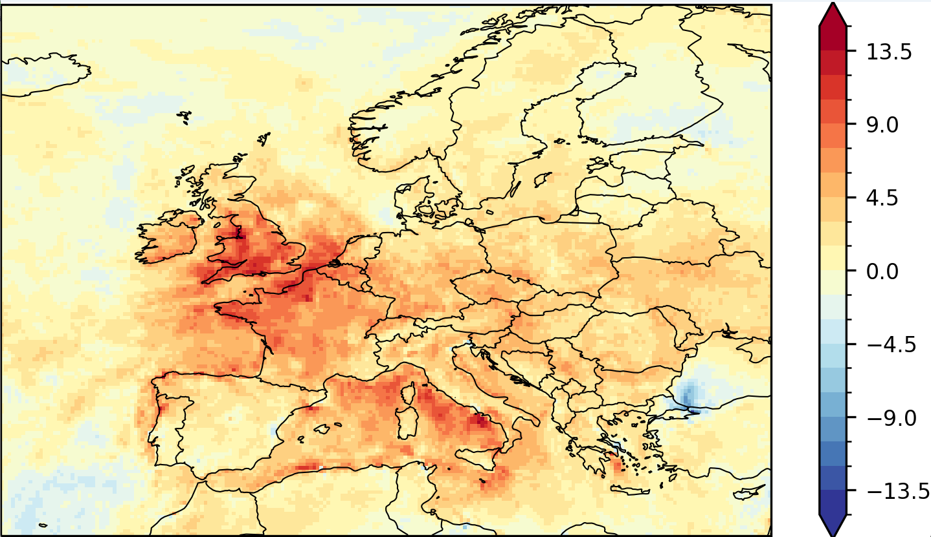
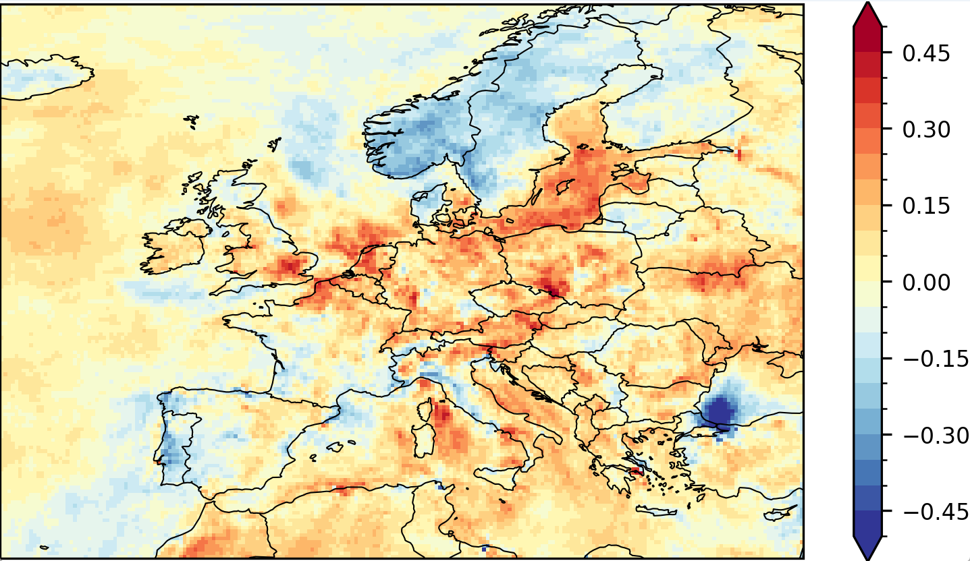
Results: Ozone concentrations
4MDA8
Similar pattern between annual ozone, annual average of ozone daily max, SOMO35. Only 4DMA8 has a specific pattern with increase over the whole domain
Main drivers for ozone are:
Temperature (R² between 0.1 and 0.5)
LAI. Increases of LAI can lead to an increase of deposition velocities
Boundary conditions
4MDA8

Slide 12
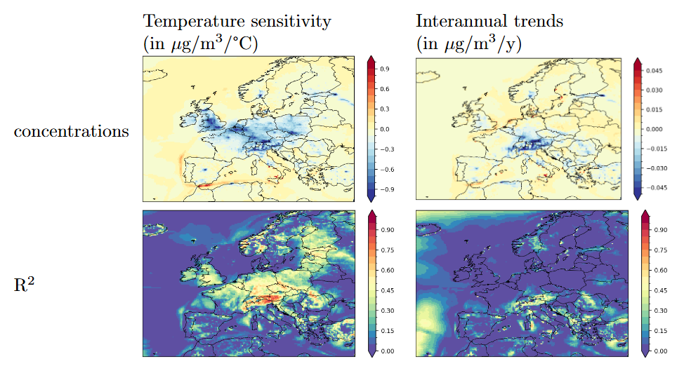
Resuls: NO₂ concentrations
Annual NO₂ concentrations are strongly driven by annual temperature (R² around 0,5 in central Europe)
Almost no evolution if emissions are assumed to be constant

Slide 13
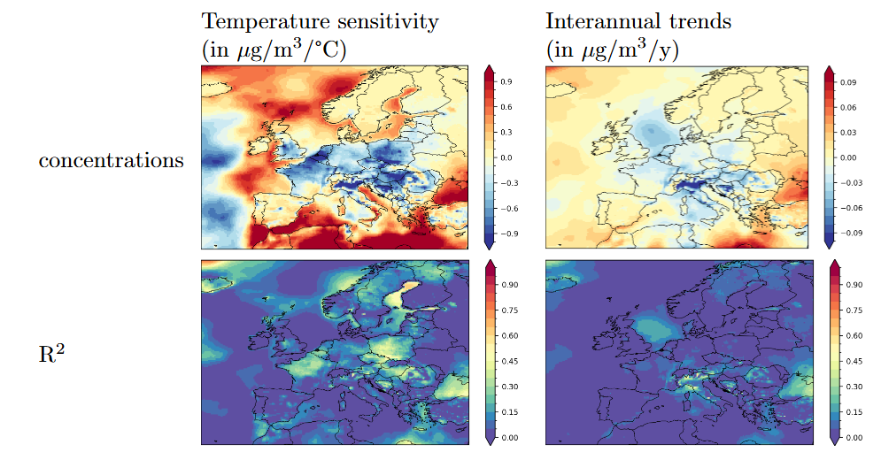
Results: PM10 concentrations
Decrease of SIA (even though NH₃ emissions increase) due to higher temperature
Decrease of primary PM (decrease of residential emissions)
Slight increase of SOA, fungal spore and dusts. The increase of dusts is due to more frequent periods with south-north winds.

Slide 14
Conclusions
Strong dependence of emissions on climate change:
More BVOC, more spores, more NH₃ but less NOx and PM
Isoprene emissions are strongly affected by the decrease in the soil humidity. Other VOC should be affected too but not a lot of data. Studies indicate an increase of some monoterpenes and a decrease of other monoterpenes with a decrease in soil humidity.
Difficulties to validate biogenic emissions
Effect of climate change on concentrations:
The evolution of LAI due to CO₂ fertilization, or increase in dry conditions plays an important role in the evolution of VOC emissions and ozone concentrations.
Concentrations of natural and biogenic PM increased while anthropogenic PM decreased
Effect of climate change on deposition:
Deposition is also affected: increase in NHx deposition, stable NOx deposition but lower SOx deposition

