Slide 1
Annual vs. short-term transboundary contributions to air pollutant concentrations in Poland
Aleksander Norowski, Paweł Durka,
Grzegorz Jeleniewicz, Joanna Strużewska,
Department of Atmospheric and Climate Modelling

Slide 2
Motivation
Current legislative obligations in terms of transboundary transport assessment and annual air quality assessment
New 2024/2881 directive
Requests from Ministry of Climate and Environment
Practical question:
  How to assess transboundary contribution
    By region vs. country
    Period vs. year
    Percent vs. absolute value (in the context of exceedances)
    All together vs. individual neighbouring countries
    Consistent emission inventory (EMEP or CAMS) vs. detailed national (but higher in the country)
    Using BF – shall we normalize contributions
    How to deal with secondary aerosols
  How to exchange the information with neighbours

Slide 3
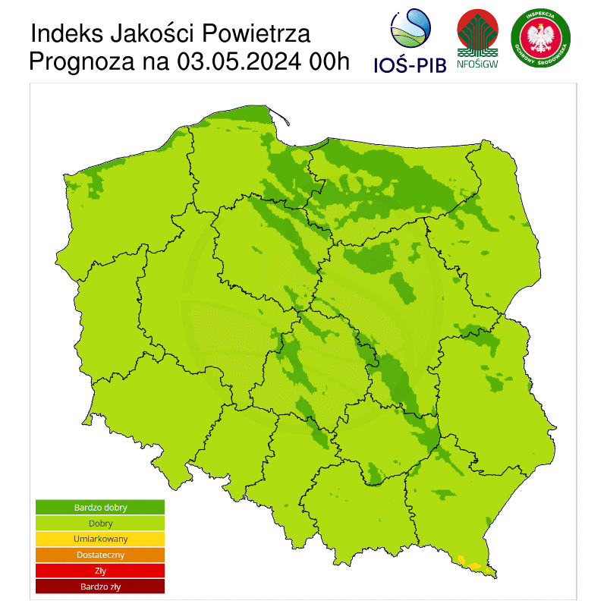
IEP-NRI is legislated to carry out AQ modelling for policy support
Chief Inspectorate of Environmental Protection:
  Daily operational forecast (3 day forecast)
  Annual air quality assessment (20th of March) + source contribution by 15 of April
  5-year assessment (30th of May)
  Impact of transboundary transport (30th of June)
  Station representativeness (30th of October)
Ministry of Climate and Environment:
  National Air Quality Improvement Plan (30th of September)

Slide 4
What is provided:
Every year:
  Source/sector contributions including transboundary transport for PM!0 and PM2.5 using national emission inventory in 2,5km resolution (a a supplementary information for the annual assessment)
  Transboundary transport assessment calculated on a larger grid with most up-to-date EMEP emission inventory for a set of regulated pollutants: NO2, SO2, O3, PM10, PM2.5, BaP
Modelling for NAPCP
Research projects e.g. LifeREMY
CAMS based estimates of desert dust and wild fires PM10

Slide 5
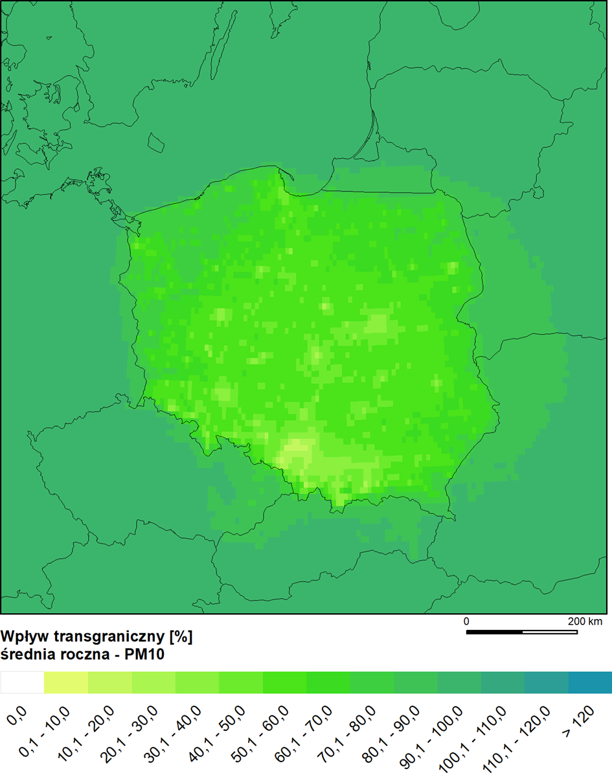
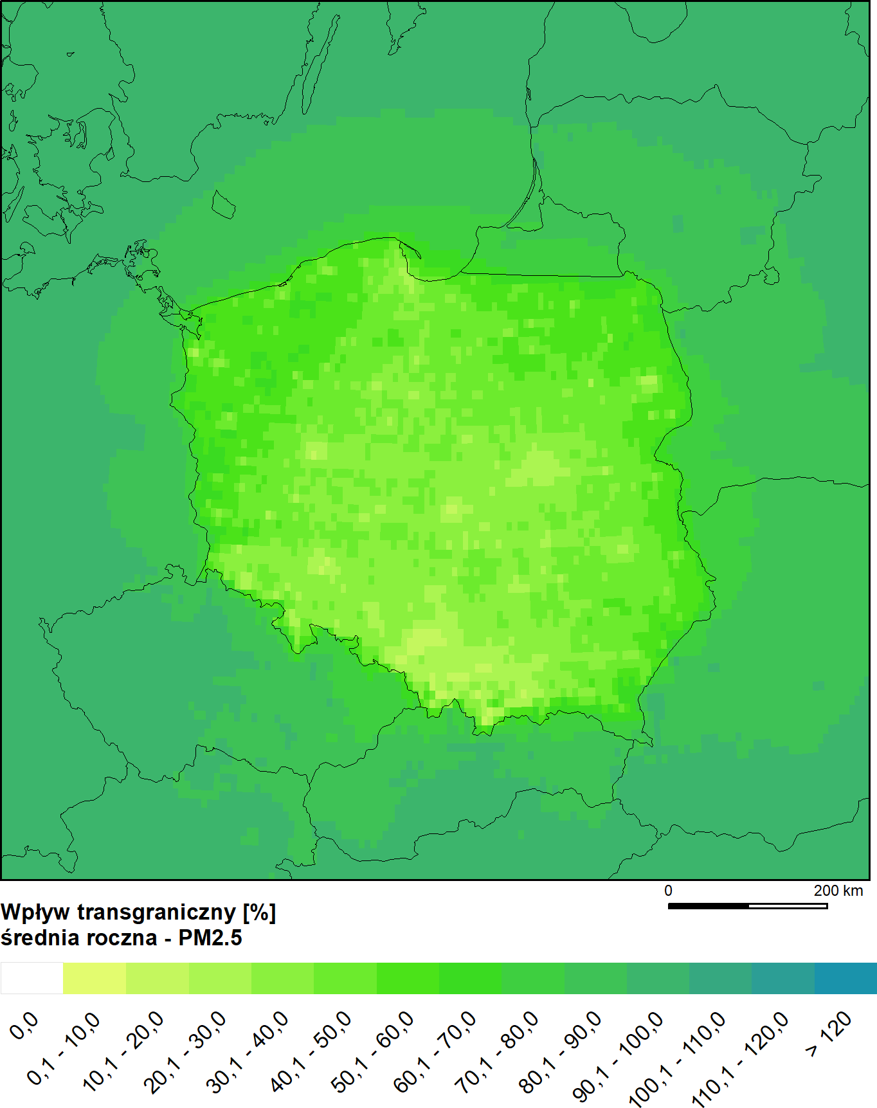
Transboundary contribution in 2023 – PM_{10 ,} PM_{2.5}
Annual average PM₁₀
Annual average PM_{2.5}

Slide 6
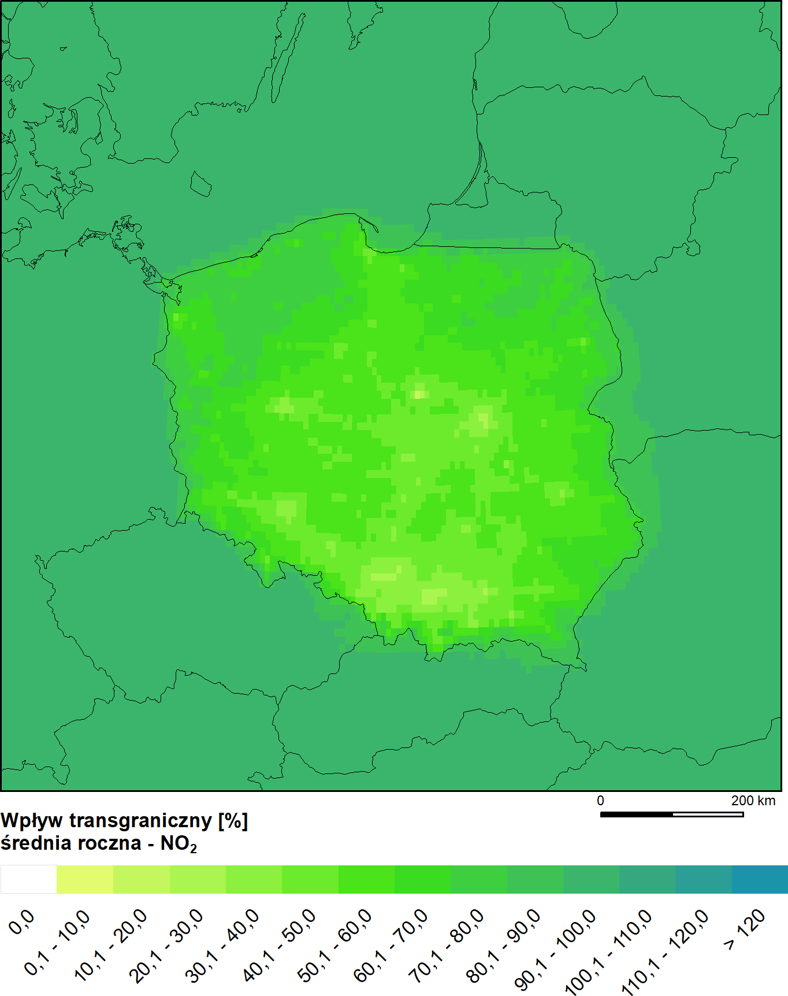
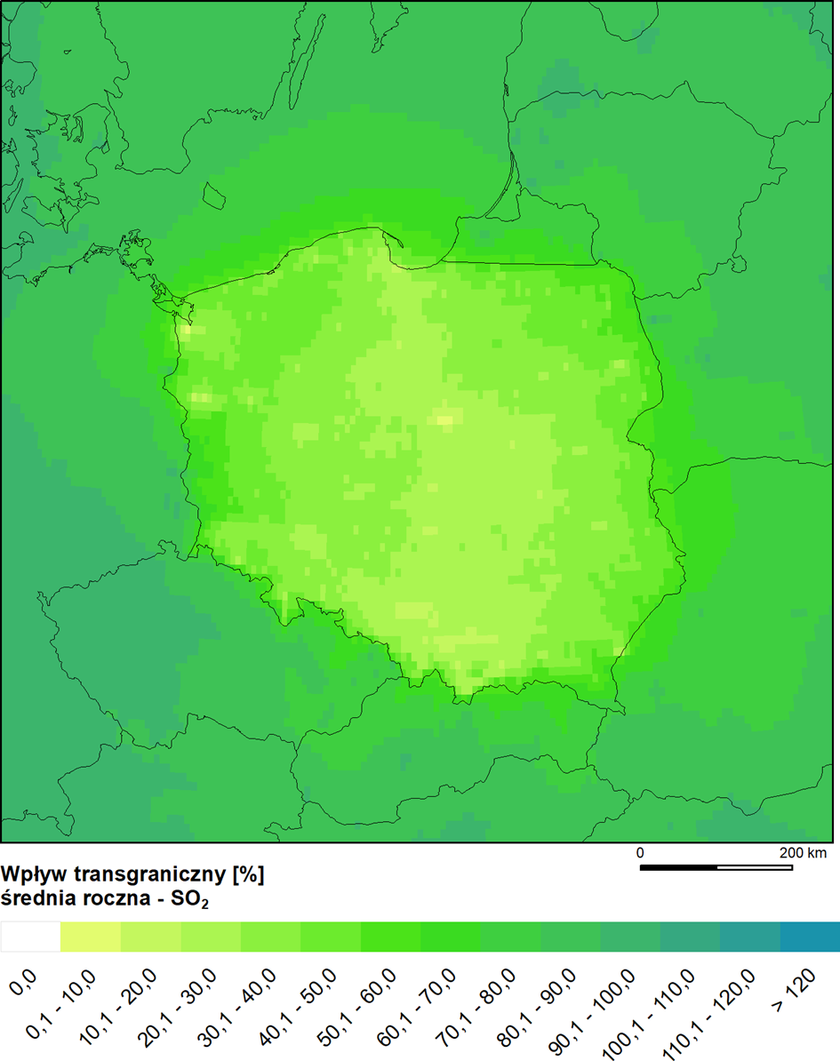
Transboundary contribution – NO_{2 ,} SO₂
Annual average NO₂
Annual average SO₂

Slide 7
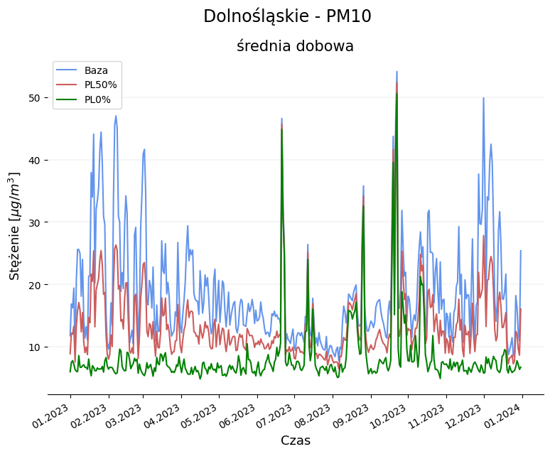
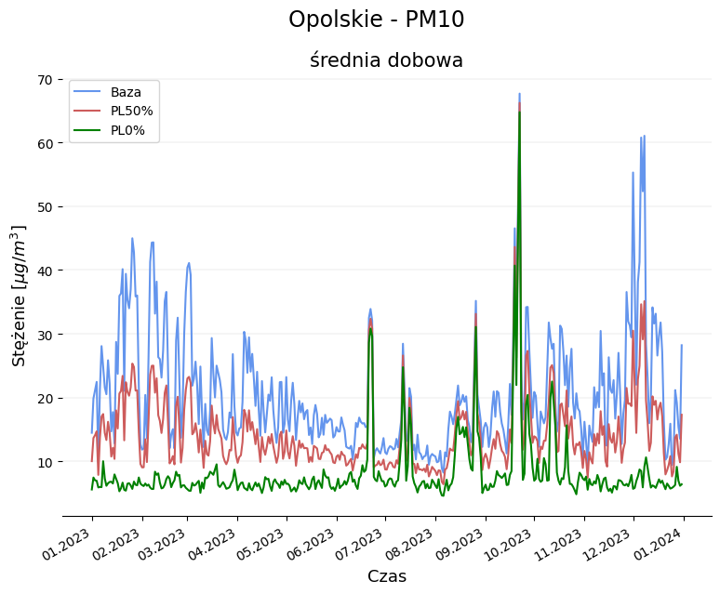
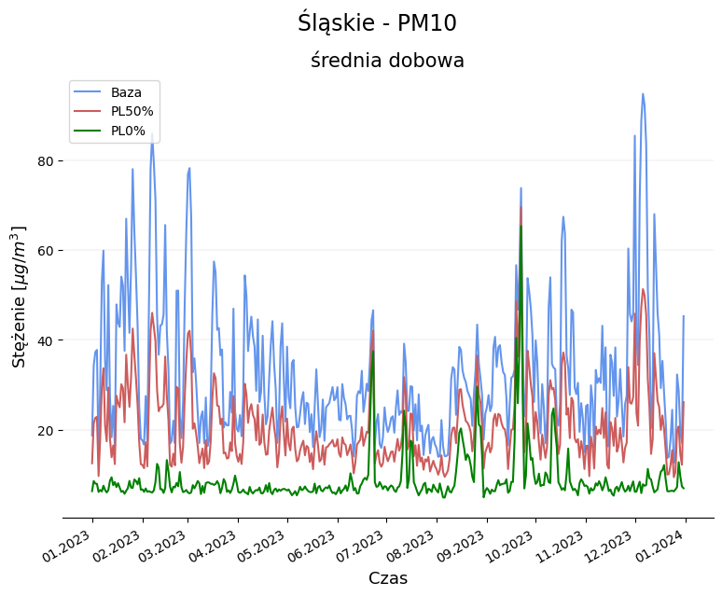
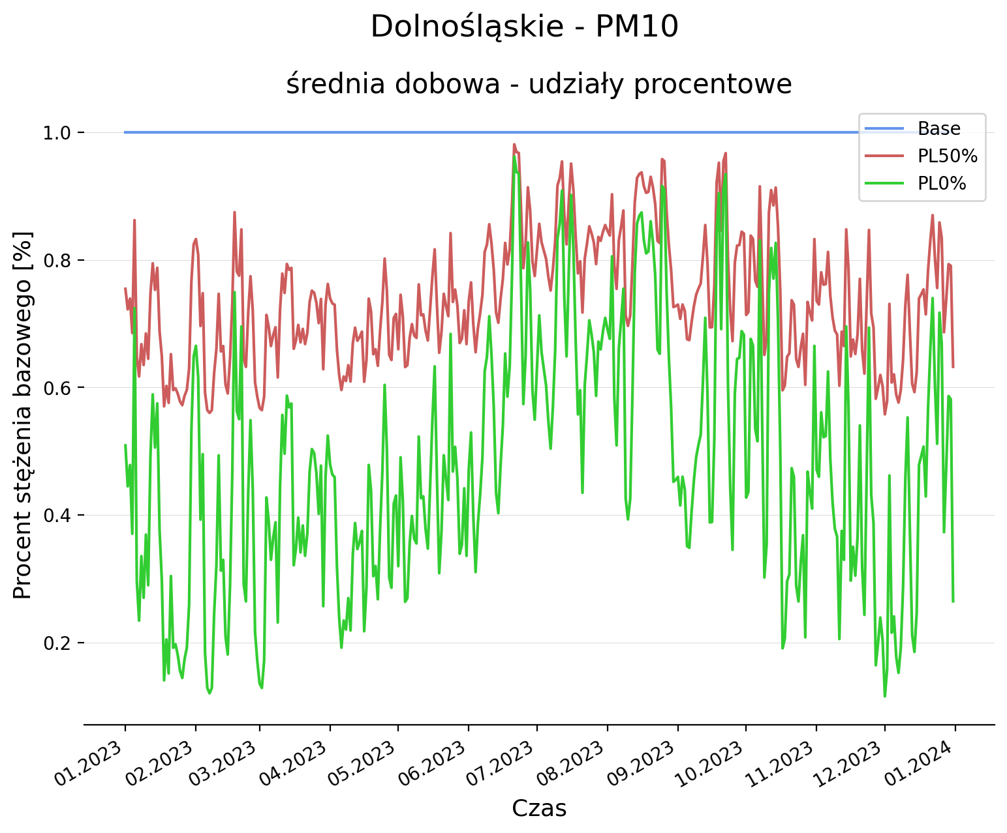
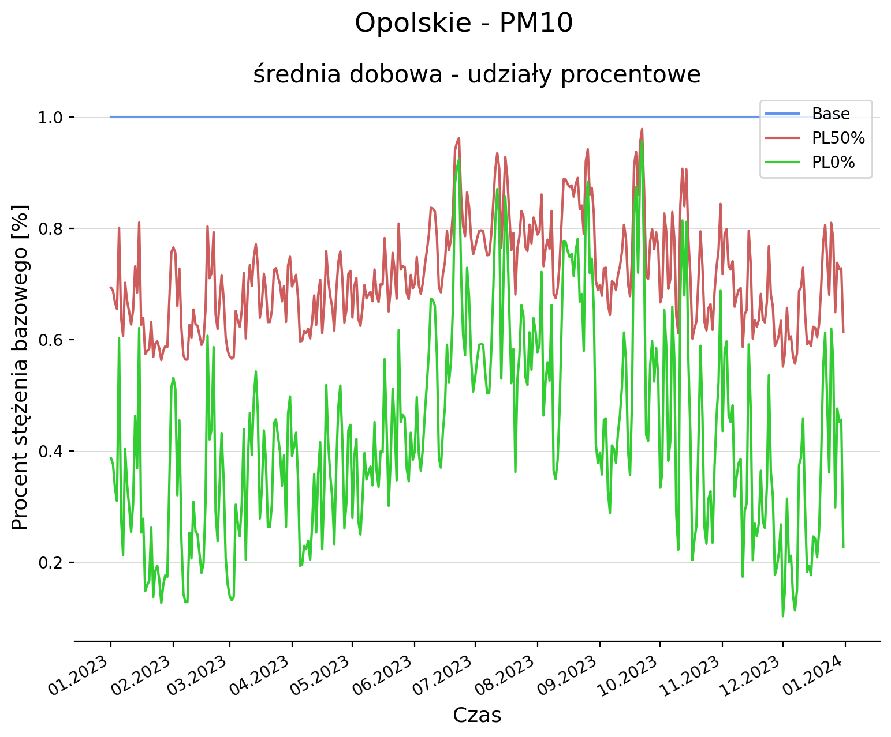
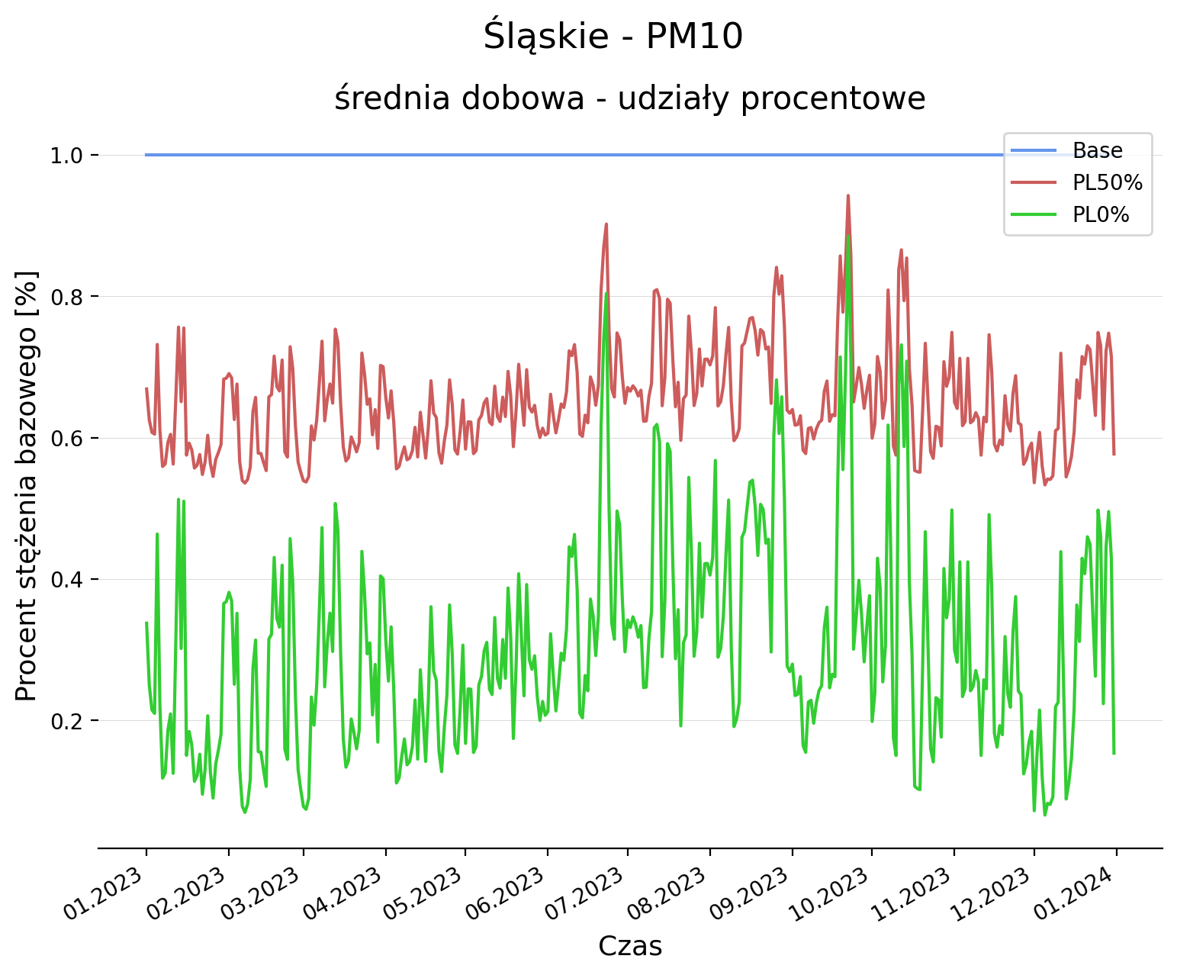
Regional analysis of transboundary transport – PM₁₀
Scenario daily average
Percentage of base daily average

Slide 8
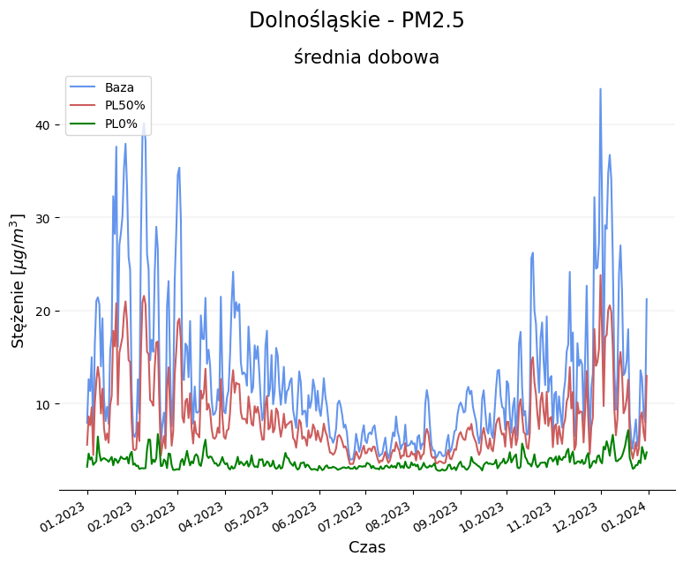
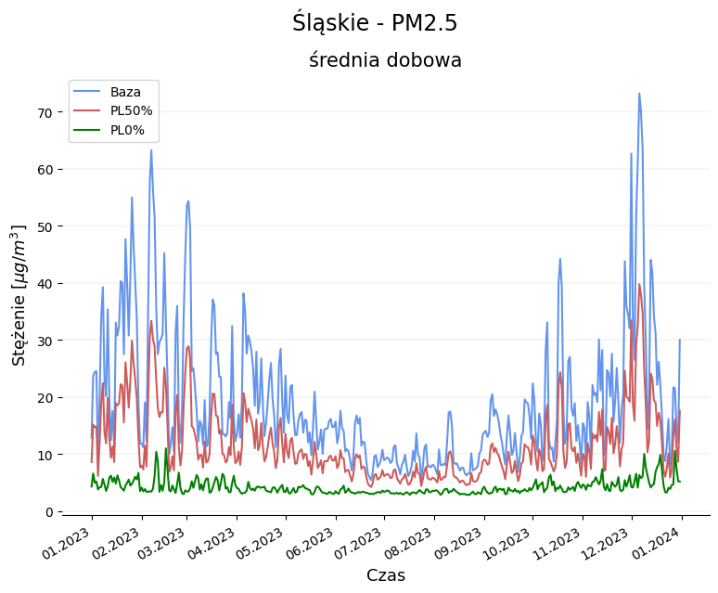
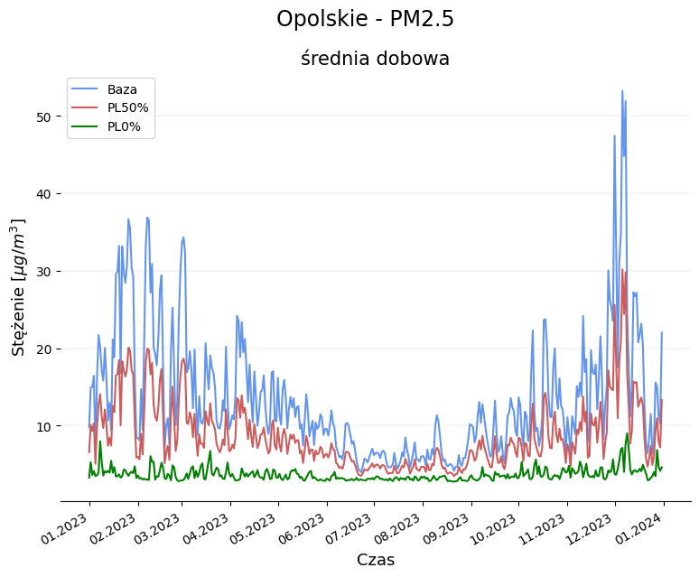
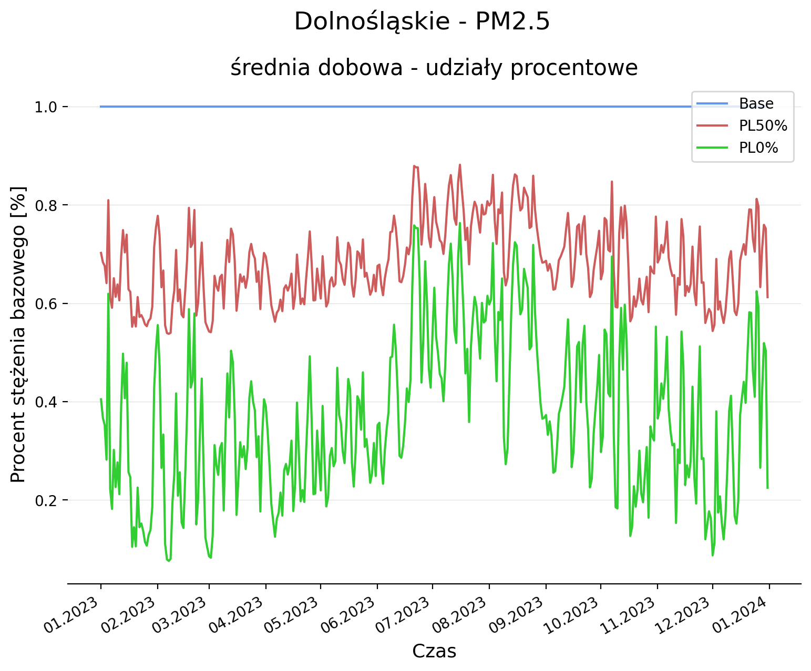
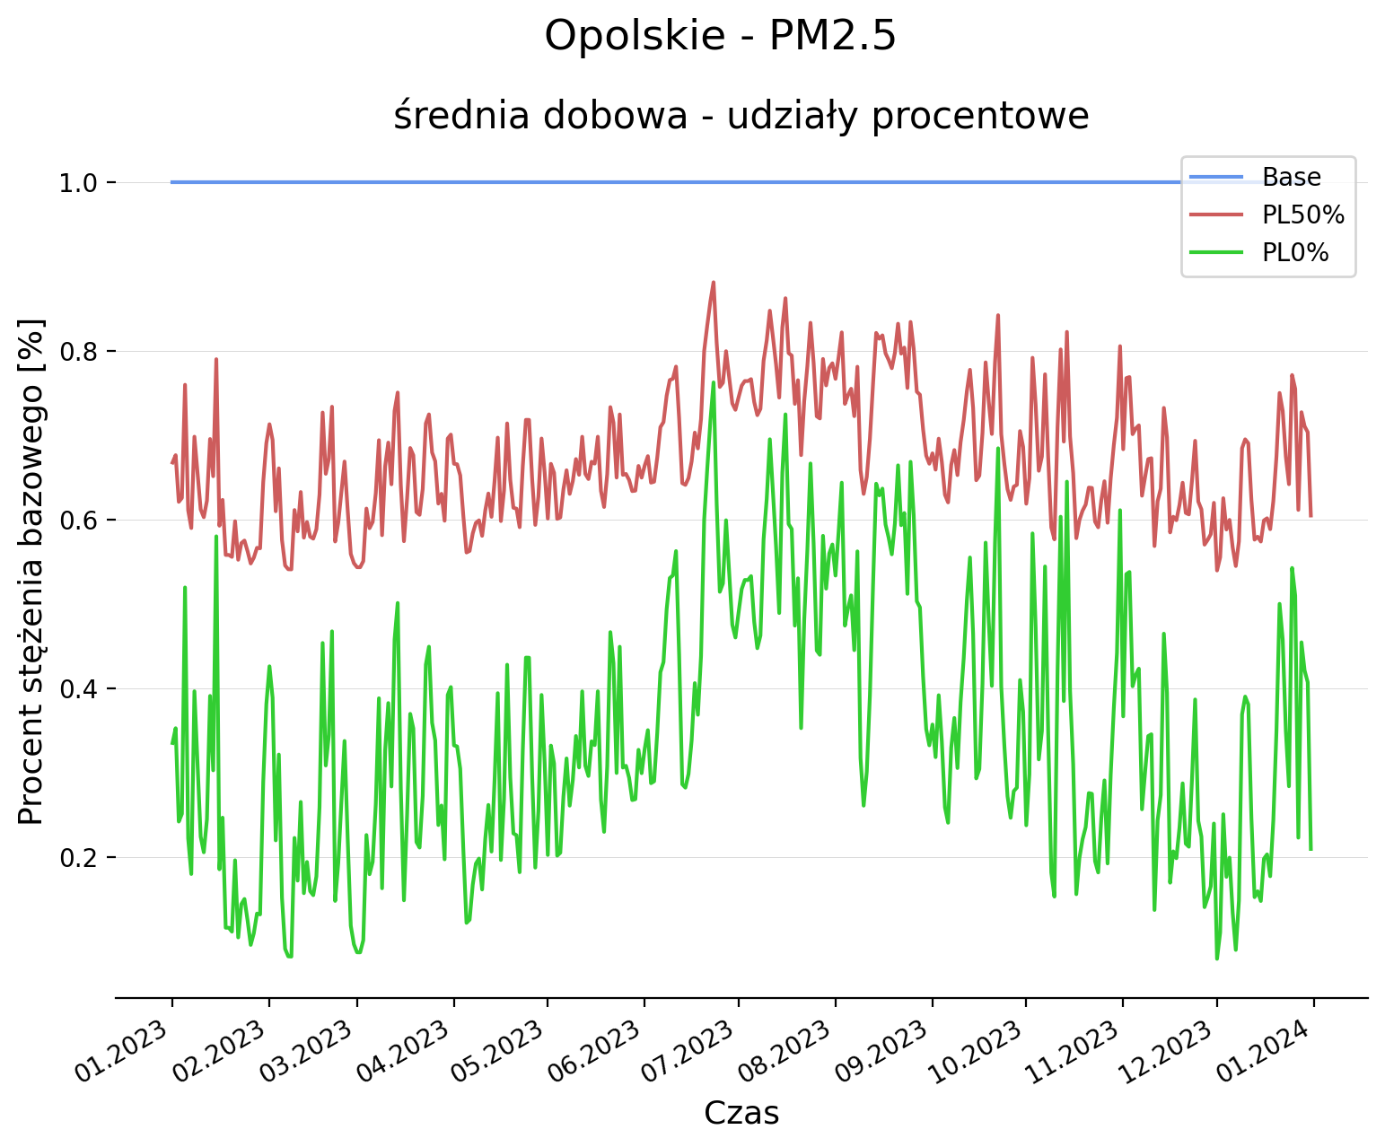
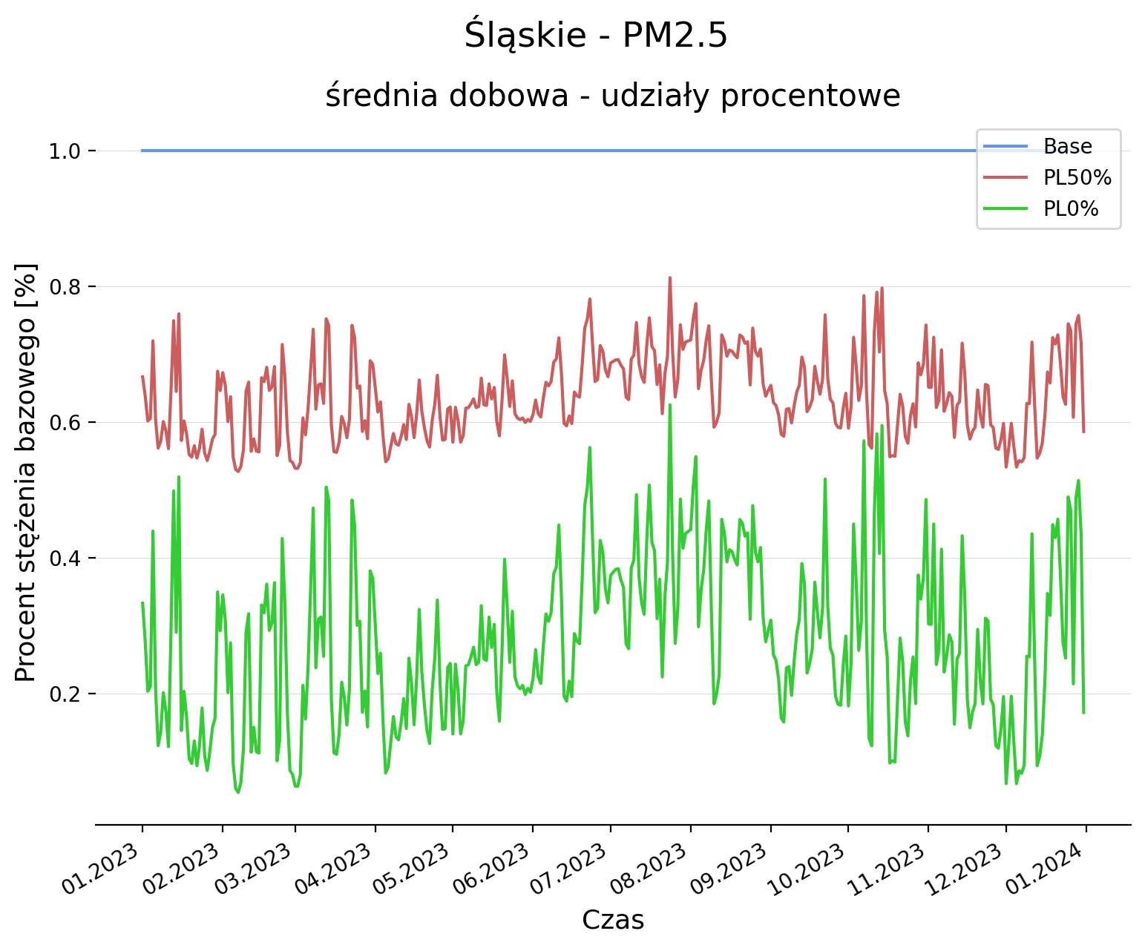
Regional analysis of transboundary transport – PM_{2.5}
Scenario daily average
Percentage of base daily average

Slide 9
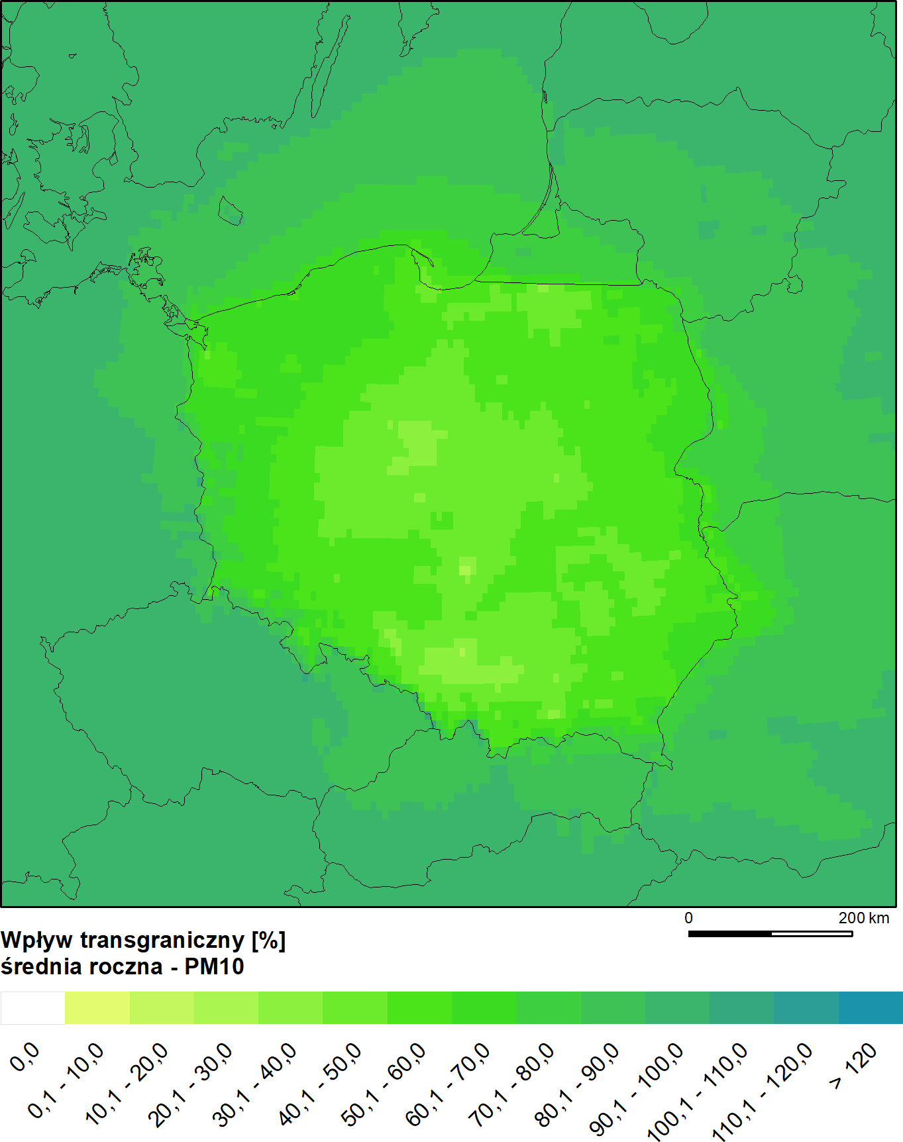
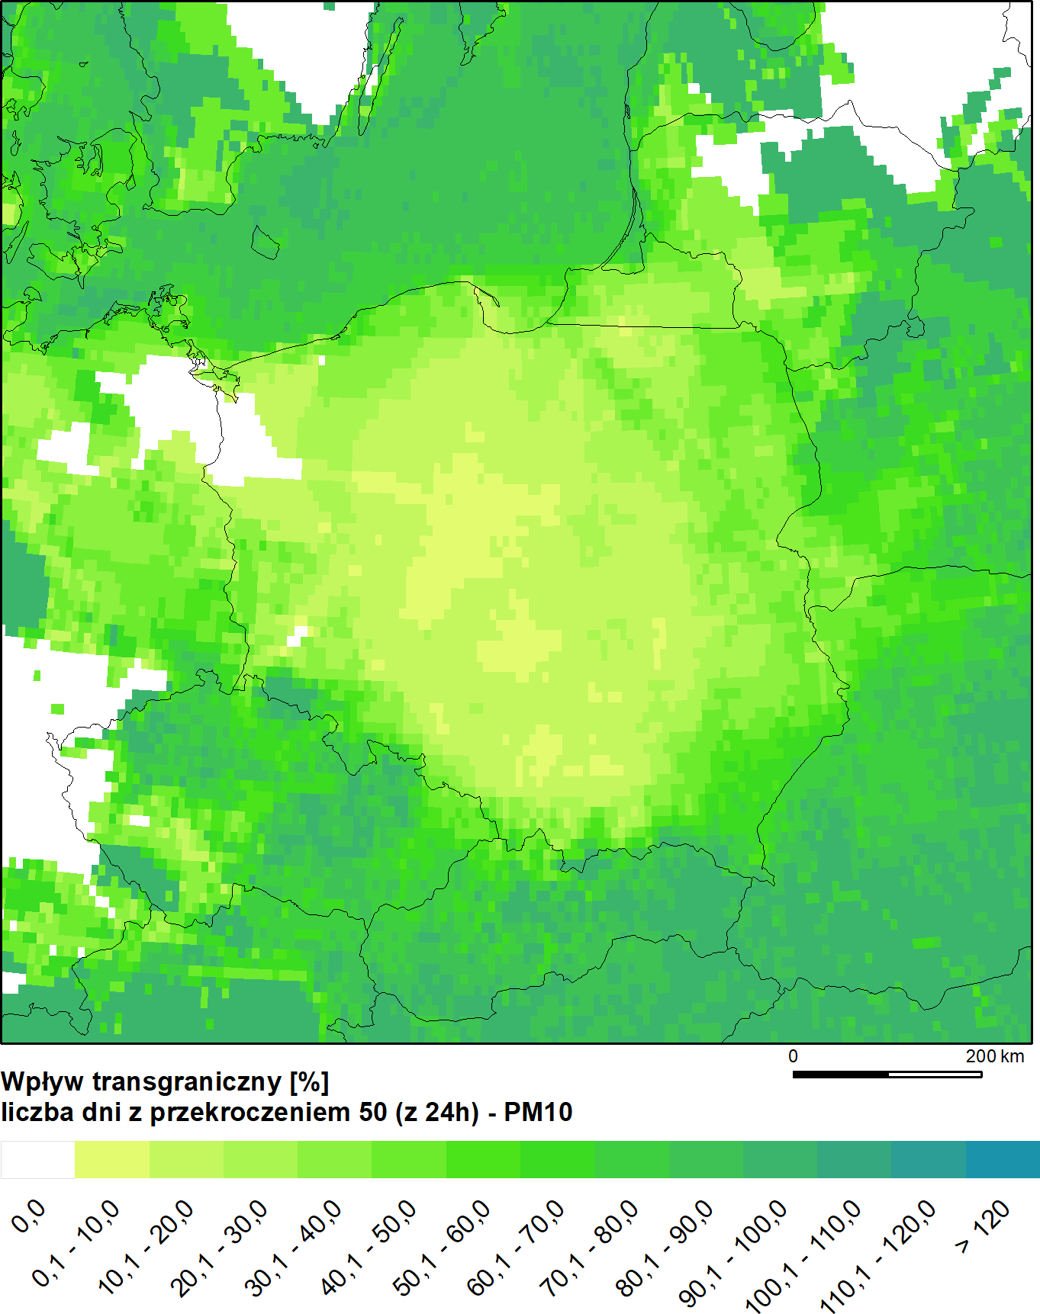
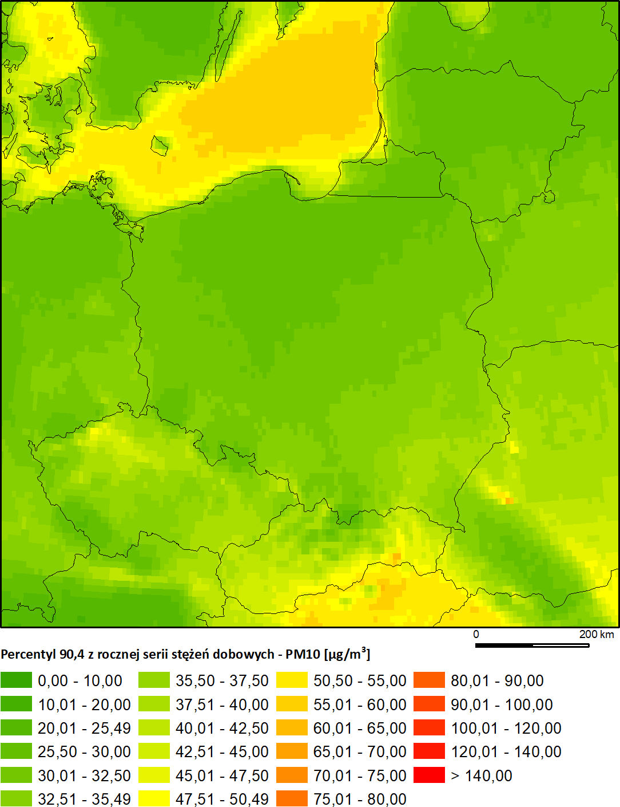
Contribution depends on the parameter

Slide 10
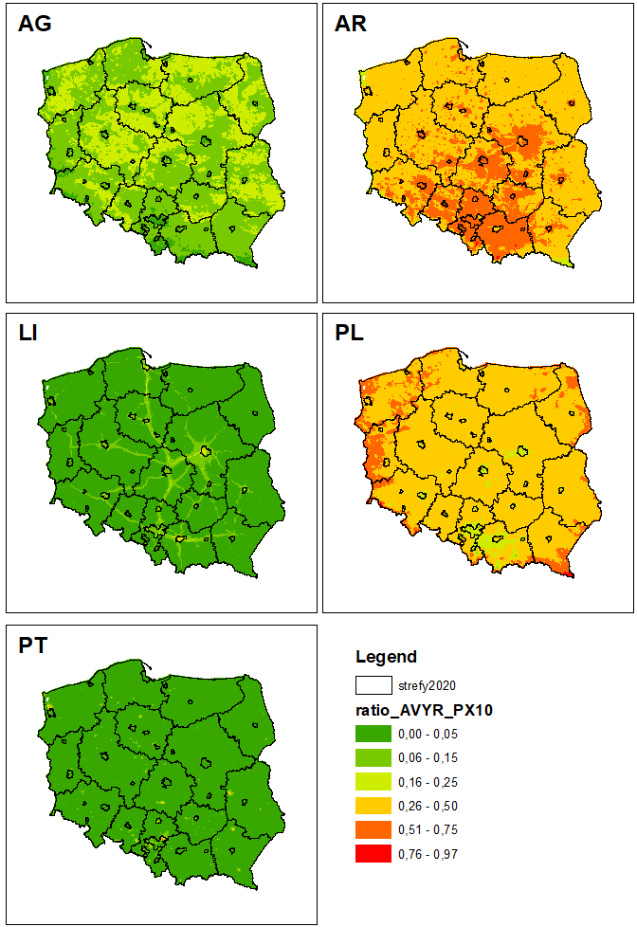
Source contribution for the assessment
  PT - energy and industry (SNAP 1, 3, 4, 5, 6)
  AR - municipal and residential sources (SNAP 2 and 9)
  LI - line sources (SNAP 7 and 8)
  AG - agriculture (SNAP 10)
  0PL – transboundary
PM10 | Residential | Transport | 0 PL | Industry | Agricuture
min | 27 | 3 | 15 | 3 | 2
max | 68 | 16 | 56 | 21 | 32
average | 49 | 7 | 29 | 7 | 8
PM2.5 | Residential | Transport | 0 PL | Industry | Agricuture
min | 36 | 2 | 13 | 2 | 1
max | 75 | 14 | 54 | 19 | 9
średnia | 59 | 6 | 27 | 5 | 3
2.5km resolution
CBE emissions
“Brute force”

Slide 11
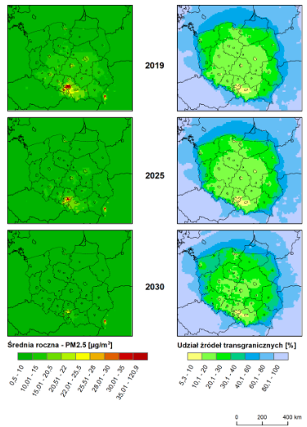
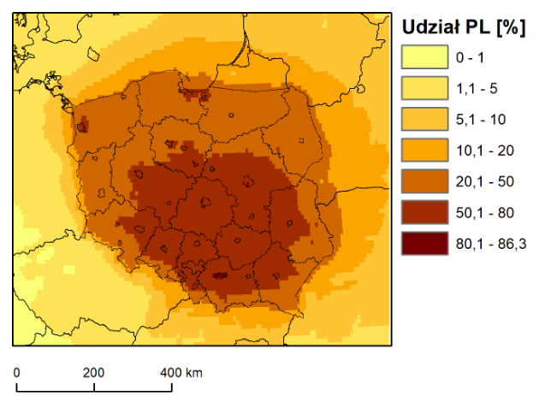
NAPCP (update)
Left panel – PM2.5 annual concentration
Right panel – contribution of transboundary transport [%]
NO₂ annual average – contribution of emissions from Poland [%]

Slide 12
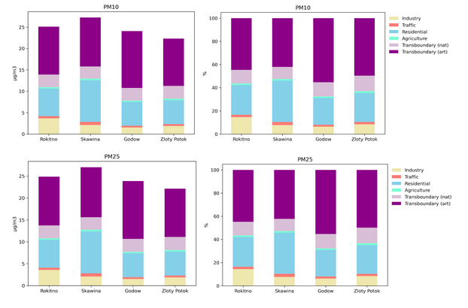
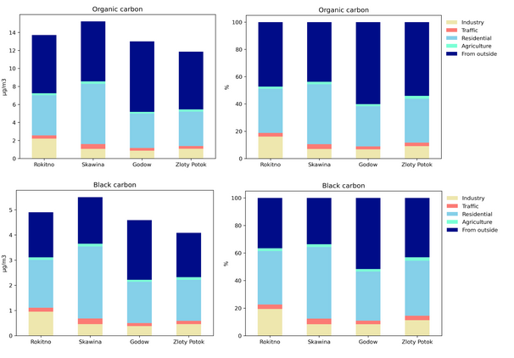
SPL source contribution (diagnostic phase 2019)

Slide 13
Summary
This year Ministry od climate and Environment and Chief Inspectorate of Environmental Protection requested the change:
  Contributions for the assessment are mode detailed (sector breakdown)
  Transboundary contribution will be assessed separately from neighbouring countries
A new protocol will be developed as annual contribution is not sufficient/informative
Article 21
1. Where transboundary transport of air pollution from one or more Member State contributes significantly to the exceedance of any limit value, ozone target value, average exposure reduction obligation or alert threshold in another Member State, that other Member State shall notify the Member States from which the air pollution originated and the Commission thereof.

Slide 14
Thank You!
pawel.durka@ios.edu.pl
aleksander.norowski@ios.edu.pl

