Slide 1

Southeast Asia Forest Fires: Their Impact on Malaysia's Air Quality Today and in the Future
Janice Scheffler, M. Vieno, R. Beck, D. Kelley, T. Liska, Y. Wang, S. J. Tomlinson, E. J. Carnell, J. M. Bullock, E. Nemitz

Slide 2
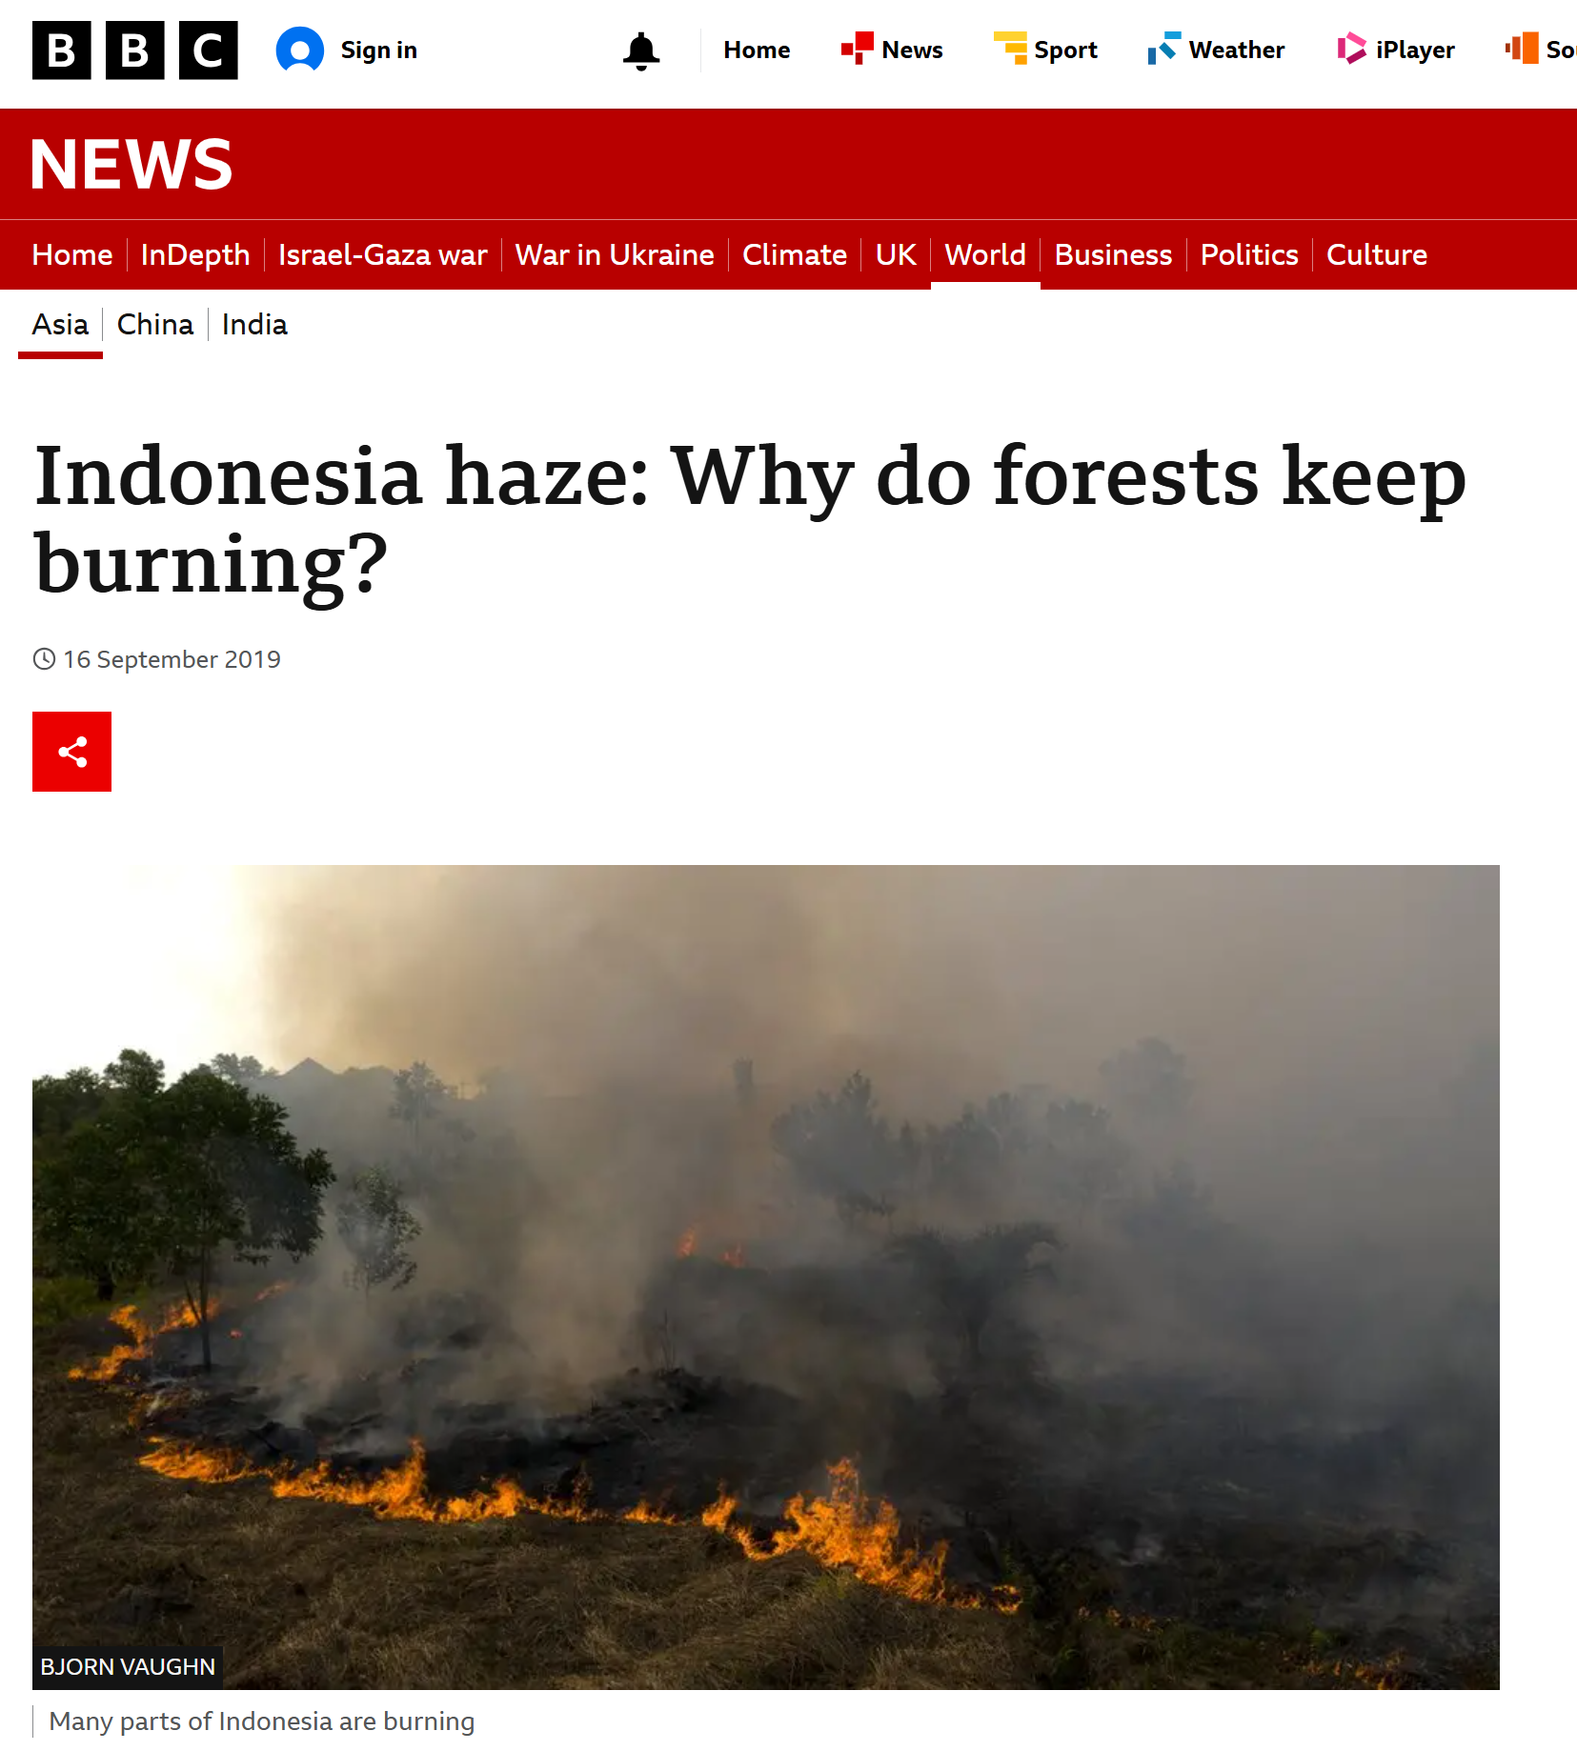
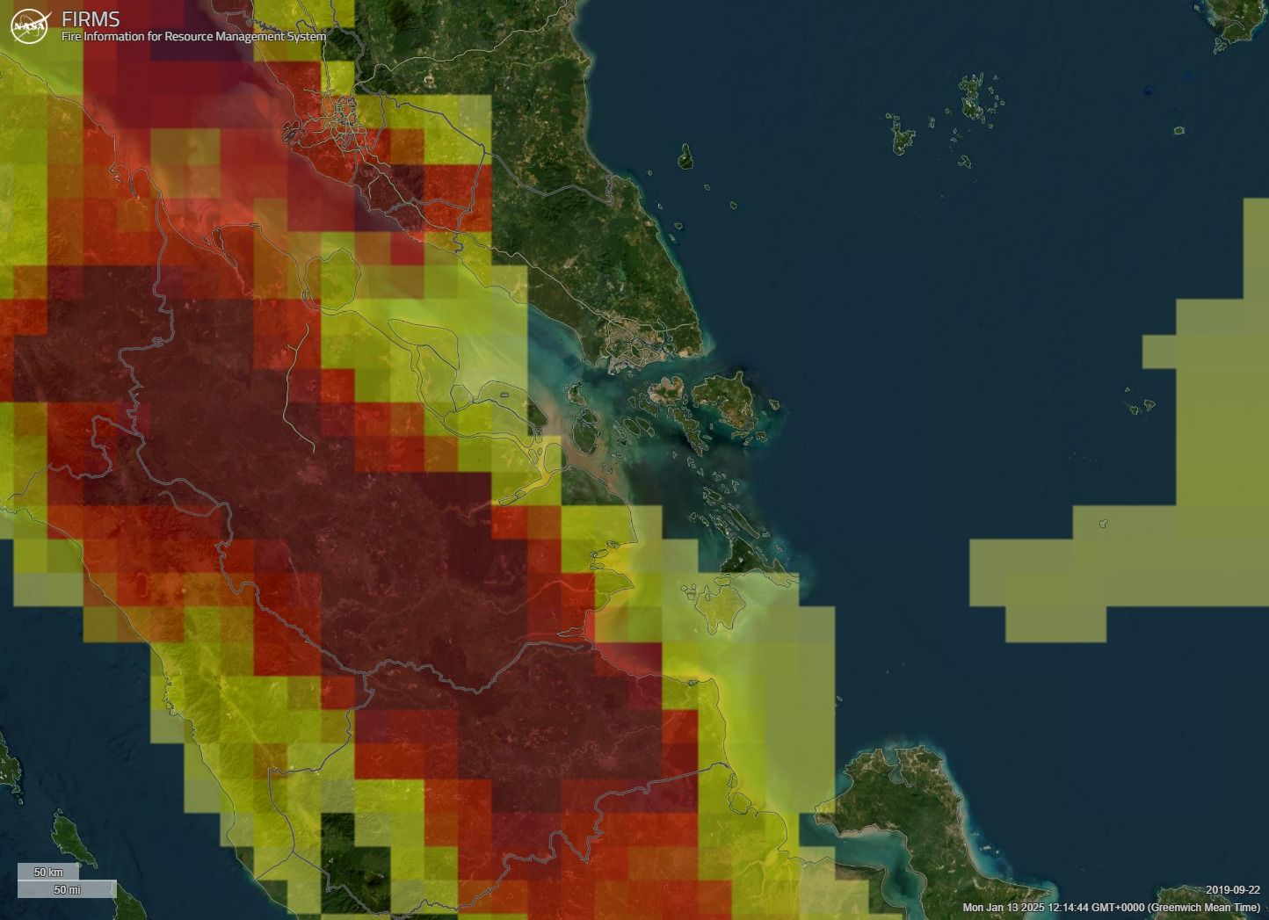
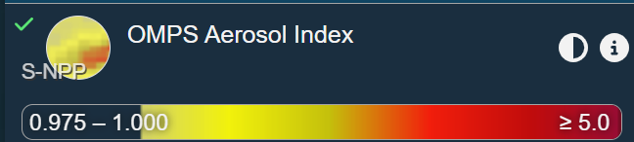
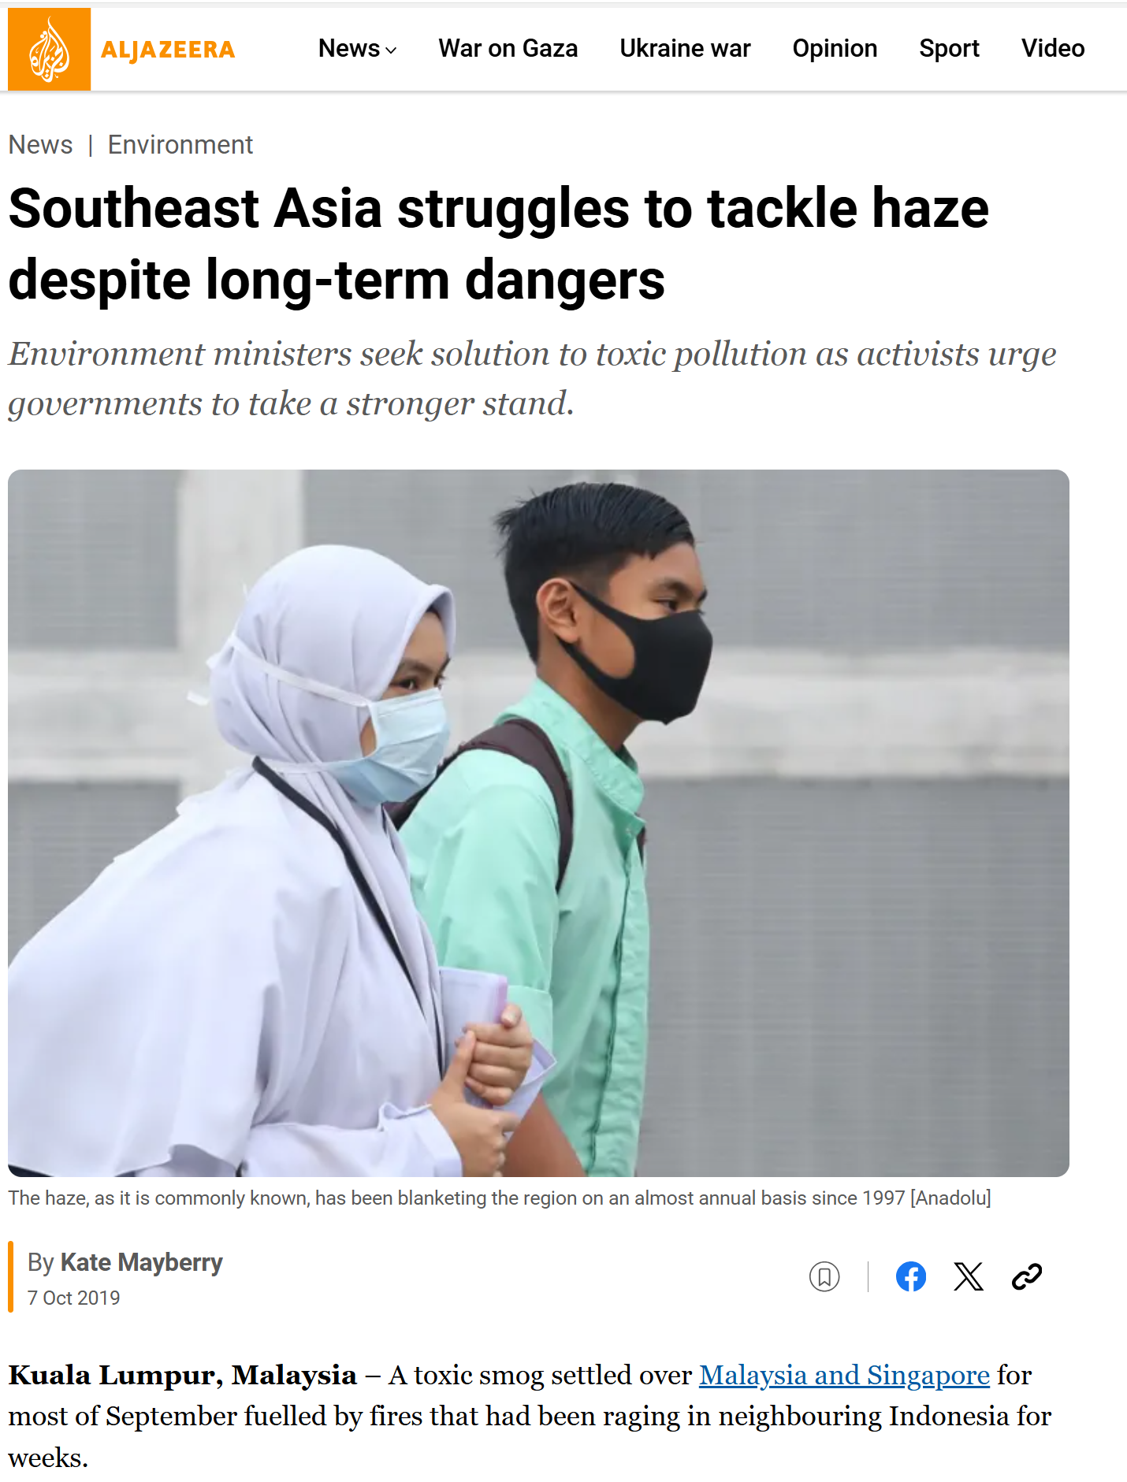
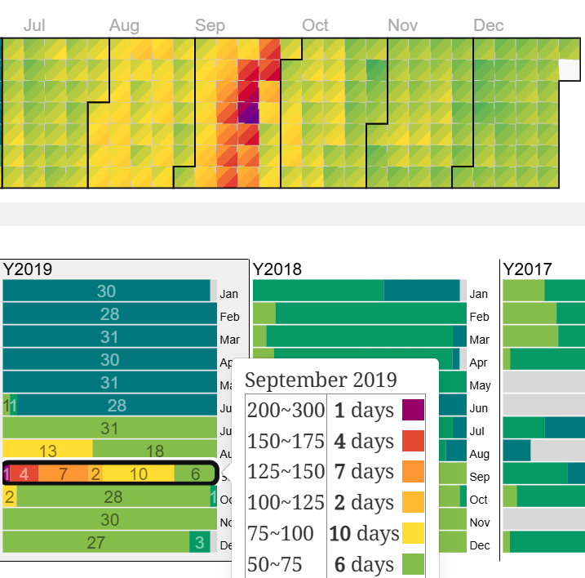
22 Sep 2019
Near KL
From: aqicn.org/map/malaysia/
Data are unverified and unofficial
Air Quality Index

Slide 3
For current conditions:
What are the contributions to air pollution of domestic and foreign sources of anthropogenic and forest fire emissions?
For future conditions:
How will the predicted increase in forest fire emissions affect Air Quality in South East Asia?

Slide 4
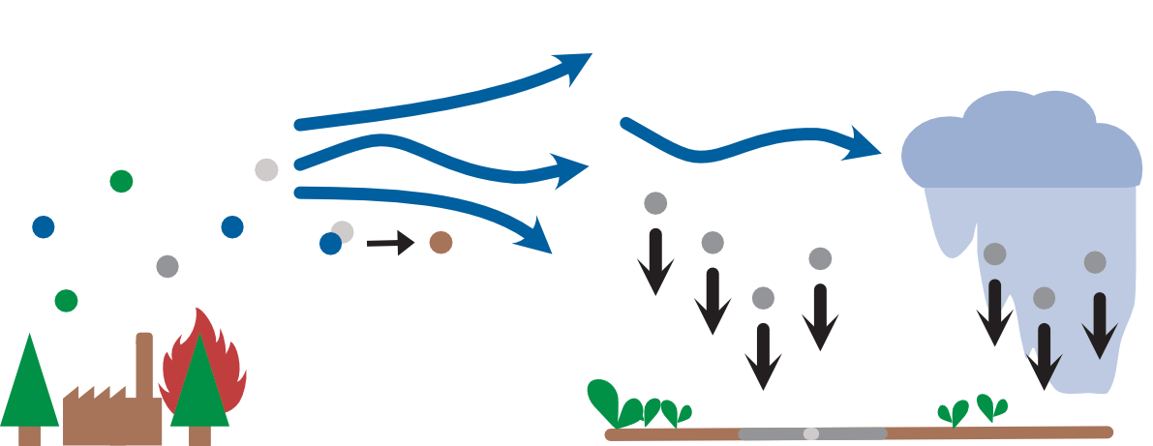
Atmospheric chemistry transport modelling
EMEP4UK - atmospheric chemistry transport model (Simpson et al., 2012; Vieno et al., 2016)
3D chemistry with > 80 species, e.g.
Ozone
Particulate matter
Nitrogen dioxide
Secondary inorganic and organic aerosols
deposition
transport
dry
wet
Meteorology:
Weather and Research Forecasting model (WRF)(Skamarock et al., 2019)
Chemistry transport model:
European Monitoring and Evaluation Programme model (EMEP MSC-W) (Simpson et al., 2012)
Application to UK: Vieno et al., 2016 a, b
chemistry
emissions
land cover
Graphic by J. Scheffler

Slide 5
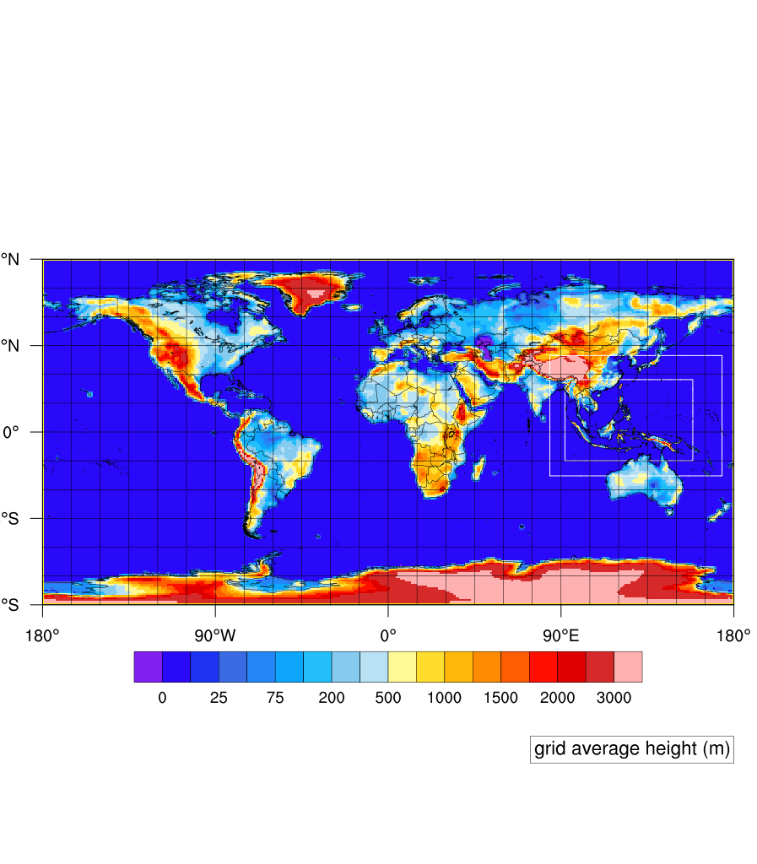
EMEP setup for Southeast Asia
EMEP MSC-W rv5.0
(Simpson et al., 2012; Vieno et al., 2016 a,b)
Global domain (1° x 1°) with nested Southeast Asian domain (0.1° x 0.1° ~= 11 km x 11 km)
Meteorology nudged to ERA5 for 2019
(Skamarock et al., 2019)
Anthropogenic emissions:
HTAP3 valid for 2018 (https://edgar.jrc.ec.europa.eu/dataset_htap_v3)
Forest Fire emissions:
FINN v1.5 for 2019 (Hersbach et al., 2020)
  satellite detection of active fires
  land cover type to determine the emission estimates

Slide 6

What are the origins of air pollution?
Biogenic:
Volcanoes
BVOCs – from plants
Dust
Lightning NO_{X}
Forest Fires
Anthropogenic:
Waste management
Energy
Ground Transport
International Shipping
Aviation
Industry
Residential
Agriculture
Designed by Freepik

Slide 7
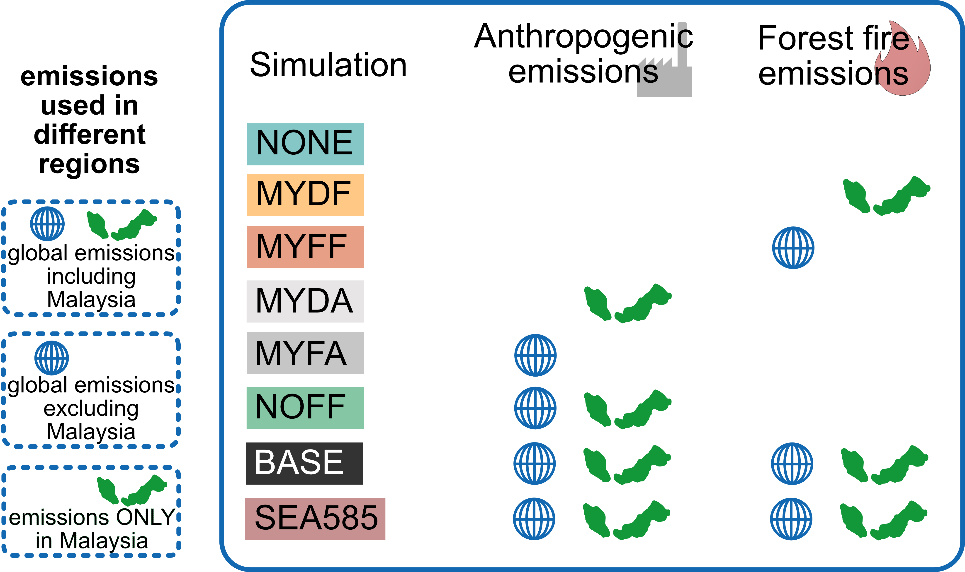
Model simulations
Land surface model JULES-INFERNO-VN6P3 (Mangeon et al., 2016; Burton et al., 2019) calculated burnt area and C and N demission for the SSP5-RCP8.5 climate change scenario:
in SEASIA increase of average C emission by forest fire by 46 %

Slide 8
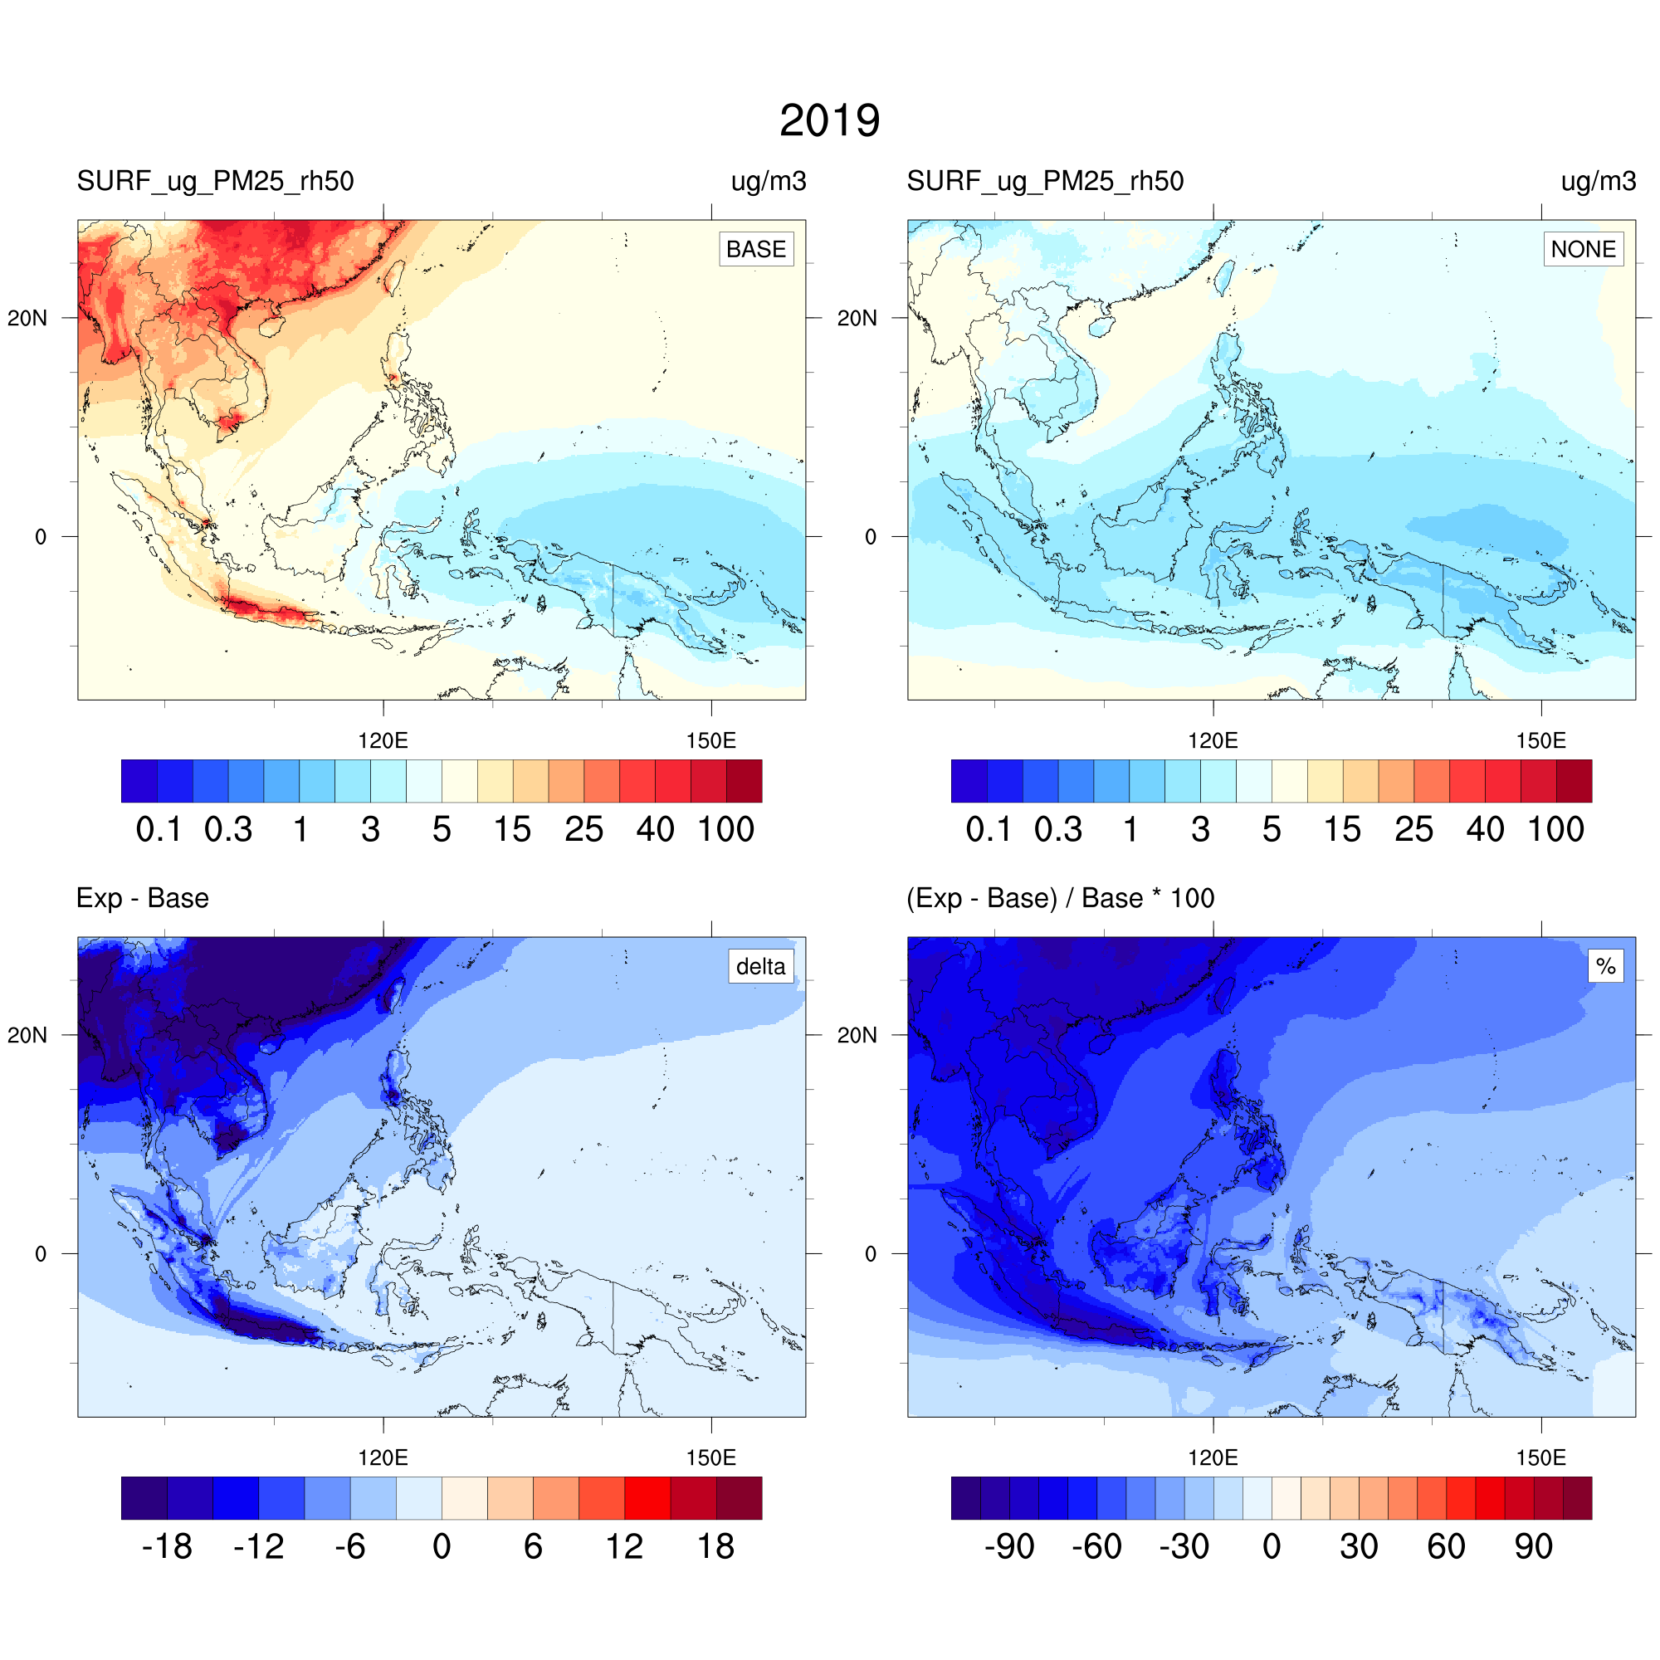
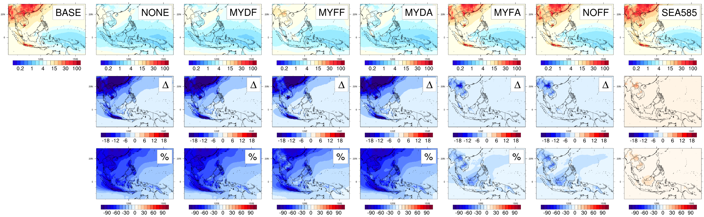
Annual mean PM_{2.5} concentration
[μg m⁻³]
WHO Air Quality guidelines 2021
No fire
No anthr
Annual
24-hour
Fire only
Anthropogenic only
No fire
Projection

Slide 9
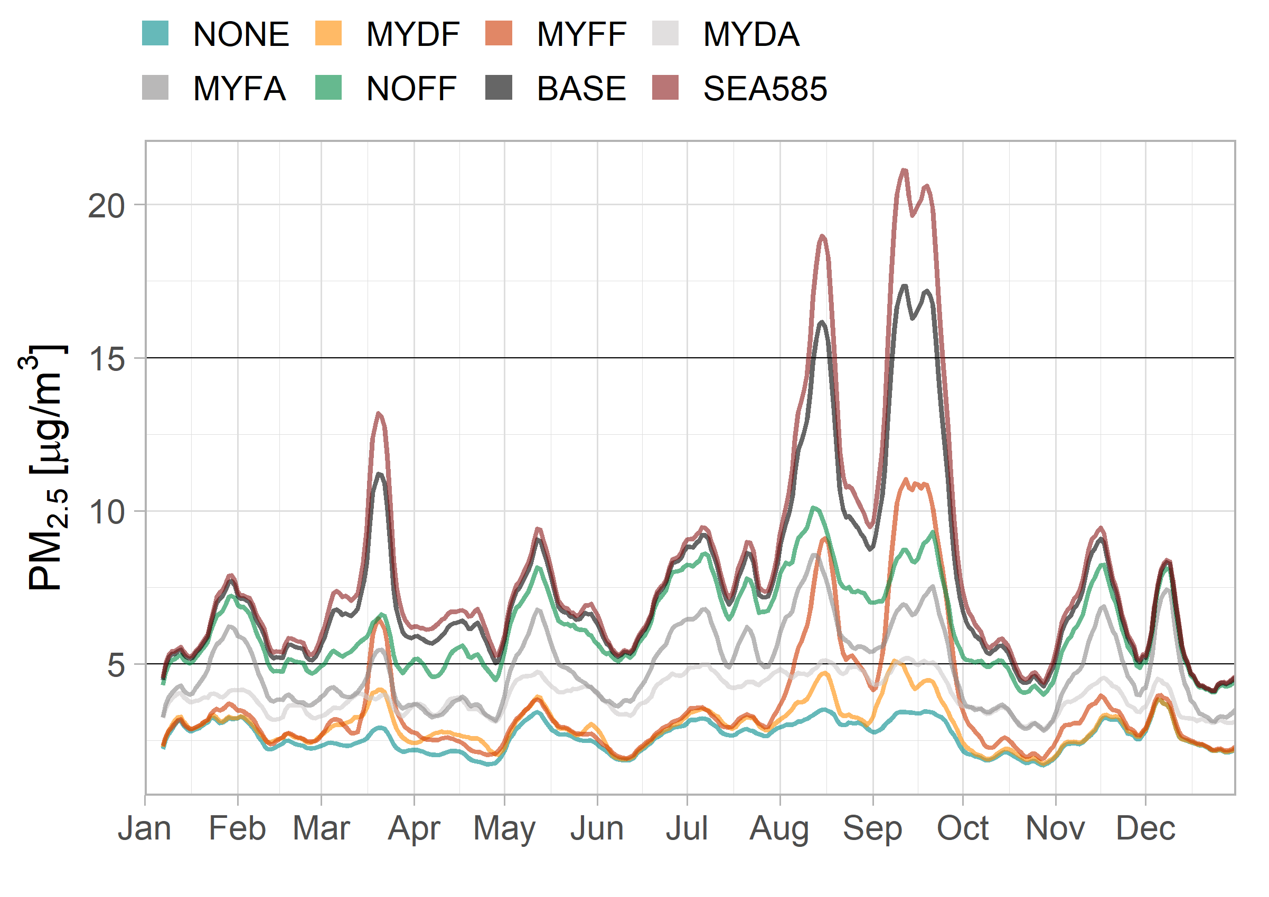
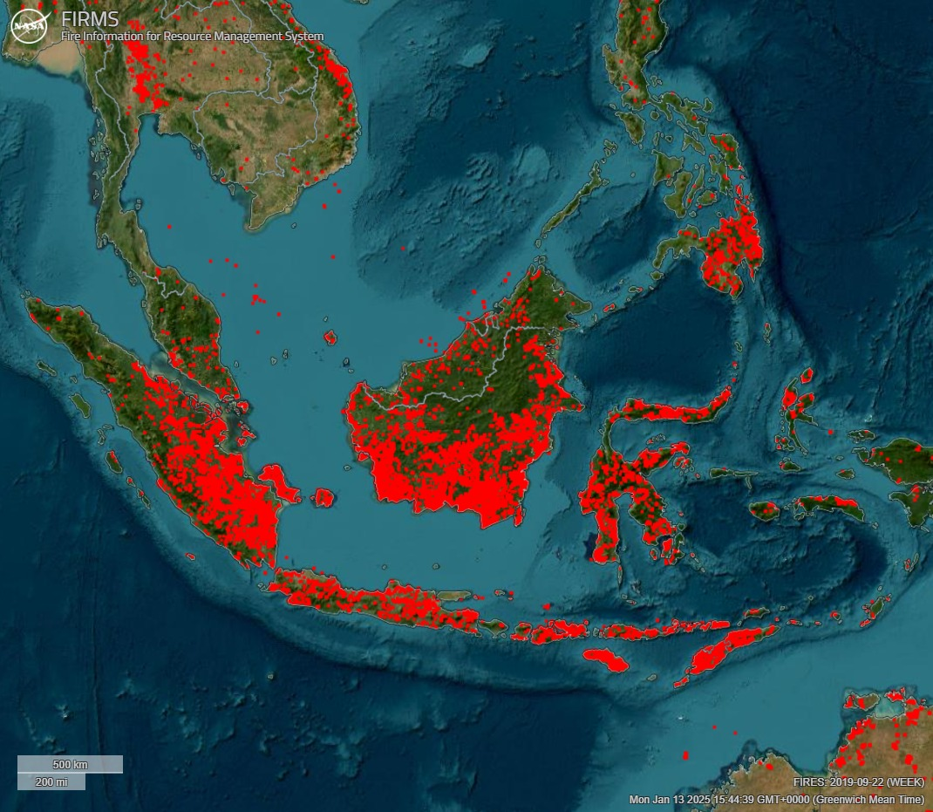
22 Sep 2019
AQG 2021
24-hour
FIRMS by NASA
2019-09-22 (7 days)
AQG 2021
annual

Slide 10
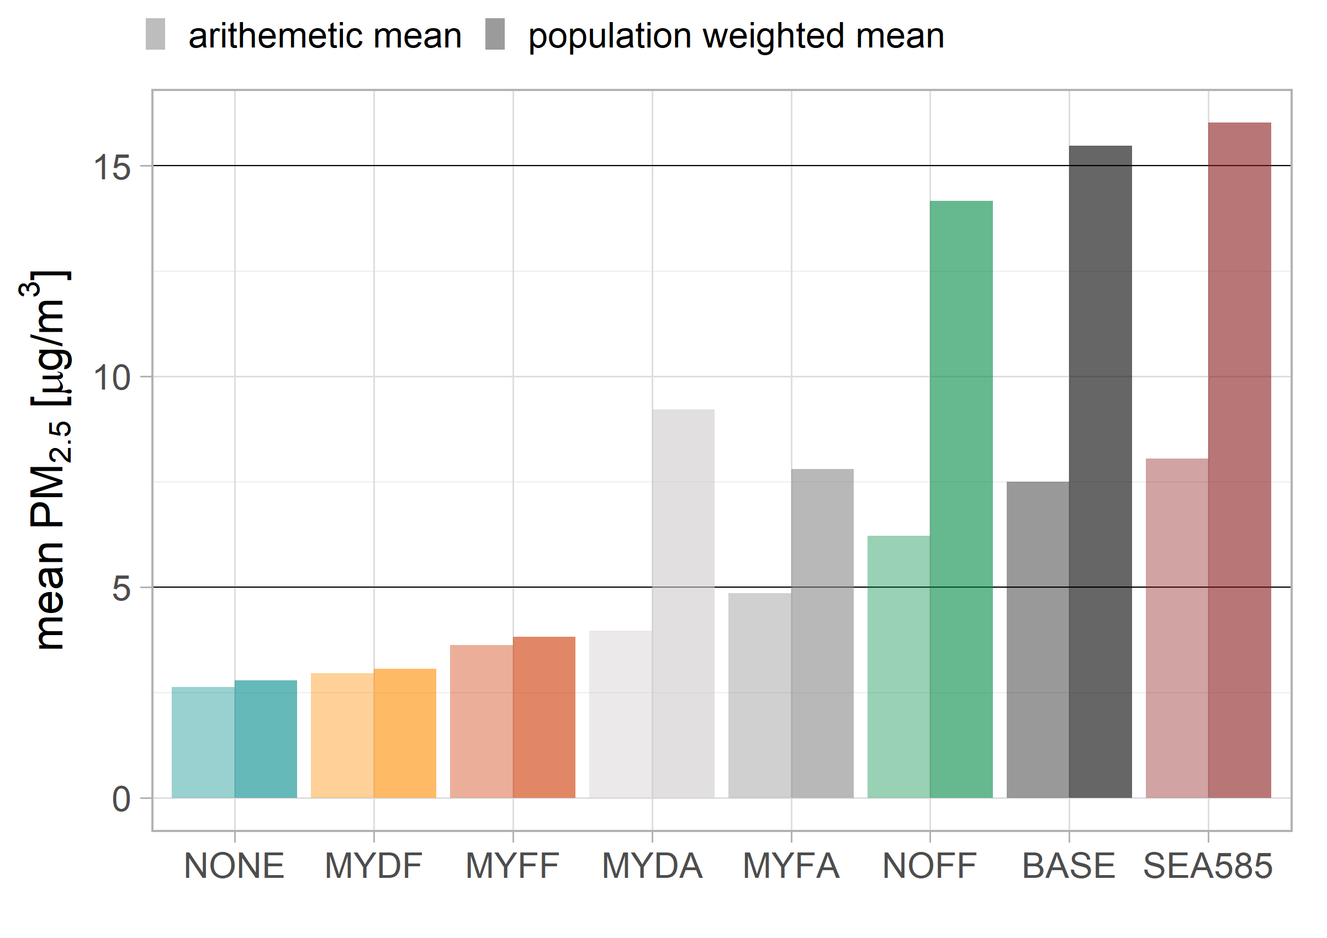
Population weighted PM_{2.5} concentration
The largest impact on population health are from anthropogenic sources
Domestic anthropogenic sources have a higher impact on the population health than air pollution from long-range transport.
The projected increase in forest fires at the end of the 21st century will put additional burden on population health.

Slide 11
Conclusions
A large proportion of PM_{2.5} pollution in Malaysia is caused by anthropogenic emissions. Long-range transport increases country-wide pollution but domestic sources cause peaks in urban centres.
Forest fire emissions further exacerbate air pollution levels.
An increase in forest fire emissions with a SSP5-8.5 scenario will add 8 more days of country mean exceedance of 15 μg m⁻³ .

Slide 13
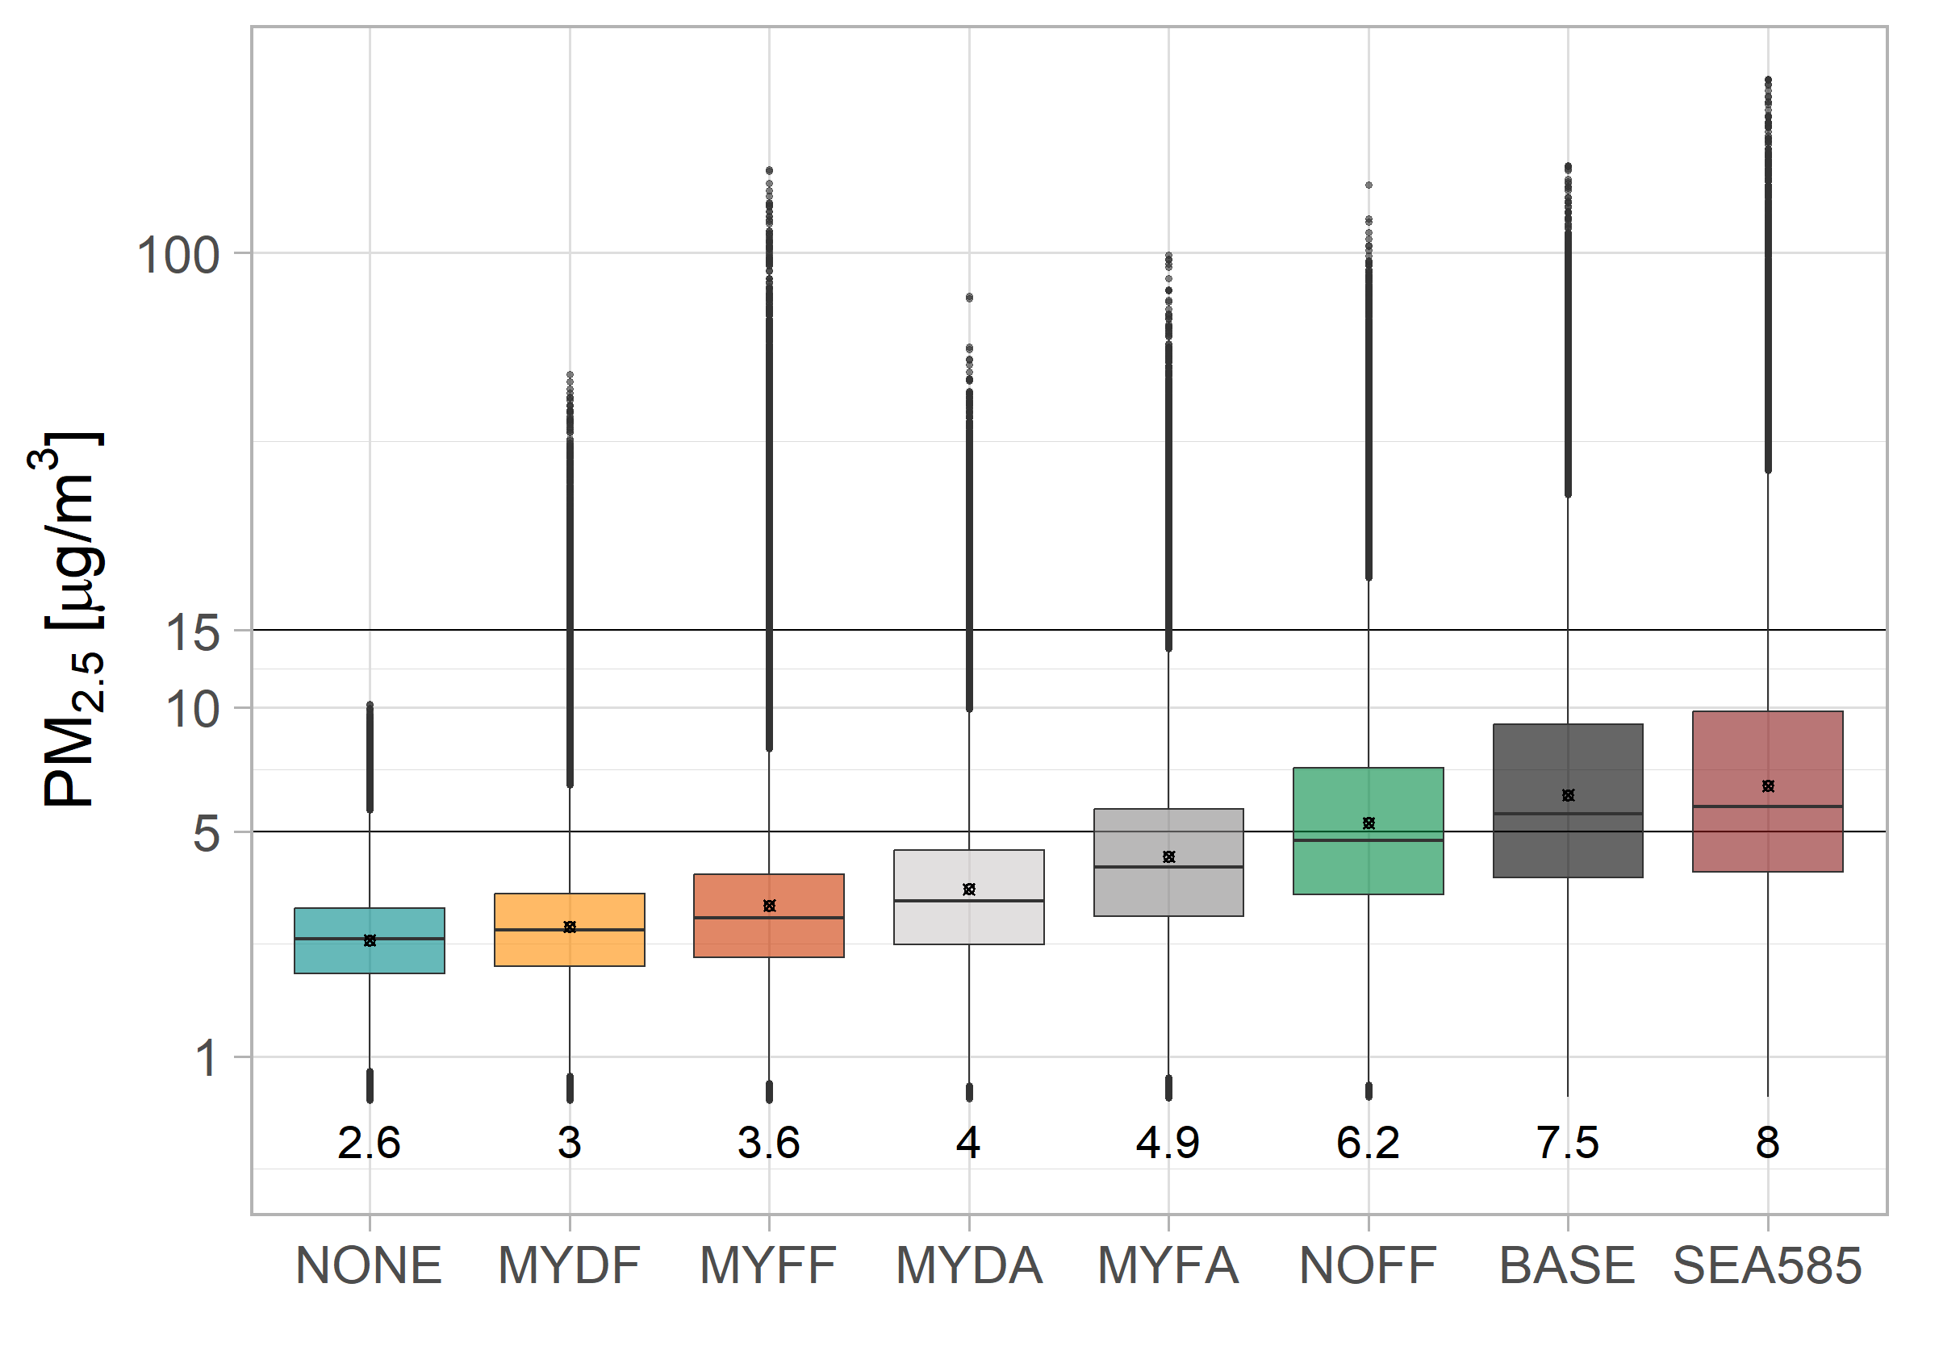

Slide 14
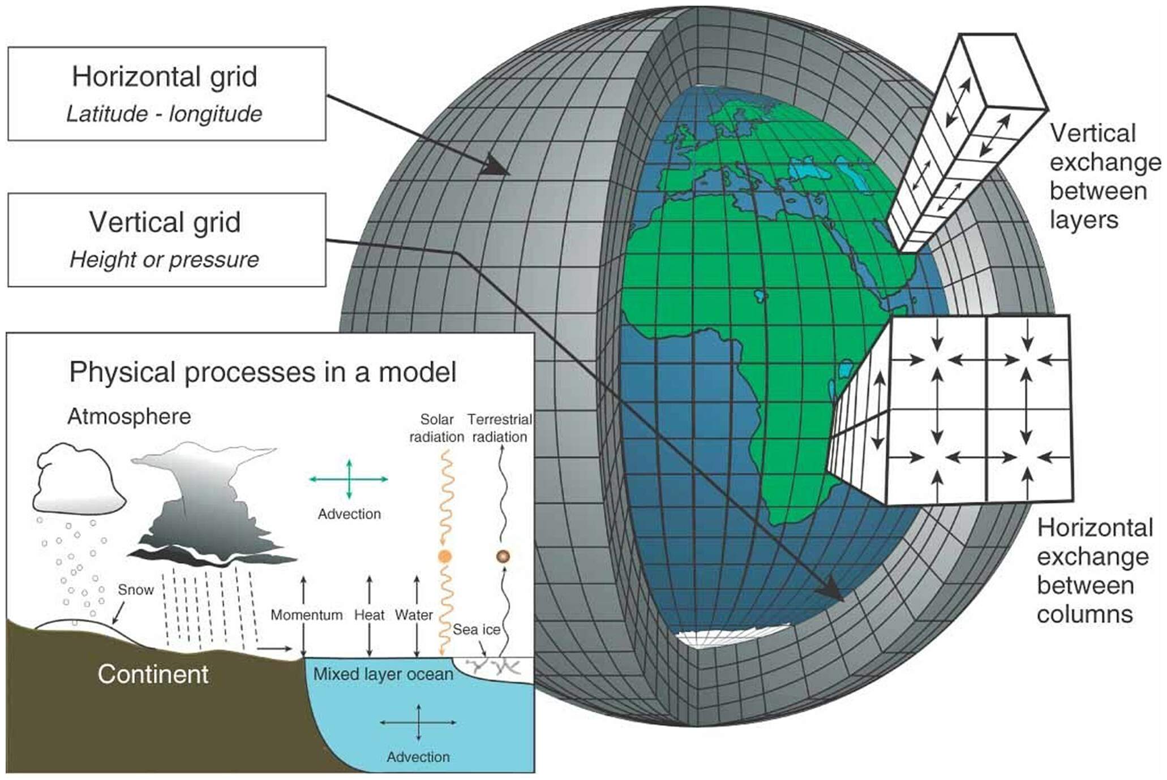
Introduction to Atmospheric Modelling
Mathematical model describing atmospheric
  Dynamics
  Thermodynamics
  Chemistry
Partial differential equations being solved on a grid
Types of models:
  Numerical weather prediction models
  Climate models: General circulation models (GCMs) & Earth system models (ESMs)
  With chemistry: Chemistry climate models (CCMs) & Chemistry transport models (CTMs)
From Edwards (2010): Schematic representation of the Cartesian grid structure used in finite-difference GCMs. Graphic by Courtney Ritz and Trevor Burnham.

Slide 15
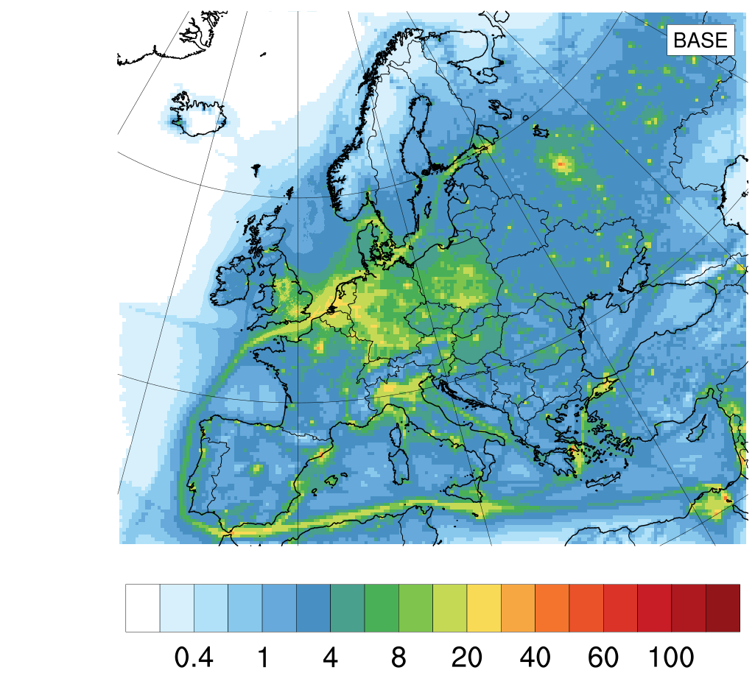
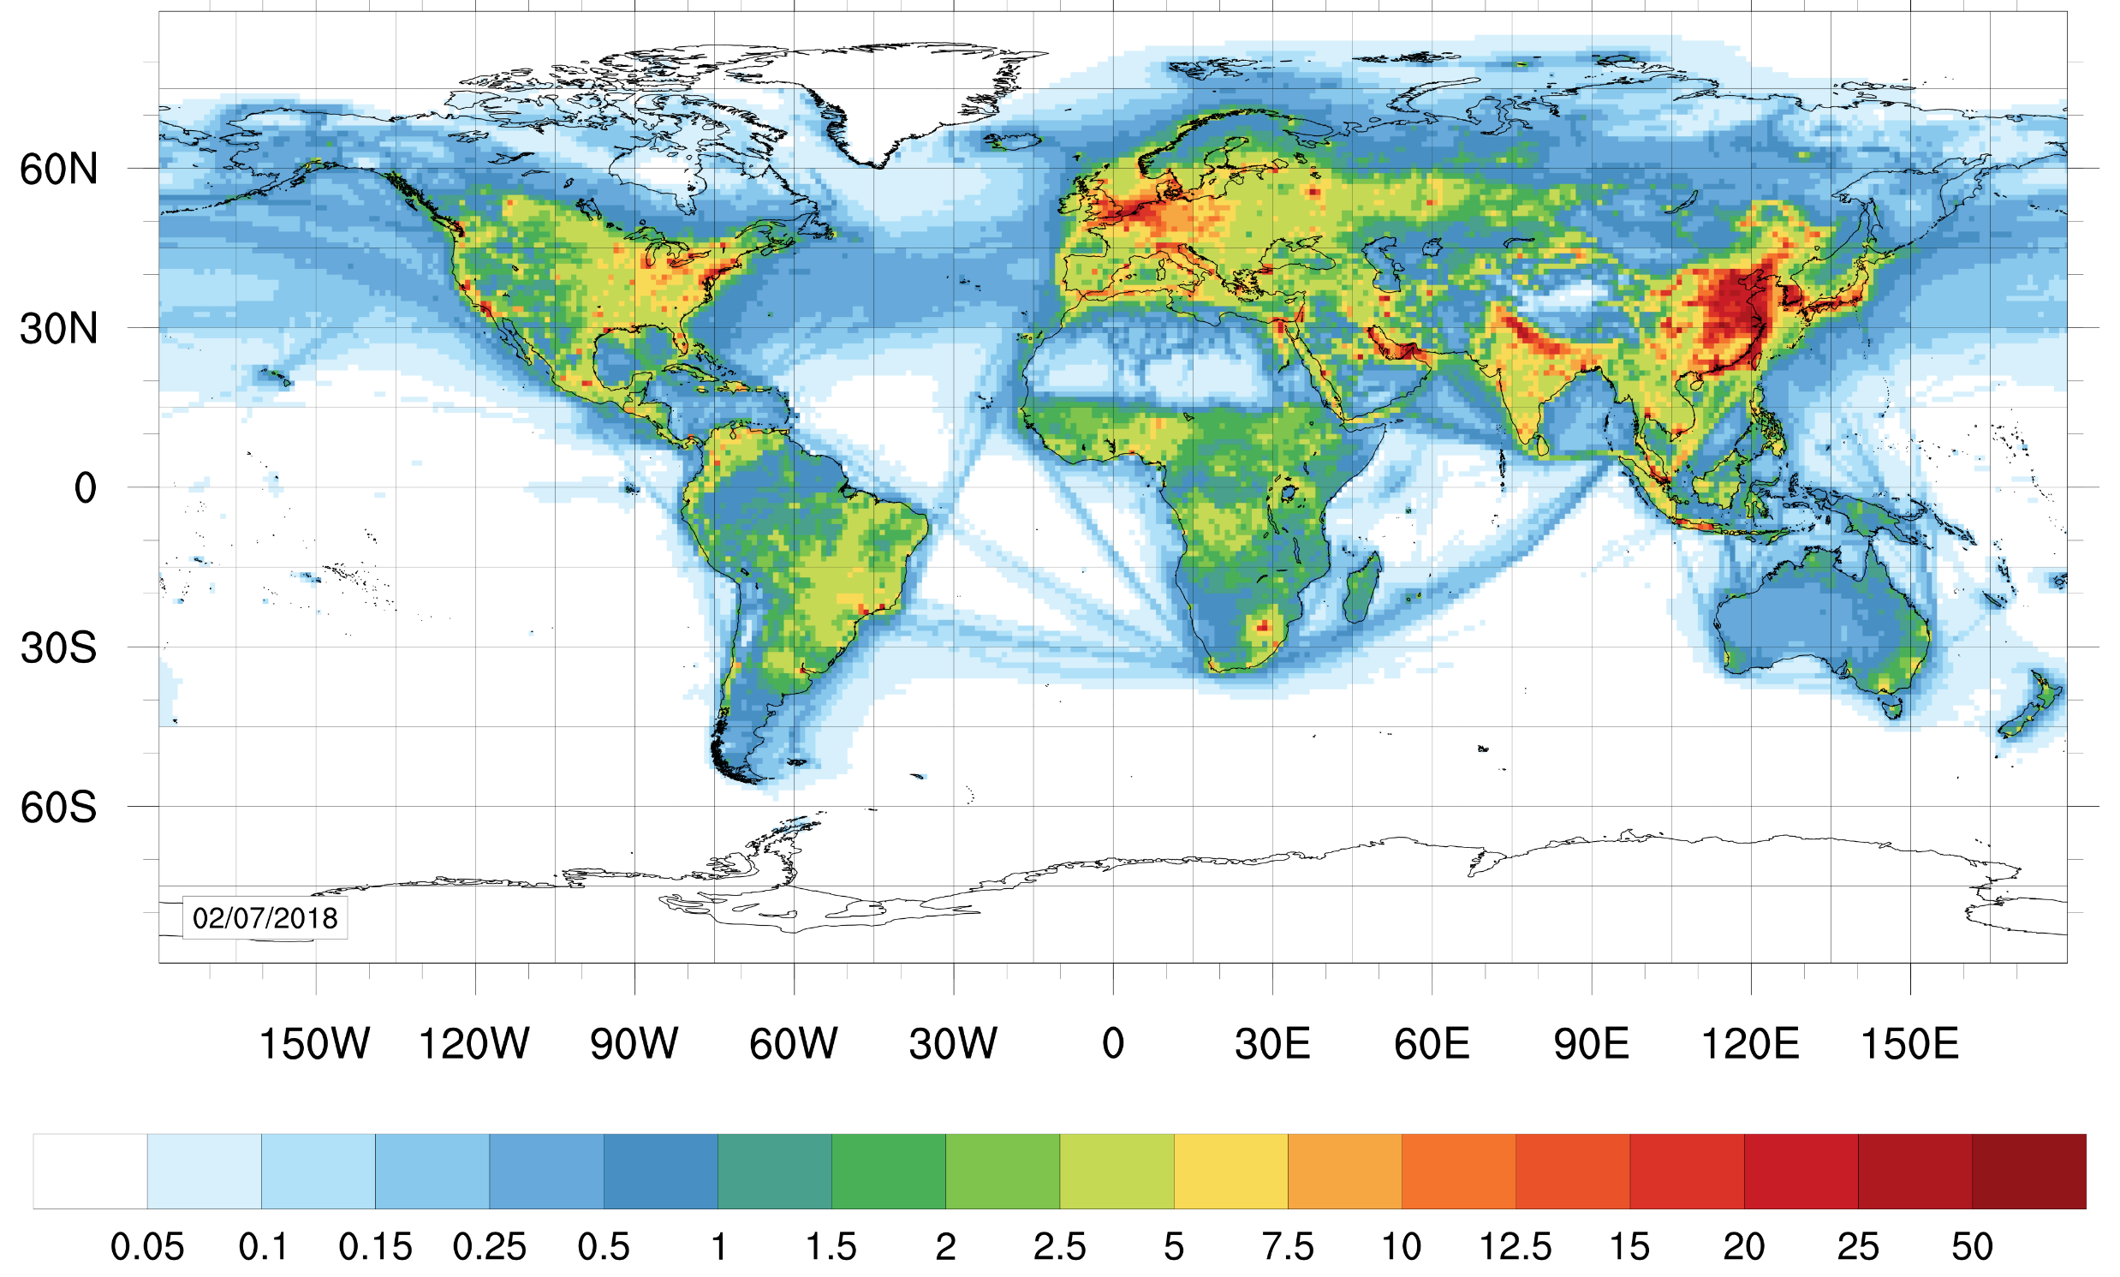
The EMEP4UK-WRF model
EU domain 27x27 km²
EMEP4UK-WRF is based/identical to the EMEP MSC-W model
(www.emep.int – Norwegian Meteorological office)
Meteorology driver is the Weather Research & Forecasting model (www.wrf-model.org)
The typical vertical domain from surface (~45 m) up to 100 hPa ( ~16 km)
Our typical Europe and UK application: 27x27 km² for EU with the nested UK at 3x3 km²
Globally at 1°×1° degree and with nested domains at 0.11°×0.11° (e.g. South Asia Nitrogen Hub project)
The emissions are derived from NEAI (UK), EMEP (EU), EDGAR (global), and HTAP (global)
Chemical schemes varies in complexity, also including the CRI scheme (Jenkin, M. E., et al. (2019))
UK 3x3 km²
EMEP MSC-W model
www.emep.int - https://github.com/metno/emep-ctm
EMEP4UK model
www.emep4uk.ceh.ac.uk
NAEI emissions:
https://naei.beis.gov.uk/data/mapping
EMEP emissions:
https://www.ceip.at/webdab-emission-database/emissions-as-used-in-emep-models
EDGAR emissions:
https://edgar.jrc.ec.europa.eu/emissions_data_and_maps
HTAP emissions:
https://edgar.jrc.ec.europa.eu/dataset_htap_v3
Global domain 1°x1°
NO₂ µg m-3
EMEP4UK specific papers
ACP Vieno et. al, 2010, 2014, 2016, ERL Vieno et. al, 2016, GMD Ge et. al, 2021, ACP Ge et. 2022, Science Gu et al. 2021
EMEP MSC-W model (ACP Simpson et al., 2012) and EMEP 2023 report
SA domain 0.11°x0.11°
Slide adapted from M. Vieno

Slide 16
What if we didn’t have anthropogenic emissions or forest fires?
NONE:
No anthropogenic emissions or forest fires
ONLY:
biogenic emissions
BASE:
2019 anthropogenic and forest fire emissions
Annual mean concentration:
2.6 μg m⁻³
Country average daily mean exceeded 15 μg m⁻³ :
0 days
Annual mean concentration:
7.5 μg m⁻³
Country average daily mean exceeded 15 μg m⁻³ :
20 days

Slide 17
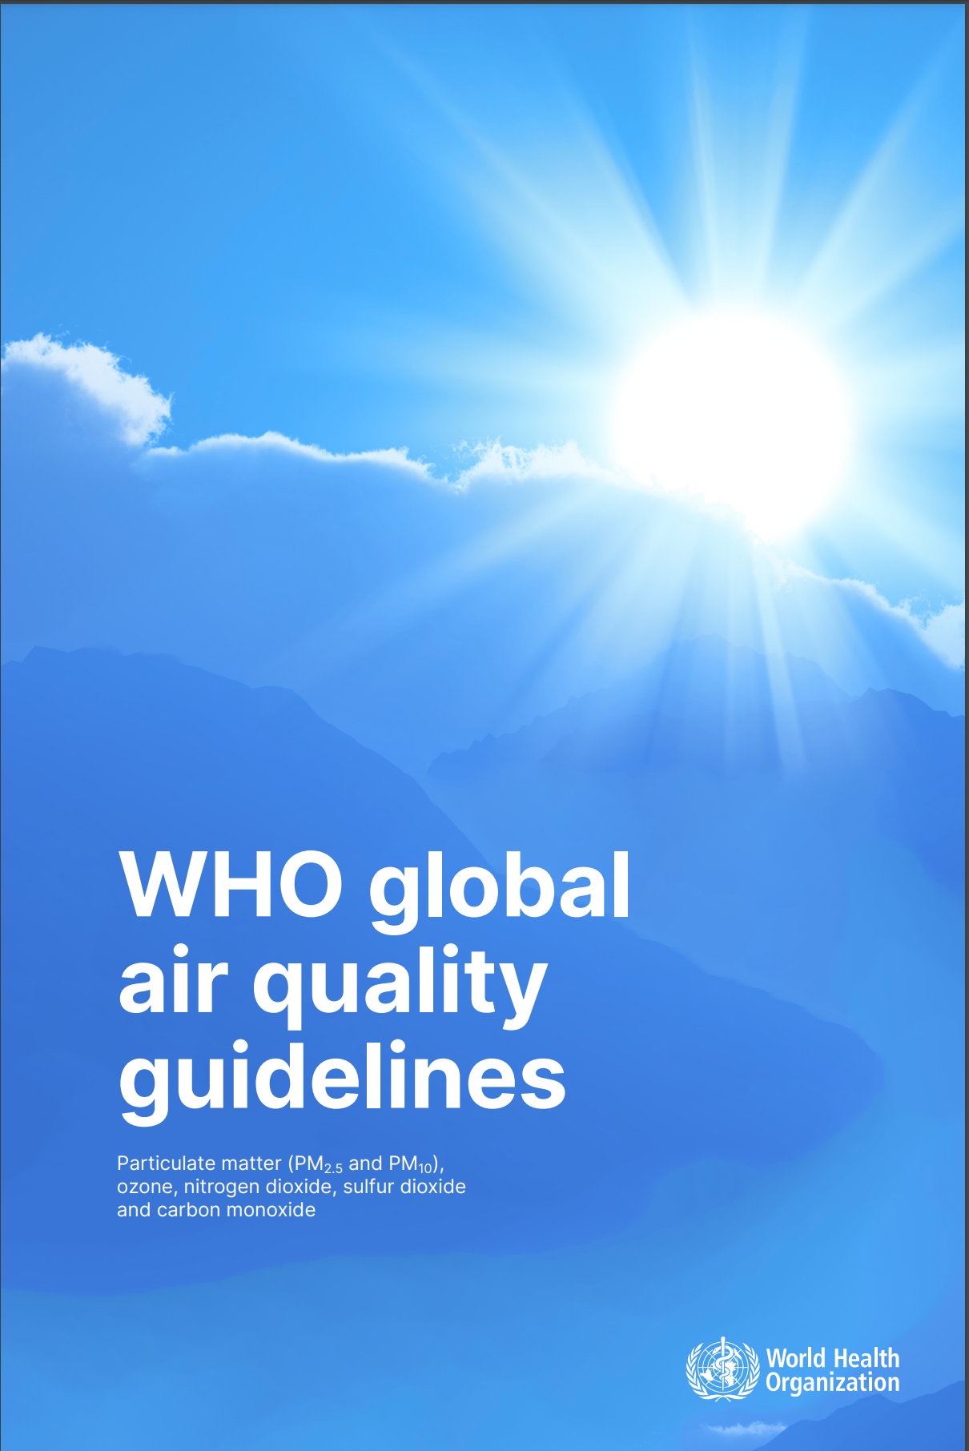
WHO Air Quality Guidelines 2021
For PM_{2.5}:
Annual mean < 5 μg m⁻³
24-hour mean < 15 μg m⁻³
→ not to be exceeded more than
3-4 times a year

