Slide 1


Towards a globally nested EMEP4UK model
Damaris Tan
Mathew R. Heal, Eiko Nemitz, Massimo Vieno, Stefan Reis, David S. Stevenson
2025-05-06
TFMM 2025 Annual Meeting (Potsdam)
Notes:
In this presentation, focus more on numbers and key regions

Slide 2
The status quo

Slide 3
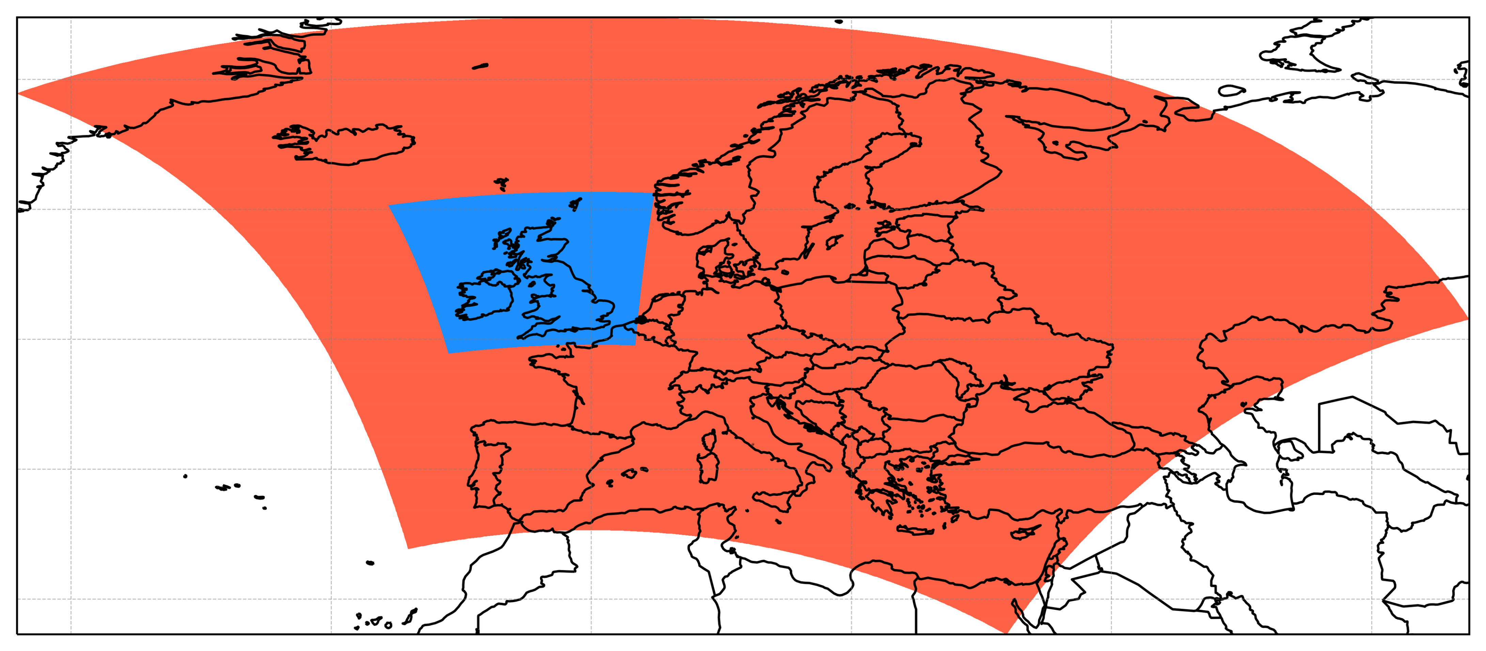

EMEP4UK: standard configuration
      Based on EMEP MSC-W model, a Eulerian ACTM
      Uses WRF meteorology
      Nested European (EU) domain > UK domain
      Standard boundary conditions around the EU domain: ‘prescribed BCs’
EU domain (27 km)
with prescribed BCs
UK domain (3 km)

Slide 4
Aims and Rationale

Slide 5
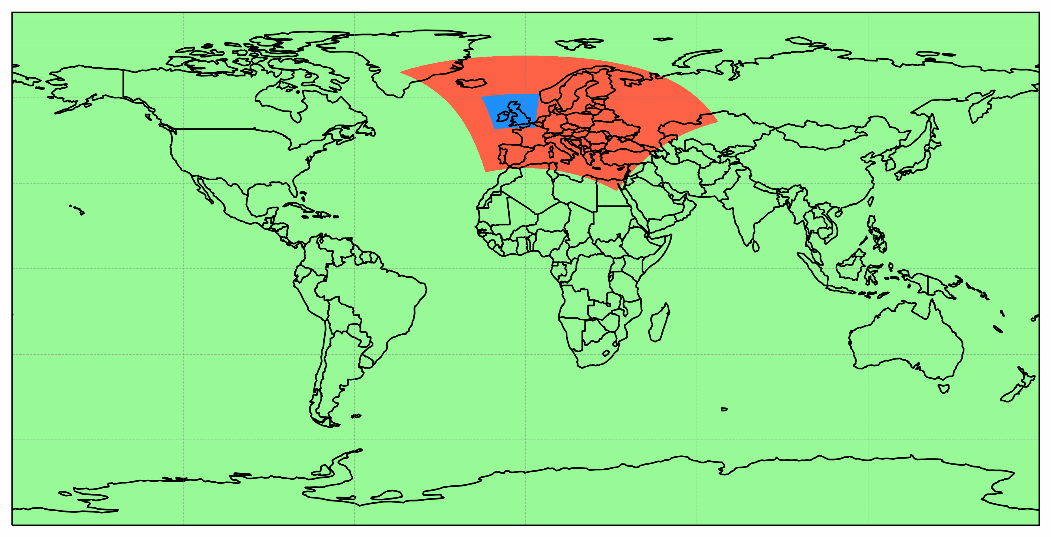
Aim: to globally nest the EMEP4UK model
UK domain (3 km)
EU domain (27 km)
with prescribed BCs
Global domain (1 deg)
provides BCs for EU domain

Slide 6
Why?
      EMEP4UK gives good results when focussing on emissions in the EU domain
      Why do I need a globally nested version?
      In general: a globally nested version is needed when considering transboundary contributions from outside the EU domain
      Important for countries at edges of EU domain e.g. UK
      Likely to become increasingly important as Europe aims to reduce anthropogenic emissions
      Also important for episodic natural contributions from outside EU domain (volcanoes, Saharan dust, wildfires…)

Slide 7
A more specific example: biomass burning
      I am interested in the impact of biomass burning on the UK
      Europe has little biomass burning compared to the rest of the globe
      → important to consider biomass burning emissions from outside the EU domain

Slide 8
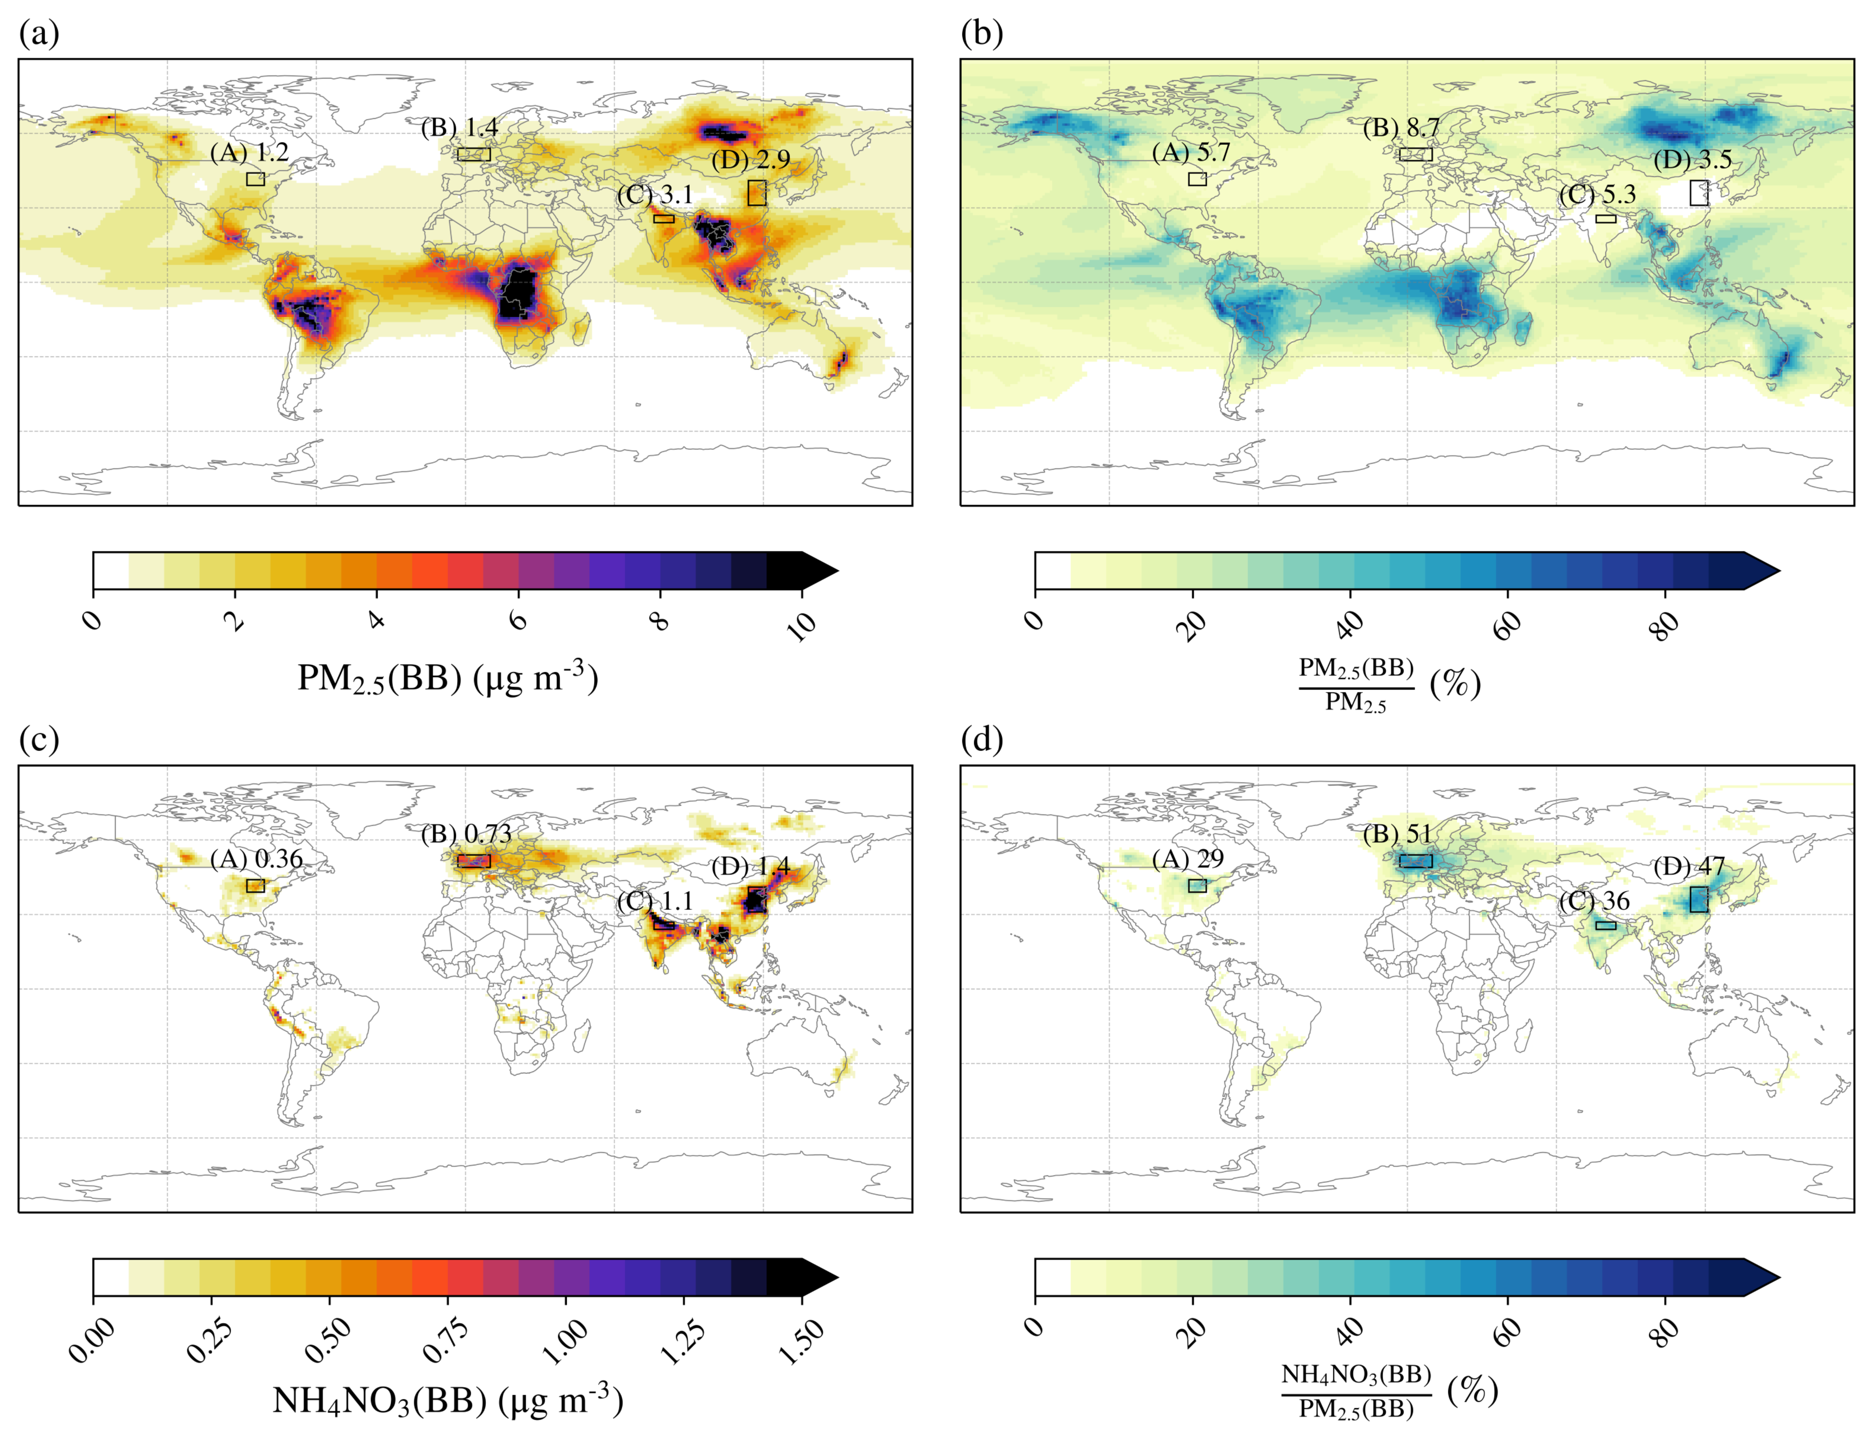
A more specific example: biomass burning
      I am interested in the impact of biomass burning on the UK
      Europe has little biomass burning compared to the rest of the globe
      → important to consider biomass burning emissions from outside the EU domain
2019 annual average PM_{2.5} associated with biomass burning:

Slide 9
A more specific example: biomass burning
      I am interested in the impact of biomass burning on the UK
      Europe has little biomass burning compared to the rest of the globe
      → important to consider biomass burning emissions from outside the EU domain
~50% is NH₄NO₃ enhancement, which cannot be attributed to BB using measurements alone
2019 annual average PM_{2.5} associated with biomass burning:

Slide 10
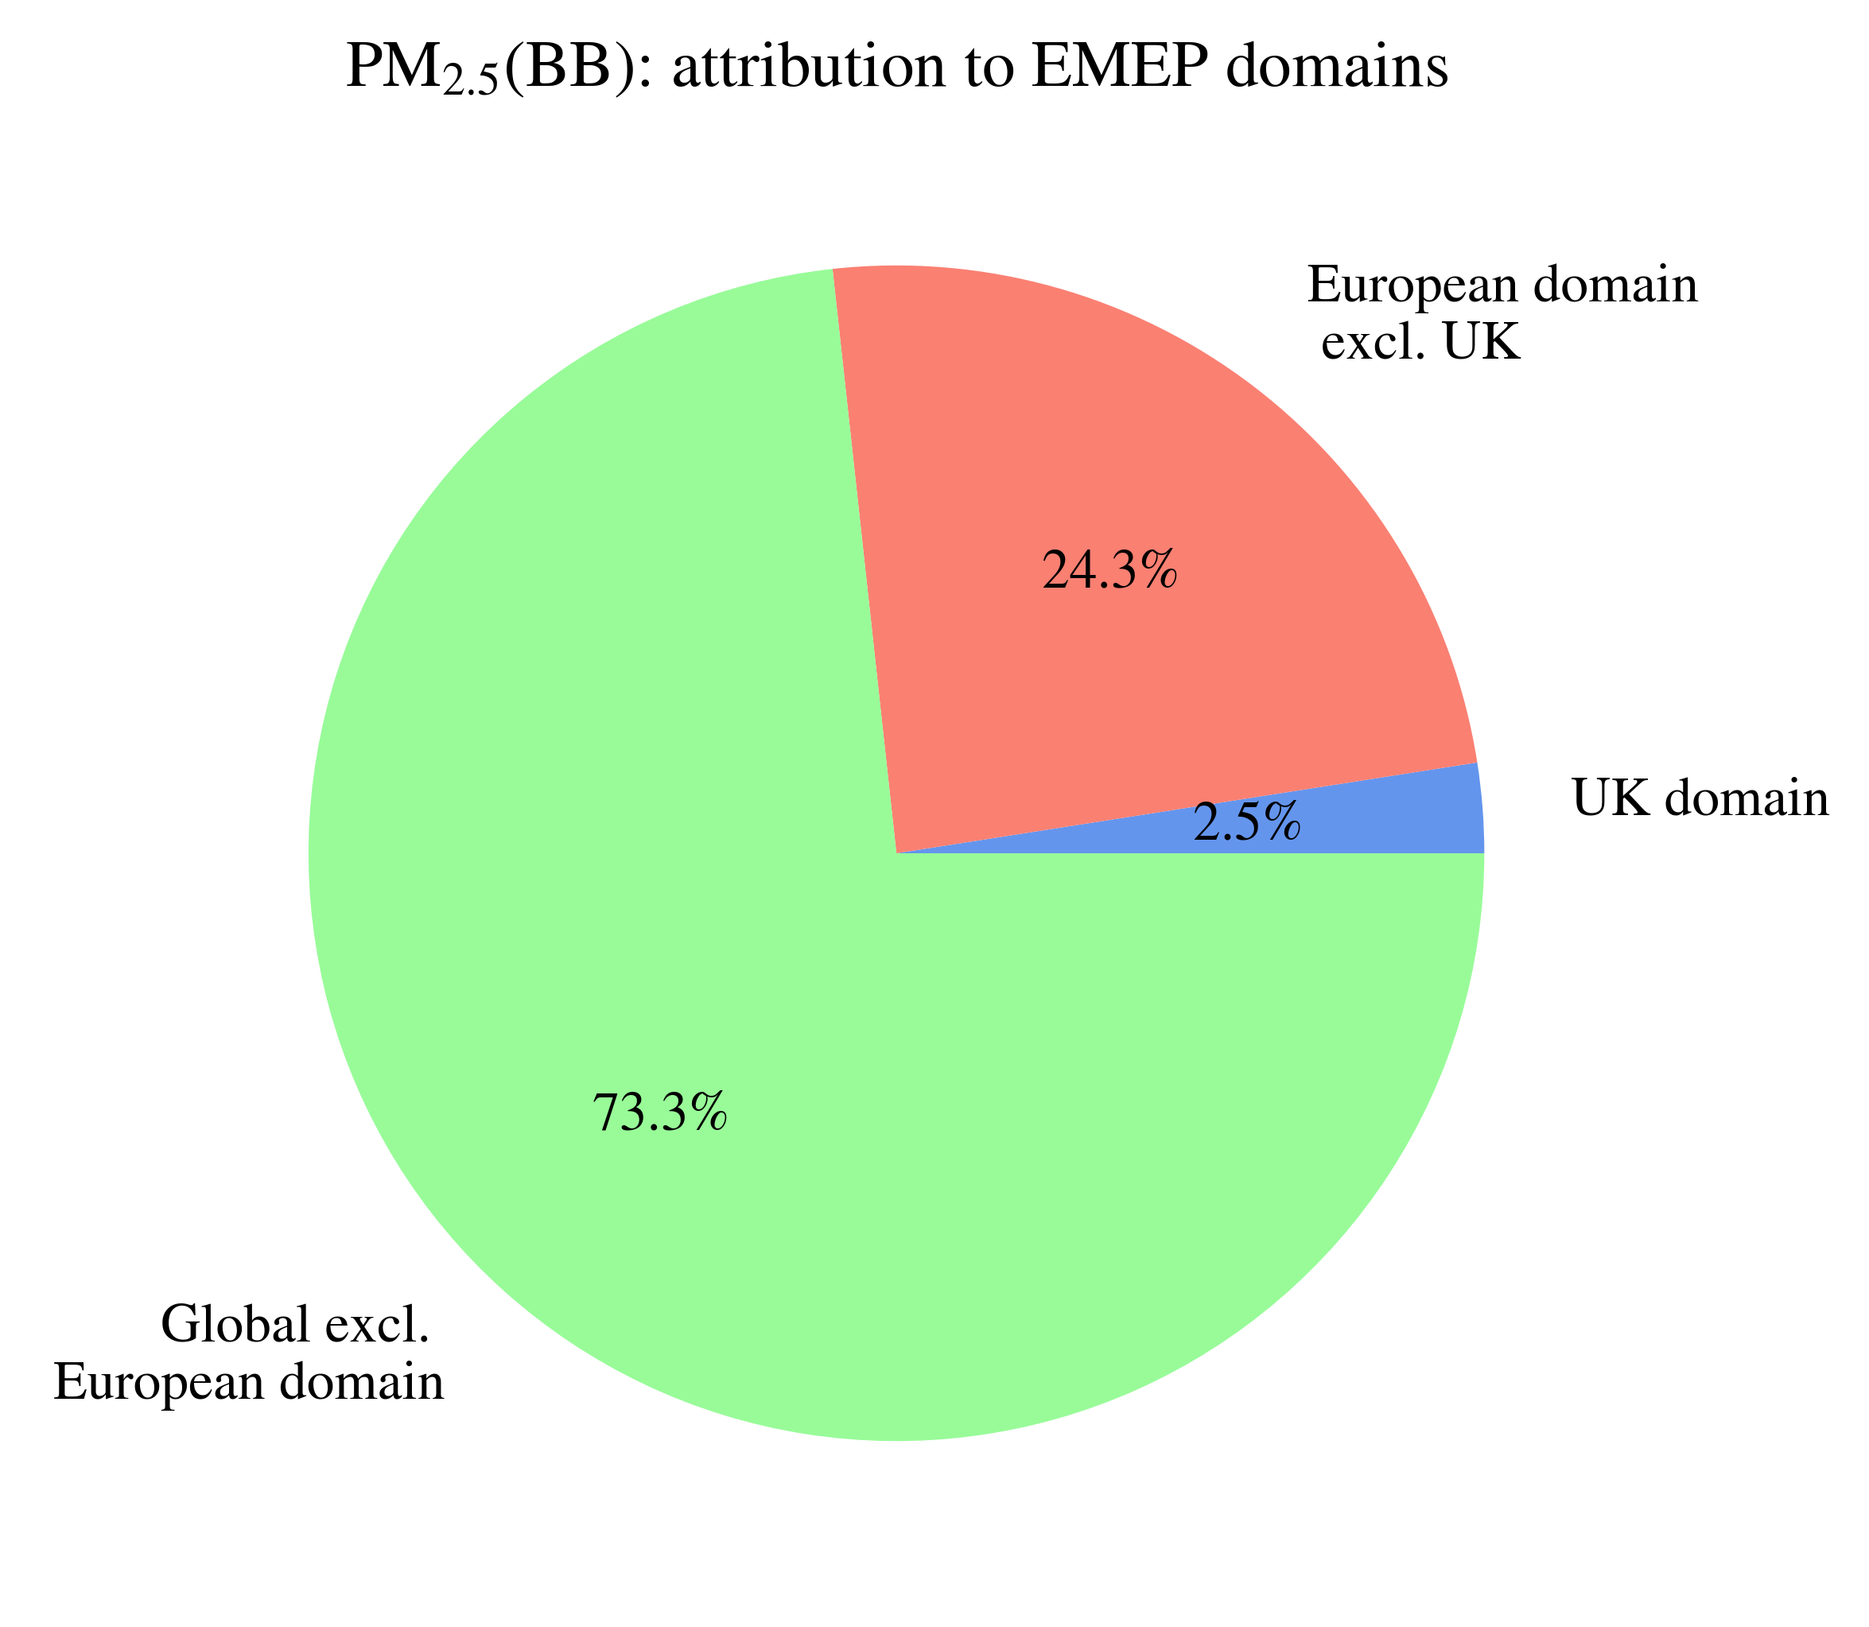
A more specific example: biomass burning
      I am interested in the impact of biomass burning on the UK
      Europe has little biomass burning compared to the rest of the globe
      → important to consider biomass burning emissions from outside the EU domain
2019 annual average PM_{2.5} associated with biomass burning:
Over the UK:
Not accurately capture by the standard configuration of EMEP4UK

Slide 11
Model details

Slide 12
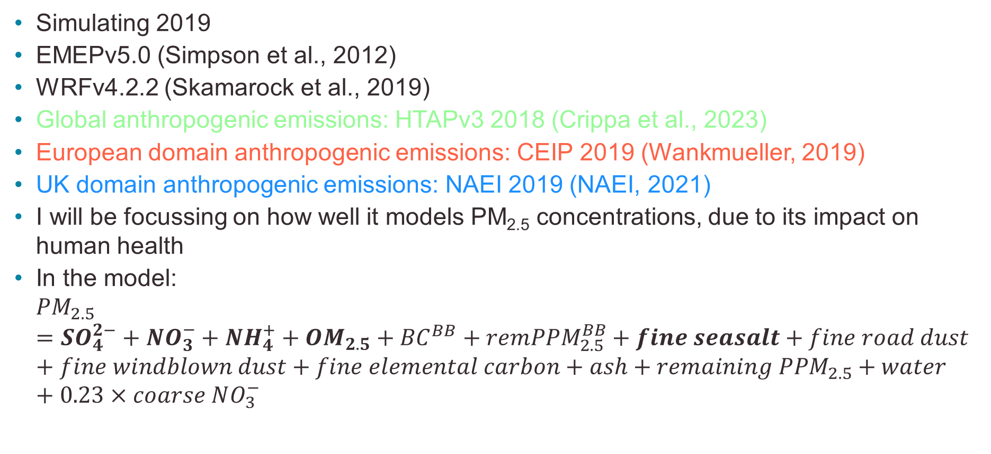
Model details…
      Simulating 2019
      EMEPv5.0 (Simpson et al., 2012)
      WRFv4.2.2 (Skamarock et al., 2019)
      Global anthropogenic emissions: HTAPv3 2018 (Crippa et al., 2023)
      European domain anthropogenic emissions: CEIP 2019 (Wankmueller, 2019)
      UK domain anthropogenic emissions: NAEI 2019 (NAEI, 2021)
      I will be focussing on how well it models PM_{2.5} concentrations, due to its impact on human health
      In the model:
      ${PM}_{2.5}={SO}_{4}^{2−}+{NO}_{3}^{−}+{NH}_{4}^{+}+{OM}_{2.5}+{BC}^{BB}+{remPPM}_{2.5}^{BB}+fine seasalt+fine road dust+fine windblown dust+fine elemental carbon+ash+remaining {PPM}_{2.5}+water+0.23×coarse NO_{3}^{−}$

Slide 13
Model evaluation
Annual mean PM_{2.5}: comparing standard configuration and globally nested versions of EMEP4UK to measurements.

Slide 14
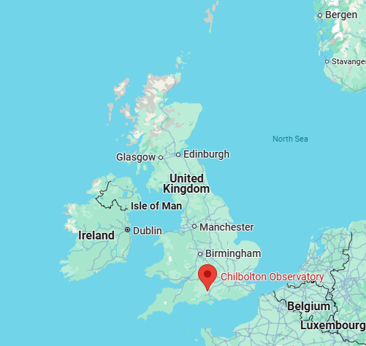
Comparison to measurements at Chilbolton Observatory supersite (annual averages)
      One of the UK’s supersites
      Measures:
        Sulfate in PM_{2.5}
        Ammonium in PM_{2.5}
        Nitrate in PM_{2.5}
        Sodium Chloride in PM_{2.5}
        Black Carbon at several wavelengths
        Organic aerosol mass in PM_{2.5}
      Limitations:
        only one site
        only 160 days of measurements for 2019 – annual average
        Comparing 3 km grid cell with point measurement
Notes:
NCEP = US National Centre for Environmental Protection
NCAR = National Centre for Atmospheric Research
GFS = Global Forecast System
NAEI = National Atmospheric Emissions Inventory
CEIP = Centre for Emission Inventories and Projections
MARS = Model for Aerosols Reacting System

Slide 15
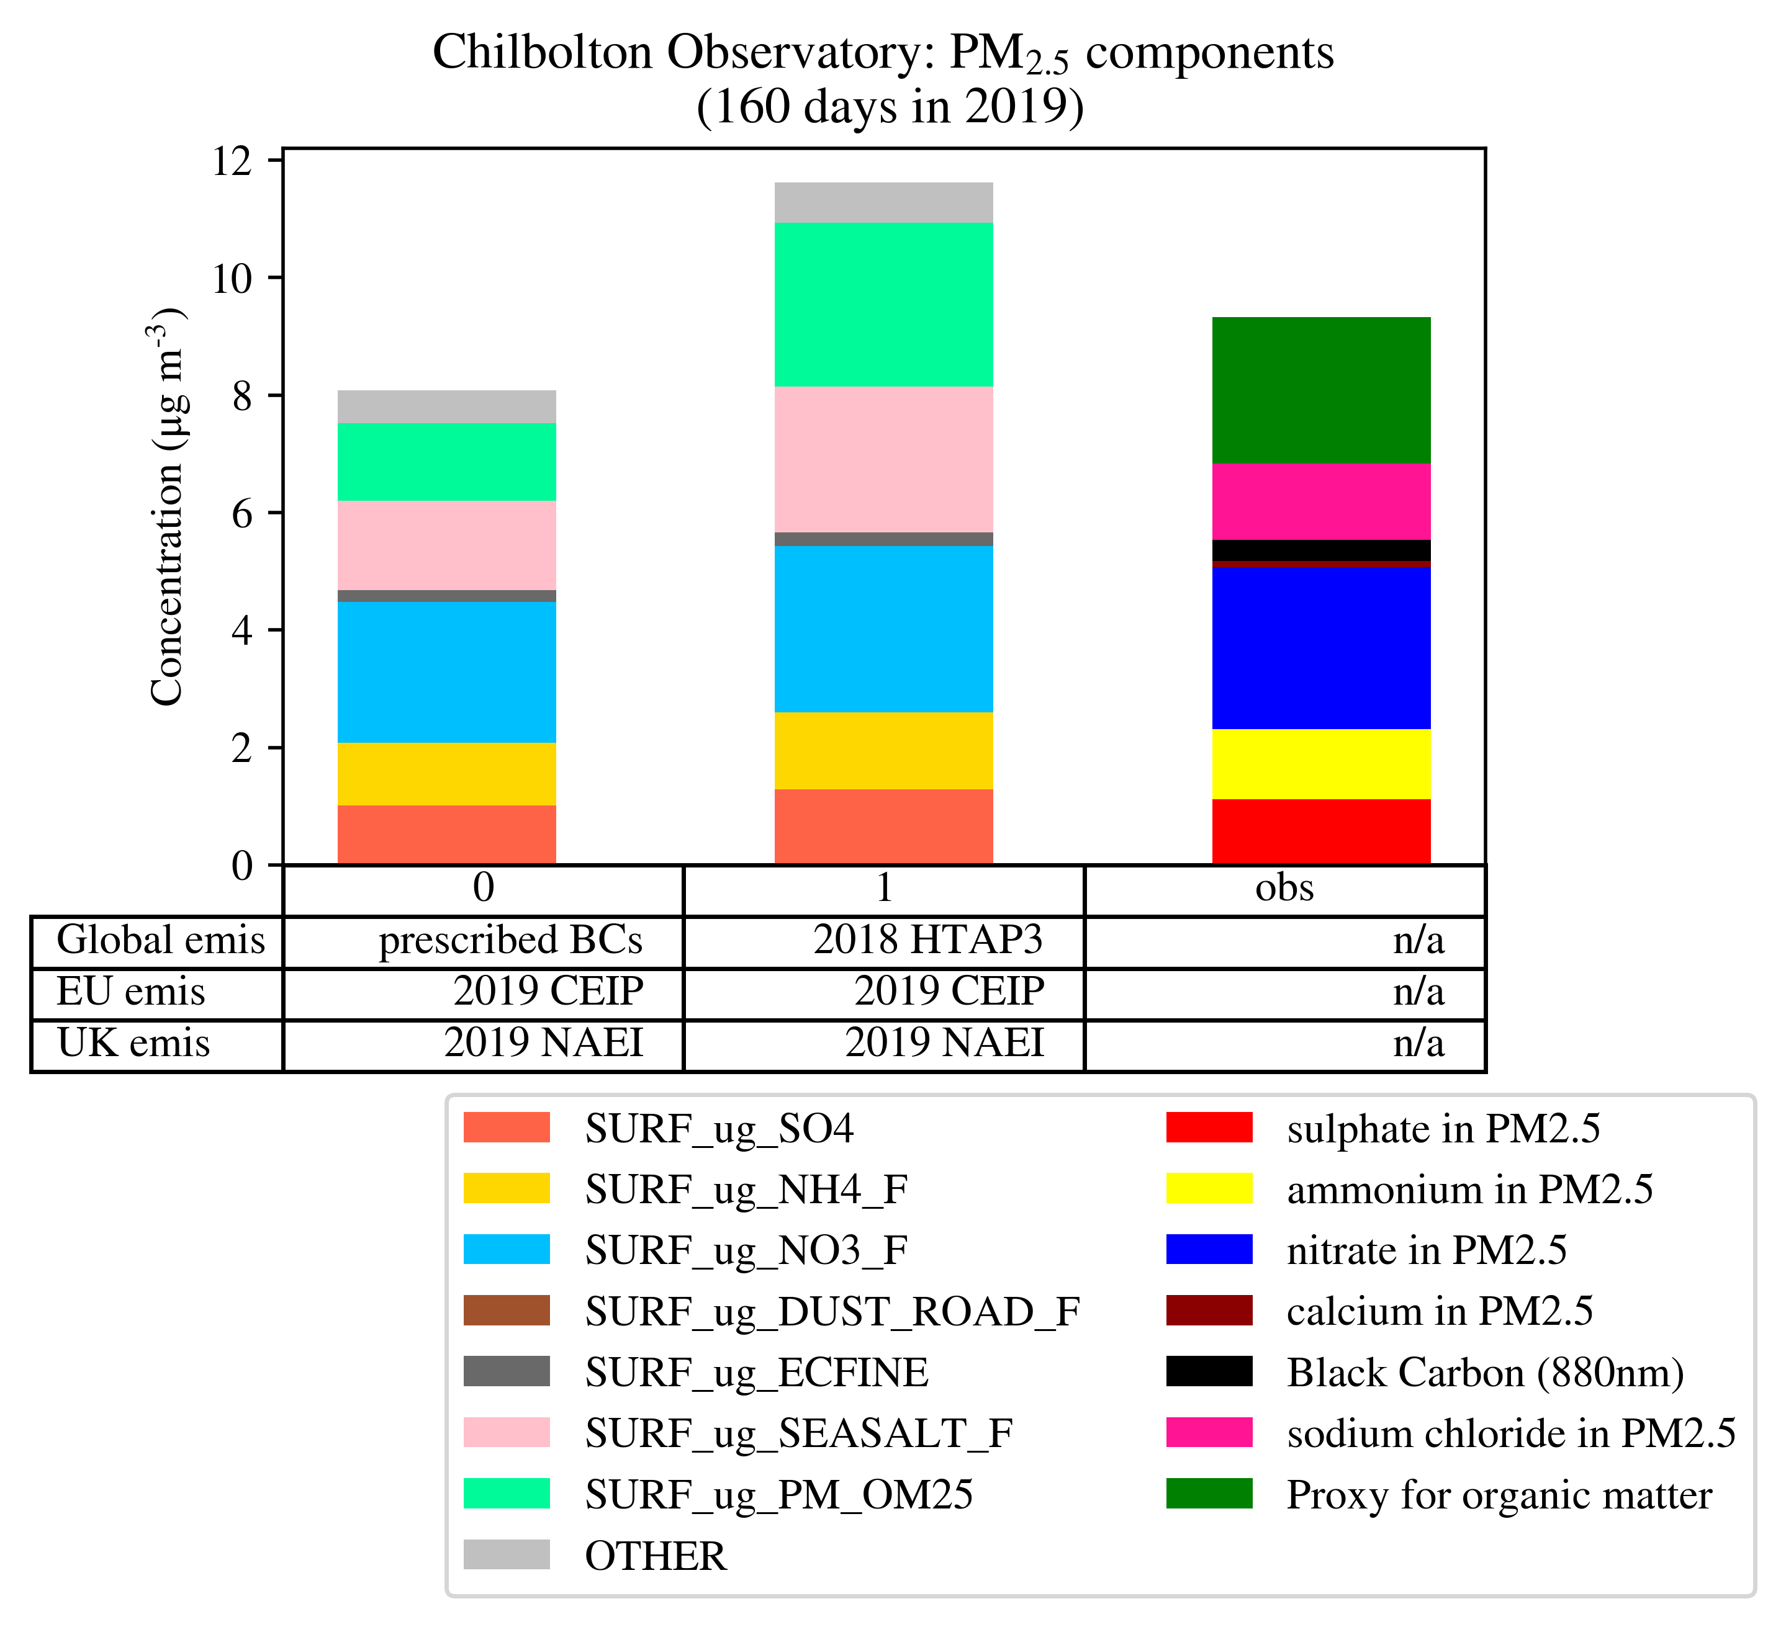
Measurements
2023 annual average used as proxy for 2019
2019 annual average (160 daily averages)
Sodium chloride used as proxy for seasalt
Notes:
NCEP = US National Centre for Environmental Protection
NCAR = National Centre for Atmospheric Research
GFS = Global Forecast System
NAEI = National Atmospheric Emissions Inventory
CEIP = Centre for Emission Inventories and Projections
MARS = Model for Aerosols Reacting System

Slide 16
Standard configuration (prescribed BCs)
Standard configuration
      Good agreement with measurement (at first glance)
      Inorganics and organic matter too low
Notes:
NCEP = US National Centre for Environmental Protection
NCAR = National Centre for Atmospheric Research
GFS = Global Forecast System
NAEI = National Atmospheric Emissions Inventory
CEIP = Centre for Emission Inventories and Projections
MARS = Model for Aerosols Reacting System

Slide 17
Globally nested UK run
      Inorganics are good!
      Seasalt is too high (to do with the model version, not the nesting)
      Organics are ok – but hard to tell because measurements are uncertain
Globally nested
Standard configuration
Notes:
NCEP = US National Centre for Environmental Protection
NCAR = National Centre for Atmospheric Research
GFS = Global Forecast System
NAEI = National Atmospheric Emissions Inventory
CEIP = Centre for Emission Inventories and Projections
MARS = Model for Aerosols Reacting System

Slide 18
Reasons for discrepancies between globally nested model and measurements

Slide 19
Reasons for disagreement with measurement (mostly to do with the global run)
      Measurements are uncertain
      Emissions, incl. shipping
      Resolution of the global model run – addressing this would require higher computational expense
      Lifetime wrt deposition
      Convection – currently convective parameterisation is omitted from global scale model runs. However, at scales ≥ 10 km, convective processes become important and might be a reason for over-predicting long-range transport.
        Christina Hood (UKCEH) looking into this – initial results indicate that convection will make a difference, but that this is not the key issue
      Probably a combination of all of the above + many other reasons…
Notes:
NCEP = US National Centre for Environmental Protection
NCAR = National Centre for Atmospheric Research
GFS = Global Forecast System
NAEI = National Atmospheric Emissions Inventory
CEIP = Centre for Emission Inventories and Projections
MARS = Model for Aerosols Reacting System

Slide 20
Conclusions

Slide 21
Conclusions
      Tested a globally nested version of EMEP4UK (based on EMEP MSC-W v5.0 with WRF meteorology)
      Important for considering long-range transport from outside EU domain, especially for countries at the edges
        e.g. Biomass burning - 75% of which comes from the global domain, which is not accurately capture by EMEP4UK in its standard configuration
      Tested 2019 by comparing annual PM_{2.5} mean concentrations to measurements from the Chilbolton Observatory supersite
      Overall there is overestimation compared to measurements (while the standard configuration underestimated)
        Model does well for inorganic aerosols
        Organic matter is ok but measurements are uncertain
      Reasons for deviation from measurement: resolution, emissions, convection
Notes:
NCEP = US National Centre for Environmental Protection
NCAR = National Centre for Atmospheric Research
GFS = Global Forecast System
NAEI = National Atmospheric Emissions Inventory
CEIP = Centre for Emission Inventories and Projections
MARS = Model for Aerosols Reacting System

Slide 22
Thank you
For more information:
damtan@ceh.ac.uk
damaris.tan@ed.ac.uk
github.com/DYTTan

