Slide 1
Overview of CAMS global activities – long range transport context
26th EMEP Task Force on Measurements and Modelling Meeting, 5-7 May 2025
Mark Parrington (mark.parrington@ecmwf.int), Laurence Rouil, Richard Engelen, Johannes Flemming

Slide 2
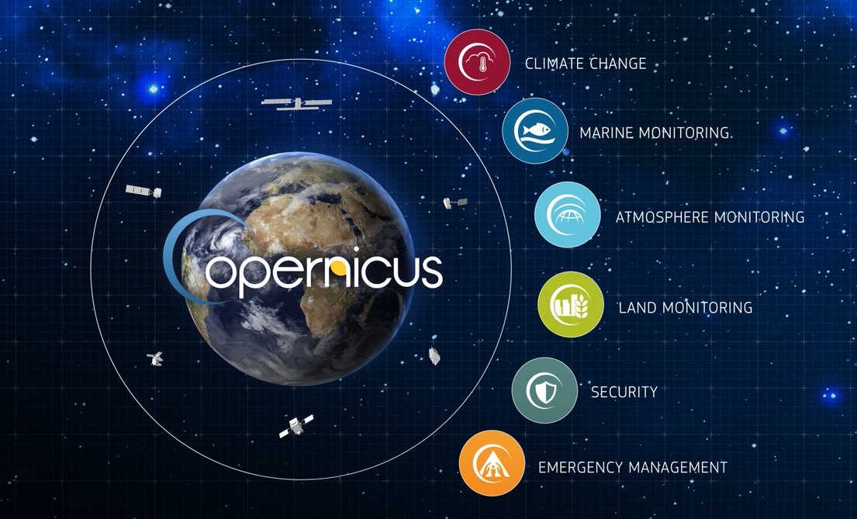
Copernicus Atmosphere Monitoring Service
CAMS is one of six thematic information services provided by
the Copernicus Earth Observation Programme of the European Union.
Implemented (and C3S) by ECMWF on behalf of the European Commission
Fire danger and flood forecasts provided to CEMS

Slide 3
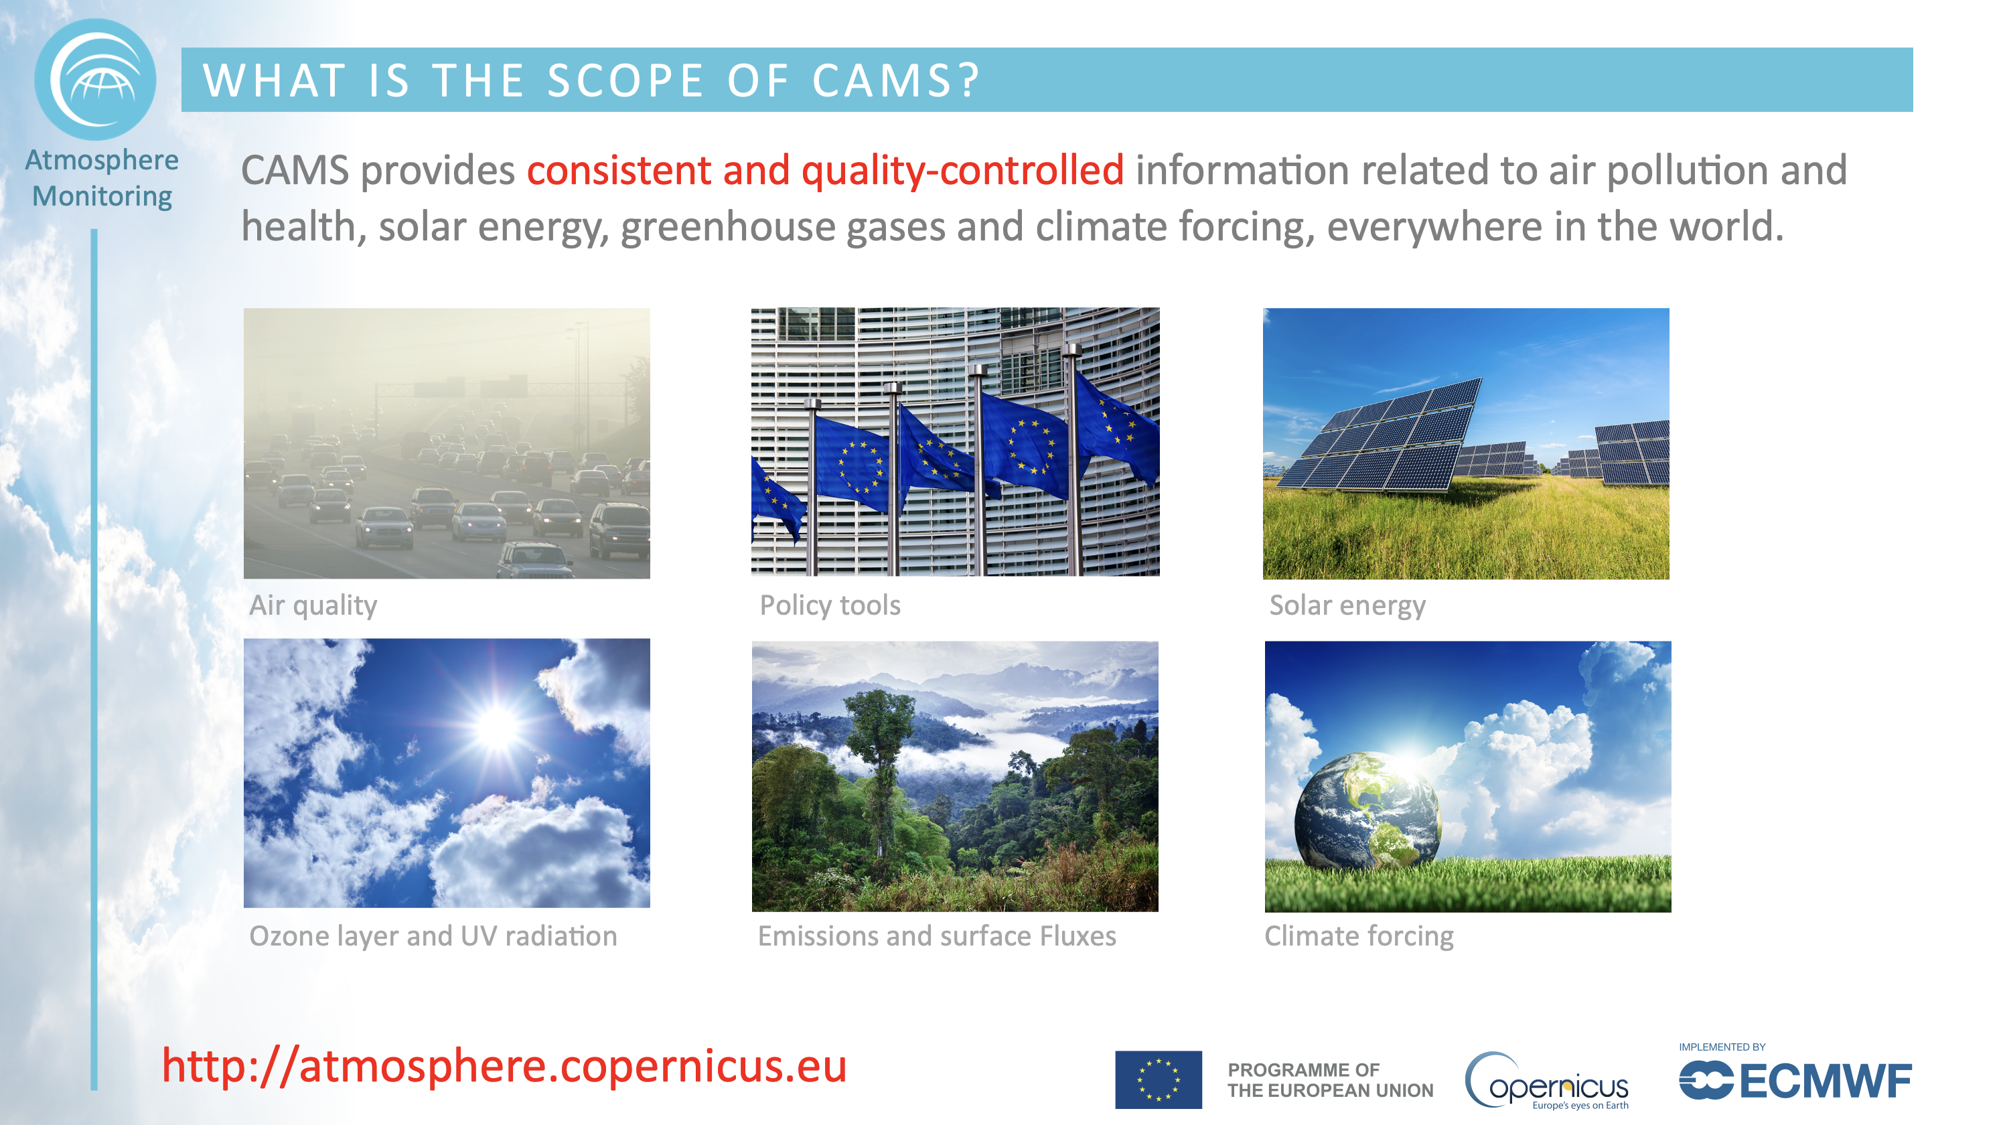

Slide 4
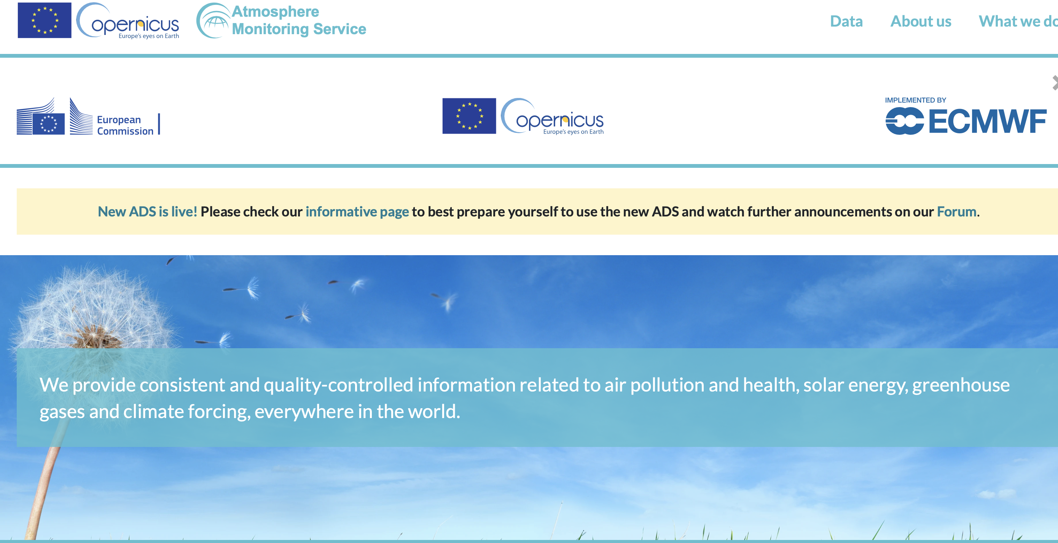
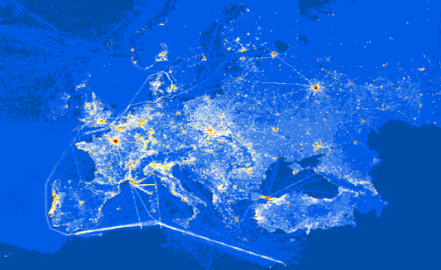
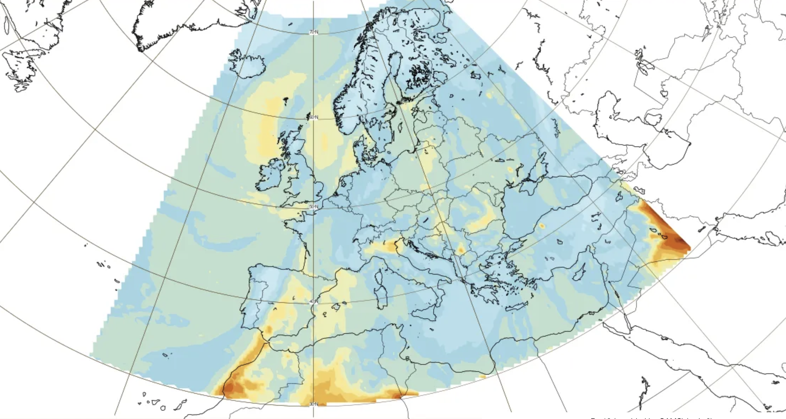
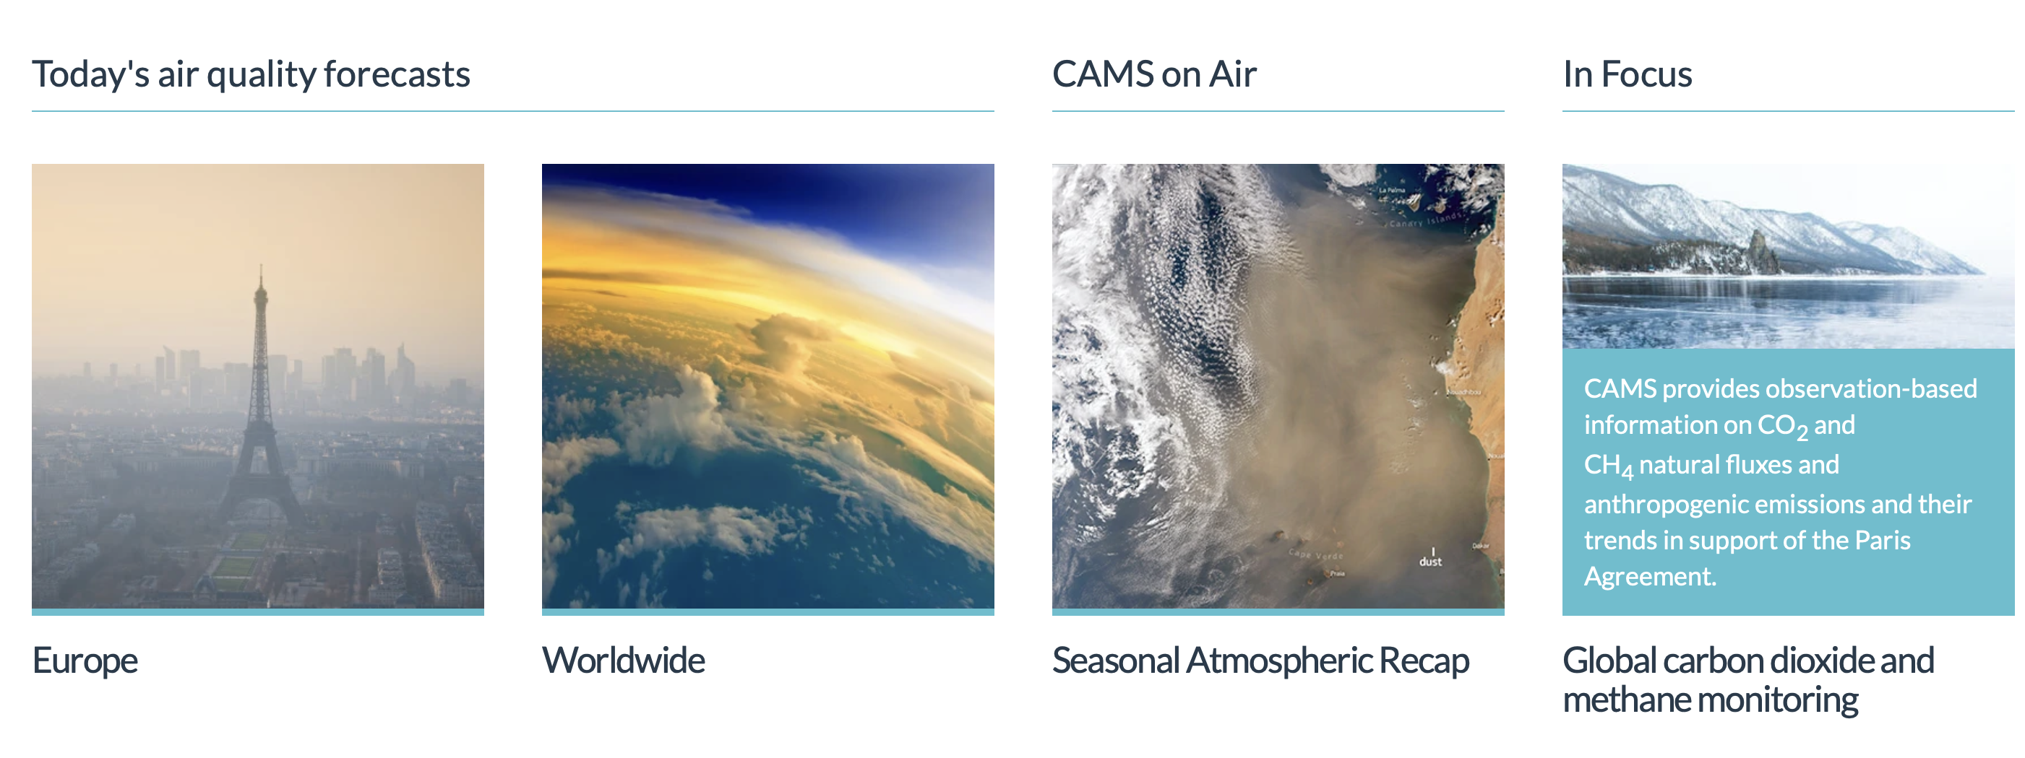
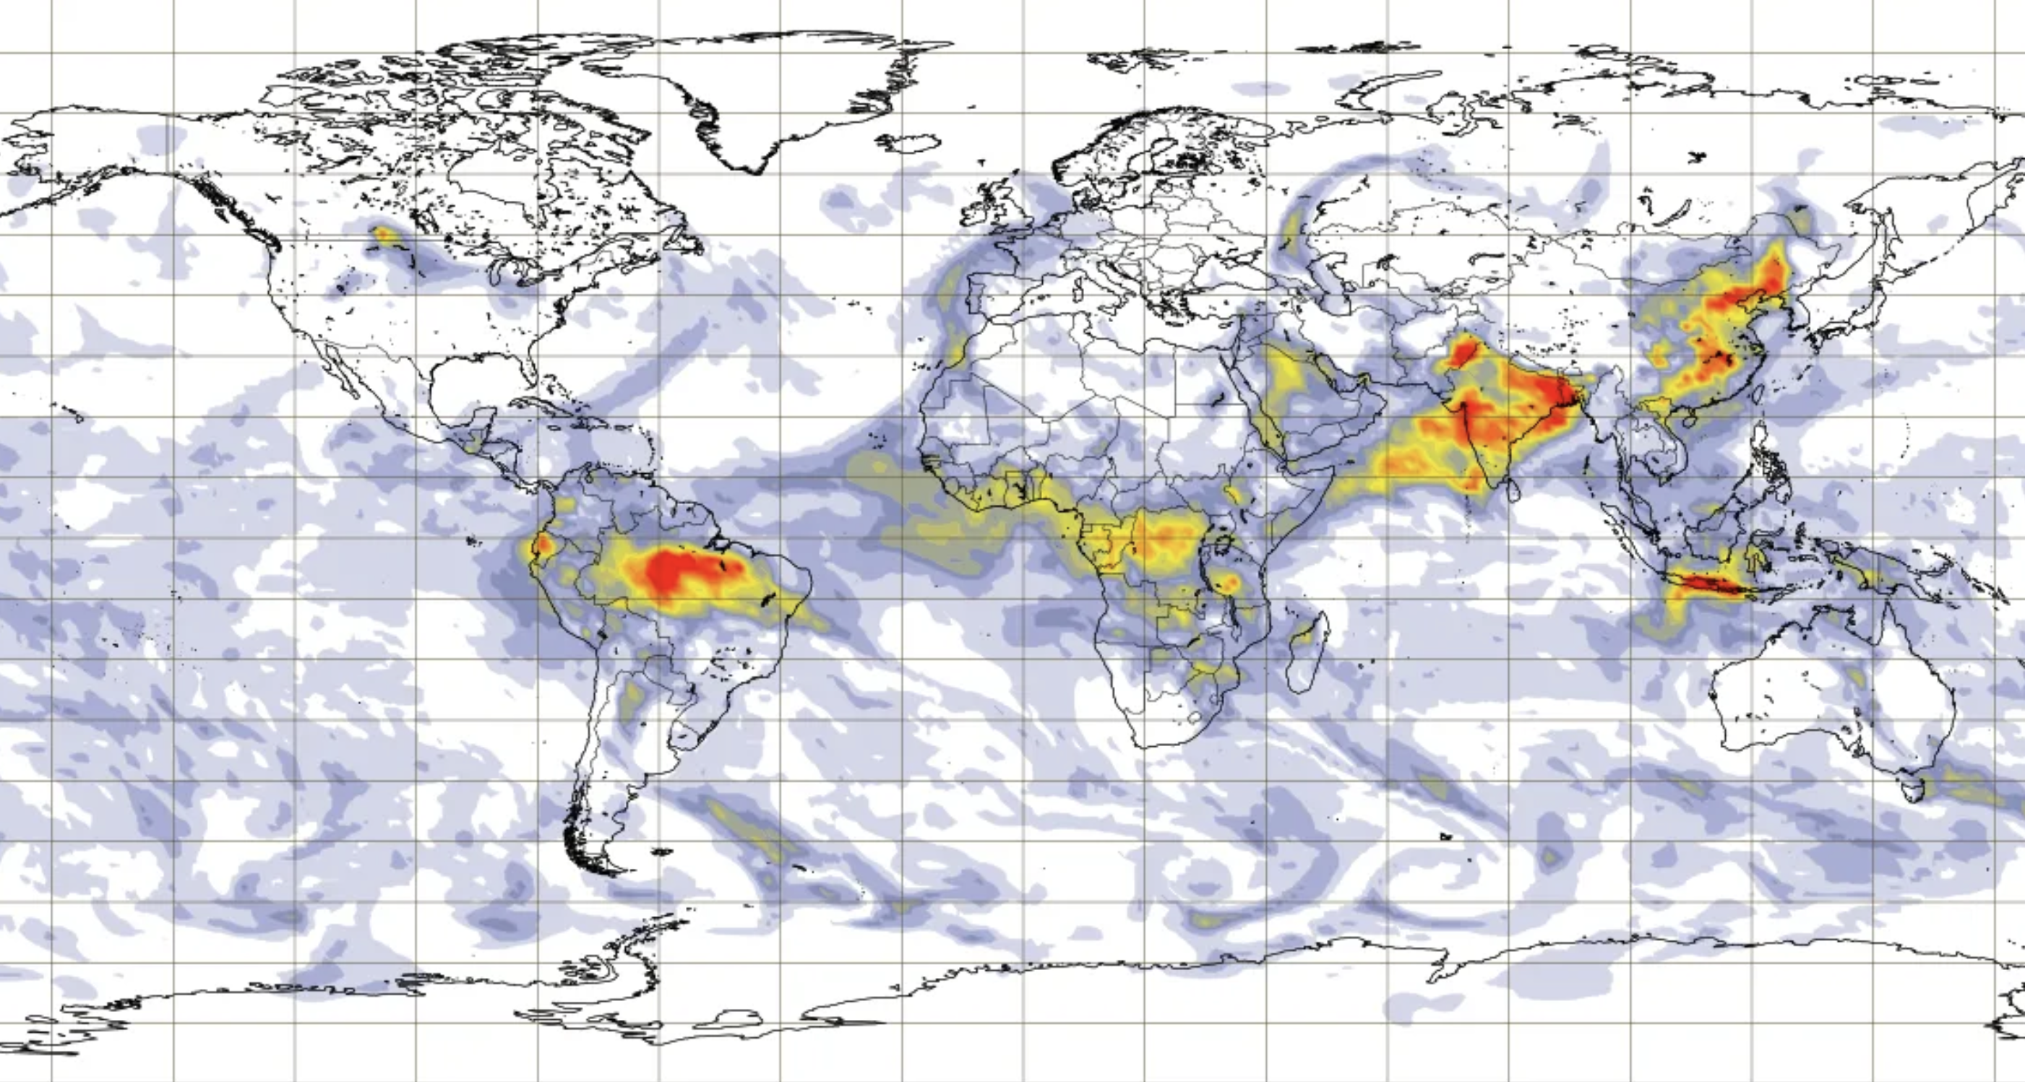
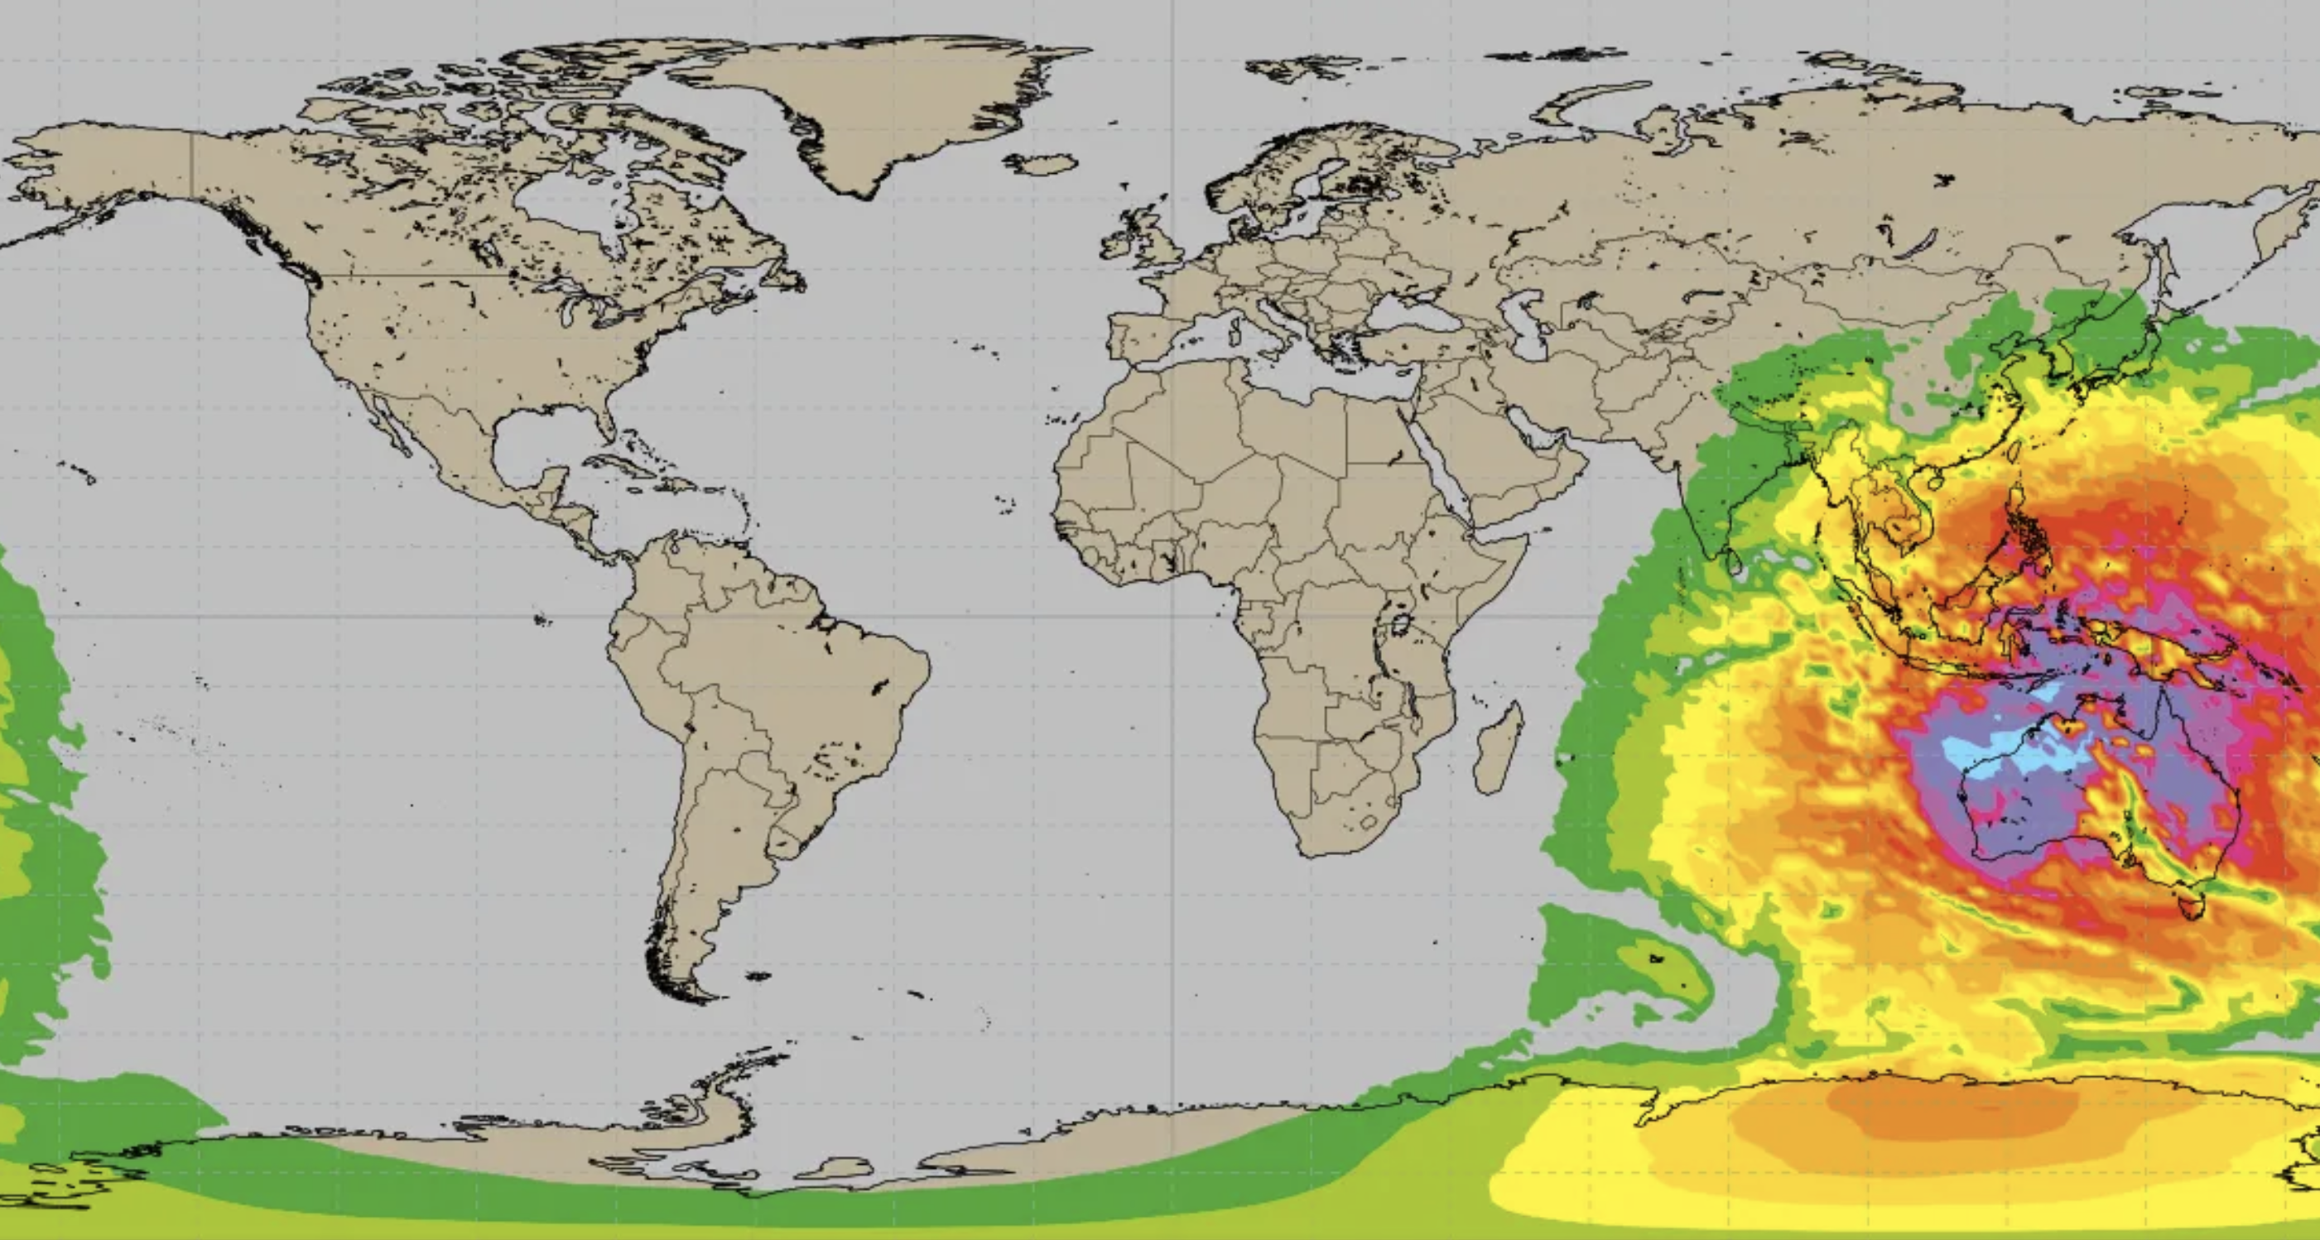
CAMS PORTFOLIO
CAMS provides open & free information products based on Earth Observations about:
past, current and near-future (forecasts) global and regional atmospheric composition;
European air quality;
Ozone layer monitoring;
emissions and surface fluxes of key pollutants and greenhouse gases;
solar radiation;
climate radiative forcing.
http://atmosphere.copernicus.eu
http://ads.atmosphere.copernicus.eu

Slide 5
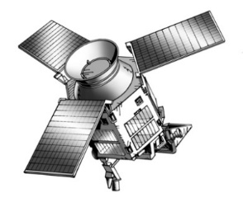
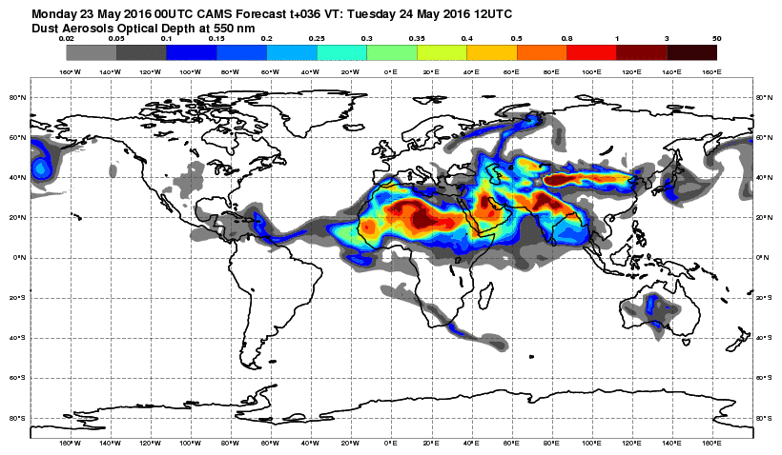
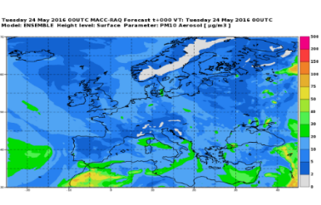
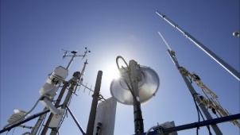
Global and Regional CAMS systems
CAMS SERVICE CHAIN
Data assimilation
ECMWF
IFS
global,
40x40 km
Global
CAMS Emissions
Satellite Observations
(AOD, O₃, CO, NO₂, SO₂)
GFAS
wildfire emissions
Boundary Conditions
11 regional CTMs over Europe,
10x10 km
Surface AQ observations
European CAMS
Emissions
Data assimilation
10
https://atmosphere.copernicus.eu
15

Slide 6
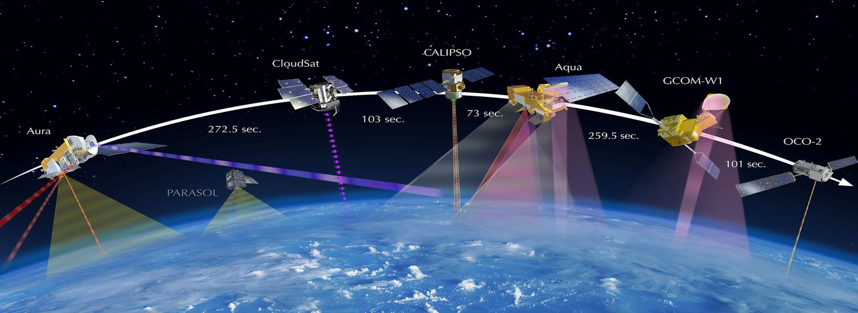
Earth Observation in CAMS
Species | Instruments
CAMS NRT
O₃ | S5P, GOME-2, OMI, OMPS-NP, MLS, OMPS-LP, GEMS
CO | S5P, IASI, MOPITT
NO₂ | S5P, GOME-2, GEMS
Aerosol | MODIS, VIIRS, PMAp, S3
CO₂ | GOSAT, IASI, OCO-2
CH₄ | GOSAT, IASI, S5P
SO₂ (volcanic) | S5P, GOME-2, IASI
SO2 (anthropogenic) | S5P
HCHO | S5P
GFAS fire emissions | MODIS, VIIRS, GOES, Himawari, S3
CAMS uses Earth Observation data from many satellites for atmospheric composition and weather.
---- Used
---- Undergoing testing

Slide 7
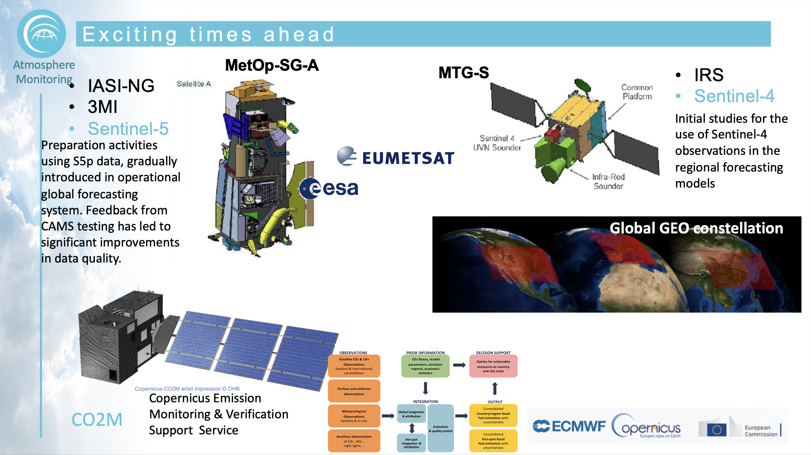

Slide 8
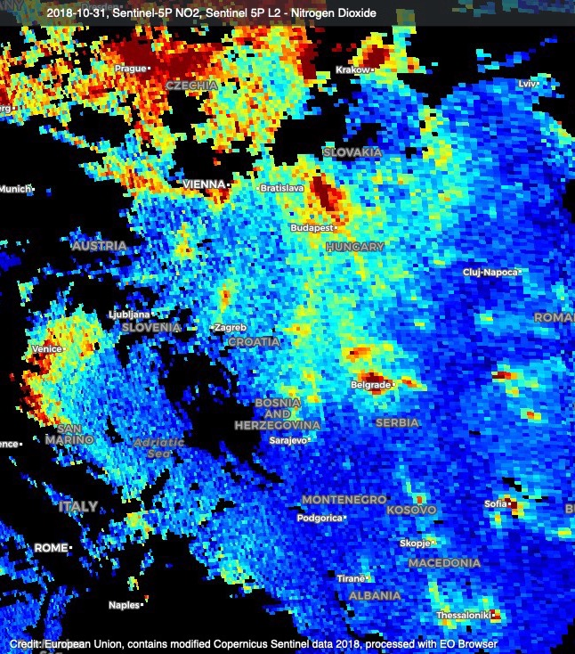
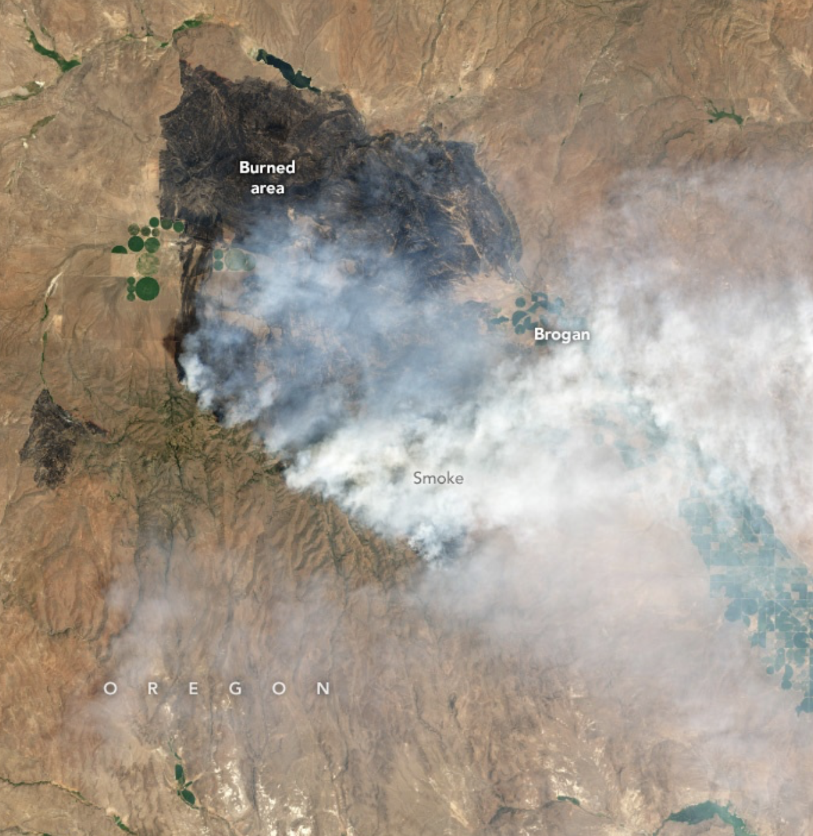
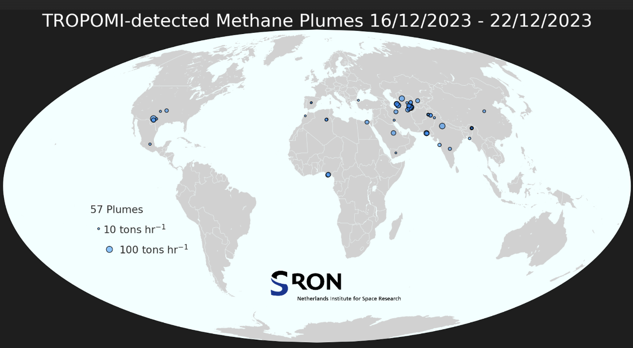
Satellite observations : a game changer ?
To monitor areas that are not well covered by in-situ networks
To monitor exceptional emission events and long-range patterns : dust plumes, wildfires, volcanoes eruptions
To support emission reporting checking or detection of emissions sources (inverse modelling approaches)
BUT :
  Sattelites monitor columns or half-columns,
  Need calibration processes to retrieve data
  Revisit the same area “only” periodically,
  Do not see anything in cloudly conditions
Availability of geostationnary sattelites monitoring atmospheric composition likely to be the most promising development to complement in-situ networks : TEMPO (US), GEMS(Korea), Sentinel 4 (Europe - 2025)

Slide 9
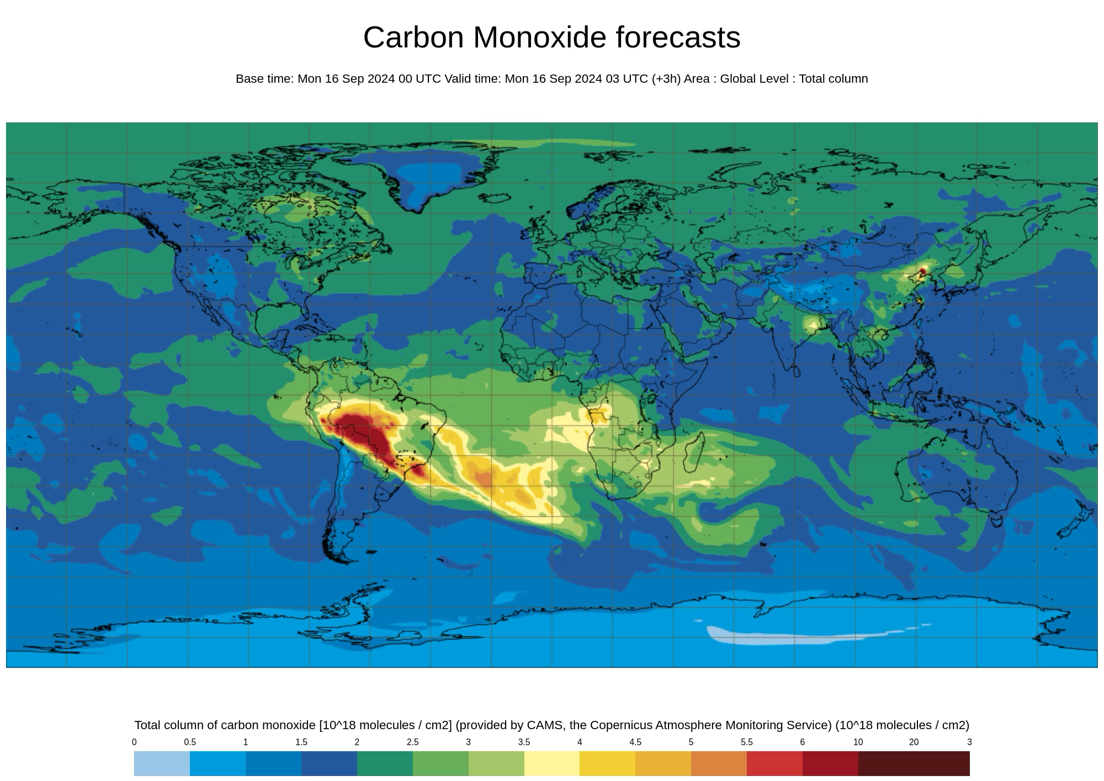
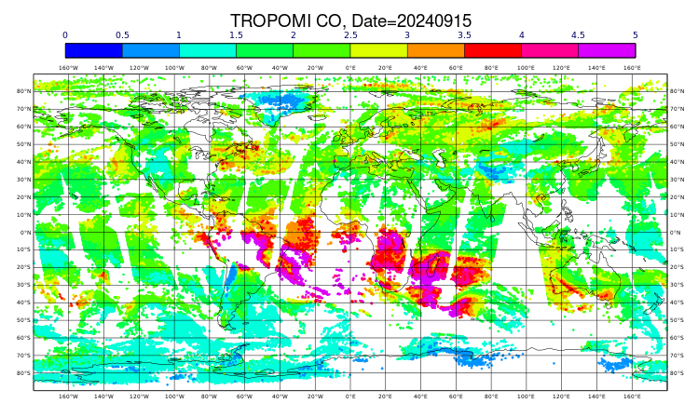
CAMS Global Forecasts – CO as example
Satellite observations (S-5p, MOPITT & IASI)
Medium-range forecast
Forecast
Analysis
Forecast
Analysis
Yesterday’s forecast is adjusted by today’s observations to produce the outlook for tomorrow. Every day.
11

Slide 10
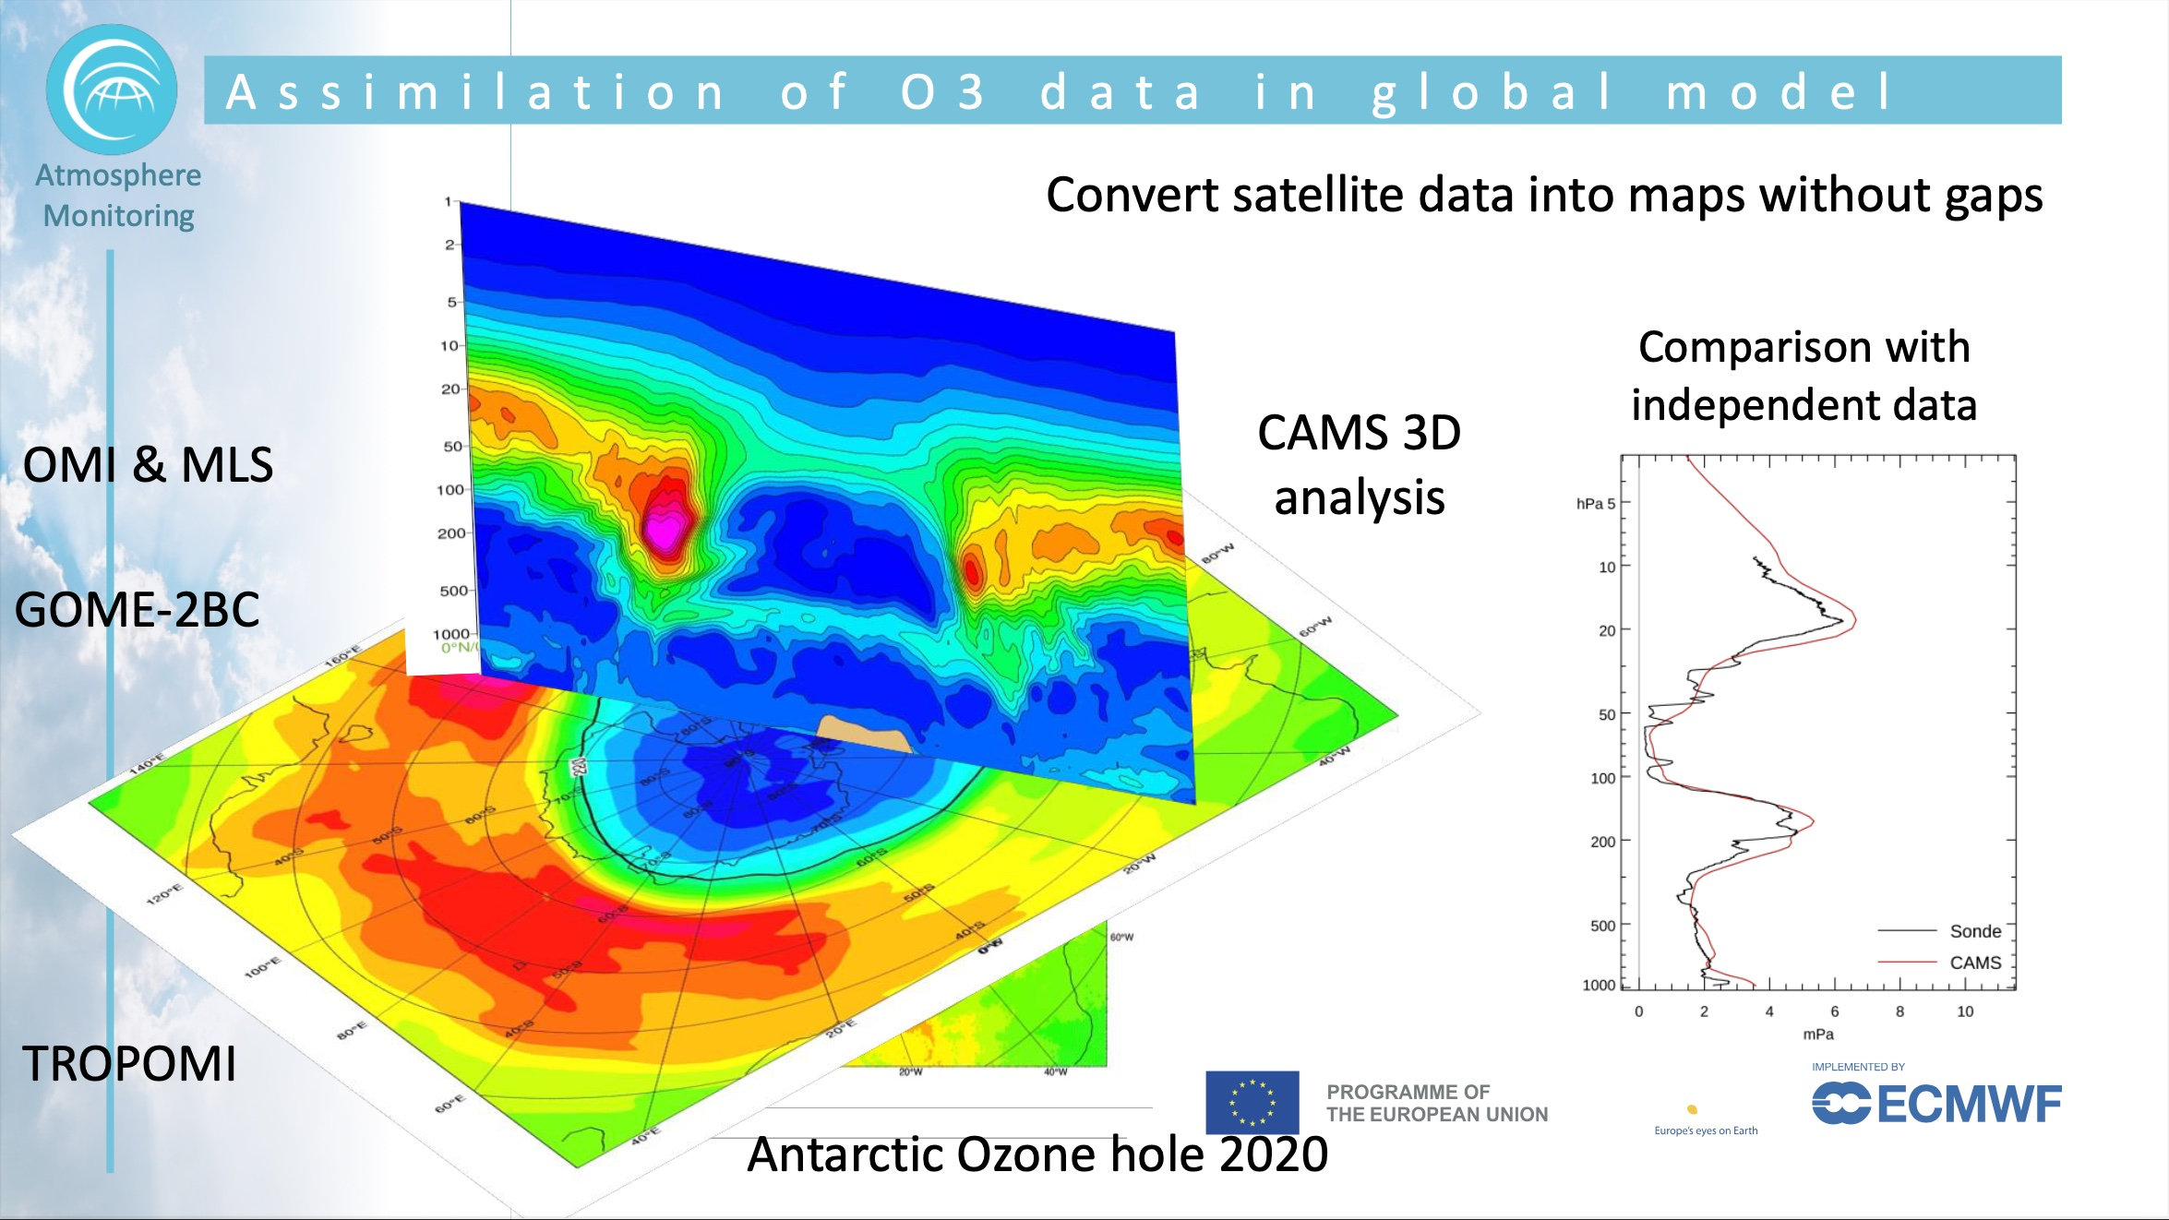
c/o Antje Inness
Information on vertical distribution

Slide 11
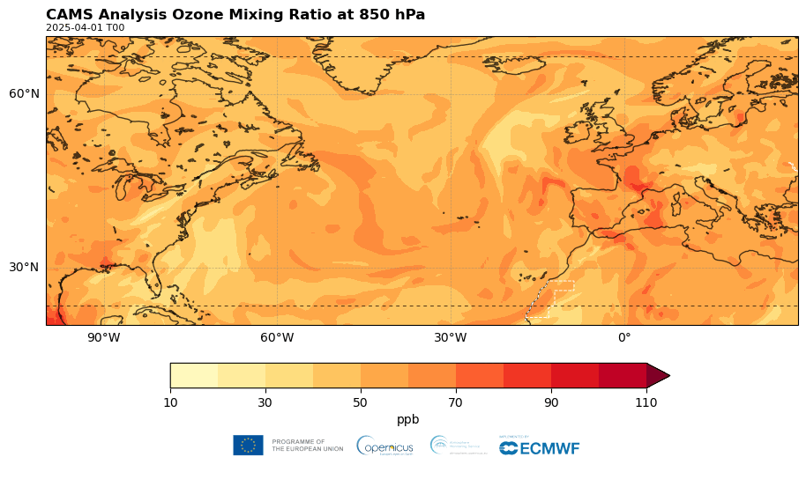
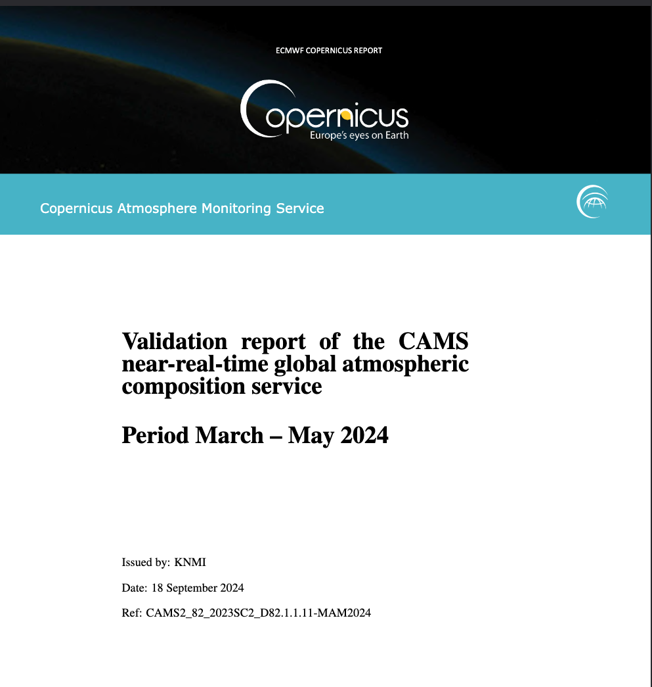
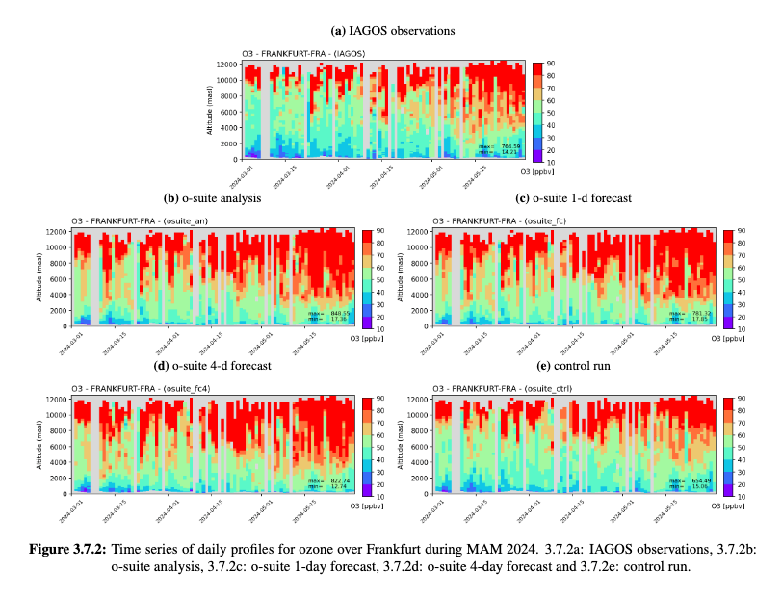
CAMS products are supported by routine evaluation and quality control against independent measurements.
For example, long-range transport of tropospheric ozone evaluated against profiles measured over airports (+cruise altitude) around the world by IAGOS.
https://atmosphere.copernicus.eu/quality-assurance
https://www.iagos.org/products/

Slide 12

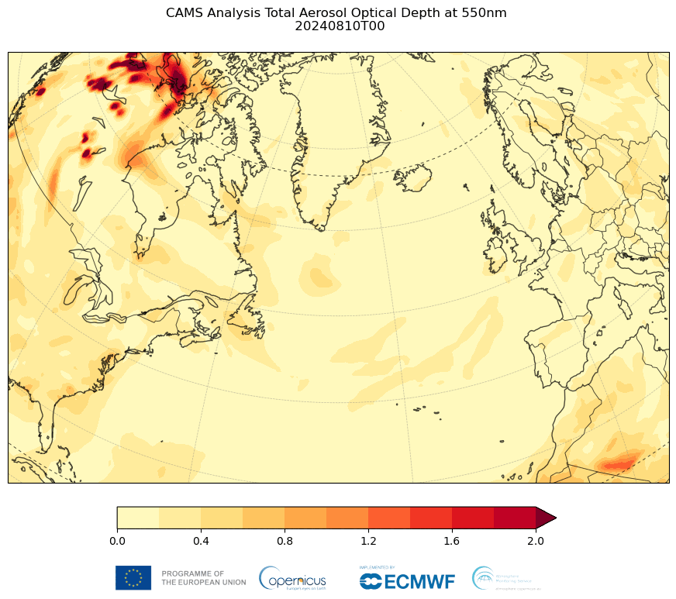
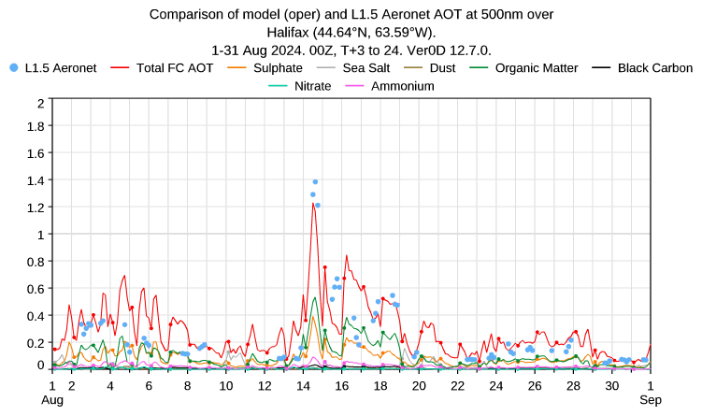
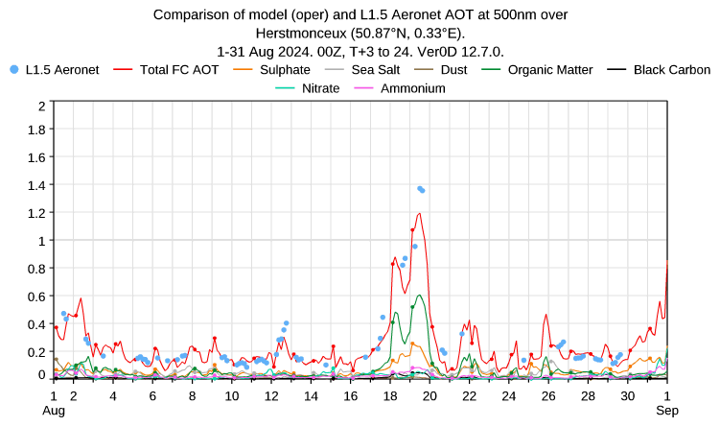
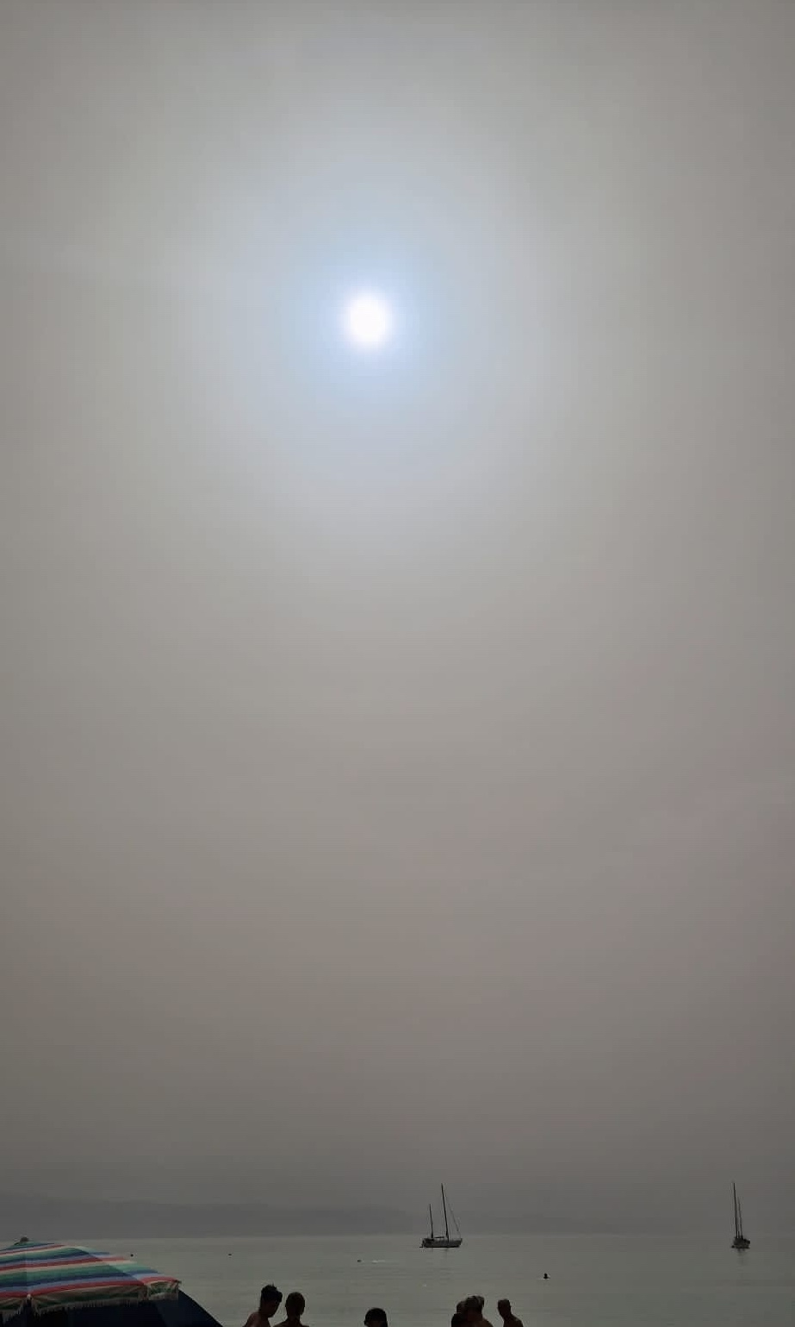
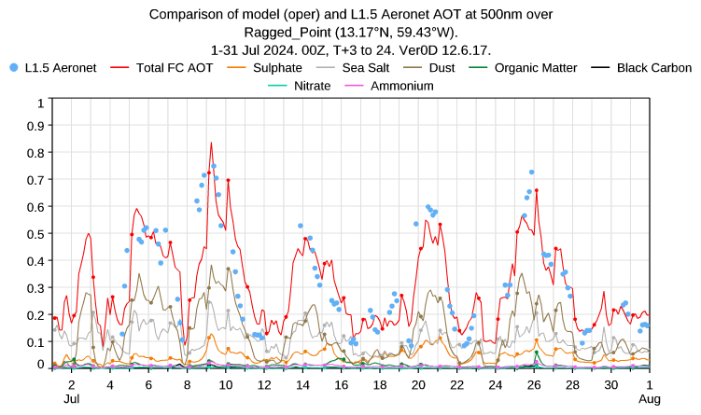
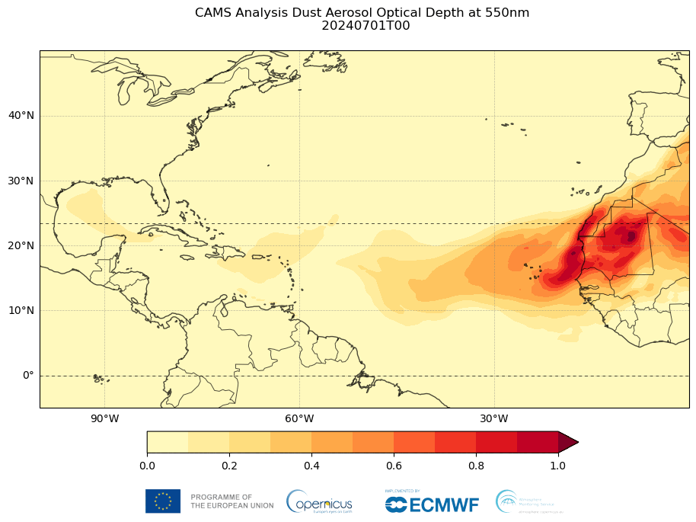
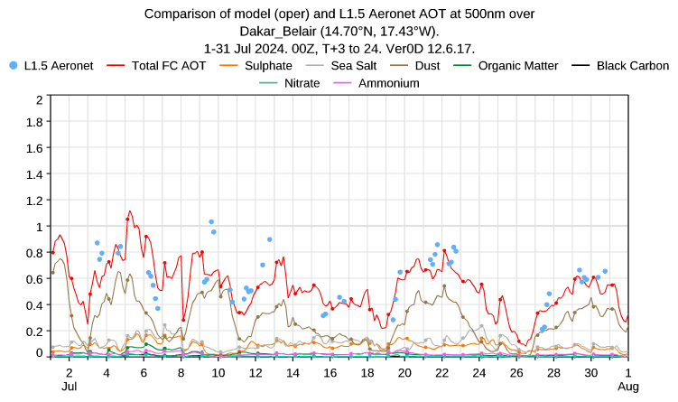
Monitoring transboundary air pollution events
Wildfires (August 2024)
Dust (July 2024)

Slide 13
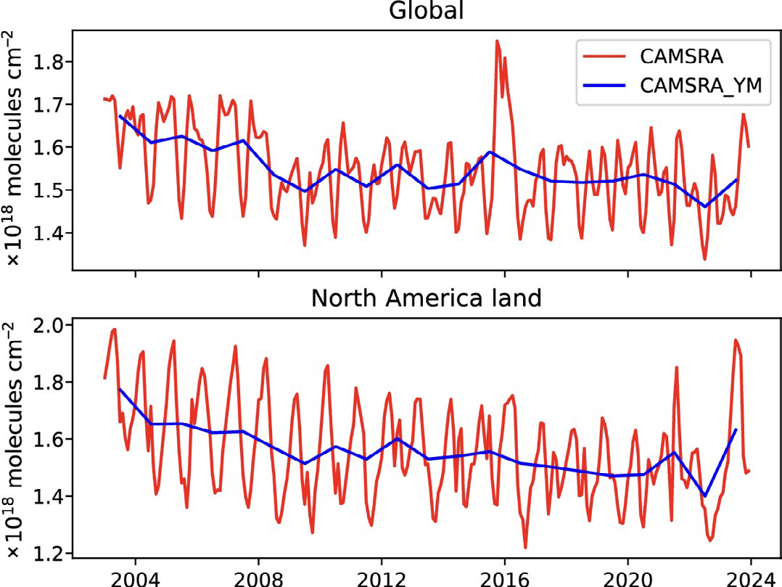
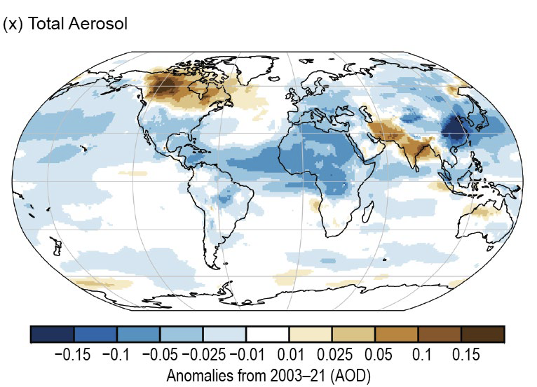
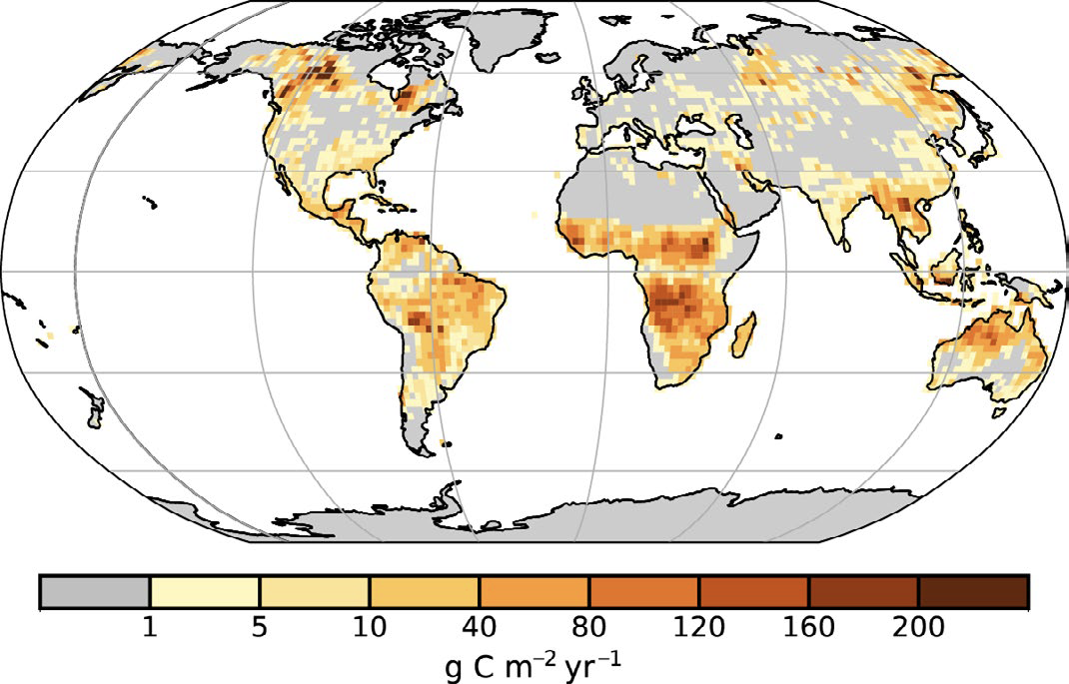
Global reanalysis of atmospheric composition (EAC4)
The atmosphere datastore now contains a full 22-year global re-analysis dataset for reactive gases and aerosol (EAC4).
The re-analysis takes stock of all available observation datasets using a fixed version of the CAMS forecast model. It is the BEST ESTIMATE of atmospheric composition patterns and evolution over the last two decades.
https://ads.atmosphere.copernicus.eu/datasets/cams-global-reanalysis-eac4?tab=overview
Total aerosol
Carbon monoxide
CAMS contributes to the BAMS State of the Climate with detailed information on carbon monoxide, aerosols and fire emissions.
17
Fire emissions
Inness et al. 2019, https://doi.org/10.5194/acp-19-3515-2019

Slide 14
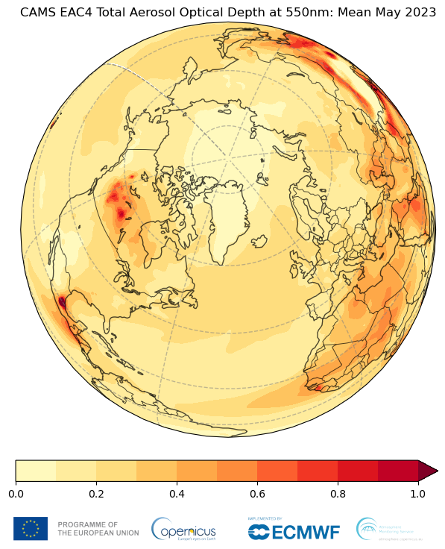
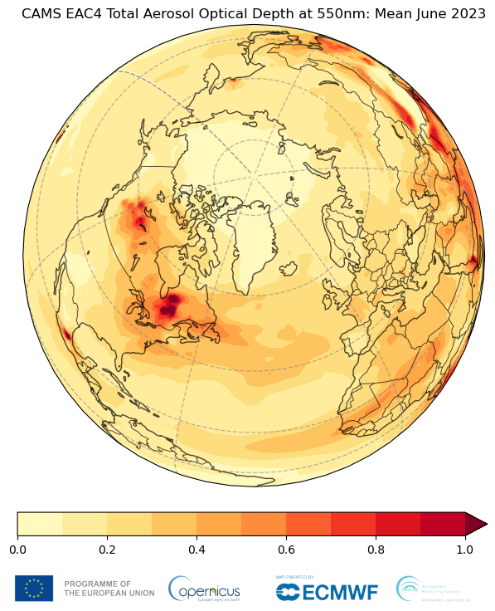
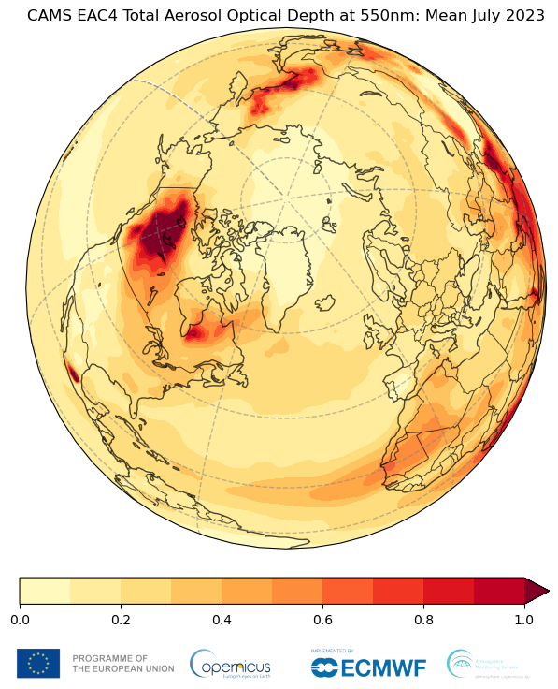
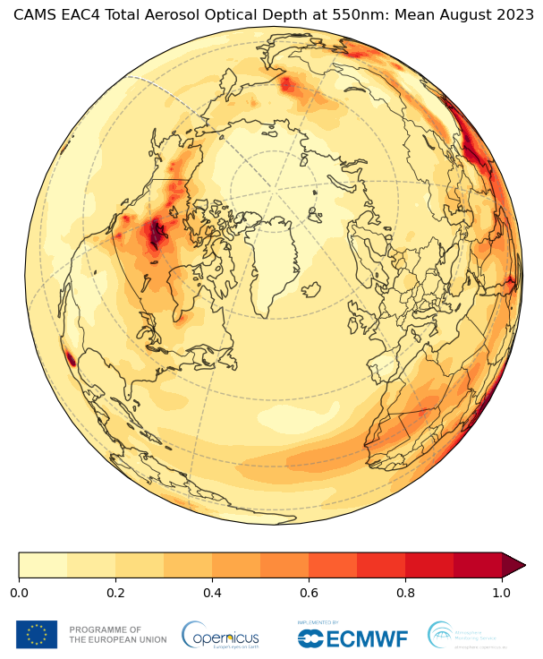
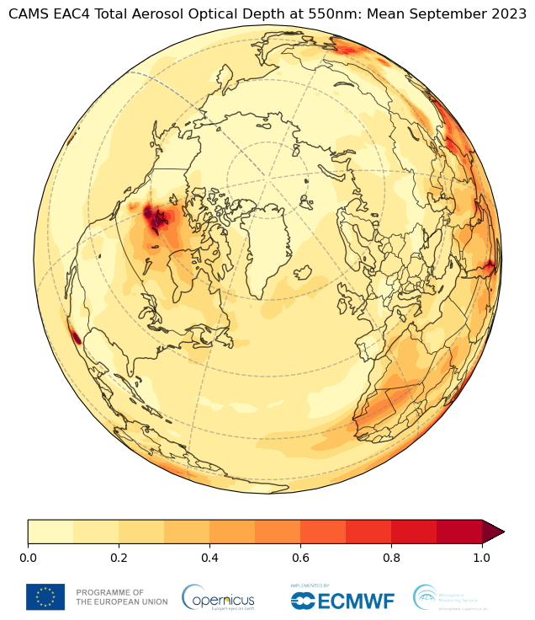
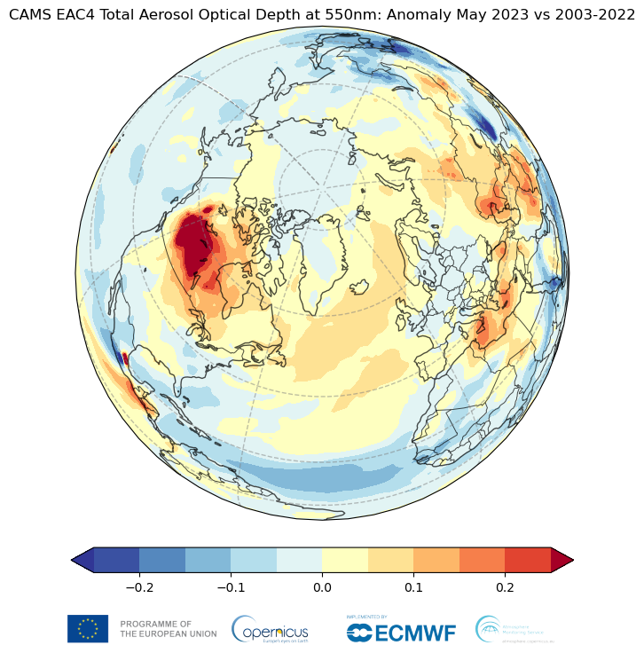
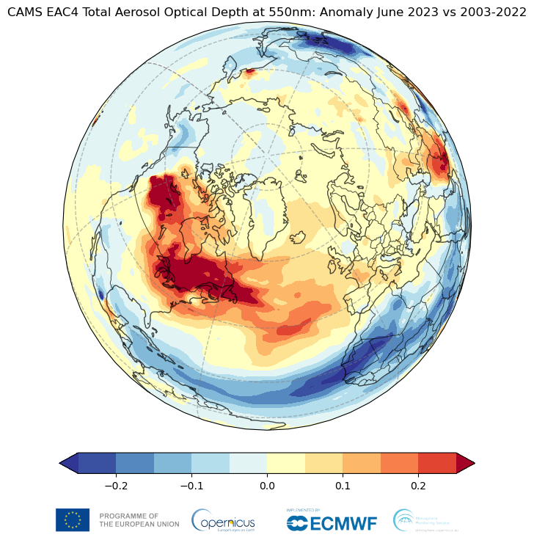
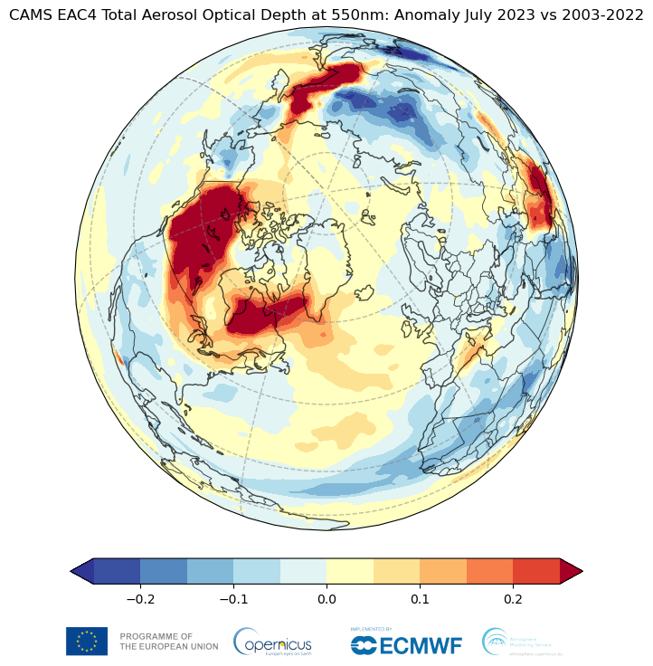
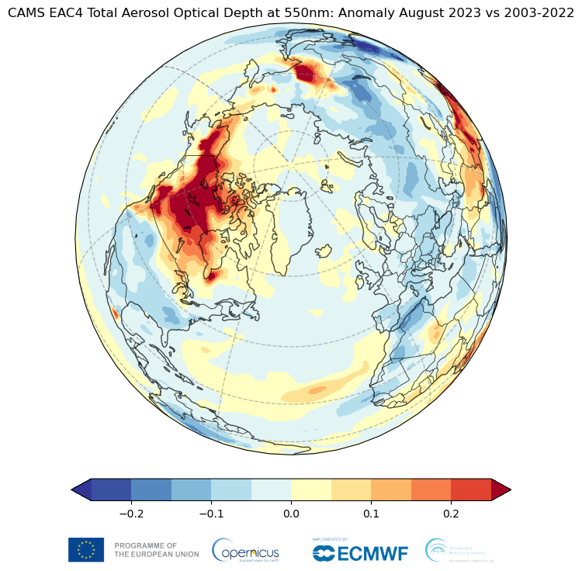
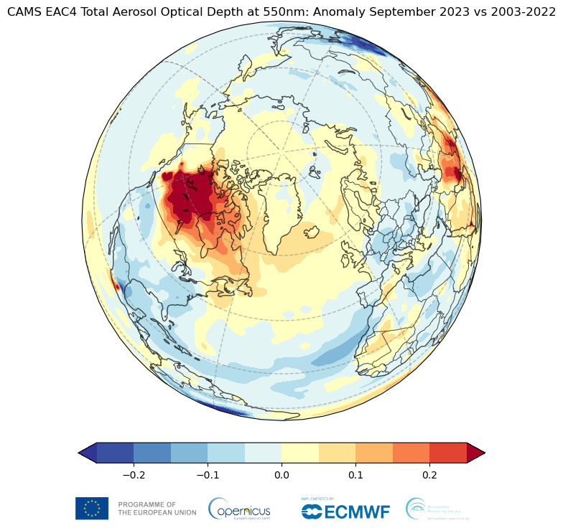
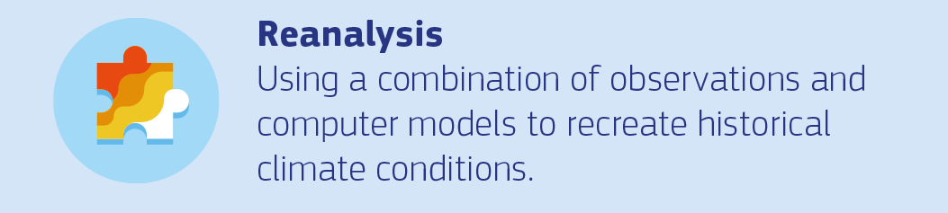
2023 monthly mean AOD anomalies
May
June
July
August
September
Monthly mean AOD
Monthly mean AOD anomaly
Inness et al. 2019, https://doi.org/10.5194/acp-19-3515-2019

Slide 15
The new global reanalysis of atmospheric composition (EAC5)
A new CAMS reanalysis of global atmospheric composition (EAC5) is being prepared to incorporate updated modelling and observations.
Key updates include:
  Increased horizontal and vertical resolution (40 km, 137 levels)
  Stratospheric chemistry of BASCOE CTM ( +60 species)
  Secondary aerosols (Nitrates, Ammonium, SOA)
  Online biogenic VOC emissions scheme
  Improved modelling approach for aerosol and chemistry as of IFS cycle 49r1 (EQSAM4Clim, updates of dry and wet deposition and dust and sea salt fluxes)
  New assimilated retrievals of atmospheric composition:
    Sentinel 5P (Ozone, NO2, SO2, CO)
    AOD from VIIRS and Sentinel 3
  Anthropogenic emissions from the CAMS-GLOB-ANT M1 mosaic
  1 hourly temporal resolution
Start in Q2/Q3 2025 with completion in 2028

Slide 16
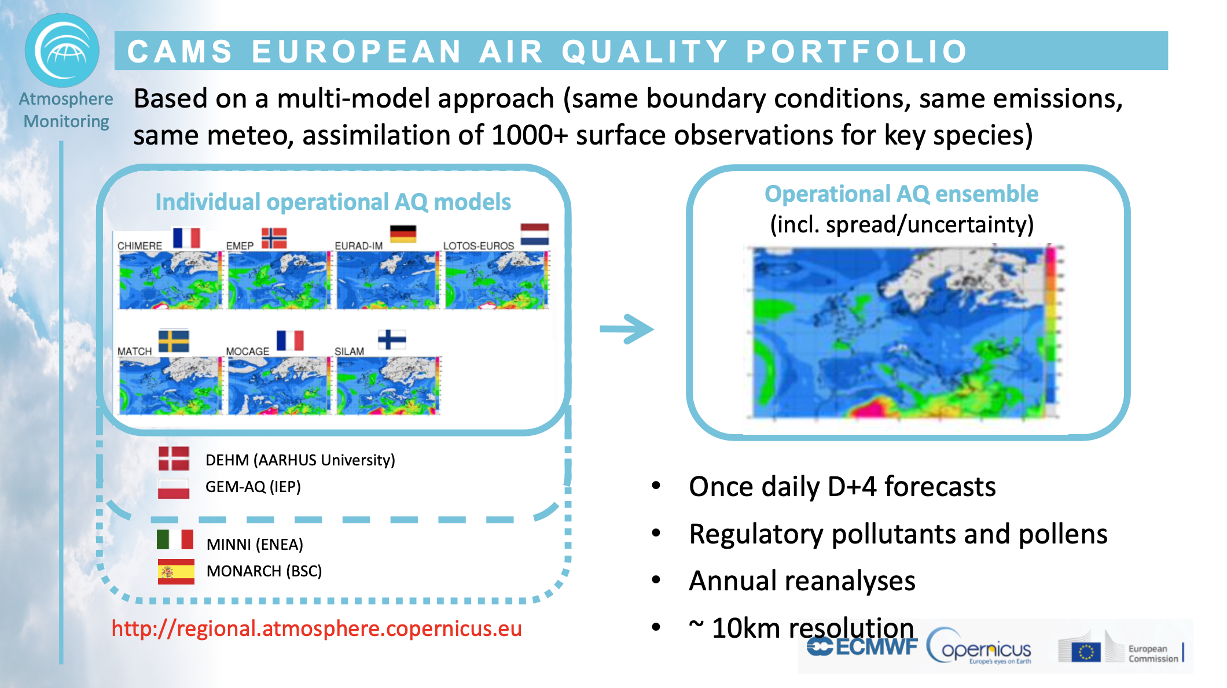

Slide 17
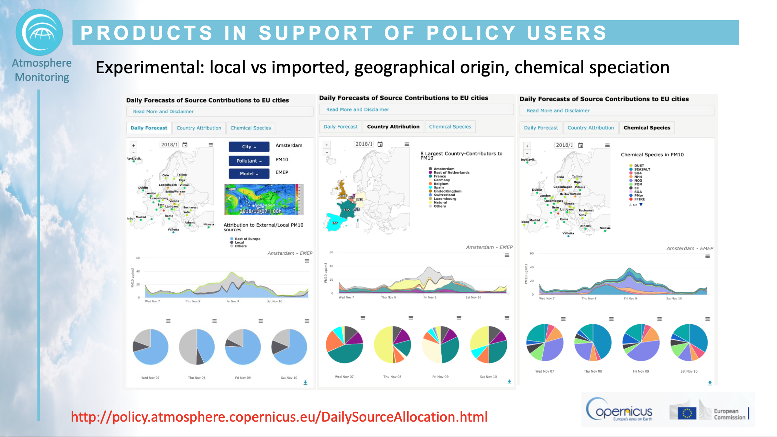

Slide 18
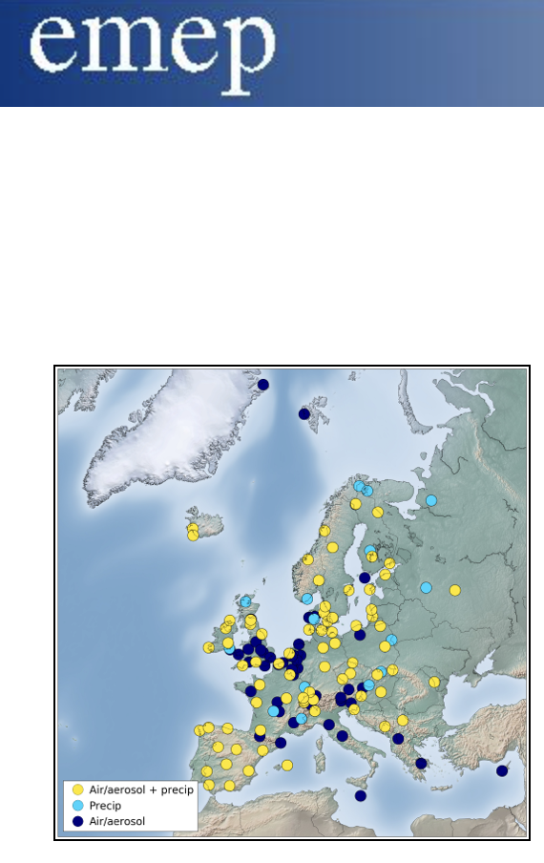


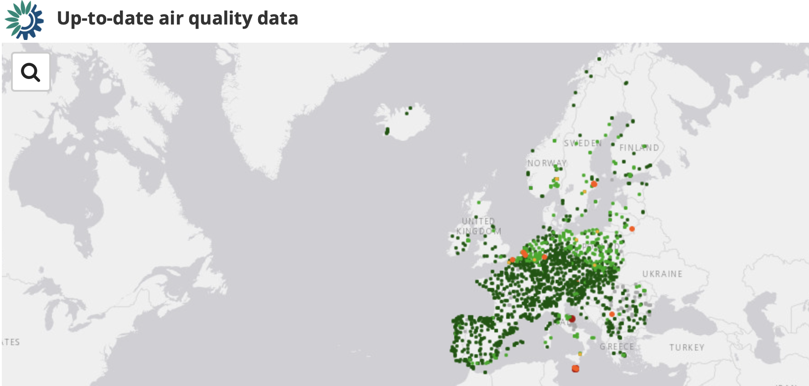


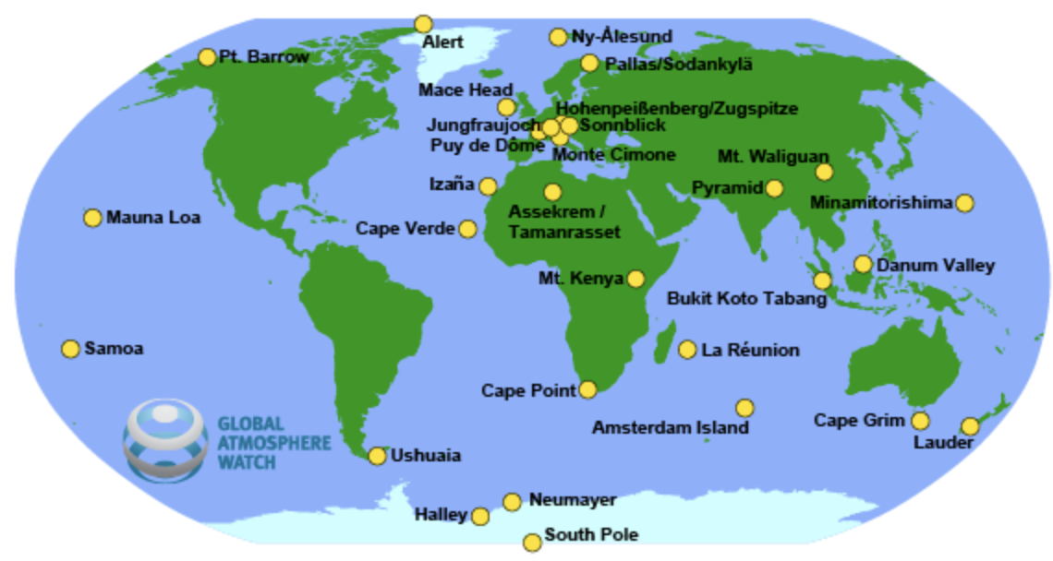
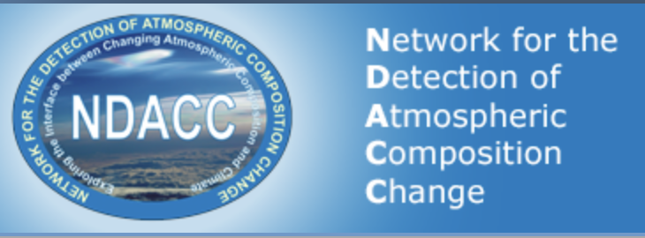




Maximised use of in-situ observations
Collaboration with the EEA

Slide 19






CAMS support to international activities
5

Slide 20
Summary
CAMS provides operational forecasts, analyses and reanalysis of 3-D global atmospheric composition based on Earth Observation data.
  Operational regional air quality forecasts for Europe take background atmospheric composition as lateral boundary conditions from the global outputs.
Routine monitoring of the CAMS products is performed to analyse changes in atmospheric composition including wildfire smoke, desert dust, volcanic eruptions and air pollution episodes.
All data are fully open access and supported by routine evaluation and quality control against independent measurements.

Slide 21

Copernicus EU
@copernicusecmwf
Copernicus ECMWF
Copernicus EU
Copernicus ECMWF
@CopernicusEU
@CopernicusECMWF
www.copernicus.eu
atmosphere.copernicus.eu
@copernicusecmwf.bsky.social
Thank you for your attention !

