Slide 1
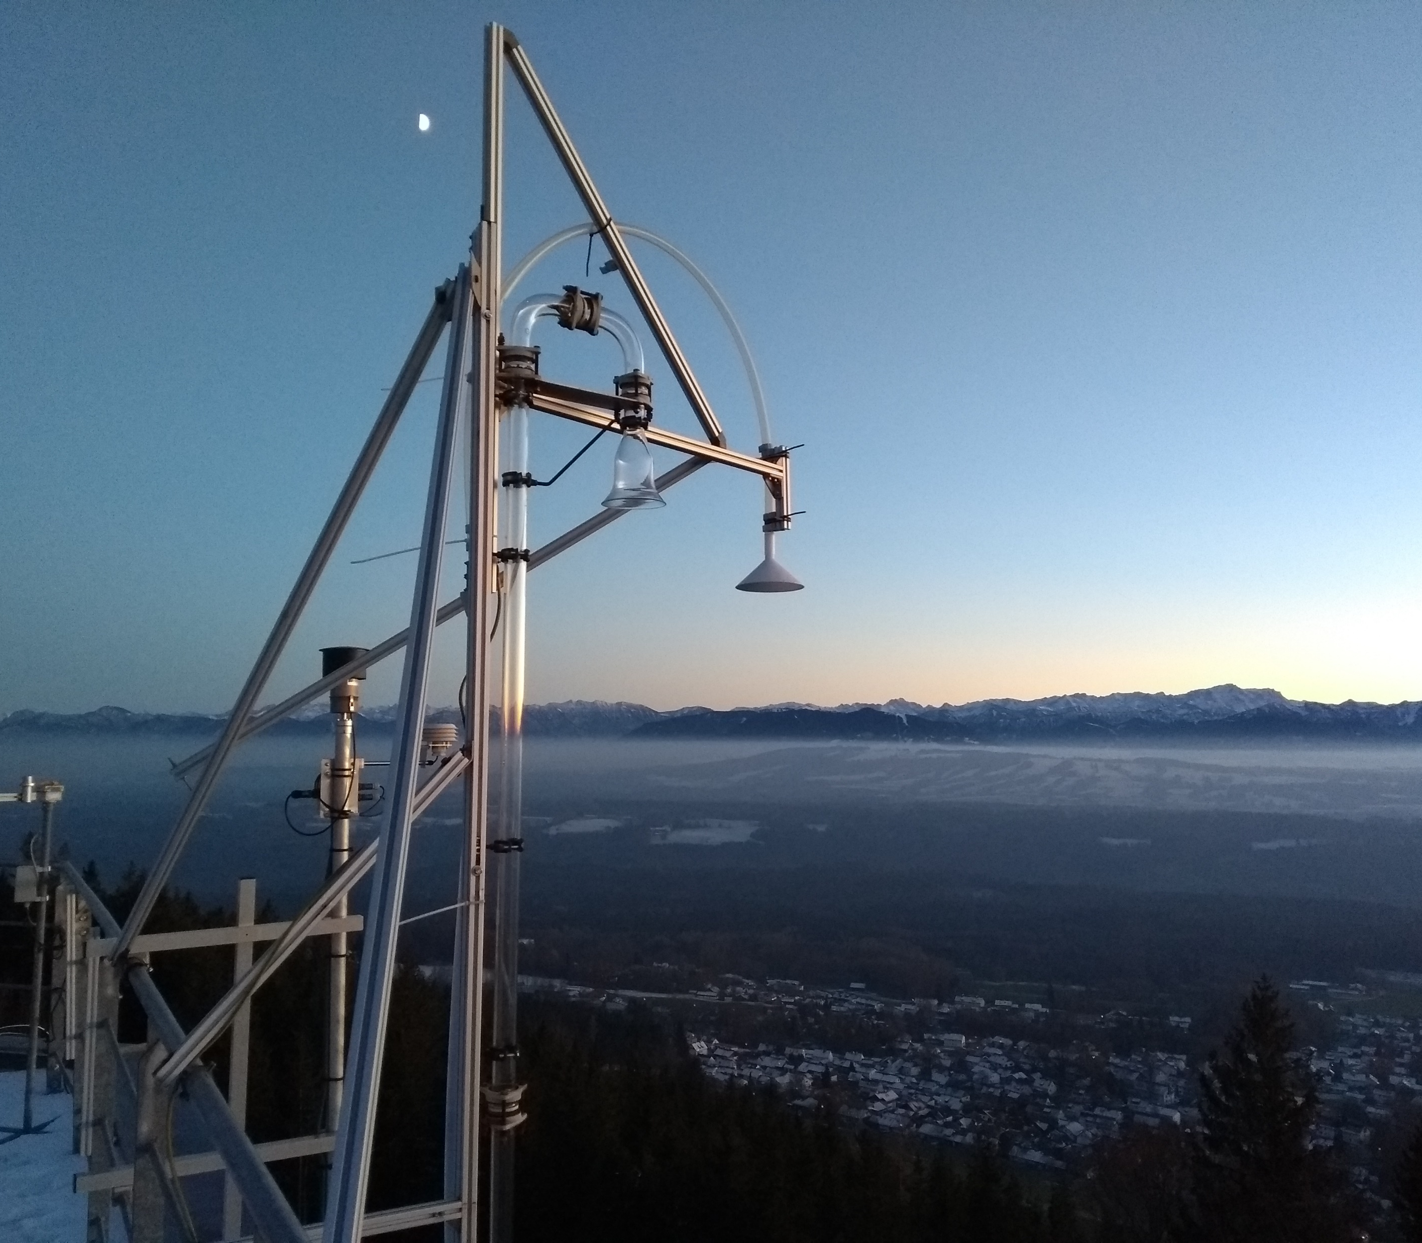

Status and data availability from IMP 2022/2024
Wenche Aas,, Therese Salameh, Heidi Hellén, Marvin Dufresne, Jean-luc Jaffrezo, Pontus Roldin, Sverre Solberg, Svetlana Tsyro, Robert Wegener, Karl Espen Yttri et al.
Foto: Anja Claude (DWD) from Hohenpeißenberg.

Slide 2
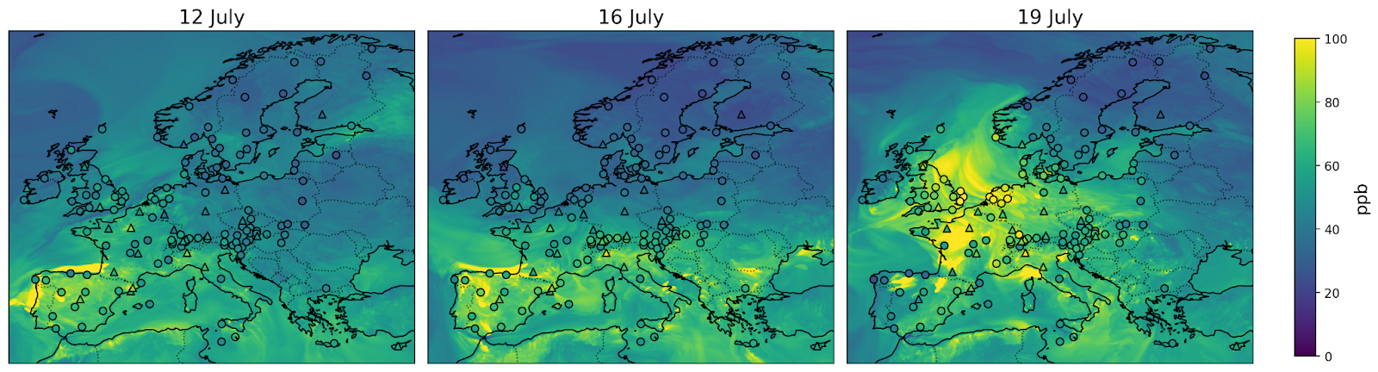
Ozone developing during the heat wave in 2022 (daily max)
The summer of 2022 in Europe was, at the time, the warmest on record. Severe drought. Hot polluted air masses in Norwest Europe in the end of the week
EMEP model with an average bias for ozone daily maxima with 8%
  slightly higher overestimation (11%) at low concentration sites (below 50 ppb)
  slightly underestimating (-3%) at high concentration ( above 80ppb)

Slide 3

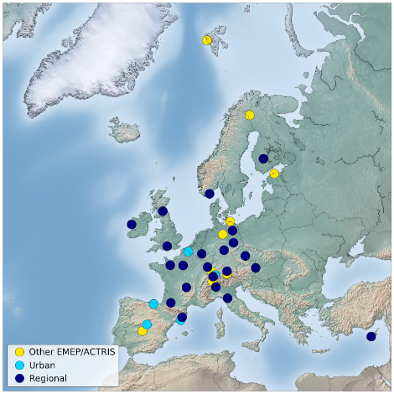
Overview of measurements during July 2022 campaign
30 sites, of these 17 sites measured all VOC groups (NMHCs, Aromatics, O-VOCs, monoterpenes) while 23 sites analyzed organic tracers.
More than 120 VOC species and 47 tracers
All VOCs averaged to 12-16 UTC
A draft paper is in progress to be submitted before the summer
  Aim to describe the effect this heatwave had on the VOC, ozone and PM levels

Slide 4
Data selection (several method measure same compounds)
Non-Methane Hydrocarbons (NMHC):
  C2–C6 range: Data from canisters and monitors were used. Monitor data were prioritized
  C7–C12 Range: Data from Tenax tubes and GC/FID monitors were used. Monitor data were prioritized
Aromatic hydrocarbons.
Data were collected from canisters, Tenax tubes and monitors. Monitor data was prioritized. Benzene and toluene data from canisters were prioritized before Tenax tubes, while Tenax tubes for the other aromatic compounds.
Terpenes:
Monoterpenes were collected from Tenax tubes and PTR-MS. Tenax tube data were prioritized
Sesquiterpenes data were exclusively taken from Tenax tubes.
Oxygenated VOCs:
Data were collected from DNPH cartridges, GC/FID and PTR-MS. DNPH data were prioritized.
Chemical speciation of aerosols and tracer analysis.
  The tracer analyses were all done at the same laboratory.
  The PM mass and EC/OC were also measured as part of the regular EMEP monitoring. These data are prioritized

Slide 5
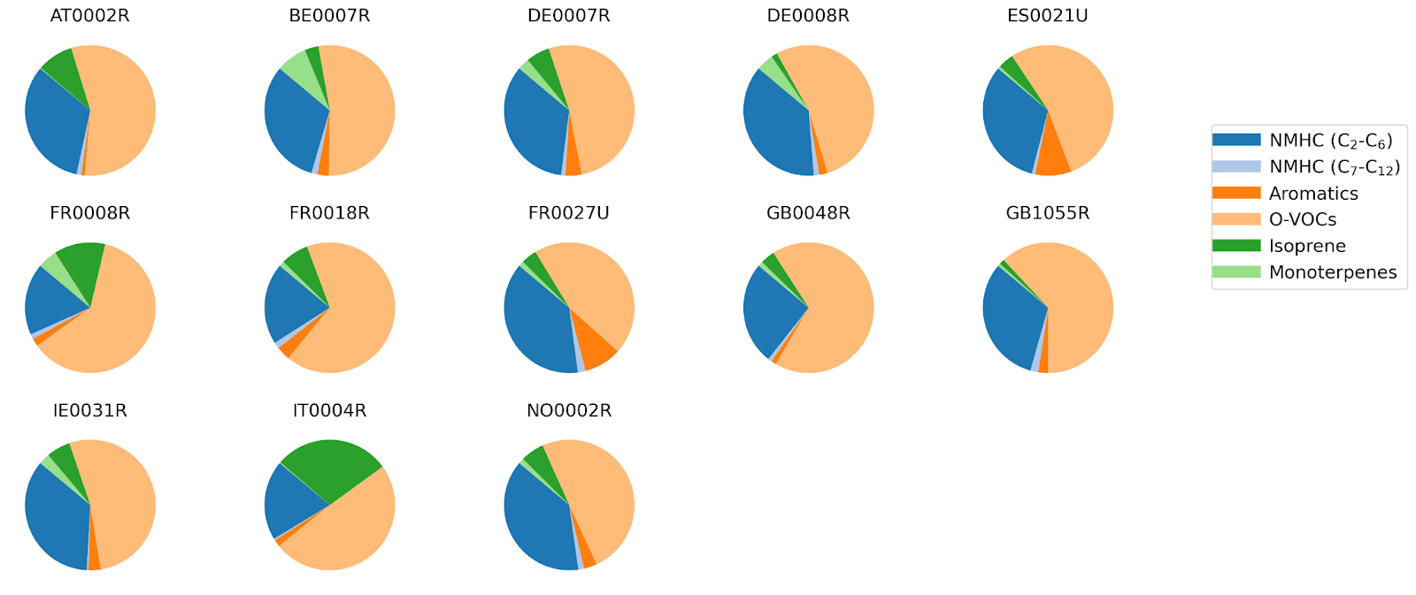
Relative contribution of different VOCs
Notes:
O-VOCs and C₂-C₆ NMHCs were found to dominate the total VOC concentrations at most locations, particularly when isoprene was included as part of the NMHC group. Notably, isoprene levels were exceptionally high at Ispra (IT0004R).

Slide 6
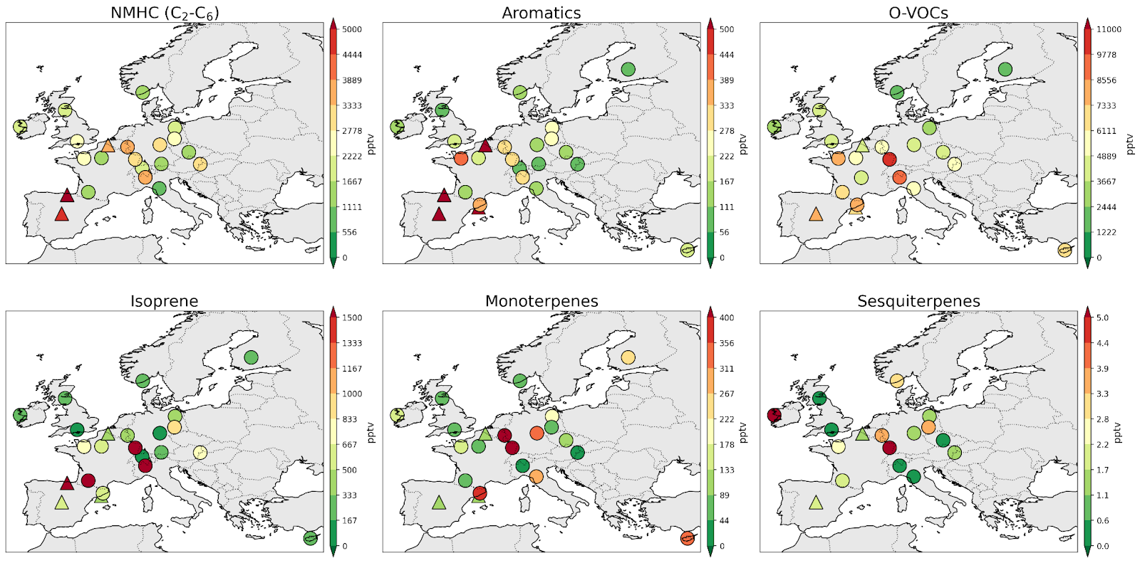
Average concentration for the IMP week (12-19 July 2022 )

Slide 7
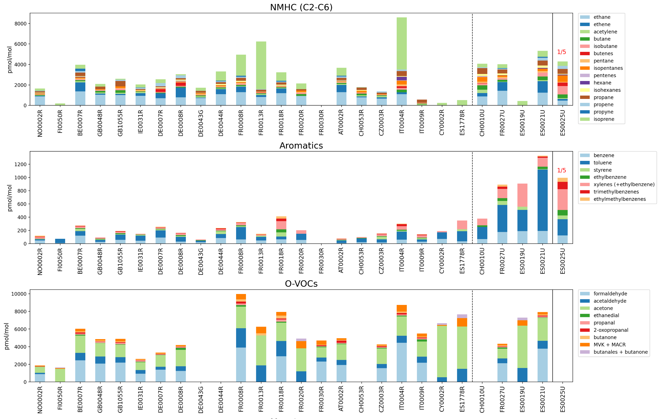
VOC speci- ation

Slide 8

Terpenes

Slide 9
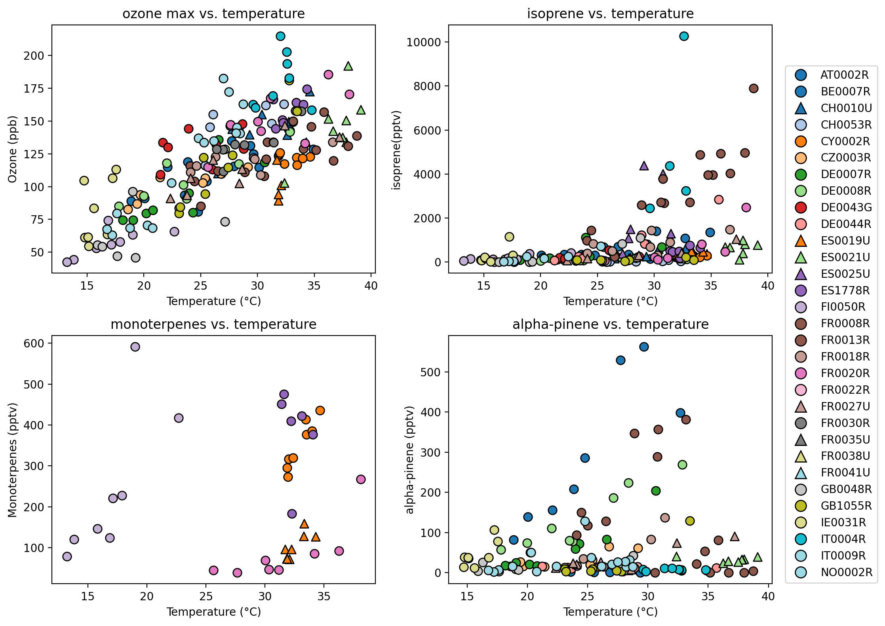
Ozone and biogenic VOCs vs temperature

Slide 10
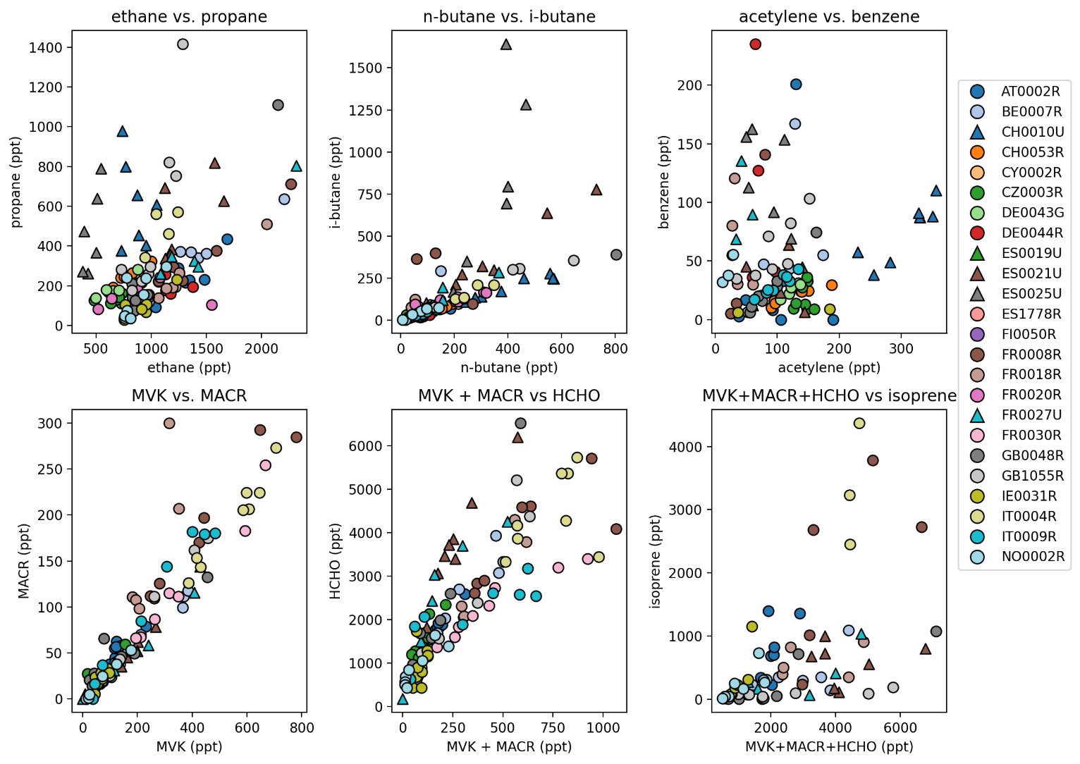
O-VOCs related to isoprene
Isoprene methacrolein (MACR) and methyl vinyl ketone (MVK)
MACR and MVK formaldehyde (HCHO)
Madrid higher HCHO –closer to primary combustion sources
Ispra and Donon higher isoprene – photochemistry not progresses suffiently
Site variations suggesting varying ages of air masses from emissions of biogenic sources.

Slide 11
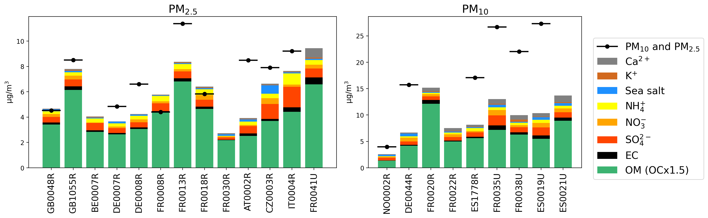
PM speciation
Organic aerosols dominant PM: 28± 5 % PM₁₀ and 61± 20% of PM_{2.5}

Slide 12
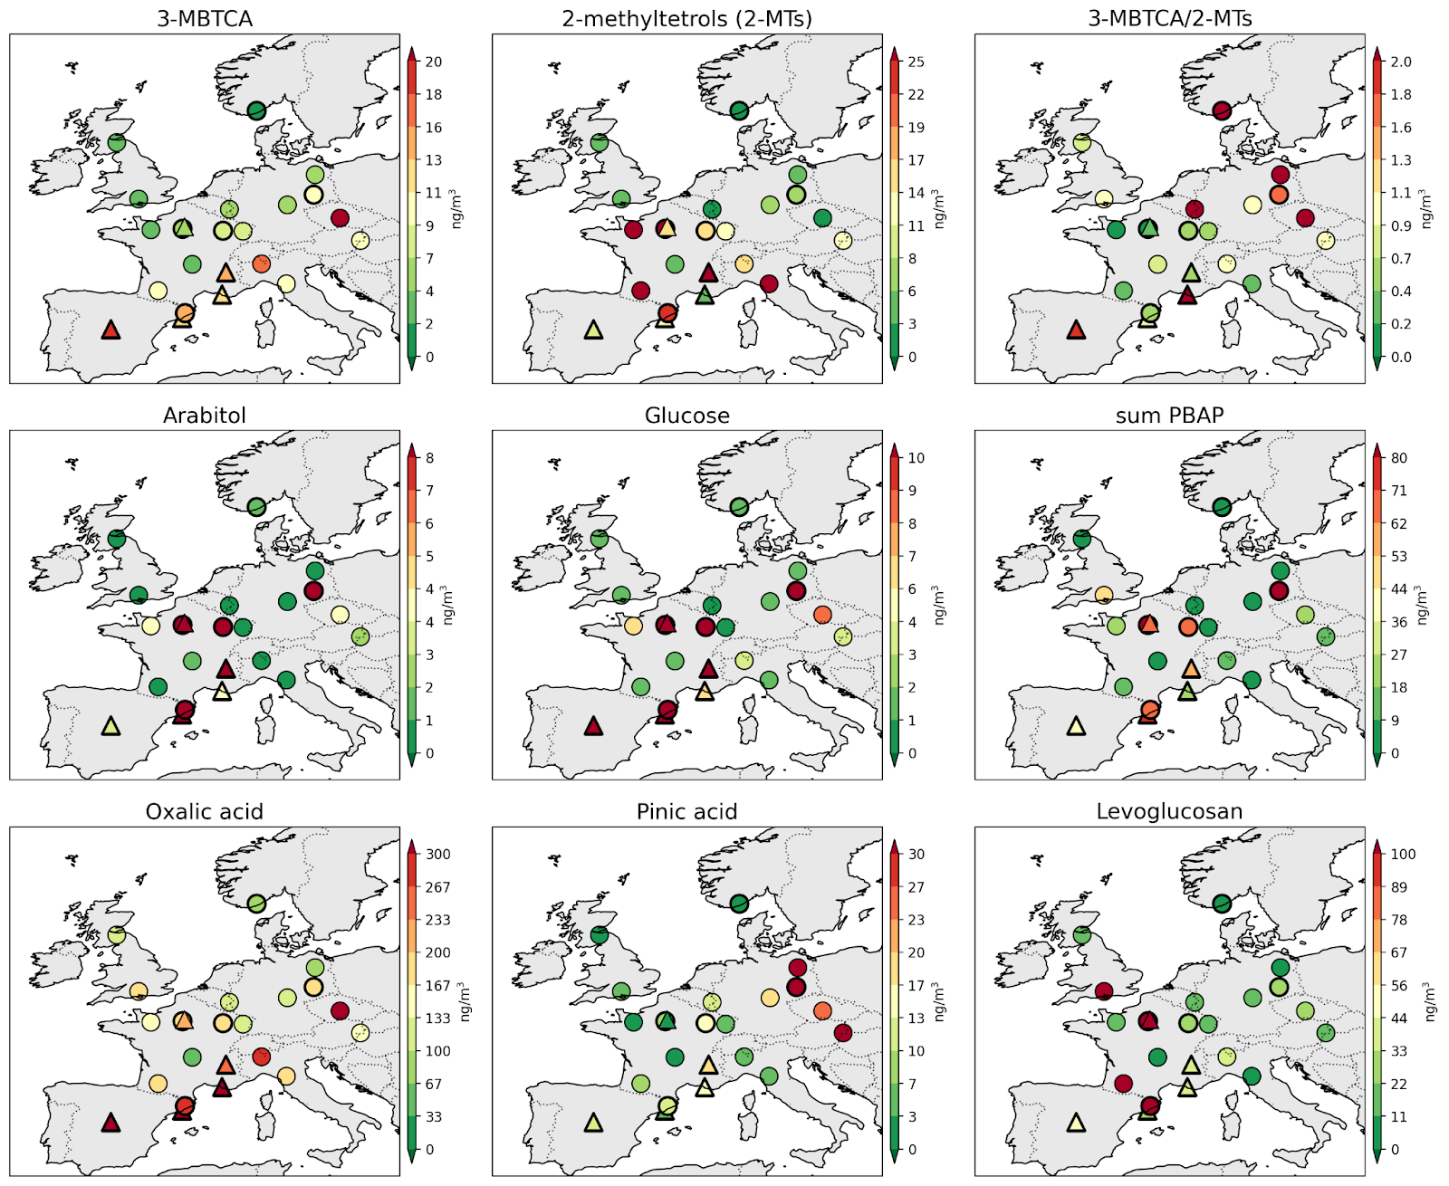
Tracers used for assessing the importance of sources
Biomass burning(BB)
BSOA from α-pinene
Primarly biological aerosols (PBAP)

Slide 13
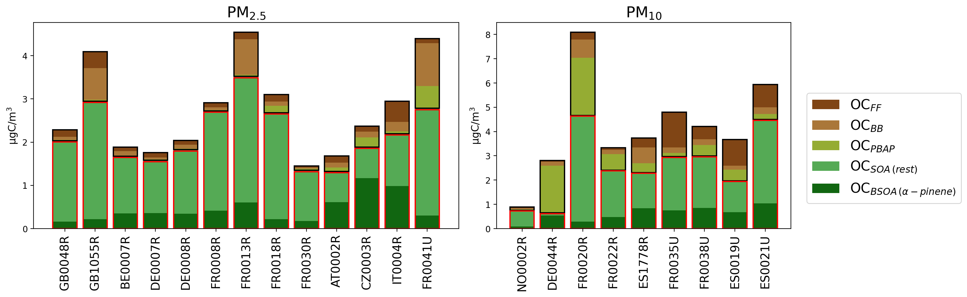
OC sources, tracer method (PRELIMINARY)
Notes:
OC_{BB} was estimated using levoglucosan x4.7
OC_{FF} was calculated as from a OC primary factor x EC – OC_{BB}
OC_{PBAP} was calculated using the sum of the three PBAP tracers (arabitol, mannitol, glucose) x14.6
BSOA from α-pinene oxidation (OC_{BSOA α-pinene}) was estimated using concentrations of 3-MBTCA x57
The remaining OC, referred to as OC_{SOA rest,} from the oxidation of isoprene and anthropogenic emissions.

Slide 14
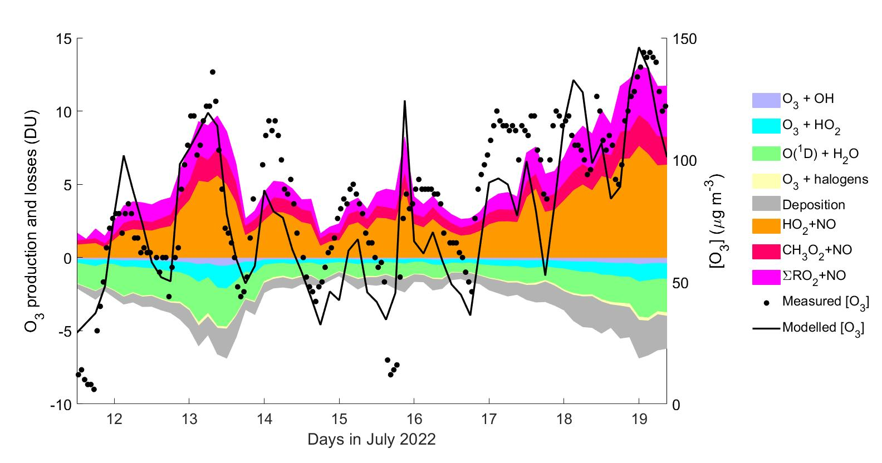
The importances of various VOCs on ozone and SOA formation
Most of the sites in this study are in background areas, and the most potent ozone- and SOA- forming VOCs especially from anthropogenic sources may already have undergone atmospheric reactions.
Ongoing modelling work (ADCHEM ) to assess:
  aerosol formation and growth (left)
  ozone formation and sinks on the air trajectories reaching the sites (right)
PRELIMINARY. Example Vielsalam:

Slide 15
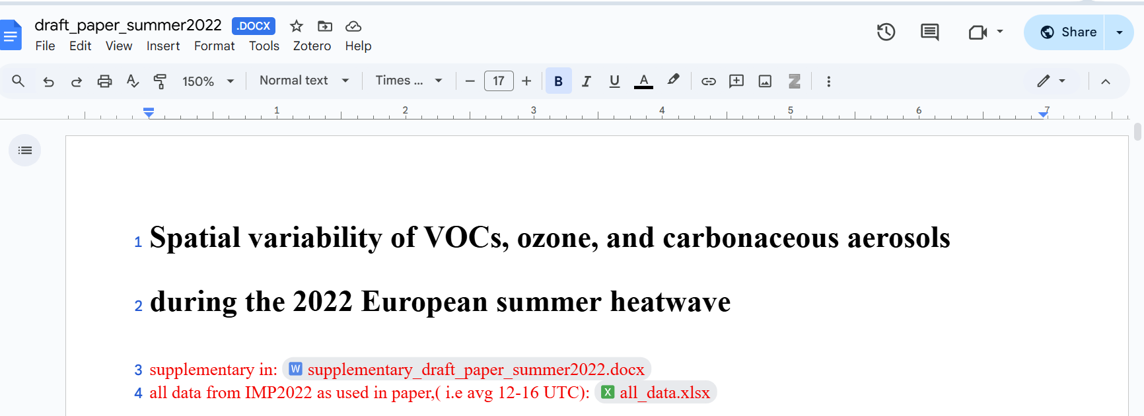
Draft paper available in shared document

Slide 16


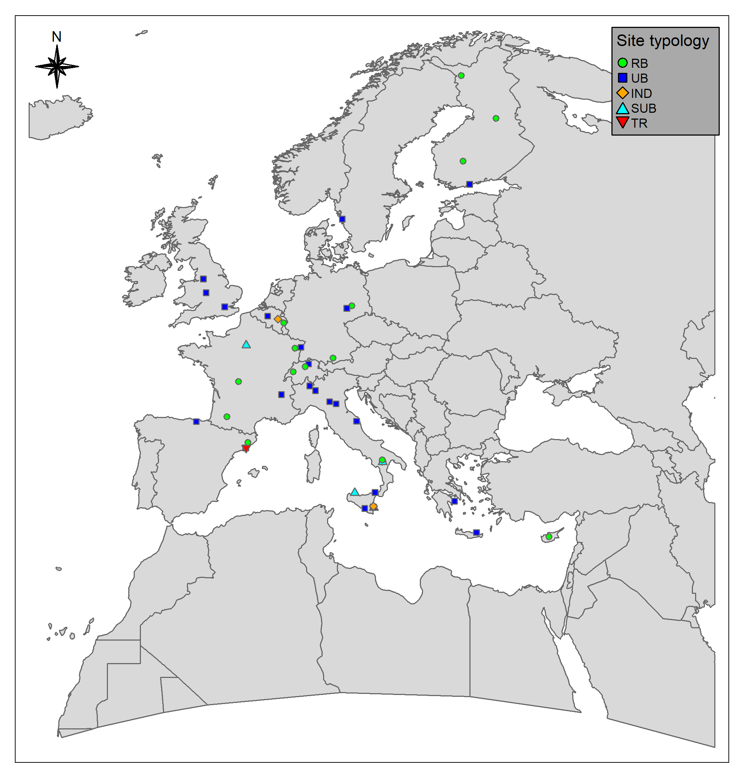
“EUROVOC: EUROpe-wide intensive campaign on Volatile Organic Compounds”
2nd pan European intensive measurement period (IMP) on VOCs organized by the TFMM-EMEP/ACTRIS/RIURBANS
To gain deeper insights into VOC emissions, including their temporal development and speciation, by deploying high-resolution measurements at sites near emission sources (e.g., urban, industrial, traffic, harbour, and forest areas)
Period: 1 month - September 2024
46 urban and rural sites across Europe (ACTRIS NF, EMEP, GAW, Local Air Quality Monitoring Networks, ACTRIS/ICOS sites): 16 regional background and 30 urban and suburban, mainly background
Collaboration with instrument manufacturers
Contact: Thérèse Salameh

Slide 17
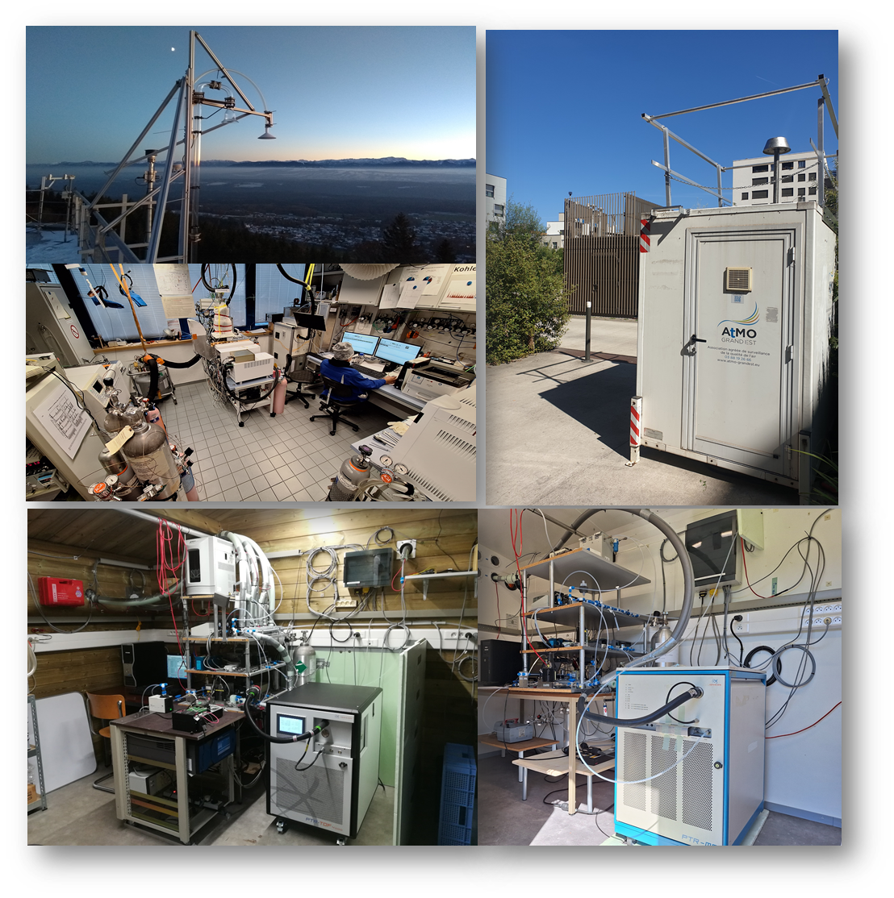
“EUROVOC: EUROpe-wide intensive campaign on Volatile Organic Compounds”
2nd pan European intensive measurement period (IMP) on VOCs organized by the TFMM-EMEP/ACTRIS/RIURBANS
Data submission status: data from 32 sites received or directly submitted to EBAS (for ACTRIS sites)
Online measurement at all the sites with additional offline measurements, including 14 sites with PTR-MS
From the received data: 14 sites measured OVOC and 1 site measured terpenes
O₃ and NO_{x} also measured at the majority of the sites and more compounds at some sites : PM, CO, CO₂, CH₄…
Figure : Overview of participant sites (Photos: ACTRIS NF (Hohenpeissenberg - Allemagne), AASQA (Atmo Grand Est – France), EMEP/ICOS/ACTRIS NF (Vielsalm & Space Pole sites - Belgique )

Slide 18
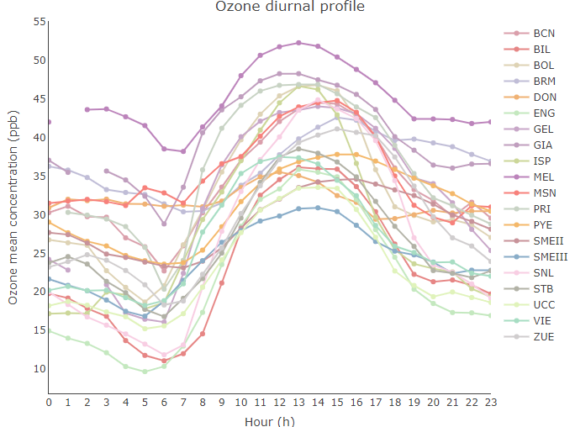
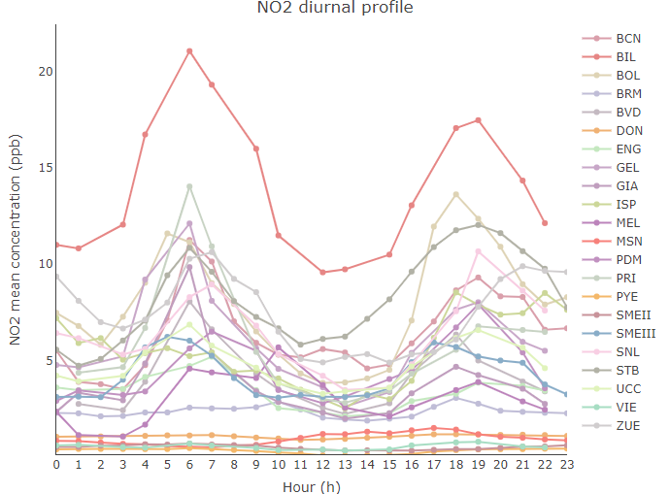
Preliminary results: Ozone & NO₂ diurnal profiles observed at many sites

Slide 19
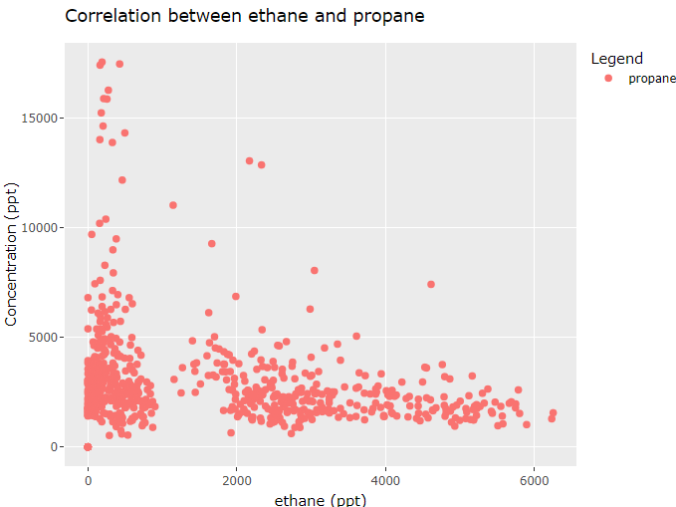
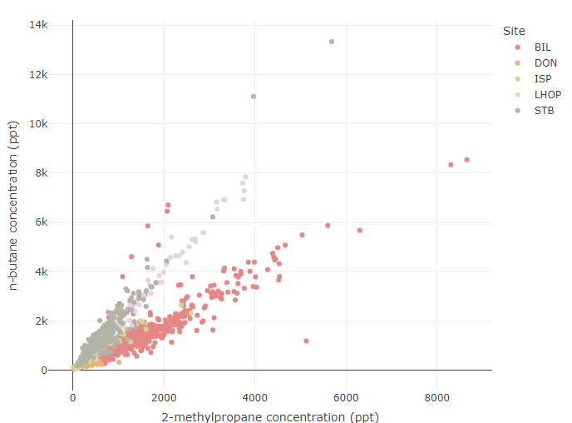
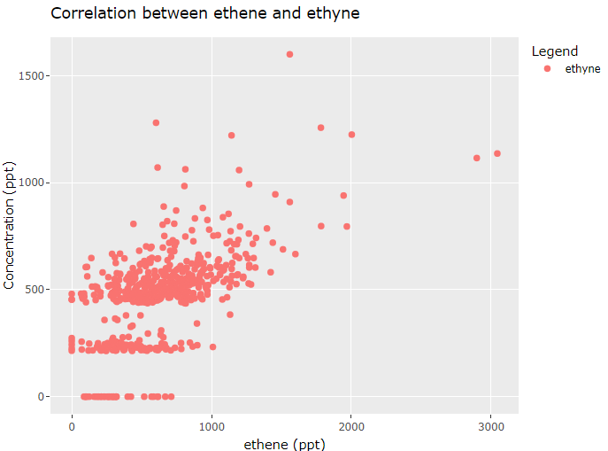
VOC QA/QC assessment
QA/QC done for all received data: in general good quality of the data
… But data from some sites have to be strongly investigated before their submission in EBAS

Slide 20
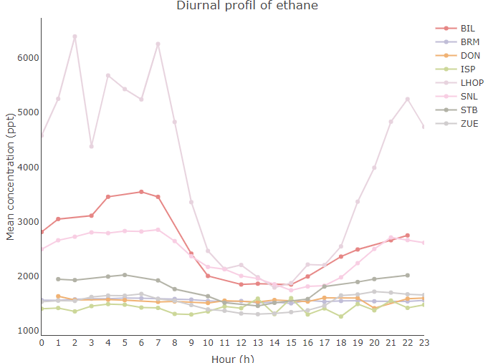
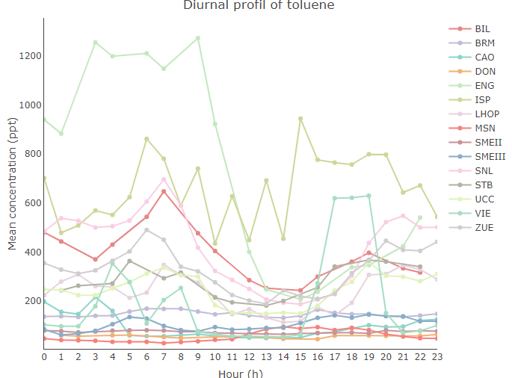
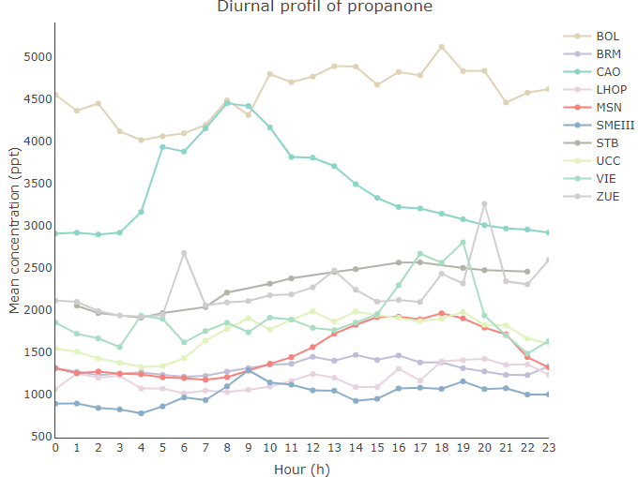
Diurnal variability of VOC to be checked after final validation
Perspectives:
-Data QA/QC evaluation => submission to EBAS
-PhD of Félix Moreau at IMT Nord Europe – Jan. 2025:
« DéCOV : Déterminants de la variabilité spatio-temporelle dans l'air ambiant extérieur des Composés Organiques Volatiles : impact sur l'ozone et l'aérosol organique secondaire ».
-PhD of XX?? at IMT Nord Europe – Oct. 2025:
“Observation-based evaluation of the factors influencing ozone formation across Europe”

Slide 21
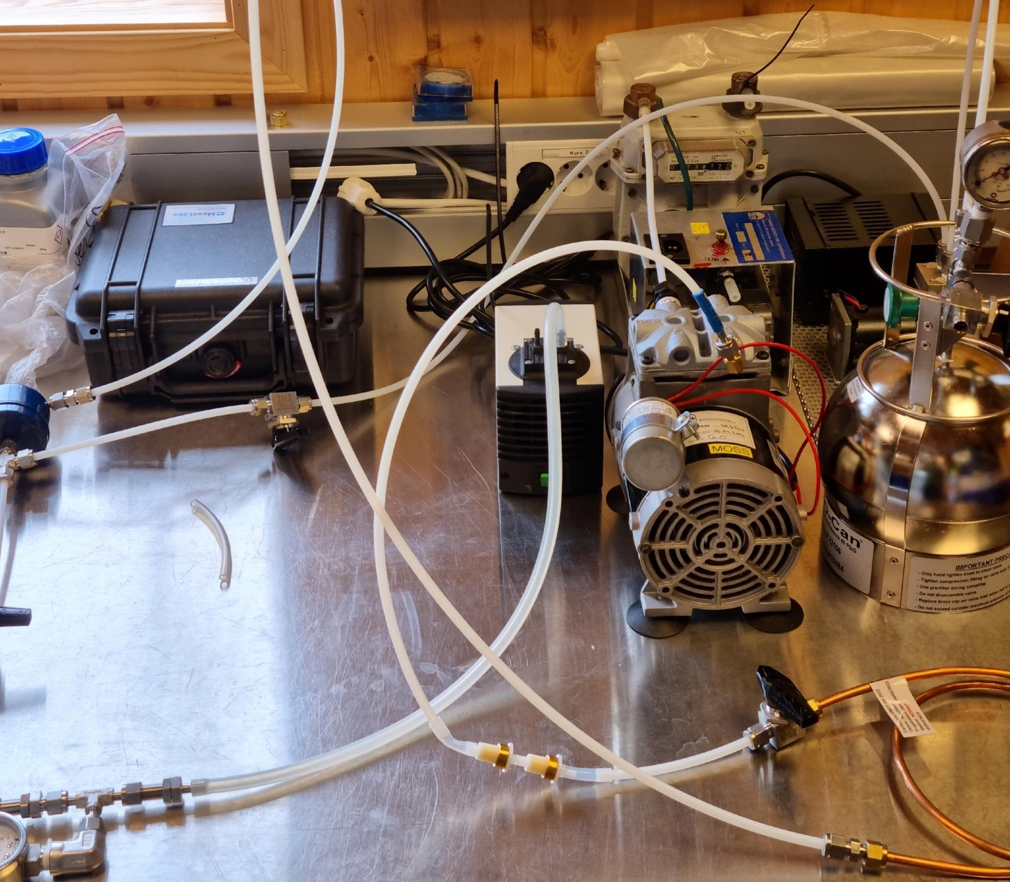
Thank you!
THANK YOU

