Slide 1

July 2022 Modelling Exercise (O₃/VOC)- preliminary results
Institution | Model
FMI | SILAM
IOS-PIB | CAMx
IOS-PIB | GEM-AQ
METNO | EMEP
UKCEH | EMEP4UK
EMPA | ICON-ART
BSC | MONARCH
CIEMAT | CHIMERE_13
CIEMAT | CHIMERE_23
INSERIS | CHIMERE_23
ENEA | MINNI_M
ENEA | MINNI_P
Contributions from Modelling Teams:

Slide 2
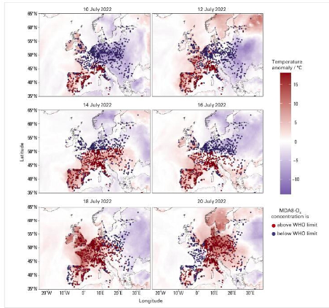
Intensive Measurement Period 12-19 July 2022
WMO Air Quality and Climate Bulletin no. 3
(September 2023)

Slide 3
Science questions for the 2024-2025 period (1)
How biogenic and anthropogenic VOCs contribute to ozone formation episodes across Europe:
  How well do models reproduce ozone variability and levels?
  How well do models reproduce VOC variability and levels?
  How to compare modelled and observed VOC species?
  How to deal with VOC emissions in the models?
  Common approach for ozone regime analysis
Feedback to decision makers:
How much can VOC mitigation impact the reduction of ozone episodes and background ozone levels
%

Slide 4
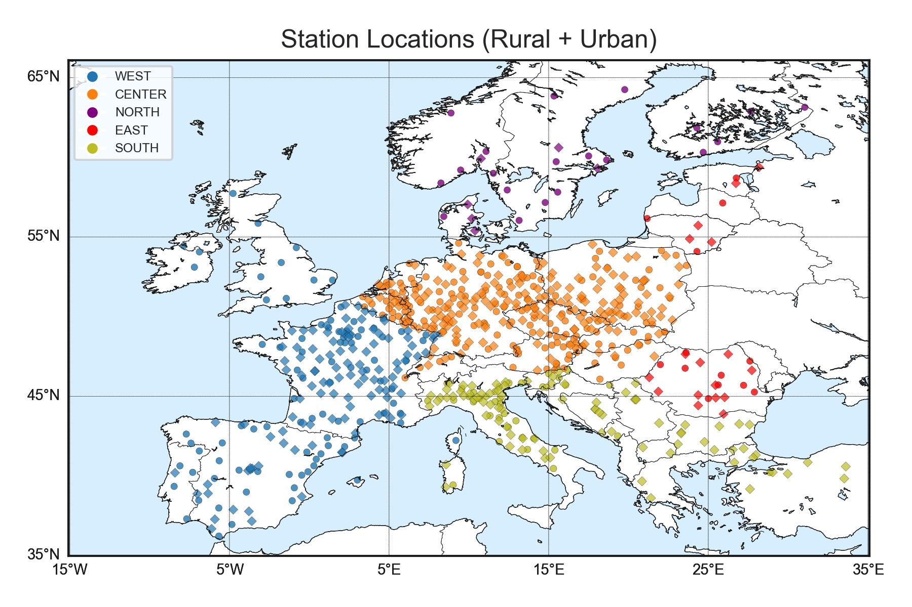
Analysis: stratification by periods and regions
  Geographical distribution – 6 regions:
  Europe,
  CEU (173),
  WEU (89),
  EEU (14),
  NEU (23),
  SEU (33)
  Temporal distribution – 6 periods:
  1 - 31/07 (month)
  12 - 19/07 (campaign)
  1 - 7/07 (week #1)
  8 - 15/07 (week #2)
  16 - 22/07 (week #3)
  23 - 31/07 (week #4)

Slide 5
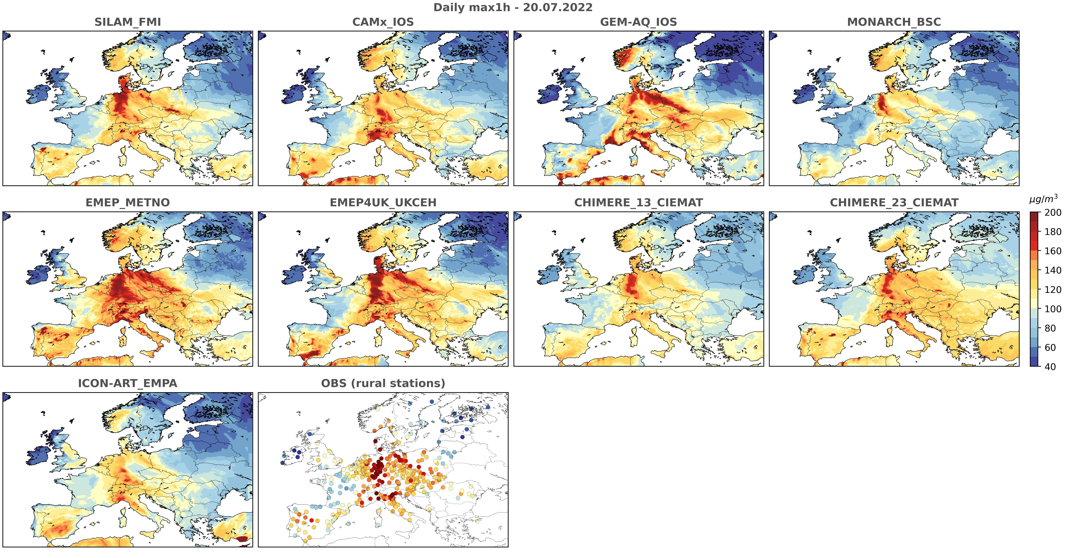
The general pattern of ozone evolution was similar across all models, largely driven by meteorology, but there were significant regional differences

Slide 6
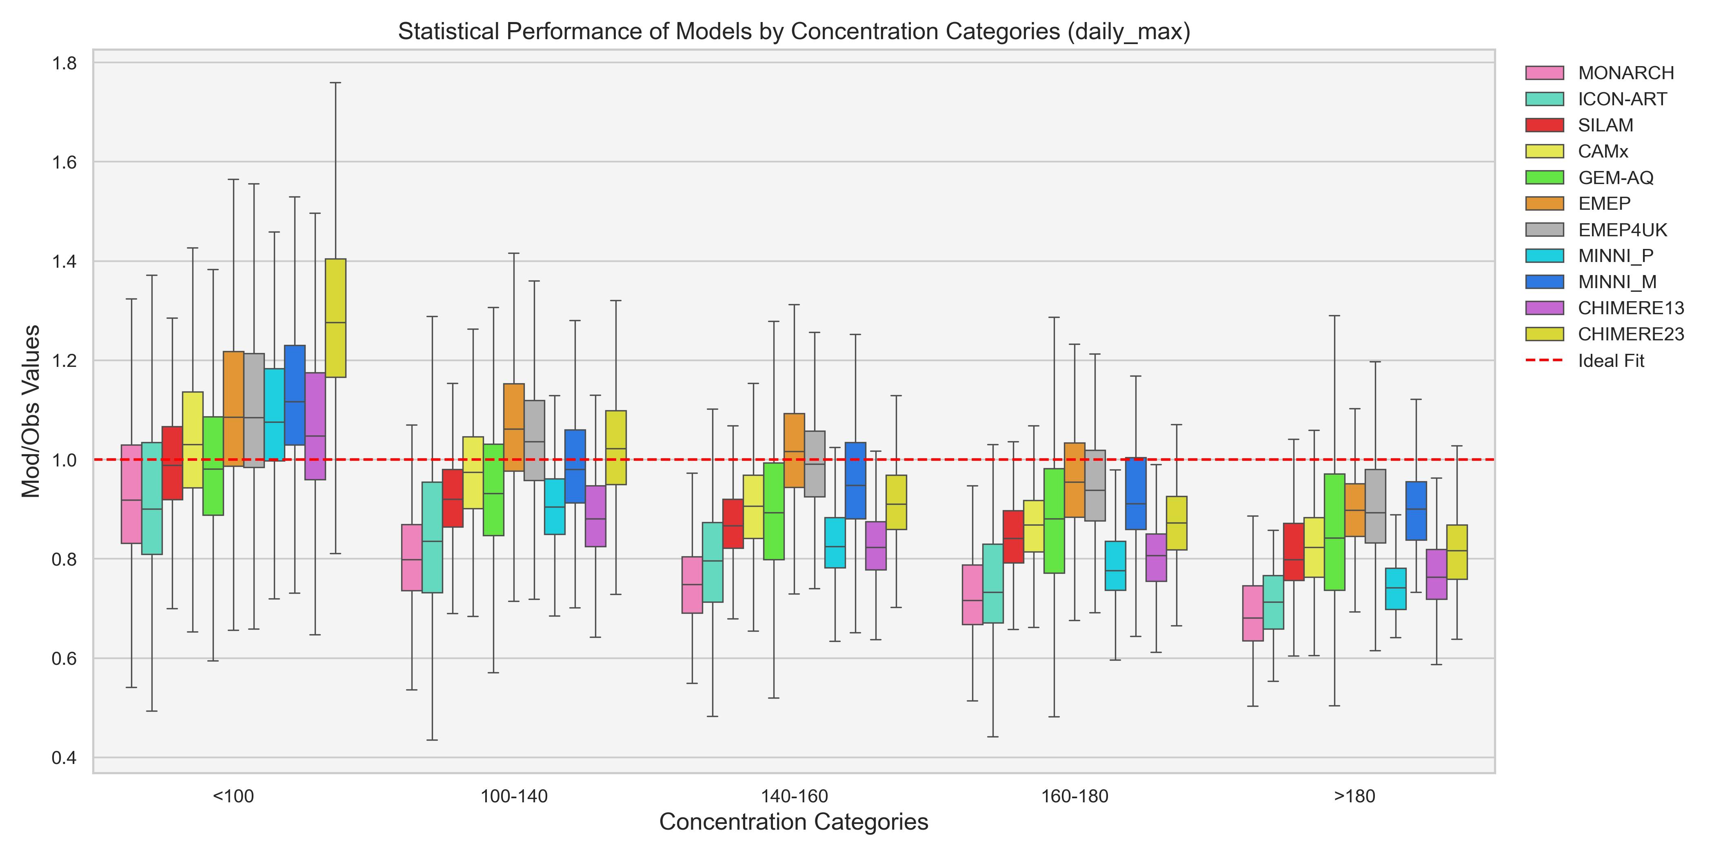
O3 daily maximum by concentration threshold
All models tend to underestimate highest O₃ concentrations

Slide 7
Impact of biogenic emissions

Slide 8
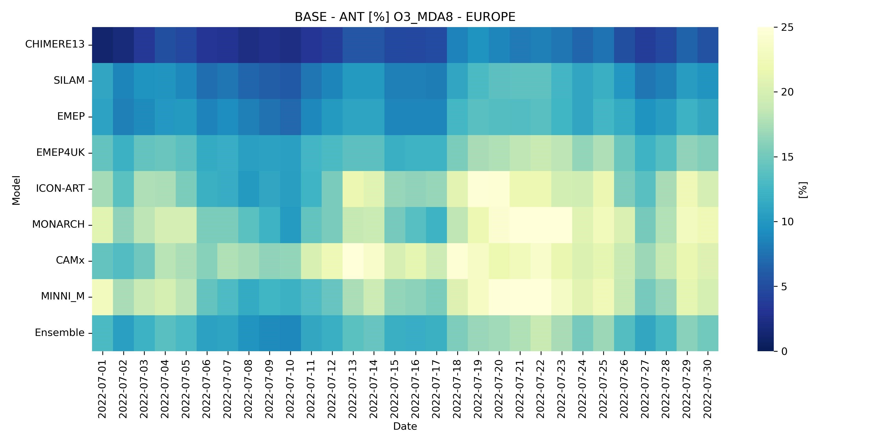
differences - O3_MDA8 - all models
Biogenic VOC contribution is higher during episode period

Slide 9
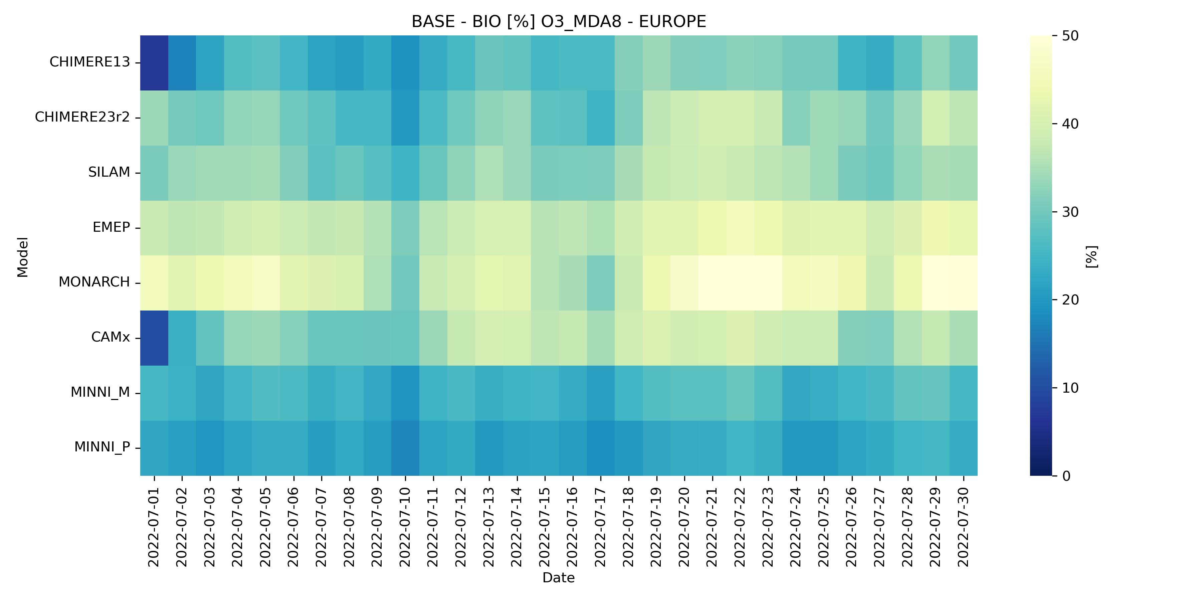
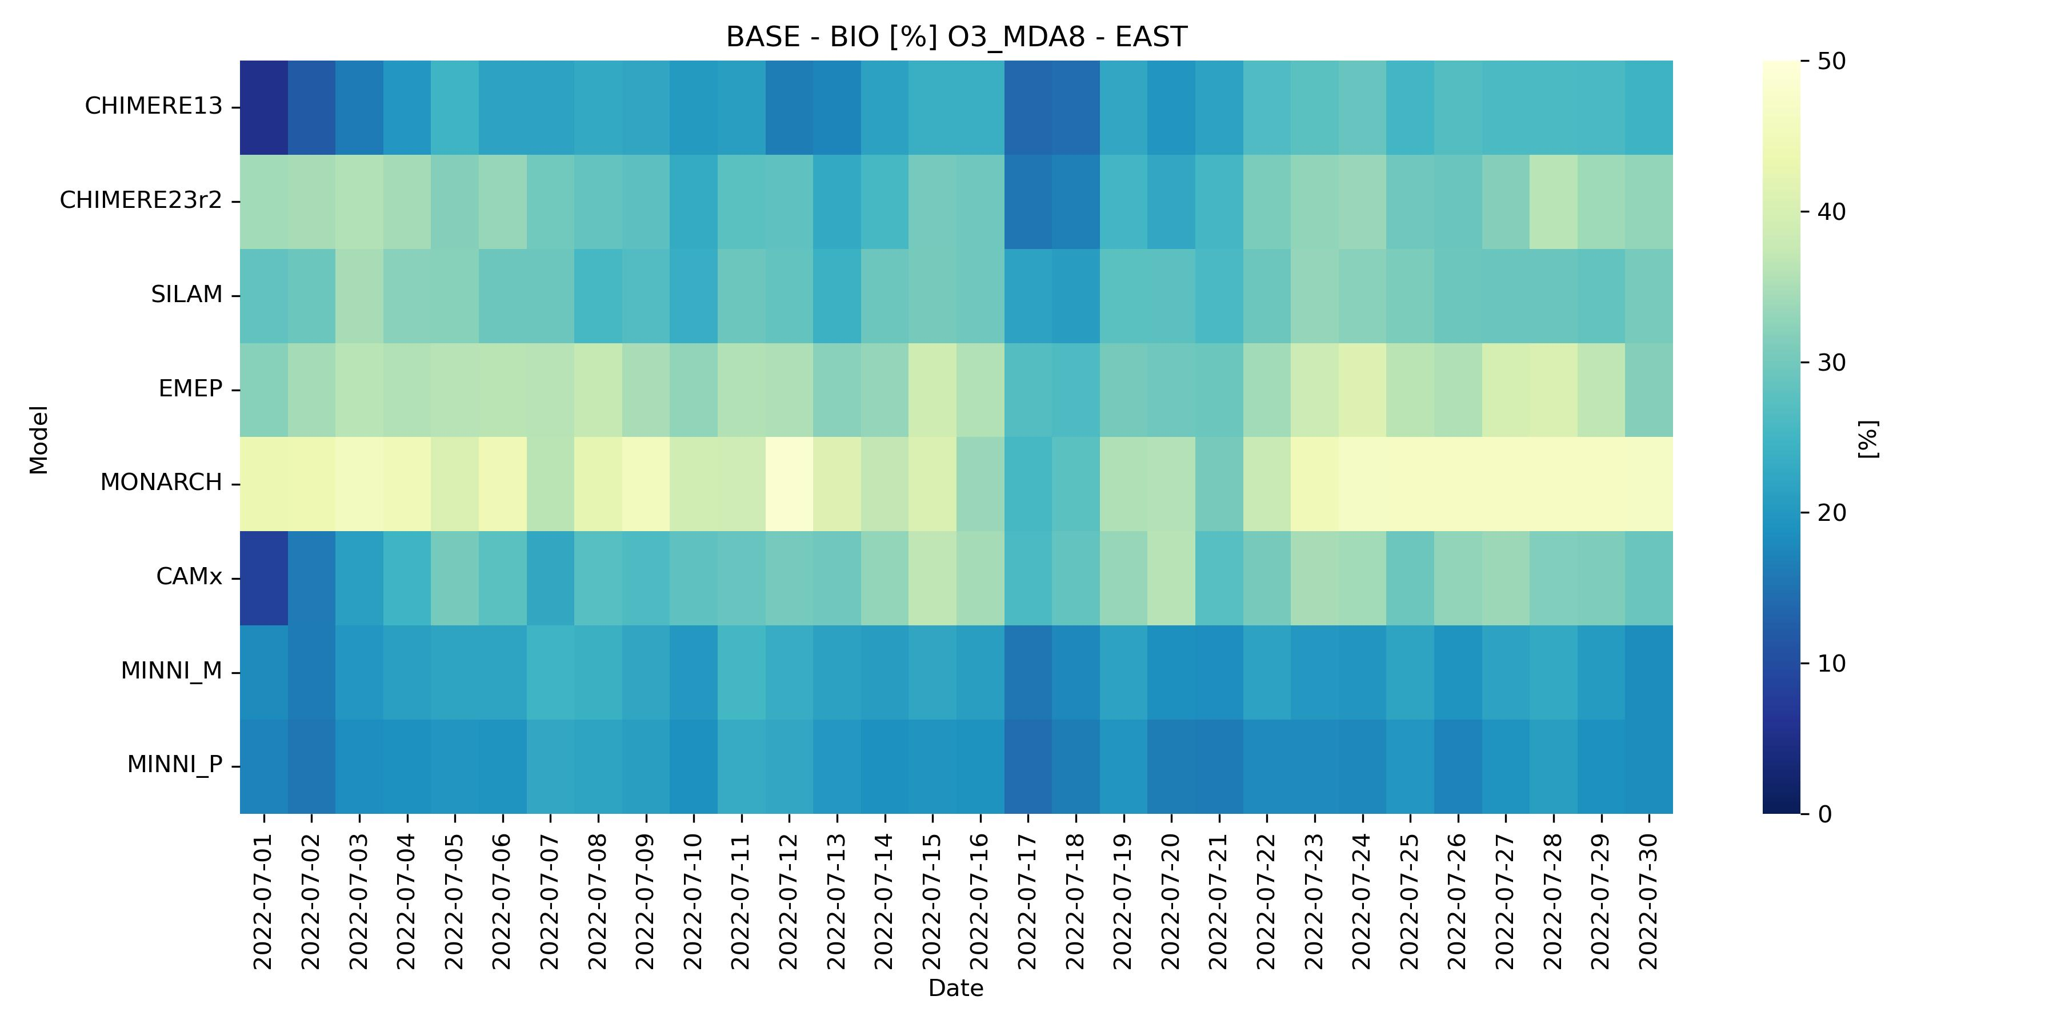
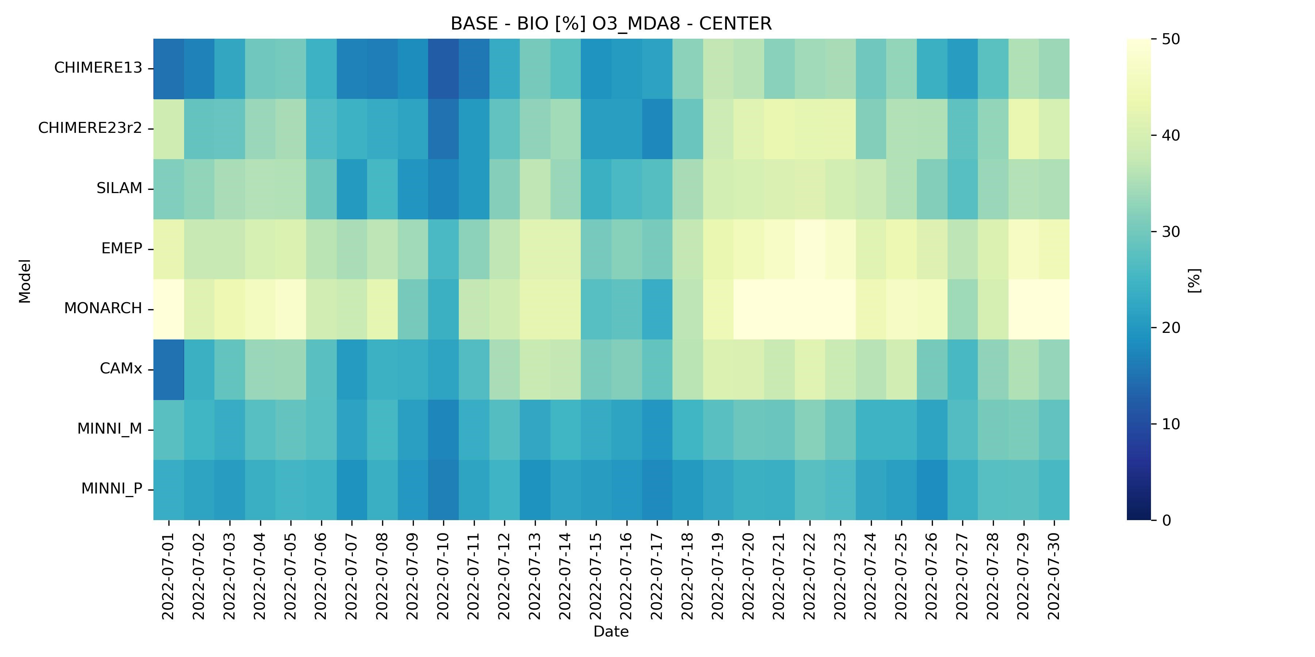
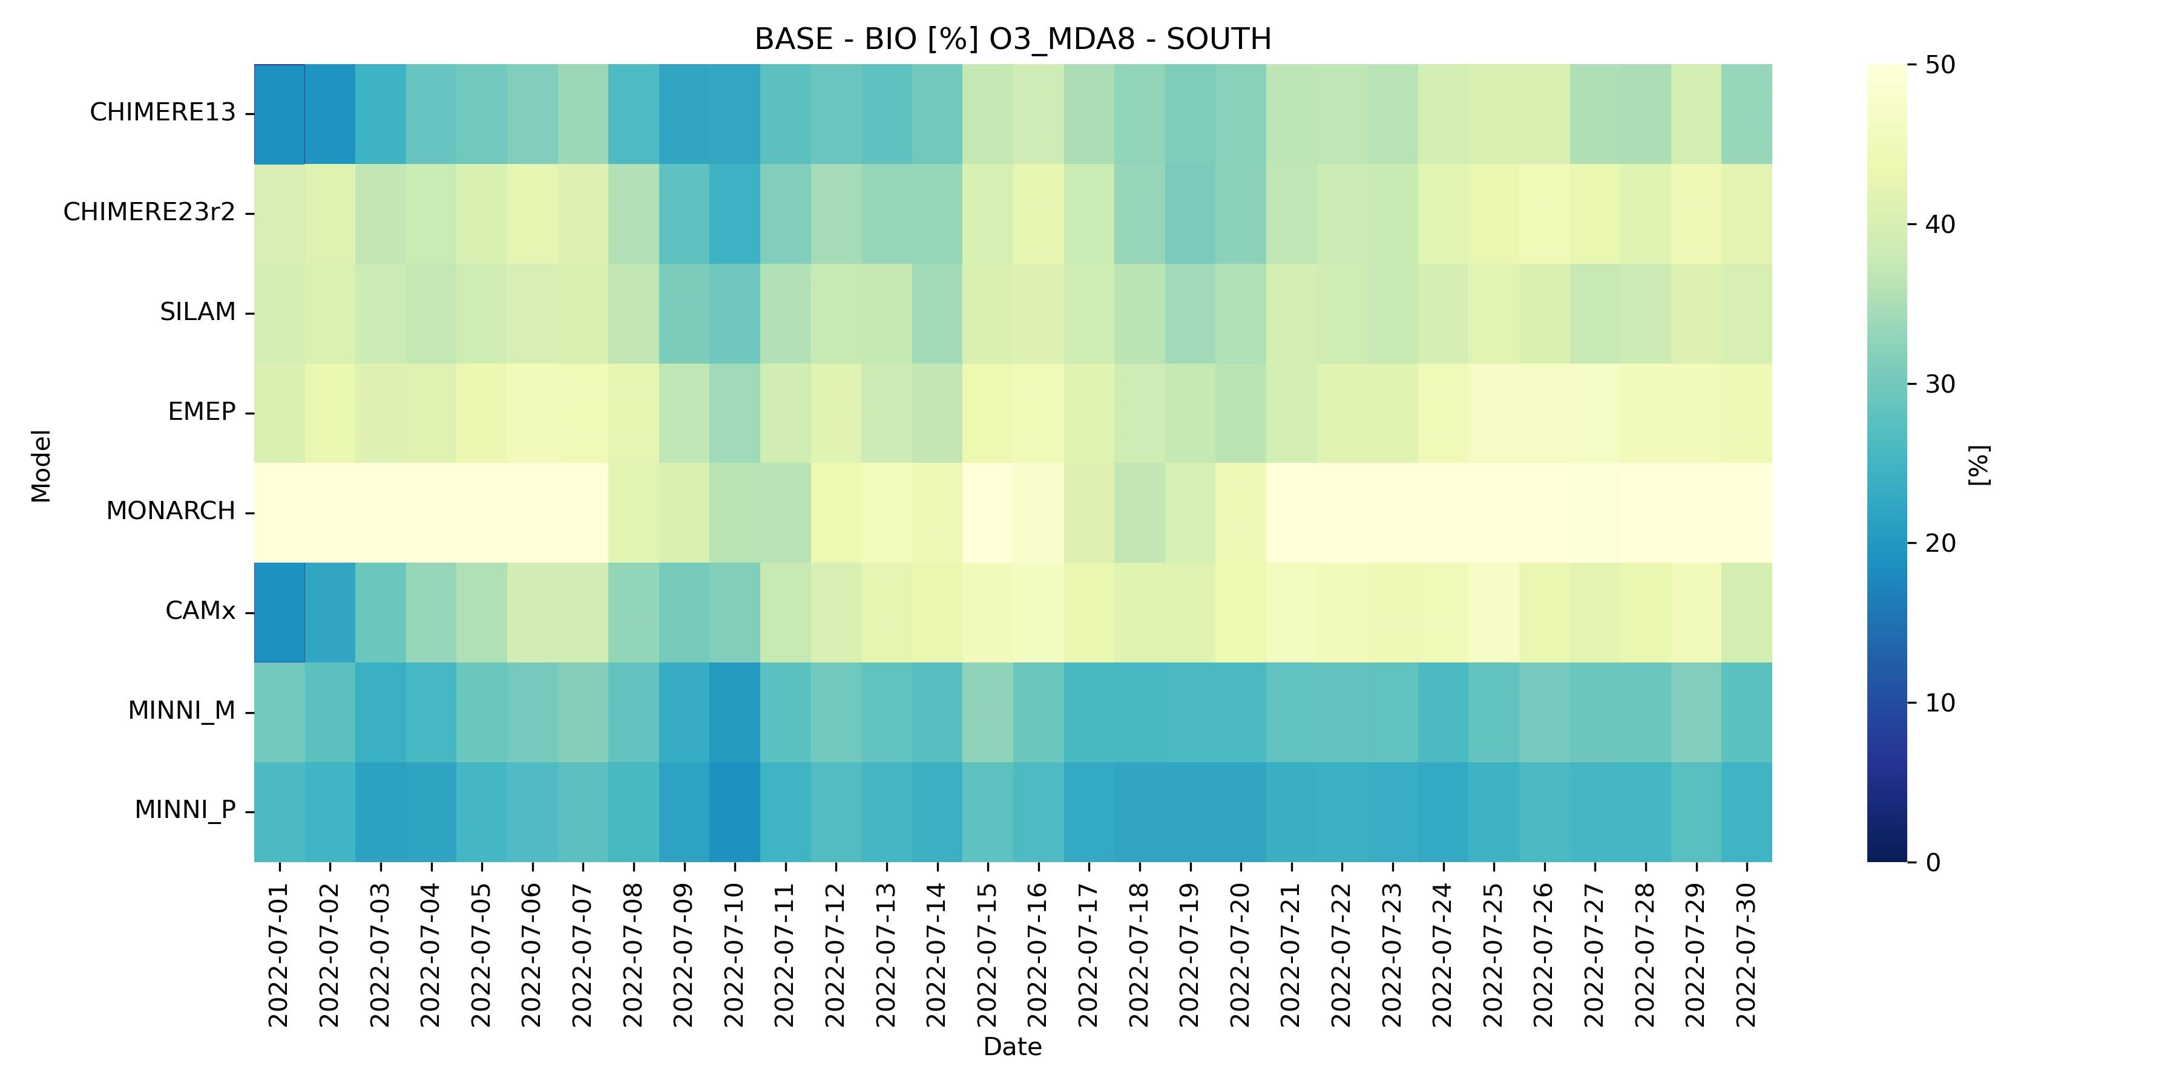
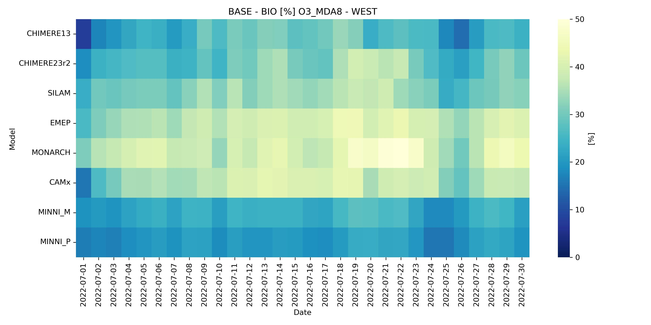
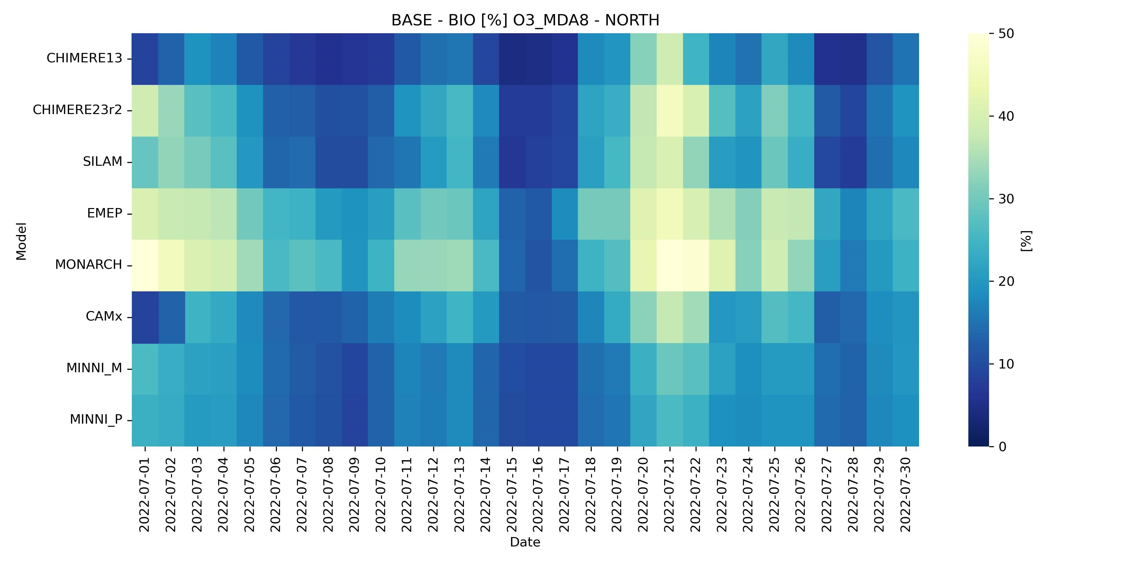
differences - O3_MDA8 - all models
Model dependent but more stable during entire July (only NORTH regions is the exception)

Slide 10
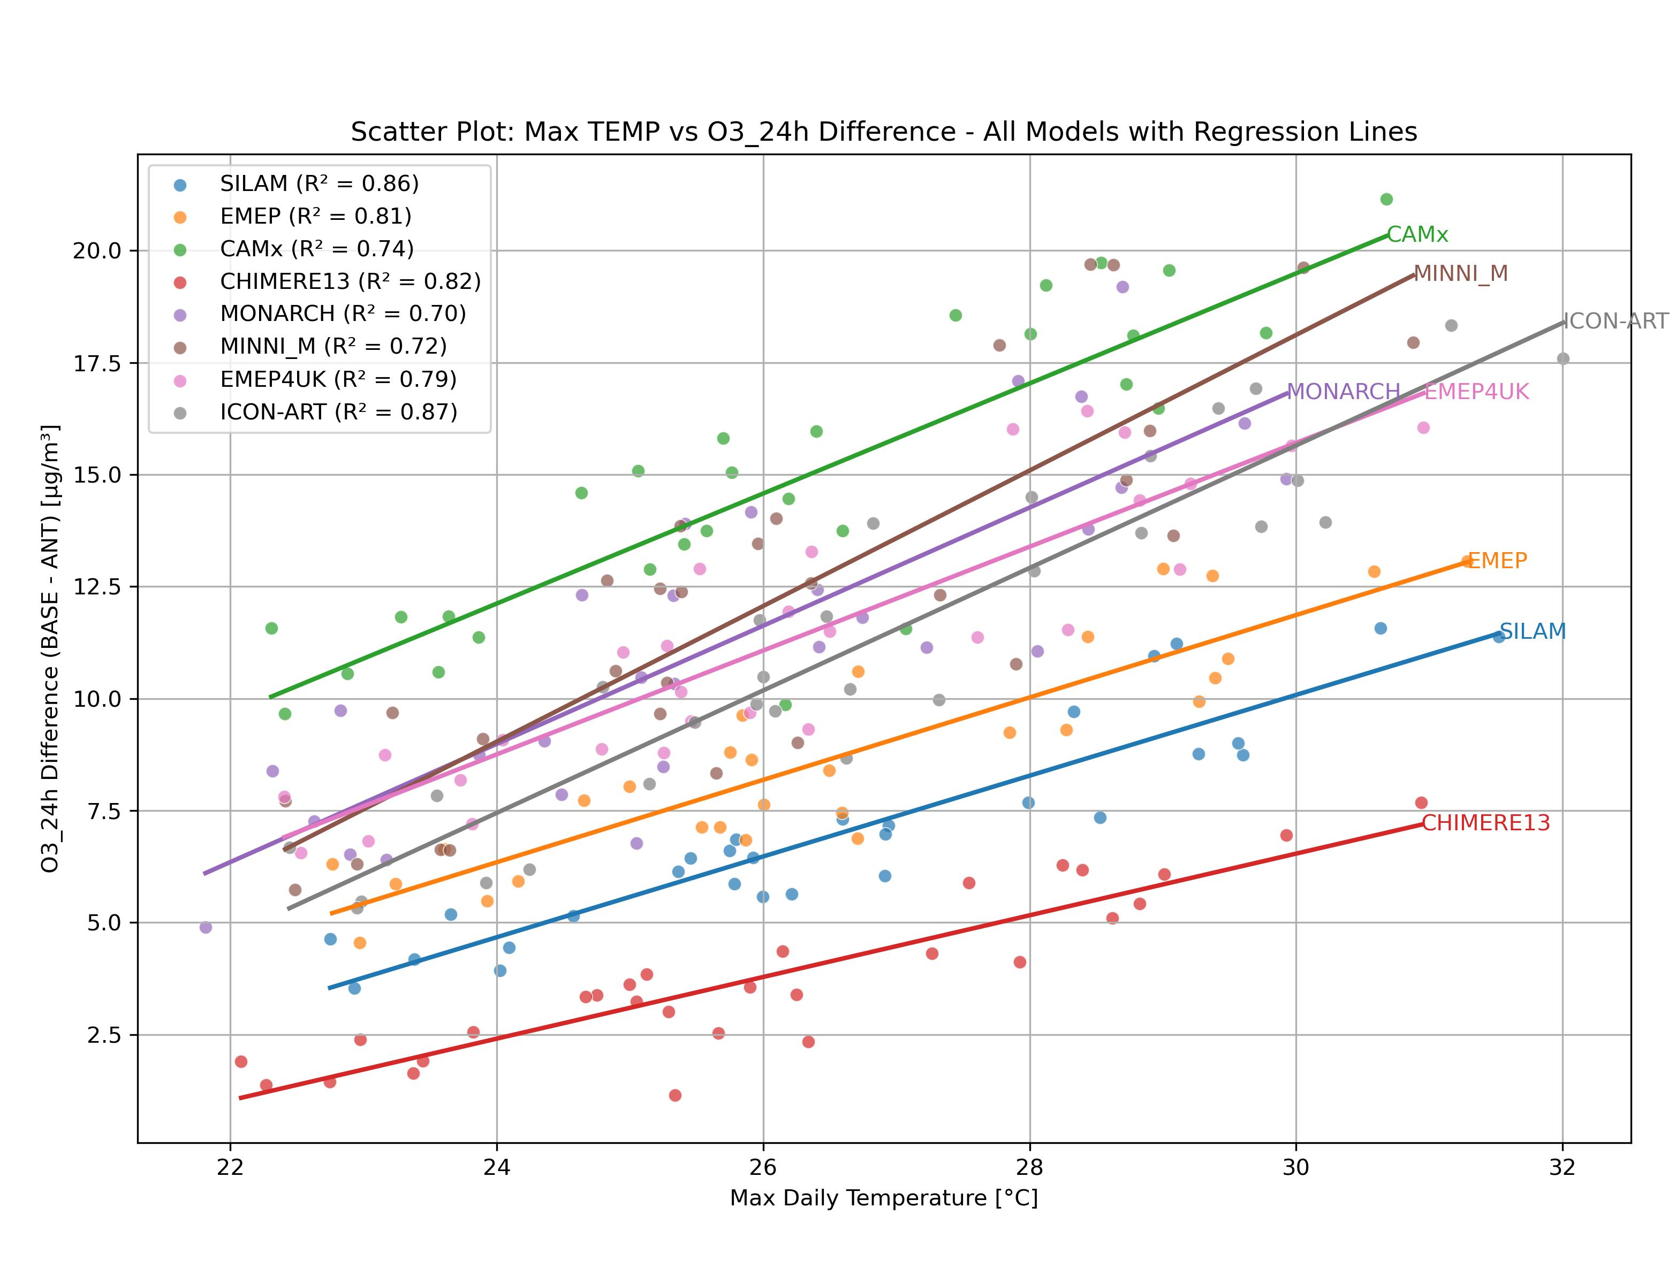
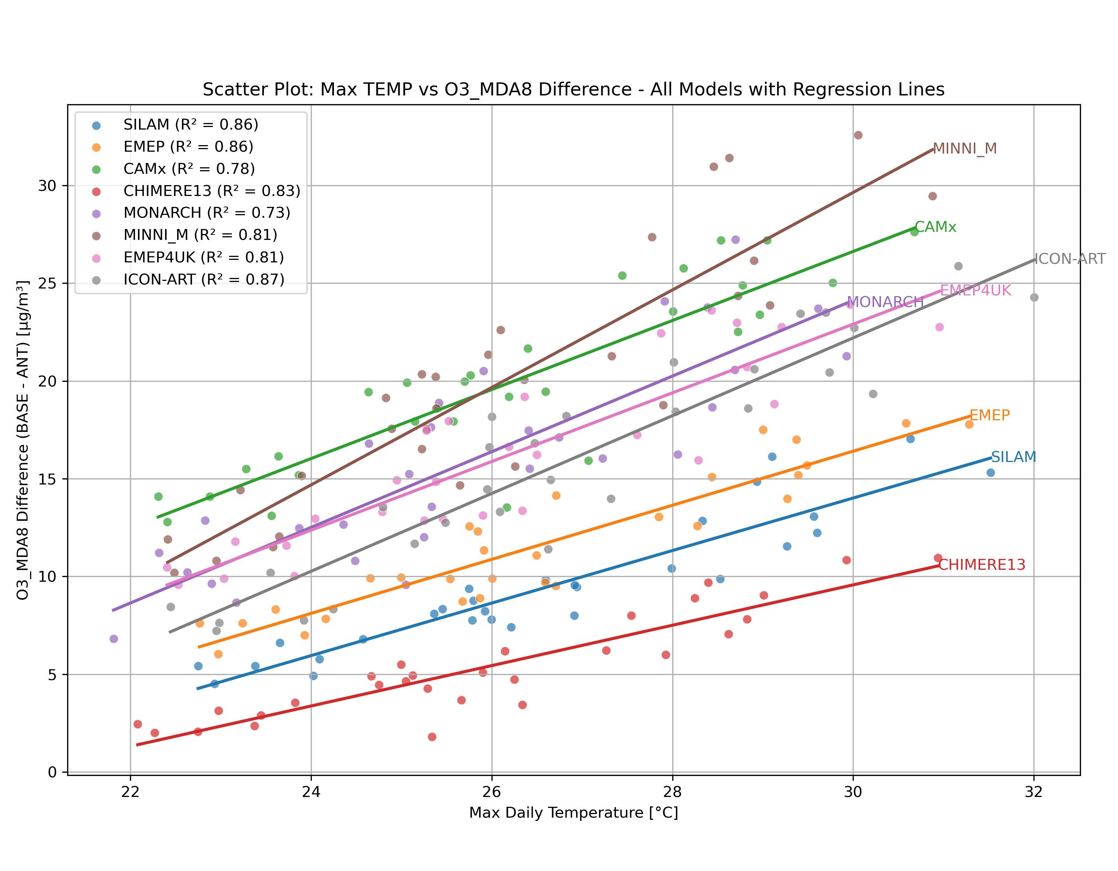
TEMP vs O3 concentration increment
Increment due to biogenic emission seem to be quasi-linear function of the temperature

Slide 11
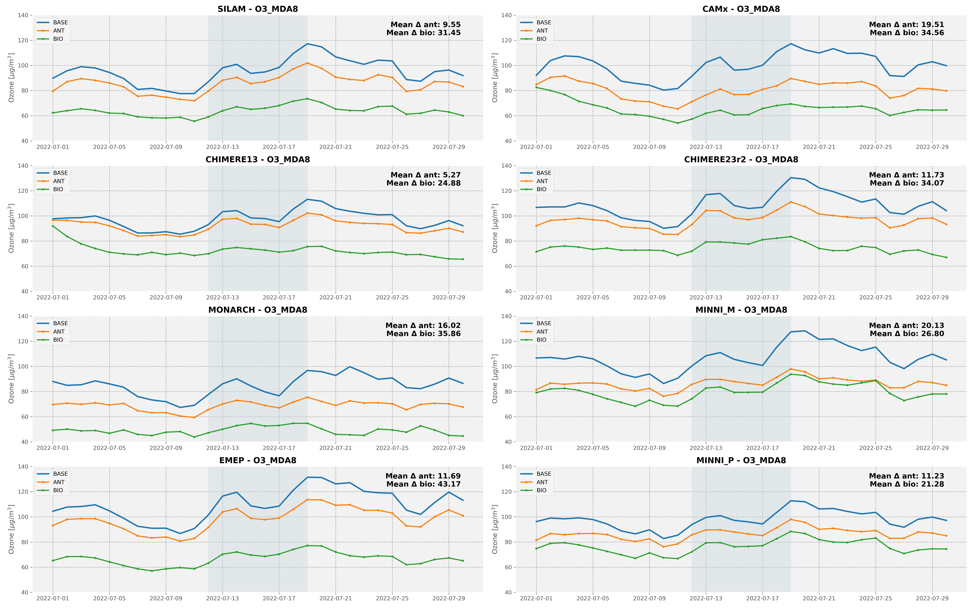
Europa - Time series ad.3 O3_mda8

Slide 12
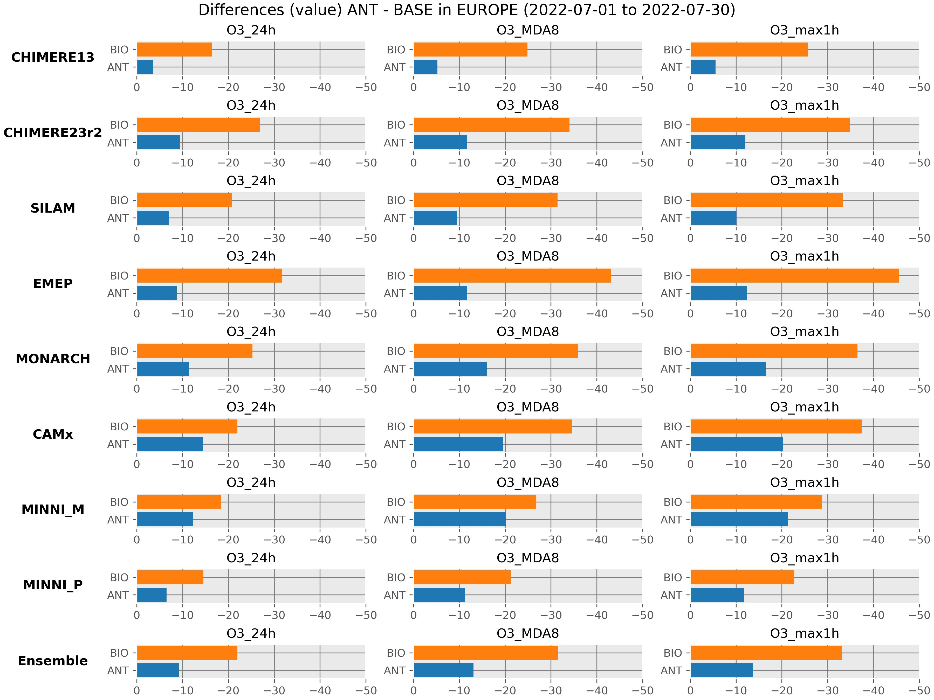
Diff [ug/m3] ANT-BASE, BIO-BASE Europe

Slide 13
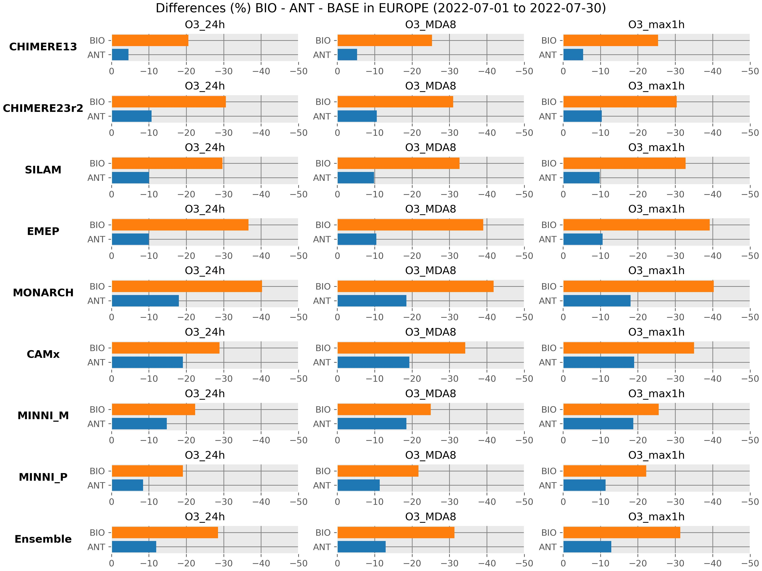
Diff [%] ANT-BASE, BIO-BASE Europe

Slide 14
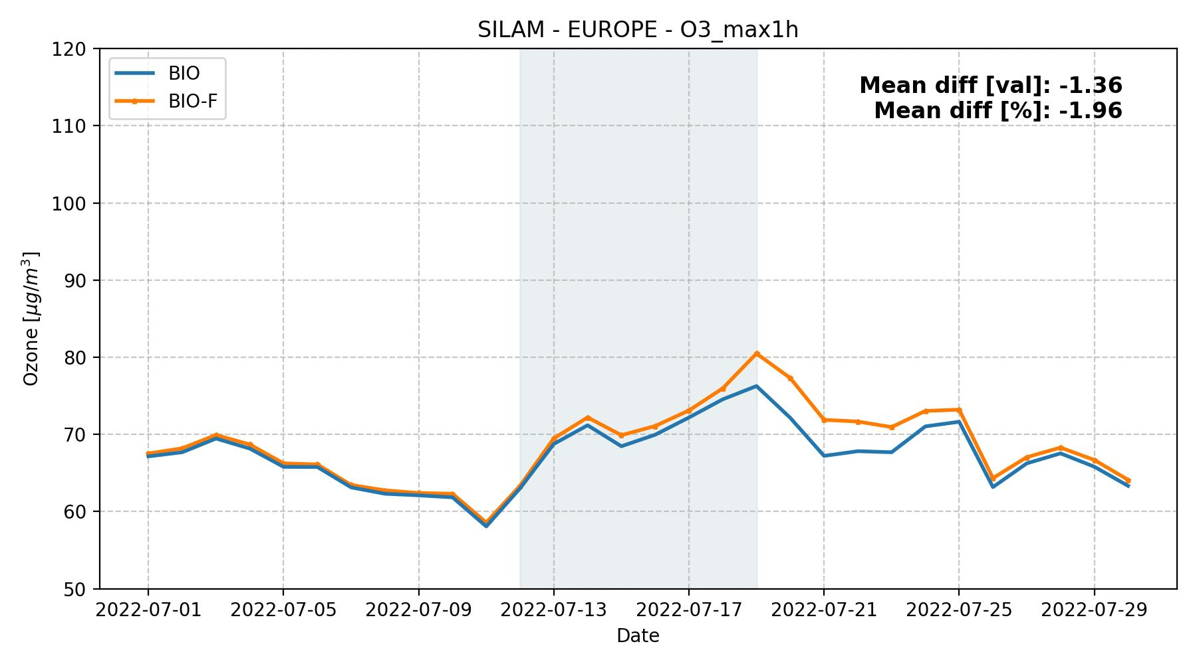
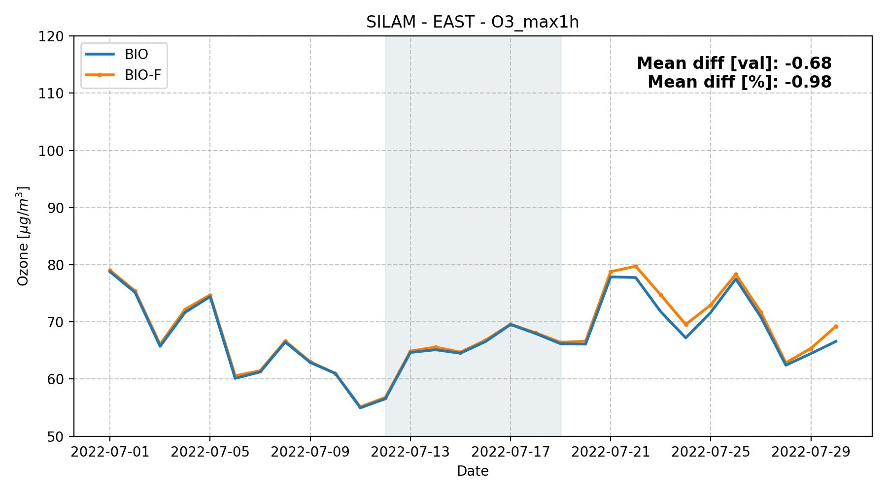
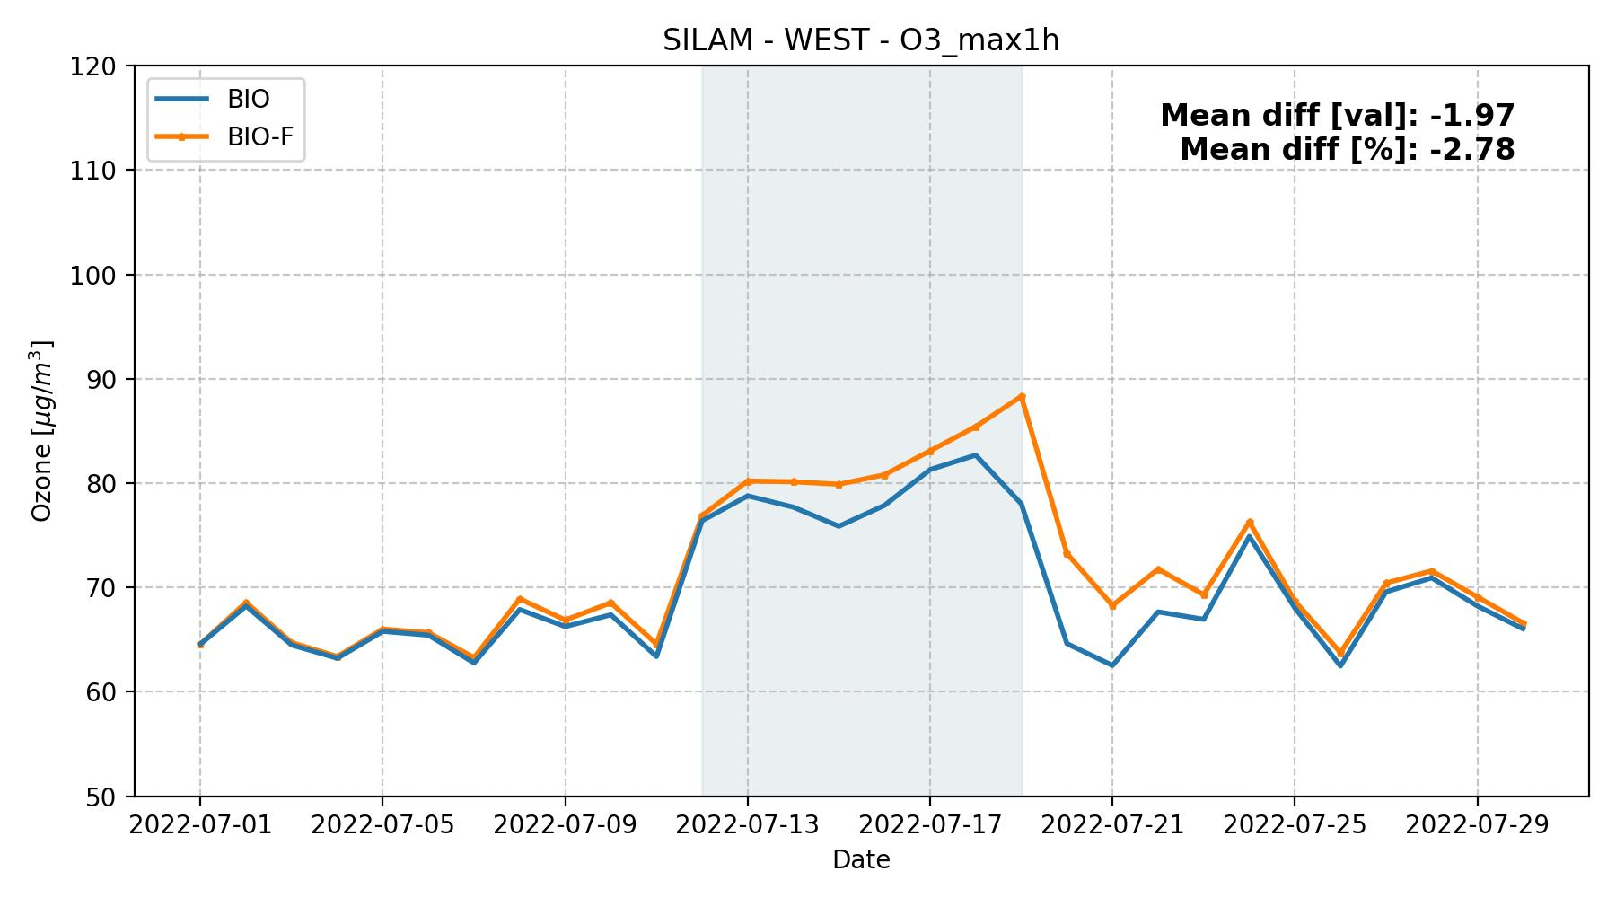
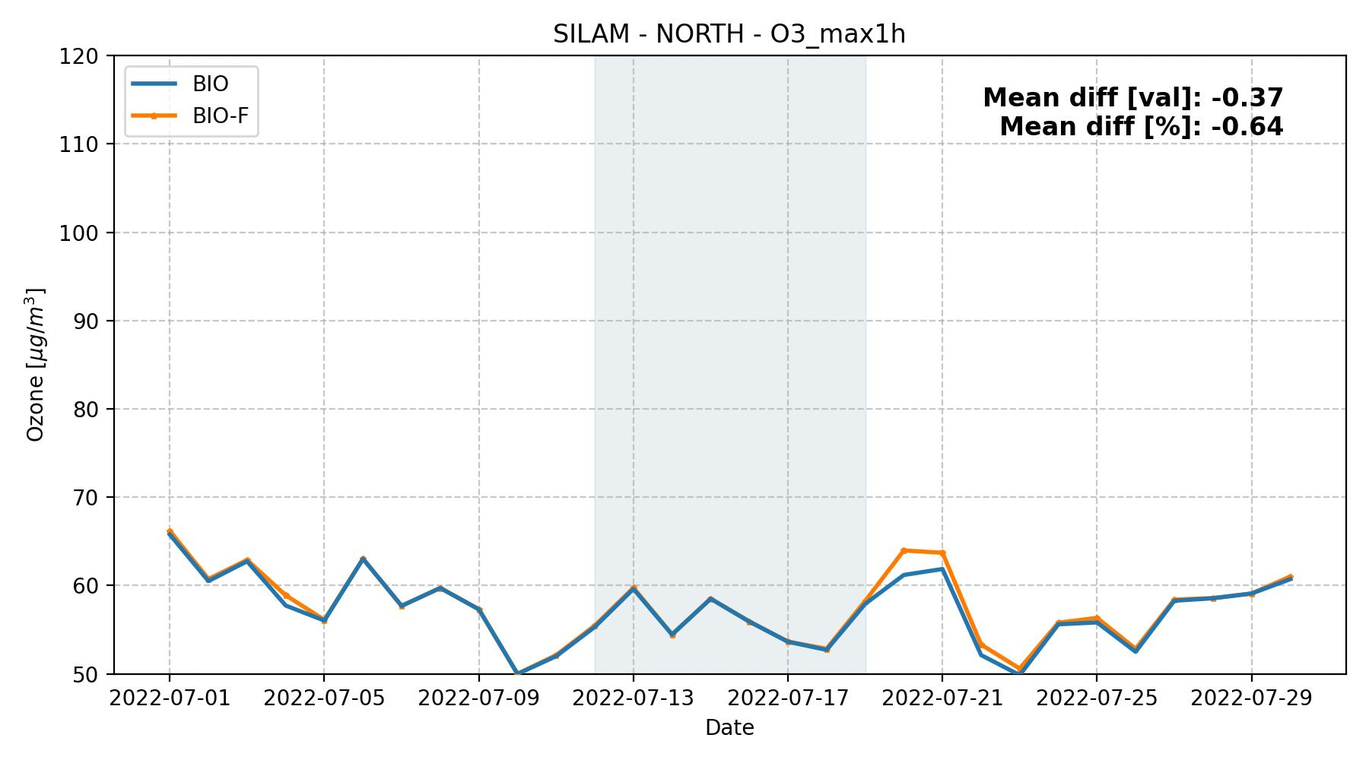
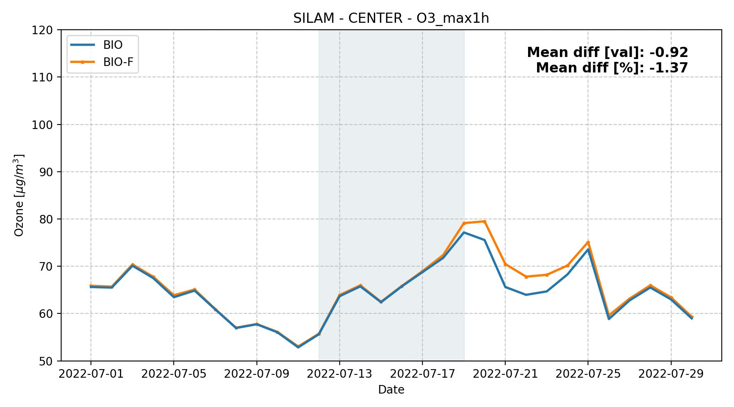
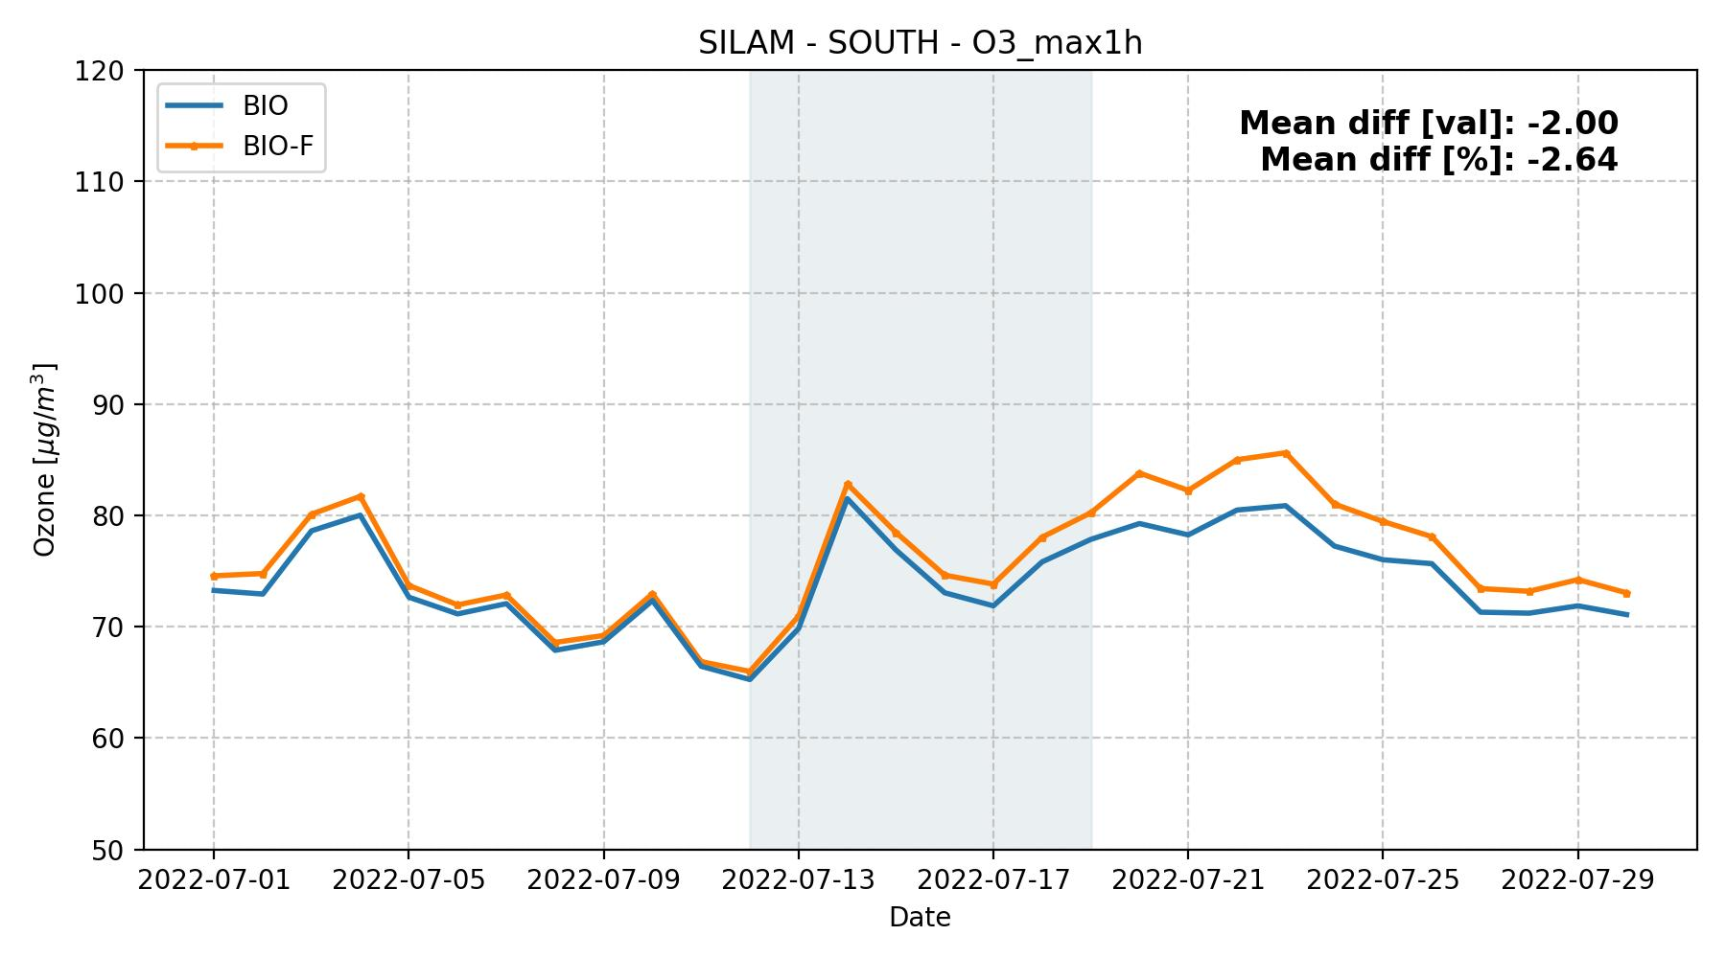
BIO vs BIO-Fires (all regions)

Slide 15
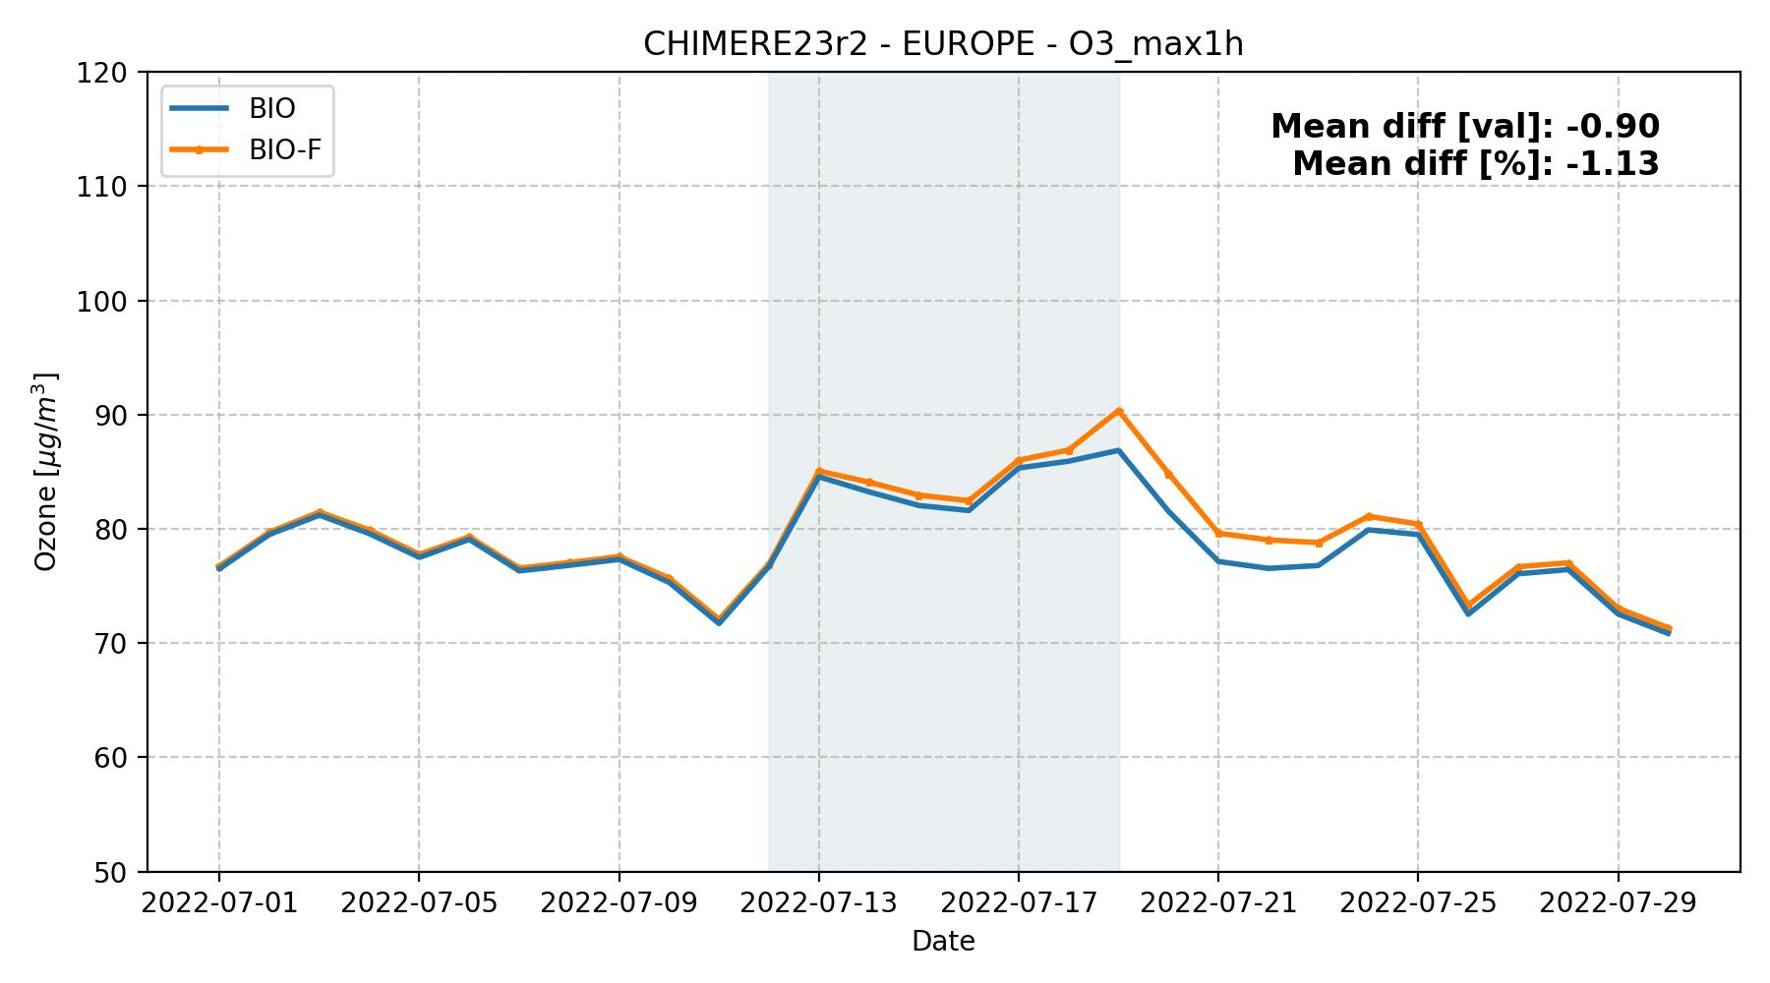
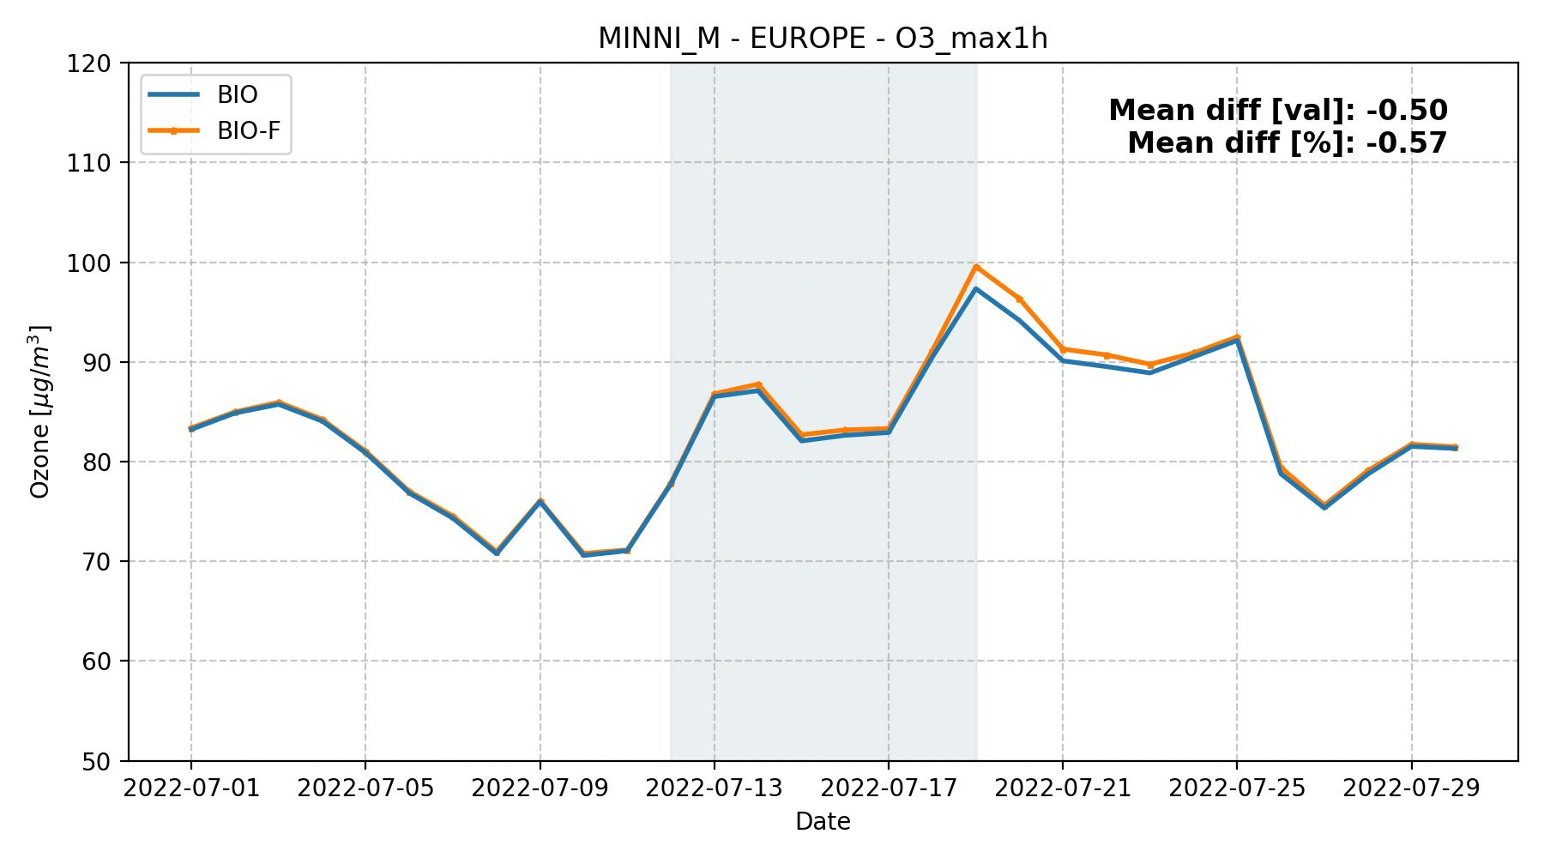
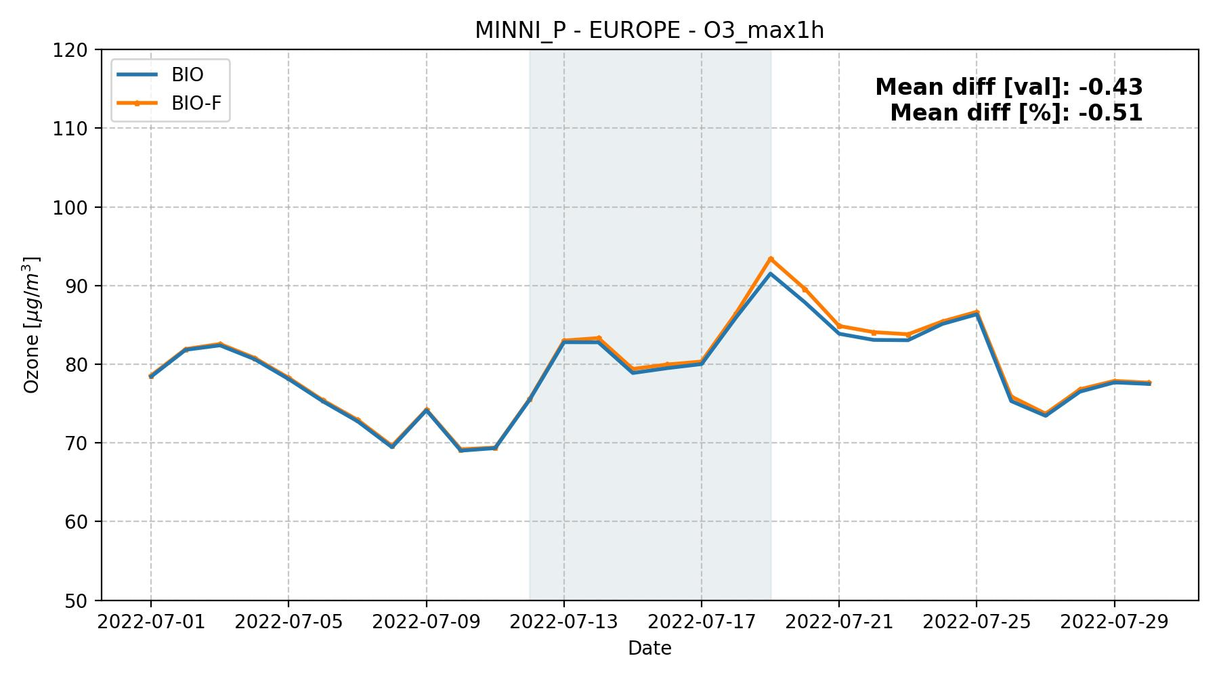
BIO vs BIO-Fires (all models)

Slide 16
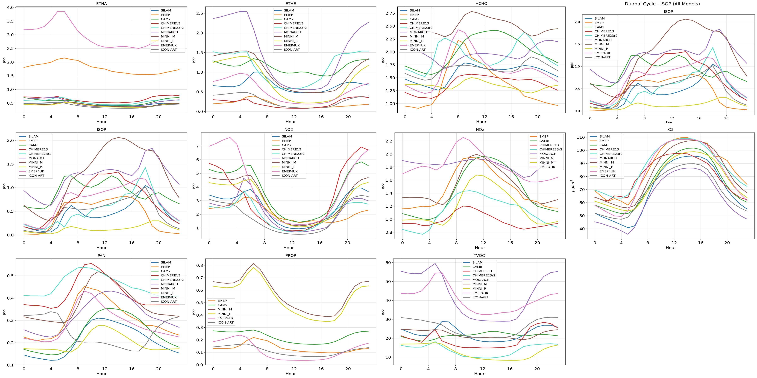
Diurnal cycle - all species, BASE, Europe

Slide 17
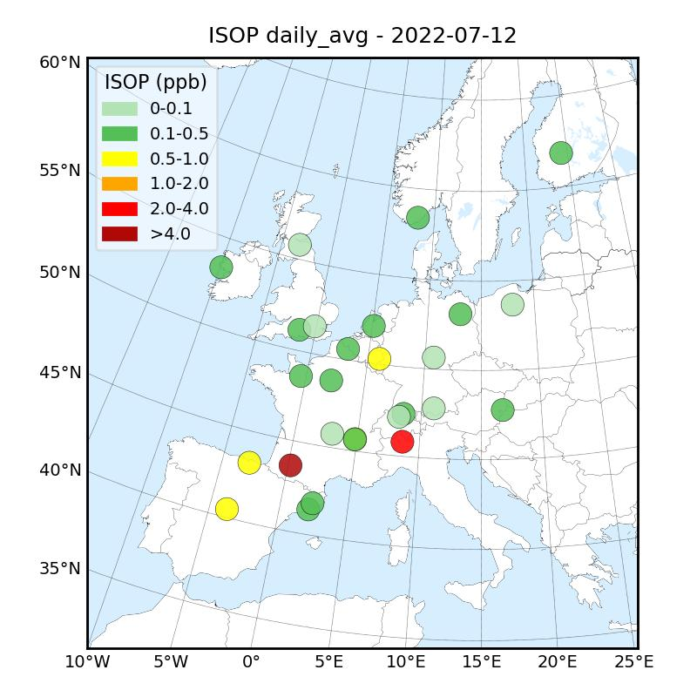
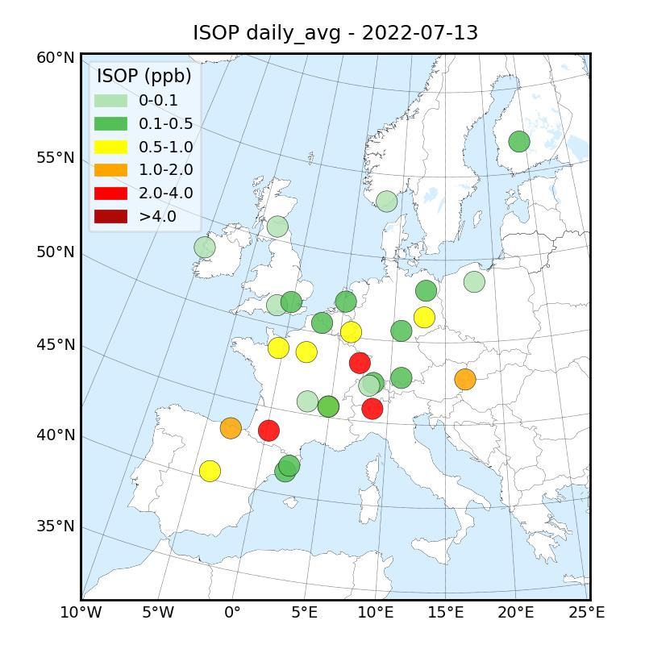
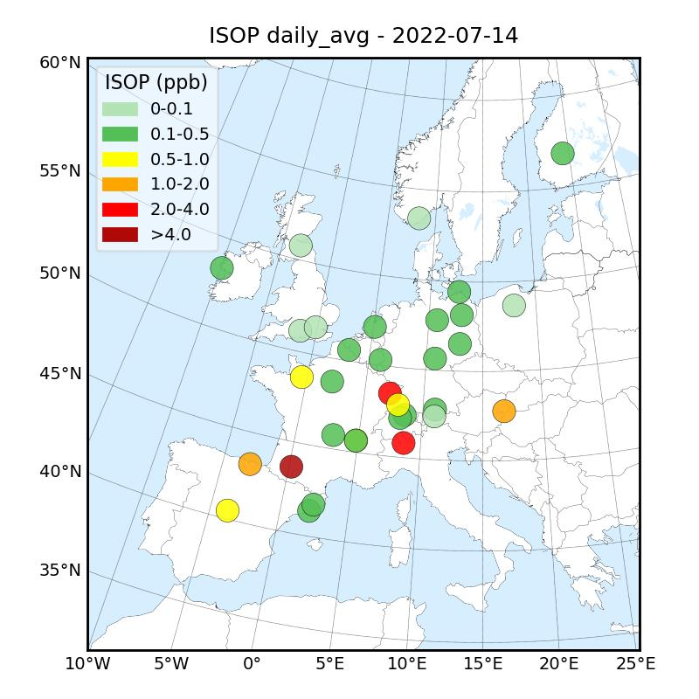
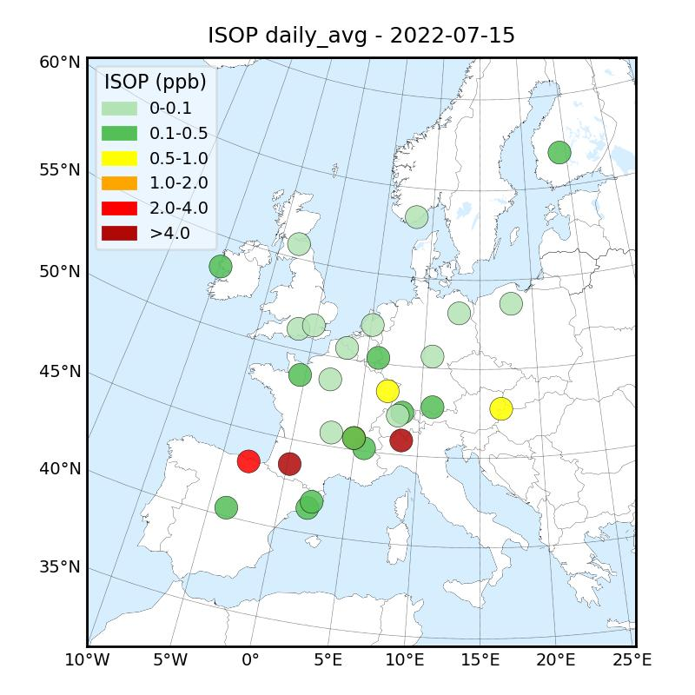
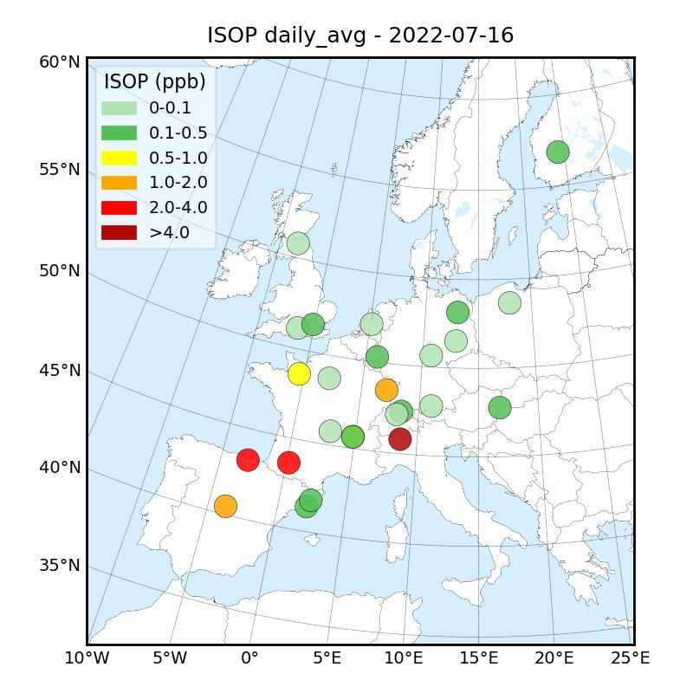

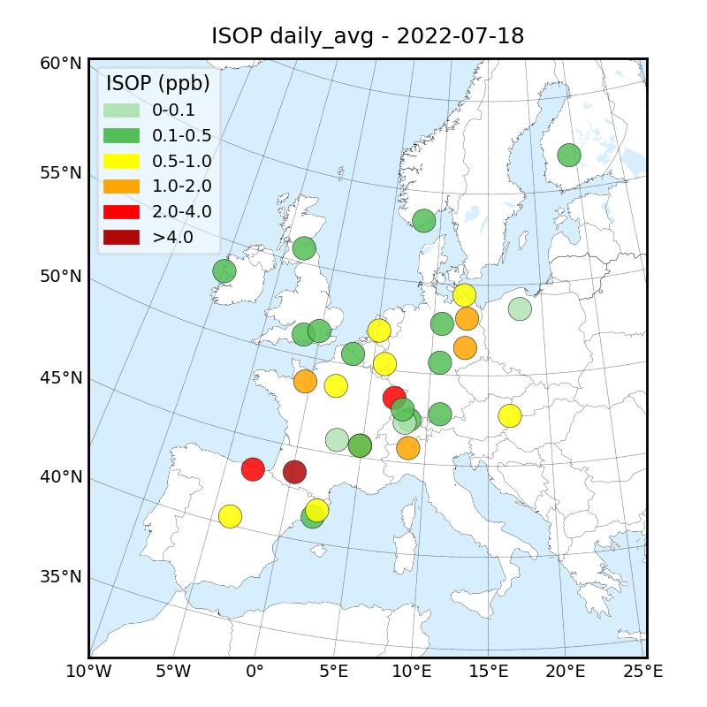
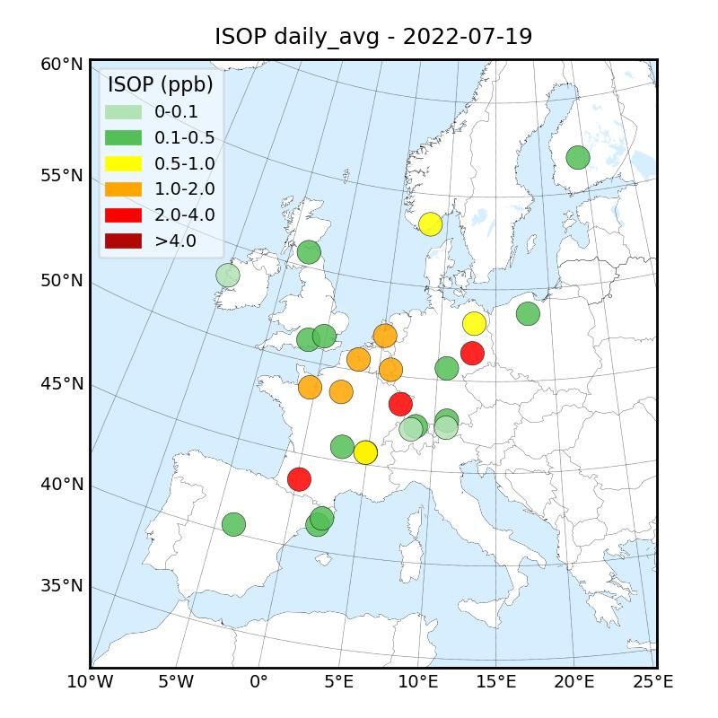
Isoprene - daily average* (12.07 - 19.07)

Slide 18
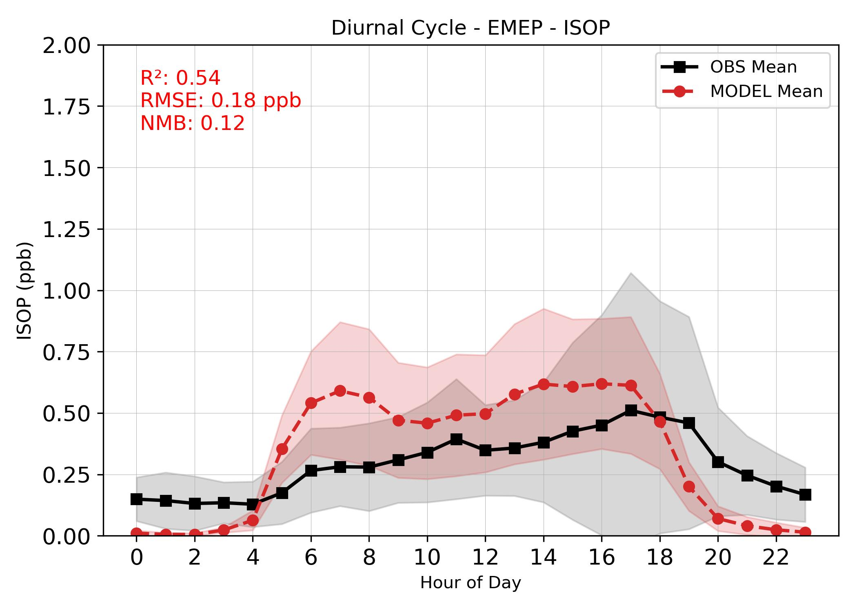
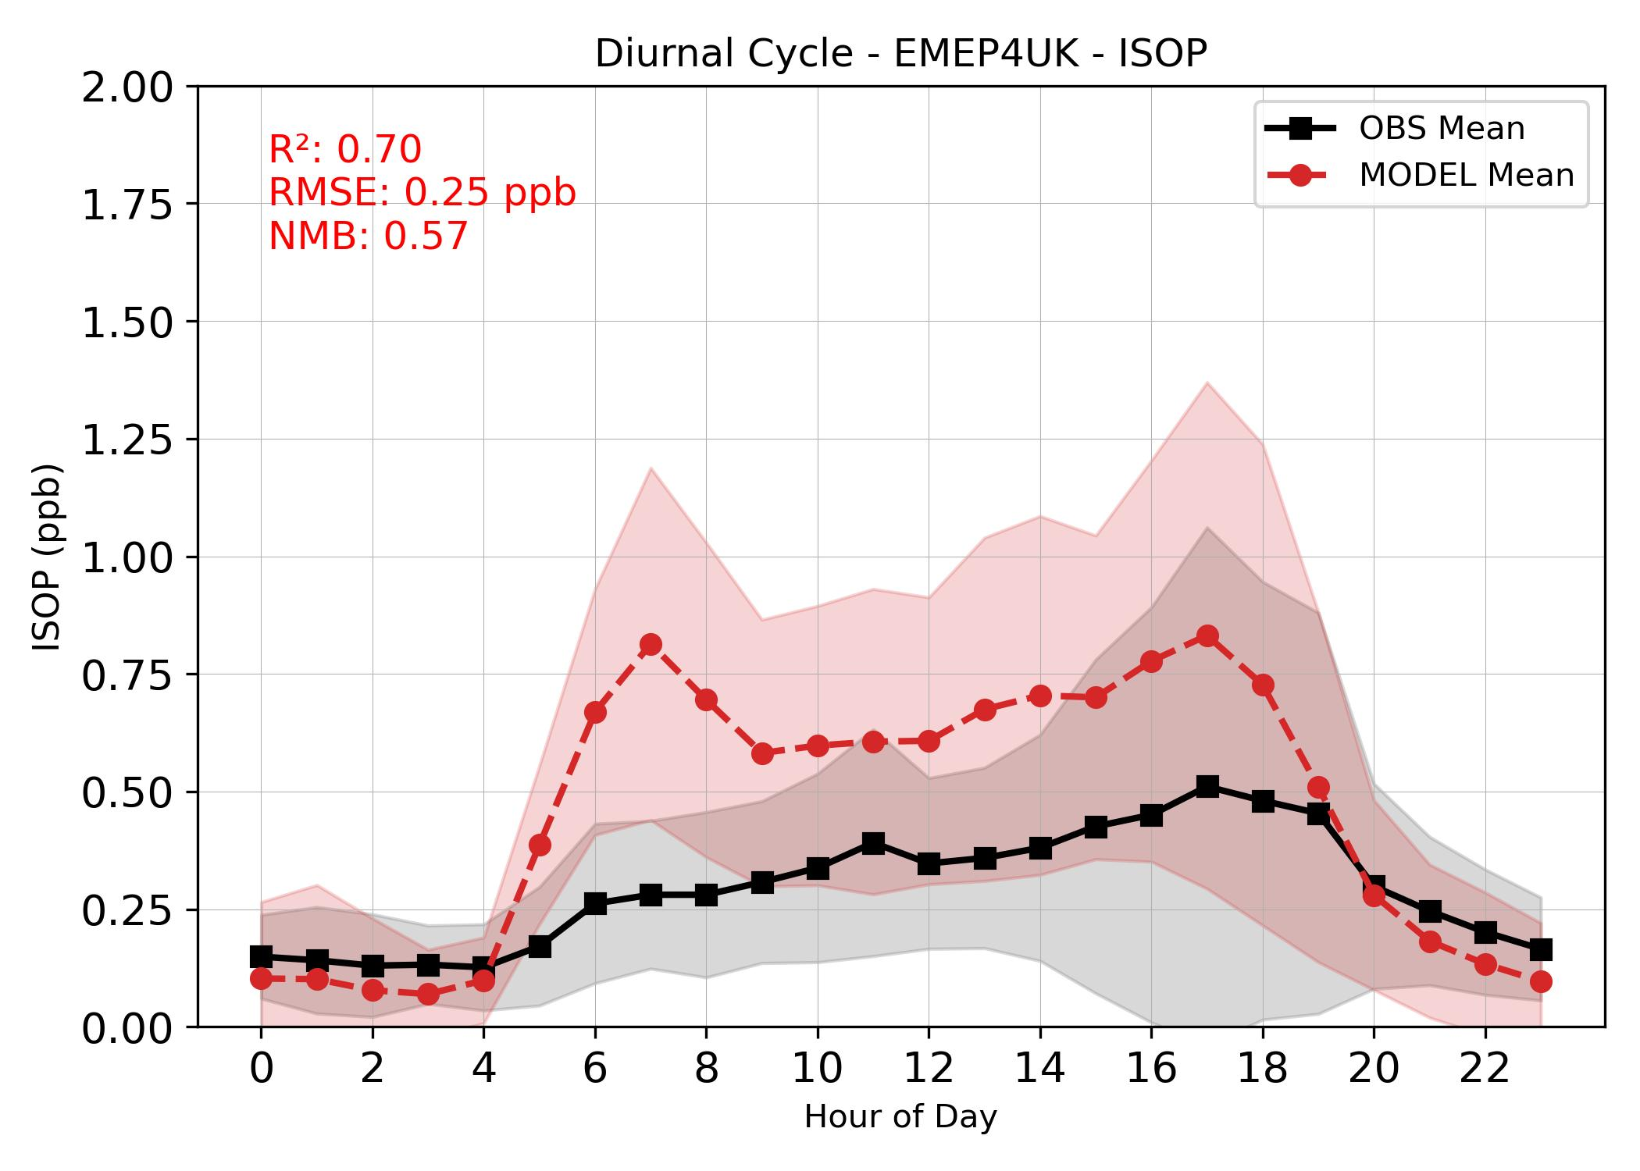
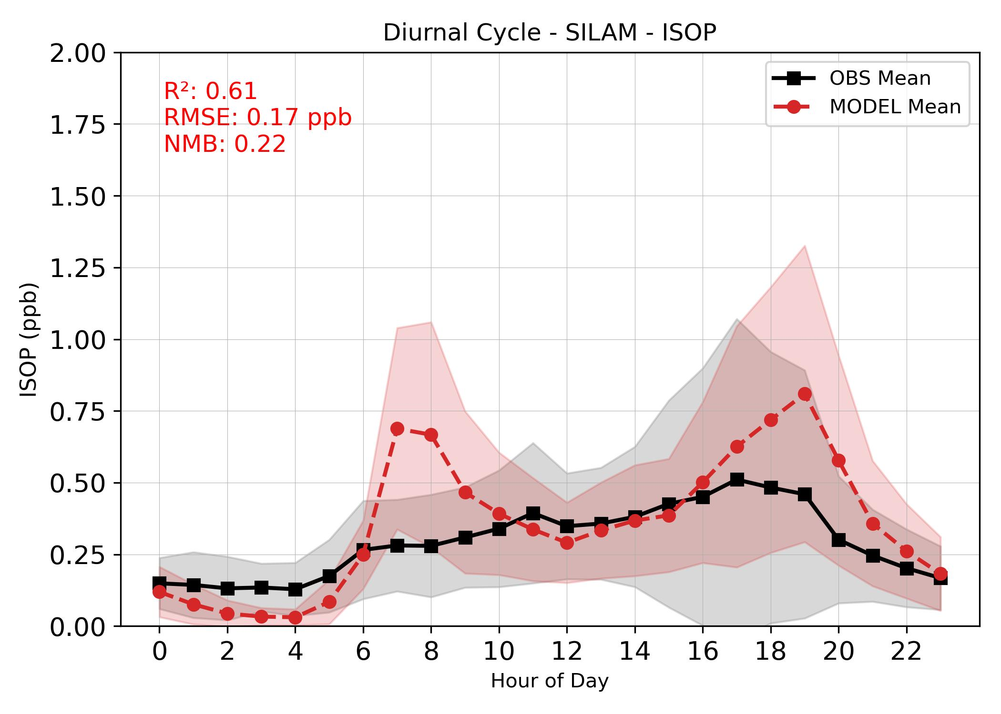
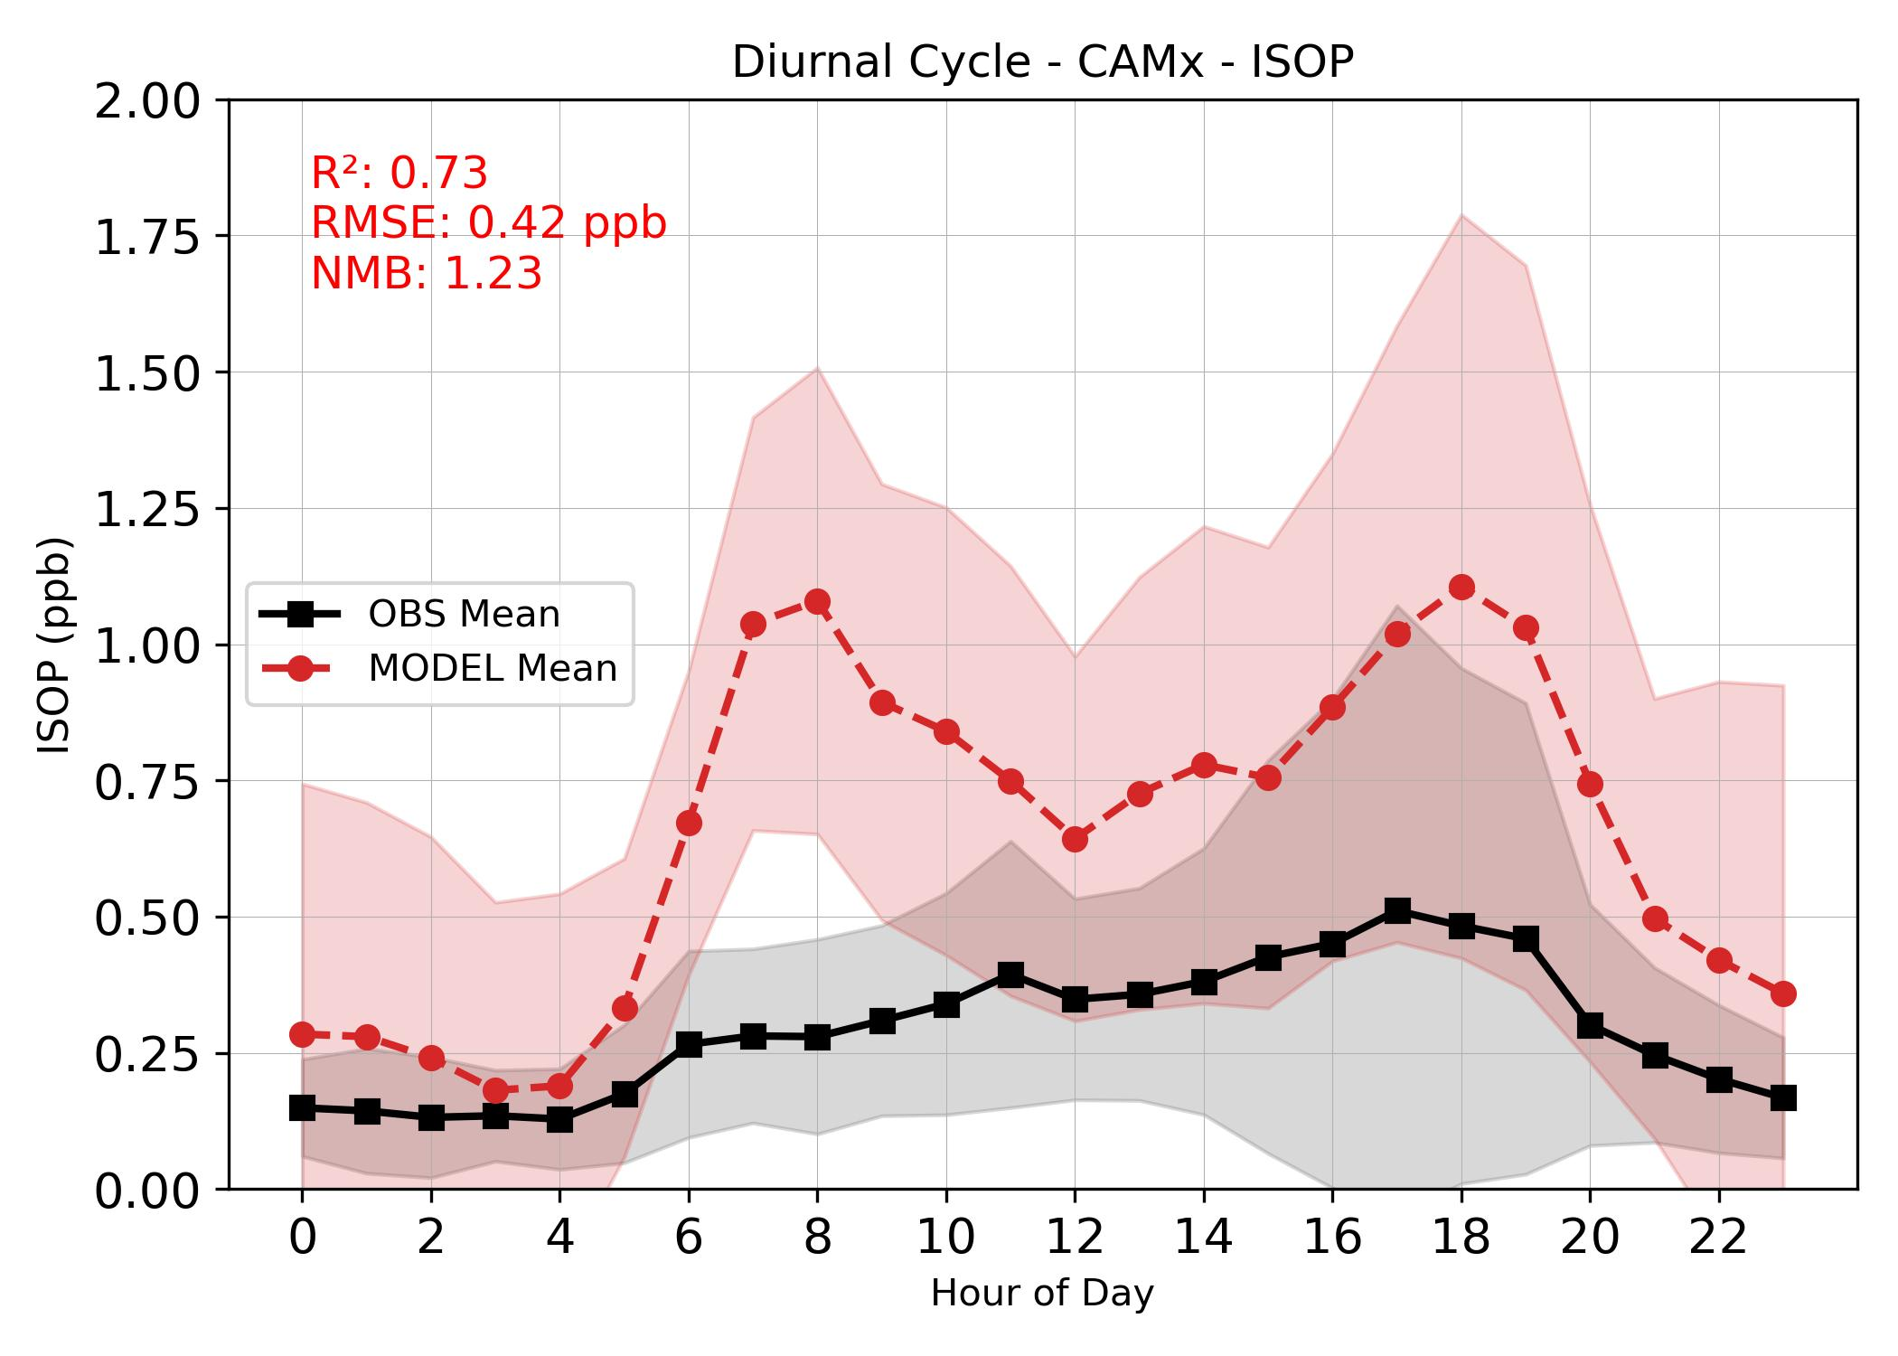
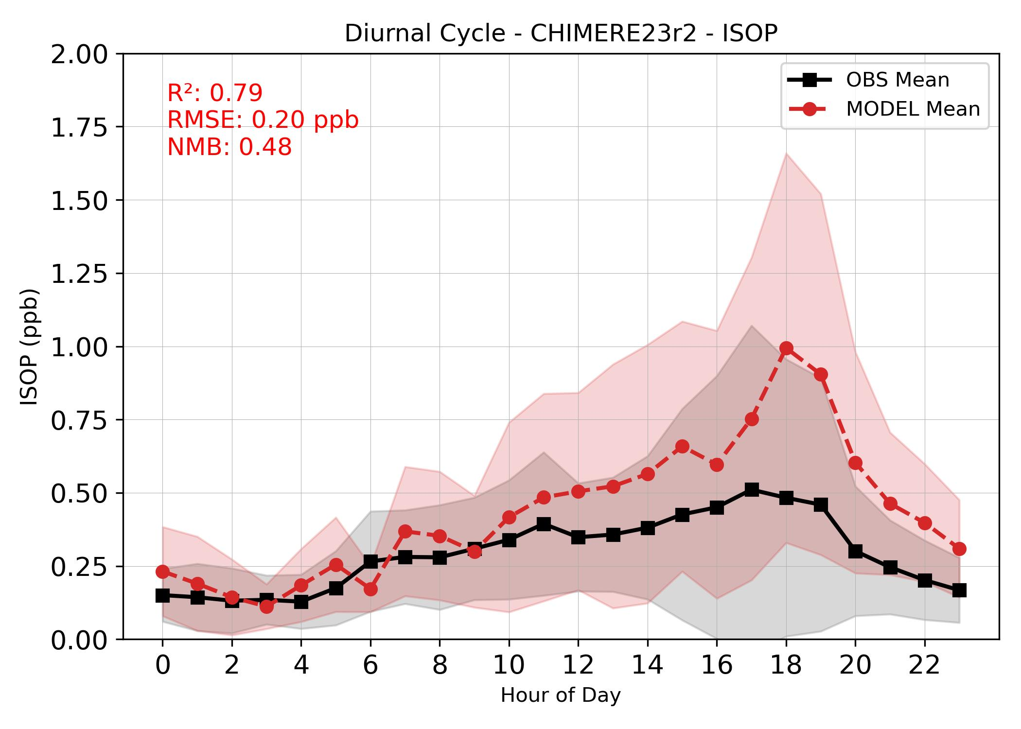
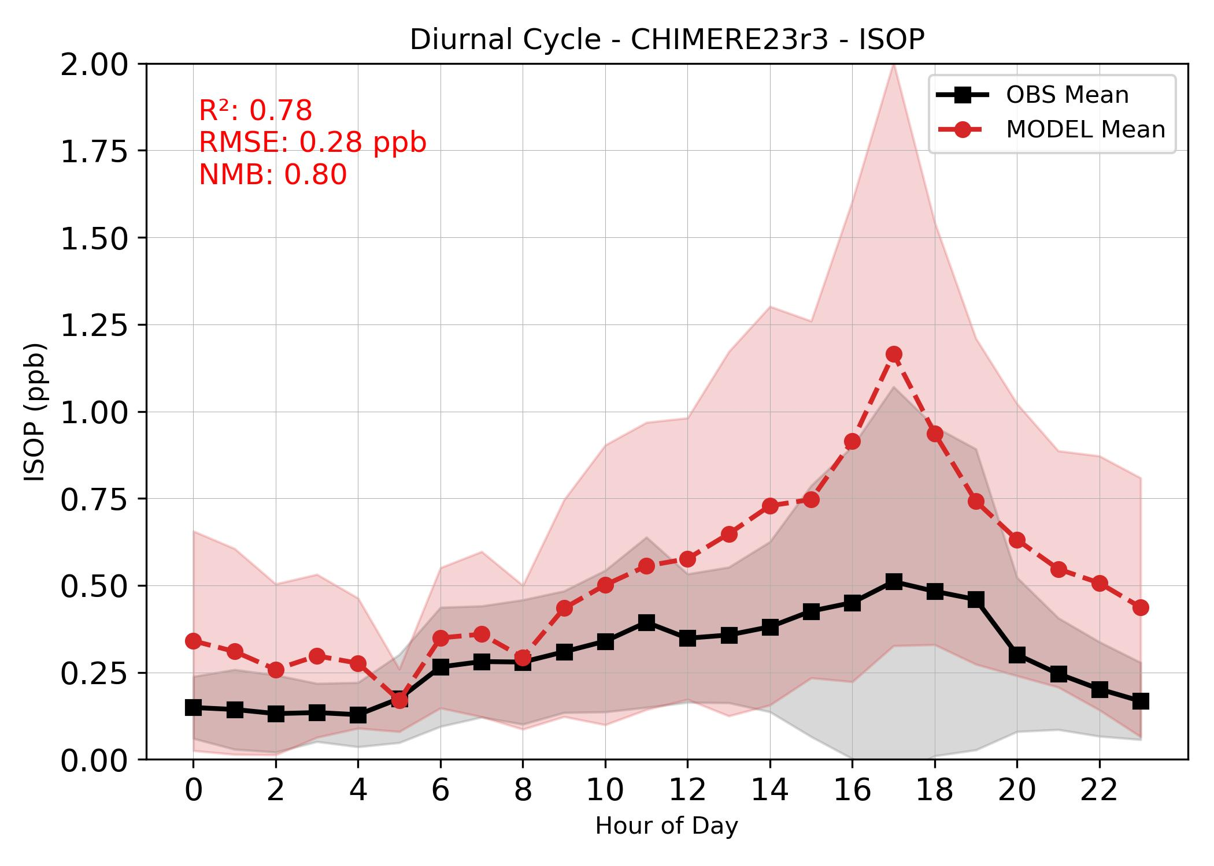
Isoprene - diurnal cycle

Slide 19
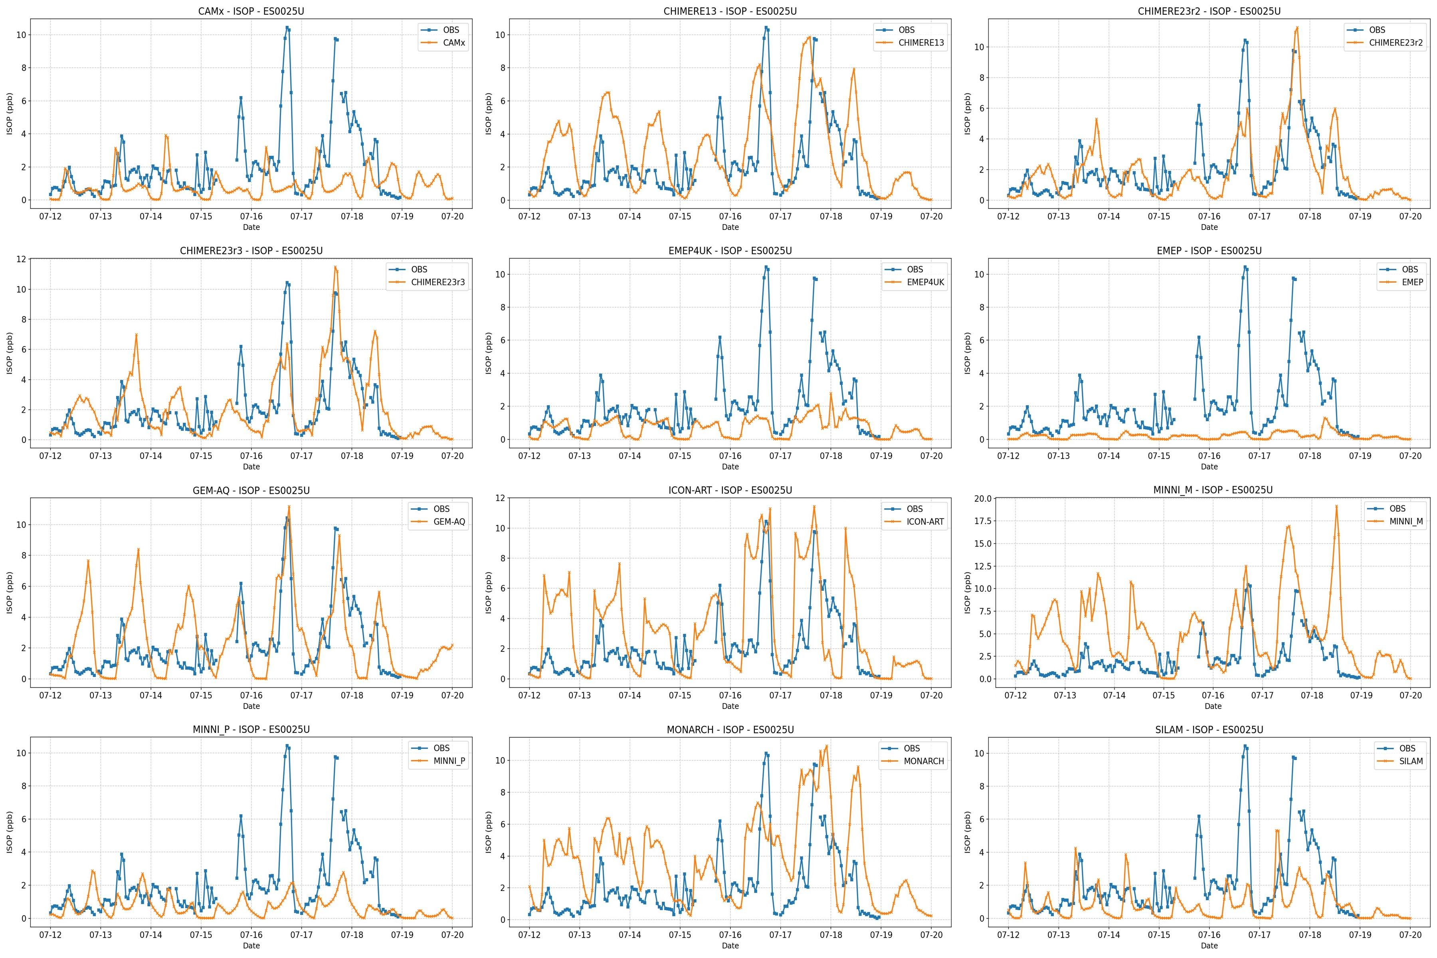
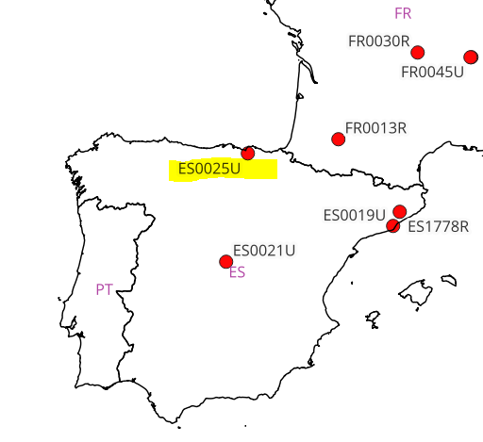
Isoprene
all models, ES0025U
Bilbao, María Díaz de Haro,
Urban, residential,
911.0 m

Slide 20
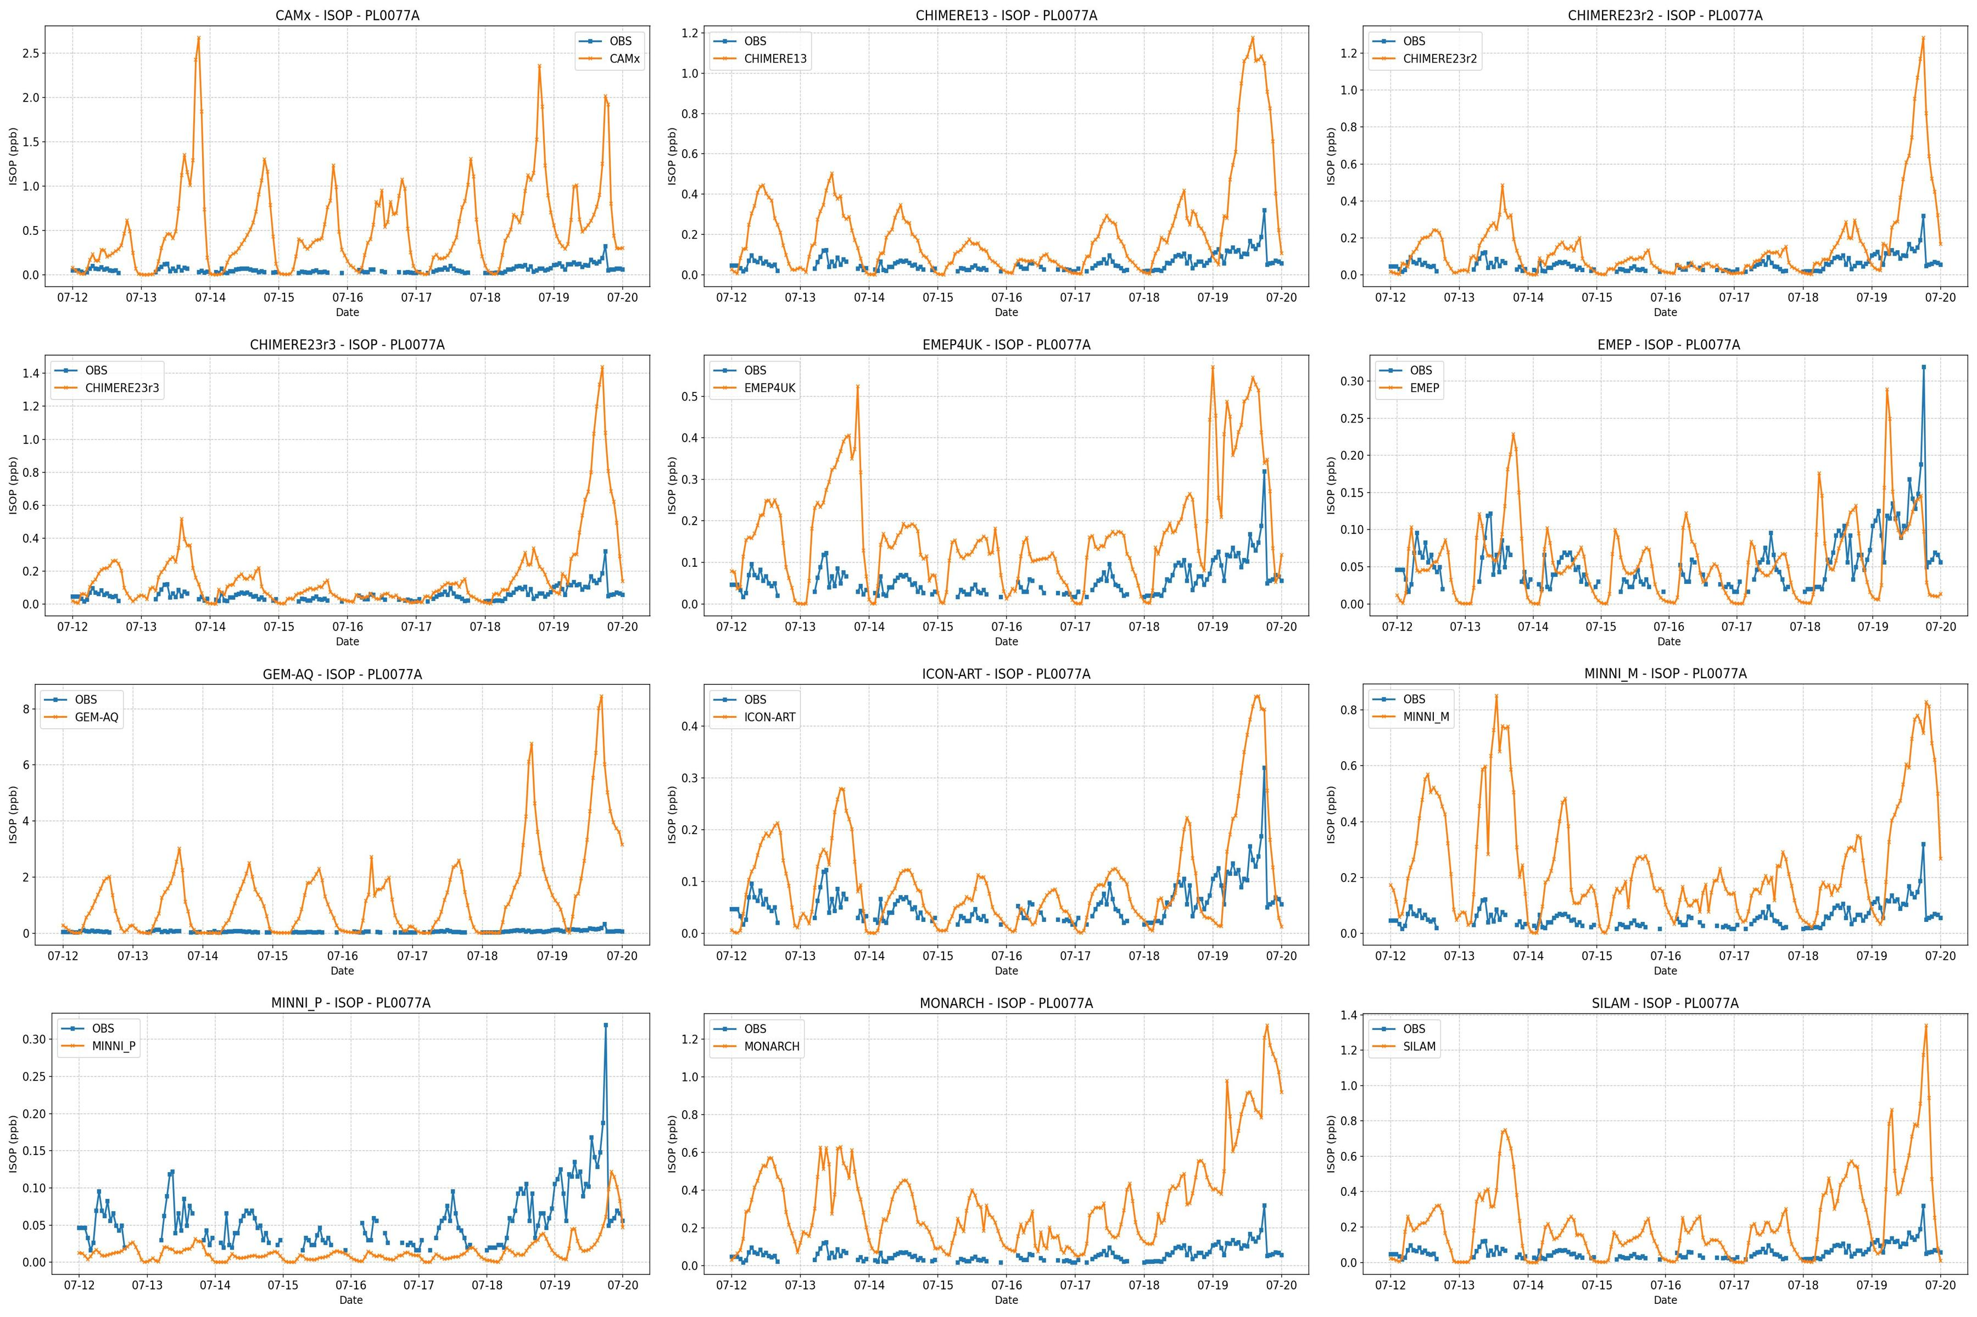
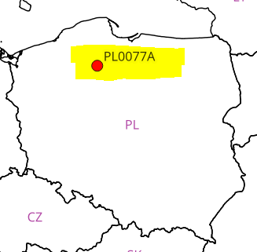
Isoprene all models, PL0077A
Zielonka, Bory Tucholskie,
Background, rural

Slide 21
Summary and next steps
Evaluation:
  Overall evolution pattern similar for all models (meteo-driven) but quite significant regional differences
  Daily maximum overestimated < 100ug/m³ and underestimated > 140ug/m³
Biogenic contribution (only athropogenic emissions):
  On average biogenic emissions contributed to the increase of ozone concentrations by 10-15%
  The biogenic contribution was slightly lower at rural stations for all models
  Biogenic VOC contribution was higher during the episode period
  Ozone increment due to biogenic emission seem to be a linear function of the temperature
Anthropogenic contribution:
  On average anthropogenic emissions contributed to the increase of ozone concentrations by 20-30%
  Anthropogenic contribution was higher because both precursor groups play a role
  Anthropogenic contribution is more model dependent and stable in the analysed period (in spite of NORTH)

Slide 22
Summary and next steps
Fires: fire emissions in „biogenic-only” run incresed O₃ concentrations
Accuracy of iosoprene represenation (preliminary):
  Limited set of stations – only 24-h
  Two stations with highest concentraions removed from the analysis
  In most models double maximum – not conformed in measuremenst
  Model accuracy for isoprene stronglu depend on the day and staion location

Slide 23
Next steps
Analysis of other VOC species
Analysis of isoprene emissions (including temporal variability)
Analysis on NOx, NOz and PAN
Chemical regime indices
Report + publications

Slide 24
Thank you

