Slide 1
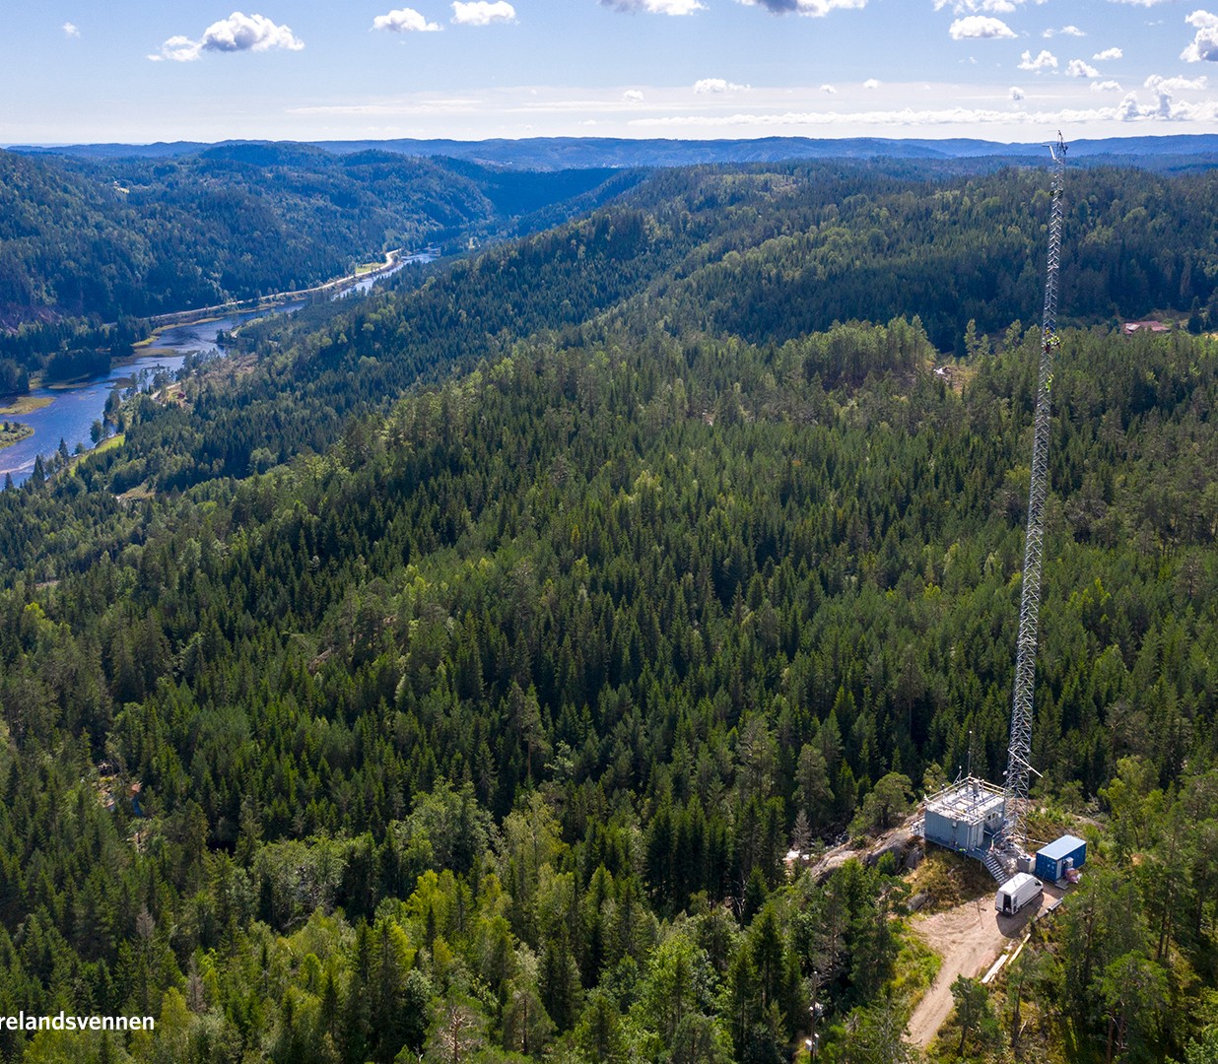

Slide 2
Equivalent black carbon observations and source apportionment in EYE-CLIMA and AeroVal
Stephen M. Platt (sp@nilu.no), Sabine Eckhardt, Wenche Aas, Karl Espen Yttri

Slide 3
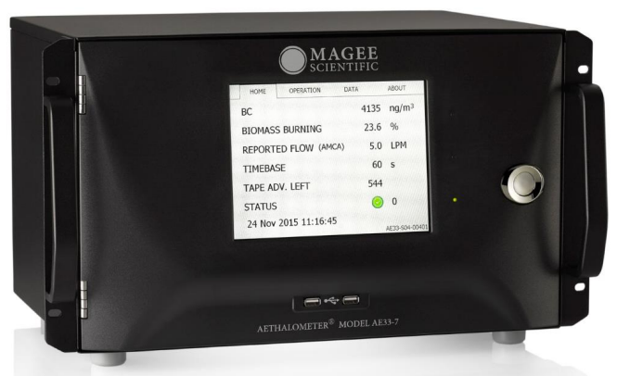
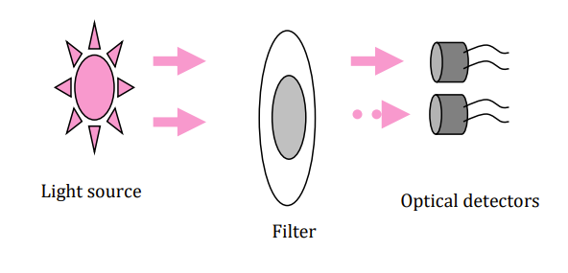
Equivalent black carbon observations
AE 33 aethalometer and basic illustration of measurement technique (Magee, from the instrument manual)
Equivalent black carbon (eBC): operationally defined in recent EU air quality directive as black carbon derived from optical methods.
Required parameter at super sites.
Common method is filter absorption photometry and conversion via mass absorption cross section (MAC). eBC=absorption/ MAC.
*DIRECTIVE (EU) 2024/2881 OF THE EUROPEAN PARLIAMENT AND OF THE COUNCIL of 23 October 2024 on ambient air quality and cleaner air for Europe https://eur-lex.europa.eu/legal-content/EN/TXT/PDF/?uri=OJ:L_202402881

Slide 4
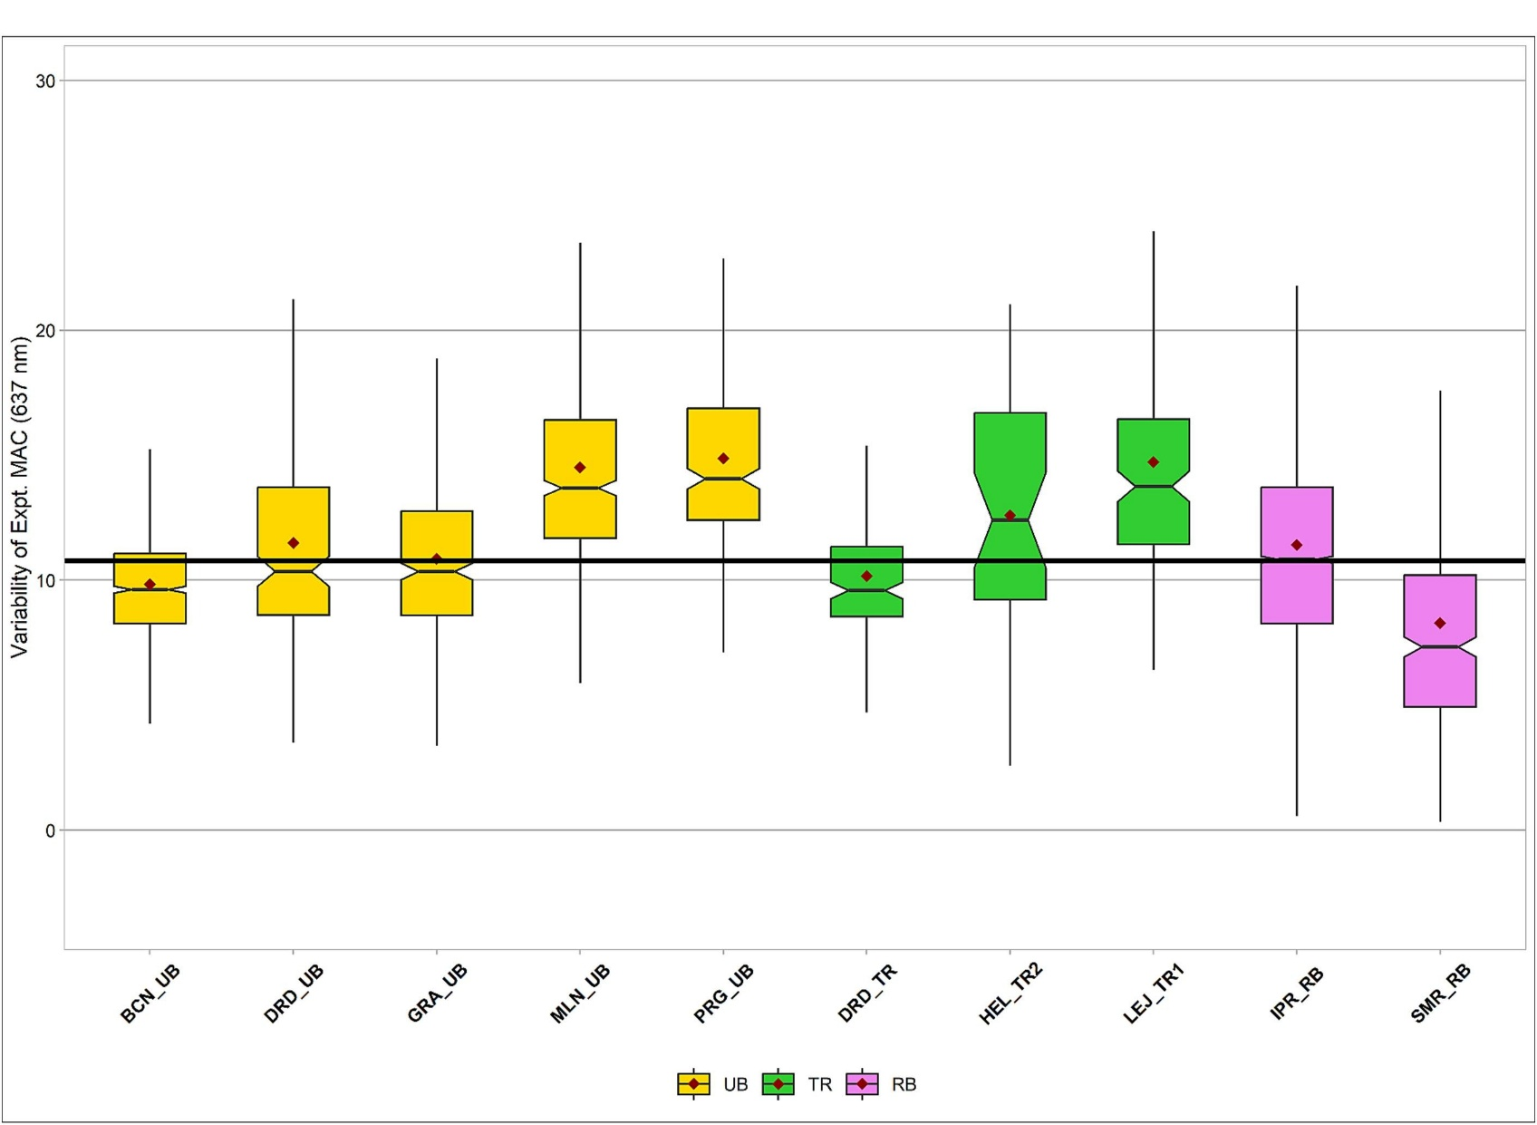
Need for harmonized measurements
High demand for regional scale model intercomparisons and assessment via inversion models (e.g., EYE-CLIMA).
MAC is highly variable e.g., influenced by coating, mixing state, while data provision via ACTRIS as a level 3 product (ebas.nilu.no) uses a fixed value, i.e., without a site-specific reference.
Exist numerous institutions who do not upload data to open access platforms.
Tailor datasets to the needs of specific modelling exercise with respect to how data are compiled, time stamp, fixing formatting errors etc.
Variability in MAC across sites seen in Savadkoohi et al. 2024 at urban (yellow), traffic (green), and rural background (magenta) sites.

Slide 5
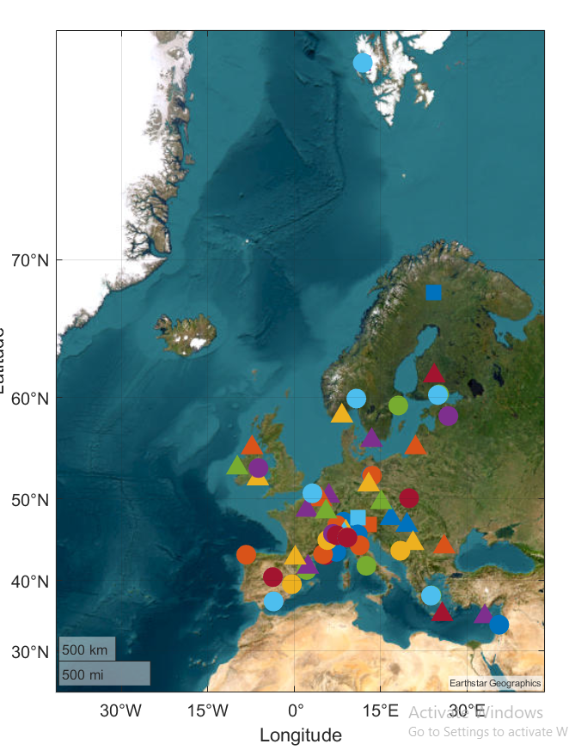
Harmonised dataset
67 sites across Europe (dominated by urban)+ Trollhaugen
Data from EMEP/ ACTRIS / COLOSSAL 2017-18 intensive measurement period, ACTRIS, RI URBANS, ebas.nilu.no and some individual data provision
Hourly aethalometer data from 2015 to 2023
Common treatment of MAC via normalisation to co-located elemental carbon (EC) filter measurments, MAC=∑absorption/ ∑ EC. Use of instrument MAC when no EC available

Slide 6
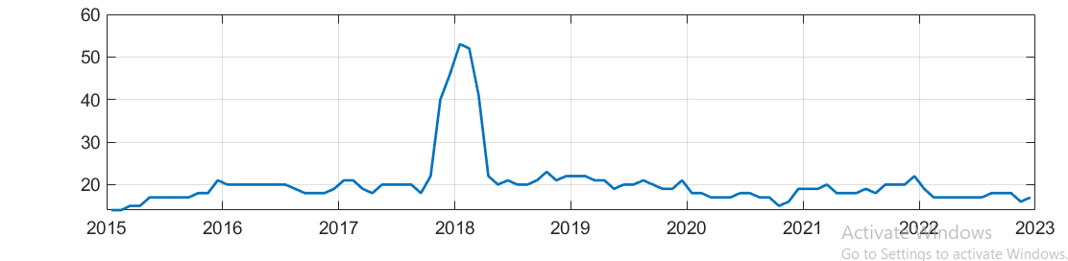
Harmonised dataset
68 sites across Europe (dominated by urban).
Data from ACTRIS / COLOSSAL 2017-18 intensive measurement period, ACTRIS, RI URBANS, ebas.nilu.no and some individual data provision,
Hourly data from 2015 to 2023.
Common treatment of MAC via normalisation to co-located elemental carbon (EC) filter measurements, MAC=absorption/ EC. Use of instrument MAC when no EC available.
Huge jump in data coverage for EMEP IMP
Number of sites

Slide 7
Overview of eBC levels and MAC
Average MAC value was 10.6 and highly variable as expected. No dependence on site classification
Average eBC concentrations highest in urban and eastern European sites. Lowest at global sites.
Span orders of magnitude

Slide 8
Harmonised dataset
Average MAC value was 10.6 and highly variable as expected. No dependence on site classification
Average eBC concentrations highest in urban and eastern European sites. Lowest at global sites.
Span orders of magnitude
See also next talk for in depth analysis!

Slide 9

Source apportionment of eBC
Succesful climate mitigation and air quality regulations require knowledge of eBC sources.
Multi wavelength aethalometer: spectral fingerprint (absorption Ångstrøm exponent, AAE).
AAE heavily influenced by combustion conditions hence source apportionment is possible for liquid fuel (almost exclusively combustion engine, traffic) and solid fuel (many sources, mainly residential heating/ woodburning).
Important to note that a limitation of the observations is that it does not align with inventory categories.
Continuation of SA work as part of EYE-CLIMA project (https://eyeclima.eu/)

Slide 10
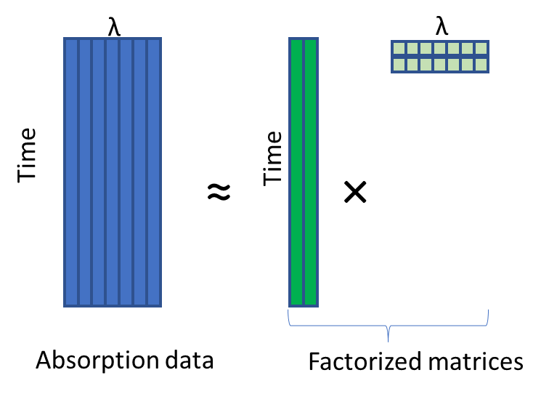
Source apportionment models for eBC
Model 1) The aethalometer model using bulk data observed AAE. Simple equations but highly sensitive to AAE and sometimes yields negative concentrations (may be presented in next talk)
Model 2) The aethalometer model using AAE derived from NNMF profile
Model 3) Using the NNMF output time series (Lee and Seung iterative algorithm).
Simplified schematic of matrix factorisation

Slide 11
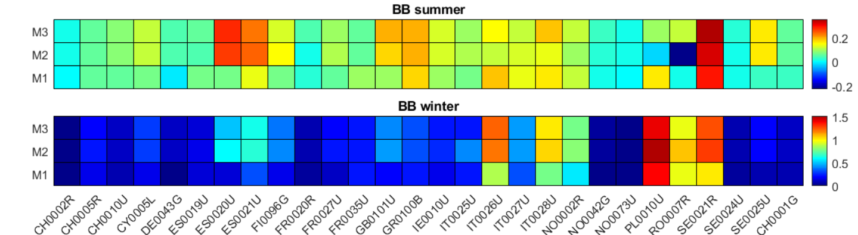
Solid and liquid fuel fractions
Aeth. Model 1
Hybrid Model 2
NNMF Model3
Aeth. Model 1
Hybrid Model 2
NNMF Model 3
Clear correlation between model approach, though NNMF gives lower solid fuel (biomass burning) fractions
Levels of solid fuel eBC are higher in winter than summer indicative of residential heating
Northern and eastern Europe and Italy have higher levels

Slide 12
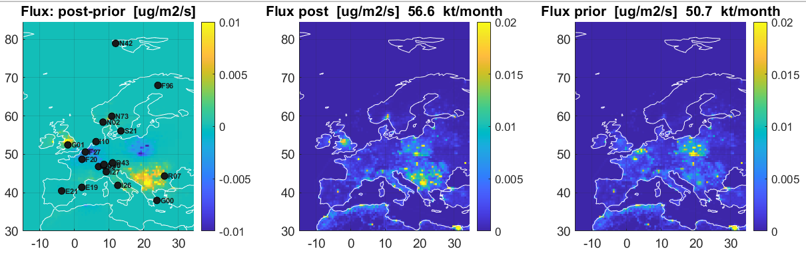
Inversion model work in EYE CLIMA
The inversion model FLEXINVERT uses transport model FLEXPART, and observations, to move prior emission inventory data (GFAS / GFED.) closer to the oberved atmsopheric value to produce a posterior estimate
So far inversions for total eBC but SA to follow.
Few stations, particularly rural background with long times series, high sensitivity in Northern and Eastern Europe to data from a single country/ station, .e.g. Romanian data.
The posterior is higher than the prior in UK, Scandinavia and South East Europe; lower in Central and Eastern Europe

Slide 13
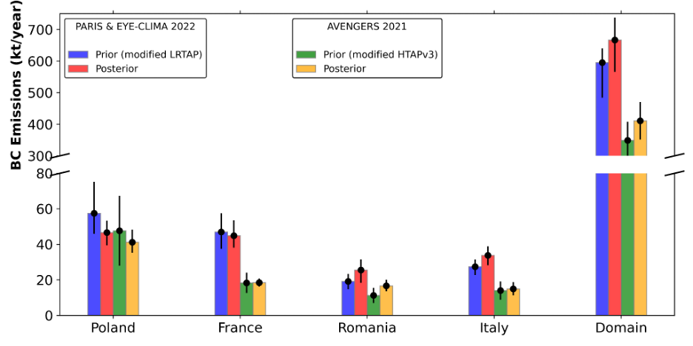
Posterior emissions in EYE-CLIMA/ PARIS / AVENGERS
Harmonised data used in PARIS and EYECLIMA (AVENGERS uses mostly RiUrbans data).
Variable reduction in uncertainties , all projects indicate a small uderestimate in the prior inventories on average but with national variation.
Poland & France: Posterior estimates are consistently lower than priors across both datasets, with better constraint
Romania & Italy: Posterior emissions increase slightly compared to priors in PARIS & EYE-CLIMA, but remain lower in AVENGERS.

Slide 14
Conclusions
Harmonised Dataset Creation
Developed a harmonised dataset from 68 Eye-Clima sites, improving data consistency across regions.
High MAC Variability
Significant variability in mass absorption cross-section (MAC); supports the need for co-located elemental carbon (EC) measurements.
Black Carbon Source Apportionment
Improved source attribution using aethalometer and NNMF models, enabling clearer separation of liquid vs. solid fuel sources.
Model Intercomparison
Strong agreement across methods (aethalometer, hybrid, NNMF); NNMF consistently shows lower solid fuel contributions.
Inversion Modeling
Inversion models help refine black carbon emission estimates, particularly in Scandinavia and Southeast Europe.
Future Needs
Expanded station coverage, especially in Southeast Europe, is essential to reduce uncertainties and improve emission estimates.

Slide 15
Takk for oss.

Slide 16
Science Matters

Slide 17
Supplementary on adapted AAE
Histogram of 5 years’ absorption Angstrøm exponent
Aethalometer model using simple equations, highly sensitive to a priori absorption Aangstrøm exponent (AAE, wavelength dependence of absorption)
The AAE must be adapted to the measurement time series
The best approach is to derive this paramter from the obsservations, do not rely on e.g. Zotter et al., (2017).
The first percentile is a an approximation of pure liquid fuel, the 99th percentile represents pure solid fuel signal, see e.g. Tobler et al., (2021)

Slide 18
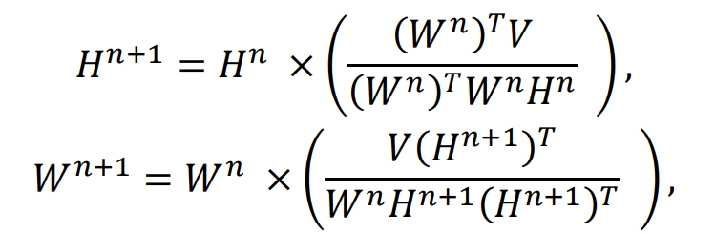
Supplementary on NNMF
Model 1) The aethalometer model. Simple equations but highly sensitive to a priori inputs and sometimes yields negative concentrations
Model 2) The aethalometer model using Ångstrøm exponent pair derived from NNMF
Model 3) Using the NNMF output time series (Lee and Seung iterative algorithm). See report for details.
‘Complicated’ equations of matrix factorisation
Lee and Seung, Iterative update of profile H then time series W
The original matrix factorisation
Simple and fast, with no error matrix (has pros and cons)

Slide 19
Solid and liquid fuel fractions
Aeth. Model 1
Hybrid model 2
NNMF model3
Aeth. Model 1
Hybrid model 2
NNMF model 3
Clear correlation between model approach, though NNMF gives lower solid fuel fractions
Levels of solid fuel eBC are higher in winter than summer indicative of residential heating
Northern and eastern Europe and Italy have higher levels

Slide 20
Intercomparison of models
AAE values of all absorption data (probability density) and the NNMF output (Zeppelin):
Comparison of NNMF (M3) and the aethalometer model (M2)
NNMF seems quite good at finding representative AAE values
Using NNMF derived AAE values with the aethalometer model yields favourable comparison
If the NNMF AAE is reasonable, it will closely match the solid fuel fraction from the aethalometer model

Slide 21
Inversion model work
The inversion model FLEXINVERT uses tranport model FLEXPART, and observations, to move prior emission inventory data closer to the oberved atamsopheric value to produce a posterior estimate
So far inversions for total eBC (conversion between absorption and eBC is always using EC from filters)

Slide 22
Inversion model work
The inversion model FLEXINVERT uses tranport model FLEXPART, and observations, to move prior emission inventory data closer to the oberved atamsopheric value to produce a posterior estimate
So far inversions for total eBC (conversion between absorption and eBC is always using EC from filters)
The posterior is higher than the prior in UK, Scandinavia and South East Europe; lower in central and Eastern

Slide 23
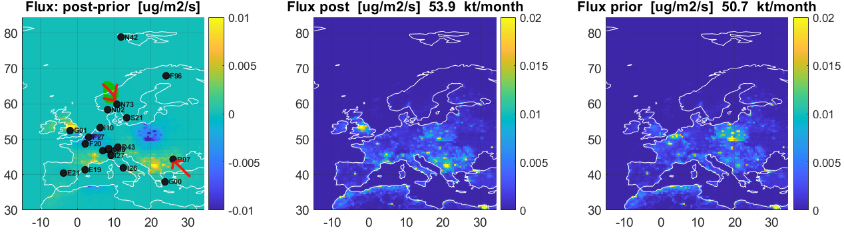
Inversion model work
The inversion model FLEXINVERT uses tranport model FLEXPART, and observations, to move prior emission inventory data closer to the oberved atamsopheric value to produce a posterior estimate
So far inversions for total eBC (conversion between absorption and eBC is always using EC from filters)
A major caveat is the low station coverage in South East Europe! An example how WeBaSOOP data could be crucial

