Slide 1

PAH Source Attribution in Europe: A Modelled and Moss-Based Perspective
Isabel Garcia Arevalo, Oleg Travnikov,
Milena Horvat
Jožef Stefan Institute Ljubljana, Slovenia

Slide 2
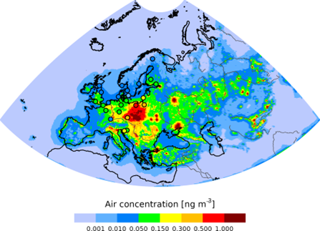
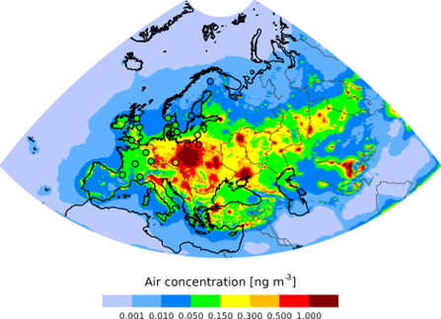
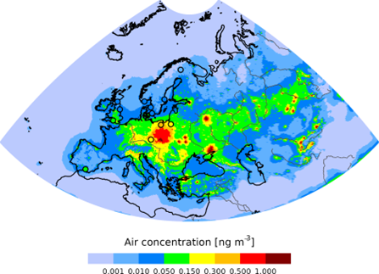
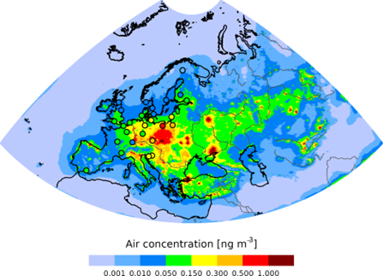

Polycyclic Aromatic Hydrocarbons -PAHs
PAHs - organic pollutants formed during incomplete combustion of fossil fuels and biomass, and industrial activities.
Known for their toxicity, persistence, and potential carcinogenicity.
BaP
BbF
Focus on 4 PAH simulations (BaP, BbF, BkF, IP)
BkF
IcdP
Multi-scale, multi-pollutant chemical transport model:
  GLEMOS model

Slide 3
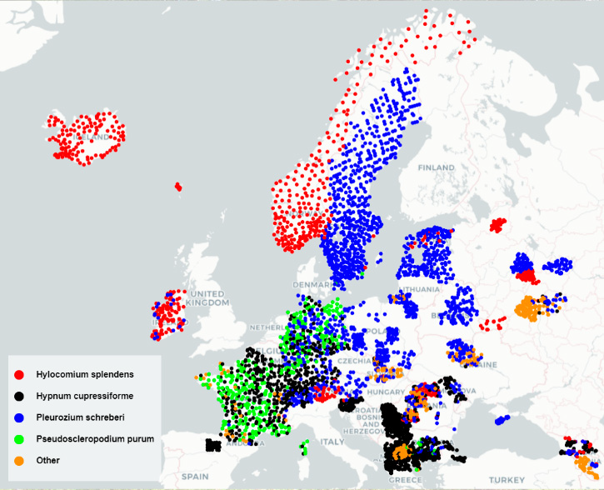
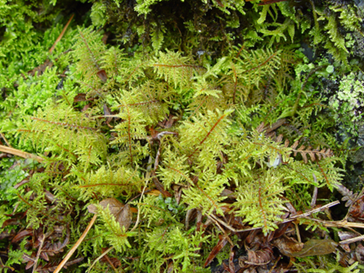
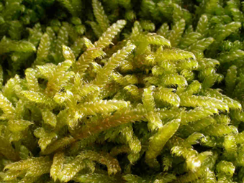
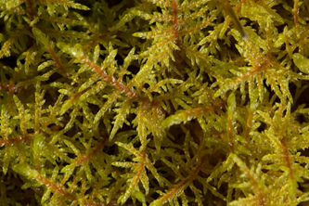
Moss biomonitoring
Sensitive to atmospheric pollutants → detect low concentrations of PAHs
Accumulate pollutants over time → long-term monitoring of air quality and trends
Using mosses as bioindicators is a more affordable alternative
Easily collected from various locations → broad spatial coverage of pollution
Hylocomium Splendens
Hypnum cupressiforme
Pleurozium schreberi
Samples of naturally growing moss collected during the summer of 2015

Slide 4
Source attribution analysis
Molecular diagnosis ratios
Receptor models (PCA-MLR, PMF)
Compound specific isotope analysis
Compound specific radiocarbon analysis CSRA
Measurements
Field simulation
Source – receptor matrix simulation
Modelling
Regions
Countries
Sources

Slide 5
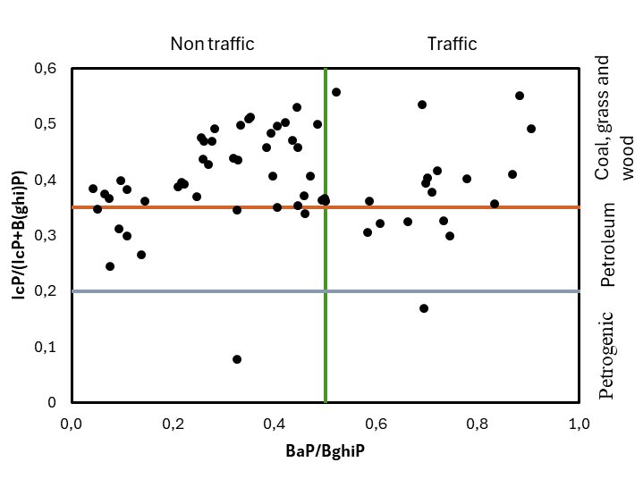
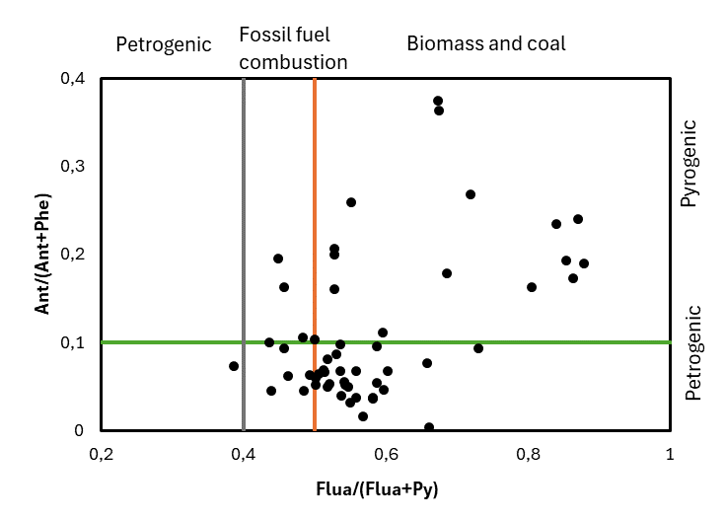
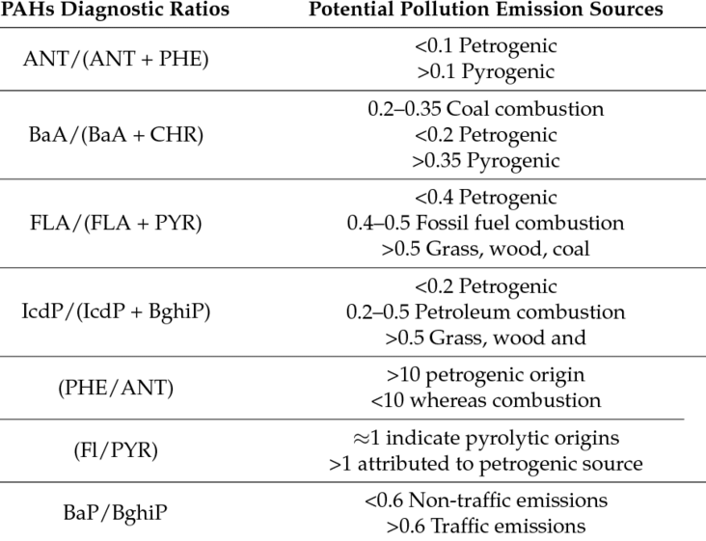
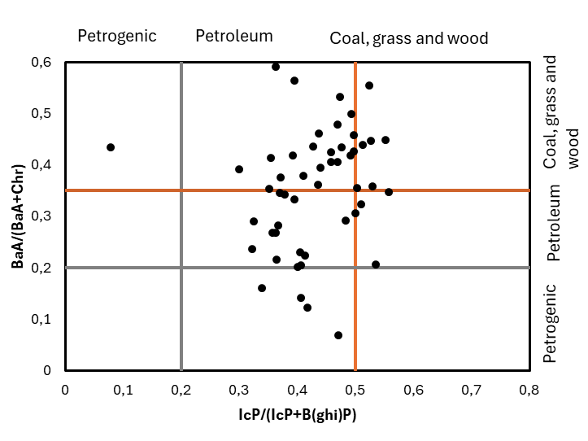
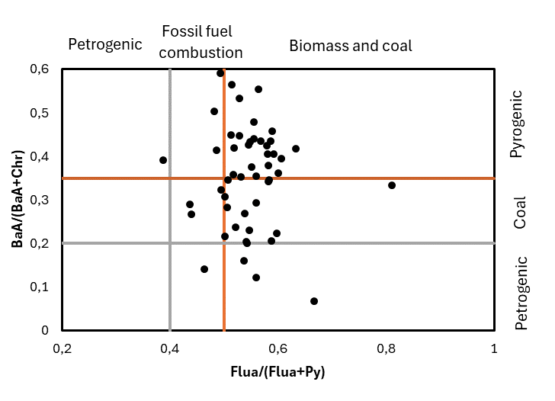
Diagnostic ratios
Moss measurements from 2015 moss survey across Europe*
Identify the sources of PAHs by comparing the concentrations of different PAH compounds
PAHs origin: petrogenic (oil-based) or pyrogenic (combustion) sources
(Katarzyna et al., 2017)
Moss measurements obtained in collaboration with ICP-Vegetation.

Slide 6
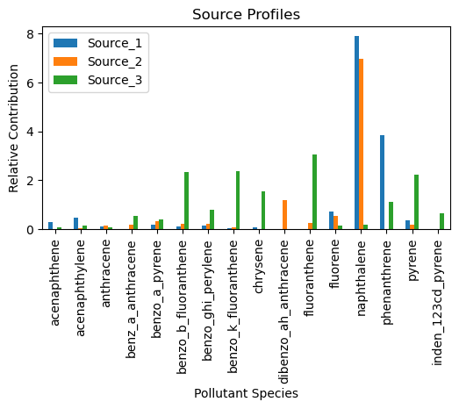
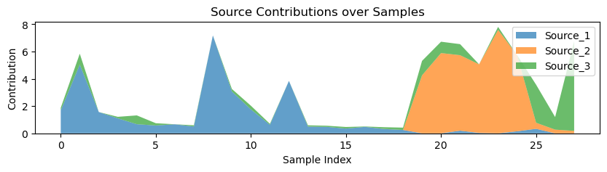
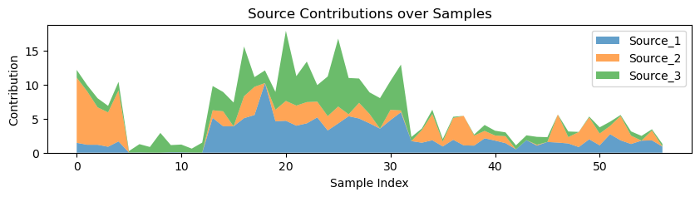
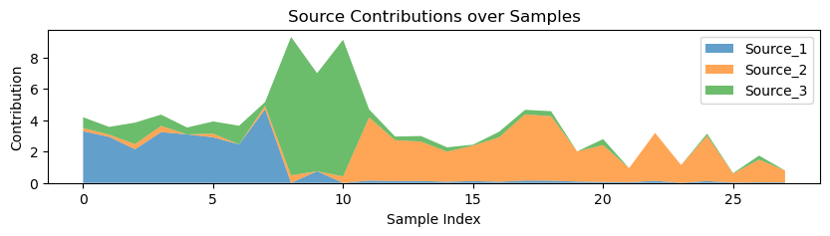
Receptor models: Positive matrix factorization (PMF)
Hylocomium Splendens
Multivariate factor analysis tool that decomposes a matrix of measured chemical concentrations into:
  Source profiles (F): characteristic fingerprints of pollution sources.
  Source contributions (G): how much each source contributes to each sample.
Used to qualify and quantify PAH sources based on patterns and co-occurrence of LMW and HMW PAH to group them into likely source factors.
Hypnum cupressiforme
Pleurozium schreberi

Slide 7
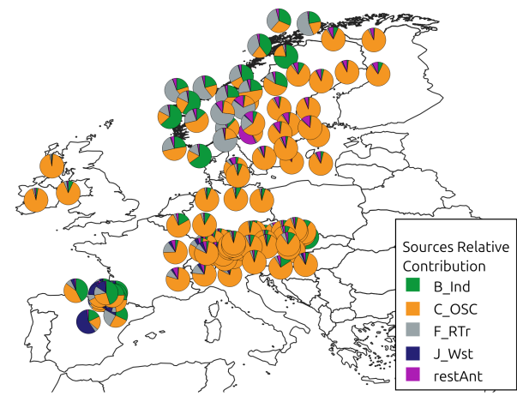
PAH modelling source attribution
Total (4PAH) source receptor simulation results over the available moss measurements from 2015 moss survey.
Main sources relative contribution spatial distribution across moss sampling sites
  Differences between countries/ regions
Concept approval – complex analysis of pollution patterns and source attribution
Comparison of PAH source attribution using moss data (diagnostic ratios and PMF) with source-receptor simulations
Results partially presented at TF meeting of ICP-Vegetation (Tirana, Albania, 10-13 February 2025)

Slide 8
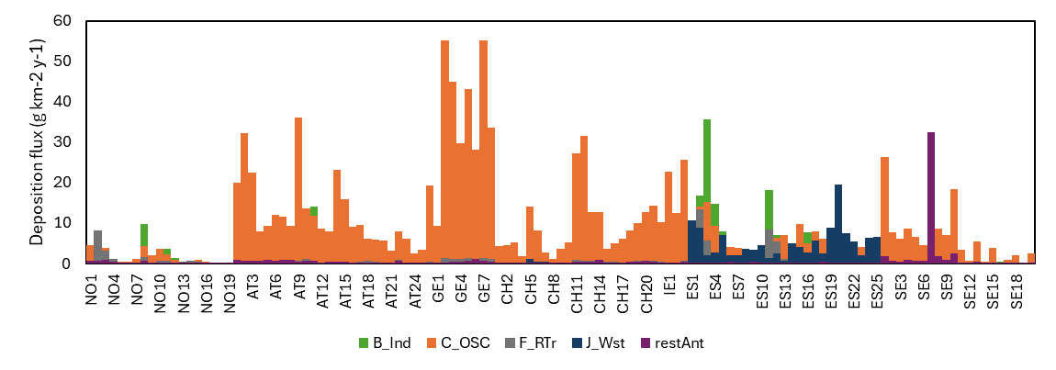
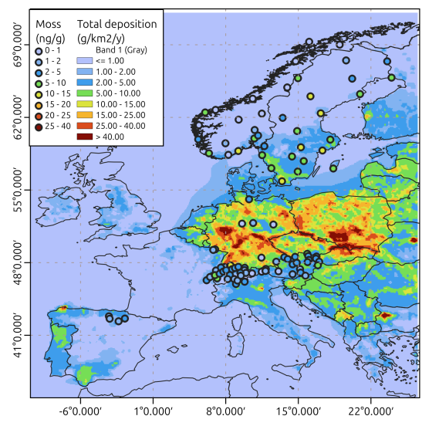
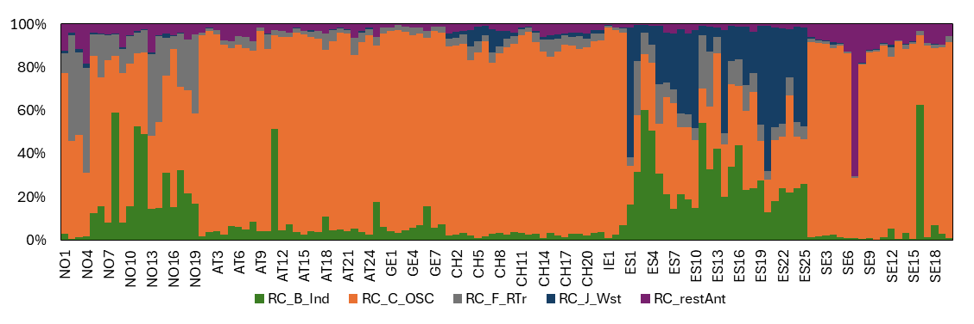
Source receptor simulation for BaP
PAH source deposition flux
Simulated PAH deposition vs. concentrations in mosses for 2015
Relative source contribution

Slide 9
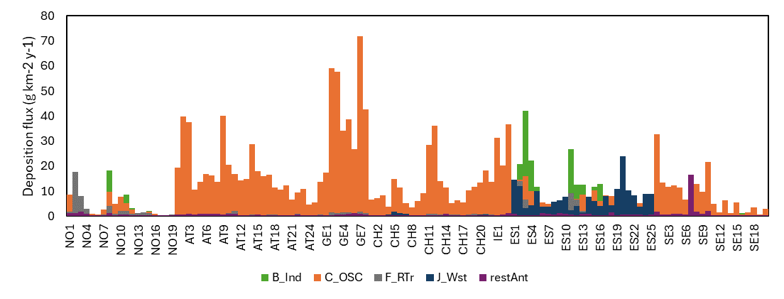
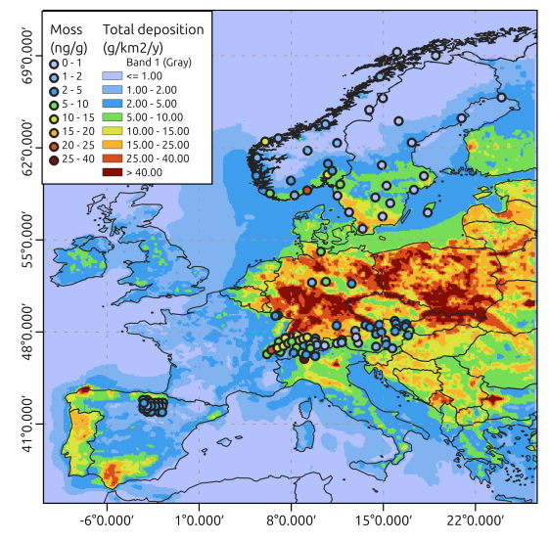
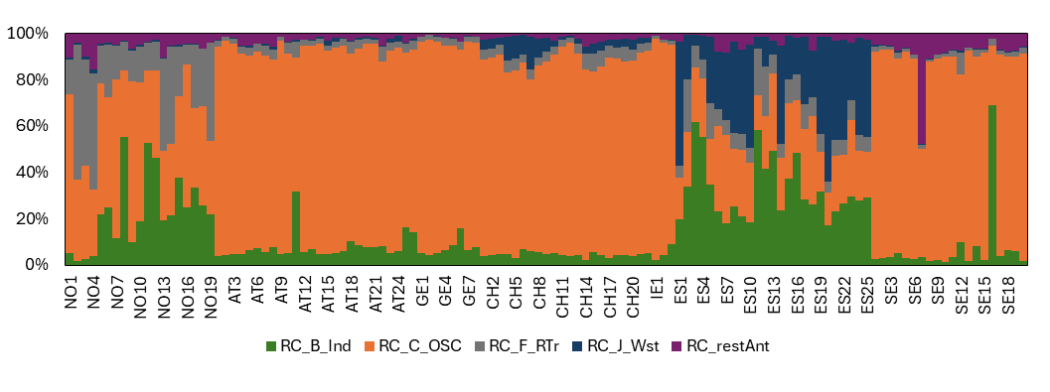
Source receptor simulation for BbF
PAH source deposition flux
Simulated PAH deposition vs. concentrations in mosses for 2015
Relative source contribution

Slide 10
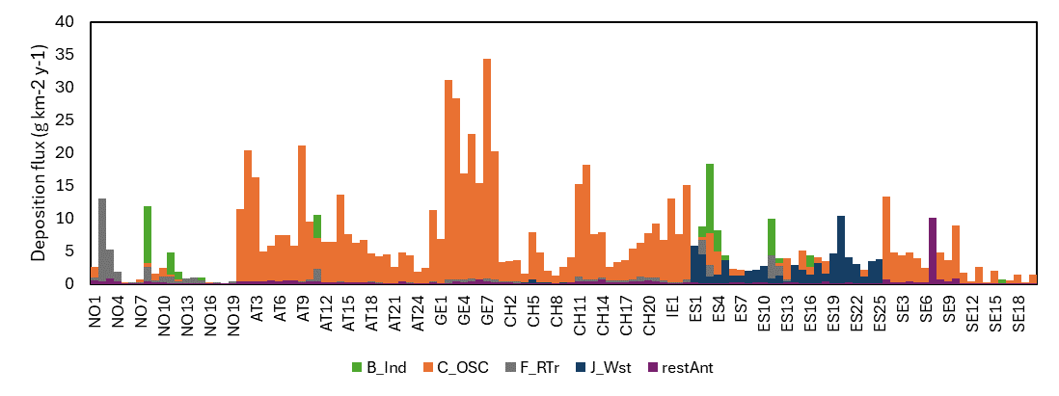
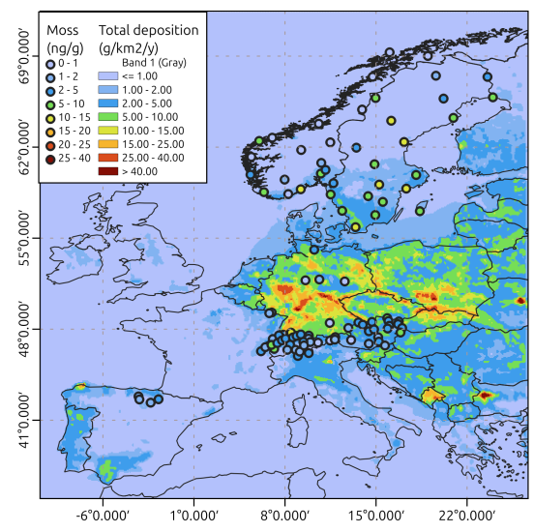
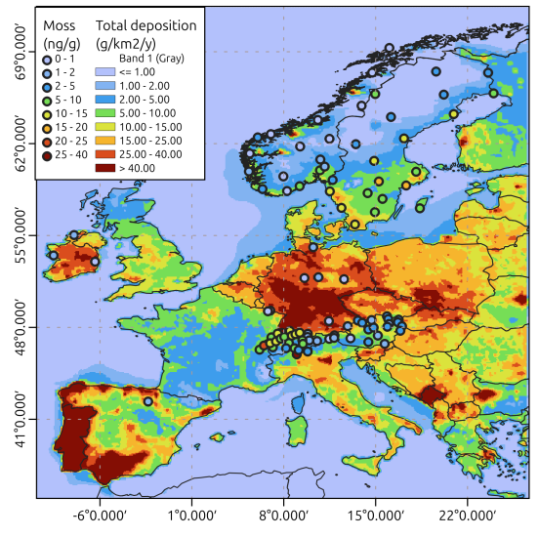
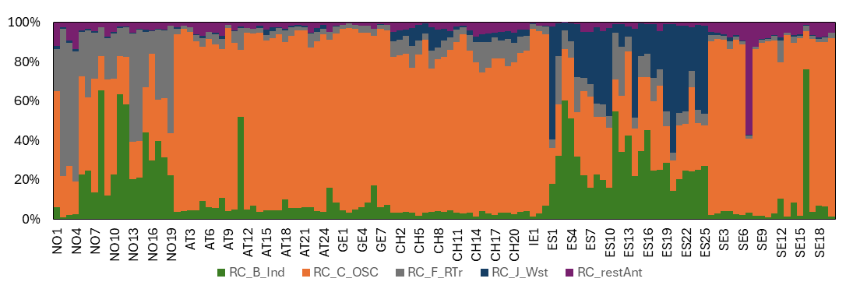
Source receptor simulation for BkF
PAH source deposition flux
Simulated PAH deposition vs. concentrations in mosses for 2015
Relative source contribution

Slide 11
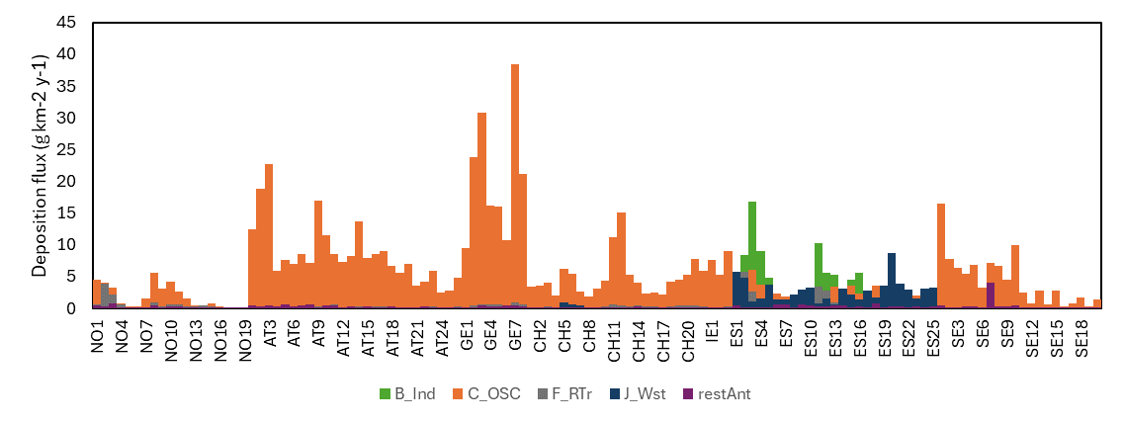
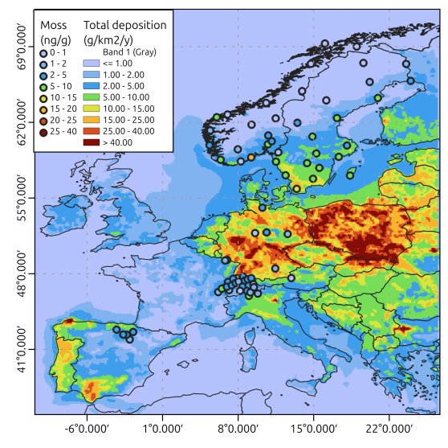
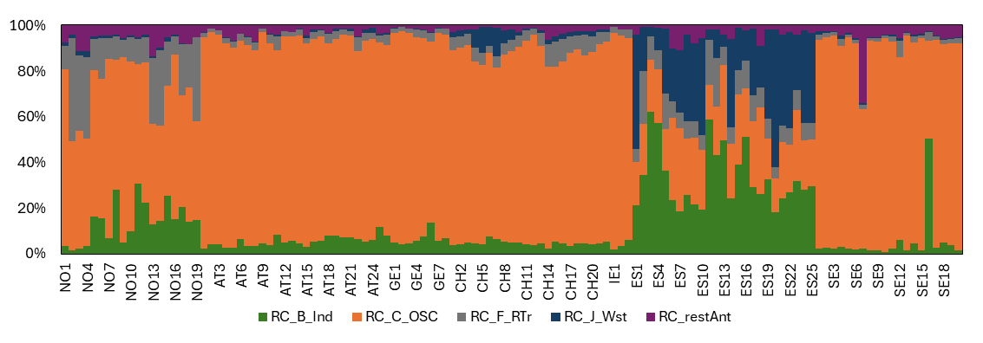
Source receptor simulation for IP
PAH source deposition flux
Simulated PAH deposition vs. concentrations in mosses for 2015
Relative source contribution

Slide 12
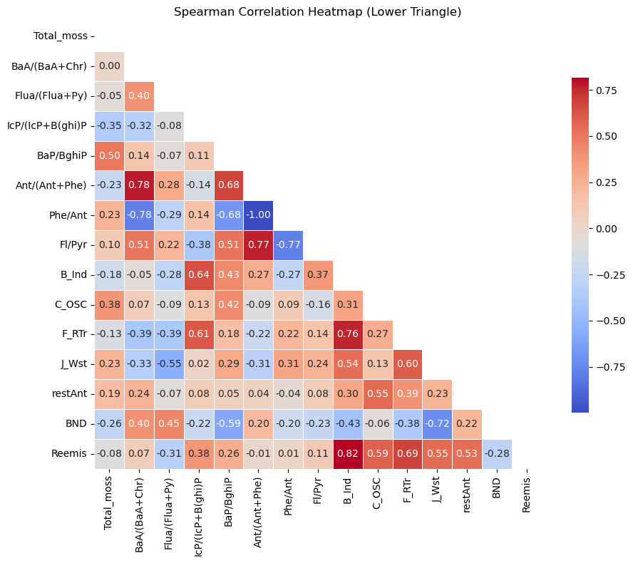
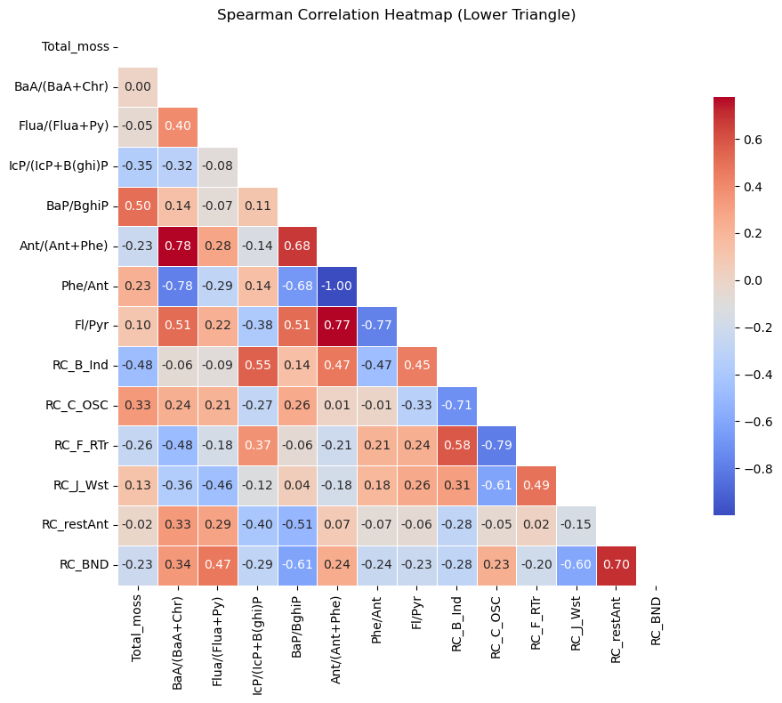
PAH modelling vs. moss biomonitoring
Source deposition flux of 4 principal PAH vs.
Molecular diagnosis ratios
Source Relative contribution of 4 principal PAH vs.
Molecular diagnosis ratios

Slide 13
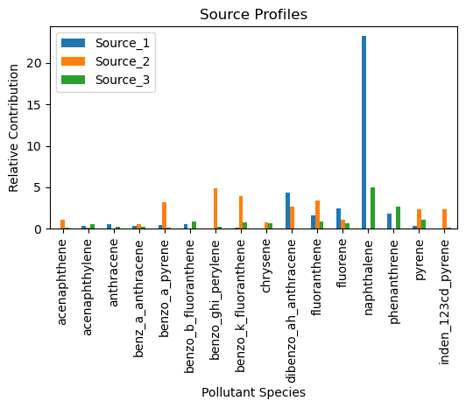
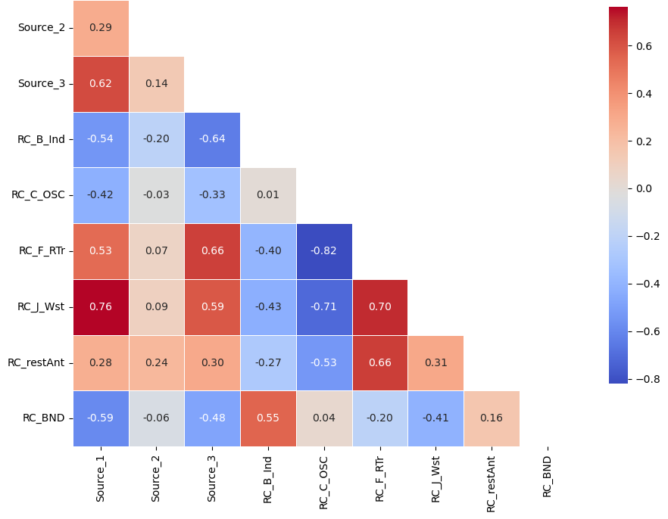
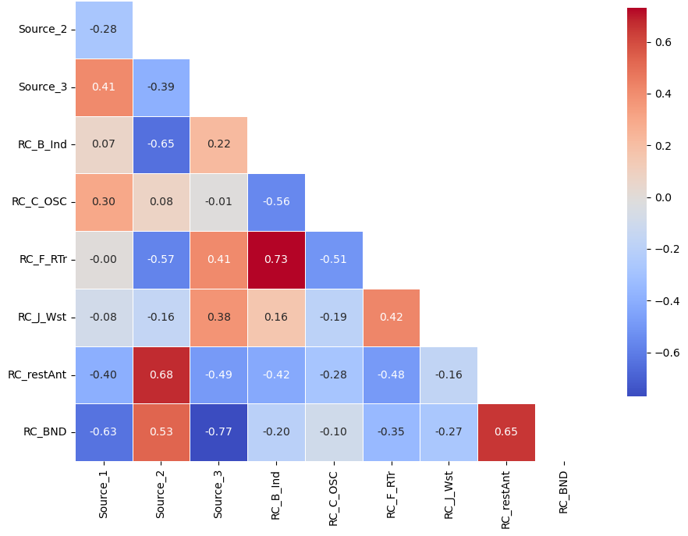
PAH modelling vs. moss biomonitoring
Hypnum cupressiforme
Pleurozium schreberi

Slide 14
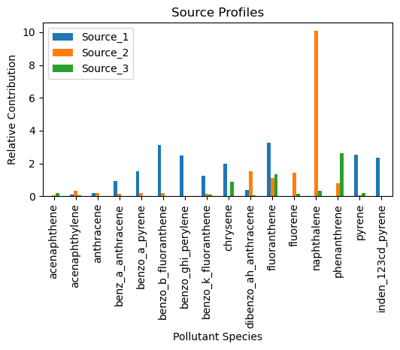
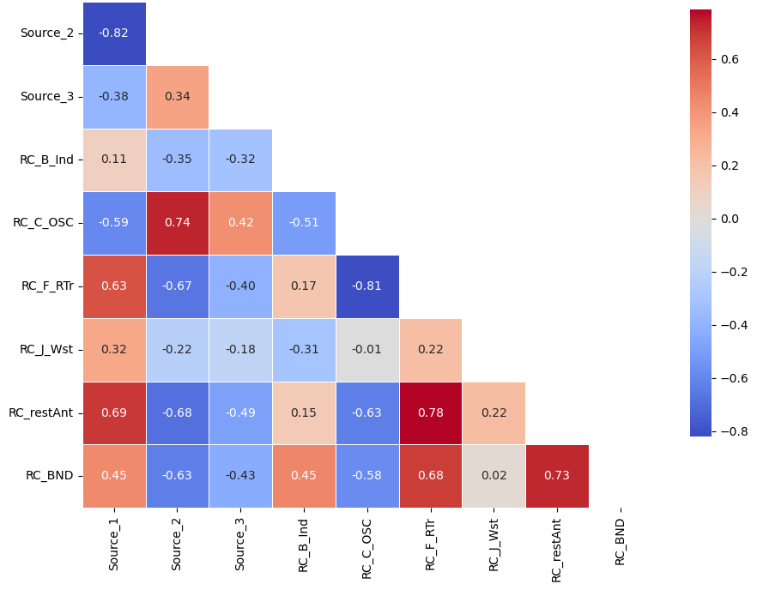
PAH modelling vs. moss biomonitoring
Hylocomium Splendens
Conclusions and perspectives
PAH source attribution depends on available data for moss measurements and quality of reported emissions data for source-receptor simulations.
  Both methods to qualify and quantify source attribution (diagnostic ratios and PMF) by mosses agree with source-receptor simulations.
  Correlation to PAH particulate deposition and source contribution is Moss-specific/ country specific.
Future work:
  Further co-operation with ICP-Vegetation on PAHs
  Case study for Slovenia – compound specific isotope composition

Slide 15
Thank you!

Slide 16
References
Kozak, Katarzyna & Ruman, Marek & Kosek, Klaudia & Karasiński, Grzegorz & Stachnik, Lukasz & Polkowska, Żaneta. (2017). Impact of Volcanic Eruptions on the Occurrence of PAHs Compounds in the Aquatic Ecosystem of the Southern Part of West Spitsbergen (Hornsund Fjord, Svalbard). Water. 9. 1. 10.3390/w9010042.

