Slide 1
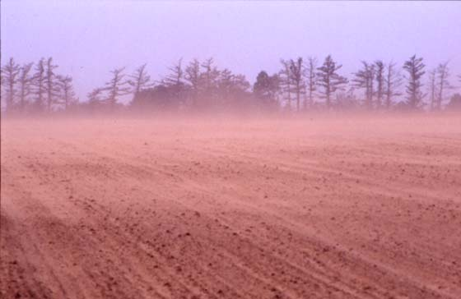
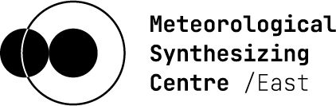

“Effect of dust resuspension on heavy metal pollution:
A sensitivity analysis“
Viktoria Koncz, Oleg Travnikov
Notes:
Hi Everybody!!
My name is Viktoria Koncz, and I joined to MSC-E center as a postdoc in October, where I started working on athmospheric modelling of heavy metals.

Slide 2
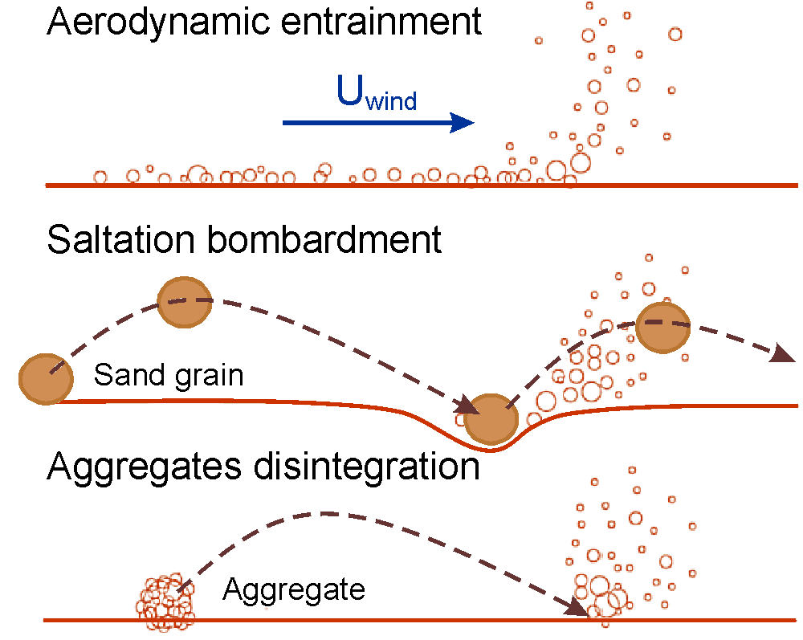
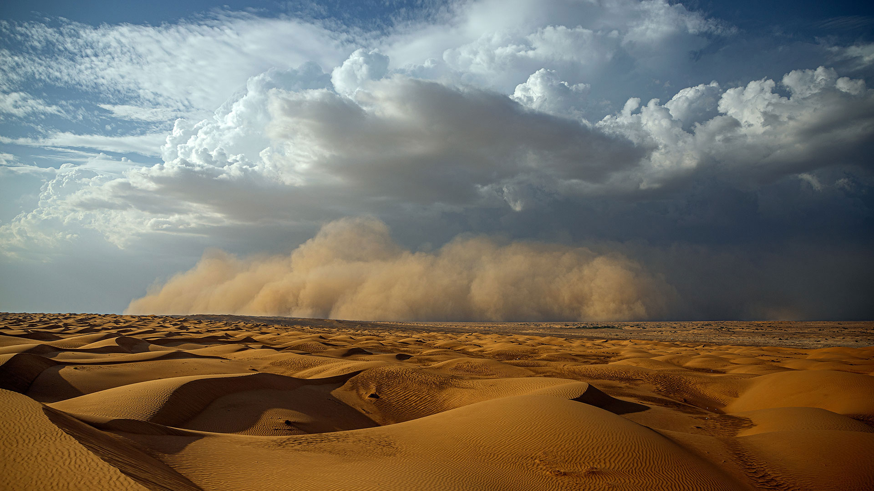
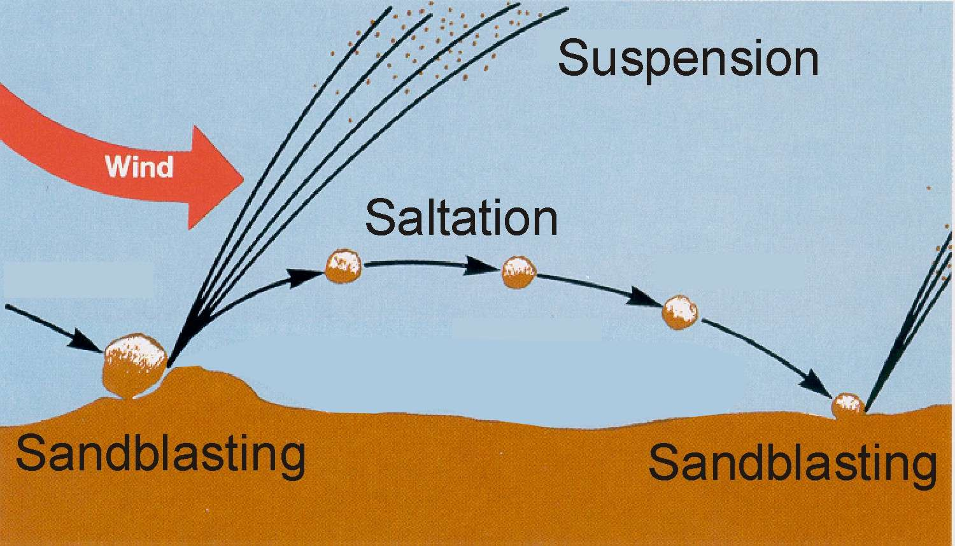
Wind resuspension of dust
Provides a source of dust and contaminants for the atmosphere
Saltation: moved by wind stress close to the surface jumping from one place to another
Sandblasting: when the saltating aggregated impact the ground they can eject much smaller particles, which can be easily suspended by wind

Slide 3
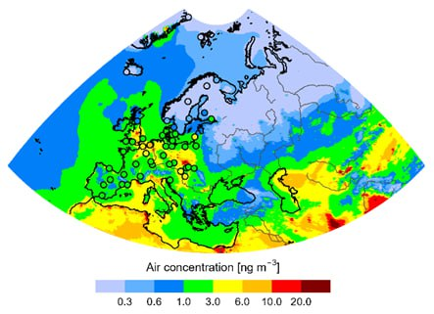
Motivation
Large contribution of wind resuspension to particulate heavy metals (Pb, Cd)
High uncertainty of resuspension simulations
Revision of the dust module:
  Original GLEMOS scheme: based on Marticorena-Bergametti scheme (MB95)
  Parameterisation of the original scheme:
    Sensitivity analysis
  Testing other dust resuspension schemes
Contribution to Pb deposition in EMEP countries
Notes:
Heavy metals like lead and cadmium are travelling in the athmosphere with dust in a particulate bound form. Wind resuspension has a large contribution to Pb deposition in EMEP countries, like this diagram shows.
Unfortunately, the mechanism of resuspension is highly uncertain, there are a lot of uncertainities in the process parameterisation.
The mechanism of wind resuspension can be dividied into 2 categories: saltation, and sandblastion.
…. Maybe here more about saltation and sandblastion. Saltation means horizontal movement of soil aggregates, saltation starts if the wind friction velocity reaches a critical value. Sandblastion is when saltating aggregated reaches the ground, and eject much smaller particles. These particles can be easily suspended by wind.

Slide 4
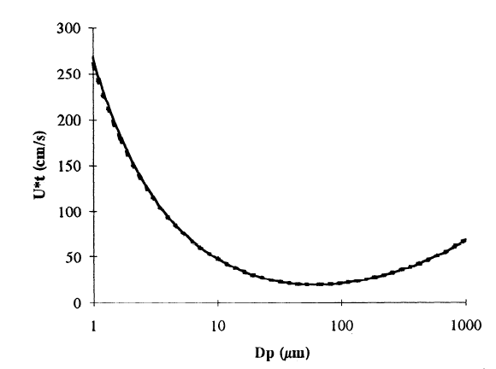
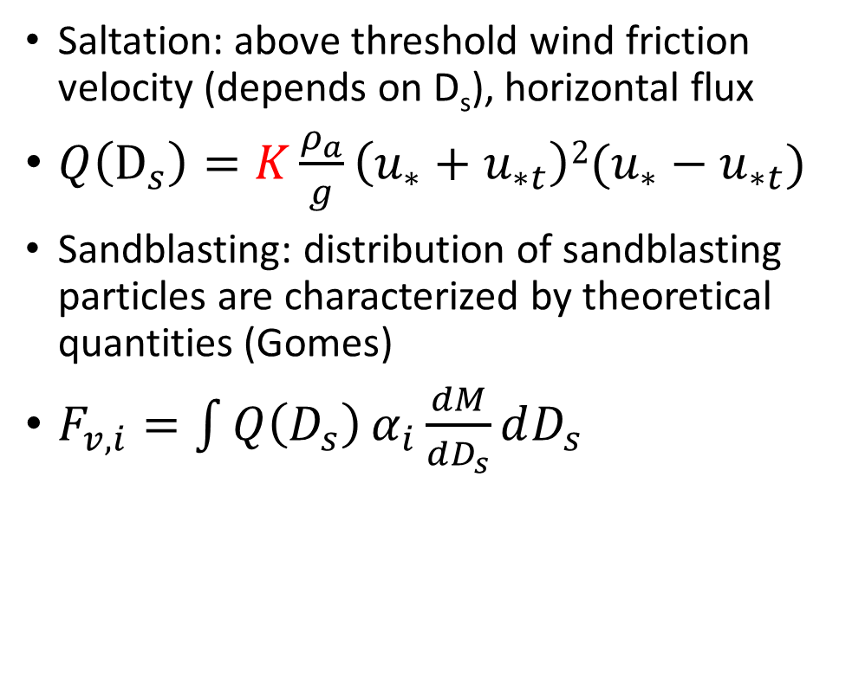
Sensitivity of the original scheme
Introduction
Saltation: above threshold wind friction velocity (depends on D_{s}), horizontal flux
$Q\left(D_{s}\right)=K\frac{ρ_{a}}{g}\left(u_{∗}+u_{∗t}\right){2(u}_{∗}−u_{∗t})$
Sandblasting: distribution of sandblasting particles are characterized by theoretical quantities (Gomes)
$F_{v,i}=\int{Q\left(D_{s}\right)}α_{i}\frac{dM}{dD_{s}}dD_{s}$
Notes:
Briefly about the original scheme:
The saltation equation belonging to the scheme were introduced by Marticorena and Bergametti with the parameterisation of threshold friction velocity. If the wind friction velocity reaches a critical value, the threshold friction velocity depends on the size of the particle, soil wetness saltation starts.
The threshold friction velocity depends on the protection of the erodible soil by roughness elements, this is called drag partitioning. According to drag partitioning the ratio of friction velocity corresponding to the erodible surface to the whole friction velocity can be calculated in the following way introduced by Shao:
The sandblasting model was developed by Alfaro and Gomes, in which the effeiciency of the sandblasting process is decribed by theoretical quantities like binding energies, fraction of kinetic energy of a soil aggregate required to release dust particles belonging to different modes.
It should be mentioned here that the soil concentration of heavy metals are still highly uncertain, influencing the results of heavy metal simulations. For this reason we simulated dust as well.

Slide 5
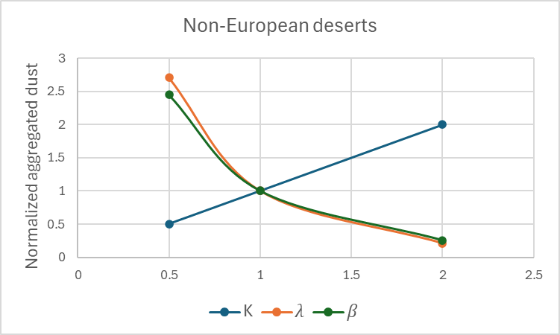
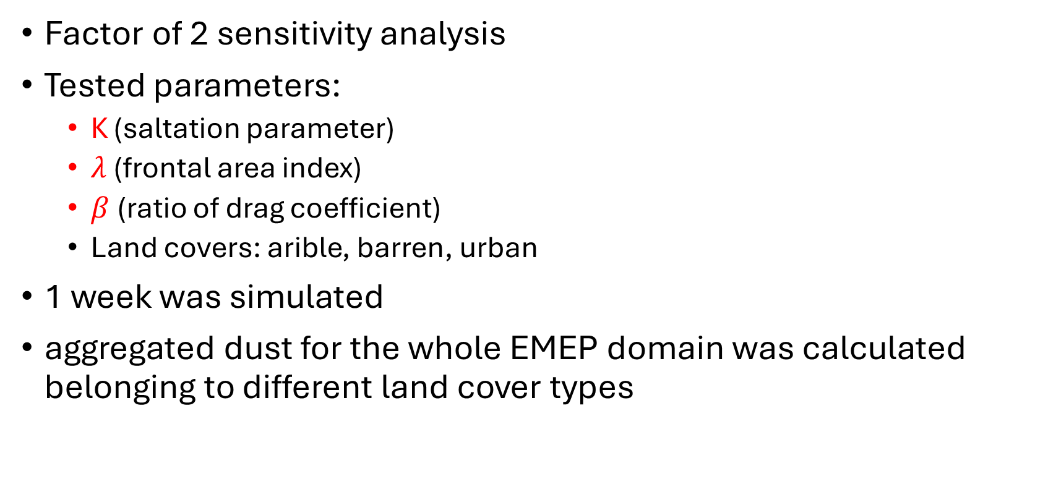
Sensitivity of the original scheme
Tested parameters
Factor of 2 sensitivity analysis
Tested parameters:
  K (saltation parameter)
  $λ$ (frontal area index)
  $β$(ratio of drag coefficient)
  Land covers: arible, barren, urban
1 week was simulated
aggregated dust for the whole EMEP domain was calculated belonging to different land cover types
Notes:
Some parameters from the dust scheme were chosen, to which multiple values exists in the literature depending on the land cover type. The land cover type, where resuspension might occur, can be: arible, barren, and urban. To these values a 2 factor sensitivity test was carried out, which means that the value to multiplied by 2 and divided by 2, and the same simulations were carried out with the modified parameters. The output metric of the test is aggregated dust for the whole EMEP domain for a randomly picked 1 week long.

Slide 6
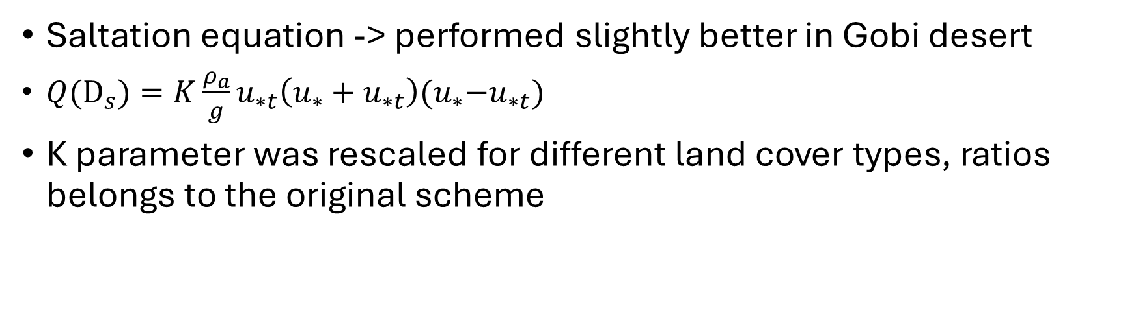
Testing other dust suspension schemes
Kok’s saltation equation (Kok12) (Li et al., Characteristics of dust emission over desert steppe, 2024)
Saltation equation -> performed slightly better in Gobi desert
$Q{(D}_{s})=K\frac{ρ_{a}}{g}u_{∗t}\left(u_{∗}+u_{∗t}\right){(u}_{∗}−u_{∗t})$
K parameter was rescaled for different land cover types, ratios belongs to the original scheme
Notes:
There are other dust suspension schemes existing in the literature. I found in a paper, that Kok saltation equation performed slightly better in Gobi desert. In the paper only the C_DK parameter for deserts was introduced, for other land cover types it was rescaled like K depends on land cover types.

Slide 7
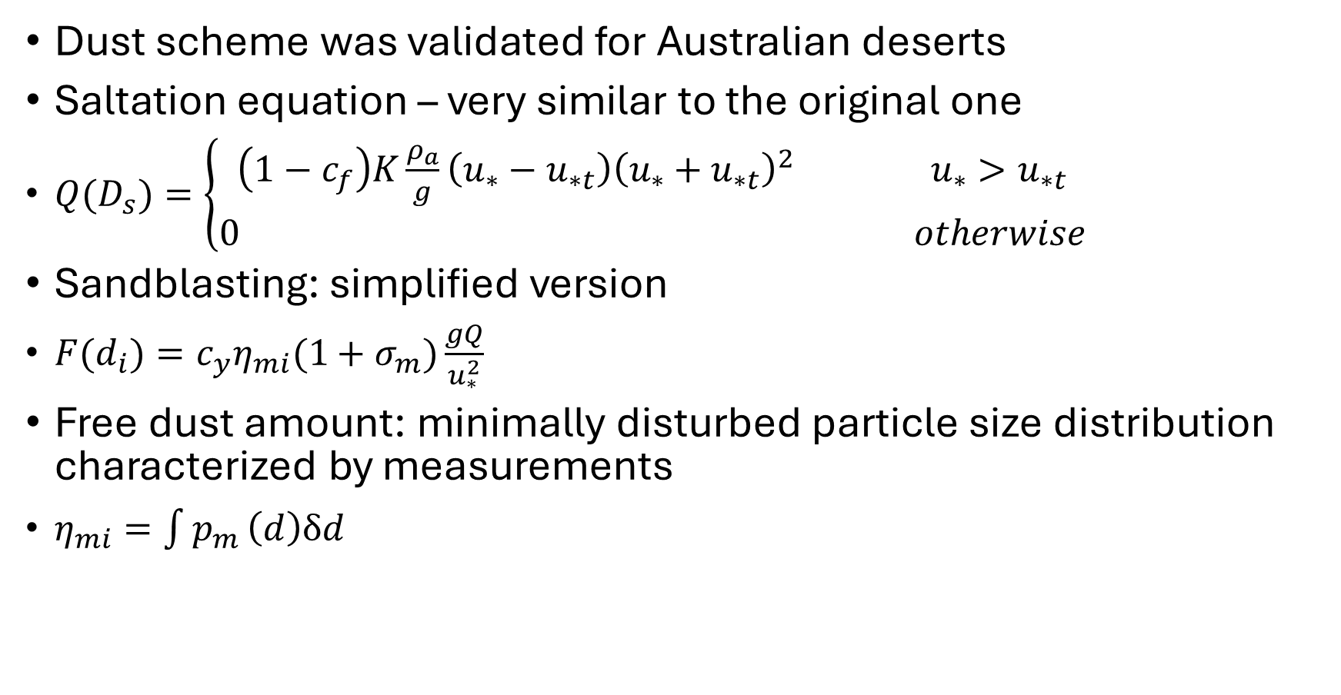
Testing other dust suspension schemes
Scheme (Shao04) (Shao et al., Parameterization of size-resolved dust emission and validation with measurements, 2011)
Dust scheme was validated for Australian deserts
Saltation equation – very similar to the original one
$Q(D_{s})=\left\{\begin{aligned}\left(1−c_{f}\right)K\frac{ρ_{a}}{g}\left(u_{∗}−u_{∗t}\right){\left(u_{∗}+u_{∗t}\right)}^{2} u_{∗}>u_{∗t} \\ 0 otherwise\end{aligned}\right.$
Sandblasting: simplified version
$F(d_{i})=c_{y}η_{mi}(1+σ_{m})\frac{gQ}{u_{∗}^{2}}$
Free dust amount: minimally disturbed particle size distribution characterized by measurements
$η_{mi}=\int{p_{m }\left(d\right)δd}$
Notes:
The other scheme which was picked for testing is the Shao04 scheme. This is a quiet general and promising dust resuspension scheme performed well in Australian deserts. Instead of operating with binding energies, and other theoretical parameters, for different desert locations and soil samples, and soil texture tpyes the size distribution of particles after sandblastion were measured. So the approach is different. The particle size distribution after sandblastion is somewhere between the minimally dispersed and fully dispersed particle size distribution. In the found paper the simplified scheme was suggested, performed well in deserts, so we implemented this one. The suggested values of the empirical parameters were applied. The saltation equation of the original scheme is very similar to the original scheme.
Sigma_m: bombardment efficiency
Sigma_p: ratio of free dust and that of aggregated dust (eta_mi/eta_fi)

Slide 8
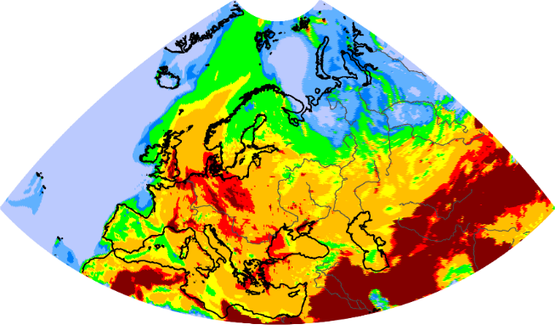
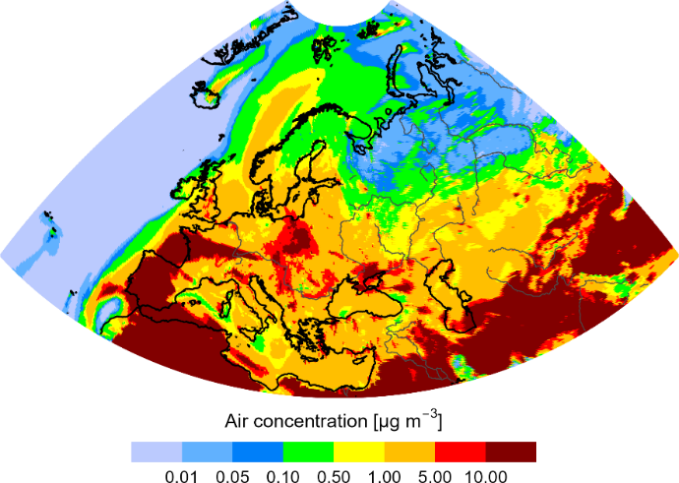
Testing other dust suspension schemes
Validation of the dust schemes for dust
Soil concentration of HMs are uncertain
Dust event was picked: Sahara dust intrusion from March 2022
Measurements: EBAS database, PM10
Mainly focused on Spanish sites, where the dust intrusion was the most pronounced
March 13, 2022
March 15, 2022
PM10 air concentration
PM10 air concentration
Notes:
For validation purposes, and prior testing of the dust schemes a dust event, and PM10 air concentrations were simulated. The picked dust event is the Sahara dust intrusion from March 2022.
The measurements were downloaded from the EBAS database. During the study we mainly focused on Spanish sites, where the dust intrusion was the most pronounced.

Slide 9
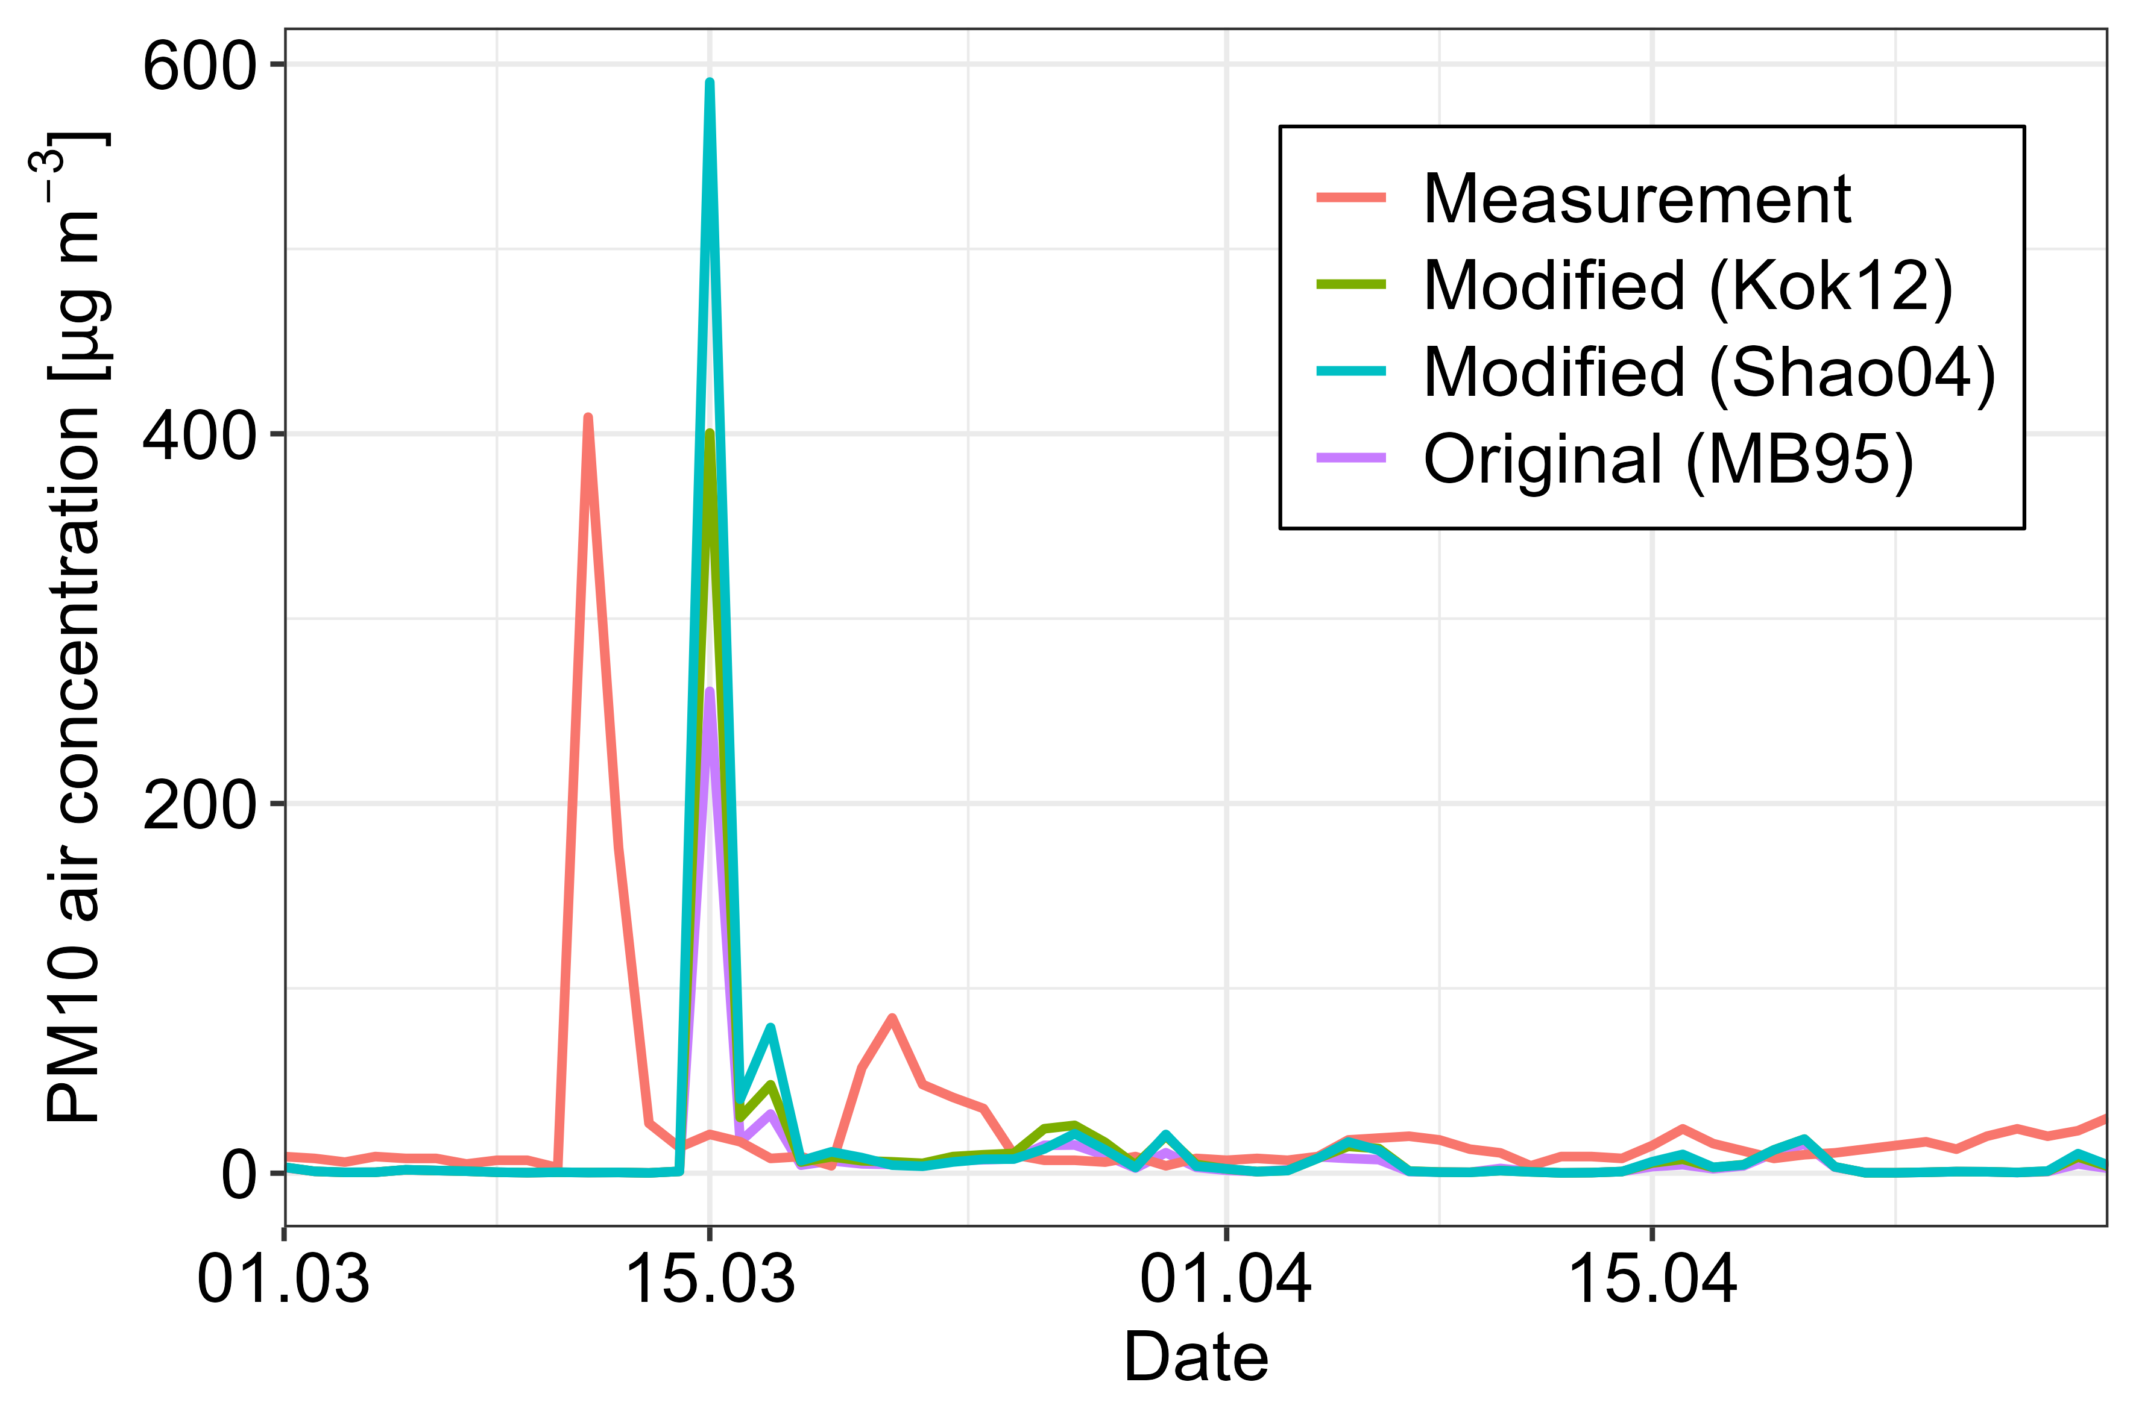
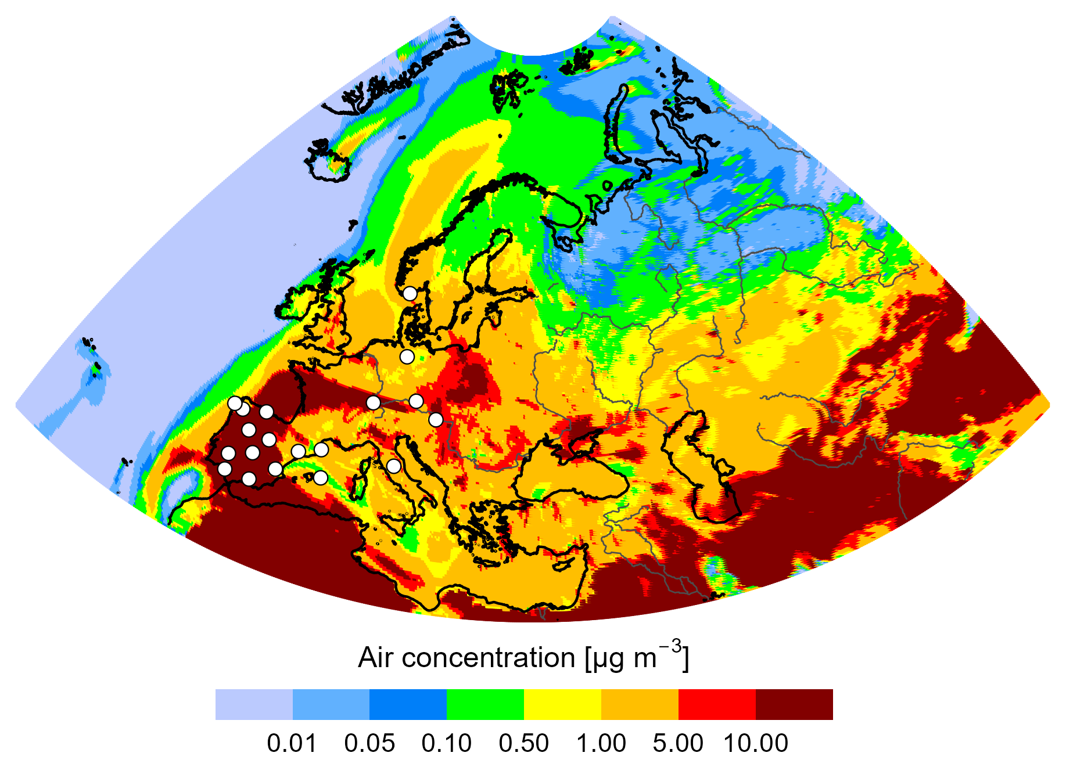
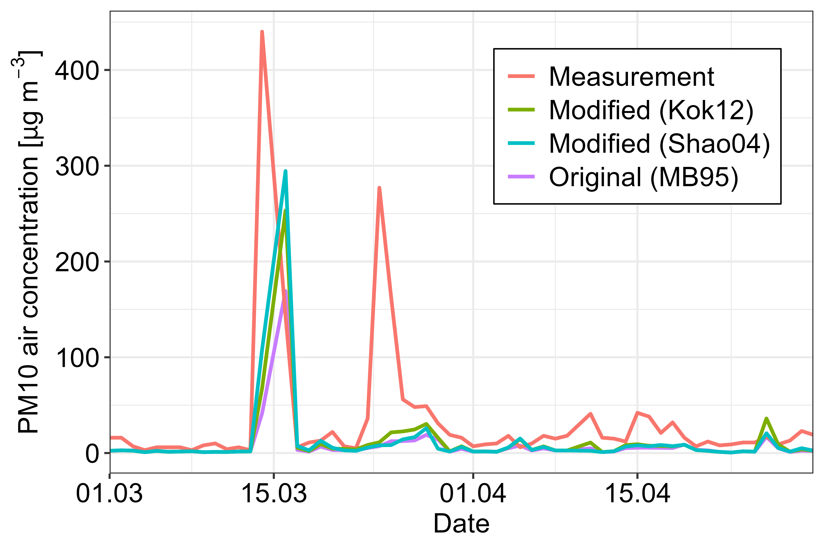
Testing other dust suspension schemes
Validation of the dust schemes for dust
Mainly the peaks are given back
Usually there is a delay
Modified schemes produce more dust
Notes:
This is a quiet general figure belonging to a Spanish site. This high peak belongs to the dust intrusion, and these are the simulated intrusion peaks. The schemes performs similarly, in a comparable way, and mainly the peaks can be reproduced by simulations. Sometimes there is a delay between measured and simulated peaks. It is usual, that the modified schesem produce more dust.

Slide 10
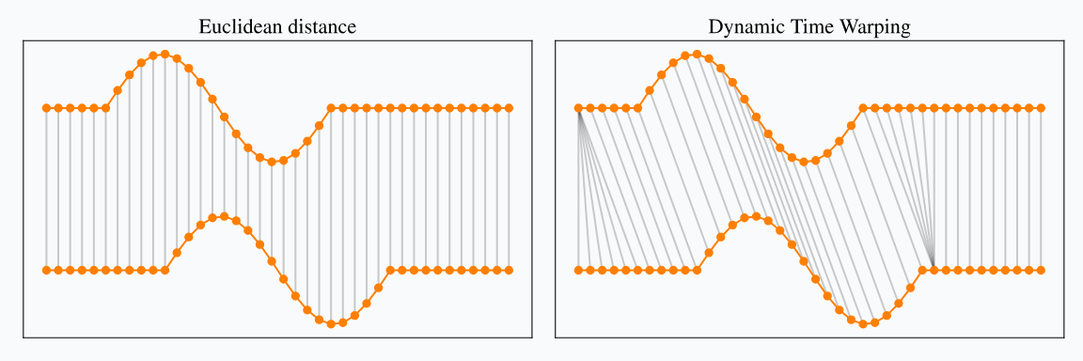
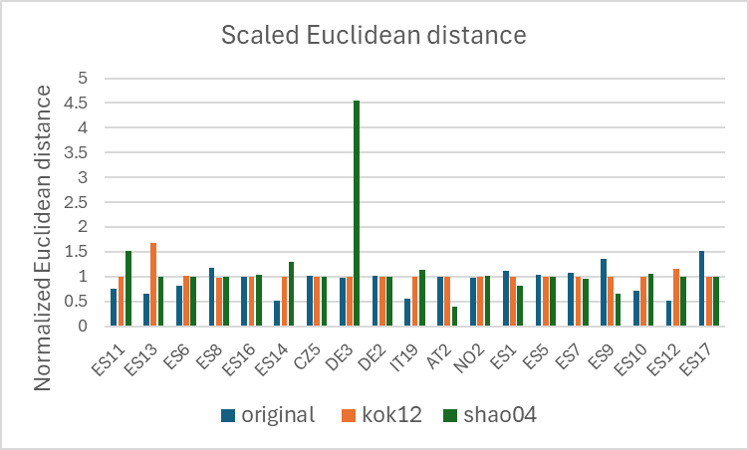
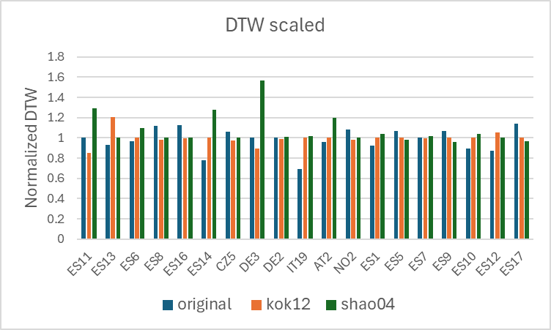
Testing other dust suspension schemes
Validation of the dust schemes for dust

Slide 11
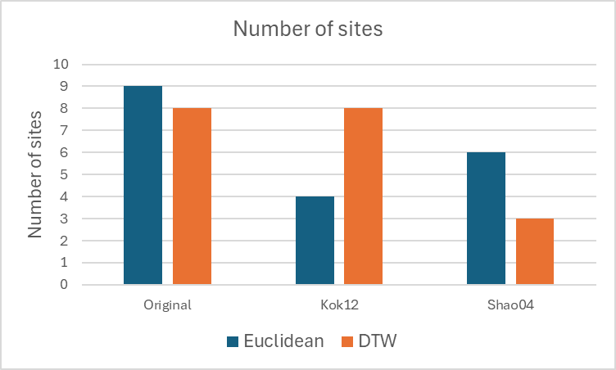
Testing other dust suspension schemes
Validation of the dust schemes for dust

Slide 12
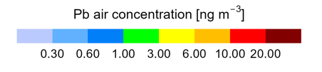
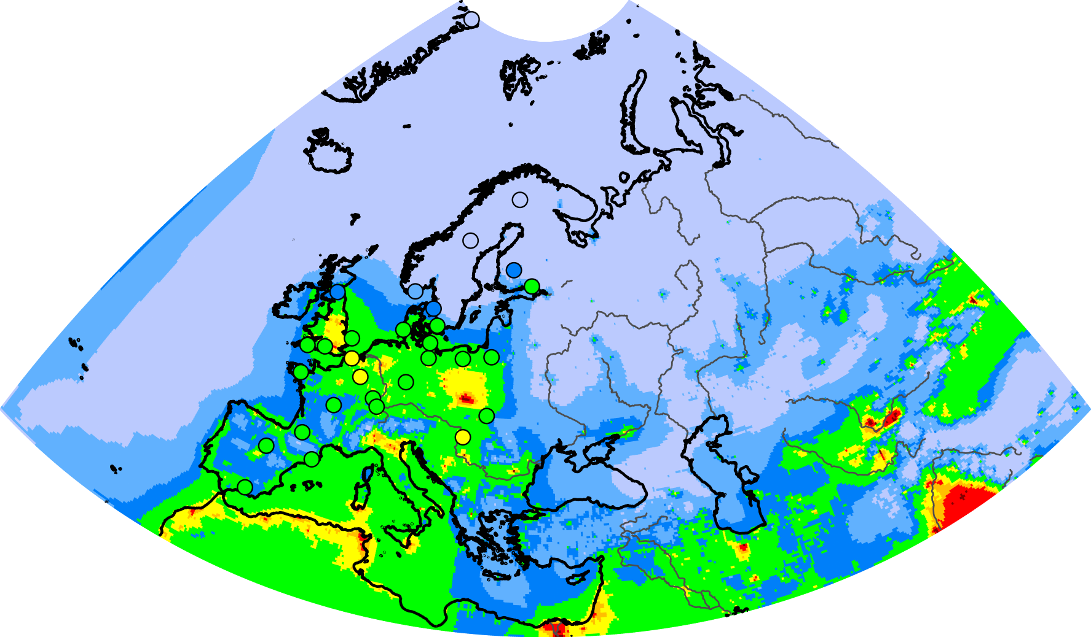
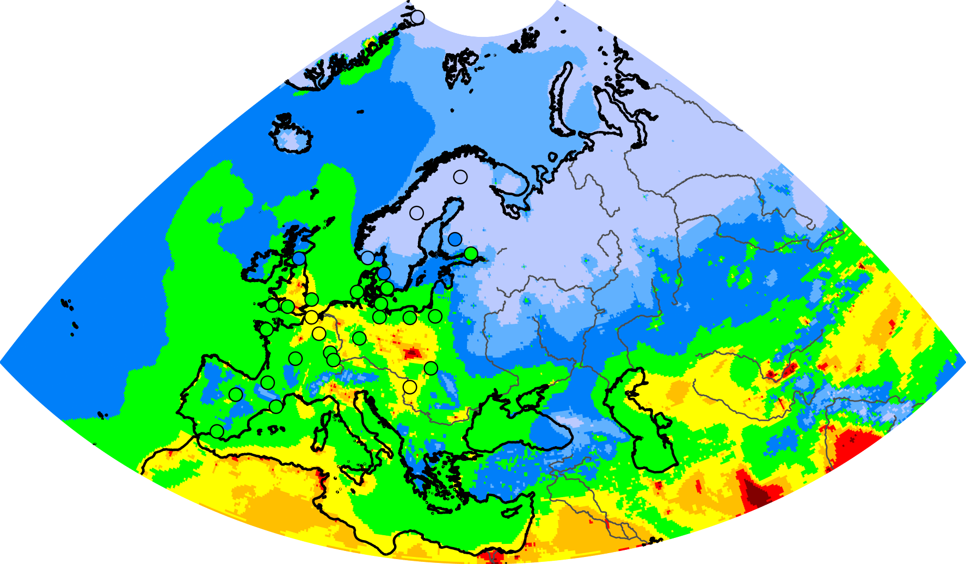
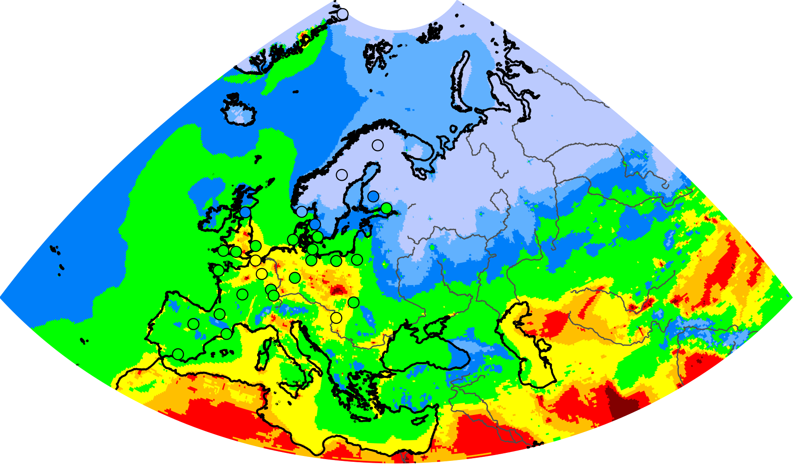
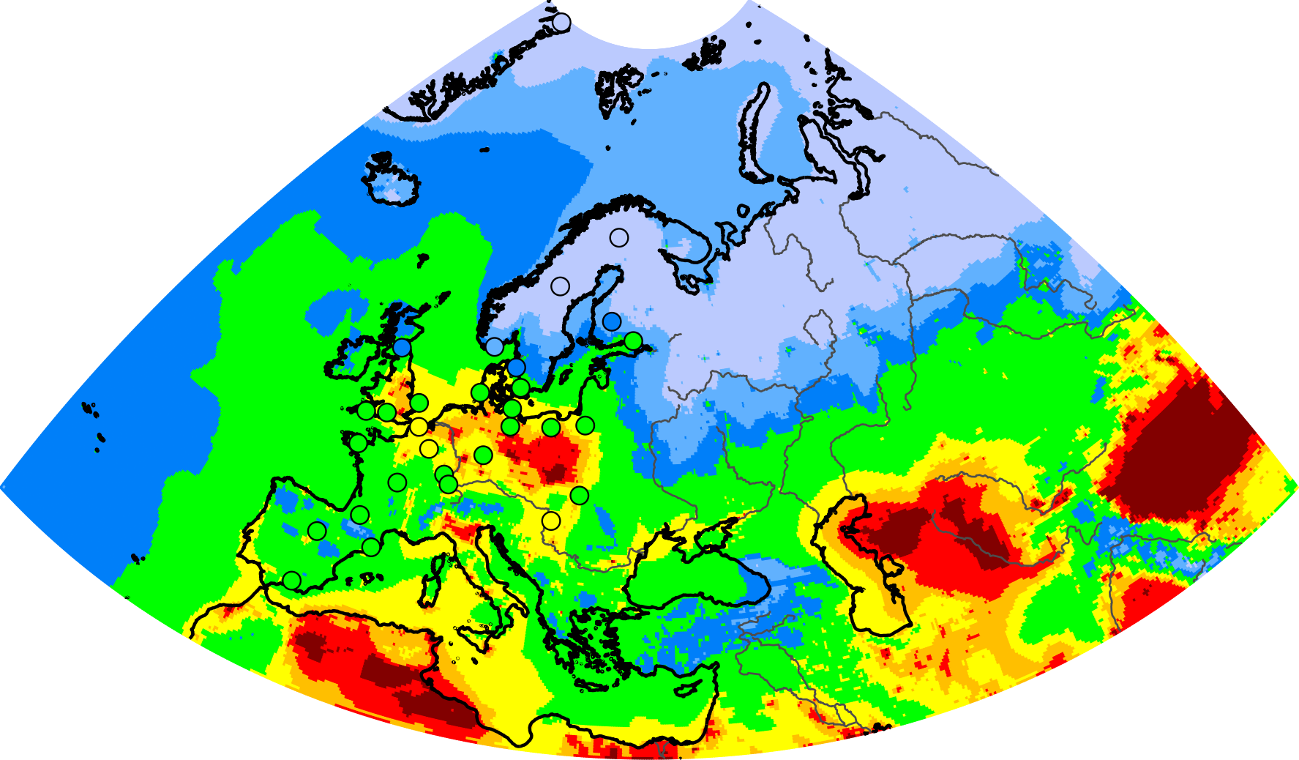
Effect on simulation of long-term heavy metal pollution (Pb)
No resuspension
Original
Kok12
Shao04

Slide 13
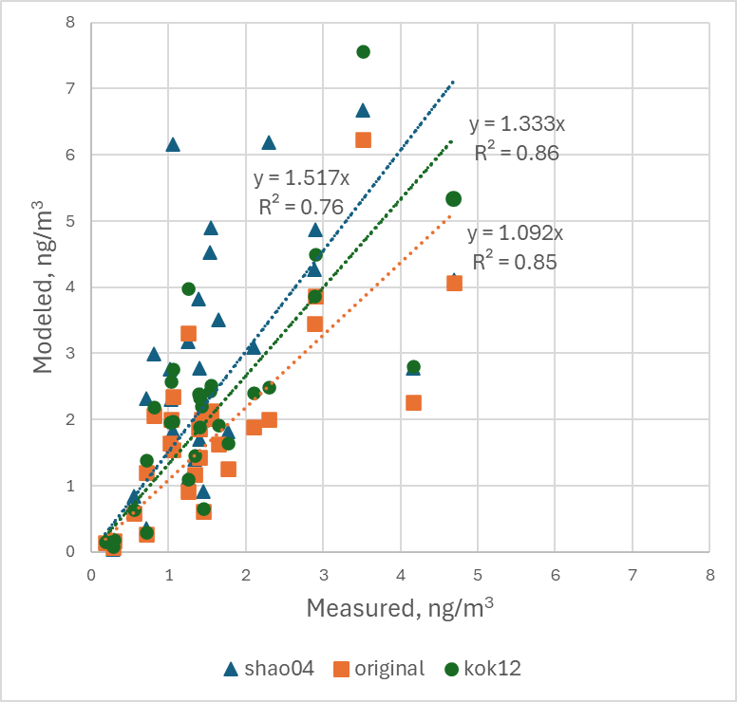
Comparison with measurements (Pb)
All available sites are taken into account
Correlation, average bias and linear regression between modeled values and measurements were calculated

Slide 14
Conclusion
All tested dust schemes generally capture significant dust suspension events
The schemes differ in the amount of suspended dust rather than in the timing of suspension episodes
The original GLEMOS scheme shows the best overall performance under the testing conditions
There are still uncertain parameters in all considered schemes that require further refinement and testing to improve model performance

Slide 15
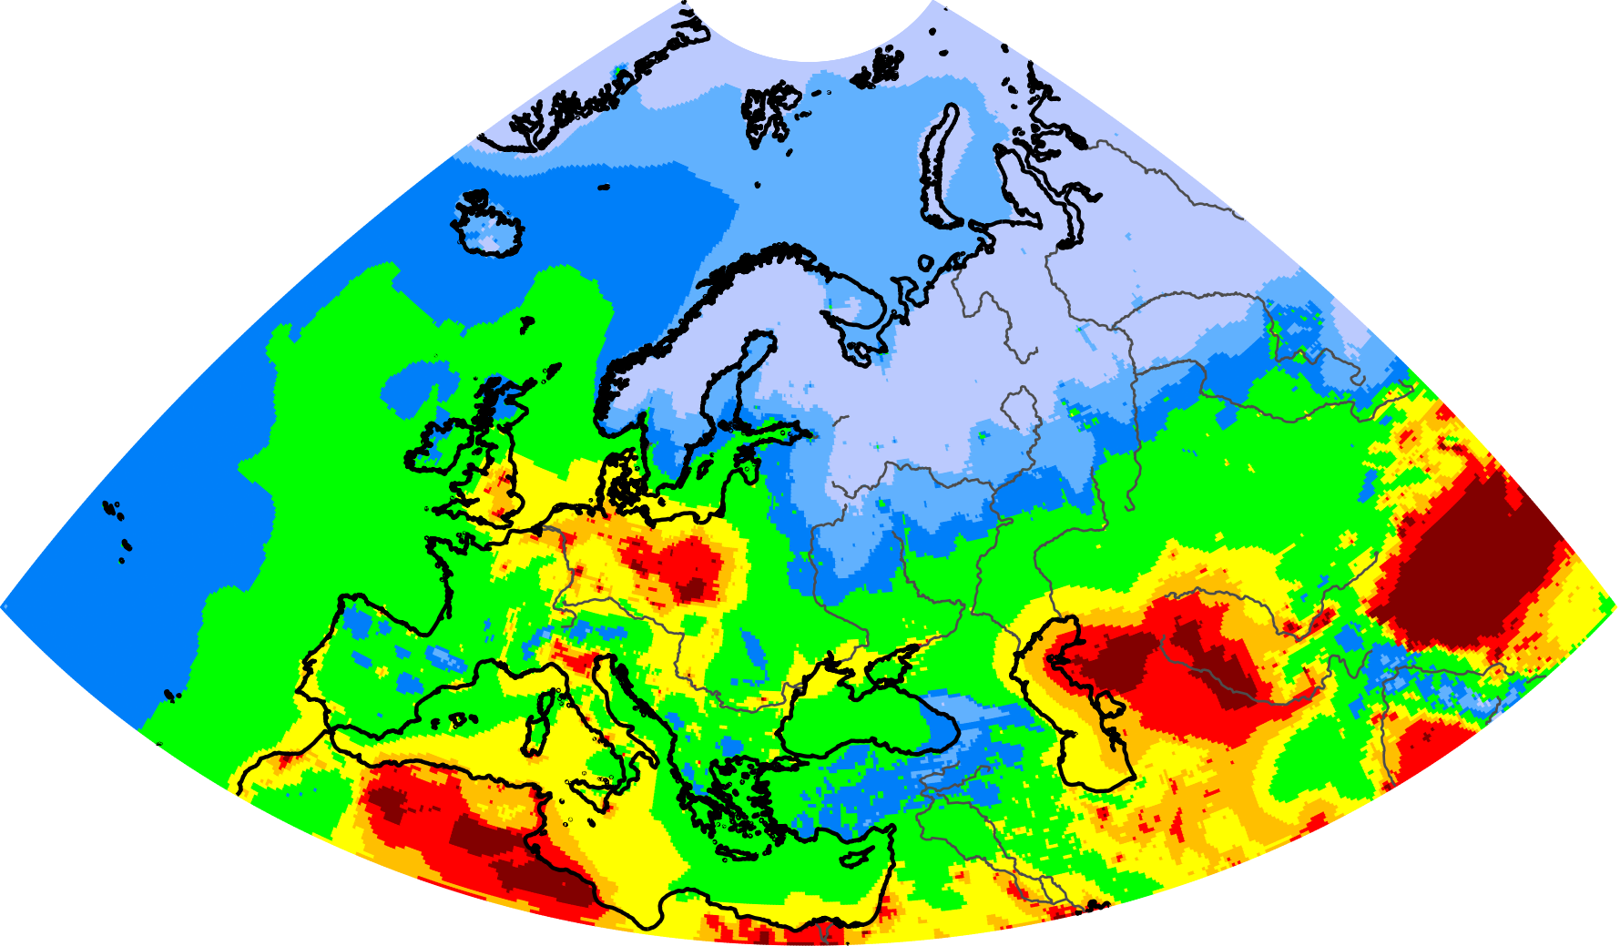
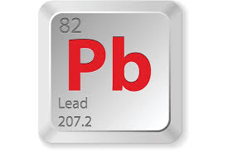
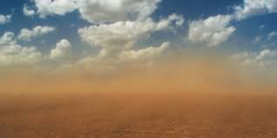

Thank you for your attention!

