Slide 1

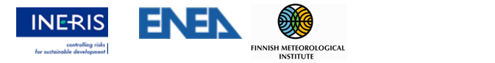
Eurodelta-Carb B(a)P multi-model intercomparison study
Intercomparison and Evaluation of modelled Benzo(a)pyrene concentrations (and deposition) in Europe
Marta G. Vivanco¹ , Mark R. Theobald¹, Victoria Gil¹, Alexey Gusev, Florian Couvidat², Mario Adani³, Ilaria D’Elia³, Gino Briganti³, Andrea Bolignano³, Massimo D’Isidoro³, Mihaela Mircea³, Felicita Russo³, Rostislav D. Kouznetsov⁴, Evgeny V. Kadantsev⁴, Mikhail A. Sofiev⁴, Augustin Colette² , Coralina Hernández¹, Juan Luis Garrido¹
¹Atmospheric Modelling Unit, Centro de Investigaciones Energéticas, Medioambientales y Tecnológicas (CIEMAT), Spain
²National Institute for Industrial Environment and Risks (INERIS), France
³ Italian National Agency for New Technologies, Energy and Sustainable Economic Development (ENEA), Italy
⁴Finnish Meteorological Institute (FMI), Finland
1
2
3
4
Task Force on Measurements and Modelling, 5 - 7 May. 2025, Potsdam, Germany

Slide 2
Contents:
Update of the intercomparison and evaluation of atmospheric concentrations estimated by GLEMOS, CHIMERE, MINNI, SILAM
  Model evaluation
  Gas/particle ratios
  Deposition rates : total, dry , wet

Slide 3
Eurodelta-Carb B(a)P multi-model intercomparison study
Prescribed modelling domain
Prescribed B(a)P annual emissions (2018)
Prescribed emissions for other pollutants (CAMs)
Free: Meteorological input
Differences:
  Intra-annual changes of B(a)P emissions
  boundary conditions
  fire emissions
  Model parameterizations (gas to particle conversion, deposition, chemistry)
Participating models
New model updates: SILAM and MINNI
More variables submitted by SILAM and MINNI

Slide 4
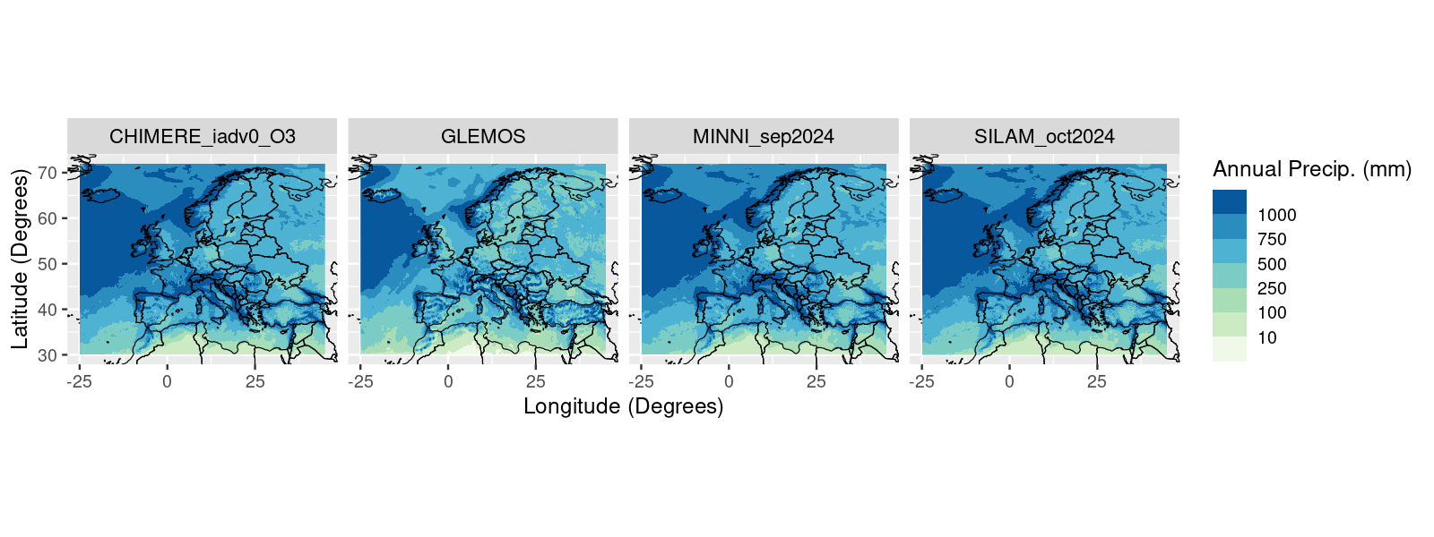
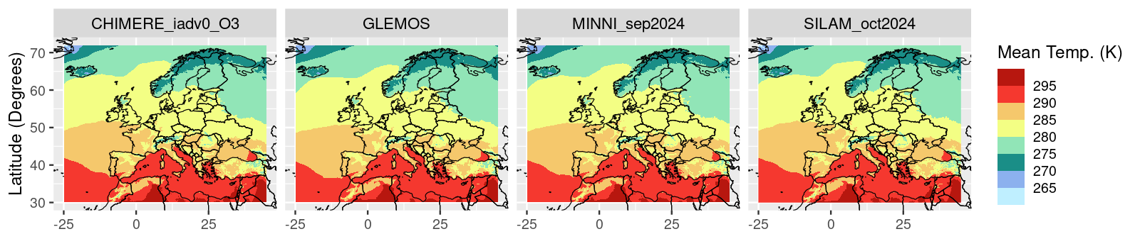
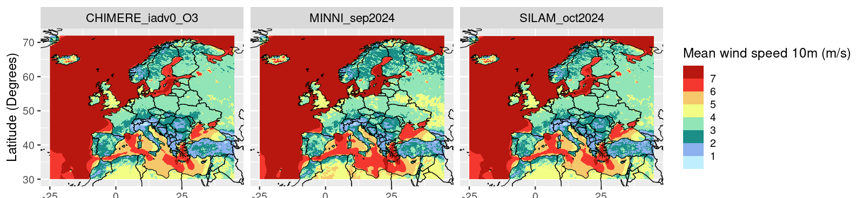
Meteorology
All the models used IFS meteorology, but: GLEMOS-> IFS refined with WRF; CHIMERE->IFS with PBL calculated by the model; SILAM -> some processing for PBL and vertical wind)
Annual precipitation (mm)
Mean annual temperature (2 m)
(K)
Mean annual wind speed (10 m)
(m/s)
(Not available for GLEMOS)

Slide 5
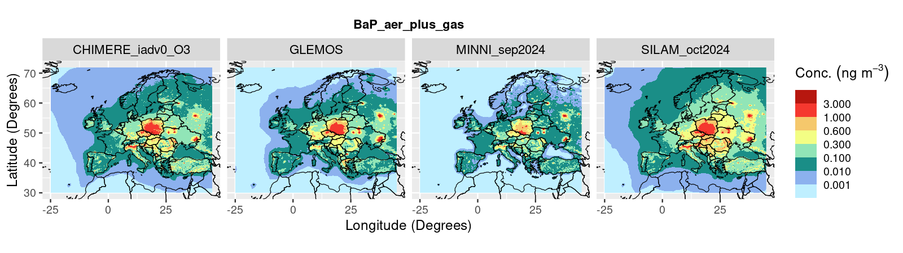
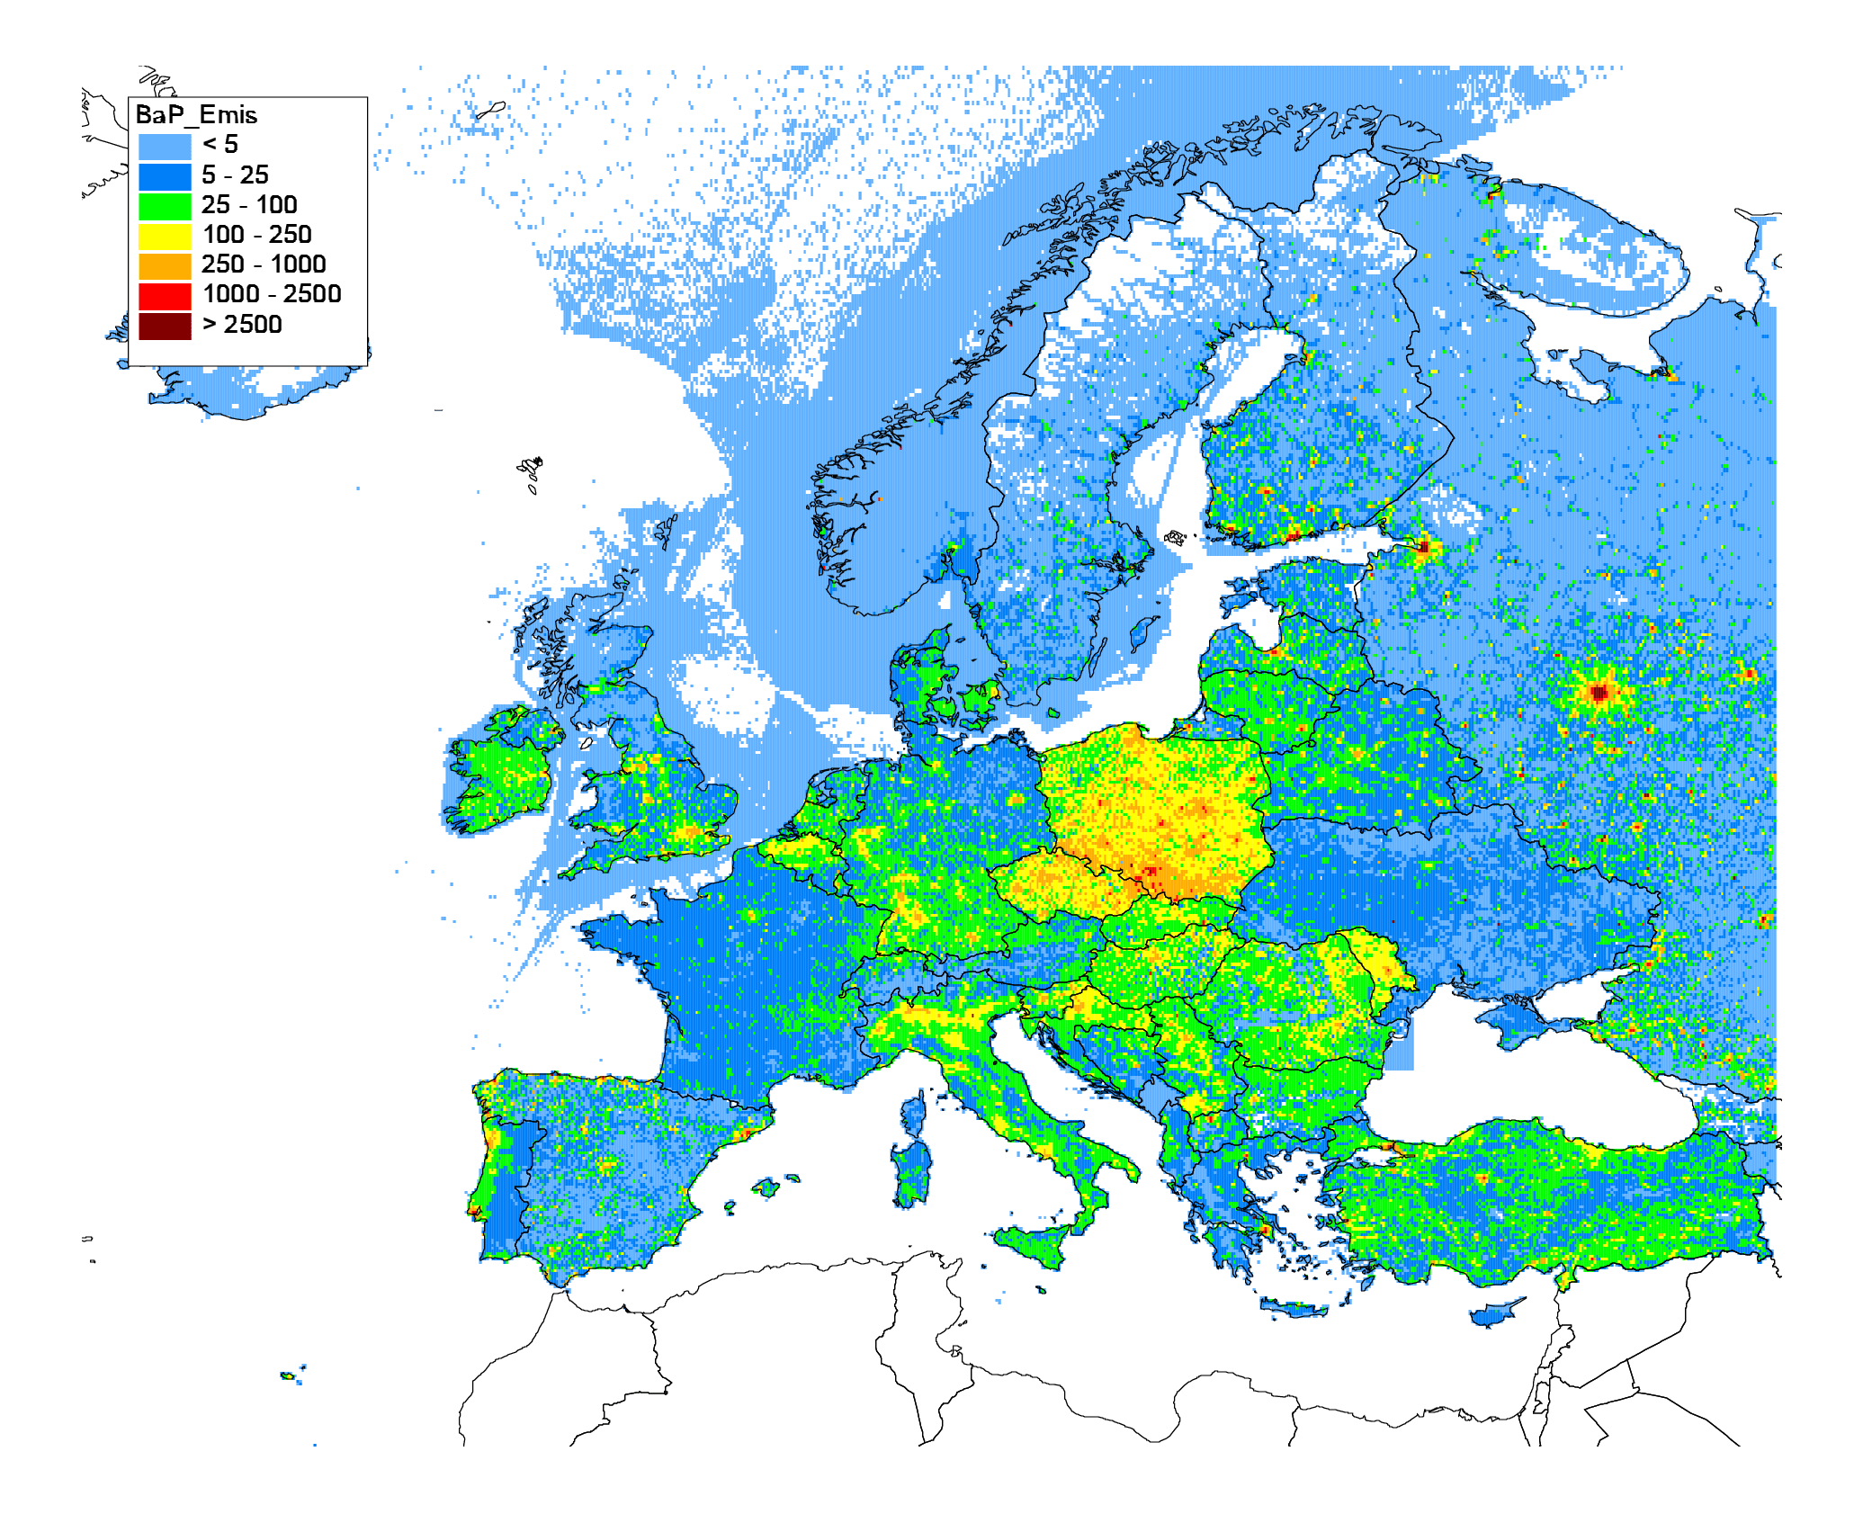
Annual emissions
(2018)
Annual mean modelled B(a)P concentrations (2018) (aerosol + gas)
CEIP emission inventory for 2018 (submission of 2021)
CHIMERE
GLEMOS
MINNI
SILAM
B(a)P annual emission fluxes for 2018, g km⁻² yr⁻¹

Slide 6
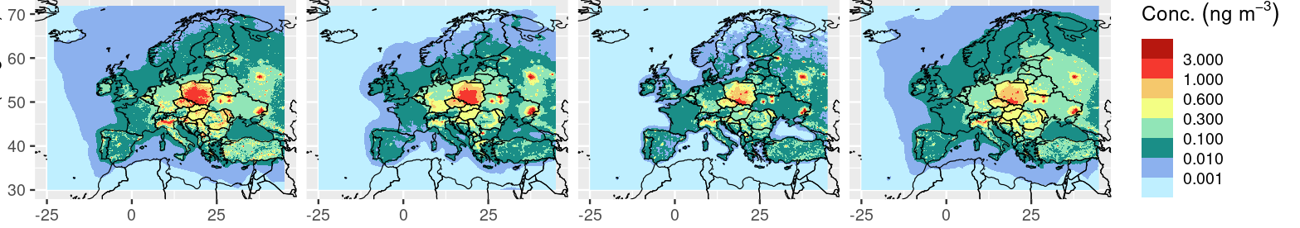
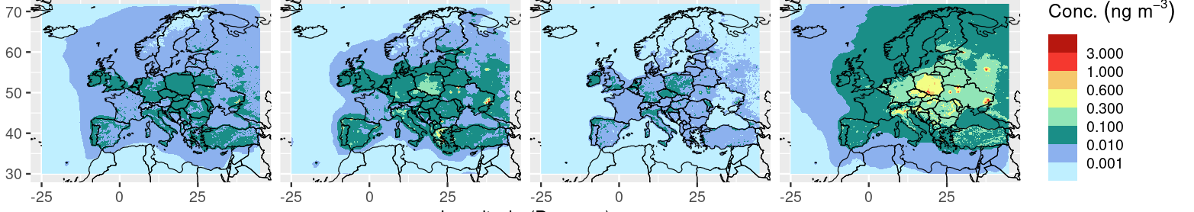
CHIMERE
GLEMOS
MINNI
SILAM
B(a)P conc.
Aerosol + Gas
Aerosol
Gas
In general all models have B(a)P mainly in the aerosol component
Notes:
Main contribution for all the models come from the aerosol phase. SILAM presents the highest gas concentration and MINNI the lowest. SILAM seems to show the lowest aerosol/gas ratio

Slide 7
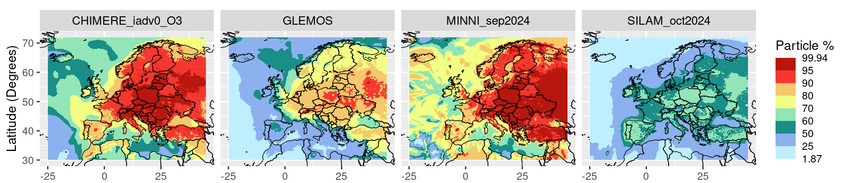
CHIMERE
GLEMOS
MINNI
SILAM
B(a)P conc.
Aerosol + Gas
Aerosol
Aerosol/Total
In general all models have B(a)P mainly in the aerosol component
In general all models have similar spatial gradients (except SILAM)
CHIMERE and MINNI have the highest particle to total ratios, SILAM the lowest
Notes:
Main contribution for all the models come from the aerosol phase. SILAM presents the highest gas concentration and MINNI the lowest. SILAM seems to show the lowest aerosol/gas ratio

Slide 8
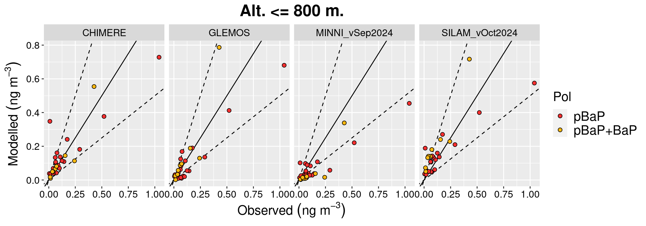
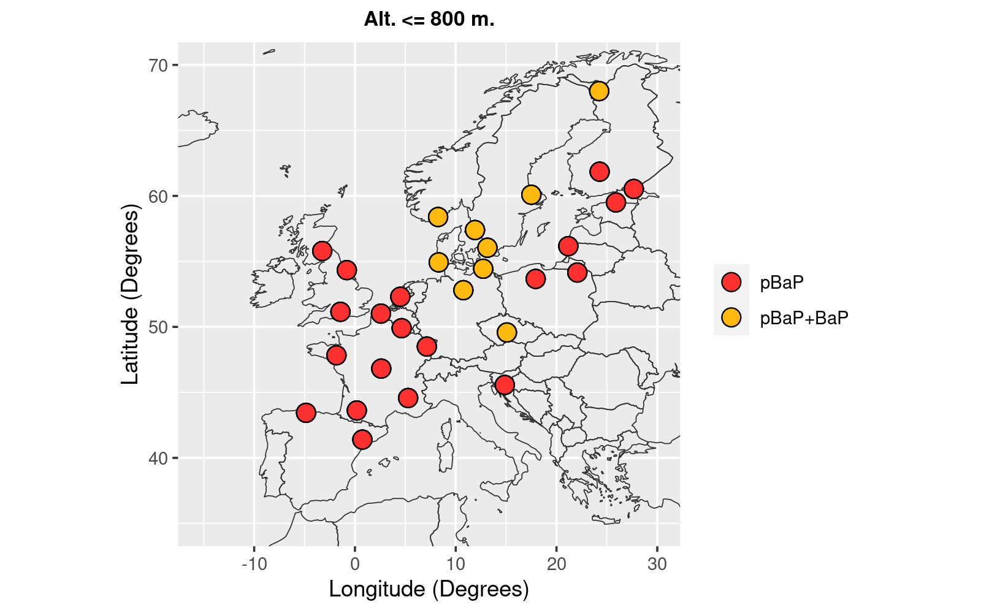
Model evaluation (B(a)P concentrations, EMEP stations, Altitude < 800 m)
Station Locations
BaP in PM₁₀
BaP total (part. + gas)
AER.
Model | n | O_MEAN | M_MEAN | FAC2 | FB | NMB | NRMSE | r
CHIMERE | 20 | 0.156 | 0.160 | 80% | 0.025 | 2% | 0.75 | 0.89
GLEMOS | 20 | 0.156 | 0.114 | 45% | -0.312 | -27% | 0.66 | 0.95
MINNI_vSep2024 | 20 | 0.156 | 0.079 | 40% | -0.656 | -49% | 1.05 | 0.94
SILAM_vOct2024 | 20 | 0.156 | 0.150 | 90% | -0.041 | -4% | 0.78 | 0.93
BaP in PM₁₀
Model | n | O_MEAN | M_MEAN | FAC2 | FB | NMB | NRMSE | r
CHIMERE | 9 | 0.118 | 0.121 | 89% | 0.022 | 2% | 0.52 | 0.93
GLEMOS | 9 | 0.118 | 0.156 | 89% | 0.279 | 32% | 1.08 | 0.92
MINNI_vSep2024 | 9 | 0.118 | 0.050 | 11% | -0.803 | -57% | 0.80 | 0.87
SILAM_vOct2024 | 9 | 0.118 | 0.211 | 33% | 0.568 | 79% | 1.03 | 0.94
TOTAL
(part. + gas)

Slide 9
Model evaluation (B(a)P concentrations, EMEP stations, Altitude < 800 m)
Station Locations
Very high spatial correlation for all the models
CHIMERE: a bit better performance for total than for aerosol
GLEMOS: underestimation of aerosol phase and overestimation of total
MINNI: underestimation of both, particle and total
SILAM: Small bias for aerosol phase but overestimates total
AER.
Model | n | O_MEAN | M_MEAN | FAC2 | FB | NMB | NRMSE | r
CHIMERE | 20 | 0.156 | 0.160 | 80% | 0.025 | 2% | 0.75 | 0.89
GLEMOS | 20 | 0.156 | 0.114 | 45% | -0.312 | -27% | 0.66 | 0.95
MINNI_vSep2024 | 20 | 0.156 | 0.079 | 40% | -0.656 | -49% | 1.05 | 0.94
SILAM_vOct2024 | 20 | 0.156 | 0.150 | 90% | -0.041 | -4% | 0.78 | 0.93
BaP in PM₁₀
Model | n | O_MEAN | M_MEAN | FAC2 | FB | NMB | NRMSE | r
CHIMERE | 9 | 0.118 | 0.121 | 89% | 0.022 | 2% | 0.52 | 0.93
GLEMOS | 9 | 0.118 | 0.156 | 89% | 0.279 | 32% | 1.08 | 0.92
MINNI_vSep2024 | 9 | 0.118 | 0.050 | 11% | -0.803 | -57% | 0.80 | 0.87
SILAM_vOct2024 | 9 | 0.118 | 0.211 | 33% | 0.568 | 79% | 1.03 | 0.94
TOTAL
(part. + gas)

Slide 10
Model evaluation (B(a)P concentrations, EMEP stations, Altitude < 800 m)
Station Locations
Very high spatial correlation for all the models
CHIMERE: a bit better performance for total than for aerosol
GLEMOS: underestimation of aerosol phase and overestimation of total
MINNI: underestimation of both, particle and total
SILAM: Small bias for aerosol phase but overestimates total
AER.
Model | n | O_MEAN | M_MEAN | FAC2 | FB | NMB | NRMSE | r
CHIMERE | 20 | 0.156 | 0.160 | 80% | 0.025 | 2% | 0.75 | 0.89
GLEMOS | 20 | 0.156 | 0.114 | 45% | -0.312 | -27% | 0.66 | 0.95
MINNI_vSep2024 | 20 | 0.156 | 0.079 | 40% | -0.656 | -49% | 1.05 | 0.94
SILAM_vOct2024 | 20 | 0.156 | 0.150 | 90% | -0.041 | -4% | 0.78 | 0.93
BaP in PM₁₀
Model | n | O_MEAN | M_MEAN | FAC2 | FB | NMB | NRMSE | r
CHIMERE | 9 | 0.118 | 0.121 | 89% | 0.022 | 2% | 0.52 | 0.93
GLEMOS | 9 | 0.118 | 0.156 | 89% | 0.279 | 32% | 1.08 | 0.92
MINNI_vSep2024 | 9 | 0.118 | 0.050 | 11% | -0.803 | -57% | 0.80 | 0.87
SILAM_vOct2024 | 9 | 0.118 | 0.211 | 33% | 0.568 | 79% | 1.03 | 0.94
TOTAL
(part. + gas)

Slide 11
Model evaluation (B(a)P concentrations, EMEP stations, Altitude < 800 m)
Station Locations
Very high spatial correlation for all the models
CHIMERE: a bit better performance for total than for aerosol
GLEMOS: underestimation of aerosol phase and overestimation of total
MINNI: underestimation of both, particle and total
SILAM: Small bias for aerosol phase but overestimates total
AER.
Model | n | O_MEAN | M_MEAN | FAC2 | FB | NMB | NRMSE | r
CHIMERE | 20 | 0.156 | 0.160 | 80% | 0.025 | 2% | 0.75 | 0.89
GLEMOS | 20 | 0.156 | 0.114 | 45% | -0.312 | -27% | 0.66 | 0.95
MINNI_vSep2024 | 20 | 0.156 | 0.079 | 40% | -0.656 | -49% | 1.05 | 0.94
SILAM_vOct2024 | 20 | 0.156 | 0.150 | 90% | -0.041 | -4% | 0.78 | 0.93
BaP in PM₁₀
Model | n | O_MEAN | M_MEAN | FAC2 | FB | NMB | NRMSE | r
CHIMERE | 9 | 0.118 | 0.121 | 89% | 0.022 | 2% | 0.52 | 0.93
GLEMOS | 9 | 0.118 | 0.156 | 89% | 0.279 | 32% | 1.08 | 0.92
MINNI_vSep2024 | 9 | 0.118 | 0.050 | 11% | -0.803 | -57% | 0.80 | 0.87
SILAM_vOct2024 | 9 | 0.118 | 0.211 | 33% | 0.568 | 79% | 1.03 | 0.94
TOTAL
(part. + gas)

Slide 12
Model evaluation (B(a)P concentrations, EMEP stations, Altitude < 800 m)
Station Locations
Very high spatial correlation for all the models
CHIMERE: a bit better performance for total than for aerosol
GLEMOS: underestimation of aerosol phase and overestimation of total
MINNI: underestimation of both, particle and total
SILAM: Small bias for aerosol phase but overestimates total
AER.
Model | n | O_MEAN | M_MEAN | FAC2 | FB | NMB | NRMSE | r
CHIMERE | 20 | 0.156 | 0.160 | 80% | 0.025 | 2% | 0.75 | 0.89
GLEMOS | 20 | 0.156 | 0.114 | 45% | -0.312 | -27% | 0.66 | 0.95
MINNI_vSep2024 | 20 | 0.156 | 0.079 | 40% | -0.656 | -49% | 1.05 | 0.94
SILAM_vOct2024 | 20 | 0.156 | 0.150 | 90% | -0.041 | -4% | 0.78 | 0.93
BaP in PM₁₀
Model | n | O_MEAN | M_MEAN | FAC2 | FB | NMB | NRMSE | r
CHIMERE | 9 | 0.118 | 0.121 | 89% | 0.022 | 2% | 0.52 | 0.93
GLEMOS | 9 | 0.118 | 0.156 | 89% | 0.279 | 32% | 1.08 | 0.92
MINNI_vSep2024 | 9 | 0.118 | 0.050 | 11% | -0.803 | -57% | 0.80 | 0.87
SILAM_vOct2024 | 9 | 0.118 | 0.211 | 33% | 0.568 | 79% | 1.03 | 0.94
TOTAL
(part. + gas)

Slide 13
Model evaluation (B(a)P concentrations, EMEP stations, Altitude < 800 m)
Station Locations
Very high spatial correlation for all the models
CHIMERE: a bit better performance for total than for aerosol
GLEMOS: underestimation of aerosol phase and overestimation of total
MINNI: underestimation of both, particle and total
SILAM: Small bias for aerosol phase but overestimates total
AER.
Model | n | O_MEAN | M_MEAN | FAC2 | FB | NMB | NRMSE | r
CHIMERE | 20 | 0.156 | 0.160 | 80% | 0.025 | 2% | 0.75 | 0.89
GLEMOS | 20 | 0.156 | 0.114 | 45% | -0.312 | -27% | 0.66 | 0.95
MINNI_vSep2024 | 20 | 0.156 | 0.079 | 40% | -0.656 | -49% | 1.05 | 0.94
SILAM_vOct2024 | 20 | 0.156 | 0.150 | 90% | -0.041 | -4% | 0.78 | 0.93
BaP in PM₁₀
Model | n | O_MEAN | M_MEAN | FAC2 | FB | NMB | NRMSE | r
CHIMERE | 9 | 0.118 | 0.121 | 89% | 0.022 | 2% | 0.52 | 0.93
GLEMOS | 9 | 0.118 | 0.156 | 89% | 0.279 | 32% | 1.08 | 0.92
MINNI_vSep2024 | 9 | 0.118 | 0.050 | 11% | -0.803 | -57% | 0.80 | 0.87
SILAM_vOct2024 | 9 | 0.118 | 0.211 | 33% | 0.568 | 79% | 1.03 | 0.94
TOTAL
(part. + gas)

Slide 14
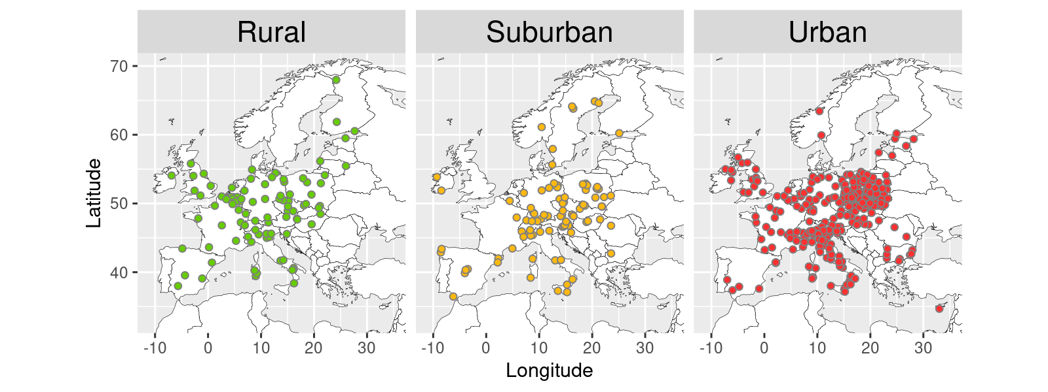
Model evaluation (B(a)P in PM₁₀, AQ e-Reporting EEA)
European monitoring stations

Slide 15
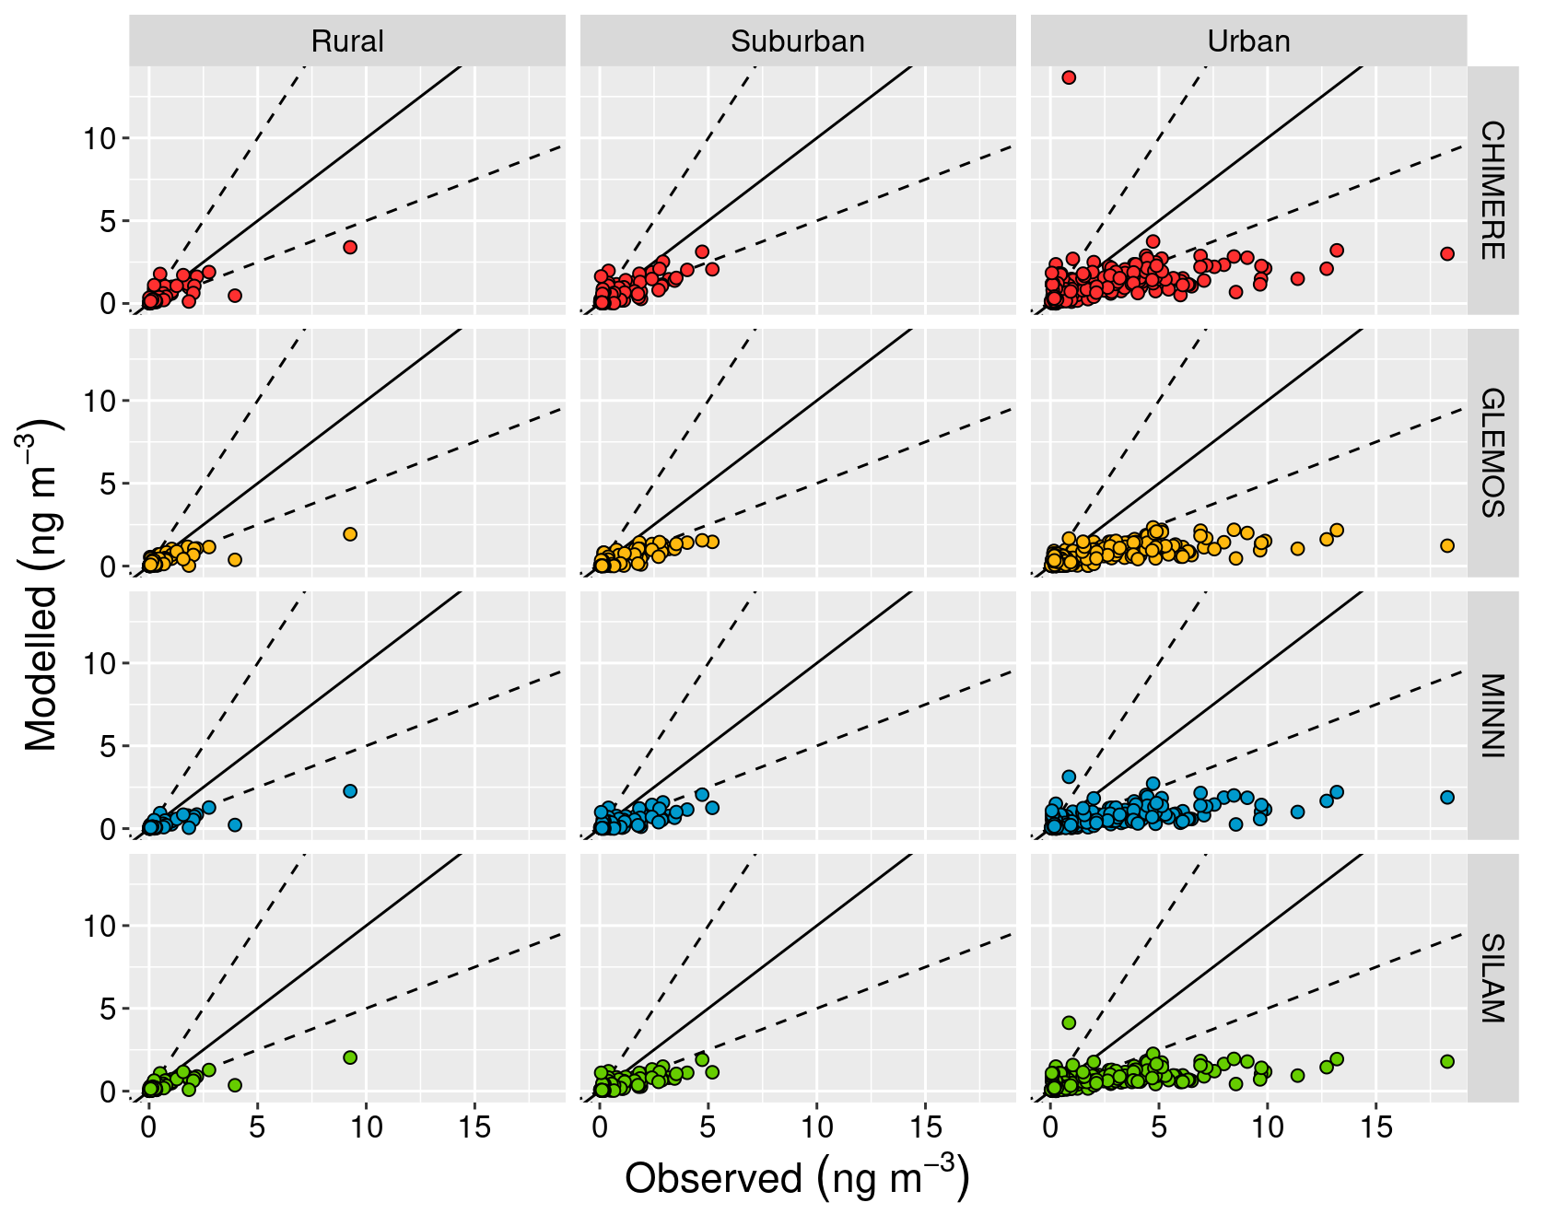
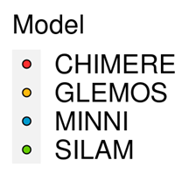
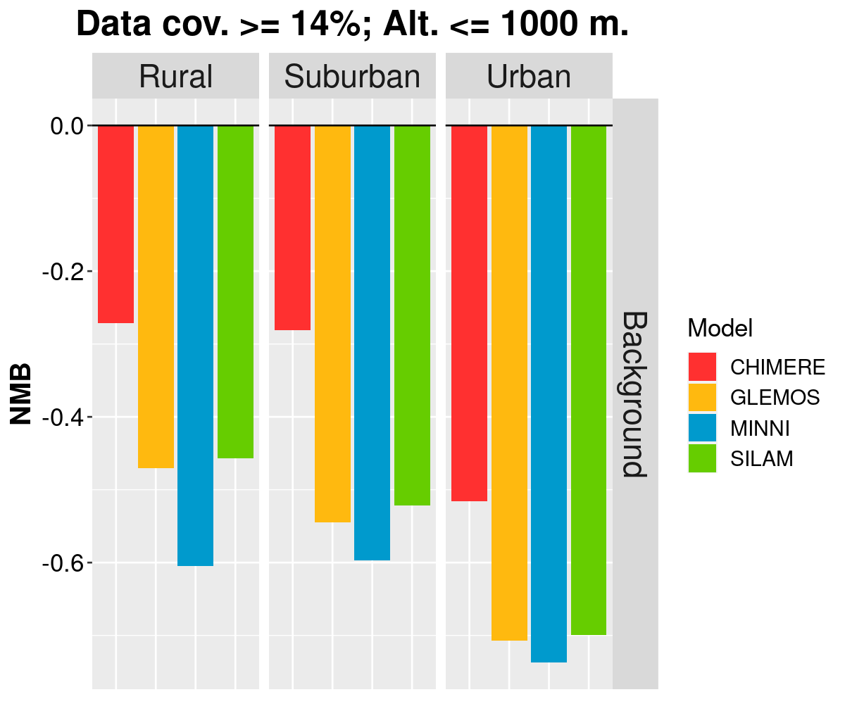
Model evaluation (B(a)P in PM₁₀, AQ e-Reporting EEA)
General underestimation of concentrations, especially at urban sites (site representativeness? High density in Poland & Italy)
Larger errors than for EMEP sites

Slide 16
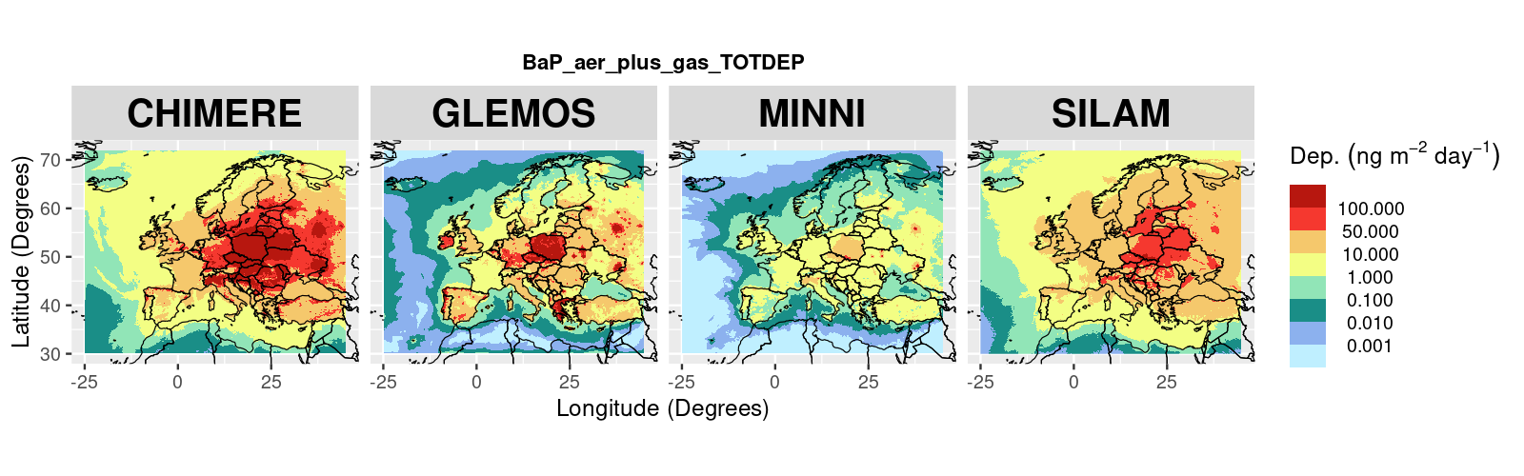
Total Deposition B(a)P particle + gas
In general: CHIMERE > SILAM > GLEMOS > MINNI
Although there are spatial variations

Slide 17
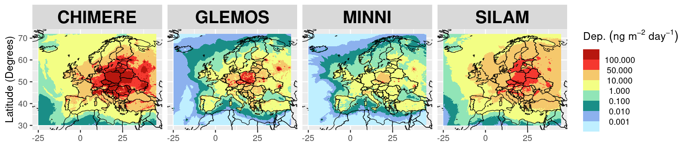
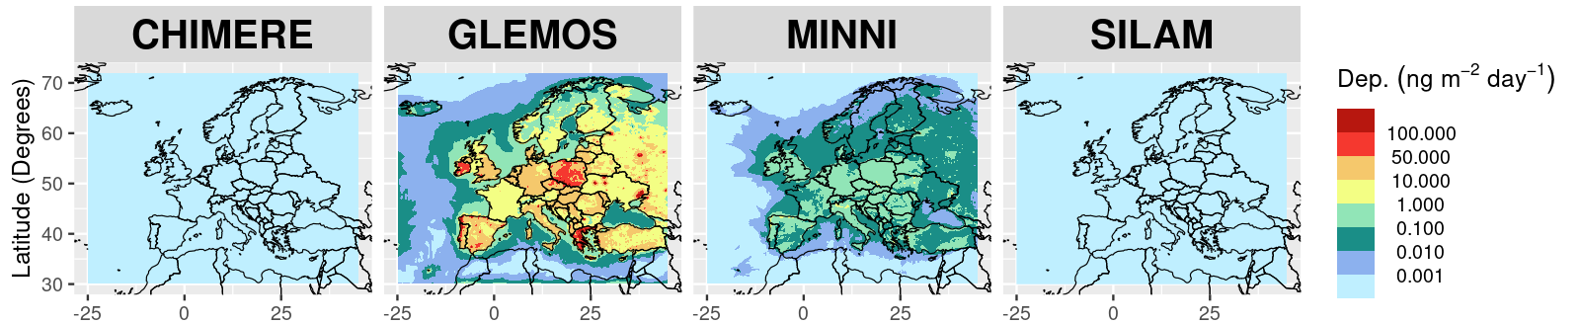
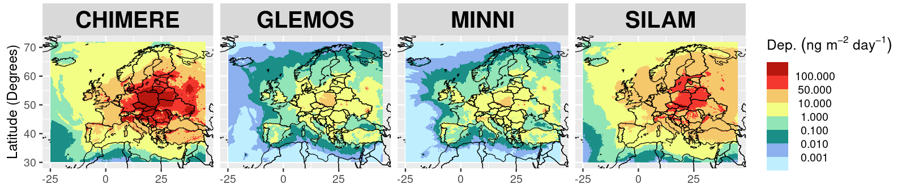
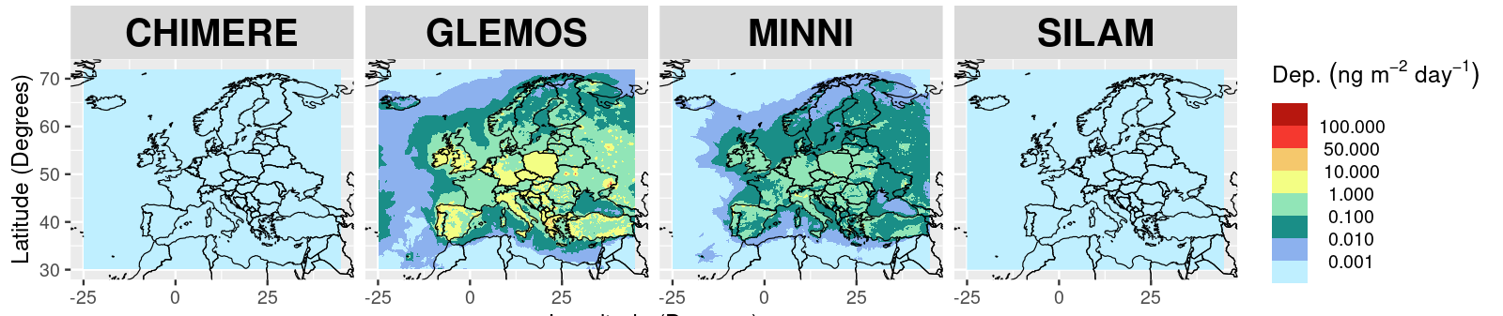
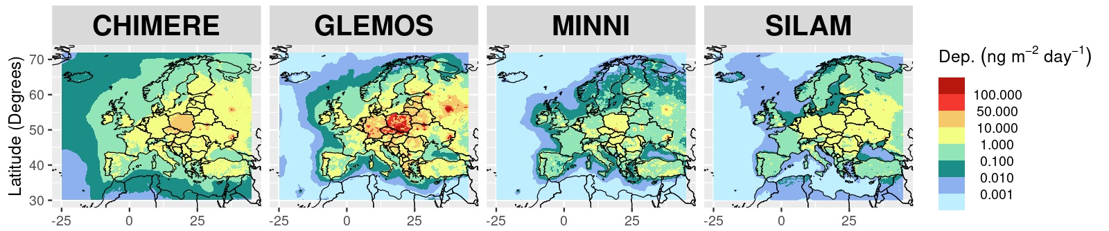
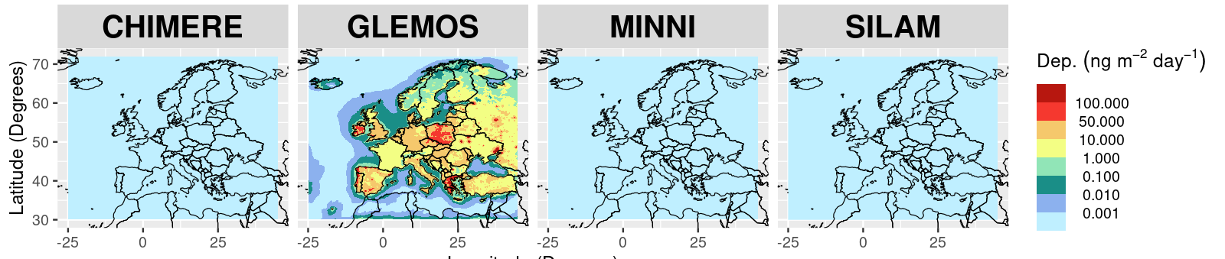
B(a)P particle dep.
B(a)P gas dep.
Tot. dep.
Tot. dep.
Wet dep.
Wet dep.
Dry dep.
Dry dep.
CHIMERE and SILAM: Largest particle deposition rates (mainly wet)
CHIMERE, SILAM, MINNI: Wet deposition of particles > dry deposition of particles
GLEMOS: Dry deposition of particles > wet deposition of particles
GLEMOS: Gas deposition rates are quite similar to those of particles (or higher)

Slide 18
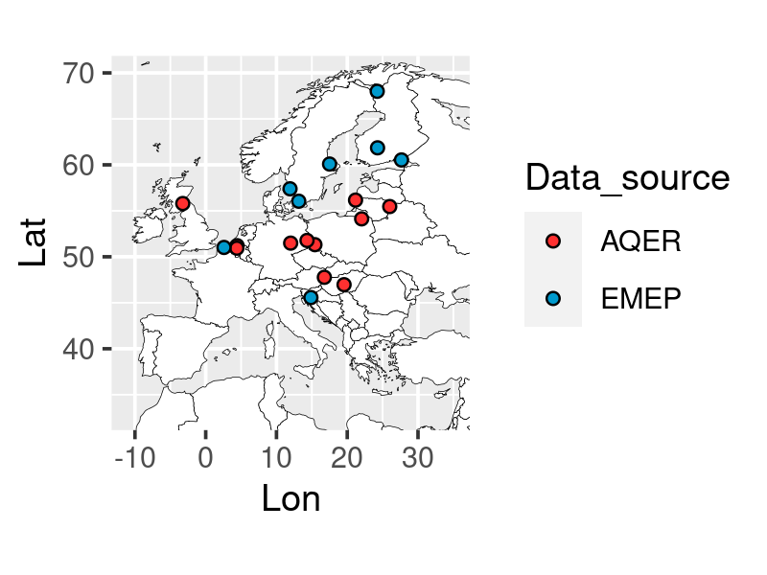
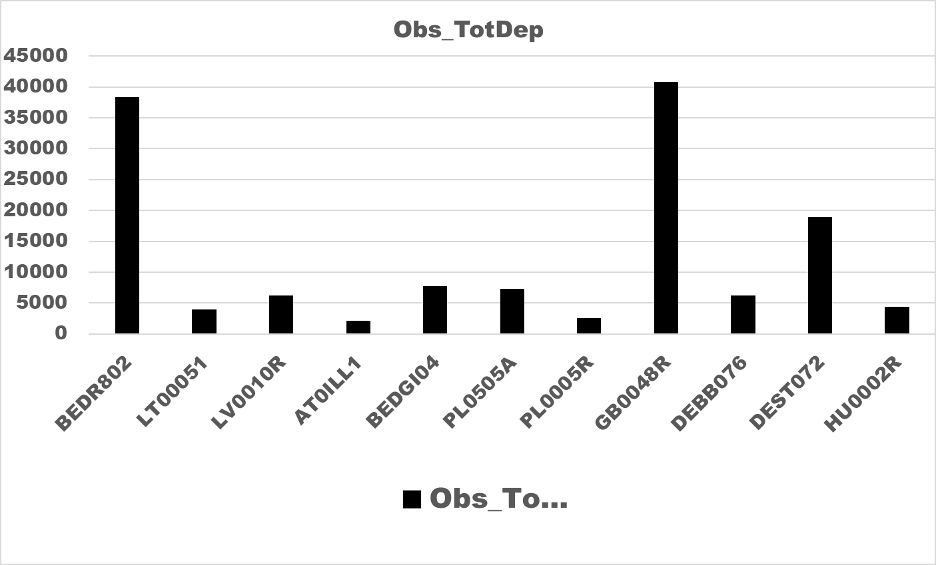
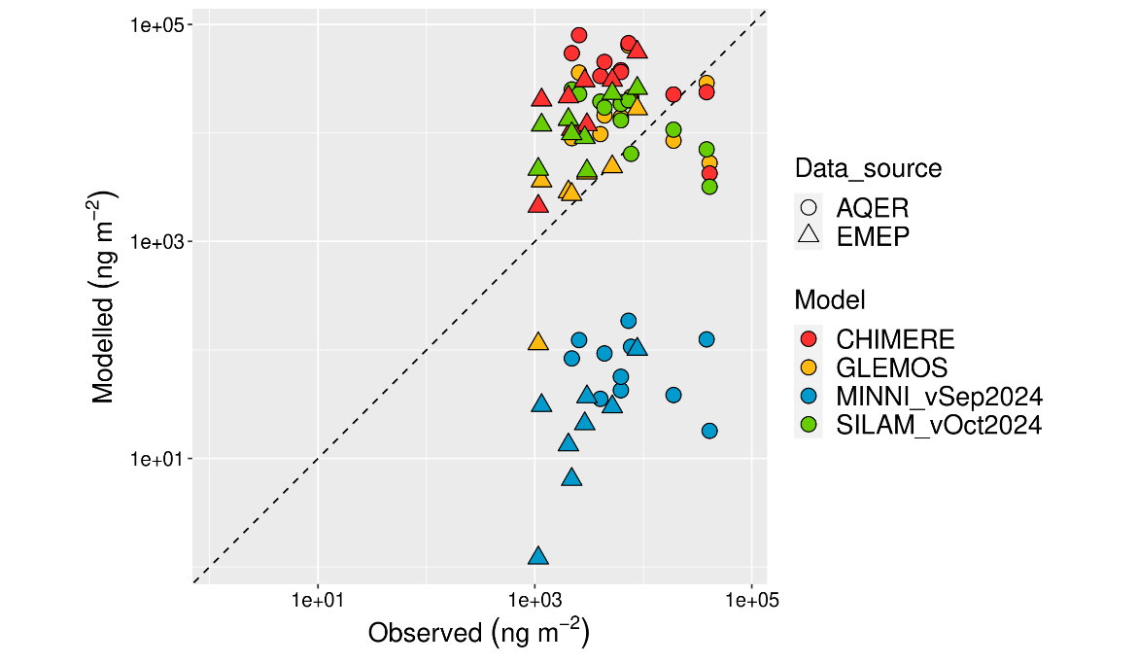
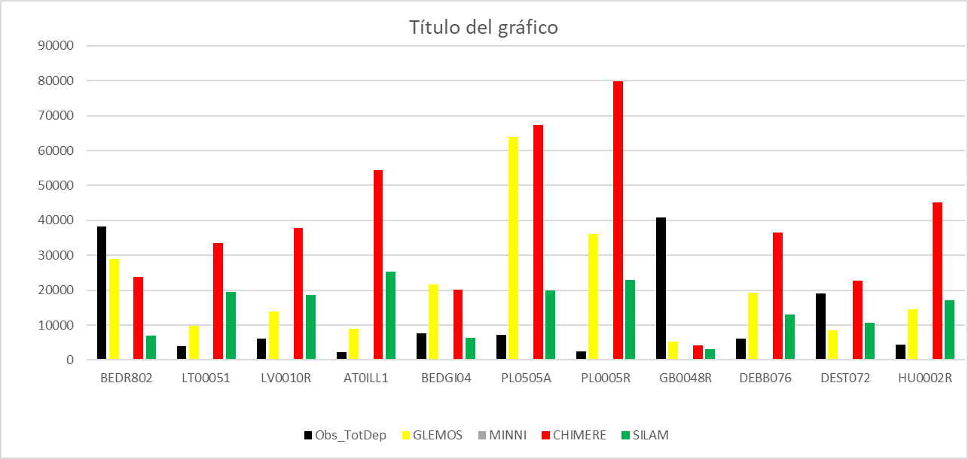
Air concentration (gas +aerosol)
Total Deposition B(a)P particle + gas
Annual precipitation (mm)

Slide 19
Conclusions I
New model updates: SILAM and MINNI
More variables submitted by SILAM and MINNI
B(a)P AIR CONCENTRATIOS:
EMEP SITES Altitude < 800 m :
Very high spatial correlation for all the models
CHIMERE: a bit better performance for total than for aerosol
GLEMOS: underestimation of aerosol phase and overestimation of total
MINNI: underestimation of both, particle and total
SILAM: Small bias for aerosol phase but overestimates total
B(a)P in PM10, AQ e-Reporting EEA
General underestimation of concentrations, especially at urban sites
Larger errors than for EMEP sites

Slide 20
Conclusions II
GAS/PARTICLE RATIO:
Significant differences for aerosol/total ratio. In general all models have similar spatial gradients
CHIMERE and MINNI have the highest particle to total ratios, SILAM the lowest
Few measurements for the gas phase
DEPOSITION:
Significant differences between models for deposition (particles, gas, wet, dry)
Doubts about the measurements for deposition (e.g. very low values in areas with high concentrations)
With the information available, overestimation of deposition, specially CHIMERE (and MINNI underestimation)
Few observations in general in Southern Europe
Total deposition: In general: CHIMERE > SILAM > GLEMOS > MINNI (although there are spatial variations)
CHIMERE and SILAM: Largest particle deposition rates (mainly wet)
CHIMERE, SILAM, MINNI: WDEP of particles > DDEP of particles || GLEMOS: DDEP of particles > WDEP of particles
GLEMOS: Particle deposition rates are quite similar to those of gas

Slide 21
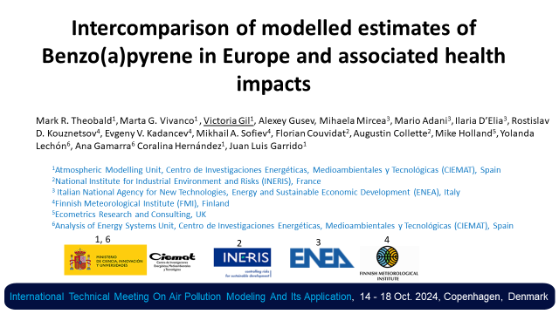
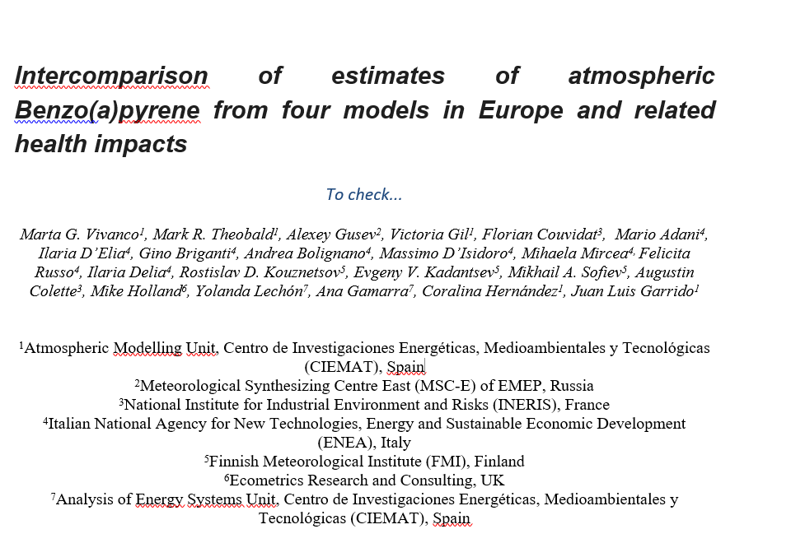
Results presented at the International Technical Meeting On Air Pollution Modeling And Its Application, 14 - 18 Oct. 2024, Copenhagen, Denmark
Manuscript on-going (already circulated to authors in April, waiting for comments)
Future POPs campaign: Good idea
(opportunities for measurements of gas phase? Deposition? Increased spatial coverage of measurements?)

Slide 22



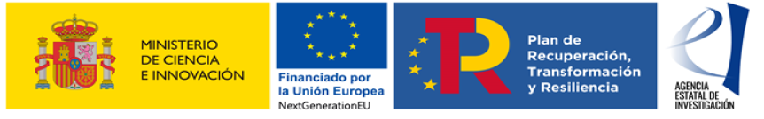

Thank you!
Project TED2021-132431B-I00 (TRANSAIRE: Transition to cleaner air in Spain) funded by MCIN/AEI/ 10.13039/501100011033 and by the European Union NextGenerationEU/PRTR
We also thank the Ministry for the Ecological Transition and Demographic Challenge (MITERD)
m.garcia@ciemat.es
mark.theobald@ciemat.es

