Slide 2
Supersites in Czech Republic within DIRECTIVE (EU) 2024/2881on ambient air quality and cleaner air for Europe
RNDr. Adéla Holubová Šmejkalová Ph.D.
Head of Košetice Observatory
Department of Air Quality Protection
Czech Hydrometeorological Institute

Slide 3
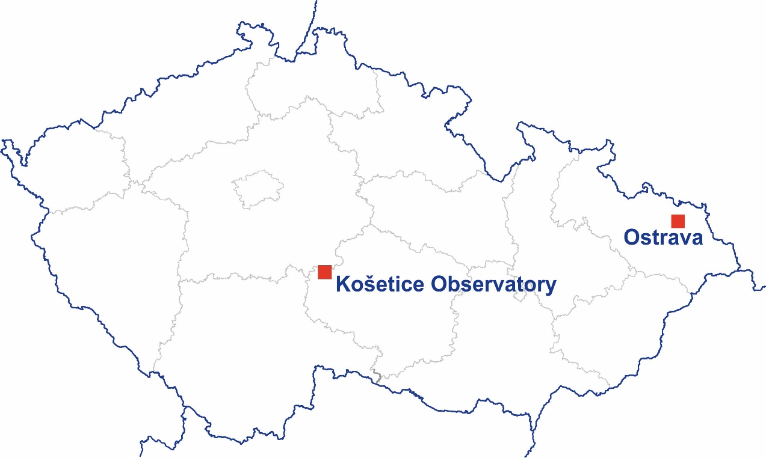
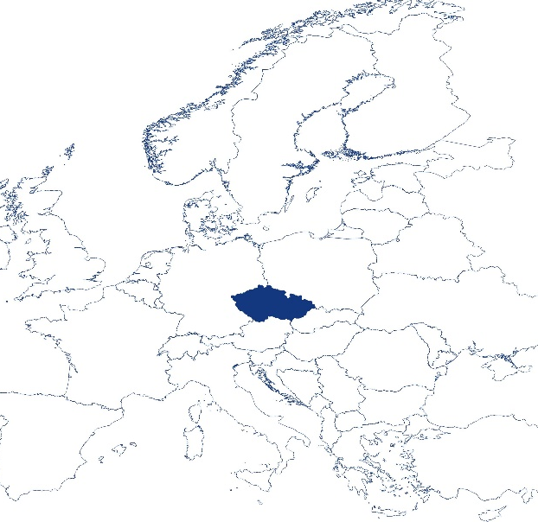
Supersites in the Czech Republic
Košetice Observatory – Rural background station
Ostrava (Poruba) – Urban background station

Slide 4
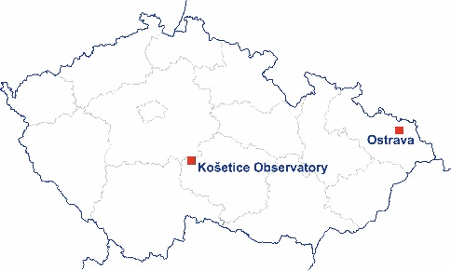
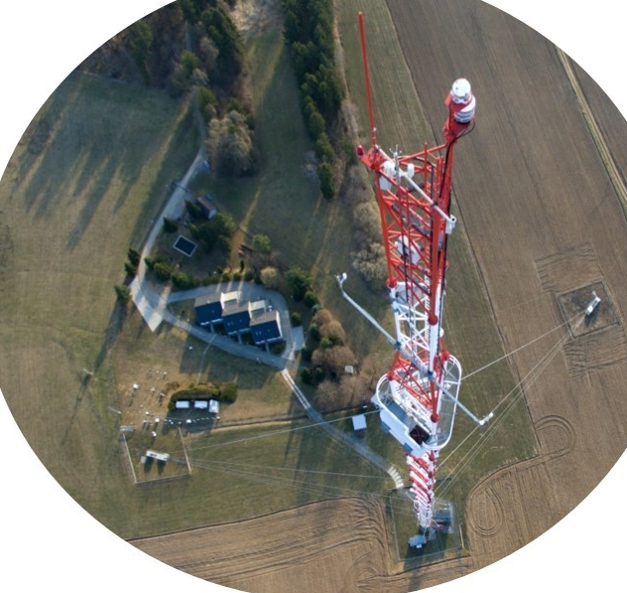
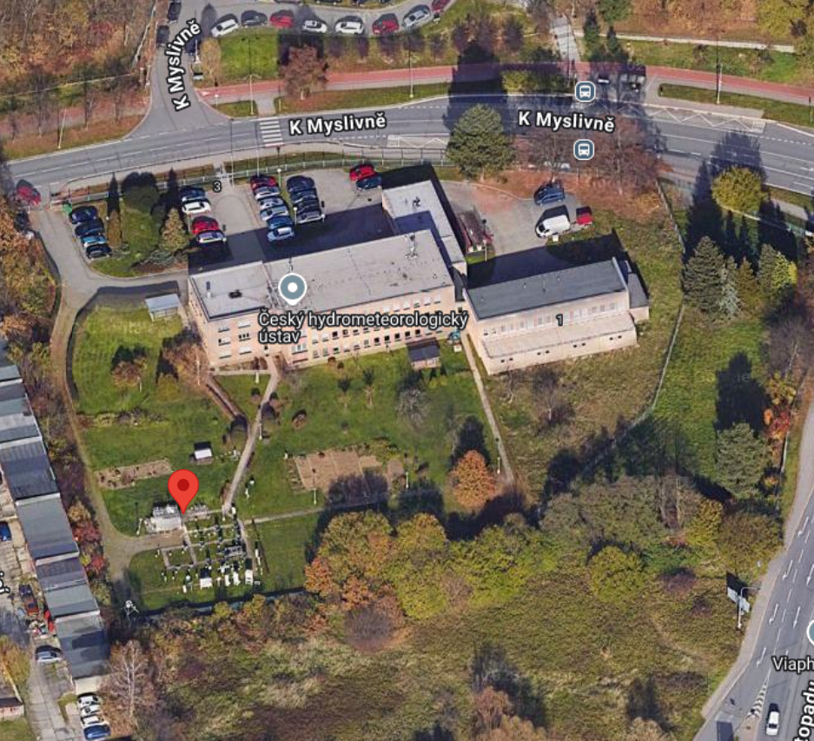
Košetice Observatory –
Rural background station
- station of the National Air Quality monitoring network
- station EMEP level 2
- ICP IM level 1
- GAW regional station
- ACTRIS RI station
Ostrava (Poruba) – Urban background station
- station of the National Air Quality monitoring network

Slide 5
Pollutant | Urban background Ostrava | Rural background Košetice
PM₁₀ | ✓ | ✓
PM_{2,5} | ✓ (N) | ✓
Heavy metals (As, Cd, Ni, Pb) | ✓ | ✓
BC | ✓ (N) | ✓
Chemical composition of PM_{2.5} |  | ✓
Size distribution of UFP | ✓ (N) | ✓
UFP | ✓ (N) | ✓
NO_{2 ,} NO, NO_{X} | ✓ | ✓
Tropospheric ozon O₃ | ✓ (N) | ✓
SO₂ | ✓ | ✓
CO | ✓ (N) | ✓
Benzene | ✓ | ✓
benzo[a]pyrene | ✓ | ✓
Ammonia NH₃ |  | ✓ (N)
VOC online |  | ✓ (N)
Total gaseous mercury |  | ✓
Total deposition BaP, PAH | ✓ (N) | ✓
Total deposition As, Cd, Ni, Pb | ✓ (N) | ✓
Depozition Hg | ✓ | ✓
*(N) new measurement

