Slide 1
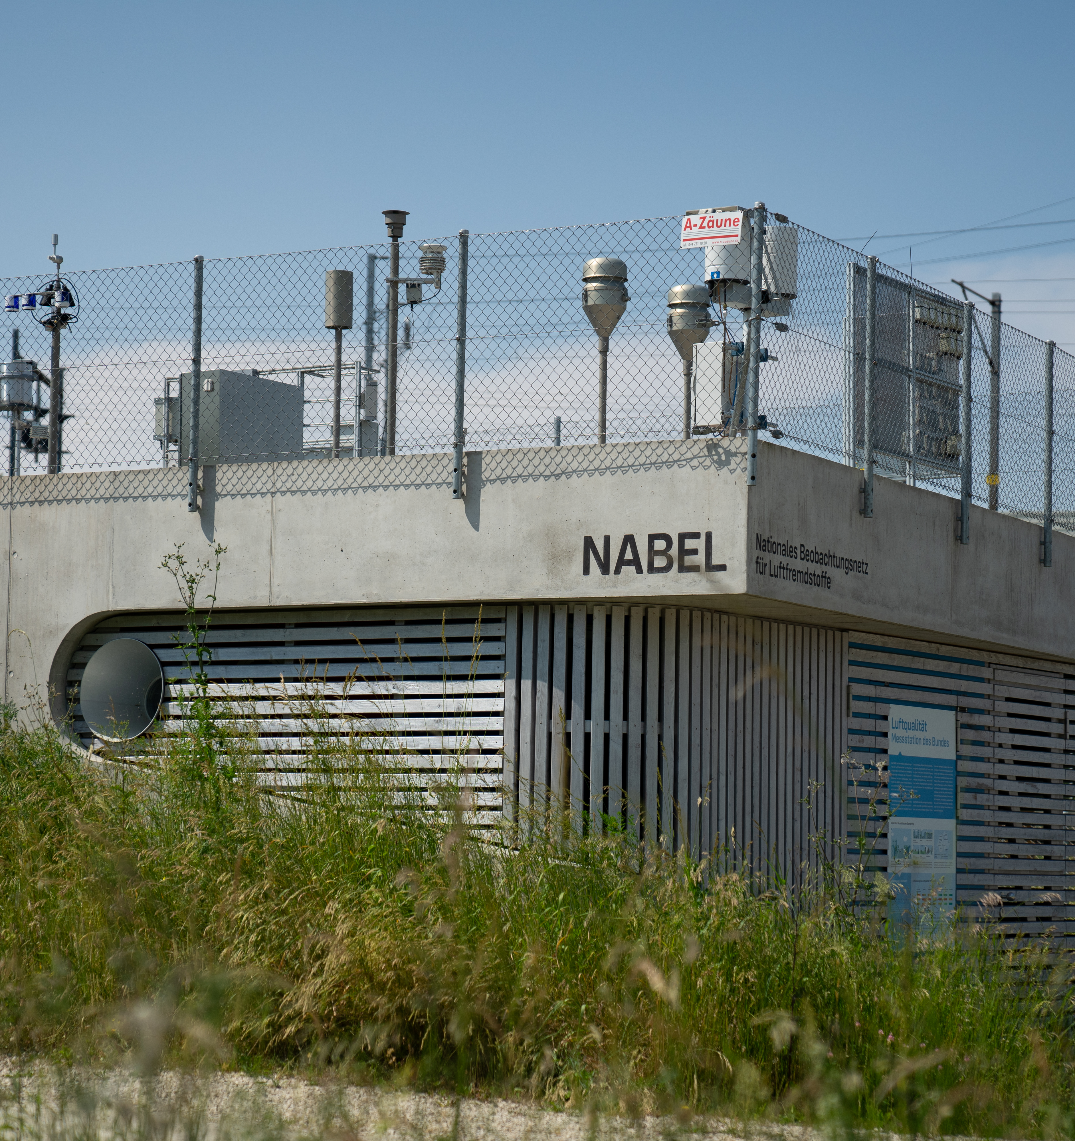
Supersites in Switzerland
Christoph Hueglin (Empa) & Michael Schibig (FOEN)
TFMM 05 May 2025

Slide 2
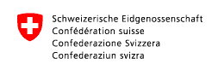


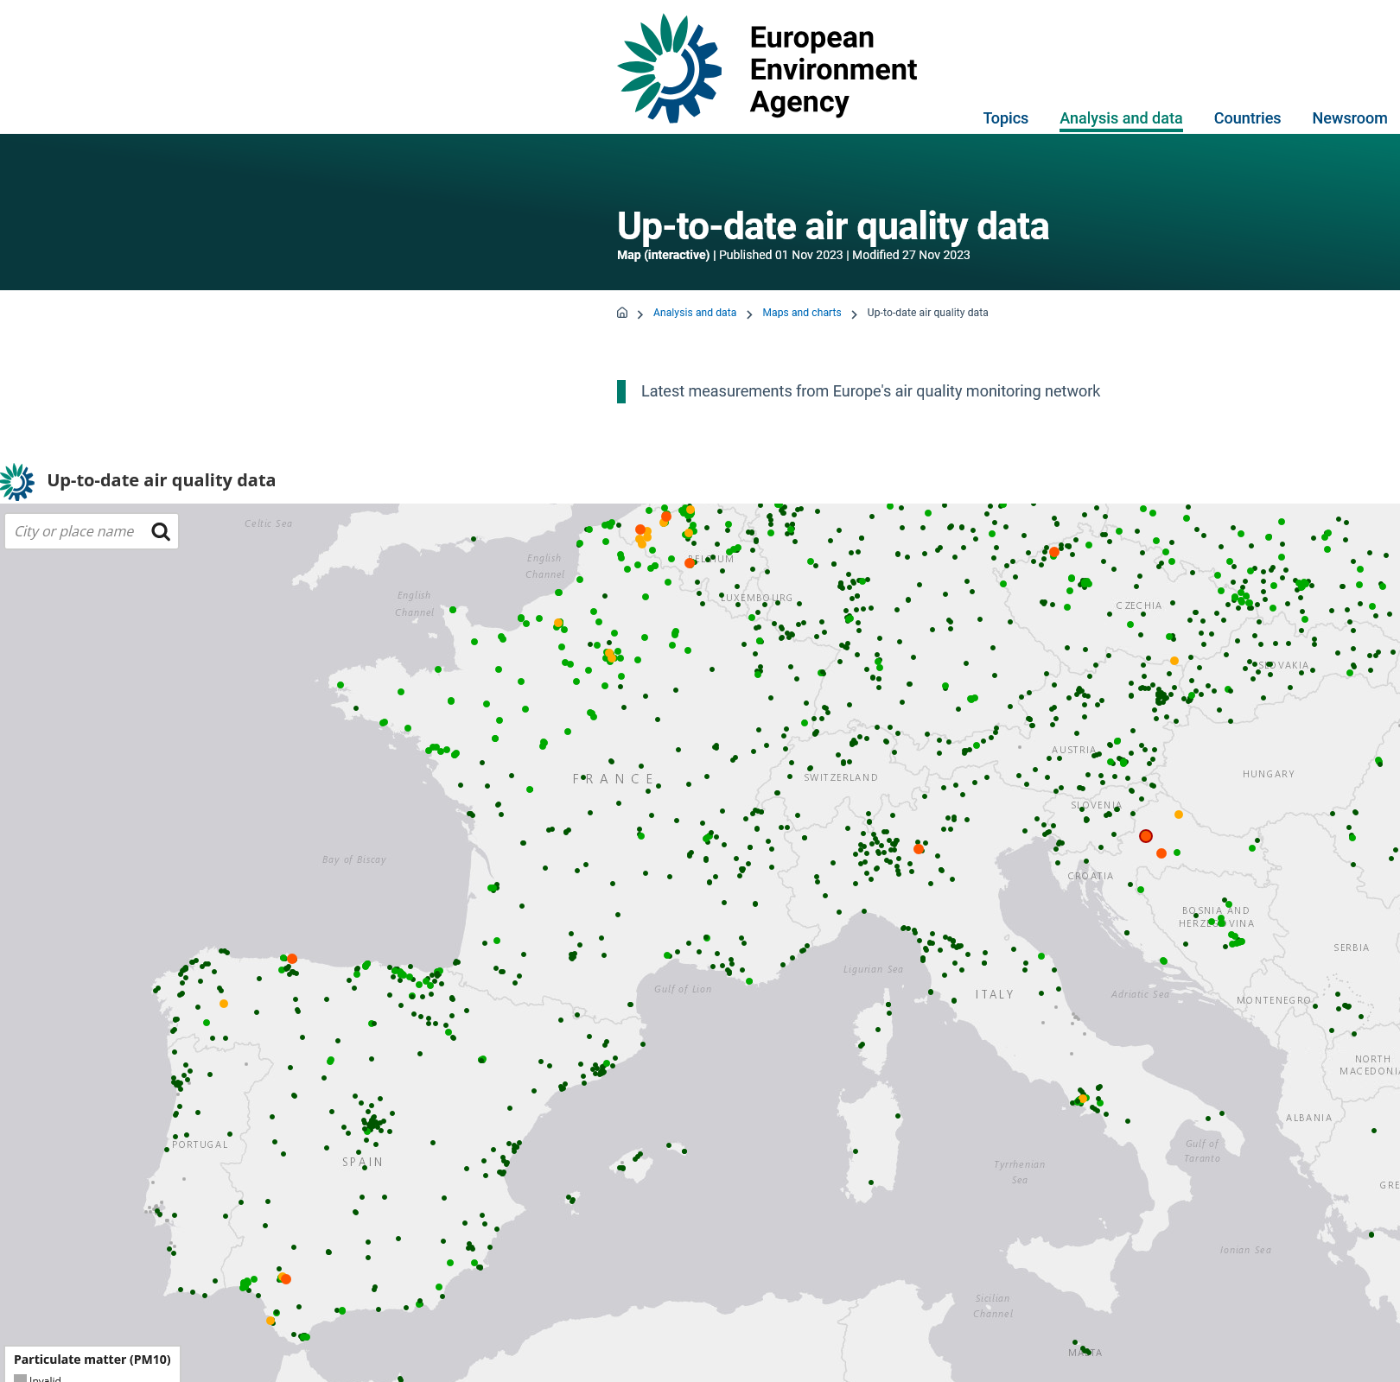
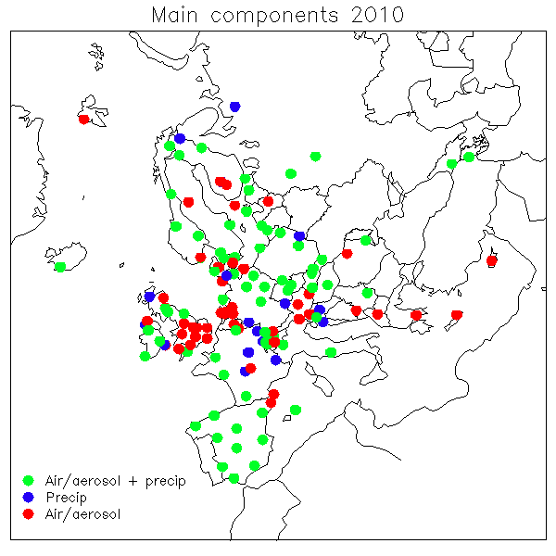


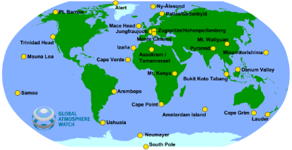
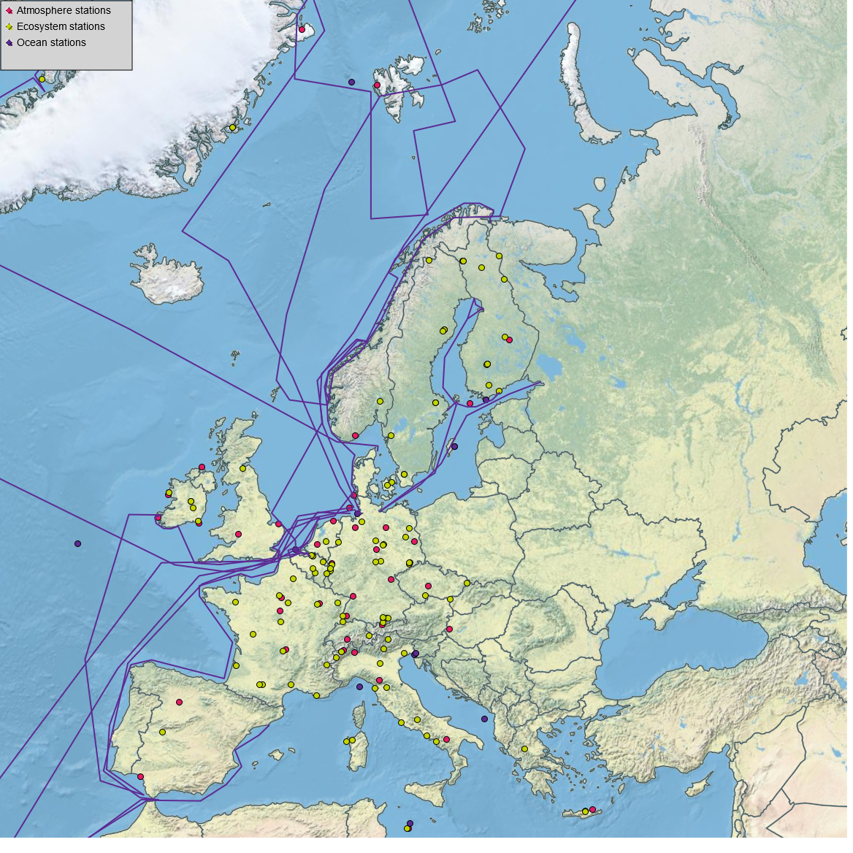



Swiss National Air Pollution Monitoring Network NABEL
Assessment of actual state of air quality
Creating a basis for Swiss clean air policy
Monitoring the effectiveness of implemented measures
Information for the public
Support of international treaties and programs
Research platform
christoph.hueglin@empa.ch ❘ TFMM ❘ 05.05.2025

Slide 3
Swiss National Air Pollution Monitoring Network NABEL – measurement program
Gases
Aerosols
Hueglin et al. Chimia 2024
christoph.hueglin@empa.ch ❘ TFMM ❘ 05.05.2025

Slide 4
Supersites according to EU AQD 2024/2881 (Article 10)
Urban background: One monitoring supersite per 10 million inhabitants (member states < 10 million inhabitants = one supersite)
Rural background: One monitoring supersite if member state territory is between 10’000 km² and 100’000 km². One monitoring supersite per 100’000 km² for member states with territory more than 100’000 km².
Country | Population (mio.) | Area (km²) | Urban background | Rural background
Germany | 83.8 | 357’592 | 8 | 3
France | 68.6 | 632’702 | 6 | 6
Switzerland* | 8.9 | 41’291 | 1 | 1
* Switzerland is not an EU member state and EU AQD is not binding (Switzerland is member of EFTA)
christoph.hueglin@empa.ch ❘ TFMM ❘ 05.05.2025

Slide 5
Measurement program of supersites according to EU AQD 2024/2881
Pollutant | Rural background supersite Payerne (NABEL, Emep, GAW, ACTRIS) | Urban background supersite Zurich-Kaserne (NABEL)
PM10, PM2.5, UFP, BC | X (M) | X (M)
NO₂, O₃, SO₂, CO | X (M) | X (M)
Size distribution of UFP | X¹⁾ (R) | X (M)
BaP and other PAHs | X (M) | X (M)
Deposition of BaP and other PAHs | -- (M) | -- (M)
As, Cd, Pb, Ni | X (M) | X (M)
Deposition of As, Cd, Pb, Ni | (X) (M) | (X) (M)
Benzene | -- | X (M)
Chemical composition of PM2.5 | (X) (M)²⁾ | (X) (M)²⁾
Total gaseous mercury | -- (M)³⁾ | -- (R)³⁾
Particulate matter oxidative potential | -- (R) | -- (R)
NH₃ | X (R) | X (R)
Levoglucosan | -- (R) | -- (R)
Particulate and gaseous divalent mercury | -- (R) | -- (R)
Nitric acid | X (R) | -- (R)
X measured
(X) partially measured
-- not measured
mandatory
(R) recommended
¹⁾ measured by Paul Scherrer
Institute (PSI) within ACTRIS
²⁾ partially measured in PM10
³⁾ measured in 2022/2023,
Osterwalder et al. (2024)
christoph.hueglin@empa.ch ❘ TFMM ❘ 05.05.2025

Slide 6
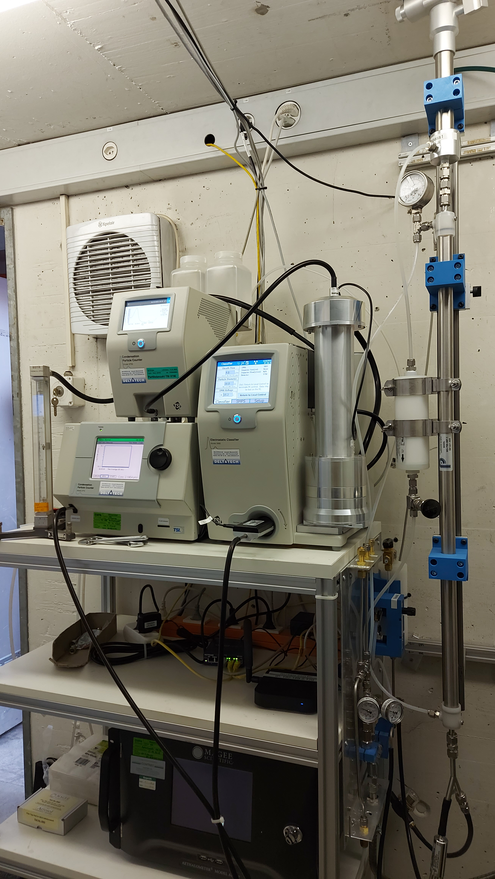
MPSS in Zurich-Kaserne
Compliant with CEN/TS 17434 and ACTRIS
In operation since June 2023
Operation requires expert knowledge
Data capture: 85%
Practical challenges regarding QA/QC and data management still need to be solved
Conclusion:
Set-up and operation of supersites can be done by MS that have the resources and the experience from activities in programs such as EMEP and ACTRIS.
Otherwise the set-up/operation of supersite might be difficult and support will be needed
Setup in June 2023. In the meantime, the independent second CPC (here a TSI 3775) has been replaced by a CEN TS 17434:2020 compliant instrument (TSI 3750-10)
christoph.hueglin@empa.ch ❘ TFMM ❘ 05.05.2025

