Slide 1




Supersites in FI
Tuukka Petäjä
5.5. 2025

Slide 2
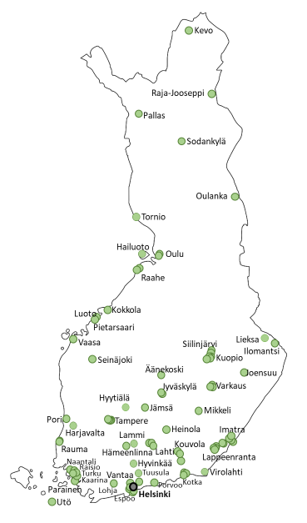
Current AQ monitoring in Finland
Urban AQ monitoring handled on local level – by the municipalities.
Rural AQ monitoring duty of FMI as stated in the legislation
Number of site types:
Fixed traffic ~45 sites
Fixed industrial ~40 sites
Fixed urban background ~30 sites
Fixed regional background, 10+ sites
Number of measurement sites in Finland in 2025 (approximately):
PM₁₀ 70 sites
NO_{x} 60 sites
PM_{2.5} 50 sites
SO₂ 40 sites
O₃ 20 sites
PAHs in PM10 10 sites
Metals in PM10 10 sites
Black carbon 10 sites
UFP (as CPC) 10 sites
PNSD 10 sites
Ammonia 5 sites
Methane 5 sites (GHG)
CO 6 sites (GHG)
EC/OC 3 sites
Main ions 3 sites
VOCs 3+campaigns
TRS 25
35 networks
measuring AQ at
100+ sites
Katriina Kyllönen, FMI

Slide 3
Air Quality Monitoring:
New concept in AQD: Air Quality Supersites
Requirement for supersites
Urban background supersite: one per 10 M people
Rural background supersite: one per 100 000 km2
Case Finland
1 urban supersite
3 rural supersites
Kumpula SMEAR?
Pallas, Hyytiälä, Virolahti?
New responsibilities, utilising research infrastructures
Mandatory measurements
  The ”old” pollutants
  Ultrafine particles
  PNSD
  Black carbon
  Ammonia
Recommended measurements
  The ”old” ones
  PM oxidative potential
  Levoglucosan
  Nitric acic
Old monitoring requirements:
Gases:
SO2, NO2/NO/NOx, O3, CO
VOC
Mercury
PM mass:
PM2,5
PM10
PM2,5 chemical composition
Ions: Sulphate, nitrate, ammo-nium, chloride, calcium, mag-nesium, potassium, and sodium;
Elemental and organic carbon (EC/OC)
PM10 trace components
Benzo(a)pyrene and other PAHs;
Metals: arsenic, cadmium, nickel, lead
Deposition
PAHs, metals, mercury
Katriina Kyllönen, FMI

Slide 4
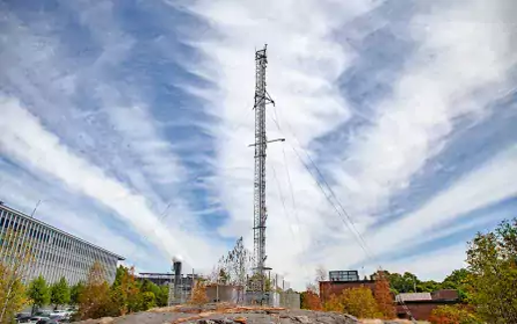
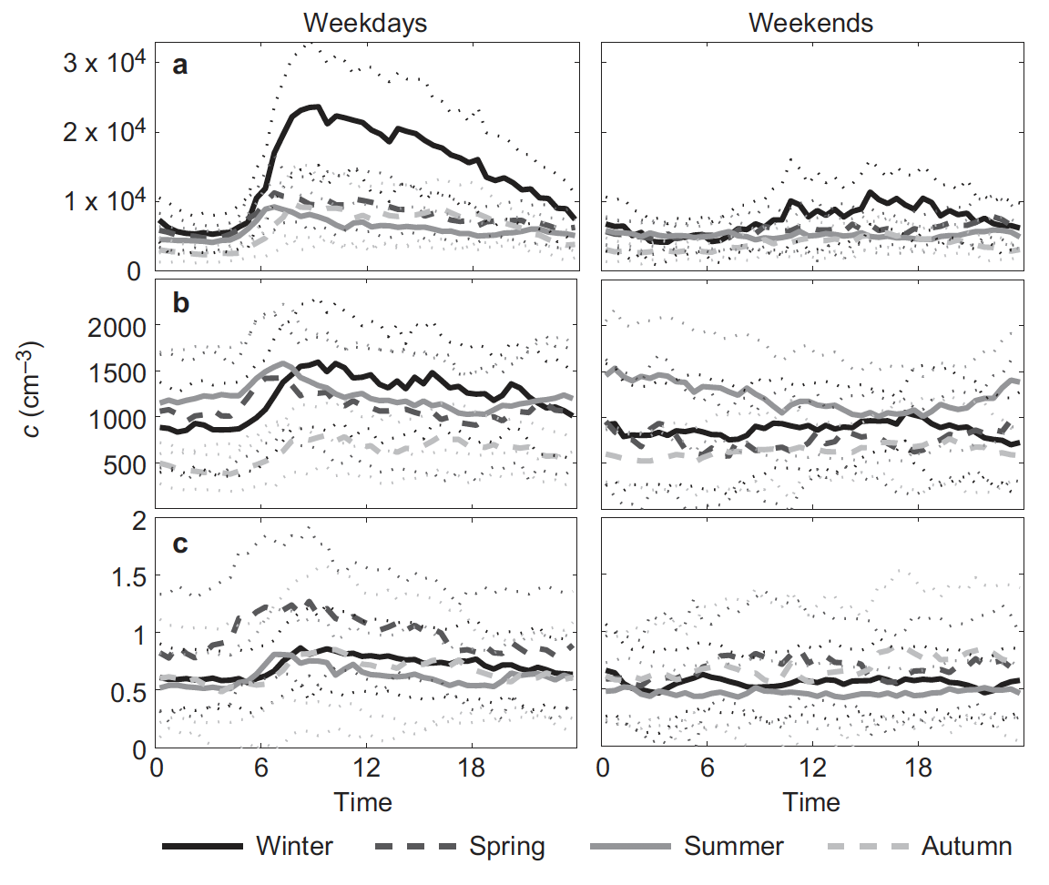
SMEAR III urban background site in Kumpula Campus in Helsinki
Collaborative effort of University of Helsinki (UHEL), Finnish Meteorological Institute and Helsinki (FMI) Region Environmental Services (HSY)
Aerosol size distribution and number concentration measurements since 2001
Black Carbon measurements
ACTRIS aerosol in-situ and trace gas in-situ observation site
ICOS Ecosystem site
Diurnal cycle of UFPs (top), accumulation mode (middle) and coarse mode (bottom)

Slide 5
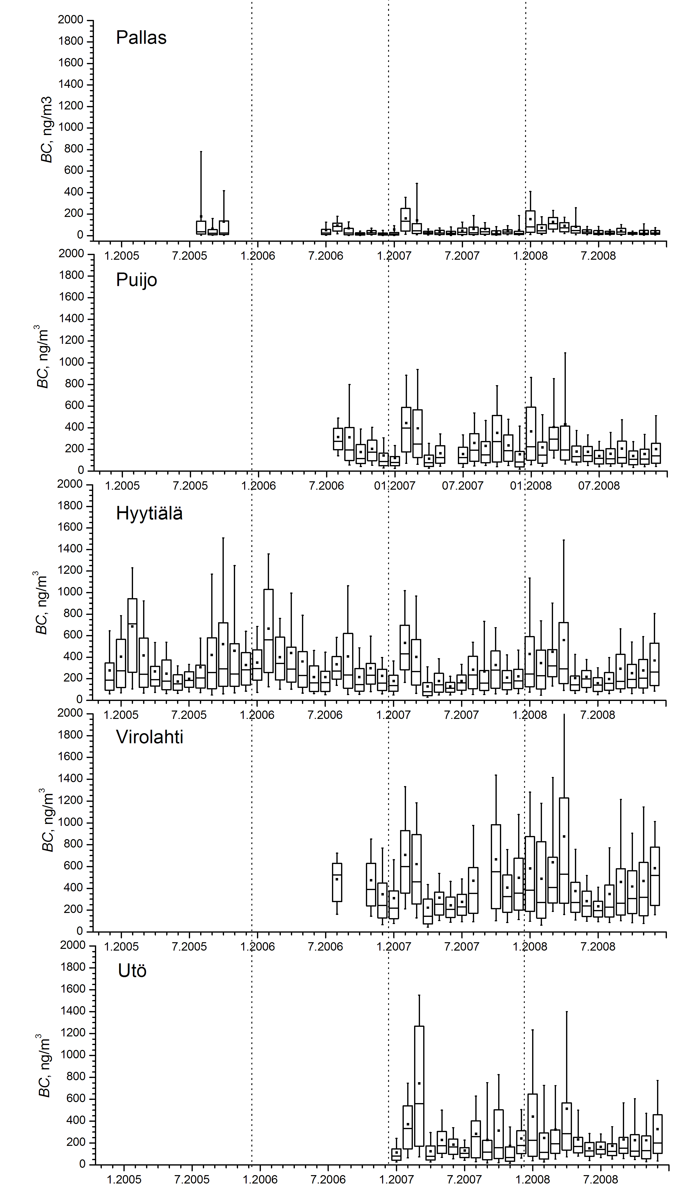
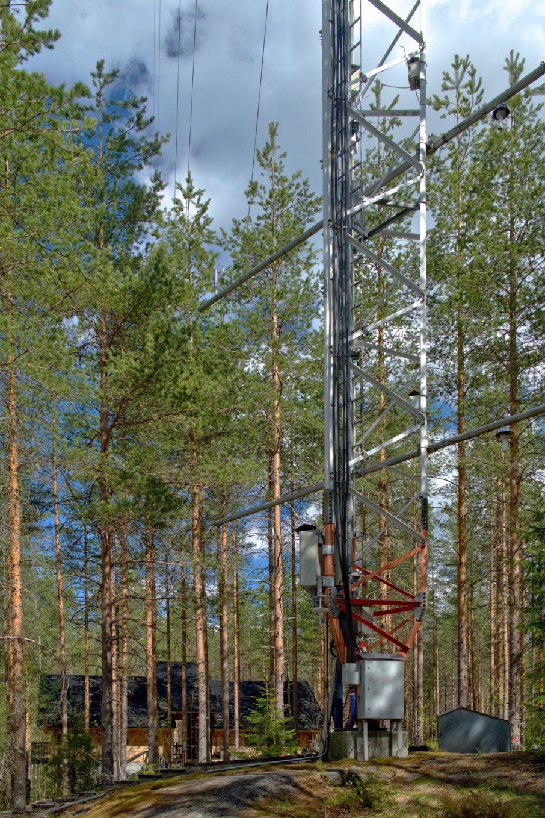
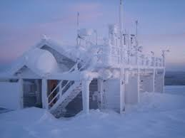
Rural background sites in Hyytiälä and Pallas
Long-term observations since 1990s
Background sites in boreal and sub-Arctic environment
Includes UFP, eBC measurements
Contributes to ACTRIS, ICOS, eLTER and ANAEE infrastructures

Slide 6
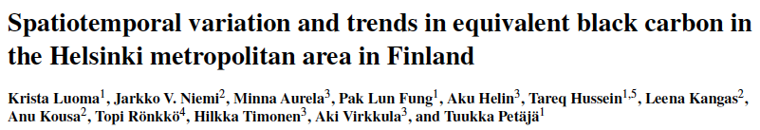
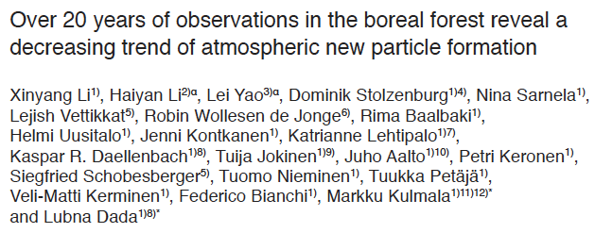

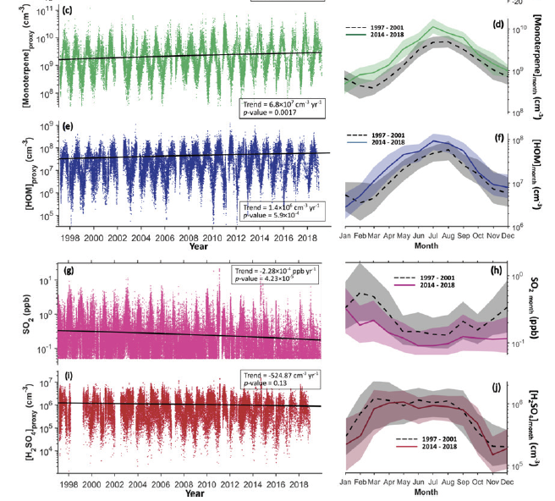

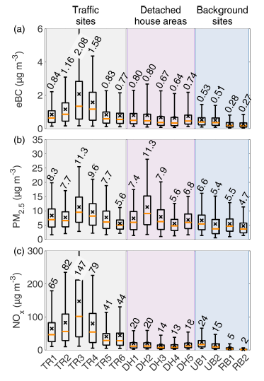
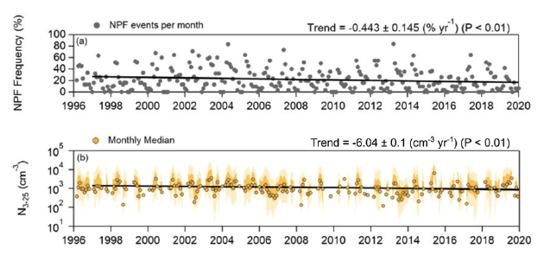
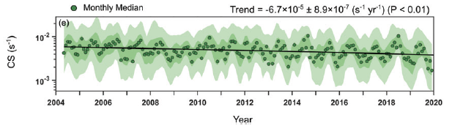
Organic vapor concentration increase
SO₂ and sulfuric acid decrease
Condensation sink decrease
Nucleation mode concentration decrease

Slide 7
Thanks for your attention!
tuukka.petaja@actris.eu
tuukka.petaja@helsinki.fi

Slide 8
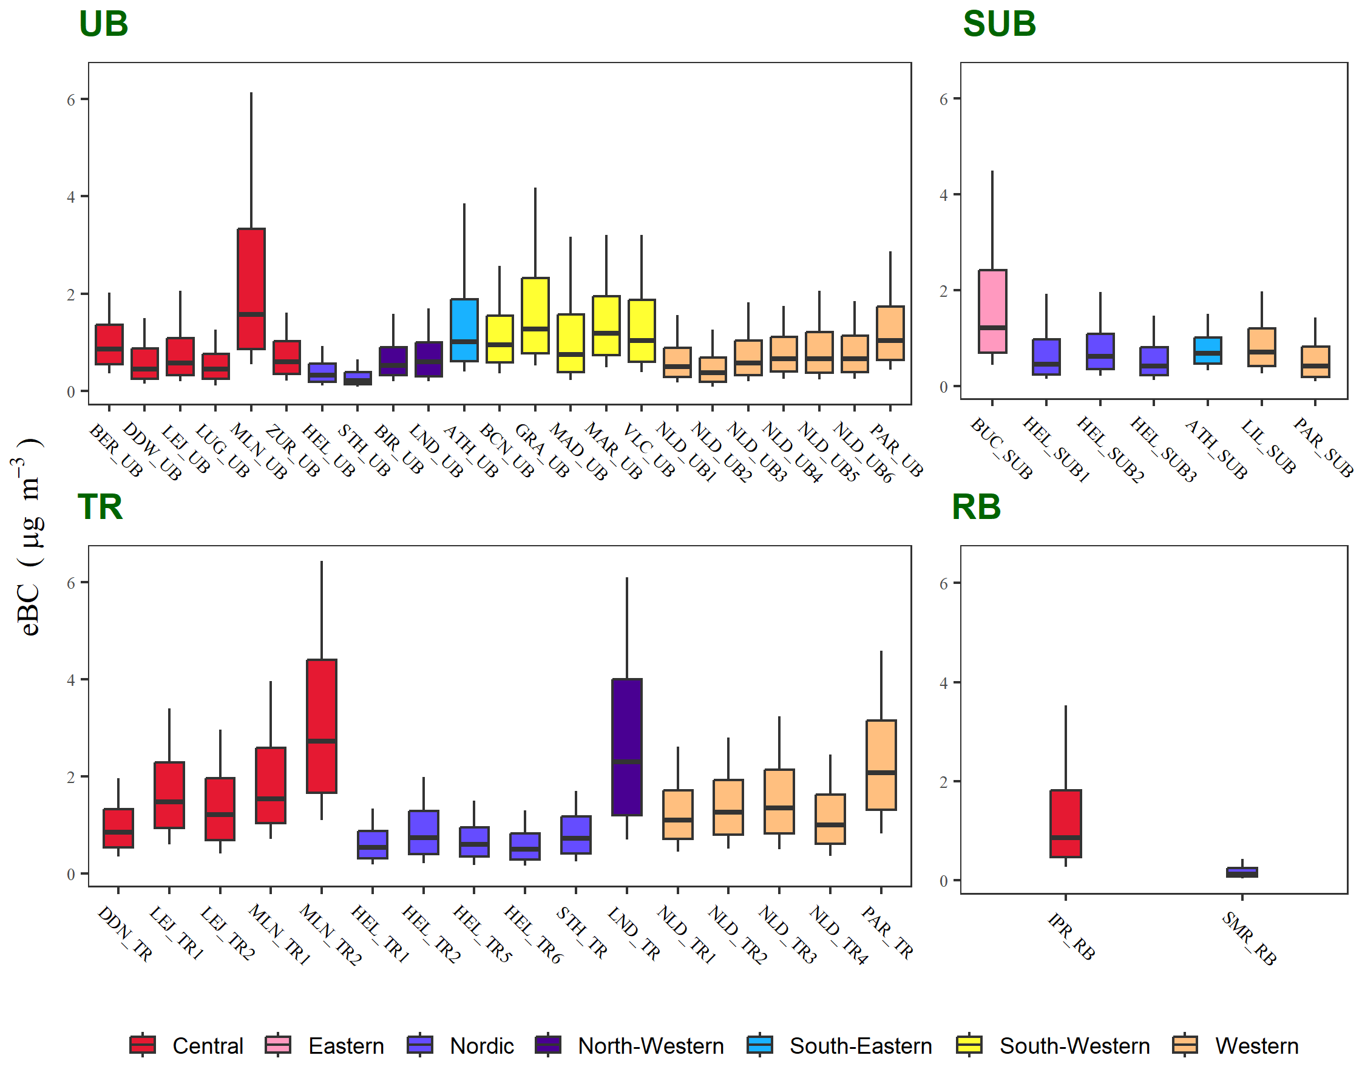
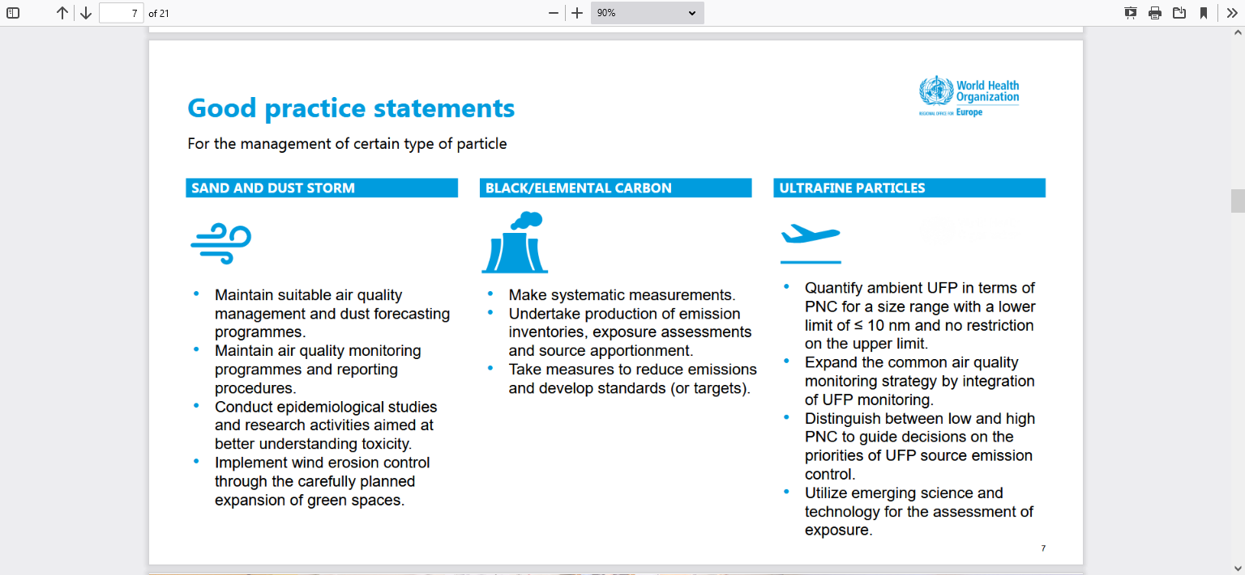
Black carbon in Europe
Variability of hourly averaged eBC mass concentrations at 50 sites between 2017 and 2019 categorized by the type of site and region.
Source: RI-URBANS booklet, modified from Savadkoohi et al. (2023).
Notes:
Almost 20% of the sites from Finland!

Slide 9
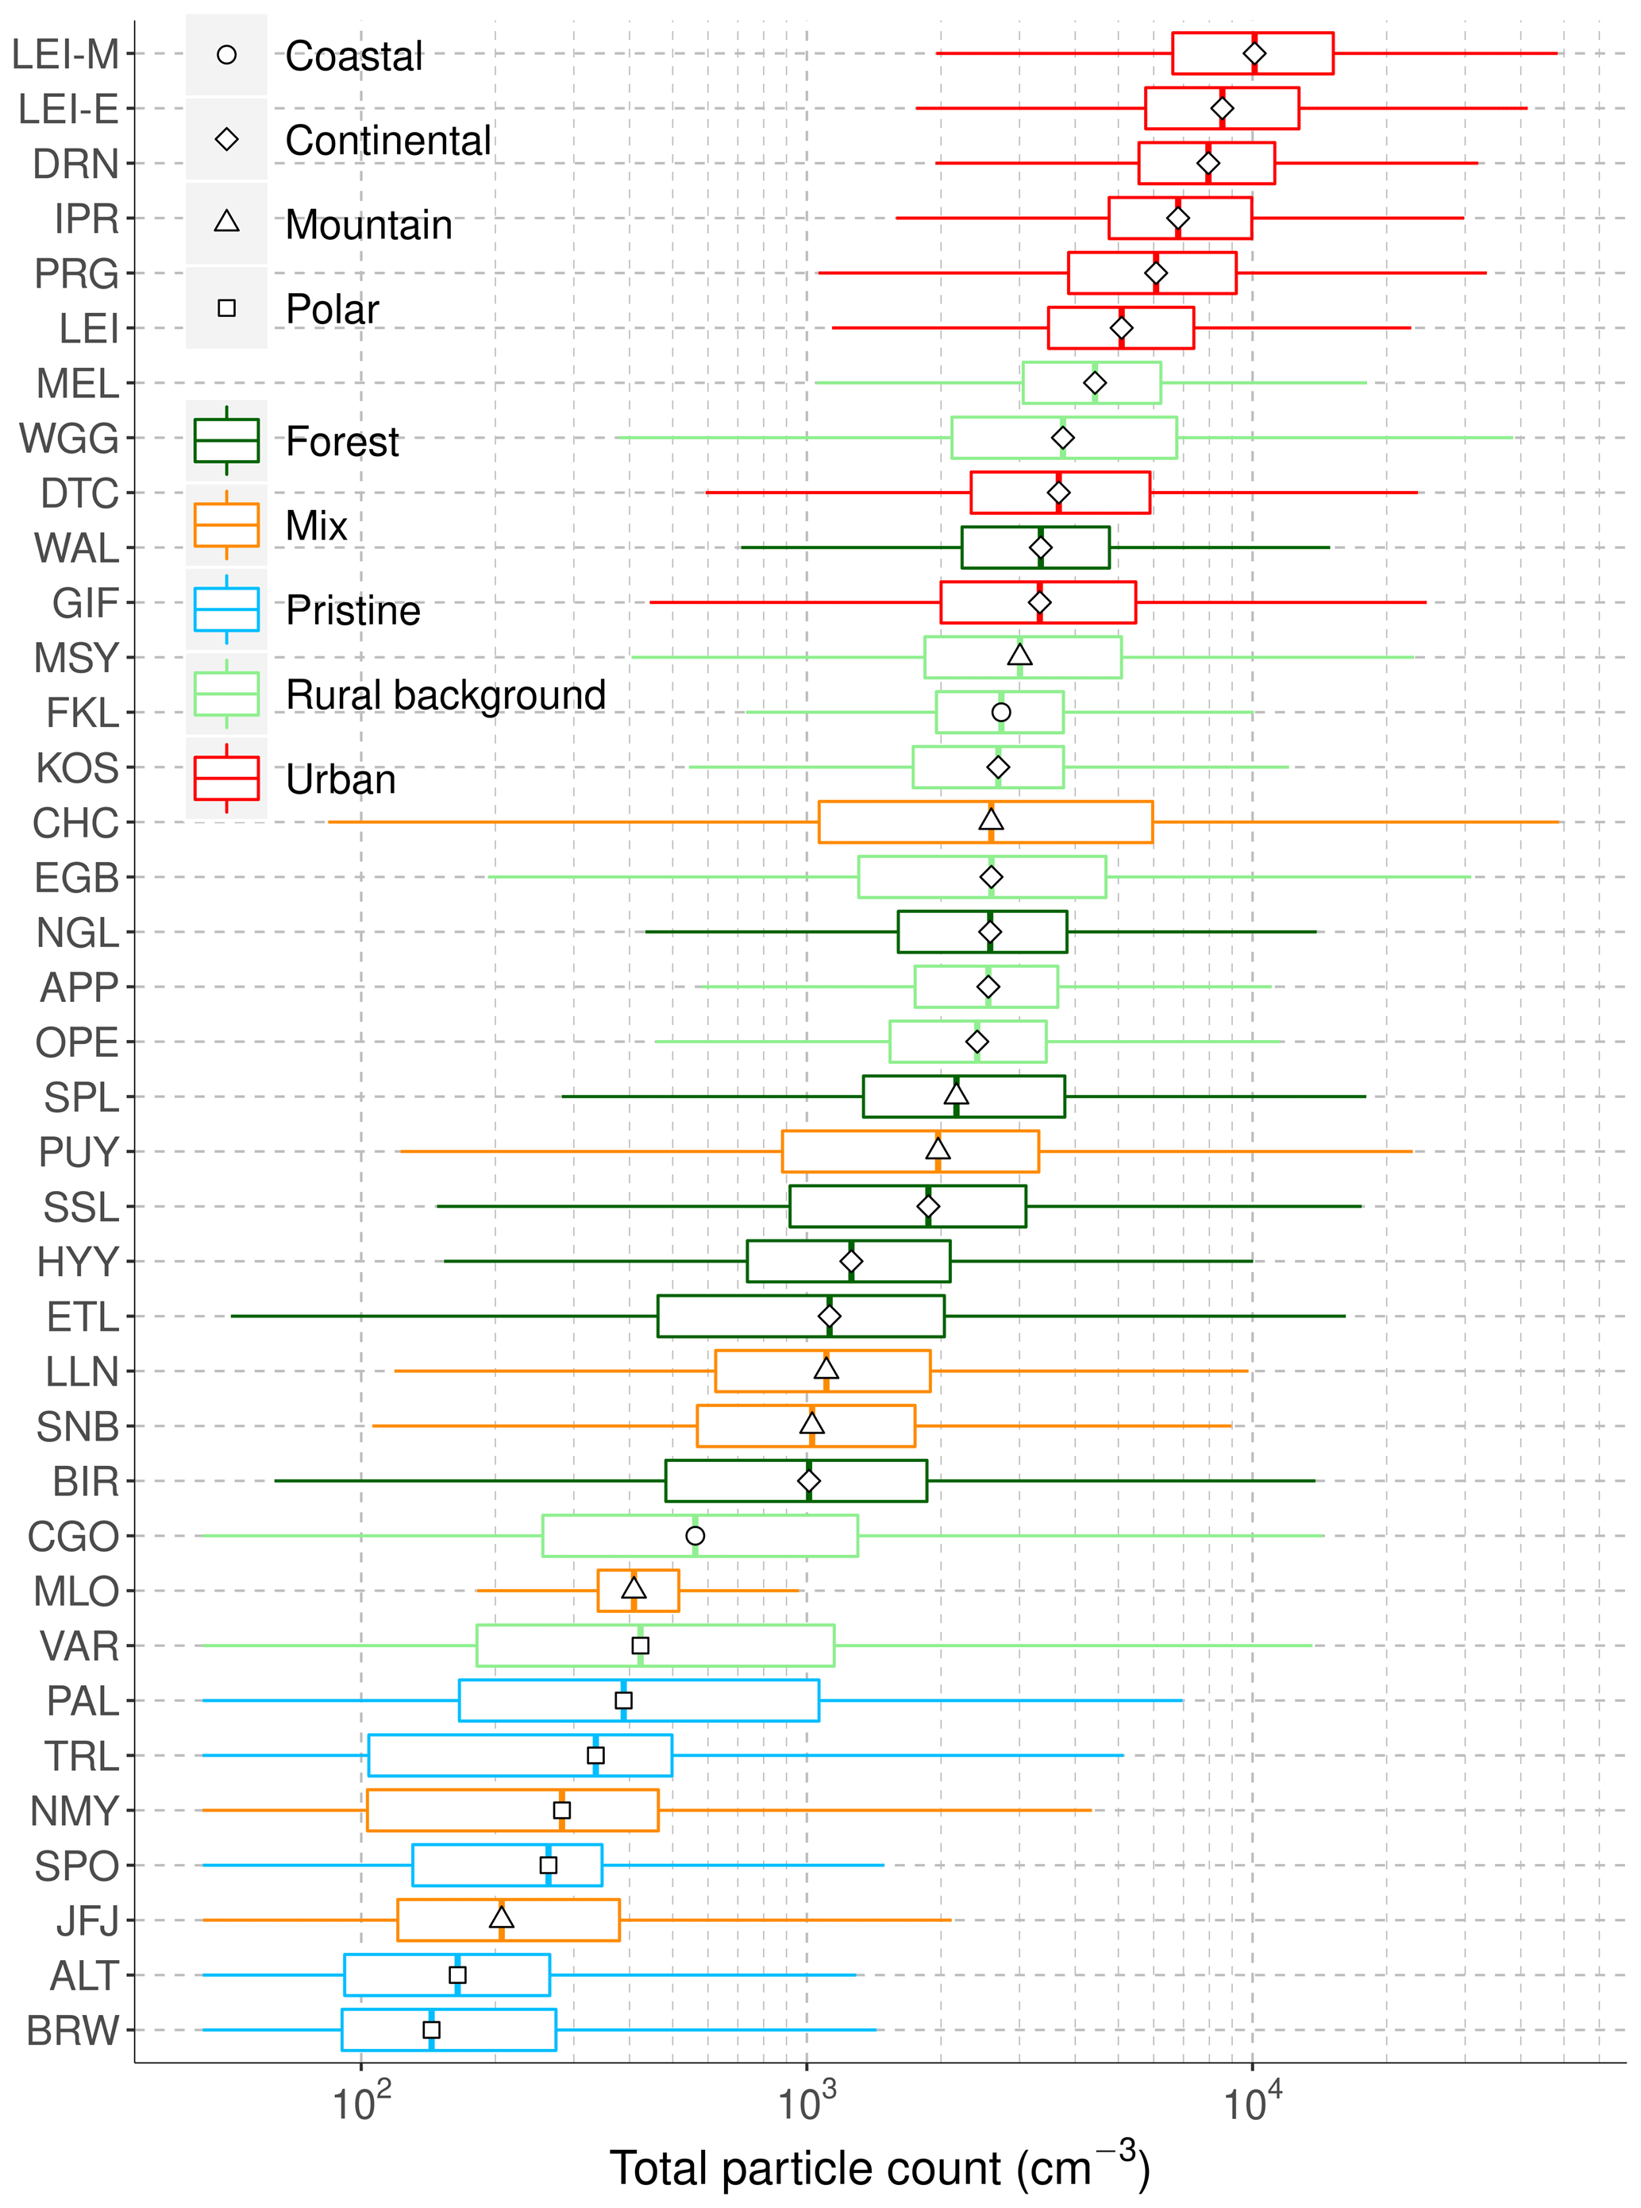
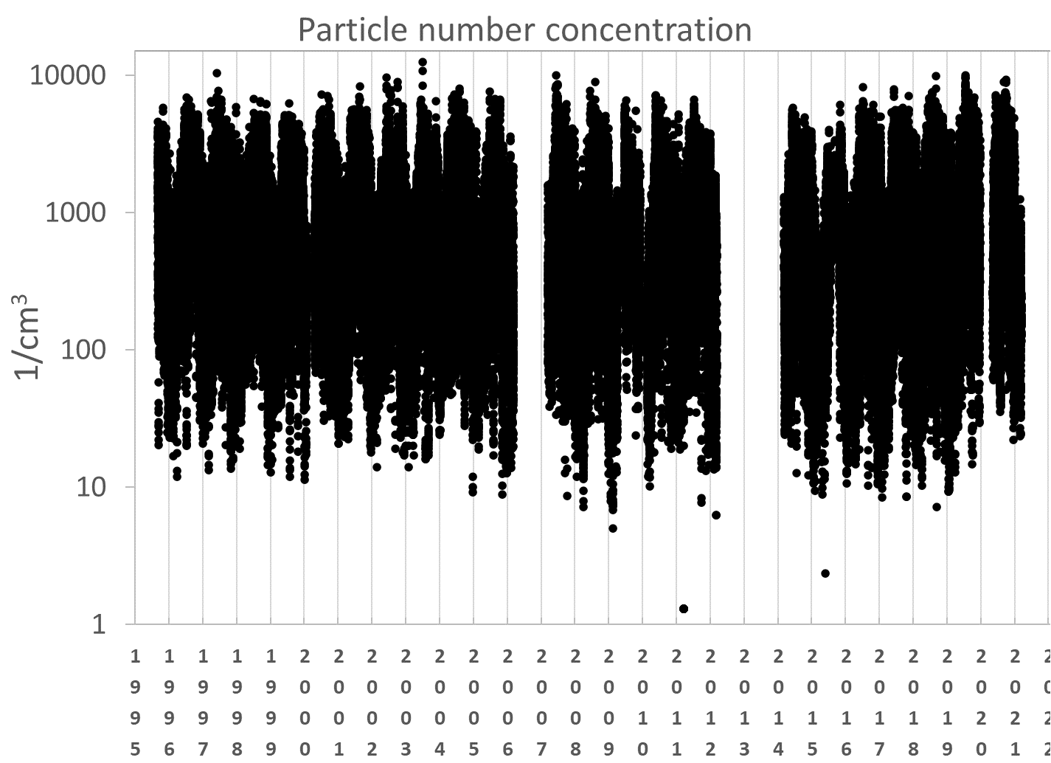
Ultrafine particles and particle number size distribution
Data: FMI
Pallas 1996-2021 PNC concentrations
Large seasonal concentration differences
  Maximum in the summer
  Minimum in the winter
-> Secondary, natural aerosol production during summer
Laj et al. Atmospheric Measurement Techniques, 2020
Notes:
Pallas and Värriö particle concentrations among the lowest

Slide 10
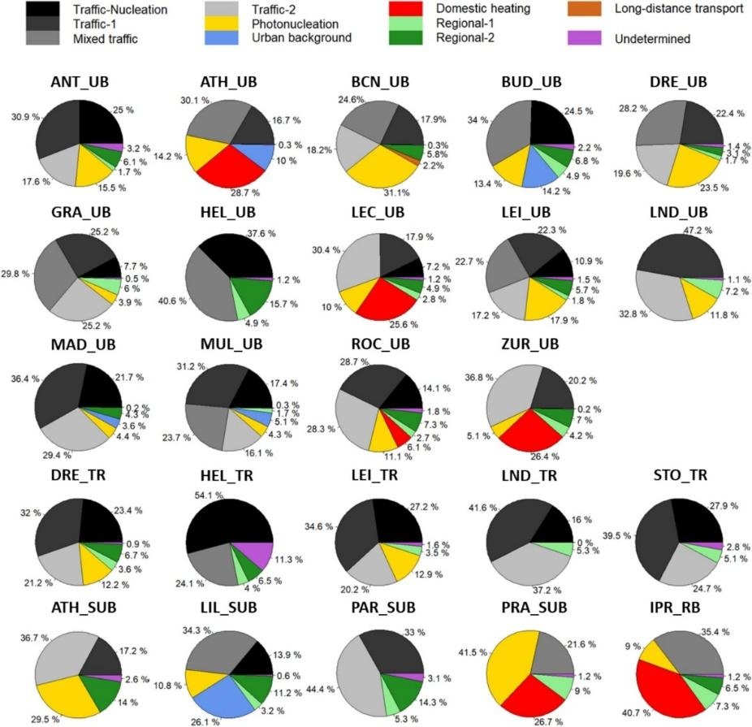
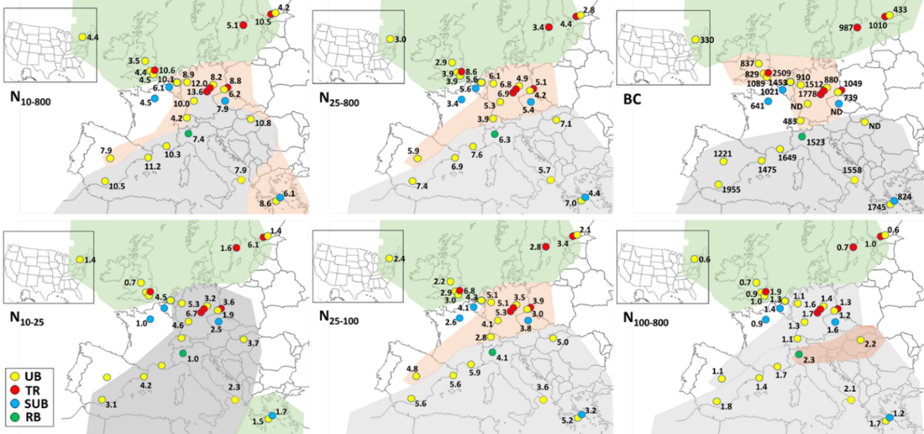
Ultrafine particles and size fractions in Europe (+BC)
Regional variability of averaged 2017–2019 particle number concentrations (in # cm⁻³ 10³) size fractions (in # cm⁻³ 10³) and black carbon (BC in ng m⁻³) in Europe. For the size fraction of 10–25 nm (N₁₀₋₂₅), only sites with a lower size detection limit of 10–14 nm are included.
UB, Urban background; TR, traffic; SUB, Suburban background; RB, Regional background.
Source: RI-URBANS booklet, modified from Trechera et al. (2023) and Garcia-Marlès et al. (2024).

Slide 11
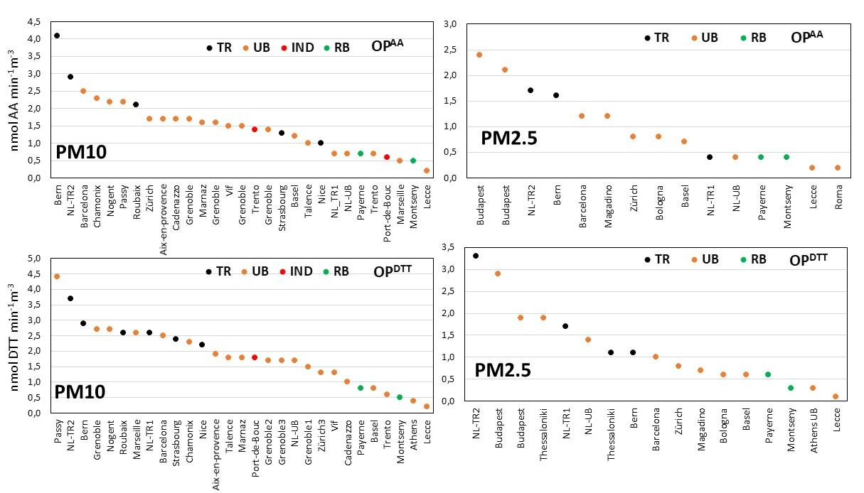


Oxidative potential of particulate matter (OP of PM) represents the capacity of PM to invoke oxidative reactions or to generate reactive oxygen species (ROS) in a biological media (Bates et al., 2015; and Uzu et al., 2011, among others).
Finland
OP^{AA} and OP^{DTT} volume of PM mean values (nmol min⁻¹ m⁻³) in (mostly) urban sites, reported by Janssen et al. (2014), Argyropoulos et al. (2016), Visentin et al. (2016), Paraskevopoulou et al. (2019), Pietrogrande et al. (2019, and references therein), Weber (2021), Weber et al. (2021), Grange et al. (2022), Dominutti et al. (2023), In ‘t Veld et al. (2023a) and Vörösmarty et al. (2023).

