Slide 1







Slide 2





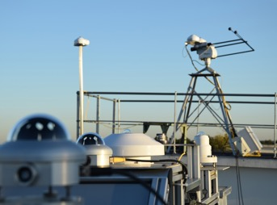


WHAT IS ACTRIS?
Aerosol, Clouds and Trace Gases Research Infrastructure (ACTRIS) is a pan-European research infrastructure having the goal to produce high-quality integrated datasets in the field of atmospheric sciences. ACTRIS provides different services, including access to instrumented platforms, tailored for scientific and technological usage.
 | In Situ | Remote Sensing
Aerosol
Clouds
Trace Gases

Slide 3
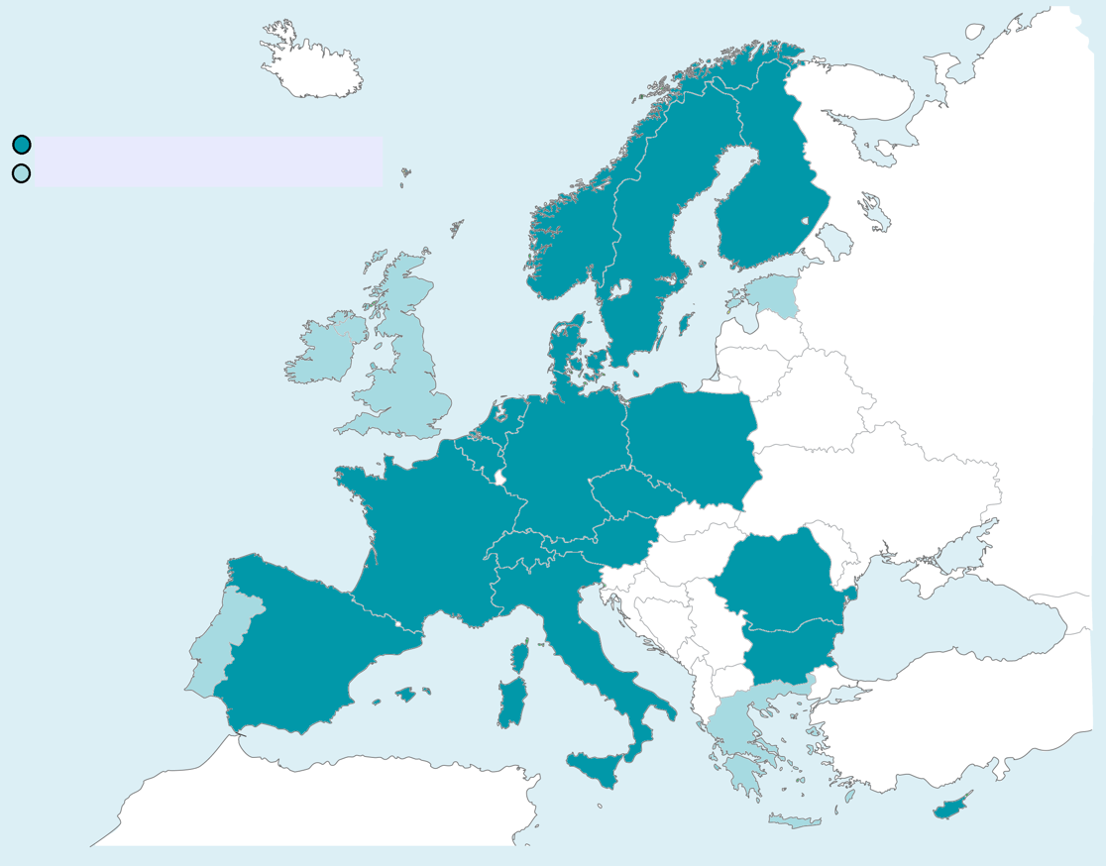
ACTRIS ERIC established on 25th April 2023
16 member countries: Austria Belgium Bulgaria Czechia Cyprus Denmark Finland France Germany Italy Netherlands Norway Poland Romania Spain Sweden
One permanent observer:
Switzerland
One in membership process:
Greece
Three in negotiation process:
Estonia Ireland Portugal
Members and permanent observers of ACTRIS ERIC
Countries otherwise involved in ACTRIS

Slide 4
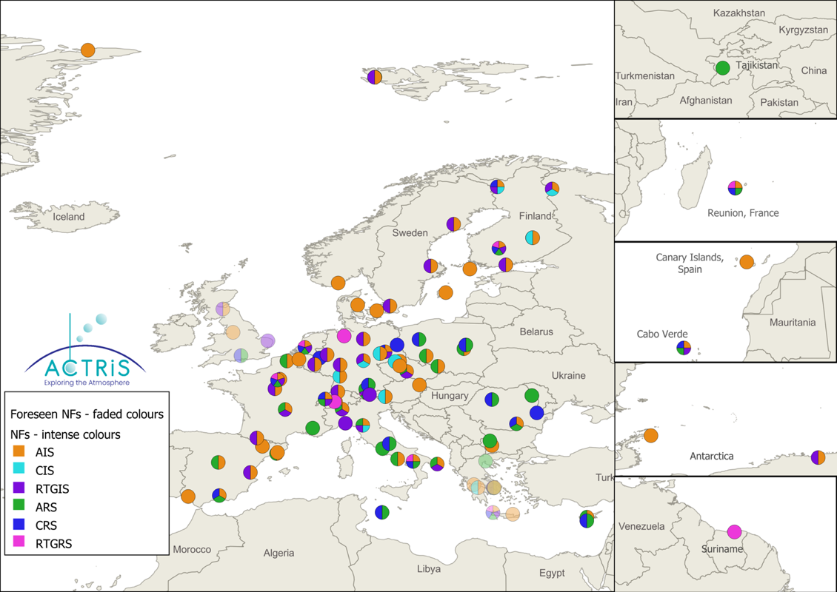
ACTRIS NATIONAL FACILITIES –THE BACKBONE OF THE RI
80 Observatory Platforms
Fixed ground-based stations delivering long-term high-quality data on aerosol, clouds and trace gases via remote-sensing and in situ measurement techniques.

Slide 5
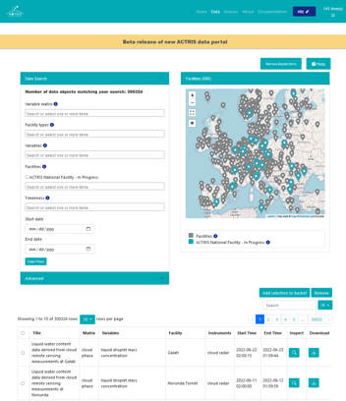
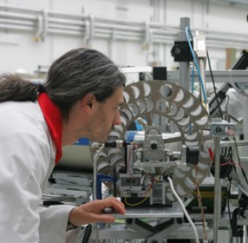
ACTRIS core services – technical support and data provision
Provided by 6 Topical Centres
Standard operation procedures developed for all ACTRIS techniques and variables
Standards for harmonised measurement and data processing protocols
Harmonised retrieval methods for geophysical products
Certification of National Facility measurements by providing an ACTRIS label after a thorough evaluation process
Led by NILU, Norway, with 5 RPOs operating the Data Centre Units located in Norway, Finland, France, Italy and Spain
Available for free via the ACTRIS Data Centre
Common measurement and data processing protocols + QA/QC
Virtual tools for processing data online
Over 100 variables

Slide 6
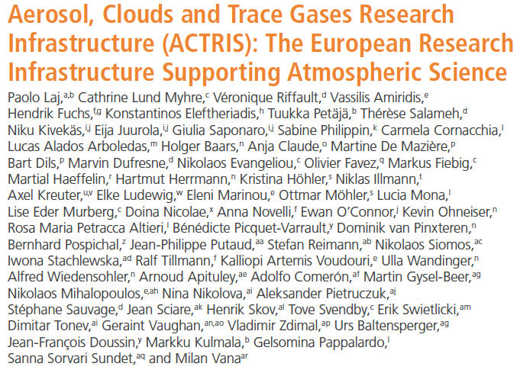

Major achievements:
1) Development of atmospheric measurement techniques and methodologies
2) Contributions to understanding of atmospheric processes
3) Trends and variability of atmospheric composition
4) Studies on air quality and climate change
5) Monitor extreme events and atmospheric hazards
Challenges:
1) Maintain attractiveness to evolving community needs
2) Ensure regular technological upgrades
3) Maintain a sustainable transnational.access program
4) Extend the user-base with cross-disciplinary services
5) Contribute to global atmospheric observations
6) Support data to respond to societal needs
Laj et al. (2024): a comprehensive description of ACTRIS

Slide 7



RI-URBANS
Research Infrastructures Services Reinforcing Air Quality Monitoring Capacities in European Urban & Industrial AreaS
Tuukka Petäjä & Xavier Querol
GUIDANCE DOCUMENTS
FOR SERVICE TOOLS
Prepared in collaboration with ACTRIS and IAGOS

Slide 8







14 countries, 26 beneficiaries, 1 associated beneficiary, starting with 11 cities, 17 associated collaborators
October 2021 – September 2025

Slide 9
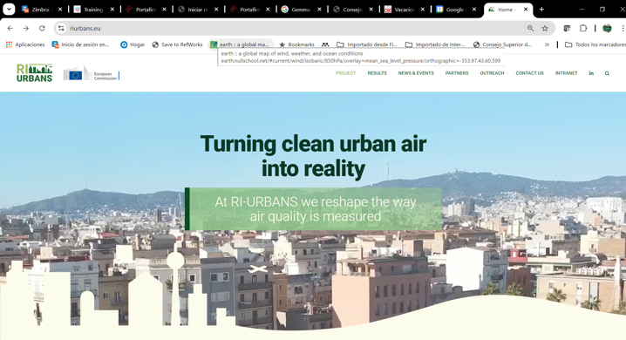
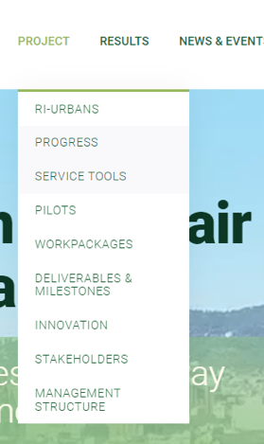
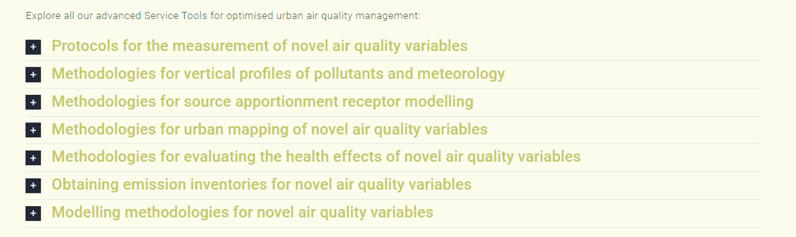
RI-URBANS’ service tools
https://riurbans.eu/project/#service-tools

Slide 10
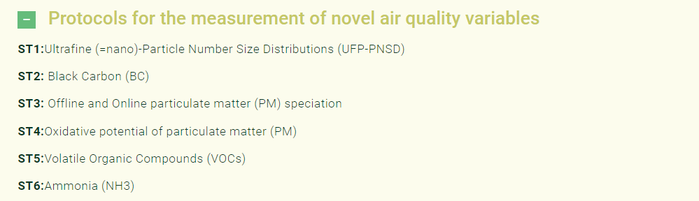
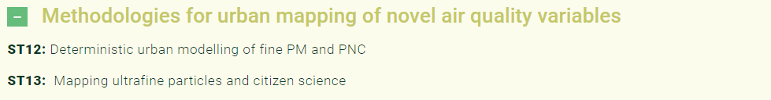
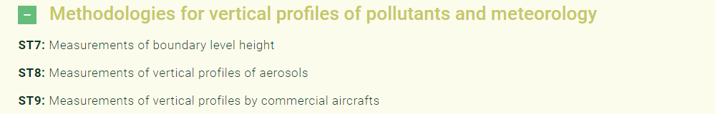

RI-URBANS’ service tools
https://riurbans.eu/project/#service-tools

Slide 11
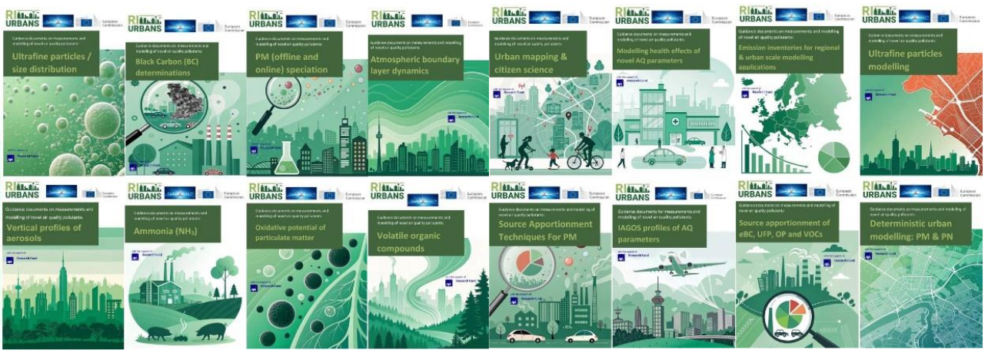
Internal structure of a Service Tool
1. Definitions
2. Measurement methods and quality control
  Based on ACTRIS, CEN etc standards
3. Pan-European overview
4. Recommendations and main findings

Slide 12

The RI-URBANS booklet

Slide 13




A series of training events addressing harmonised measurements of emerging pollutants of the new Air Quality Directive
Training # 1: 23.1. 2025 @ 09:30 – 11:30 CET
Aerosol particle number concentration:
https://riurbans.eu/a-series-of-training-events-addressing-harmonized-measurements-of-emerging-pollutants-of-the-new-air-quality-directive/
Training # 2: 27.1. 2025 @ 09:30 – 11:30 CET
Aerosol particle number size distribution:
https://riurbans.eu/follow-up-second-training-on-harmonized-measurements-of-emerging-pollutants/
Training # 3: 11.2. 2025 @ 09:30 – 11:30 CET
Equivalent Black Carbon:
https://riurbans.eu/follow-up-third-training-on-harmonized-measurements-of-emerging-pollutants-focused-on-equivalent-black-carbon/
Training # 4 and beyond: tbd
Data management, ammonia, oxidative potential, VOCs, …
Contact:
tuukka.petaja@actris.eu; tuukka.petaja@helsinki.fi
Xavier.querol@idaea.csic.es

Slide 14
Next steps
Joint discussions an regarding data management of the new air quality parameters (UFP, BC) are on-going (ACTRIS, RI-URBANS, AQUILA, EEA, JRC)
Service Tools available on-line:
  https://riurbans.eu/project/#service-tools
RI-URBANS Science Conference in Barcelona
  8.9.-9. 2025
RI-URBANS stakeholder seminar (on-line)
  10.9.2025

Slide 15



Thank you very much for your attention!!
tuukka.petaja@actris.eu
tuukka.petaja@helsinki.fi
xavier.querol@idaea.csic.es

