Slide 1


TFMM update and work plan
Joanna Struzewska¹, Paolo Laj ²
¹Institute of Environmental Protection - National Research Institute
²World Meteorological Organization
05/05/2025, 26th TFMM Annual Meeting, Potsdam

Slide 2
TFMM organization in 2024
Email address: tfmm@ios.edu.pl
On-line briefs:
  TFMM online briefs related to July 2022 modelling Exercise
  New work plan discussion
Presentation at EGU 2025 Air Quality Modelling session
5-7 May 2025 - 26th TFMM annual meeting
June TFMM newsletter (based on the outcomes from the annual meeting)

Slide 3
Work plan items lead by TFMM (6)
No | Workplan item | Status
1.1.1.1 | Contribution of VOCs during high ozone pollution episodes | IMP 2024 – completed Survey on models – completed Modelling exercise – ongoing
1.1.1.3 | Aerosol chemical speciation in different models | 2025 - in collaboration Lessons learned from other EU projects
1.1.1.4 | Representation of intermediate and semi-volatile condensable emissions
1.1.1.8a | Finalise the Eurodelta-BaP model intercomparison | CIEMAT with ENEA, Ineris and FMI (manuscript ready)
1.1.1.8b | Assessment of the BaP related health effects | ARP will be made available for TFMM
1.3.5 | Low-Cost Sensor review - WMO report | Published: GAW Report No. 293
1.1.1.2 | Chemicals of emerging concern | Published: EMEP/CCC report 5/2024

Slide 4
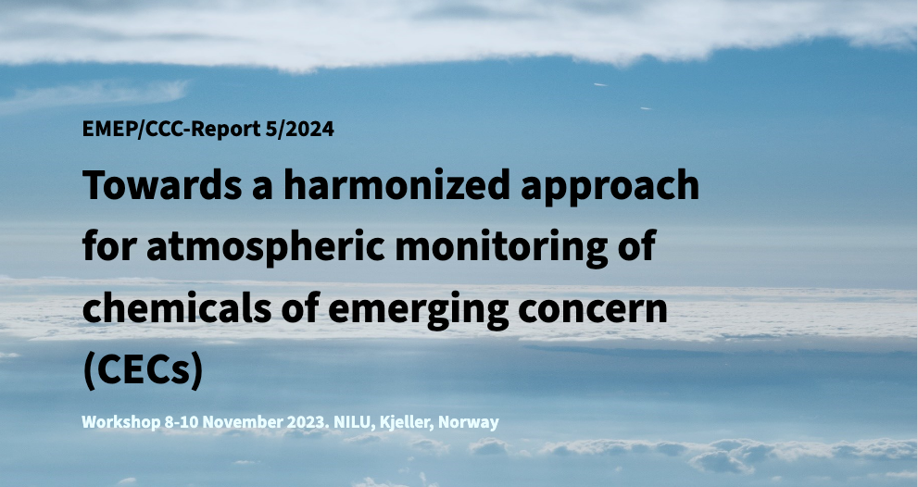

CEC workshop

Slide 5
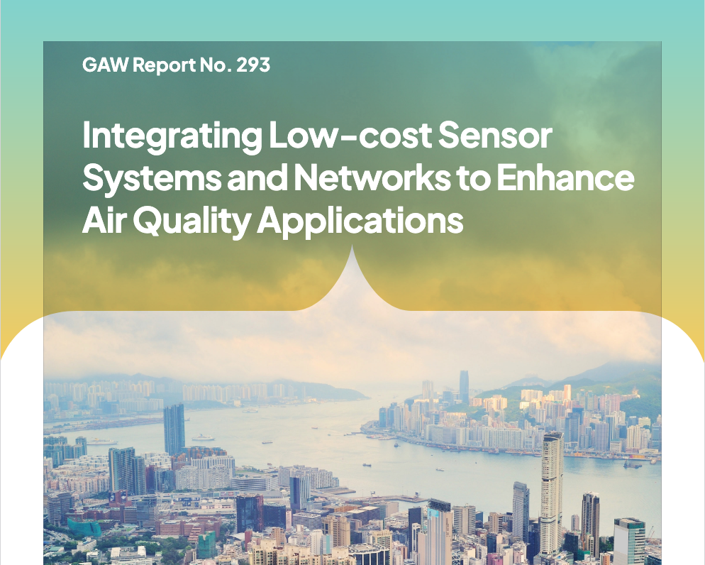

LCS (WMO)

Slide 6
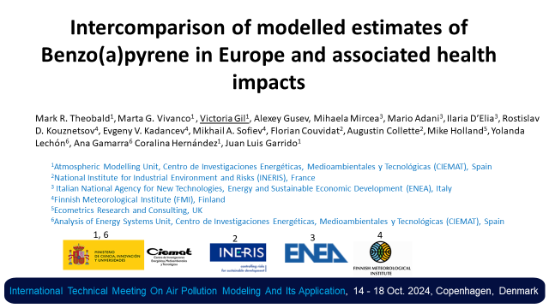
EurodeltaBAP
New model updates: SILAM and MINNI
More variables submitted by SILAM and MINNI
Results analysed at CIEMAT and presented at the International Technical Meeting On Air Pollution Modeling And Its Application, 14 - 18 Oct. 2024, Copenhagen, Denmark
Manuscript ready to submit

Slide 7

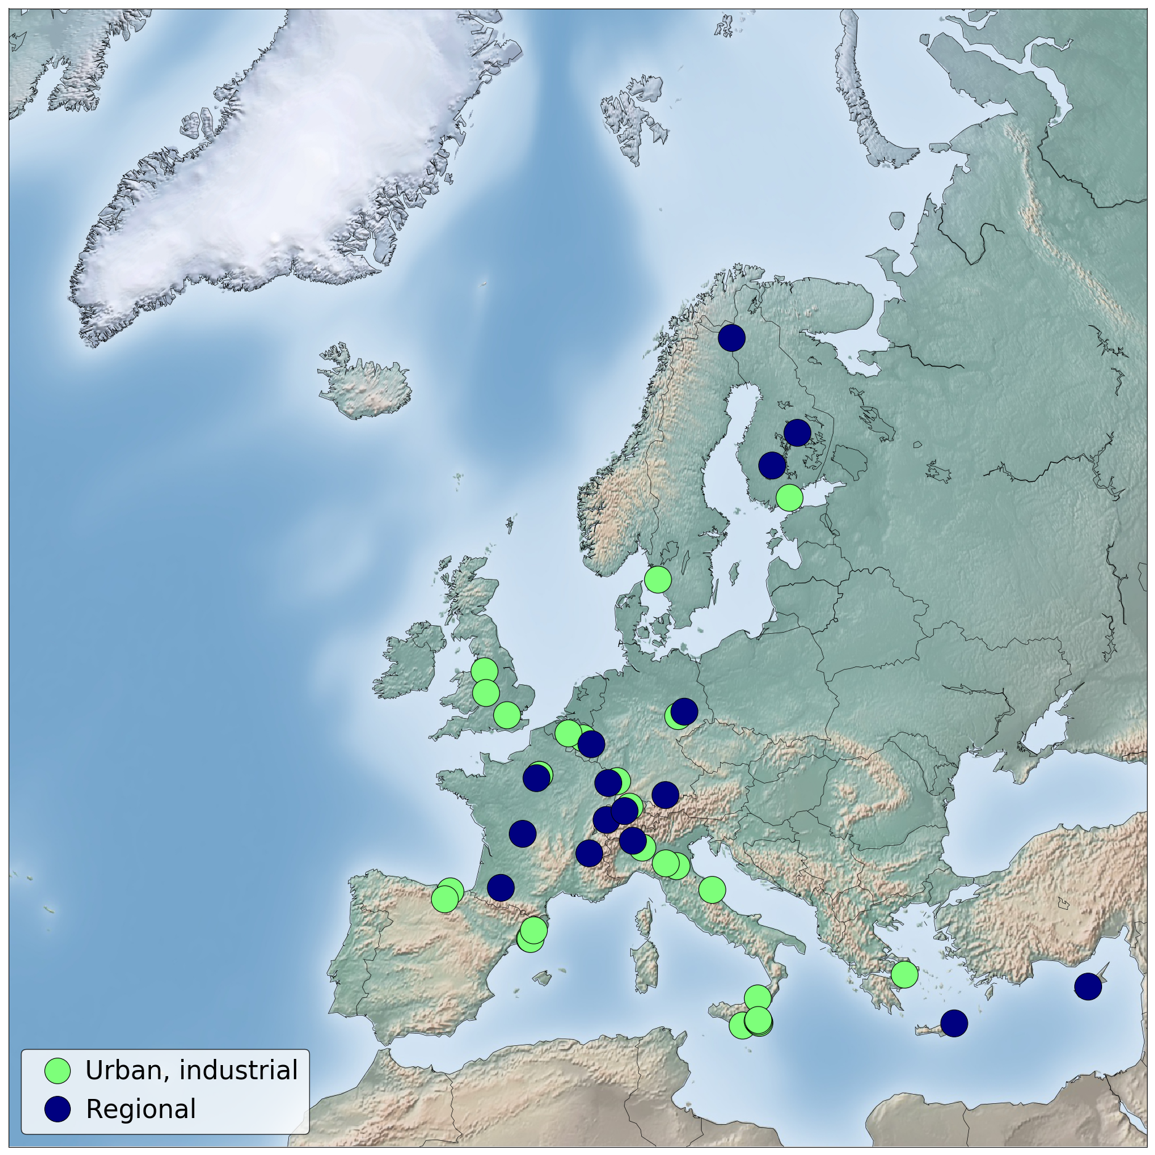



2nd VOC intensive measurement conducted September2024
Measurements closer to emission sources, thus more focus on industrial and urban sites, combined with regional sites in the vicinity.
high-resolution instrumentation,
complement with manual measurements at selected sites to get the full range of species.
1 month measurement
Ca 45 sites participate
IMT Nord Europe (France) has the scientific/logistic lead
Close cooperation with activities in
RI-URBANS and ACTRIS

Slide 8
July 2022 Modelling Exercise (IMP22)
IEP-NRI | CAMx 7.20
IEP-NRI | GEM-AQ
BSC | MONARCH
FMI | SILAM
UKCEH | EMEP4UK
ENEA | MINNI (x2)
Met.no/MSC-W | EMEP
CIEMAT | CHIMERE (x2)
EMPA | ICON-ART

Slide 9
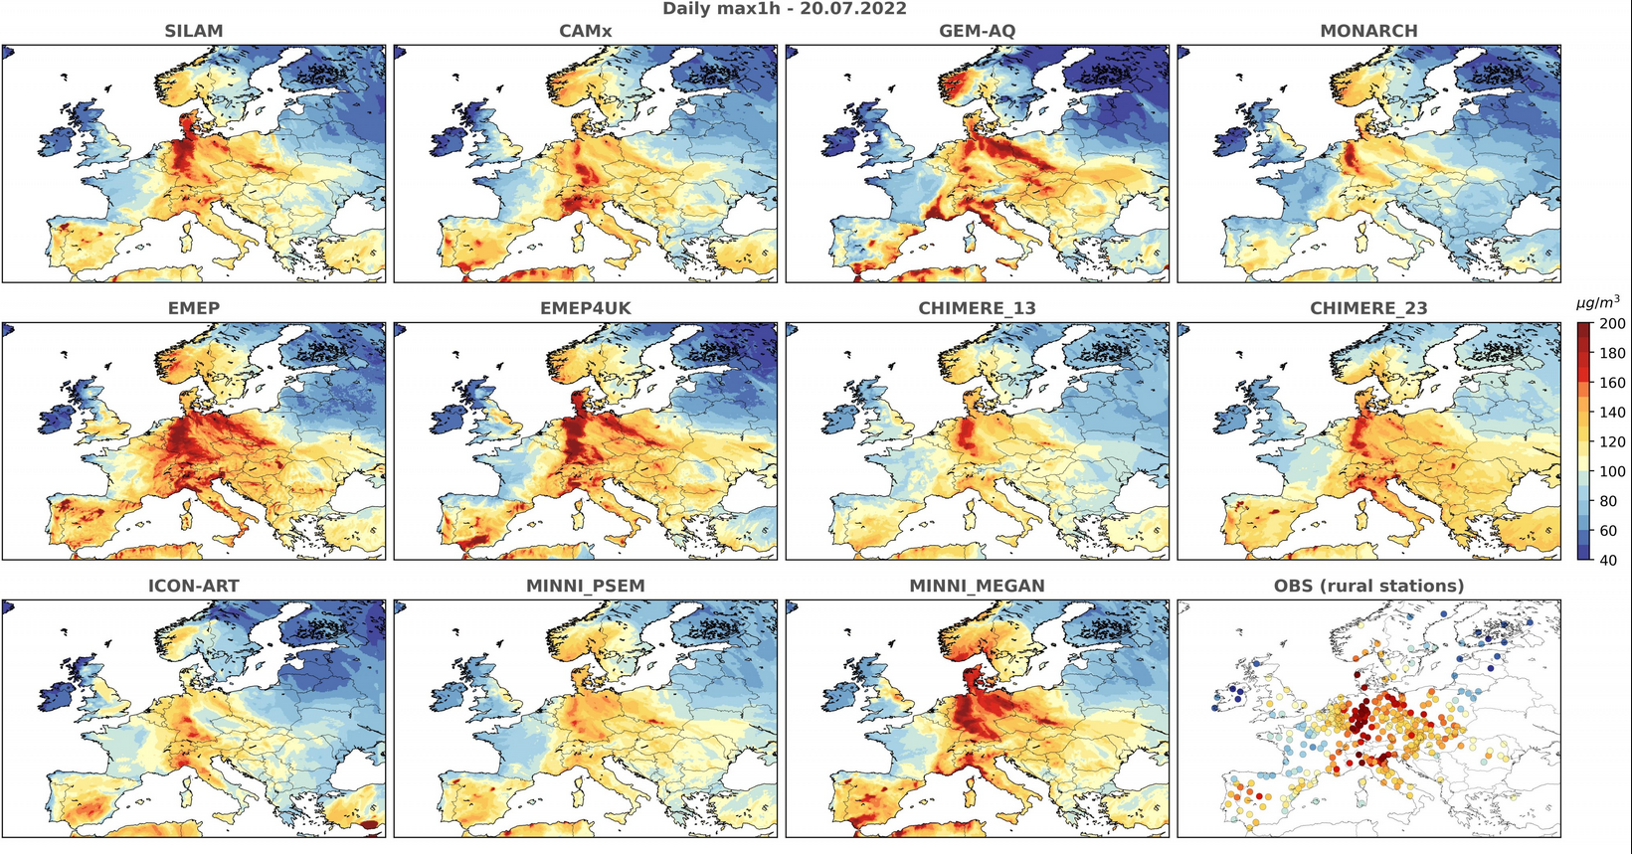

Slide 10
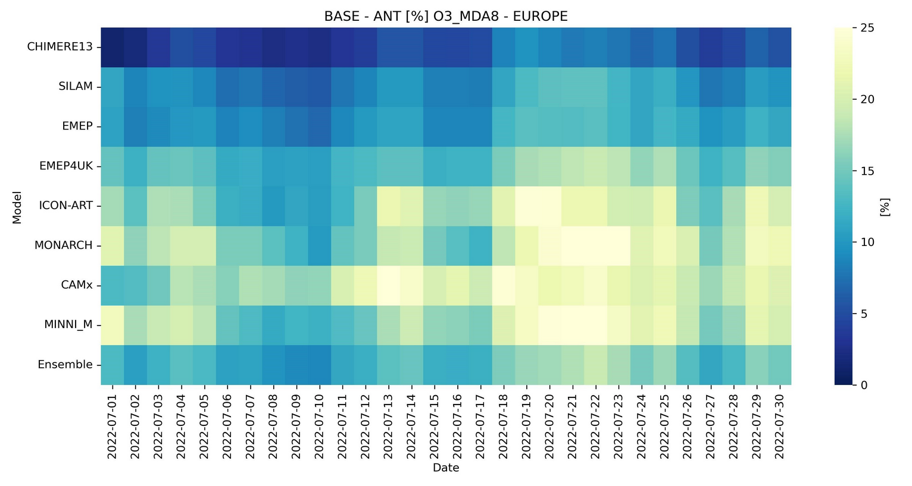
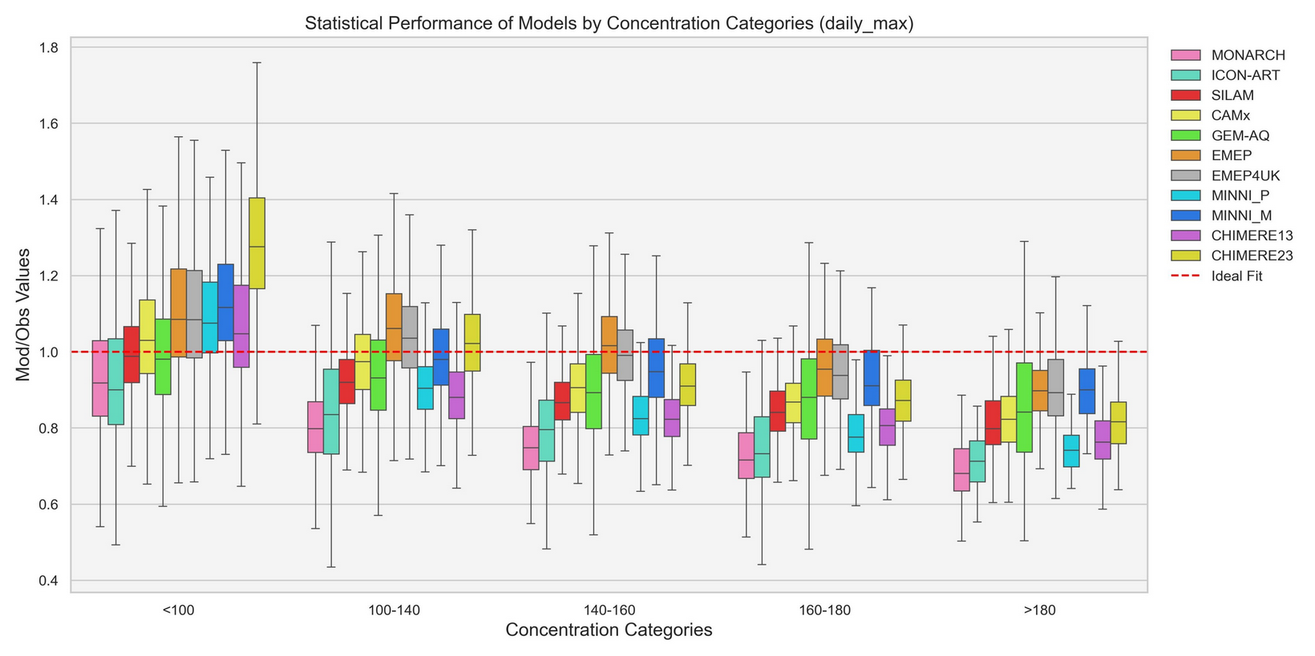
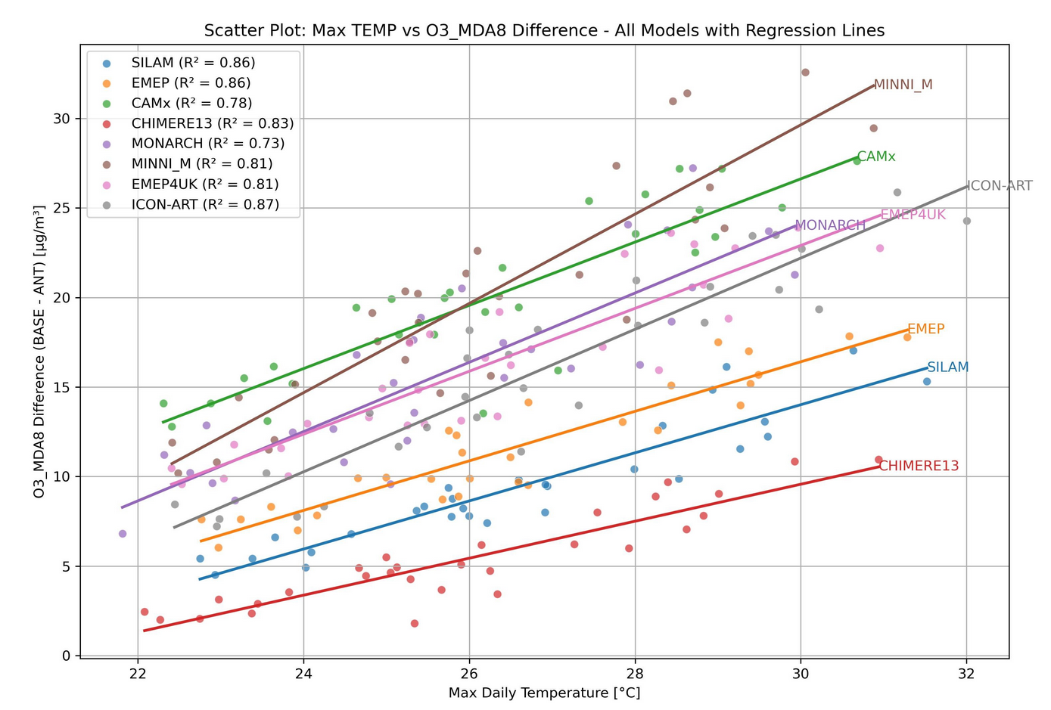
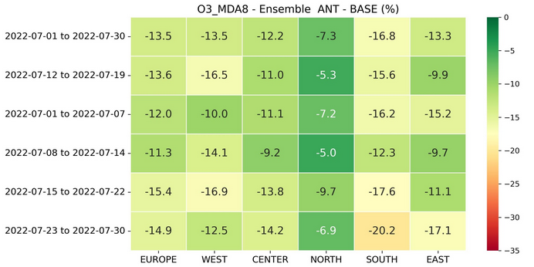
Major outcome
(to be revised)
Biogenic VOC contribution is higher during episode period
All models tend to underestimate highest O3 concentrations
Depending on the region and period biogenic VOC contributed to high ozone concetration 5-10% NE, 12-20% SE; 10-17% the rest of regions
Increment due to biogenic emission seem to be quasi-linear function of the temperature

Slide 11
Science questions for the 2024-2025 period (1)
How biogenic and anthropogenic VOCs contribute to ozone formation episodes across Europe;
  How well do models reproduce ozone variability and levels?
  How well do models reproduce VOC variability and levels?
  How to compare modelled and observed VOC species?
  How to deal with VOC emissions in the models?
  Common approach for ozone regime analysis
Feedback to decision makers:
How much can VOC mitigation impact the reduction of ozone episodes and background ozone levels
%

Slide 12
Science questions for the 2024-2025 period and beyond (2)
2) What is the contribution of secondary aerosol production as compared to primary;
  To what extend do primary aerosol reproduce variability and pattern of the observed PM10/PM2.5?
  What is the natural component in the background?
  How does secondary aerosols production differ between the models?
  Are available emission data sufficient to reproduce aerosol chemical composition?
  How to compare observed and modelled chemical components
Feedback to decision makers:
Assessment of the contribution from the natural sources (no control) and secondary production (potentially nonlinear relation to the emission reduction)

Slide 13
New model survey (PM composition)
Lessons learned from:
Life Remy
HE CAMAERA
RiUrbans
Other ???
Major issues:
- aerosol scheme
- chemical components
- secondary production
- emissions (ant/nat, temporal and vertical profile)
- dry deposition and washout
- simulation-based size distribution of concentrations
- known evaluation issues
Other ?

Slide 14
Workplan items in collaboration
No | Workplan item | Leading TF/Centre
1.1.1.7 | Long-term O3 projections in relation to CH4 mitigation | TF HTAP
1.1.3.2 | O3 modelling of future scenarios | TF HTAP
1.1.4.2 | Global and regional model simulations of historical trends and future scenarios with assessment of human health and vegetation impacts | TF HTAP
1.1.1.5 | Review source-receptor methodologies: brute force and sensibilities (local fractions) and their applicability | MSC-W
1.1.1.32 | Consolidate existing evidence on health outcomes of exposure to air pollution (related to 1.1.1.8b) | TF-Health with other groups (TFIAM, TFMM)
1.1.2.3 | Develop guidance on estimating and Party’s reporting of emissions of condensable component of PM (related to 1.1.1.3 and 1.1.1.4) | CEIP and TFEIP with MSC-W and TFMM
1.1.2.4 | Develop guidance on estimating and Party’s reporting of emissions of BC | TFEIP and CEIP with TFMM

Slide 15
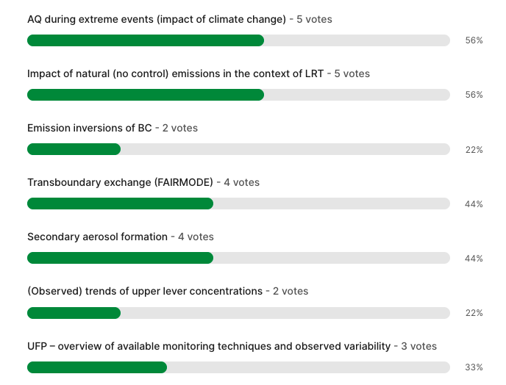
Are you willing to CONTRIBUTE to following new topics

Slide 16
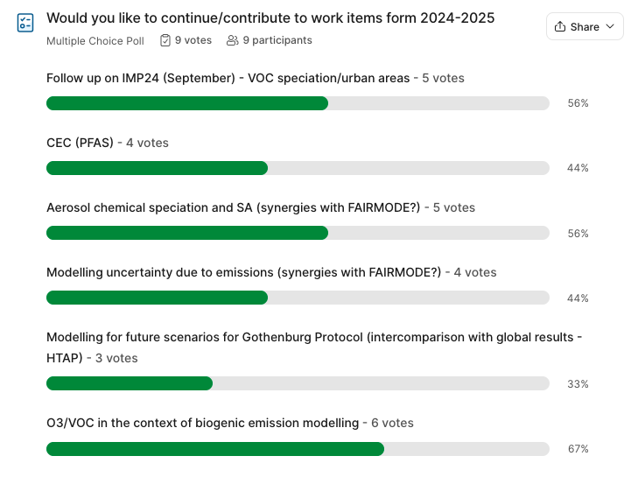

Slide 17
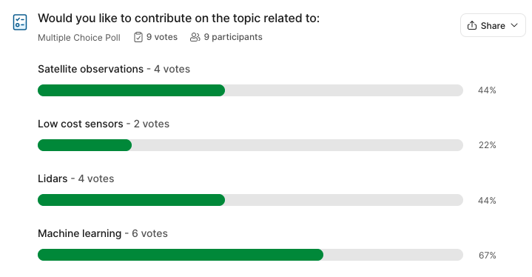
Modelling and monitoring techniques

Slide 18

Living document
Please fill in, comment, add you ideas – we will discuss it tomorrow
https://docs.google.com/document/d/16f7nRpttSJYQwDvwNN0zY1S12Tw-mlSOMZ_u9cAsm_A/edit?tab=t.0

Slide 19
Thank you

