Slide 1
Progress of work CCC
Wenche Aas , Anne Hjellbrekke , Richard Ruud , Helene Halvorsen and Kjetil Tørseth

Slide 2
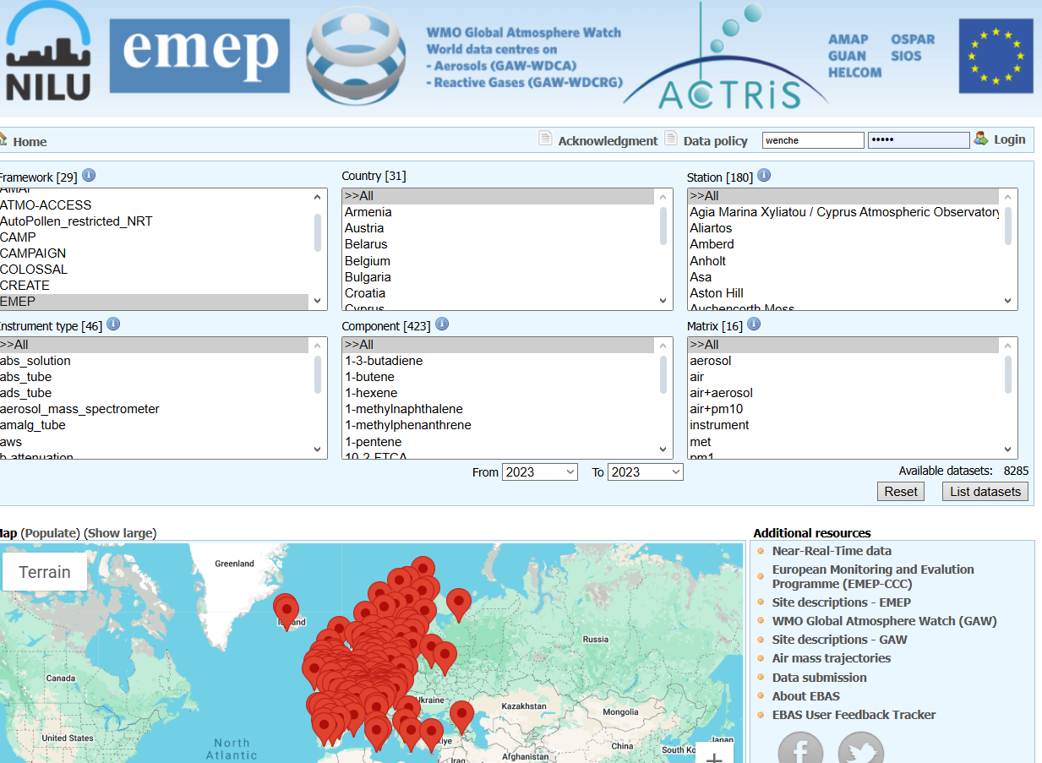
Status of the EMEP 2023 data reporting
The 2023 data have been reported from all expected Parties and everything is available in EBAS
Not receiving data from:
GE, MD, ME, MK, PT, RS
https://ebas.nilu.no

Slide 3
Portugal will again become active in EMEP
3 background stations will be integrated in the EMEP monitoring network
Armenia has some challenges with maintaining their station
Ambered been measuring level 1 components since 2012. Their instruments are getting old and need to be upgraded Please reach out if suggestion in respect of funding and/or donations

Slide 4
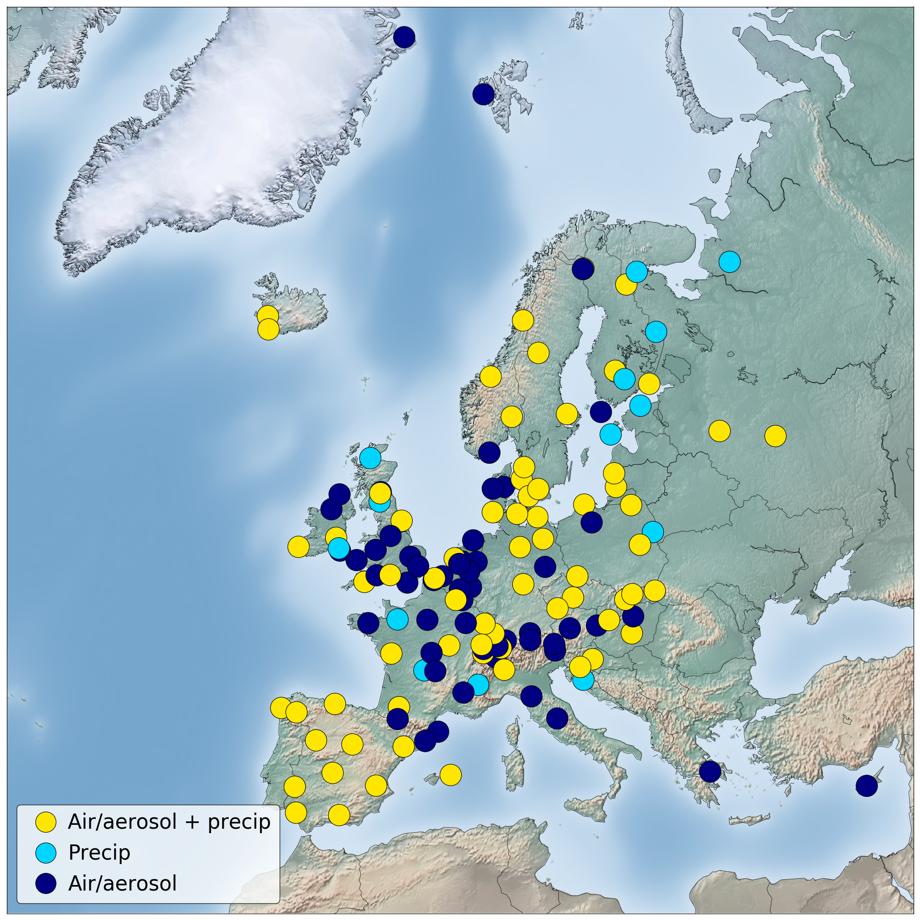
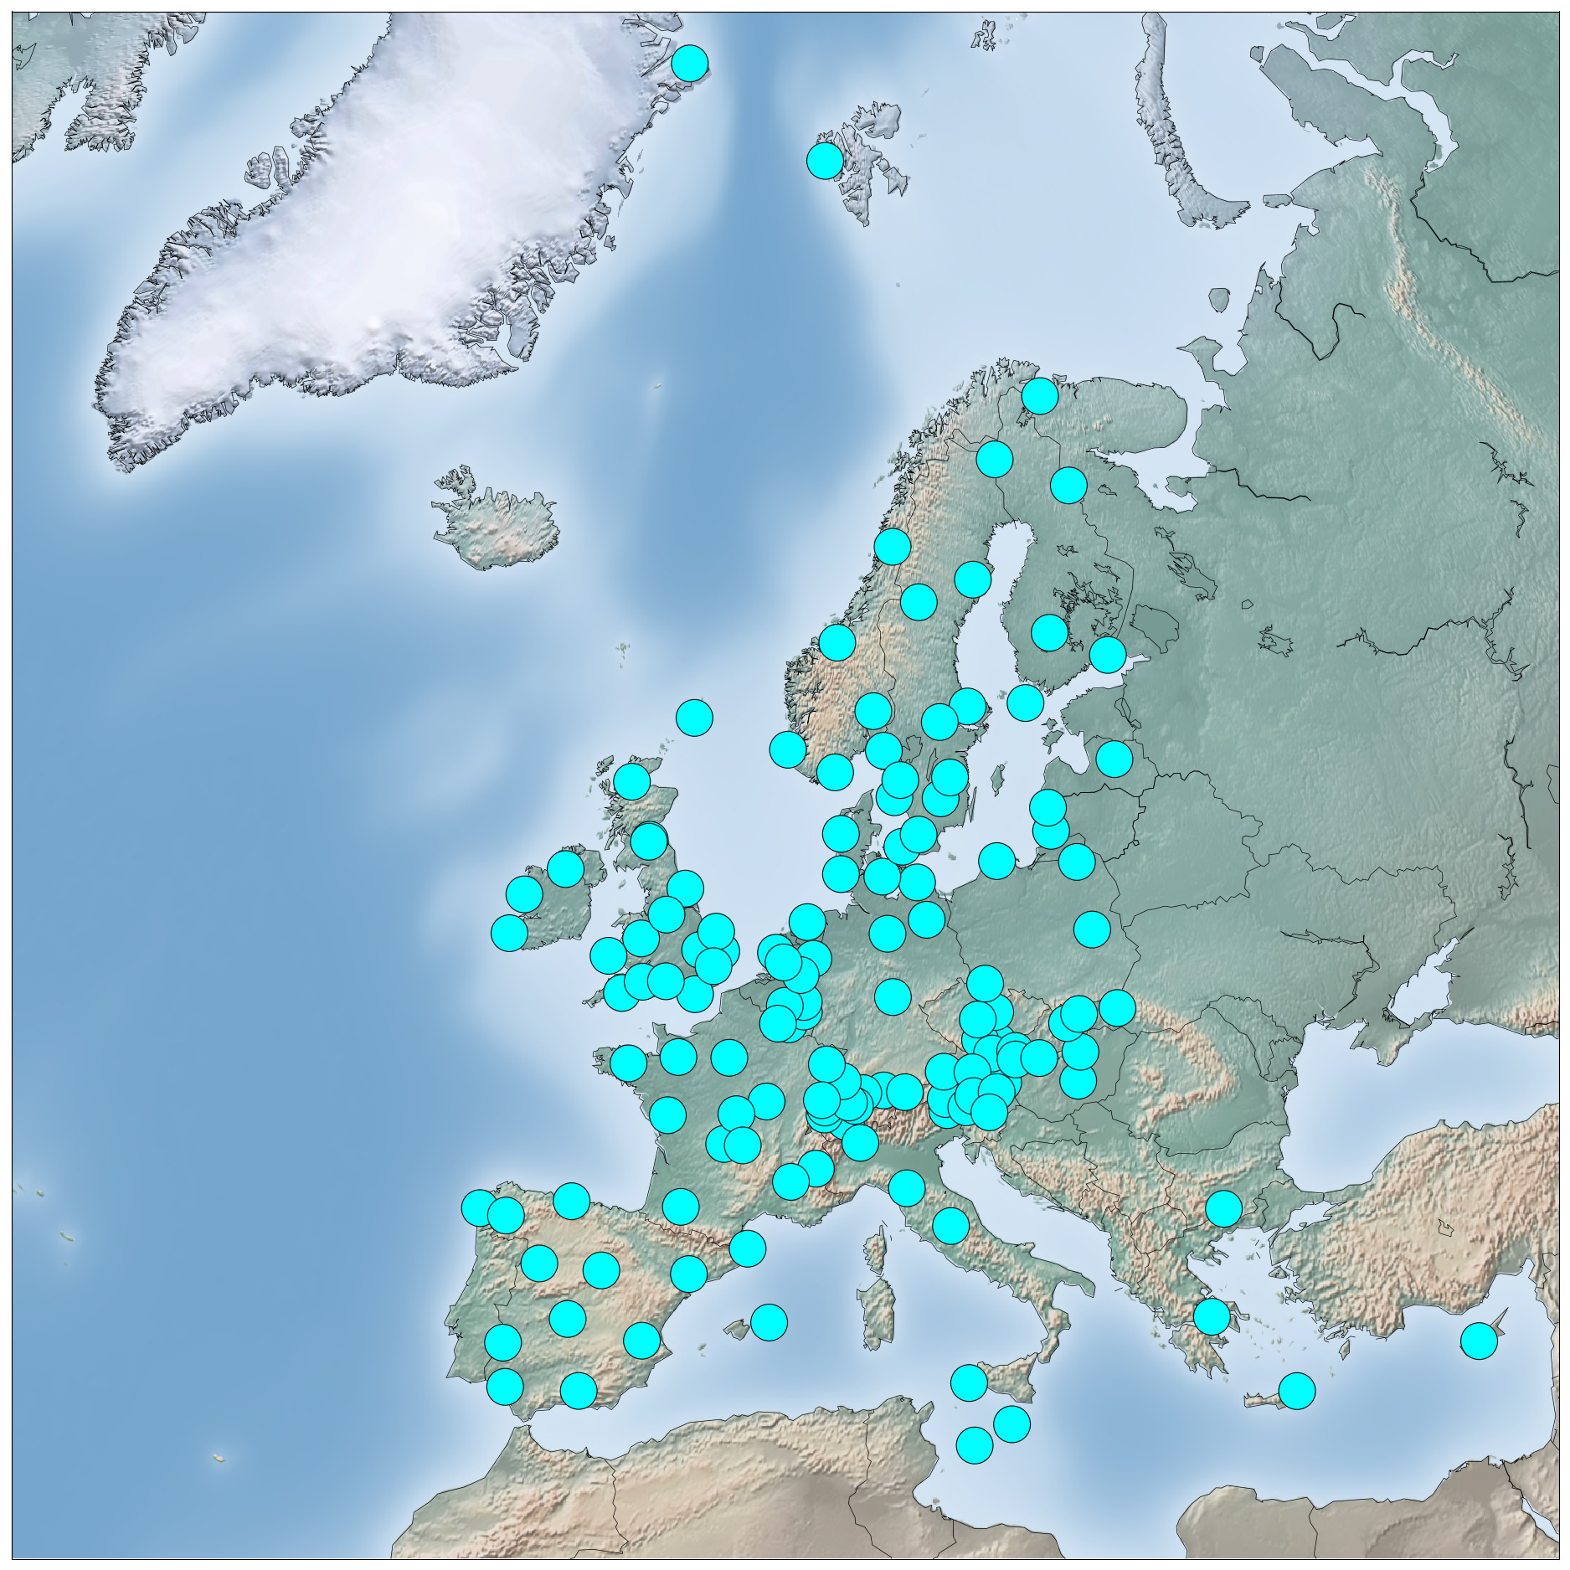
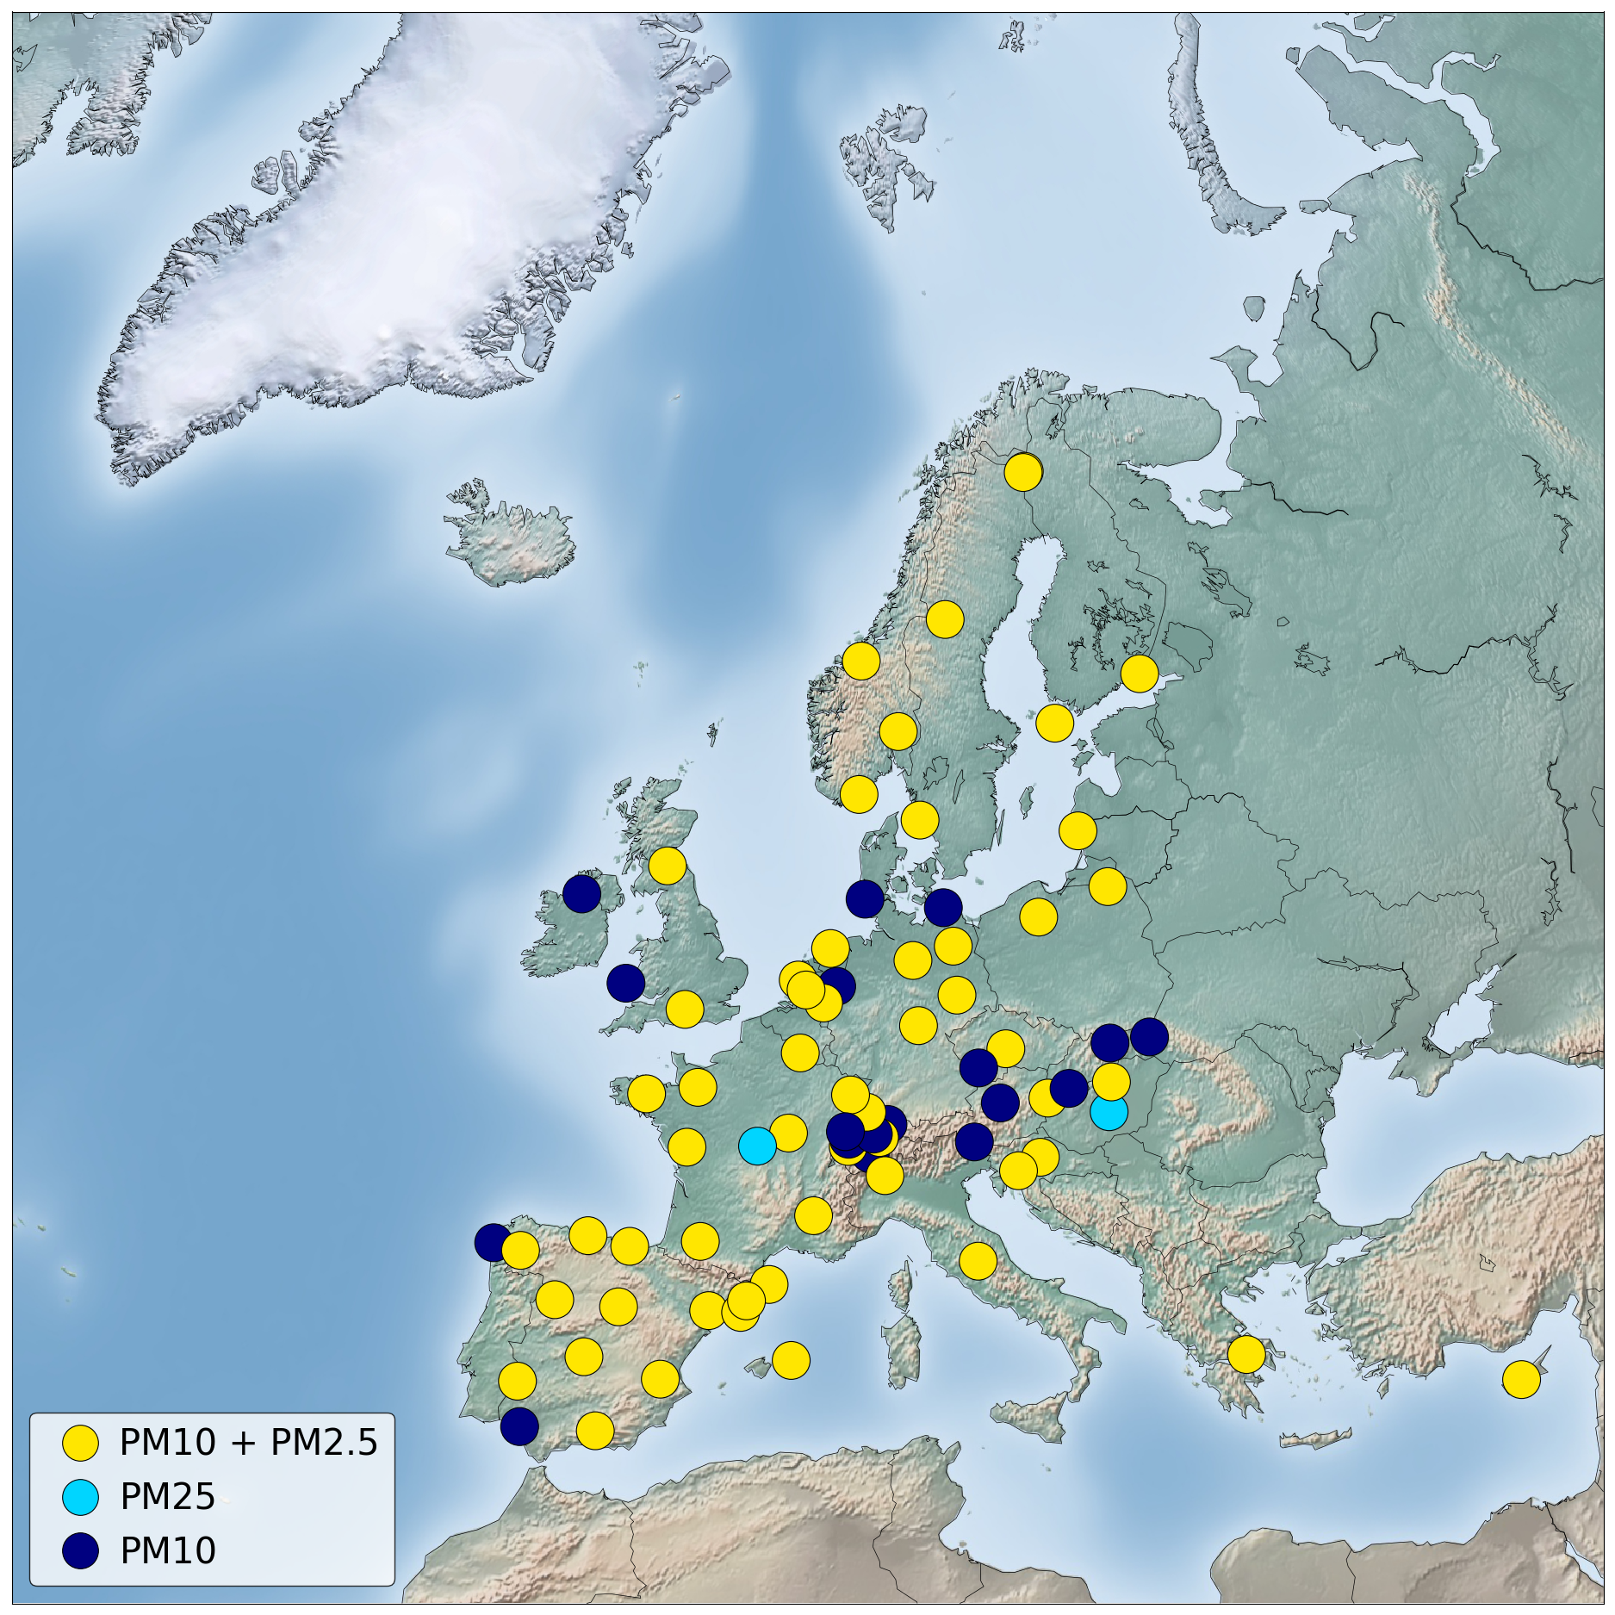
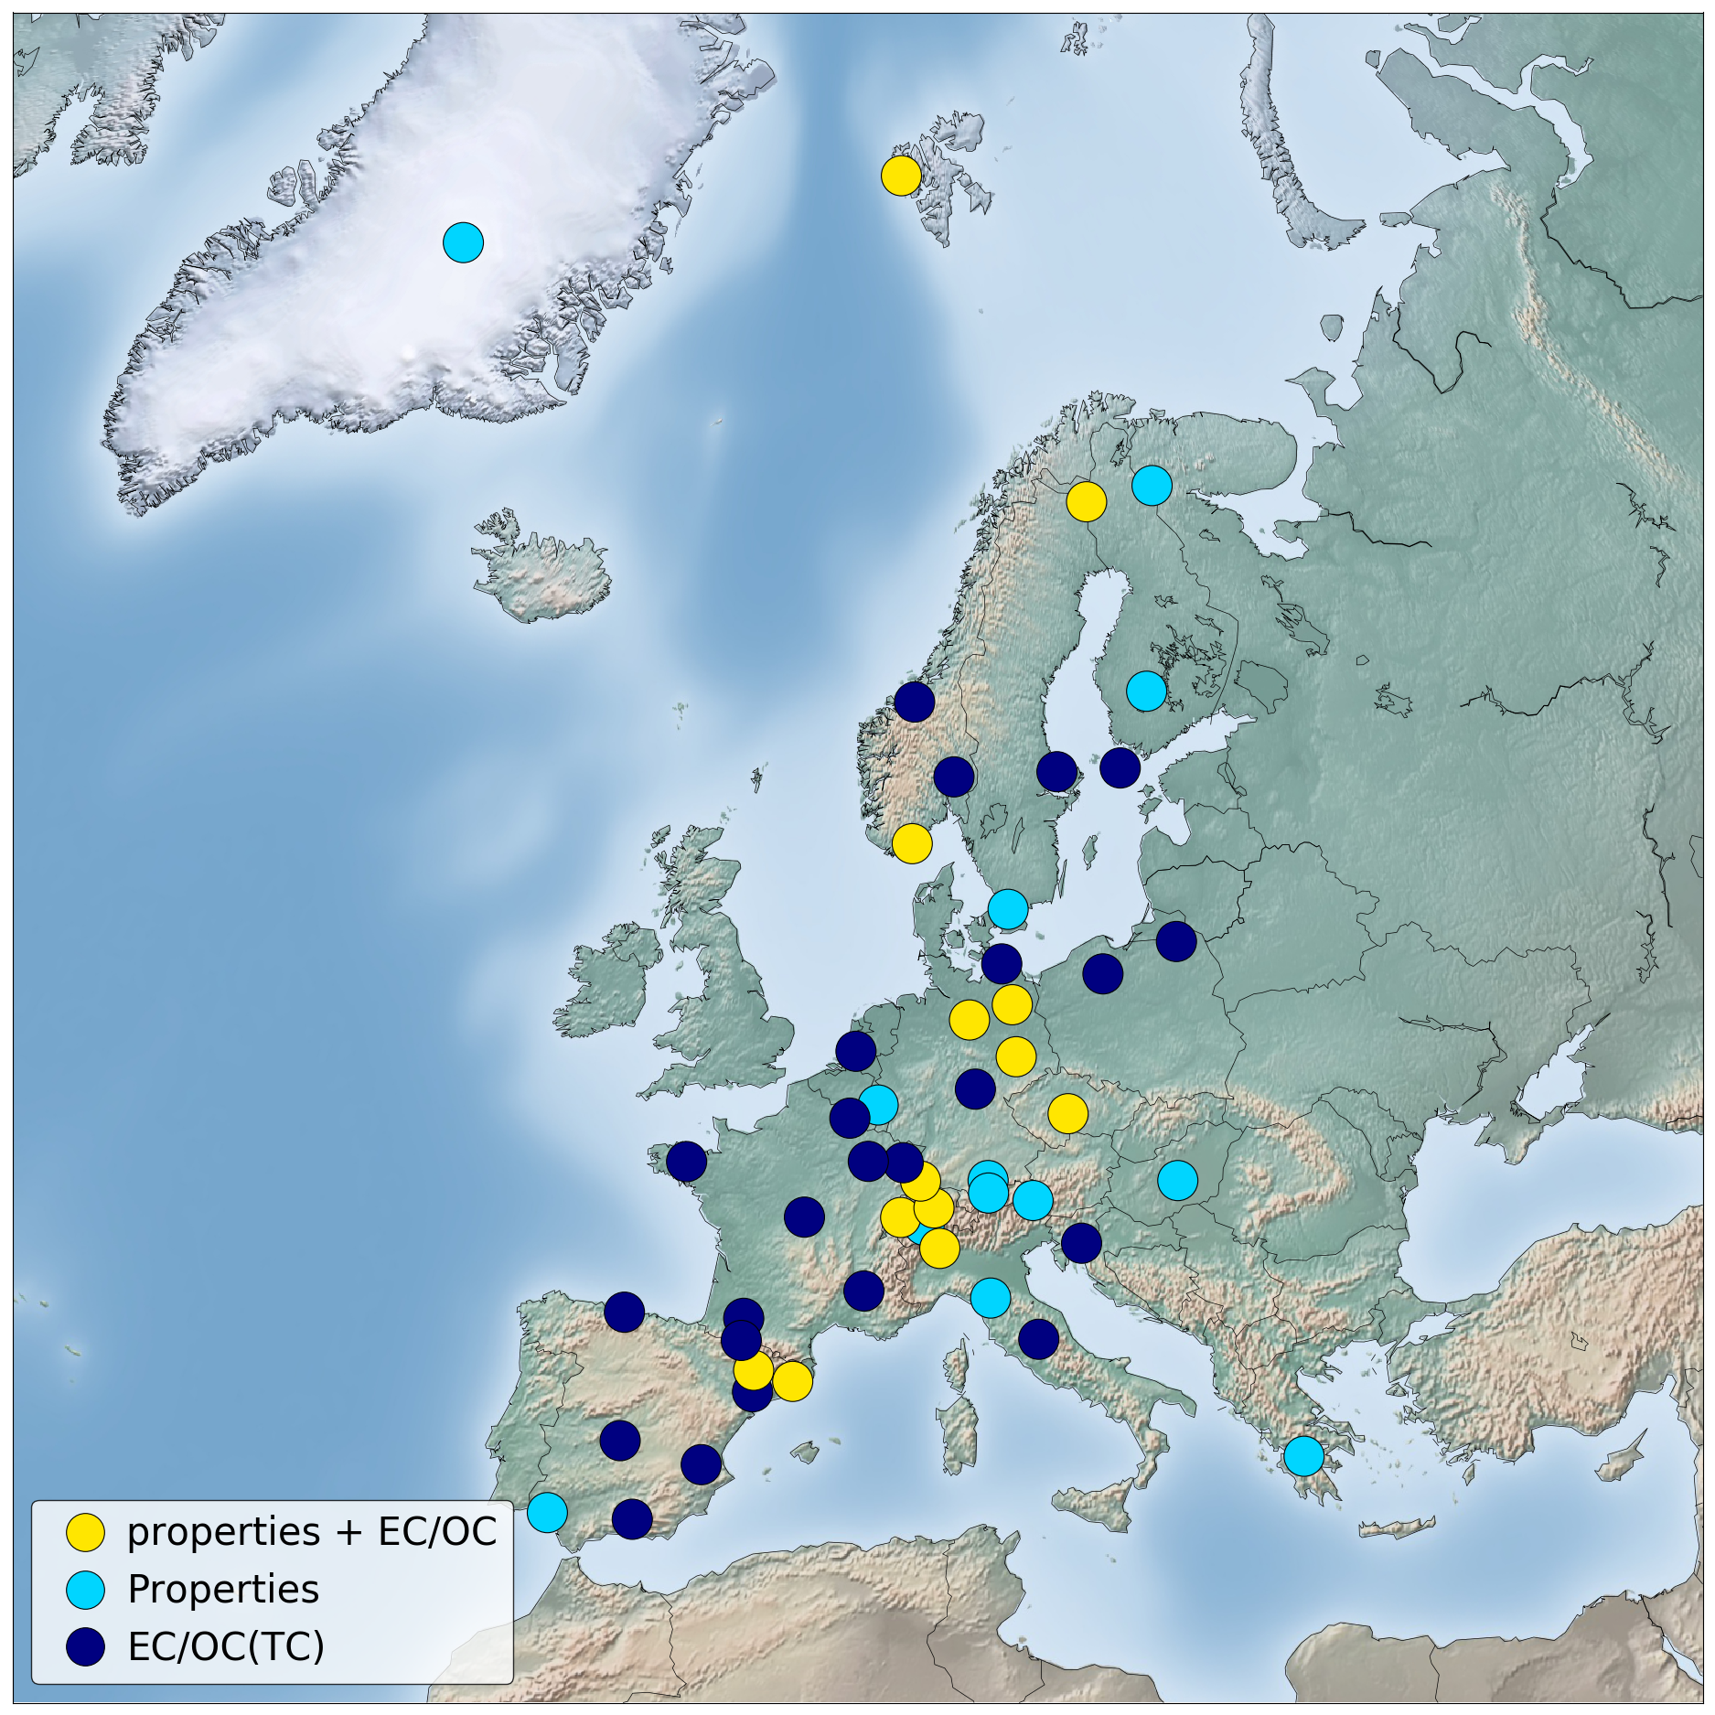
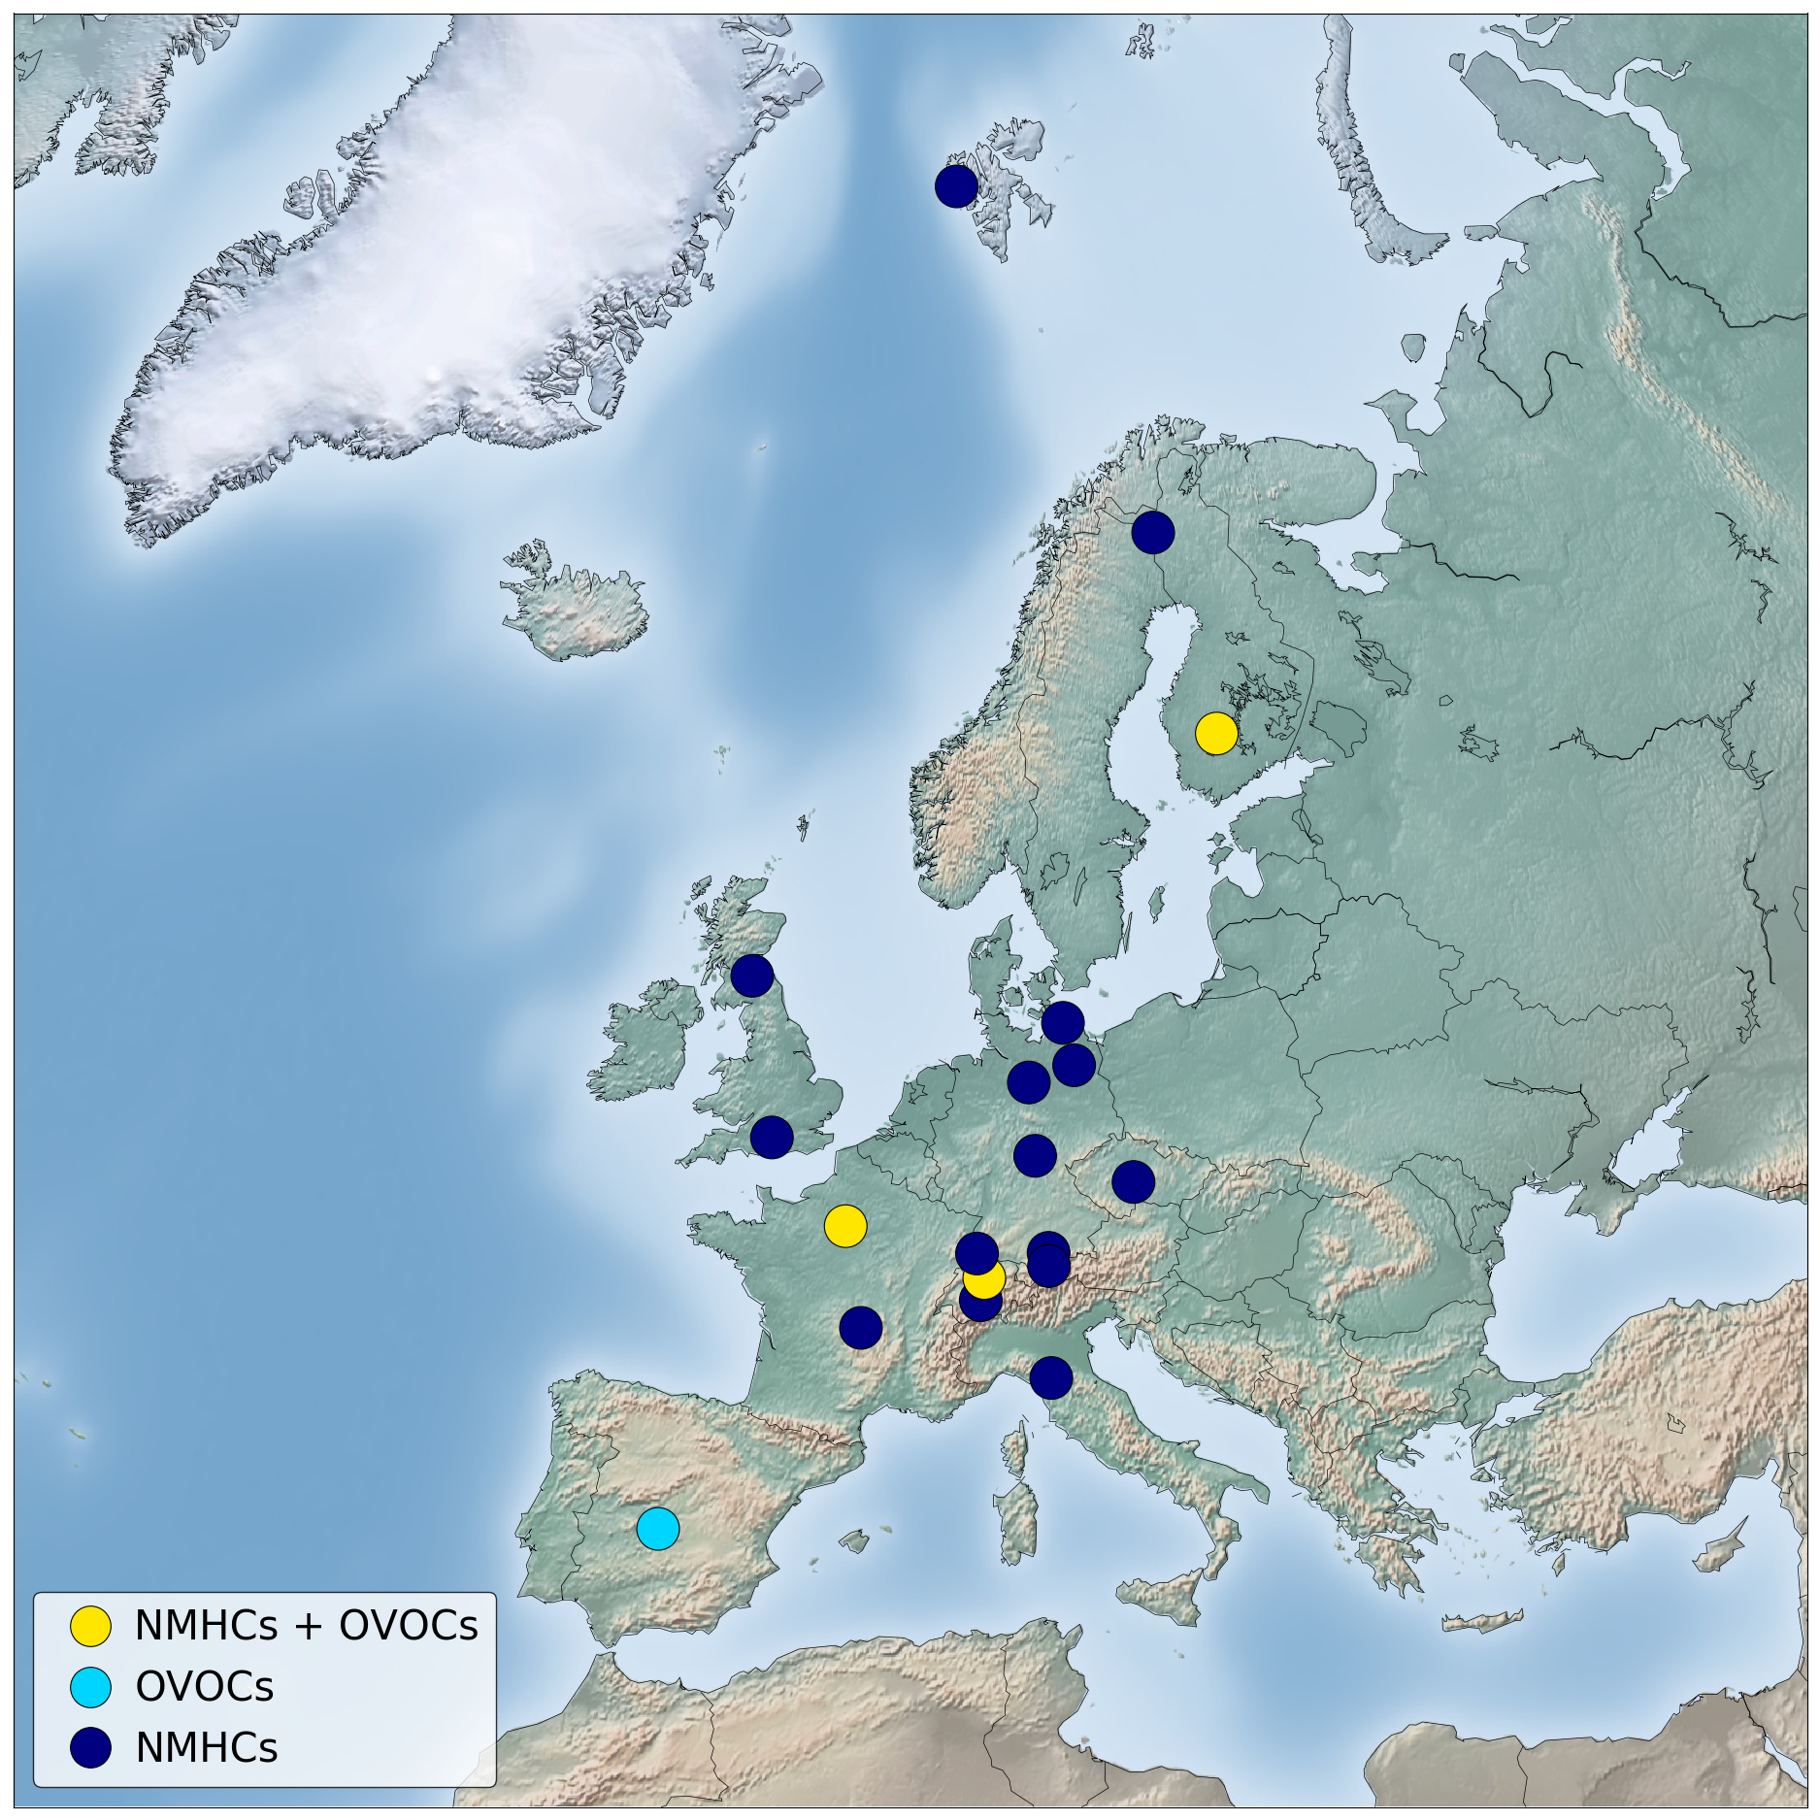
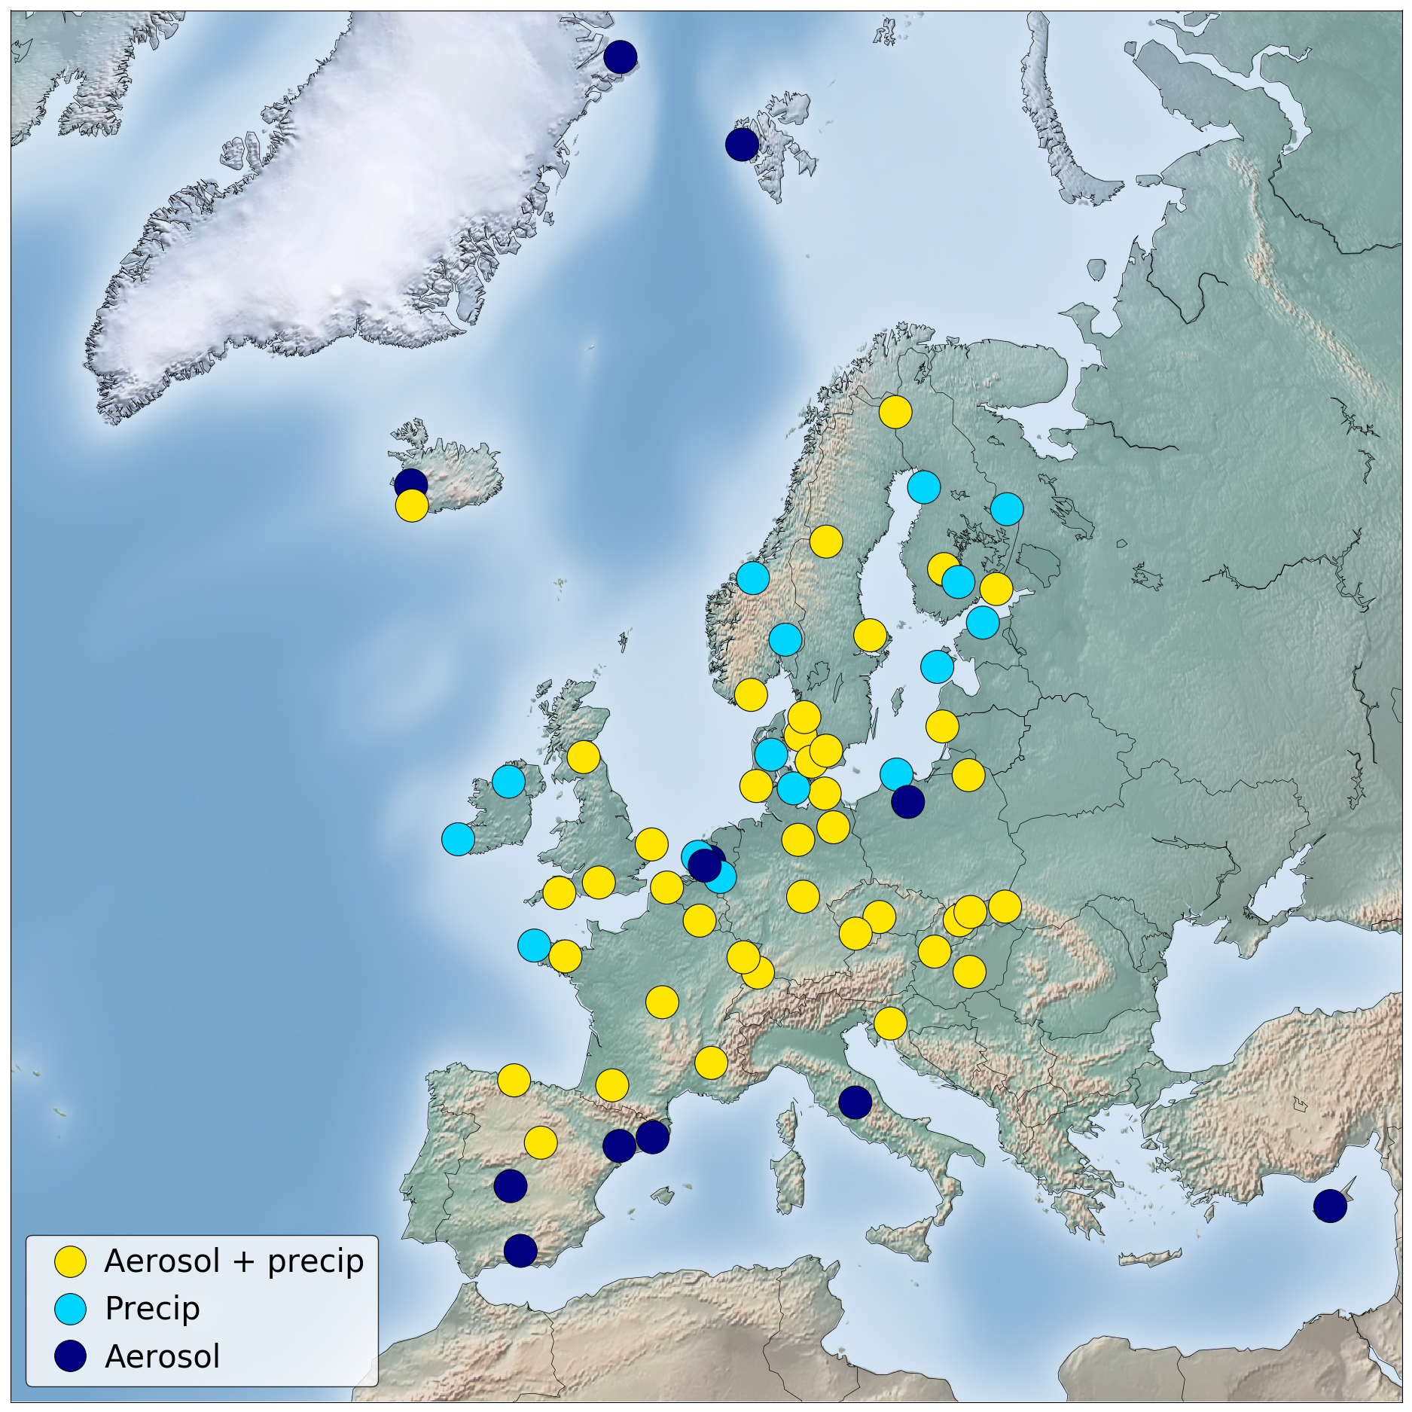
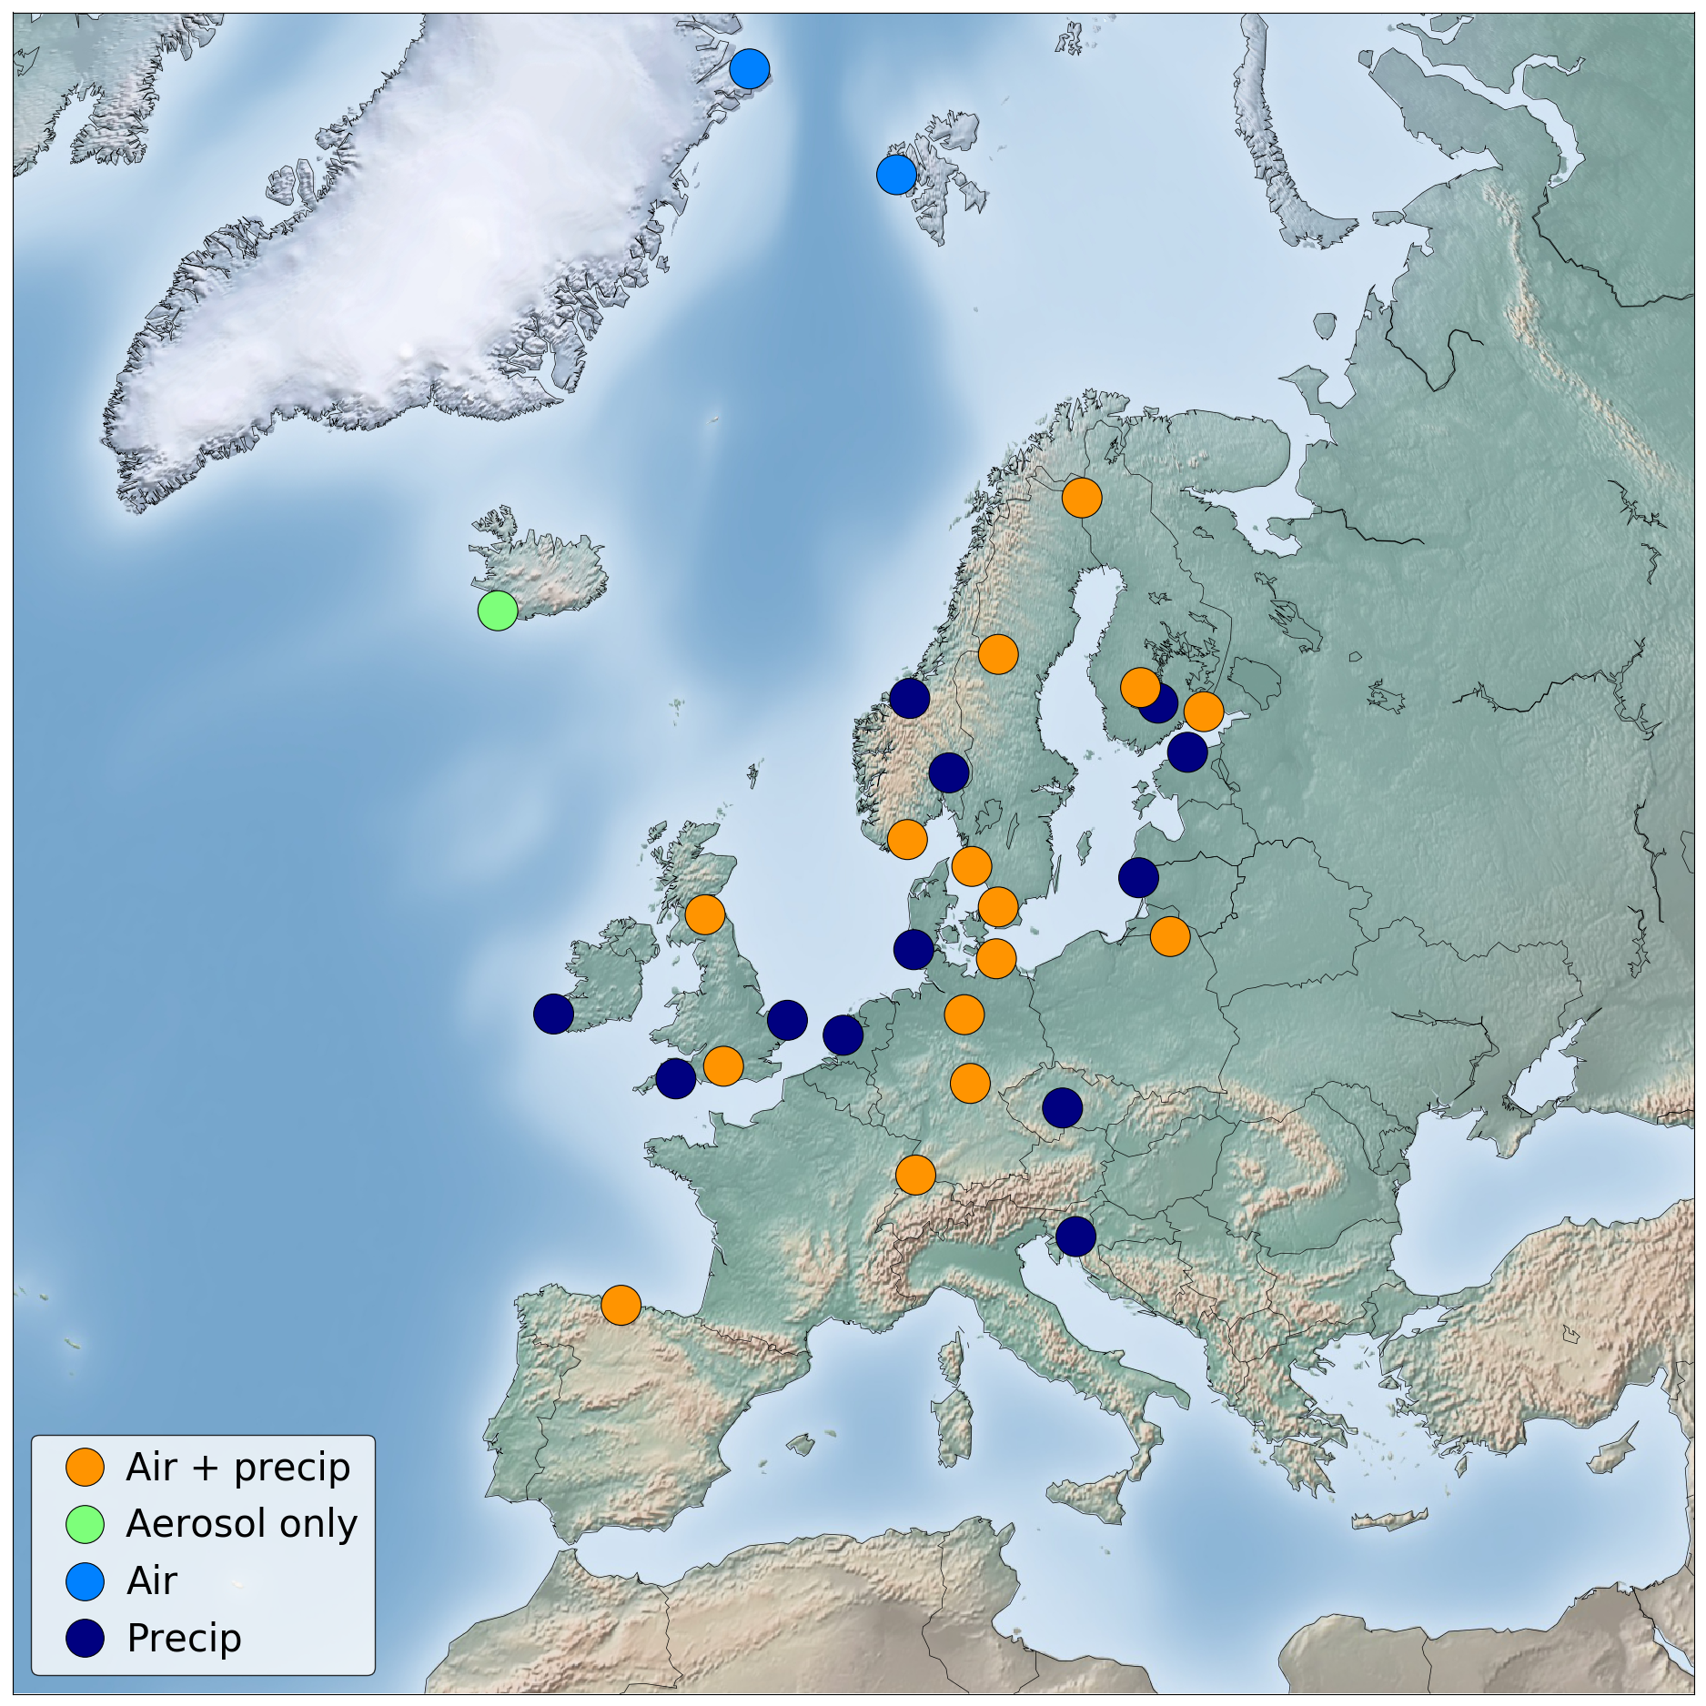
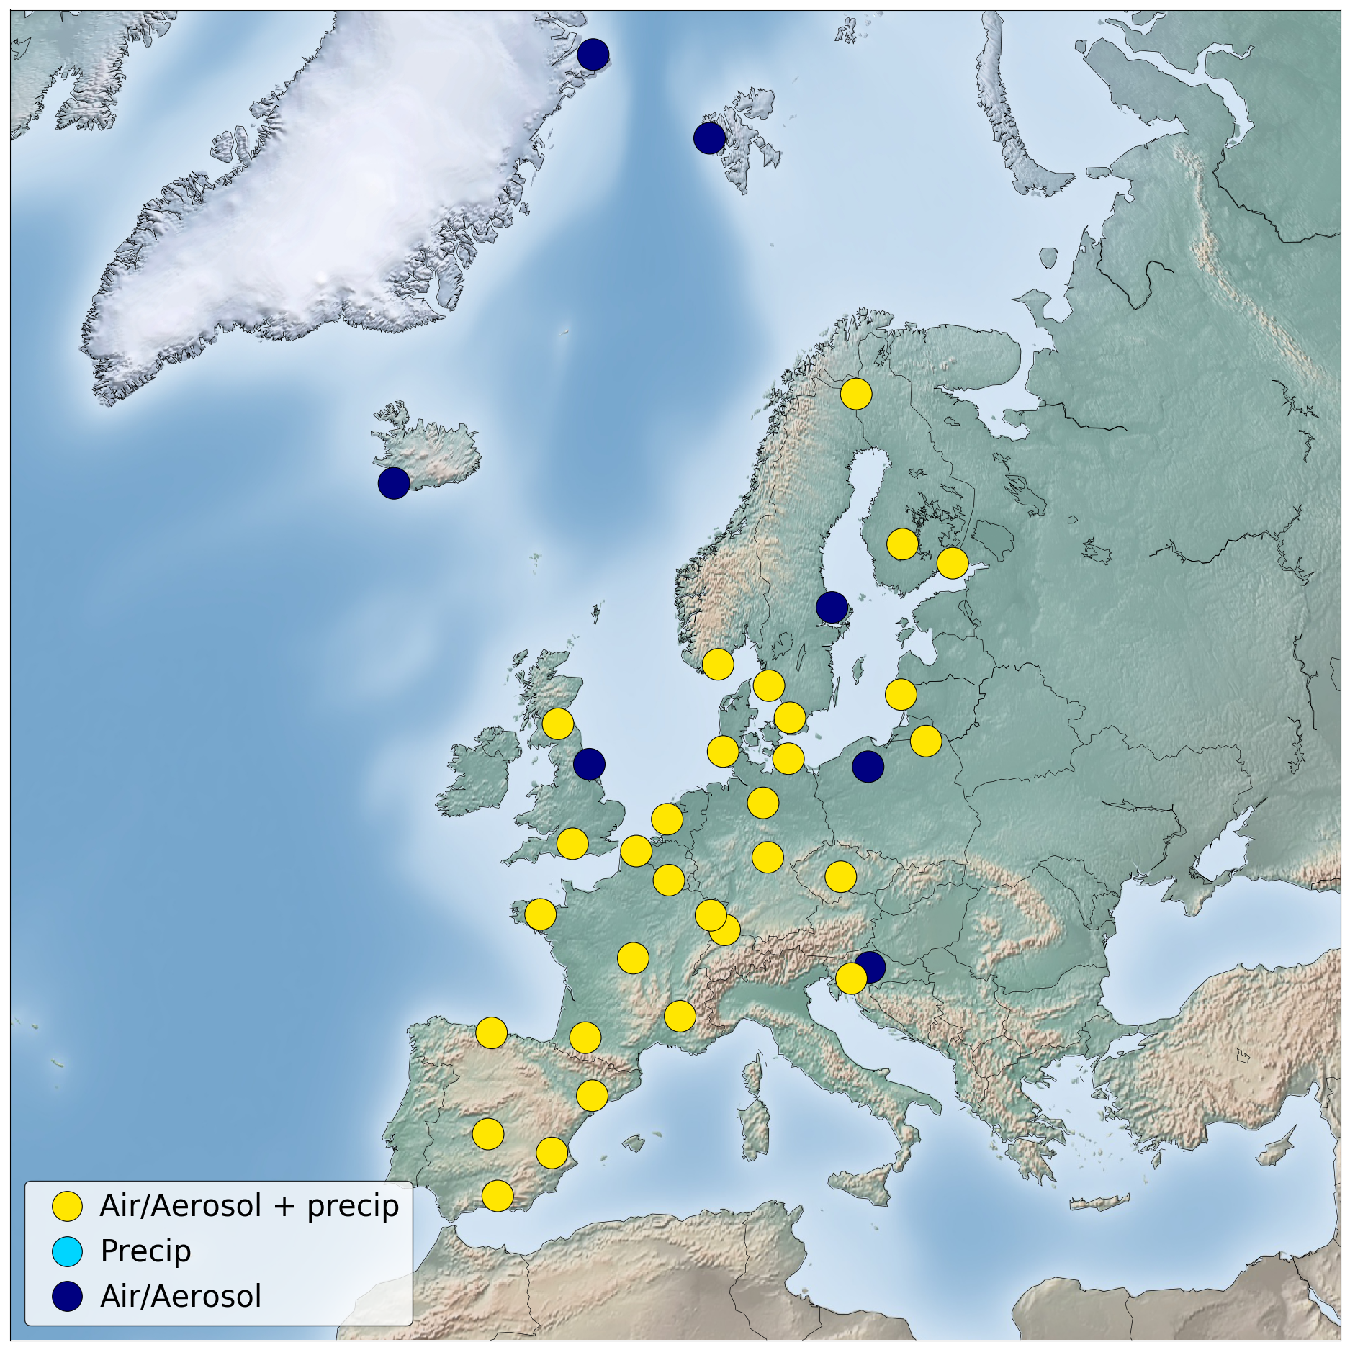
Measurement sites
Inorg.:138 sites
from 29 Parties
Ozone, 138 sites
from 25 Parties
PM: 76 sites
from 20 Parties
Aerosol prop: 50 sites
from 17 Parties
VOC: 19 sites
from 9 Parties
HM: 67 sites
from 21 Parties
Hg: 27 sites
from 14 Parties
POPs: 37 sites
from 16 Parties
Notes:
several of the Parties only measure and report PAHs (i.e. 10 Parties and 28 sites).

Slide 5
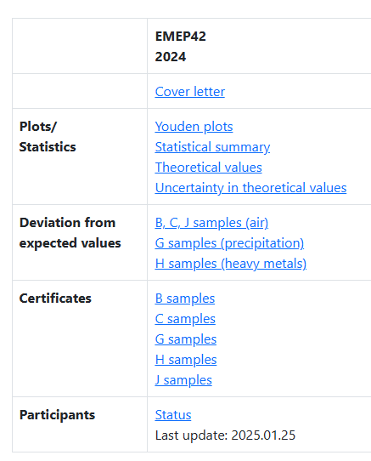
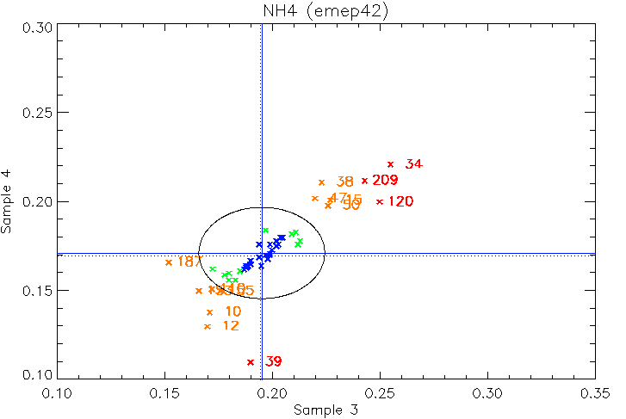
Status EMEP laboratory intercomparison.
Results for EMEP 42 for 2024 are available.
2025 is distributed
https://emep-ccc.nilu.no/intercomparison

Slide 6
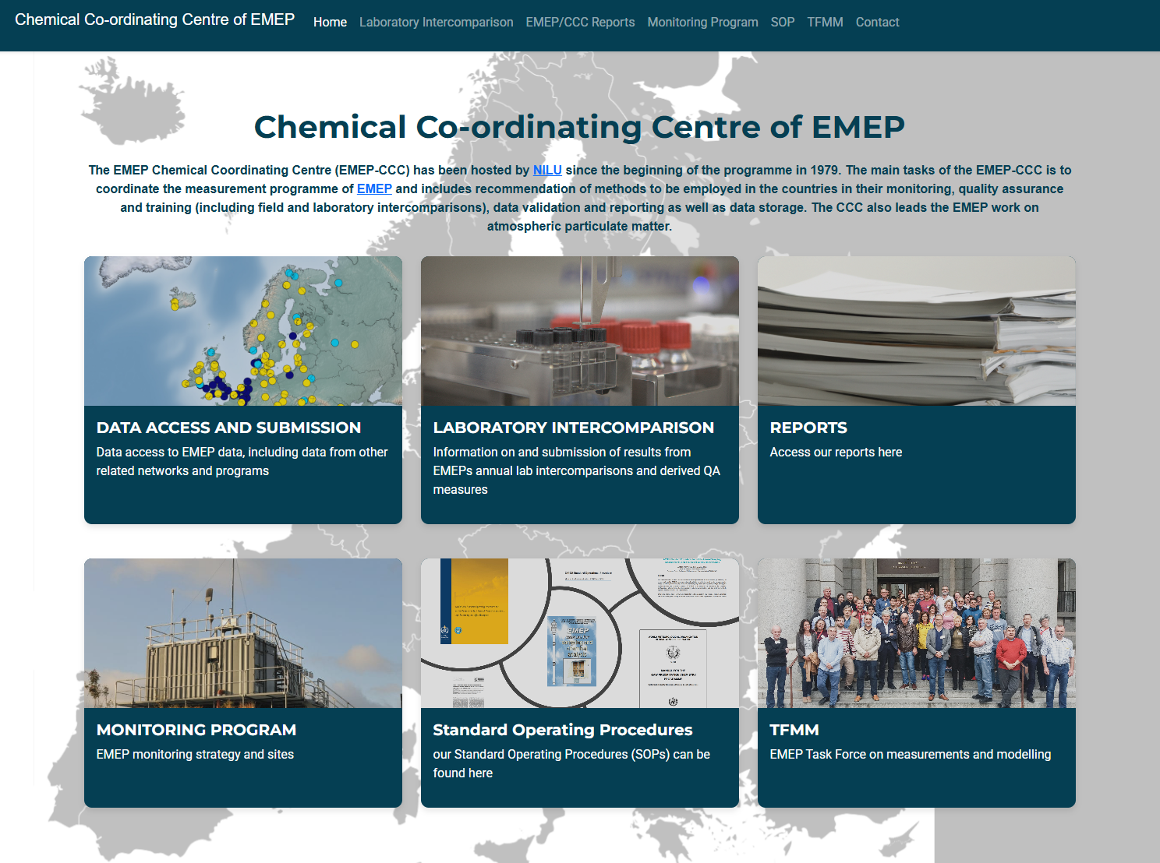
New CCC web pages
https://emep-ccc.nilu.no

Slide 7
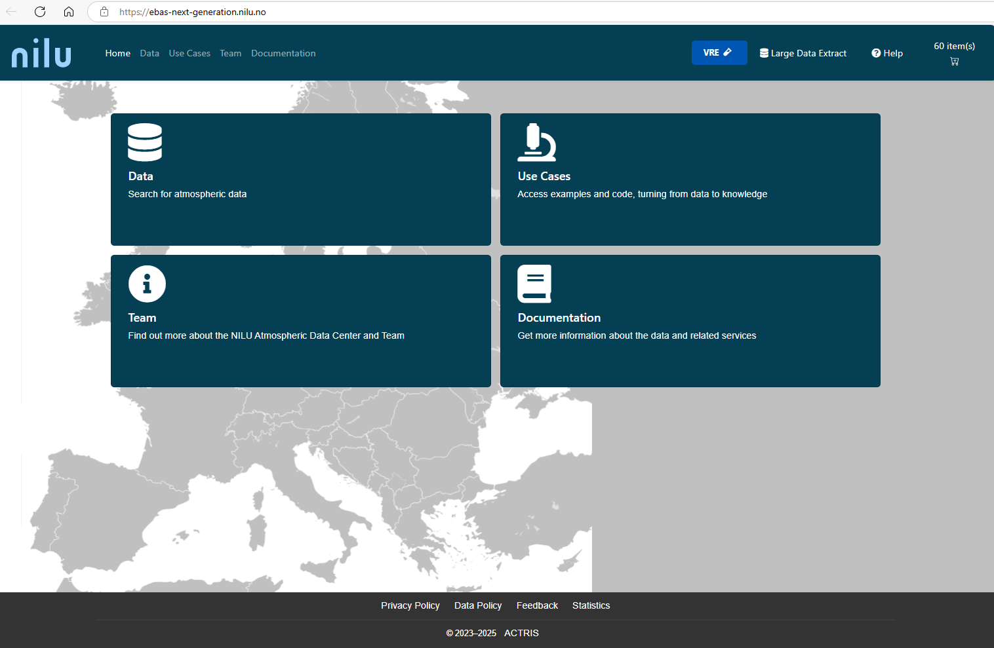
New data portal for ebas to be launched later this year

Slide 8
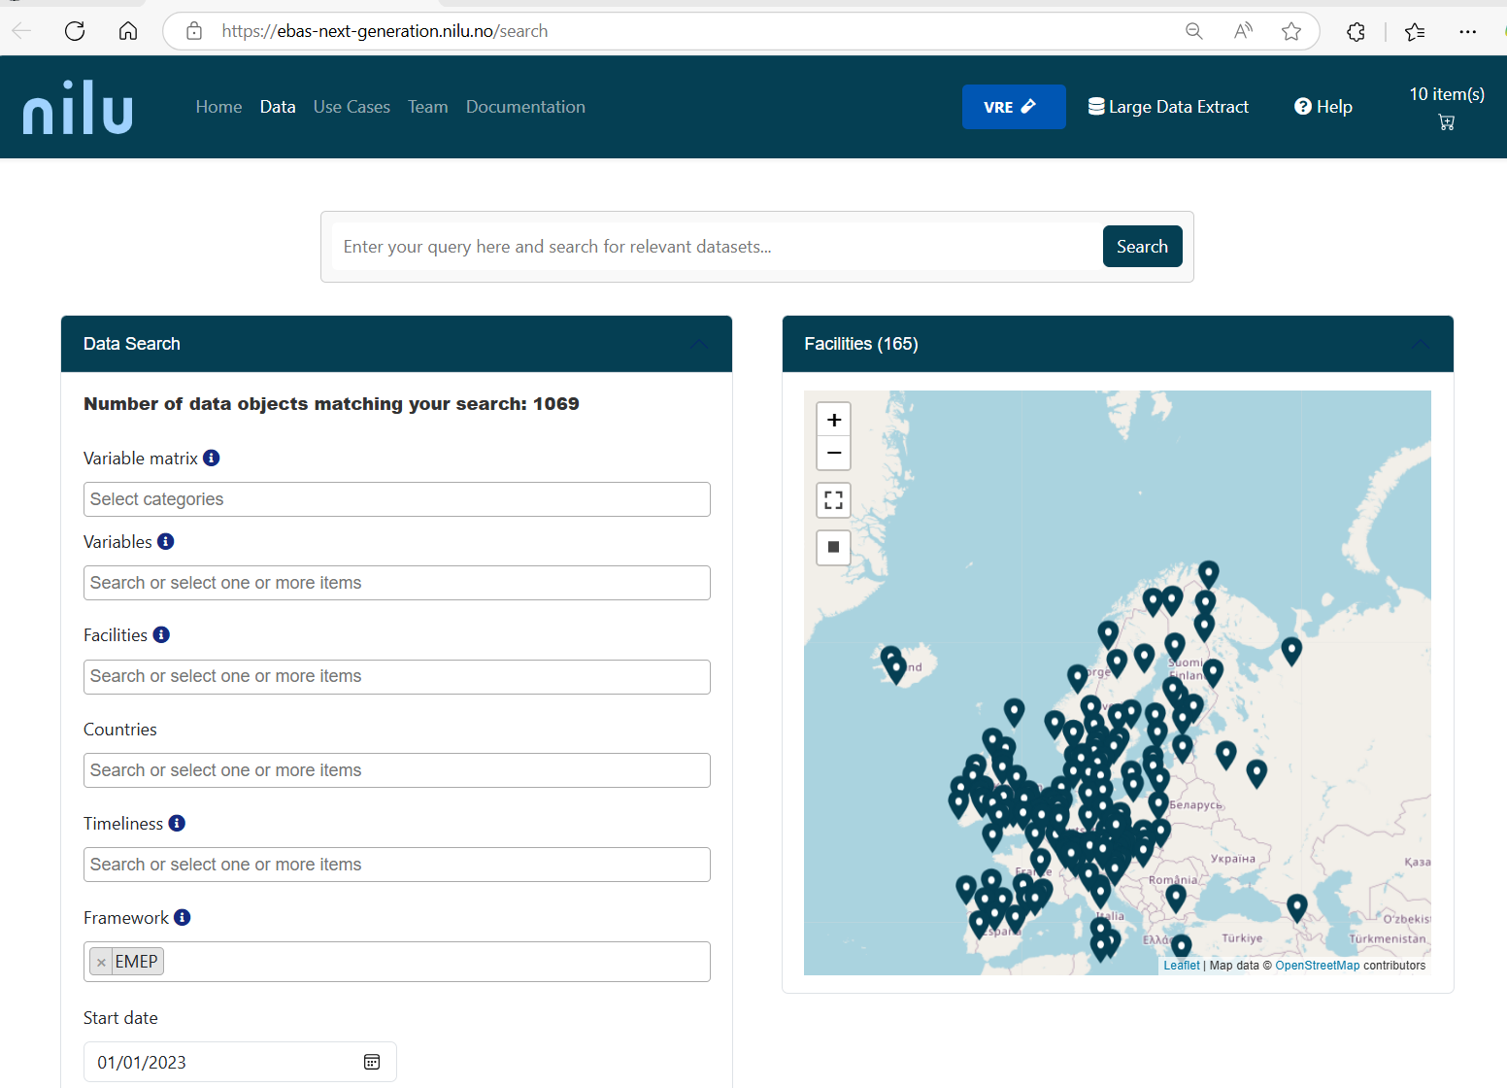


Slide 9
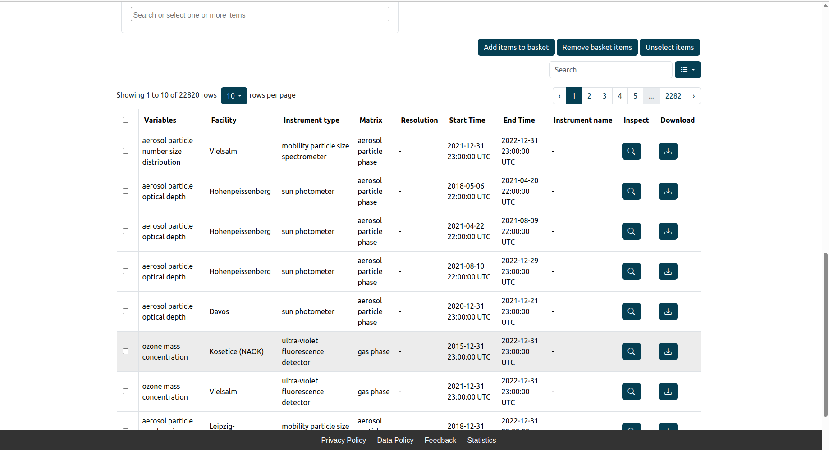

Slide 10
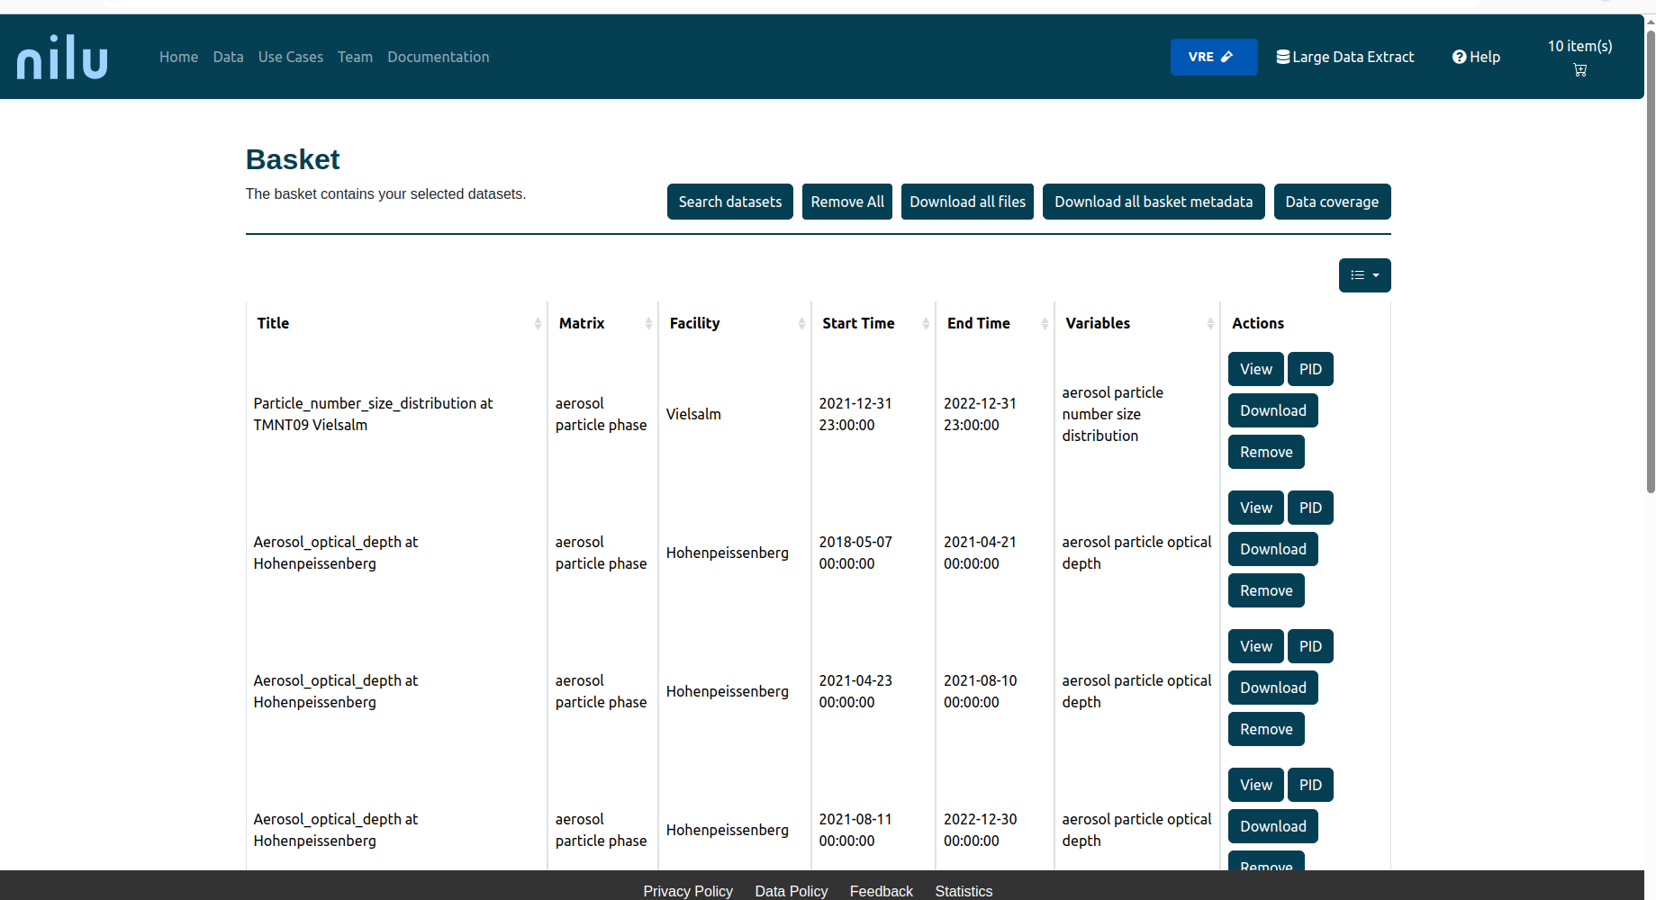

Slide 11
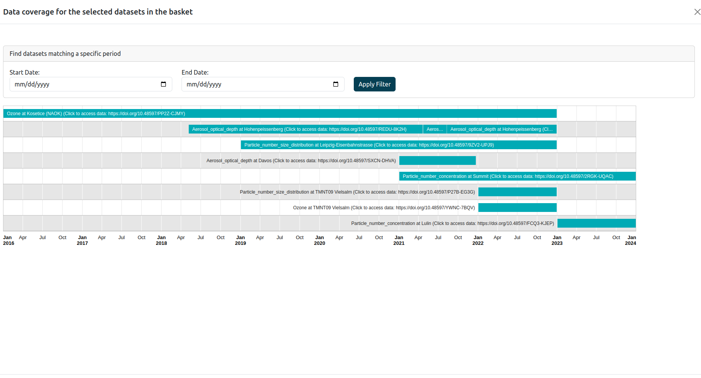

Slide 12
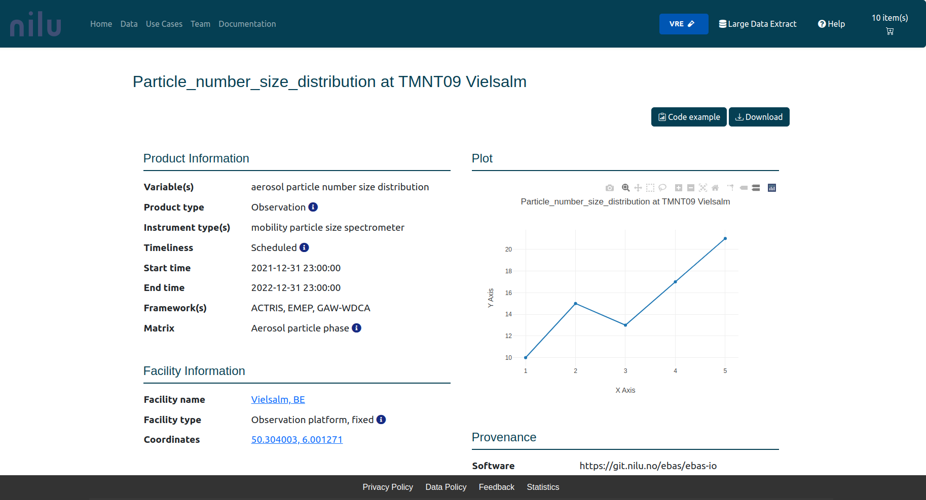

Slide 13
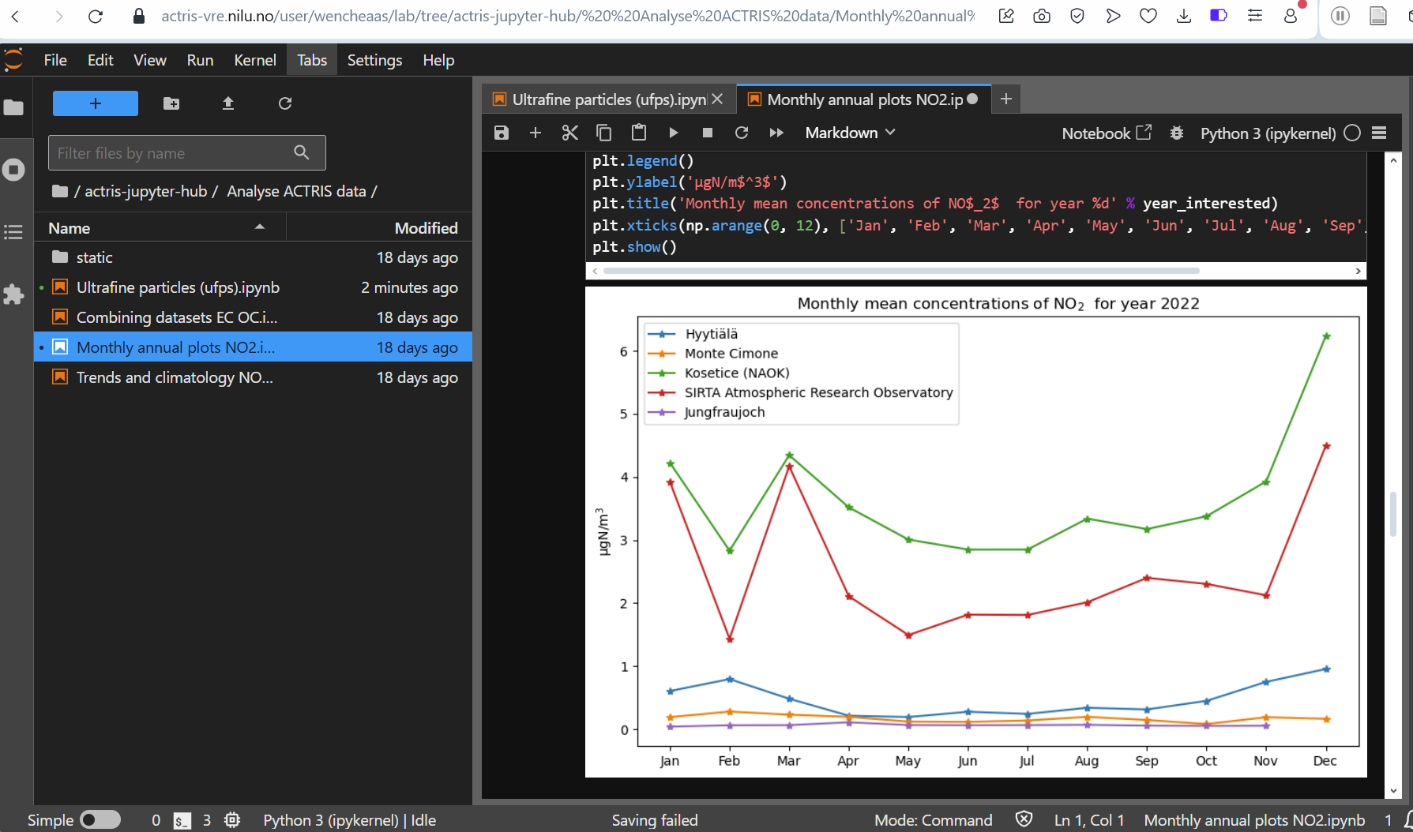

Slide 14
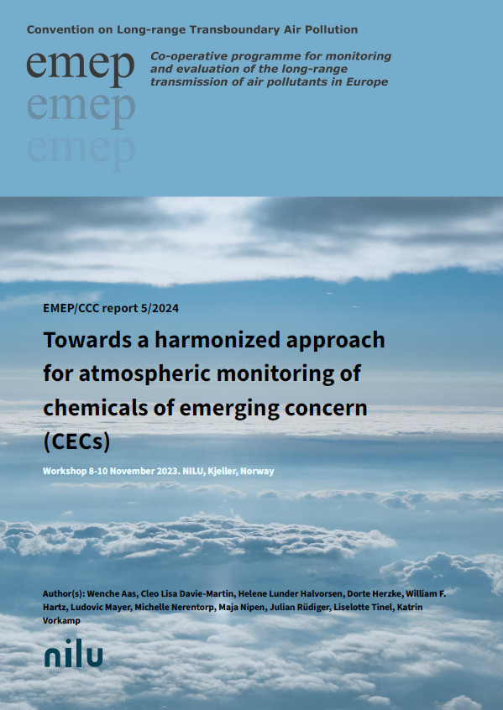
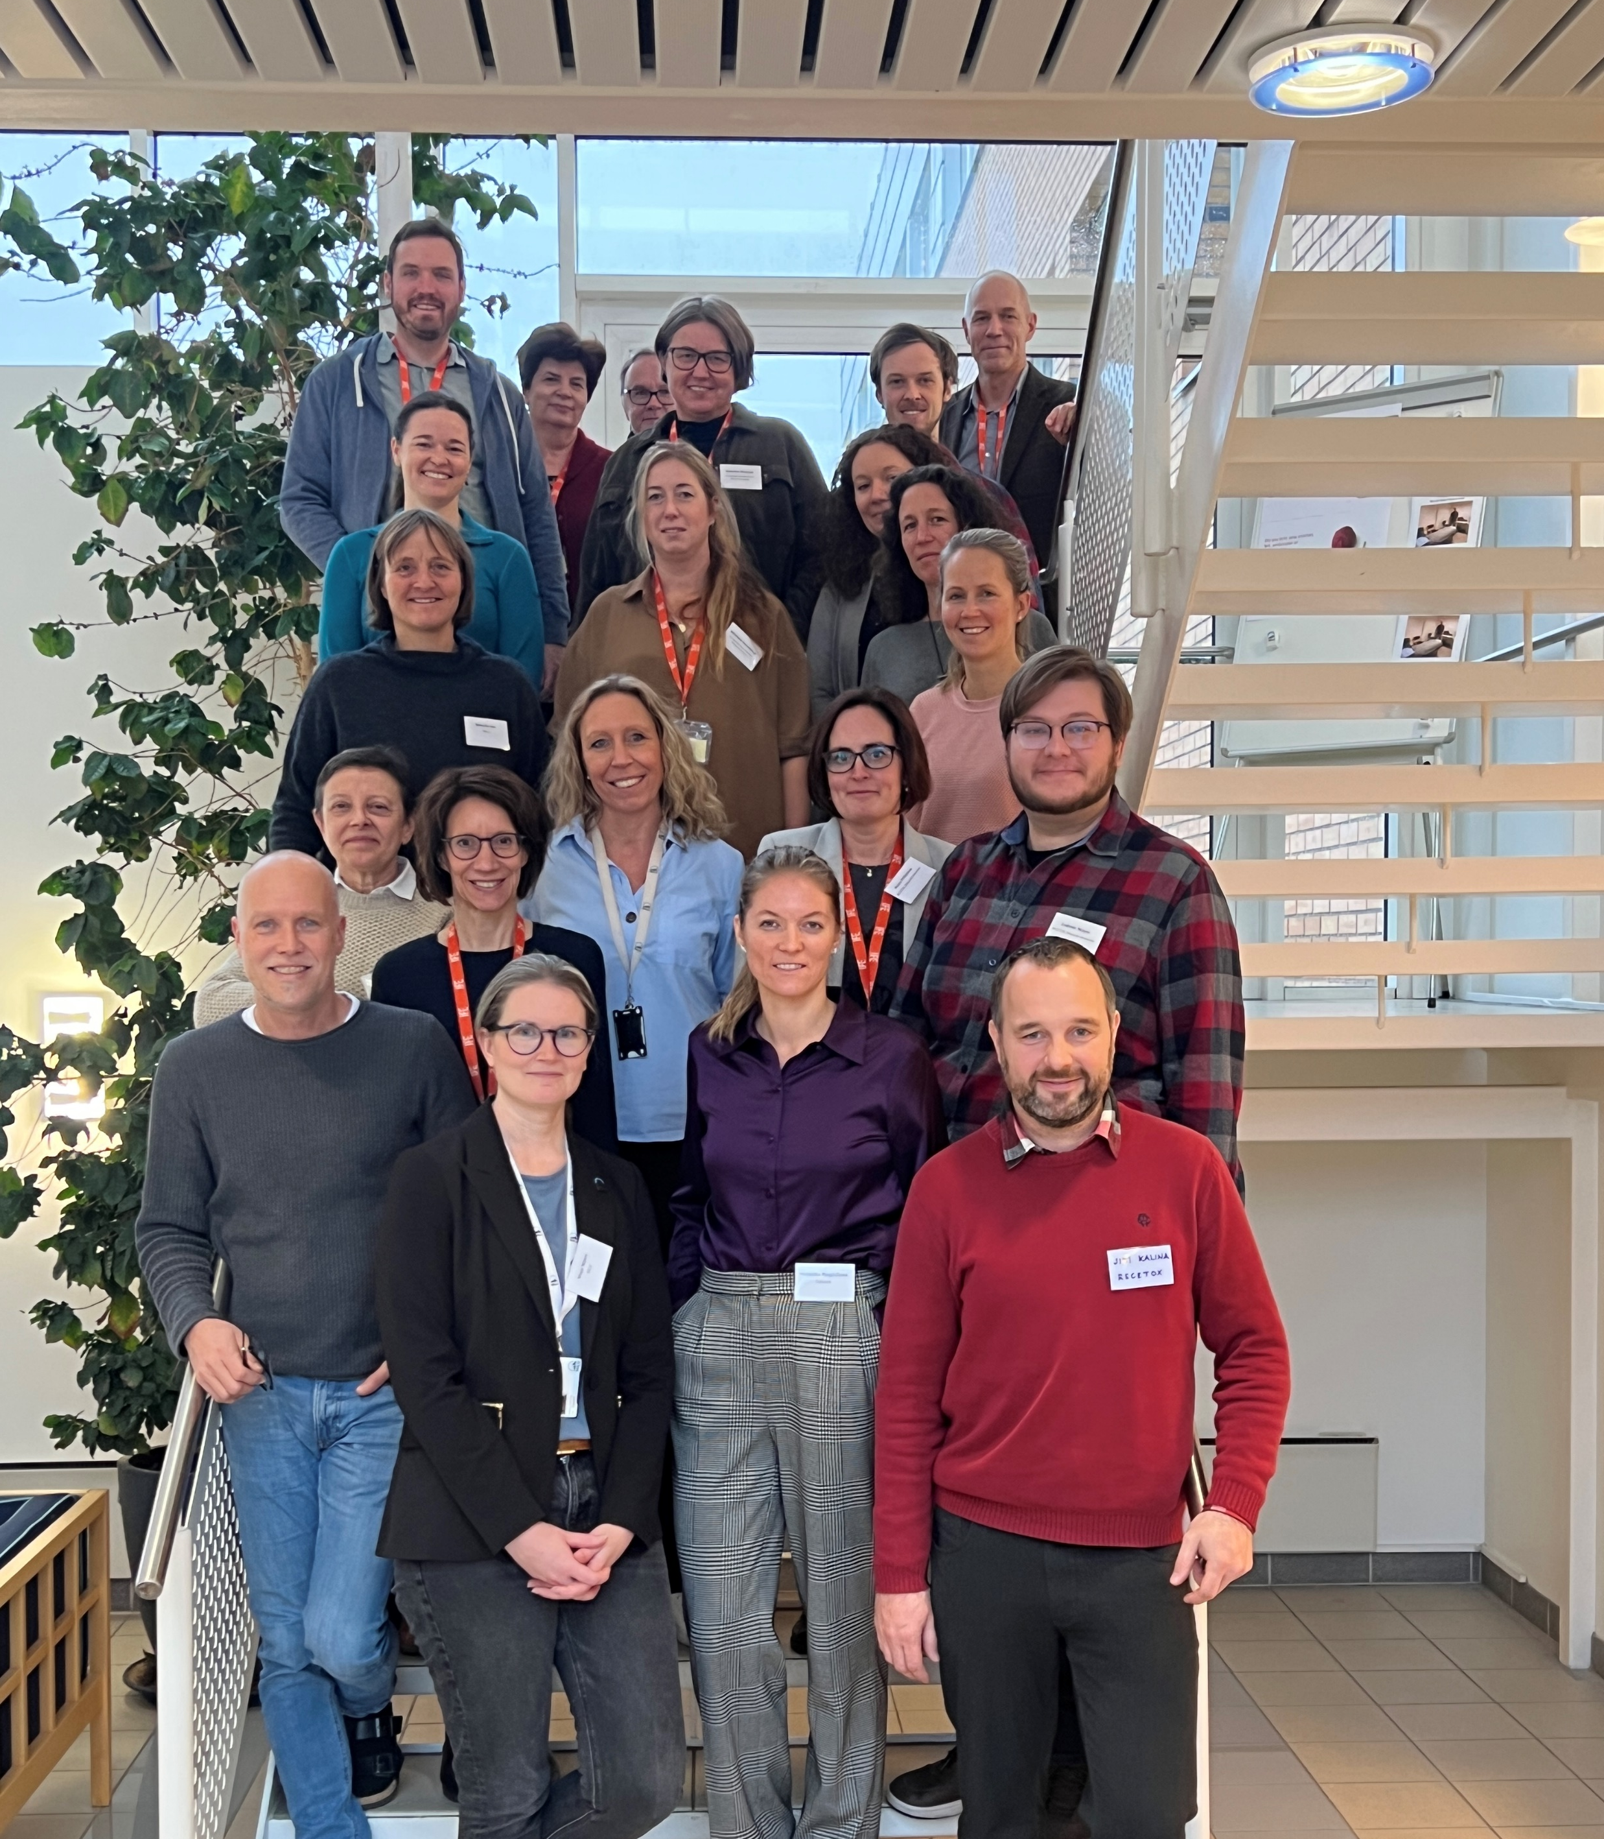
Towards a harmonized approach for atmospheric monitoring of Chemicals of Emerging Concern (CECs)
Workshop 8-10 November 2023 at NILU, Kjeller, Norway.
Thematic sessions:
Siloxane and Chloro-paraffins
PFAS
Flame retardant
Microplastic and plastic additives
Notes:
The overall aim of this workshop was to recommend approaches for sampling and analysis of CECs to support the needs of EMEP and harmonized with other regional and global monitoring programmes. Experts shared experiences of measuring CEC, the current scientific knowledge and gaps. Challenges and recommendations regarding various aspect in the sampling chain and in the analysis was discussed.

Slide 15
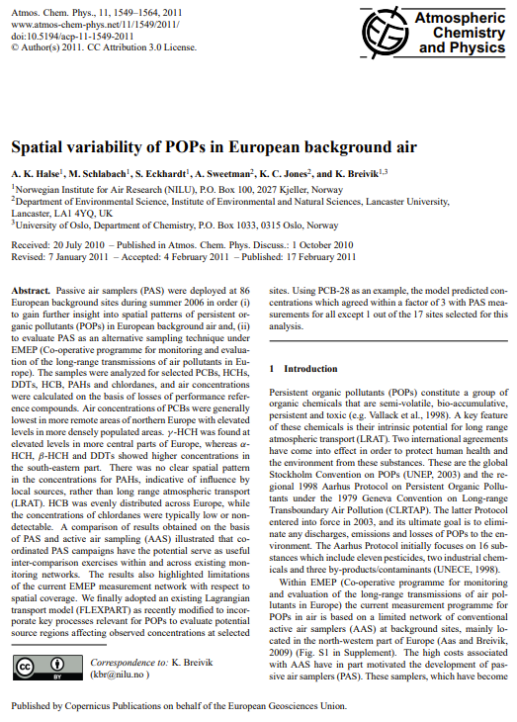
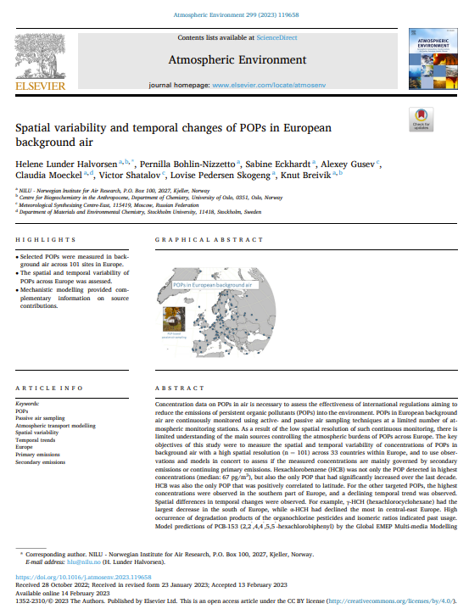
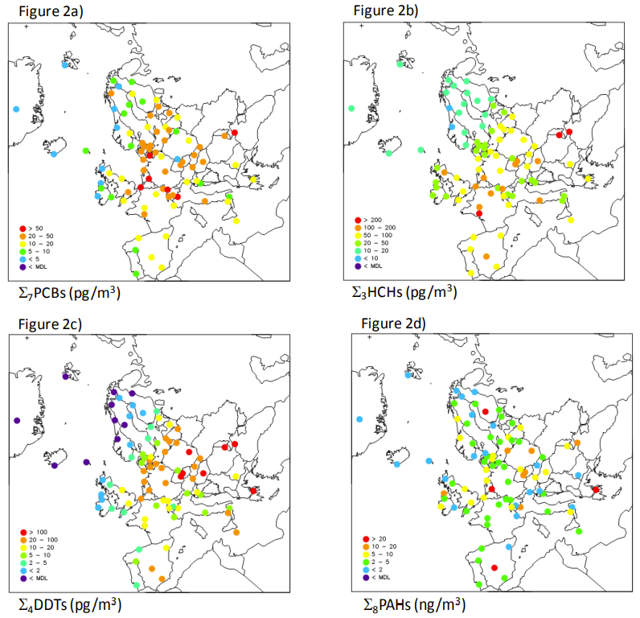
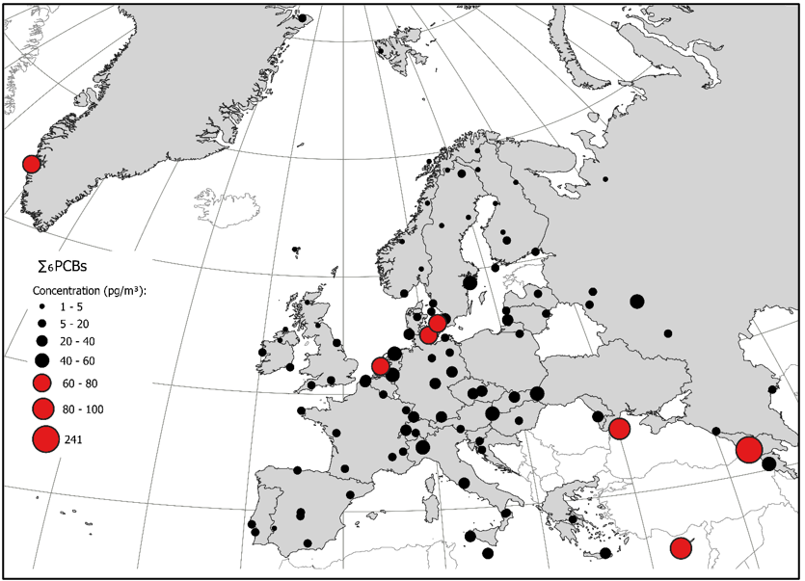
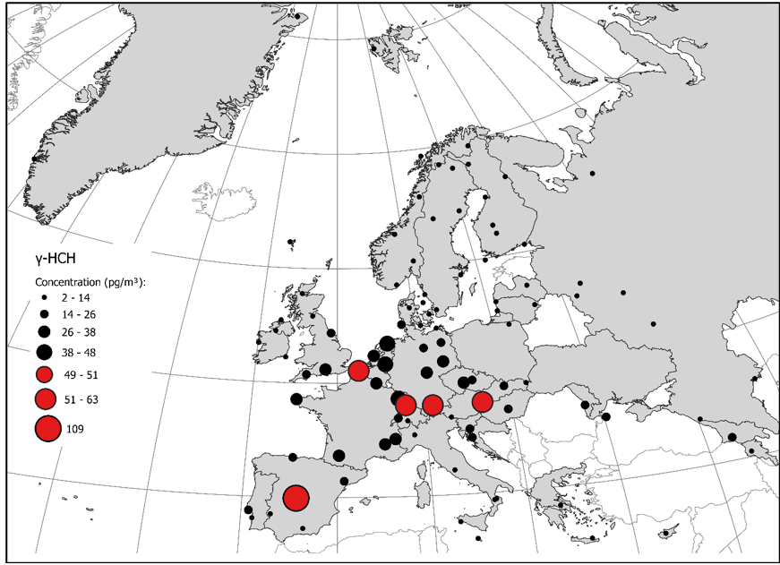
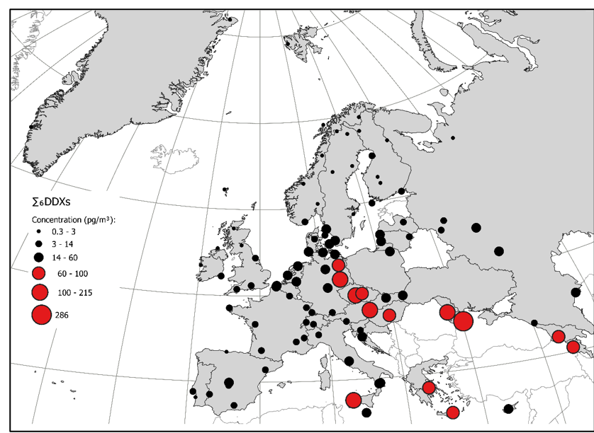
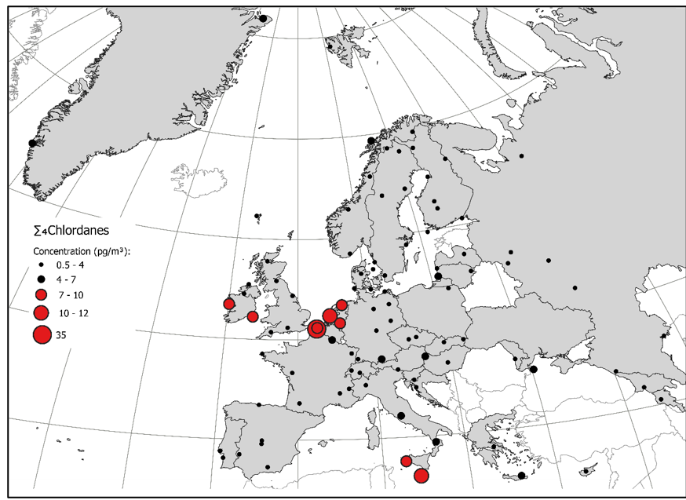
POP passive measurement campaigns with 10 years intervals. What about 2026?
2006
2016

Slide 16
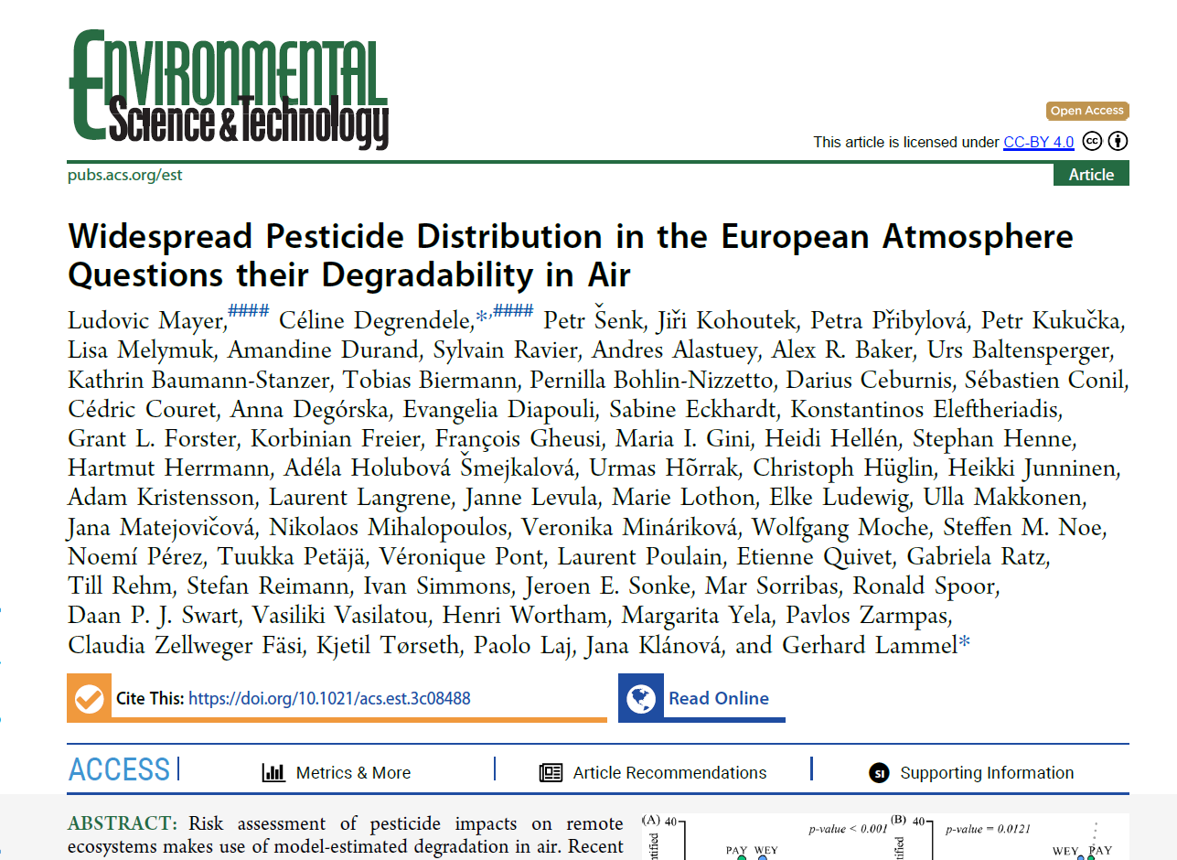
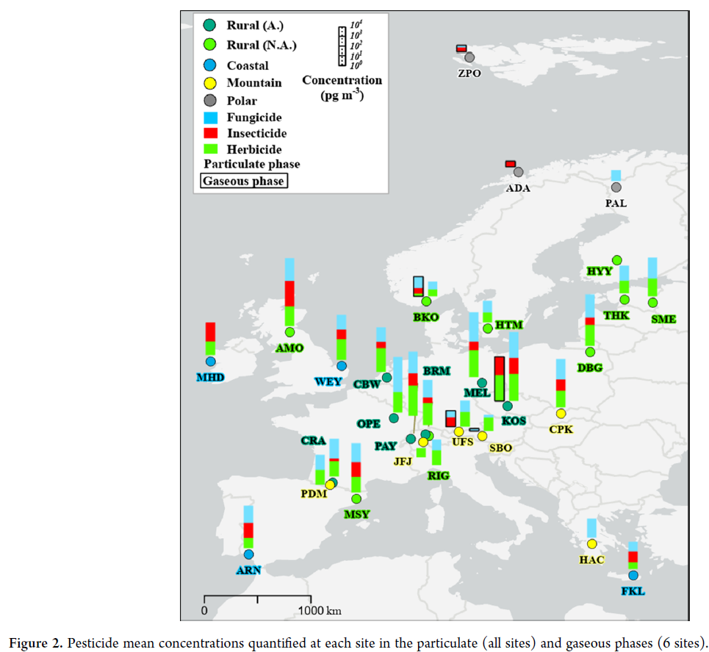

Slide 17

Fourth phase of the Global monotoring plan (GMP)
Stockholm Convention
Drafting team for the regions are established. CCC involved in the WEOG drafting team
Now data collection phase. For European air data, EMEP, AMAP, EEA, MONET, GAPS are identified
Initial draft to be presented in June 2026
Publication Oct- Dec 2026

Slide 18
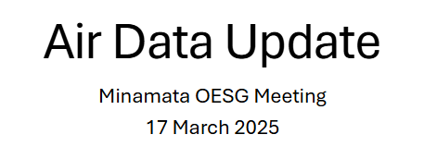
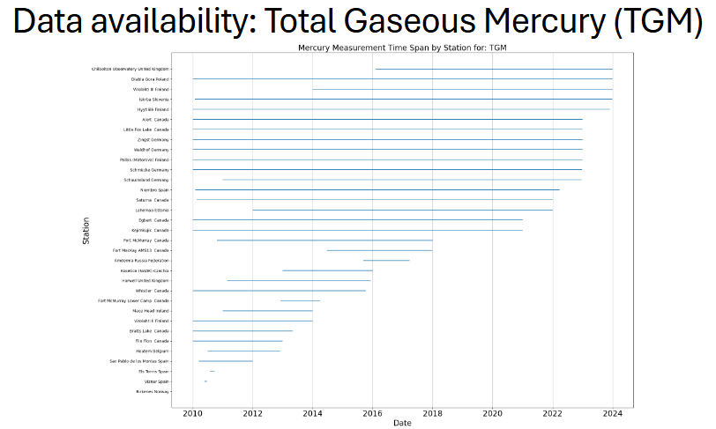
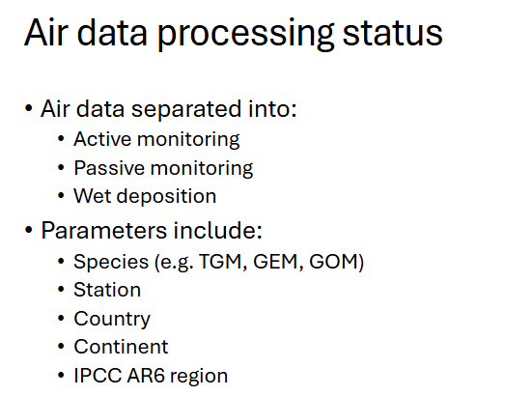
Data to Minamata Convention on Hg

Slide 19
Summary
EMEP program is stable with few changes from year to year
Improved efficiency in data acquisition.
All the 2023 data has been reported and are available in EBAS
Next generation EBAS to be launched this year. Feedback wanted and training will be provided
Workplan items to be discussed
VOC 2024 campaign
Support the new EU AAQD on emerging pollutants (i.e. UFP and PNSD, eBC, VOCs, NH₃), of which EMEP has long experience in measuring.
POPs (PFAS, link to GMP), measuremnt campaign including chemical of emerging concern (CEC)

