Slide 1
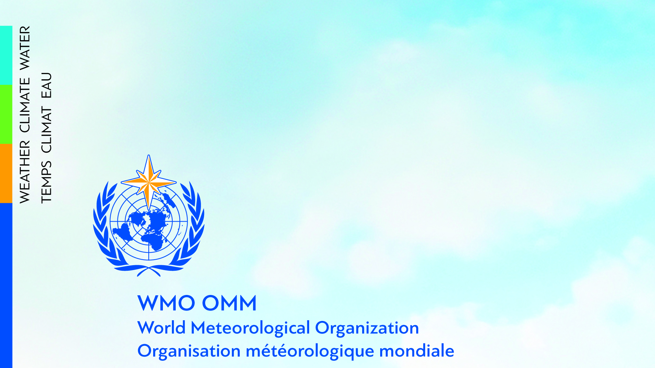
Hello
Bonjour
News for WMO/GAW
Paolo Laj
Head, Atmospheric Environment Research

Slide 2
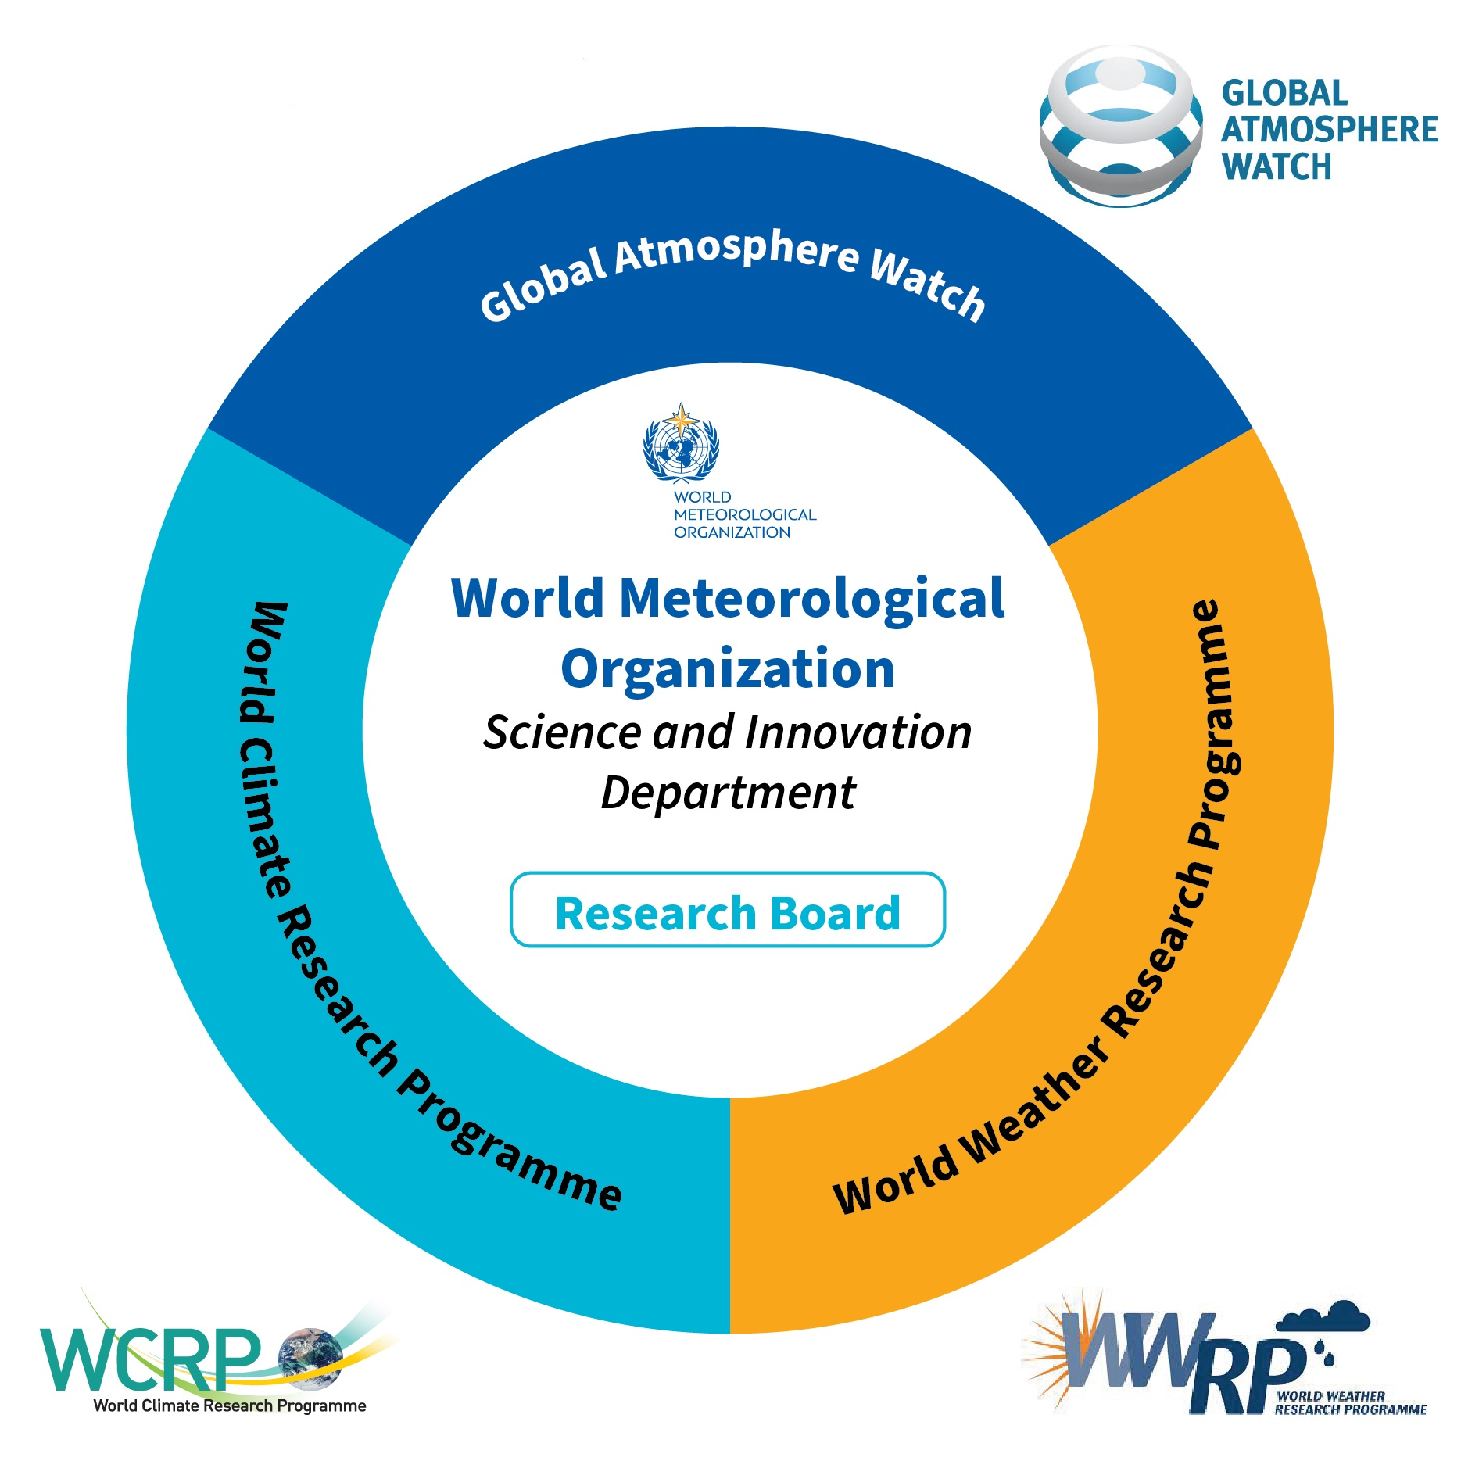

WMO Science and Innovation Department
Science & Innovation
V. Bouchet, new director as of May, 1st, 2025
World Weather Research Programme (WWRP)
https://community.wmo.int/activity-areas/wwrp
World Climate Research Programme (WCRP)
https://www.wcrp-climate.org
Atmospheric Environments Research Global Atmosphere Watch (GAW)
https://community.wmo.int/activity-areas/gaw
The Science and Innovation Department (SI) leverages the global research community to advance the understanding of the Earth system, improve policy-relevant science, and enhance the science-for-services value cycle.

Slide 3
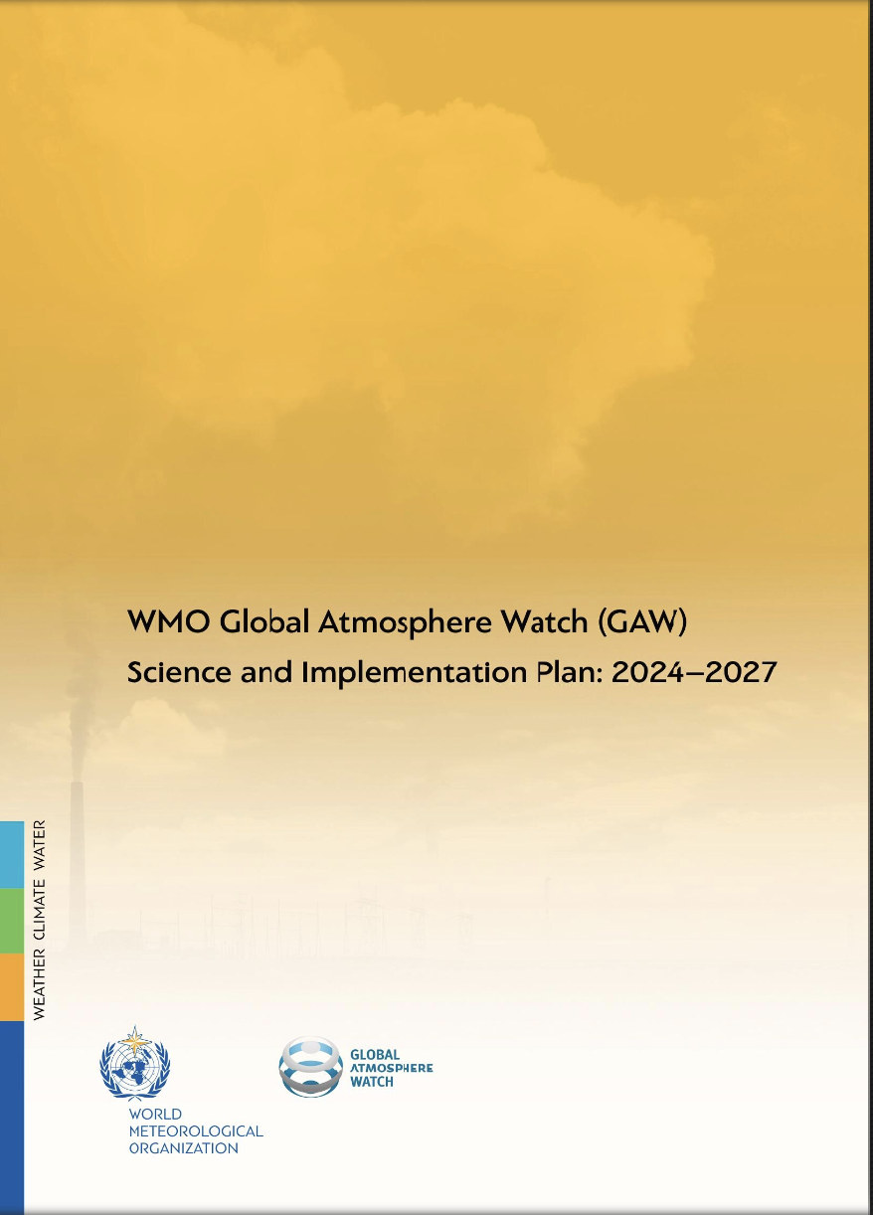
Global Atmosphere Watch
Monitoring Infrastructure: provision of harmonized atmospheric composition data from GAW stations, including some EMEP stations
Scientific assessments and guidance : advancing scientific understanding through analysis of global and regional data sets (gaps, trends and variability in a changing climate), guidance to evolving needs
Science-for-Services Initiatives: engage with user communities for supporting Services, Policies, and Treaties, promoting research-to-Operation activities
Capacity Building and education: provide training opportunities for all GAW users from all regions
Communication and raising awareness : comprehensive, policy-relevant synthesis on the state of atmospheric composition.

Slide 4
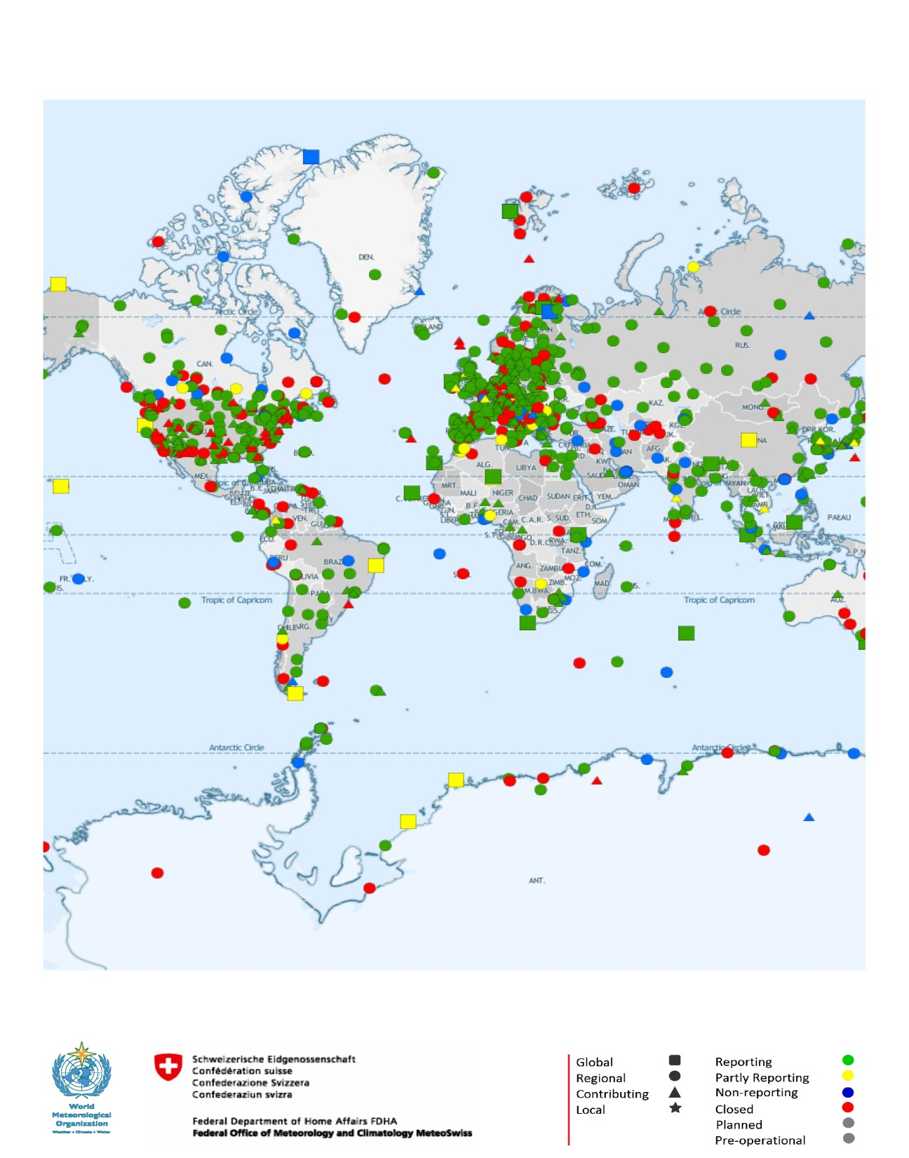
Global Atmosphere Watch: Monitoring Infrastructure
AEROSOL
REACTIVE GAS
DEPOSITION
OZONE UV
GHG
  New Global station: Trollhaugen Station, located in Antarctica, operated by Norway
  New regional station : station Kasprowy Wierch (KAS) – Poland
  Upgrading GAWSIS by re-connecting to World and Regional Data Centers
  Revising the organization of the GAW data chain, empowering Regions

Slide 5
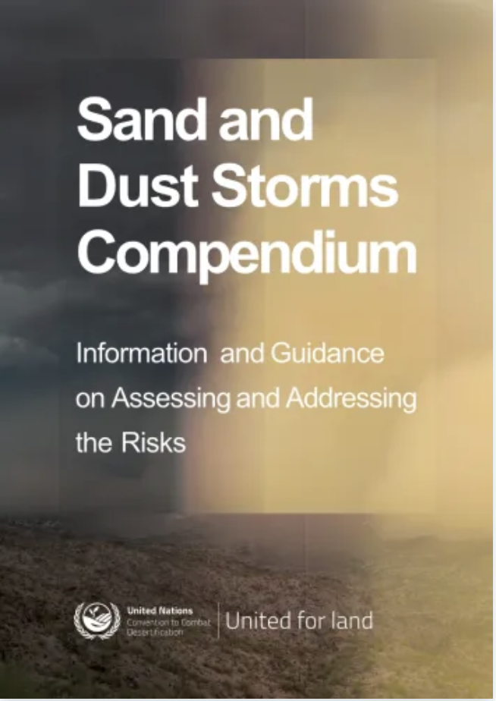
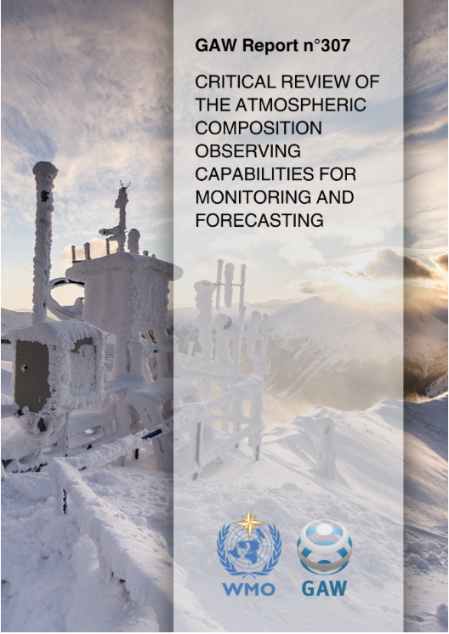
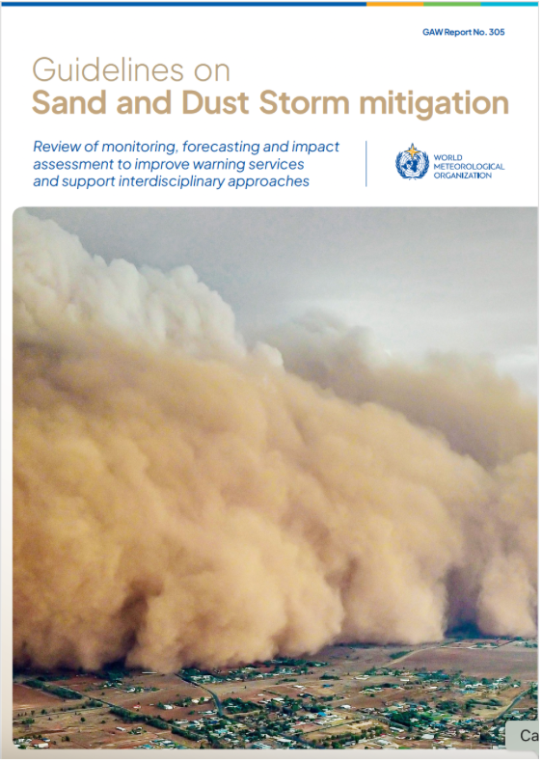
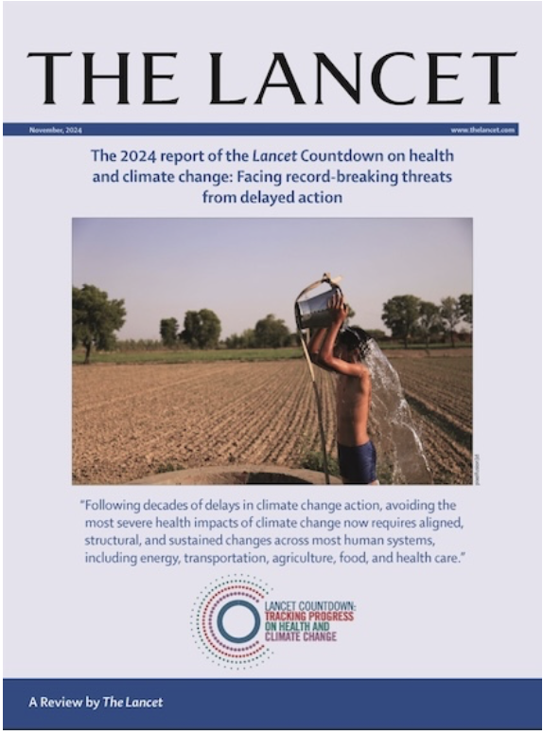
Global Atmosphere Watch: Scientific assessments and guidance
  Encourage community scientific papers and reports (AQ, Climate and Health, EC/OC Worldwide, SDS, Ocean deposition, etc.. ), bringing Science to policy levels
  Joint meetings of the WMO/GAW expert groups for integrated approaches : Short-lived atmospheric species (Nov. 2024), Urban activities (April 2025), GHG, Ozone and ODS (July 2025)

Slide 6
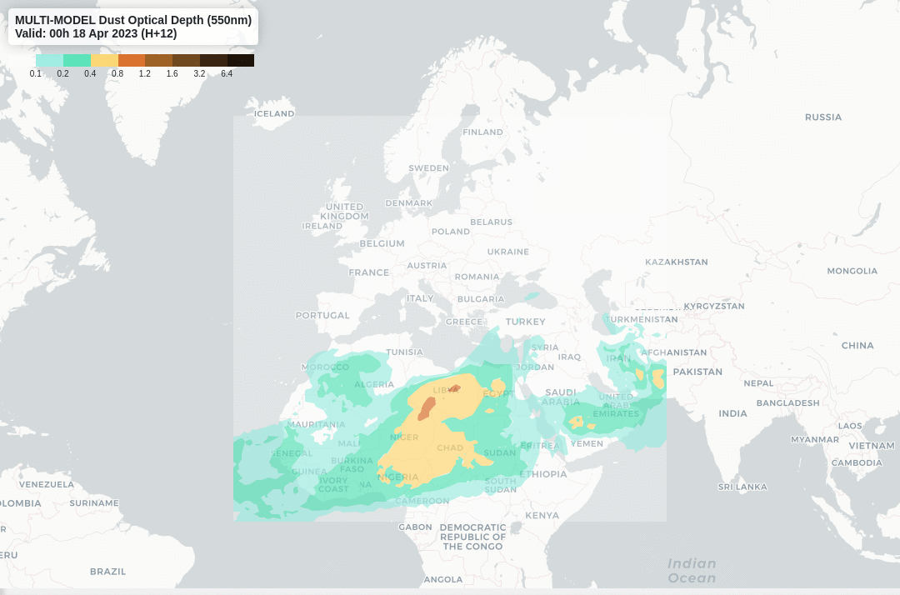
Global Atmosphere Watch: Science-for-Services Initiatives
Air Quality forecasting (GAFIS), GHG emission and removal (IG³IS) and total deposition of Atmospheric pollutants (MMF-GTAD)
New ARCH ( AiR Quality Climate and Health) working group now operational : recommend research, operational requirements and capacity needs for future climate and Health services.

Slide 7
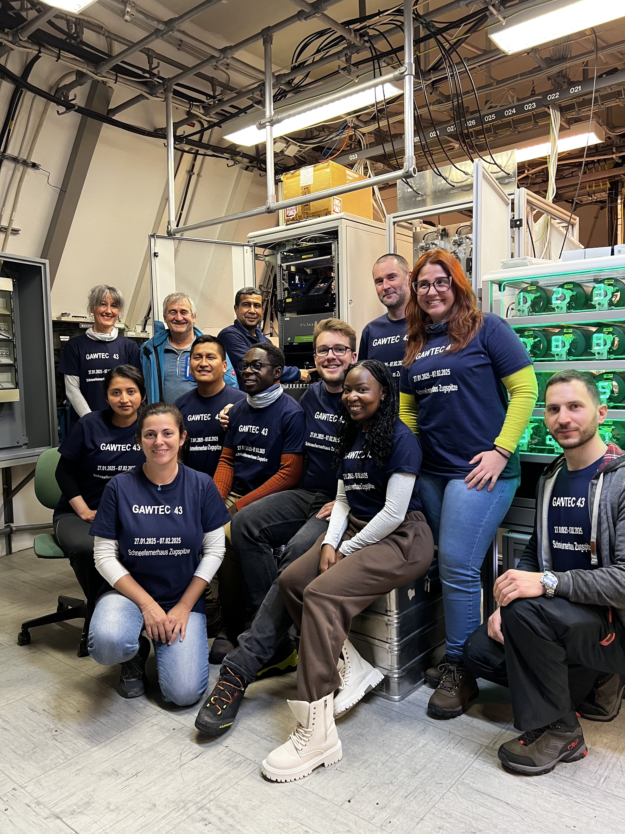
Global Atmosphere Watch: Capacity Building and education
New Expert Team on Atmospheric Composition Capacity Building and Education’ (ET-ACCBE): strategic guidance to GAW capacity building
GAWTEC 43 on Greenhouse gas measurements successfully held and GAWTEC most likely to continue as hands-on AND online courses
Empowering Regional Training and GAW regional ecosystems. Need for specific training activites related to EMEP ?

Slide 8
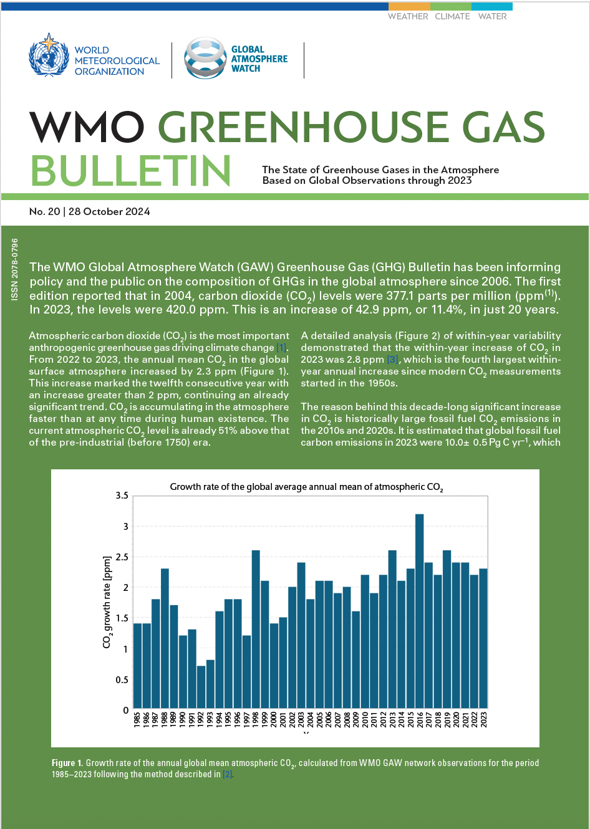
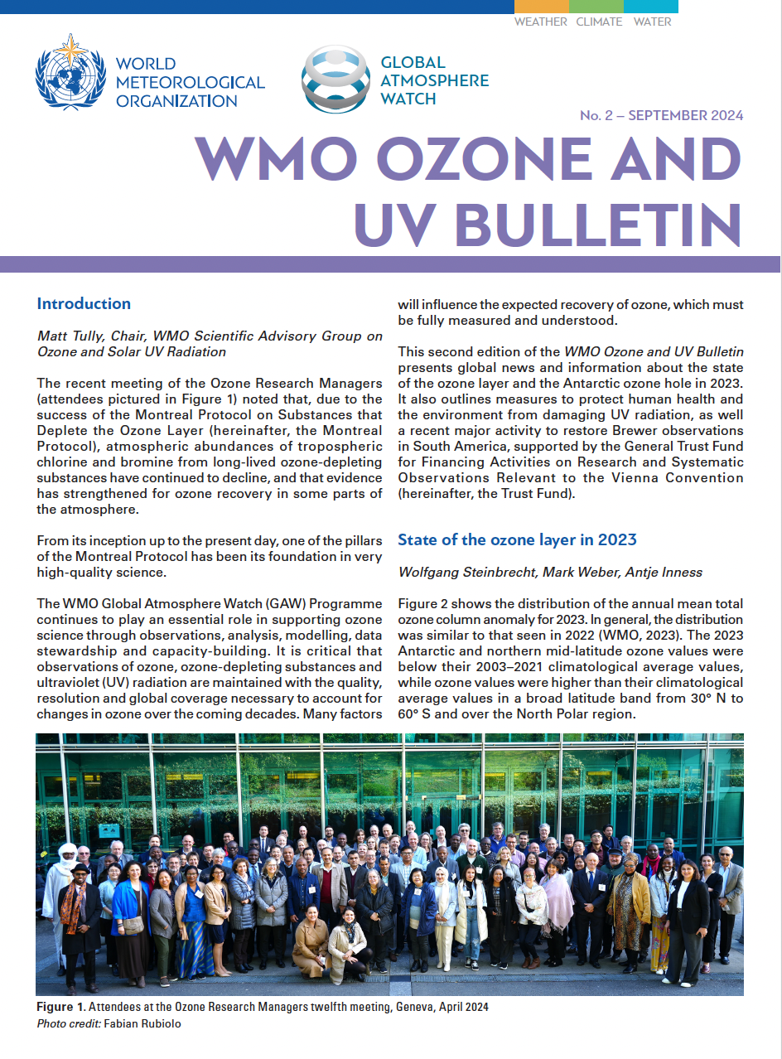
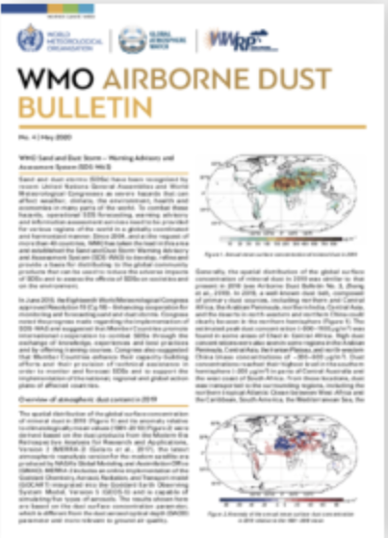
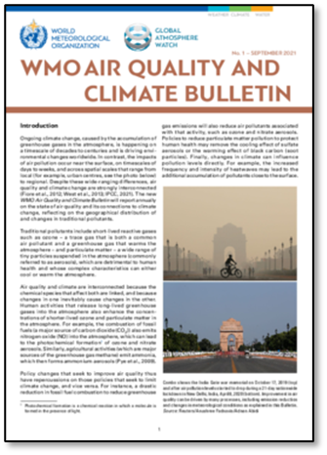
Global Atmosphere Watch: Communication
WMO bulletins: comprehensive, policy-relevant synthesis on the state of atmospheric composition.
Atmospheric Indicators initiative : Complete the bulletin series with new atmospheric indicators for a State of Atmospheric composition series
GAW Symposium 2026: April 13-17, 2026, Geneva. Launching the 2028-2031 GAW strategy
Subscribe to GAW Newsletters

Slide 9
GAW in a European Context
Monitoring Infrastructure: links to EMEP and to European Research Infrastructures (ACTRIS, IAGOS, ICOS)
Scientific assessments and guidance : Tends to be Global but appreciate the regional initiatives (i.e. work on BC performed within RI-URBANS / ACTRIS) Science-for-
Services Initiatives: regional centers in Europe for SDS-WAS (BSC/AEMET) and work towards additional centers (G3W). Ongoing EU projects (iClimateAction) will mobilize European Data Centers.
Capacity Building and education: GAWTEC 44 to be discussed and how better streamlining different initiatives

Slide 10
Hello
Bonjour
Thank you !

