Slide 1

EMEP MSC-E activities: Progress and plans
Oleg Travnikov, Isabel Garcia Arevalo, Jan Gačnik, Reza Gholizadeh, Mikhail Kleimenov, Viktória Koncz,
Milena Horvat
Jožef Stefan Institute Ljubljana, Slovenia

Slide 2
On-going research and development
Revision of the GLEMOS dust resuspension scheme
Mercury research and model updates
Source attribution of PAH pollution (model + mosses)
Pilot study for the Western Balkans
Multi-media simulations of POPs
Proposals for the 2026-2027 workplan

Slide 3
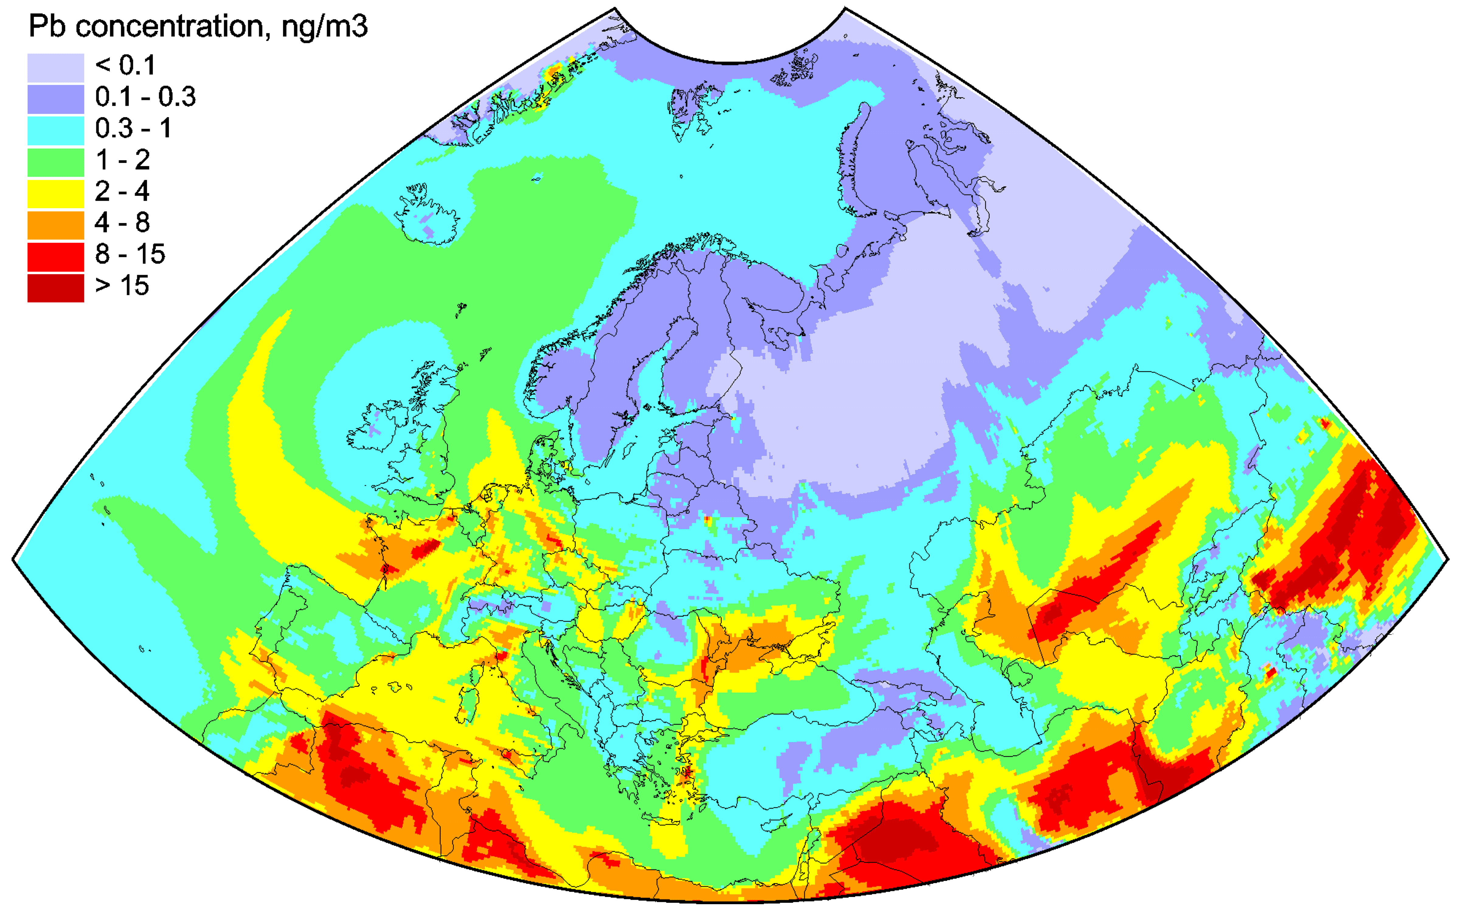
Revision of dust resuspension scheme
Pb air concentration in EMEP countries (2022)
Motivation:
Particulate metals (Cd, Pb) in air are strongly affected by wind suspension of dust from:
  Natural surfaces (deserts, barren lands, sea water)
  Arable and urban areas
Contribution of re-suspension to Pb air concentrations (March 2022)
Heavy metal re-suspension modelling contains significant uncertainties
The GLEMOS dust suspension scheme has not been updated for many years

Slide 4
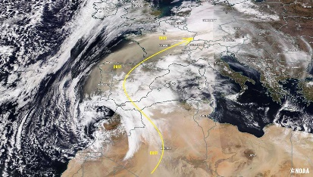
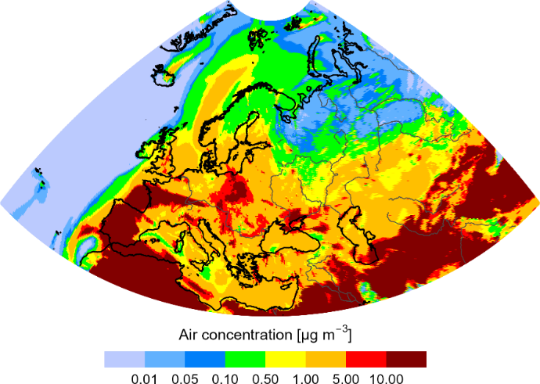
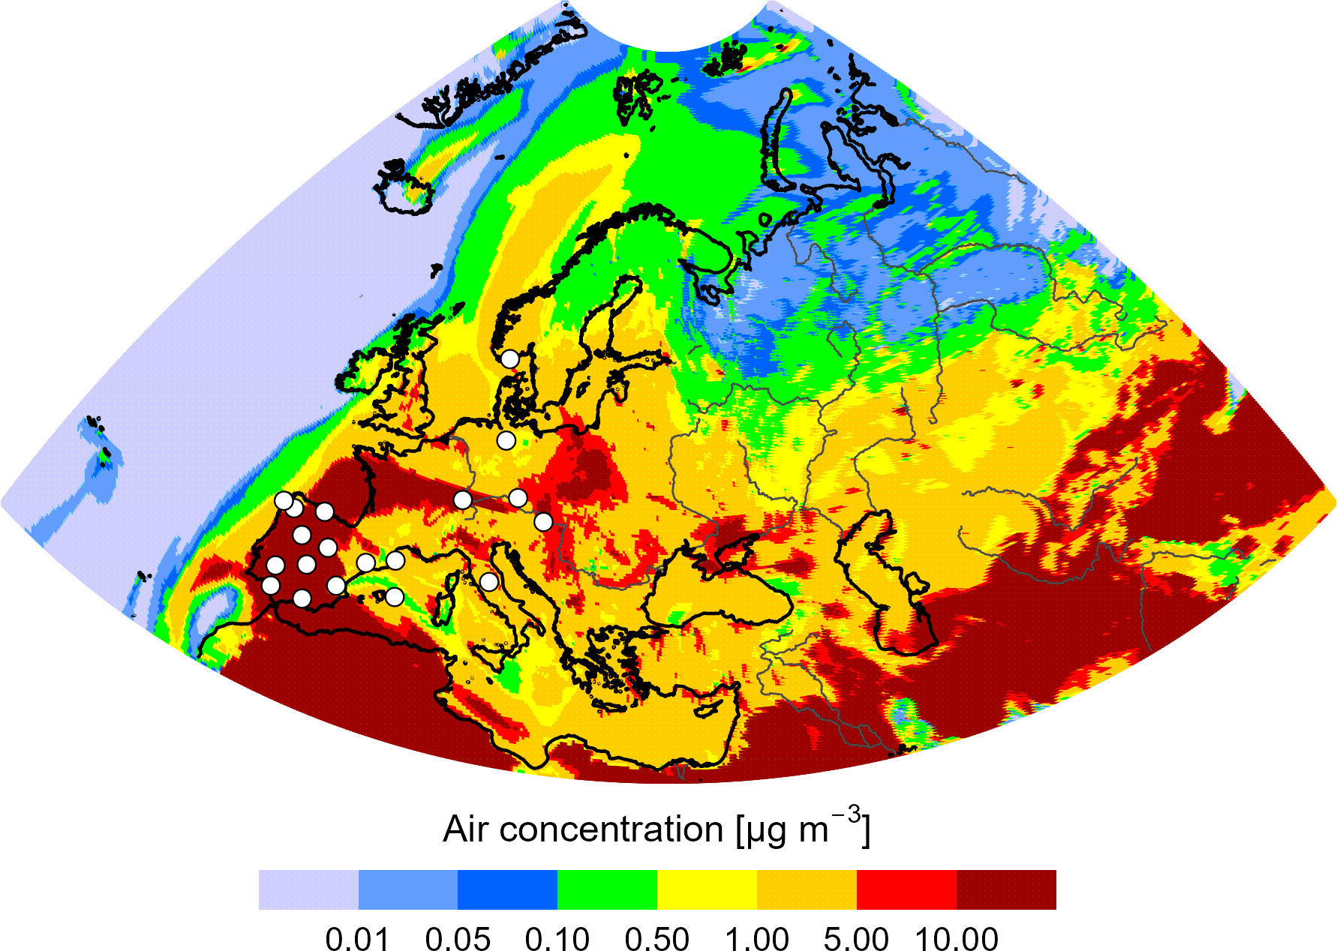
Revision of dust resuspension scheme
PM10 concentration (15 March 2022)
On-going study:
Evaluation and sensitivity analysis of the current GLEMOS dust suspension scheme
Testing alternative dust suspension schemes
San Pablo de los Montes (Spain)
Simulation of Saharan dust intrusion episodes (March-April 2022)
Doñana (Spain)
Evaluation of dust simulations vs. PM10 measurements
Simulations of Pb and Cd wind resuspension with different schemes
More details in separate presentation

Slide 5
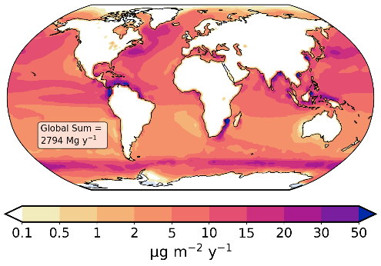
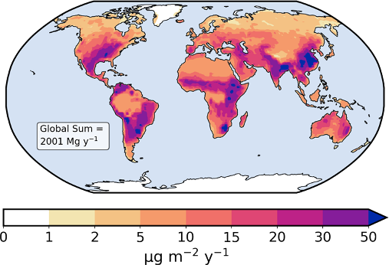
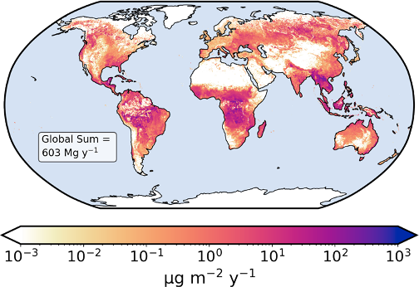
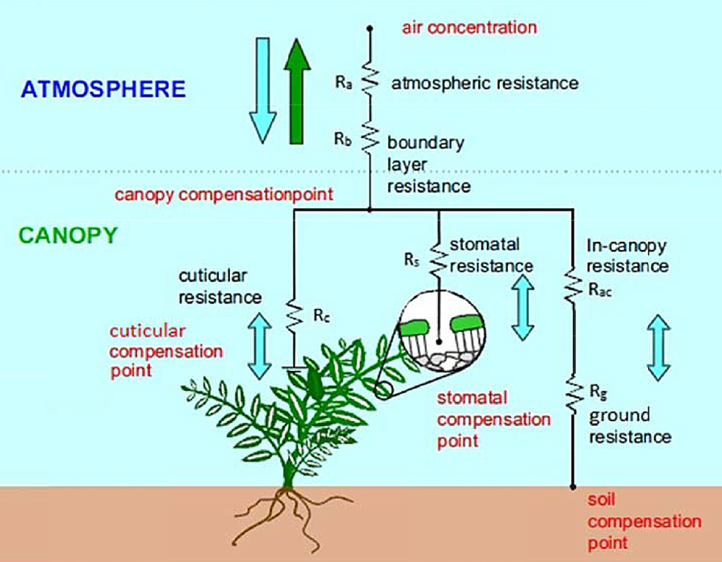
Mercury research and model updates
Ocean Hg emission
GLEMOS on-going updates for mercury:
Geogenic emissions (ocean and terrestrial evasion, wildfires, volcanos)
Terrestrial Hg emission
Wildfires
Refinement of chemical mechanisms (gas-particle partitioning, reaction rates)
Revision of Hg⁰ dry deposition scheme and air-water exchange
Hg⁰ air-vegetation exchange
Future research:
Study of Hg heterogeneous processes and influence of dust pollution events on Hg chemistry (in collaboration with JSI)
Wang et al., 2014

Slide 6
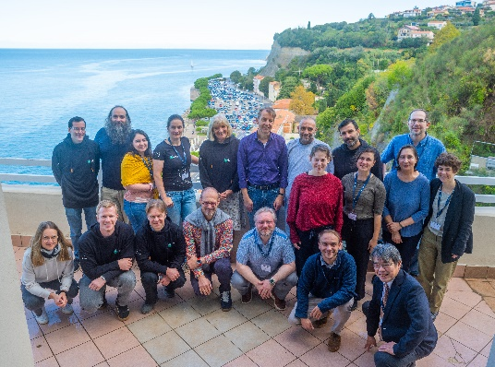
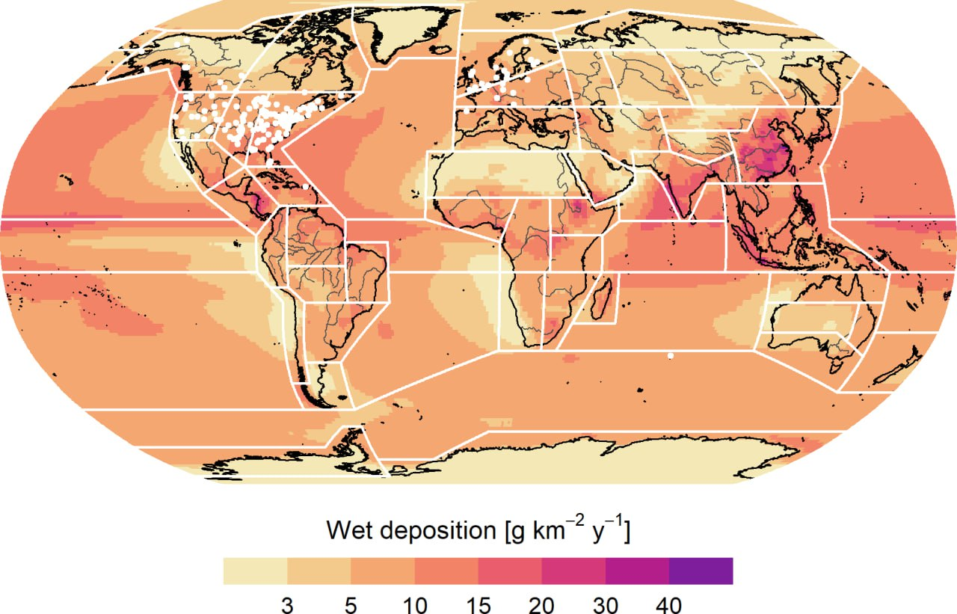
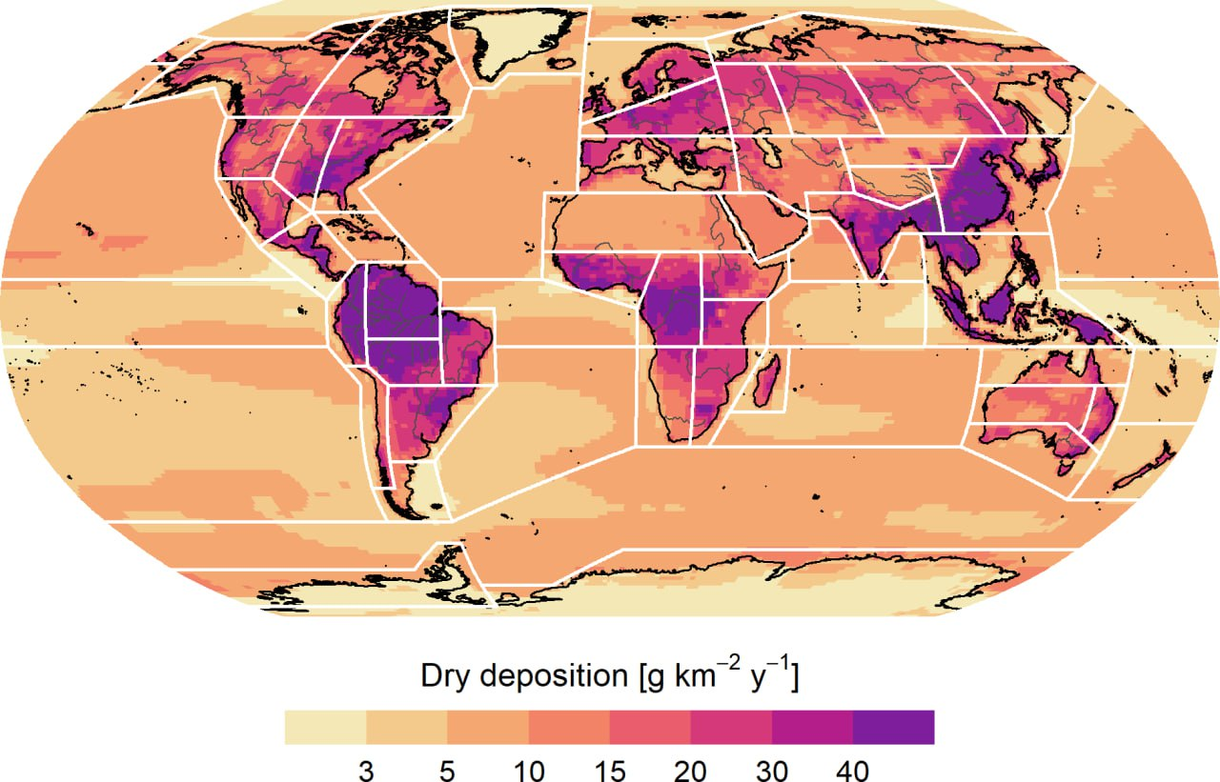
MCHgMAP project
Co-operation with TF HTAP and Minamata Convention
MCHgMAP workshop participants (October, 2024)
Project activities:
Multi-model simulations coupling atmospheric, ocean and terrestrial models
MCHgMAP project workshop organized by MSC-E/JSI (Slovenia, October 2024)
First results were presented at the Minamata Convention OESG meeting (Japan, March 2025)
Model ensemble simulations (2010-2020)
Hg wet deposition
Hg dry deposition
Multi-model simulations will be further discussed at the TF HTAP meeting (Potsdam, 7-9 May, 2025)

Slide 7
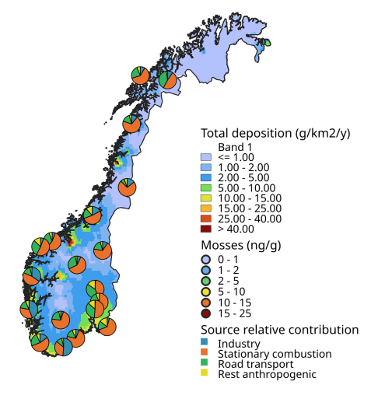
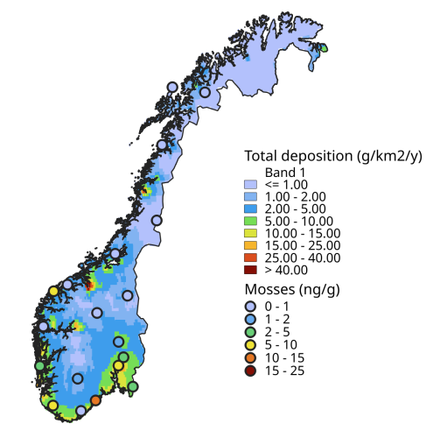
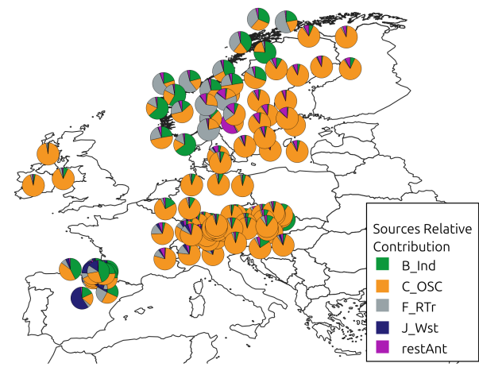
Source attribution of PAH pollution
Complex analysis involving modelling and moss biomonitoring
- Industry
Polycyclic aromatic hydrocarbons (PAHs) - POPs largely formed from incomplete combustion of fossil fuels and biofuels
PAH source attribution using source-receptor simulations (GLEMOS) and moss measurement data (ICP-Vegetation)
Multi-scale analysis:
- Stationary combustion
- Road transport
- Waste
- Other
  Pilot study for Norway
  Regional study for European countries
More details in separate presentation

Slide 8
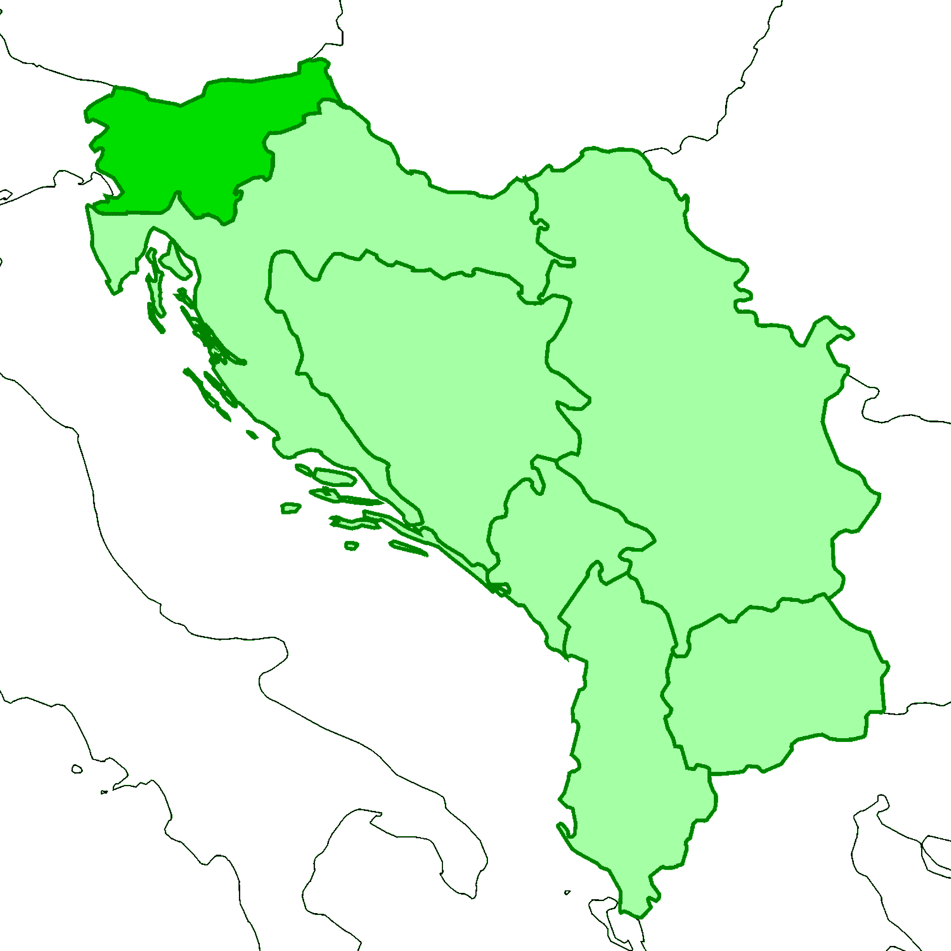
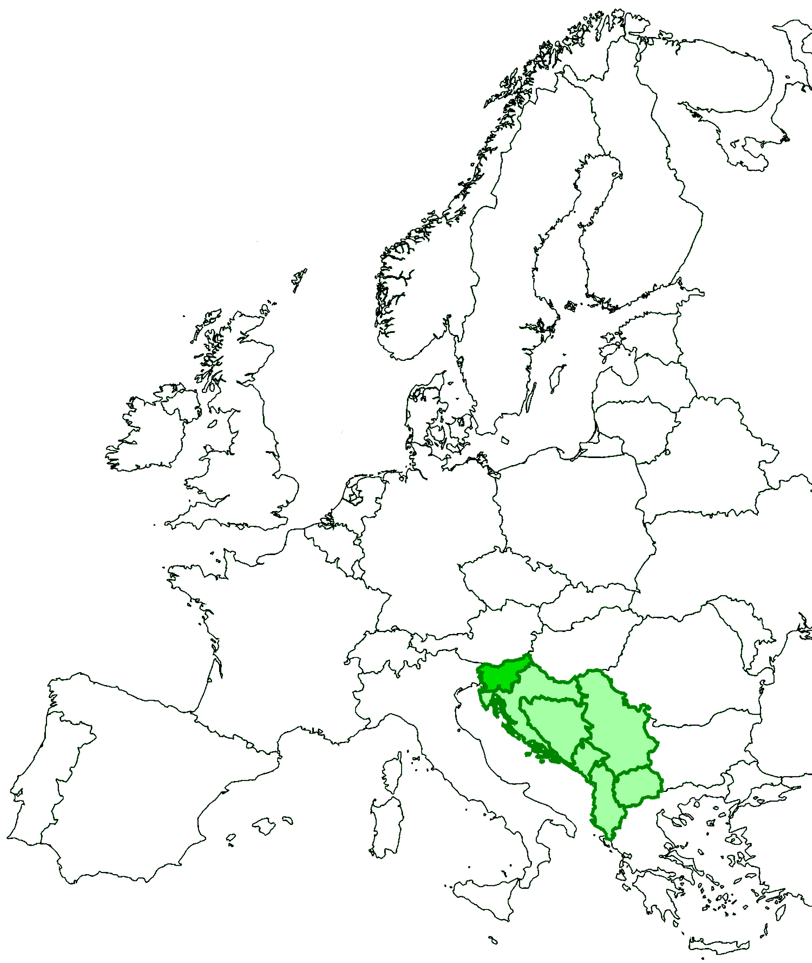
Pilot study for the Western Balkans
Countries:
Slovenia, Croatia, Montenegro, Serbia, Bosnia & Herzegovina, North Macedonia, Albania
Slovenia
Croatia
Bosnia & Herzegovina
Serbia
Pollutants:
PAHs – B(a)P, B(b)F, B(k)F, I(cd)P, …
Montenegro
North Macedonia
Albania
Phase I (2025-2026):
Country-scale assessment for Slovenia
Exploring possibility to extent the study to other Balkan countries

Slide 9
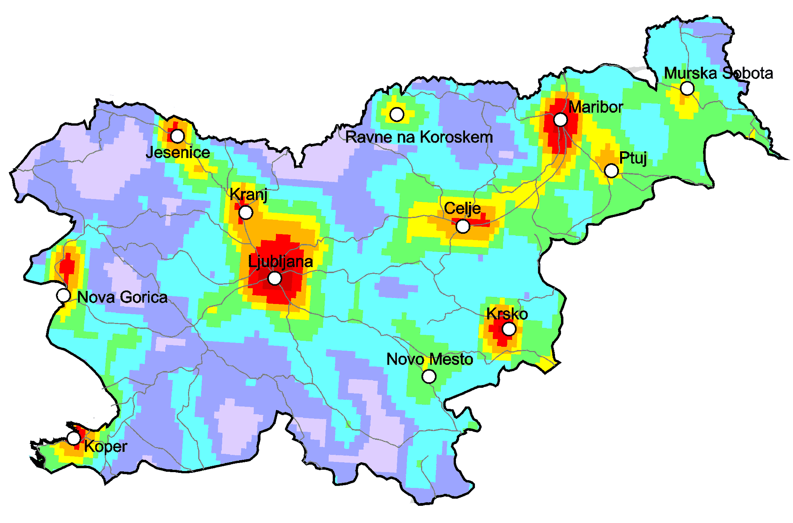
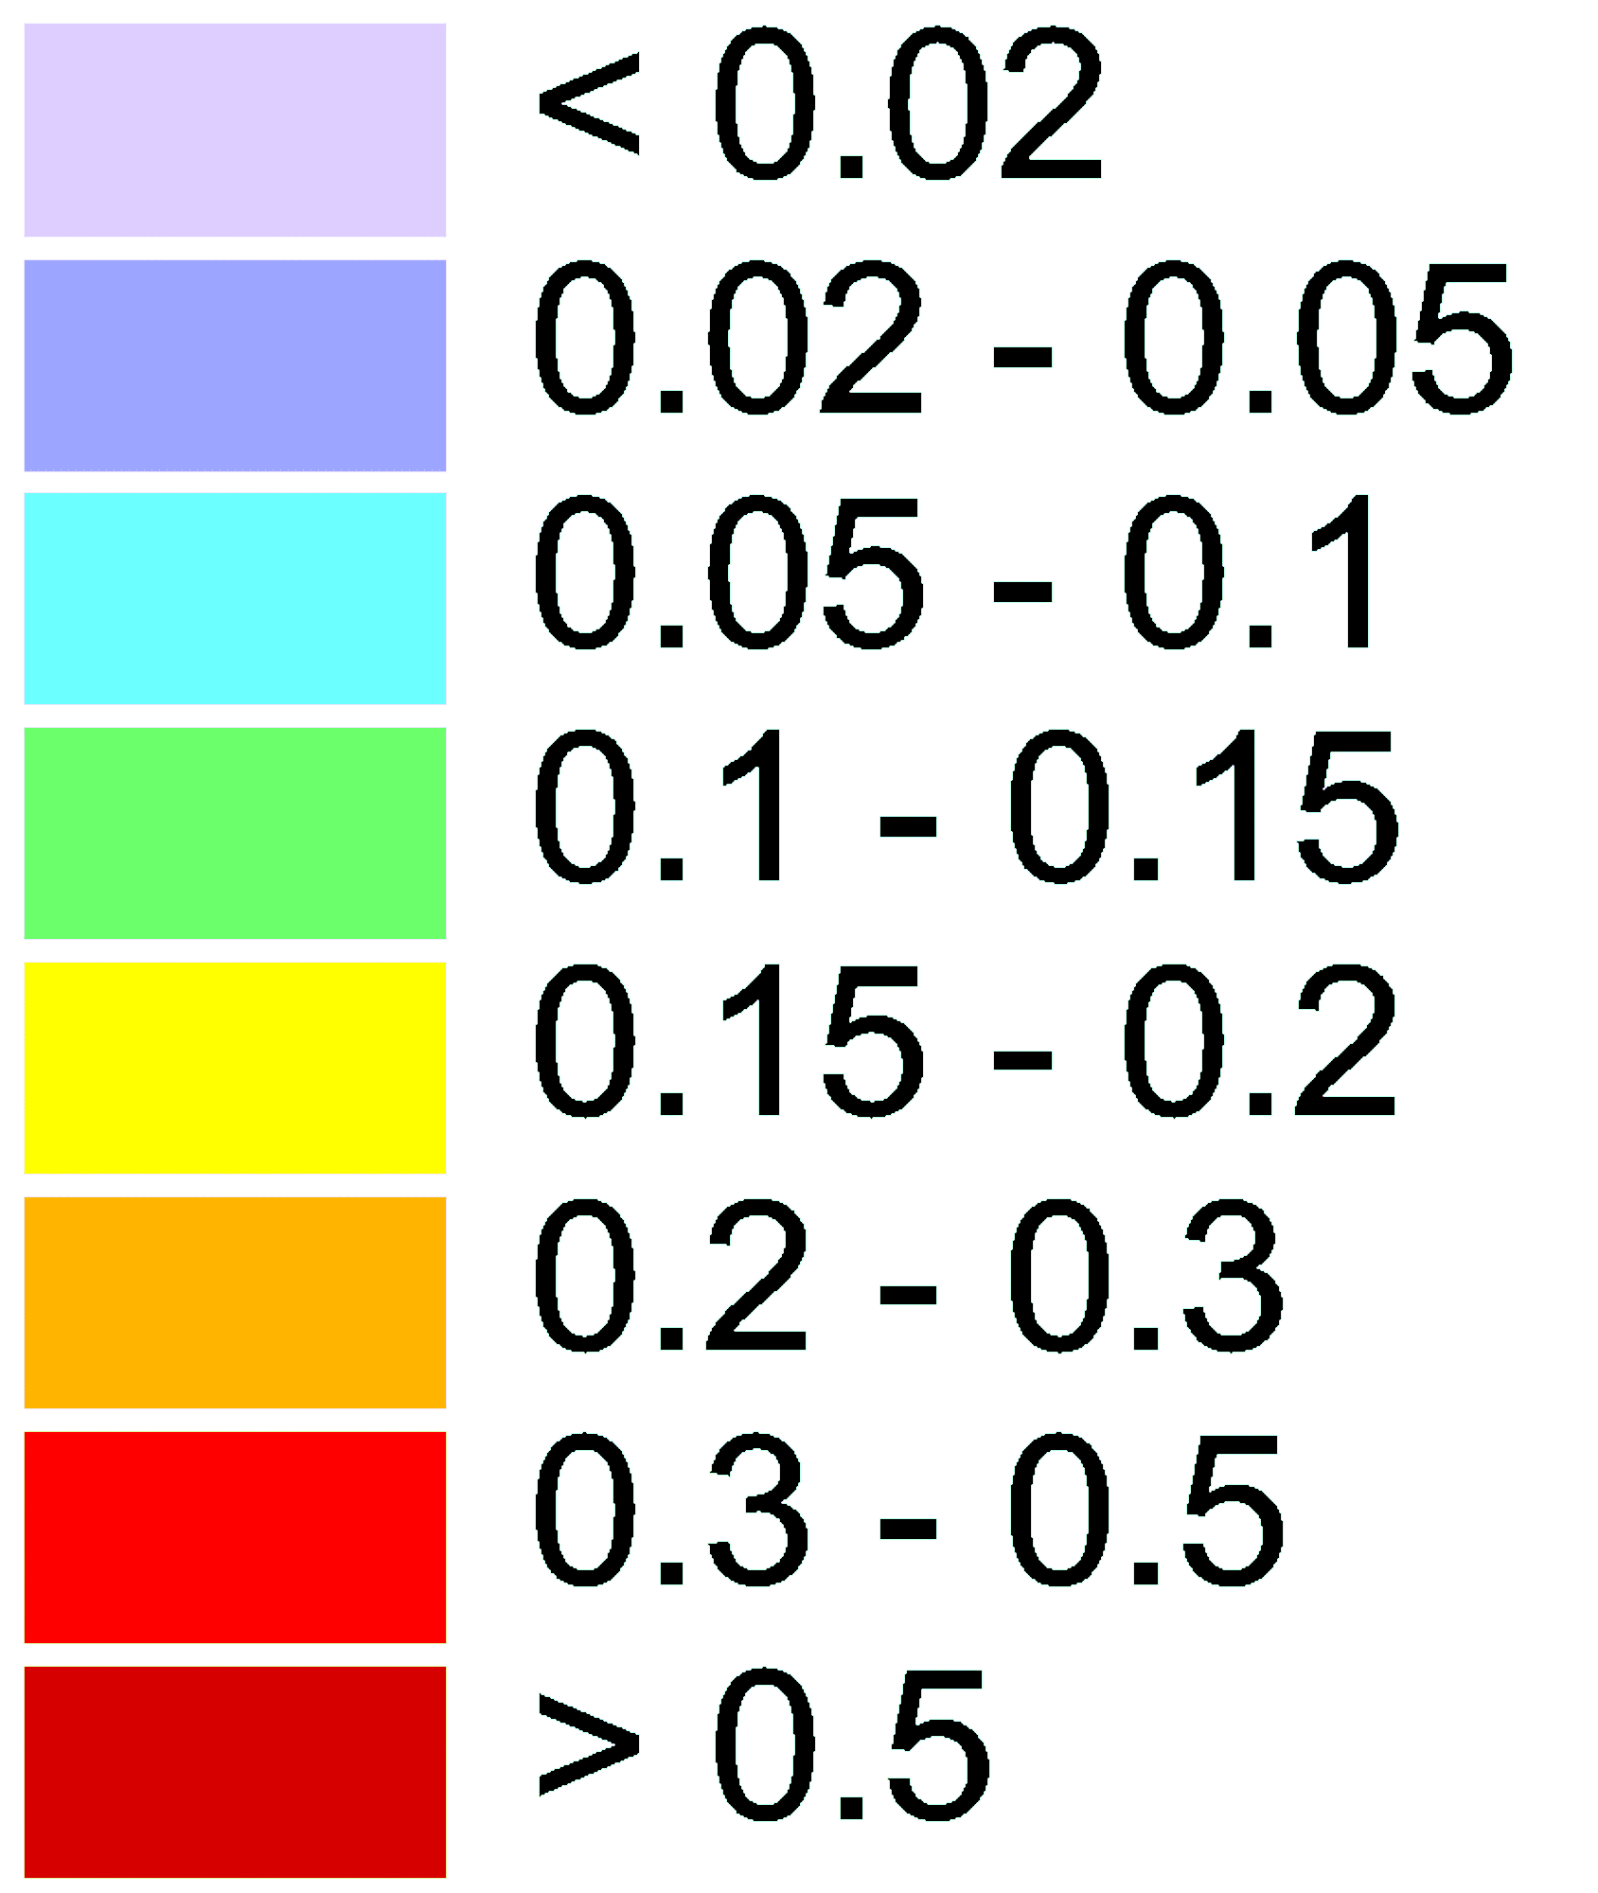
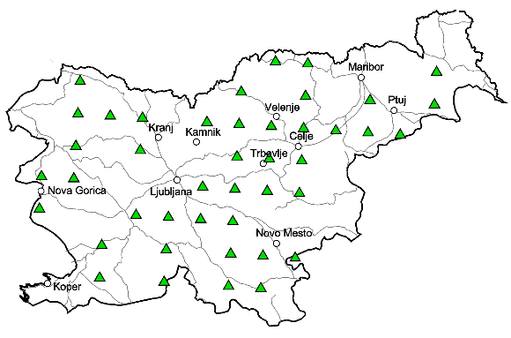
Pilot study: Slovenia
B(a)P emissions in Slovenia (2019)
On-going activities:
Collection of emissions data:
  Fine-resolution national emissions
  Collection of monitoring data:
  Air monitoring (EMEP data, AQ e-Reporting, measurement campaigns - stable isotope composition)
  Moss and lichen archives
Preparation for fine-resolution simulations of PAH levels and source attribution
kg km⁻² y⁻¹
- EMEP site
- AQ e-Reporting
- Field campaign
Moss measurement sites

Slide 10
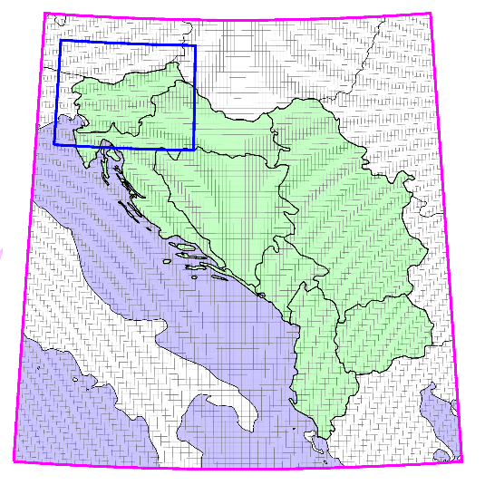
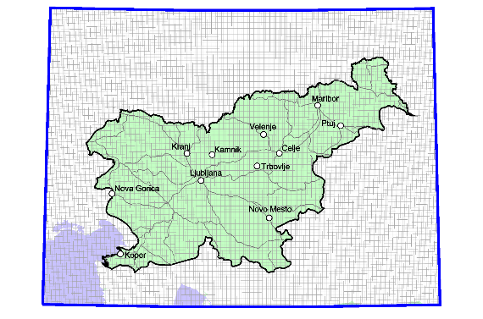
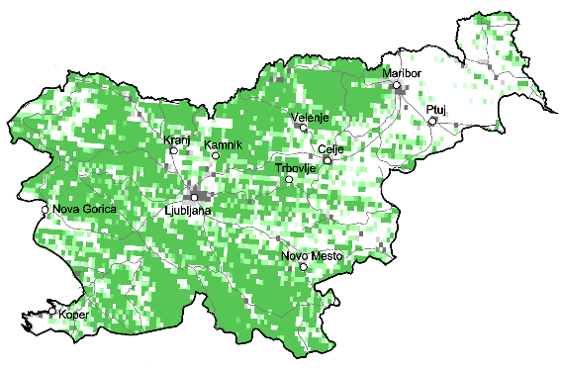
Pilot study: Slovenia
Model domains
Simulations program:
  Two nested domains – Western Balkans (0.1°×0.1°) and Slovenia (0.02°×0.02°)
PAH concentration and deposition patterns, trends
Source-receptor modelling (national vs. transboundary sources, emission sectors, large point sources)
Evaluation vs. observations (air monitoring, mosses/lichens, stable isotopes)
Testing emission scenarios
Slovenia (0.02°×0.02°)
Western Balkans (0.1°×0.1°)
On-going work:
Preparation of the model set-up and input data for modelling (emissions, meteorology, reactants, land cover)
Land cover data for 2020 (forests)

Slide 11
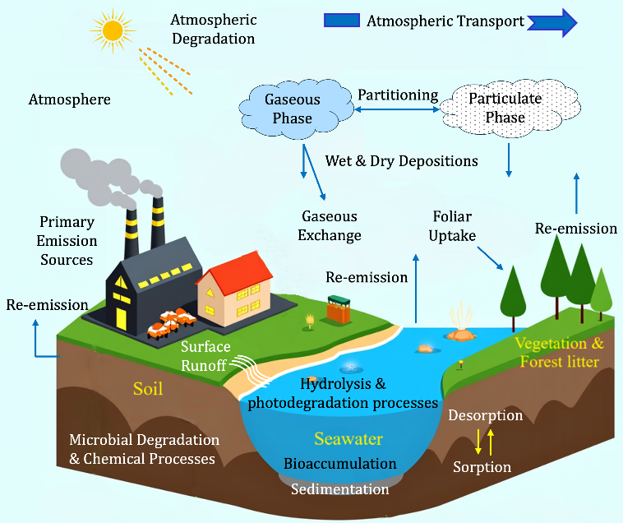
Multi-media POP simulations
Unintentional POPs:
Hexachlorobenzene (HCB), Polychlorinated biphenyls (PCBs), Polychlorinated dibenzo-p-dioxins and dibenzofurans (PCDDs/PCDFs)
POP cycling among environmental compartments
Peculiarities and uncertainties:
Inter-media cycling and accumulation in environmental compartments
  Lack of emissions data (incomplete emissions reporting, no congener composition, limited historical data)
  Complex mixtures with diverse properties of congeners
  Poorly known processes in environmental media

Slide 12
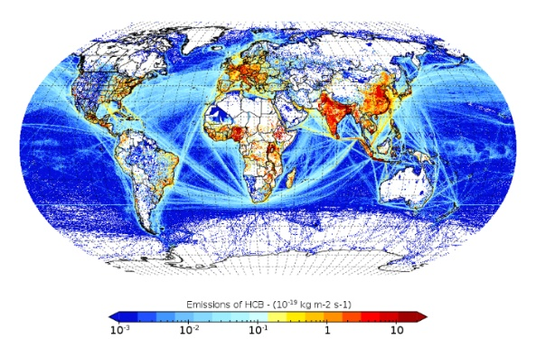
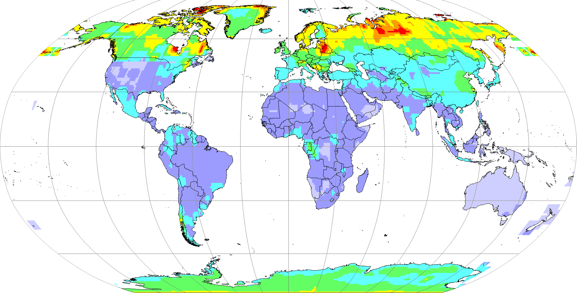
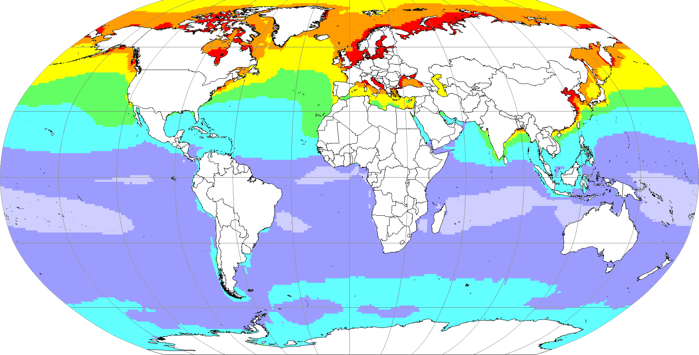
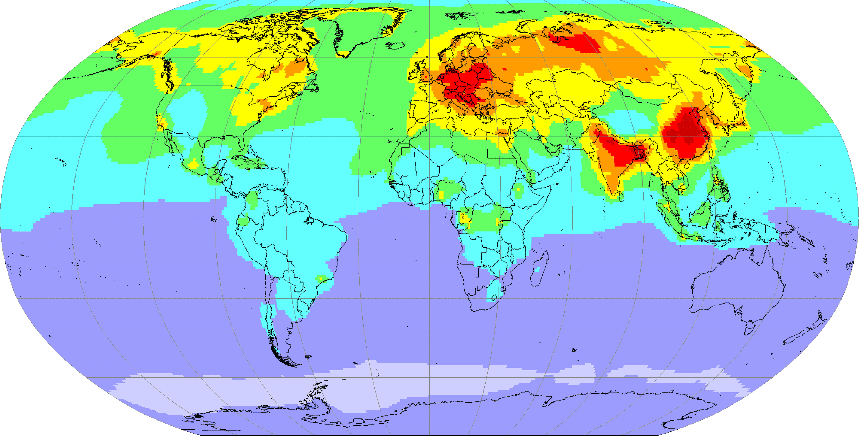
Multi-media POP simulations
HCB emissions in 2015 (EDGAR v6.0)
Current development activities:
  Revising GLEMOS parameterisations of POP multi-media processes
  Testing global emissions inventories (EDGAR, PKU-LZU)
  Conducting long-term historical simulations to evaluate accumulation in media
HCB multi-media simulations
Soil
Future research:
Update of GLEMOS parameterisations of POP chemical degradation in the atmosphere
Co-operation with TF HTAP on the HTAP Fires project (wildfires effects on PAH and PCDD/Fs pollution)
Water
Air
0
3
5
9
12
18
25
35
pg m⁻³

Slide 13
Proposals for Workplan 2026-2027
Process studies and model development
Study of Hg heterogeneous processes and influence of dust pollution events on Hg chemistry (cooperation with JSI)
Revision and re-evaluation of gas-particle partitioning and chemical degradation of POPs in the atmosphere
Co-operation with TFMM
  A pilot study of PAH pollution in the Western Balkans
  Study of natural sources of atmospheric PM and its chemical composition (including metals and POPs)
Co-operation with TF HTAP
  Multi-model assessment and attribution of Hg trends (MCHgMAP, phase II)
  Multi-model, multi-pollutant study of fire impacts (HTAP Fires)

Slide 14
Proposals for Workplan 2026-2027
Co-operation with WGE
  Joint analysis of moss measurement data on heavy metals and PAHs (ICP-Vegetation)

