Slide 1


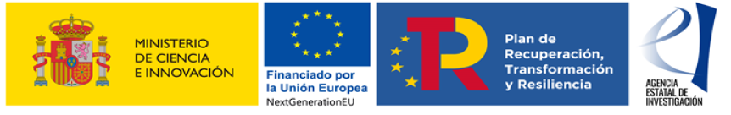

TFMM meeting May 2023, Warsaw (Poland)
On the challenges of assessing the effects of emissions reductions on air quality: a modelling and an observational analysis for the COVID-19 case study
Marta G. Vivanco, Mark R. Theobald, Coralina Hernández, Juan Luis Garrido, Victoria Gil, Alejandro Rodríguez, Fernando Martín
Carlos Ordóñez, José Manuel Garrido
Marc Guevara, Hervé Petetin

Slide 2
BOO: Based On Observations
Outline
Challenging study for O3
Description of the methodologies to estimate impacts
Before impacts… ¿How well do the BOO approaches perform (“Evaluation” of BOO-methodologies)
Comparison of impacts from 3 BOO methods + model in Spain
Comparison of impacts from 2 BOO methods + model in Europe. Different metrics for ozone
Impact: Effect of emission reduction on air concentration

Slide 3
Impacts of emission reductions from observations
Impacts
Concentration
?
5 Previous years
  Mean
  GAM
  ML
BOO
2015
Concentration
BAU
2016
2020
2020
2017
meteorology
2018
2020
2019
meteorology
GAM: Ordóñez et al.
ML: Petetin et al.; Querol et al.
Vivanco et al. 2023, in progress

Slide 4
GAM
(Generalised Additive Model)
GBM/ML
(Gradient Boosting Machine, ML model based on decision trees)
AQ e-Reporting
(hourly values)
O₃: max8hd
NO₂: mhd
All sites
O₃: maxhd, max8hd, mhd
NO₂: maxhd, mhd
Sites in metropolitan areas of Spain
(Rural+urban background+industrial+traffic)
Daily mean air temperature at 2m, minimum and maximum 2m temperature
Daily mean fields of the zonal and meridional wind component at 10m
Surface pressure
Total cloud cover
Net solar radiation at the surface
Downward solar radiation at the surface
Downward UV radiation at the Surface
Boundary layer height
Daily maximum air temperatura at 2m
Daily mean fields of the zonal and meridional wind component at 10m
500 hPa geopotential height
2m specific humidy
Downward solar radiation flux
Daily accumulated precipitation
ERA5
Synoptic situation
Weekday
Date index
Julian date
Weekday
Model Training
(per pollutant, metric, site)
ERA5 2020
Predicted 2020 concentration

Slide 5
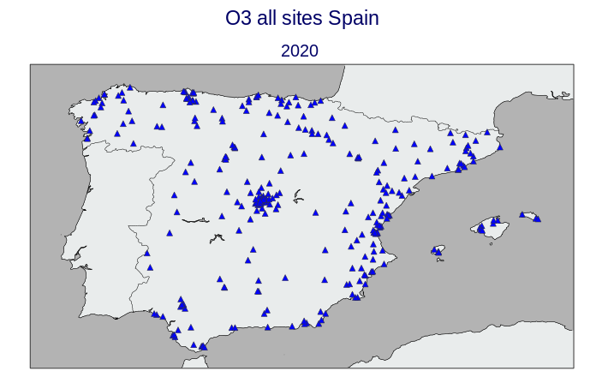
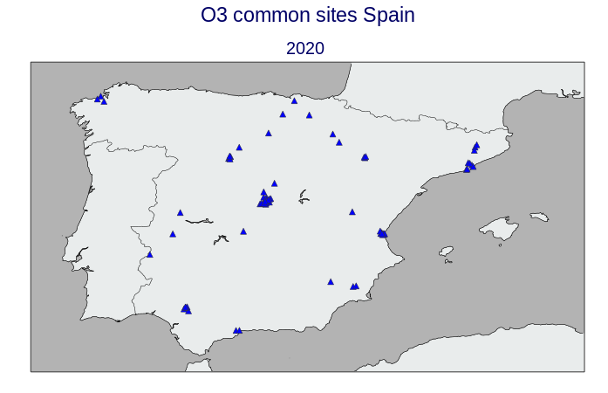
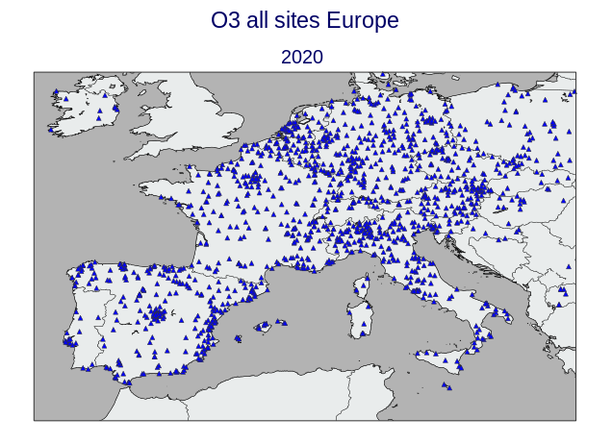
GAM & MEAN
GBM/ML

Slide 6
CHIMERE model
  European domain 0.15ºx0.15º
  Spanish domain: 0.05ºx0.05º
  2020 Ecmwf meteorology
  Emissions:
Simulation “BAU” 2020
Simulation 2020 (COVID)
2018
2018
Reductions applied to 2018
Guevara et al. 2021
Vivanco et al. 2023, in progress

Slide 7
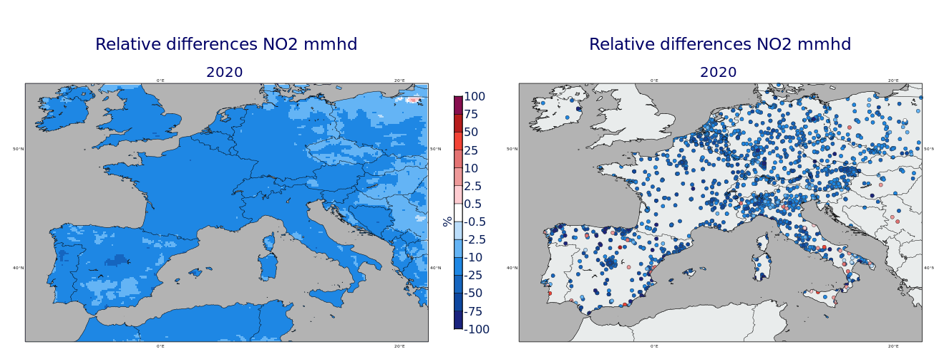
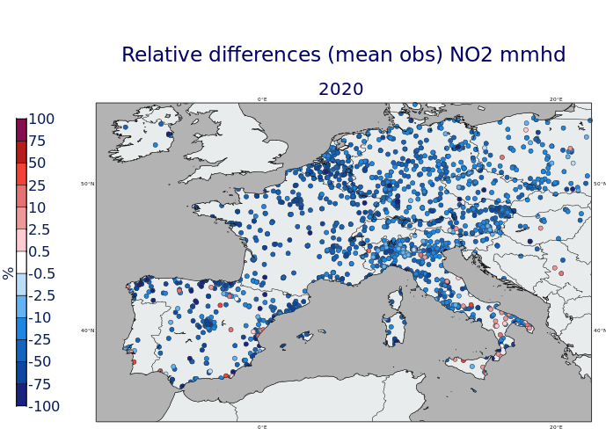
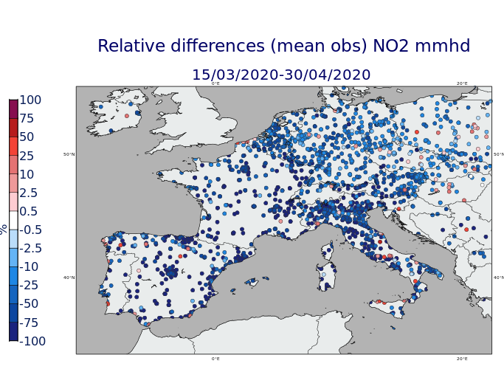

2020
NO₂: mean
All sites
CHIMERE
GAM
MEAN OBS
Quite good agreement between BOO methods, and between them and the CTM
15/03/ → 30/04
CHIMERE
GAM
MEAN OBS

Slide 8
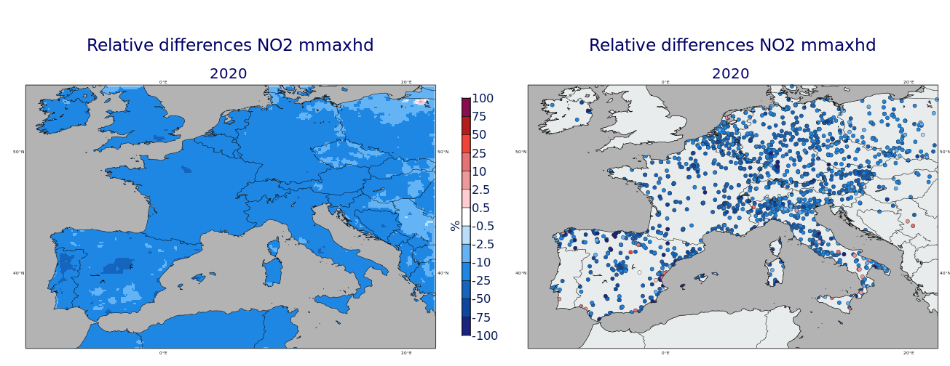
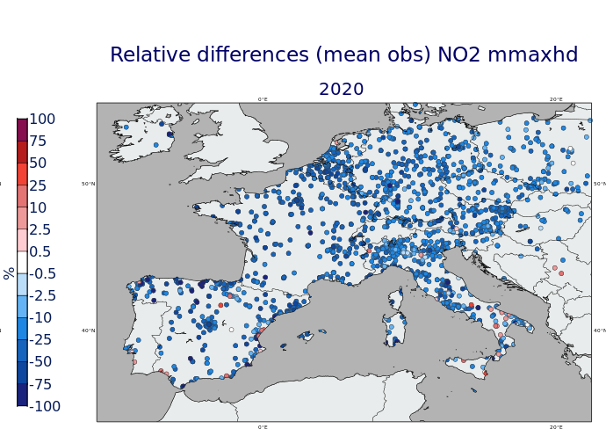

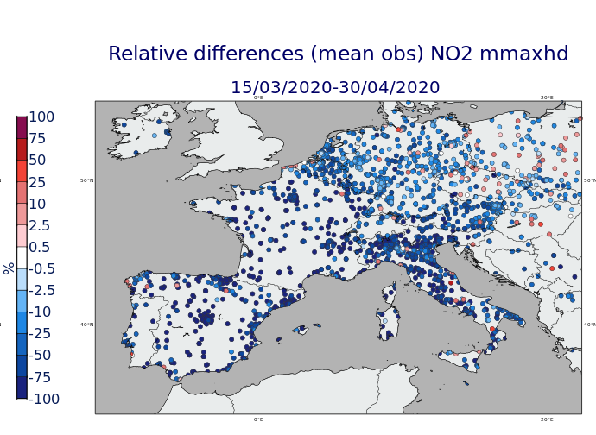
2020
NO₂: mean of máximum values
All sites
CHIMERE
GAM
MEAN OBS
15/03/ → 30/04
CHIMERE
GAM
MEAN OBS

Slide 9
O3
How would the GAM perform, for example to estimate 2019? Or how well could the 2014-2018 mean be used as a guide for 2019 real conc.?
Concentration
Similar procedure to obtain 2019 concentration
  Mean
  GAM
5 Previous years
2014
Concentration
BAU
2015
2019
2019
2016
meteorology
+
Jan, Feb 2020
+
Jan, Feb 2020
2017
2018
“BAU” year
Vivanco et al. 2023, in progress

Slide 10
How would the GAM perform, for example to estimate 2019? Or how well could the 2014-2018 mean be used as a guide for 2019 real conc.?
Concentration
Similar procedure to obtain 2019 concentration
  Mean
  GAM
  ML
5 Previous years
2014
Concentration
BAU
2015
Jan,Feb 2020
2020
2016
Jan, Feb 2020
meteorology
2017
Jan, Feb, 2020
“BAU” period
2018
meteorology
Jan,Feb
Vivanco et al. 2023, in progress

Slide 11
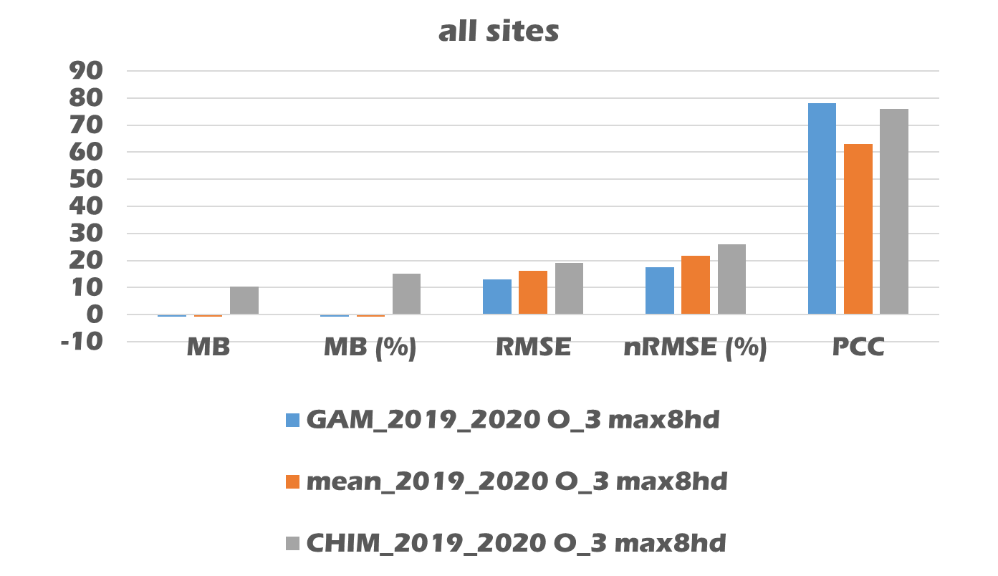
O3: “Evaluation” of the methods
2019
+
Jan, Feb 2020
PCC: Pearson Correlation Coefficient (R)
/Spain
Jan, Feb 2020
The evaluation metrics for all the methods are reasonably good to estimate “BAU” scenarios

Slide 12
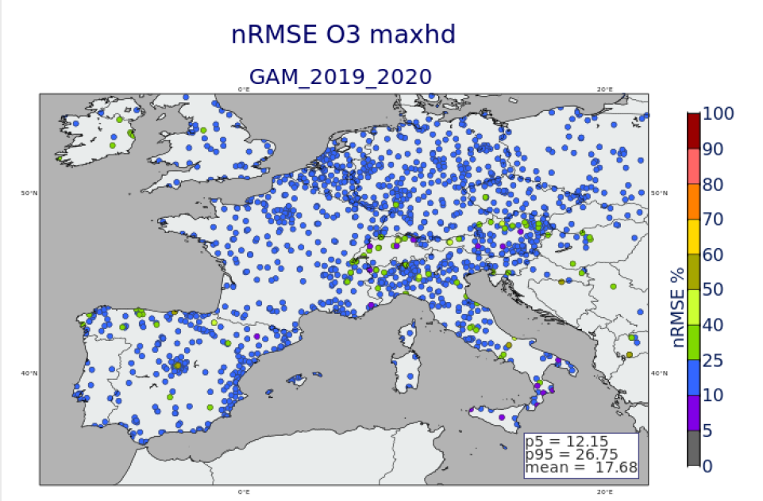
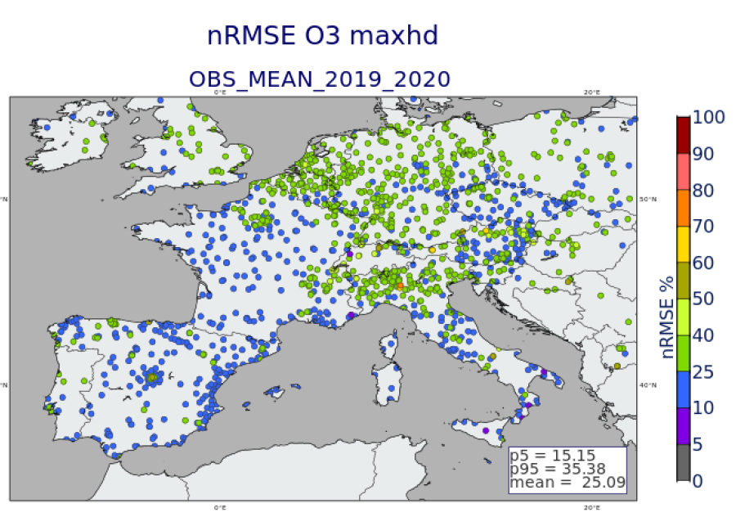
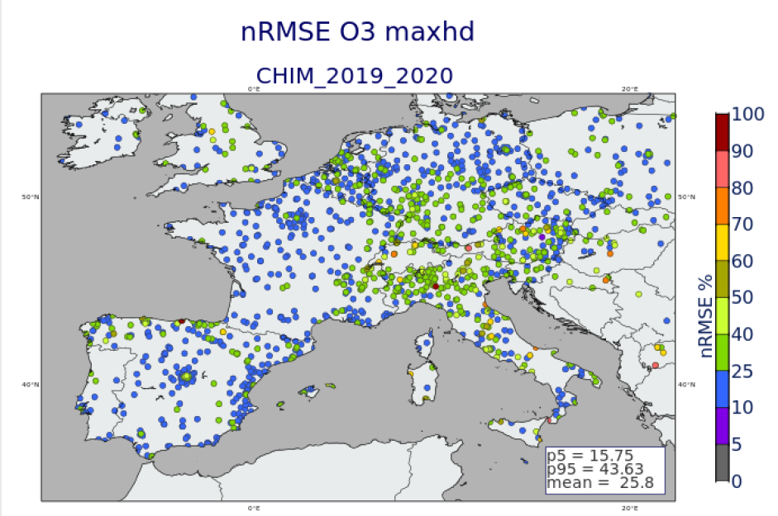
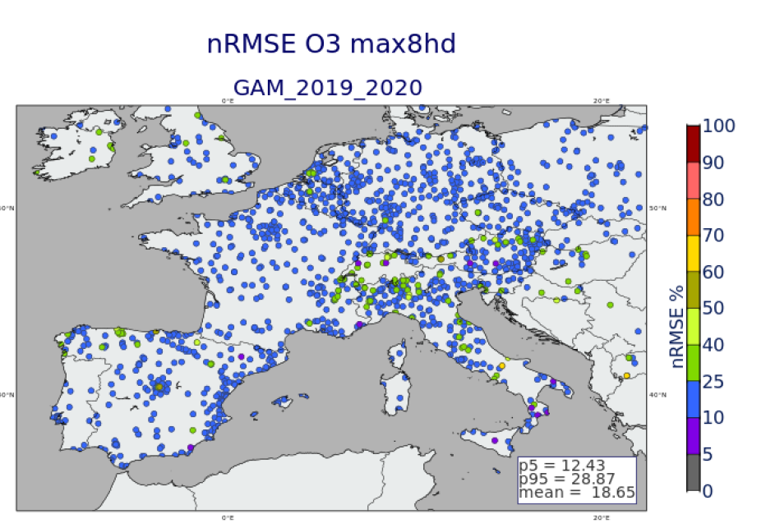
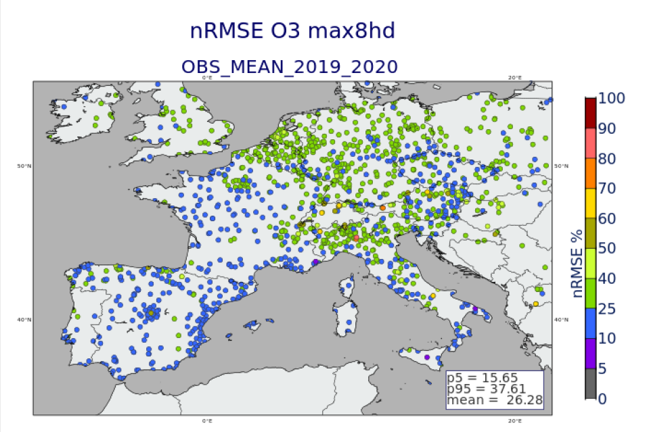
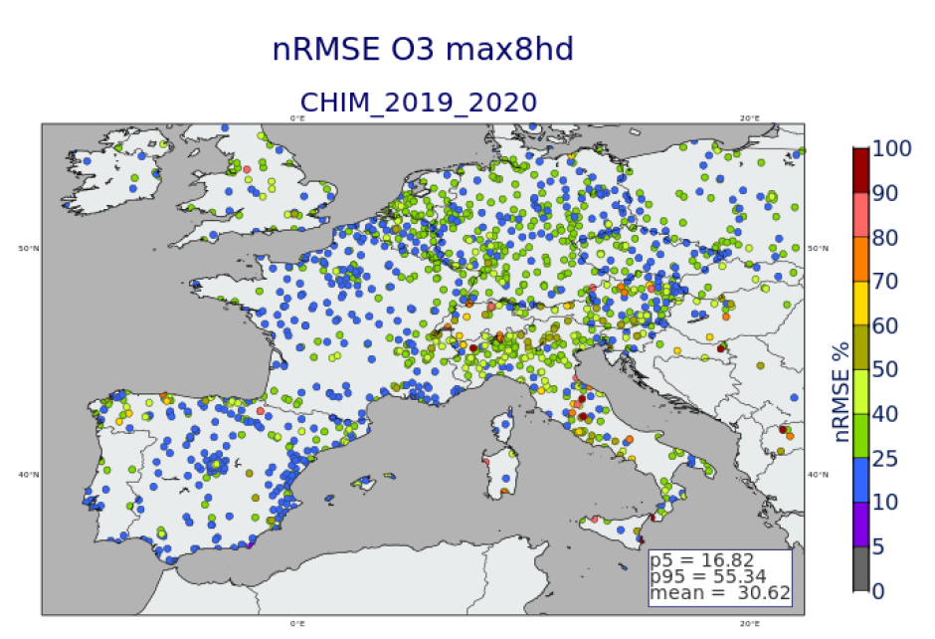
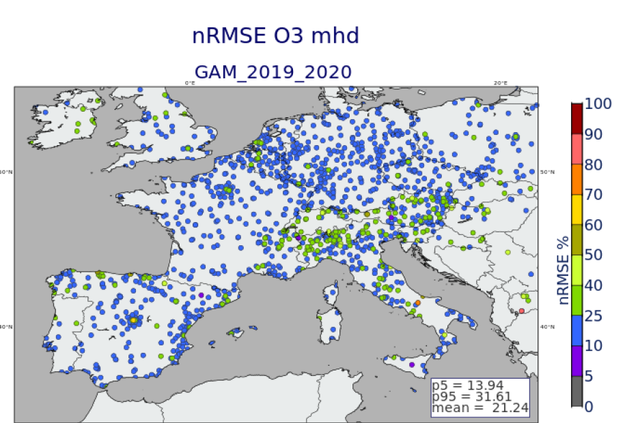
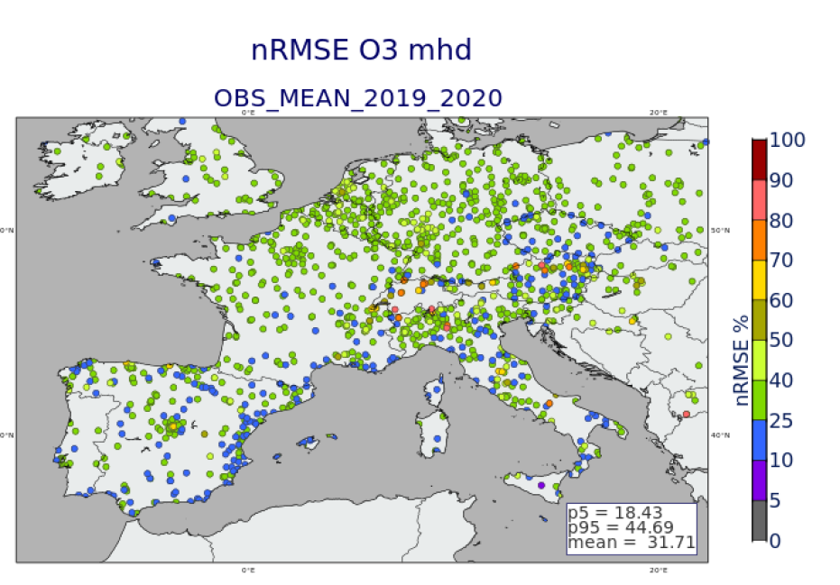
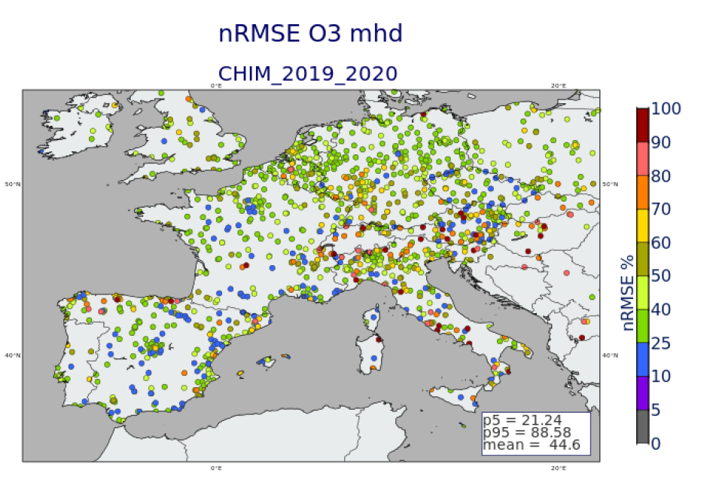
nRMSE
MEAN
CHIMERE
maxhd
GAM
max8hd
mhd

Slide 13
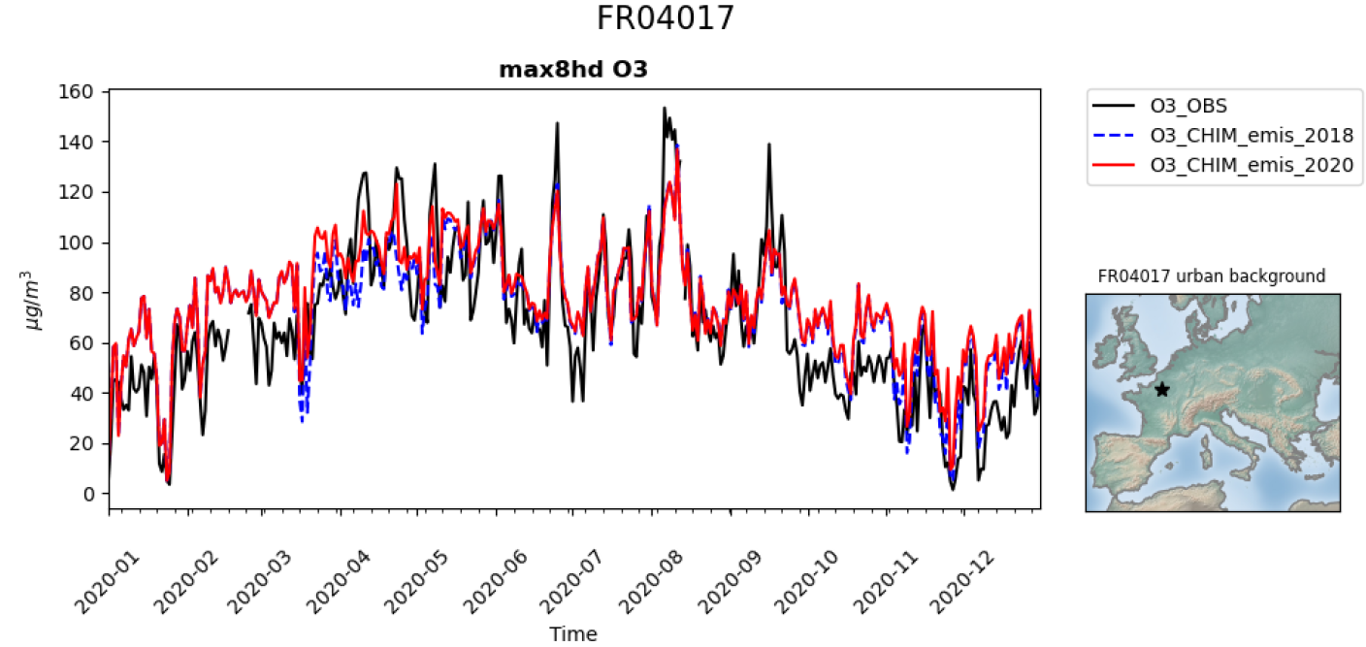
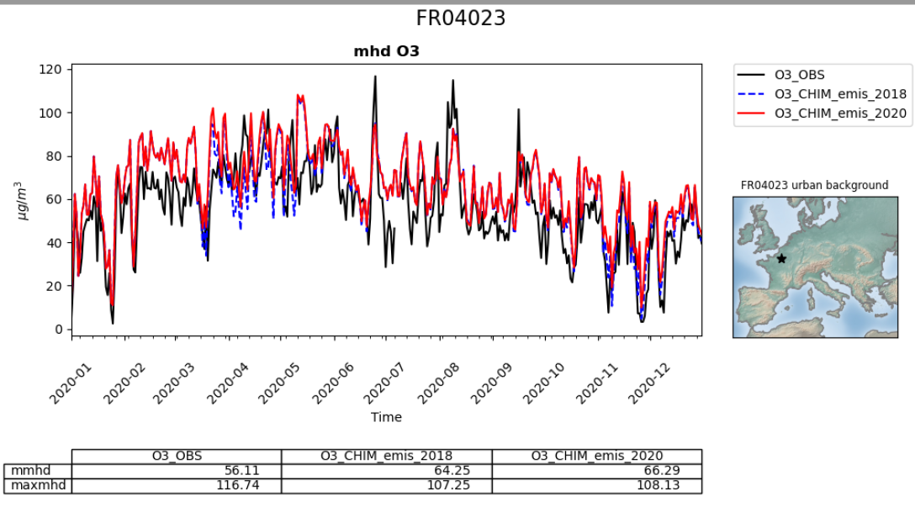
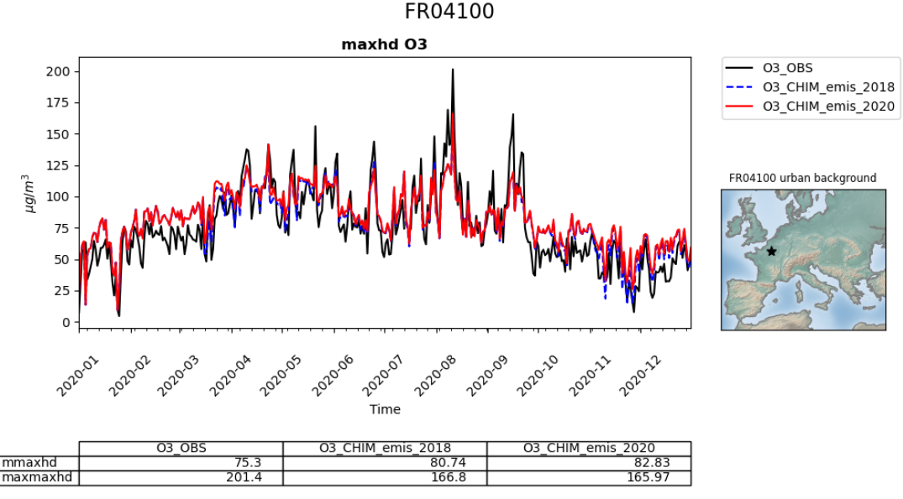

Slide 14
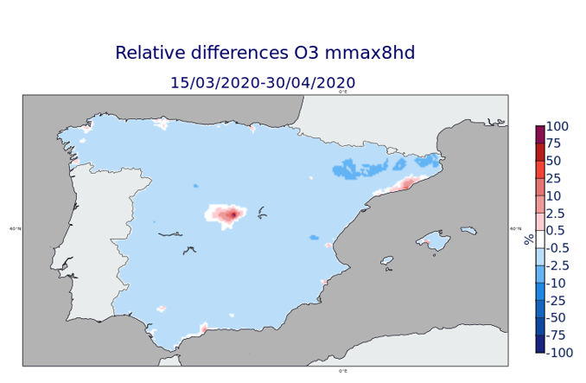
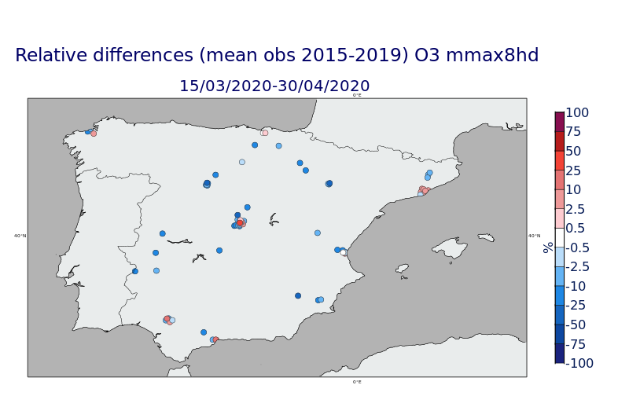
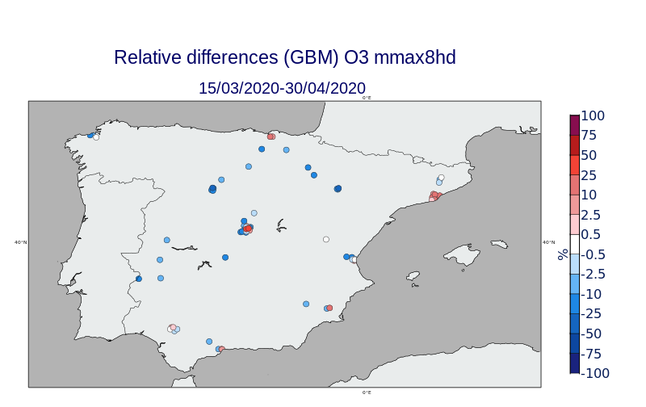
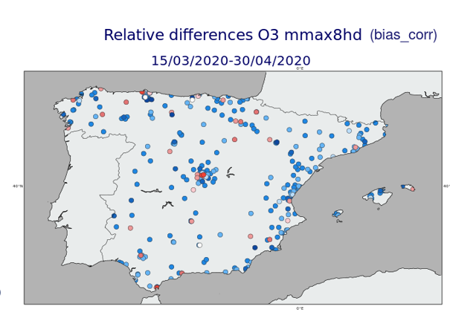
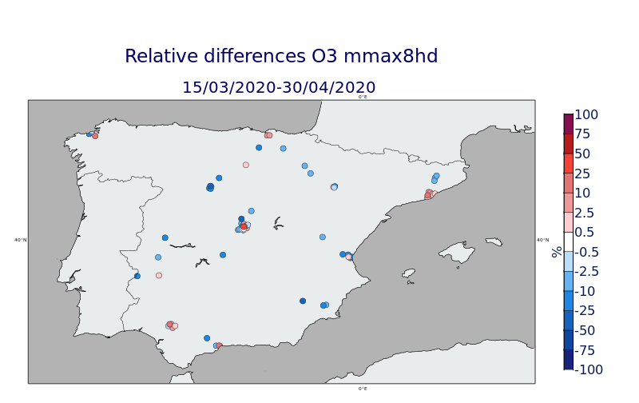
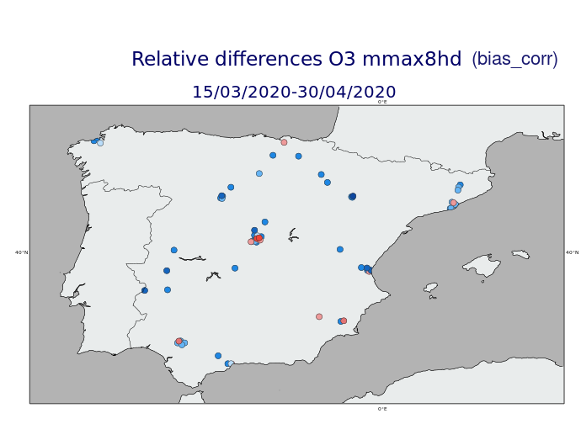
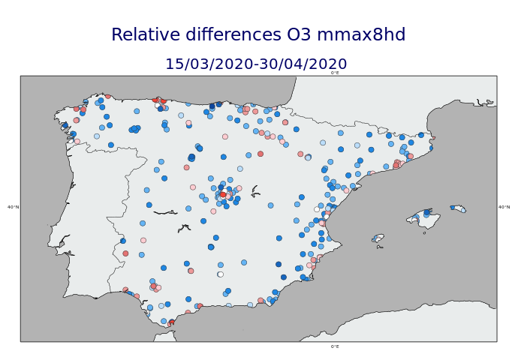
Mean of max8hd “mmax8hd”
CHIMERE
MEAN
ML
GAM
GAM
“corr” GAM

Slide 15
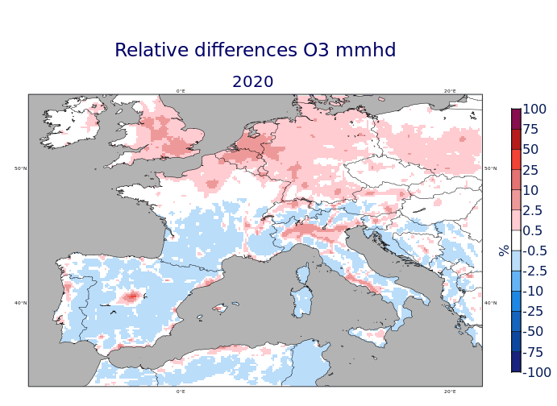
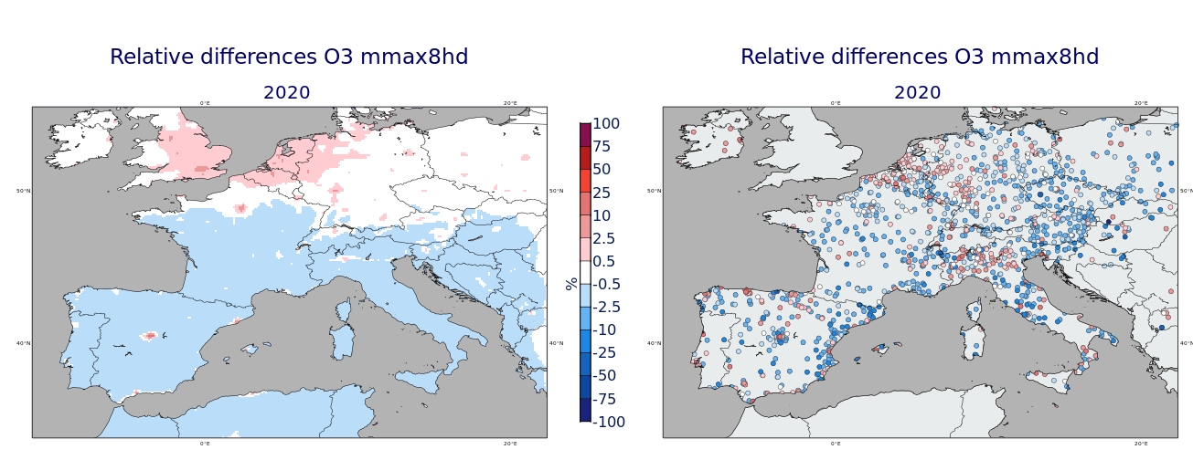
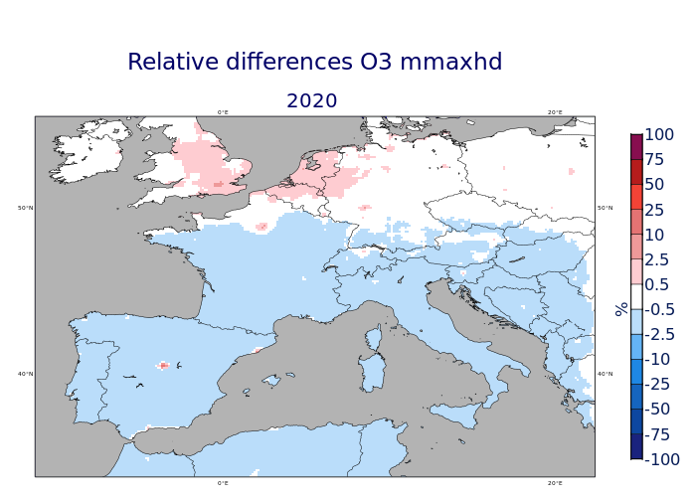
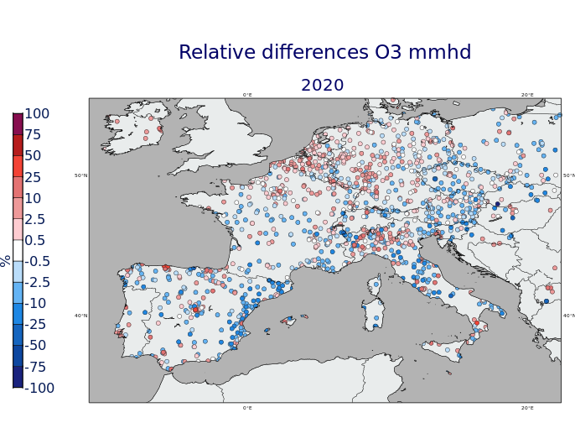
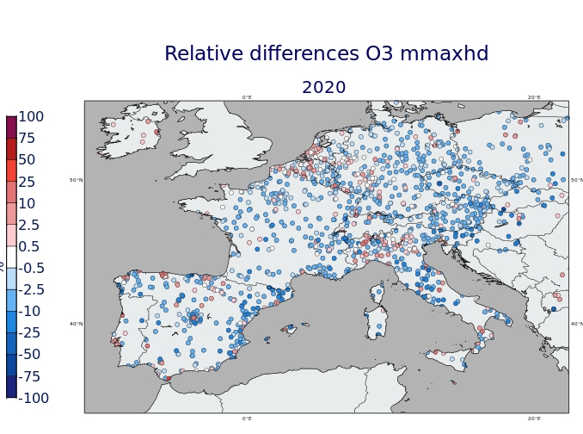
Relative Differences (2020)
mhd
Max8hd (mean)
Maxhd (mean)
GAM
GAM
GAM

Slide 16
Some conclusions
BOO methods are useful to estimate past reduction impacts, although they should take into account the meteorology.
Air quality models (the only tool for estimating future emission reduction impacts) can also be used, considering their uncertainties (some sites are poorly estimated).
Important to consider uncertainties in order to know where the estimate of impacts is robust (sometimes uncertainties can be higher than the estimated impacts)
Methods are better at representing high concentration metrics (maxh, max8h) than anual mean values.
BOO methods seem to confirm the tendency in the model to estimate increases of O₃ for metrics based on all hourly values (winter, nights, with more titration), and decreases for the máximum values (maxh)

Slide 17
TFMM meeting May 2023, Warsaw (Poland)
Thank you!
Acknowledgements:
Many thanks to Ministerio para la Transición Ecológica y el Reto Demográfico/ Ministry for the Ecological Transition and Demographic Challenge, Spain for supporting this study
Project TED2021-132431B-I00 (TRANSAIRE: Transition to cleaner air in Spain) funded by MCIN/AEI/ 10.13039/501100011033 and by the European Union NextGenerationEU/PRTR
References
Carlos Ordóñez, Jose M. Garrido-Perez, Ricardo García-Herrera (2020) , Early spring near-surface ozone in Europe during the COVID-19 shutdown: Meteorological effects outweigh emission changes Science of the Total Environment 747 (2020) 141322
Guevara, M., Jorba, O., Soret, A., Petetin, H., Bowdalo, D., Serradell, K., Tena, C., Denier van der Gon, H., Kuenen, J., Peuch, V.-H., and Pérez García-Pando, C.: Time-resolved emission reductions for atmospheric chemistry modelling in Europe during the COVID-19 lockdowns, Atmos. Chem. Phys., 21, 773–797, https://doi.org/10.5194/acp-21-773-2021, 2021
Alejandro Rodríguez-S ́anchez *, Marta G. Vivanco, Mark Richard Theobald, Fernando Martín. Estimating the effect of the COVID-19 pandemic on pollutant emissions in Europe. Atmospheric Pollution Research 13 (2022) 101388.
H. Petetin, D. Bowdalo, A. Soret, M. Guevara, O. Jorba, K. Serradell, and C. P´erez Garc´ıa-Pando. Meteorology-normalized impact of the covid-19 lockdown upon NO2 pollution in spain. Atmospheric Chemistry and Physics, 20(18):11119–11141, 2020.
Querol, X. Jordi Massagu´e, Andr´es Alastuey, Teresa Moreno, Gotzon Gangoiti, Enrique Mantilla, Jos´e Jaime Du´eguez, Miguel Escudero, Eliseo Monfort, Carlos P´erez Garc´ıa-Pando, Herv´e Petetin, Oriol Jorba, V´ıctor V´azquez, Jes´us de la Rosa, Alberto Campos, Marta Mu˜n´oz, Silvia Monge, Mar´ıa Herv´as, Rebeca Javato, and Mar´ıa J. Cornide. Lessons from the covid-19 air pollution decrease in spain: Now what? Science of The Total Environment, 779:146380, 2021.

