Slide 1










SCIENTIFIC BASIS FOR A SPANISH OZONE ABATEMENT PLAN
X. Querol¹, A. Alastuey¹, J. Massagué¹, A. Canals¹, N. Pérez¹, C. Reche¹, M. in ‘t Veld¹,
M. Guevara², H. Petetin², R. Garatachea², K. Oliveira², F. López², O. Jorba², C. Pérez García-Pando²,
G. Gangoiti³, E. de la Torre³
E.Mantilla⁴, J.J.Diéguez⁴, A. Muñoz⁴, E. Borras⁴, T. Vera⁴, M.Millán⁴,
M.Escudero⁵,
E. Monfort⁶, I. Celades⁶, V. Sanfelix⁶, A. López-Lilao⁶,
J. de la Rosa⁷, A. Sánchez de la Campa⁷,
C. Alves⁸
S. Monge⁹, M. Muñoz⁹, M.J. Alonso⁹, I. Mirón⁹
¹Instituto de Diagnóstico Ambiental y Estudios del Agua (IDAEA-CSIC), Barcelona, Spain
²Department Earth Sciences, Barcelona Supercomputing Centre (BSC), Barcelona, Spain
³E.T.S. Ingeniería de Bilbao, Dpto. Ingeniería Química y del Medio Ambiente, Universidad País Vasco UPV/EHU, Bilbao, Spain
⁴Centro de Estudios Ambientales del Mediterráneo, CEAM, Unidad Asociada al CSIC, Valencia, Spain
⁵Departamento Física Aplicada, Escuela Politécnica Superior, Universidad de Zaragoza, Spain
⁶Instituto de Tecnología Cerámica, Universitat Jaume I (ITC-UJI), Castelló, Spain
⁷Departamento de Ciencia de la Tierra, Universidad de Huelva (UHU), Spain
⁸Universidade de Aveiro (UA), Portugal
⁹Ministerio para la Transición Ecológica y el Reto Demográfico
O₃ (µgm⁻³)
TFMM 12 May 2023

Slide 2
1. Assessment of current (2015-2019) situation and trends (2008-2021)
2. Phenomenology of O₃ pollution episodes
3. Regionalisation of the O₃ pollution
4. VOCs and maximum O₃ formation potential in hotspot basins
5. Modelling and sensitivity analysis for three type of scenarios
This talk
Next talk by O. Jorba

Slide 3
CURRENT SITUATION (2015-2019) & TRENDS (2008-2021)
364 AQMS 2015-2019, 311 AQMS 2008-2019
AEMET 2018
KÖPPEN CLIMATE
HOURS INSOLATION
RAINFALL
MAXIMUM TEMPERATURE
Massagué et al.., 2023 Environment International

Slide 4
CURRENT SITUATION (2015-2019) & TRENDS (2008-2021)
2008-2019 TRENDS O₃ MEAN APRIL-SEPT
Massagué et al.., 2023 Environ Int
O₃ MEAN APRIL-SEPT 2015-2019

Slide 5
CURRENT SITUATION (2015-2019) & TRENDS (2008-2021)
2008-2019 SOMO35
SOMO35 2015-2019
Massagué et al.., 2023 Environ Int

Slide 6
CURRENT SITUATION (2015-2019) & TRENDS (2008-2021)
EXCEEDANCES/YEAR 120 DM8h 2015-2019
Massagué et al.., 2023 Environ Int
2008-2019 EXCEEDANCES/YEAR 120 DM8h

Slide 7
CURRENT SITUATION (2015-2019) & TRENDS (2008-2021)
2008-2019 4th HIGHEST DM8H
Massagué et al.., 2023 Environ Int
4th HIGHEST DM8H 2015-2019
EVOLUCIÓN 4º SUPERIOR MD8H 2008-2019

Slide 8
CURRENT SITUATION (2015-2019) & TRENDS (2008-2021)
2008-2019 INFORMATION THRESHOLD 180
INFORMATION THRESHOLD 180 2015-2019
Massagué et al.., 2023 Environ Int

Slide 9
CURRENT SITUATION (2015-2019) & TRENDS (2008-2021)
2008-2019 AOT40 VEGETATION
AOT40 VEGETATION 2015-2019
Massagué et al.., 2023 Environ Int

Slide 10
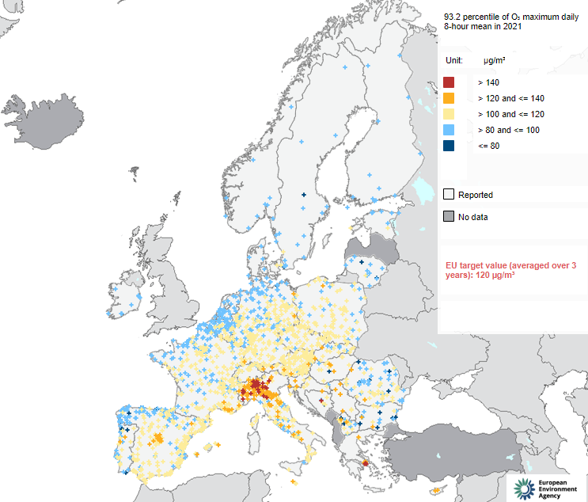

2020 & 2021
O₃, 92.3 percentile 8hDM
2017 2018 2019
2020
2008/EC/50 O3 8hDM
2021 WHO O3 8hDM
Eionet Report – ETC/ATNI 2021/8
https://www.eionet.europa.eu/etcs/etc-atni/products/etc-atni-reports/etc-atni-report-8-2021-status-report-of-air-quality-in-europe-for-year-2020-using-validated-and-up-to-date-data

Slide 11
2020 & 2021
Triennal exceedabces of 120
PERCENTILE 93.2
SOMO35
2020 | 2021
TOTAL 431 | 414
EXCEED 56 | 27
25 MAD | 16 MAD
13 AND | 5 AND
4 CV | 2 CV
4 CLM | 1 CLM
3 CyL | 1 CyL
3 CAT | 1 CAT
2 EXT | 1 EXT
1 PV
1 ARA
EXCEEDANCES 180/SITE/YEAR
N vehicles/day
Barcelona
with respect to
01-13/03/2020

Slide 12
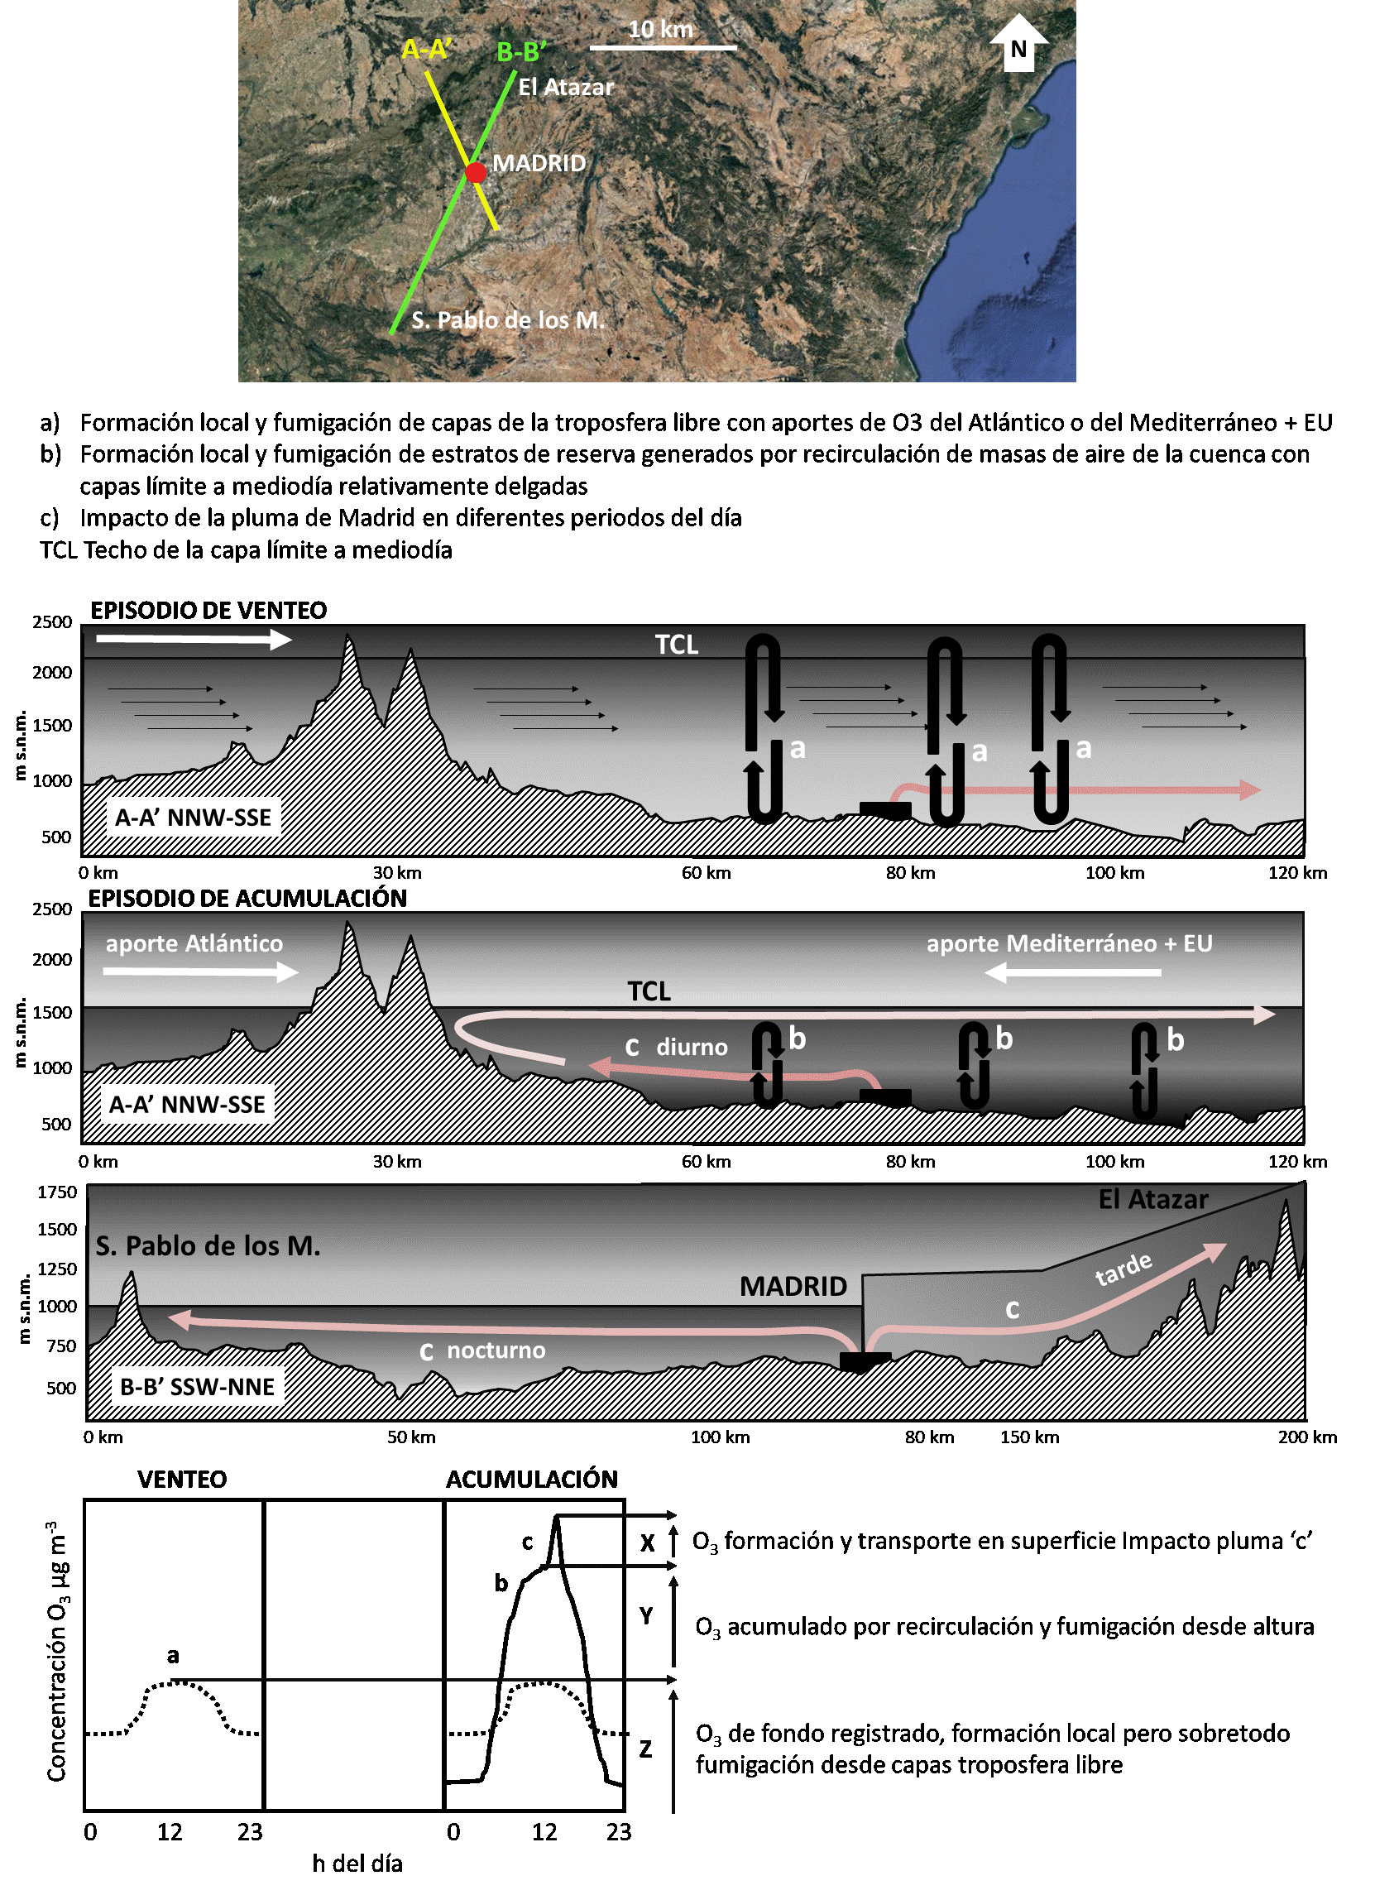
PHENOMENOLOGY OF O₃ EPISODES: MADRID & GUADALQUIVIR BASIN

Slide 13
REGIONALISATION OF THE O₃ POLLUTION
Massagué et al.., 2023 Environment International

Slide 14
REGIONALISATION OF THE O₃ POLLUTION
Massagué et al.., 2023 Environment International

Slide 15
LEVELS OF VOCS & MAXIMUM OZONE FORMATION POTENTIAL
AMBIENT MEASUREMENTS IN JULY

Slide 16
MAXIUM OZONE FORMATION POTENTIAL: AMBIENT MEASUREMENTS IN JULY
TOTAL MO₃FP (µg O₃ m⁻³)
Alkanes
Alkenes
Esters
Alkanes
Aromatics
Terpenes
Ketones
Aldehydes

Slide 17
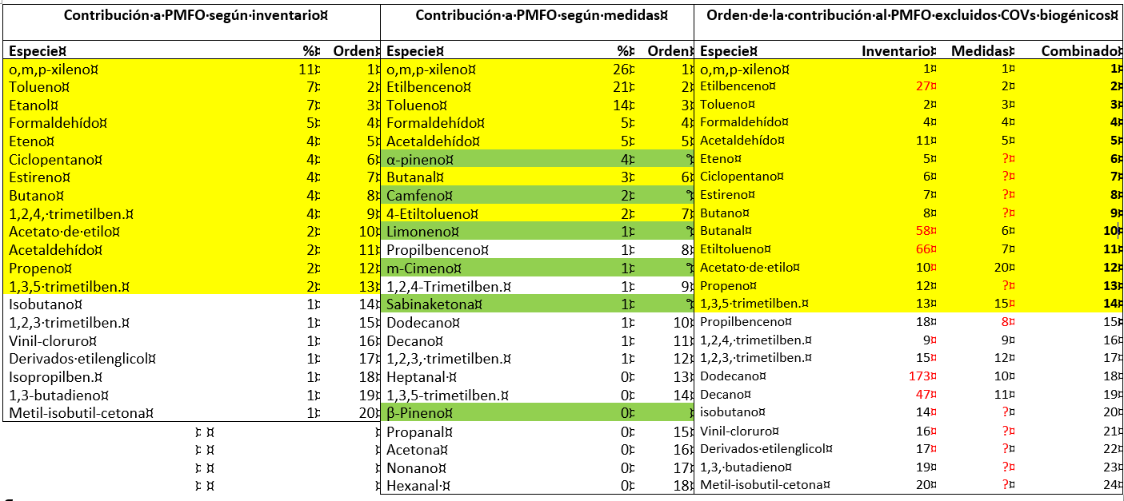
MAXIUM OZONE FORMATION POTENTIAL
AMBIENT MEASUREMENTS IN JULY COMBINED WITH SPECIATED EMISSION INVENTORIES
_{EXAMPLE: MADRID}

Slide 18
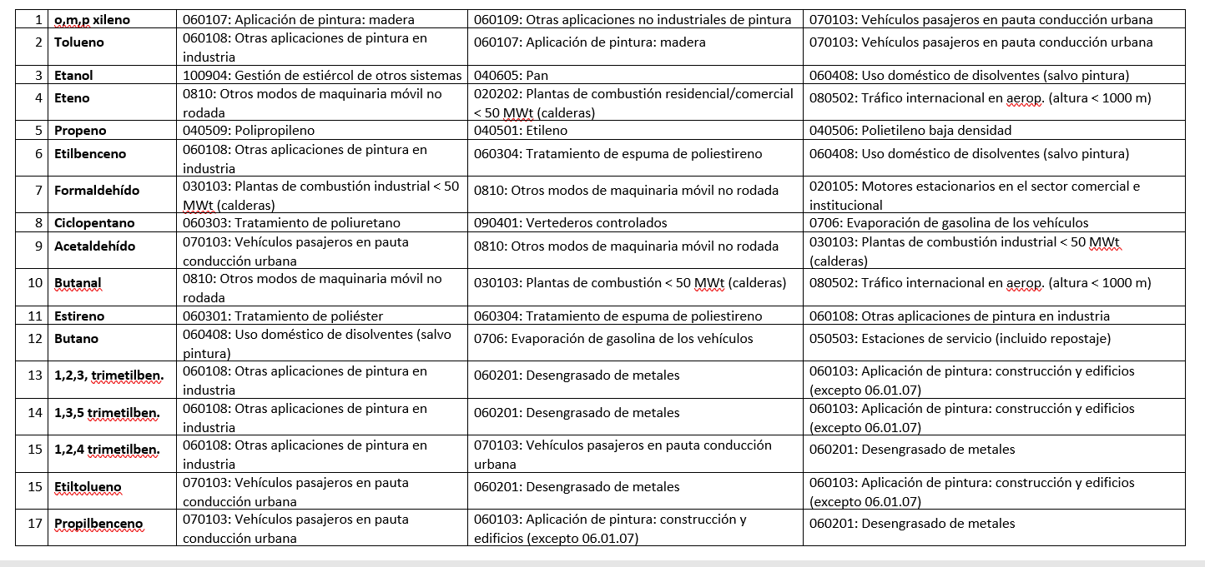
MAXIUM OZONE FORMATION POTENTIAL
AMBIENT MEASUREMENTS IN JULY COMBINED WITH SPECIATED EMISSION INVENTORIES
TARGET VOCs DUE TO THEIR HIGH MO₃FP
o,m,p xylene, toluene, etanol, etene, propene, etilbenzene, formaldehyde, ciclopentane, acetaldehyde, butanal, estirene, butane, 1,2,3, trimethylben., 1,3,5 trimethylben., 1,2,4 trimethylben., ethyltoluene an propilbenzeno

Slide 19
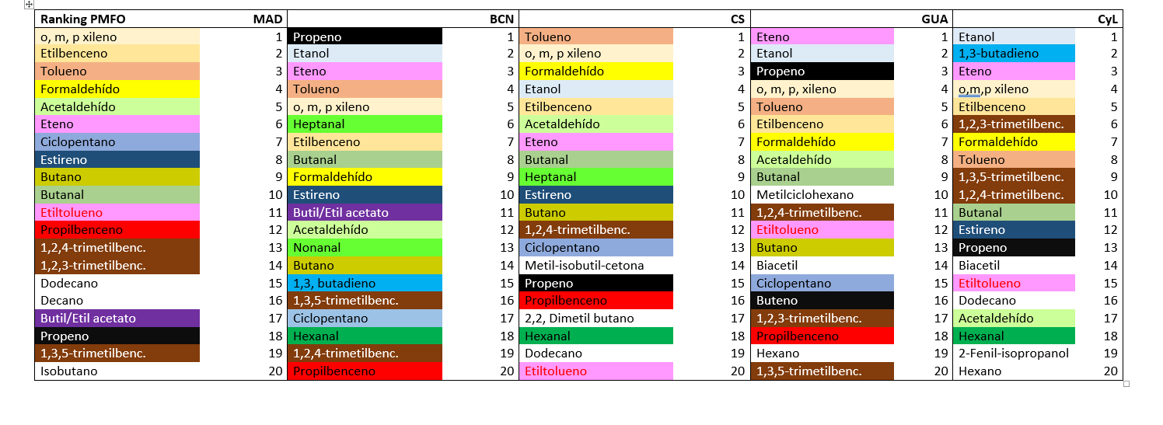
MAXIUM OZONE FORMATION POTENTIAL
AMBIENT MEASUREMENTS IN JULY COMBINED WITH SPECIATED EMISSION INVENTORIES
_{EXAMPLE: MADRID}

Slide 20
¡¡Thanks a lot for your attention!!

Slide 21
REGIONALISATION OF THE O₃ POLLUTION

Slide 22
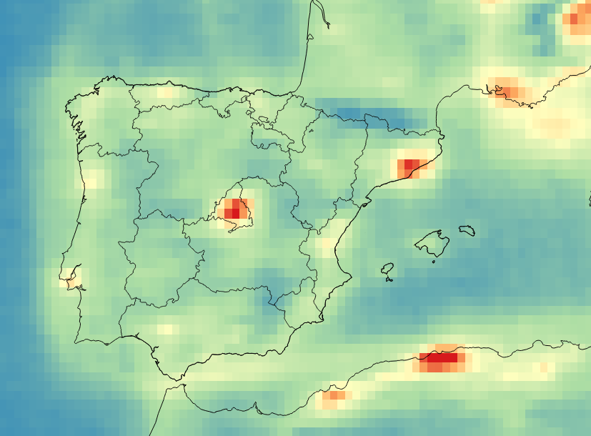
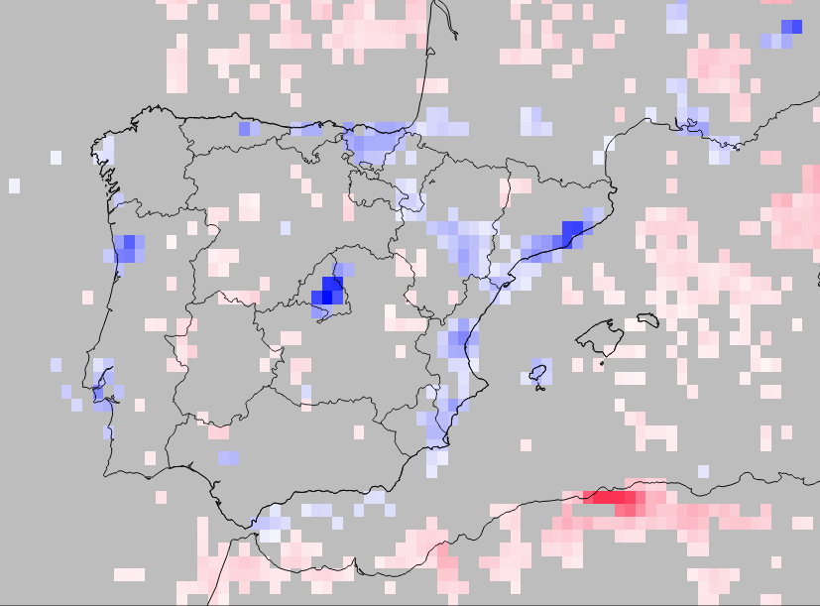
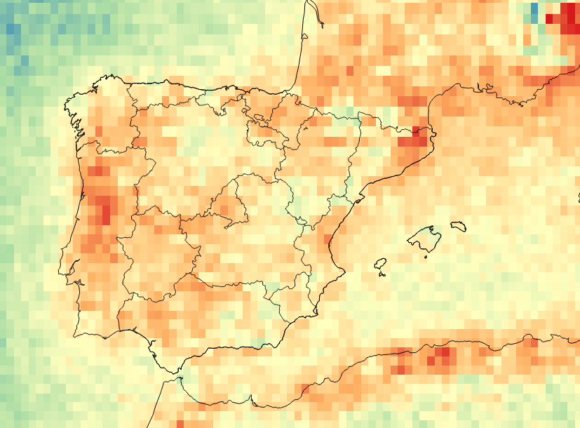
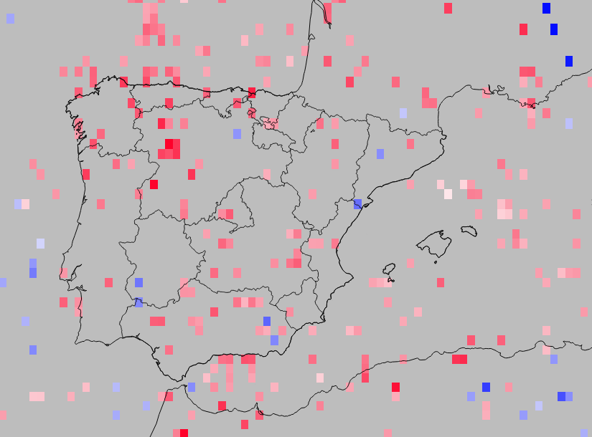
NO₂ & HCHO 2015-2019 & 2008-2018
Massagué et al.., 2023 Environ Int
REMOTE (APR-SEP) NO₂ OMI-NASA 2015-2019
2008-2019 REMOTE (APR-SEP) NO₂ OMI-NASA
NO₂ 2015─2019
NO₂ signif. trend 2008─2019
Marseille
Coruña
Oviedo
Bilbao
Barcelona
Porto
Madrid
Castellón
×10¹⁵ molec.
NO₂ cm⁻²
Valencia
+0.15
0
-0.15
Lisbon
3.5
2
0.5
Sevilla
Algiers
×10¹⁵ molec.NO₂ cm⁻²·year⁻¹
No signif. trend (p≥0.05)
HCHO 2015─2019
HCHO signif. trend 2008─2019
×10¹⁵ molec.
HCHO cm⁻²
11
6.5
2
+0.4
0
-0.4
×10¹⁵ molec. HCHO cm⁻²·year⁻¹
No signif. trend (p≥0.05)

Slide 23
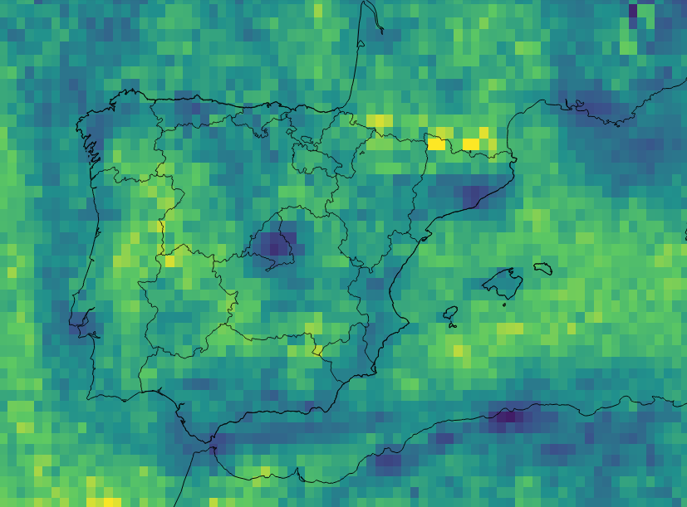
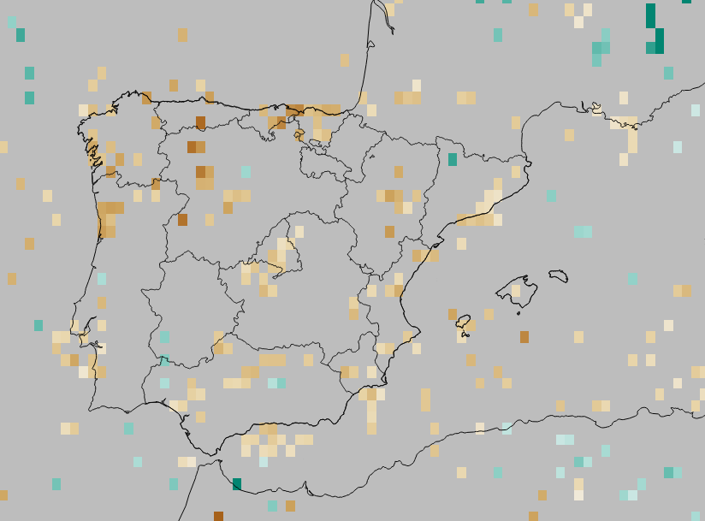
HCHO/NO₂ 2015-2019 & 2008-2018
REMOTE (APR-SEP) NO₂ OMI-NASA 2015-2019
2008-2019 REMOTE (APR-SEP) NO₂ OMI-NASA
Massagué et al.., 2023 submitted
HCHO/NO₂ 2015─2019
HCHO/NO₂ signif. trend 2008─2019
HCHO/NO₂
(no unit)
10
5.5
1
+0.15
0
-0.15
HCHO/NO₂
year⁻¹
No signif. trend (p≥0.05)

Slide 24
PHENOMENOLOGY OF O₃ EPISODES: C. VALENCIANA & BARCELONA-VIC

Slide 25
PHENOMENOLOGY OF O₃ EPISODES: CASTILLA Y LEÓN & BASQUE COUNTRY

Slide 26
PHENOMENOLOGY OF O₃ EPISODES: PUERTOLLANO

Slide 27
MAXIUM OZONE FORMATION POTENTIAL: AMBIENT MEASUREMENTS IN JULY
TOTAL MO₃FP (µg O₃ m⁻³)

