Slide 1
Surface ozone air pollution
  Short and long-term mitigation of ozone, past trends and future outlook
  Augustin COLETTE (INERIS, France)
  24th Meeting of the TFMM, Warsaw, 12 May, 2023
Ineris -
[CGR]
-
212098
[Version (doc)]

Slide 2
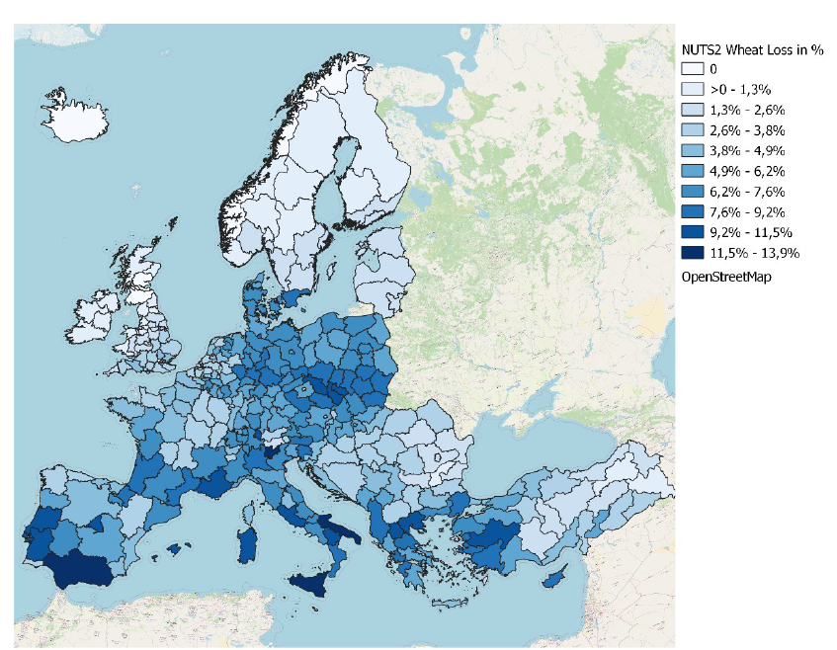
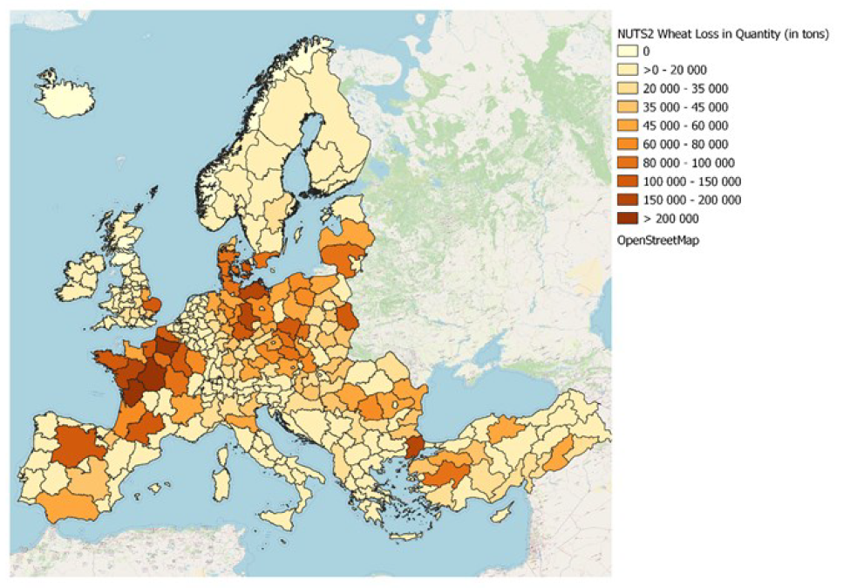
What is at stake ?
In 2020 in the EU-27:
238,000 premature deaths were attributable to exposure to PM_{2.5} concentrations above the WHO guideline level of 5 µg/m³;
49,000 premature deaths were attributable to exposure to NO₂ concentrations above the WHO guideline level of 10 µg/m³;
24,000 premature deaths were attributable to acute exposure to O₃ concentrations above 70 µg/m³.
In 2019:
5-10% wheat crop yields (1.5bn€)
https://www.eea.europa.eu/publications/air-quality-in-europe-2022/health-impacts-of-air-pollution
https://www.eea.europa.eu/publications/air-quality-in-europe-2022/health-impacts-of-air-pollution

Slide 3
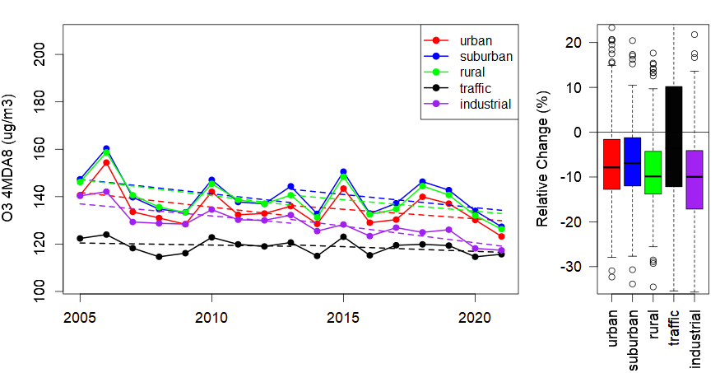
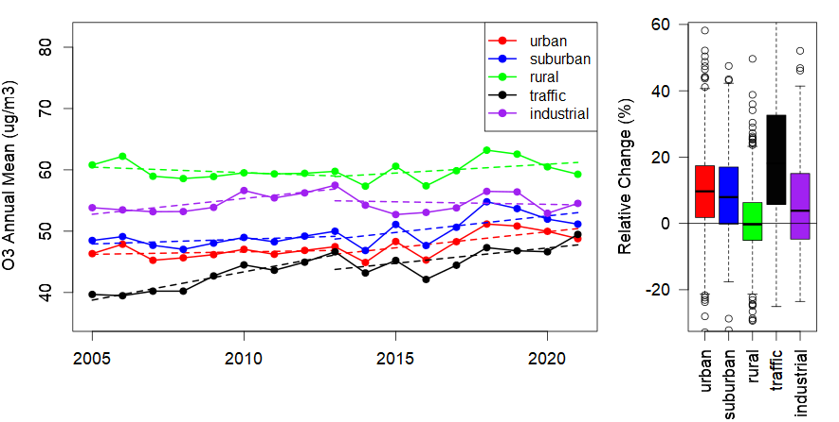
Long term trends
https://www.eionet.europa.eu/etcs/etc-atni/products/etc-atni-reports/etc-atni-report-9-2021-long-term-trends-of-air-pollutants-at-national-level-2005-2019 (updated)
Background ozone flat/increasing
  Less titration in urban areas
  Hemispheric bruden
  Meteorological variability
Peak ozone decrease up to 2010, then flat trend
  Limited efficiency of mitigation in precursors
  Levels remain lower in urban/trafic sites

Slide 4
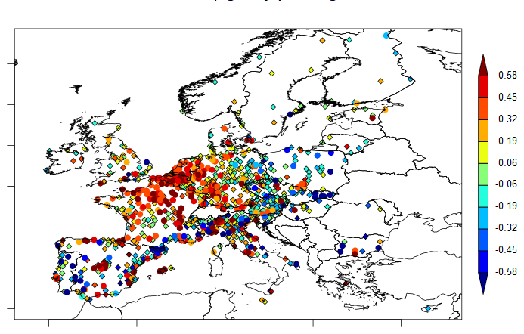
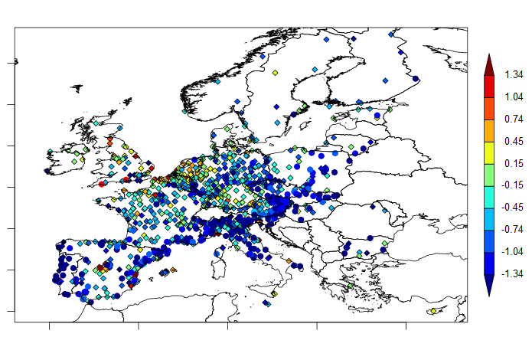
Long term trends
O3 annual mean (µg/m3/yr) 2005-2021
O3 4MDA8 peaks (µg/m3/yr) 2005-2021
Background ozone
  Many significant increases
Peaks
  Very noisy, mostly non-significant
  More decreases in south Europe

Slide 5
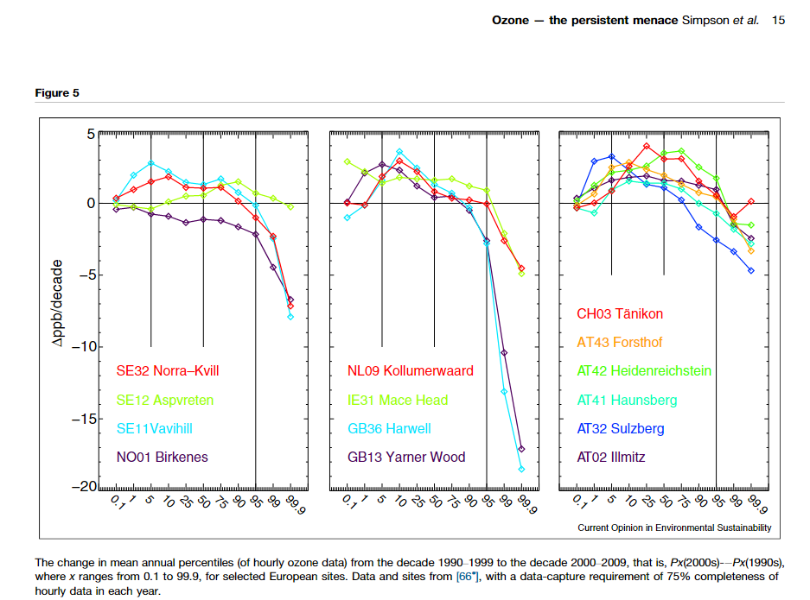
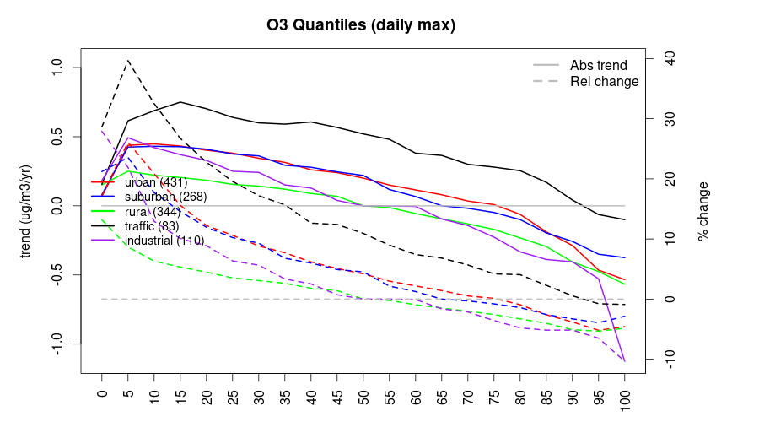
Long term trends
1990-2000 versus 2000-2010
  Decreases over highest percentiles
Distribution across ~1000 sites of daily peak trend 2005-2019
  Decreases only at sites exposed to higher quantiles, and less than 10%

Slide 6
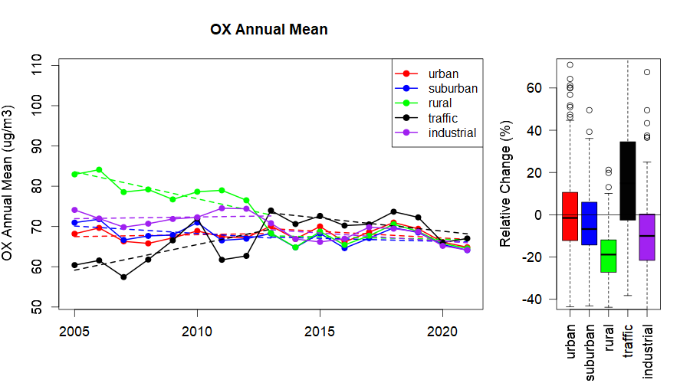
Long term trends
Clear Mismatch
  NOx & VOC trends [50%] and O3 avg [0;15%] or O3 peaks [-15; 0%]
  Questioning on the efficiency of mitigation measures
  Need to better isolate the natural versus / « mitigable » fraction
  Raising question whether increasing O3 as a result of reduced NO2 is a concern for health (if overall oxidant decrease)
Country | Nsta | Emis NOx | Emis VOC | Conc AVG | Conc MDA8
AT | 85 | -46,1 | -39,2 | 2 | -10,8
BE | 30 | -58,3 | -43,6 | 23,5 | -1,6
BG | 11 | -51 | -28,6 | -2,5 | -20,1
CZ | 40 | -50,6 | -24,8 | 1,3 | -10,1
DE | 196 | -33,2 | -32,4 | 7,8 | -4,5
ES | 146 | -50 | -25,3 | 3,6 | -9,4
FI | 9 | -53,4 | -45,1 | -3,9 | -13,6
FR | 227 | -53,2 | -33,2 | 12,3 | -6,2
HU | 15 | -42,7 | -25,6 | -4,7 | -12,4
IT | 139 | -58,2 | -41,9 | 4,8 | -10,3
NL | 23 | -53,9 | -10,7 | 18 | 3
PL | 40 | -34,3 | -22,1 | -3,5 | -11,8
PT | 26 | -52,4 | -22 | 0,9 | -17,4
SE | 13 | -39,8 | -40,1 | 3,8 | -8
EU27 | 1000 | -52,3 | -33,5 | 3 | -8,1

Slide 7
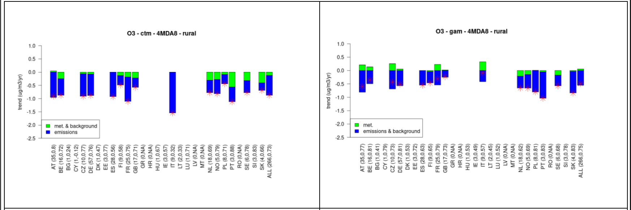
Meteorological sensitivity
https://www.eionet.europa.eu/etcs/etc-atni/products/etc-atni-reports/etc-atni-report-08-2020-understanding-air-quality-trends-in-europe-focus-on-the-relative-contribution-of-changes-in-emission-of-activity-sectors-natural-fraction-and-meteorological-variability
Meteorological variability
  Increase year-to-year variability and challenges the detection of (limited trends)
  Can not be unequivoqualy held responsible for the trend, here for 2000-2017
CTM (EMEP)
  Green: mostly decreases but also include hemispheric
GAM (Statistical)
  Meteorology contribute to the increase in some countries

Slide 8
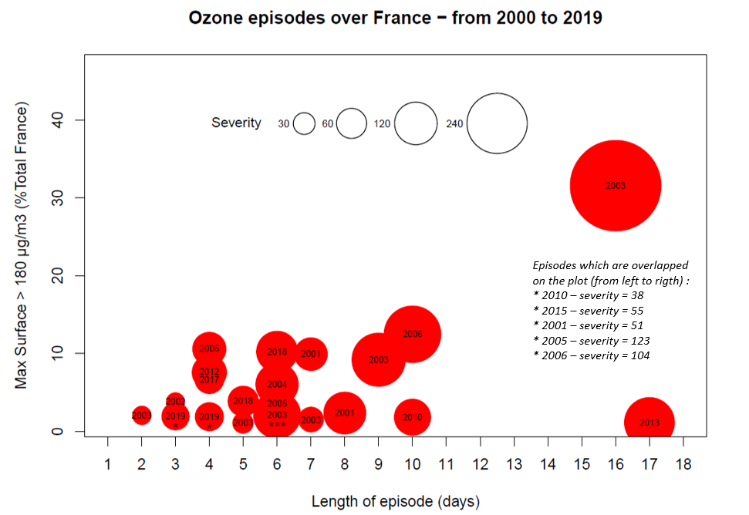
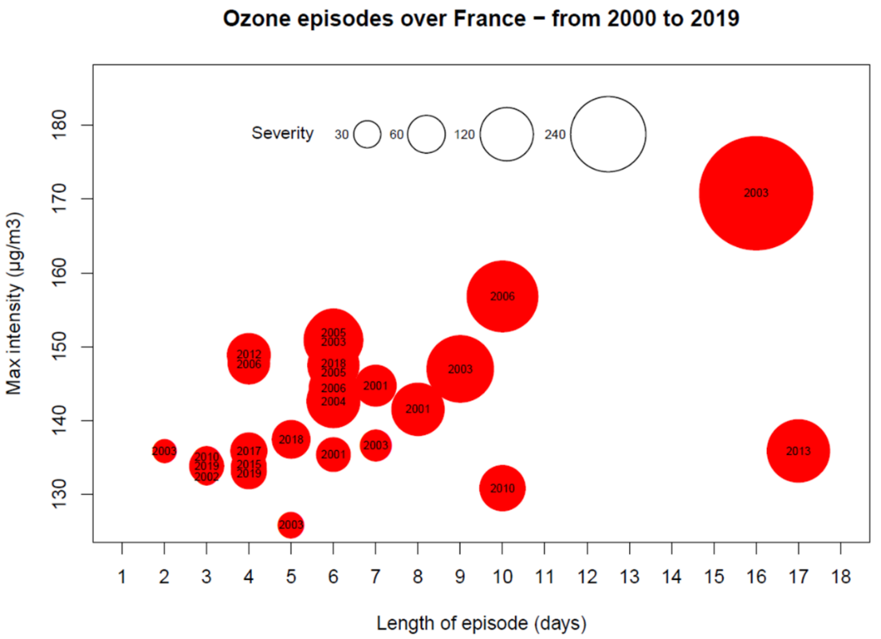
Ozone major episodes (France)

Slide 9

Efficiency of mitigation measures
Long term: 2015 versus 2050
Renske Timmermans, Jeroen Kuenen, Richard Kranenburg (TNO, NL)
Augustin Colette, Palmira Messina, Adrien Chantreux, Florian Couvidat (INERIS, FR)
David Simpson, Anna Maria Katarina Benedictow (MET, NO)
Johannes Flemming (ECMWF, DE)
https://policy.atmosphere.copernicus.eu/reports/CAMS2_71_2021SC1-1_D4.1.1-2022P2_AQProjections_202211_v1.1.pdf

Slide 10
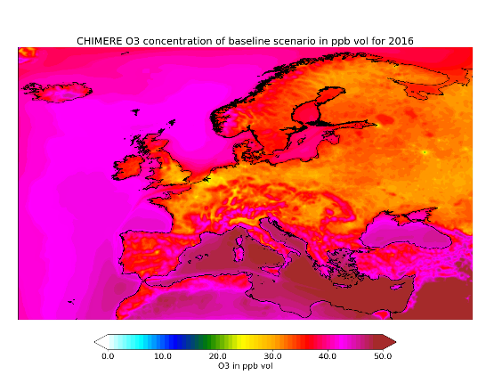
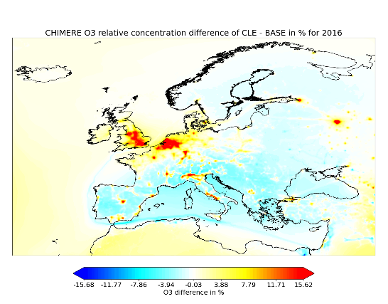
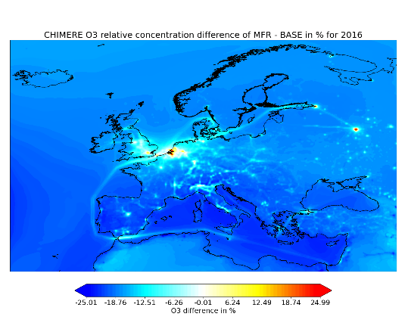
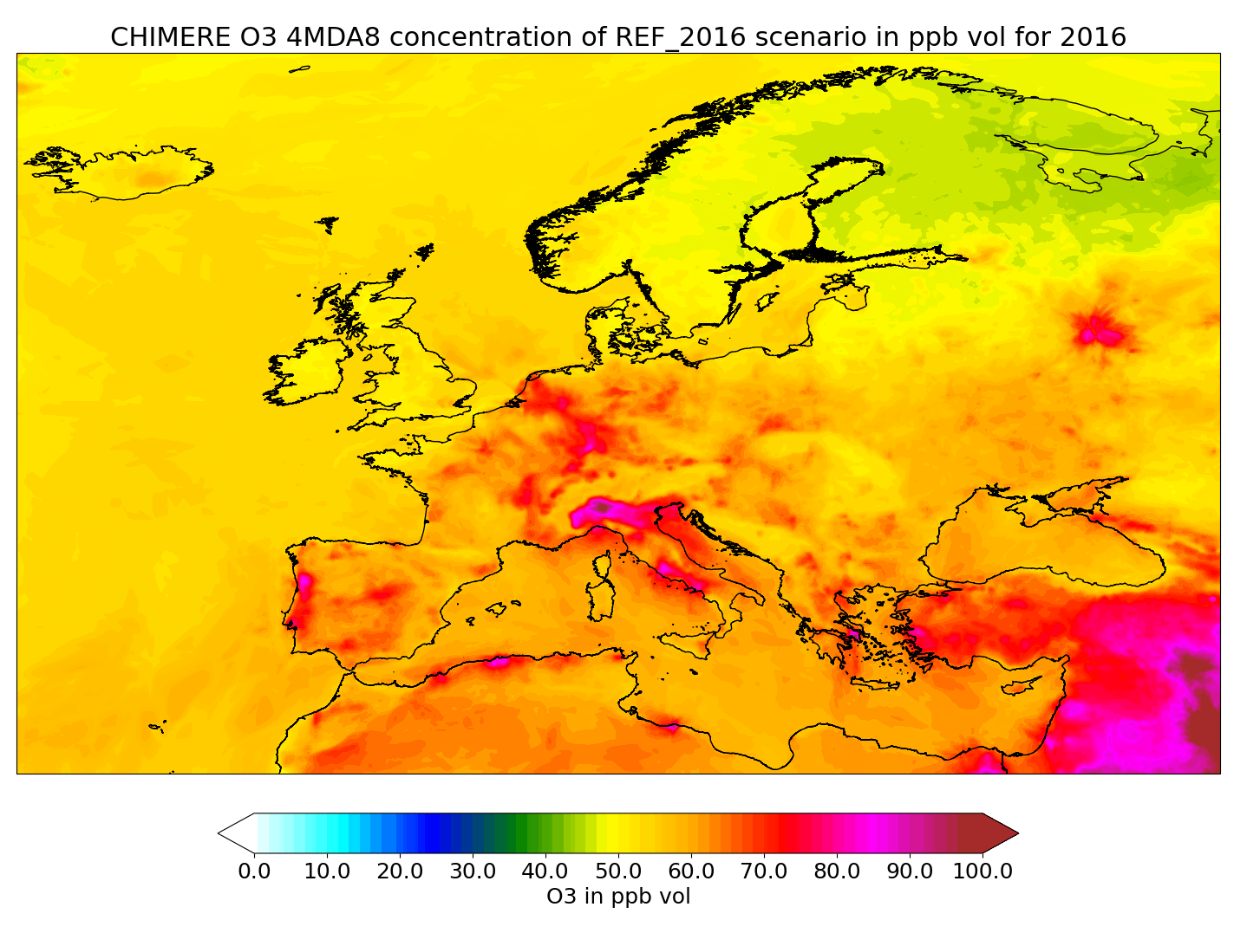
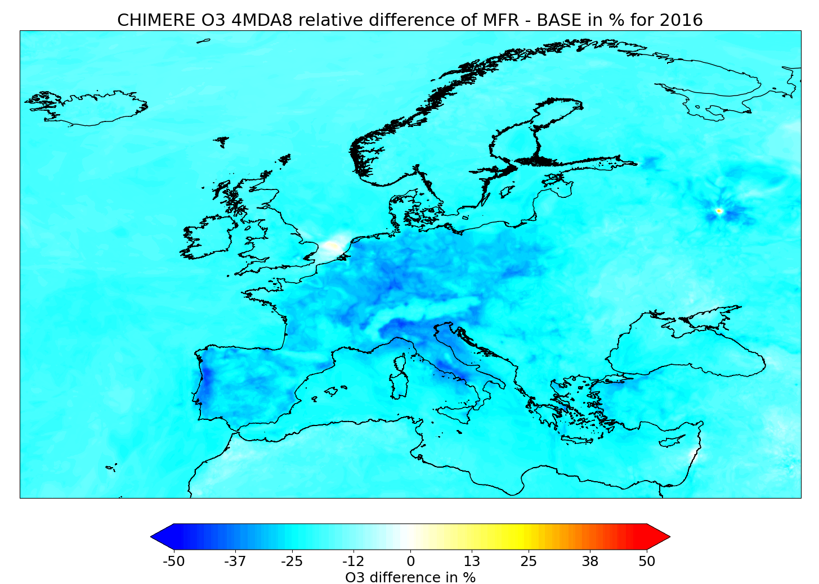
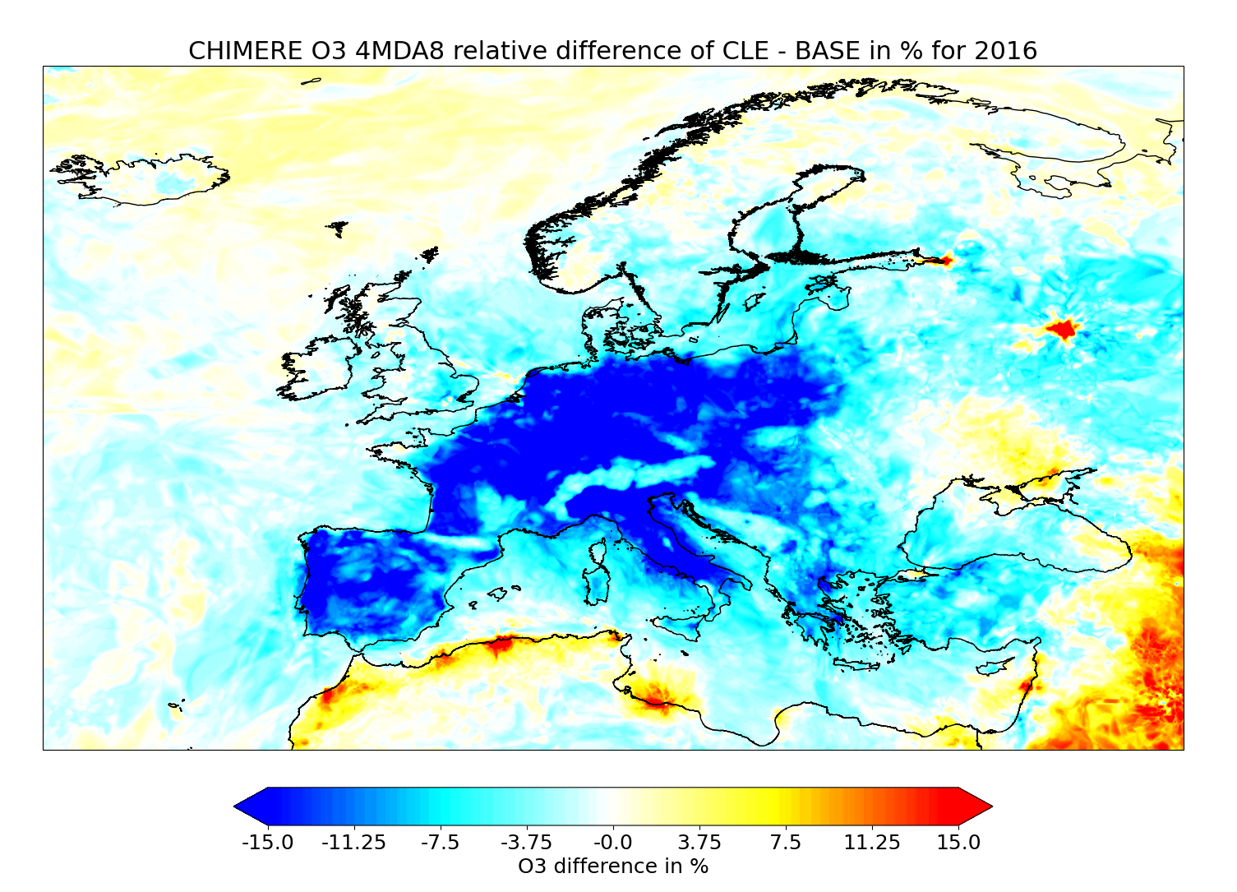
2015 versus 2050 (ECLIPSE/CAMS)
R. Timmermans (TNO), + MetNo+INERIS, CAMS
2015
2050 CLE
2050 MFR
O3avg
O3 peaks

Slide 11
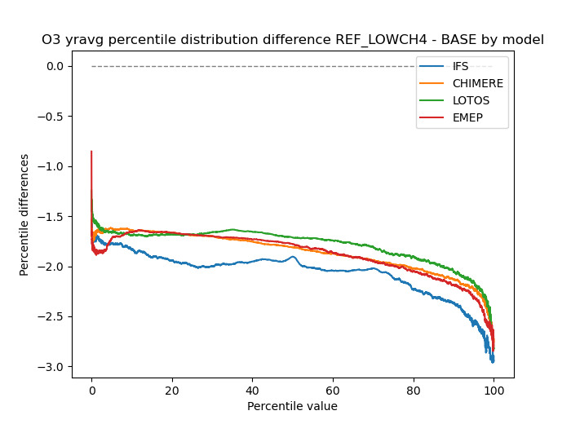
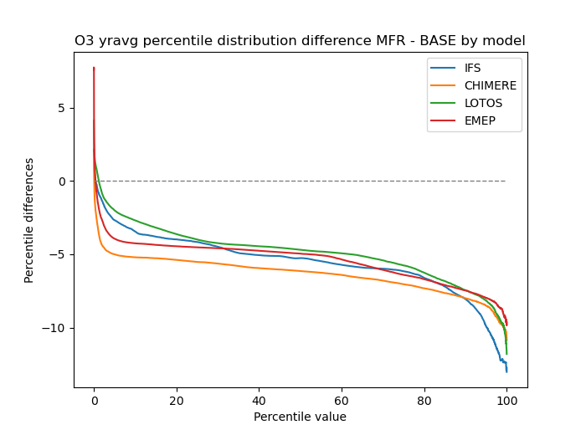
2015 versus 2050 (ECLIPSE/CAMS)
R. Timmermans (TNO), + MetNo+INERIS, CAMS
MFR scenario
28% / 50% reduction global /regional CH4 emissions
64% / 38% reduction regional NOx / VOC emissions
CH4 reduction scenario
50% reduction CH4 emissions
-1.5 to 2 ppb reduction
-3 to 6 ppb reduction

Slide 12
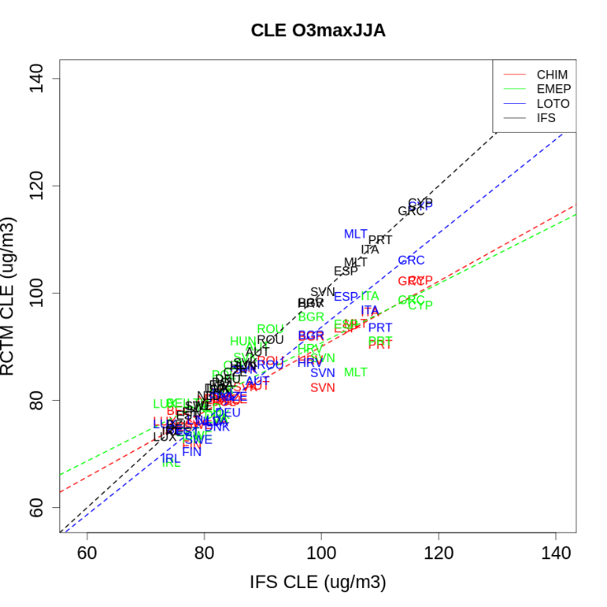
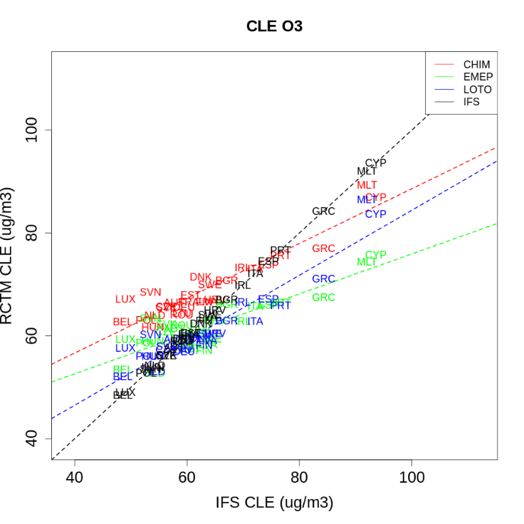

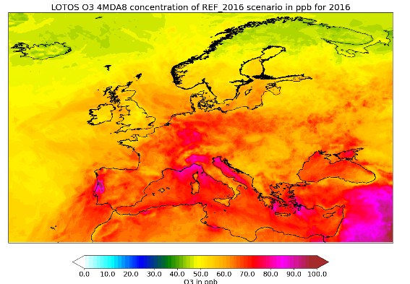
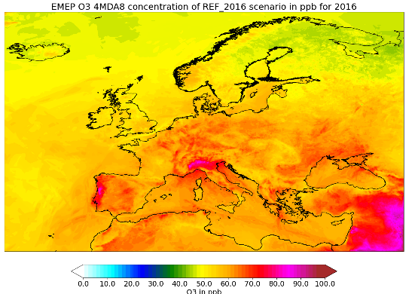
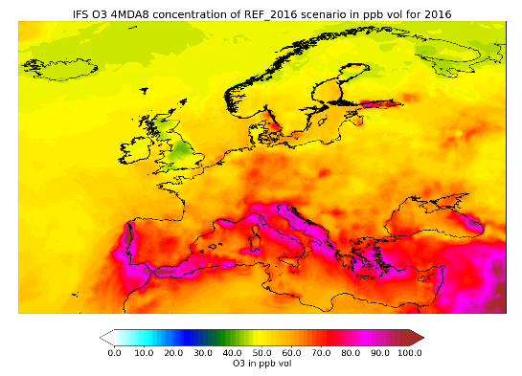
Comparing Regional/Global CTMs
O3 JJA MDA8
O3 annual avg
CHIMERE
LOTOS-EUROS
EMEP
IFS
Legend
Scatter plot to compare the exposure (as the population weighted average concentration by country)
Two ozone metrics (O3 annual mean, right, and the JJA average of the daily peaks, left)
X-axis: IFS
Y-axis: 3 RCTM (CHIMERE, EMEP, LOTOS-EUROS)
Results
The global and regional models are broadly in line, a couple of outstanding features can be highlighted in the IFS GCTM:
Overestimation of ozone peaks in Southern/High O₃ countries
Underestimation of ozone annual means in low O₃ countries (NOX-saturated) areas
Legend
Maps of 4MDA8 (4th highest peak in the year) in BASE/2015 for the 4 models

Slide 13
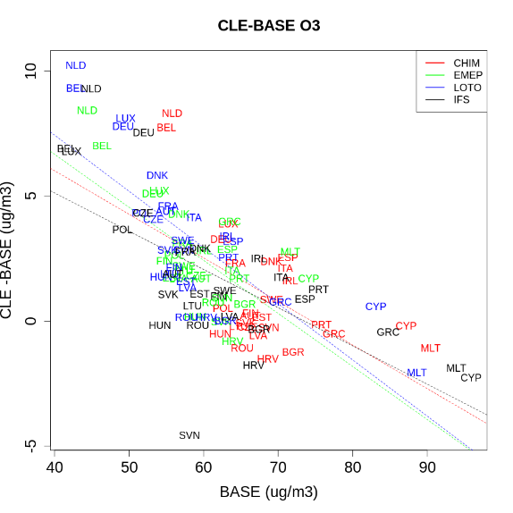
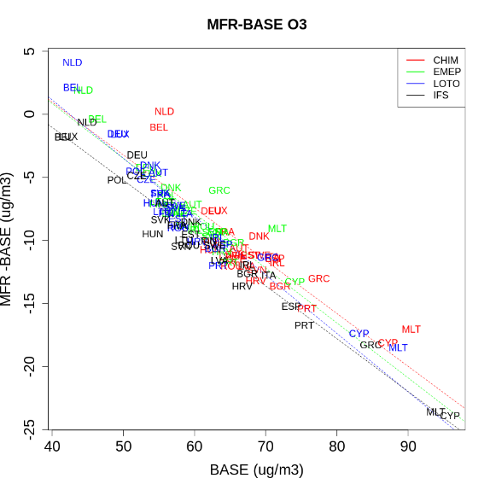
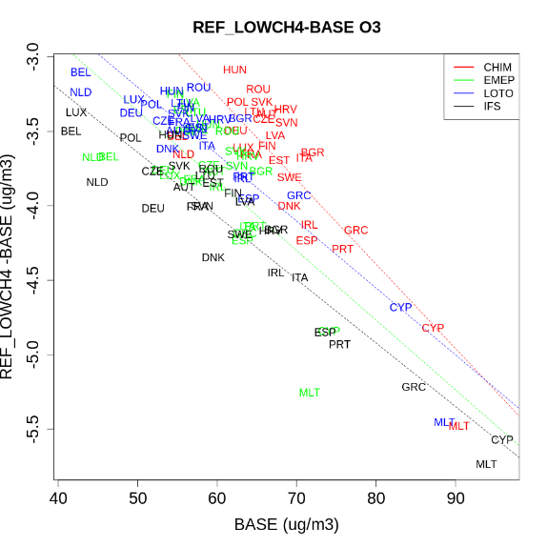
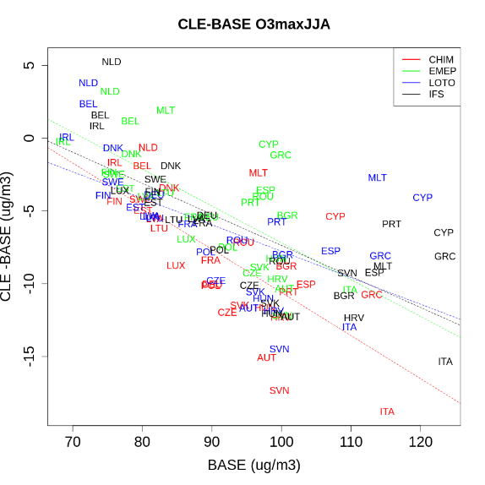
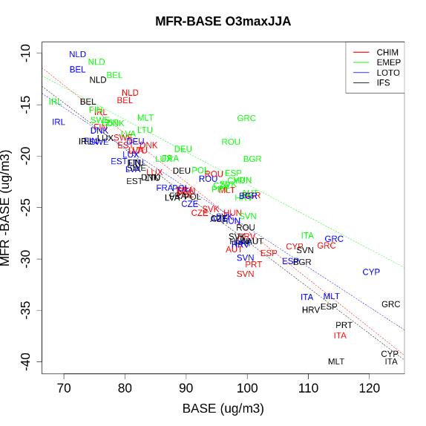
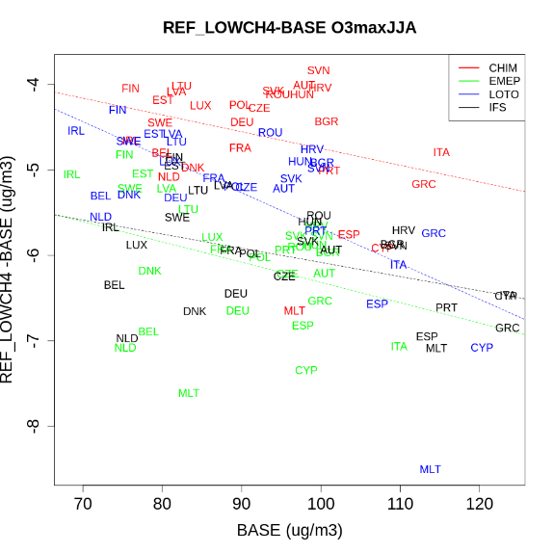
Response to emission scenarios (all models)
Legend
Scatter plot to compare the exposure (as the population weighted average concentration by country)
Two ozone metrics (O3 annual mean, top, and the JJA average of the daily peaks, bottom)
Three 2050 scenarios (from left to right)
X-axis: 2015
Y-axis: difference between 2050 and 2015 for one GCTM (IFS) and 3 RCTM (CHIMERE, EMEP, LOTOS-EUROS)
O₃ annual mean
O₃ MDA8 JJA average
Results
The CLE scenario is detrimental in Benelux/Germany (NOx-saturated), especially for O₃ annual mean, but also for peaks
This penalty is compensated in the MFR scenario (which also includes CH₄ reductions).
30-50% of this compensation is due to CH₄, the rest to VOC/NOx
In high exposure countries, the benefit of CH₄ is about 30% the benefit of MFR
The benefit of CH4 reduction is larger for high exposure countries for annual avg O3, but quite homogeneous (and significant) for O3 peaks (NOx/VOC also matter!)
Emission (2050 relative to 2015 BASE, %) | CLE | MFR | LOW CH4
NOx | -18% | -64% | 0%
NMVOC | -2% | -38% | 0%
CH₄ | +15% | -53% | -50%

Slide 14
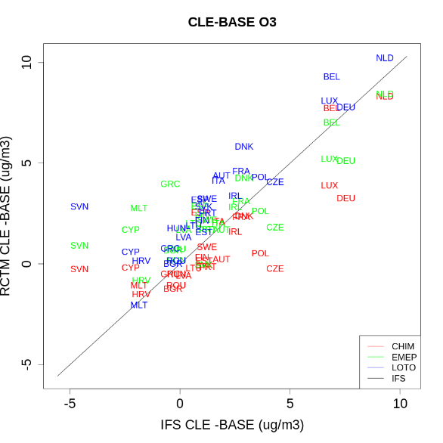
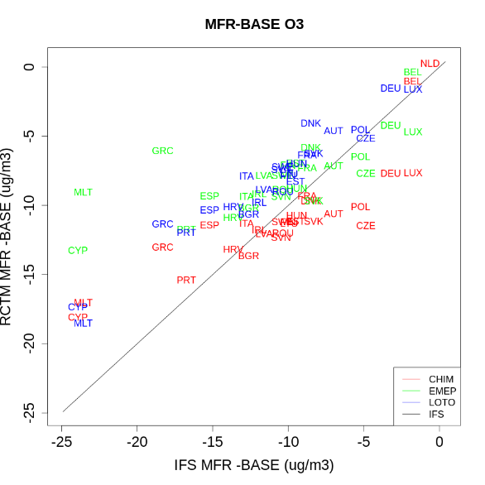
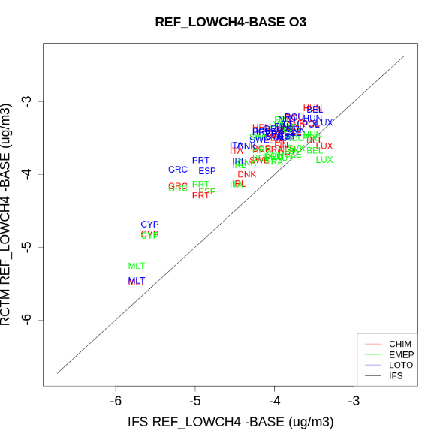
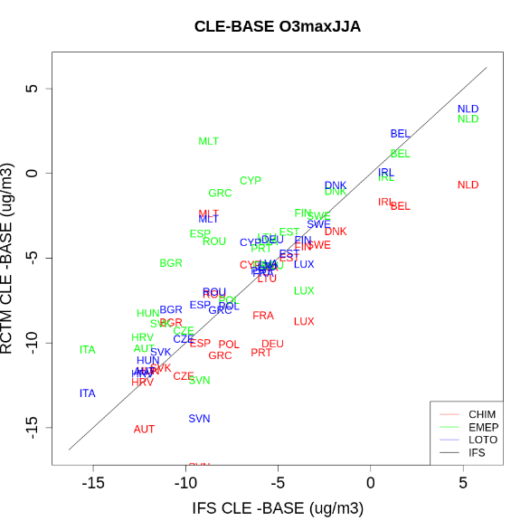
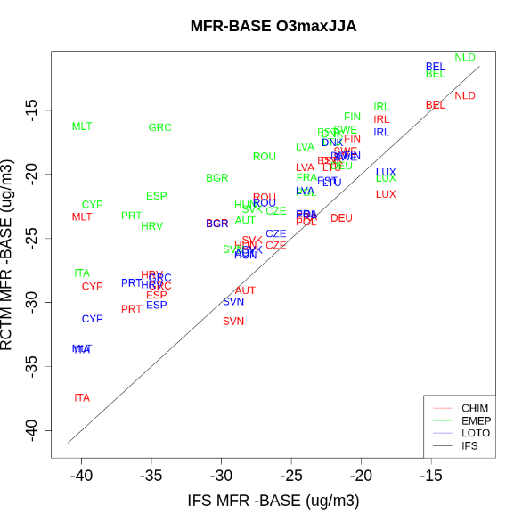
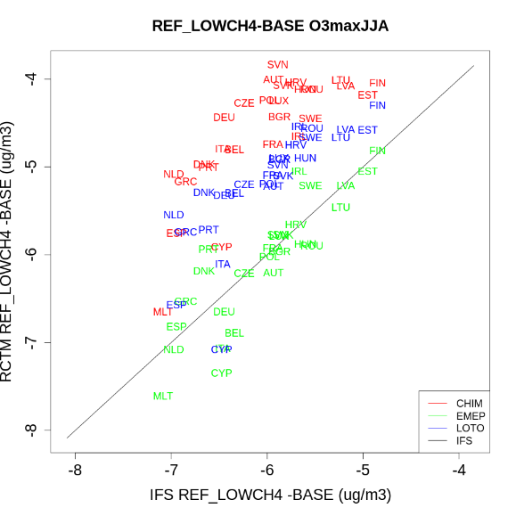
Response to emission scenarios (vs. IFS)
Legend
Scatter plot to compare the exposure (as the population weighted average concentration by country)
Two ozone metrics (O3 annual mean, top, and the JJA average of the daily peaks, bottom)
Three 2050 scenarios (from left to right)
X-axis: difference between 2050 and 2015 in the IFS GCTM
Y-axis: difference between 2050 and 2015 in the 3 RCTM (CHIMERE, EMEP, LOTOS-EUROS)
O₃ annual mean
Results
The response of IFS is within the spread of RCTMs
The only systematic feature is an overestimation of benefit of MFR for southern countries (both O₃ avg and peaks)
For peak O₃, the response to the CH₄ scenario is well aligned with EMEP, but CHIM&LOTO are lower
O₃ MDA8 JJA average

Slide 15
Efficiency of mitigation measures
Short term episodes

Slide 16
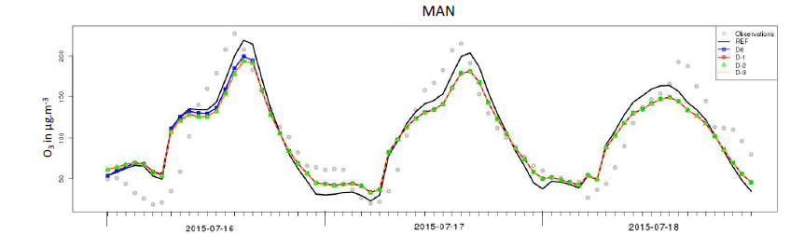
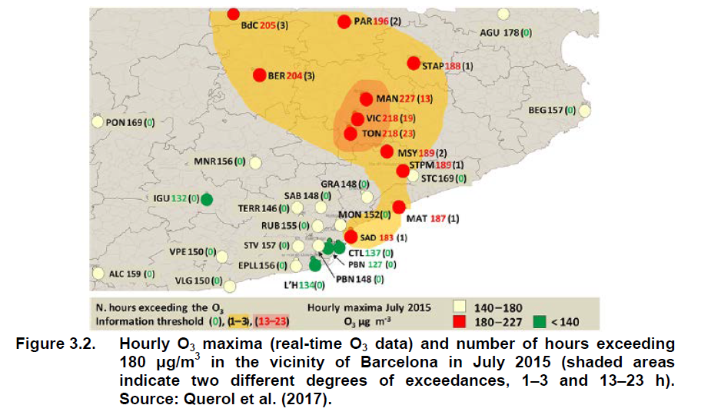
Anticipation
https://www.eionet.europa.eu/etcs/etc-atni/products/etc-atni-reports/etcacm_tp_2017_3_ozone_s-europe/@@download/file/ETCACM_TP_2017_3_Ozone_S-Europe.pdf
Add map of plume BCN report

Slide 17
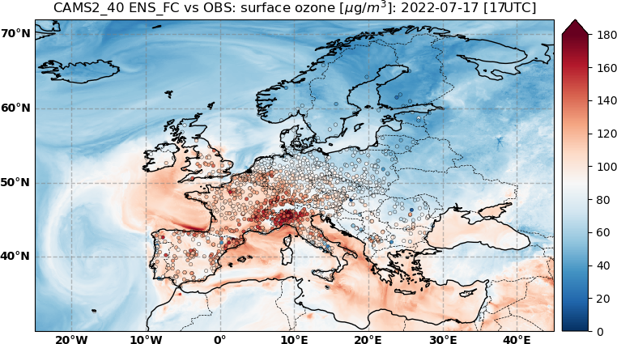
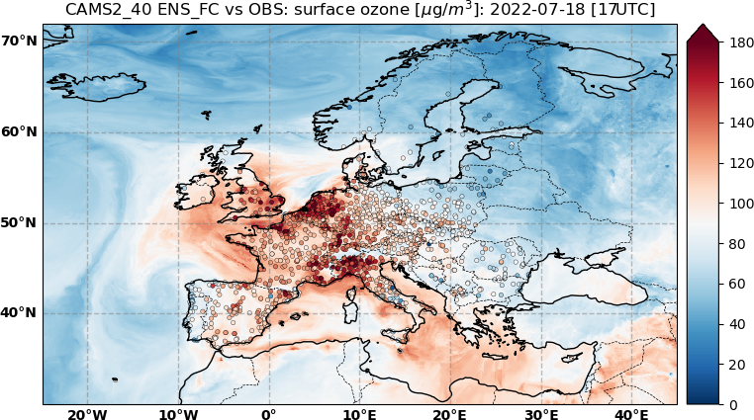
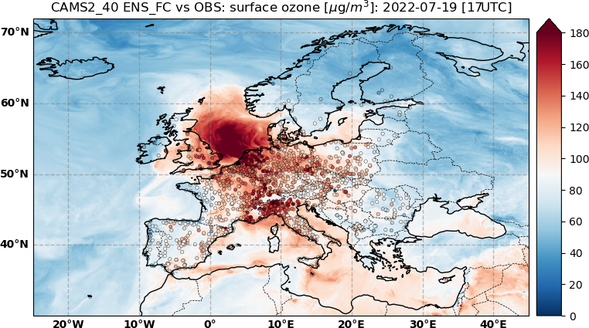
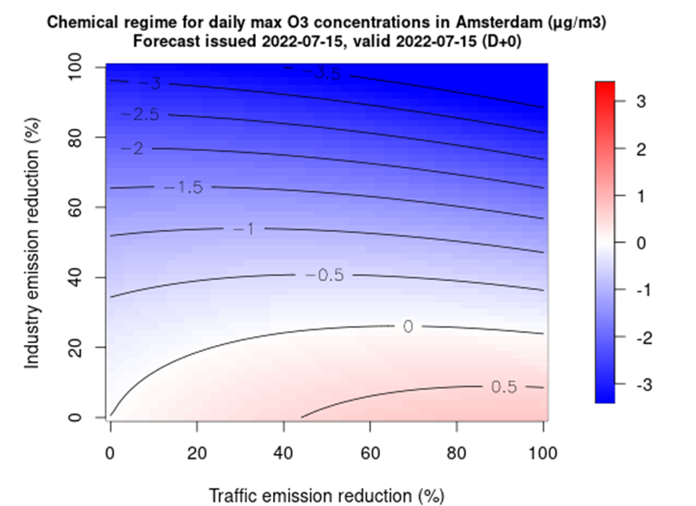
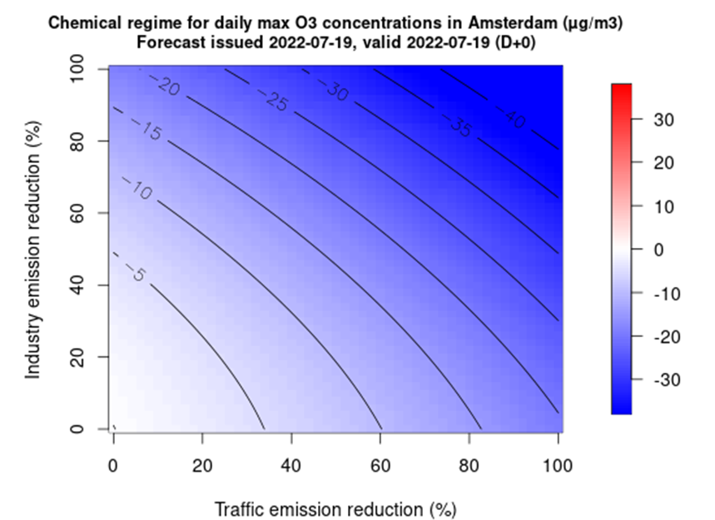
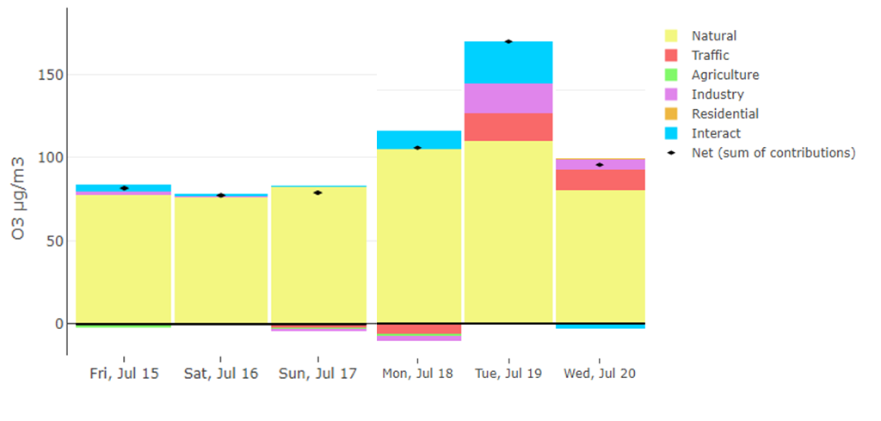
Day-to-day variability of chemical regimes

Slide 18
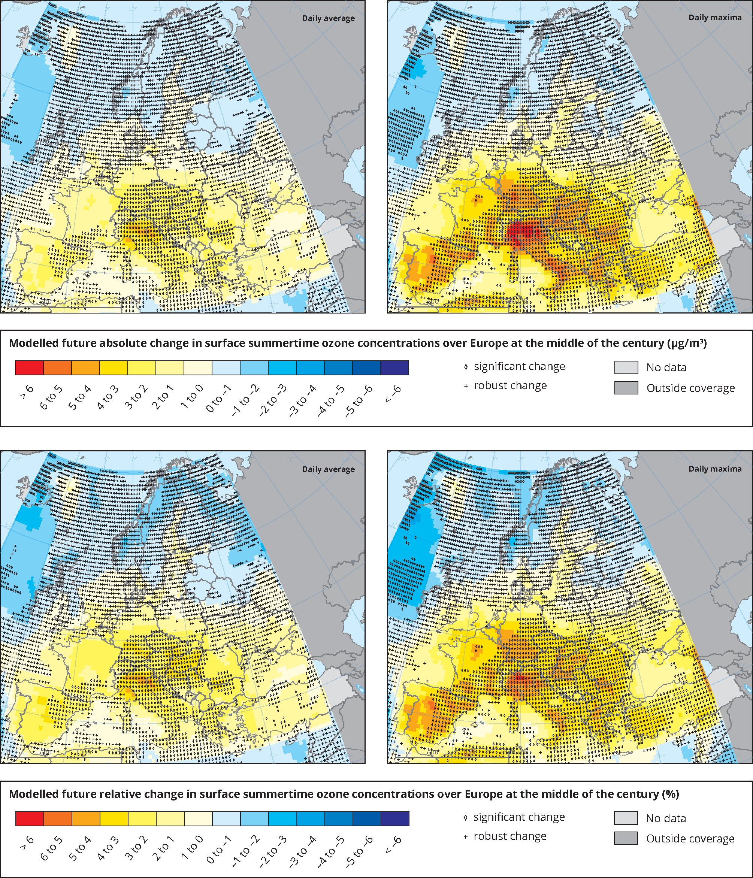
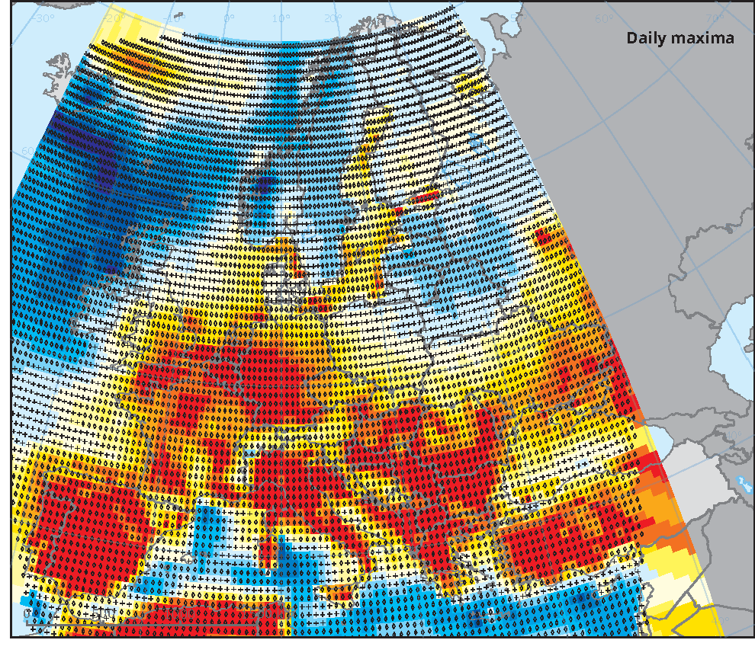
Climate projections
https://www.eea.europa.eu/data-and-maps/indicators/air-pollution-by-ozone-2/assessment
Modelled future change in surface summertime ozone concentrations (daily maxima) over Europe at the middle of the century (left) and at the end of the century (right)

Slide 19
Take Home Messages
Rough Meta-Analysis of Existing Trends & Projections
 | Concentrations | Concentrations |  | Emissions
 | O3 avg | 4MDA8 | MDA8 JJA | NOx | VOC | CH4
 | µg/m3 | µg/m3 | µg/m3 | % | % | %
Obs 2005-2021 [RB;UB] | [+2/+5] | [-12;-8] | [-12;-11] | 54 | 47 | tbc
Climate 2005/2050 [countries] |  |  | [+2;+6]
CLE 2015/2050 [countries] |  |  | [-10;-5] | -18 | -2 | Tbc
MFR+CH4 2015/2050 [countries] |  |  | [-25;-20] | -64 | -38 | -53
CH4 2015/2050 [countries] |  |  | [-7;-5] |  |  | -50

Slide 20
Take Home Messages
GP Review ECE/EB.AIR/2022/4, §17
Over the period 2000–2018, annual mean O3 increased as much as 11 per cent, whereas a slight decrease (3 per cent) was observed in rural areas.
Such a difference between station typology is driven by the titration effect: the sum of O3+NO2 declining by 2 per cent and 13 per cent for urban and rural sites, respectively.
O3 peaks decline systematically (by 11 per cent and 6 per cent at rural and urban sites, respectively), but this range of decline can be considered limited regarding the -47 per cent and -54 per cent changes for NMVOC and NOx emissions, respectively, over the same time period.
The trend in observed NO2 (37 per cent and 28 per cent decline at rural and urban sites, respectively) is, however, much lower than the reported decline in European emissions (55 per cent).
Rough Orders of Magnitude
Observed over 2005-2021
O3 Annual Means : +2 to +5 µg/m3
O3 4MDA8 -12 to -8µg/m3
Climate Penalty 2005 to 2050
MDA8 JJA avg: +5µg/m3
Anthrop. Emissions 2015 to 2050
CLE: -10 to -5 µg/m3
MFR+CH4: -25 to -20 µg/m3
CH4: -5µg/m3

Slide 21
Knowledge Gaps and Research Needs
What do we know about the past?
  Present skills in models can be improved (trend, annual variability, high peaks) => field campaing
  More can be done by taking the best of both CTM and statistical data analysis
Future projections
  Atmosphere/Surface interactions are key
    soil (NOx) and deposition
    biogenic emissions
  Climate sensitivity was not revised since 15yr+
  Climate mitigation cobenefits imply nesting global/regional/national models (esp. CH4)

Slide 22
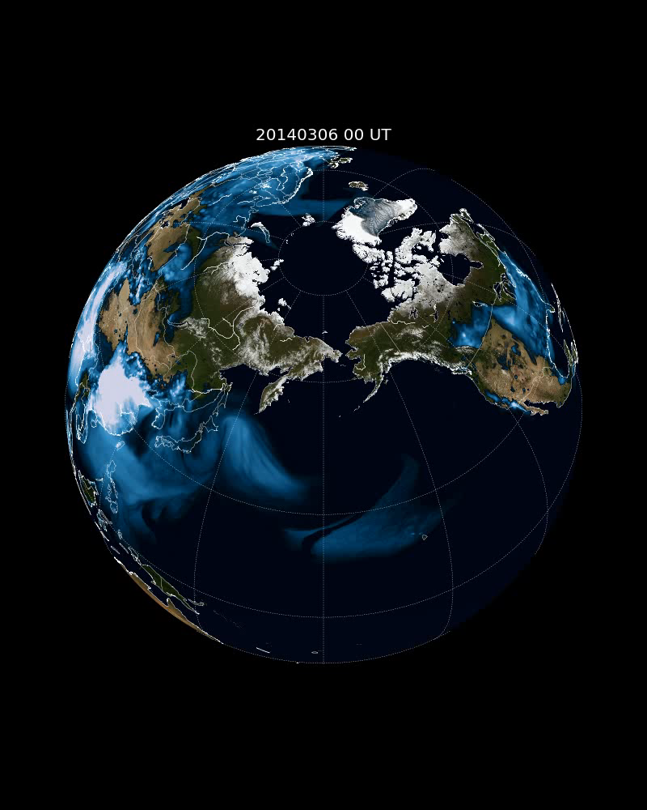
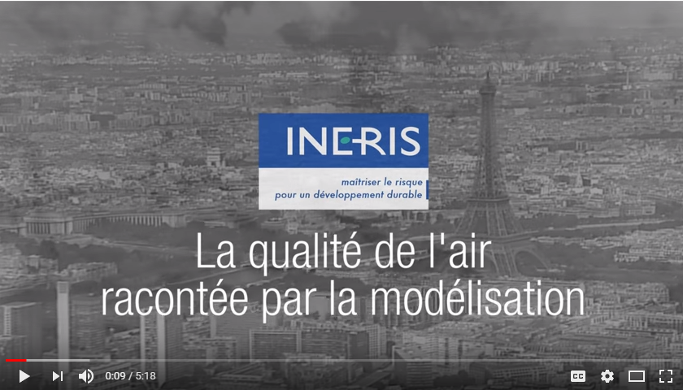
https://www.youtube.com/watch?v=mqe5MtR-TDE

