Slide 1
LONG-TERM CHANGES IN EPISODIC PEAK OZONE ACROSS EUROPE 1989 - 2018
Dick Derwent
rdscientific, United Kingdom
24th EMEP Task Force on Measurement and Modelling
Warsaw, Poland
Friday 12th May 2023

Slide 2
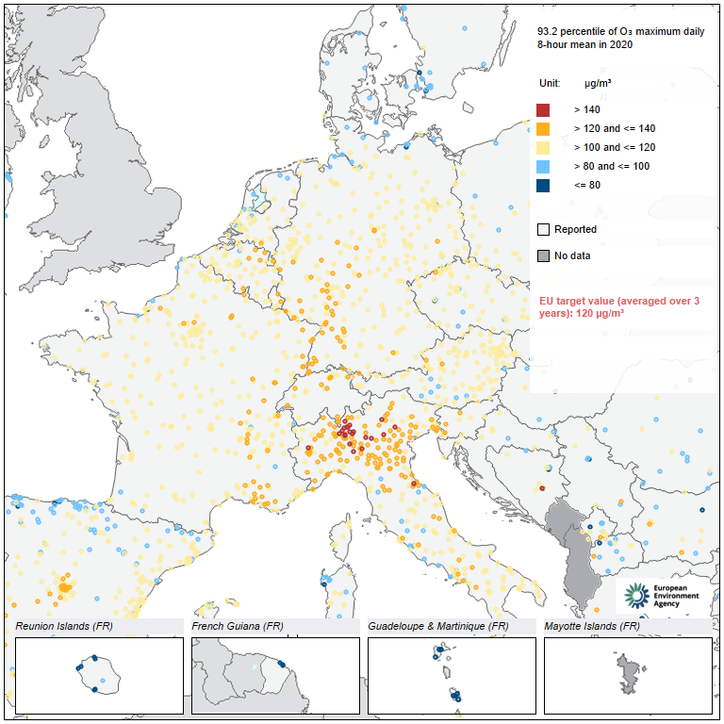
OZONE CONCENTRATIONS IN 2020 IN RELATION TO THE EU TARGET VALUE
Highest levels found in central Europe, Mediterranean countries and Portugal
21 countries including 15 EU Member States registered levels above EU target value threshold of 60 ppb
Air Quality In Europe (2021) EEA

Slide 3
LONG-TERM CHANGES IN EMEP RURAL OZONE NETWORK DATA
Analysis based on annual maximum 8-hour mean AM8 data
Data taken from NILU EBAS (Anne-Gunn Hjellbrekke acknowledged)
56 long-running stations selected covering 1989 - 2018
AM8s have exceeded WHO 50 ppb guideline in almost all years at almost all stations
Why is WHO guideline so widely exceeded?
Why has progress towards meeting the WHO guideline been so slow?

Slide 4
QUANTIFICATION OF LONG-TERM CHANGES
Annual maximum 8-hour mean ozone at a given station =
Hemispheric Transported Baseline + Regional Photochemical Enhancement
We get the Hemispheric Transported Baseline by sorting the Mace Head, Ireland observations by air mass origins
We get the Regional Photochemical Enhancement by subtracting off the Mace Head baseline from the station observations
Derwent and Parrish (2022). Atmospheric Environment 286, 119222.

Slide 5
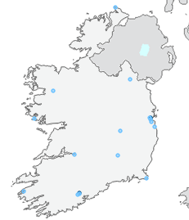
QUANTIFICATION OF HEMISPHERIC TRANSPORT BASELINE INTO EUROPE USING MACE HEAD, IRELAND OBSERVATIONS
Mace Head station
European regionally polluted air masses
Northern hemisphere
baseline air masses
European regionally polluted air masses
Regional Photochemical Enhancement
Northern hemisphere baseline air masses
Hourly ozone observations sorted using an Atmospheric Dispersion Model (NAME)

Slide 6
HEMISPHERIC BASELINE TRANSPORTED INTO EUROPE ALREADY EXCEEDS WHO 50 ppb GUIDELINE
Regional Photochemical Enhancement RPE
Hemispheric Transported Baseline HTB

Slide 7
ANNUAL MAXIMUM 8-HOUR MEAN OZONE AT 32 LOW-ALTITUDE EMEP STATIONS
Austria
Belgium
Switzerland
Germany
Denmark
Finland
Ireland
Italy
Netherlands
Norway
Sweden
AM8s exceed WHO 50 ppb guideline at almost all stations and in all years
AM8s show decline between 1989 and 2018 due to European regional emission reductions
WHO 50 ppb guideline

Slide 8
REGIONAL PHOTOCHEMICAL ENHANCEMENTS AT 32 LOW-ALTITUDE EMEP STATIONS FROM 1989 TO 2018
Regional Photochemical Enhancements were estimated by subtracting Transported Baselines from observed AM8s
Has decline levelled off?
See steady decline in Regional Photochemical Enhancements due to European regional emission reductions
Very few –ve results showing that Mace Head transported baseline provide a good estimate of baseline ozone across Europe

Slide 9
LONG-TERM CHANGES IN THE REGIONAL PHOTOCHEMICAL ENHANCEMENTS AT LOW-ALTITUDE EMEP STATIONS
The simplest mathematical relationship that includes a continuous decrease and does not drop below zero or some specified background is an exponential decrease:
AM8 = O_{3 baseline} + A exp(-1/τ )
hence:
RPE = A exp(-1/τ )
where A is the Regional Photochemical Enhancement in 2020 and τ is the e-folding time for the decrease in RPE driven by emissions reductions.
This exponential relationship was fitted through the AM8 data for the 32 low-altitude and 12 UK EMEP stations.

Slide 10
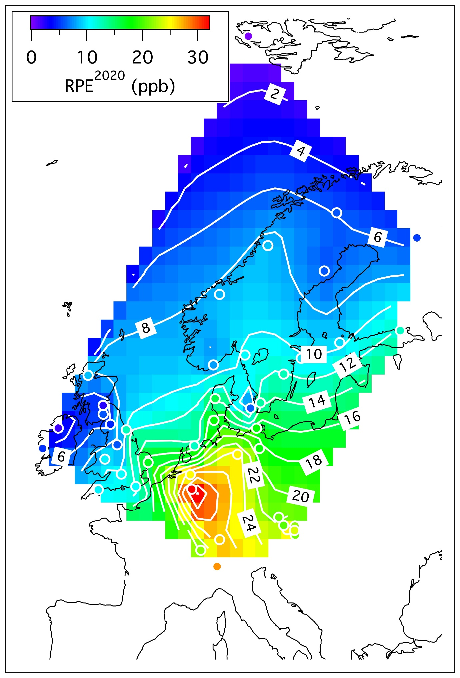
CONTOUR PLOT OF THE REGIONAL PHOTOCHEMICAL ENHANCEMENTS IN 2020
RPE average over plot is 14 ppb, making WHO guideline exceedance inevitable because:
48 + 14 = 62 >> 50 ppb
HTB in 2020 is 48 ppb
Contours peak at 32 ppb in the region where Netherlands, Belgium and Germany meet
European emissions of ozone precursors in 2020 retain a persistent capacity to drive regional photochemical ozone formation

Slide 11
AM8s AT 12 HIGH-ALTITUDE EMEP STATIONS FROM 1989 TO 2018
These are EMEP stations sited above 700 metres and up to 3578 metres
WHO 50 ppb guideline is exceeded in all years at all high-altitude stations
Transported baseline ozone appears to increase with altitude
Austria
Switzerland
Czech Republic
Germany
Slovenia
WHO 50 ppb guideline

Slide 12
TRANSPORTED HEMISPHERIC BASELINE INCREASES WITH ALTITUDE

Slide 13
REGIONAL PHOTOCHEMICAL ENHANCEMENTS FOR TWELVE UK EMEP STATIONS FROM 1989 TO 2018
Regional photochemical enhancements were estimated by subtracting Transport Baselines from AM8s
Regional Photochemical Enhancements show strong evidence of levelling off ?
Regional Photochemical Enhancements decline due to European regional emission reductions

Slide 14
CONCLUSIONS
WHO 50 ppb guideline has been exceeded in Transported Baseline at Mace Head, Ireland in air masses without any European influence
AM8s exceed WHO 50 ppb guideline at almost all EMEP stations and in all years from 1989 to 2018
Regional Photochemical Enhancements have declined due to European regional emission reductions
Decline in Regional Photochemical Enhancements has slowed because of lack of ambition in diesel NOx emission controls
Need concerted policy action globally to reduce Transport Baseline ozone

