Slide 1







An application of the EMEP-WRF model in South Asia
Massimo Vieno¹
E. Nemitz¹, C. Di Marco¹, J. Scheffler¹,
Y. Wang¹, T. Liska¹,
S. Ghude⁴, P. Pawar⁴,M. Sutton^{1,2},
P. Wind², Y. Ge^{1,2,3}, M. Heal³, S. Tomlinson¹,
E. Carnell¹, U. Dragosits¹
UK Centre for Ecology & Hydrology, UK
Norwegian meteorological institute, Norway
University of Edinburgh, UK
Indian Institute of Tropical Meteorology, India
Warsaw, 2023

Slide 2
European Nitrogen Assessment - Nitrogen Cascade
Greenhouse
gas balance
Stratospheric
ozone loss
High temperature
combustion
& industry
Nitrous Oxide
(N₂O)
Tropospheric
ozone formation
Urban air
quality
Particulate
Matter
Nitrogen oxides
(NO_{x})
Ammonium nitrate
in rain (NH₄NO₃)
Fertilizer
manufacture
Further emission
of NO_{x} & N₂O
carrying on
the cascade
Ammonia
(NH₃)
N_{r}
Crop biological
nitrogen fixation
Crops for food &
animal feed
Eventual
denitrification
to N₂
Intended
N flow
Terrestrial Eutrophication
N_{r} in
manure
Livestock farming
for food
Unintended
N flows
Natural ecosystems
Soil acidification
N form in
the cascade
Leached Nitrate
(NO₃⁻)
Nitrate in streams,
groundwater &
coastal seas
Environmental
concern from N_{r}
Freshwater Eutrophication
European Nitrogen Assessment, 2011
http://www.nine-esf.org/node/204/ENA.html
Marine Eutrophication

Slide 3
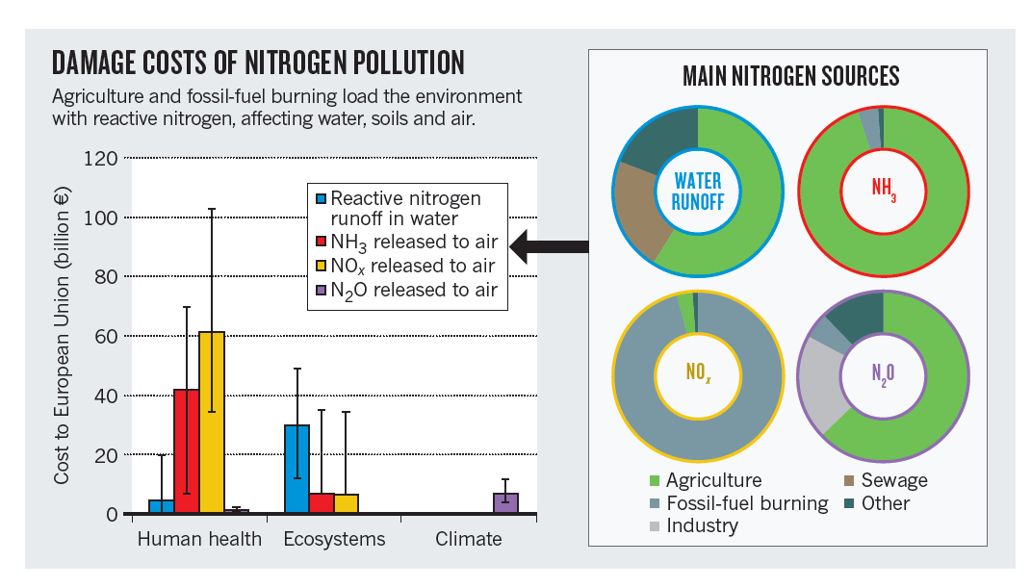
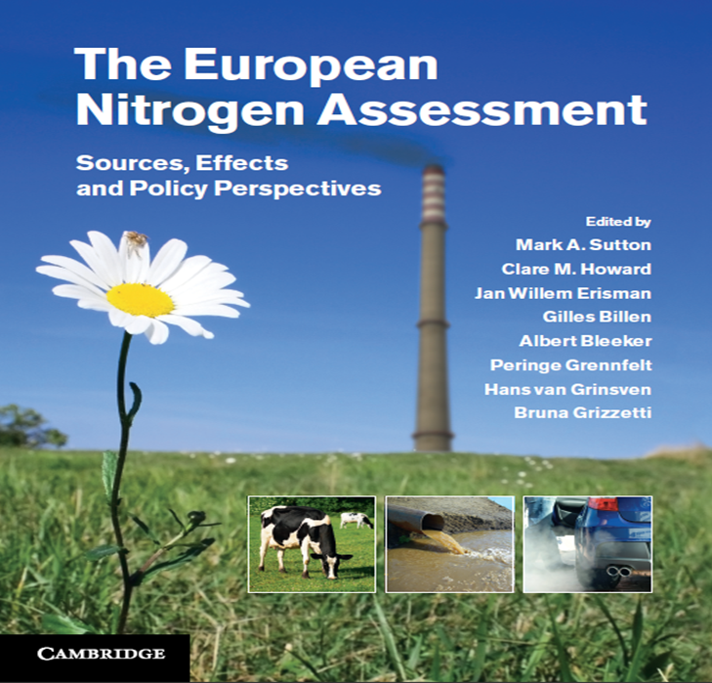
Nitrogen damage and cost in Europe
http://www.nine-esf.org/
EU Damage cost: 70 - 320 billion € / year

Slide 4
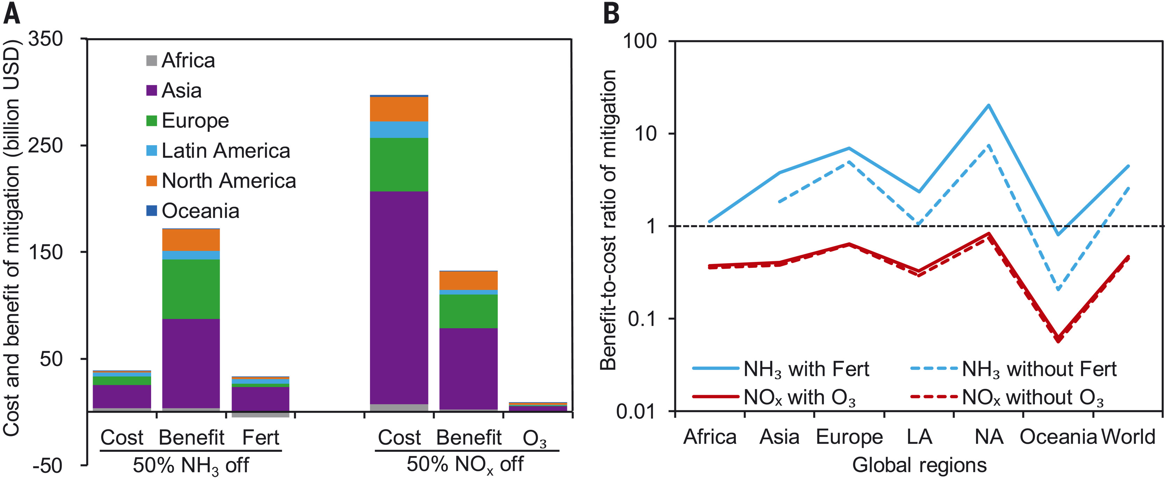
Nitrogen cost benefit on global scale
Baojing Gu et al. ,Abating ammonia is more cost-effective than nitrogen oxides for mitigating PM2.5 air pollution.
Science 374,758-762(2021).DOI:10.1126/science.abf8623

Slide 5
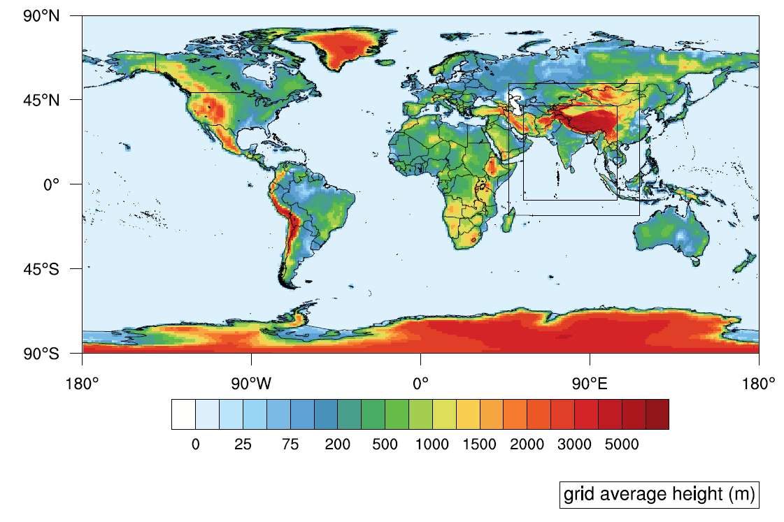
The EMEP-WRF - SUNRISE setup
EMEP-WRF is based on the CLRTAP EMEP MSC-w model (rv4.33, 4.36, and 4.45)
Meteorology driver is the Weather Research Forecast model (WRF 4.4.1) with 6-hour nudging using the ERA5 (better RH in Delhi than GFS-FNL)
Global domain at 1°x1° with nested at 0.11°x0.11°
Vertical domain from surface (typically ~45 m) up to 100hPa ( ~16 km)
Global emissions
  2015 EDGAR with SANH specific for the South Asia domain
  2015 FINN biomass burning
Thermodynamic schemes
  MARS
  EQSAM
Default EMEP chemical scheme is used here but complex chemistry schemes are available (i.e. CRIrv5) – should we sue a more complex scheme?
Global domain
Nested domains
ACP Vieno et. al, 2010, 2014, 2016 and ERL Vieno et. al, 2016
ACP Ots et al., 2016, 2018, Lin et al., 2017
Core model derived from EMEP MSC-W model
(ACP Simpson et al., 2012)
Ge et al. 2021 (GMD a global evaluation of the EMEP-WRF model)
More info:
www.emep.int
www.emep4uk.ceh.ac.uk

Slide 6
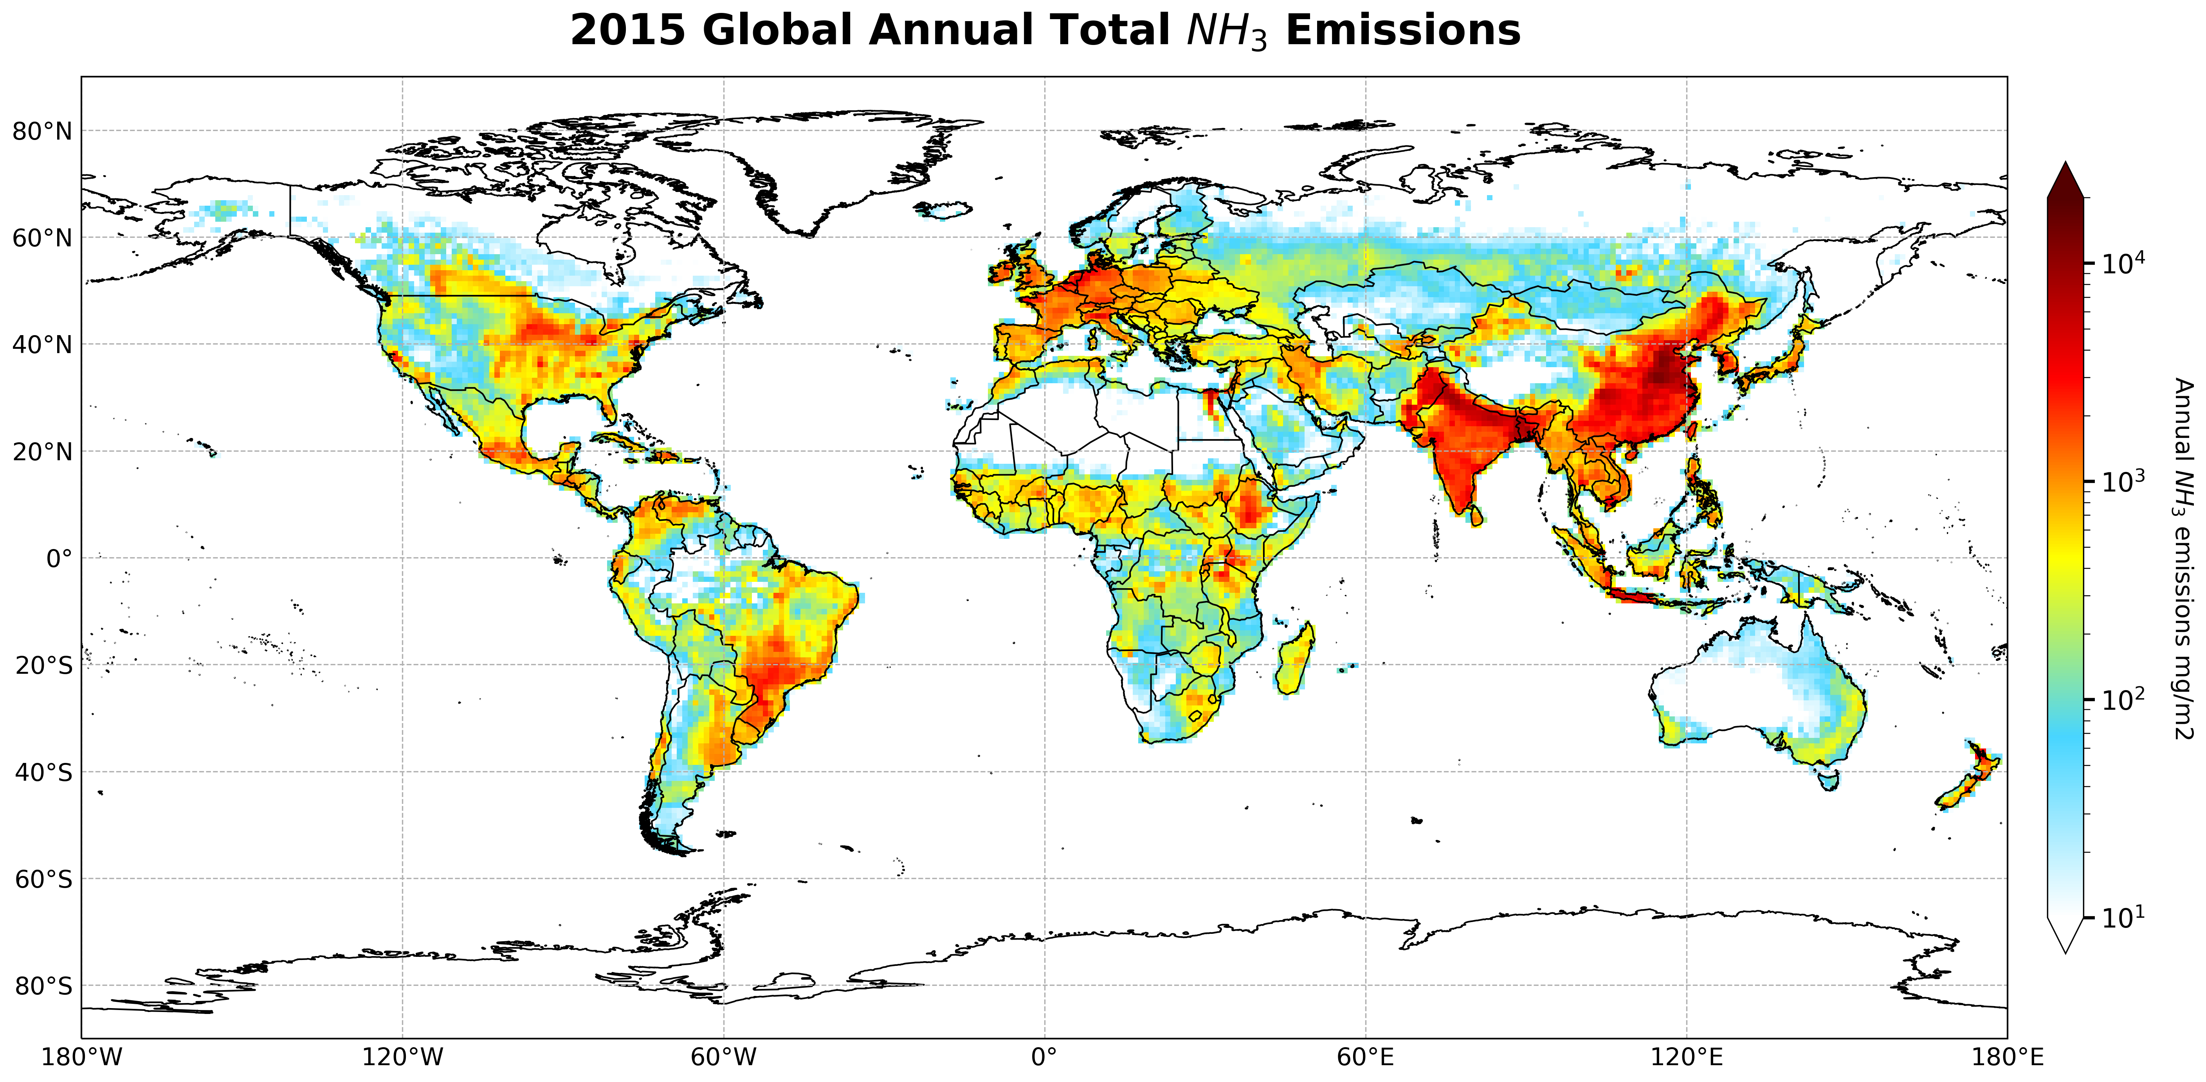
Ge, Y., Vieno, M., Stevenson, D.S., Wind, P., Heal, M.R. (2022) A new assessment of global and regional budgets, fluxes, and lifetimes of atmospheric reactive N and S gases and aerosols. Atmos. Chem. Phys. 22, 8343-8368.

Slide 7
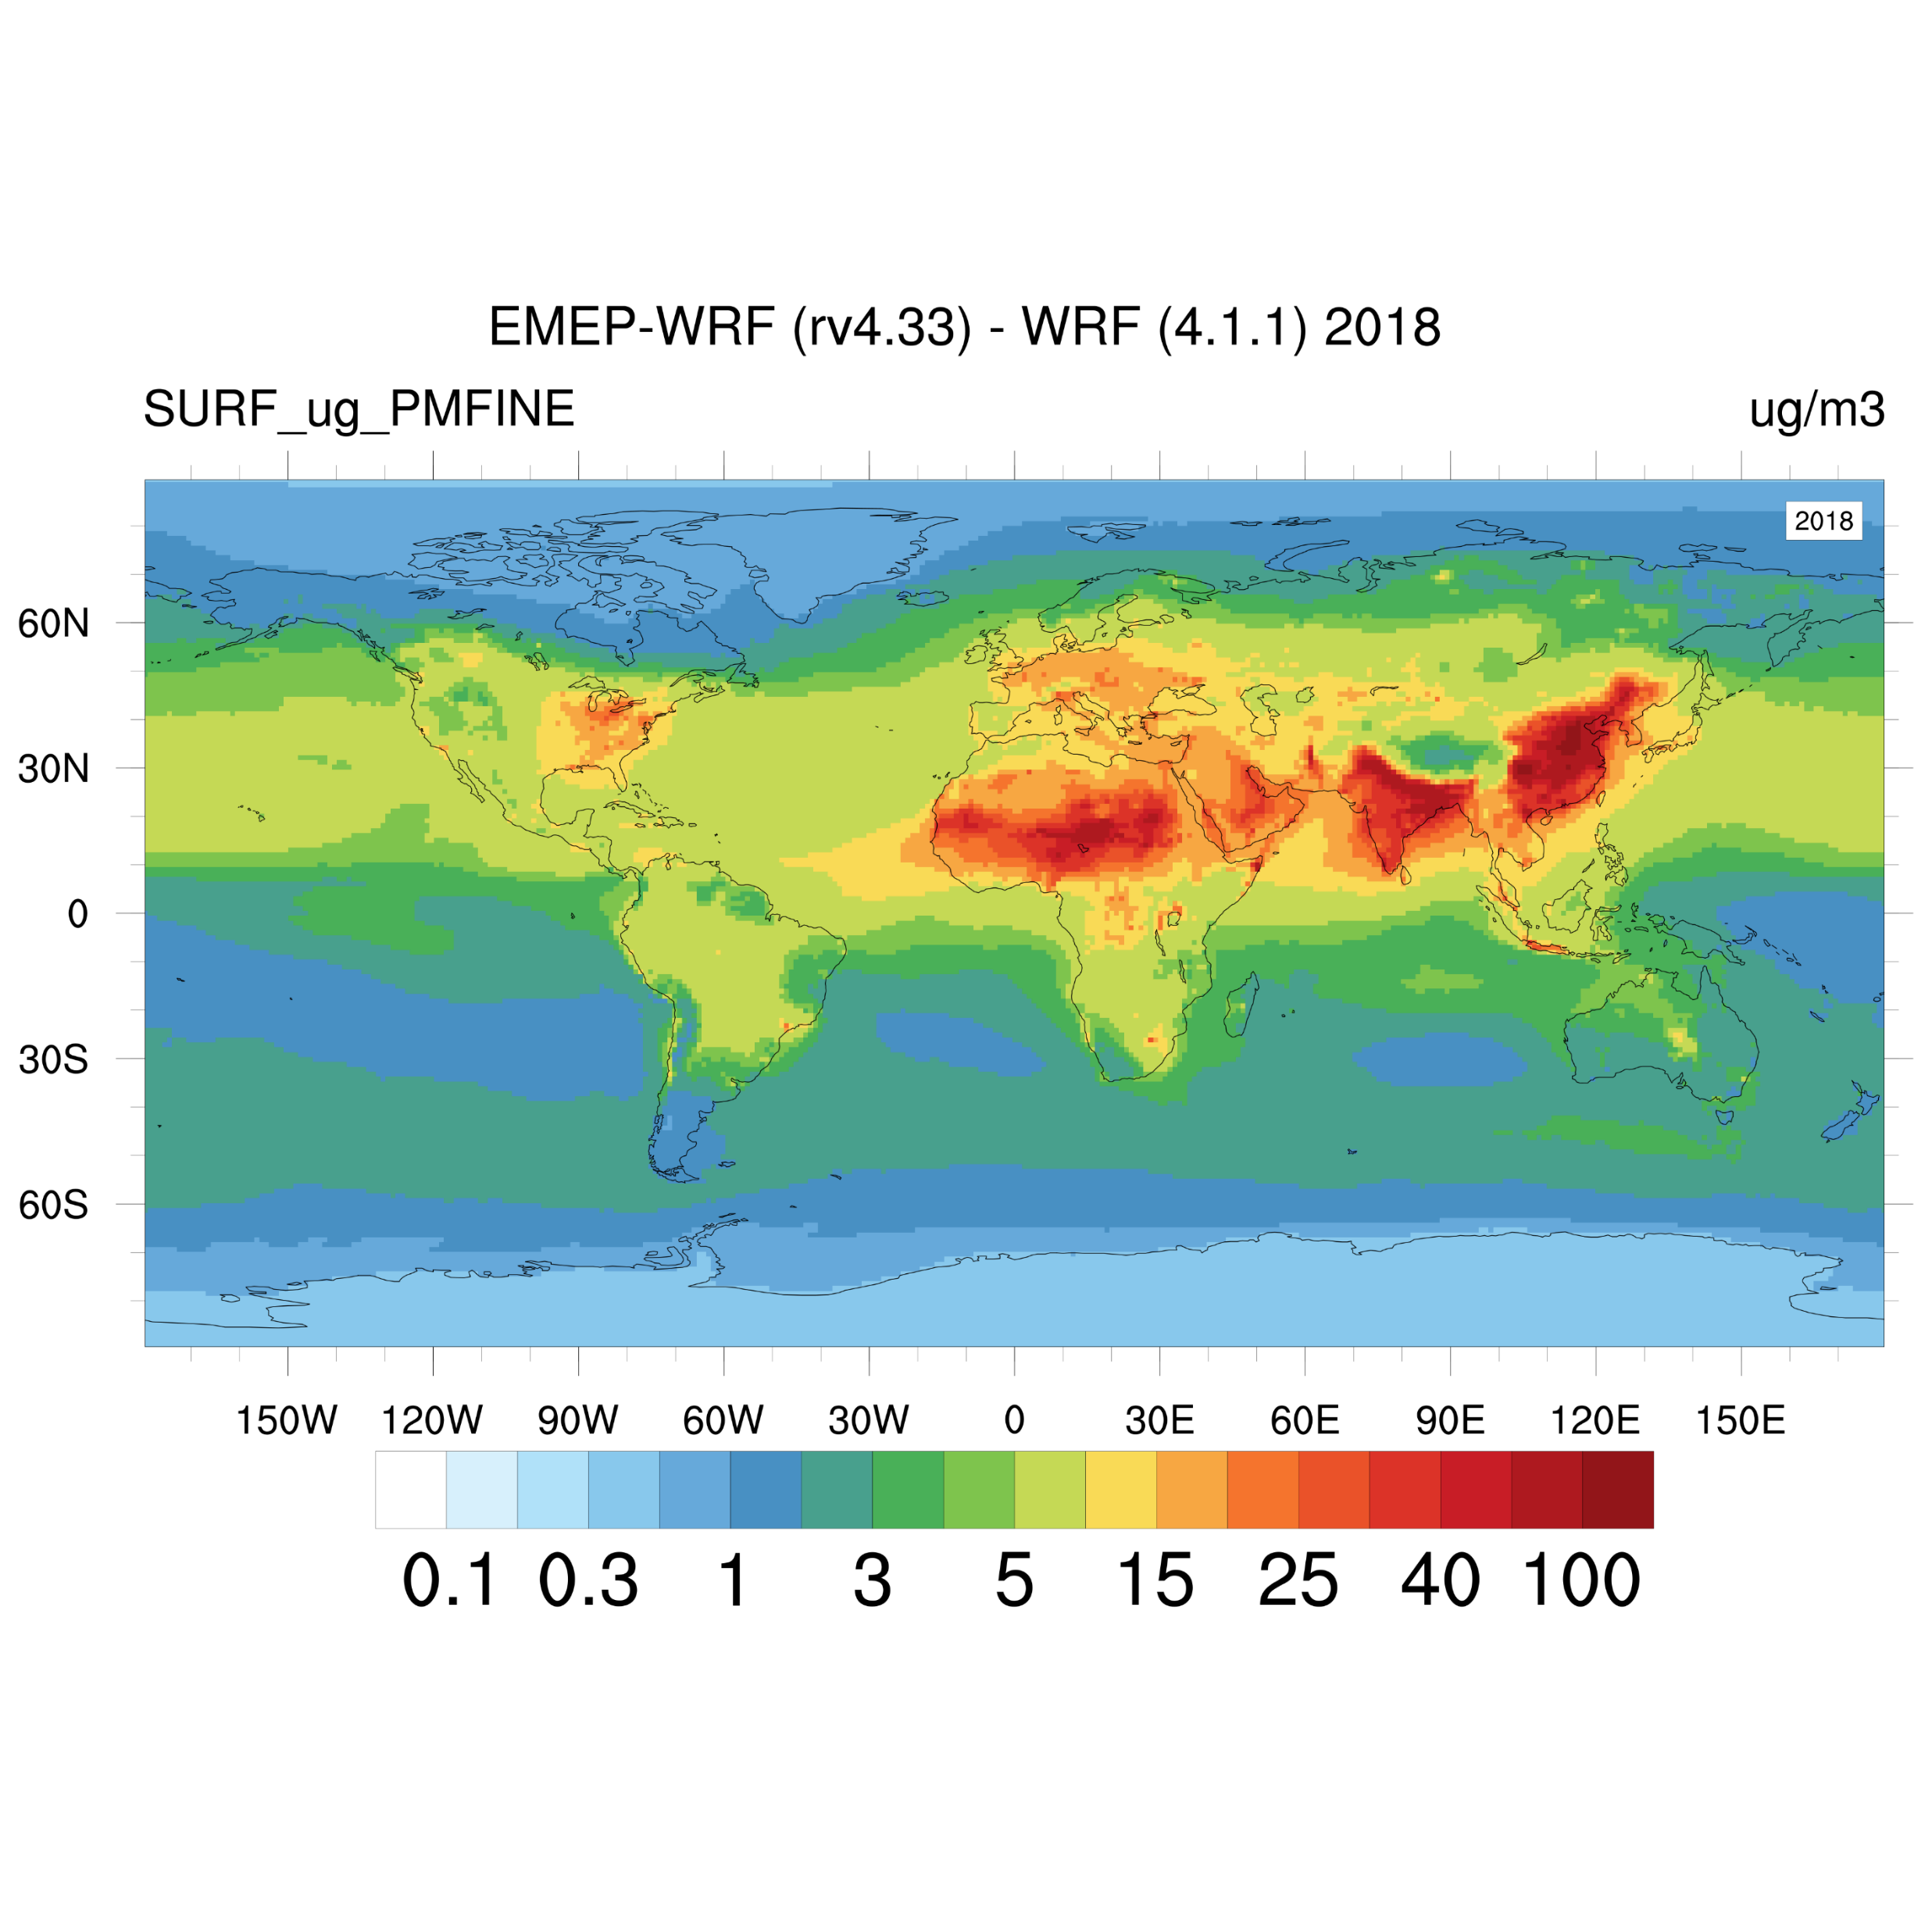
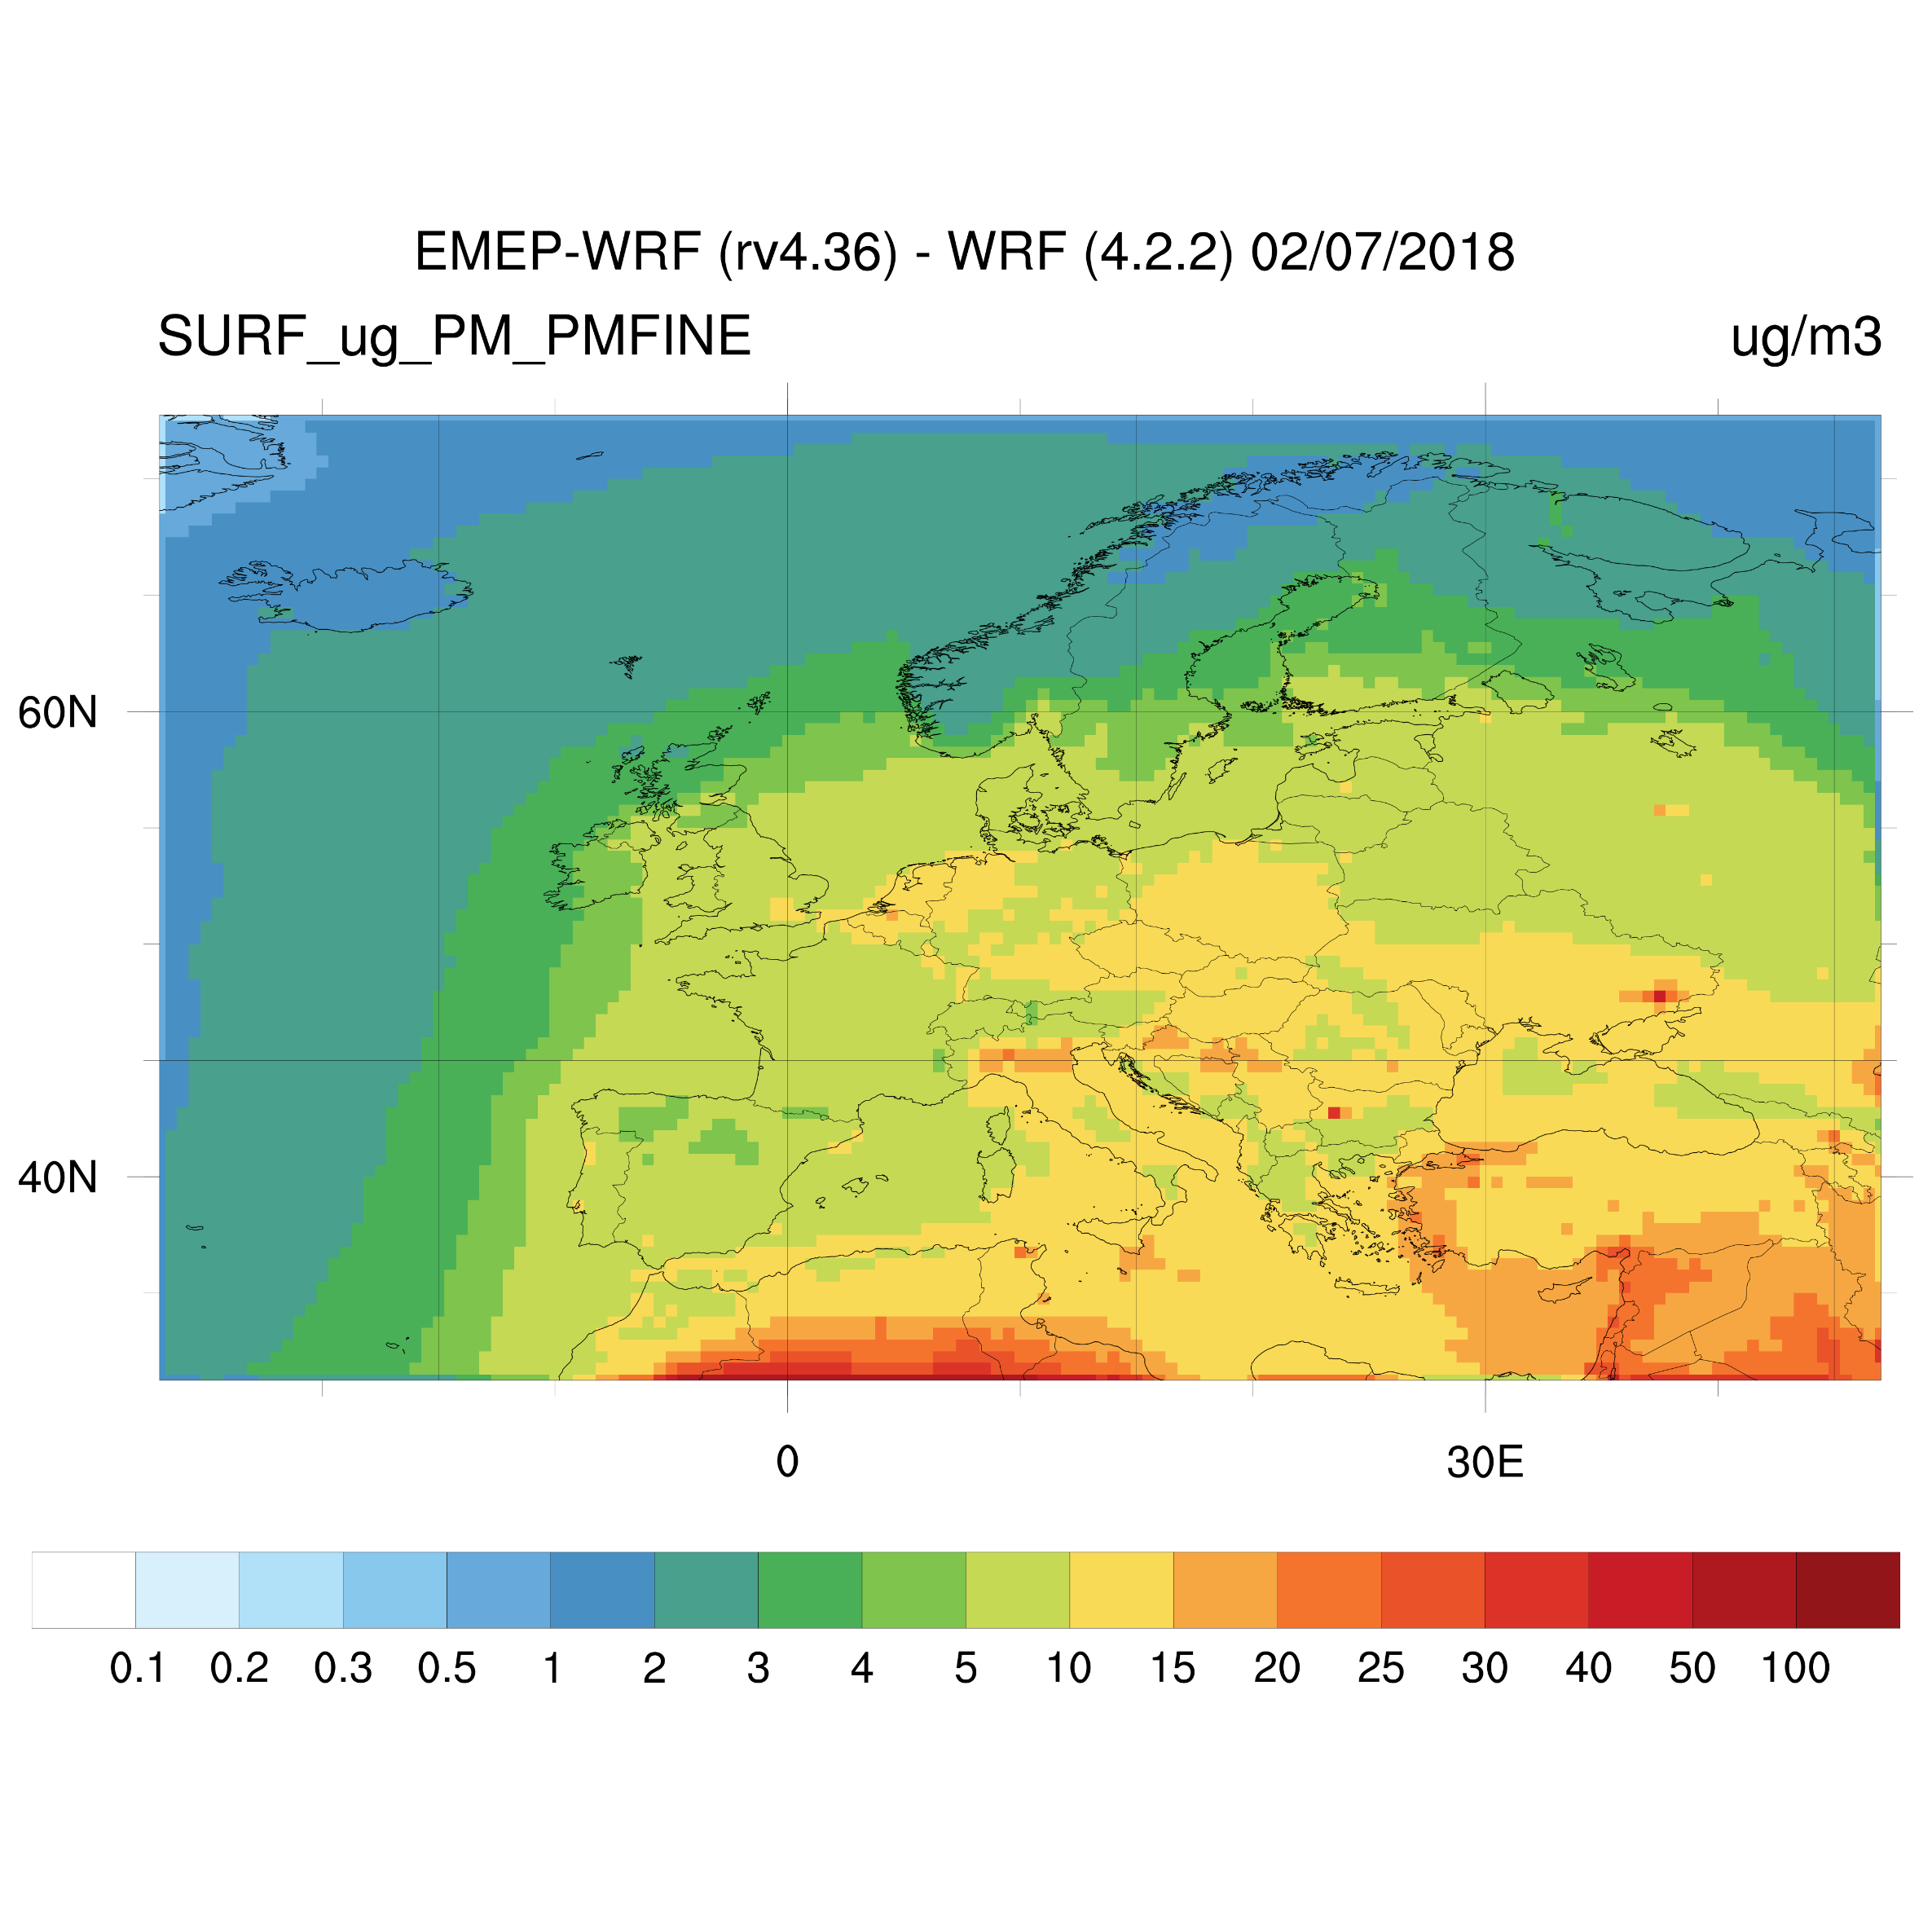
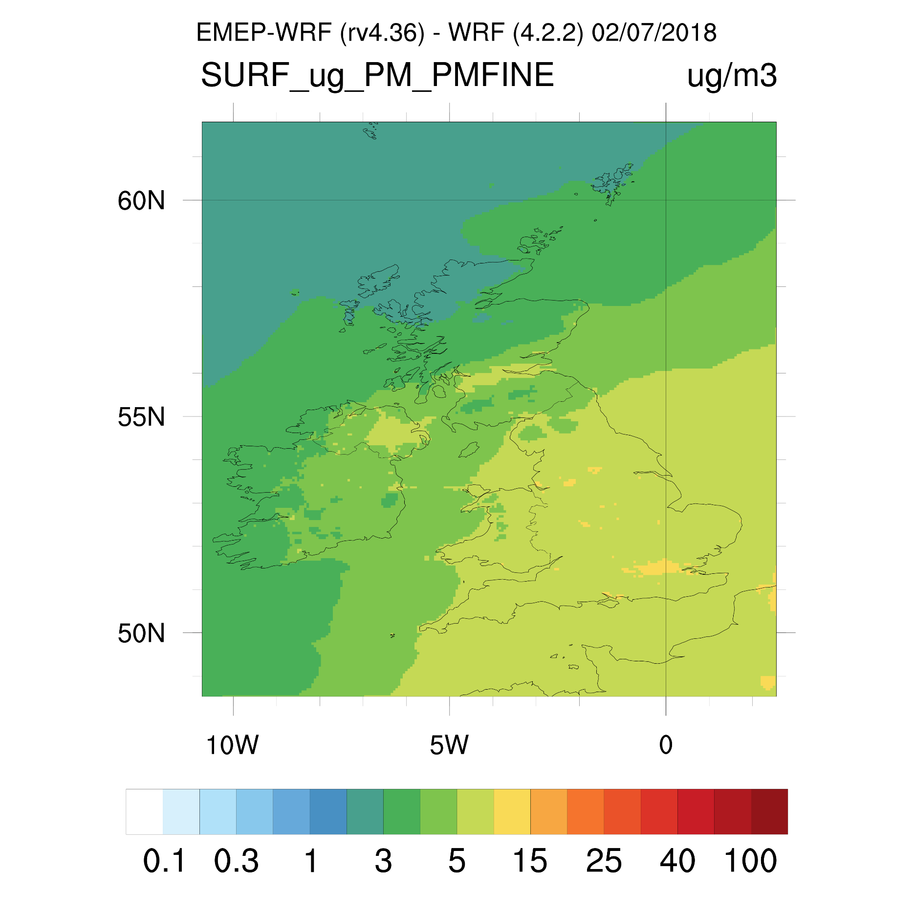
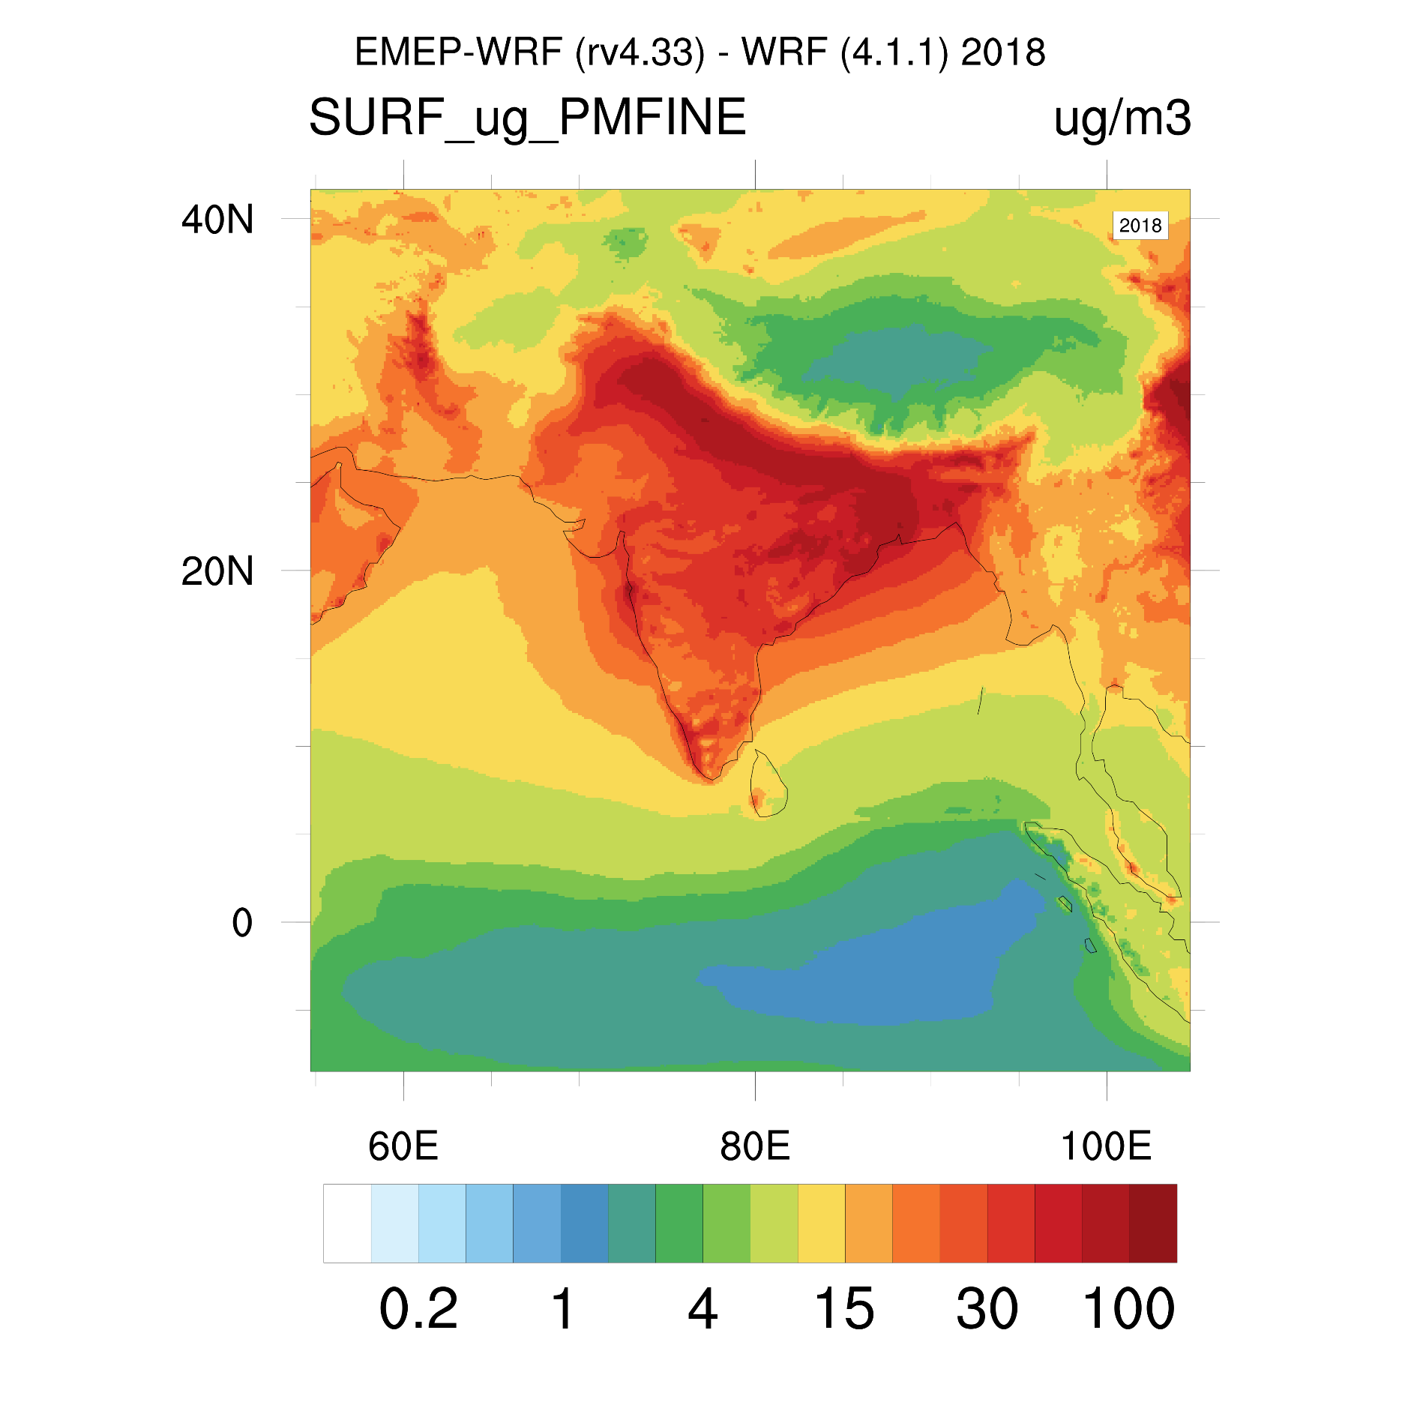
Global and UK 2018 annual mean PM_{2.5}
World
Europe
0.5°x0.5°
1°x1°
UK
South Asia
0.05°x0.05°
0.11°x0.11°

Slide 8
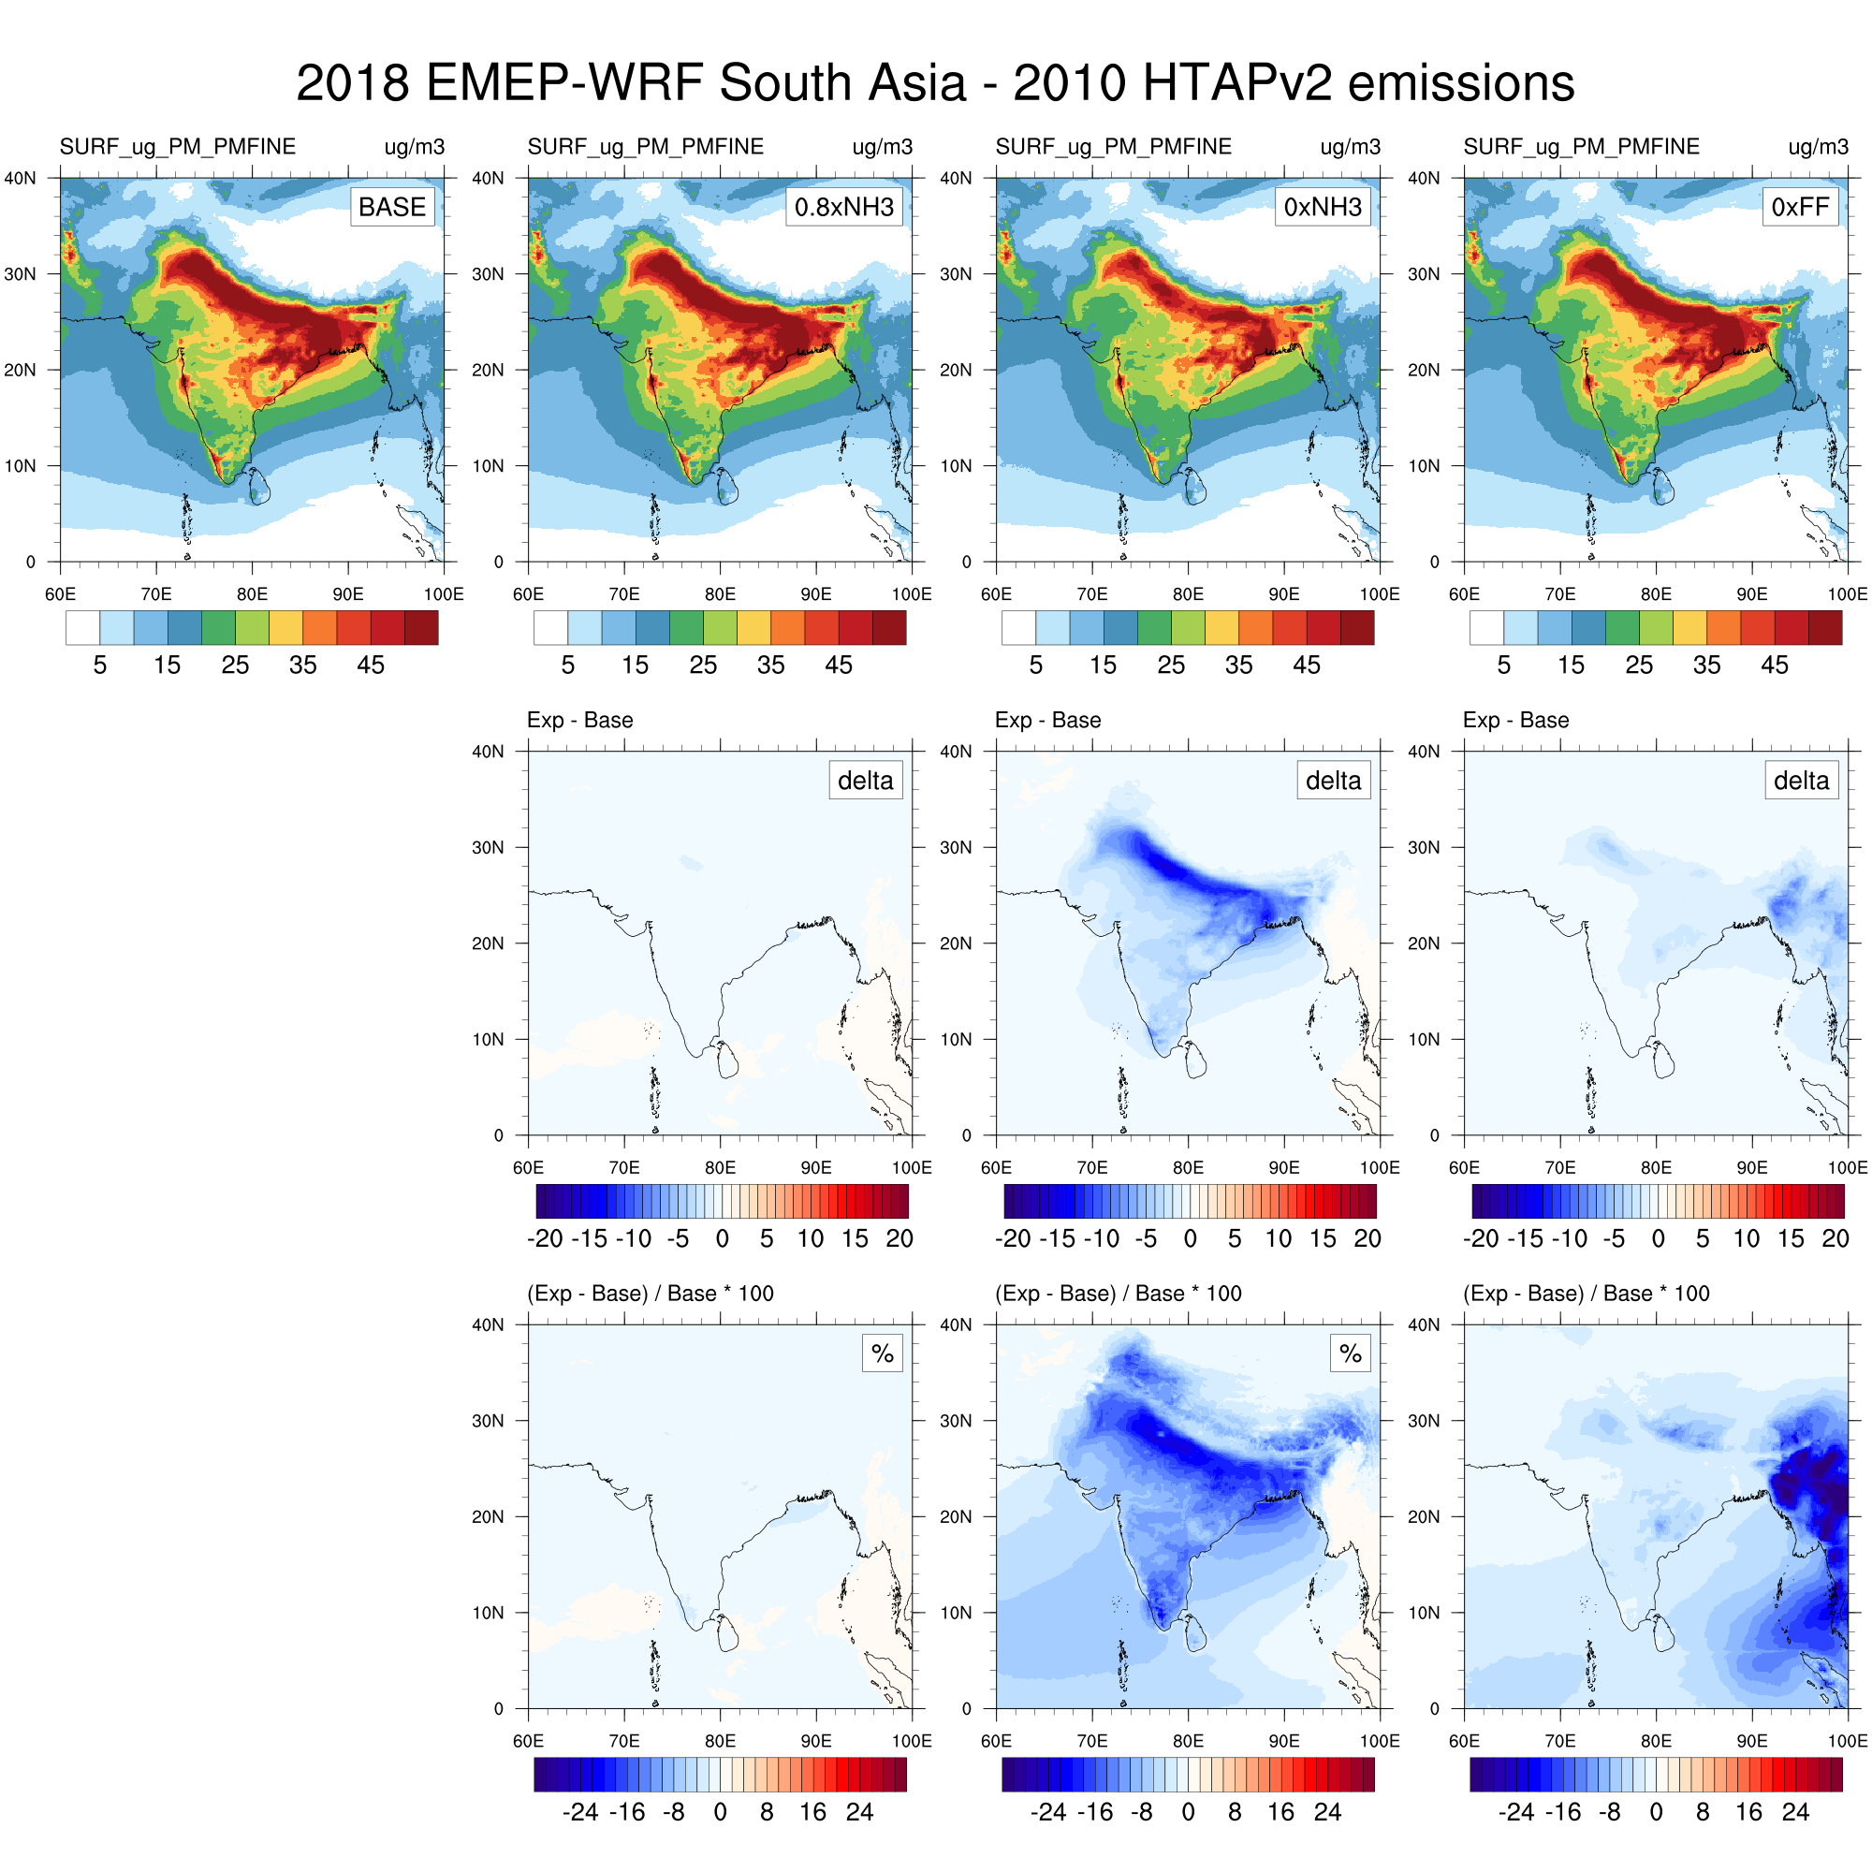
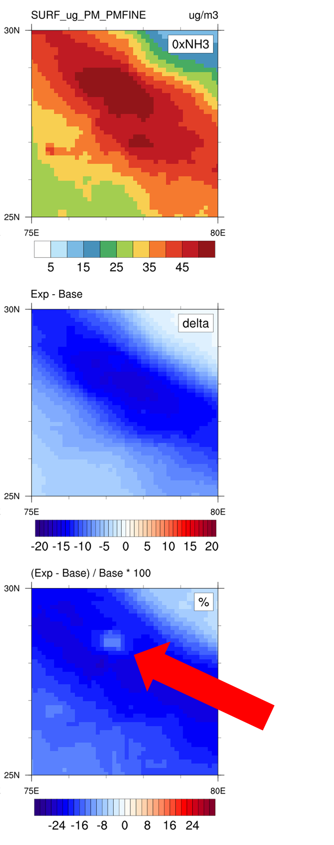
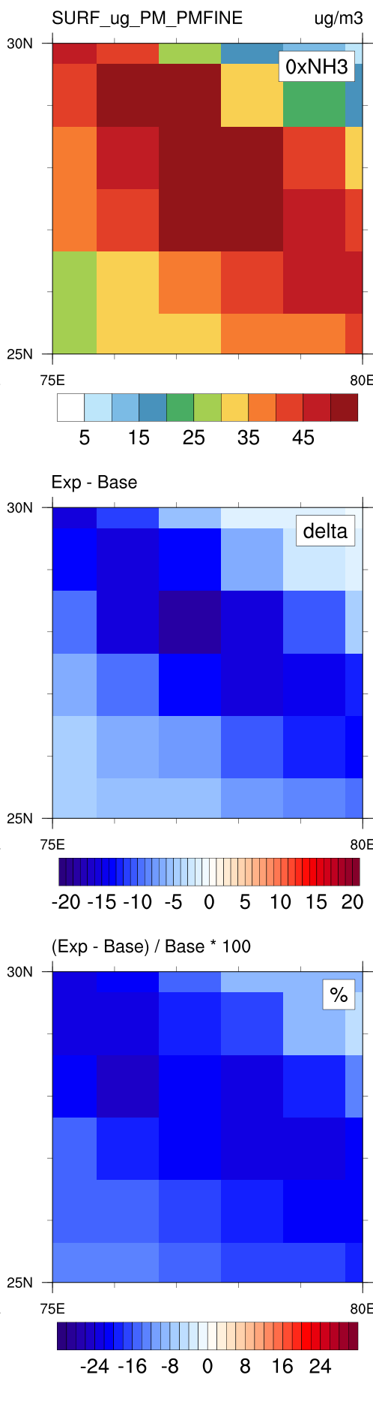
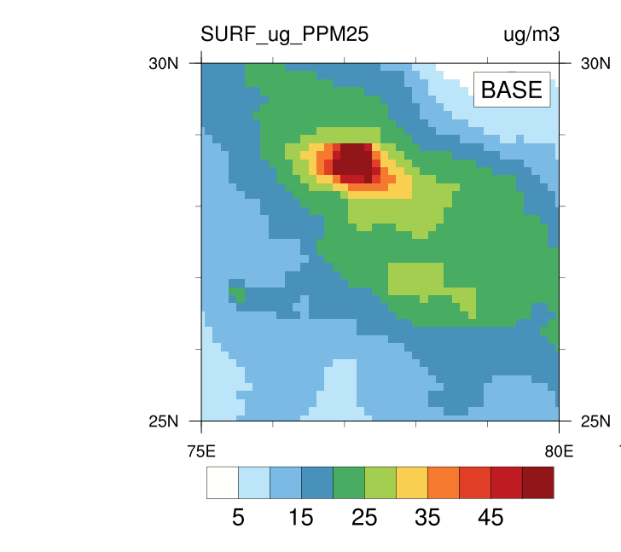
South Asia EMEP-WRF 2018 PM_{2.5} sensitivity to NH₃ reductions
Effect on the experiments on PM_{2.5}
1) A 20% NH₃ reduction reduces up to 2% PM_{2.5}
2) A full removal of NH₃ reduces up to 25% PM_{2.5}, however, in Delhi (red arrows) this percentage may be lower (~8%) as primary PM_{2.5} is the dominant source
3) Biomass burning contributes up to 30% in some areas
4) Coarser (1.0°x1.0°) model resolution gives higher percentage over Delhi (~16% vs ~8%)
0.11°x0.11°
0.11°x0.11°
1.0°x1.0°

Slide 9
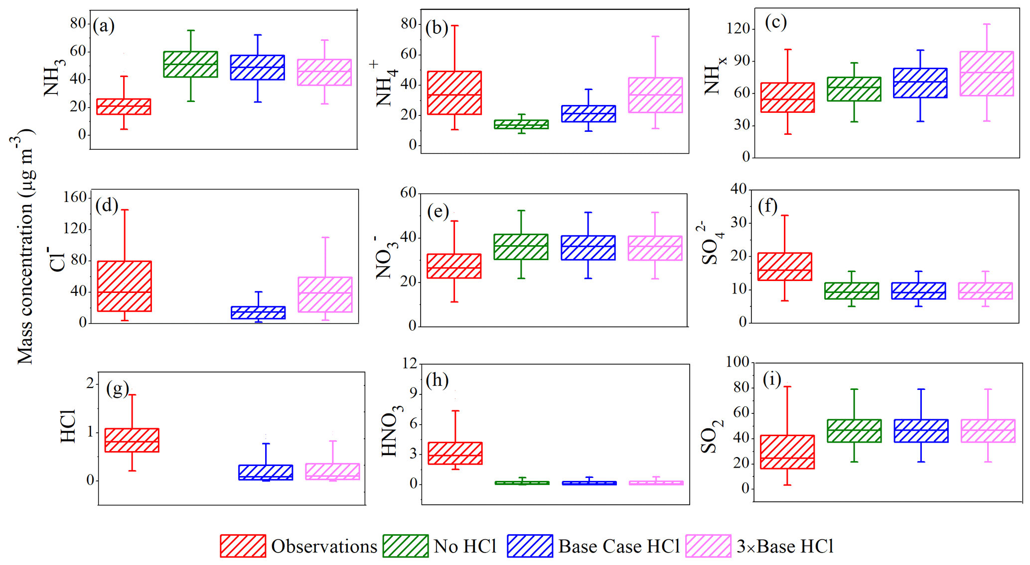
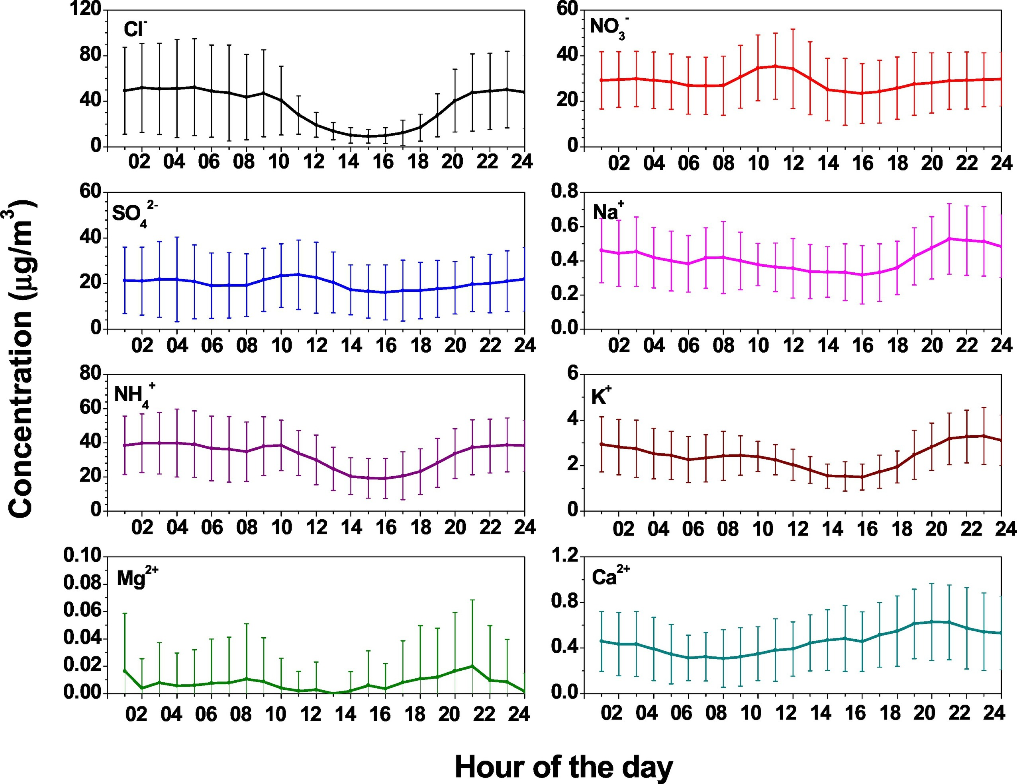
…recent studies shows the importance of HCl emissions in Delhi
Pawar et al. shows that adding HCl emissions over Delhi the results agree better with the observed PM_{2.5}
MARGA dataset at the Dheli airport
Box-and-whisker plot for trace gases and secondary inorganic aerosols from the observations (MARGA) and simulated in sensitivity test with changes in HCl emissions in no HCl (0 mol km⁻² h⁻¹), base case HCl (24.8 mol km⁻² h⁻¹), and 3 × base HCl (74 mol km⁻² h⁻¹) runs at IGIA, Delhi.
Pawar, P. V., Ghude, S. D., Govardhan, G., Acharja, P., Kulkarni, R., Kumar, R., Sinha, B., Sinha, V., Jena, C., Gunwani, P., Adhya, T. K., Nemitz, E., and Sutton, M. A.: Chloride (HCl ∕ Cl−) dominates inorganic aerosol formation from ammonia in the Indo-Gangetic Plain during winter: modeling and comparison with observations, Atmos. Chem. Phys., 23, 41–59, https://doi.org/10.5194/acp-23-41-2023, 2023.
Acharja, P., Ali, K., Trivedi, D.K., Safai, P.D., Ghude, S., Prabhakaran, T., Rajeevan, M. (2020) Characterization of atmospheric trace gases and water soluble inorganic chemical ions of PM1 and PM2.5 at Indira Gandhi International Airport, New Delhi during 2017–18 winter. Science of the Total Environment 729, 138800.

Slide 10
Few modifications of the EMEP model
Added the HCl and a specific PM_{2.5} particulate chloride (to avoid interfering with particulate chloride from sea salt)
Nitric acid and the PM_{f} deposition velocity and scavenging coefficient were used for HCl and pCl, respectively.
Monthly global HCl and pCl emissions
EDGAR+SANH monthly emissions
EQSAM (EMEP rv4.45) updated to deal with the new HCl and pCl
Using GenChem would have make this a bit easier ☺ (thanks to Dave)
Simpson, D., Bergström, R., Briolat, A., Imhof, H., Johansson, J., Priestley, M., and Valdebenito, A.: GenChem v1.0 – a chemical pre-processing and testing system for atmospheric modelling, Geosci. Model Dev., 13, 6447–6465, https://doi.org/10.5194/gmd-13-6447-2020, 2020

Slide 11
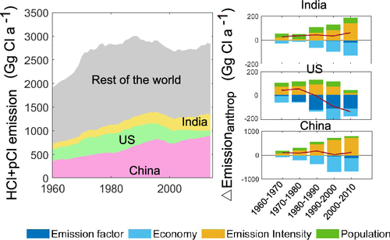
EMEP rv4.45 and HCl extension
We used a global HCl and primary pCl emissions at 0.1 x 0.1 degrees (Zhang et al., 2022)
Zhang, B., Shen, H., Yun, X., Zhong, Q., Henderson, B.H., Wang, X., Shi, L., Gunthe, S.S., Huey, L.G., Tao, S., Russell, A.G., Liu, P. (2022) Global Emissions of Hydrogen Chloride and Particulate Chloride from Continental Sources. Environmental Science & Technology 56, 3894-3904

Slide 12
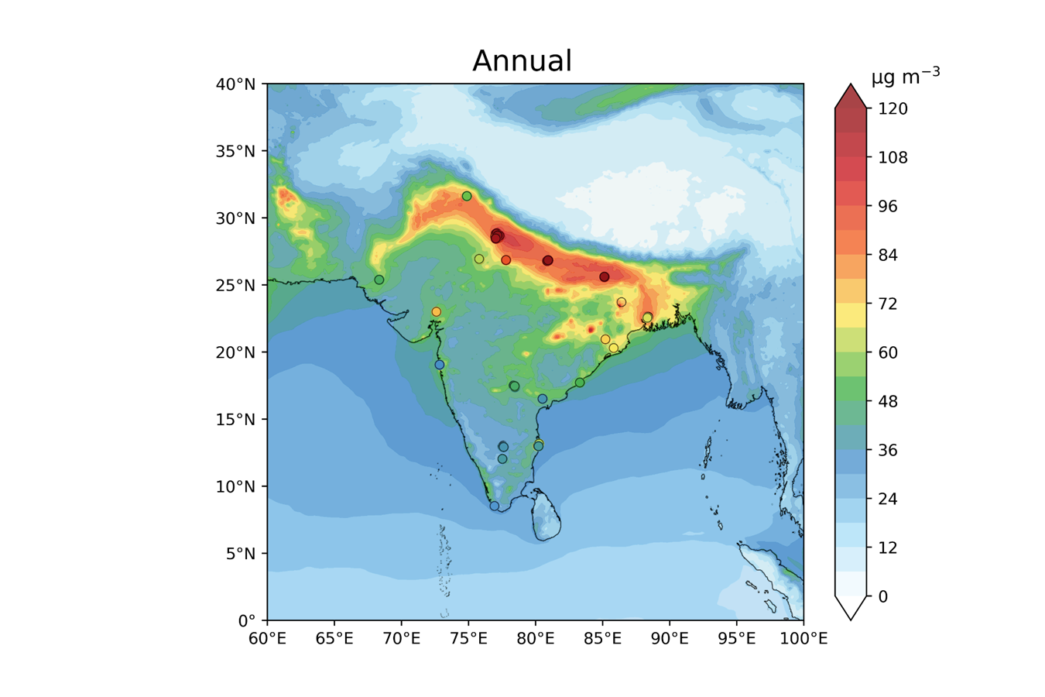
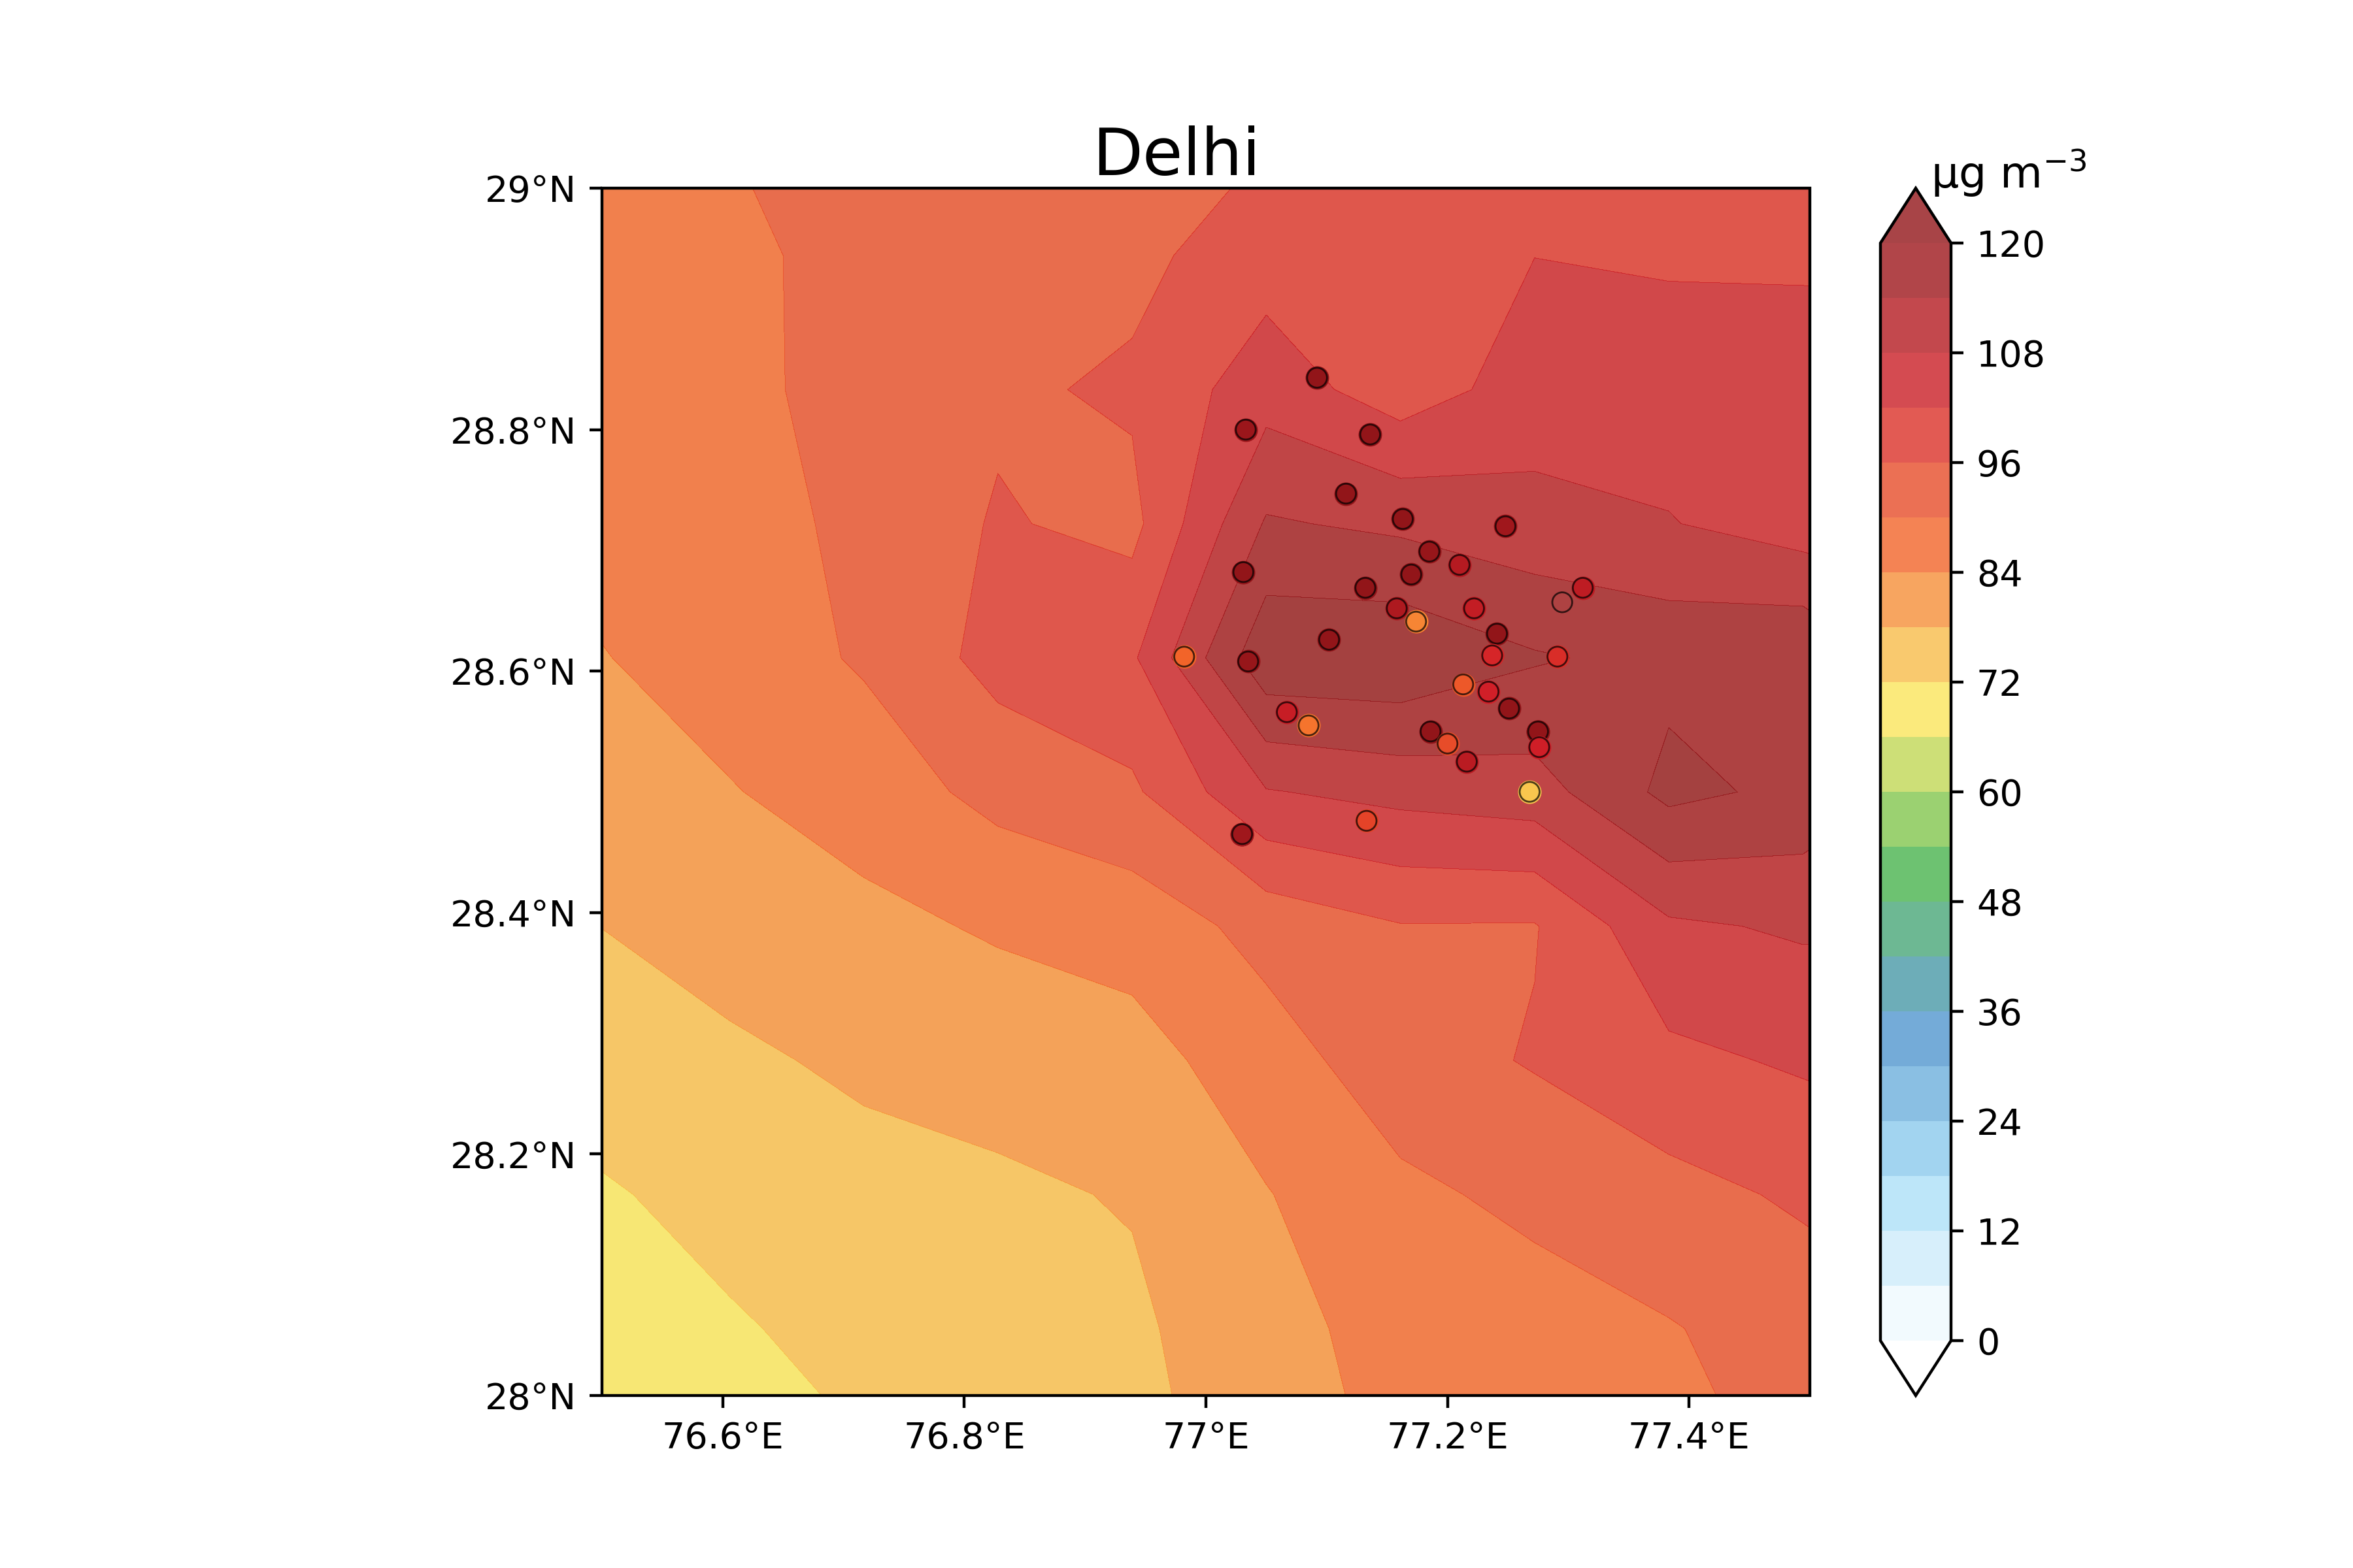
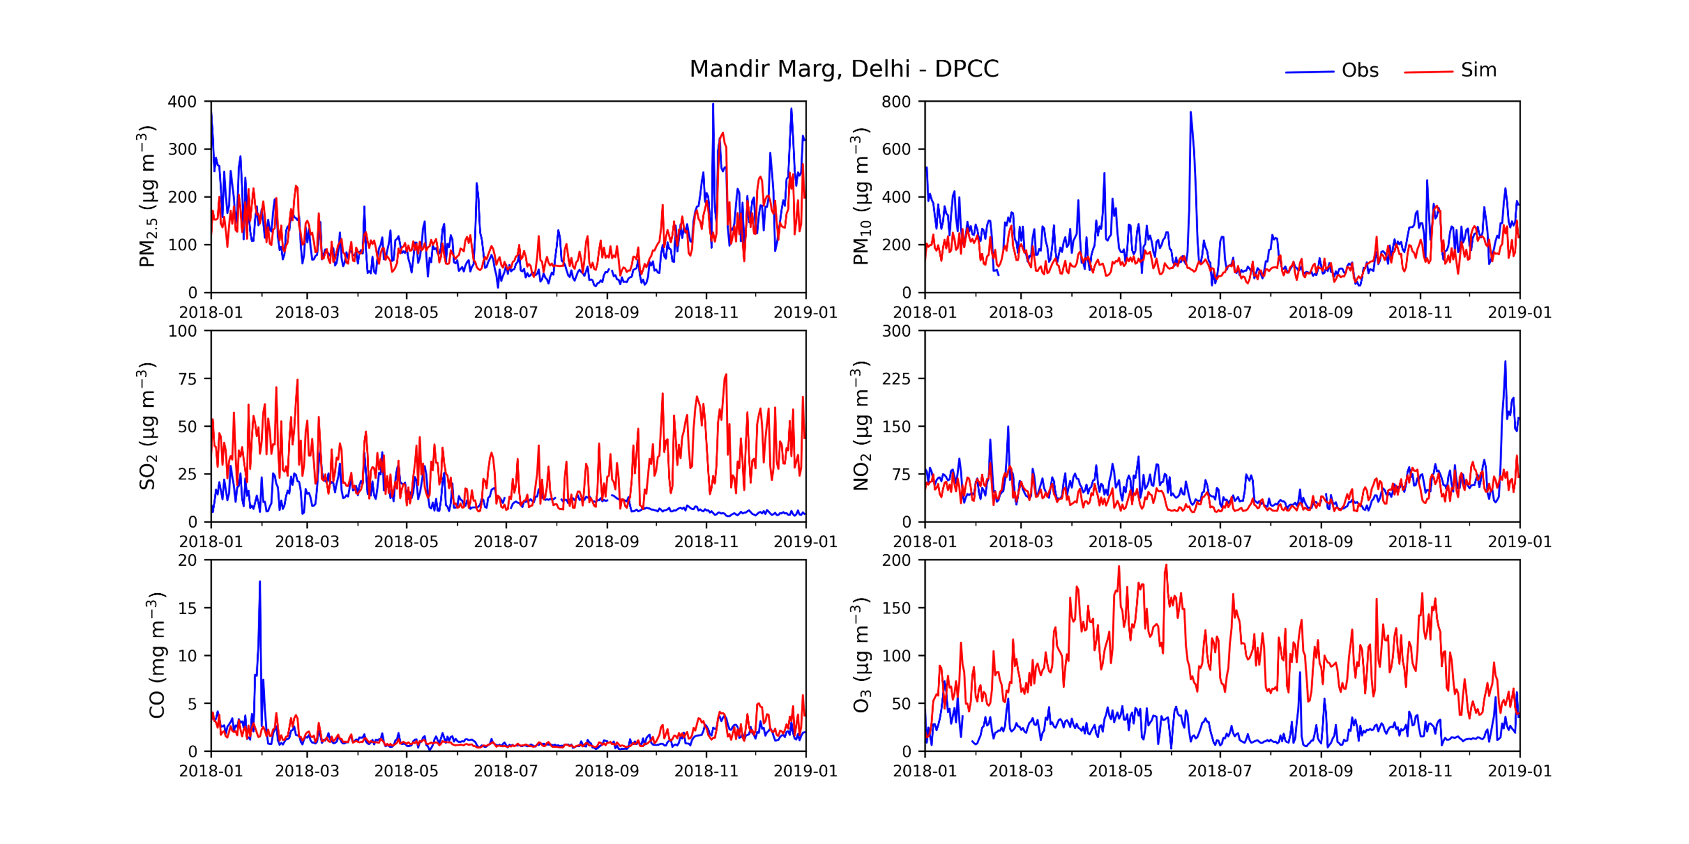

South Asia 2018 annual and daily mean PM_{2.5}
The model shows similar pattern for PM_{2.5} at several Indian sites
Other pollutants such as ozone are not what we expected, but when compared with measurement campaign data the model better capture ozone
Sulphur dioxide also shows some “uncharacteristic” pattern in the observations
https://cpcb.nic.in/
https://cpcb.nic.in/
Data uploaded using MOHAMED SHIRAZ notebook
India's Air Quality: EDA and Prediction | Kaggle
Python · geojson, Air Quality Data in India (2015 - 2020)

Slide 13
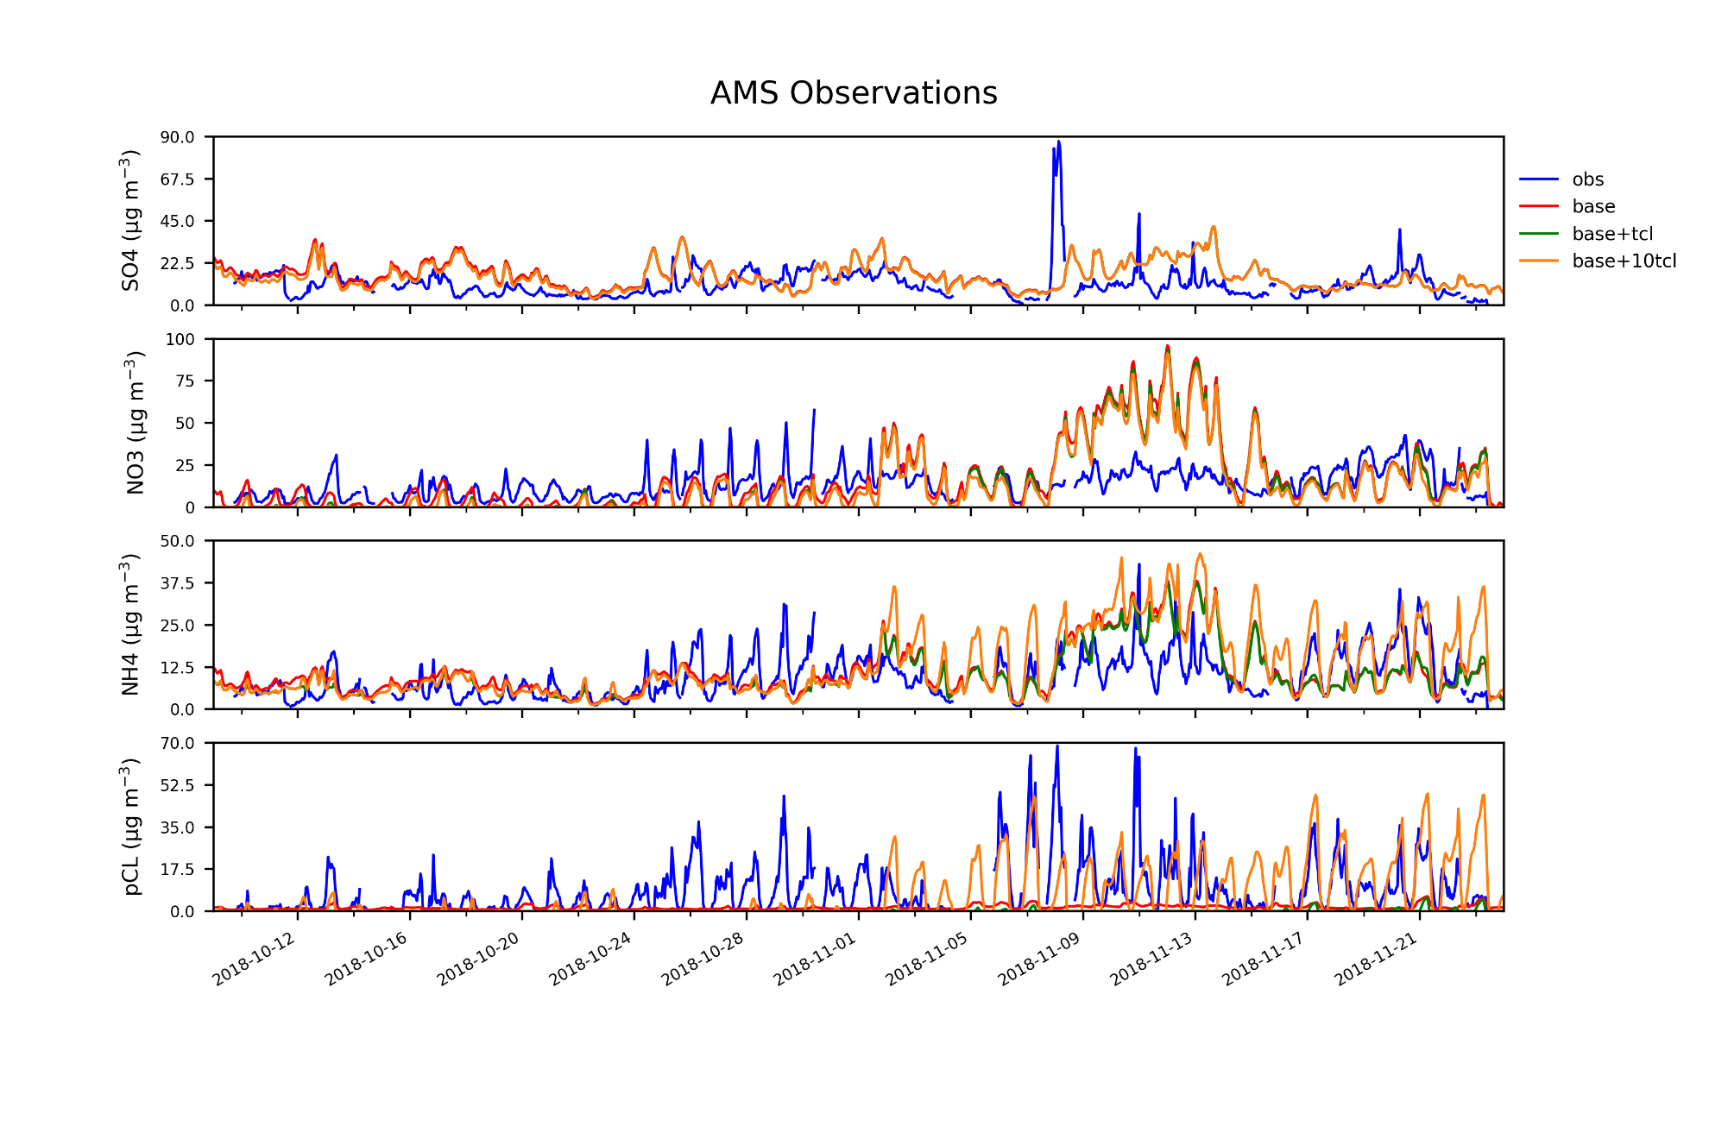
Sensitivity tests on the updated (EQSAM+HCL-pCL) EMEP model rv4.45
Preliminary results
NO₃
OBS hourly observations
RED uses the MARS thermodynamic scheme
GREEN updated EQSAM and a global emissions of HCl and primary pCl
YELLOW updated EQSAM and a global
emissions of 10xHCl and 10x primary pCl
NH₄
Cash, J. M., Langford, B...., and Nemitz, E.: Seasonal analysis of submicron aerosol in Old Delhi using high-resolution aerosol mass spectrometry: chemical characterisation, source apportionment and new marker identification, Atmos. Chem. Phys., 21, 10133–10158.
pCl
Obseravation site at:
Delhi, at IGDTUW https://www.igdtuw.ac.in/
Indira Gandhi Delhi Technical University For Women
APHH-Delhi campaign, and aerosol is provided by UKCEH, Eiko Nemitz

Slide 14
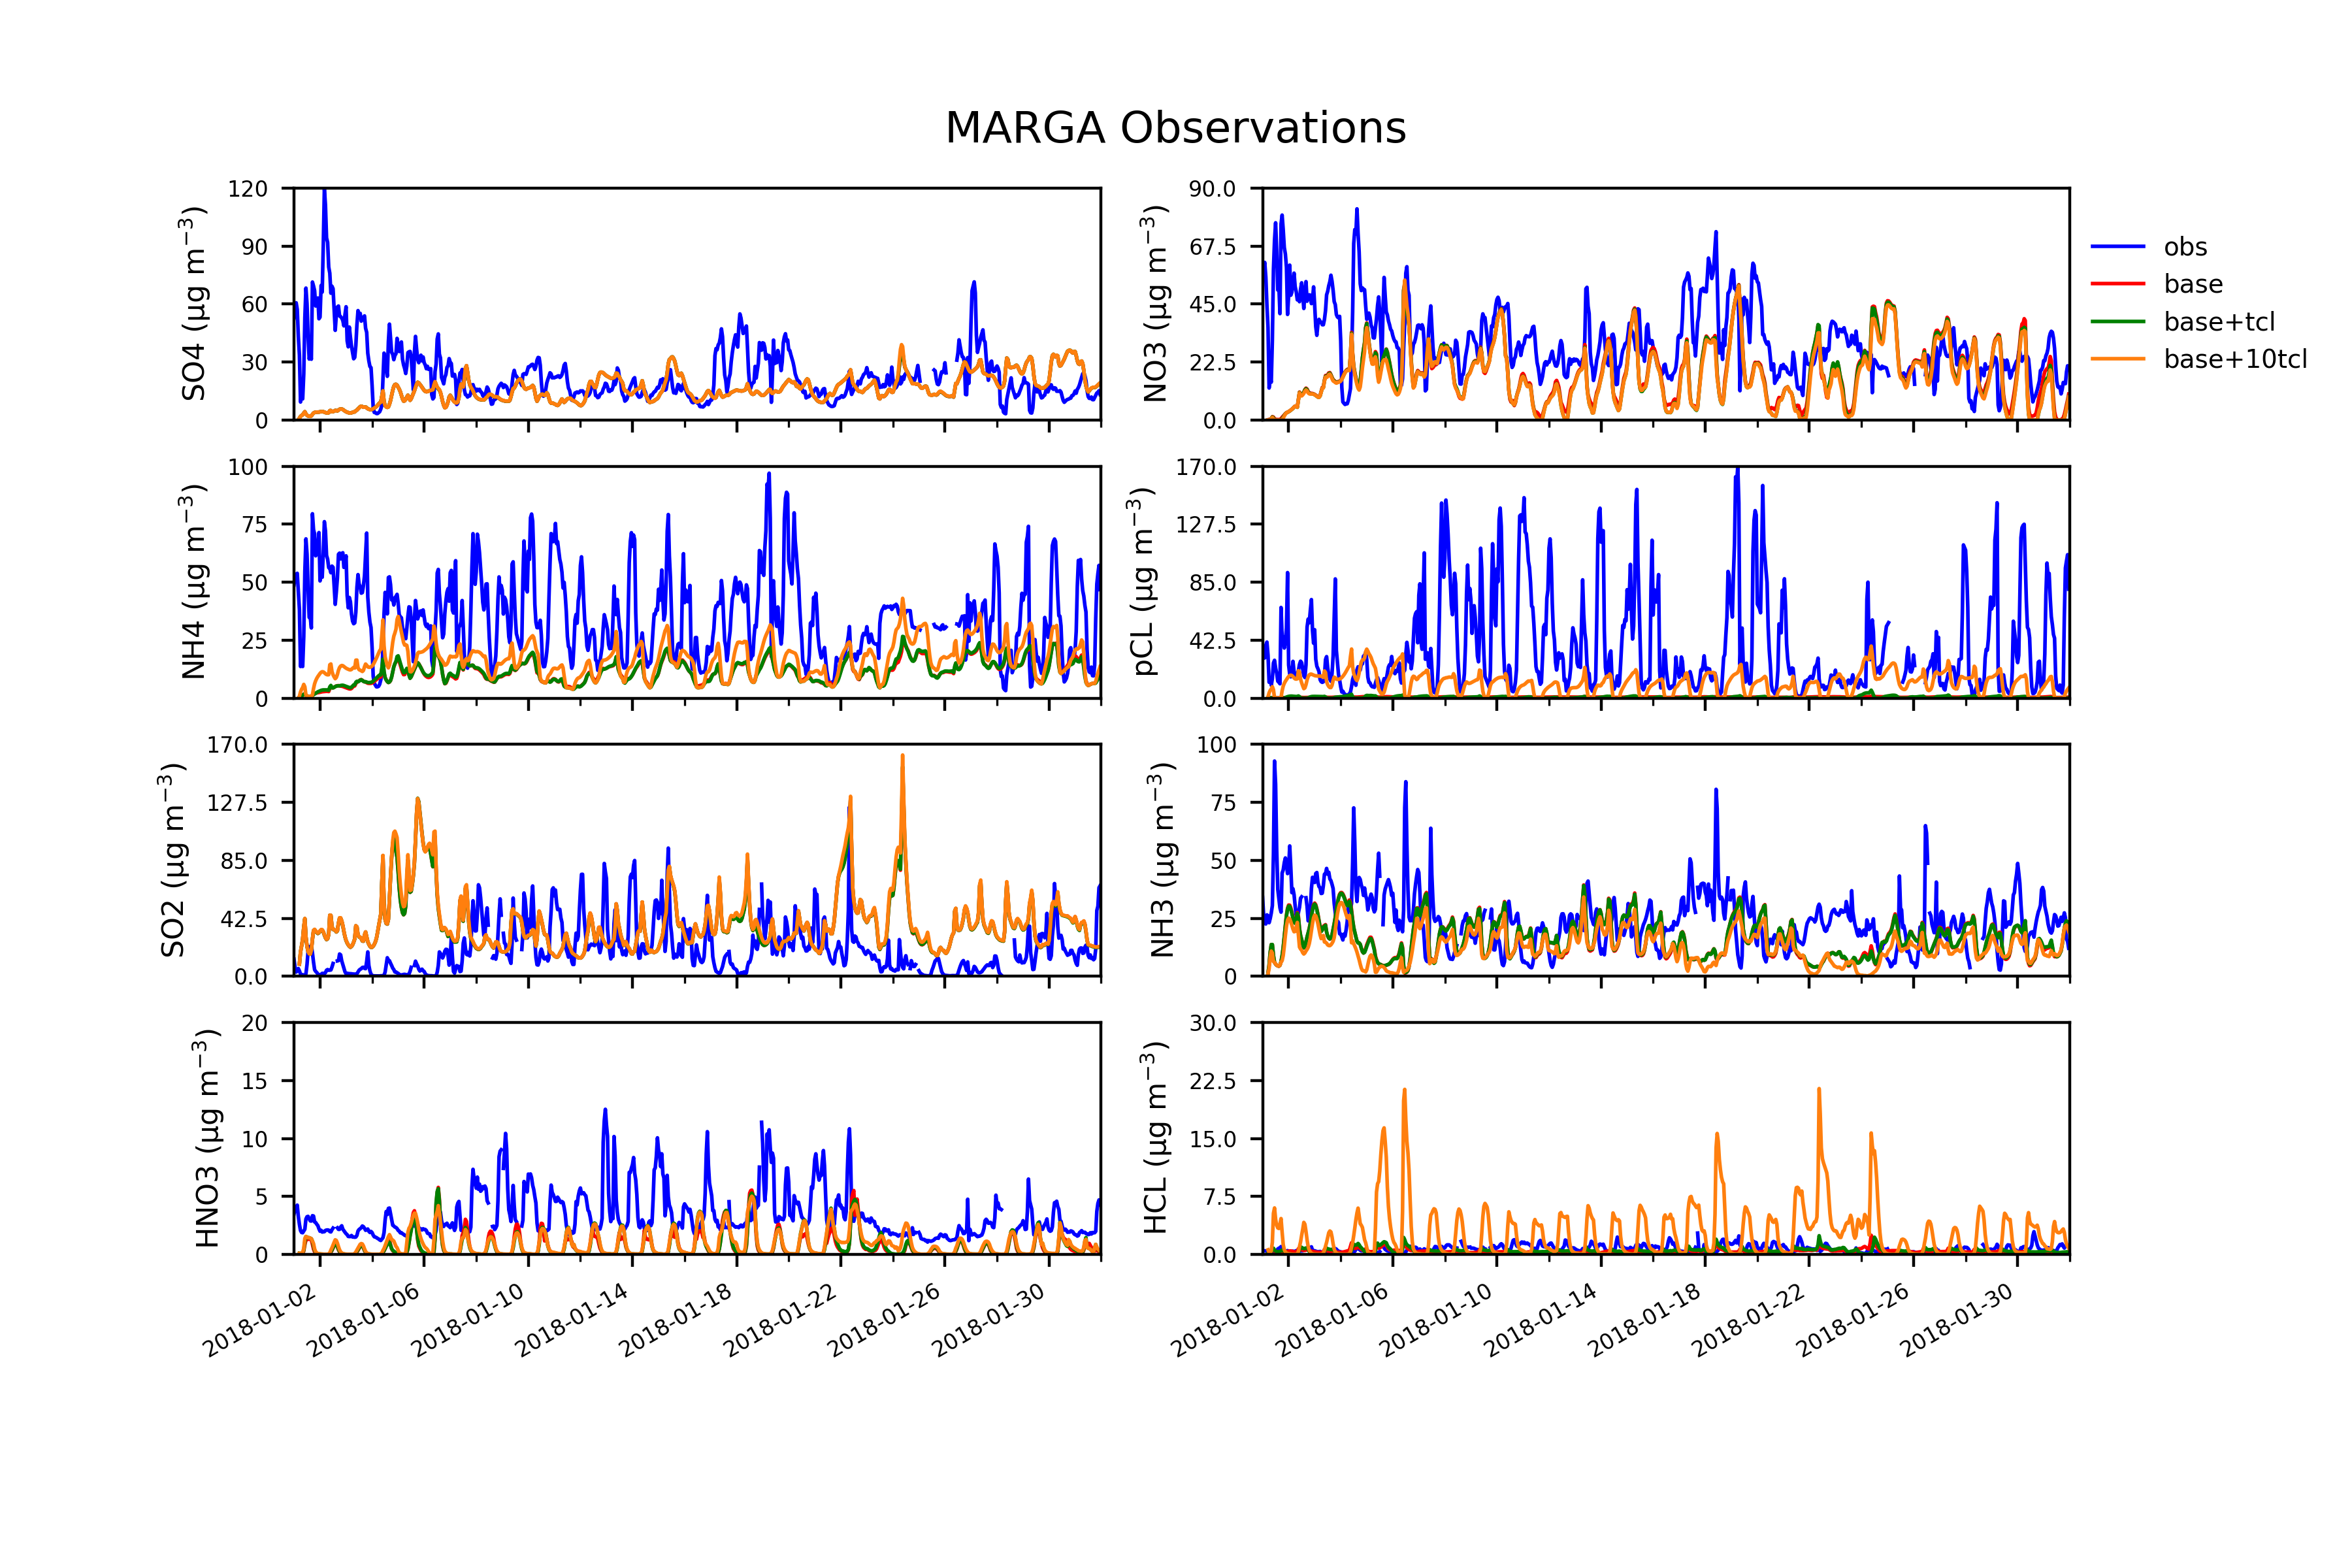
Sensitivity tests on the updated (EQSAM+HCL-pCL) EMEP model rv4.45
Preliminary results
OBS hourly observations
RED uses the MARS thermodynamic scheme
GREEN updated EQSAM and a global emissions of HCl and primary pCl
YELLOW updated EQSAM and a global emissions of 10xHCl and 10xprimary pCl
Acharja, P., Ali, K., Trivedi, D.K., Safai, P.D., Ghude, S., Prabhakaran, T., Rajeevan, M. (2020) Characterization of atmospheric trace gases and water soluble inorganic chemical ions of PM1 and PM2.5 at Indira Gandhi International Airport, New Delhi during 2017–18 winter. Science of the Total Environment 729, 138800.
Pawar, P. V., Ghude, S. D., Govardhan, G., Acharja, P., Kulkarni, R., Kumar, R., Sinha, B., Sinha, V., Jena, C., Gunwani, P., Adhya, T. K., Nemitz, E., and Sutton, M. A.: Chloride (HCl ∕ Cl−) dominates inorganic aerosol formation from ammonia in the Indo-Gangetic Plain during winter: modeling and comparison with observations, Atmos. Chem. Phys., 23, 41–59, https://doi.org/10.5194/acp-23-41-2023, 2023.

Slide 15
The EMEP-WRF + HCl seems to address in part the particulate Cl observed from the AMS when the global emissions are multiplied by 10.
However, the model does not reproduce the high value of particulate chloride observed by the MARGA instrument deployed at Delhi airport in Jan 2018
What to do next?
Under SANH the timing of NH₃ have been revised, we may extend this to other pollutants
Higher resolution EMEP and perhaps uEMEP over Delhi
Better understanding the observations vs model results
Revise the EQSAM+HCl scheme and perhaps look at the WRF-Chem aerosols scheme

Slide 16
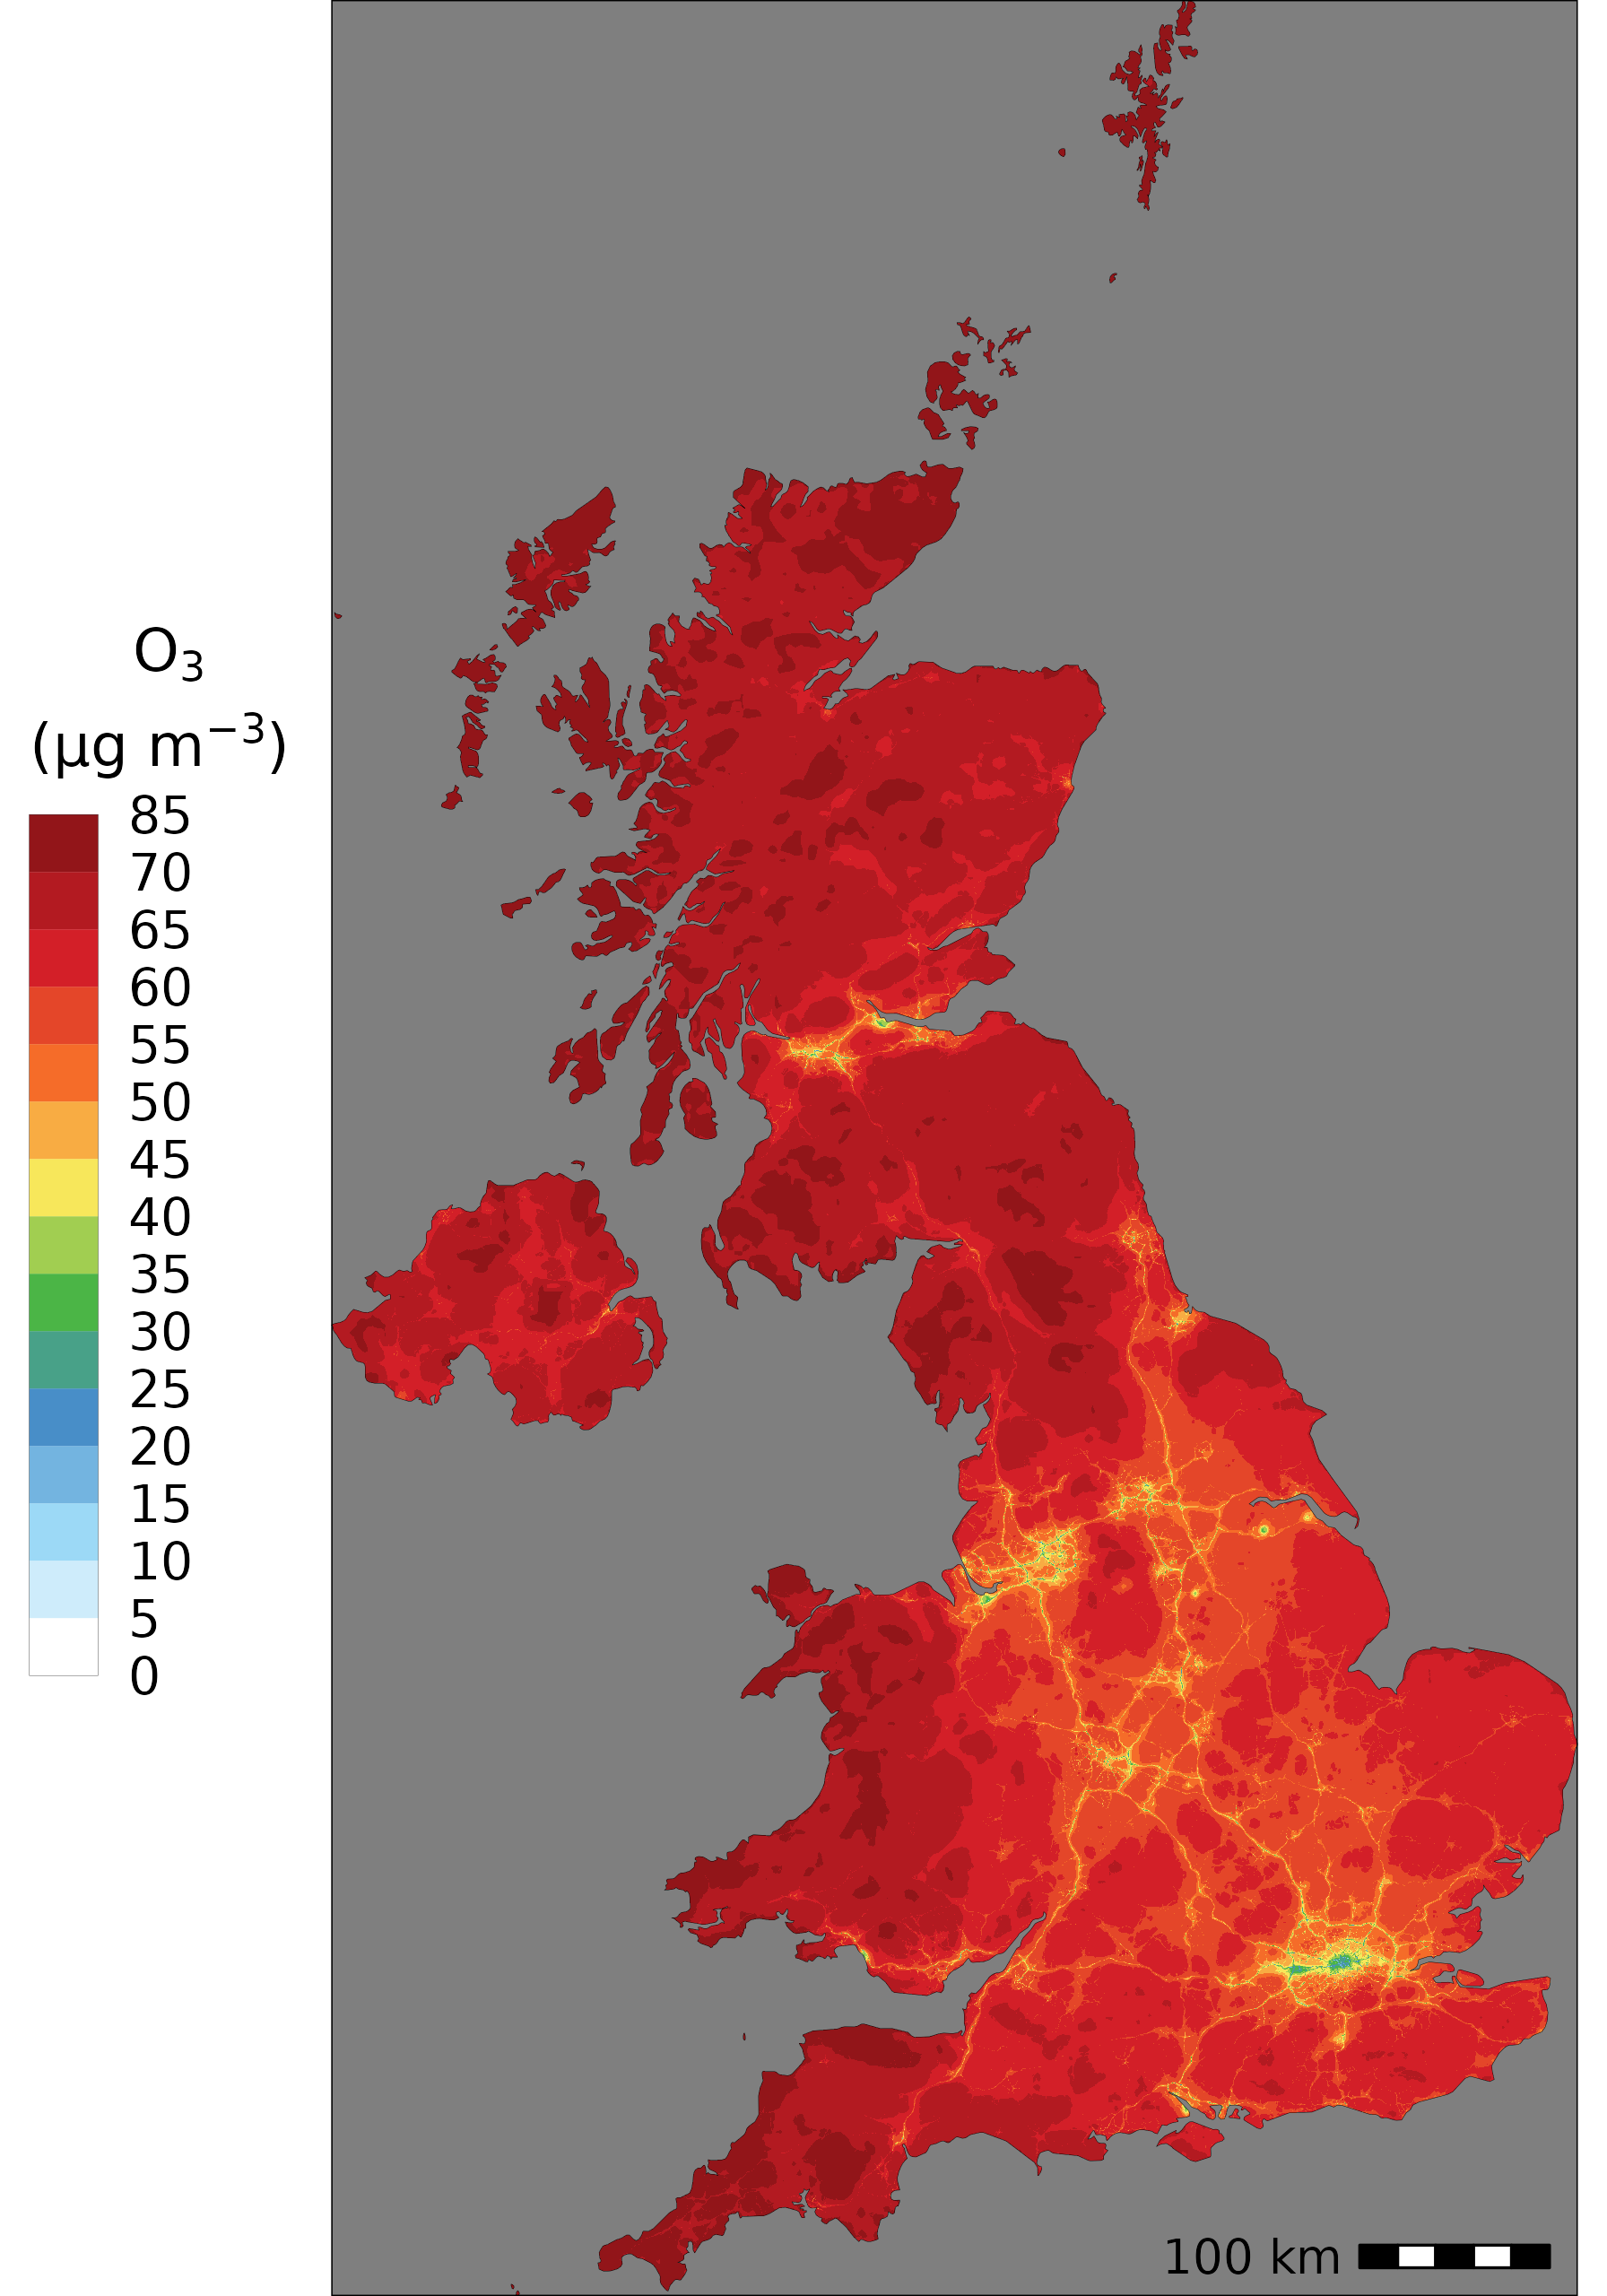
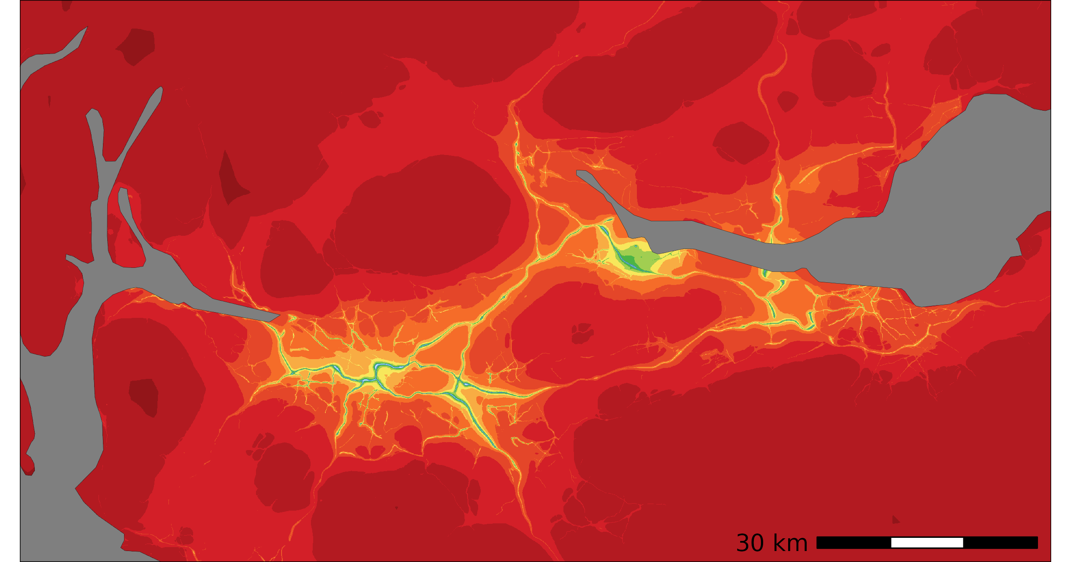
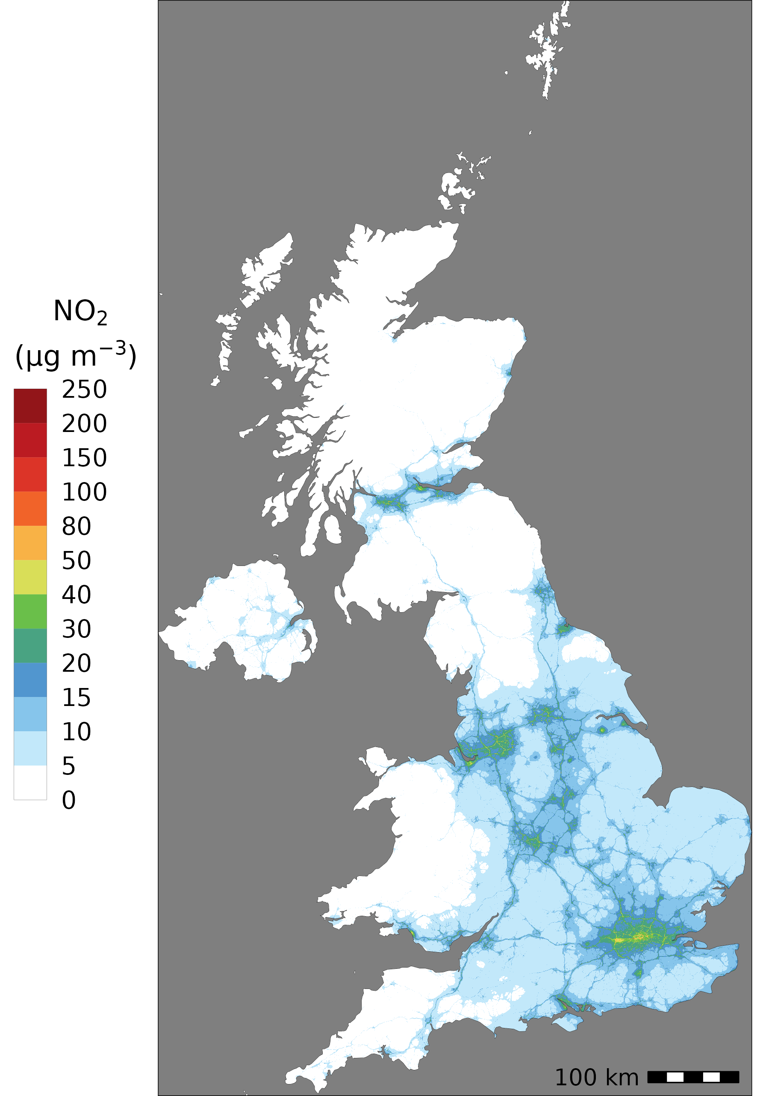
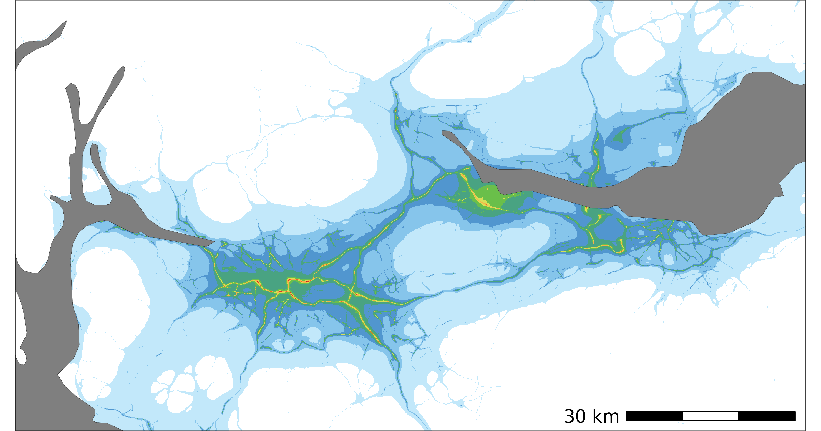
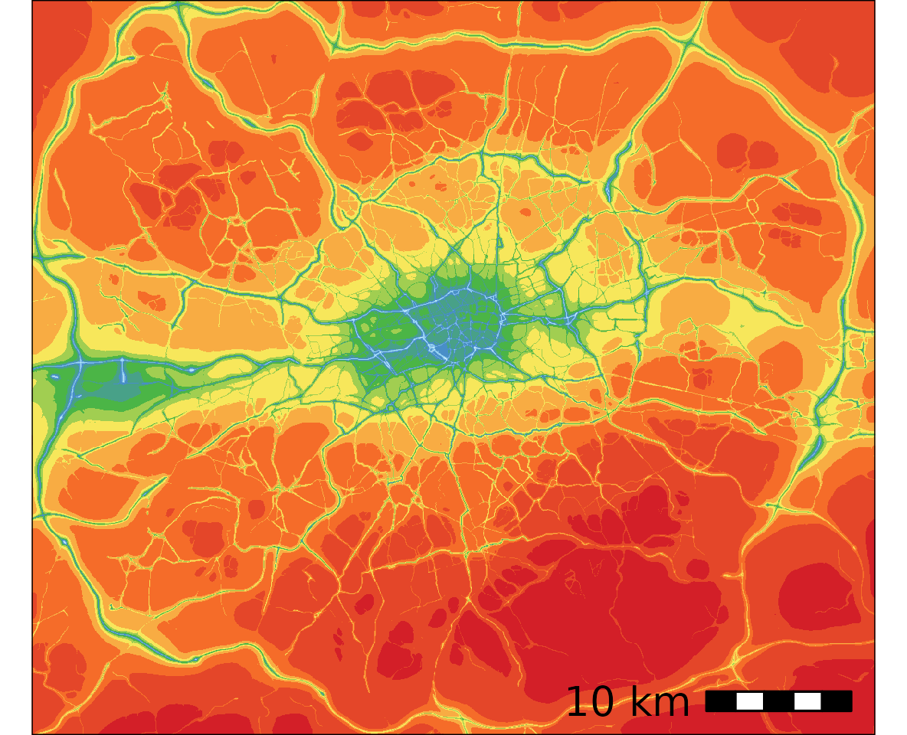
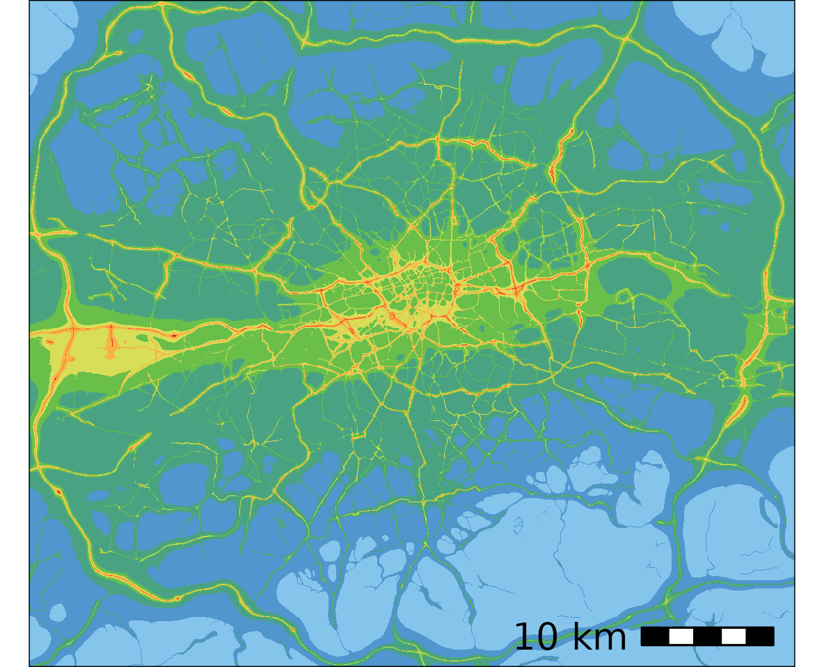
We may extend the uEMEP to Delhi to distinguish between locally produced and long range generated air pollution
The EMEP4UK was successfully applied at 50x50 m² for the whole UK
Mu, Q., Denby, B. R., Wærsted, E. G., and Fagerli, H.: Downscaling of air pollutants in Europe using uEMEP_v6, Geosci. Model Dev., 15, 449–465, https://doi.org/10.5194/gmd-15-449-2022, 2022

Slide 17
Summary and conclusions
HCl is a very important pollutant that need to be included for South Asia
The available speciated observations are mainly focused in Dehli, and this may bias the model development (other campaigns may be available)
The complexity of the chemical and mereological interaction may not be captured at the coarse resolution of ~10x10km²
Emissions are, as usual critical; missing sources, biogenic, timing, …
The EMEP model was relatively easy to update
Many thanks

Slide 18
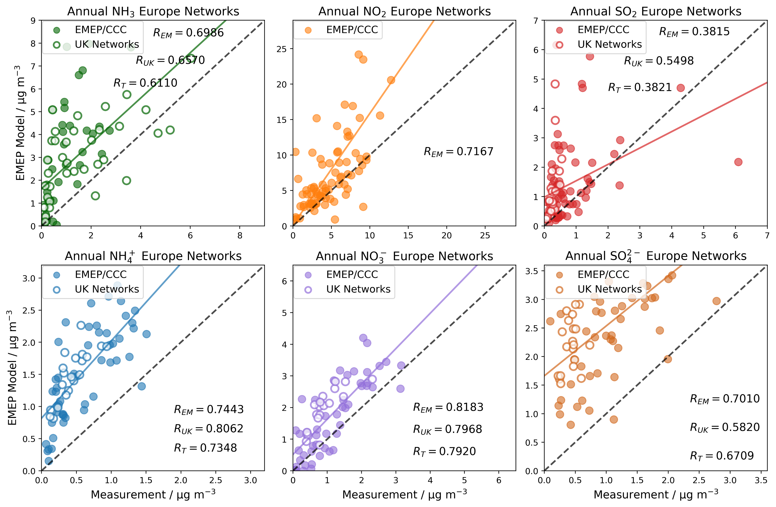
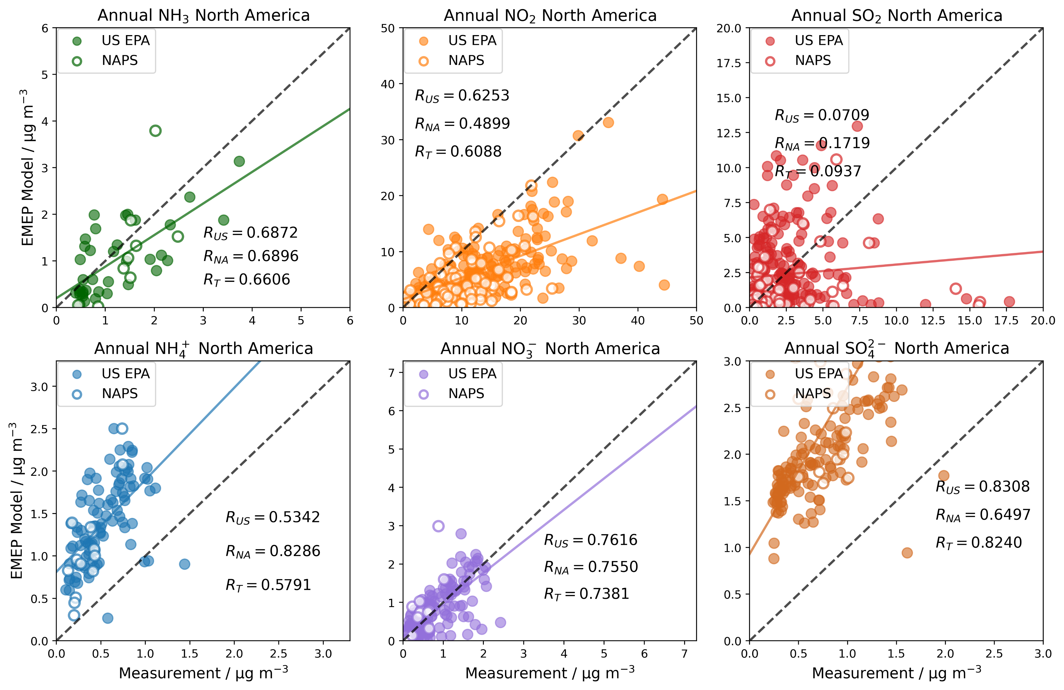
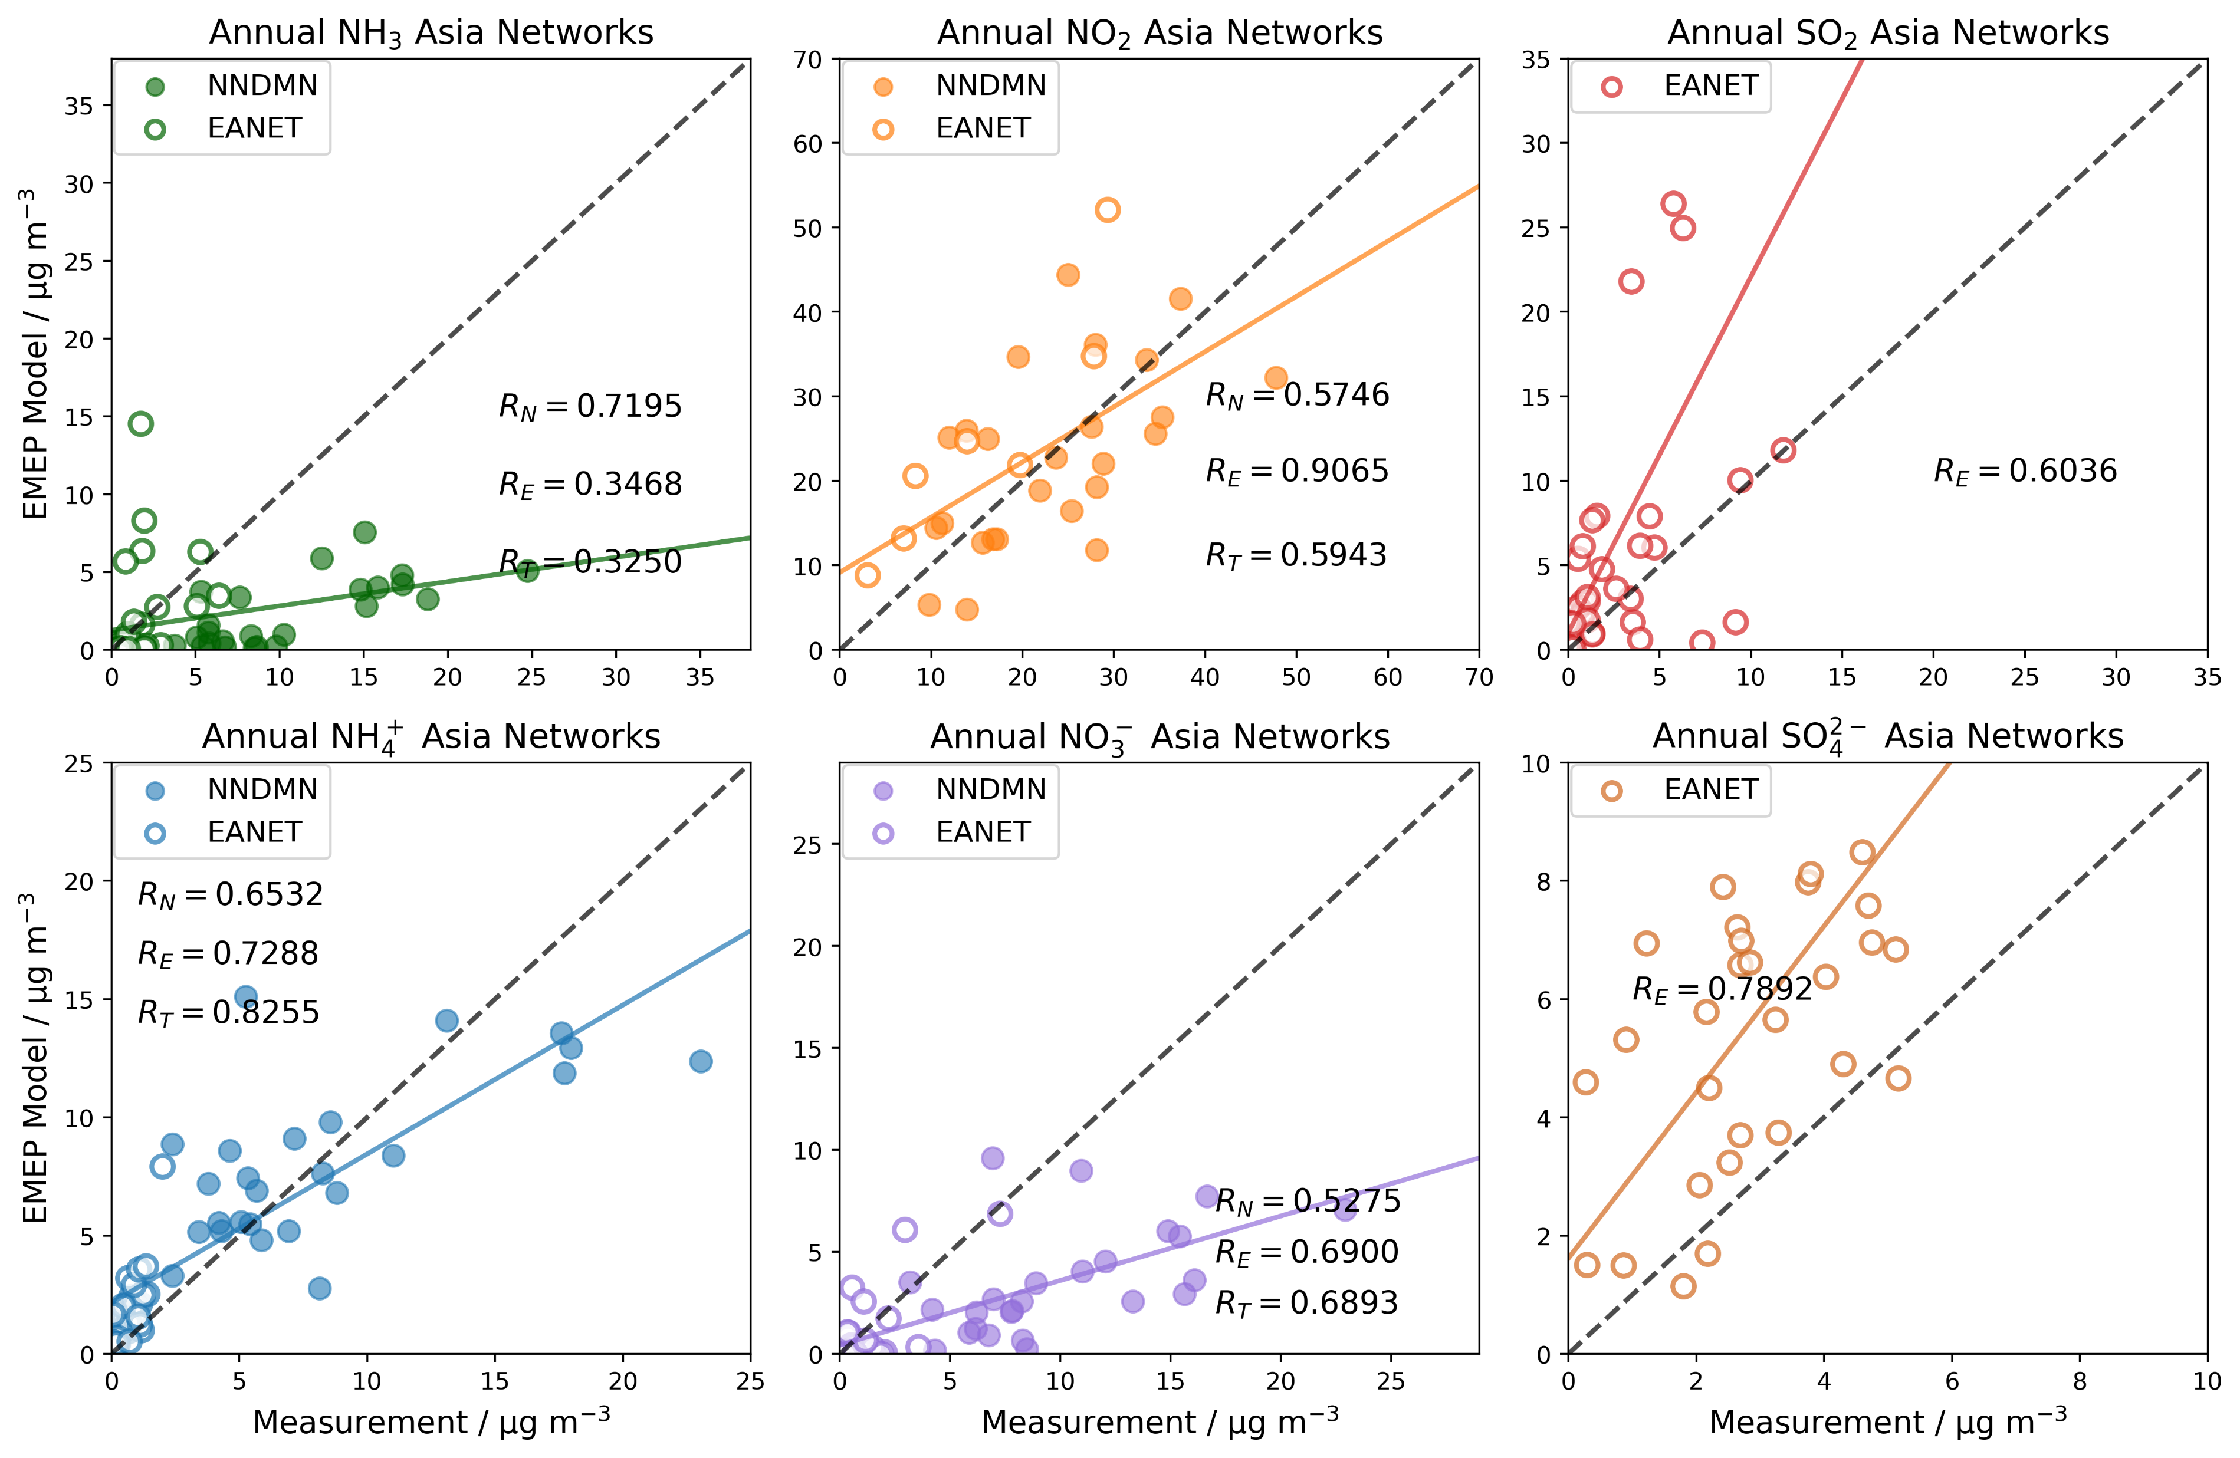
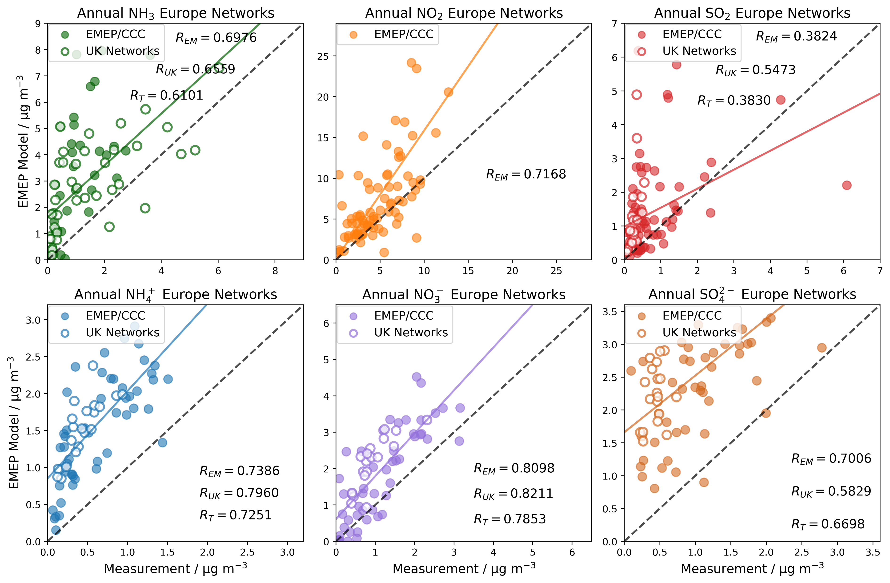
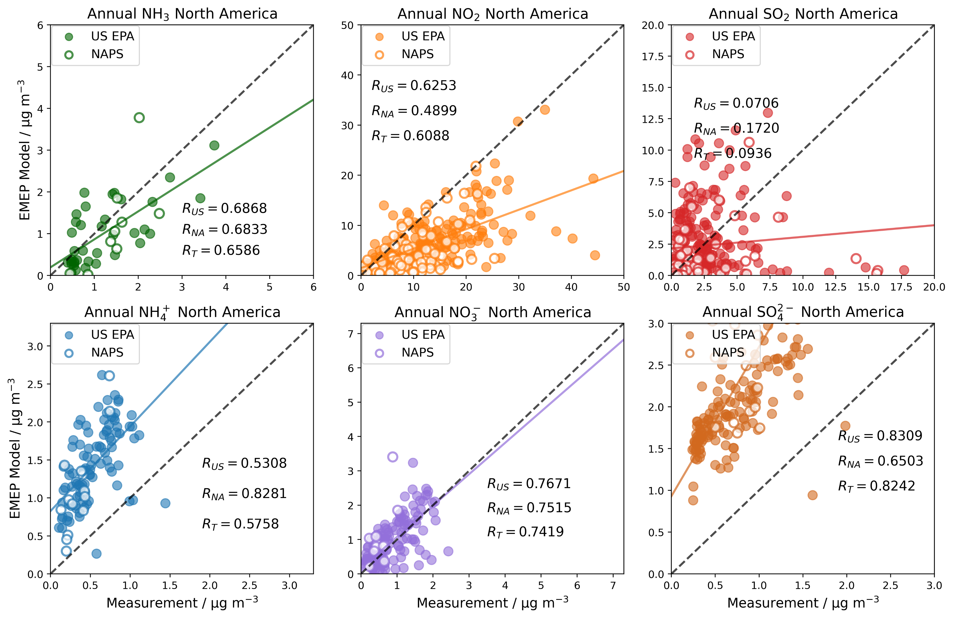
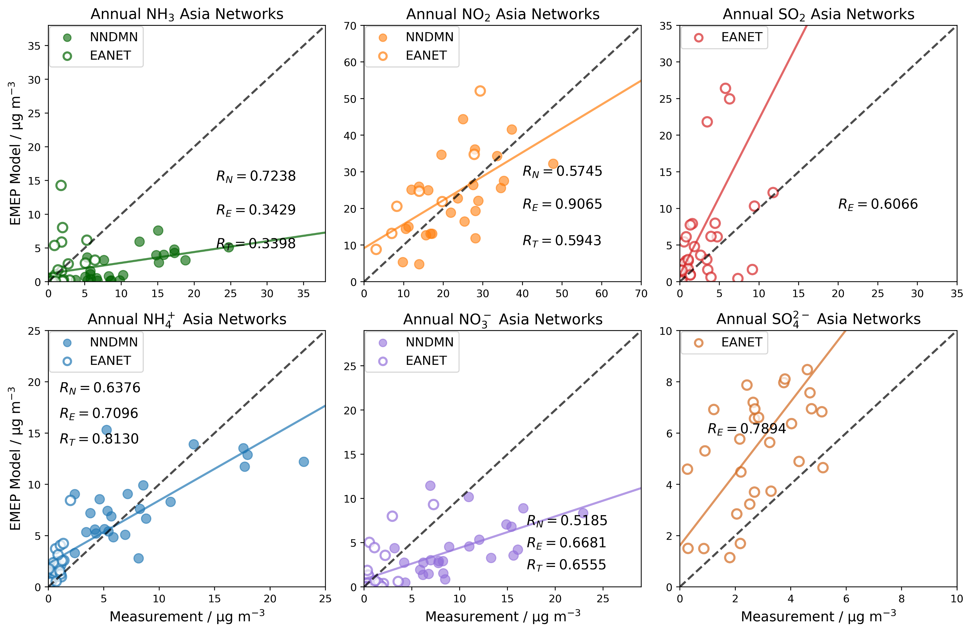
Based on Ge at al. 2021
Ge, Y., Heal, M.R., Stevenson, D.S., Wind, P., Vieno, M. (2021) Evaluation of global EMEP MSC-W (rv4.34) WRF (v3.9.1.1) model surface concentrations and wet deposition of reactive N and S with measurements. Geosci. Model Dev. 14, 7021-7046-
Global evaluation with observations EMEP rv4.45
EQSAM
Equilibrium simplified aerosol model
MARS
Model for an Aerosol Reacting System
Europe
North America
Asia

Slide 19
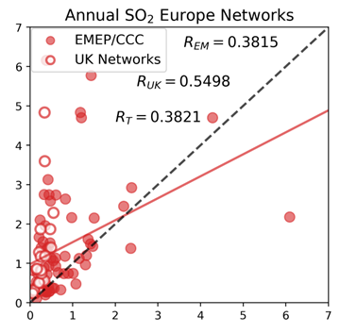
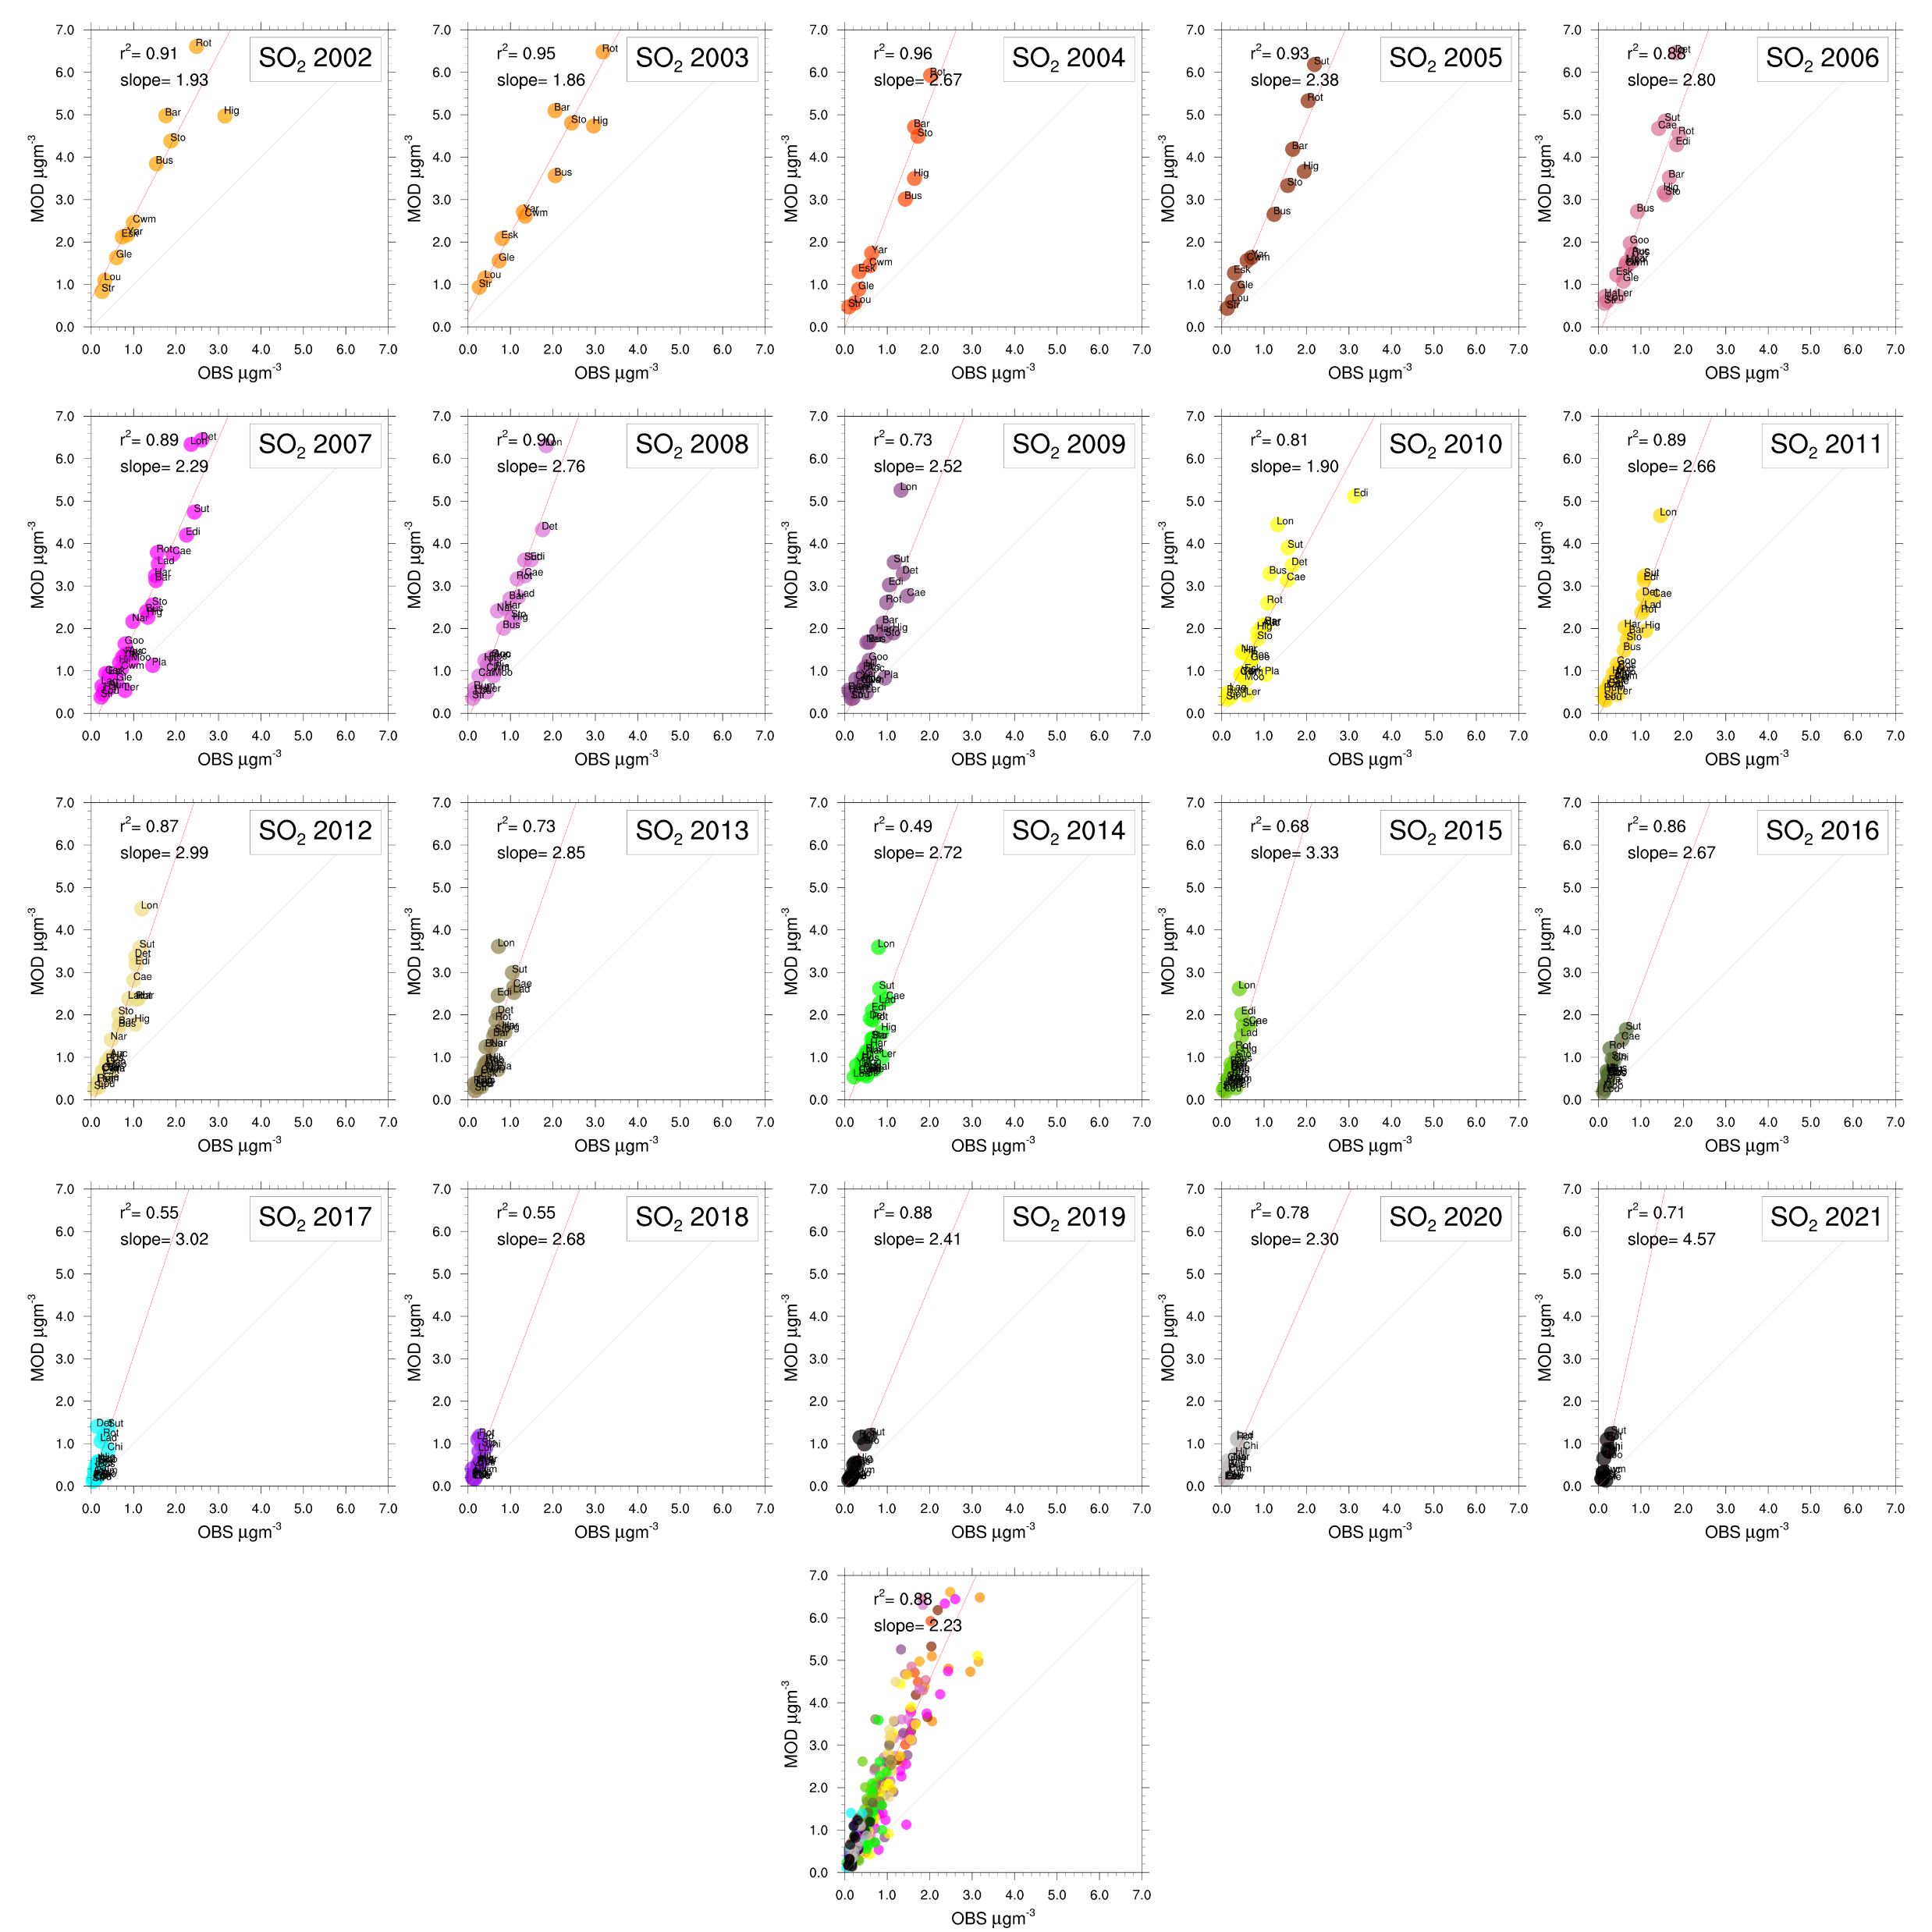
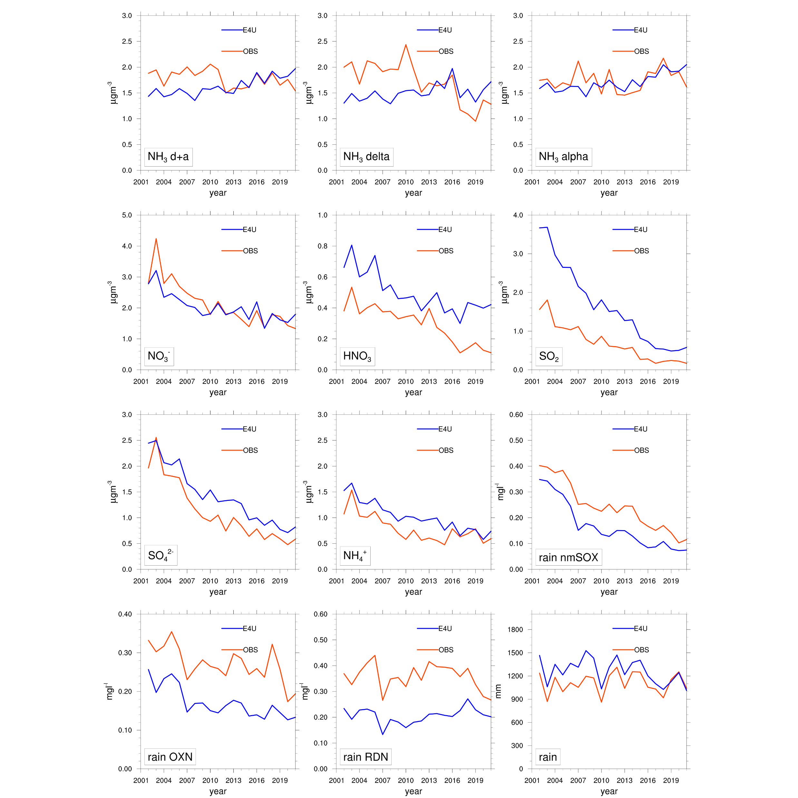
Small diversion from the presentation topic…
EMEP-WRF 1ºx1º
EMEP4UK 3x3km²
EMEP4UK 3x3km²
2015

Slide 20
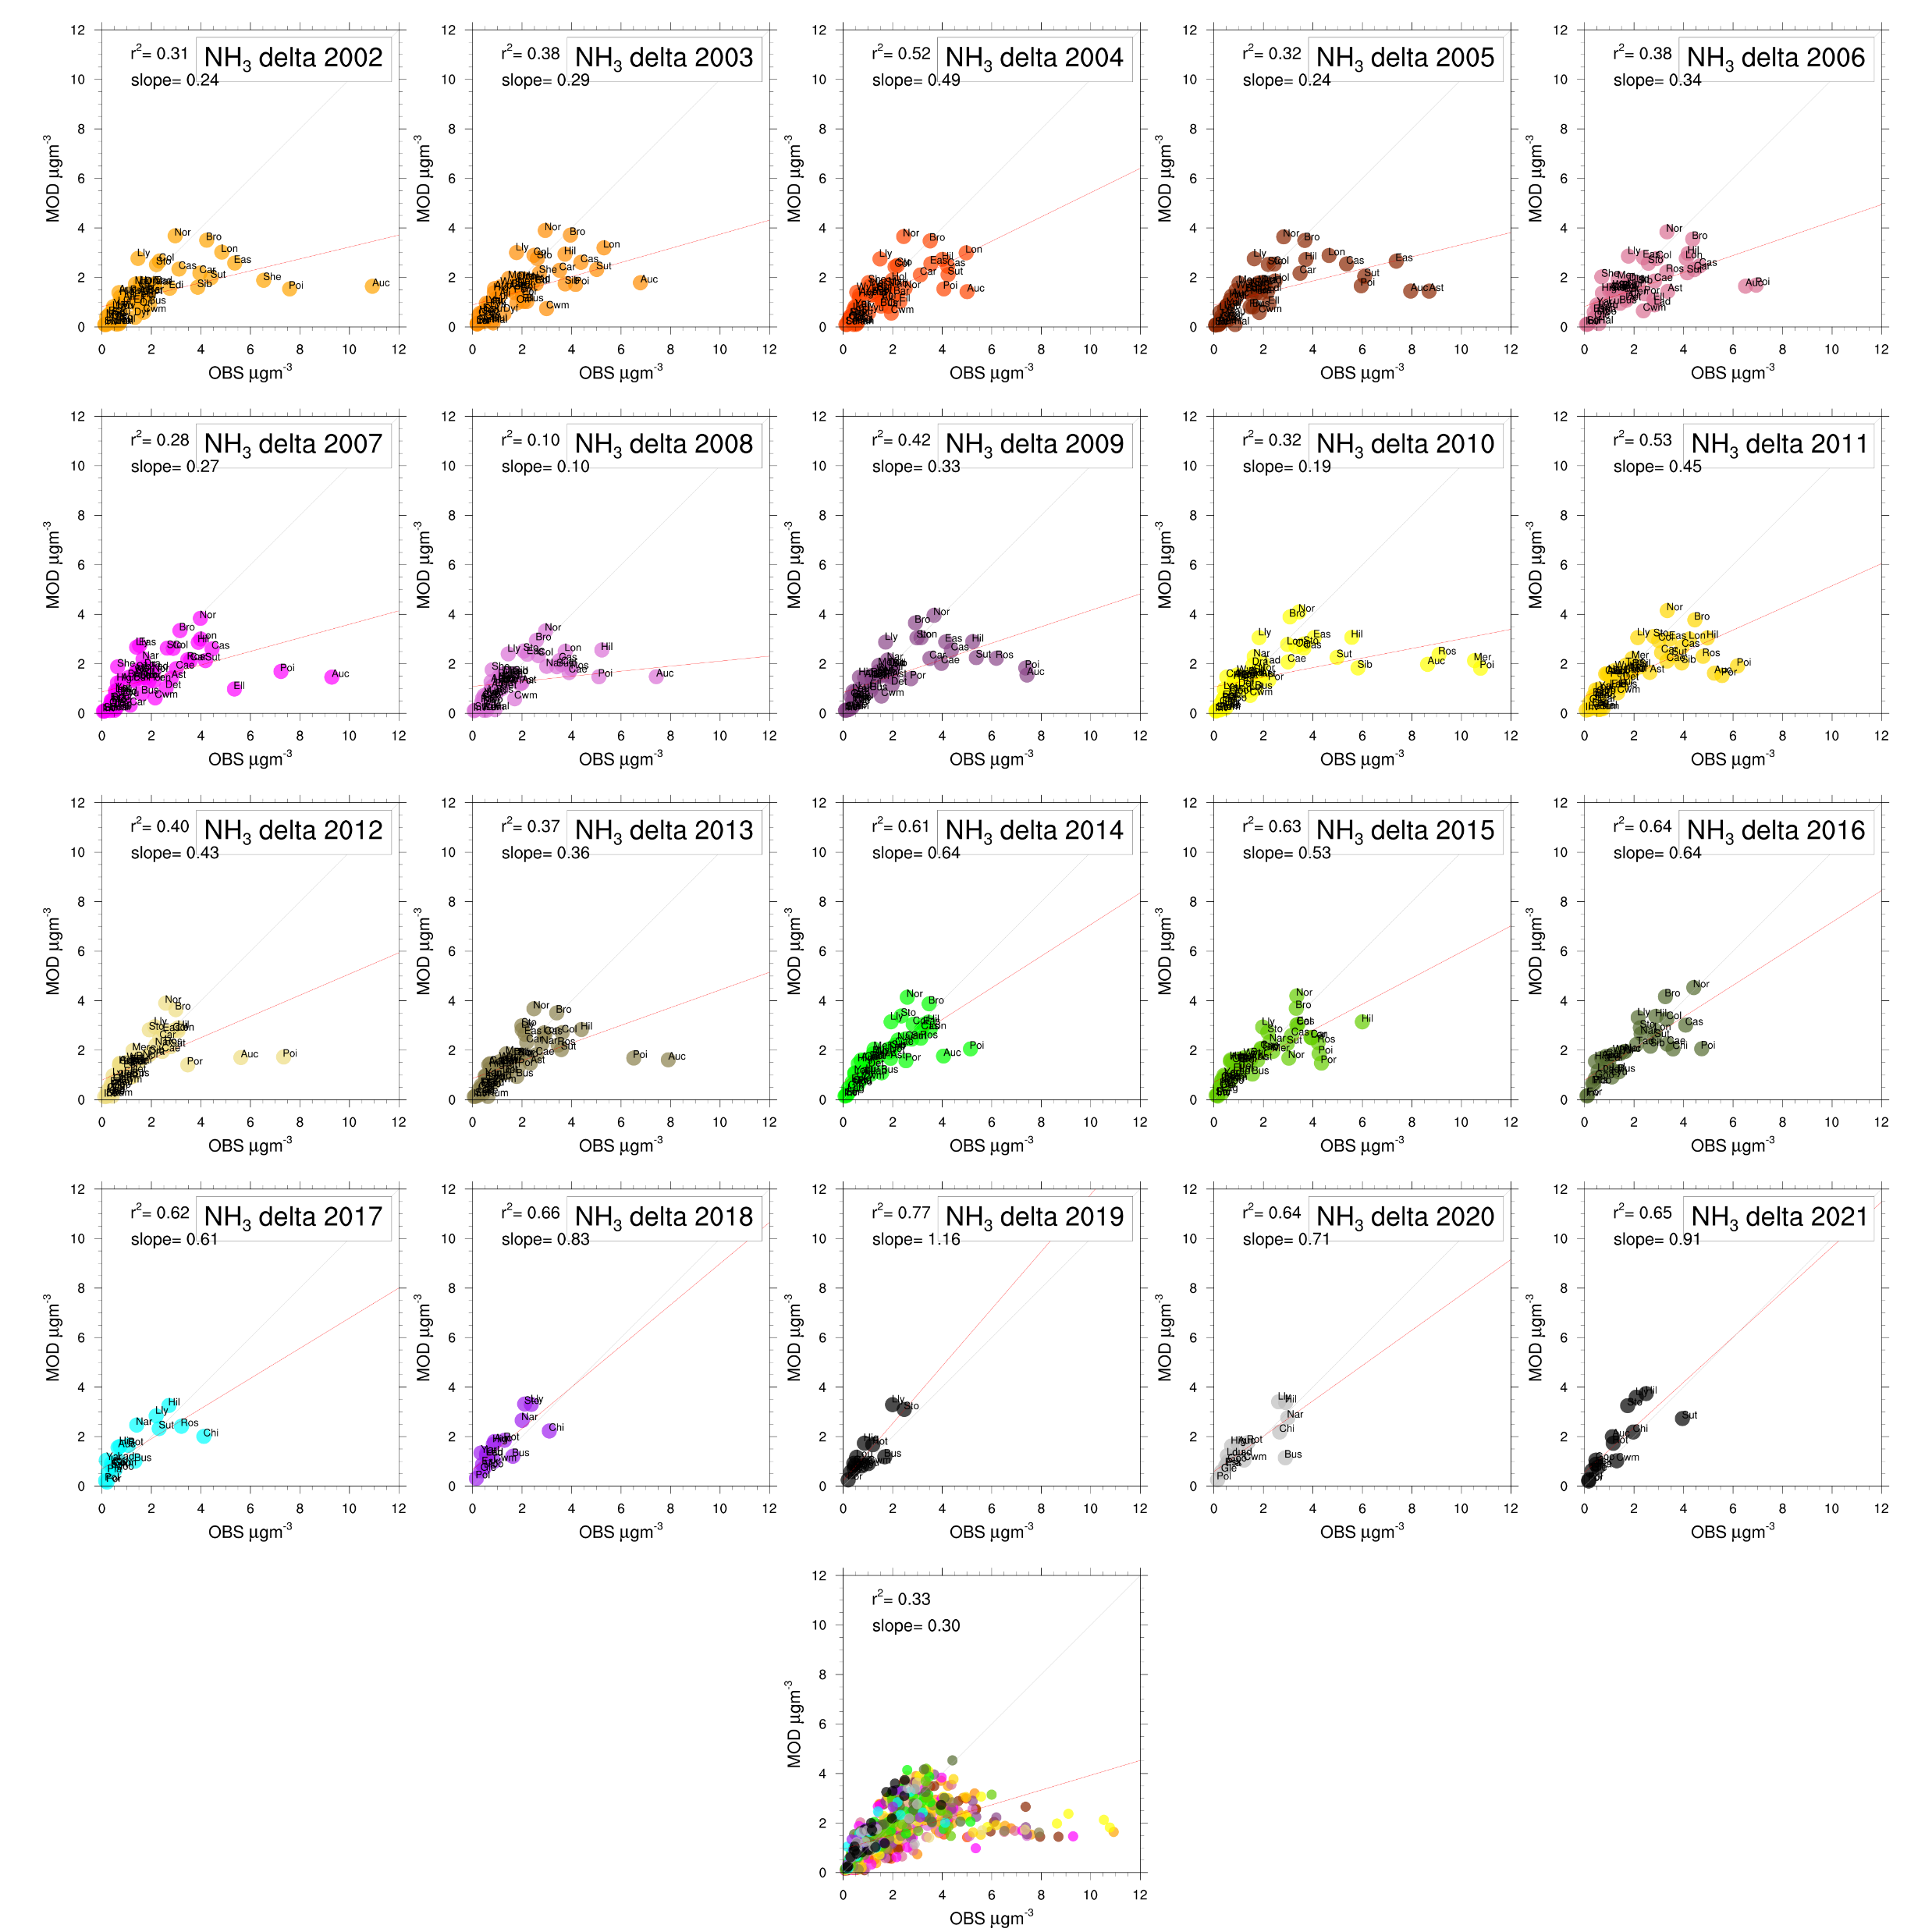
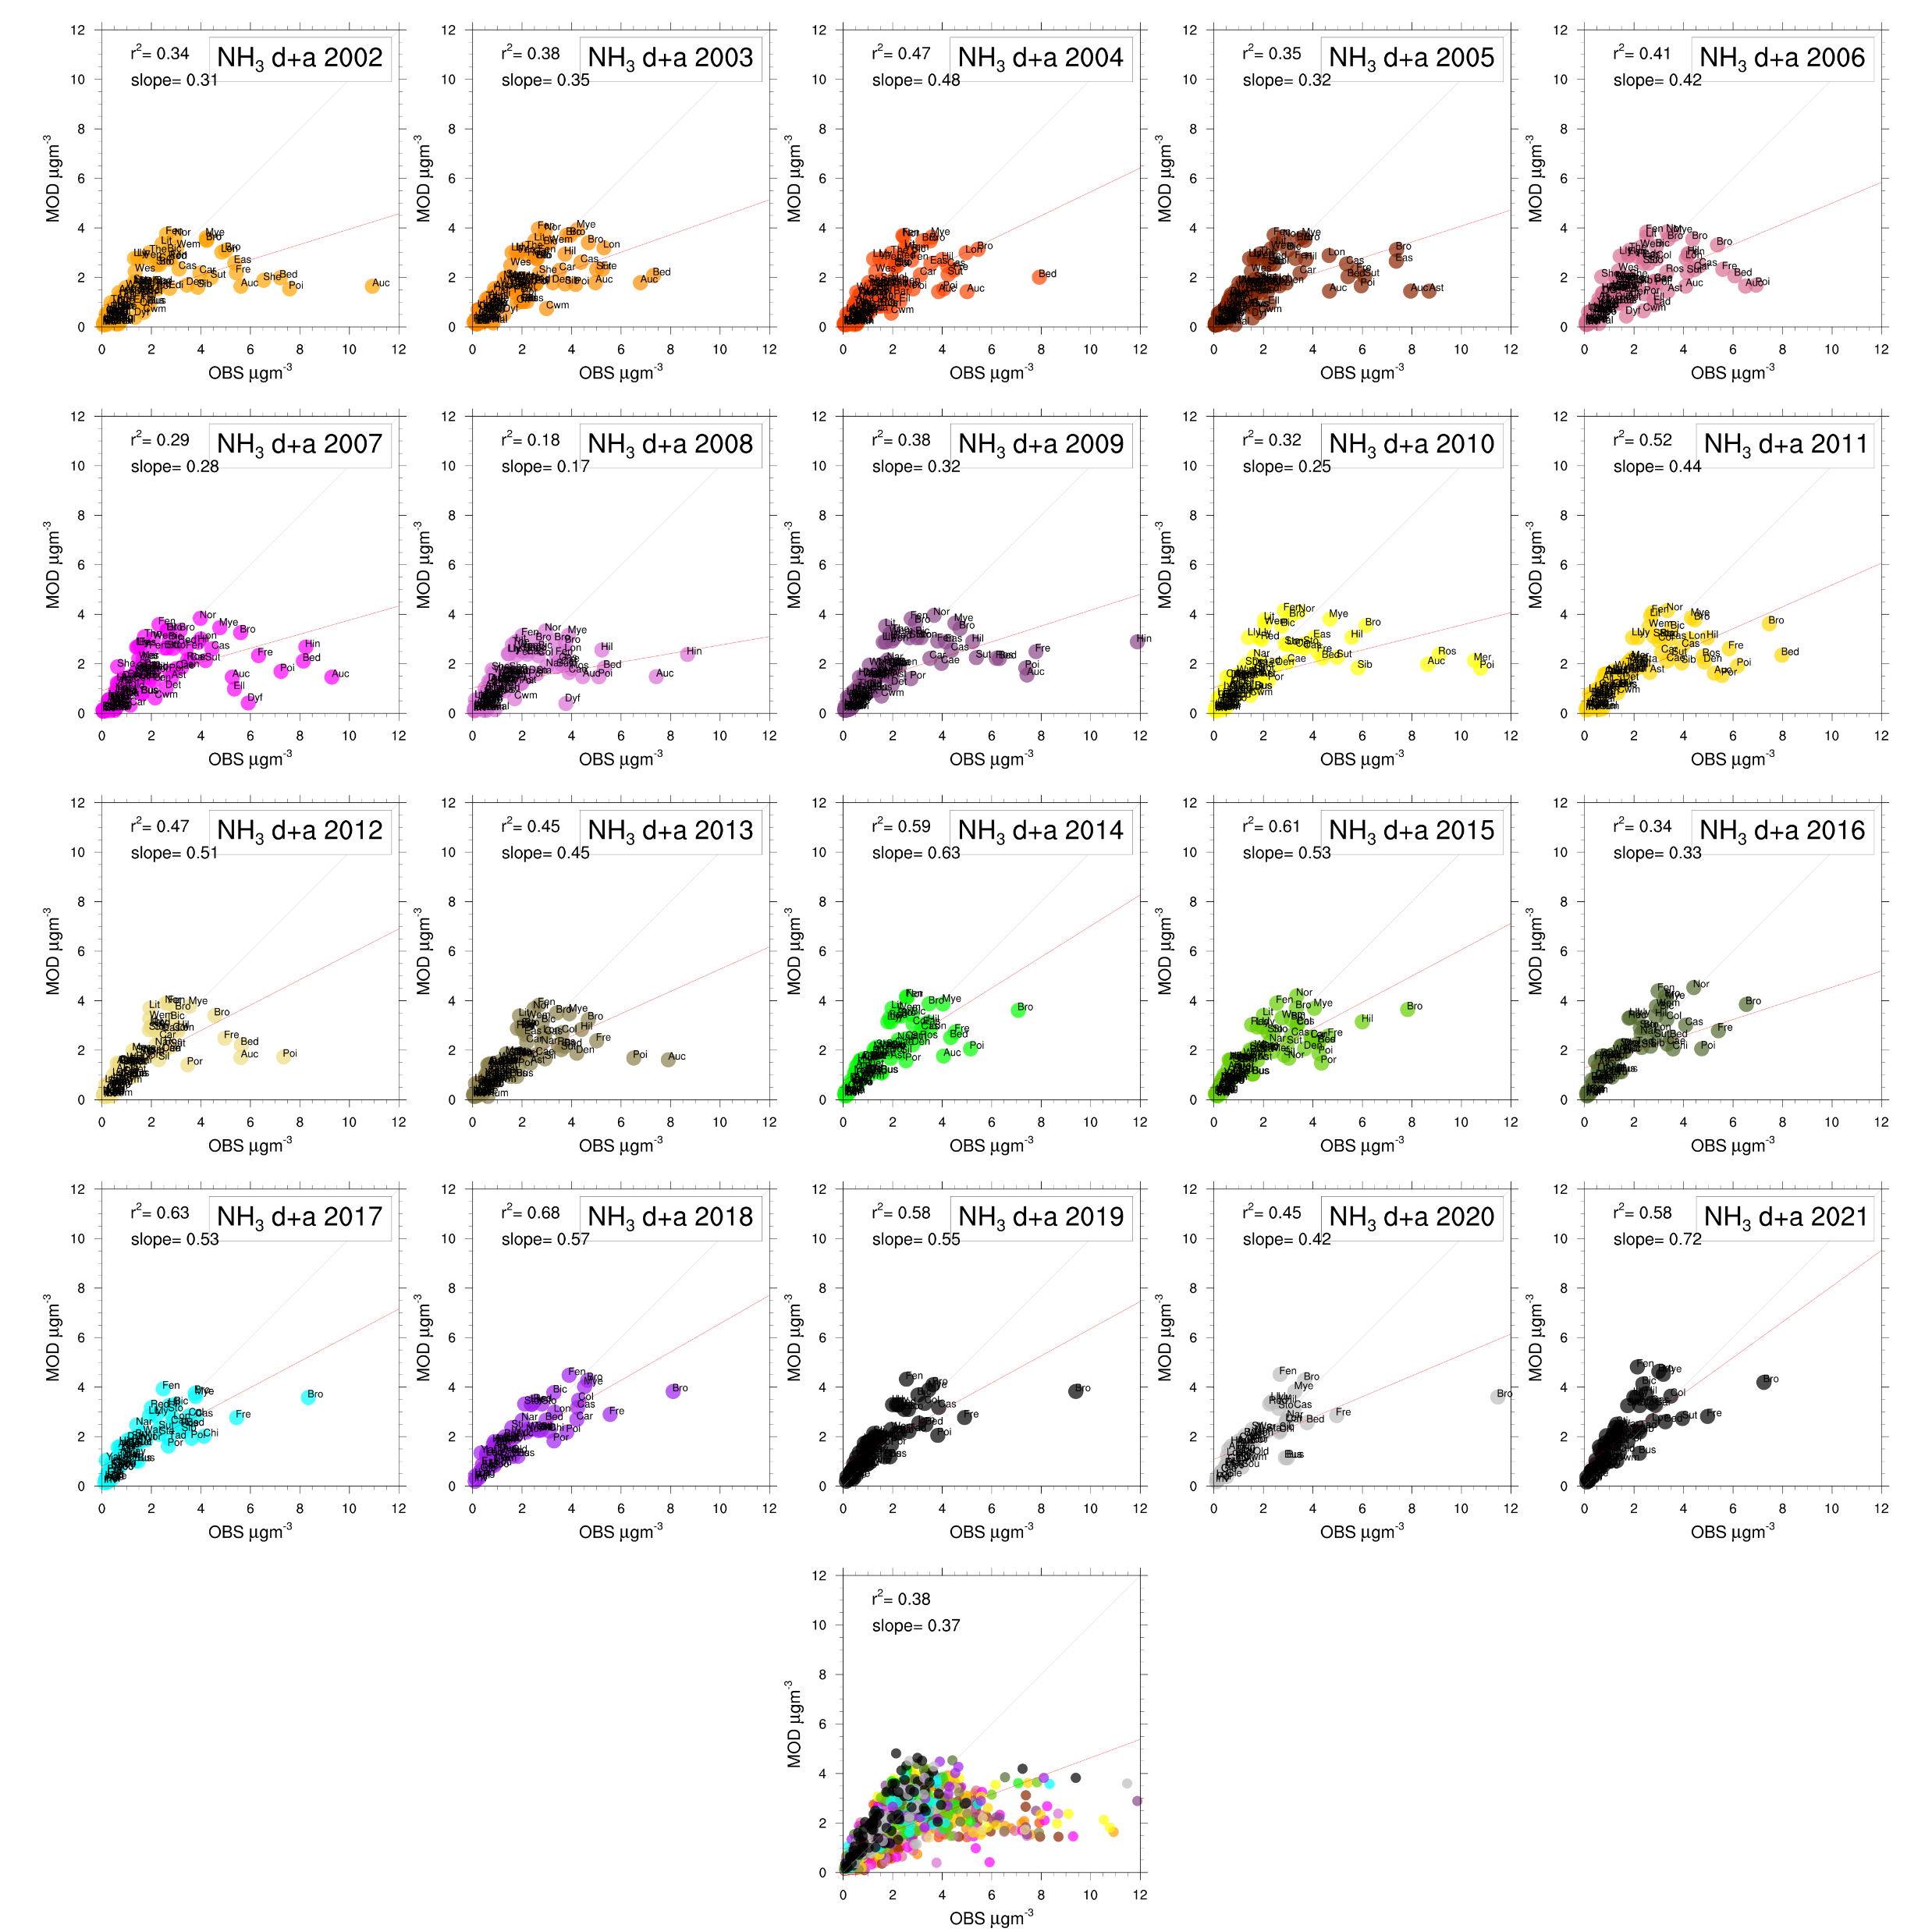
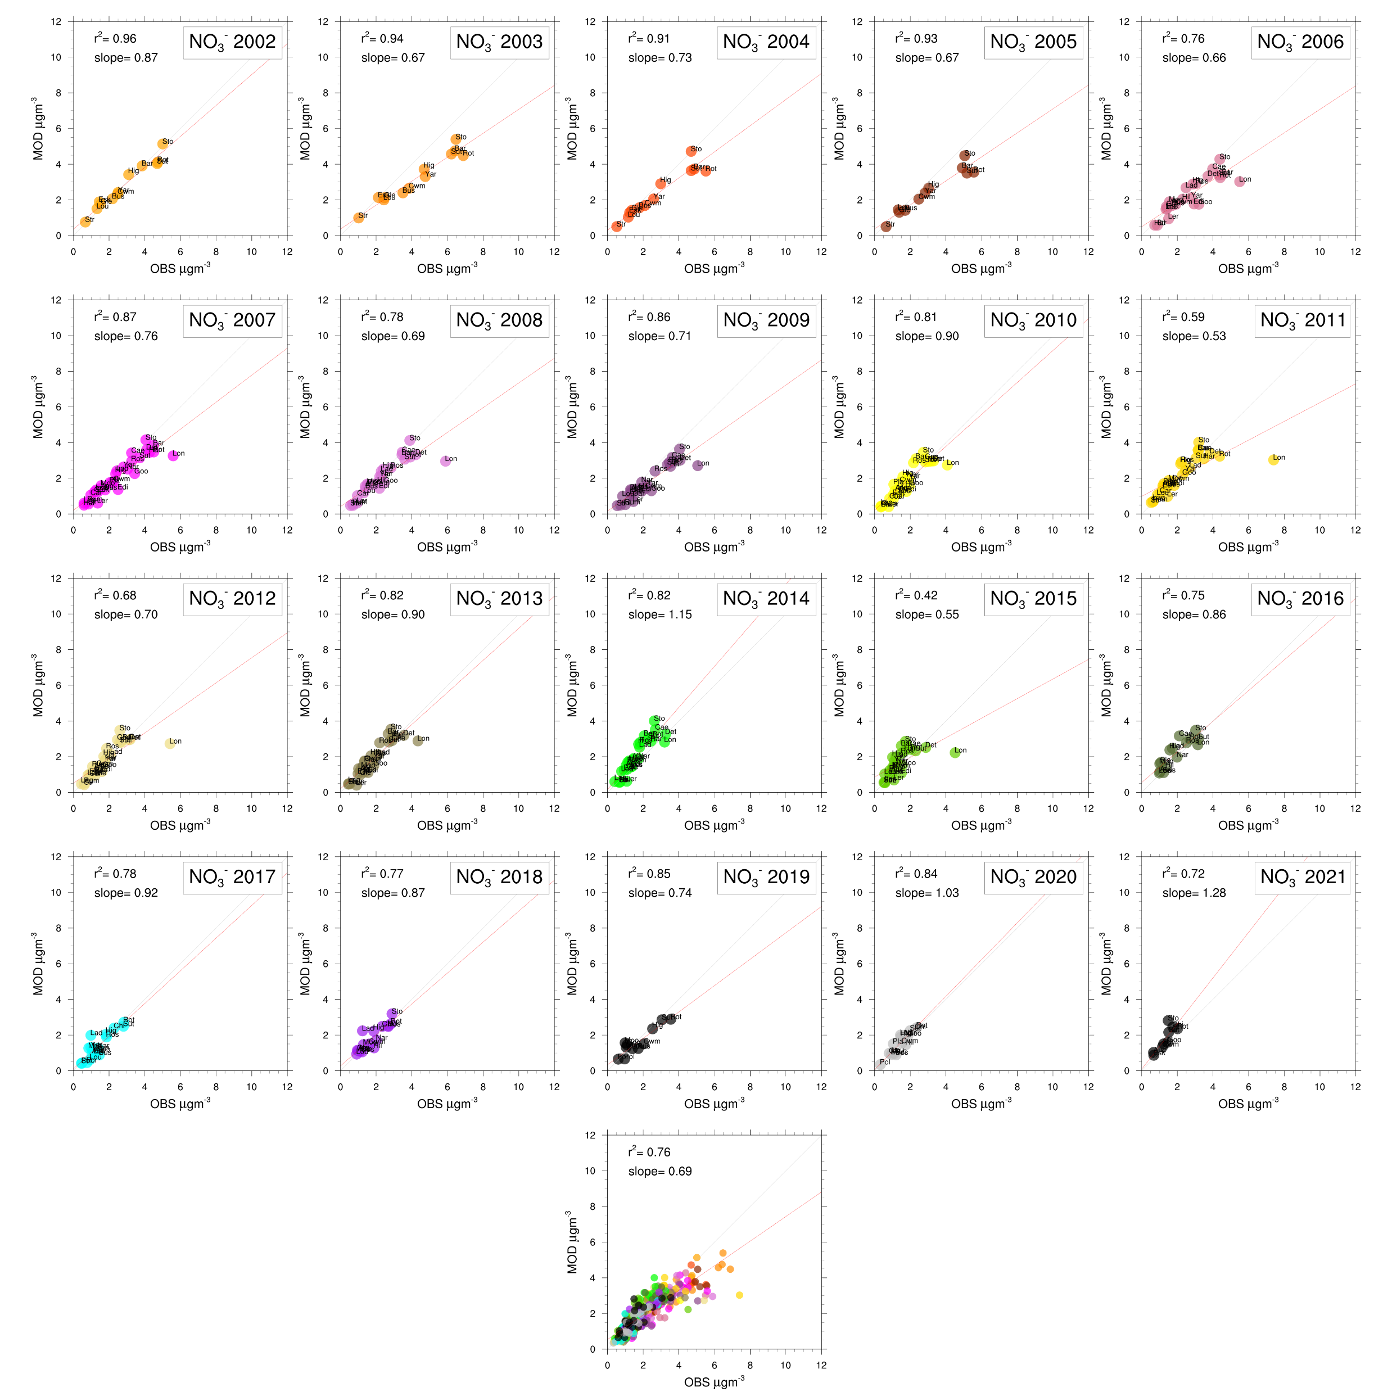
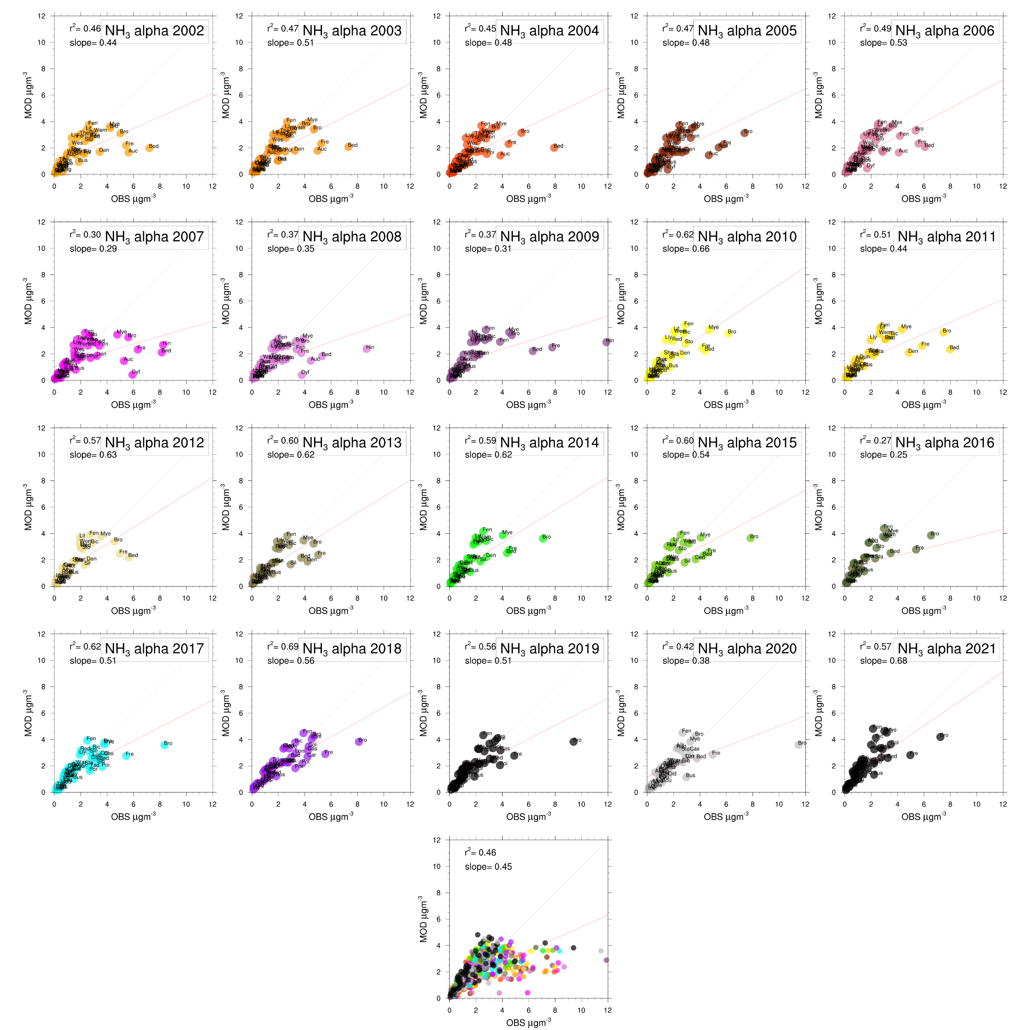

Slide 21
Fig. 3. Cost and benefit to reduce 50% of NH₃ and NO_{x} emission in 2013.
(A) Abatement cost, benefit of prevented mortality from reduced PM_{2.5}, fertilizer saving (Fert), and ground-level ozone pollution (O₃) mitigation. (B) Ratio of benefit of prevented mortality from PM_{2.5} mitigation to cost, with values for NH₃ and NO_{x} shown with and without the benefit from fertilizer saving and O₃ mitigation caused by NO_{x} reduction, respectively. The benefit in (B) only refers to benefit of prevented mortality derived from PM_{2.5} mitigation caused by NH₃ and NO_{x} abatement. LA, Latin America, NA, North America. For Africa, fertilizer savings are negative because of too little N_{r} input compared with crop need, and the best management practices would increase N_{r} fertilizer use (see the supplementary materials).

