Slide 1
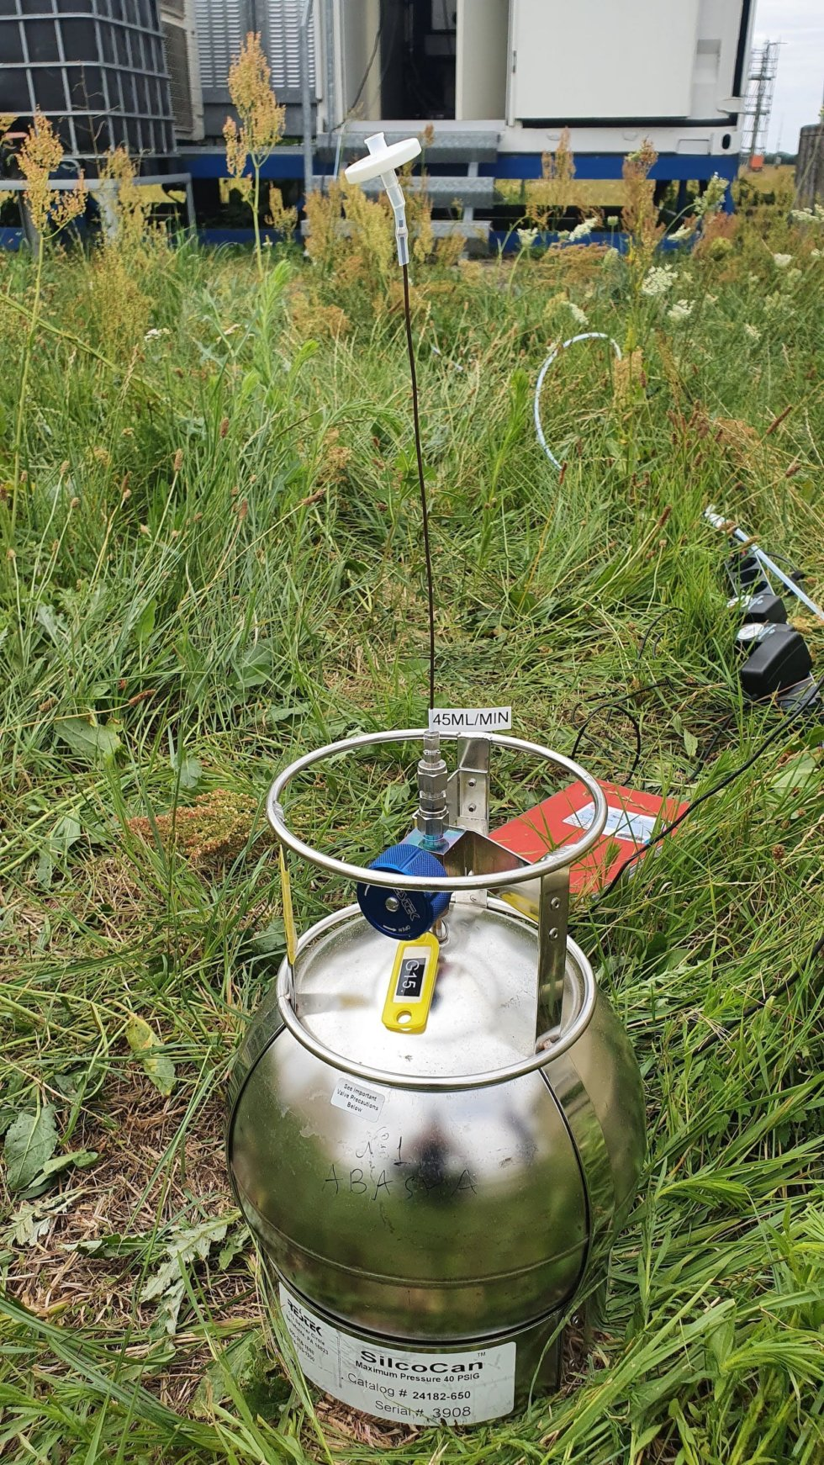
Measurements of volatile organic compounds during the 2022 intensive
campaign
Robert Wegener, Dieter Klemp, René Dubus, Lukas Kesper
Norway

Slide 2
VOC Canister Measurements
During the 2022 intensive canisters were shipped to 9 sites for VOC analysis

Slide 3
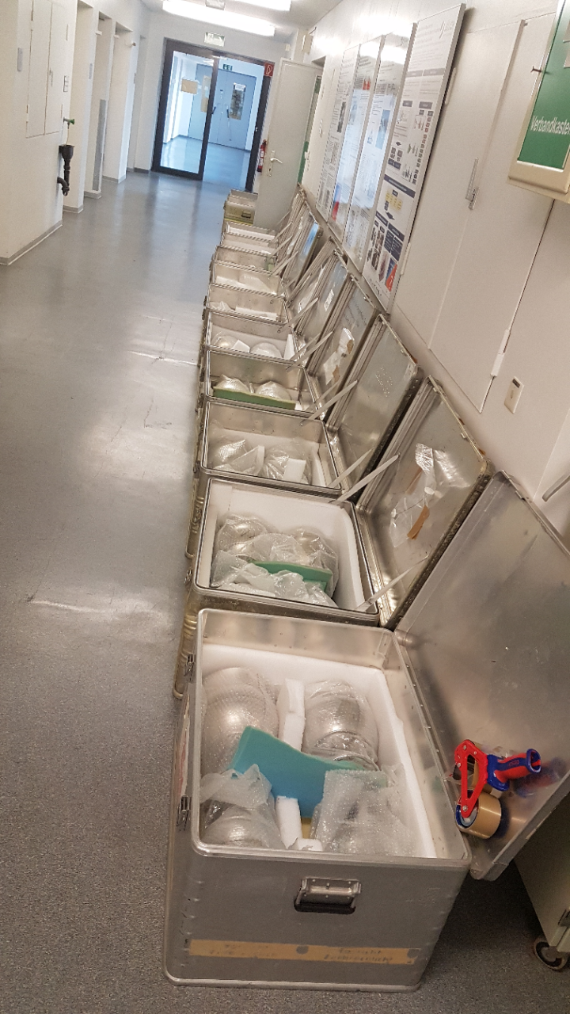
Sampling
8 Canisters were shipped to the sites and return 5 days after sampling the latest to subsequently be analyzed
Sampling was done at noon over a period of one hour

Slide 4
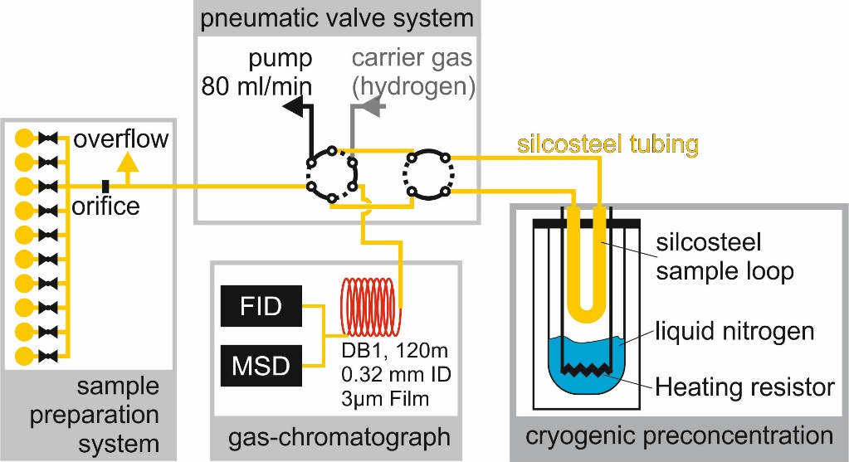
Analysis
Canisters were be pressurized and analysed with GC/MS/FID Quantification was done by FID (according to SOP for VOC)
Separation is done with a 120 m DB1 column
Calibration: 74-component standard nmhc gas standard
OVOC gas standard NPL

Slide 5
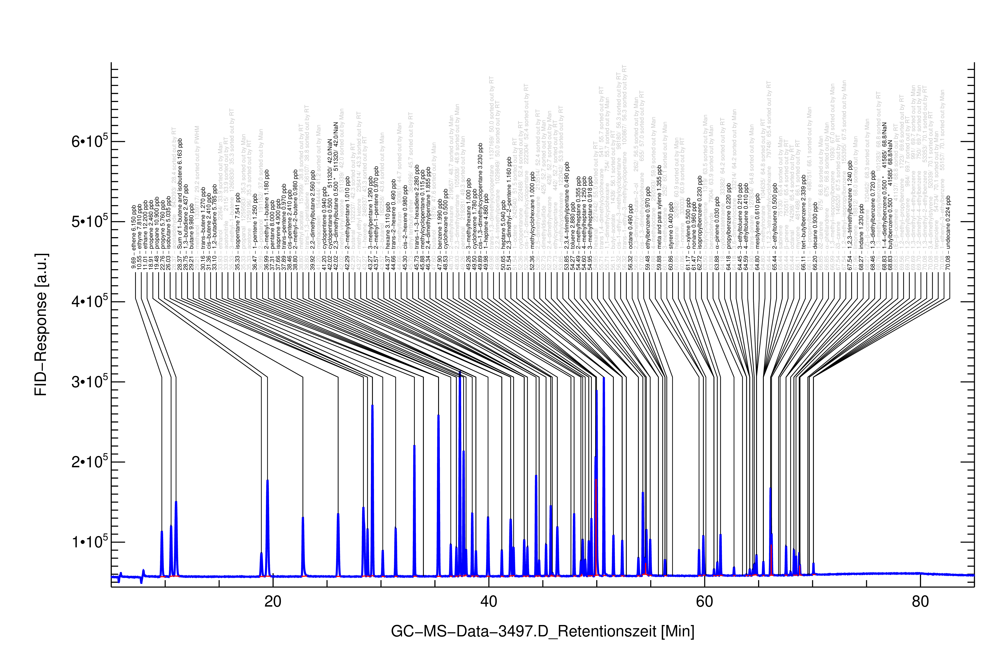
Analysis
Canisters were be pressurized and analysed with GC/MS/FID Quantification is done by FID
Separation is done with a 120 m DB1 column
Calibration: 74-component standard nmhc gas standard
OVOC gas standard NPL
VOCs from C2 to C12 are separated

Slide 6
Analysis
Canisters were be pressurized and analysed with GC/MS/FID Quantification is done by FID
Separation is done with a 120 m DB1 column
Calibration: 74-component standard nmhc gas standard
OVOC gas standard NPL
VOCs from C2 to C12 are separated
Standard agrees for most of the compound to the WCC-VOC standard

Slide 7
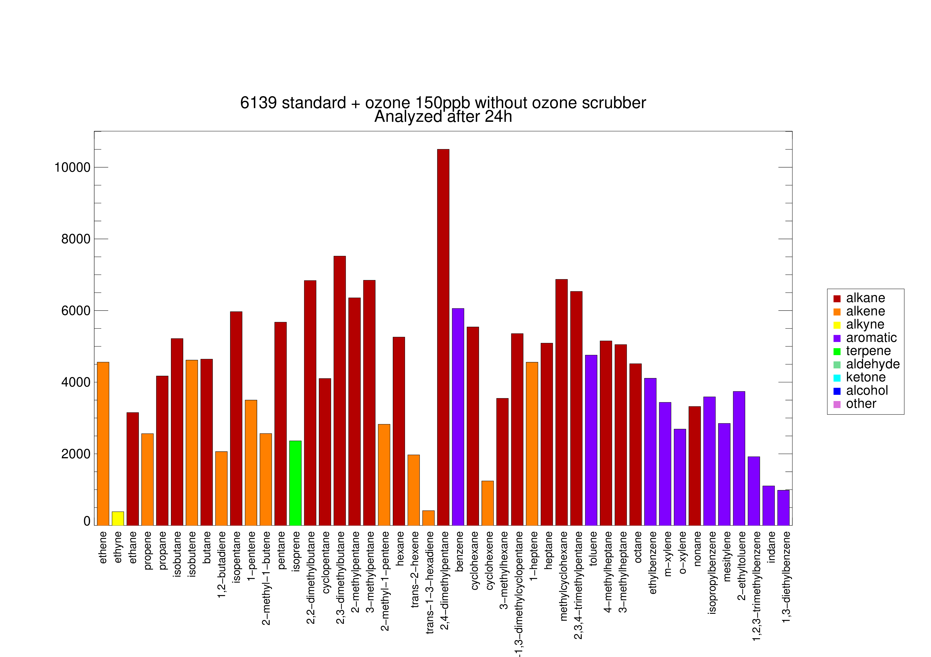
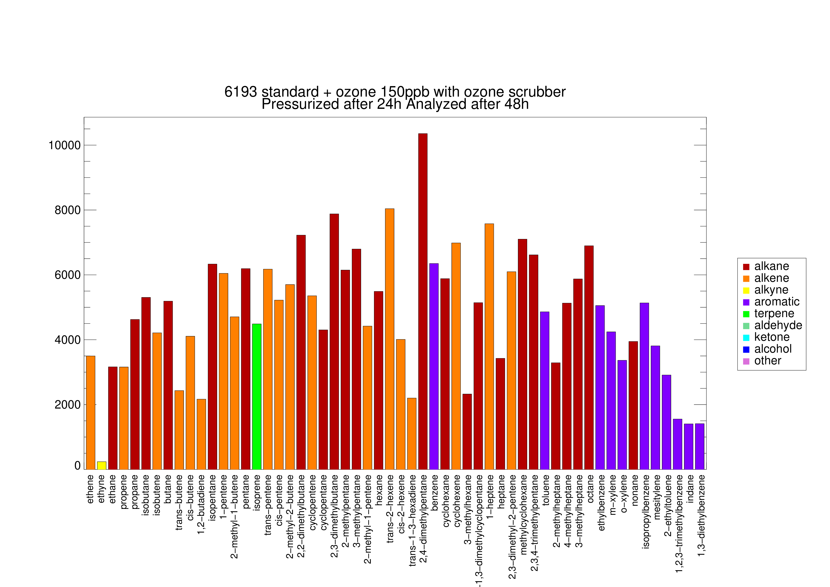
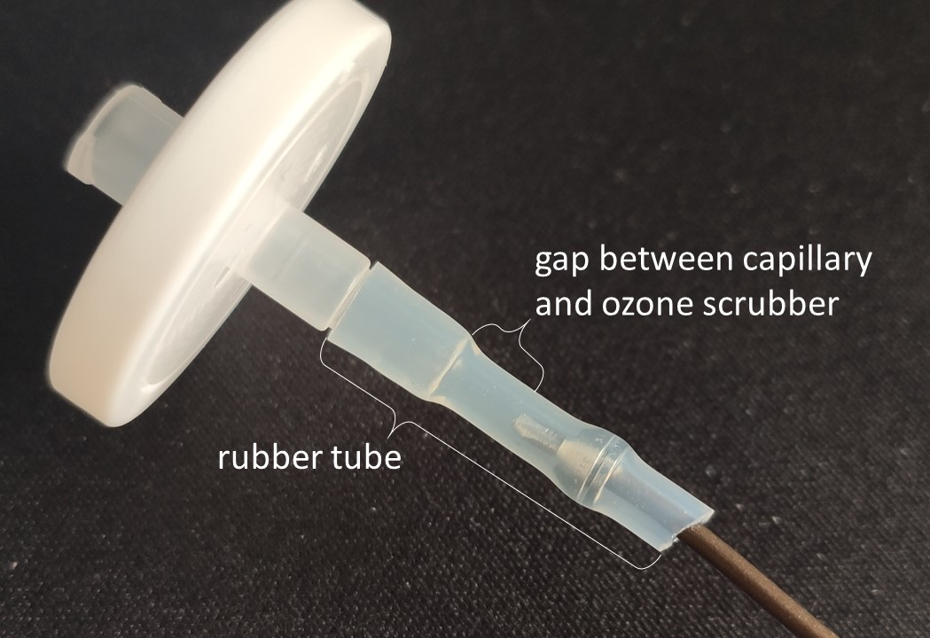
Ozone interference
Ozone can react in the canister
Use of an ozone scrubber with Sodium thiosulfate prevents ozone from entering into the canister according to Helmig et al.
Fig. 1

Slide 8
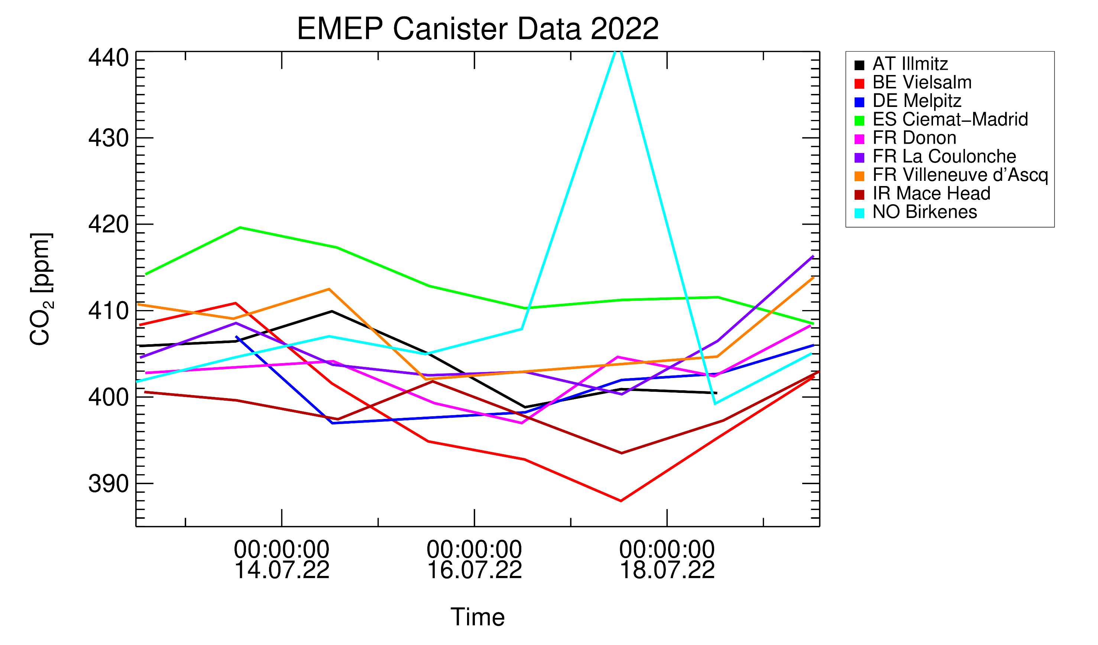
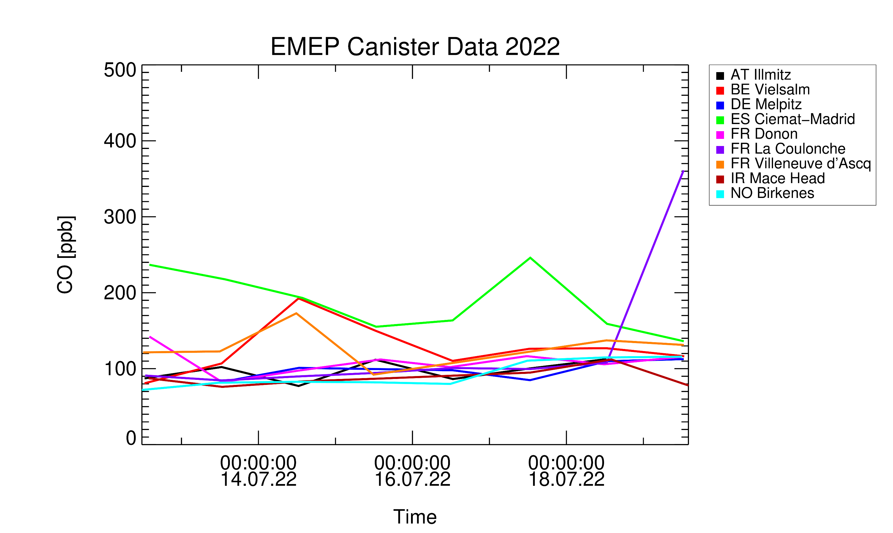
Inorganics gases from the canisters

Slide 9
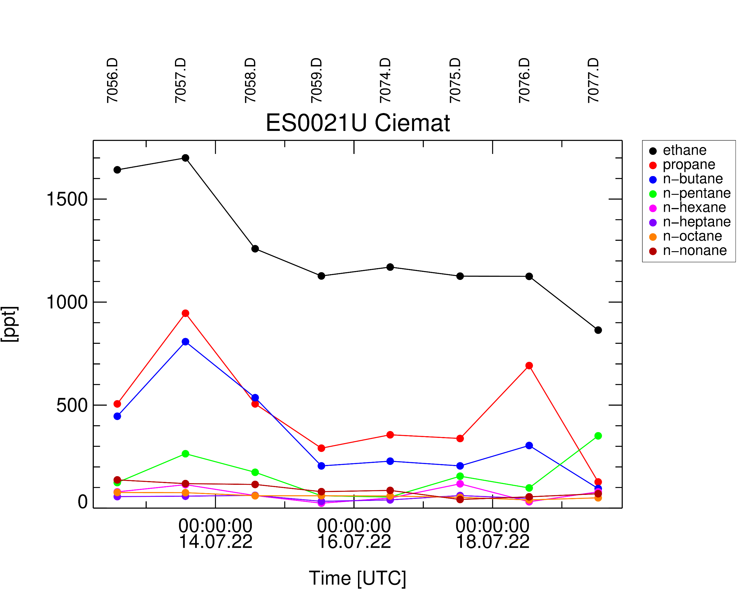
Inorganics gases from the canisters

Slide 10
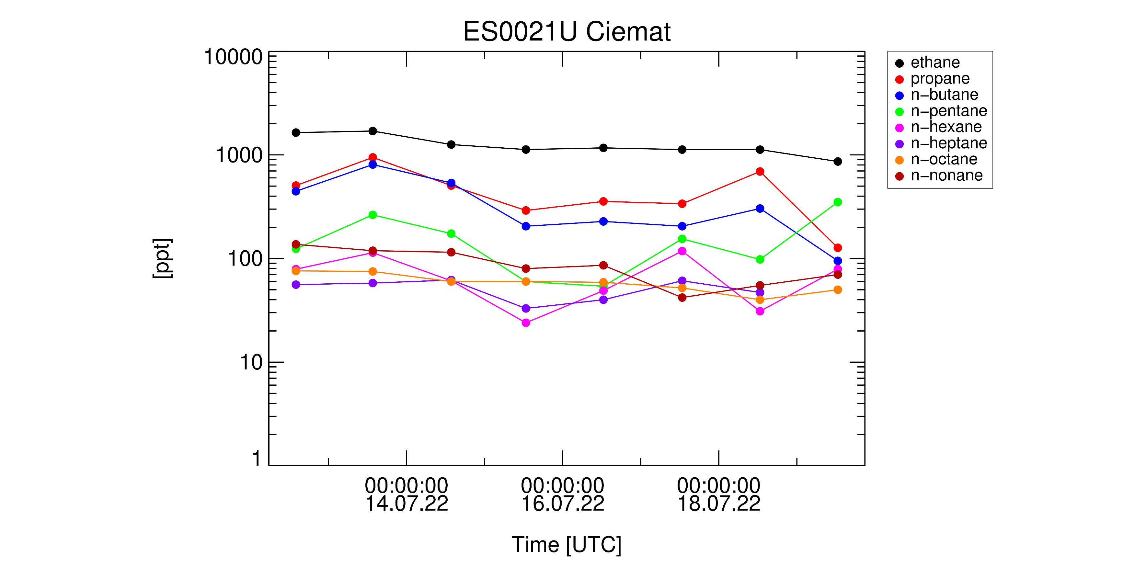
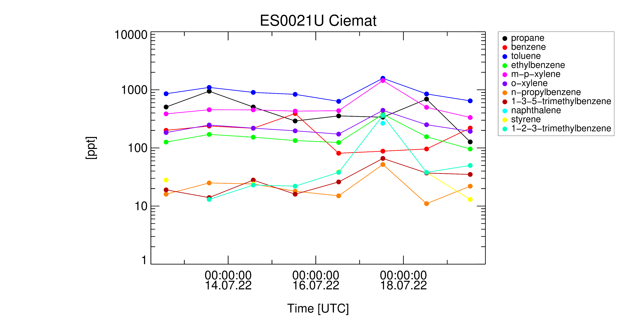
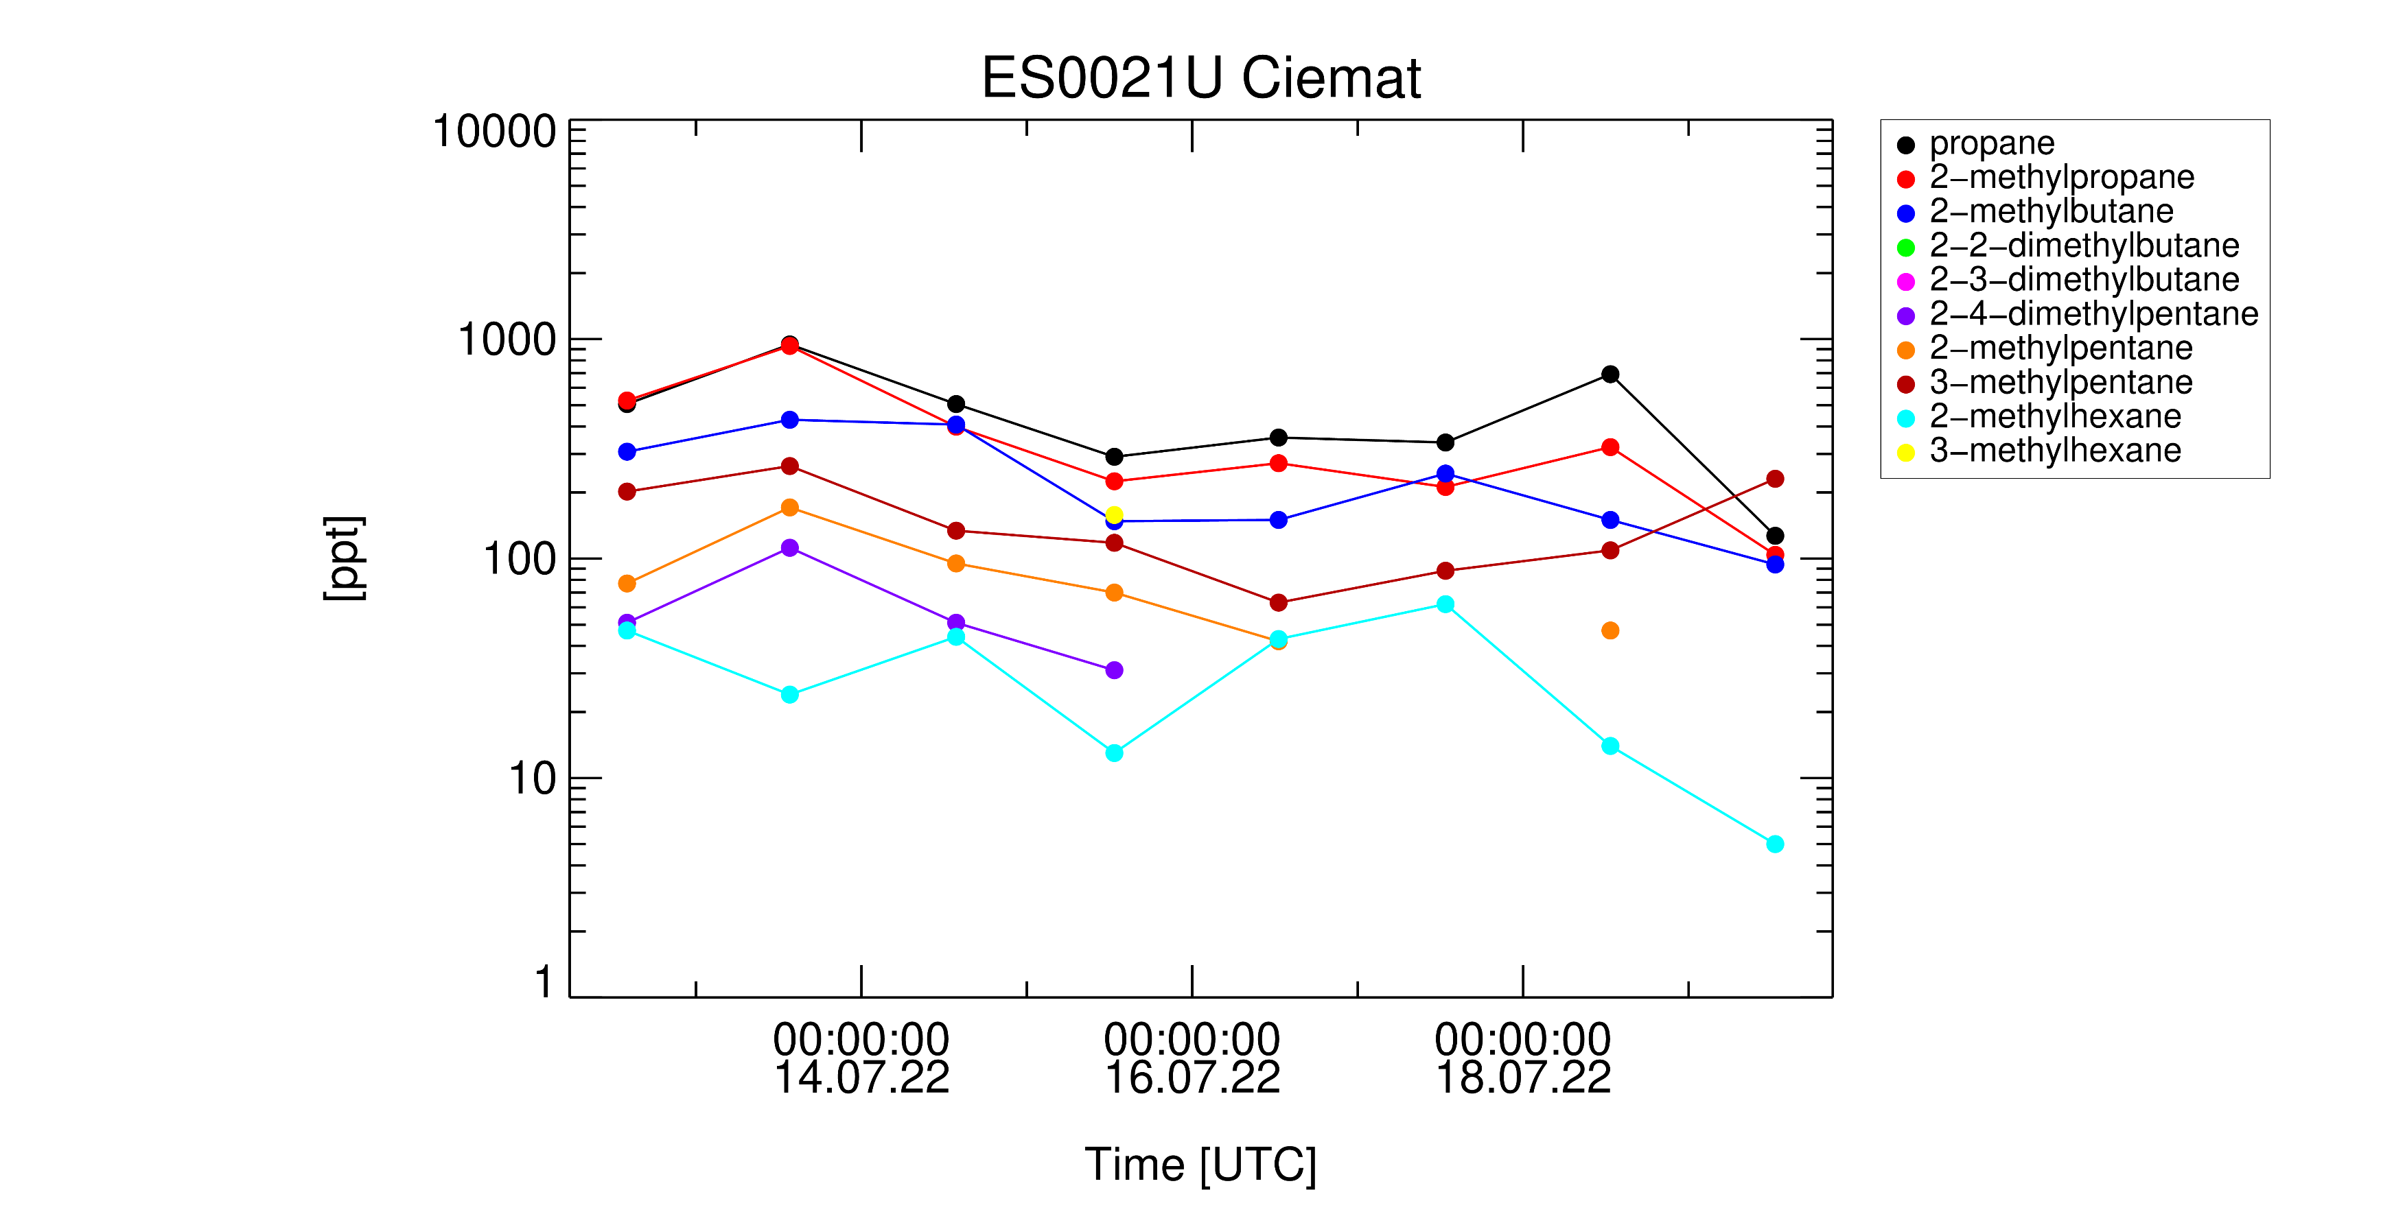
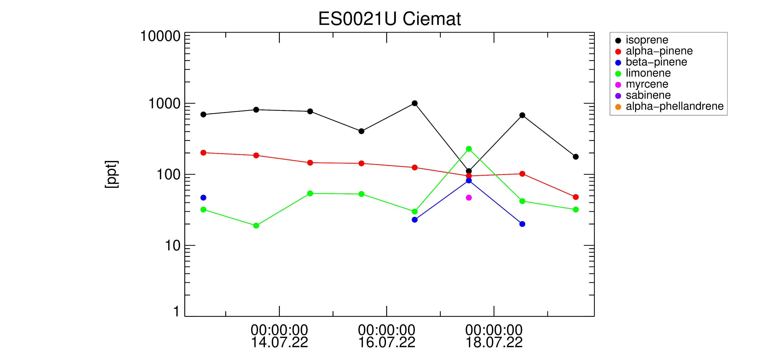
Inorganics at the sites

Slide 11
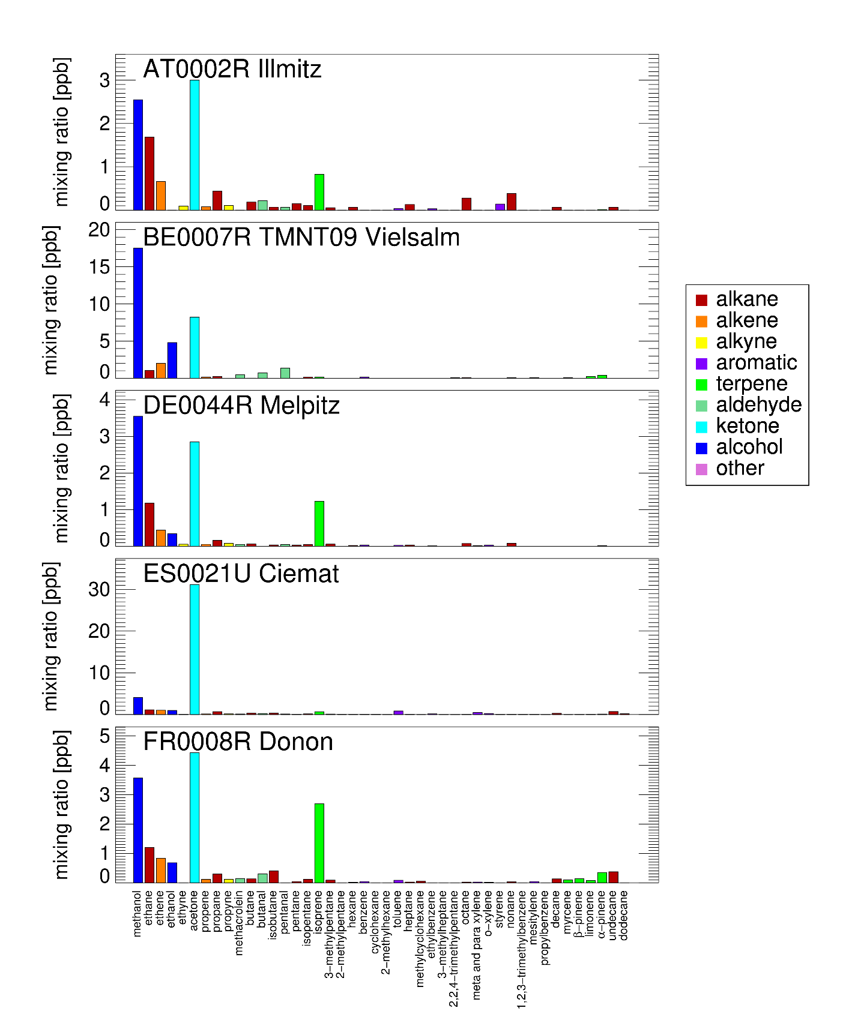
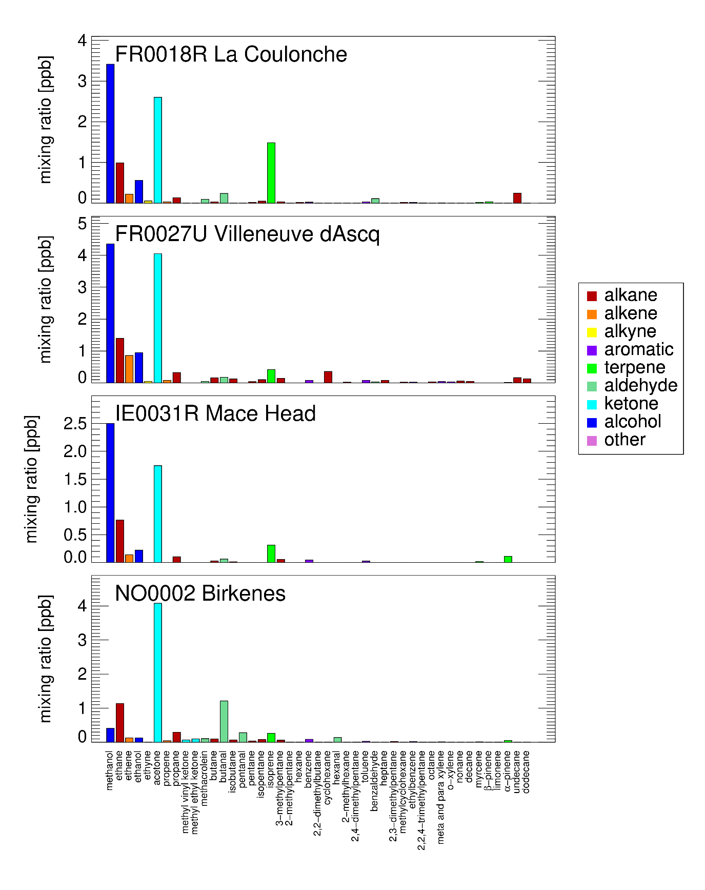
VOC VOC pattern at different European Sites (2022/07/18)

Slide 12
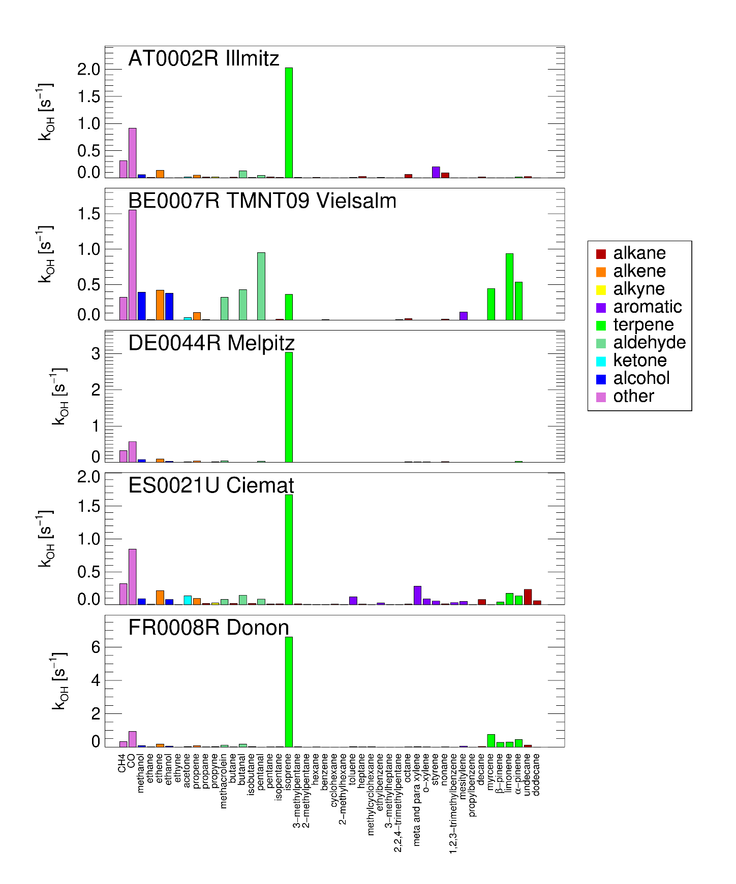
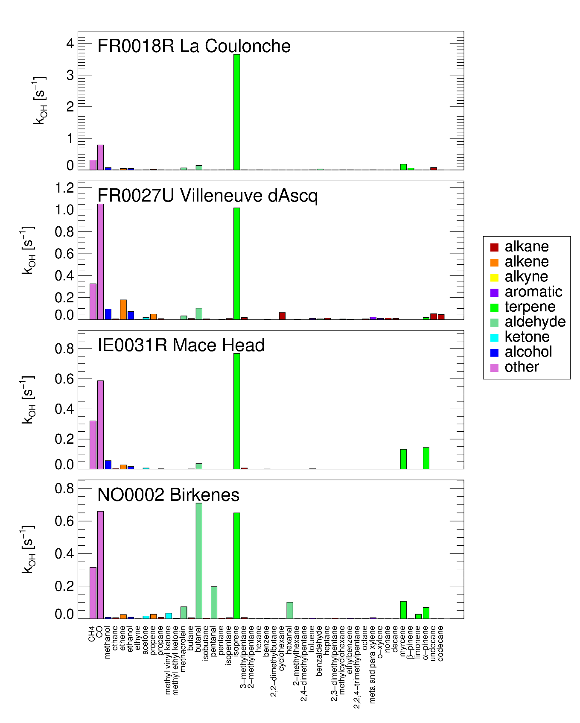
VOC VOC pattern at different European Sites (2022/07/18)

Slide 13
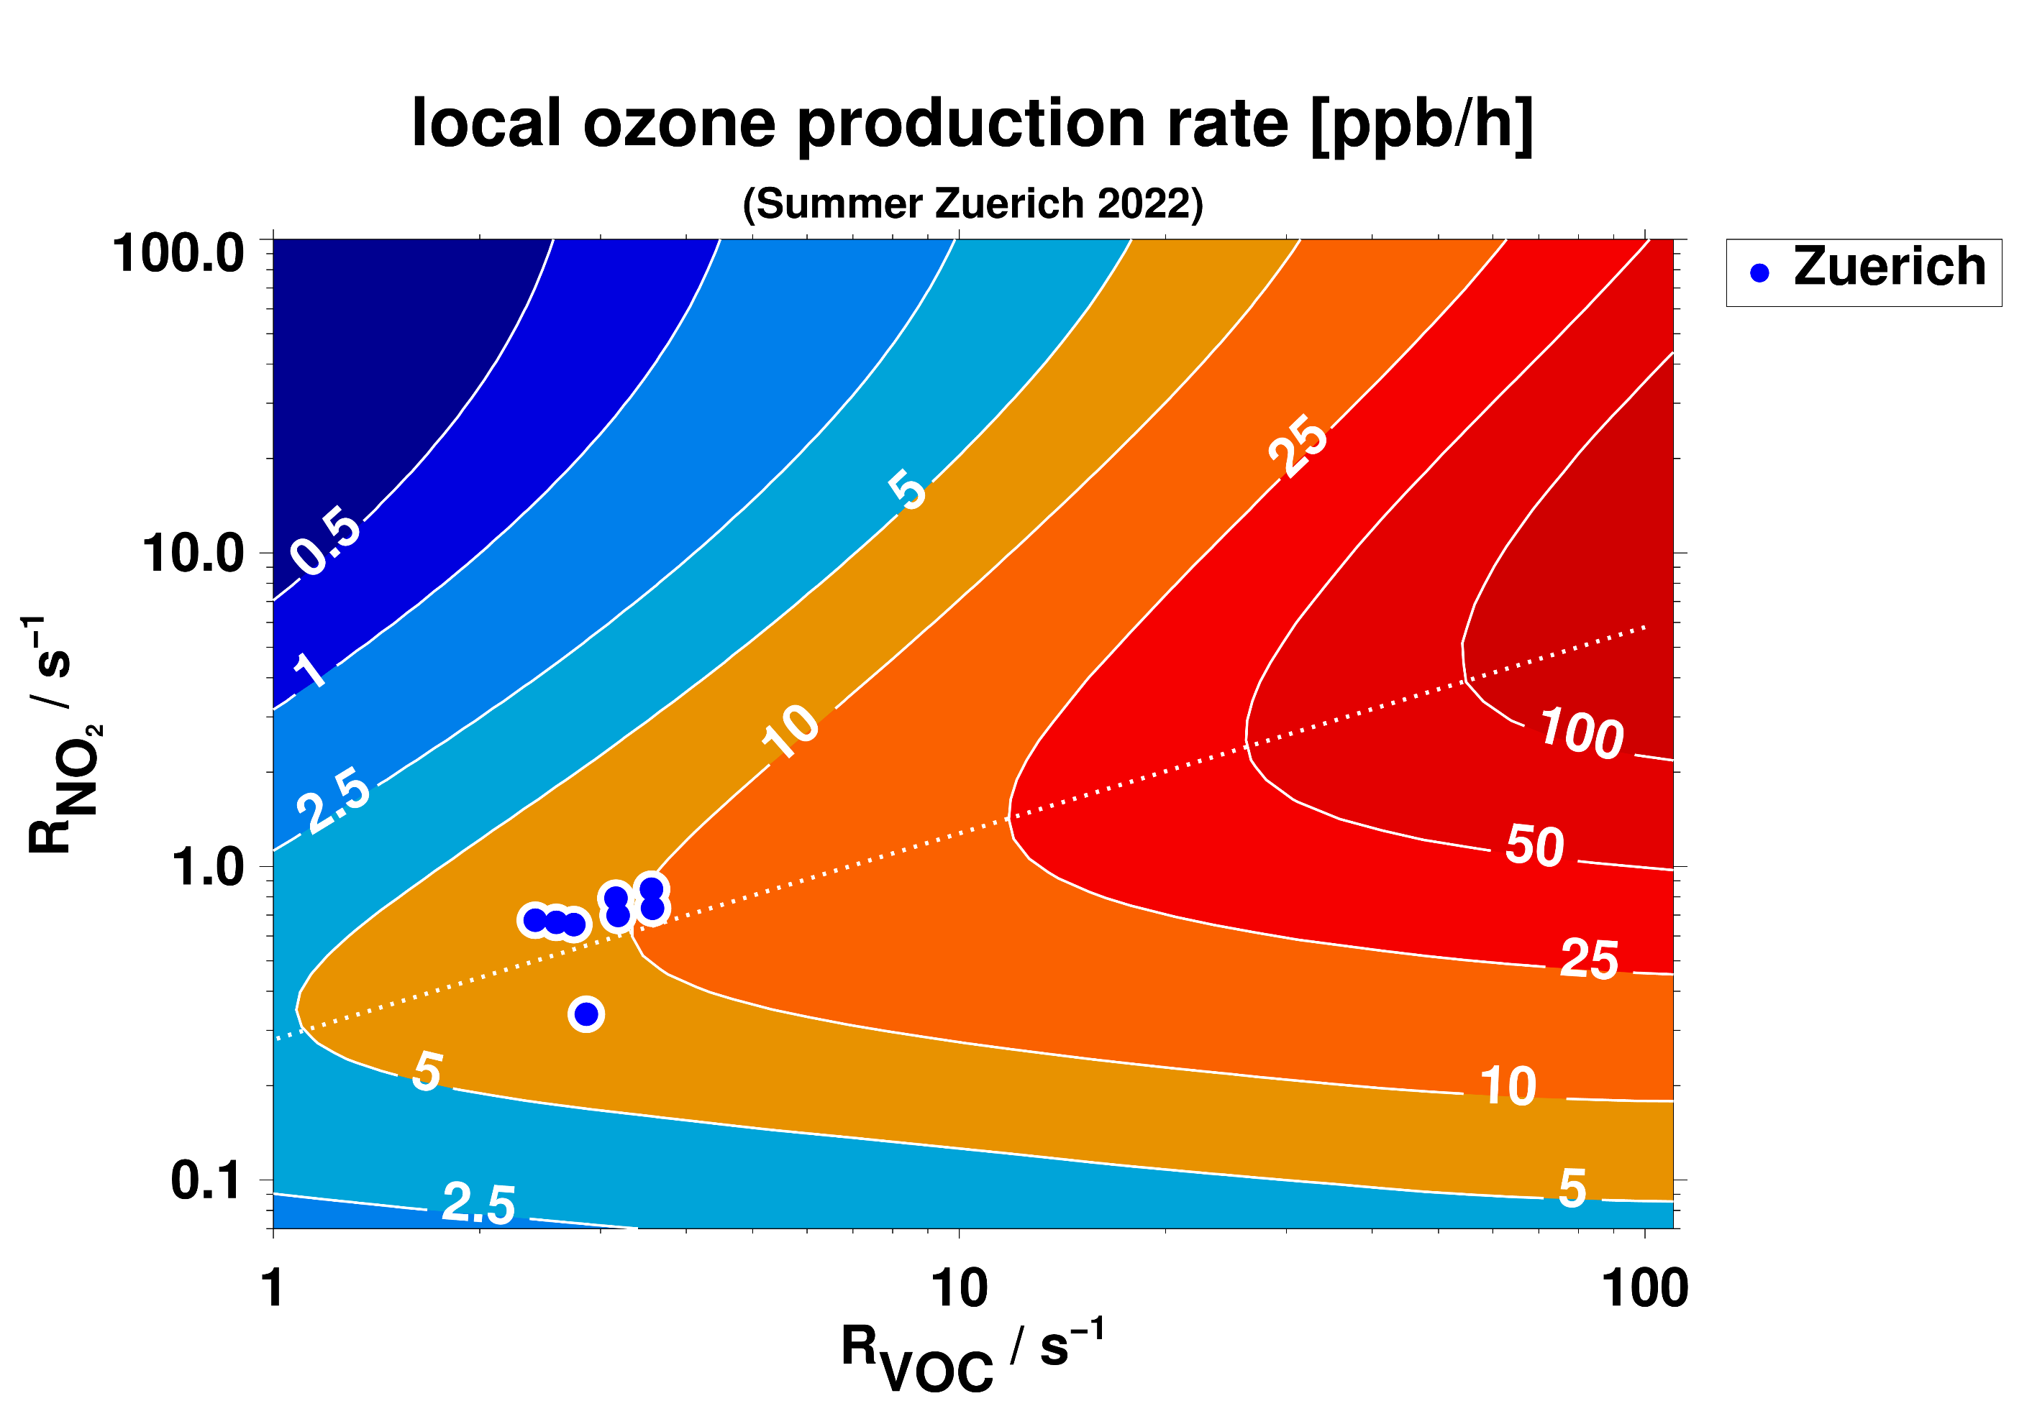
Local ozone production rate
Ozone production after 10 minutes
Ozone= 60 ppb
J_{O1D} = 2.9x10⁻⁵s-¹ J_{NO2} = 8.4x10⁻³s⁻¹

Slide 14
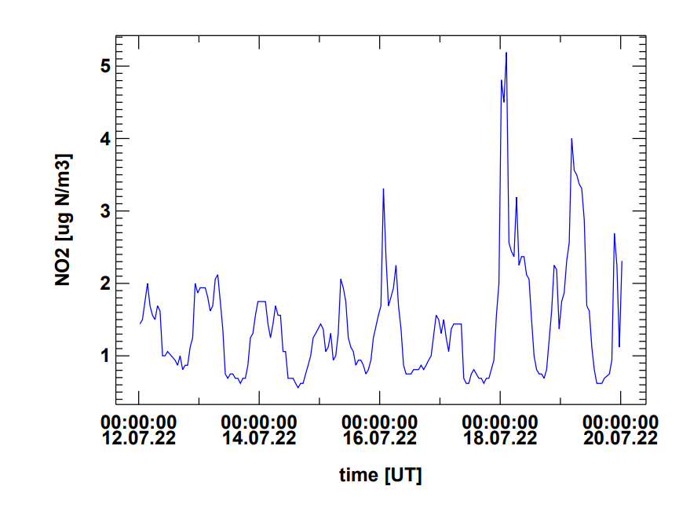
VOC VOC pattern at different European Sites (2022/07/18)
NO2 concentration at Illmitz is rather low
VOC OH reactivity is moderate

Slide 15
Local ozone production rate

Slide 16
Local ozone production rate
From: Ehlers et al., Faraday Discuss., 2016, 189, 407-437

Slide 17
Next Steps
Comparison with other VOC measuremnets
Quality Control using the @VOC@ tool
Calculate local ozone rates production at different sites
Where does the air come from ? (Trajectory analysis, CMB analysis

Slide 18
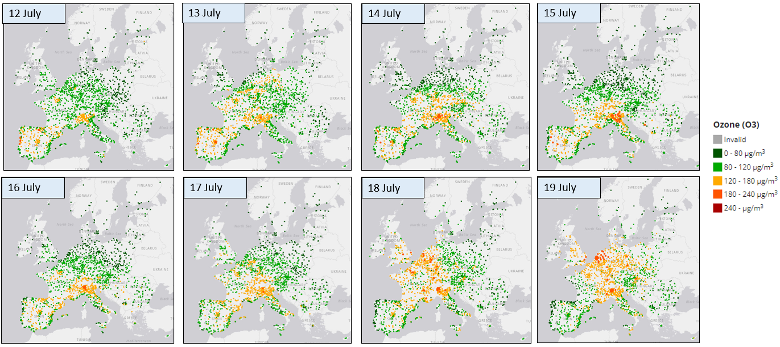
Thank you !

