Slide 1
Status and first results from the O₃/VOC/SOA EMEP Intensive Measurement Period of 2022
Wenche Aas, Sverre Solberg et al.

Slide 2
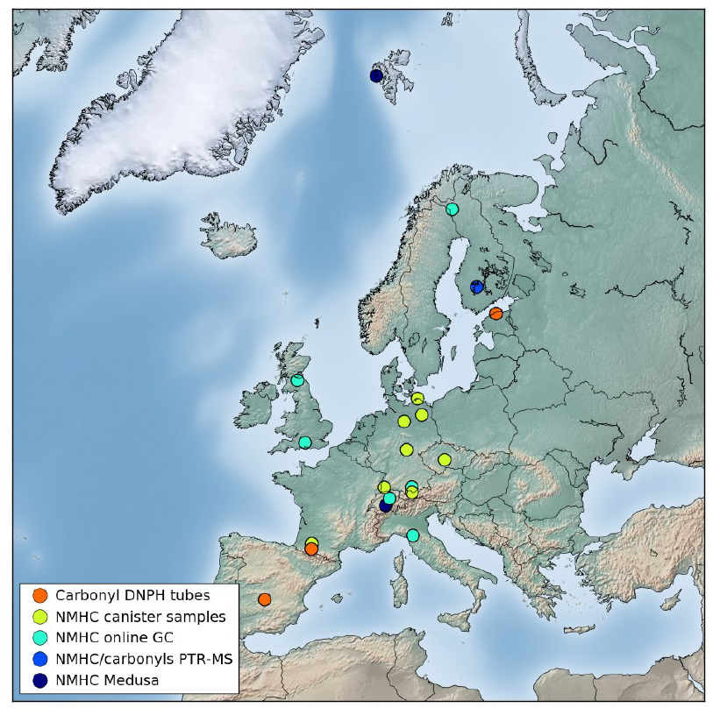
Objectives
Monitoring of VOCs in EMEP
The EMEP network is not targeted particularly for major ozone episodes:
Several sites with 1-2 samples per week.
Very few sites measuring oxygenated VOCs (O-VOC)
Hydrocarbons (NMHCs). Differences in the range of compounds and methods
Monoterpenes is hardly reported to EMEP
Tropospheric ozone is an adverse environmental and health problem in Europe, with need for a better understanding:
Why are ozone episode levels typically underpredicted by atmospheric transport models?
How the reductions in NMVOC and NOx emissions impact on the summer episodes.
Better utilisation of EMEP VOC monitoring data
What is the effect of a warmer climate?
What is the level of secondary organic aerosol (SOA), especially from biogenic VOCs, during high O3 events?

Slide 3

The setup for the one week intensive sampling
Sites already have ozone, NOx/NO₂ observations, several also EC/OC
Forecasted the best week for high ozone levels
Extended the regular EMEP observations
  include missing VOC component groups (NMHC, OVOC, Monoterpenes)
  increase sampling frequency to daily sampling all the sites
  Equip sites with continuous sampling if available (i.e. PTR-(ToF)-MS, GC/FID)
Additional manual sampling.
Distributed devices and centralised analysis:
  NMHC: Canister air sampling (FZ Jülich, Germany)
  O-VOCs: DNPH cartridge (IMT, France)
  Monoterpenes: Tenax tubes (FMI, Finland)
  SOA tracers: Use part of EC OC filters from regular monitoring (IGE, France)
Sponsored by:

Slide 4
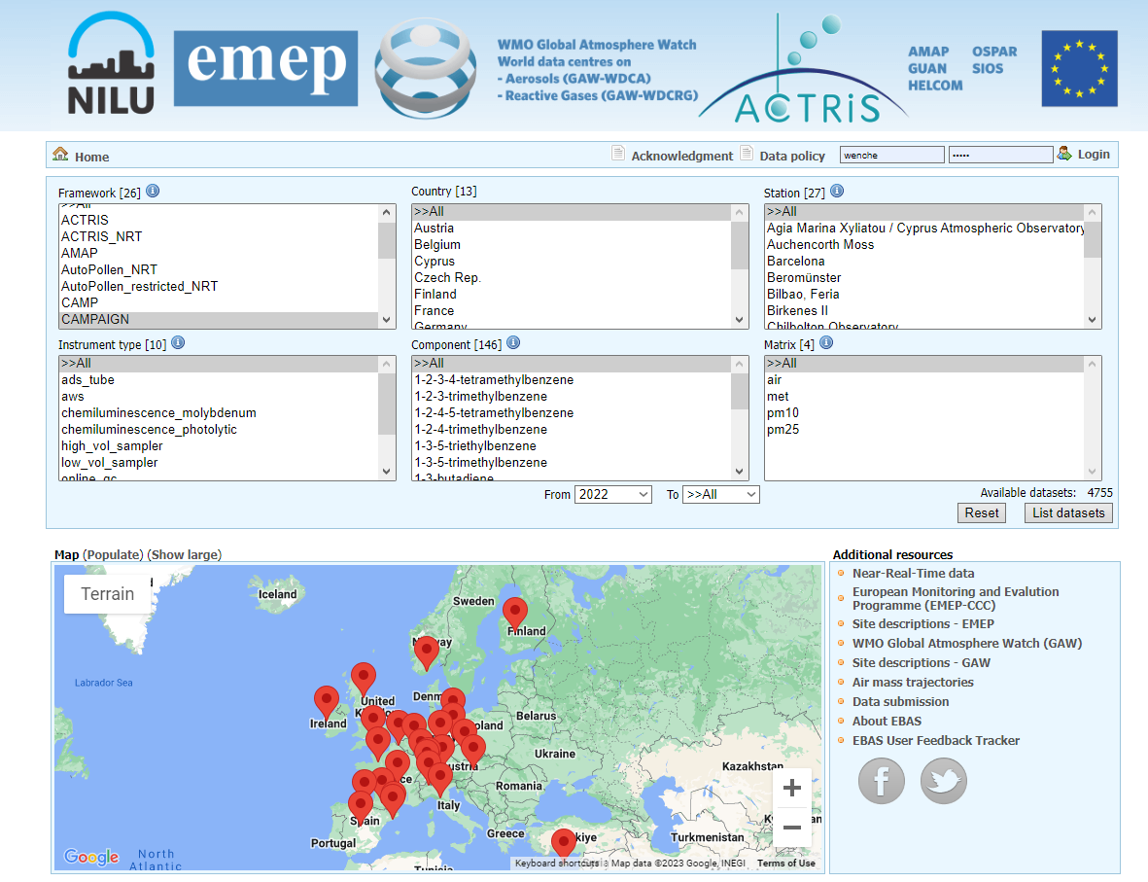
Status of data in EBAS (pr 10 May):
4755 datasets
13 countries
27 sites
146 components
https://ebas-data.nilu.no

Slide 5
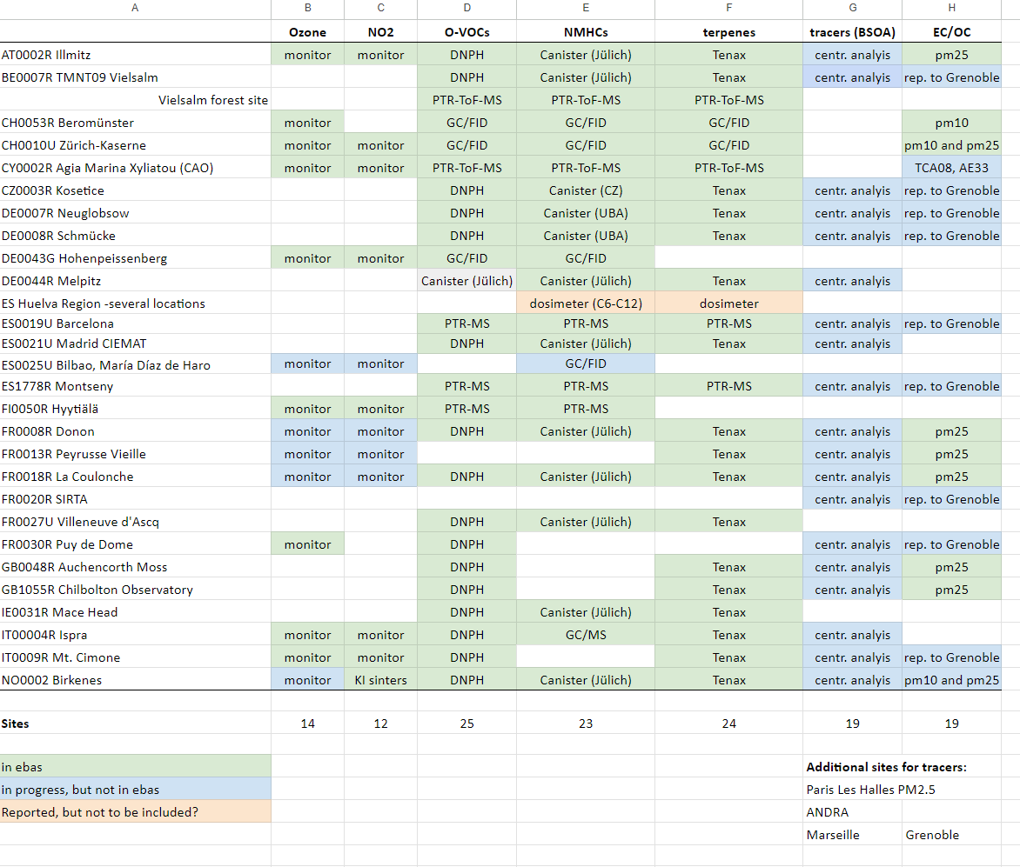
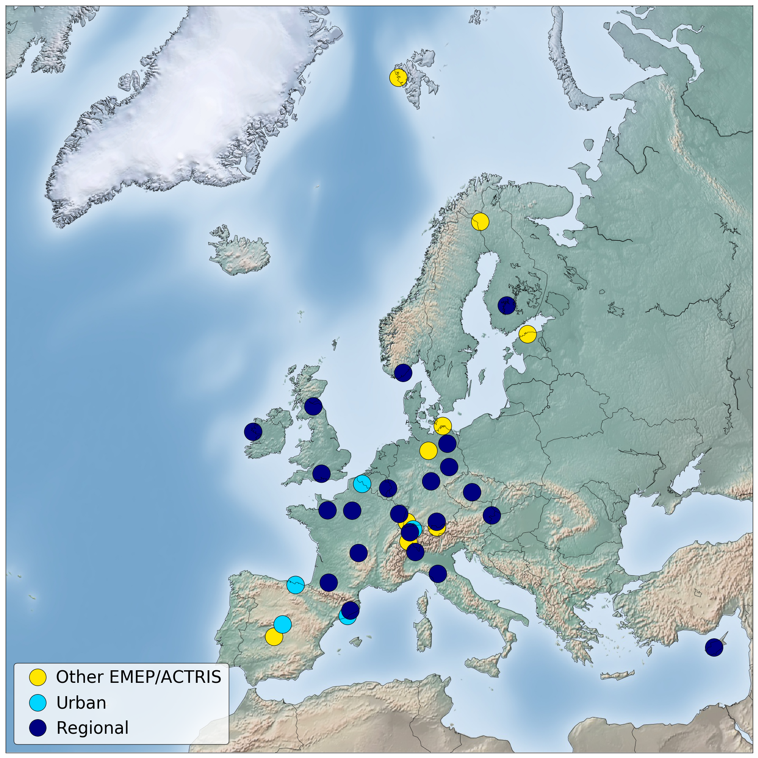
Available data from the measurement period

Slide 6
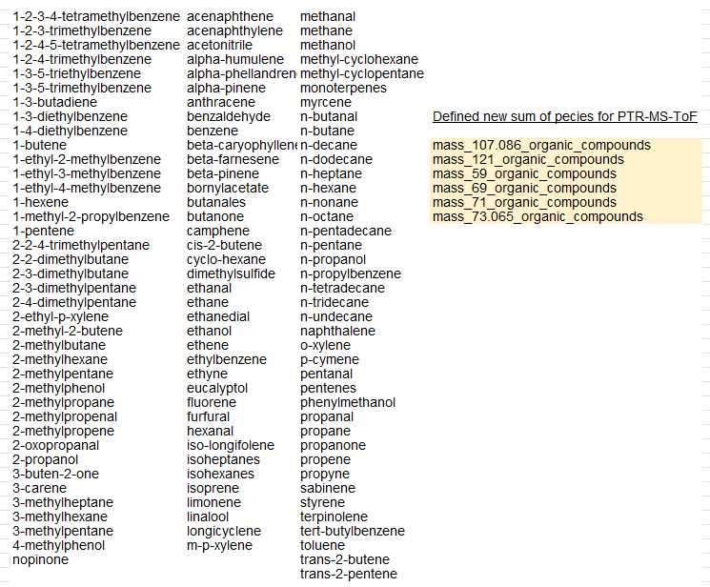
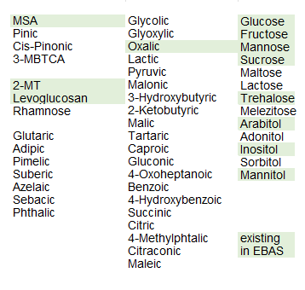
A lot of species, several new components to EBAS
VOCs (116 different species, and 6 sum of species)
Organic tracers (46 different)
Additional parameters:
NOx,O₃,EC,OC,PM,inorganic ions, CO,CO2, met.

Slide 7
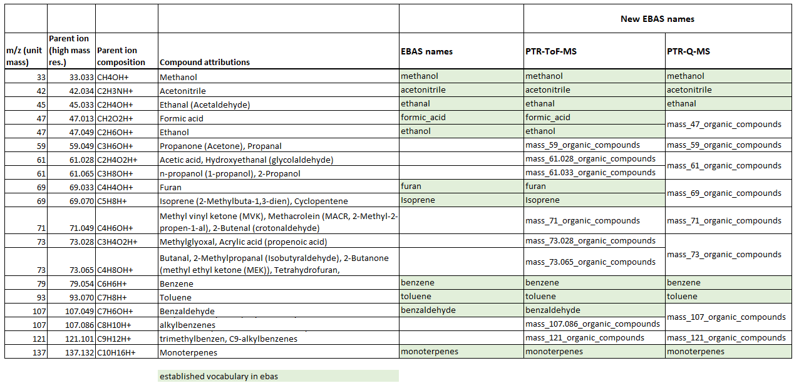
Defined new naming convention for PTR-MS and PTR-ToF-MS in Cooperation with ACTRIS CiGas
Groups (mz) in accordance to GLOVOCS («Master compound assignment guide for PTRMS users”): http://glovocs.creaf.cat/guide/

Slide 8
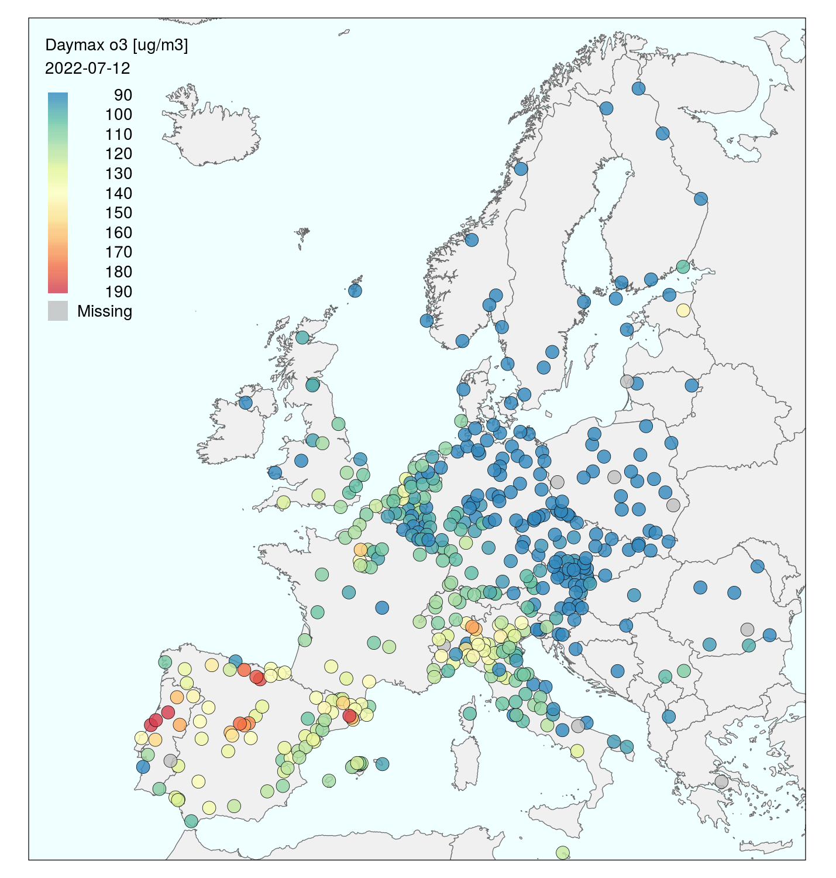
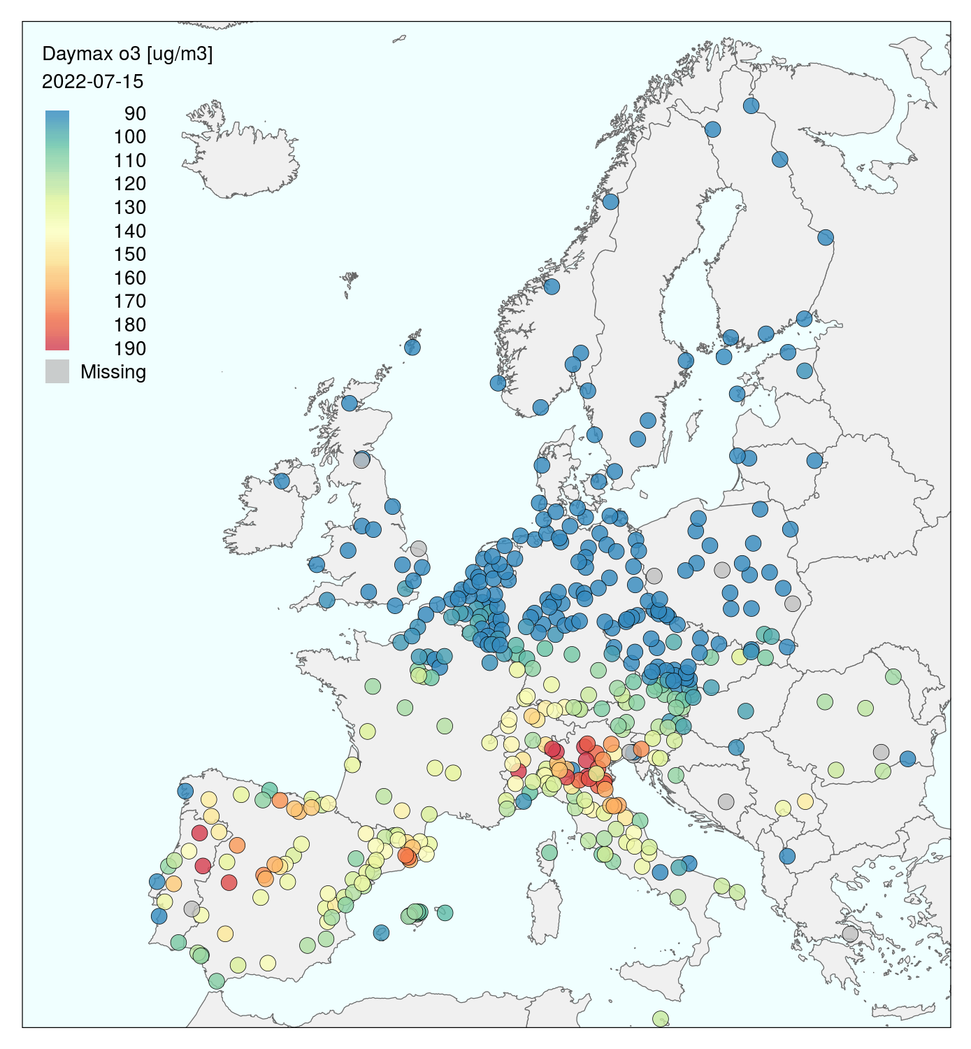
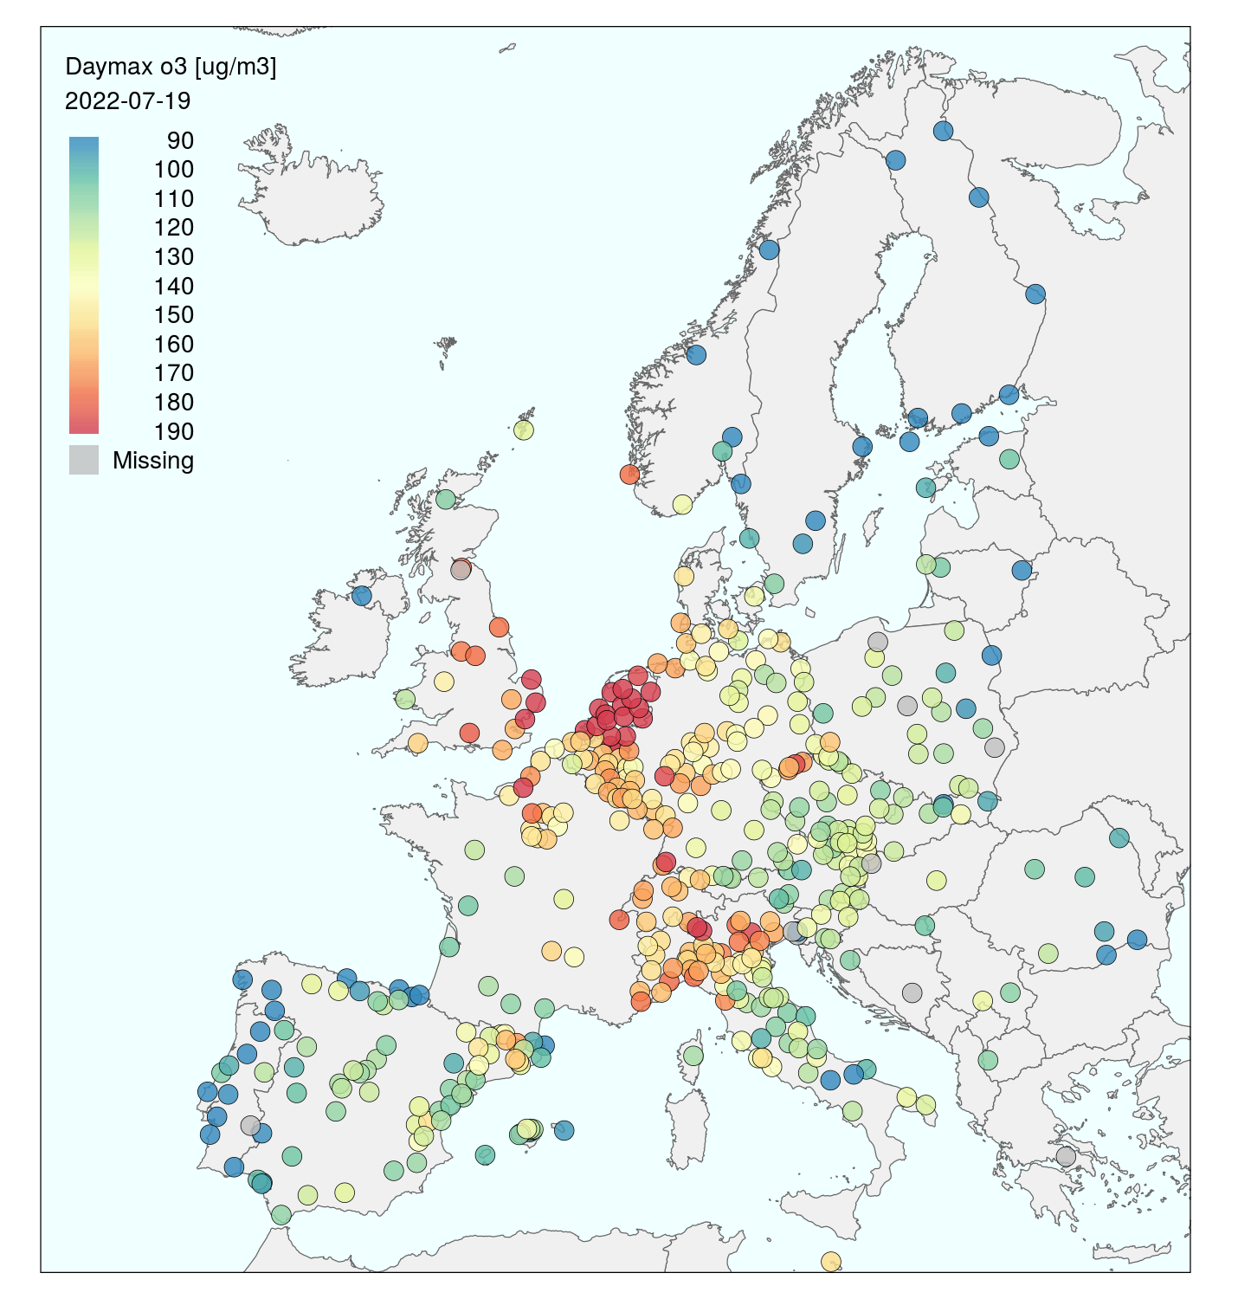
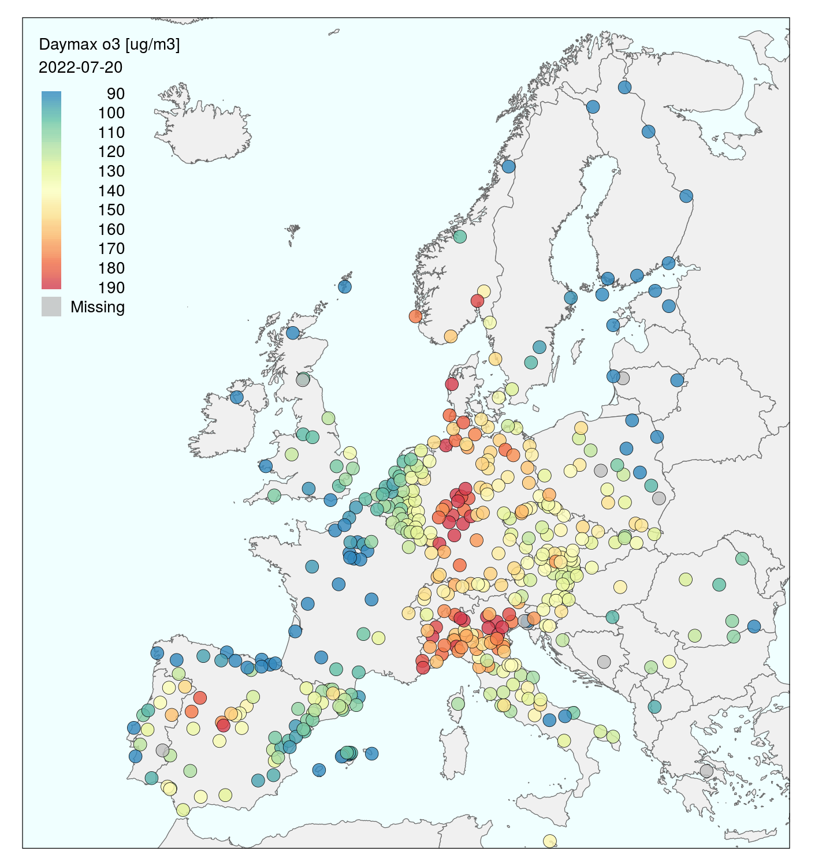
Ozone, daily maximum (Data from EEA)
12. July
15. July
19. July
20. July

Slide 9
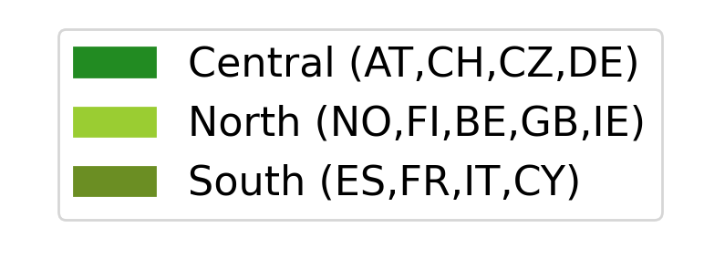
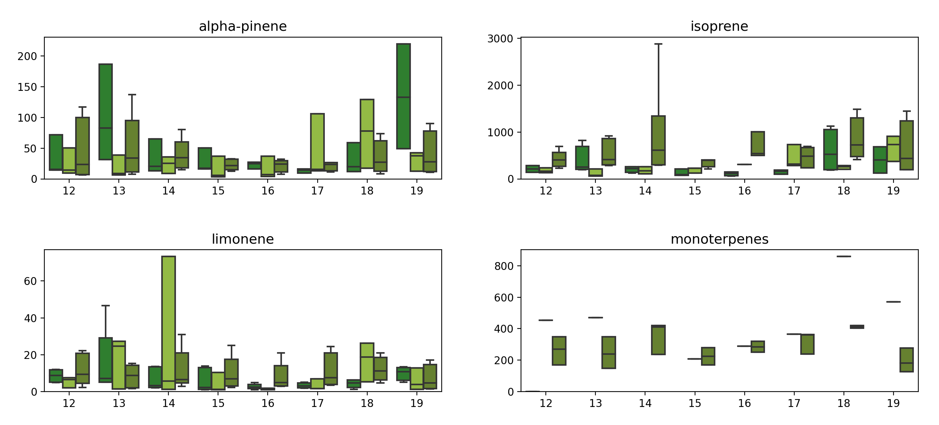
Concentrations of biogenic VOCs (at mid day)
Notes:
Monoterpenes is a sum of species from PTR-MS
Isoprene measured by the grab sampler –steel canister and PTR-MS. It is produced and emitted by many species of trees (major producers are oaks, poplars, eucalyptus, and some legumes).
A-pinene and limonene are terpenes measured by tenax. (and canister)
Pinenes are emitted from pines (conifers),
Limonene from oil of citrus fruit peels.
Isoprene from deciduous/broadleaf forest and scrubs

Slide 10
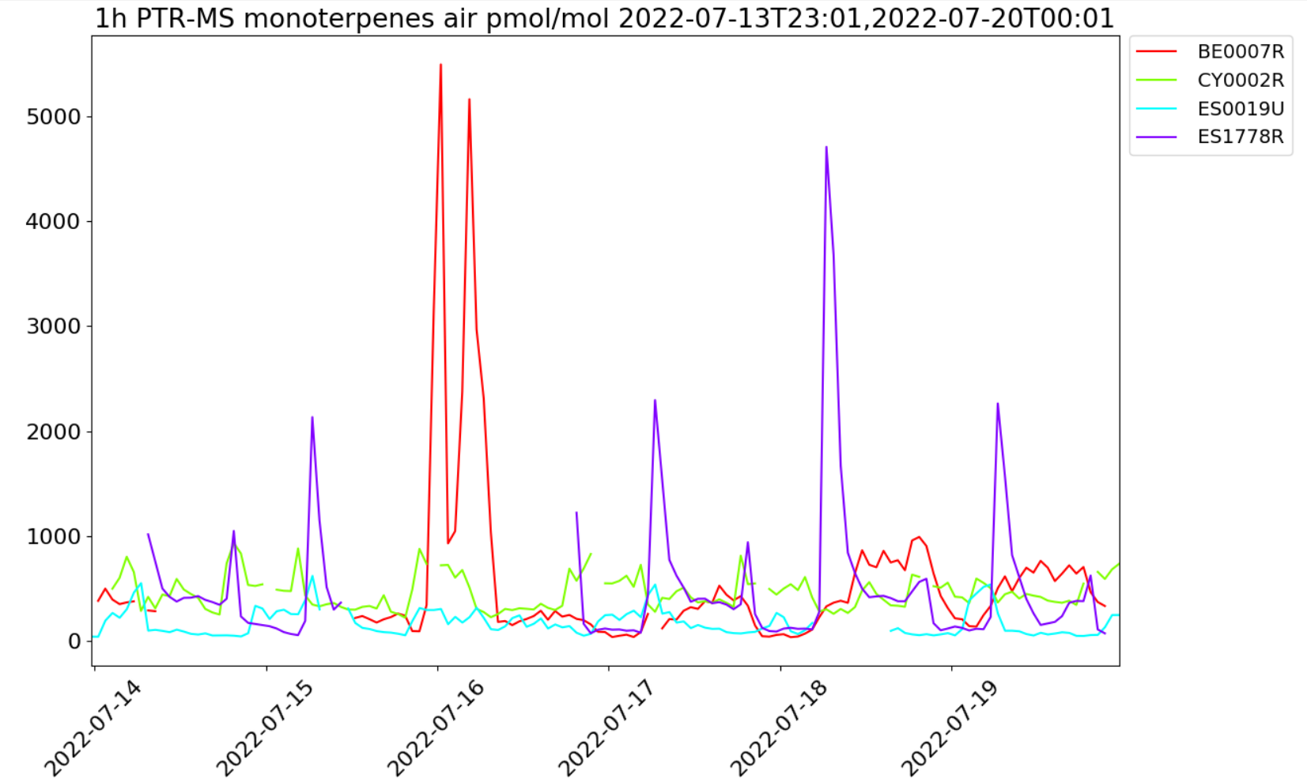
Monoterpenes from PTR-MS

Slide 11
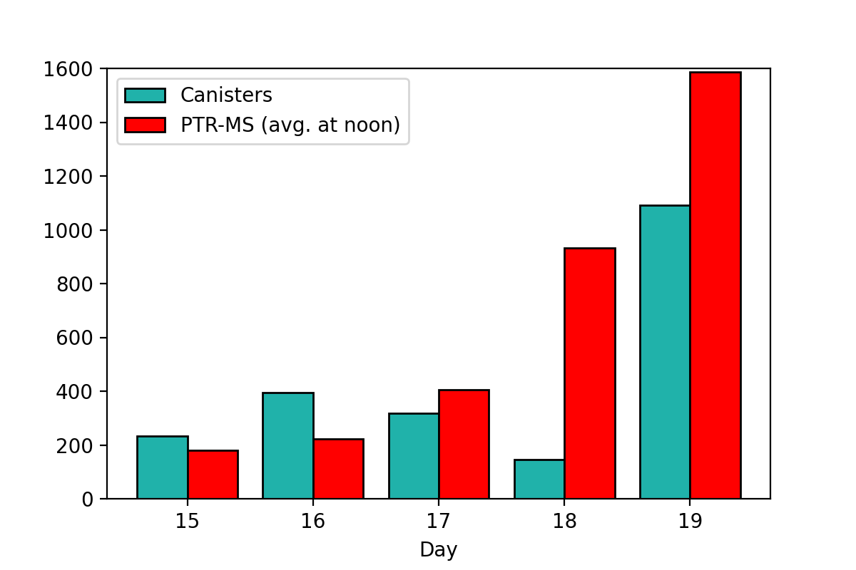
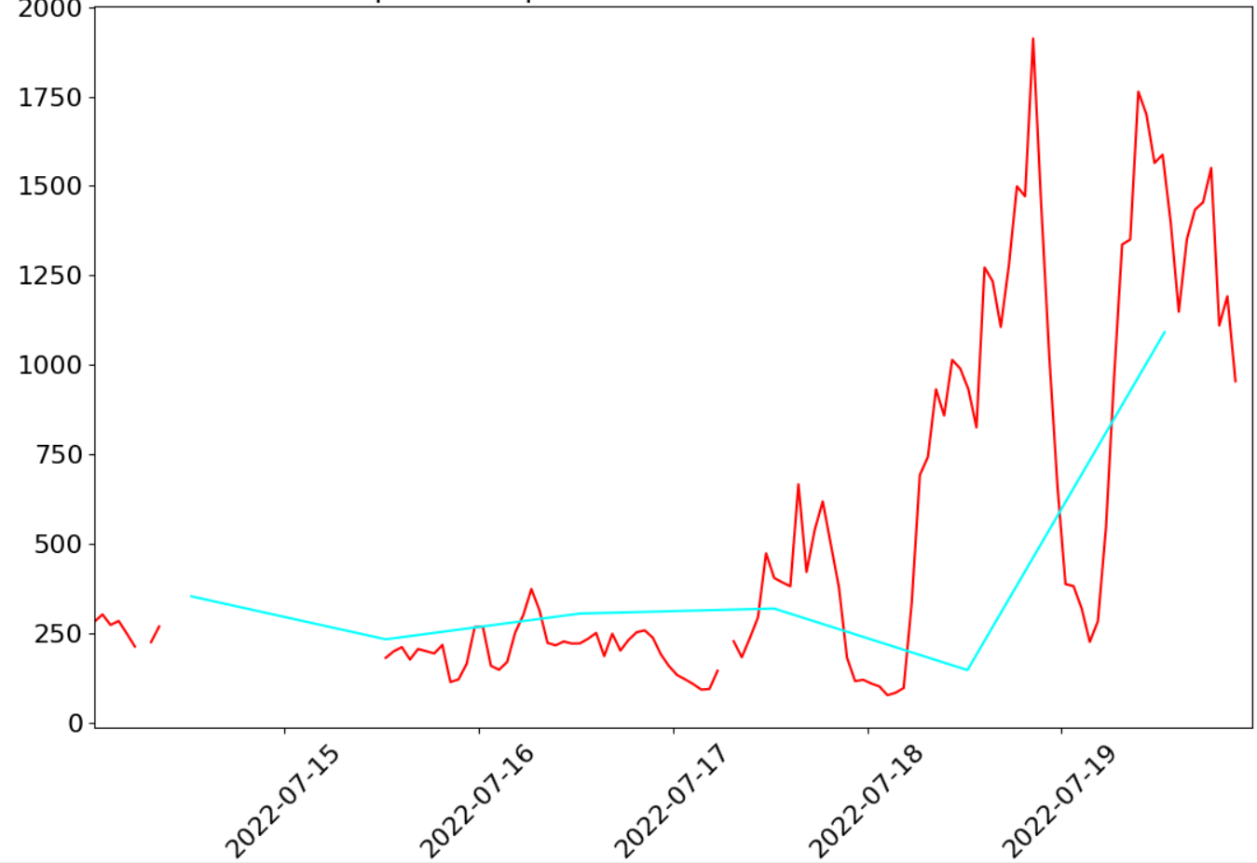

Isoprene with canisters and PTR-MS at Vielsalm (BE0007)
Hourly PTR-MS vs grab sampler Canister
PTR-MS vs grab sampler (canisters)

Slide 12
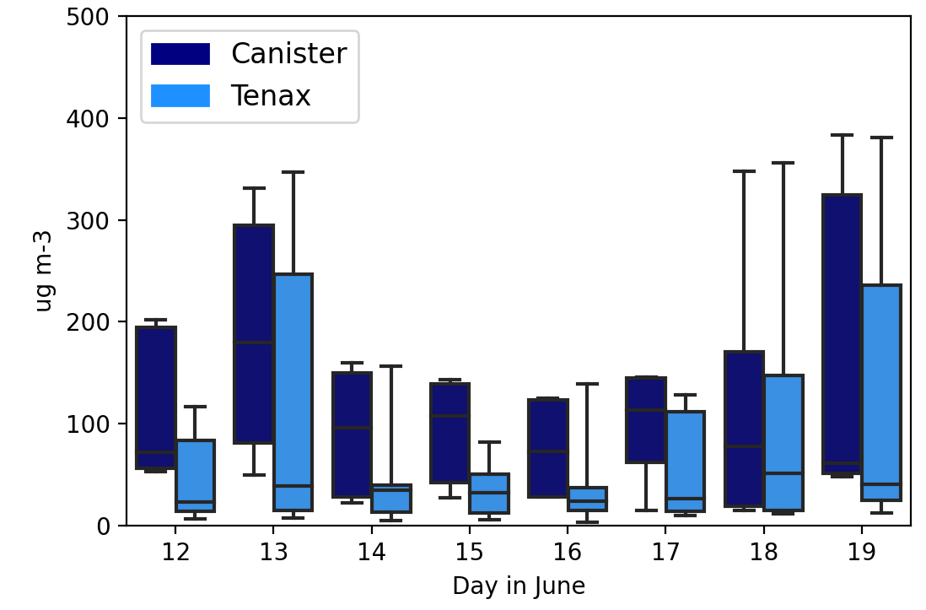
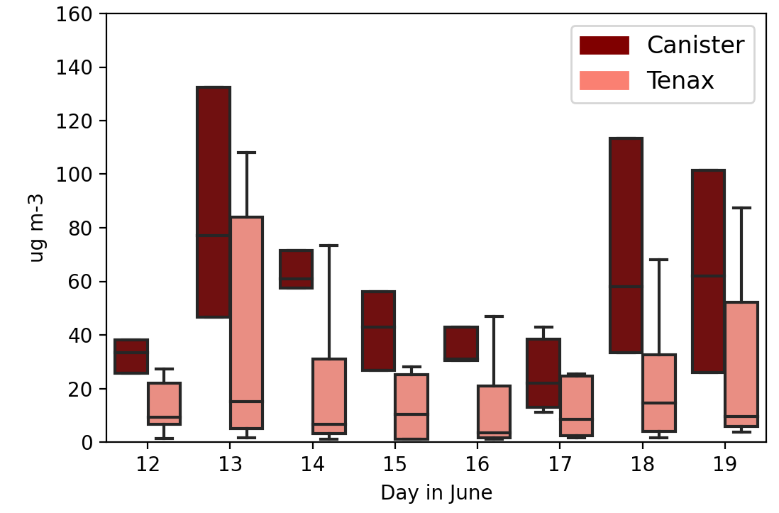


Some compounds sampled both with canisters and Tenax tubes
α-pinene
Limonene
α–pinene
Parallel at the following sites:
AT0002R', 'BE0007R', 'DE0044R', 'ES0021U', 'FR0008R', 'FR0018R', 'FR0027U', 'IE0031R', 'NO0002R’

Slide 13
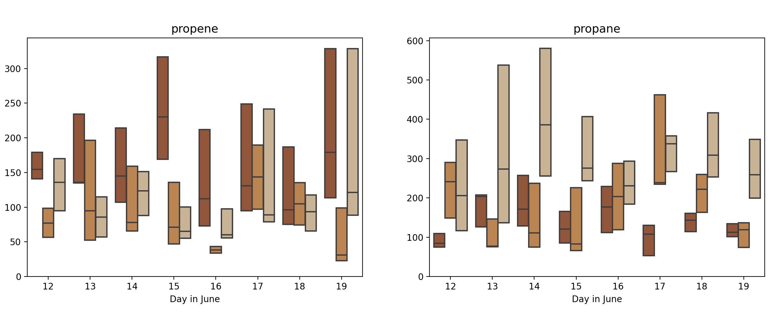
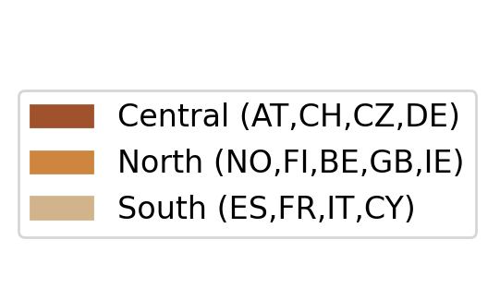
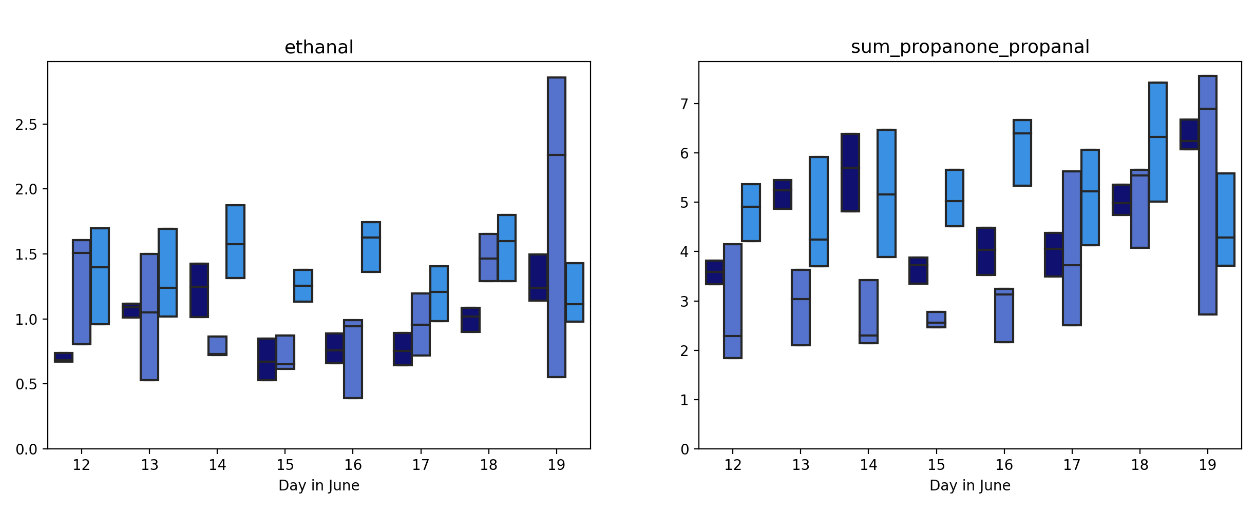
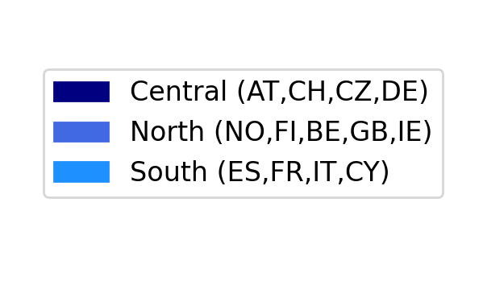
Concentrations of some O-VOC and NMHCs

Slide 14
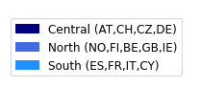
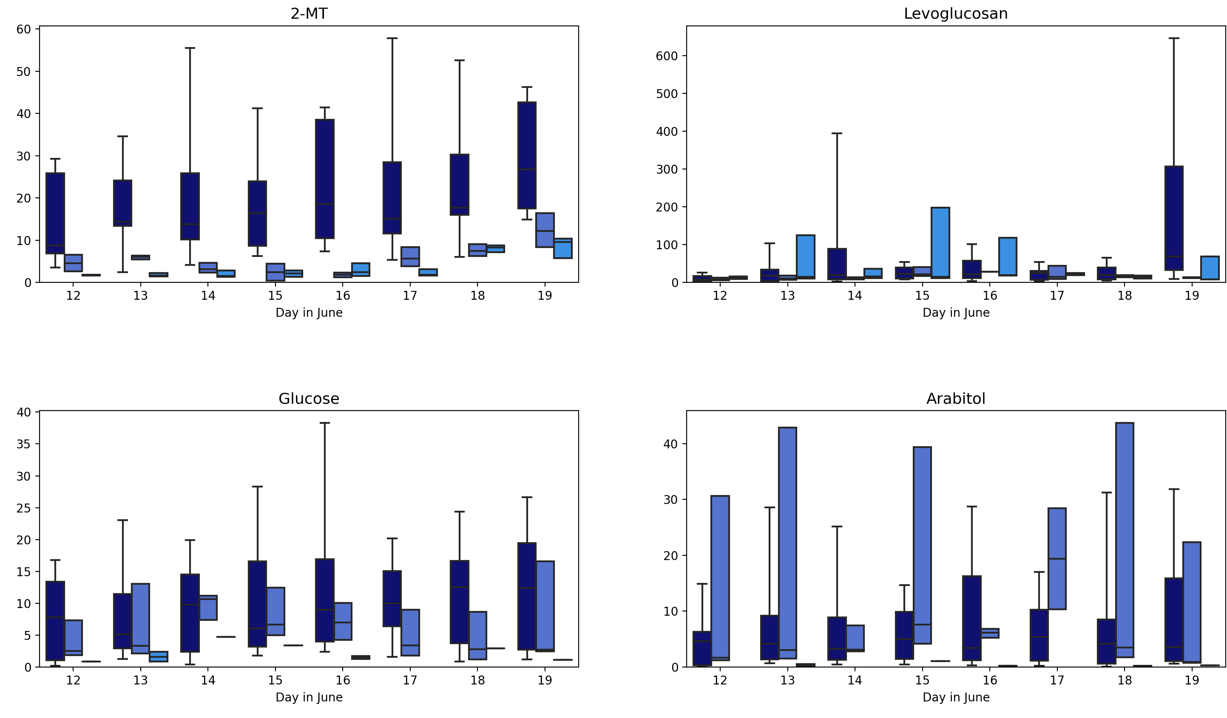
Tracers for secondary organic aerosols

Slide 15
The next steps
Include BSOA in EBAS as well as missing O₃ and Nox
Include an overview of the observations in this year EMEP status report.
An overview paper to be published this autumn.
Combination with models essential to assess ozone production and if the end products is in line with the observations of O₃, NOX, VOCs , tracers of SOA
  Evaluate the quality of the observations and which observations to use for model evaluation
      Evaluate whether the summer campaign provide new insight into the ozone production during heat waves
      Is there a need to repeat the campaign in the next work plan period?

