Slide 1
Quantifying the wet and dry atmospheric deposition of microplastics in Switzerland
Narain M. Ashta, Empa, Eawag, ETH Zurich
Ralf Kaegi, Eawag
Christoph Hueglin, Empa
TFMM Meeting, Warsaw, 10-12.05.2023

Slide 2
What are microplastics?
Plastic particles < 5 mm and > 1 µm in diameter
> intentionally produced for industrial and commercial uses (e.g. cosmetics)
> unintentionally generated from larger plastic items or synthetic textiles
Morphology: fibers, fragments, films, foams, spheres/beads
Detected in air, soil, water, snow, sea ice, biota, food, blood etc.
Properties: extreme persistence, potential for long-range environmental transport
Environmental hazards and adverse health effects: largely unknown
Cai et al. 2017
Notes:
plastic-free setup to minimize contamination
sampling duration → 1 year
sampling frequency → weekly to monthly (depending on meteorological conditions)

Slide 3
Atmospheric microplastics research
Microplastics (MP) in air reported in 2015 (Dris et al., 2015)
Atmospheric transport to remote regions reported in 2019 (Allen et al., 2019)
Since then, many studies reporting MP in air/deposition samples
Notes:
plastic-free setup to minimize contamination
sampling duration → 1 year
sampling frequency → weekly to monthly (depending on meteorological conditions)

Slide 4
Atmospheric microplastics research
Research gaps:
Lack of harmonized sample preparation and analytical methods for MP
> difficult to compare results across studies
Lack of data on particle recovery rates throughout analytical chain
> particle losses during sample treatment not tracked
> significant uncertainties in currently reported MP concentrations
Notes:
plastic-free setup to minimize contamination
sampling duration → 1 year
sampling frequency → weekly to monthly (depending on meteorological conditions)

Slide 5
FOEN-funded parallel projects on microplastics analytics
Research projects funded by the
Swiss Federal Office for the Environment
(FOEN)
3/2022 – 2/2026
Add-on project on atmospheric
deposition of tire wear
(funded by the Swiss Federal Roads Office FEDRO) 8/2023 – 7/2025
Narain M. Ashta
Christoph Hüglin
Expertise and advise from
Kristopher McNeill
Michael Sander
atmospheric deposition
Guillaume Crosset-Perrotin
Ralf Kägi
Julie Tolu
soil
sewage sludge
surface waters (rivers)
Angélique Moraz
Thomas Bucheli
5
Icons created by Freepik - Flaticon

Slide 6
Goals of atmospheric MP project
Develop harmonized method for measuring MPs across different environ-mental compartments (atmosphere, sewage sludge, water and soil)
Monitor wet & dry atmos. deposition of MP across Switzerland
Determine the types and amount of MP entering the environment via the atmosphere in Switzerland (with add-on project incl. tire rubber)
Notes:
plastic-free setup to minimize contamination
sampling duration → 1 year
sampling frequency → weekly to monthly (depending on meteorological conditions)

Slide 7
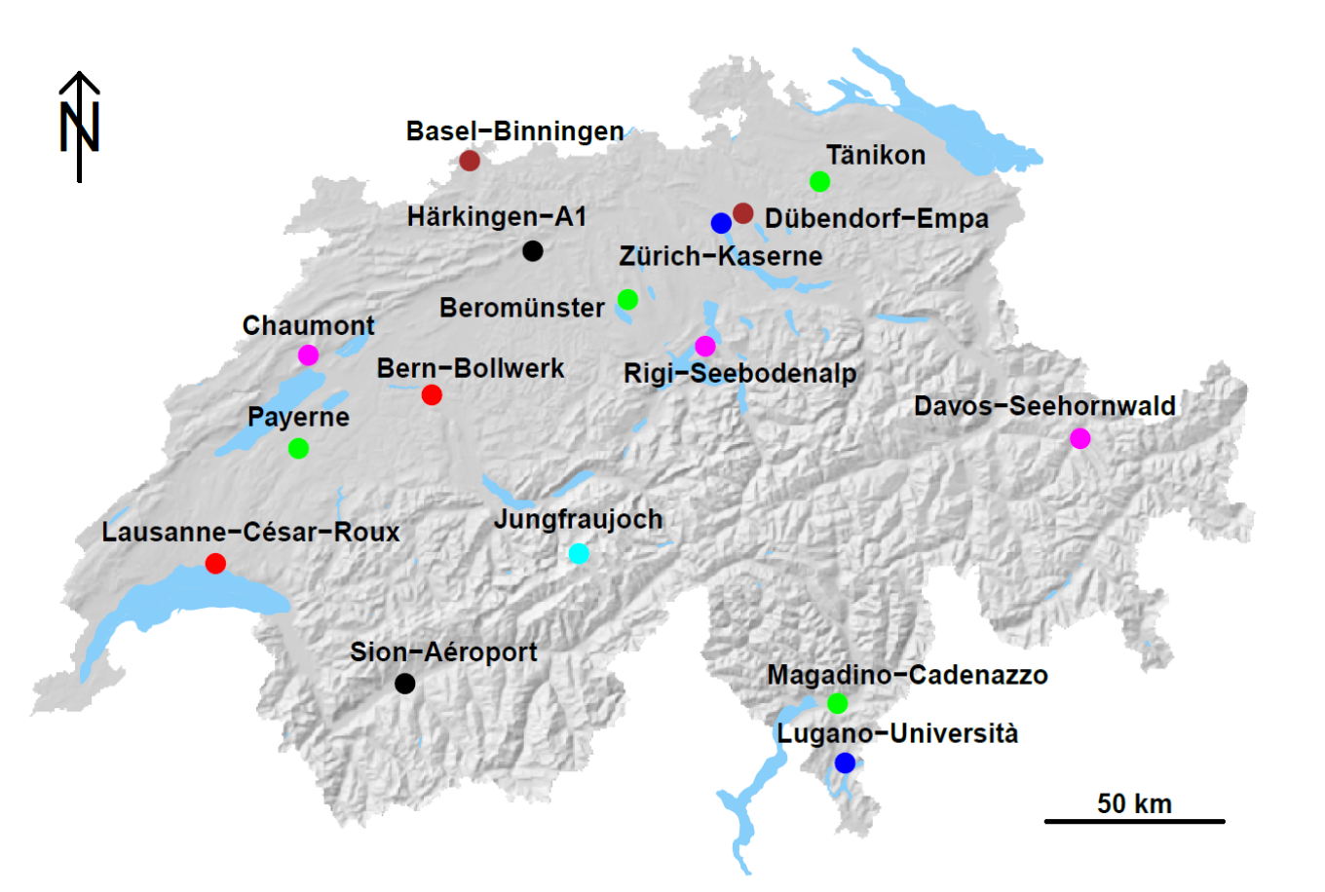
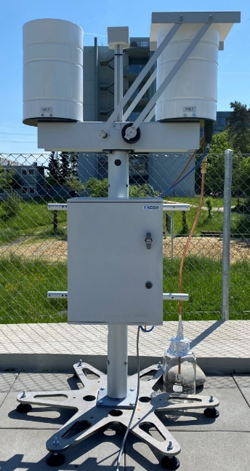
Monitoring of wet and dry deposition rates
Selected NABEL sites
for MP monitoring
Urban
Suburban
Rural
Remote
1 year monitoring (07/2023 – 06/2024)
One-month sampling interval

Slide 8
Wet & dry sampler for collecting deposition
dry deposition
collected in glass bowl
71-77%
recovery of surrogate standards
wet deposition
collected in glass bottle
18-57%
recovery of surrogate standards

Slide 9
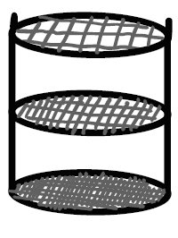
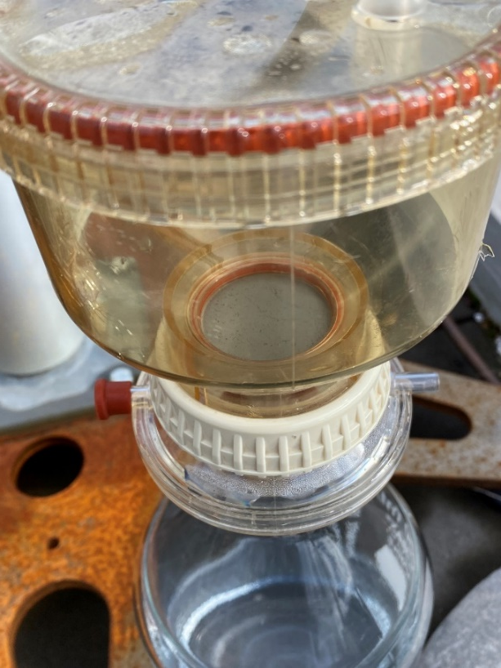
Modified sampler for collecting wet deposition
5 mm
200 µm
20 µm
<20 µm
collect size-separated particles
Directly during sampling
wet deposition
collected in glass bottle
test version of
cascade filtration unit
(metal version is currently manufactured)

Slide 10
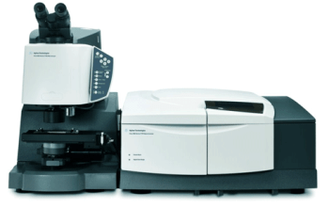
How are MP measured?
Vibrational spectroscopy: Fourier transform infrared (FTIR) (detection limit ~20 µm), Raman (1 µm)
(particle-based, non-destructive technique)
intensity (a.u.)
wavenumber (cm󠄂⁻¹)
Figure by Bruker Corp.
FTIR spectra of polyethylene (PE)
Thermogravimetric methods: Pyrolysis-Gas Chromatography-Mass Spectrometry (Py-GC-MS), TED-GC-MS
(bulk-method)
Py-GC-MS
Sample pyrolyzed at high temperature (in absence of oxygen)
Degradation products of different chemicals in sample are formed, separated and measured
Unique markers for different polymers are used to identify and quantify mass of polymers in sample
Notes:
Sample irradiated with IR light, response of particles at different wavenumbers are Fourier transformed to spectra, spectra matched with reference database
Sample pyrolyzed (heated in absence of oxygen), degradation products separated and their spectra analysed, spectra of unique markers used to determine mass of polymer

Slide 11
Sample treatment and analytical chain
5 mm
collect
extract particles
filtration
200 µm
samples
of interest
20 µm
count and add
reference MPs
to collection vessels
<20 µm
deposit particles onto filter
separate by size, density and
composition
take optical image of filter
> particle shape, size, color
cross-validate results
chemical analysis
mass- vs. count-based
> identify polymer types
> calculate recovery rate
of reference MPs
Py-GC-MS
FPA-µ-FTIR
currently
Notes:
filtration

Slide 12
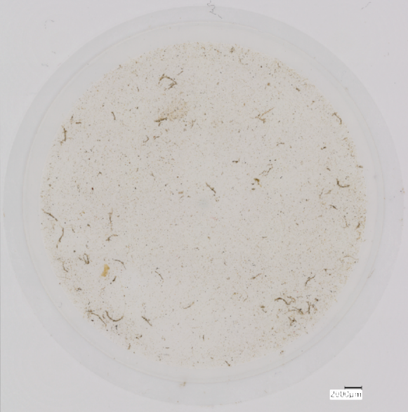
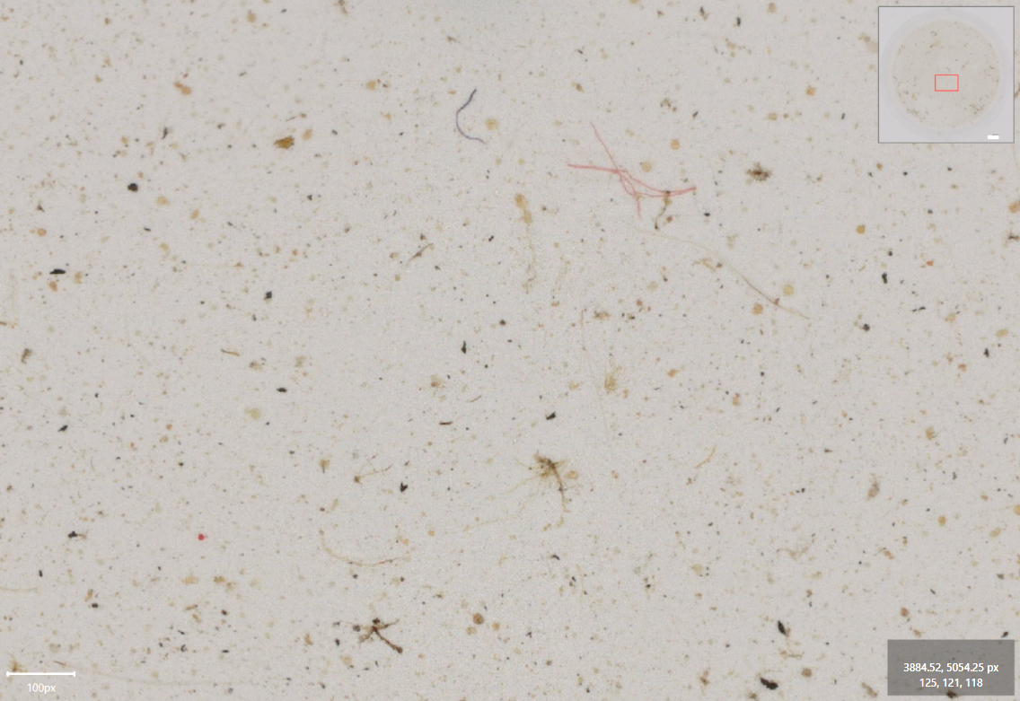
Atmospheric dry deposition sample
natural or synthetic fiber?
dust
pollen
plant fiber
reference MP
tire wear particle
2 mm
dry deposition on aluminium oxide filter (without sample treatment)

Slide 13
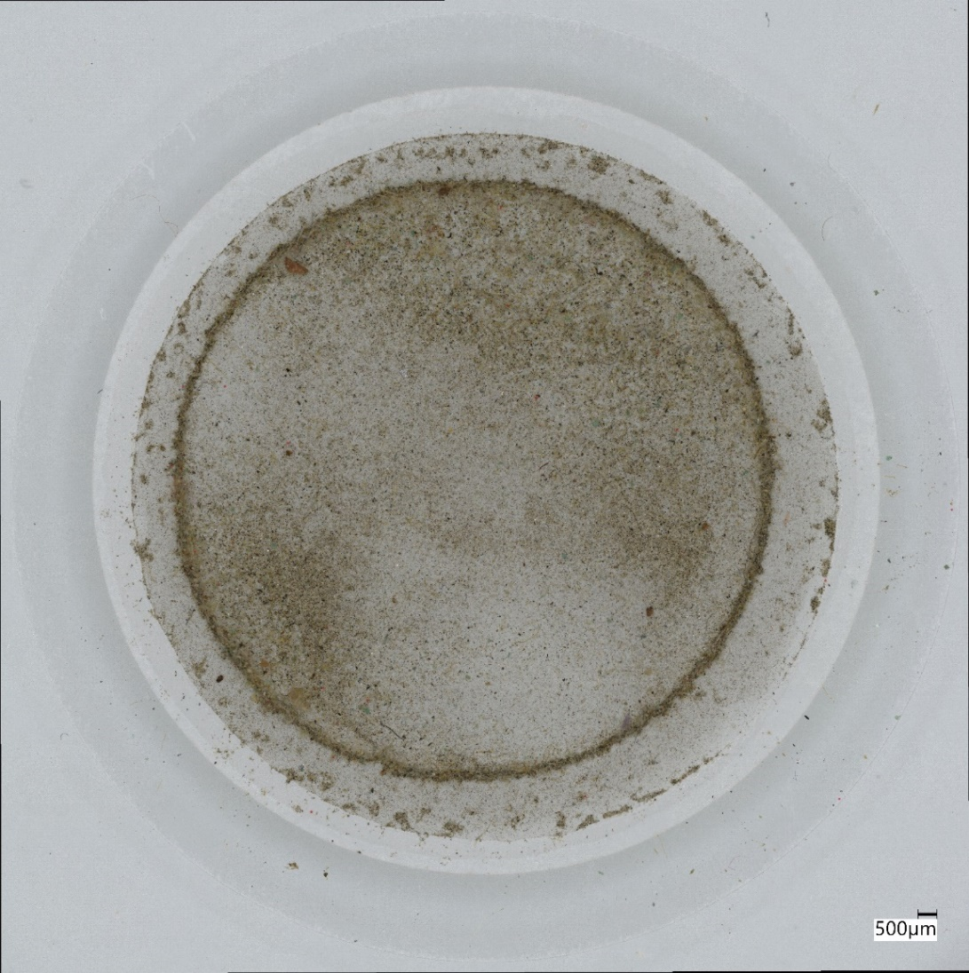
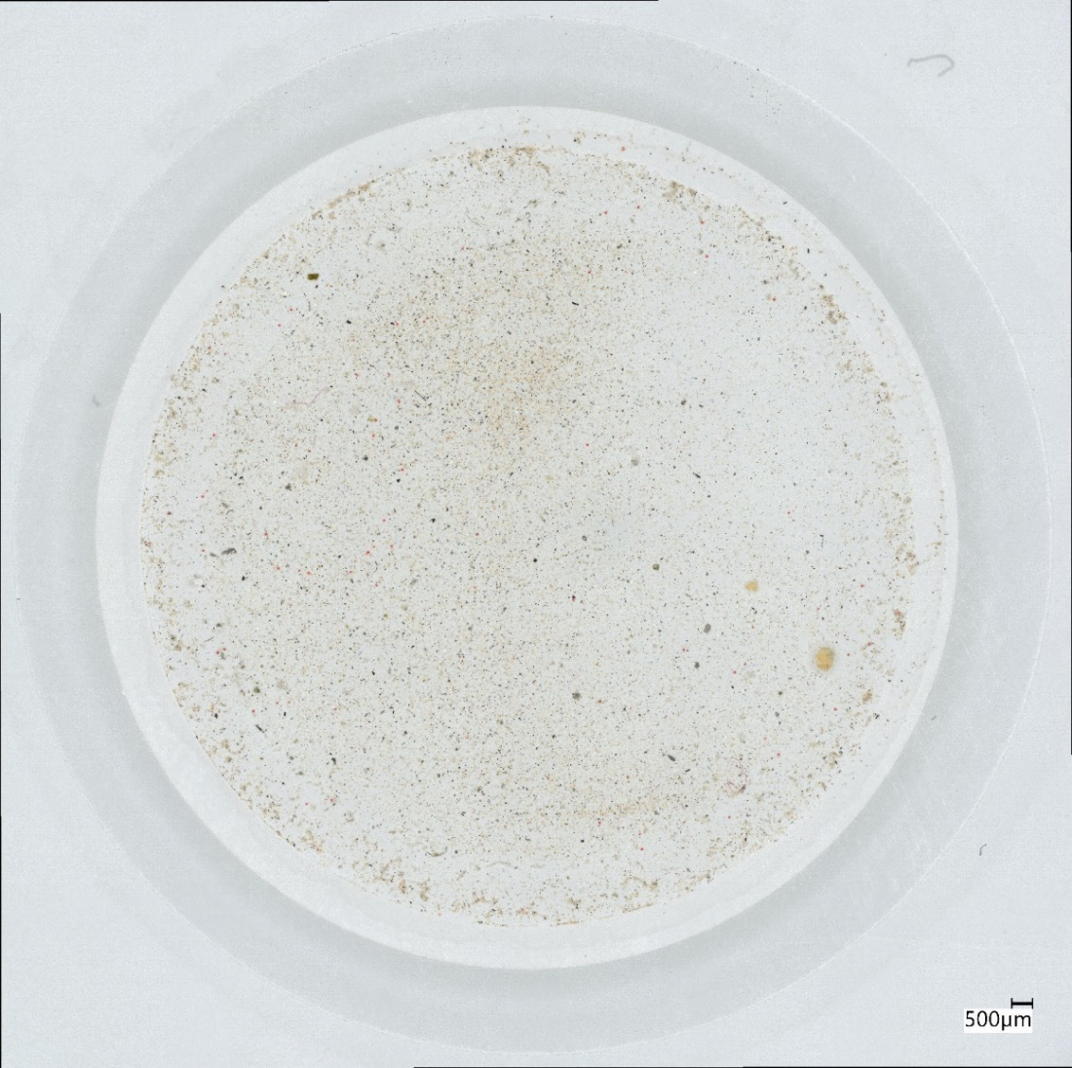
Atmospheric wet deposition sample
ve
without sample treatment
oxidative treatment

Slide 14
Atmospheric wet deposition sample
oxidative treatment

Slide 15
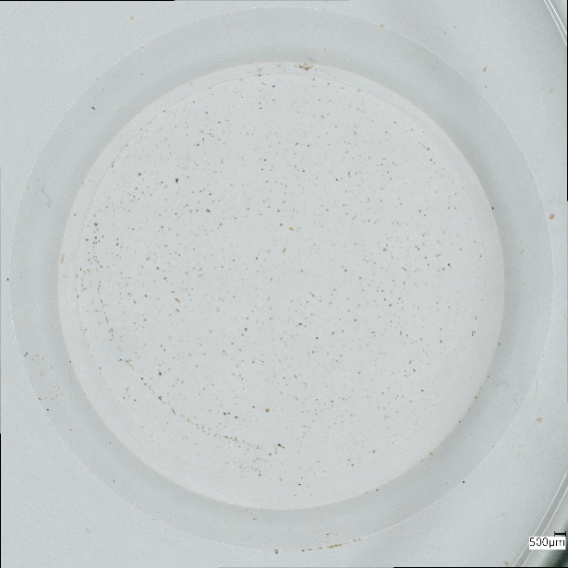
Chemical analysis using FPA-FTIR
1 FPA scan:
area = ~0.12 mm²
time = ~45 seconds
no. of spectra = 4096
⌀25-mm filter
area = ~490 mm²
no. of FPA squares = ~4088
total no. of spectra = 16.8 million
infrared beam
match with database
filter
transmission
polyethylene (PE)
Intensity (a.u.)
mirror
wavenumber (cm󠄂⁻¹)
Non-destructive technique
~ 3 days to analyze entire ⌀25-mm filter (1 sample)
for routine analysis
sub-sampling (~ 20%)

Slide 16
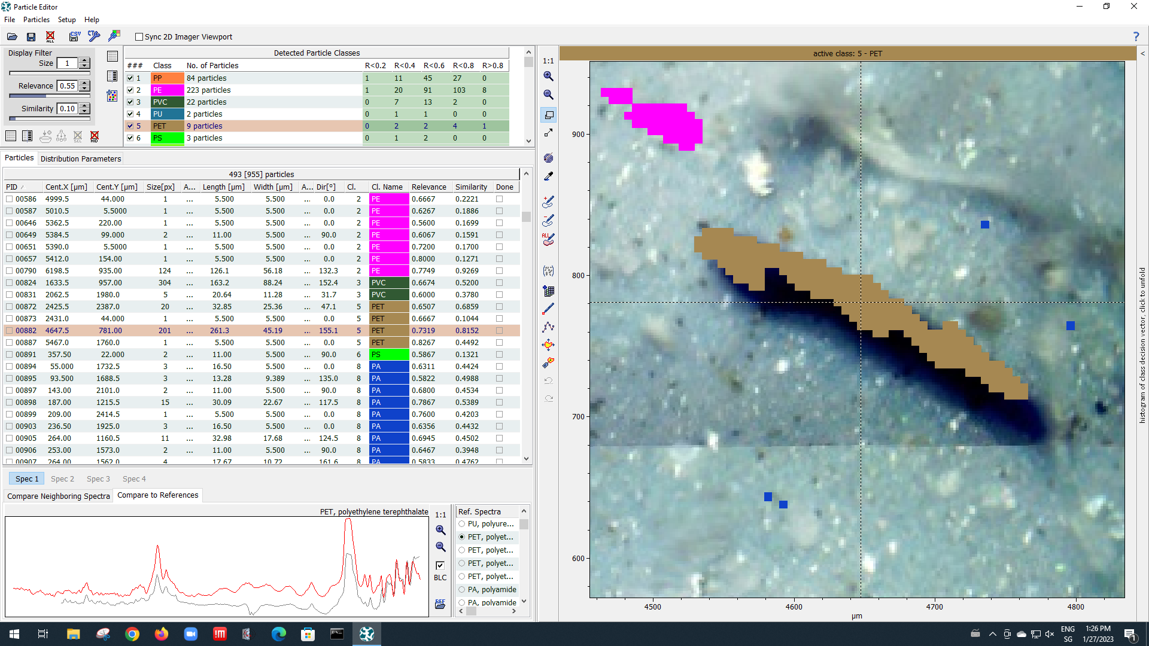
Example MP particle found in wet deposition

Slide 17
Deposition rate based on FPA-µ-FTIR
number of MPs identified
Deposition rate =
(MPs / m² / day)
fraction of filter analysed × sampling area × sampling duration
Σ (volume of particle × density of corresponding polymer)
Mass flux =
(g / m² / day)
fraction of filter analysed × sampling area × sampling duration

Slide 18
Dry deposition rate of MPs in Dübendorf
~50% of filter analyzed using FPA-µ-FTIR
20 MPs detected
> polymer types: PP, PE, PET, PMMA, PA, PAN/ABS
> fragments and fibers
suburban
Deposition rate ~ 30 MPs / m² / day
however...
uncertainties with FPA-µ-FTIR measurements
dry deposition
22 June – 26 July, 2022

Slide 19
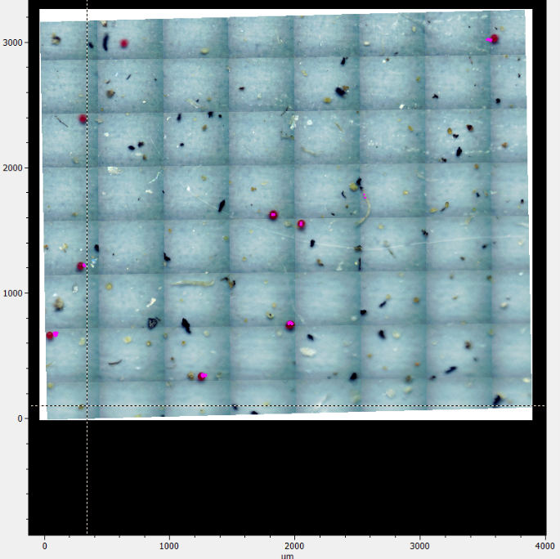
Uncertainties with FPA-µ-FTIR measurements…
Detected reference particles
Undetected reference particles

Slide 20
Summary
There is a lack of harmonized analytical methods for environmental microplastics
Results of available studies are therefore difficult to compare. Uncertainties of available studies are mostly unknown
For nanoplastics (< 1 μm) the situation is even worse
MP is transported through the atmosphere and deposited into the environment. The types and the amounts of MP depositing from the atmosphere are largely unknown
Effects of MP in the environment are also not well understood today
Research on environmental MP is needed

Slide 21
Thank you for your attention
Questions?
Many thanks to
FOEN for supporting all three MP projects
Colleagues from Agroscope, Eawag and ETH Zurich
Notes:
dry deposition

Slide 22
…due to slight bending of filter
Calibration done at one point
Measurements made over large areas
aluminium oxide filter
slightly bent
out of focus
microscope stage

Slide 23
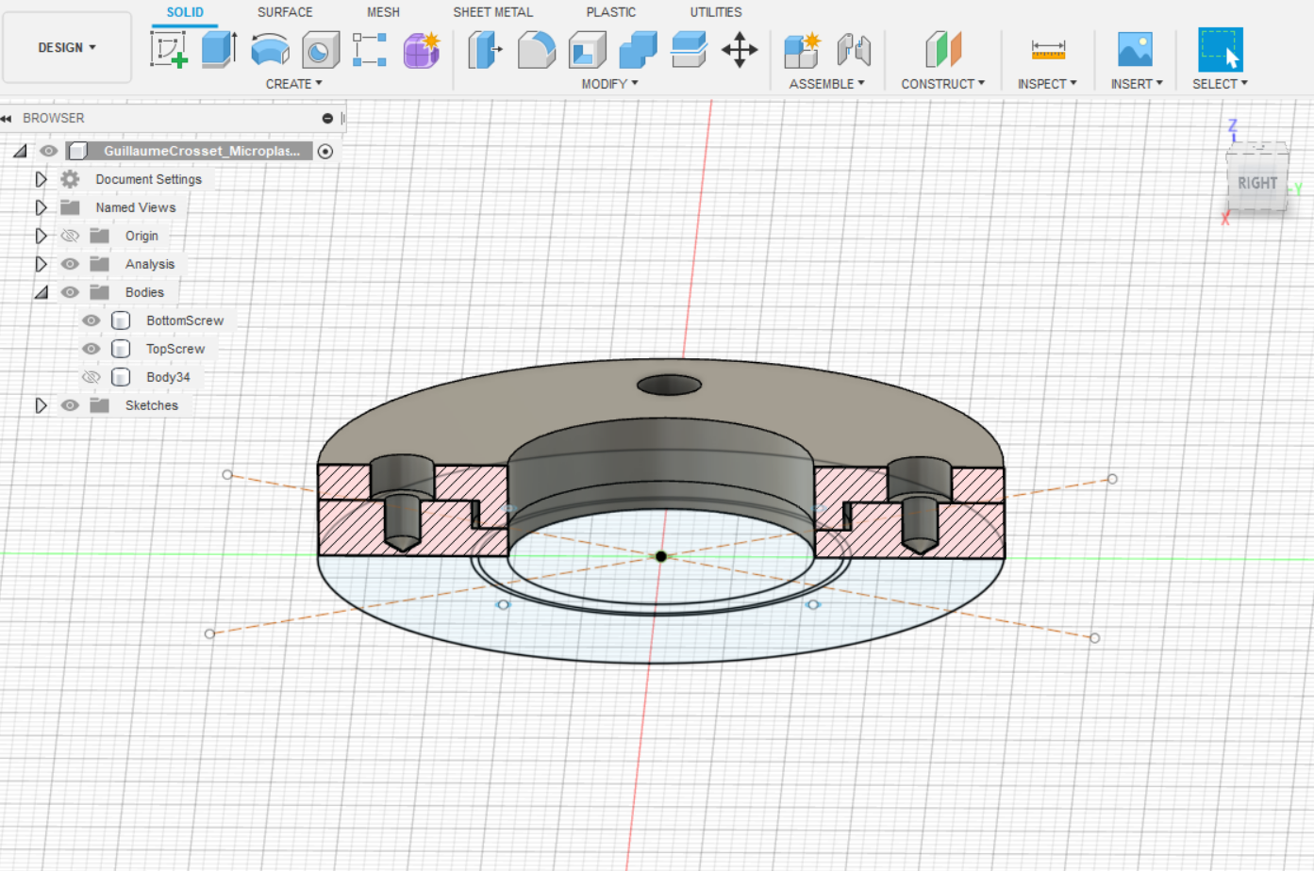
Resolving the filter bending issue
and/or use of calcium fluoride windows
(IR transparent material) to press filter
calcium fluoride window
aluminium oxide filter
calcium fluoride window
filter holder to flatten filter (in development)
Figure by Guillaume Crosset-Perrotin

Slide 24
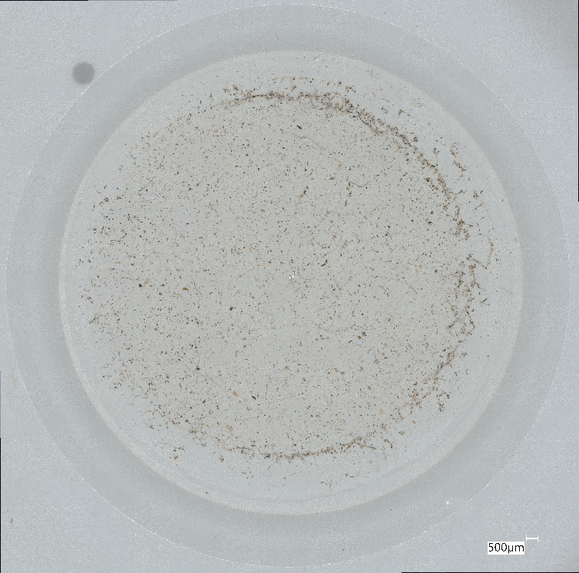
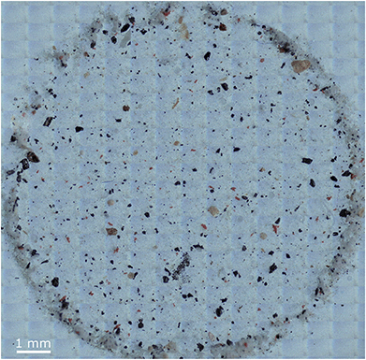
Challenges with sub-sampling
“Ring effect”
uneven distribution
of particles on filter
resolve by using
pressure filtration
instead of
vacuum filtration
(to be confirmed)
dry deposition, Dübendorf, 26 Jul – 17 Aug, 2022
Primpke et al. 2017

