Slide 1
MSC-W: Progress in 2022/2023
Hilde Fagerli, Bruce Denby, Peter Wind & rest of the EMEP/MSC-W team
TFMM, Warsaw 10-12th May 2023

Slide 2
MSC-W activities 2022/2023 presented at TFMM
Application of EMEP/uEMEP for the Gothenburg Protocol review
Source allocation of ozone: the local fraction methodology & first results
Modelling of atmospheric volatile organic compounds using the EMEP MSC-W model, Yao Ge (Thursday 11:10-11:30)
The impact of methane and global emission reductions on European surface ozone concentrations, Willem Van Caspel (Friday 9:40-10:00)
Using EMEP model in CAMS analysis of pollution episodes in European cities, Svetlana Tsyro (Wednesday 16:50-17:10) - cooperation with CAMS

Slide 3
Scenarios assessment relevant for the Gothenburg Protocol review
Can the WHO air quality guidelines be attained under a revised Gothenburg protocol (how far can we get)?
Focus on Europe: Future scenarios for the EU, West Balkans and EECCA - differences between regions?
CIAM (IIASA) provided emissions for Baseline, Maximum technical feasible reduction (MFR) and an additional scenario with diet changes and other climate related reductions (LOW)
2015, 2030, 2050 (Baseline/CLE, MFR, LOW)
Future scenarios were calculated with both 2005 & 2015 meteorology, and EMEP MSC-W model results on 0.1x0.1 degree provided to CCE, ICP Vegetation, ICP Waters, ICP materials for ex-post analysis. Here we focus on the runs using 2015 meteorology
Boundary conditions were kept constant
Focus on PM_{2.5} and NO₂ (O₃)
Additional model runs for looking at the effect of CH₄ and non-European mitigation performed - covered in presentation by Willem on Wednesday
EMEP Status Report 2022, Chapter 4 (https://emep.int/publ/reports/2022/EMEP_Status_Report_1_2022.pdf )

Slide 4
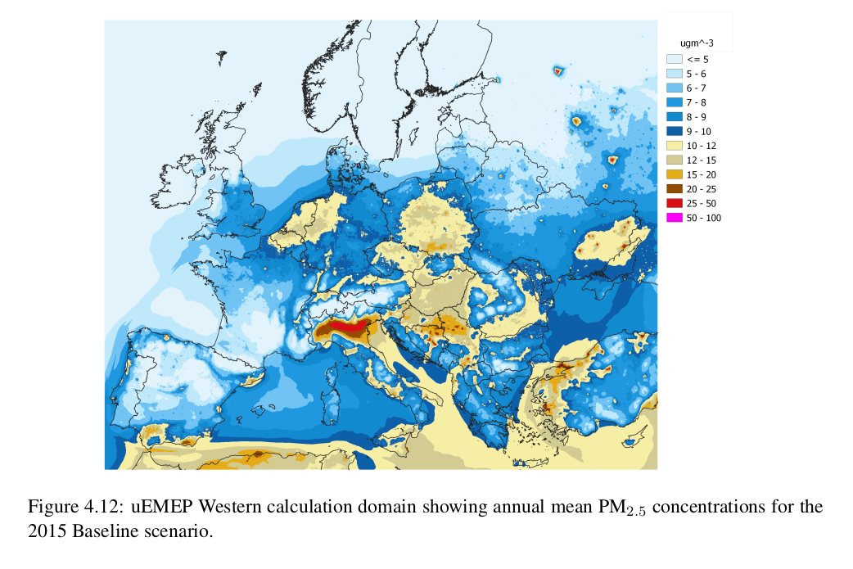
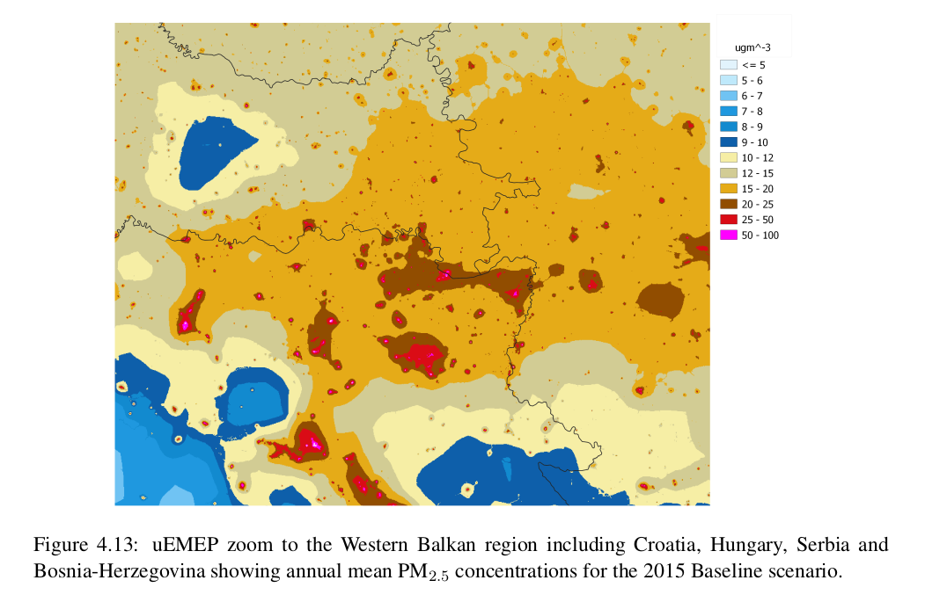
How?
WHO guidelines for annual mean PM_{2.5} = 5 𝜇g/m³ and NO₂ = 10 𝜇g/m³
Proposed EU AAQD in 2030 for PM_{2.5} = 10 𝜇g/m³ and NO₂ = 20 𝜇g/m³
EMEP/uEMEP
Regional scale EMEP (0.1x0.1 degree) + uEMEP (downscaling to ca
250 m) modelling of PM, NO₂, ozone
Comparison at AirBase stations for 2015 (check of methodology etc for present day)

Slide 5
How does uEMEP downscaling work ?
uEMEP sub-grid (250 m)
Redistributed sub-grid emissions
Dispersion
uEMEP sub-grid
Non-local
Local
Local
Combine local sub-grid with nonlocal EMEP
Non-local
Non-local
EMEP gridded emissions (0.1x0.1 degree)
EMEP grid concentration
Local fraction
EMEP
E.g. Open Street Map used as proxy for traffic

Slide 6
Validation for PM_{2.5}, O₃, NO₂
against Airbase stations (rural, urban, traffic)

Slide 7
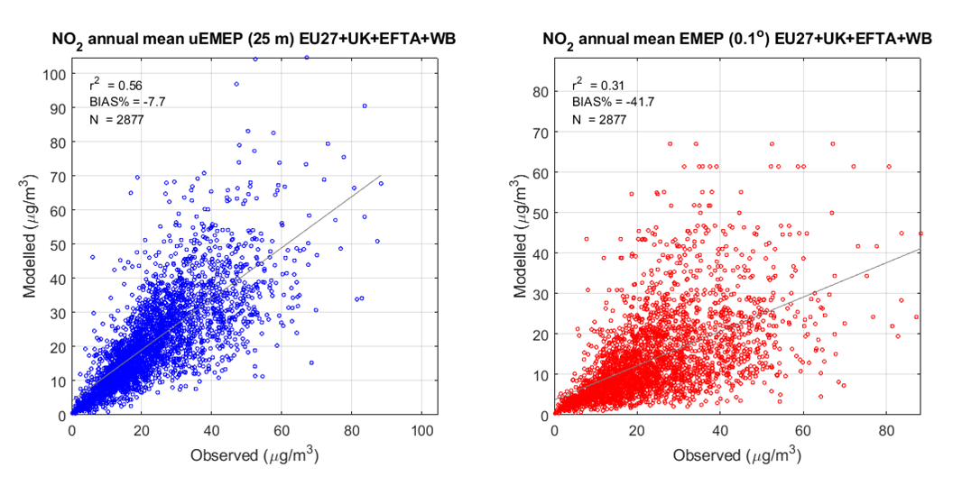
Validation NO₂ 2015 reference year against Airbase observations (including traffic stations)
uEMEP NO₂
bias = -7.7 %
r² = 0.56
EMEP NO₂
bias = -41.7 %
r² = 0.31

Slide 8
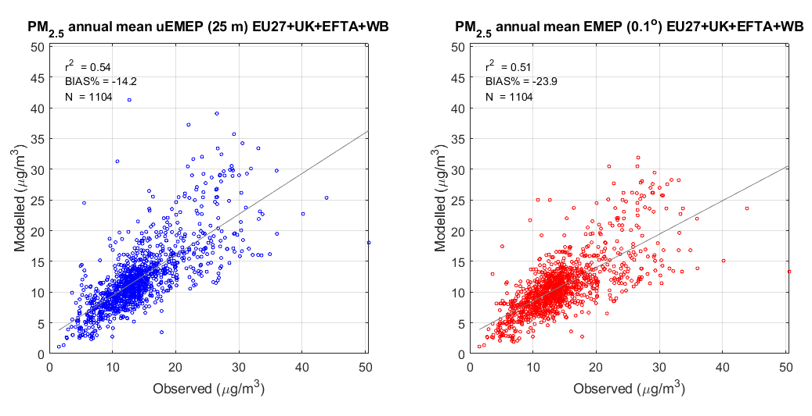
Validation PM_{2.5} 2015 reference year against Airbase observations (including traffic stations)
uEMEP PM_{2.5}
bias = -14 %
r² = 0.54
EMEP PM_{2.5}
bias = -24 %
r² = 0.51

Slide 9
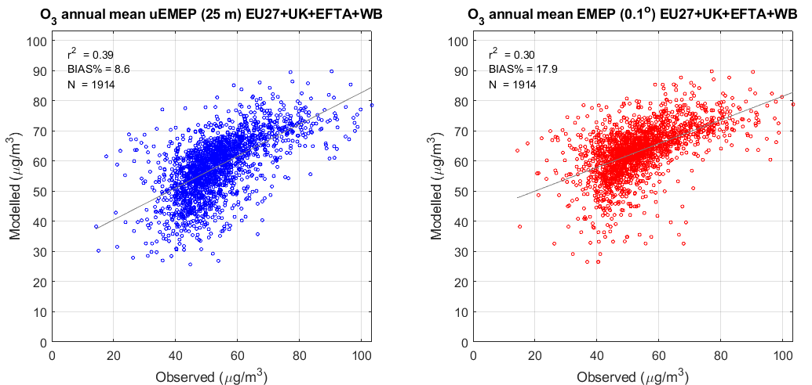
Validation O₃ 2015 reference year against Airbase observations (including traffic stations)
uEMEP O₃
bias = +8.6 %
r² = 0.39
EMEP O₃
bias = +17.9 %
r² = 0.30

Slide 10
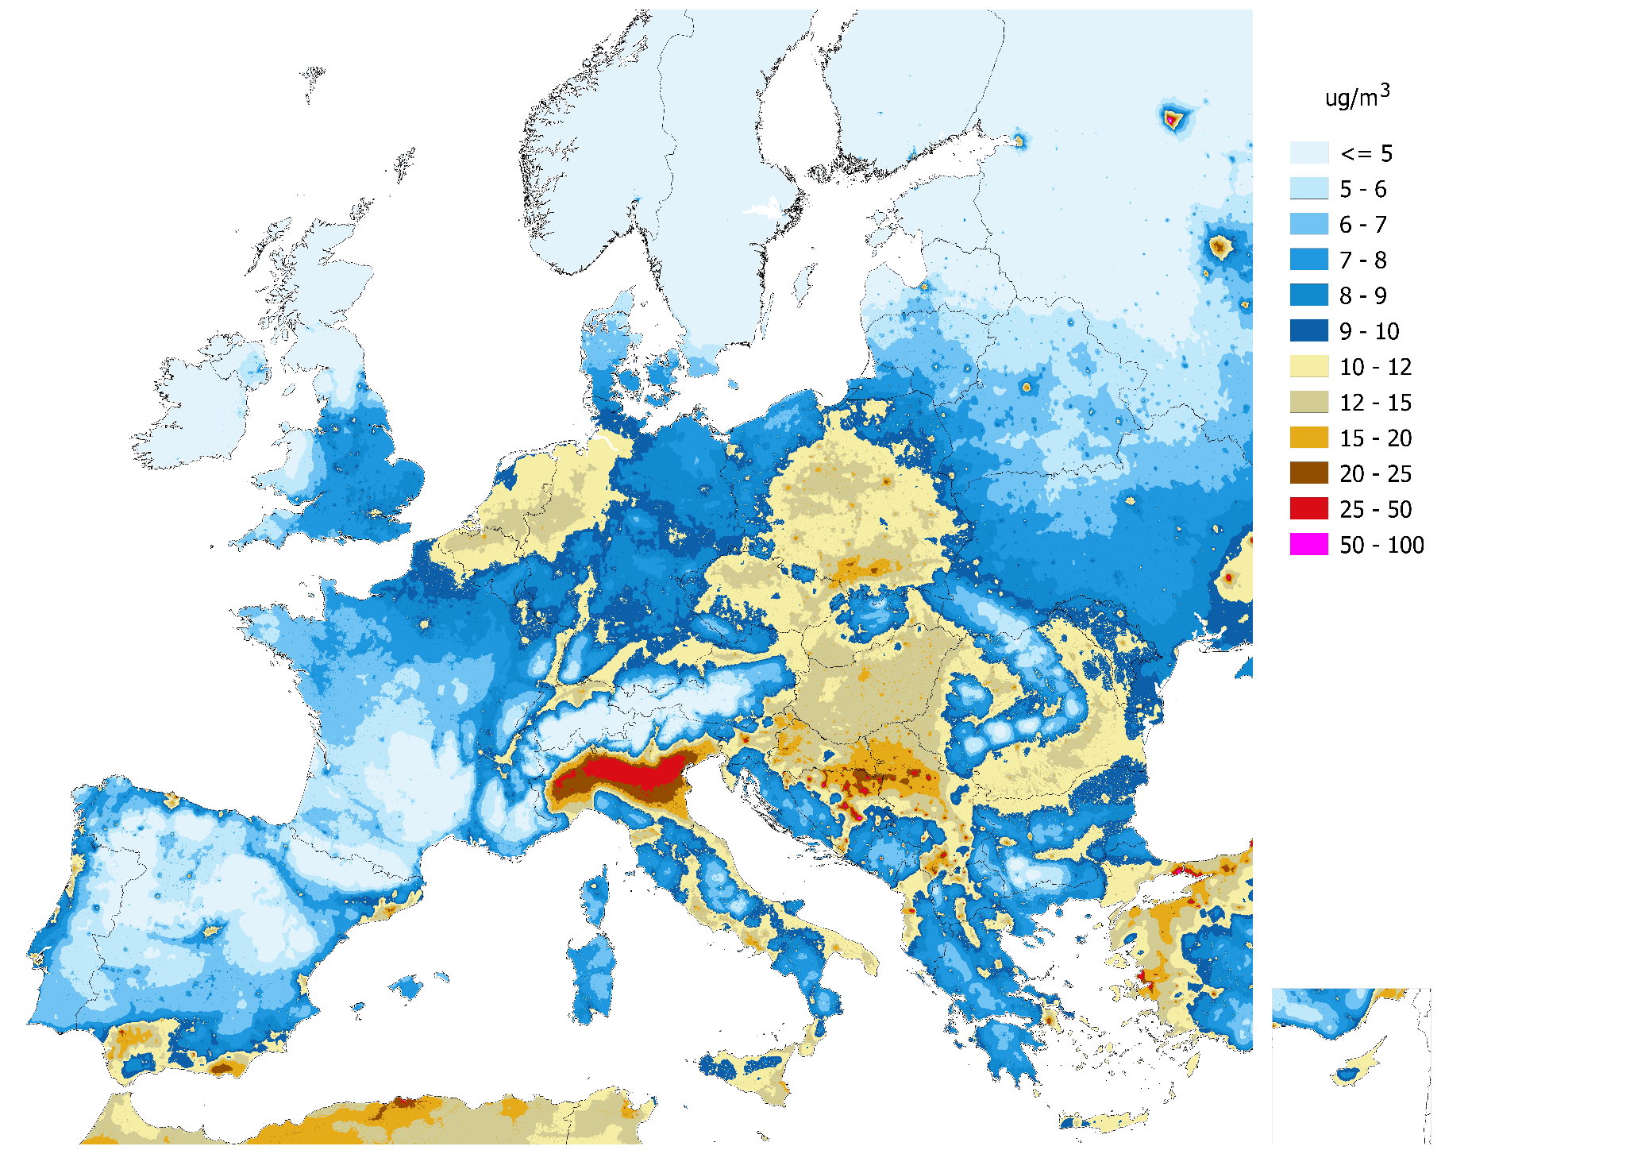
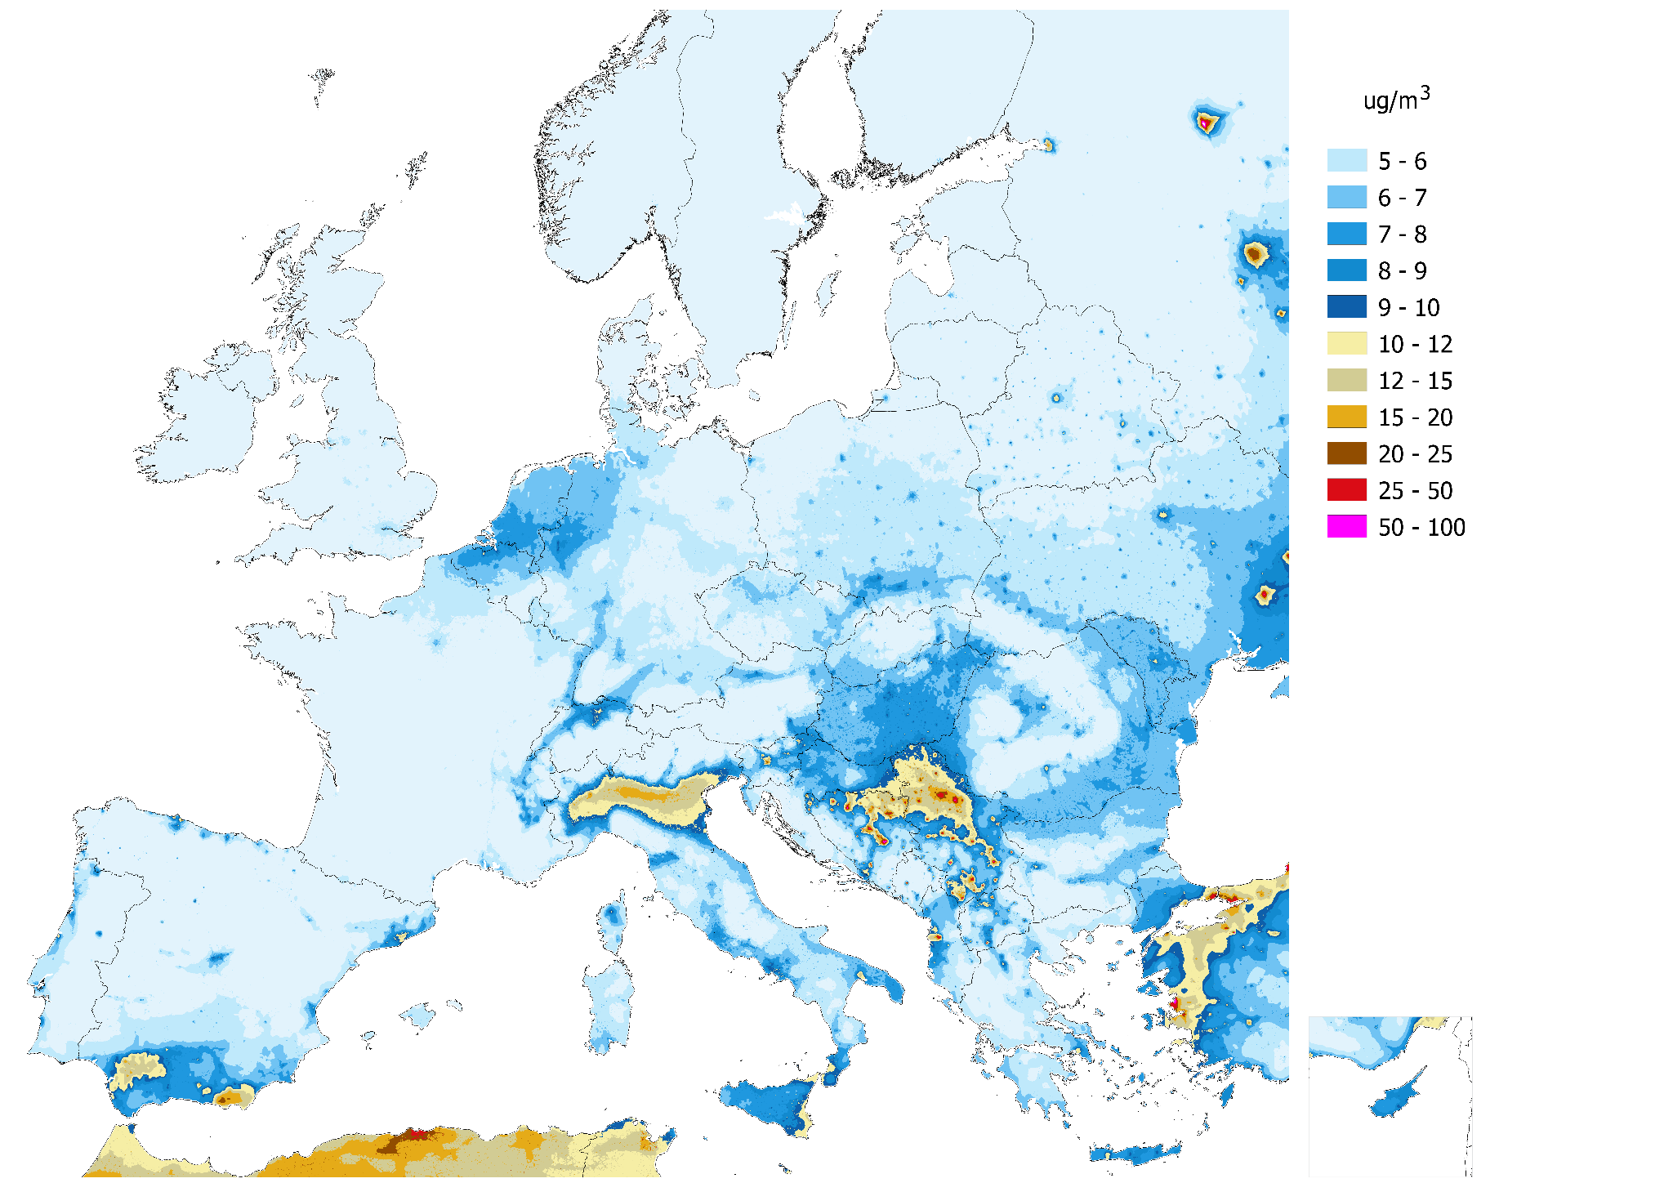
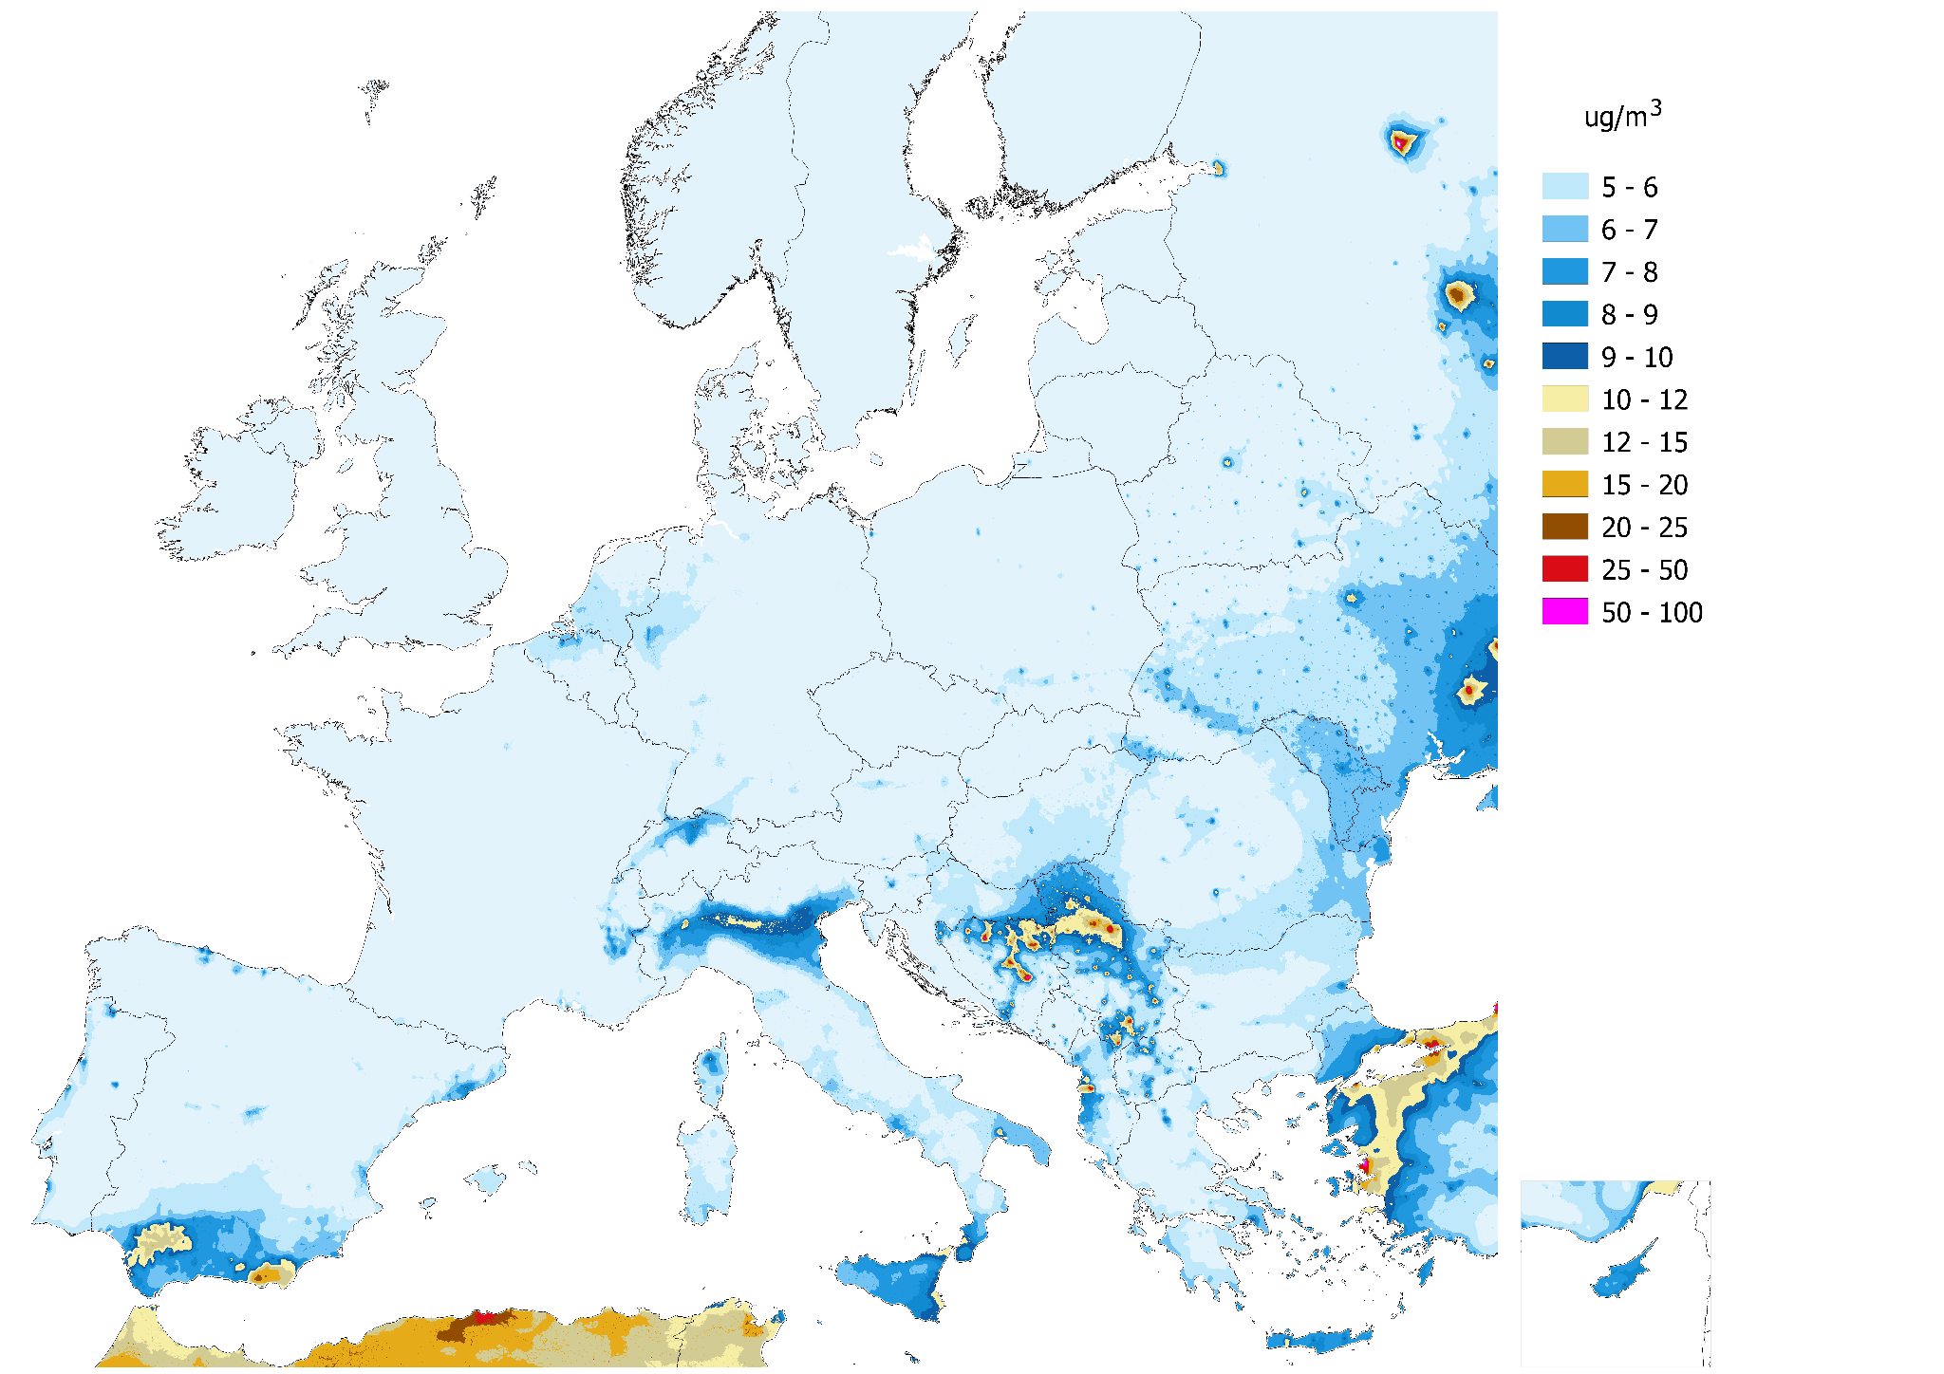
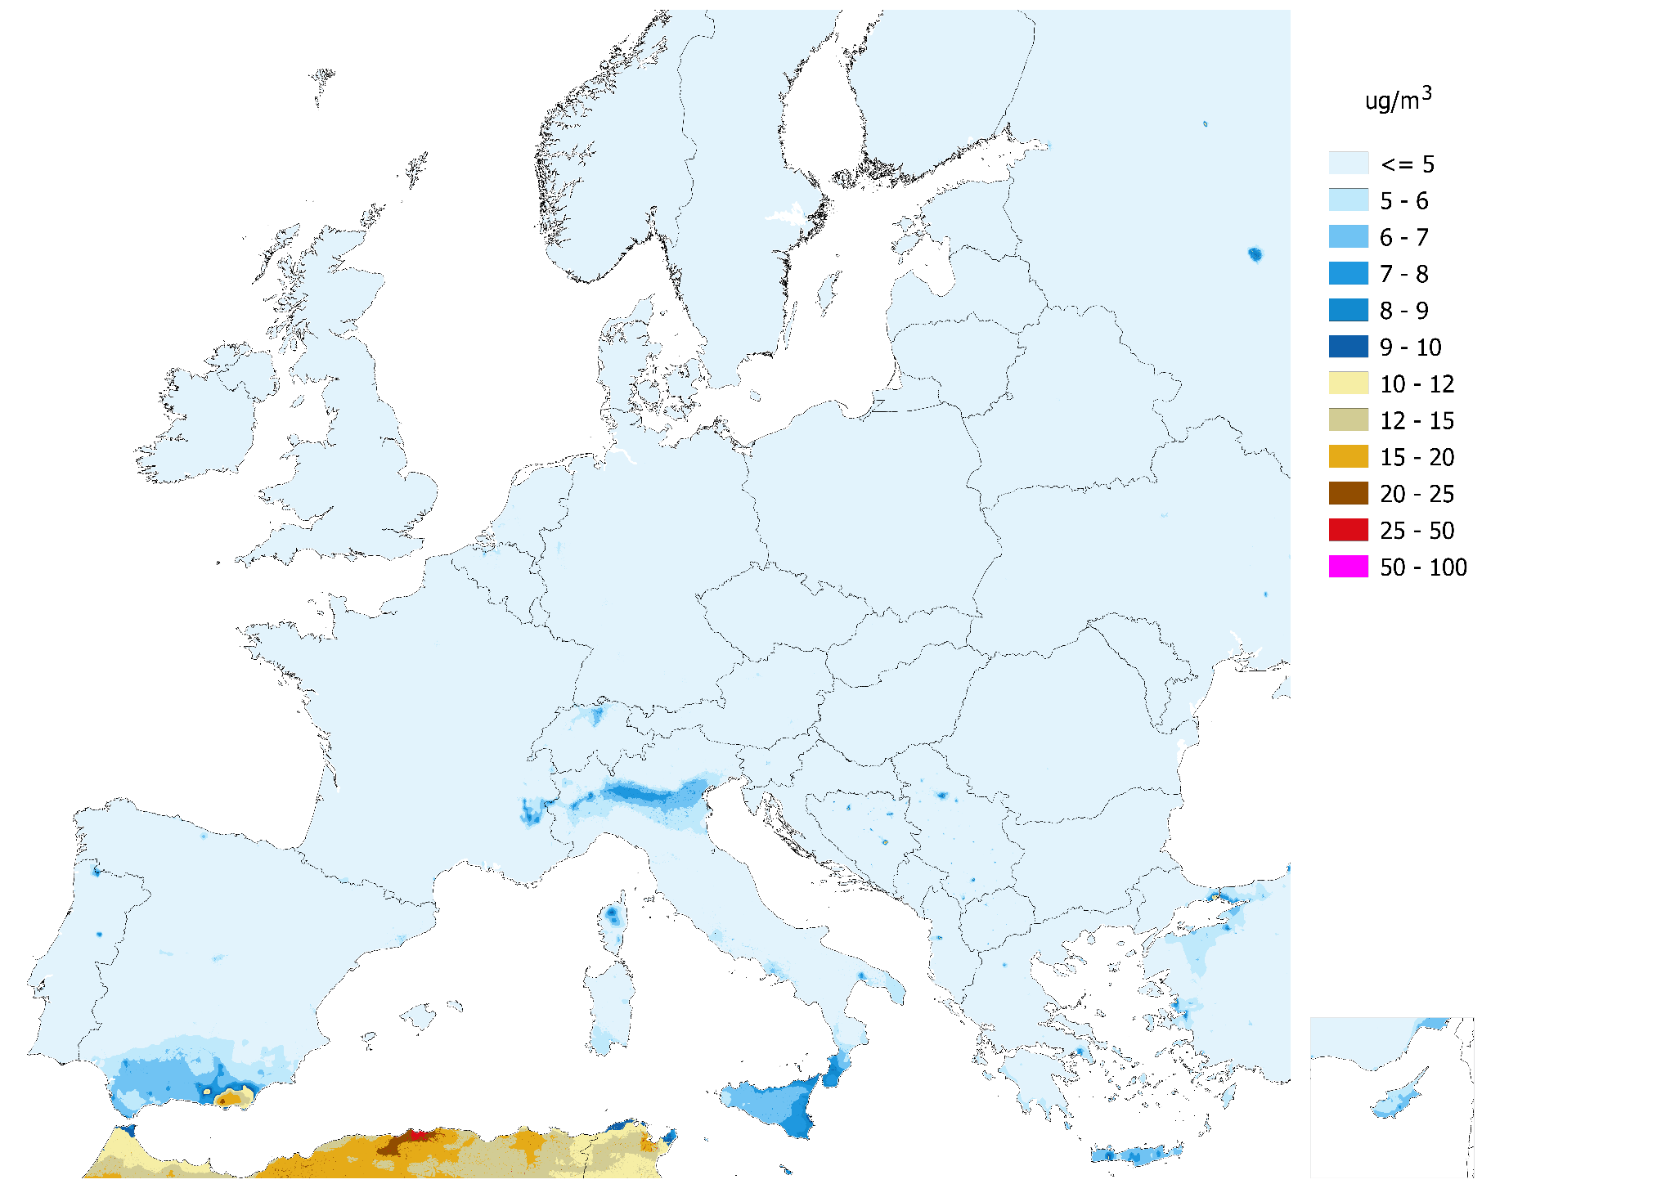
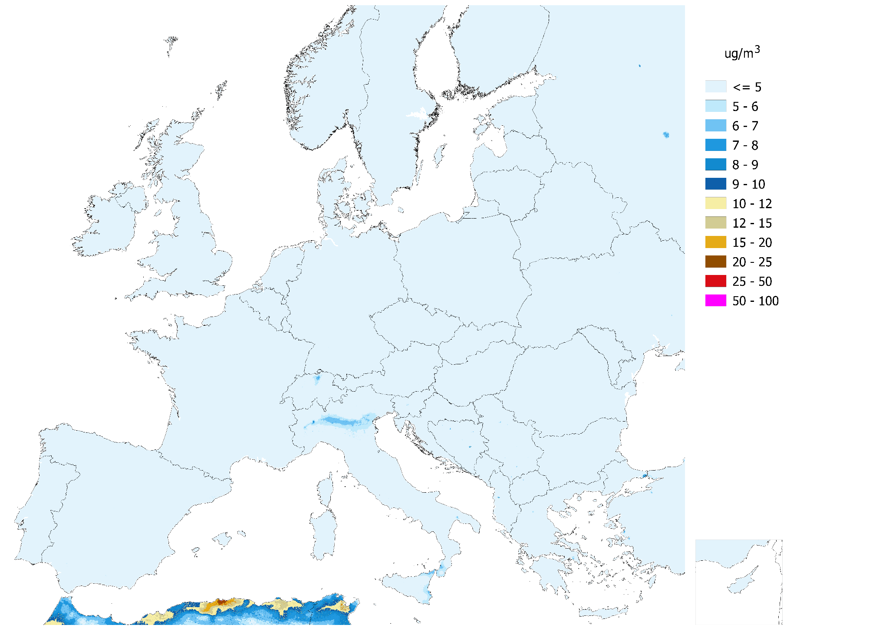
2015
2030
2050
2050 MFR
2050 LOW
2050 LOW - NATURAL
PM_{2.5}
Western part of EMEP domain

Slide 11
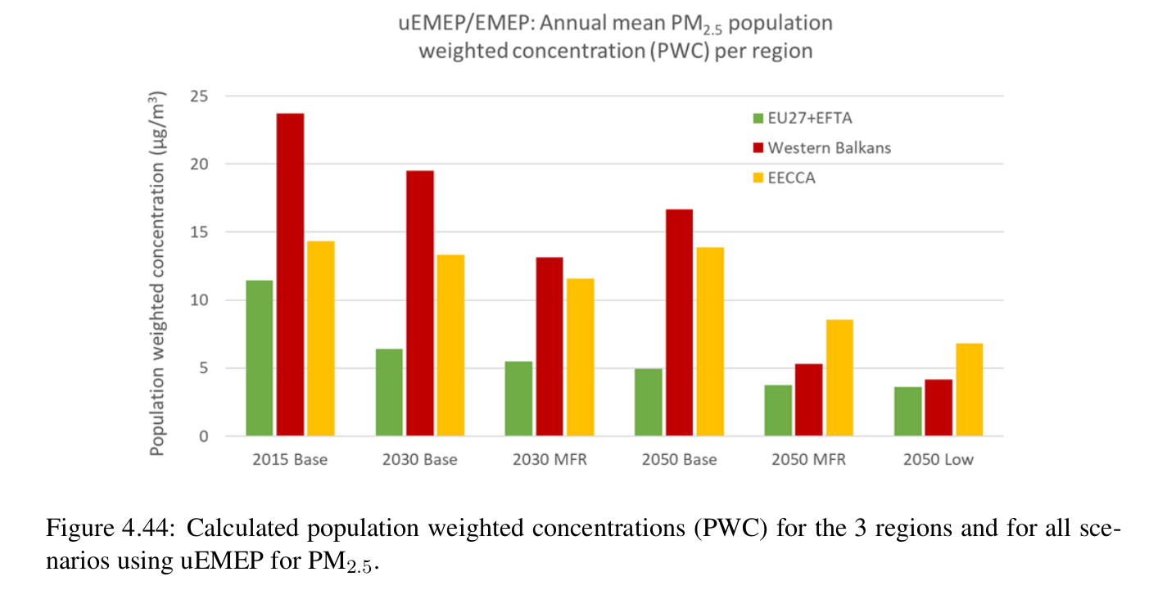
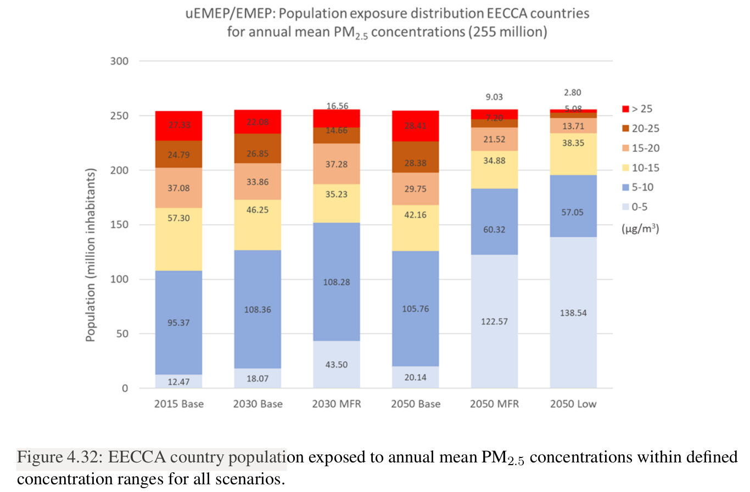
PM_{2.5}
uEMEP calculations show that in 2015 most of the population in EU, Western Balkan and EECCA live in areas that have PM_{2.5} values above current WHO annual mean guideline values of 5 μgm⁻³
By 2030, the Baseline scenario indicates that 75% of the EU population will still be exposed to PM_{2.5} levels above 5 μg m⁻³ (40% in the 2050 Baseline, 15% in 2050 MFR)
For the Western Balkan and EECCA countries, the baseline scenario shows much less improvement in the PM_{2.5} levels. For the EECCA countries, the 2050 baseline scenario gives similar levels to 2015. Implementation of more stringent air quality policies, and especially the MFR scenario, would result in significant reduction of PM_{2.5} concentrations in these countries. However, some EECCA countries are limited in achieving very low PM concentrations by high levels of wind-blown dust.

Slide 12
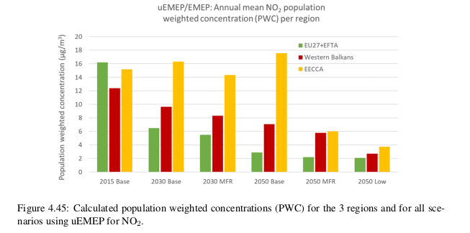
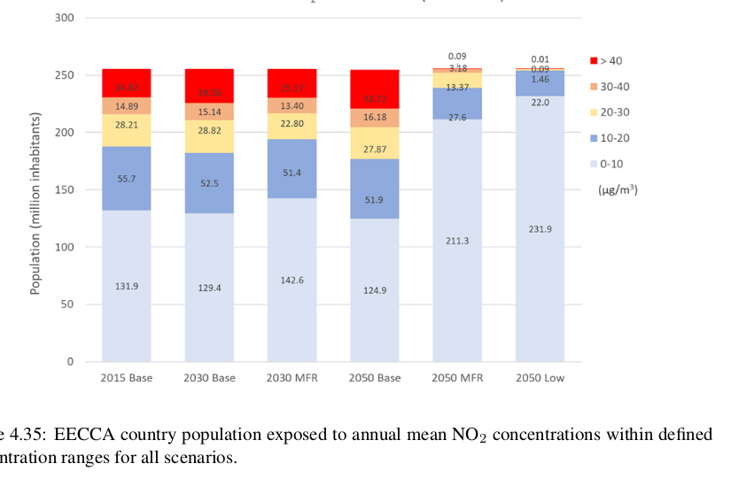
NO₂
uEMEP calculations show that in 2015 around 65% of the population in the EU, 40% of Western Balkan and 50% of EECCA countries lived in areas above the WHO NO₂ guideline value of 10 μgm⁻³
All the scenarios show that in 2050 less than 2% of the EU population are still exposed to levels above the recommended WHO exposure level of 10 μg m⁻³ . For the Western Balkan, 21% of the population is exposed to NO₂ above 10 μg m⁻³ .
For the 2050 baseline, EECCA countries show an increase in NO₂ concentrations, compared to 2015, with about 50% of the population exposed to levels above 10 μg m⁻³ and still with 13% of the population (33 million inhabitants) above the 40 μg m⁻³ level. It is only with the implementation of MFR that NO₂ concentrations approach, but do not achieve, the WHO guidance level.

Slide 13
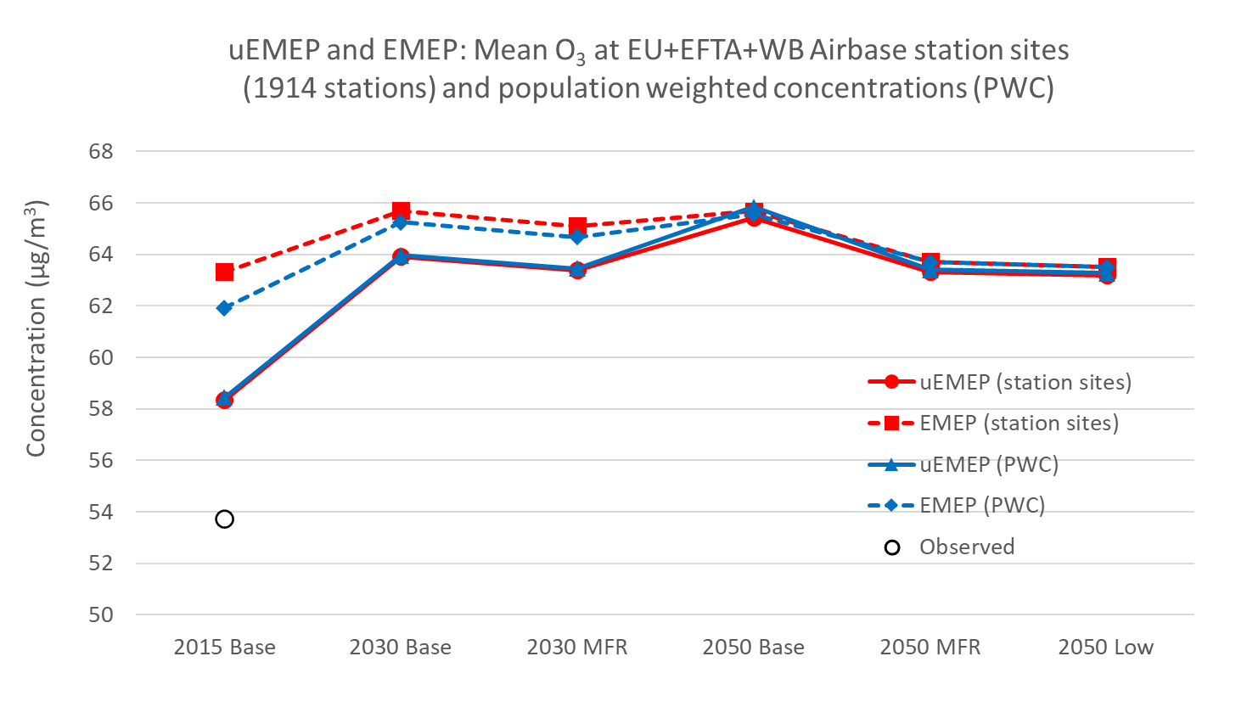

Slide 14
O₃ max: 2030 MFR - 2015, January and August

Slide 15
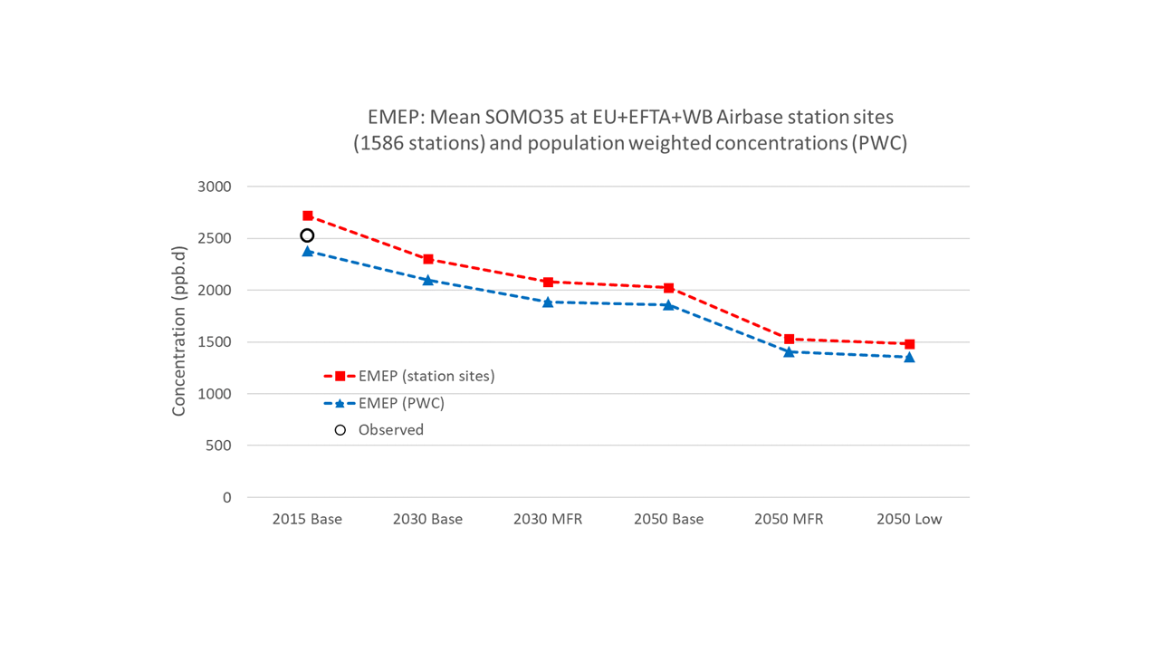
SOMO35:For each day the maximum of the running 8-hours average for O₃ is selected and the values over 35 ppb are summed over the whole year.

Slide 16
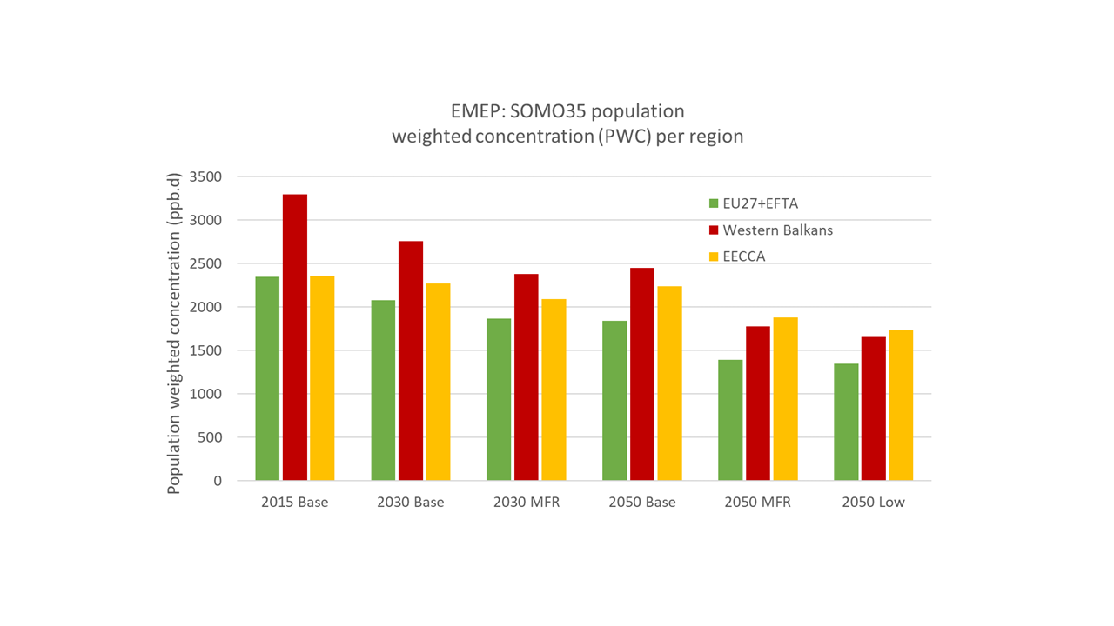
SOMO35 in EECCA - related to
NO₂ emissions
Reduction in the higher ozone values (e.g. SOMO35) everywhere for all scenarios except for EECCA (2050 MFR or LOW necessary)

Slide 17
Peak season MDA8 (WHO long term < 60 ug/m3 ) 2015 and 2050 low
MDA8=Peak-season average of daily maximum 8-hour mean ozone concentrations.

Slide 18
Summary
PM_{2.5}:
Achieving 5 𝜇g/m³ is not likely for EU27+EFTA, Western Balkans or EECCA
NO₂:
Achieving 10 𝜇g/m³ for NO₂ is not likely under any scenario for EECCA, but may be possible in 2050 LOW for Western Balkans and 2050 Base for EU+EFTA
Ozone:
Reduction in the higher ozone values (e.g. SOMO35) everywhere for all scenarios except for EECCA (2050 MFR or LOW necessary)
Winter time ozone is increasing due to less titration, summer time is reduced
WHO guideline values for ozone will not be met even for 2050 Low (only by European action)
W. van Caspel on Friday: Taking into account changes in methane, global LOW scenario

Slide 19
Source allocation of ozone: the local fraction methodology & first results
Originally developed to give the fractions of pollutants from local sources. Used for downscaling (uEMEP)
A technical method to track a large number (10 000 s) of pollutant sources.
New: can track pollutants through chemical reactions (non linear species can be tracked)
Gives the sensibility to (small) changes in emissions
For example ∂O₃/∂E_{k_NOx} , how much Ozone changes for changes in NOx emissions in region k.

Slide 20
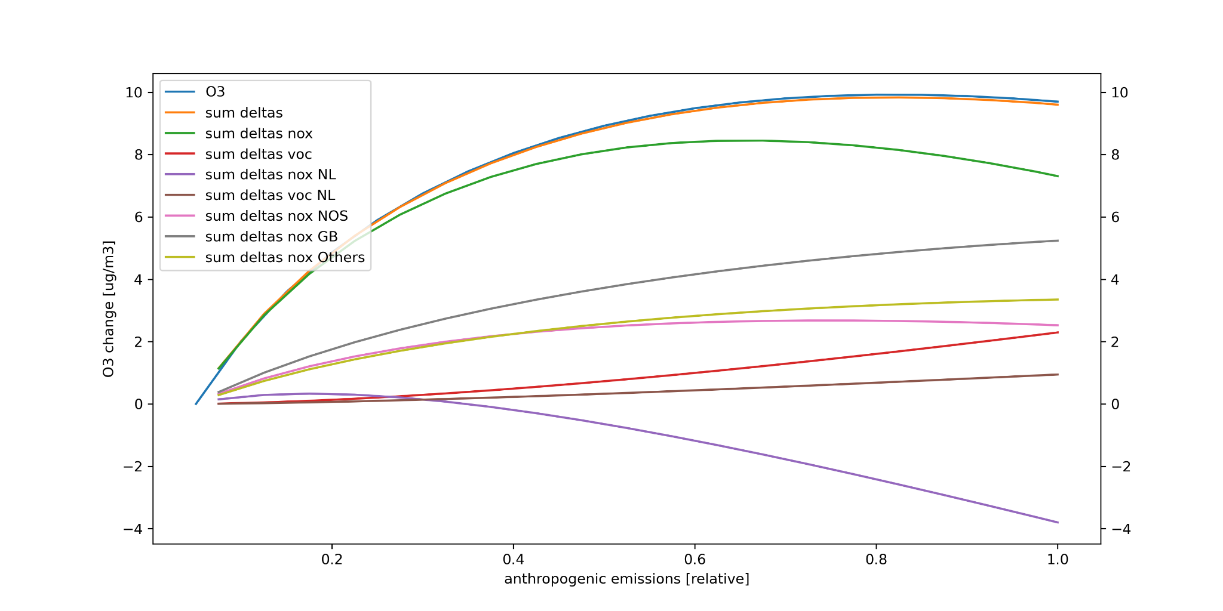
NL O₃ concentrations, July All anthropogenic VOC NOx antropogenic emis 0->full

Slide 21
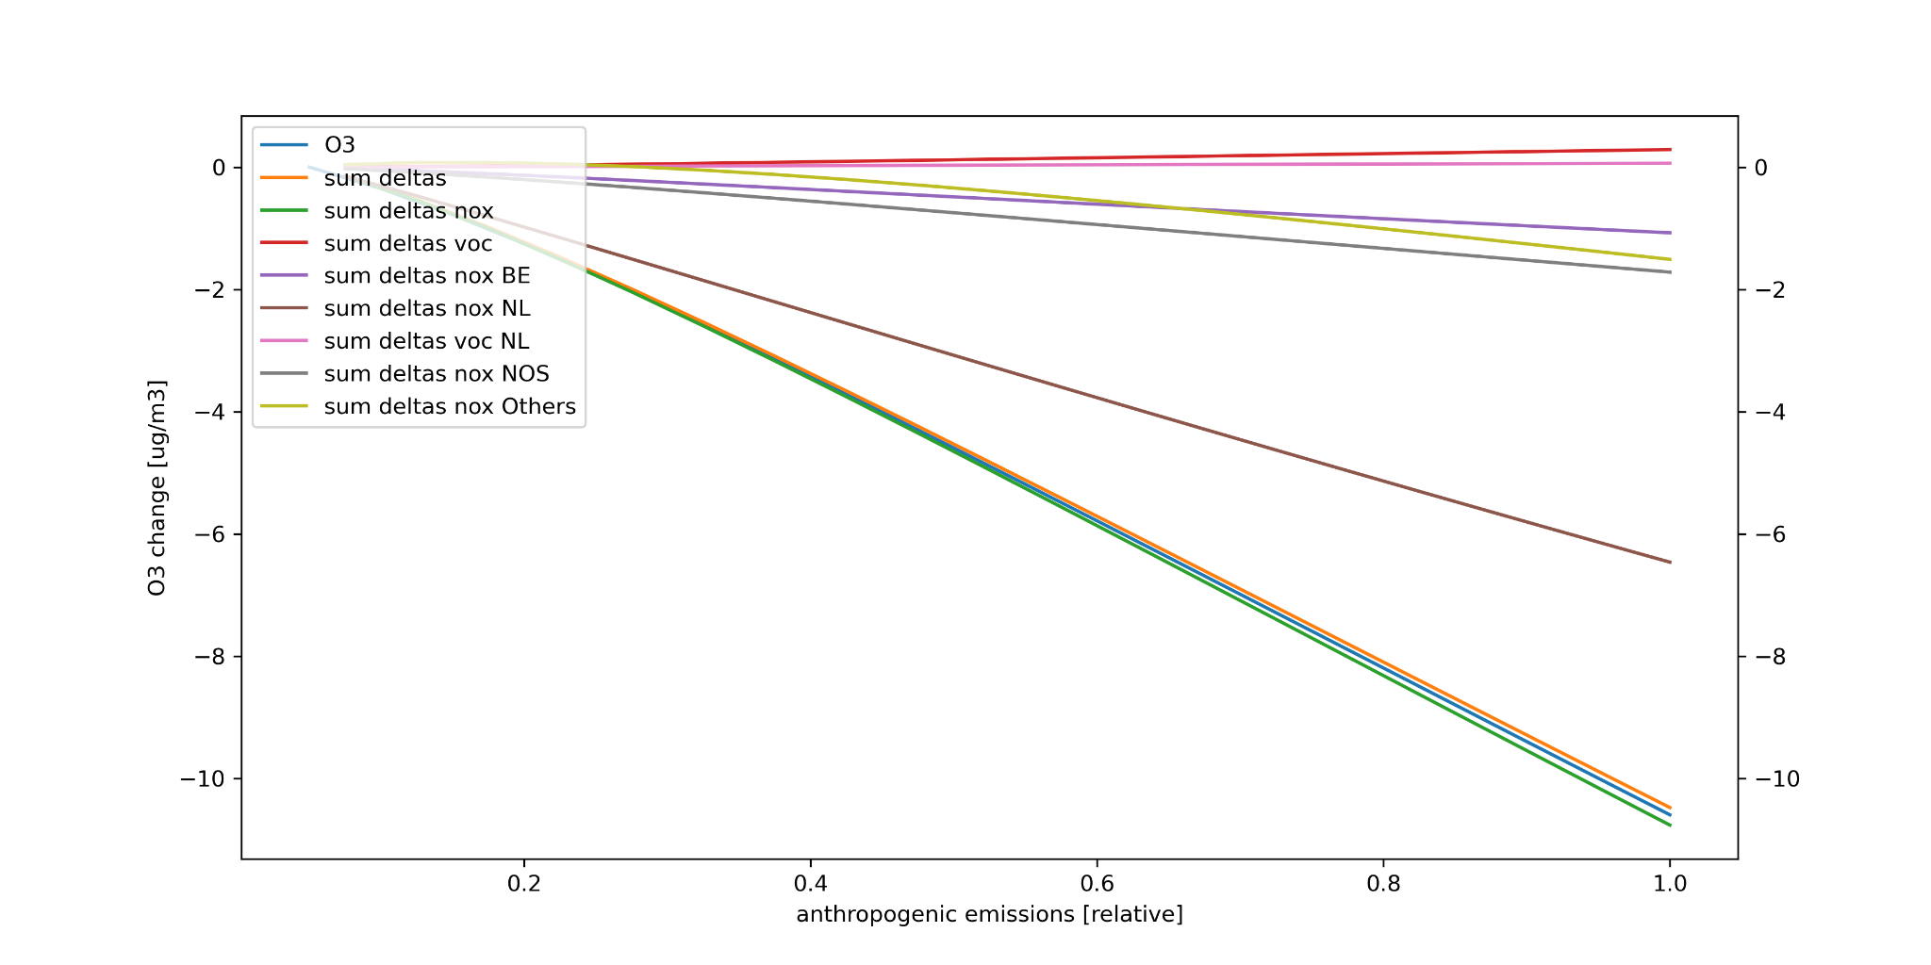
NL O₃ concentrations, Feb All anthropogenic VOC NOx emis 0->full

Slide 22
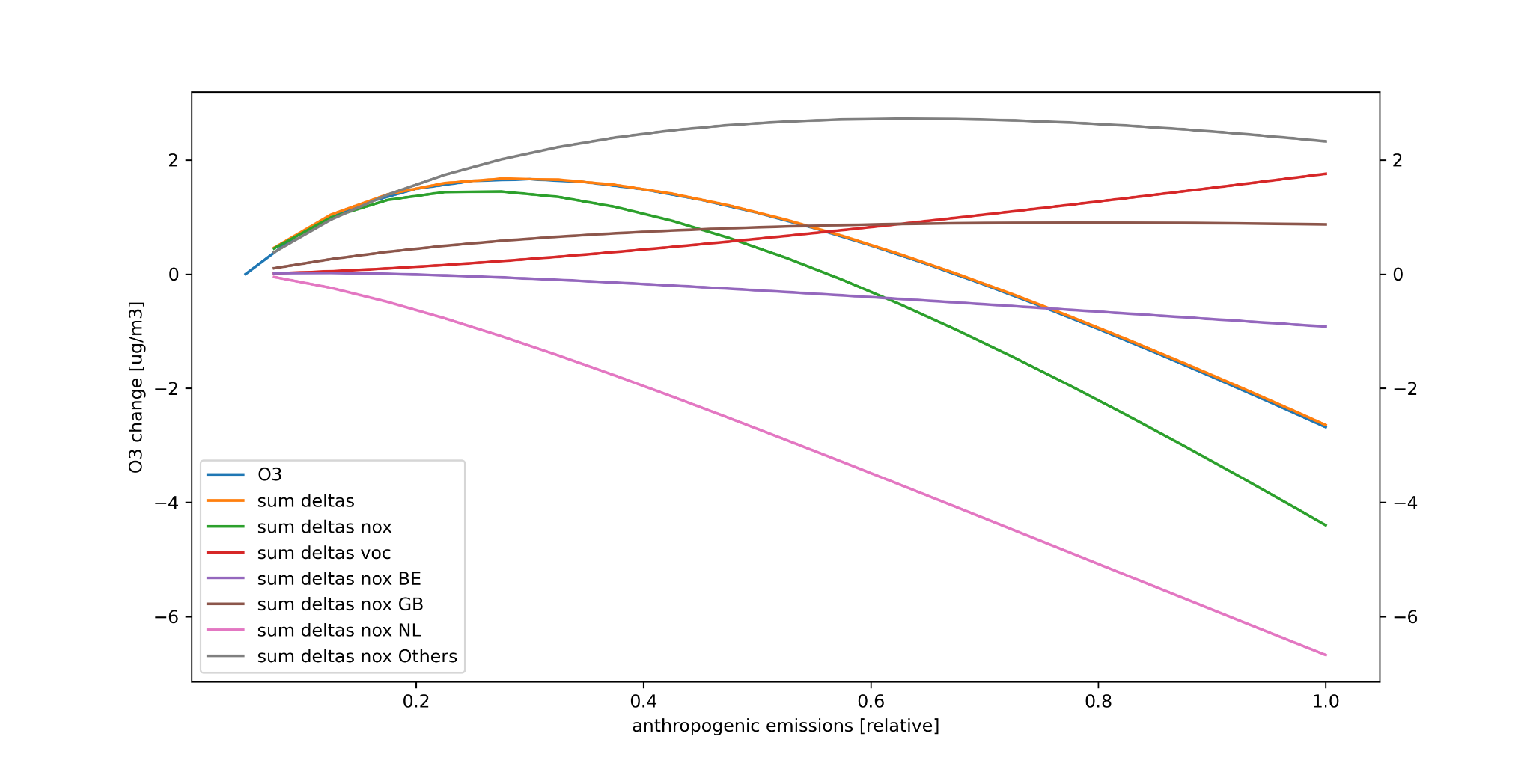
NL O₃ concentrations, one year All anthropogenic VOC NOx emis 0->full

Slide 23
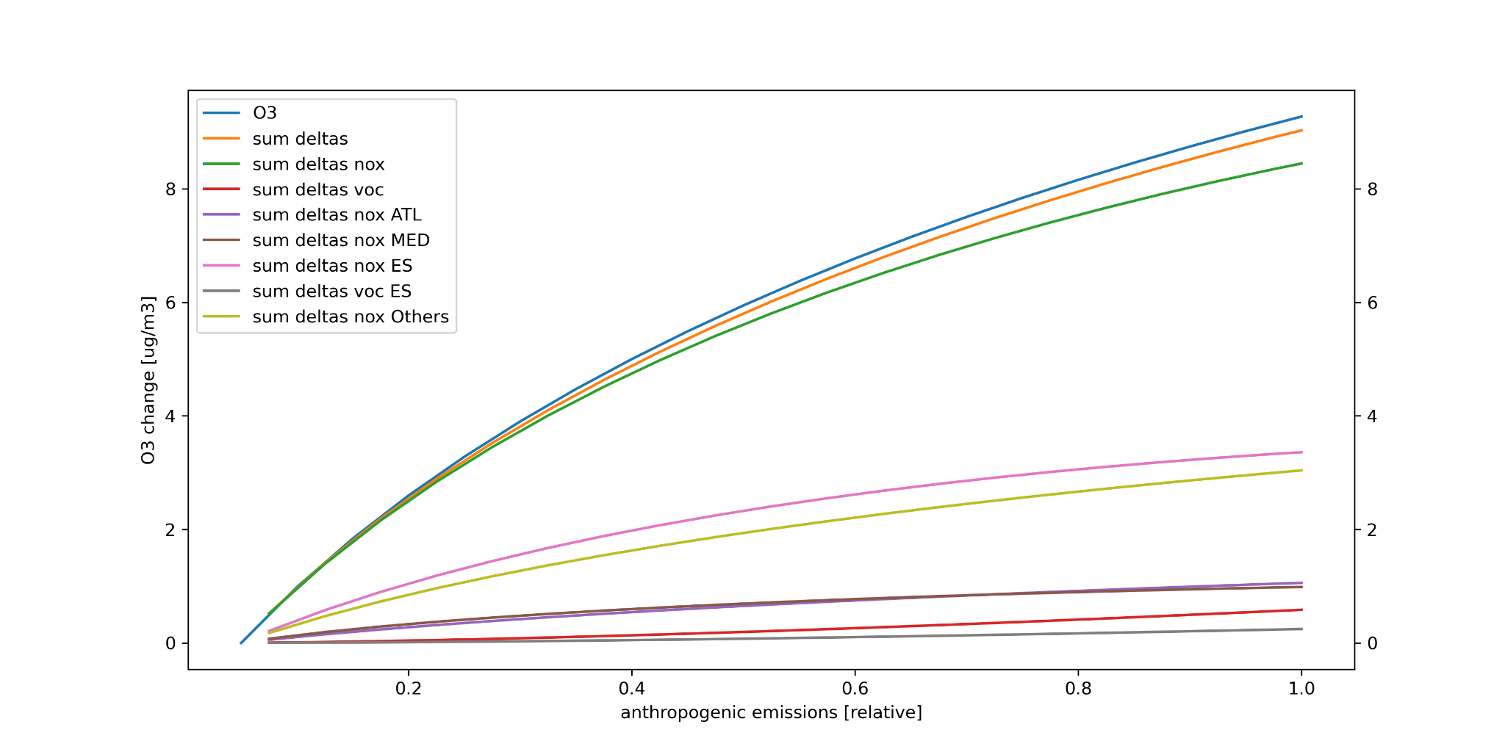
Spain O₃ concentrations, one year All anthropogenic VOC NOx emis 0->full

Slide 24
Summary
Local Fractions allow to compute the concentration/emissions relationship over a large emission range very efficiently
Work now and further:
Include more relevant indicators (e.g. O₃max, SOMO35, MDA8)
Investigate non-linearities, e.g. vary levels of emissions
Discuss & work with CIAM above inclusion in GAINS
Compare methodologies, e.g. TFHTAP
Working on how to use and present all this information

Slide 25
EXTRA SLIDES

Slide 26
Trends in reduced nitrogen
Change in NH₃ emissions: -12% (west EMEP)
NH₃+ NH₄⁺:
Obs: - 28%
Mod: - 26%
NH₄⁺ aerosol:
Obs: - 49 %
Mod: - 49 %
NH₃ in air: very few statistically
significant trends (and few sites),
but on average a positive trends
(by ca. 30%)
Reduced N wet deposition: few statistically significant trends
Obs: - 6%
Mod: - 5%
The modest reductions in reported
NH₃ emissions in EMEP west is
confirmed by observations and
modelling results. Large differences
in trends for different reduced nitrogen
compounds can be explained by interactions with sulphur and oxidized nitrogen compounds
Do the reduced formation of NH₄⁺ aerosol imply reduced transport distance (more ‘local’ deposition)?

Slide 27
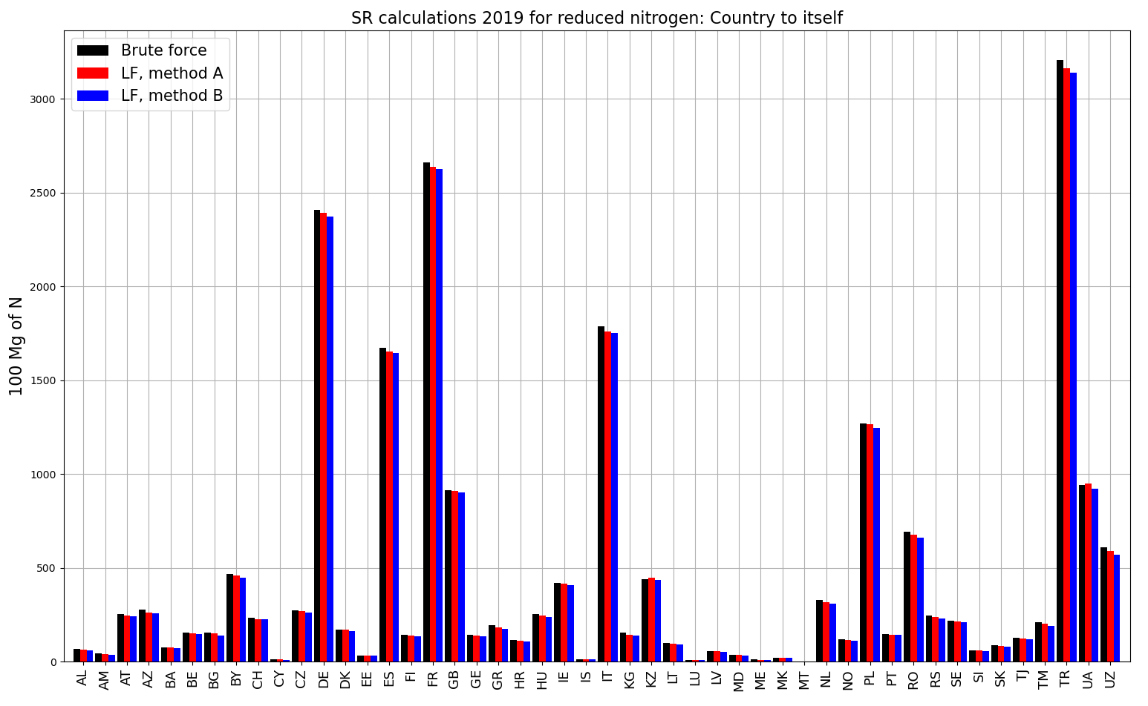
Country-to-itself contributions, brute force and ‘local fraction’

Slide 28
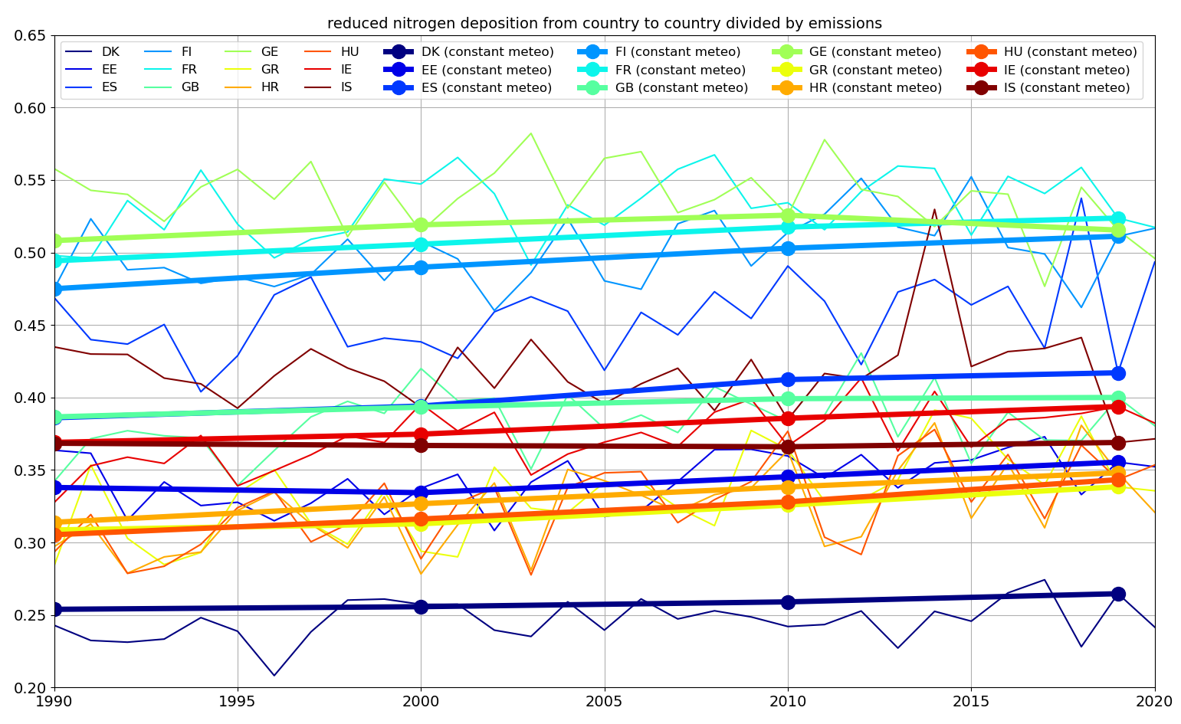
Trend in the fraction of NH₃ emission that deposits within the country itself
Positive slope (stat. sign. for half) for all countries except 5 EECCA, 1 West Balkan and NL
15 countries has a trend of more than 3%/decade
EMEP Status report 1/2022

Slide 29
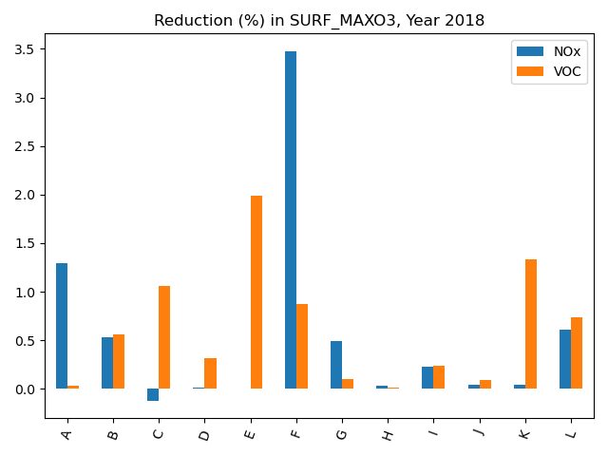

Slide 30
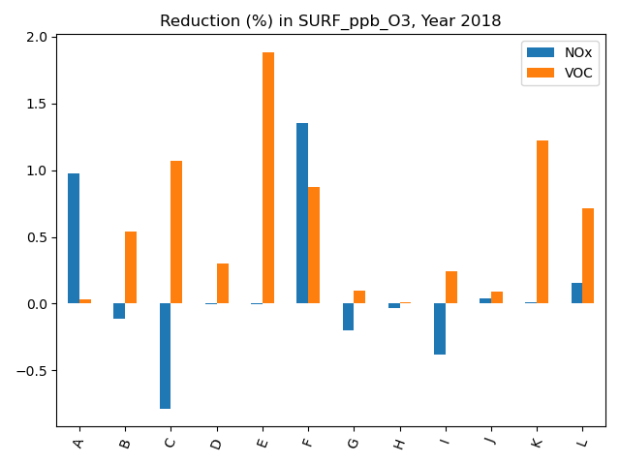

Slide 31
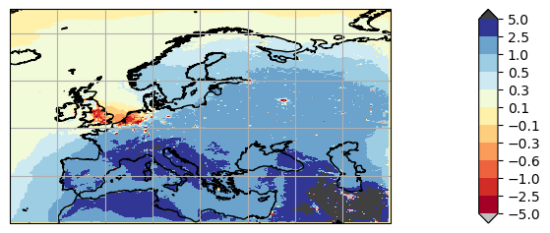
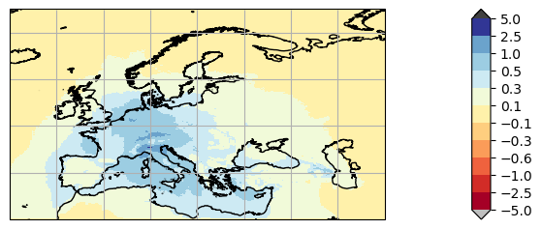
NOx-F VOC K

Slide 32
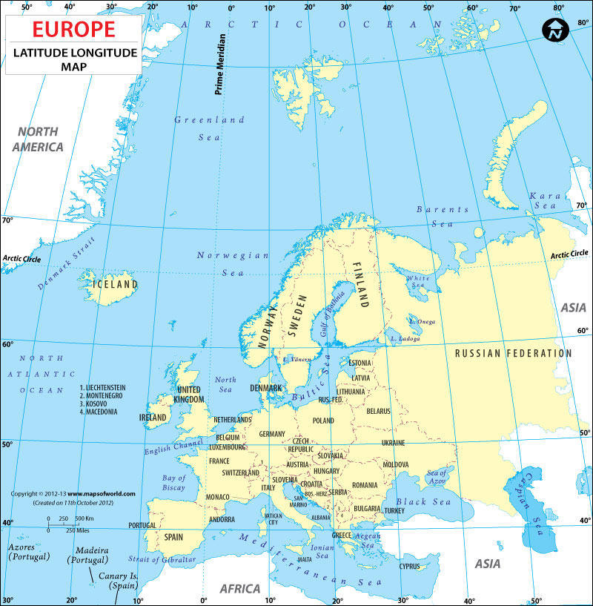
lon: -2 to 21 deg E, and lat: 43 to 55

Slide 33
WP 2022/2023 elements
1.1.1.2 Revising historical PM_{2.5} emissions from residential combustion to consistently include condensable organics and assessment of the implication for the review of the Gothenburg Protocol => Report 2022 (MSC-W, CIAM, CCC, CEIP, TNO)
1.1.1.4 Review of the use of in-situ VOC measurements (TFMM, CCC, MSC-W)
1.1.1.7 Preparation of data and model EMEP/MSC-W country to grid MSC-W calculations that are necessary for “Multiscale GAINS” (MSC-W)
1.1.1.8 Analysis of changes in chemical regime for N-compounds: is the efficiency of future NH₃ measures changing? Impact on aerosol concentrations and depositions. Is the transport distance of reduced N changing? (MSC-W)
1.1.1.14 Ozone flux-based risk assessment for vegetation for air pollution scenarios (ICP-Veg, CIAM, TFMM, TFHTAP)
1.1.3.1 Scenario assessment relevant for the Gothenburg Protocol (2022−2023) review and potential revision using multiscale GAINS and EMEP/uEMEP and including an extension of the GAINS domain (EECCA/West Balkans/Turkey) (CIAM, TFIAM, MSC-W)
1.1.3.3 Assessing observed trends in air pollution at the various scales (TFMM, TFHTAP, TFIAM, MSC-W)
1.2.2 Focus on EECCA and West Balkan countries (MSC-W, CIAM, CEIP, TFTEI, MSC-E)
1.3.1 Cooperation with HELCOM and OSPAR; marine environment protection

Slide 34
WP elements for MSC-W 2024/2025
Scenario assessment relevant for a potential GP revision using multiscale GAINS and EMEP/uEMEP
Focus on EECCA and West Balkan countries (trends, spatial distribution, projections, assessments including use of satellite data). (MSC-W, CIAM, CEIP)
Assess the importance of global LOW scenario (including CH₄ pledge) for European O₃ 2030-2050 and other relevant (CH4) scenarios (also in co-operation with TFHTAP)
Review of methodologies: brute force & sensibilities (local fractions) and their applicability (including IAM)
Work on the inclusion of ozone in IAM (GAINS), importance of agricultural NMVOC
Evaluation EMEP/MSC-W model against in-situ VOC measurements from IMP 2022 and EMEP network (and HCHO from satellites)
Condensable organics/OC (make better use of the EMEP/ACTRIS/COLOSSAL campaign and other data to understand sources), (MSC-W, CCC, TFMM)
Contribute to TFHTAP exercise on CH₄ (?), Fires (TFHTAP, MSC-W)
Increased cooperation with WGE (use of observational data from ICP Forest, use of uEMEP for effects related work)

