Slide 1
Air quality modelling activities in Poland (including arsenic)
Joanna Strużewska
Department of Atmospheric and Climate Modelling
Institute of Environmental Protection – National Research Institute
10.05.2023, Warsaw
24th EMEP Task Force on Measurement and Modelling Meeting

Slide 2
IEP-NRI is legislated to carry out AQ modelling for policy support
Chief Inspectorate of Environmental Protection:
Daily operational forecast (3 day forecast)
Annual air quality assessment (20 of March)
5-year assessment (30 of May)
Impact of transboundary transport (30 of June)
Station representativeness (30 of October)
Ministry of Climate and Environment:
National Air Quality Improvement Plan (30 of September)

Slide 3
Modelling domains
Central Europe: ~ 10km
Boundary conditions
Transboundary assessment
Poland: ~2.5 km
Annual assessment
Forecast
Station representativeness
30 urban zones: 500m
Annual assessment

Slide 4
GEM-AQ model
Global Environmental Multiscale – Air Quality model
MAQNet (2001-2008) – Kaminski at al., 2008
On-line model (host meteorological model GEM, from Environment and Climate Change Canada)
Optimal Interpolation used for surface station assimilation
Gas phase chemistry based on the extended ADOM-IIB mechanism
Sectional aerosol module (12 bins)
Anthropogenic and biogenic emissions
HDD modulated residential emissions
For the national modelling Central Emission Database is used

Slide 5
Species requested
 | Forecast | Annual assessment | 5year assessment | Trnasboundary | National Air Quality Plan | Station representativness
O₃ | x | x | x | x | x | x
NO₂ | x | x | x | x | x | x
NOx |  | x | x | x | x | x
SO₂ | x | x | x | x | x | x
CO |  |  |  |  |  | x
PM₁₀ | x | x | x | x | x | x
PM_{2.5} | (x) | x | x | x | x | x
B[a]P |  | x | x | x | x | x
As |  | x (2023) |  |  |  | x
Ni |  |  |  |  |  | x
Cd |  |  |  |  |  | x
Pb |  |  |  |  |  | x
Benzene |  |  |  |  |  | x

Slide 6
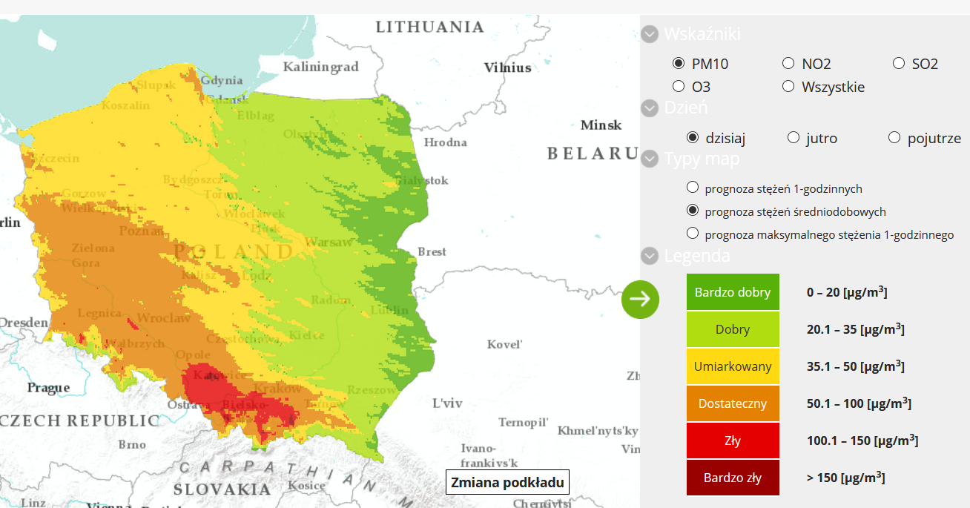
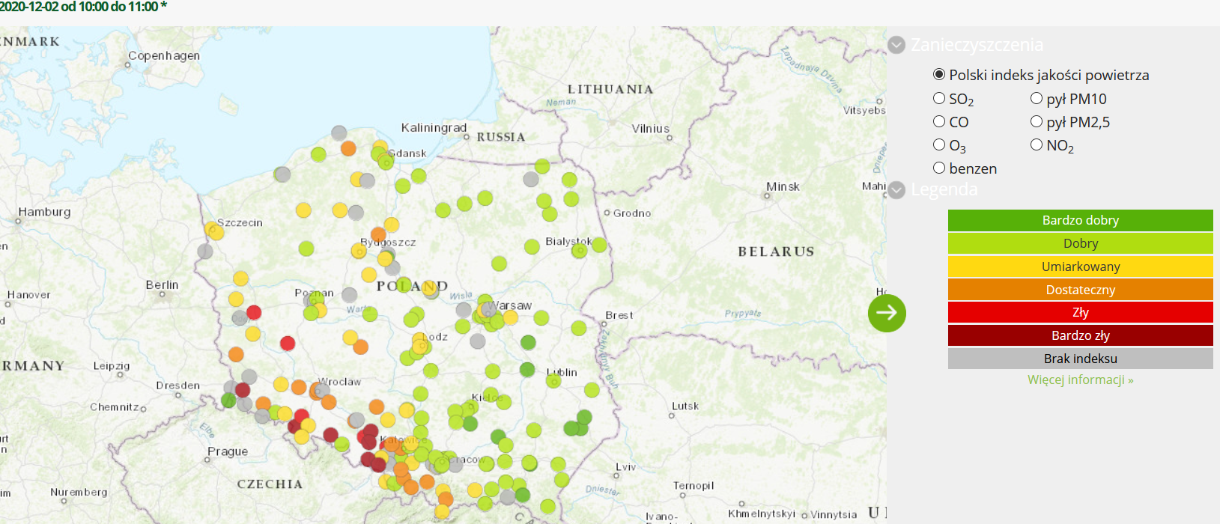
1) AQ Forecast - CEIP portal https://powietrze.gios.gov.pl/pjp/airPollution AQ index on IEP-NRI https://ios.edu.pl/jakosc-powietrza/ AQ index API https://api.prognozy.ios.edu.pl/ daily averages for administrative units

Slide 7
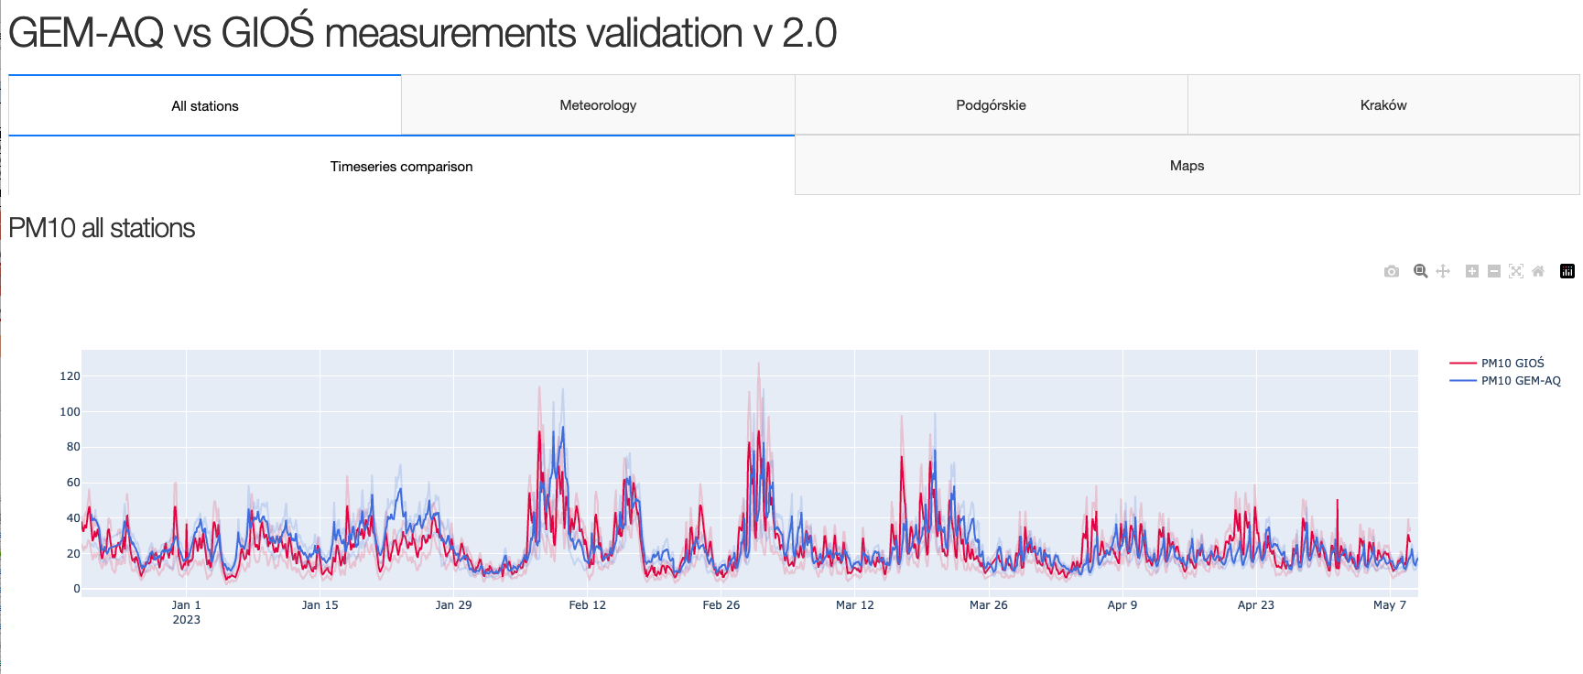
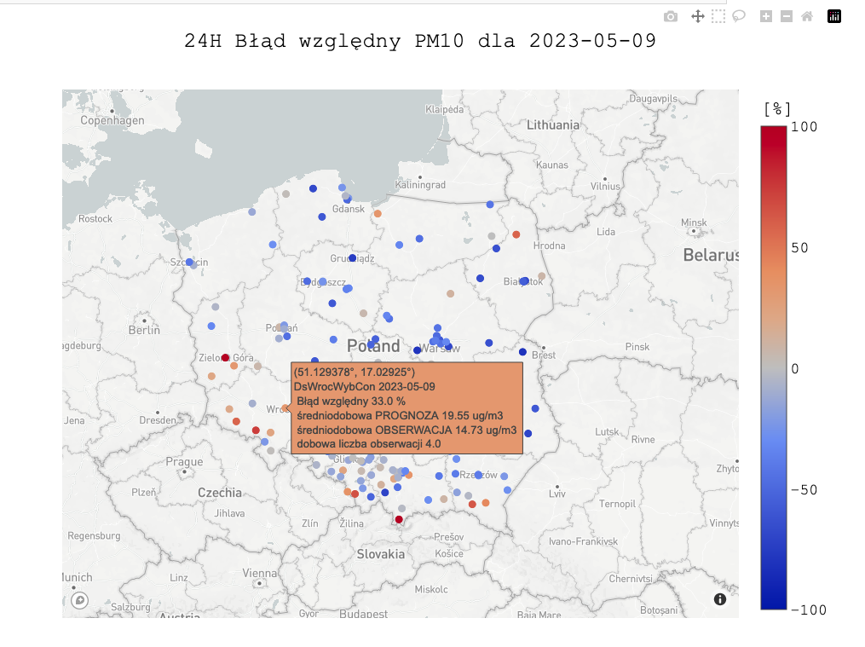
AQ Forecast - evaluation dashboard

Slide 8
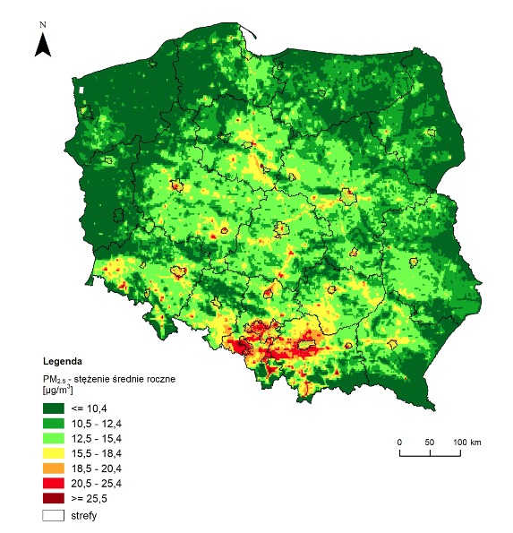
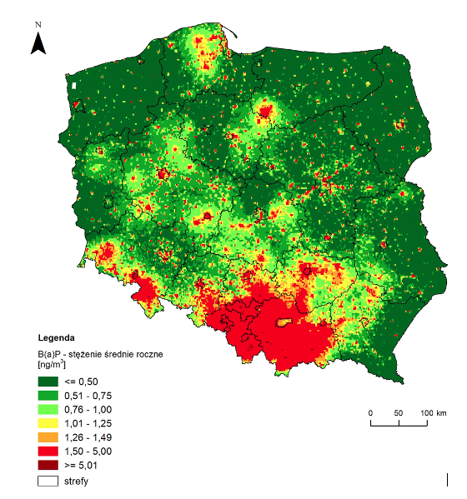
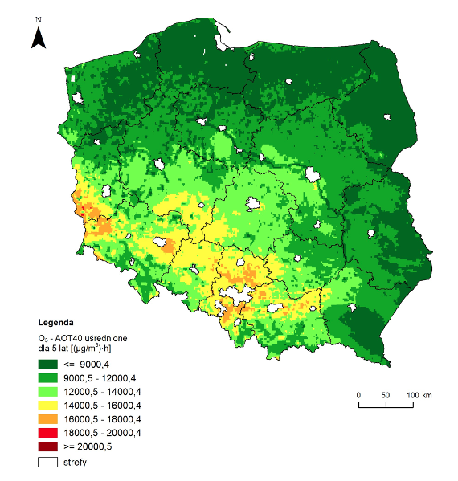
2) Annual AQ assessment 2022
5y AOT40
2018-2022
PM_{2.5} annual average
BaP annual average
Collaboration with FAIRMODE “Composite mapping”

Slide 9
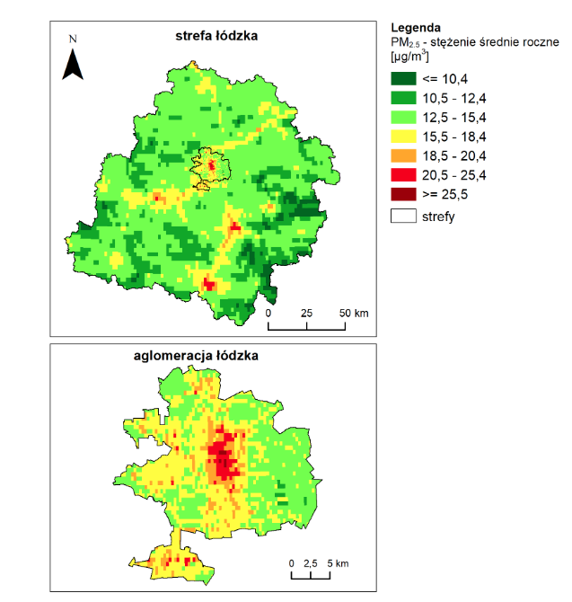
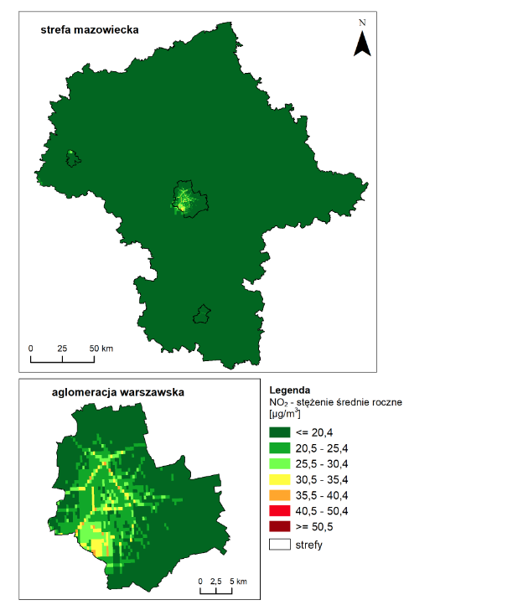
Annual AQ assessment 2022
PM_{2.5} annual average - Łodzkie
NO₂ annual average - Mazowieckie

Slide 10
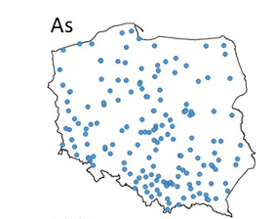
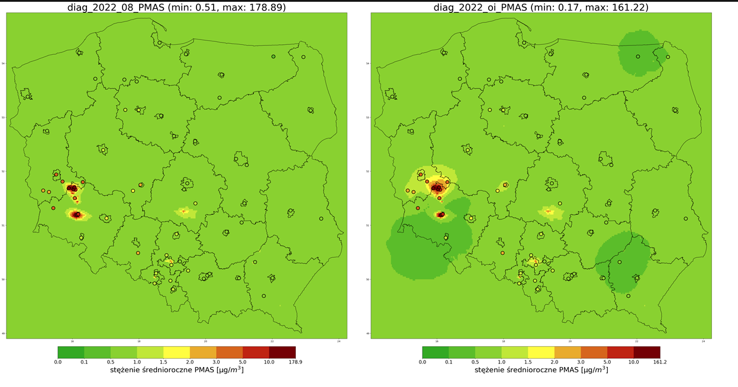
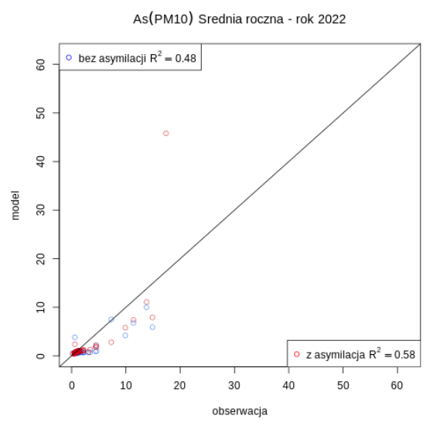
Arsenic (PM₁₀) annual assessment
Data from 64 stations for assimilation

Slide 11
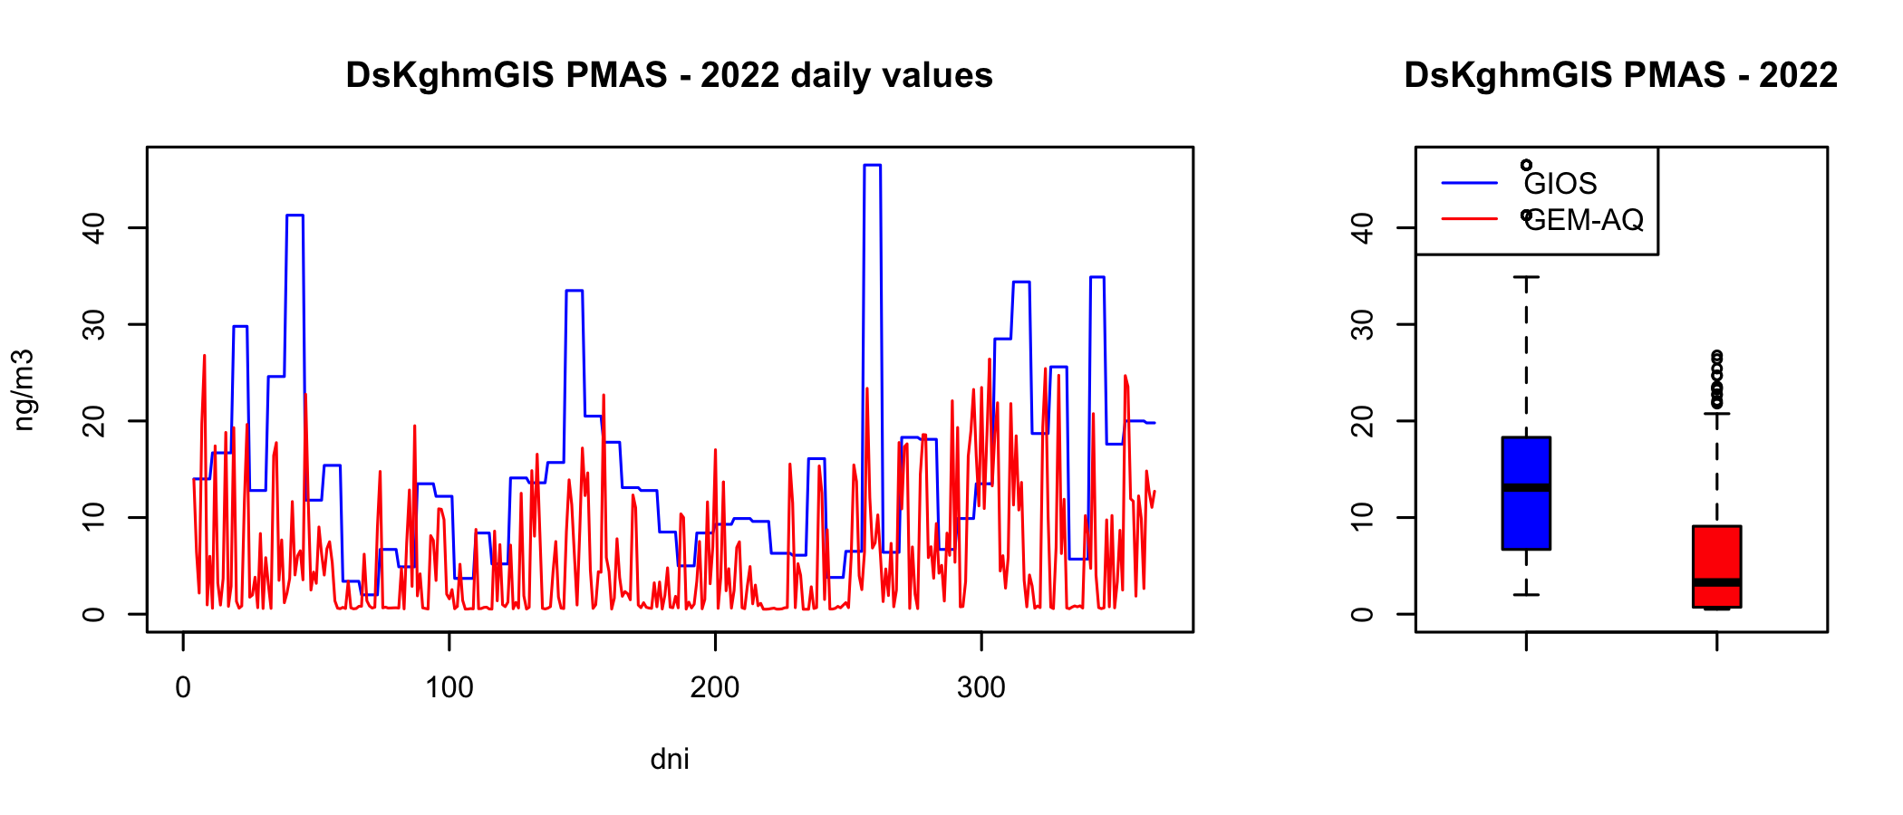
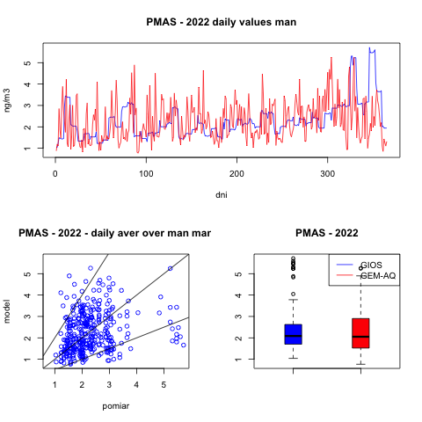
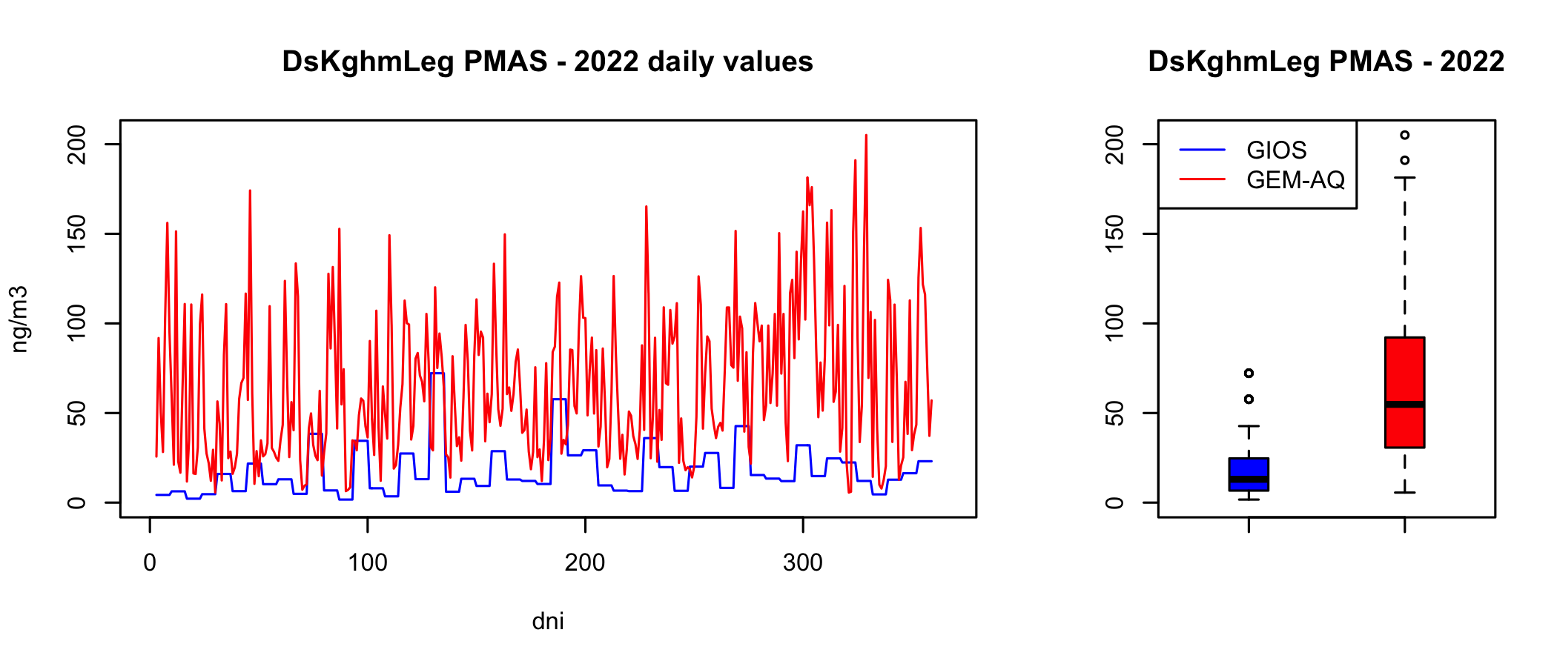
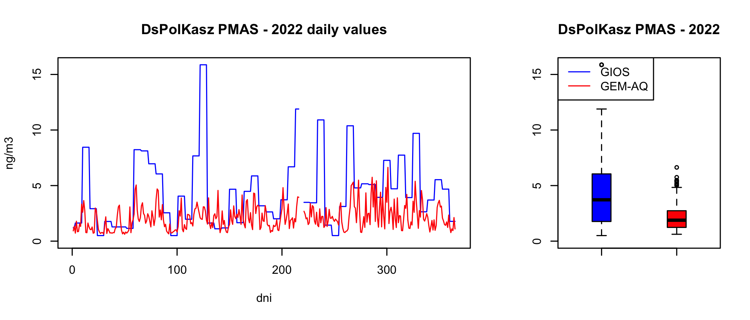
As (PM₁₀) annual assessment

Slide 12
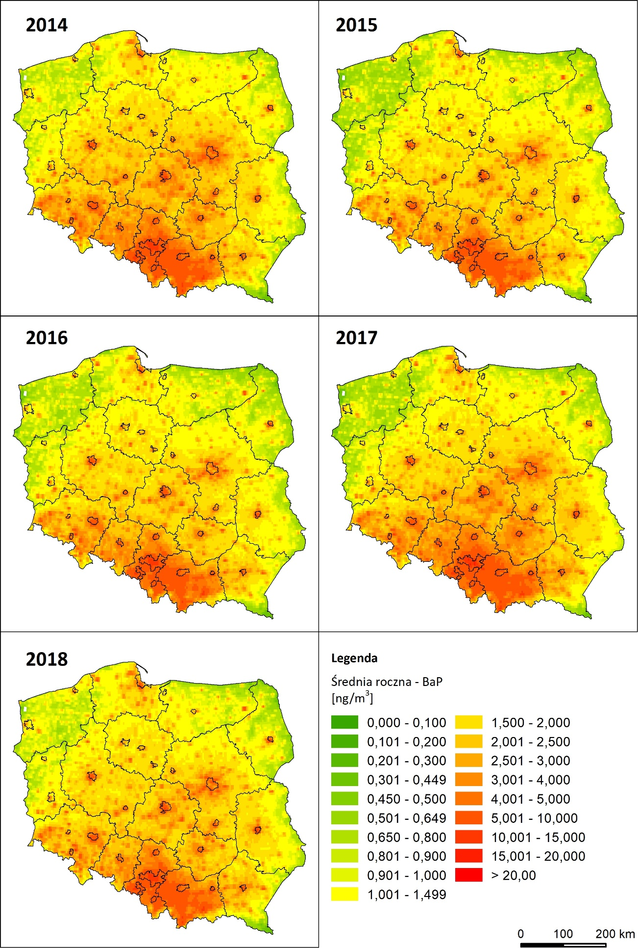
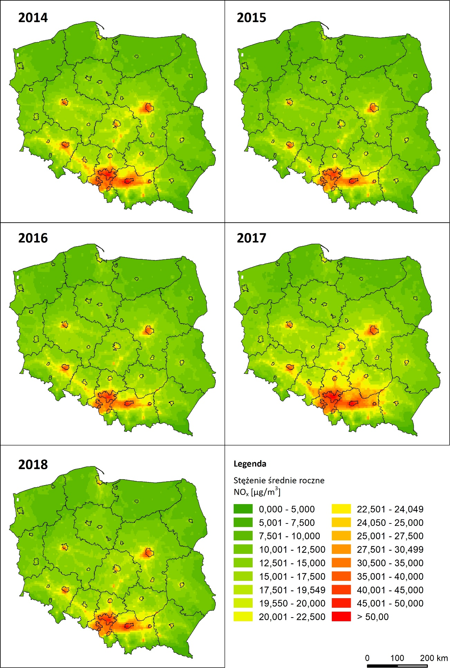
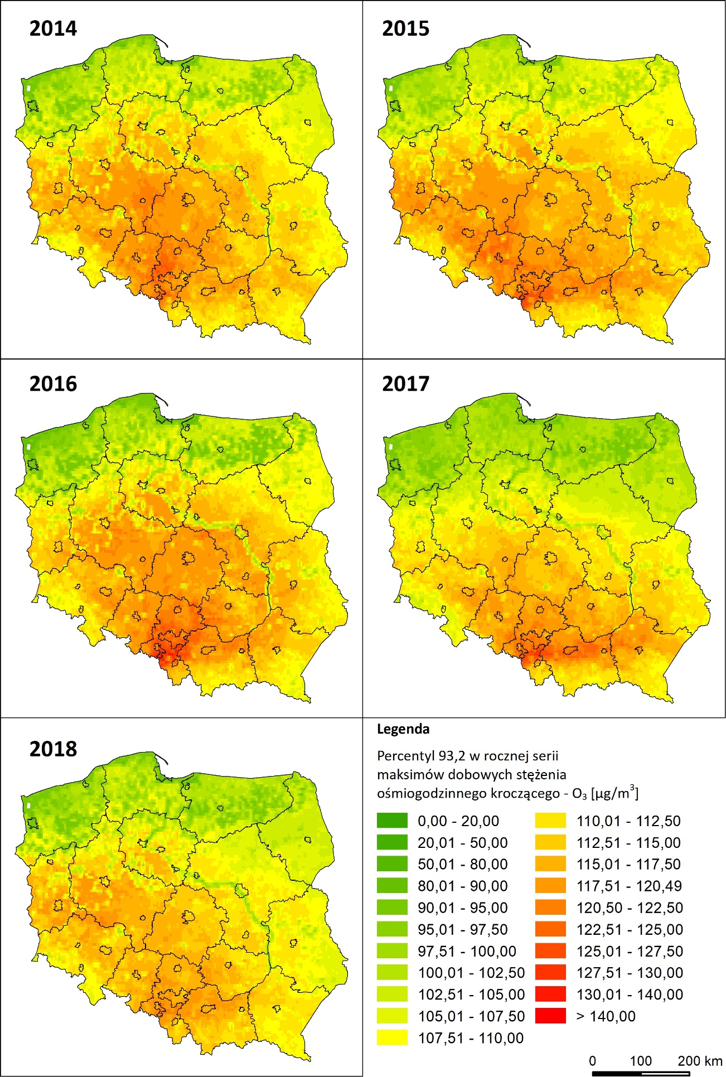
3) 5-year assessment 2014-2018 (next in 2023)

Slide 13
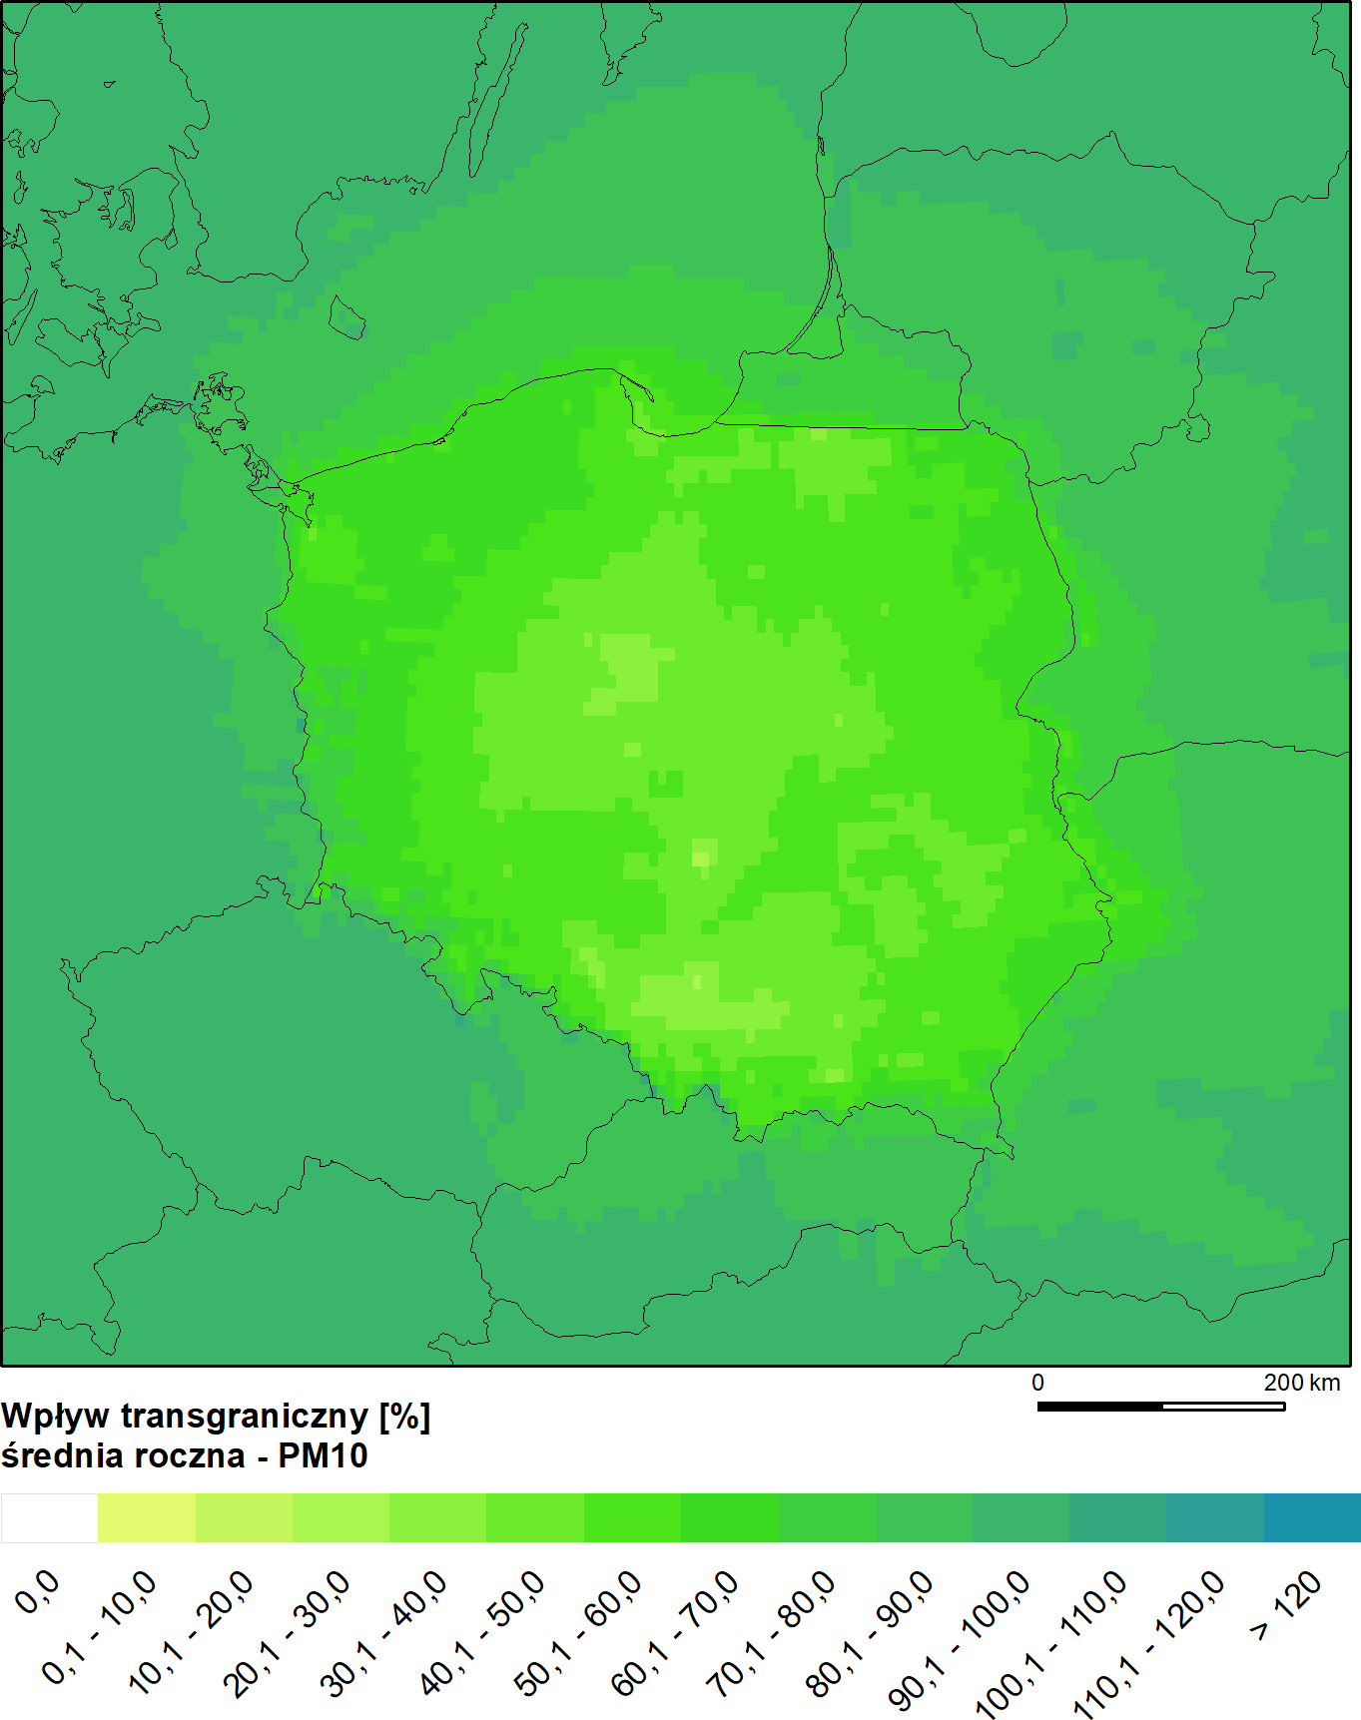
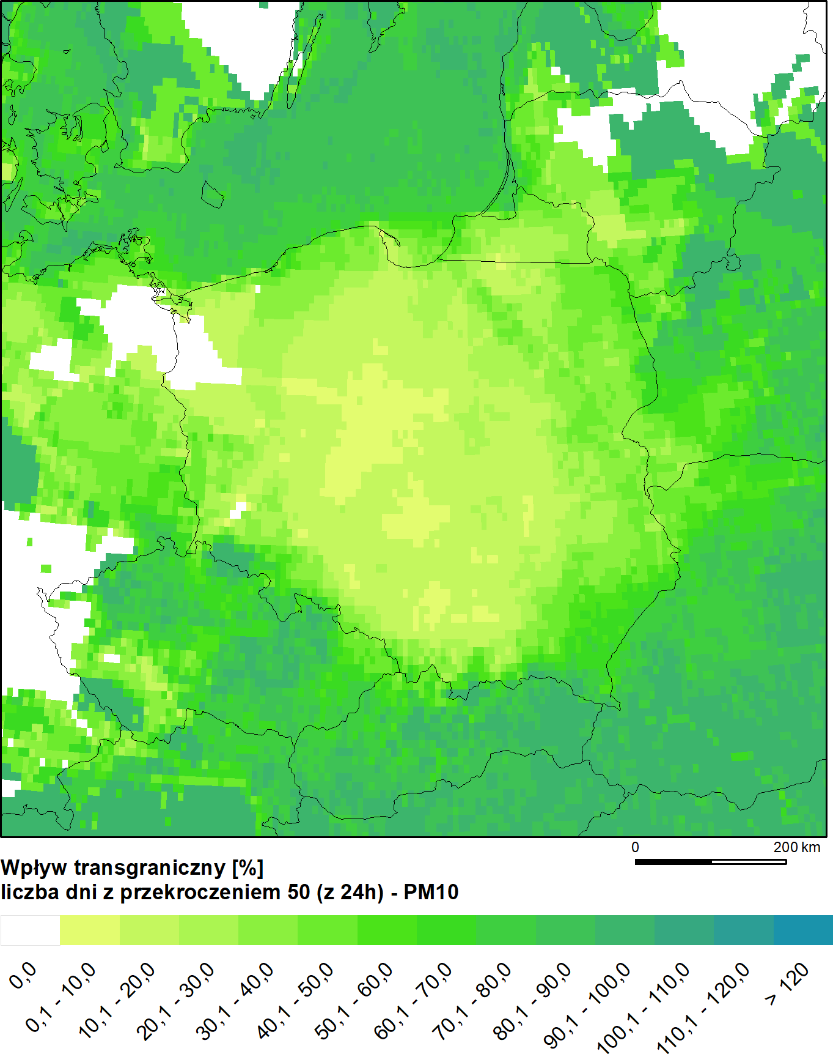
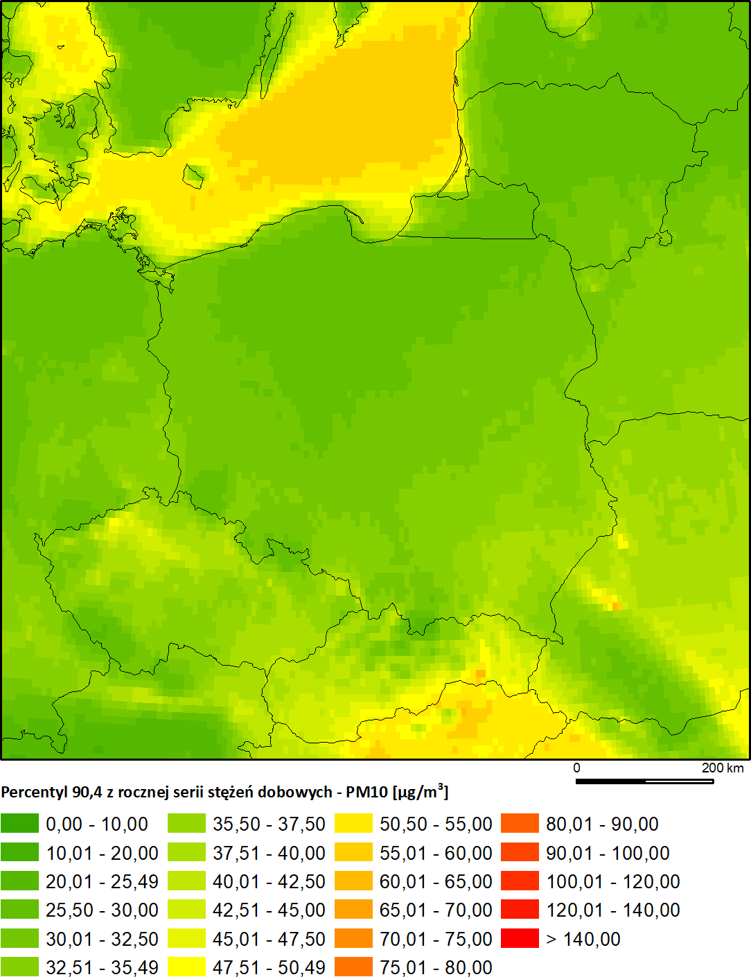
4) Transboundary impact assessment
10km resolution
Using most up to date EMEP inventory
“Brute force”

Slide 14
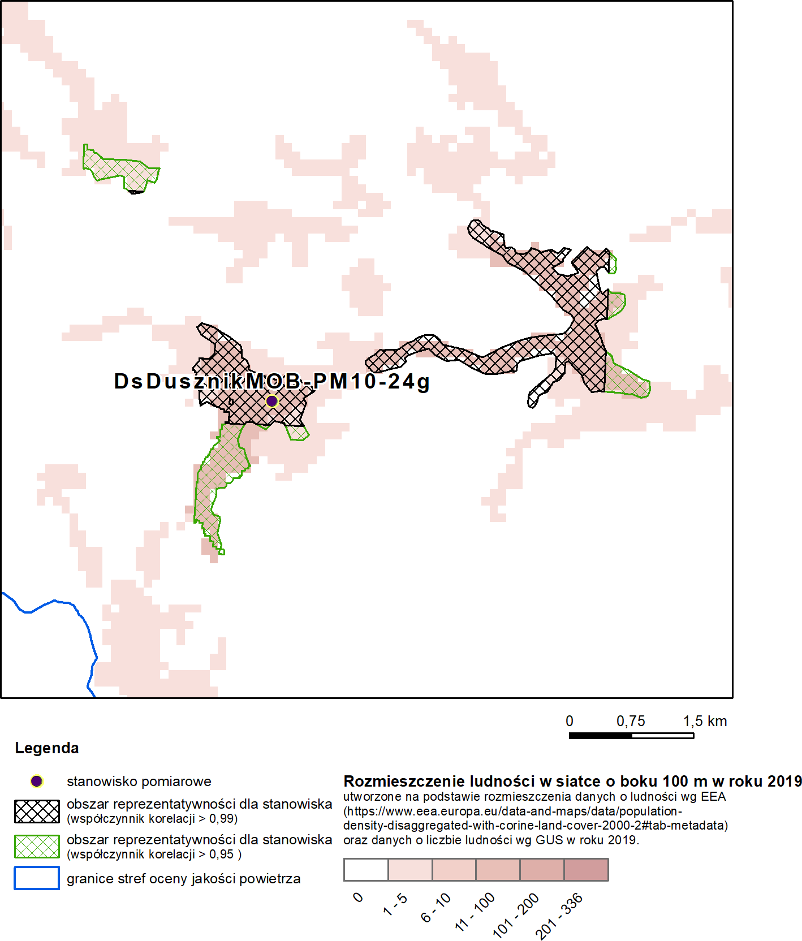
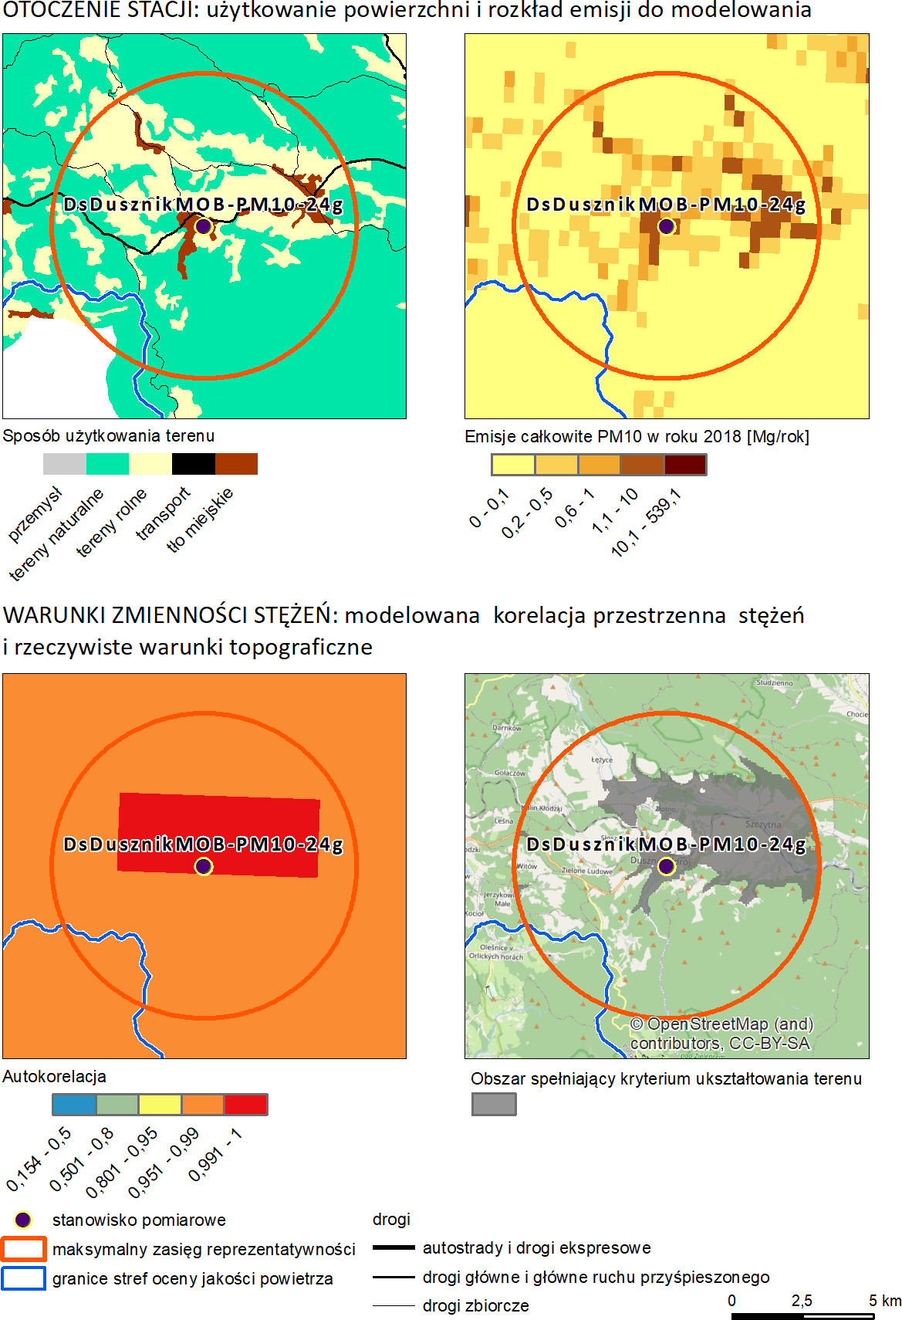
5) Station representativeness
Detailed evaluation (temporal variability)
Large set of tracers (including metals in PM10)
Cooperation with FAIRMODE CT8

Slide 15
6) National Air Quality Plan (Ministry of Climate and Environment)
2019 – Transboundary transport analysis using EMEP and the national emission database (2018 meteo)
2020 - Effectiveness of the national “Clean Air Program” (2019 meteo)
2021 - Joint effectiveness of regional Air Quality Plans in the 2022 and 2026 horizons (2020 meteo) → are we going to meet thresholds set in the WHO guidelines
2022 - Implementation of emission strategies based assumptions of the Update of the National Air Protection Program in the horizon to 2030 and 2040 (2021 meteo)
2023 – Under discussions with the Ministry of Climate and Environment

Slide 16
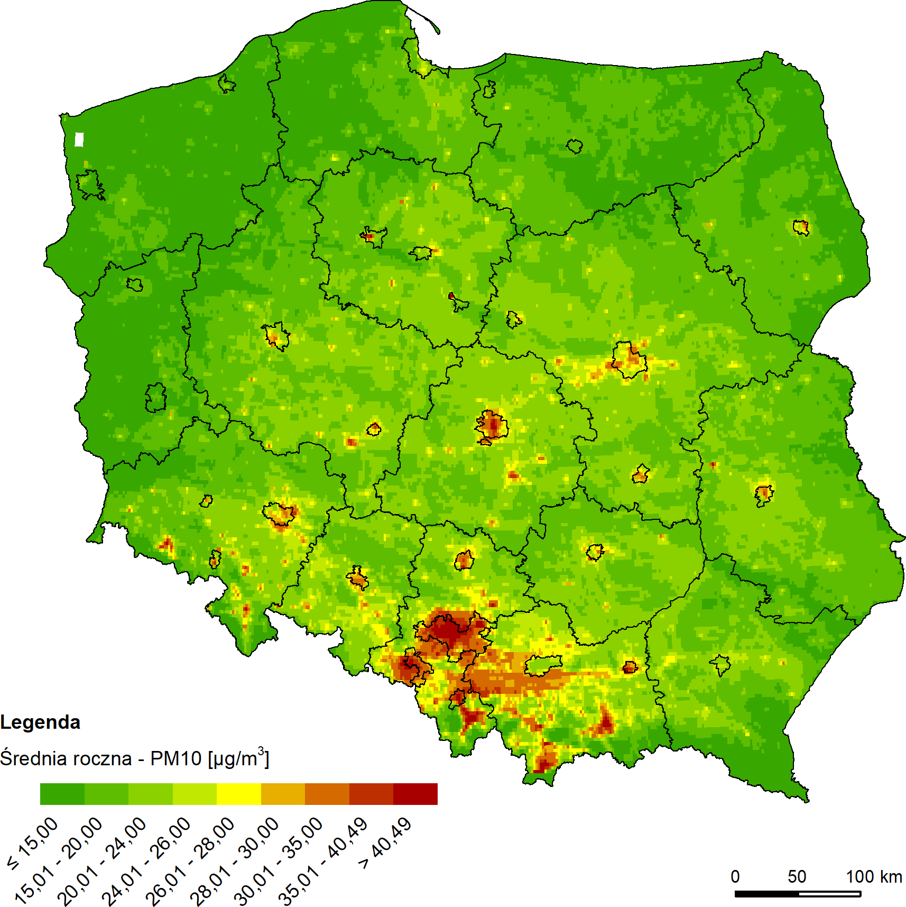
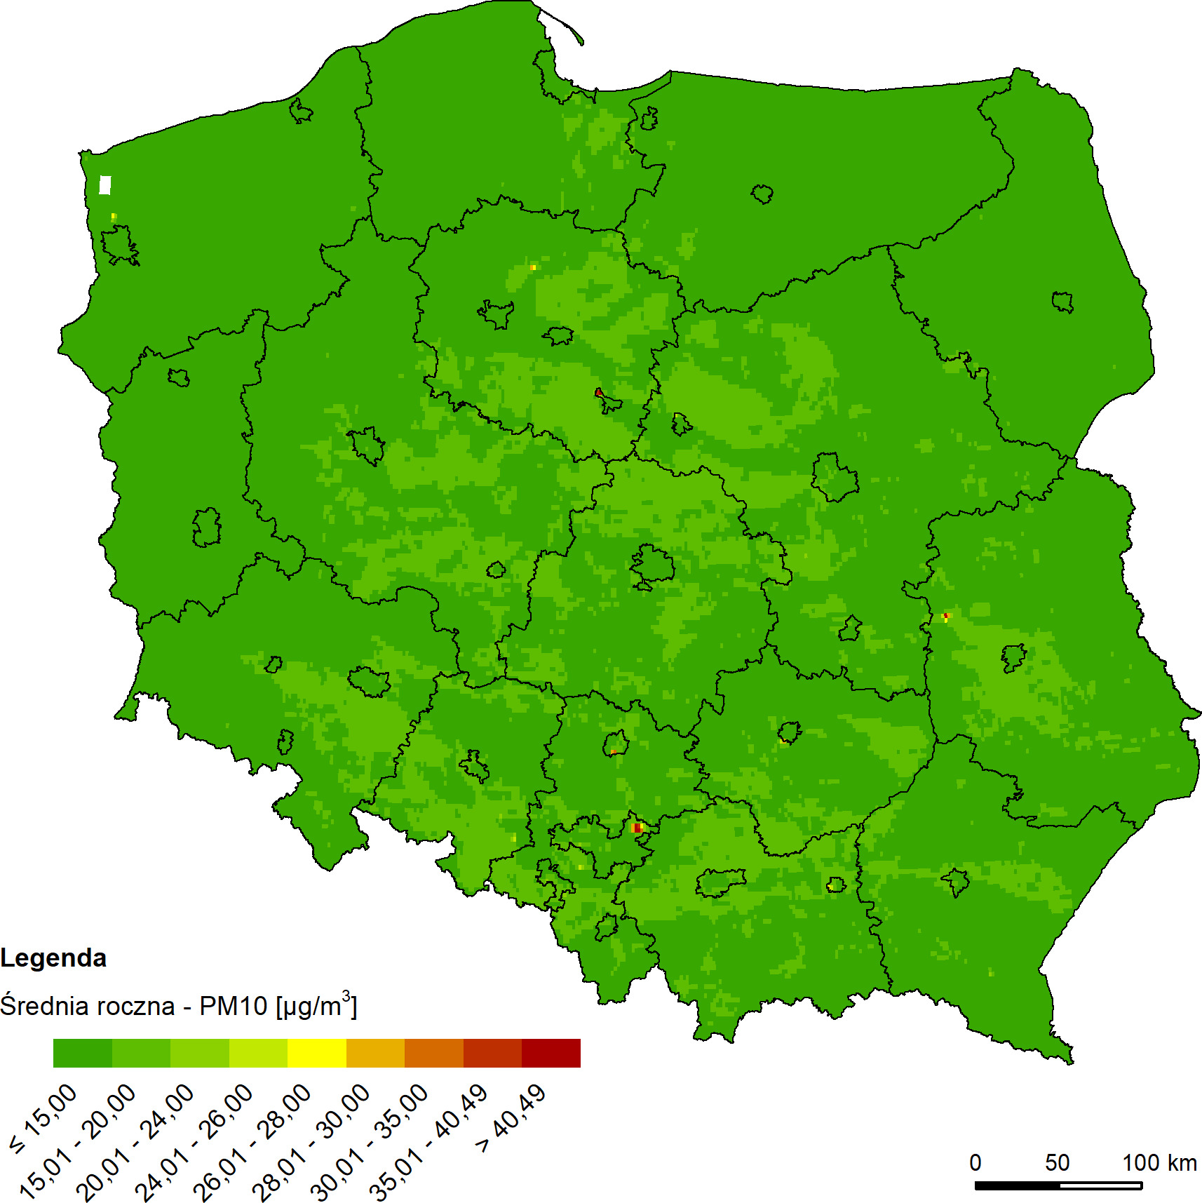
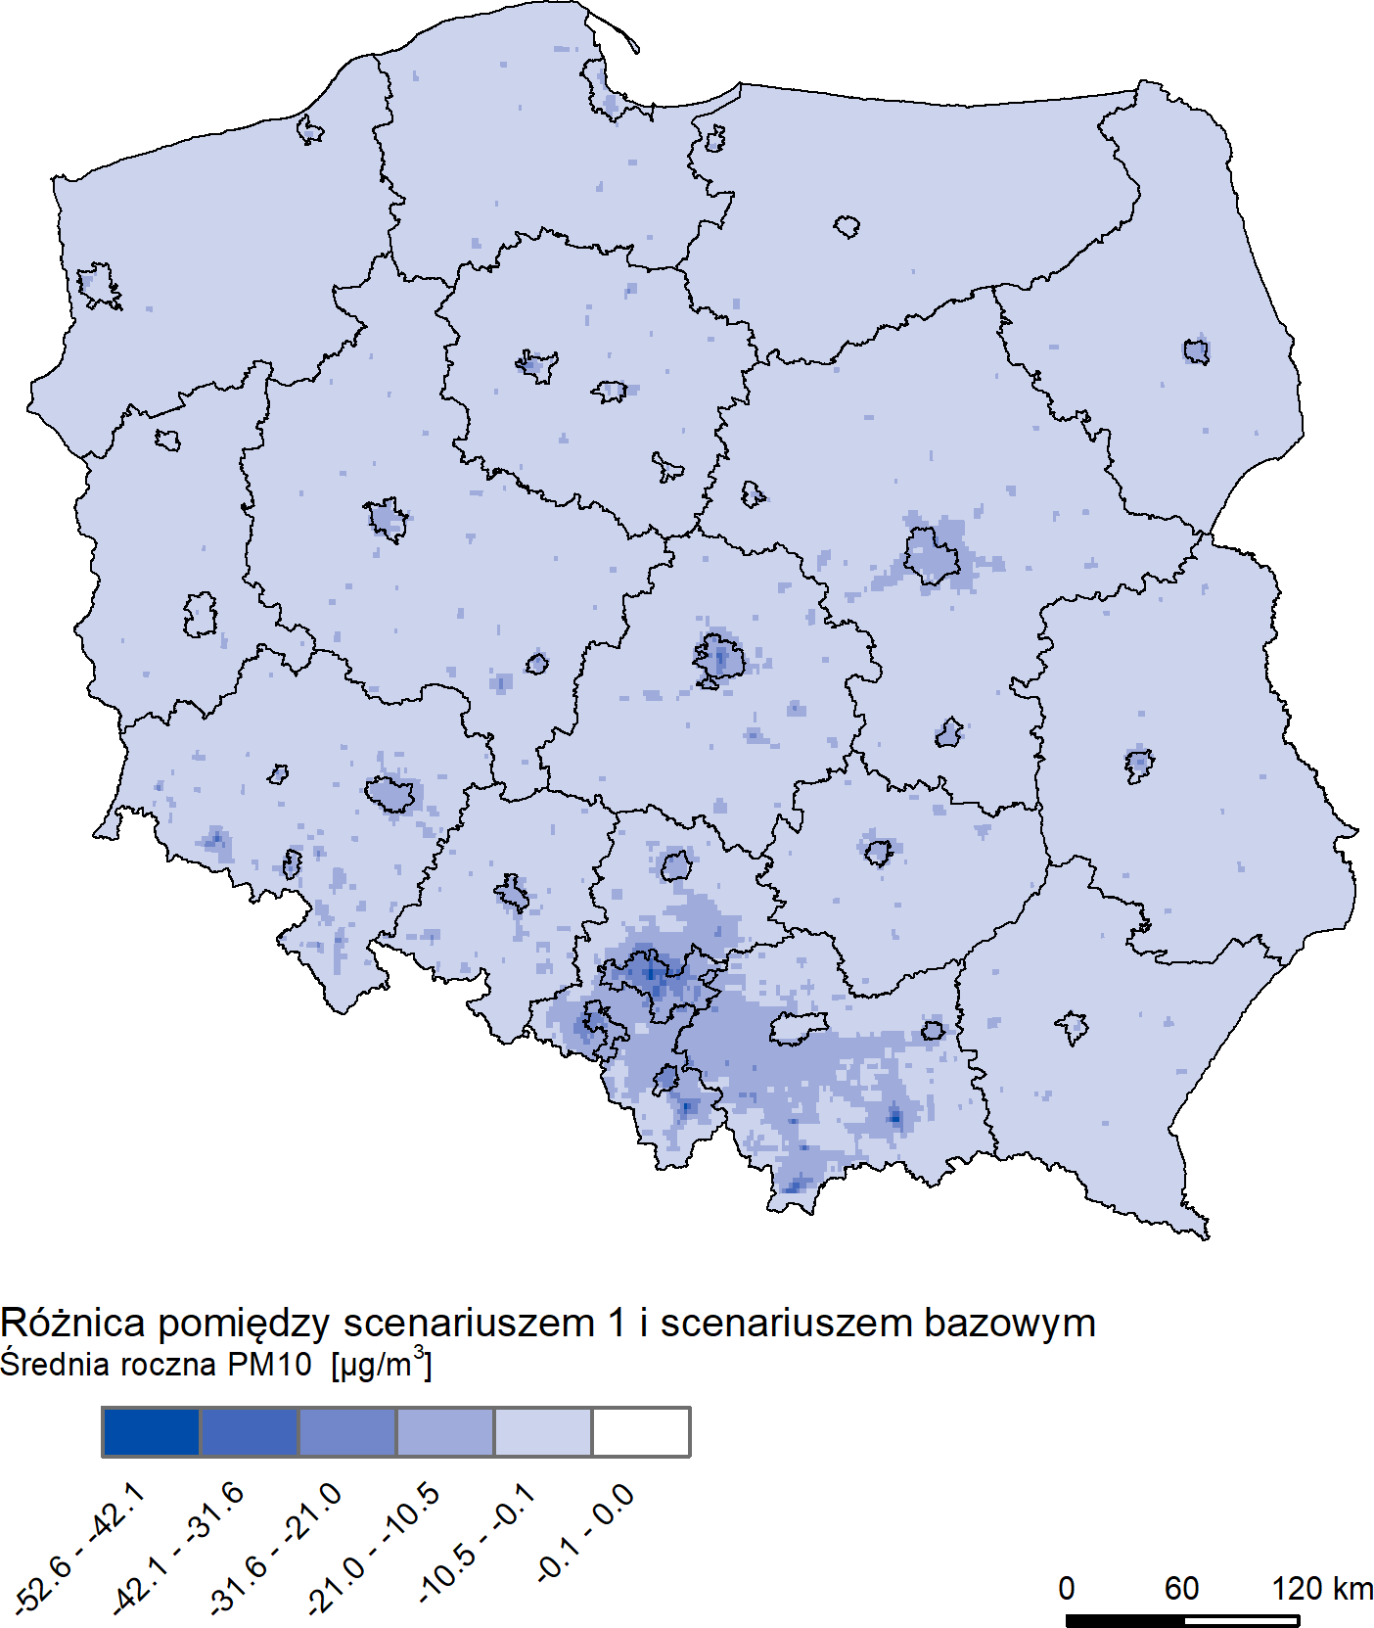
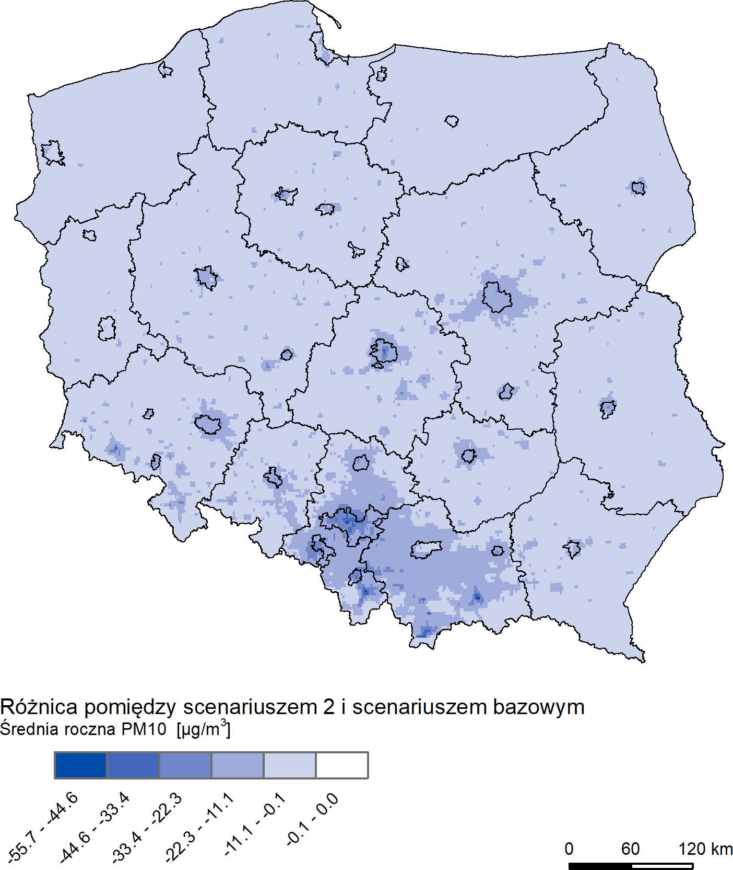
PM₁₀ - annual average
2021
Scenario 1
Scenario 2

Slide 17
Other modelling activities
Source contribution analysis
support for the annual assessment
SHERPA-BU based on the GEM-AQ modelling
Local scale modelling + vertical structure of PMs (+ measurement campaigns using sensors)
National Air Pollution Control Programme (NEC Directive)
10-year run 2011-2020 (EMEP emissions)
CAMS2_40 operational forecast and requested scenario runs

Slide 18
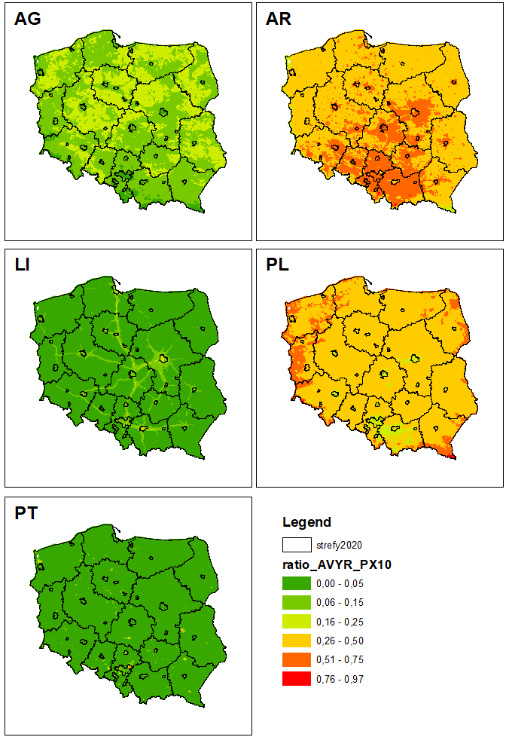
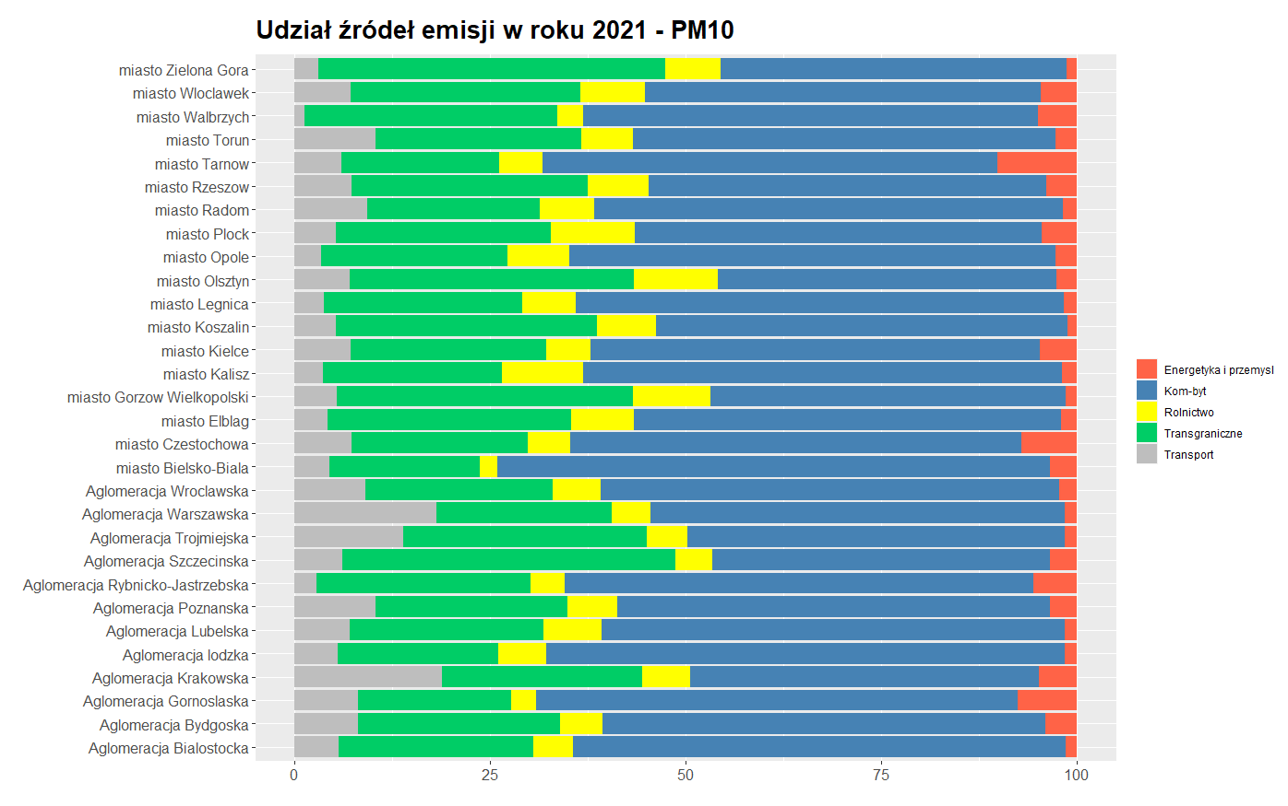
Source contribution
PT - energy and industry (SNAP 1, 3, 4, 5, 6)
AR - municipal and residential sources (SNAP 2 and 9)
LI - line sources (SNAP 7 and 8)
AG - agriculture (SNAP 10)
0PL – transboundary

Slide 19
SHERPA-BU for Poland sherpa.kaskada.tk
Based on the GEM-AQ scenarios for 2018

Slide 20
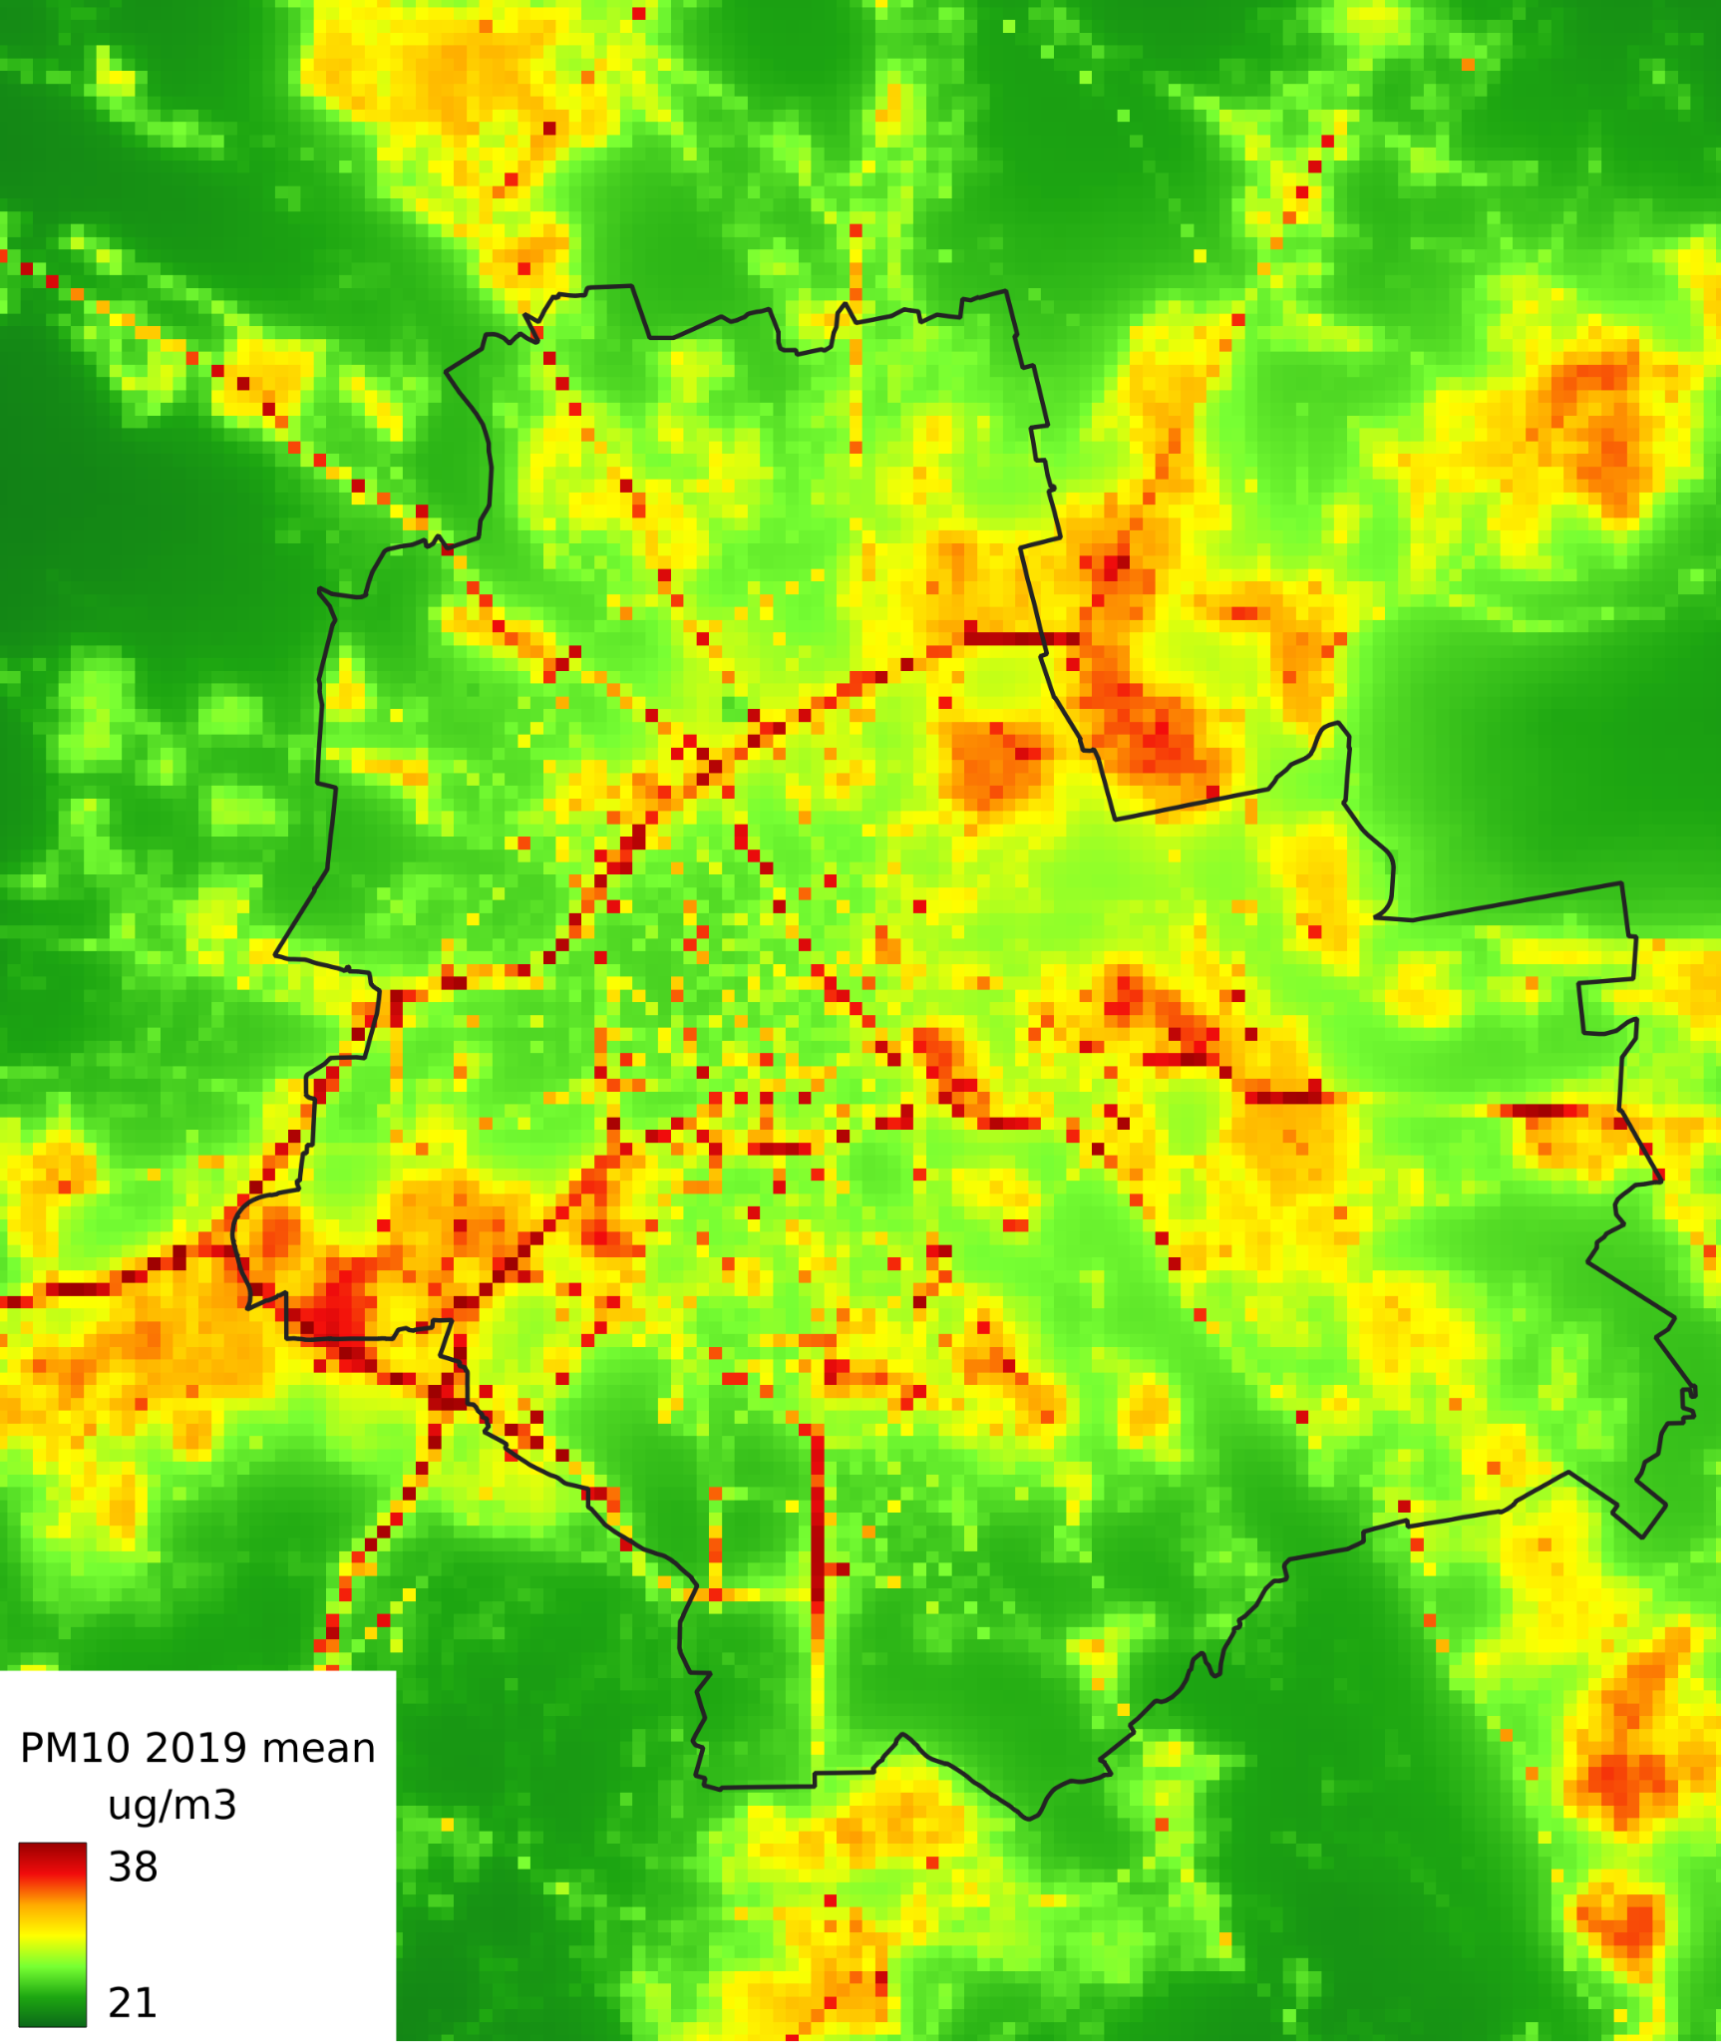
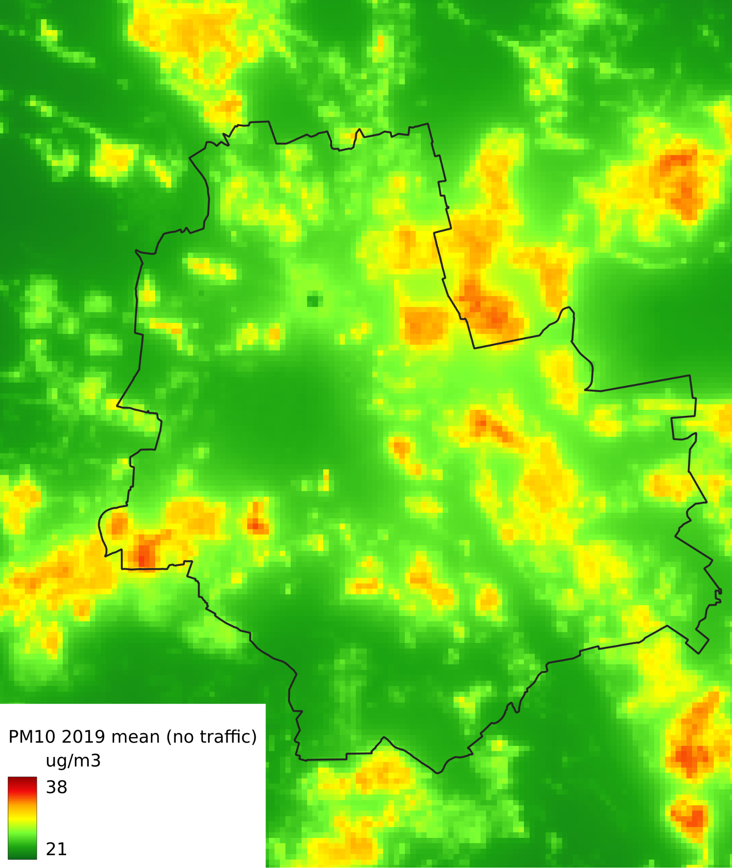
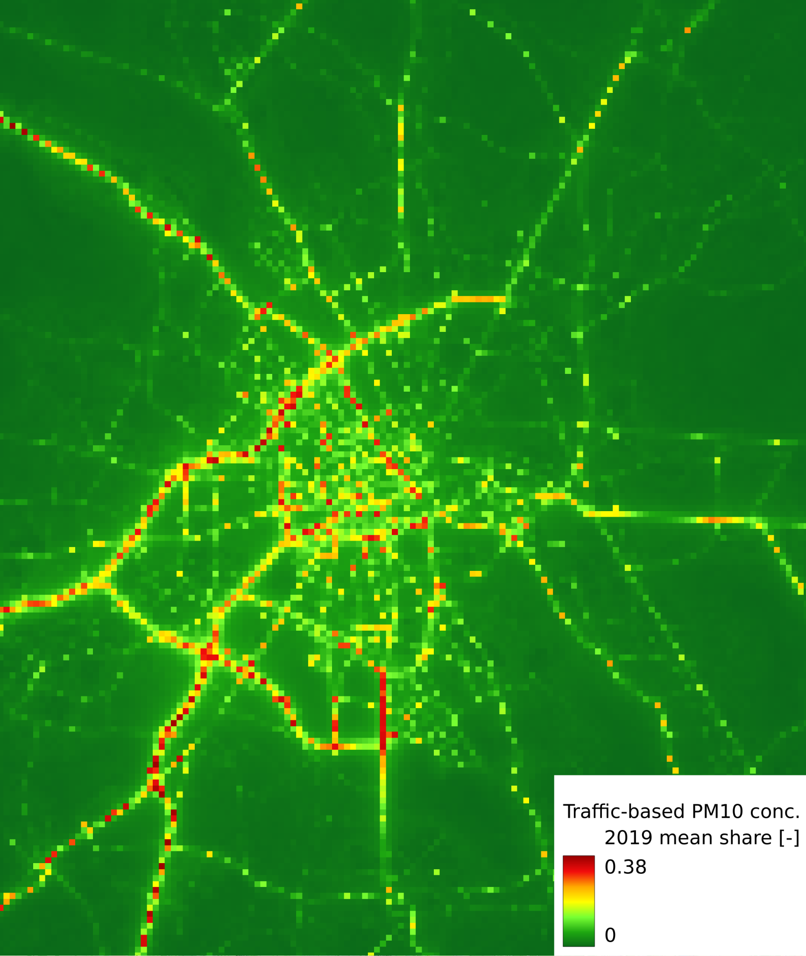
Warsaw PM₁₀ annual average Gaussian model + Random Forest
base scenario
without traffic
Traffic are emissions responsible for up to 38% PM₁₀ concentration
Traffic contribution

Slide 21
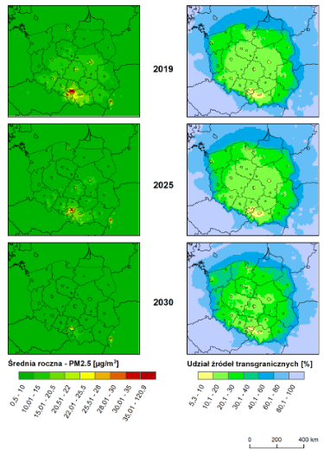
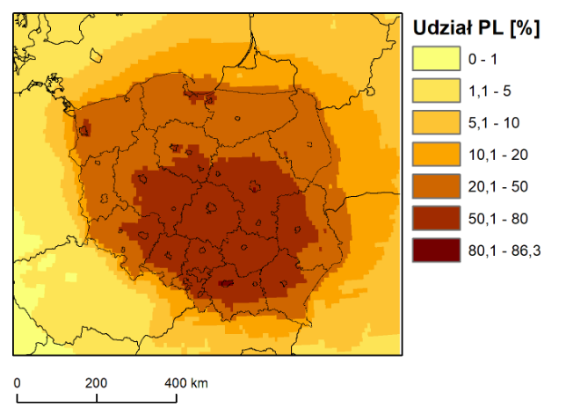
NAPCP (update)
Left panel – PM2.5 annual concentration
Right panel – contribution of transboundary transport [%]
NO₂ annual average – contribution of emissions from Poland [%]

Slide 22
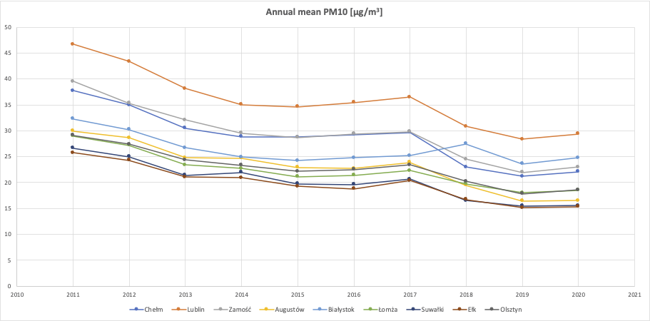
10 year trend of air pollution in Poland
GEM-AQ model at 4km resolution, EMEP emissions

Slide 23
International collaboration
CAMS2_40 Regional European AQ forecast
CAMS_72_PL National Collaboration Programme for Poland
HE CAMEO
Life REMY
FAIRMODE
EMEP (TFMM, TFIAM, HTAP, EPCAC)
TOAR II - Tropospheric Ozone Assessment Report, International Global Atmospheric Chemistry Project

Slide 24
Summary 1/2
Air quality modelling as a support tool for decision-making is well established and legislated
Systematic approach combines modelling, emission inventory and measurements
Feedback from the modelling to the emission group helps to identify gaps
Evaluation against measurements helps to improve both emissions and representation of the temporal variability of sources
Routine operation allows for building the knowledgebase
Scale interactions: European → national → zones/regions →cities

Slide 25
Summary 2/2
EMEP emission data is used routinely for the regional simulations. Transboundary impact calculated at 10 km with EMEP emissions and at 2.5km with the national BU emission database
Evaluation of the modelled aerosol composition analysis brings insight into the emission uncertainties (e.g. temperature dependent fuel mix in the residential sector; significant differences in year-to-year reporting)
Evaluation of As showed the need to revise emission inventory and understand temporal variability
New modelling activities:
HE CAMEO – focus on NH₃ and SIA (global to regional scales)
HTAP – focus on CH₄ (global to regional scales)

Slide 26
Thank you

