Slide 1
Progress in EMEP activities Measurements and modelling
A. Colette & L. Labrador, TFMM co-chairs
Joint EMEP SB & WGE Bureaux Meeting
Uppsala, April 2023

Slide 2
Content
Gothenburg Protocol Review Group
Contribution to AAQD Recast
WorkPlan items for 2024-2025
MSC-East

Slide 3
Gothenburg protocol review
Gothenburg Protocol Review Group
UNECE website / LRTAP Meetings / 42nd Session of Exec. Body
Official Documents
ECE/EB.AIR/2022/4 : Scientific information for the review of the Gothenburg Protocol(Annex I)
ECE/EB.AIR/2022/5 : Technical information for the review of the Gothenburg Protocol (Annex II)
https://unece.org/info/Environmental-Policy/Air-Pollution/events/367824

Slide 4
Gothenburg protocol review
Items relevant to TFMM
Adequacy between model & observations (& emissions)
Long term trends
Mismatch of DJF OC trends
Low annual variability in models for O3
Bridging scales for O3 (CH4/HTAP)
Impacts (crops, ecosystems, health)
Condensables
Future projections

Slide 5
Gothenburg protocol review
Increased resolution in modelling
Large impact for exposure (§80)
Modest for S/R Matrices (same order as country border definition) (§81)
Global models disagreement on the magnitude of the pre-industrial to present-day trend in groundlevel O3 and underestimation of the magnitude of the observed trend (§82)
EMEP monitoring network: hardly any (long-term) EMEP observations in Eastern Europe, the Caucasus and Central Asia and the Western Balkans (§87)
FAIR Principle:
Open Access to models, model results and observations should develop into the Convention to stimulate use of this material for research activities and national assessments and support improvement of those tools.
However, such objectives raise several questions related to the data and intellectual property rights, reuse of data and tools, responsibility and licensing that are not completely resolved

Slide 6
Revision of EU AAQD
EMEP/CCC with input of EMEP/TFMM Chair
https://ec.europa.eu/info/law/better-regulation/have-your-say/initiatives/12677-Air-quality-revision-of-EU-rules/F3388503_en
Public consultation closed but ongoing iterations with Council & Parliament
To be discussed Thursday 11/5, possible follow-up with ACTRIS/RI-Urbans

Slide 7
Workplan
2022-2023 Workplan | 2024-2025 Workplan
EMEP Intensive Measurement Period O3/VOC/SOA 2022 | Analysis & Modelling
O3 CH4 global/regional scenarios | O3 scales, past and future (climate) trends
Condensables (Emissions) | Model/Measurements Validation
Eurodelta-BaP | Tbc
CEC Workshop | Follow-up

Slide 8
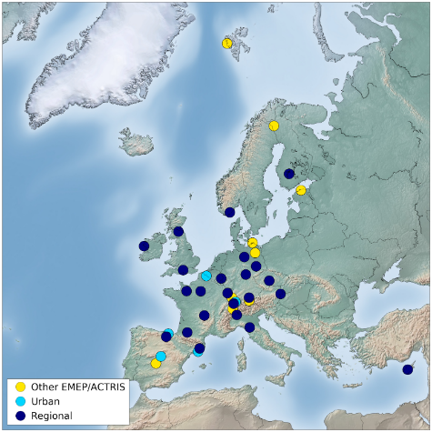
O3/VOC/SOA EMEP-IMP 2022
The rationale of EMEP Intensive Measurement Periods (EIMP)
Rely on the strenght of the existing EMEP network, and foster an incremental effort for a limited period of time, which is supported mainly by national resources
The 2022 edition was an exception, with additional financial support provided by ESIG
2022/2023 O3/VOC EIMP
Designed to address following workplan items:
Knowledge of processes driving high O3 episodes in Europe (e.g. bio/anth VOC) [1.1.1.3]
Strenghten the use of in-situ observations for models development and emission verification [1.1.1.4]
Status
Very successful campaign held mid July 2022
Coordination by CCC, ~25 contributions stations in 13 State Parties
Centralised analysis VOC & SOA markers in IMT (FR), FZJ (DE), FMI (FI), UGE (FR)
Forecast / Campaign triggering : CAMS / MetNo / CCC / INERIS
Follow-up
Webinar 17/10/23 and discussion at TFMM (May 2023)
Decision not to replicate the experiment in 2023, while progressing on the analysis
https://projects.nilu.no/ccc/tfmm/

Slide 9
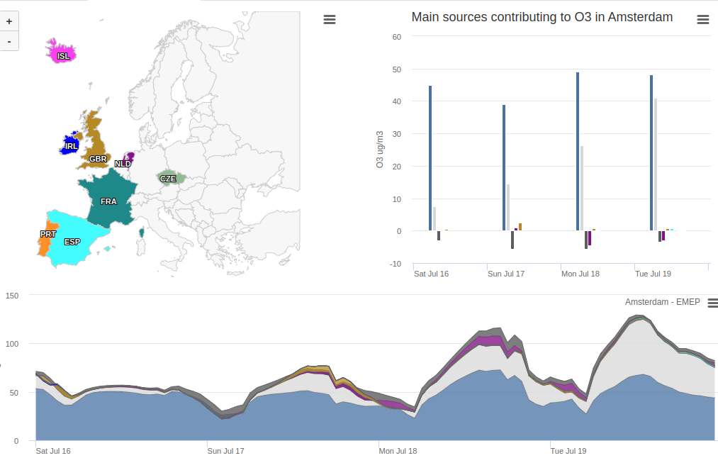
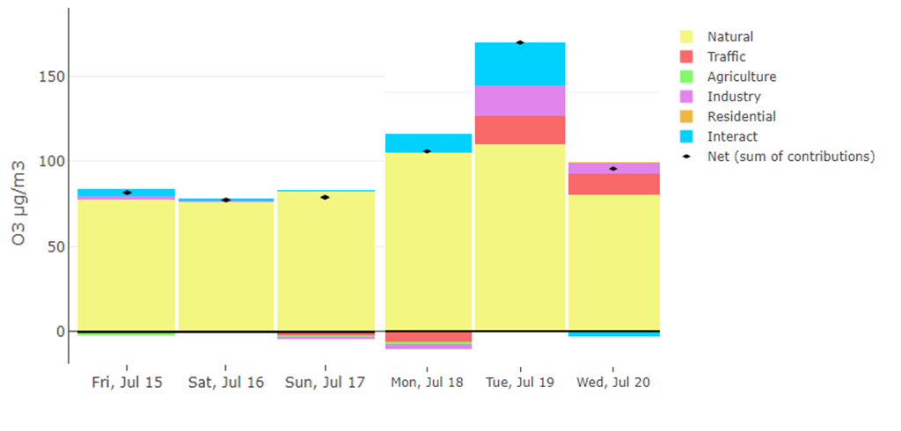
O3/VOC/SOA EMEP-IMP 2022
Possible Workplan items for 2024-2025
Taking stock of the EMEP Intensive Measurement Period of Summer 2022 on O3/VOC/SOA to strengthen VOC monitoring in the EMEP network and use of the data model validation and emission verification
Specific activities
Consolidation & interpretation of measurements collected in 2022
Lessons learnt for O3 & SOA precursor Monitoring
Metrology of VOCs, synergy with online monitoring (e.g. ACTRIS)
Benefit for long term monitoring: increase the completeness of VOC monitoring within EMEP
Use of observation for model or emission verification
Individual VOCs with “signature” to given sources (inc. biogenic/anthropogenic)
Validation of models during high ozone episodes
Matching observed/modelled VOC species
Validation of Tagging/Source apportionment
Underestimation of O3 variability in models (GP Review, Annex I, para 18)
CAMS Policy Service Source apportionment
EMEP S/R (top), CHIMERE/AirControlToolbox (bot)
https://policy.atmosphere.copernicus.eu/

Slide 10
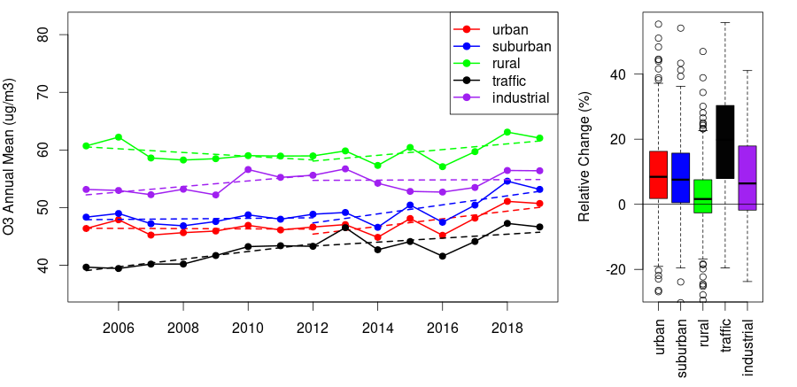
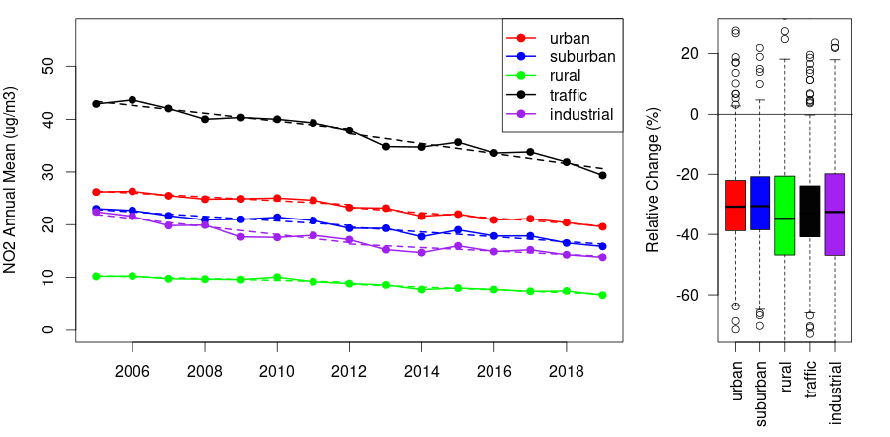
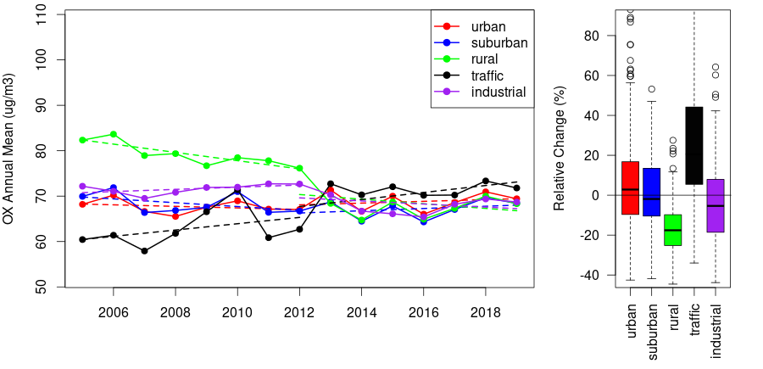
O3: CH4/Trends/sCALES
Possible Workplan items for 2024-2025
On the basis of recent evidence, long-term trends and uncertainty in future projections, provide insight in the robustness of modelled long term ozone projections in relation to climate adaptation and methane mitigation
Specific activities:
Assess the ability of the models to capture ozone trends & variability
Link with HTAP to bridge the scales between global&regional past trends and future projections (inc. CH4)
Meta-analysis of existing projections (GP Review, Annex I, Chap VII)
Accounting for the climate penalty on ozone/heat waves
Linking with WGE for crop yields (ICP-V) and health (TFH)
O3
+
NO2
=
OX

Slide 11
COndensables
Progress in 2022-2023
Essentially on the reporting of emissions
Gap-filling/consolidation with « science-based »
Possible Workplan items for 2024-2025
Consolidate the representation of intermediate and semi-volatile condensable emission in the models and the validation against existing observations of OC and eBC
Specific activities
Review IVOC/SVOC “splits” in the models (not only for residential, also very significant for trafic & solvent as precursors of SOA)
Develop validation procedures: OC and eBC (inc. Source App, ACTRIS, RI-Urbans)
Mistmatch on OC wintertime trend in model/observations (GP Review, Annex I, para 25)
A. Guion, M. Gherras, M. Savadoohi

Slide 12
HM&POP
Progress in 2022/2023
Eurodelta-BaP (CIEMAT/MSC-East)
Workshop on Chemicals of Emerging Concern, fall 2023 (CCC)
Possible Workplan items for 2024-2025
Follow-up on the outcome of the Workshop organized in the fall 2023 on the monitoring of Chemical of Emerging Concerns
Tbc: Eurodelta-BaP, HM & POP Country Case studies

Slide 13
Misc. Monitoring
Progress in 2022/2023
Feedback to AAQD Proposal in 2022 on supersites
Possible Workplan items for 2024-2025
Contribute to update of the Low Cost Sensor review of WMO

