Slide 1
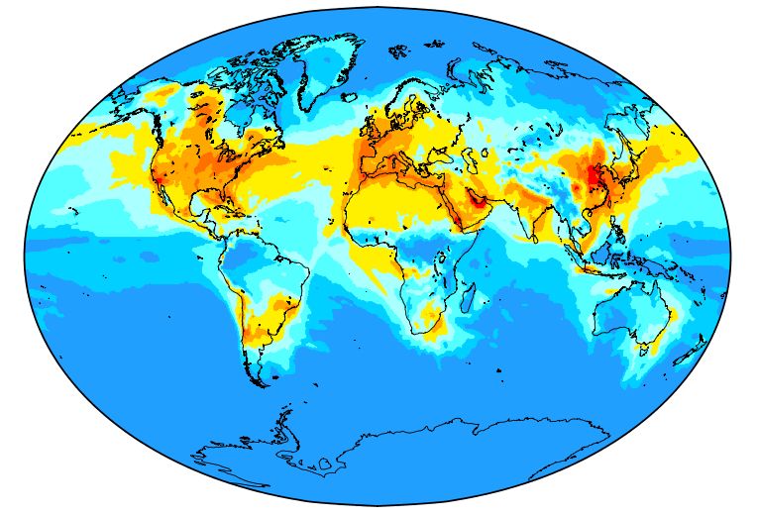
Update on WMO Measurement-Model Fusion for Global Total Atmospheric Deposition (MMF–GTAD) Initiative:
Supporting Science, Policy, and Sustainable Development Goals
Amanda Cole (amanda.cole@ec.gc.ca)
Environment and Climate Change Canada
MMF-GTAD Initiative Steering Committee
Task Force on Measurements and Modelling Meeting
3-5 May 2022

Slide 2
Outline
Overview of initiative goals
Updates since 2020
Upcoming activities

Slide 3
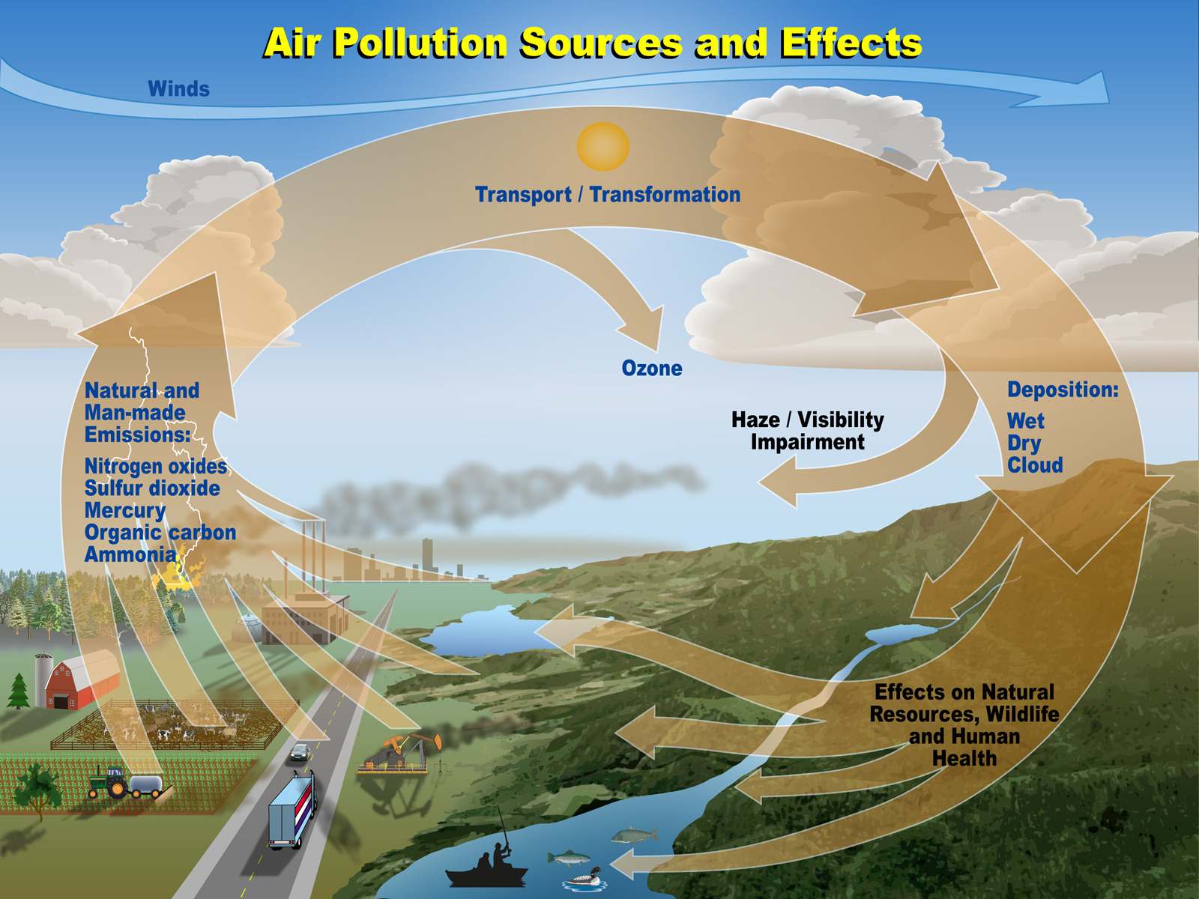
Atmospheric deposition is a key component of the Earth System
Loss process for airborne pollutants, therefore a critical term for concentrations in the air
Pathway for pollutants to enter terrestrial and aquatic ecosystems
Once deposited, pollutants can cause both short-term and cumulative effects, including indirect effects

Slide 4
Atmospheric Deposition and Sustainable Development
Direct and indirect links to UN Sustainable Development Goals due to impacts of atmospheric deposition of O₃, N and S on crop yields, nitrate leaching, acidification, eutrophication, and climate

Slide 5
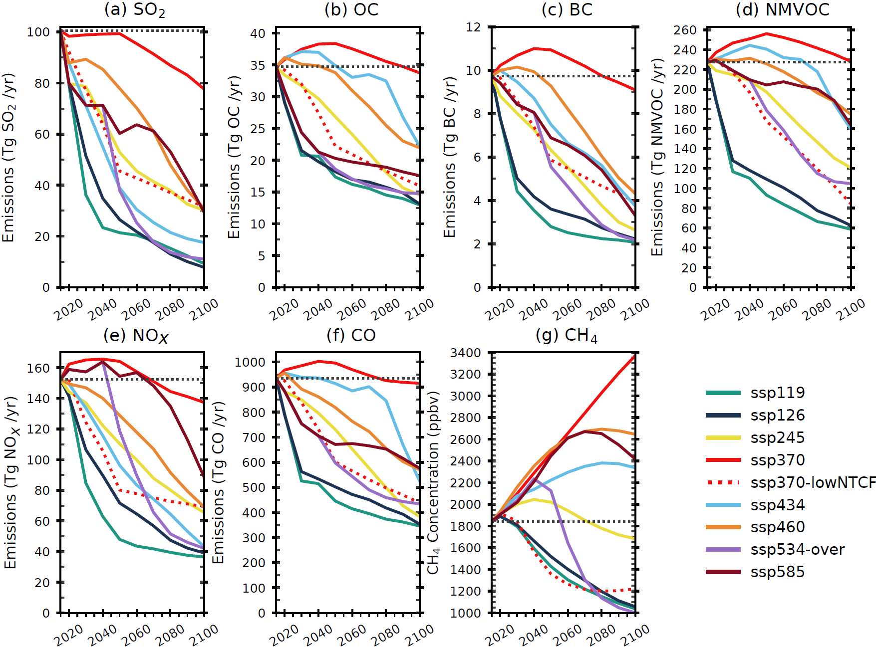
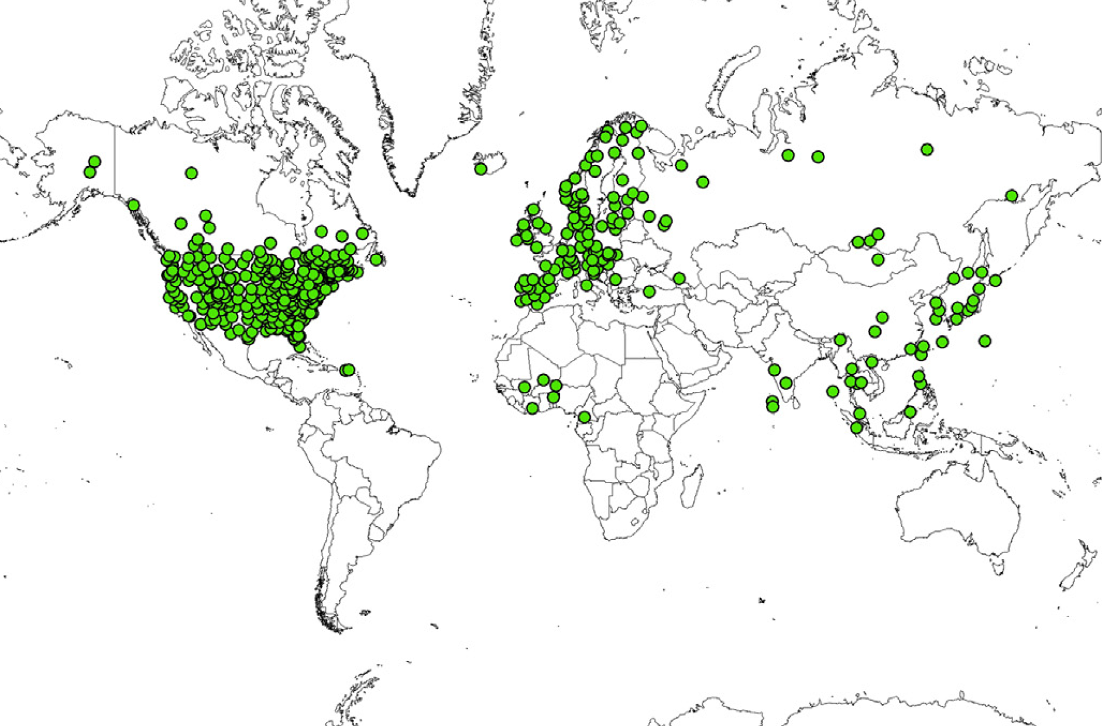
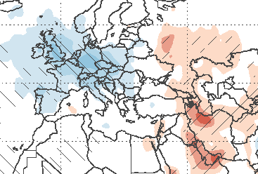
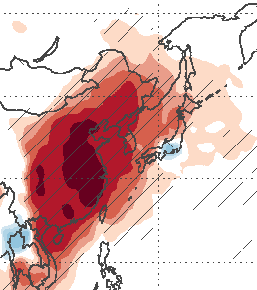
Why a WMO GAW Initiative?
Turnock et al. (2020)
Vet et al. (2014)
Geddes et al. (2017)
A “Science for Services” initiative focused on deposition can support decision-making where data are limited
Notes:
Atmospheric deposition is changing rapidly due to trends in anthropogenic emissions
Large uncertainties in total deposition throughout the sparsely observed regions of the world – maybe where it matters most!
→ ecosystem cost-benefit analysis for countries that don’t have monitoring
→ role of specific species in total overall budget
Local emissions can be decoupled from local deposition due to long range transport

Slide 6
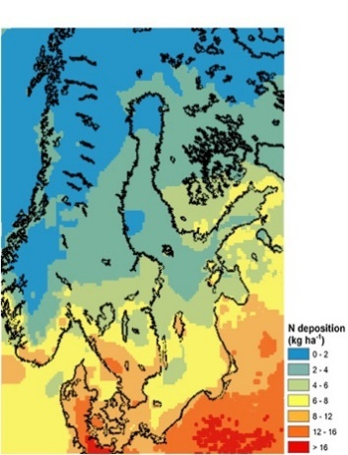
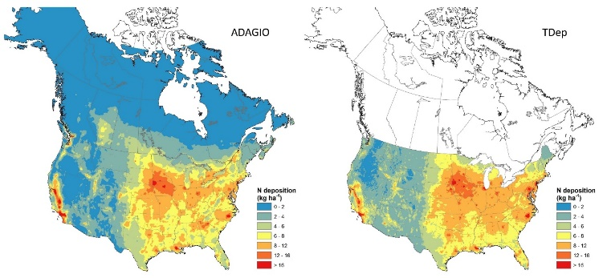
MMF-GTAD: a Science-for-Services Initiative
In order to assess the impacts of atmospheric deposition on the environment and the UN Sustainable Development Goals, there is a need for 'best possible' atmospheric deposition maps produced operationally on a global scale. For this we propose using “Measurement-Model Fusion.”
Existing and emerging regional products provide templates and case studies
Adapted from Schwede et al., 2019, and Andersson et al., 2018.

Slide 7
Outline
Overview of Initiative goals
Updates since 2020:
Implementation Plan
Stakeholder engagement
Short-term objectives
Upcoming activities

Slide 8
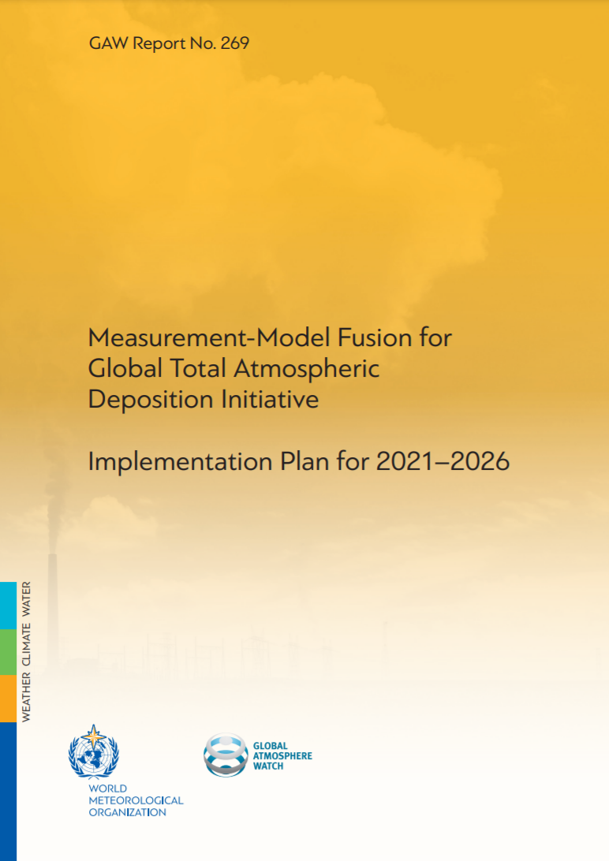
MMF-GTAD Implementation Plan
Outlines the motivation for MMF-GTAD
Identifies potential stakeholders/users
Lays out initiative objectives and plans
https://library.wmo.int/doc_num.php?explnum_id=10831

Slide 9
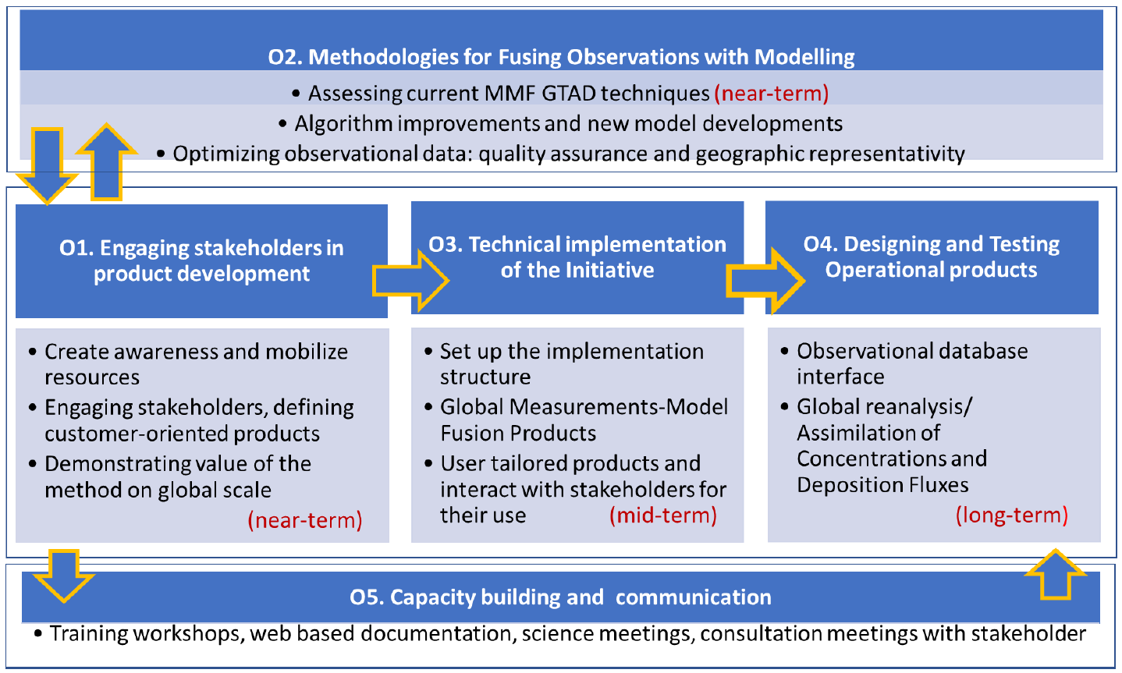
MMF-GTAD Implementation Plan
Notes:
O1
Awareness: -meetings/conferences/publications
Engagement: stakeholder engagement advisory team
Value: regional products

Slide 10
MMF-GTAD Implementation Plan
Notes:
O2
Assessment: Regional approaches, advancing global mapping capability
Workshop
Algorithms: Model improvements (e.g. dry deposition, bidirectional fluxes, receptor responses)
Uncertainty estimates
Completeness of chemical budgets
Emission inventories
Data assimilation/inverse modeling
Observations: Standard methodologies, harmonized protocols, quality assurance
Sparseness, identify gaps, high-value measurements to expand networks
New capabilities: new observables and land surface detail
Role of citizen science?
Role of satellite observations?

Slide 11
MMF-GTAD Implementation Plan
Notes:
O3
Developing an MMF-GTAD operational system
Data Activities: gathering, quality assurance, archiving of regional measurement data at a single facility
Operations Activities: applying fusion techniques to the mode data and model outputs to accomplish our vision statement
Applications Activities: consulting with stakeholder advisory group, conversion our operational products into user-specific products for specific applications (exploring downscaling, maps, uncertainties, technical advice…)
Vision: after a proof of concept pilot, product will be extended for the PAST (year 2000) to recent years
NOTE: a by product of this will be global maps of trace gas and potentially aerosol concentrations in addition to the deposition products

Slide 12
MMF-GTAD Implementation Plan
Notes:
O5
Reaching out to relevant science/policy communities and organizations where deposition is a large unknown or limited
Imagining planning hands on workshops, student exchanges, dedicated workshops
Web-based learning modules
NASA ARSET training modules?
In addition to providing technical training: user/stakeholder advice and input – how can science really inform stakeholder needs, and how can stakeholders ask and really valorize scientific products?

Slide 13
Stakeholder engagement (O1, O5)
UN Food Systems Summit Science Days
6 July 2021 side event “Risks to agriculture from air pollution” organized by WMO and Indian Institute of Science Education and Research
Four presentations and panel discussion on the impact of ozone on agriculture and tools to address it, including MMF-GTAD
UNFCCC COP 26
6 November 2021 side event at IPCC-WMO-UKMO pavilion, “Atmospheric deposition, the invisible threat – impacts on agriculture, ecosystem and oceans”
Four presentations on impacts of deposition and MMF-GTAD
GAW-supported side events IPCC-WMO-UKMO Pavilion at UNFCCC COP26 | World Meteorological Organization

Slide 14
Stakeholder engagement (O1)
Contract with Swedish Environmental Research Institute (IVL)
Gap analysis
Mapping of users and sponsors
Communication/consultation plan
 | 2021 |  |  |  | 2022
Activity | Sept. | Oct. | Nov. | Dec. | Jan. | Feb. | March | April | May
Assignment Management
Mapping of stakeholders
Advocate the initiative
Evaluate financial mechanisms through Business Model Canvas
Advice on communication
Support stakeholder consultation
Deliverable
Database (D1) |  |  | X
Comm. outline (D2) |  |  |  |  |  | X
Final Report (D3) |  |  |  |  |  |  |  |  | X
Extended due to ongoing travel restrictions

Slide 15
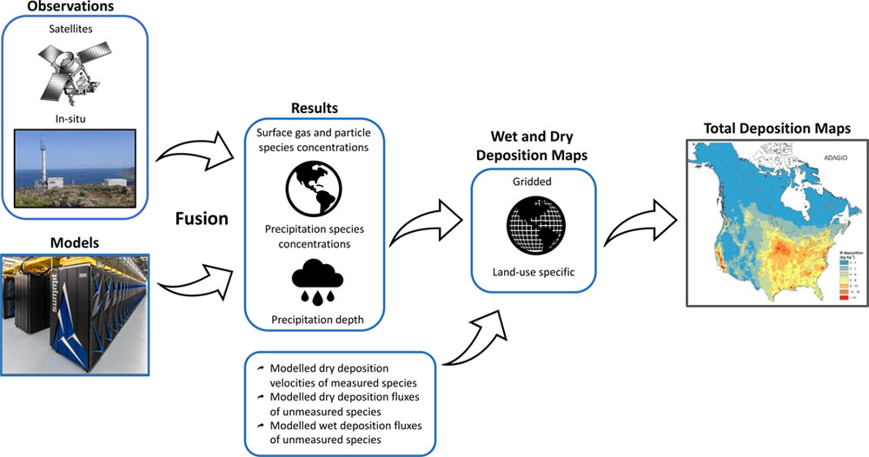
Short-term objectives
Publication of overview paper (O5):
Identifies need
Reviews state of the science
Discusses limitations
Lays out roadmap
Fu et al., Improving Estimates of sulfur, nitrogen, and ozone total deposition through multi-model and measurement-model fusion approaches. Environ. Sci. Technol. 2022, 56, 4, 2134-2142

Slide 16
Short-term objectives
Completion of the data gathering activity in December 2021 (O3)
Harmonized 2010 data from major regional and national monitoring networks in Europe, N. America, East Asia, Africa
Publically available scripts
At Norwegian Institute for Air Research (NILU, W. Aas) with WMO support
Initialization of 2010 global pilot projects (O1, O3)
Ozone deposition underway at Boston U (J. Geddes) with ECCC support
Global N and S based on 2010 HTAP multi-model mean, IDW approach (J. Fu, U. of Tennessee)

Slide 17
Outline
Overview of Initiative goals
Updates since 2020
Upcoming activities
Release of global pilot output
Stakeholder meeting and consultations
MMF techniques workshop

Slide 18
Upcoming activities
Stakeholder consultation
Suggested strategy: identify users and then associated sponsors
Use case studies from regions to show utility
Provide demonstration global products from pilot projects

Slide 19
Upcoming activities
MMF-GTAD Techniques Workshop
Virtual science symposium week of 19-23 September 2022
Update on state of the science since 2019
Method development (O2)
Capacity building (O5)
In-person expert meeting 6-7 October 2022
Advance plans for moving Initiative forward in light of stakeholder needs, operational approaches, and current techniques (O3, O4)

Slide 20
Summary
The MMF-GTAD Initiative will provide ongoing atmospheric deposition estimates that are consistent around the globe to address societal needs (long-term goal)
Initial products will include dry deposition of O₃ and total deposition of nitrogen and sulphur
We continue to move forward on all of our listed objectives with the committed support of GAW/WMO and the steering committee

Slide 21
MMF-GTAD Steering Committee
Amanda Cole, Environment and Climate Change Canada, Canada (chair)
Wenche Aas, Norwegian Institute for Air Research, Norway
Camilla Andersson, Swedish Meteorological and Hydrological Institute, Sweden
Leonard Barrie, McGill & Stockholm Universities, The Cyprus Institute
Frank Dentener, European Commission
Joshua Fu, University of Tennessee, USA
Corinne Galy-Lacaux, CNRS, France
Jeffrey Geddes, Boston University, USA
Maria Kanakidou, University of Crete, Greece
Fabien Paulot, NOAA, USA
Donna Schwede, US Environmental Protection Agency, USA
Robert Vet, Retired from ECCC, Canada
Lorenzo Labrador, GAW Secretariat

